Slide 1
Den juridiske metode ved anvendelsen av internasjonale menneskerettighetskonvensjoner
JUS5701
Kjetil Mujezinović Larsen

Slide 2
Læringskrav
Kunnskap:
Studenten skal ha:
God kunnskap om de generelle spørsmål om tolkning av menneskerettighetskonvensjoner
…
Ferdigheter:
Studenten skal kunne:
Tolke og anvende internasjonale menneskerettighets-konvensjoner
…

Slide 3
Oversikt over dobbelttimen
Menneskerettigheter er en spesiell del av folkeretten
Folkerettslig metode
…men hva med internrettslig metode i menneskerettsspørsmål?
Hva er spesielt med menneskerettslig metode?
Dekket i forelesning # 1, men vi samler trådene

Slide 4
Kilder i folkeretten
ICJ-statuttene, artikkel 38:
(a) international conventions, whether general or particular, establishing rules expressly recognized by the contesting states;
(b) international custom, as evidence of a general practice accepted as law;
(c) the general principles of law recognized by civilized nations;
(d) judicial decisions and the teachings of the most highly qualified publicists of the various nations, as subsidiary means for the determination of rules of law.
Hva med menneskerettigheter?
Forarbeider, europeisk konsensus, utsagn fra internasjonale fora, reelle hensyn, etterfølgende statspraksis

Slide 5
Metode i folkeretten
Vienna Convention on the Law of Treaties
Art. 31. General rule of interpretation.
1. A treaty shall be interpreted in good faith in accordance with the ordinary meaning to be given to the terms of the treaty in their context and in the light of its object and purpose.
2. The context for the purpose of the interpretation of a treaty shall comprise, in addition to the text, including its preamble and annexes:
(a) any agreement relating to the treaty which was made between all the parties in connection with the conclusion of the treaty;
(b) any instrument which was made by one or more parties in connection with the conclusion of the treaty and accepted by the other parties as an instrument related to the treaty.
3. There shall be taken into account, together with the context:
(a) any subsequent agreement between the parties regarding the interpretation of the treaty or the application of its provisions;
(b) any subsequent practice in the application of the treaty which establishes the agreement of the parties regarding its interpretation;
(c) Any relevant rules of international law applicable in the relations between the parties.
Art. 32. Supplementary means of interpretation.
Recourse may be had to supplementary means of interpretation, including the preparatory work of the treaty and the circumstances of its conclusion, in order to confirm the meaning resulting from the application of article 31, or to determine the meaning when the interpretation according to article 31:
(a) leaves the meaning ambiguous or obscure; or
(b) leads to a result which is manifestly absurd or unreasonable
In good faith
Noen særtrekk
Statssuverenitet mot individers rettigheter
Et sterkt effektivitetsprinsipp
Dynamisk tolkning
Større vekt på rettspraksis
Ordinary meaning
Objektiv
Subjektiv
Teleologisk
In their context
Object and purpose
“While the Court is not formally bound to follow its previous judgments, it is in the interests of legal certainty, foreseeability and equality before the law that it should not depart, without good reason, from precedents laid down in previous cases”
“The Convention is intended to guarantee not rights that are theoretical or illusory but rights that are practical and effective”
International law: Treaties which limit the sovereignty of Contracting States must be interpreted restrictively
The Convention is a living instrument which must be interpreted in light of present-day conditions.

Slide 6
‘International conventions’
Horizontal Relationship
State
State
State
Vertical Relationship
State
State
Individual

Slide 7
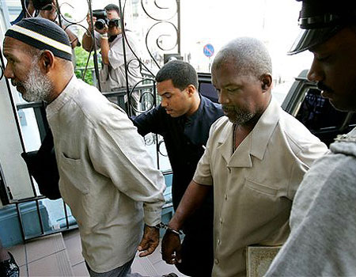
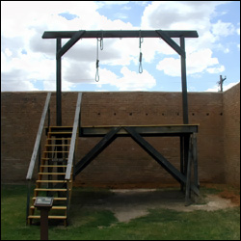
In good faith
Some particular features
State sovereignty vs. rights of individuals
A strong principle of effectiveness
Evolutive (dynamic) interpretation
Greater place for jurisprudence
Golder v. UK (1975), para. 29: “The Court is prepared to consider … that it should be guided by Articles 31 to 33 of the Vienna Convention of 23 May 1969 on the Law of Treaties.”
Banković (2001), para. 55:
“The Court recalls that the Convention must be interpreted in the light of the rules set out in the Vienna Convention 1969”
Effektivitet er ikke utilitarisme:
Rawle Kennedy v. Trinidad & Tobago, 1999 HRC 845
Ordinary meaning
Objective
Subjective
Teleological
In their context
Object and purpose
What about human rights treaties?

Slide 8
EMK art. 8: «Enhver har rett til respekt for … sitt hjem»
Er et selskaps hovedkontor beskyttet?
SP art. 2: Staten skal sikre rettighetene i konvensjonen «for alle som befinner seg på dens territorium og er undergitt dens jurisdiksjon».
Gjelder SP når en stat opptrer utenfor eget territorium?

Slide 9
EMK art. 5.1.c: «Ingen må bli berøvet sin frihet unntatt … når det er rimelig grunn til å anse dette nødvendig for å hindre ham i å begå en straffbar handling»
Er preventiv (forebyggende) fengsling tillatt?

Slide 10
EMK art. 12: Retten til å gifte seg – har man rett til skilsmisse?
EMK art. 2: Retten til liv – har man en «rett til å dø»?

Slide 11
Noen særspørsmål
Rettighetskonflikter (Lillo-Stenberg)
«Fair balance»
Skjønnsmargin (Lautsi)

Slide 12
Norske rettsanvendere
Rt. 2002 s. 557 (”Dobbeltstraff I” (tilleggsskatt)):
”Norske domstoler skal ved tolkingen av EMK benytte samme metode som EMD, men med den reservasjon at det i første rekke er EMD som skal utvikle konvensjonen.”
Britisk House of Lords: «No more, but certainly no less» eller «no less, but certainly no more»?

Slide 13
Sedvanerett
ICJ-statuttene art. 38
(a) international conventions, whether general or particular, establishing rules expressly recognized by the contesting states;
(b) international custom, as evidence of a general practice accepted as law;
(c) the general principles of law recognized by civilized nations;
(d) judicial decisions and the teachings of the most highly qualified publicists of the various nations, as subsidiary means for the determination of rules of law.
1
2
3
4
Usus
Opinio juris

