Slide 1
Analyzing multimedia content

Slide 2
Lets watch a video
Video

Slide 3
What did we see?
Can you describe some of the emotions?

Slide 4
What is analysis of multimedia
You just analyzed a piece of multimedia content
Looking at pictures, videos, text etc. for patterns
Prevalent in modern society, can you guess why?

Slide 5
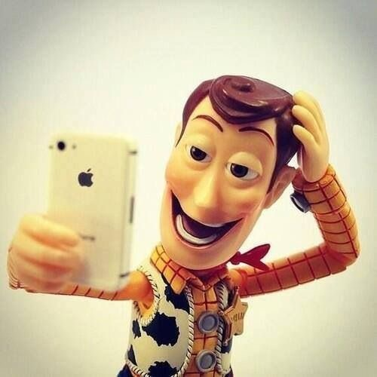

Slide 6
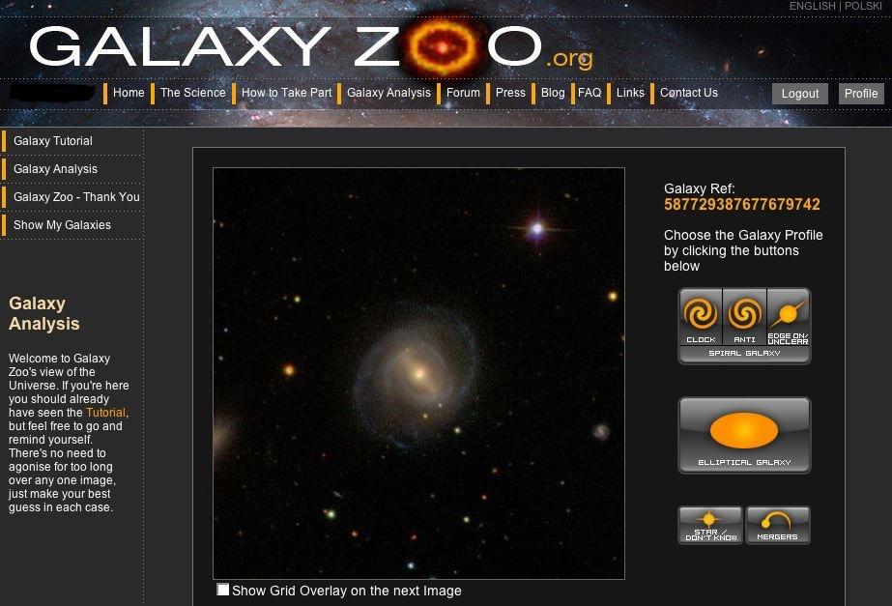
How has it been used?
Galaxy Zoo. Finding out how galaxies form through
crowdsourcing, over 50 million galaxies processed

Slide 7
So how do we analyze?

Slide 8
In general
Prepare the study
Large sample
Annotation
Web based research
2 different approaches

Slide 9
Manual approach
Positives:
Flexible
More failsafe results
Negatives:
Extremely time consuming, remember the video?
Humans have Biases.

Slide 10
Automated approach
Positives:
Can handle massive amounts of data
Non-biased information
Negatives:

Slide 11
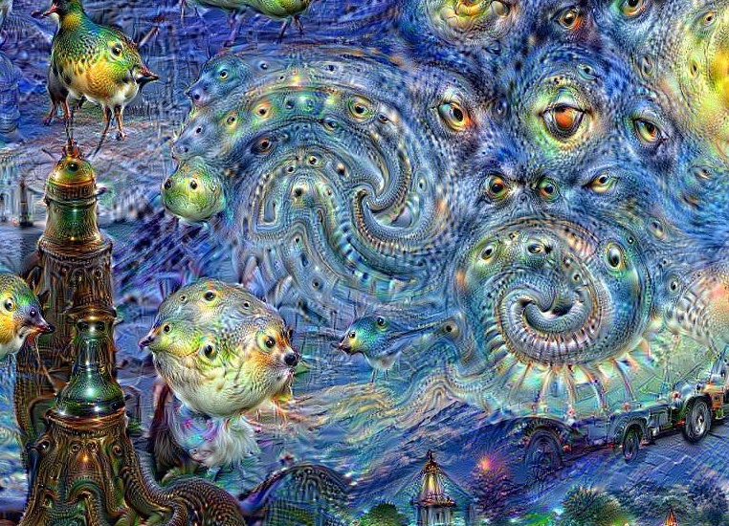
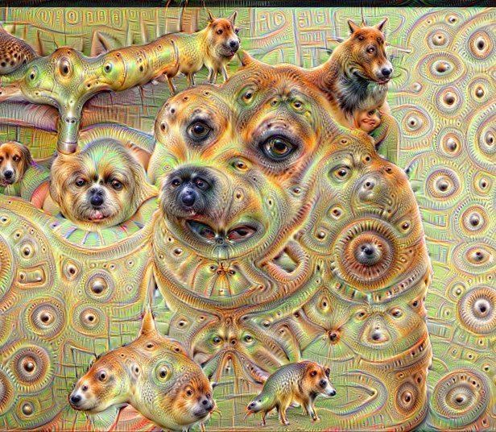

Slide 12
But wait, there is a third way!

Slide 13
Semi automated approach
How:
Generalizing manual data
Positives:
Large amounts of data get processed
Higher accuracy of data then automated
Negatives:
Less accurate than completely manual data
Will still carry some bias from the initial human input

Slide 14
How is this used in HCI?
Action recognition
Motion tracking
Face recognition
Mouse tracking
etc.

Slide 15
How would i do this in my project?
Use a search engine
Program a simple java program
Using already existing software like:
PhotoSpread
PodScope
etc.

Slide 16
«Any questions?»
– Sebastian Røed Mangseth 15.09.15

