Slide 1
The Resource Rent and Taxation
Lone Semmingsen, Tax Policy Department
Norwegian Ministry of Finance 9 April 2010

Slide 2
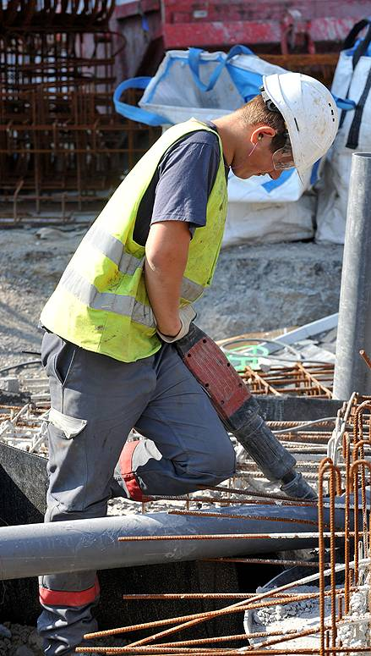
Taxing Natural Resources - Key Aspects
Extraordinary profits
Immobile resources
A good tax base!
Profit based tax rules
Stability
Predictability
Simplicity
Efficient tax administration

Slide 3
Design of the Norwegian System
Super-profit:
Potential for increased tax take
Extra allowance for ordinary returns
Should not distort investment incentives
Ordinary income:
28% on net income as in other industries
Neutrality between industries
Tax on ordinary returns and super-profit

Slide 4
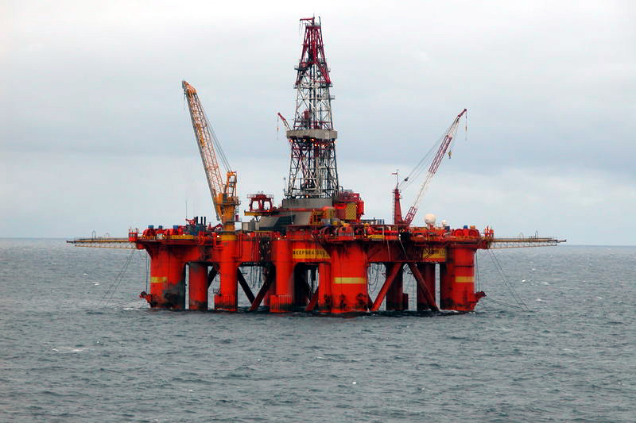
Petroleum Taxation
Production from 1971
Resource rent tax introduced 1975
Tax rate 50 %, total marginal tax rate 78 %
profit based
CO2 tax and NOX tax (negative external effects)
Royalty phased out from 2000

Slide 5
Total Government Take from the Petroleum Sector

Slide 6
Petroleum Production on the NCS

Slide 7
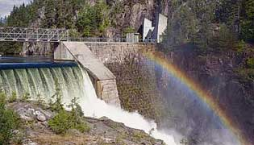
Hydro Power Taxation
Production from about 1900
Resource rent tax introduced 1997
RRT tax rate 30 %, total marginal tax rate 58%
The RRT is neutral with regard to investments
Property tax 0,7 % (municipalities)
License fee and entitlement to buy max 10 % of power generated (state, county and municipalities)

Slide 8
Hydro Power - Resource Rent Tax 1997-2008

Slide 9
Norwegian Economic Structure 2009
Share of investments
Share of exports
Petroleum (27%)
Petroleum (46%)
Other
Other
Share of GDP
Share of state revenues
Petroleum (22%)
Petroleum (28%)
Other
Other
9
Notes:
9

Slide 10
State Direct Financial Interest (SDFI)
The SDFI is an arrangement where the state keeps an interest in a number of oil and gas fields.
Each interest is decided when licenses are awarded, and the size of state interest varies between fields.
The state pays its share of investments and costs and receives a corresponding share of the gross income from the license.
When Statoil was listed and partially privatised in 2001, the administration of the SDFI portfolio was transferred to a new state-owned trust company, Petoro.
Petoro is funded over the state budget and does not receive any of the income from the SDFI.

Slide 11
The Government Pension Fund – Global

Slide 12
Tax basis - Petroleum on company basis – ring fenced against mainland
Sales income (norm prices)
- Operating costs
- Capital depreciation (16,7 pct. over 6 years)
- Financial costs
- (Deficits from previous years)
= Ordinary tax base liable to 28 pct. tax
- Uplift (investment based extra depreciation, 7,5 pct. 4 years)
- (Excess uplift from previous years)
= Tax base liable to 50 pct. tax
Companies without taxable income
Carry forward with interest - (risk free + 0,5%)*(1-0,28)
Tax refund (pay out) of exploration costs
Final losses can be sold or tax reimbursed from the state

Slide 13
Tax basis – Hydropower
Sales income (market prices)
Operating costs
Concession fees
Property tax
Depreciation (linear: installations 1,5% equipment 2,5%)
Uplift (tax values * risk free rate)
= Tax base liable to 30 pct. tax
Negative resource rent will be entitled to a tax
refund (pay out)

Slide 14
Petroleum Tax – Adapting to Profitability
Exploration project – Value for companies after tax

Slide 15
Hydropower production
Revenues to local/regional government (2006)
Concessionary duties (2006) 640 mill. NOK
Concession power (2006) 2 600 mill. NOK
Property tax 0,7% (2006) 1 900 mill. NOK
Natural resource tax 1 600 mill. NOK
Local/regional ownership 45% of production
Source: Revidert nasjonalbudsjett 2008
State revenues (2008)
Ordinary tax 28% 5 000 mill. NOK
Resource rent tax 30% 5 623 mill. NOK
Tax deductions -2 809 mill. NOK
State ownership – Statkraft >40% of production
Source: SSB

