Slide 1
Digital Resources for dScience
Gard Thomassen, PhD
Assistant Director, University Centre for Information Technology
University of Oslo, Norway

Slide 2
Long tail
Problem size
Performance and/or price
Sigma2
/ other
USIT/ITF
Institutes
No. of users

Slide 3
Long tail
Problem size
Performance and/or price
Need for support
Sigma2 /
other
USIT/ITF
Institutes
No. of users

Slide 4
Long tail
Covered by this talk
Need for support
Problem size
Performance and/or price
Sigma2 / other
USIT/ITF
Institutes
No. of users

Slide 5


Service areas

Slide 6
HPC and massive storage in Norway
Ministry of Education -> SIKT -> Sigma2 AS -> NRIS
  BOTT -> NRIS
  NRIS == Operations and user support for HPC and storage from Sigma2 AS

Slide 7

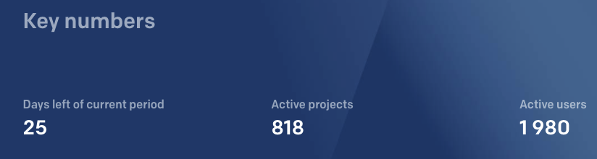
Digital resources nationally
https://www.sigma2.no/

Slide 8
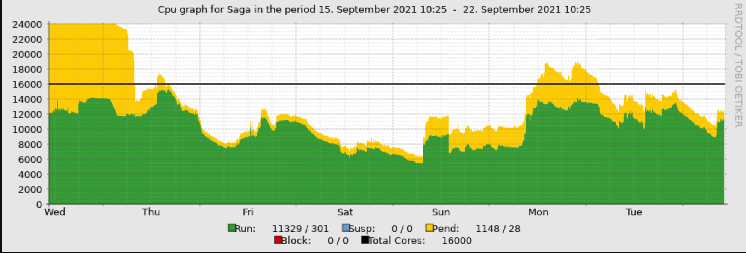
Saga HPC delivered by Sigma2 thorugh NRIS

Slide 9
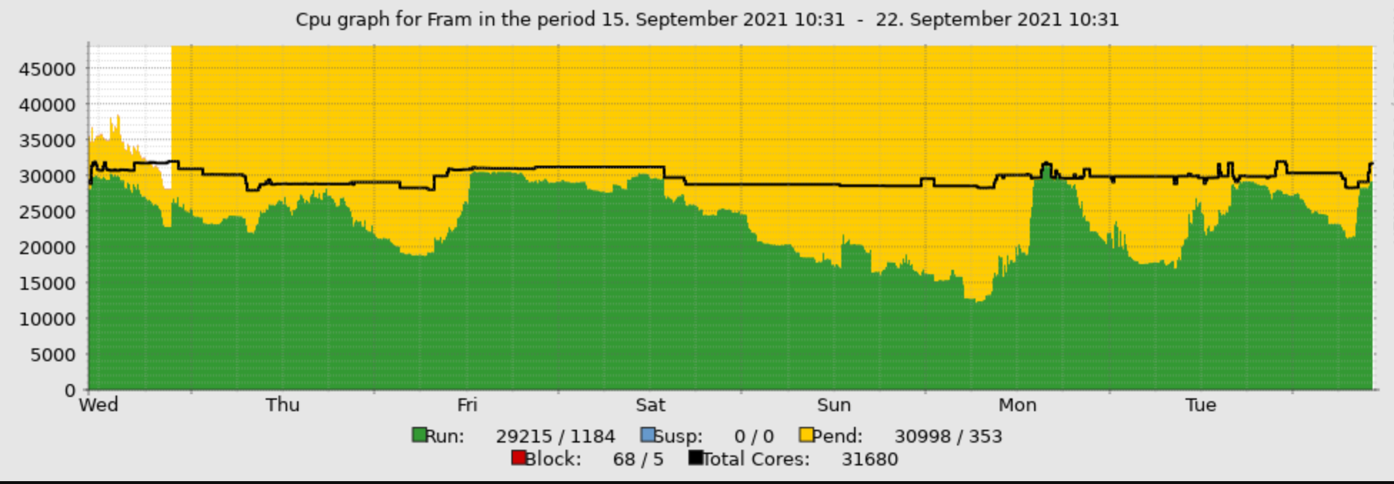
FRAM HPC delivered by Sigma2 through NRIS

Slide 10
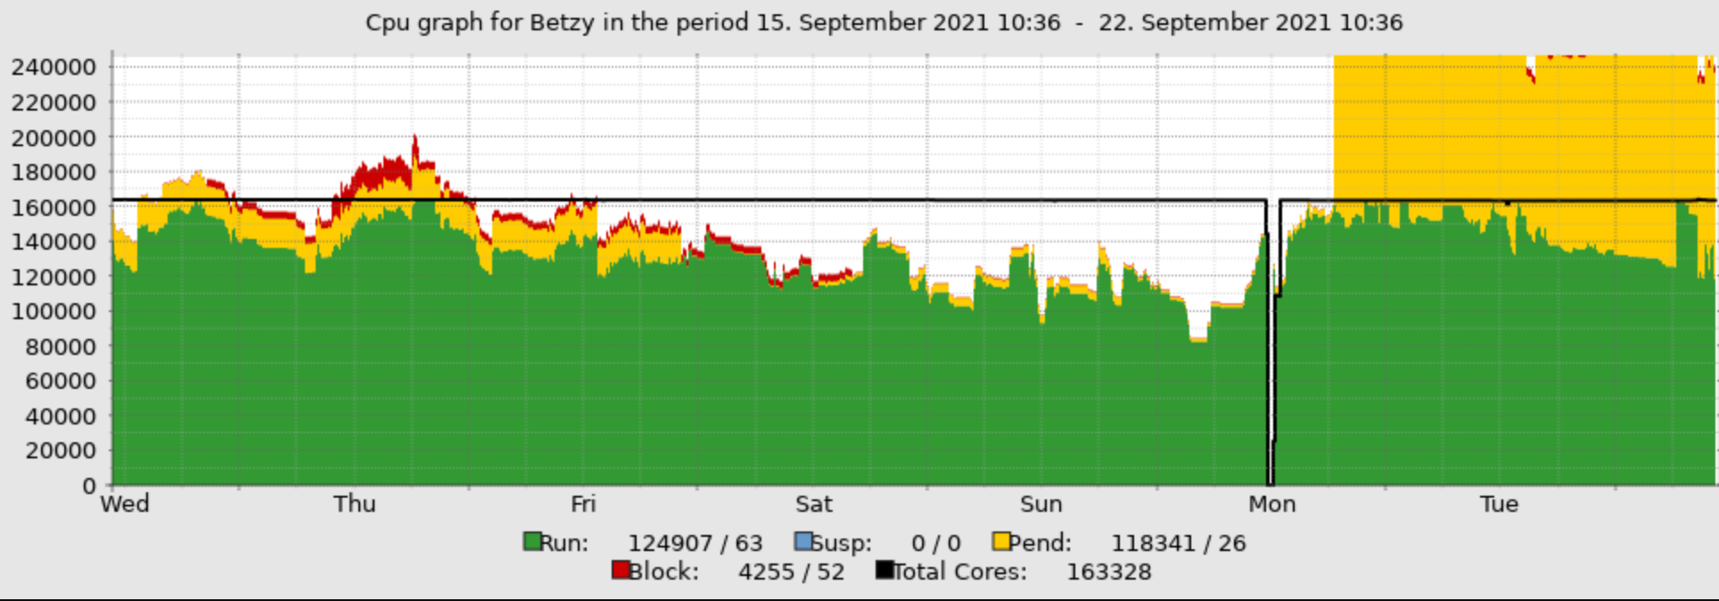
Betzy HPC delivered by Sigma2 through NRIS
Betzy reached 56th place on world top 500 in June 2020

Slide 11
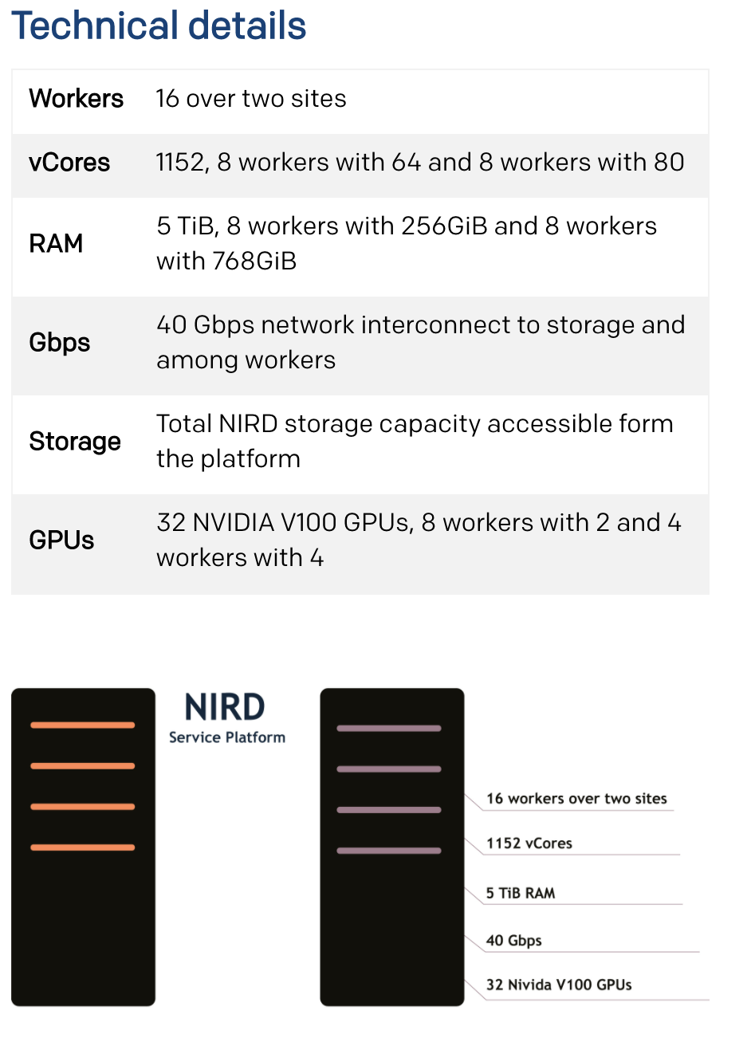
NIRD service platform

Slide 12
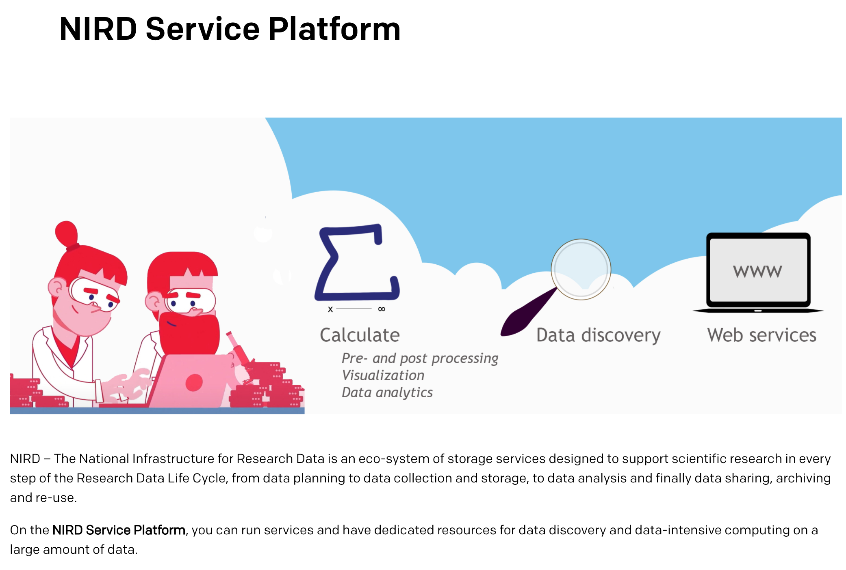

Slide 13

TSD HPC/Storage delivered by Sigma2 through NRIS
2300 cores
Huge memory nodes
GPU nodes
1.37PiB storage

Slide 14
NIRD archive @Sigma2 thorugh NRIS
What is the Research Data Archive?
The Research Data Archive is a repository that provides long-term storage for research
data and is compliant with the Open Archival Information System (OAIS) reference
model.
The aim of the archive is to provide (public) access to published research data and to
promote cross-disciplinary studies. The Archive is mandated to ensure the dataset
remains accessible for up to 10 years after the publishing date.
The information about the stored data (metadata) will be publicly accessible and some
of the metadata will be distributed and harvested by other services.
https://archive.sigma2.no/
Free of charge!

Slide 15
Easy DMP @Sigma2 through NRIS
EasyDMP is a service that offers researchers, with minimal experience in data management, a simple way of creating Data Management Plan (DMP). This is achieved by transforming any funding agency's or institution’s data management guidelines and policies into a series of easy to answer questions, many containing a simple list of canned answers to pick from.
https://easydmp.sigma2.no/
Free of charge!

Slide 16
Advanced User Support (AUS) @Sigma2 through NRIS
Advanced user support offers help that goes beyond basic user support to provide specialised and more in‐depth competence to a research group or community using the national e-infrastructure. This includes free, dedicated efforts from our highly competent experts to enable or boost the potential exploitation of our HPC resources and data services. Ultimately, the advanced user support should contribute to effective and optimal use of the national computing and data‐storage facilities.
https://www.sigma2.no/advanced-user-support#apply-for-aus-project-based

Slide 17
















Scientific software provisioning
Standard
Flexible/DIY
NRIS Easybuild
National HPC
Local Easybuild
Local resources
We can help with DIY solutions on best-effort basis (for the right price)
If at all possible, we very much recommend sticking with the standard solution
oracle, azure, amazon, google, ...
Local resources
Notes:
Or even come with a container provided by a fellow researcher.
So to sum it up, we can be provide as flexible services as you want, but the more flexible you like things to be, the more you will have to do on your own. So if you are in doubt that you have the time, we do recommend the standard path.

Slide 18






Digital resources internationally
International research infrastructures
International research archives
Commercial cloud providers
Competence through Euro HPC CC

Slide 19
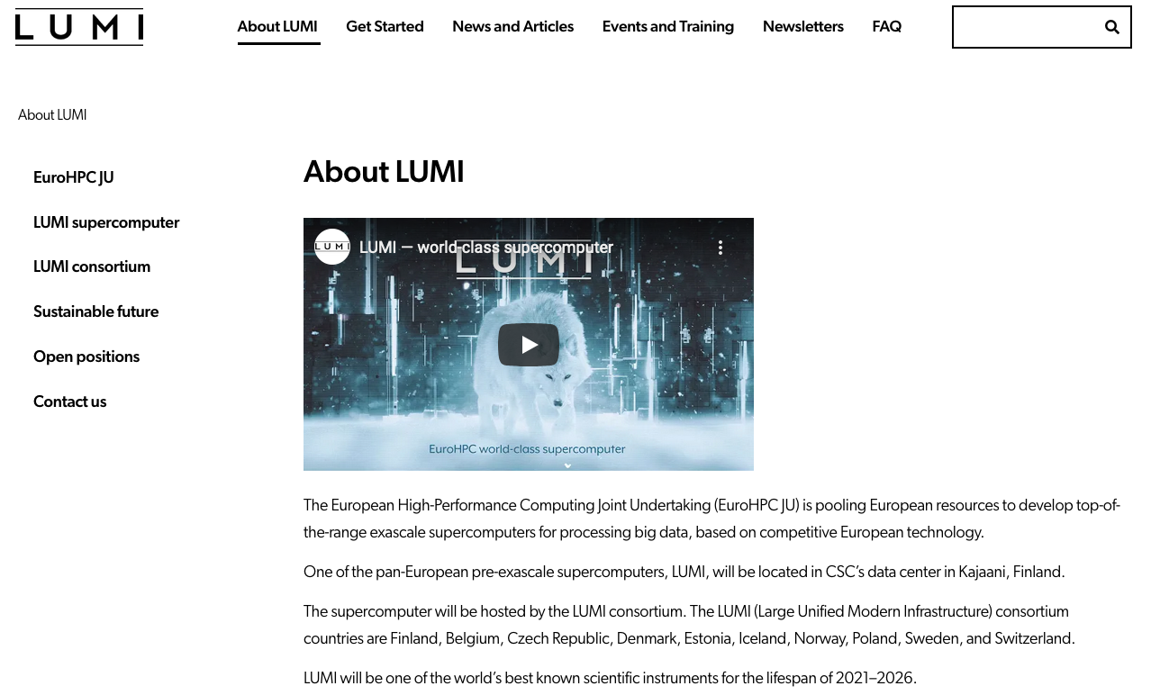
LUMI – preExascale HPC – Norway is a partner
550+ PetaFlops
Available through Uninett Sigma2 AS
Quite high step-in level
LUMI «C» from 6th Oct 2021
Norwegian pilot communities:
  Climate research
  Solar Physics
  Natural Language Processing
https://www.lumi-supercomputer.eu/about-lumi/

Slide 20


Slide 21
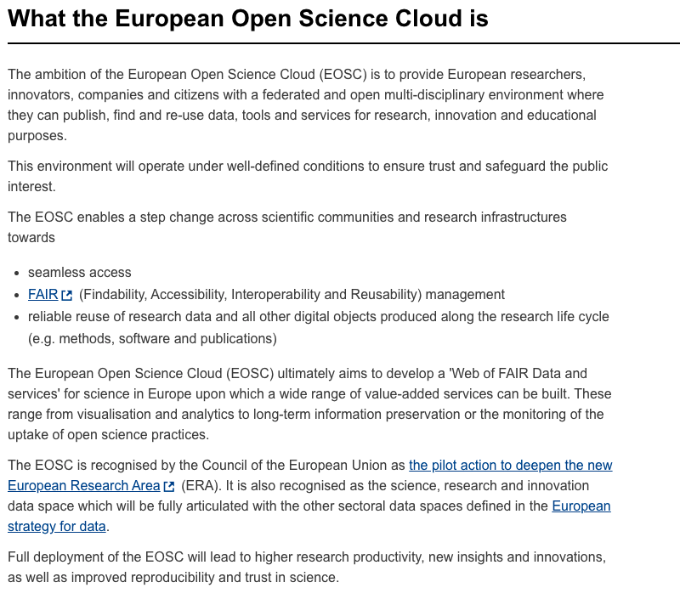
European Open Science Cloud (ec.europa.eu)

Slide 22
European Open Science Cloud (ec.europa.eu)
Environment and Climate
Our Digital Future
Jobs and Economy
Protecting our citizens and our values
Europe in the world
Democrazy and rights

Slide 23
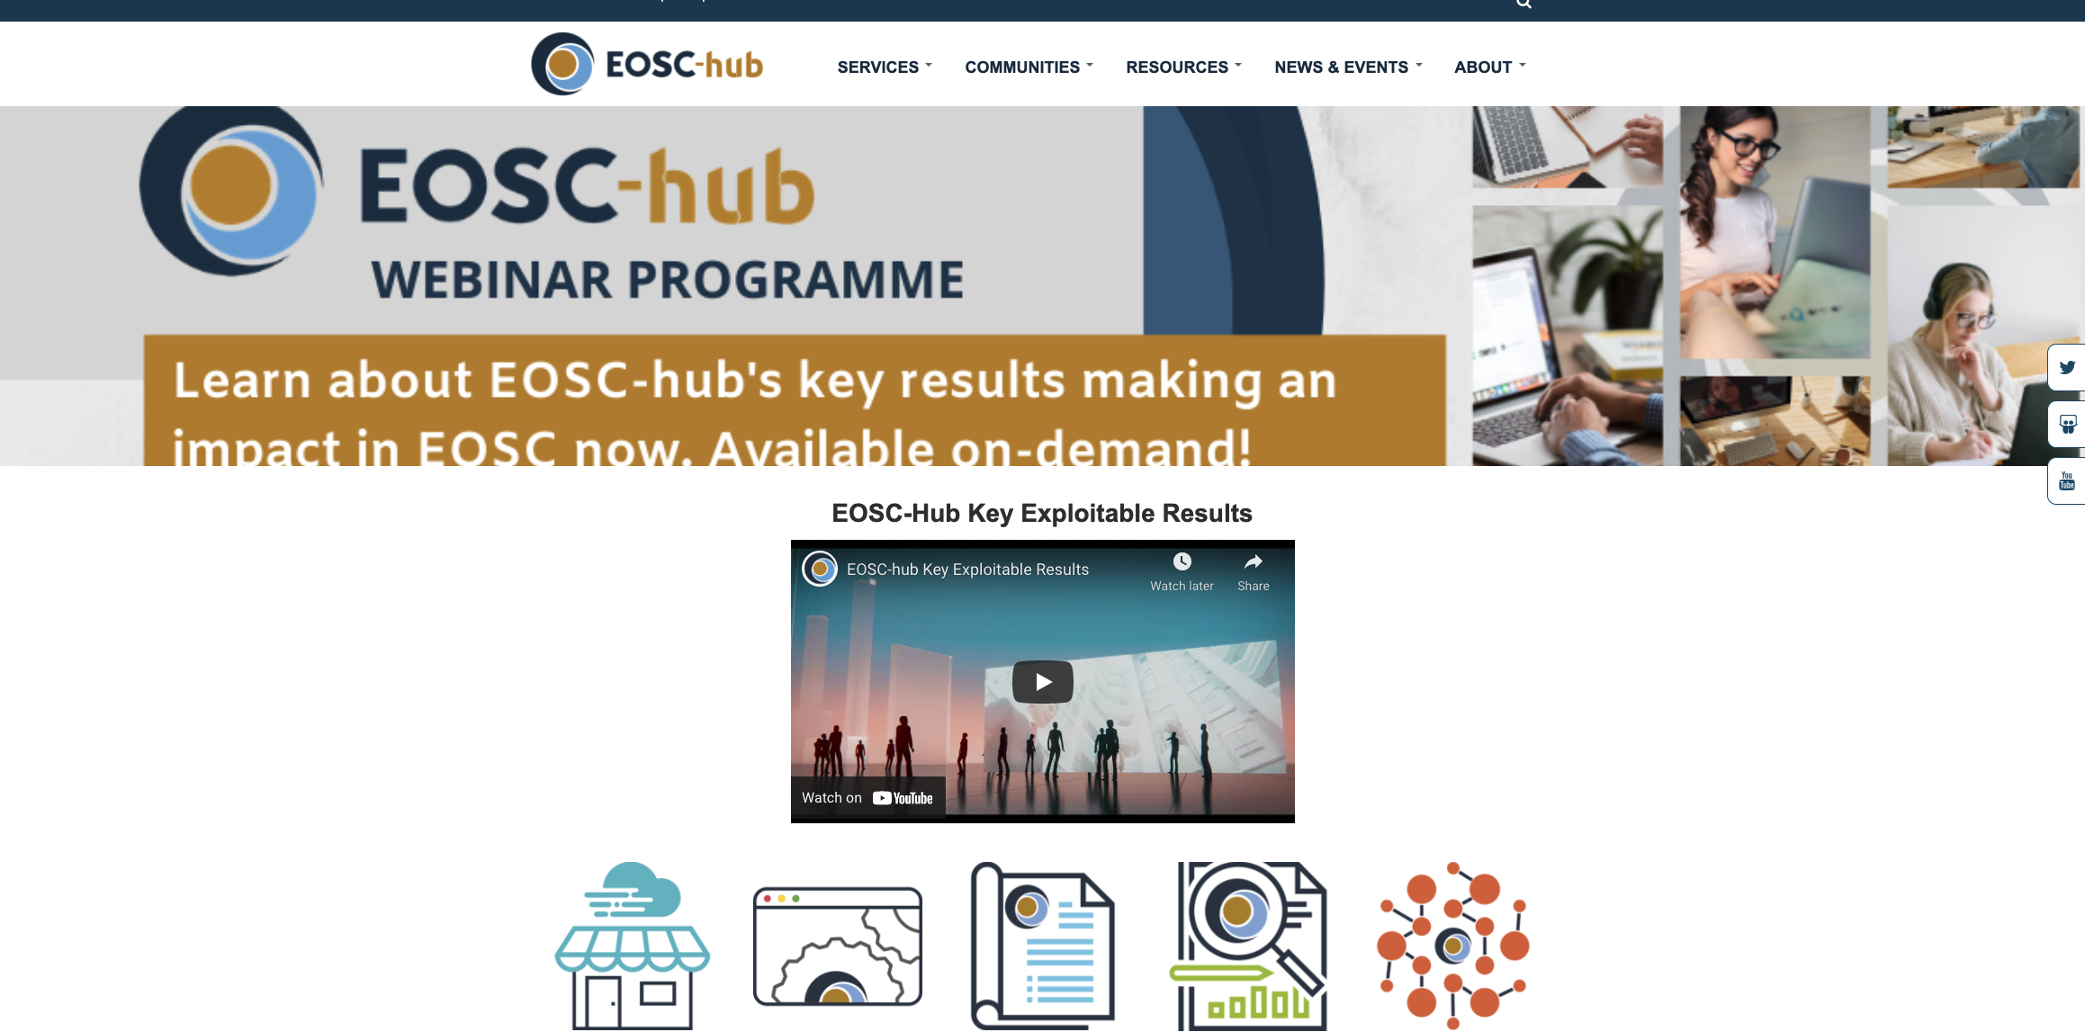
European Open Science Cloud (ec.europa.eu)
Calls and programs: See https://www.eosc-life.eu/opencall/

Slide 24
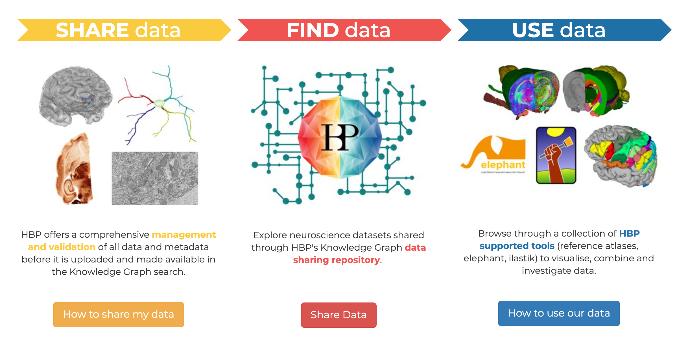

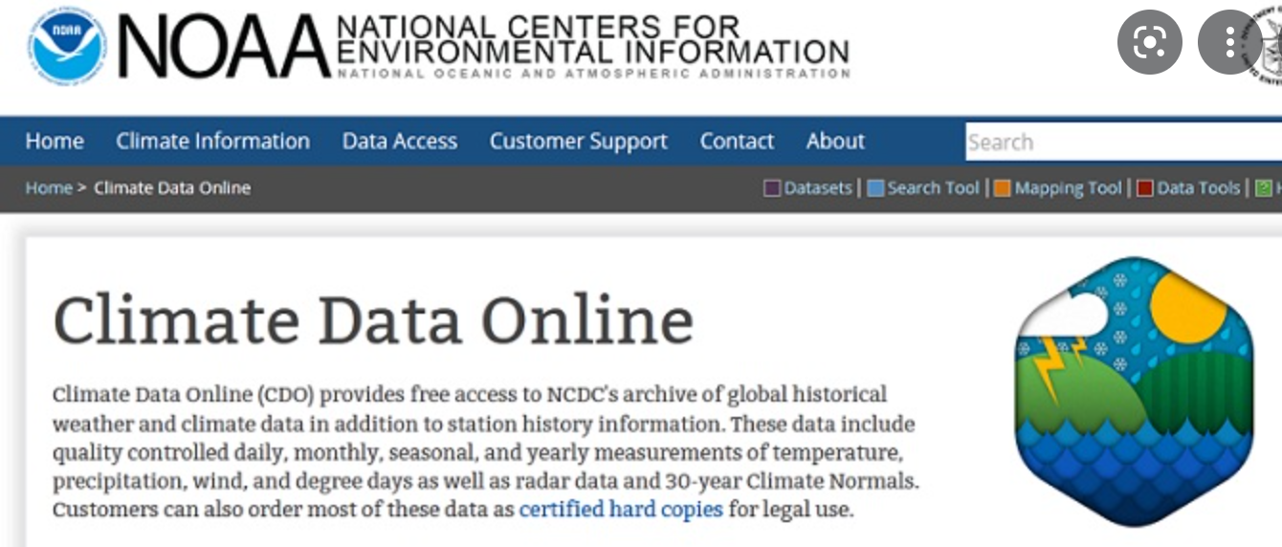
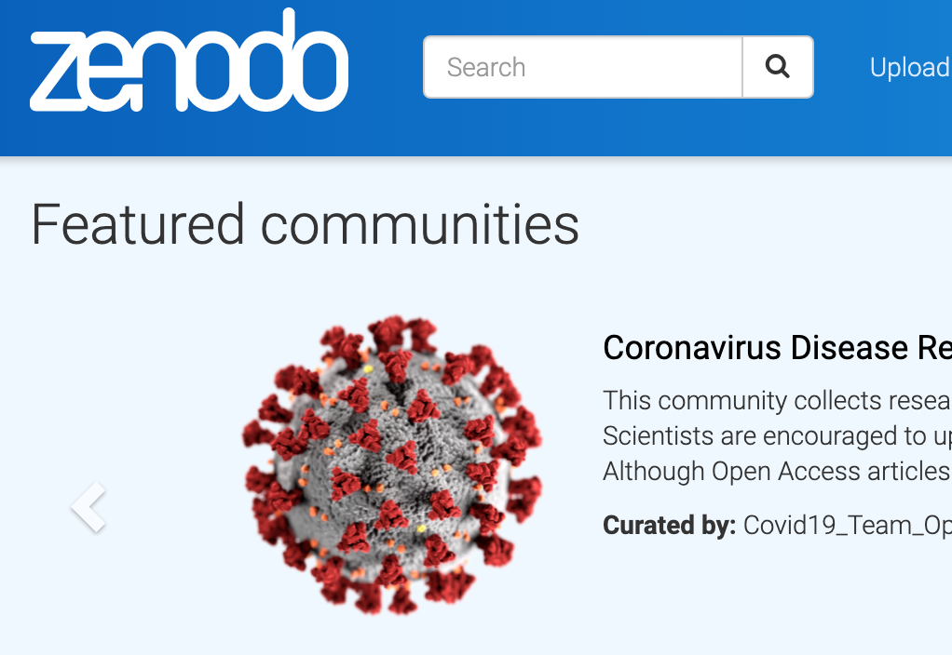

International research data archives

Slide 25
Questions
ITF-sjefer@usit.uio.no

Slide 26
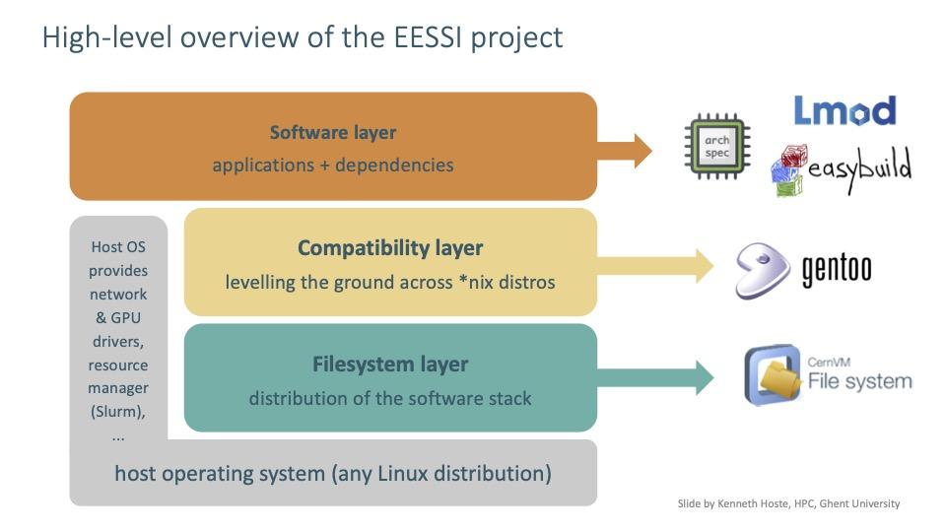
Scientific software provisioning
Standard
NRIS Easybuild
National HPC
Local Easybuild
Local resources
We can help with DIY solutions on best-effort basis (for the right price)
If at all possible, we very much recommend sticking with the standard solution
Collaborating with/participating in NESSI and EESSI projects
Notes:
Or even come with a container provided by a fellow researcher.
So to sum it up, we can be provide as flexible services as you want, but the more flexible you like things to be, the more you will have to do on your own. So if you are in doubt that you have the time, we do recommend the standard path.

