Slide 1

Welcome to the Faculty of Humanities

Slide 2
Getting started!
We wish you a warm welcome to the Faculty of Humanities at the University of Oslo.
To help you get started, we have put together a small introductory presentation, that will give you the key information you need before arriving in Oslo and for the first few weeks.

Slide 3
Visa and permits
Possible requirements pertaining to visas and permits must be checked and followed up upon well in advance of your planned arrival in Norway. These preparations lay the ground for a smooth and efficient relocation experience.
Our International Staff Mobility Office (ISMO) will be able to assist you with any questions you might have in this regard.
ISMO also has a very helpful website with useful information on this topic: Visa & permits - University of Oslo (uio.no)

Slide 4
Housing and accommodation
Finding suitable accommodation should be your top priority.
There is a higher demand for reseacher housing than the existing facilities can cover. Therefore, it would be a good idea to look into private housing options right from the beginning.
In order to obtain a permanent Norwegian ID number, you need a housing contract that is valid for at least 6 months.
The International Staff Mobility Office has a website that will guide you through both housing through UiO and housing on the private market: Accommodation for international researchers and staff - University of Oslo (uio.no)

Slide 5
Bringing a partner and/or children?
This website has useful information on finding meaningful occupation for your partner in Norway: Accompanied by partner - University of Oslo (uio.no)
This website has useful information on daycare, schools, and social benefits if you are bringing children: Bringing kids - University of Oslo (uio.no)

Slide 6
Getting to know the University of Oslo
Presentation of the University of Oslo:
  general-presentation-of-uio.pptx (live.com)
Strategy and plans:
  Strategy and plans - University of Oslo (uio.no)
Organisation chart:
  Organisation chart - University of Oslo (uio.no)

Slide 7
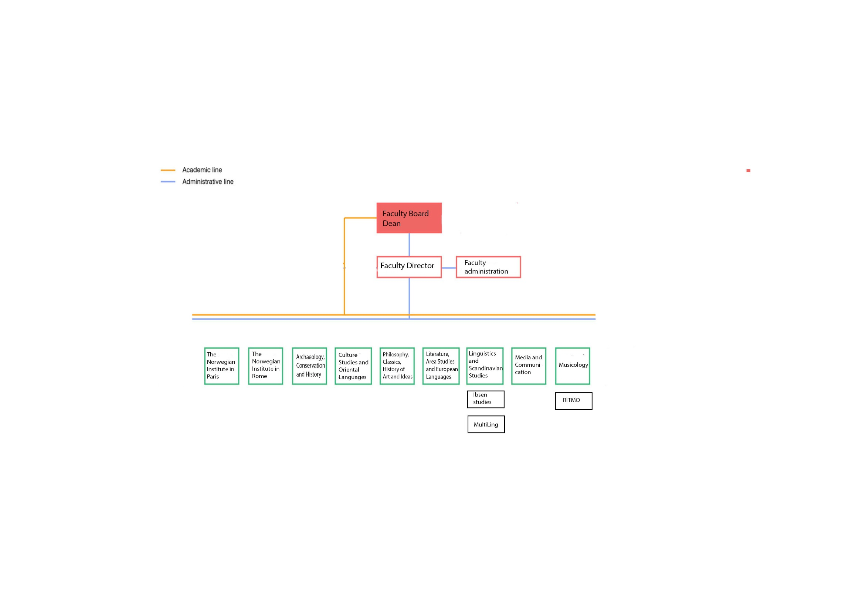
The Faculty of Humanities
Notes:
UNIVERSITETET I OSLO – ORGANISASJON pr. 21.10.2018

Slide 8
The Faculty of Humanities
Faculty management
Dean: Frode Helland
Pro-Dean for Research and Research Training: Mathilde Skoie
Pro-Dean for Studies: Gunn Enli
Administrative management
Faculty Director: Monica Bakken
Faculty Board members:
Current members

Slide 9
Campus and areas
The University of Oslo has several campuses and areas:
  Campus Blindern
  Campus Downtown
  Campus Tøyen
  Gaustad and Rikshospitalet
  Geitmyrsveien and Ullevål
  Other areas including the Viking Ship museum and hospitals
The Faculty of Humanities is located primarily in Campus Blindern. The exceptions are RITMO, located in Gaustad at the Department of Psychology, as well as our two centers abroad (in Paris and Rome).

Slide 10
Important information
upon arrival

Slide 11
For employees website
The «for employees» website has important and useful information for employees at the University of Oslo: For employees (uio.no)
We highly recommend that you personalise your front page at your earliest convenience. You can add your own shortcuts and tools, and customise your news items.
Here is a guide to how you edit your personal start page: Personal start page - For employees - University of Oslo (uio.no)

Slide 12
Profile page
Profile pages at the University of Oslo (UiO) show what each employee is working on and serve as digital business cards with contact information.
Most employees at the UiO edit and update their own profile pages. Information on how to do so can be found here: How to edit your profile page - For employees - University of Oslo (uio.no)

Slide 13
Registration of sideline jobs (external work) and owner interests
A «sideline job» ("external work" in the self-service portal)is defined as work performed and assignments and offices held in addition to the employee’s ordinary university position, regardless of whether they are paid or not. Work performed through an undertaking or company that is wholly or partly owned by the employee is also considered a sideline job.
Employees report sideline jobs/external work and/or owner interests through the electronic registration solution in the self-service portal, see: User guide for registering external work and owner interests (dfo.no)

Slide 14
Self-service portal
The self-service portal is UiO's system for time and absence registration. Here you can, among other things, register absences, submit travel invoices or apply for expense reimbursements.
Link to user guide: Get started with the new self-service portal! - For employees - University of Oslo (uio.no)

