Slide 1
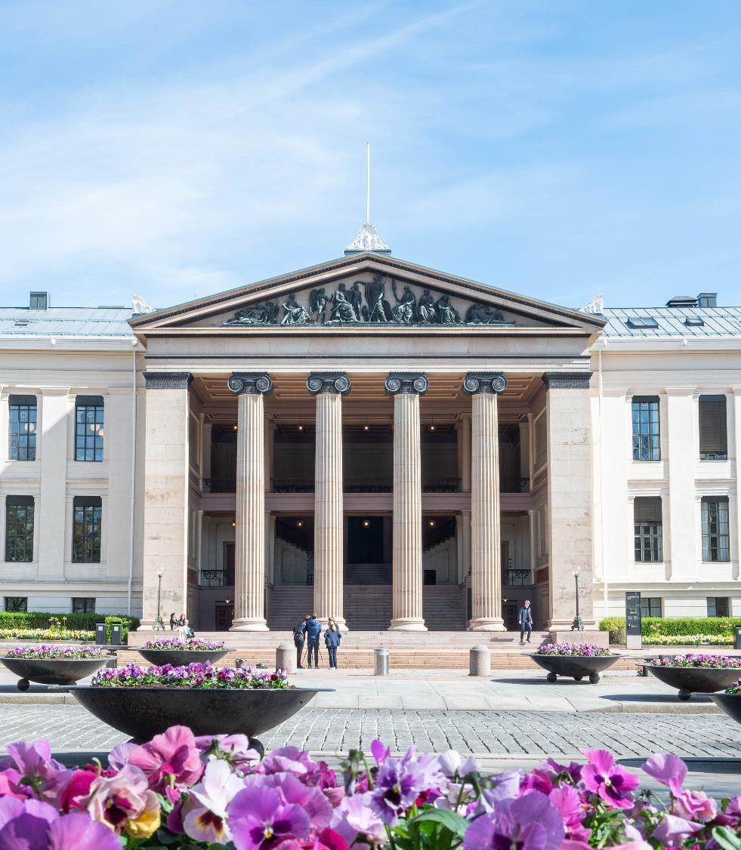
A leading European university
Photo: UiO/Anders Lien
Notes:
Norway’s oldest institution for research and higher education – since 1811

Slide 2
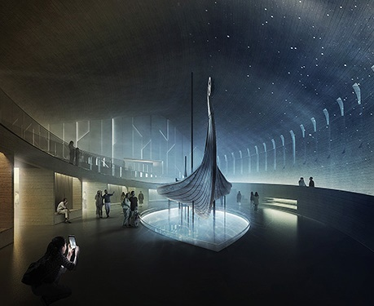
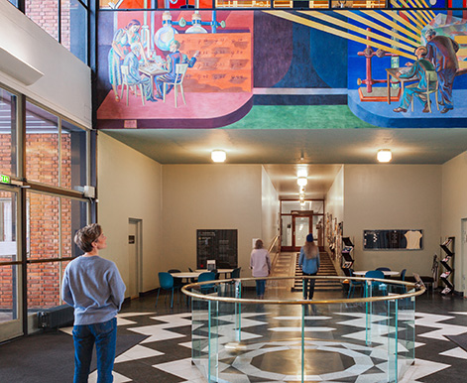


University of Oslo today
8 faculties
226 study programmes
476 completed PhDs
World’s 83rd best research university
5 Nobel Prize Laureates
Photo: AART Architects
Photo: UiO/Jarli & Jordan
Centre for global sustainability
University Library
2 museums
6,900 employees
3,014 researchers
27,400 students
Photo: Jarli & Jordan/UiO
Photo: UiO/Jarli & Jordan
Photo: UiO/Jarli & Jordan
Notes:
World’s 83rd best research university: Shanghai Ranking
UiO has four disciplines in the top 50 in the rankings: public administration/political science (19), sociology (36), law (44) and educational sciences (50).
Nobel Prize Laureates: https://www.uio.no/english/about/facts/nobel-prize/

Slide 3
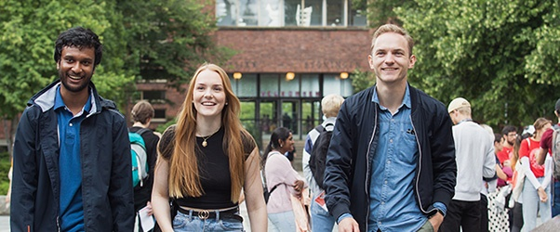
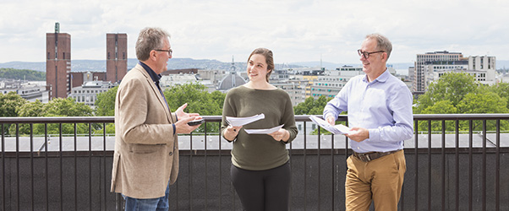


Campuses
Campus Blindern
Campus Downtown
Photo: UiO/Jarli & Jordan
Photo: UiO/Jarli & Jordan
Campus Tøyen
Decentralised medical programmes
Photo:
Lars Kristian Singelstad, SSHF
Photo: Fara Mohri
Notes:
Campus Blindern: Blindern and Gaustad.
Decentralised medical programmes: Medical students at UiO can complete part of their education at Sørlandet Hospital or Innlandet Hospital.

Slide 4
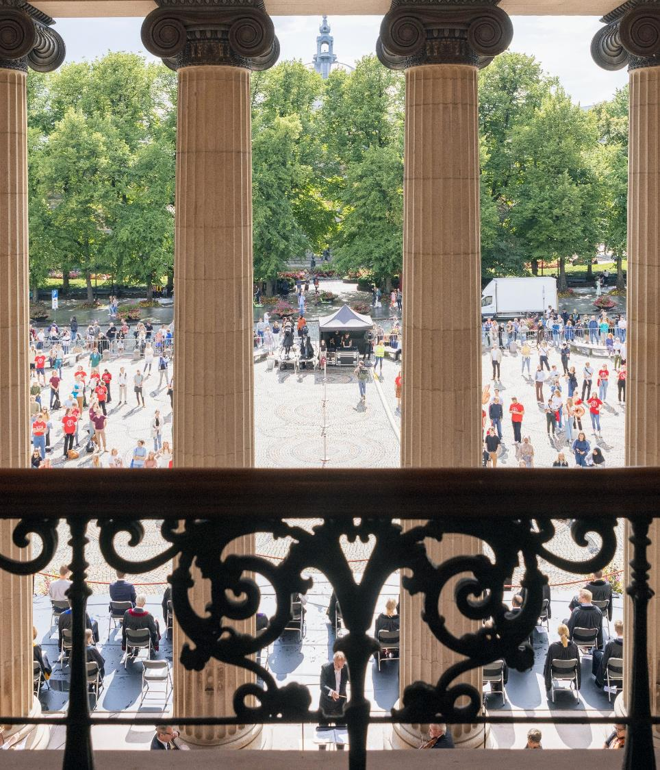
Strategy 2030
Promote independent, ground-breaking, long-term research
Educate students with the knowledge, ability and willingness to create a better world
Strengthen the dialogue with the outside world and work to ensure that knowledge is put into use
Be an innovative organisation and an attractive place of work and study
Photo: UiO/Jarli & Jordan
Notes:
Strategy 2030: https://www.uio.no/english/about/strategy/strategy-2030/index.html

Slide 5
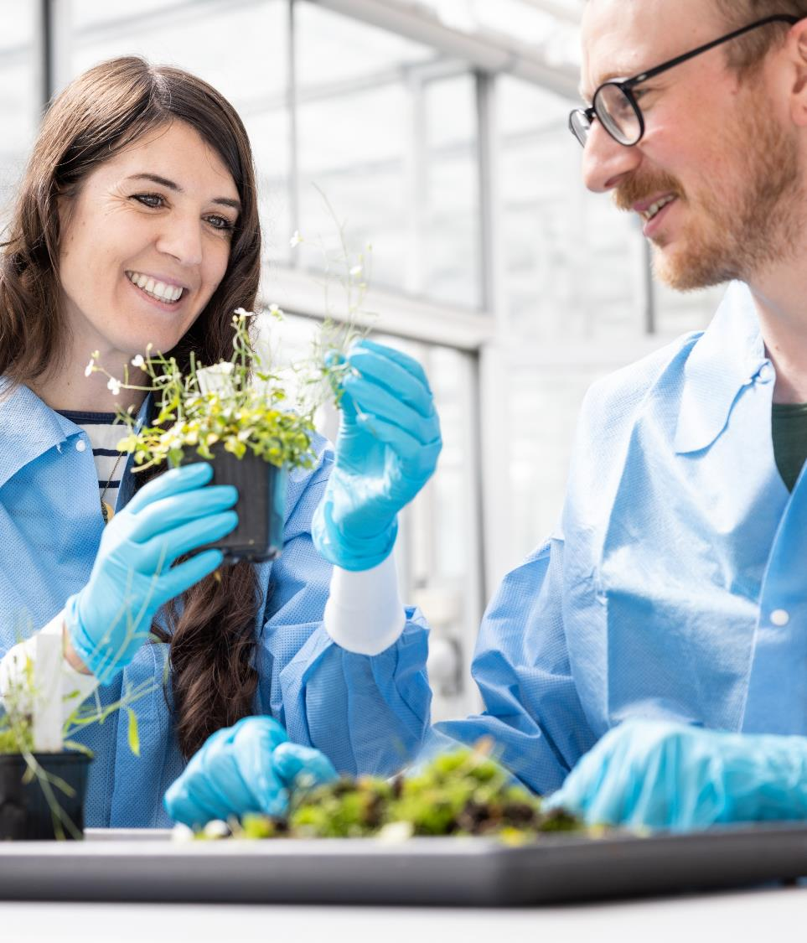
Comprehensive climate and environmental strategy
Offer all students research-based education on climate, the environment and sustainability
Strengthen interdisciplinary research and collaboration on climate, environment and sustainability
Reduce our climate footprint and further develop «green campuses»
Photo: UiO/Jarli & Jordan
Notes:
Comprehensive Climate and Environmental Strategy: https://www.uio.no/english/about/strategy/climate-and-environment/index.html

Slide 6

Diversity at UiO
High proportion of women among students and staff, younger age profile, and higher share of international representation than in the general population.
Around 52 percent of staff are women and 47 percent of staff are men
25 percent of staff have international citizenships. Postdocs: 64 percent
40 percent of professors are women
Students: 62 percent women, 28 percent with immigrant background
Photo: UiO/Jarli & Jordan
Notes:
Source: UiO's policy for diversity, equality and inclusion, https://www.uio.no/english/about/strategy/gender-equality/index.html

Slide 7
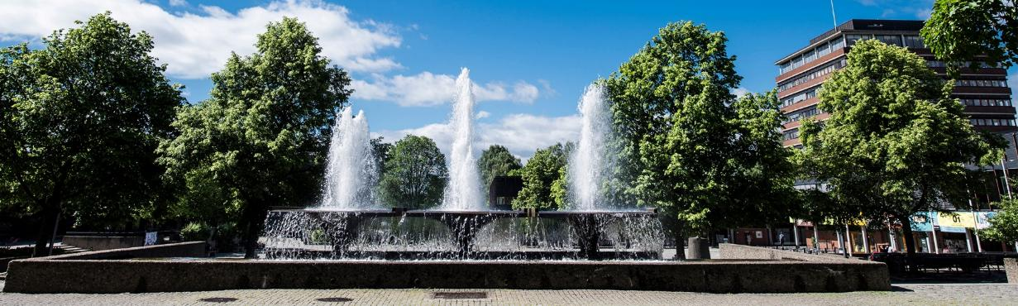
Income
Total income
University of Oslo:
9,75 BNOK
Photo: UiO/Anders Lien
6,7 BNOK
basic funding
2,5 BNOK
results-based funding
Funding from EU, Norwegian Research Council, other contributions and assignments
540 MNOK
other income
Notes:
540 million NOK: income from gifts, sales, rent.

Slide 8
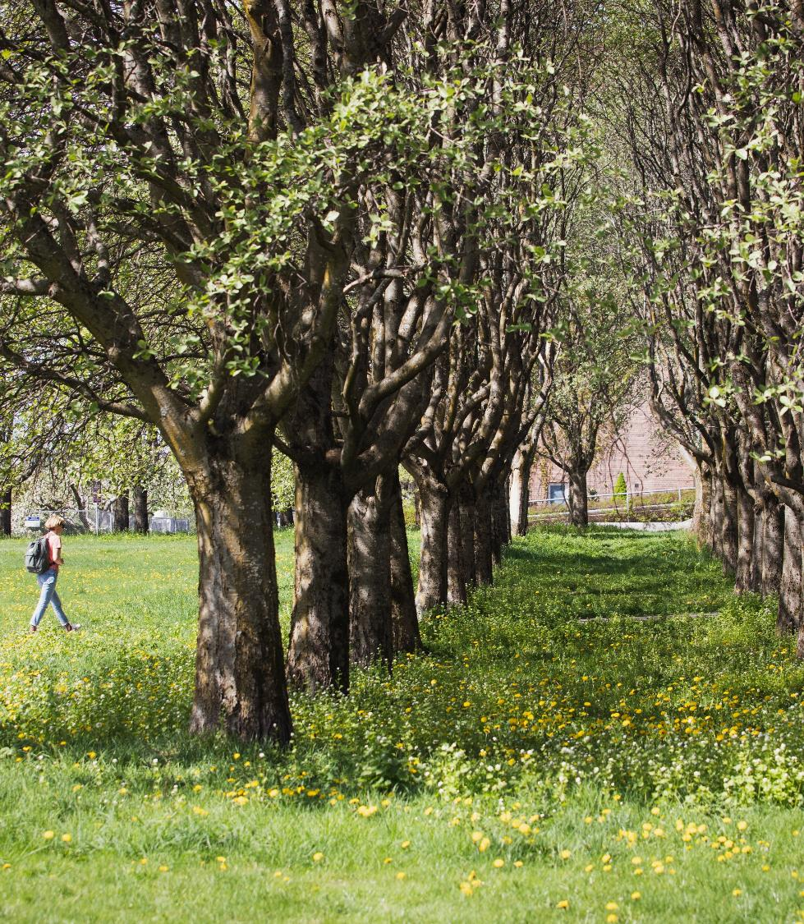
The faculties
Faculty of Humanities
Faculty of Law
Faculty of Mathematics and Natural Sciences
Faculty of Medicine
Faculty of Dentistry
Faculty of Social Sciences
Faculty of Theology
Faculty of Educational Sciences
Photo: UiO/Jarli & Jordan

Slide 9

Centre for Global
Sustainability
Founded in 2025
Interdisciplinary research, education, and dissemination within four thematic areas:
Energy, food, and resources
Health, climate, and environment
Knowledge, technology, and trust
Democracy, governance, and social justice
Sett inn bilde her
Photo: Helge Brekke
Notes:
Centre for Global Sustainability: https://www.globe.uio.no/english/about/

Slide 10
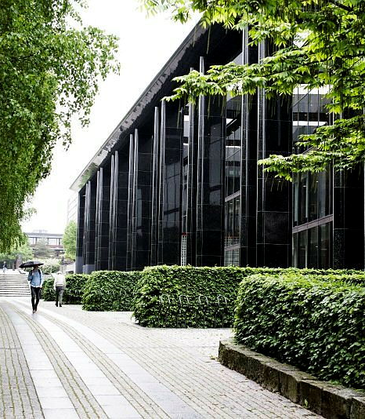
The University Library
Public research library and part of UiO
Open and accessible libraries on all campuses
Provides access to relevant academic literature for studies and research at UiO and Oslo University Hospital (OUS)
Develops tools to support the full research process
Supports student learning, digital skills, and information literacy
Photo: UiO/Anders Lien
Notes:
The University Library: https://www.ub.uio.no/english/

Slide 11
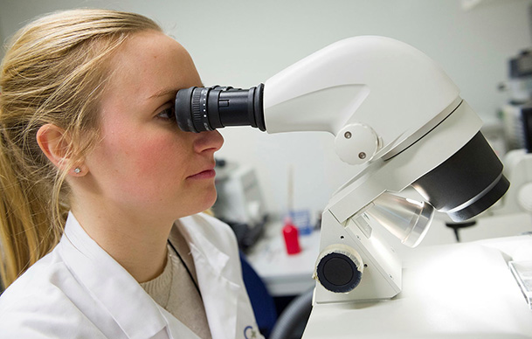


A research-intensive university
Photo:CanCell
Photo: Nicholas Doherty/Unsplash
Photo: UiO/Jarli & Jordan
Foto: Jarli & Jordan/UiO
30 active Excellent Centres
– research, innovation, education, sustainable energy
69 active projects from the
European Research Council (ERC)
101 active Marie Sklodowska-Curie-actions (from the EU)
254 active FRIPRO-projects from the Research Council of Norway (NFR)
Notes:
UiO is the project owner of 16 Excellent Centres:
10 Centres of Excellence (SFF)
4 Centres for Excellence in Education (SFU)
1 Centre for Research-based Innovation (SFI)
1 research centre for environment-friendly energy (FME)
In addition, UiO is a partner in 14 other Excellent Centres.
ERC-projects: https://www.uio.no/english/research/research-excellence/eu/erc-grants/index.html
Marie Sklodowska-Curie: The Marie Skłodowska-Curie Actions (MSCA) Doctoral Networks train and empower future researchers through international and cross-sectoral collaboration. https://www.uio.no/english/research/research-excellence/eu/msca-doctoral-networks.html
FRIPRO: FRIPRO is an open, national competitive arena within all disciplines and topics, for researchers at research organisations. Through this grant, The Research Council of Norway (NFR) fund basic, excellent research, where the project ideas come from the researchers themselves.

Slide 12
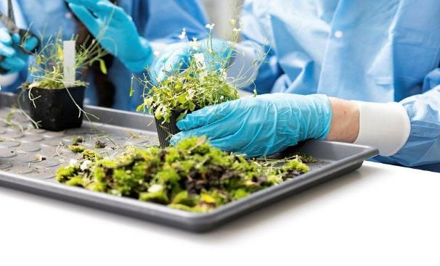
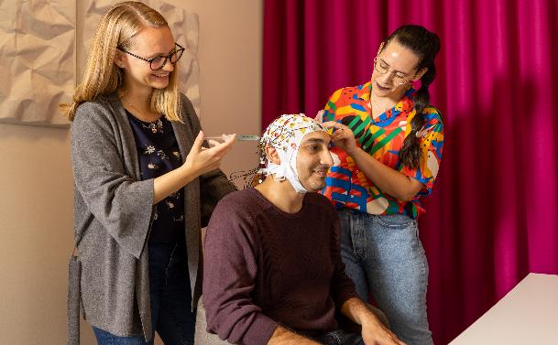
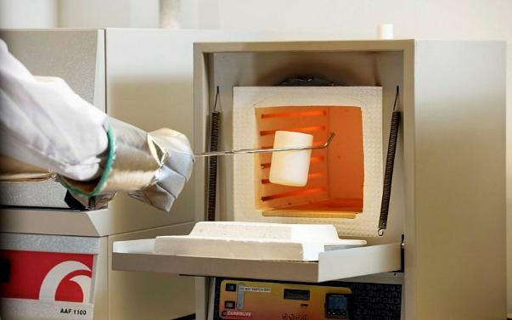
Best in Norway
Photo: UiO/Jarli & Jordan
Photo: UiO/Jarli & Jordan
Photo: UiO/Jarli & Jordan
Foto: Nicholas Doherty/Unsplash
Foto: Jarli & Jordan/UiO
10 active Centres of Excellence (SFF)
– more than 50 percent of Norway’s current SFFs
69 active ERC-projects:
– more than 40 percent of current projects in Norway
– UiO number two in the Nordic region, after Copenhagen
101 active Marie Sklodowska-Curie Actions – best in Norway, fourth in the Nordic region
254 active FRIPRO-projects
– more than 40 percent of all allocations in 2025

Slide 13
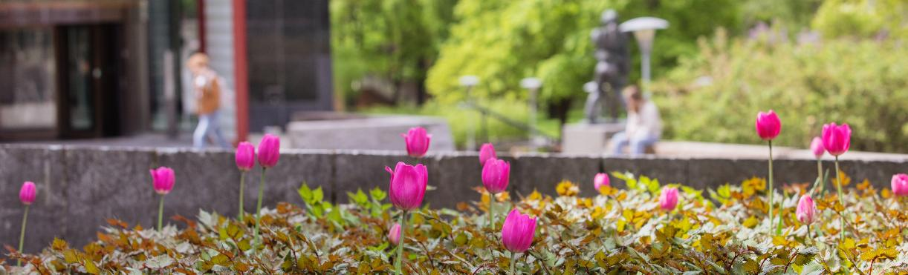
Scientific publications
Total publications University of Oslo
6,514
Photo: UiO/Jarli & Jordan
6,652
publication points (ECTS)
64 %
international co-publications
79 %
of UiO’s academic papers are open access
Notes:
Top five countries that co-published with UiO in 2025:
US – 1,330 publications
UK – 1,177 publications
Germany – 1,000 publications
Sweden – 870 publications
Italy – 678 publications

Slide 14
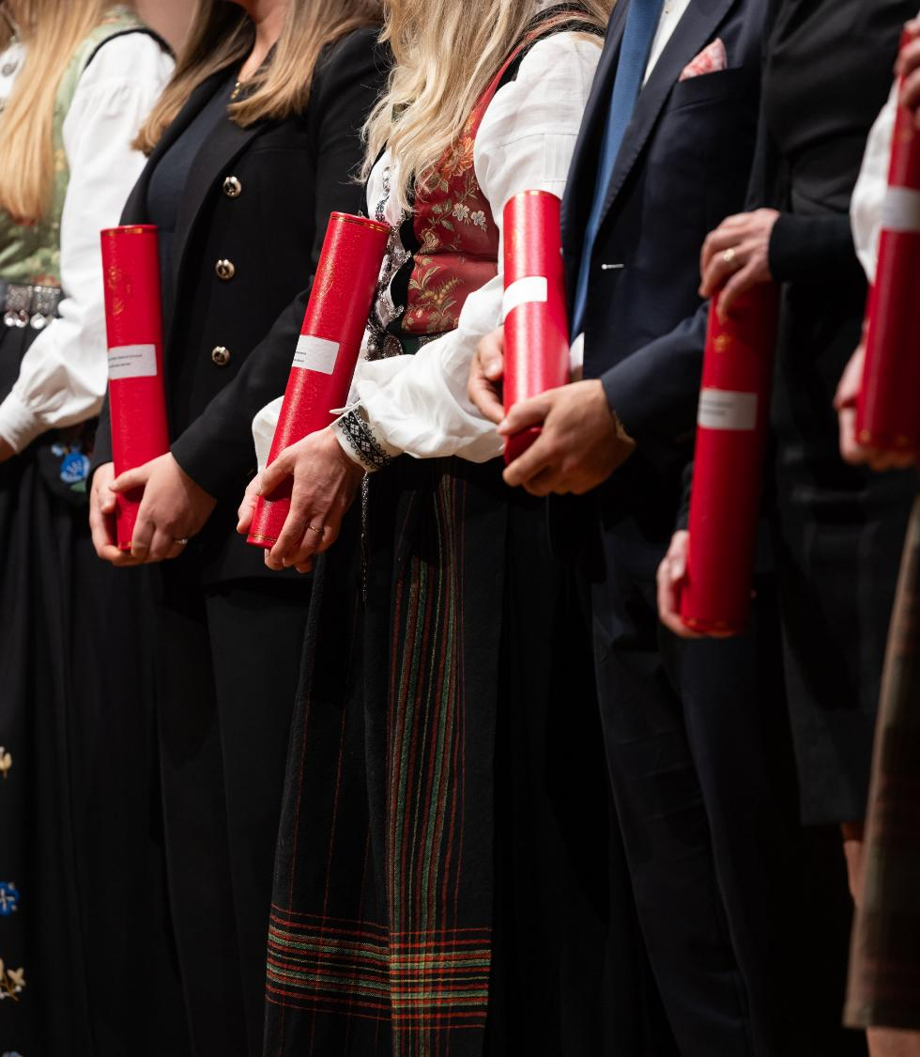
Doctorates
8 Ph.D.-programmes
476 doctoral degrees awarded in 2025
A quarter of all Norwegian doctoral degrees are awarded at UiO
Photo: Jarli & Jordan/UiO
Photo: UiO/Jarli & Jordan
Photo: UiO/Jarli & Jordan

Slide 15

Emerging technologies
UiO has been given 50 MNOK annually for a research initiative within emerging technologies
Research areas:
advanced materials and quantum technology
life sciences and biotechnology
social sciences and technology
UiO also hosts two research centres within artificial intelligence (AI): MishMash and TRUST
Additionally, UiO is a partner in four other AI-centres and one centre for quantum technology
Photo: UiO
Notes:
Emerging technologies: future-oriented technologies with uncertain trajectories, but with the transformative power to create progress and real improvements for both life and society. These technologies grow out of groundbreaking basic research, in an interaction where research and technology development are strongly interconnected.
MishMash: https://mishmash.no/
TRUST: https://www.trust-aicentre.no/english/

Slide 16
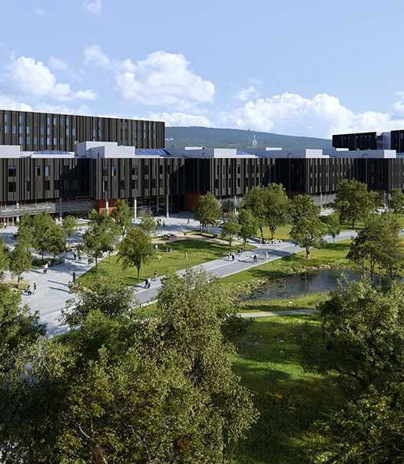
Life Science Building
UiO and parts of Oslo University Hospital moves into this high-tech flagship building
Interdisciplinary research and education within chemistry, pharmacy, biosciences, laboratory medicine, and life sciences
About 1,600 staff and 1,250 students will work together to develop new solutions to major challenges like dementia, cancer, antimicrobial resistance, and viral diseases
Illustrasjon: Ratio Arkitekter/MIR
Illustration: Ratio arkitekter/KVANT-1

Slide 17
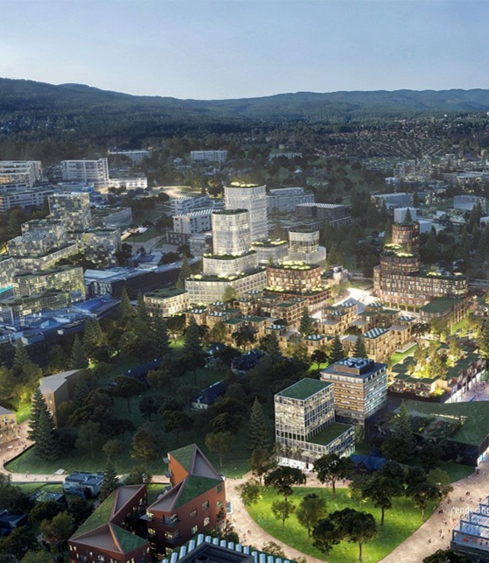
Oslo Science City
Norway’s first innovation district
Home to the country's top university, the largest hospital in the Nordic region, internationally leading research institutes, one of Europe's largest business schools, and dynamic startup environments.
The area: Majorstuen, Marienlyst, Blindern, Gaustad, Ullevål and the Radium Hospital
Illustration: Oslo Science City
Notes:
Oslo Science City: https://www.oslosciencecity.no/en

Slide 18




From basic research to innovation
Pharmaceuticals
and methods of treatment
New legislation
and regulations
Policy development
Photo: UiO/Jarli & Jordan
Photo: Francesco Saggio/UiO
Teaching
Technology
Photo: NTB/Thomas Brun
Photo: Colourbox
Notes:
Basic research is long-term research that aims to lead to new insights, without necessarily providing immediate benefit to the economy, knowledge or use. Many of the products and services we take for granted today could not have been imagined just a few years ago.
Innovation often originates from basic research. Whether it concerns pharmaceuticals, vaccines, computer technology, teaching methods, language models or new policies, laws and legislations.​

Slide 19
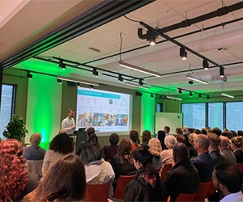


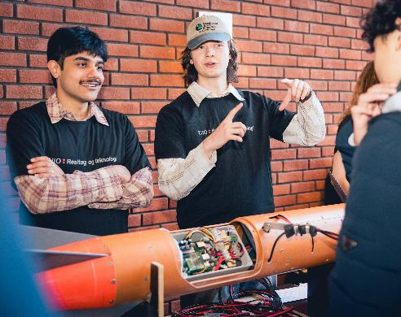
Measures for innovation
Inven2
Oslo Tech
UiO Growth House
SPARK Life Science SPARK Social Innovation
Photo: UiO Growth House
Photo: Jarli & Jordan/UiO
Startuplab
ShareLab
Insj
Innovation certificate
Co-Create
Photo: UiO/Jarli & Jordan
Photo: Jarli & Jordan/UiO
Photo: Jarli & Jordan/UiO
Notes:
Innovation at UiO – knowledge in use: https://www.uio.no/english/about/innovation/index.html
Inven2 – Technology Transfer Office – UiO together with Oslo University Hospital
Announcement of programmes, lab spaces, hosting student innovation activities etc. – we facilitate the development of good ideas and solutions for the future from our students.

Slide 20



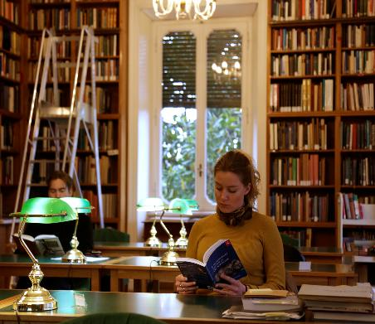
Education
Students most pleased with academic content
27,400 students
5,266 graduates
Photo: UiO/Jarli & Jordan
Photo: UiO
1,097
outgoing students
1,666
incoming students
16,744 qualified students with UiO as their first choice
Photo: UiO/Jarli & Jordan
Photo: UiO/Francesco Segrè
Notes:
Students most pleased with academic content: Studiebarometeret 2025, https://studiebarometeret.no/en
UiO receives students from the entire country, but mostly from the eastern parts of Norway.
2/3 women
28 percent of students have an immigrant background
50 percent of students have a background from outside of Norway. Most from Europe, followed by Asia.
Source: Report on equality, inclusion and diversity at UiO, https://www.uio.no/om/strategi/likestilling/rapporter/lim-rapport-2025.pdf (Norwegian only)
Exchange (DBH, 2025):
Outgoing students: 945
Incoming students: 1,519
International students: 3,647

Slide 21
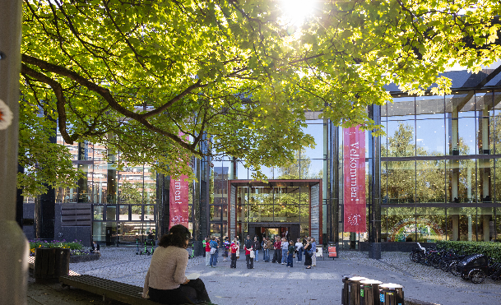
Students and study programmes
36
one-year programs
98
Master´s degree programmes
72
Bachelor´s programs
10
5-6-year programmes
Foto: Jarli & Jordan/UiO
Foto: UiO/Jarli & Jordan
8,645
students in bachelor’s programmes
5,770
students in 1,5 - 2-year master's programmes
6,340
students in 5-year master's programmes and 6-year programmes of professional study

Slide 22

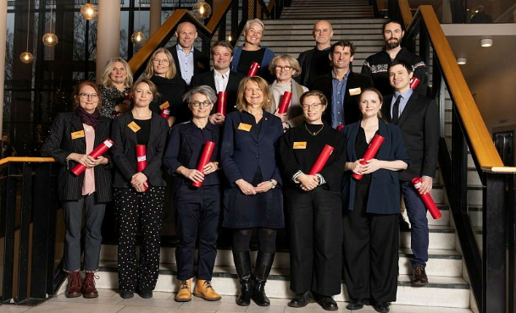
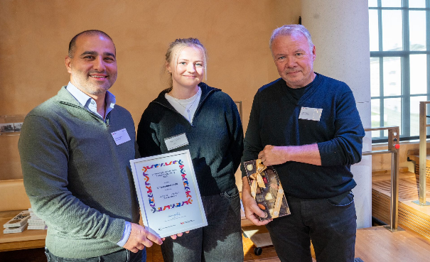
Excellence in education
Photo: UiO/Jarli & Jordan
Foto: UiO/Jarli & Jordan
Photo: UiO/Jarli & Jordan
Photo: Nina Vebø/NOKUT
Foto: Jarli & Jordan/UiO
UiO has 4 active Centres for Excellence in Education and participates in a fifth centre
Since 2020, UiO has awarded 48 individuals the title of Distinguished Educator
UiO was awarded the national Educational Quality Award for Higher Education in 2025
Notes:
The Educational Quality Award 2025 went to (from left): Omid Mirmotahari, Mali Aalbu and Yngvar Berg.
Active Centres for Excellence in Education at UiO:
IN-TED – Center for Interdisciplinary Education
CELL - Centre on Experiential Legal Learning
SHE – Centre for Sustainable Healthcare Education
CCSE – Center for Computing in Science Education
UiO participates in, but does not administrate: iEarth – Centre for integrated Earth Science Education
Centres for Excellence in Education (SFU) is a long-term effort to stimulate the development of education and innovative approaches to learning in higher education at bachelor’s and master’s degree level. The last grant was awarded in 2022, and there is currently no plans of opening for new applications.

Slide 23

International collaboration
Research and education
Collaboration programmes with the Nordic countries, the Global South, Europe, India, Brazil, South Korea, South Africa, China, Japan, Canada and the US.
Student exchange
Capacity development
International university networks and alliances
Sett inn bilde her
Photo: Colourbox
Notes:
International collaboration: https://www.uio.no/english/about/global/
See also:
Action plan for internationalisation of education 2024-2026, https://www.uio.no/english/about/strategy/internationalisation-education/index.html

Slide 24
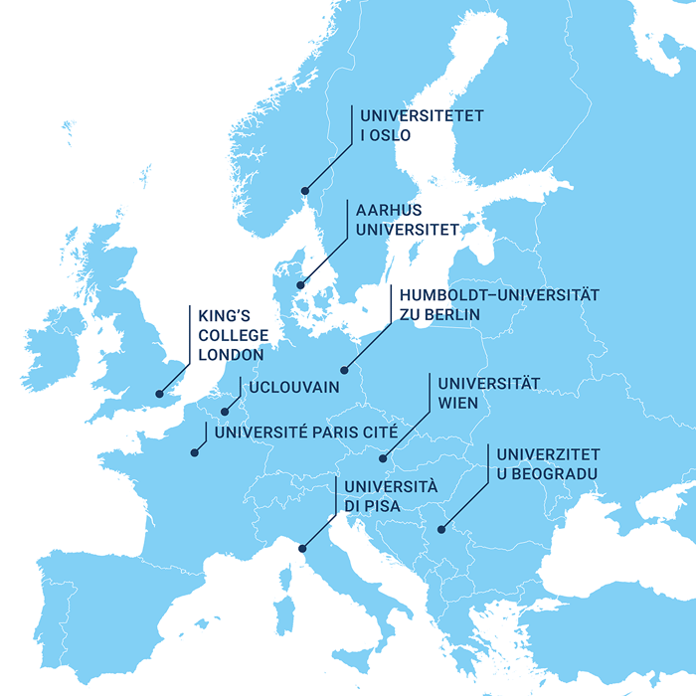
Circle U.
Establishing study programmes across the alliance
Developing knowledge-based pedagogical innovation and evidence-based educational practices
Thematic knowledge hubs (climate, global health, AI, democracy)
Mobility and career development of Early-Career Researchers
Foto: Karsten Sund/NHM/UiO
Illustration: Circle U.
Notes:
A European university alliance consisting of nine research-intensive comprehensive universities:
Universitetet i Oslo, Aarhus Universitet, Humboldt-Universität zu Berlin, King’s College London, Univerzitet u Beogradu, Université catholique de Louvain, Université Paris Cité, Università di Pisa, Universität Wien.
Circle U. Open Campus: shared digital entry point to educational activities across the alliance
Thematic knowledge hubs (climate, global health, AI, democracy): Academic networks for the development of interdisciplinary teaching and research, as well as active collaboration between academics, students and associated partners.
InCubator: student led innovation and entrepreneurship
Multilingualism, Interculturality and Language Lab (CU.mil) – offers formal and informal learning opportunities in the fields of multilingualism, interculturality and language learning. The CU.mil aims to drive the research in these fields forward, to develop multilingual and intercultural competences
Teaching Innovation Lab (CU.til) - Promoting student-centred learning, quality assurance and a learning outcomes approach, the key missions of the CU.til are to improve the educational status quo, to enhance student learning and to contribute to the professional development of academic staff.
The Community of Practice for Early Career Researchers (CU.ecr) Establish networks for Early-Career Researchers (PhDs and postdocs) through mobility and by supporting skills and career development

Slide 25
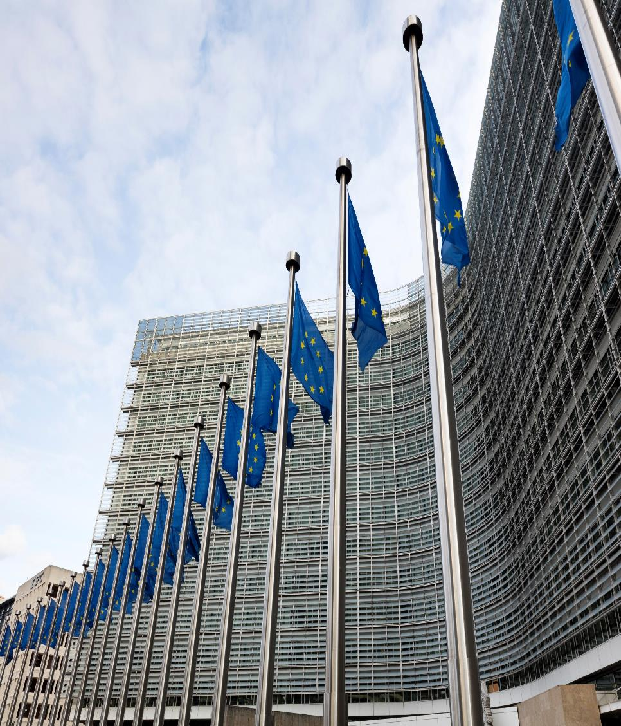
The Guild of European Research-Intensive Universities
23 research-intensive comprehensive universities from 17 European countries.
Driver for better policy-making on research and education, as well as influencing EU’s Framework Programmes
Central themes: academic freedom, open access, responsibility in international cooperation, and innovation
Photo: imageBROKER/Wilfried Wirth
Notes:
For the University of Oslo, exerting influence in the European arena is crucial, given Norwegian universities’ dependence on the shaping of EU policies, programmes and calls, and the fact that research and education policy developed in Brussels largely affects national policy and national instruments.
About The Guild: https://www.uio.no/om/internasjonalt/the-guild/ (Norwegian only)

Slide 26

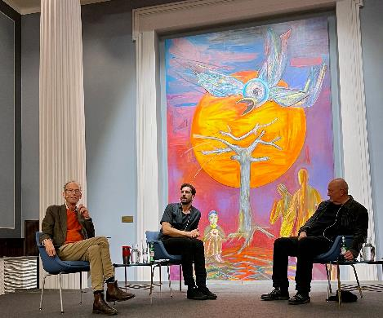
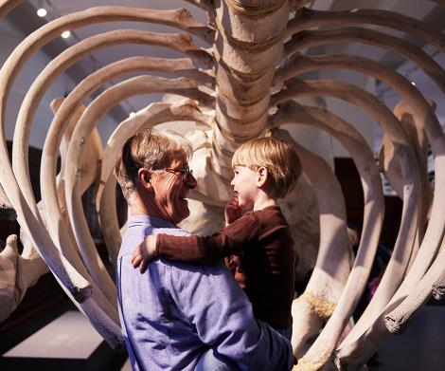
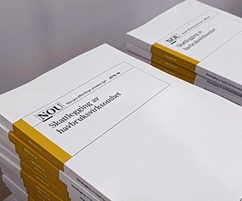
Dissemination
Climate House
Scene Domus Bibliotheca
Photo: UiO/Jarli & Jordan
Photo: UiO/Malin A. Gylvik
Natural History
Museum
Museum of
Cultural History
Official Norwegian Reports (NOUs)
Photo: Lars Petter Pettersen/NHM
Photo: Anders Furuset/Intrafish
Notes:
UiO contributes to a knowledge-based public debate through extensive dissemination activities in the media, at meetings and events, in museums and in Domus Bibliotheca.
https://www.uio.no/english/about/culture/museums/index.html
https://www.uio.no/english/research/domus-bibliotheca/
Many researchers participate in various investigative activities such as the making of Official Norwegian Reports, they are in dialogue with businesses and the public sector, and they contribute to more knowledge in several areas in society.

Slide 27

Natural History Museum
Largest natural history museum in Norway
Collection of 6 million scientific objects
209,000 visitors to indoor exhibitions in 2025
Research, collection curating, and scientific outreach about natural diversity, evolution, and climate
Situated inside the Botanical Garden at Tøyen
Foto: Karsten Sund/NHM/UiO
Photo: Natural History Museum/Lars Petter Pettersen
Notes:
Natural History Museum: https://www.nhm.uio.no/english/

Slide 28
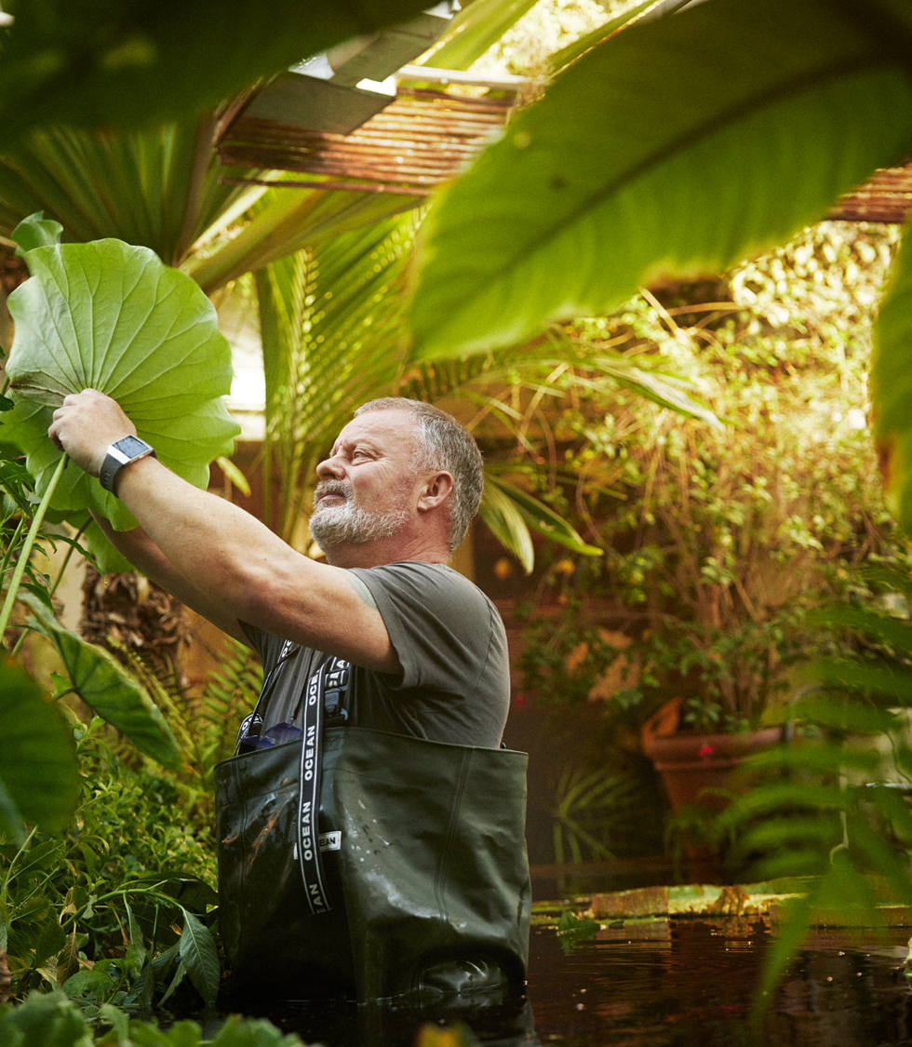
Botanical Garden
Over 4,500 plant species from across the globe
Consists of thematic gardens, including two greenhouses
The Botanical Garden conveys knowledge about plant diversity and the importance of conserving it
Used actively in research, conservation, and outreach through guided tours and in education
760,000 visitors in 2025
Foto: Karsten Sund/NHM/UiO
Foto: Per Aas/NHM/UiO
Photo: Natural History Museum/Lars Petter Pettersen
Notes:
Botanical Garden: https://www.nhm.uio.no/english/botanical-garden/index.html

Slide 29
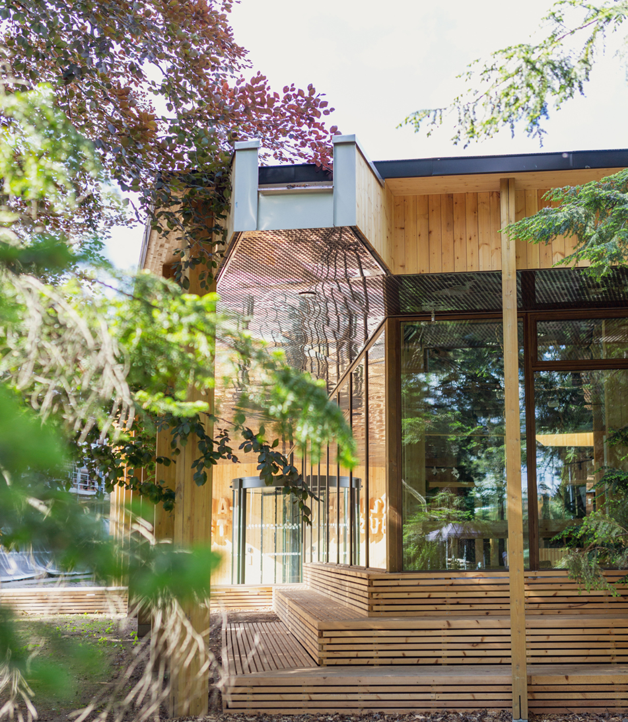
The Climate House
The Climate House is an exhibition space highlighting climate change and the environment
Through exhibitions and events, the aim is to engage audiences to reflect and act for a more sustainable future
Offers a range of curriculum-linked interdisciplinary school programmes about climate, environment, and sustainability
Photo: Natural History Museum/Jarli & Jordan
Notes:
The Climate House: https://www.nhm.uio.no/english/climate-house/index.html

Slide 30
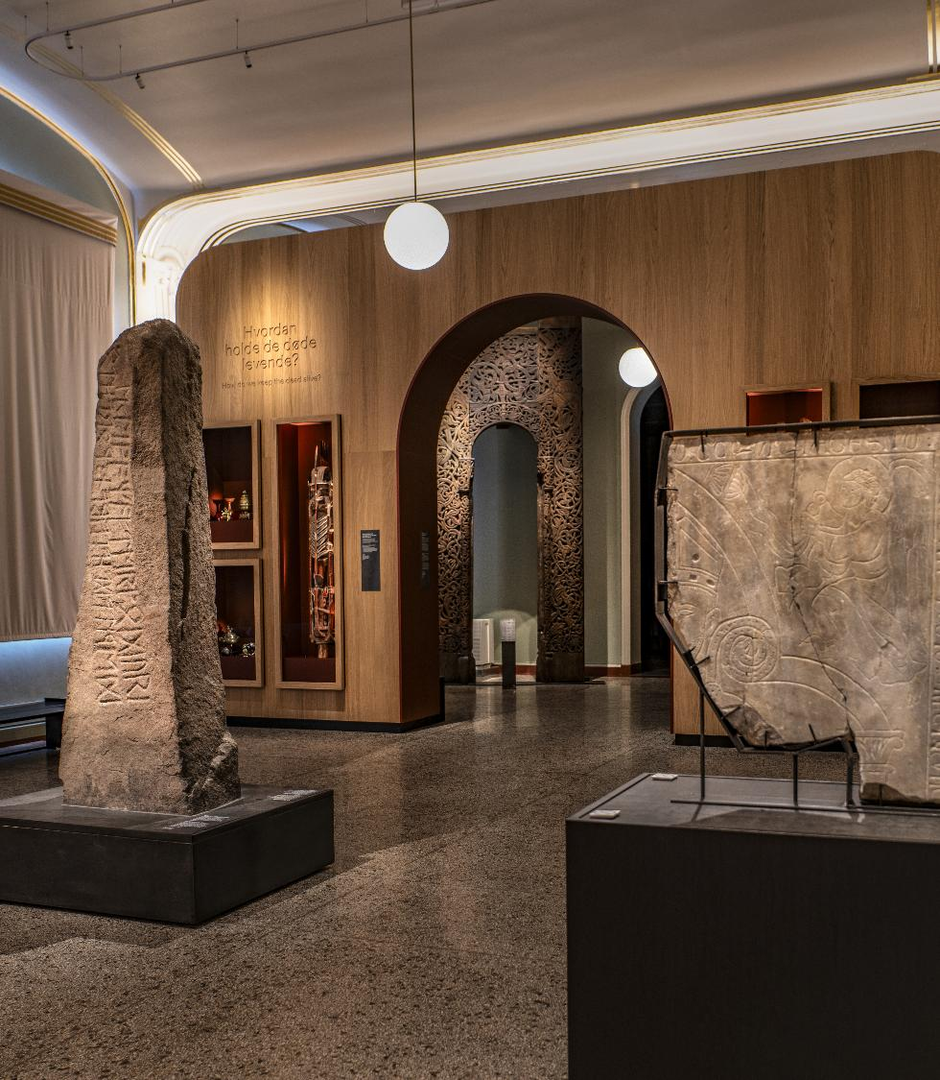
Museum of Cultural History
Norway's largest cultural history collections, with archeological objects from the Stone Age to the Middle Ages
Research, and collection management and dissemination through leading environments in areas such as archaeology, ethnography, and numismatics
Two museum buildings – the Historical Museum in central Oslo and the Museum of the Viking Age at Bygdøy
Photo: Museum of Cultural History
Notes:
Museum of Cultural History: https://www.khm.uio.no/english/index.html

Slide 31
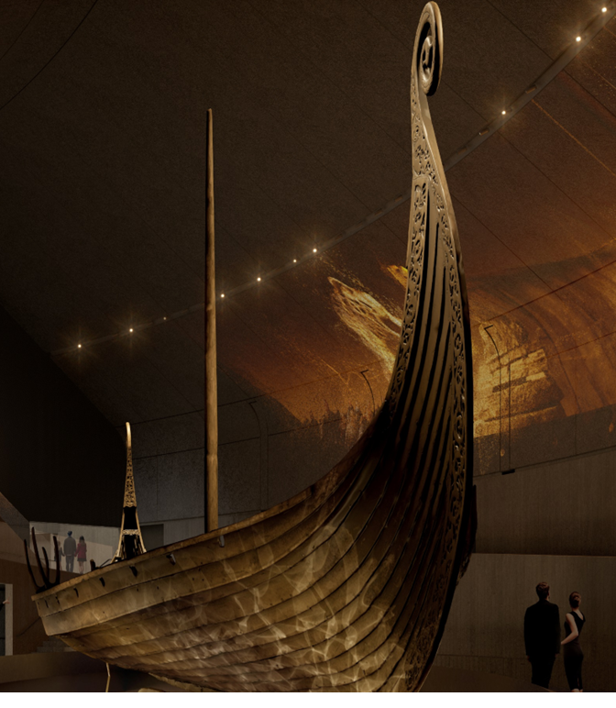
Museum of the Viking Age
World's most complete collection of Viking Age artifacts – including the world's best-preserved Viking ships
Research, collection management, and dissemination through exhibitions and guided tours
The new museum opens in 2027 – encompassing 5,500 m² of exhibitions
Rendering: RAA/VTM/AART
Notes:
Museum of the Viking Age: https://www.vikingtidsmuseet.no/english/

Slide 32
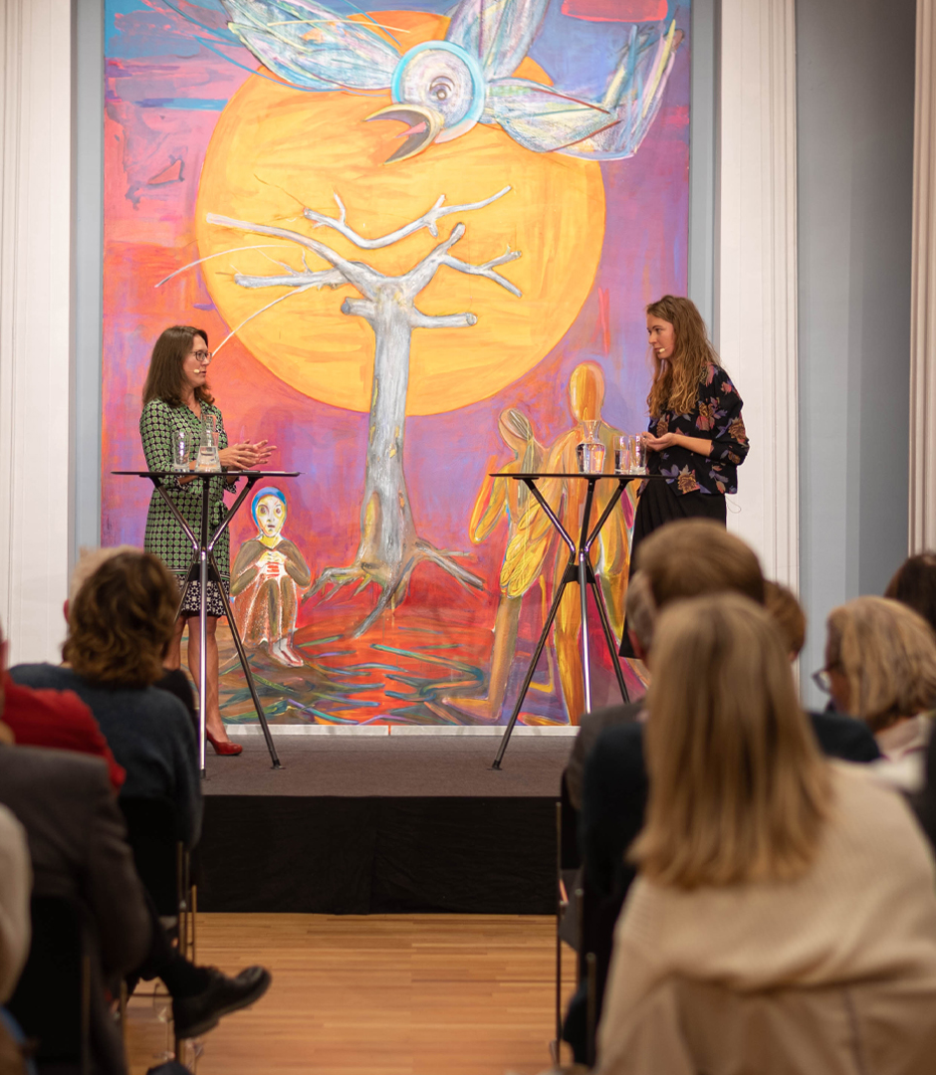
Scene Domus Bibliotheca
UiO’s arena for dialogue and dissemination
Conversations and discussions about quantum technology, democracy, biology, religion, literature, health, artificial intelligence, medicine, climate and the environment, and much more.
170 events with an audience of 12,000 in 2025
Photo: UiO
Notes:
Scene Domus Bibliotheca: https://www.uio.no/english/research/domus-bibliotheca/

Slide 33


