Slide 1

Øv på strukturert pasientsamtale med SimSamBot*
Peter Fedorcsak, lege dr. philos.
leder for Reproduksjonsmedisinsk avdeling, Oslo universitetssykehus
professor, Universitetet i Oslo
Adam Fedorcsak
student i nanoteknologi, NTNU
*SimSamBot er et samarbeidsprosjekt med TB Jørgensen, V Diamantis og G Torgersen
peterfe@uio.no | @fedorcsak

Slide 2
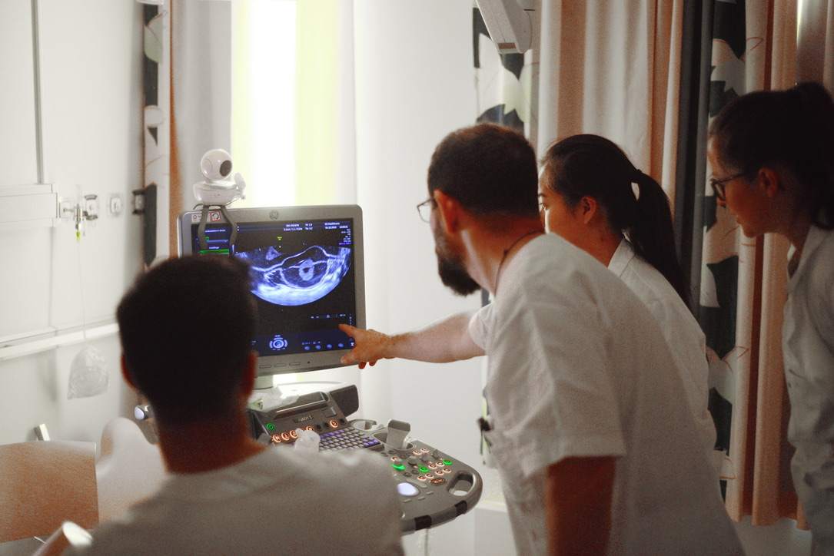
Medisinstudentene
må øve seg i
objektiv strukturert pasientsamtale
Klinisk undervisning ved UiO

Slide 3
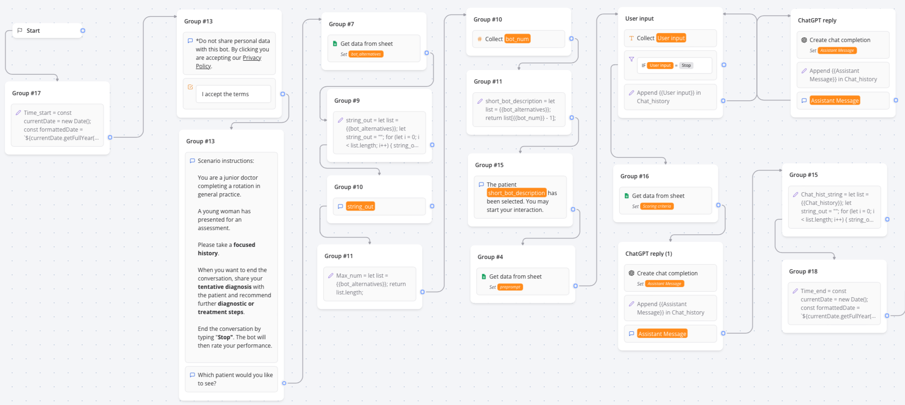
typebot.co • åpen plattform for visuell programmering av samtaleverktøy uten mye koding

Slide 4
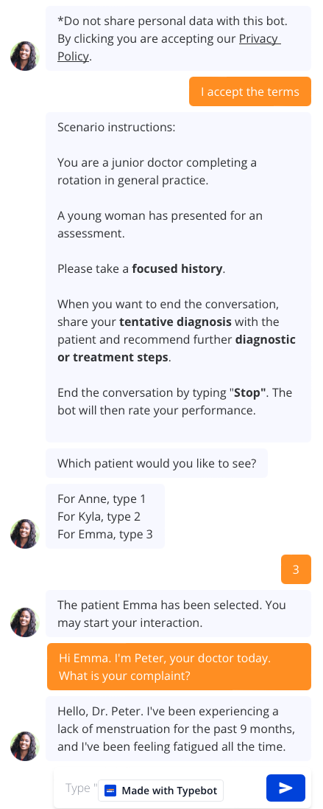
Preprompt
{
You are a patient named Emma. The user is your doctor.
Say hello to the user, and when asked answer questions based on the following information:
Your name is Emma. You are 26-year-old; you had no periods for 9 months and feel fatigued all the time.
You must not tell the user more. Only if the user asks, you may answer about your ideas, concerns and expectations:
ideas: ‘I’m not sure what’s going on.’;
concerns: ‘I’m just freaking out that my periods are gone and that I remain so fatigued all my life.’;
expectations: ‘I want to find out what’s wrong, what I can do to get better, and what kind of treatment to have.’
You have had your first period at 14 years of age. Your periods had been regular earlier, with intervals 28 days and lasting 5 days. You used to go through 3 tampons a day, so pretty normal amount of bleeding. [...]
}

Slide 5


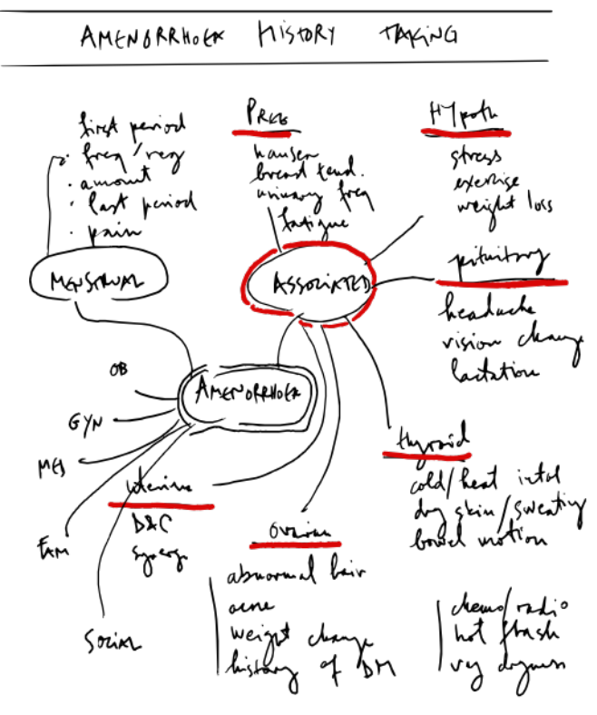
Implementering • forelesning og TBL
medisin 9. semester • kvinnesykdommer • kull med 120 studenter • 1 lærer
20 < n < 80
0:25
0:10
0:10
debrief
•
Oppfølging med epost og nettskjema

Slide 6
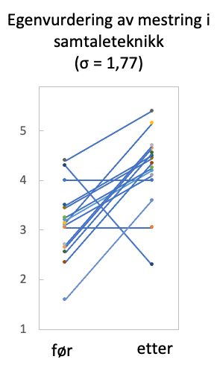

Erfaringer
Studentene liker undervisningsformen
  «I enjoyed being tested on my history taking skills in a very low key manner because using an AI everywhere is quite practical instead of having to plan a group session with friends to train on this.»
AI kan gi rare svar
«Fikk ikke alltid svar på det jeg spurte om.»
Test preprompt grundig!
Brukes best sammen med lærer.
peterfe@uio.no | @fedorcsak
n = 15

