Slide 1

Generative AI in Educational Contexts
Teaching with Generative AI
UNIPED Module, approved by LINK (15 credits)
Faculty of Education
University of Oslo

Slide 2
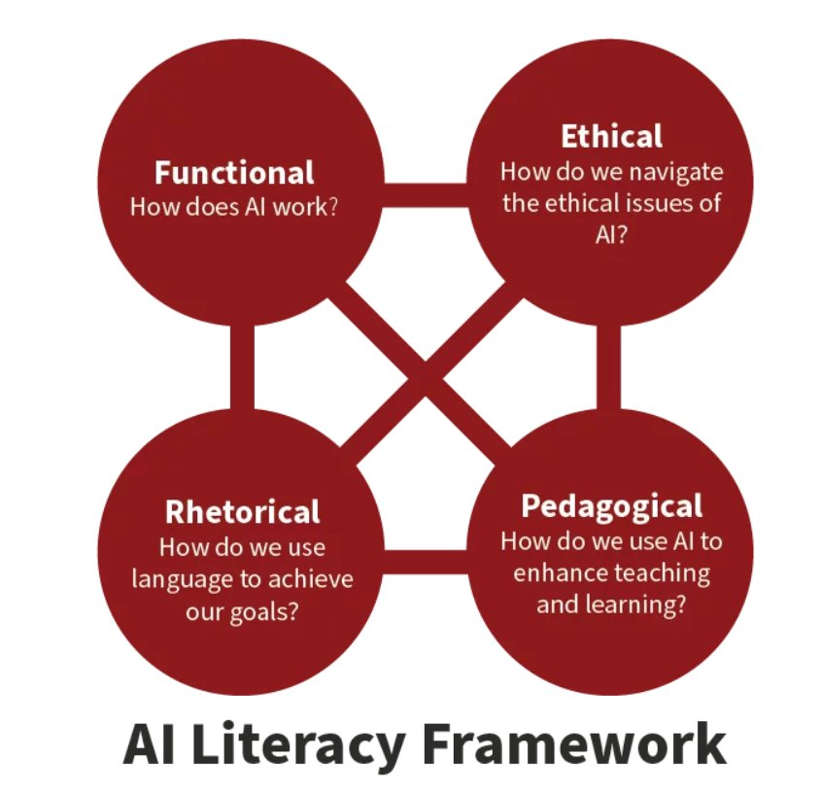
Module Overview
Meeting 1: Understanding GenAI Epistemology & Basic Use of Approved Tools for Pedagogical Applications
Meeting 2: Dynamic Formative Assessment & Matching Learning Outcomes to Assessment Types
Meeting 3: Exploring Applications and Ethical Considerations of GenAI in Education
Notes:
Meeting 1: Overview of the three workshops. Aiming for inner consistency and logic. The AI literacy framework (from Stanford) comprises understanding, critical evaluation, and effective use of AI. We emphasize ontological differences between GenAI and humans: AI has no idea as to why ideas are important or to the relative significance of perspectives. We focus on the pedagogical aspects-

Slide 3
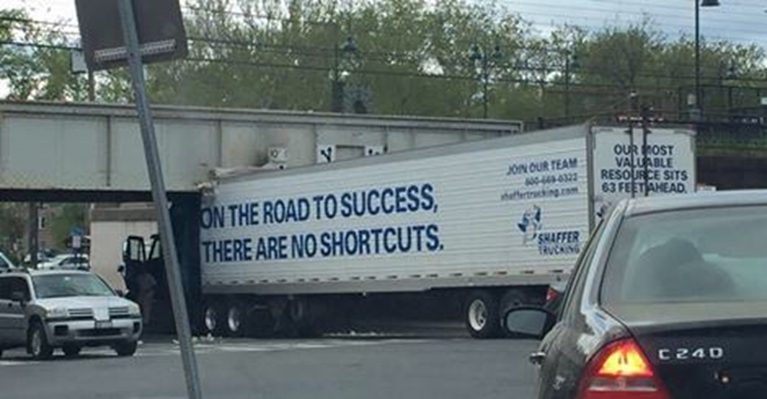
Our Focus: Hybrid intelligence
What can be identified as uniquely human qualities and competences?
How can these be operationalized in task design and educational activities and practices?
How can they be made objects for feedback, assessment, and certification?
Notes:
Vital themes/questions throughout the module. Addressed through a 'learning-by-doing' (assignment) approach. Chiu et al. (2023): "Future research should focus on (i) proposing a new pedagogical framework for AI teaching and learning..."

Slide 4
GenAI is undertheorized
There are rather few empirical studies
  Postdigital perspectives:
  make the distinction between "digital" and "non-digital" obsolete. It emphasizes a blended state of existence in everyday life (macro level). See Moylan et al. (2024) on teachers' perceptions.
Socio-material perspectives
how social and material elements are entangled; how material artifacts and social practices co-produce each other in specific practices and contexts (micro level). See e.g. Ågerfalk (2020), agency and ontology.
Ecological and dialogic perspectives
complex interactions between individuals and their environments; layers of environmental systems that interact with each other
Notes:
Three related perspectives that have emerged because of their explanatory power. Slightly different in scope.

Slide 5
Structure of the workshops:
  1. Preparations
  Research (and policy) papers – mandatory and suggested readings
2. Input
Theoretical/conceptual (hybrid intelligence, dynamic assessment…)
GenAI in use (prompt engineering, tasks, assessment rubrics…)
3. Guest spots
GenAI in use at UV/UiO, ‘ecological validity’.
4. Participants:
Tasks, presentations, discussions
Notes:
Three related perspectives that have emerged because of their explanatory power. Slightly different in scope.

Slide 6
Create a Student Assignment with GenAI
Work in groups to design a student assignment. You MUST:
Use a UiO-approved GenAI tool to plan or build the assignment, and
Include GenAI in the assignment itself
  Both you and the student need to use GenAI to complete the task
  All groups will present their assignments and reflections.

Slide 7
Designing Ongoing Feedback and Assessment with GenAI
Work in groups to design a formative assessment that students could complete in collaboration with GPT UiO.
Use GPT UiO to plan or build the formative assessment, and
Include GenAI in the assignment itself
  Both you and the student need to use GenAI to complete the task
  All groups will present their formative assessment and reflections.
Notes:
Strong connections to criteria for critical thinking and higher order skills, SCALE level suggested by Perkins. Reference this here; backdrop/inspiration.

Slide 8
After the workshop series:
Completion of an individual assignment consisting of:
a proposal for a design of a learning activity, assessment form, or
exam form incorporating generative AI, and
b) a brief (1-1,5 pages) reflection note on pedagogical principles and choices made in the aforementioned design
Esther & Gøril
Notes:
Strong connections to criteria for critical thinking and higher order skills, SCALE level suggested by Perkins. Reference this here; backdrop/inspiration.

