Slide 1

Using generativ AI in teacher education: A learning design developed through dialouge and formative assessment
Gøril Brataas
goril.brataas@ils.uio.no

Slide 2

Contextual information
Department of Teacher Education and School research, UV, UiO
Norwegian didactics in an 5 year integrated teacher education program (Lektorprogrammet)
Student group: 3 x 30 future language arts teachers
9 weeks of field placements in practice schools in the middel of the semester

Slide 3
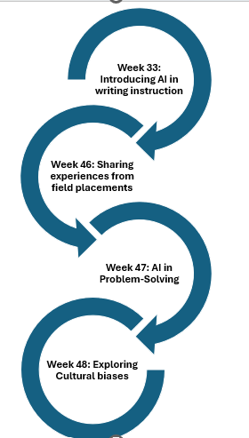
Learning design
Inspiration from the Uniped-modul and conversations with other participants
Building on the work of colleagues
Design underpinned by dialogic teaching and formative assessment

Slide 4
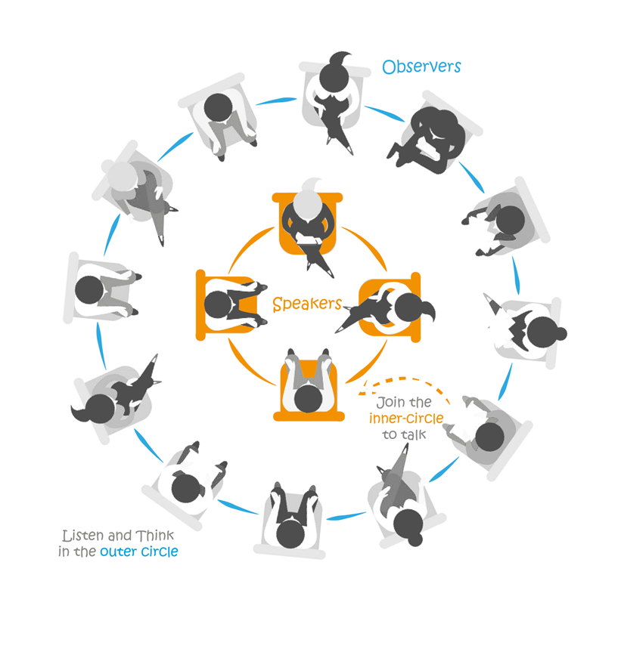
Fish bowl week 46: Sharing experiences with GenAI in practice schools
Insights:
From positive to negative attitudes towards GenAI
Few experiences with pedagogical use of GenAI
Many teacher candidates reported having used GenAI extensively as support in lesson planning

Slide 5
Week 46 and 47
AI in problem-solving
Biases in lesson planning
Discuss an AI-generated case about multilingualism in Norwegian classrooms
Explore the use of AI as a dialogic partner in problem-solving
Look for potensial biases
Plan a lesson about Sami language and culture with support from GenAI
Look for biases: Majority perspectives and stereotypes?

Slide 6

Insights and keys to success
The importance of dialogic teaching and formative assessment
The importance of a sustained and coherent approach to pedagogical use of GenAI
Collaboration with colleagues
Can teacher candidates become transformative GenAI-agents in their future workplaces?

