Slide 1

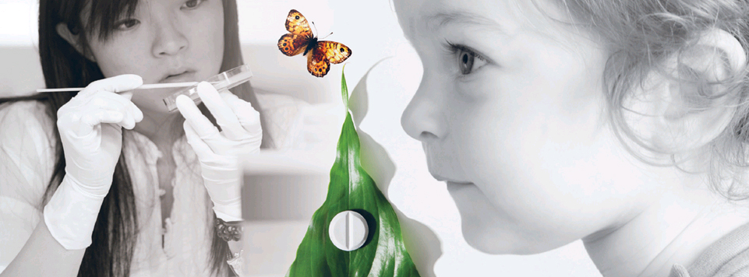

AMU-møte 18.9.2017
Finn-Eirik Johansen,
Notes:
FEJ
20 min GREENMAR Life Sciences & Interdisciplinarity
30 min UiO: Life Science: new possibilities for interdisciplinary research
AMU uka etter
ME
20 min. HIS Oslo as a life science hub in the future? UIO life science initiatives

Slide 2

What are life sciences?
All scientific disciplines studying the composition, structure and functions of living organisms.
  medicine and biology constitute the core, backed by chemistry, physics and mathematical subjects
  application of knowledge is a focus area
All scientific disciplines studying the composition, structure and functions of living organisms.
  medicine and biology constitute the core, backed by chemistry, physics and mathematical subjects
  application of knowledge is a focus area
The UiO life sciences initiative also includes social sciences and humanities when researchers:
  examine the relationship between behaviour or awareness and their biological foundation
  analyse challenges arising in the encounter between the application of the life sciences and social values and priorities

Slide 3

The UiO life science strategy
Vision: International competitiveness in the life sciences
Convergence
Interaction and interdisciplinary life sciences
1. Strengthen quality and interaction
in research
2. Recruit,
educate
and develop
talents
3. Promote innovation in the life sciences related to environment and health
4. Life sciences, ethics and society
5. Interaction and internationalization
6. Infrastructure

Slide 4
SAB-UiO profile dimension analysis
Global
Regional
Comprehensive
Focused
Curiosity-driven
Relevance-driven
Disciplinary
Interdisciplinary
Competition
Co-operation
Inward-looking culture
Outward-looking culture
Basic research
Applied research
Selectivity
  Accessibility
Dependence
Autonomy
Decentralization of authority
  Centralization of authority

Slide 5
UiO convergence environments - interdisciplinary research groups that address major challenges
Collaboration across conventional disciplinary boundaries
Integrate humanities and social sciences with life science
Promote innovations
Engage with society
Medicine, Biology
&
Natural sciences
Humanities
&
Social sciences
UiO has all the disciplines

Slide 6
Process for selection of convergence environments
Q1 2016
Q2 2016
28–29/9 2016
28/10 2016
November 2016
Define goals
Information and
feedback
from UiO scientists
Workshop with speed-dates
Submission of proposals (sketches)
31 sketches evaluated by expert panel
December 2016
March 1st 2017
April 2017
May 2017
October 2017
Feedback on sketches and call for full-length applications
Deadline for applications
March 1st
Evaluation of 22 applications by expert panel
Final decision by UiO:Life Science board
Start convergence environments

Slide 7
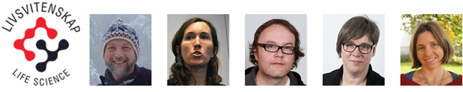
Combining natural and social sciences to understand and manage global anthropogenic toxicants (AnthroTOX)
Social Sciences
Mathematics and Natural Sciences
Medicine
Goal: To understand how environmental and social processes and their relationships dictate flows and impacts of anthropogenic toxicants from electronic waste. This will be studied within and across societies and ecosystems. Results from Tanzania will be compared to data from the Arctic.

Slide 8
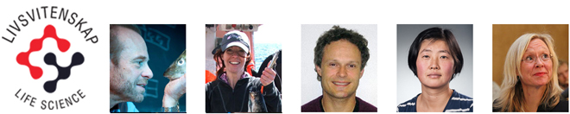
Comparative immunology of fish and humans (COMPARE)
Mathematics and Natural Sciences
Medicine
Social Sciences
Goal: To find out how the peculiar immune system of the codfishes function in detail and what its implications are for human immune disease. The results will affect future aquaculture, human medicine as well as providing a social sciences case for our awareness of the future possibilities of gene modifications of fish and humans.

Slide 9
7 convergence environments awarded May 2017
AnthroTOX: Faculty of Social Sciences (SAI, TIK center), Faculty of Mathematics and Natural Sciences (KI, IBV), Faculty of Medicine (Helsam)
COMPARE: Faculty of Mathematics and Natural Sciences (IBV, IFI), Faculty of Medicine (Klinmed), Faculty of Social Sciences (TIK)
Epigenetics and bioethics of human embryonic development: OUS/Faculty of Medicine (IMB, Klinmed, Helsam), Faculty of Humanities (IFIKK)
Programmable Cell-like Compartments: Faculty of Medicine (NCMM, Klinmed), Faculty of Mathematics and Natural Sciences (MI), Faculty of Humanities (IFIKK)
Organ on a chip and nano-device (CHIP): OUS/Faculty of Medicine (IMB), Faculty of Mathematics and Natural Sciences (FI, IFI, KI)
The genetic history of Eastern Eurasia (ARCH-GEN): Faculty of Mathematics and Natural Sciences (CEES/IBV), Museum of Cultural History
Personalised cancer therapies (PERCATHE): Faculty of Medicine (IMB, NCMM, Klinmed)

Slide 10
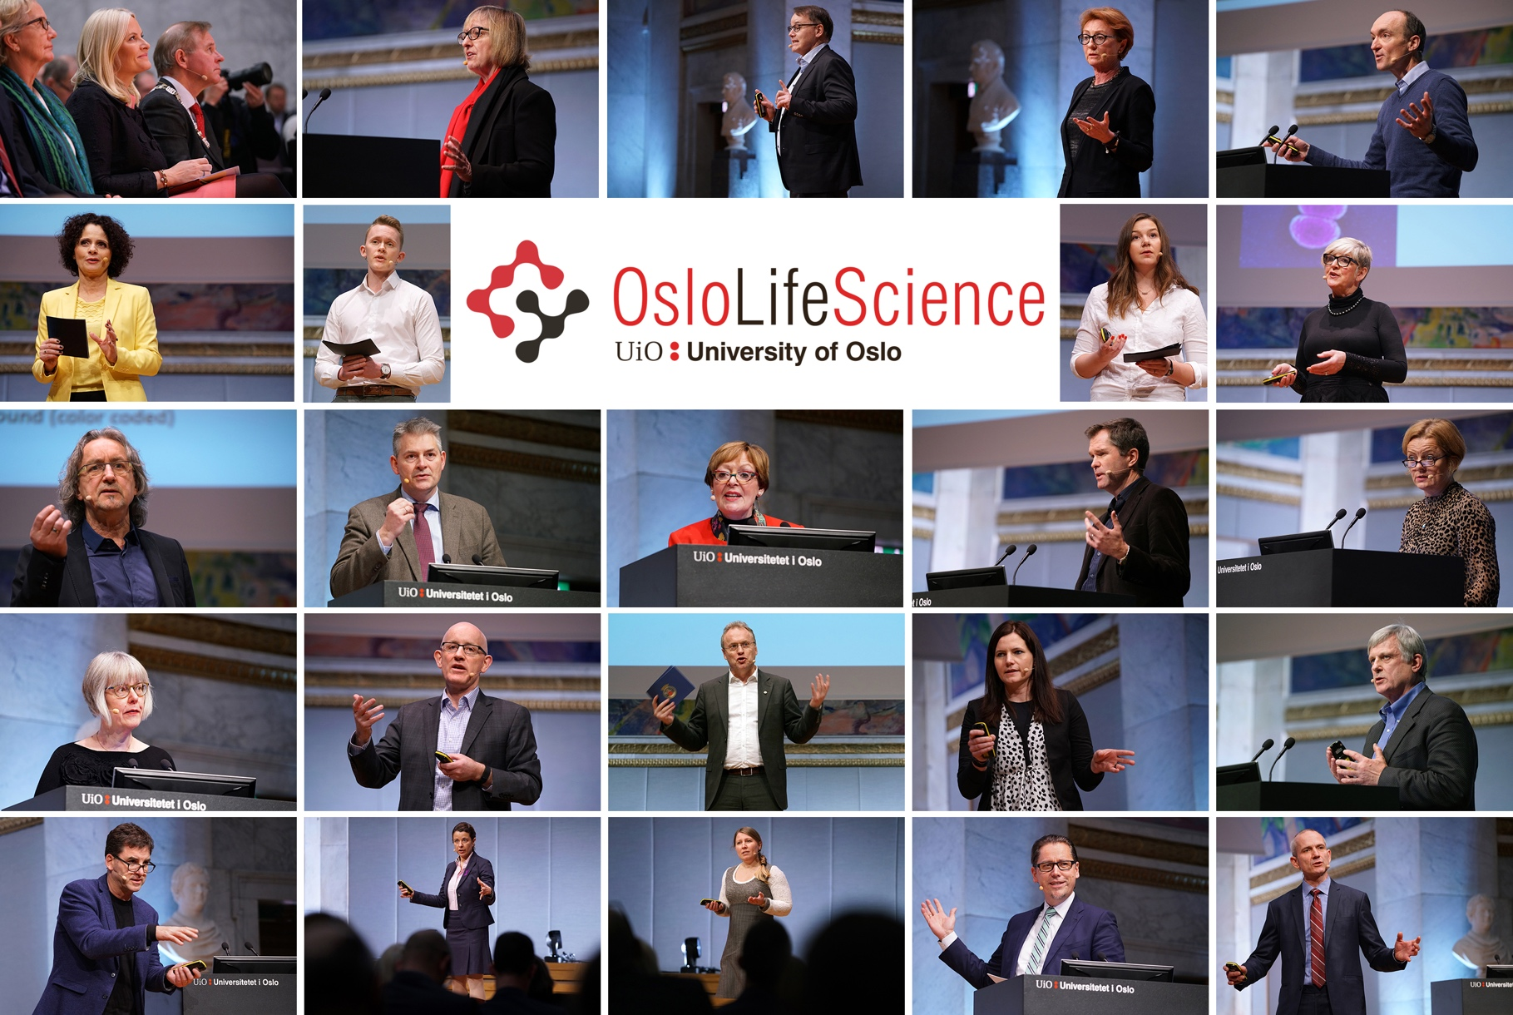
Create meeting places

Slide 11
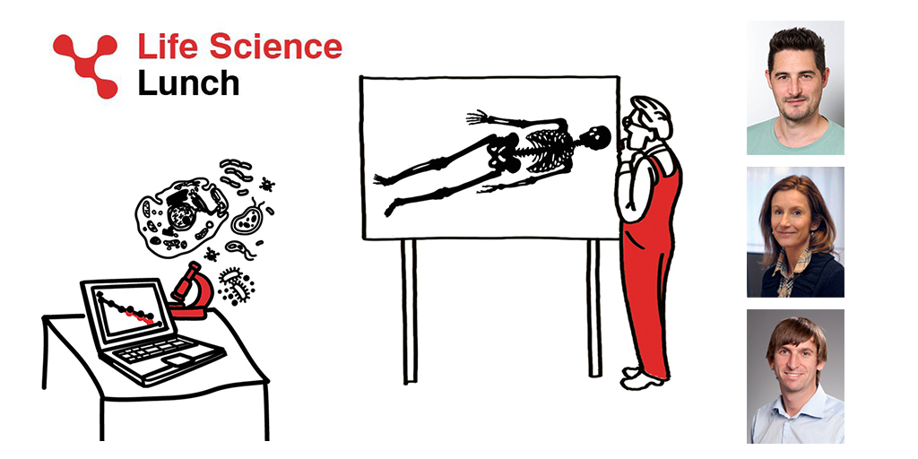
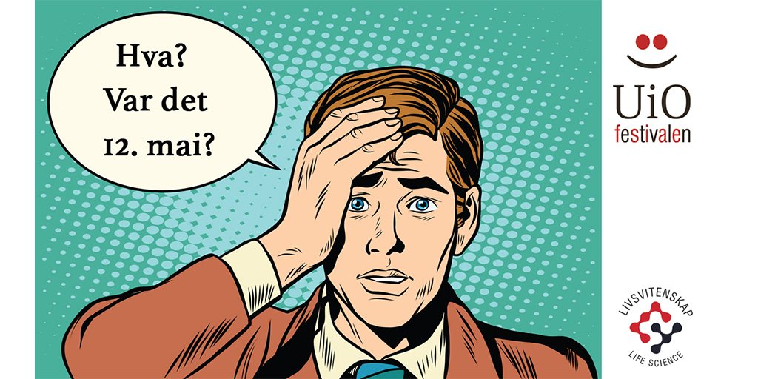
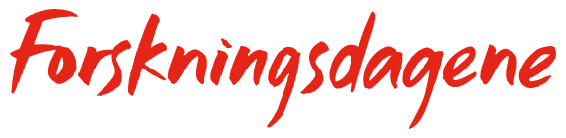
Other meeting places

Slide 12
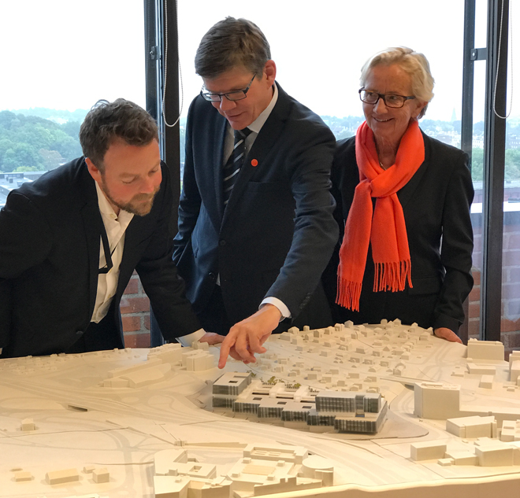
Great news 6 September 2017
– 50 mill. NOK National Budget 2018!

Slide 13
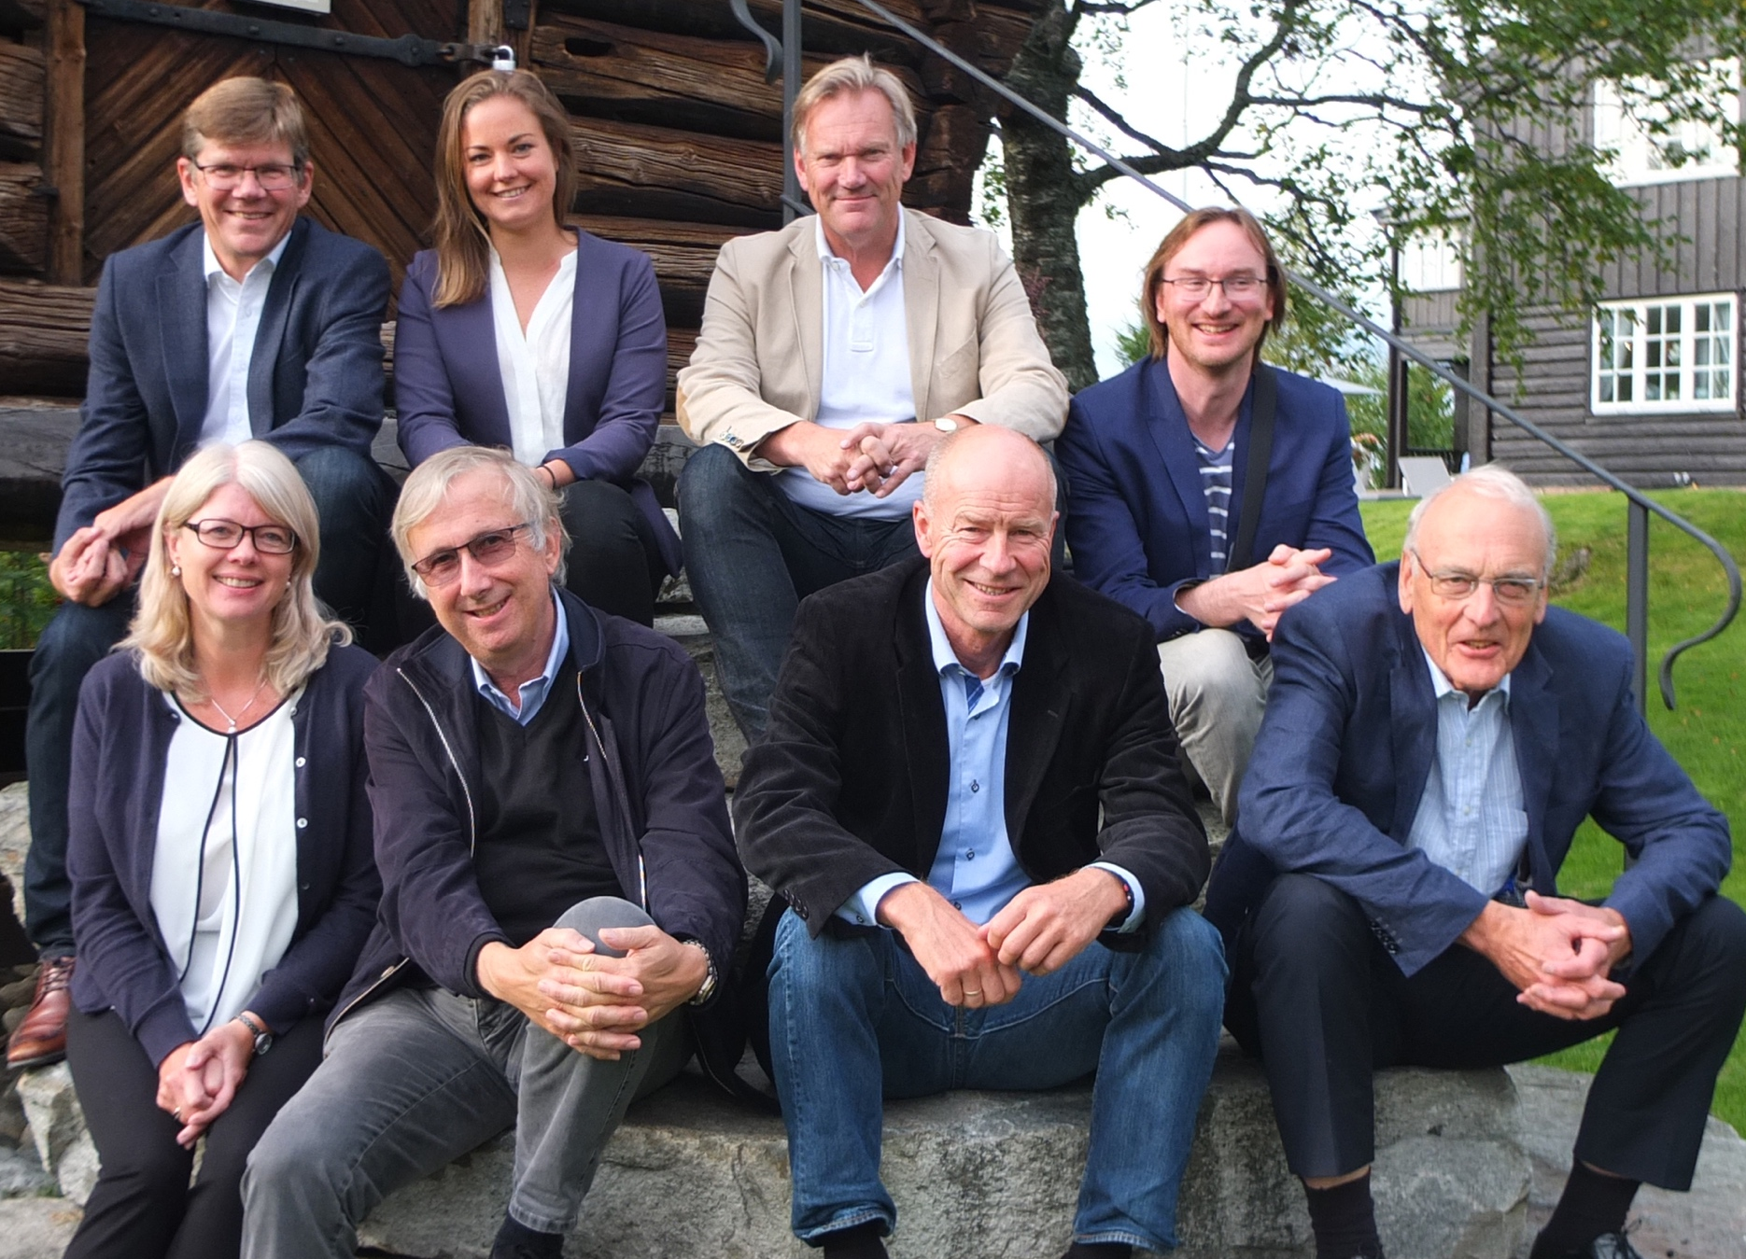
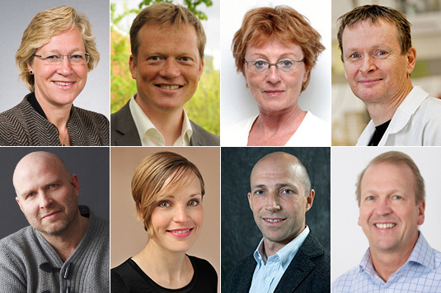
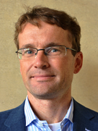
Anchoring, discussions and support
The board
Vice-Rector
3 faculties
Student rep
HSØ/OUS
External entrepreneur
Advisory management team – 5 faculties

Slide 14
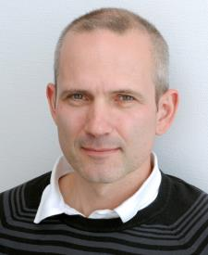
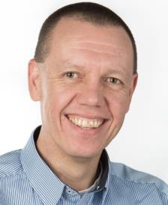
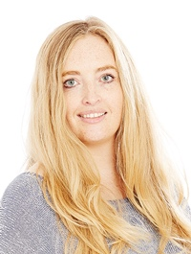
UiO:Life Science – administration
Director
  Finn-Eirik Johansen
Administrative leader
  Morten Egeberg
Communications advisor
  Norunn Torheim

Slide 15
UiO:Life Science – administration
Director
  Finn-Eirik Johansen
Administrative leader
  Morten Egeberg
Communications advisor
  Norunn Torheim

Slide 16
UiO:Life Science
– the organization
UiO board
Forum for department heads
Rector
Regional forum
UiO:Life Science board
Advisory management team
Administration
Director
Administrative leader
Communications advisor

Slide 17
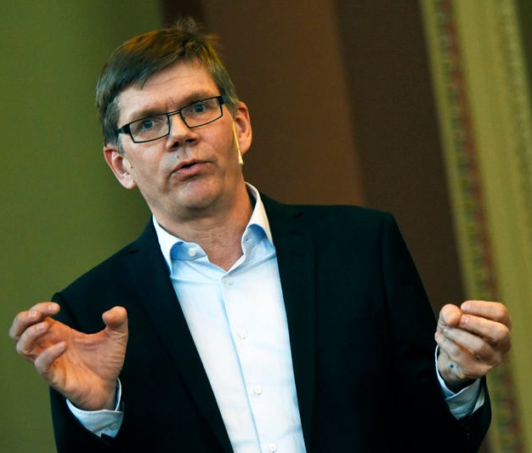
Rektoratet utsetter direktørtilsetting
Vil sikre en optimal organisering
Rektor Svein Stølen skriver i en e-post til Uniforum at rektoratet ønsker å «bruke noe mer tid for å se på helheten i UiOs livsvitenskapssatsing, herunder planene for videre utvikling av det nye bygget.»

Slide 18


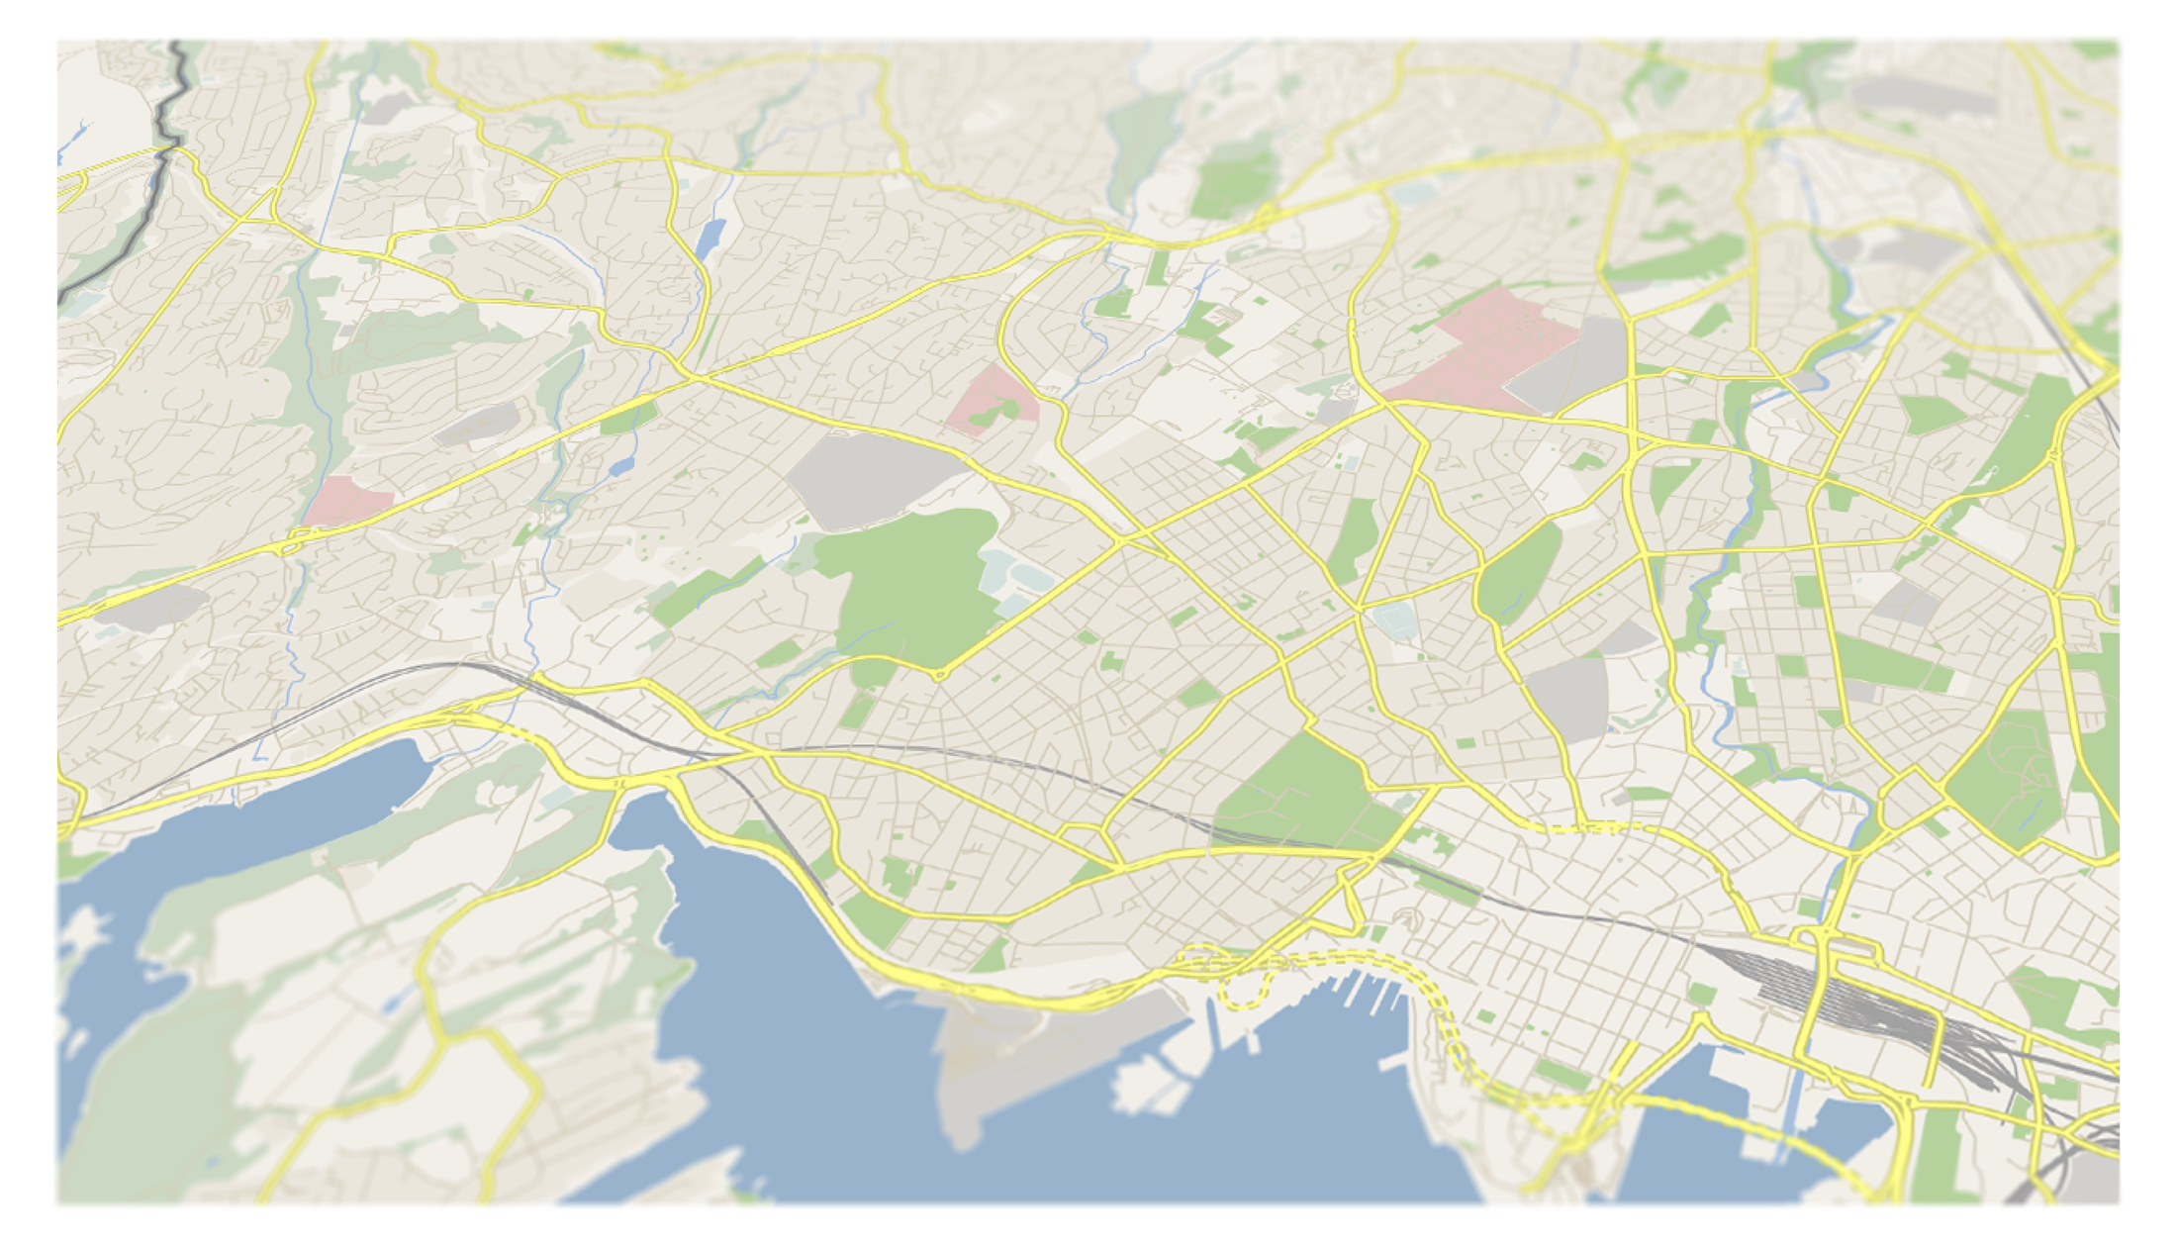

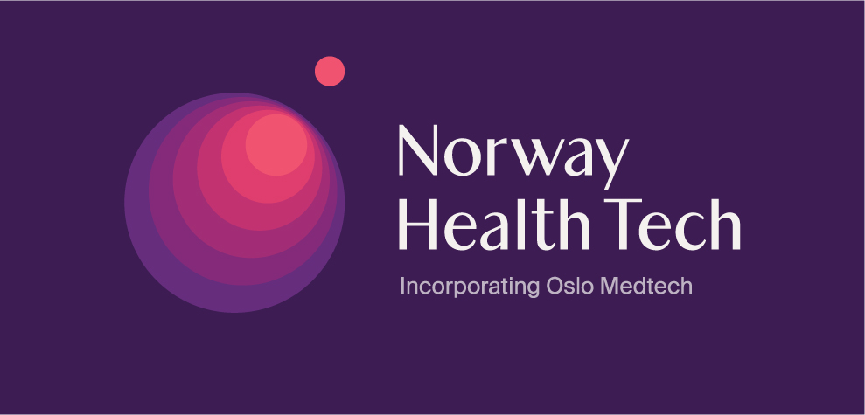









We are building
Oslo Life Science City
Notes:
So what does a life science city look like? This is a map of Oslo. Here in the center
UIO, OUS, NMBU
You have the University of Oslo surrounded by Oslo University Hospital at three relevant locations
and parts of the Norwegian University of Life Sciences that is still in the city center.
If we look at the map from the west to the east
OCC, THERMOFISHER
we find Oslo Cancer Cluster and their incubator at Montebello, an impressively driven organization that has lifted Norwegian cancer research and businesses to new levels.
we also see that the international company Thermo Fisher, which I will talk more about later, has chosen to co- locate parts of their activity with Oslo Cancer Cluster.
FORSKNINGSRÅDET, BAYER
Further south we find The Research Council of Norway – a central actor in both research and innovation as we will hear later today
And there we also have a larger international company, Bayer, which I will also talk about more in a little while, which has co-located with the Research council, maybe a coincidence I don’t know?
LMI, KOMMUNEN, BIOTEKNOLOGIRÅDET, INNOVASJON NORGE
If we move towards the city center we find the Association of Pharmaceutical Industry in Norway (LMI) and the City of Oslo, our co-organizers here today,
and the Biotechnology board and Innovation Norway, which all have important roles in this ecosystem (ELLER SI NOE MER SPESIFIKT OM HVER?)
So you see that the city of Oslo has many actors within a relatively short distance to each other.
INVEN2, OSLOTECH, KLYNGER OG INKUBATOR
But I want to bring your attention to this area north of the university here with Inven2 and Oslotech, because things have happened here
Here we find our technology transfer office Inven2 that we own together with the Oslo University Hospital
and
Oslotech which runs Oslo Science Park that houses several small companies, clusters and startups
Oslo Medtech which is a very successful med tech cluster is found here, last year both The Life Science Cluster and the health incubator Aleap was established here.
And hopefully this will really be the life science centre when
LIVSVITENSKAPSBYGGET OG OD
our planned life science building will be erected here in some years, and also a new building for the Faculty of dentistry nearby
But there are also others things that will change this map.
As many of you know the Norwegian University of Life Sciences
NMBU OG OUS, ULLEVÅL FLYTTER
will move their activity to Campus Ås in a couple of years, how will we use this area that is left behind?
Oslo University Hospital is also planning to move their activity at Ullevål to new, larger facilities at Gaustad,
how will we use this area?
My dream is that the City of Oslo will use some of these areas for life science businesses and clusters and not new apartments.
And I want to draw your attention back to Thermo Fisher and Bayer
THERMO FISHER og BAYER
– two international companies that have chosen to stay in Oslo and Norway.
Both of them have created more than 100 jobs here in Norway
Thermo Fisher’s technology is based on the Ugelstad beads that were invented in the late 70ies at NTH, they are better known as Dynabeads. Today the technology is used by researchers and pharmaceutical companies for diagnostics world wide and they are being tested for use in cancer treatments
Bayer bought the company Algeta which developed a prostate cancer therapeutics – Xofigo – based on interdisciplinary collaboration at the University of Oslo and Oslo University Hospital with biology, chemistry and physics as the basis.
Both these companies have shown that there is great potential in technologies developed here in Norway and that it is possible to succeed with keeping the activity here in Norway. I hope that other large pharmaceutical companies will follow their example.

Slide 19
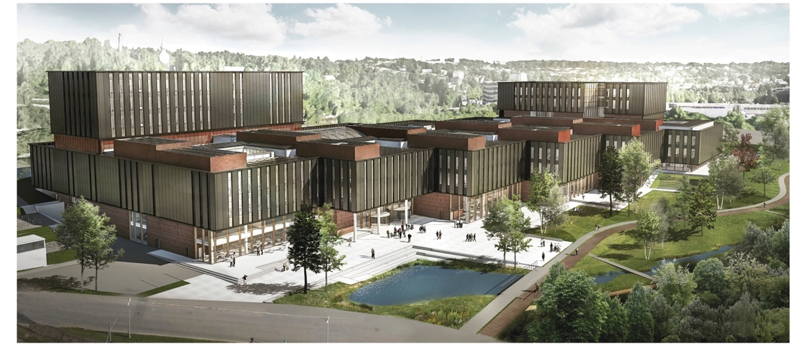
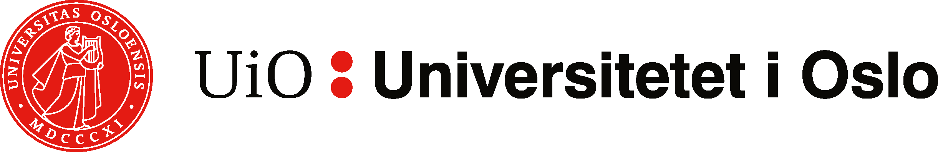
The life science building 2023
– the heart of Oslo Life Science City

