Slide 1

What is Circle U?
An open and vivid european university alliance
January 2022

Slide 2

European Universities Initiative
Initiert av EU-Kommisjonen og er en viktig pillar i the European Education Area (EEA)
41 allianser har fått status og finansiering: 17 i 2019 og 24 i 2020
Ambisjoner om å øke til 60 allianser
Circle U får:
  5 mill. Euro (Erasmus+)
  2 mill. Euro (H2020)
Notes:
Eneste allianse som ledes av en insti i et ikke-eu-medlemsland
Skal ha medlemmer i 3 av 4 europeiske regioner
Kan ha ulik tematisk profil
For å få støtte må man ha foreslått å teste noe nytt - business as usual holder ikke
Tegn til å koble EEA og ERA

Slide 3




Who are the partners?
«Likeminded» universities:
    National flagships
    Research Intensive
    Comprehensive
    Located in capitals or large cities
Six Guild universities are Circle U. members
    The Guild = strategic alliance influencing European research policy
    Circle U. = long term education cooperation
University of Oslo
Aarhus University
Kings college,
London
Humboldt Universität zu Berlin
UCLovain
Universite de Paris
University of Vienna
University of Pisa
University of Beograd

Slide 4
Hva betyr dette for UiO?

Slide 5
På lang sikt: Maraton
Gjennom Circle U. skal vi ta et betydelig steg fra mer kortsiktig og prosjektbasert samarbeid til langsiktig og integrert utdanningssamarbeid.
Ambisjonen er at dette vil gi en ramme for økt studentsentrert samarbeid:
  Betydelig vekst i utveksling av studenter (men også faglig og administrativt ansatte)
  Administrativ forenkling og skape nye muligheter for samarbeid
  Utvikling av tette faglige bånd
Transformere hvordan vi jobber med internasjonalisering av utdanning
Etablere en sterkere kultur for samarbeid på tvers av land, fag og sektorer

Slide 6
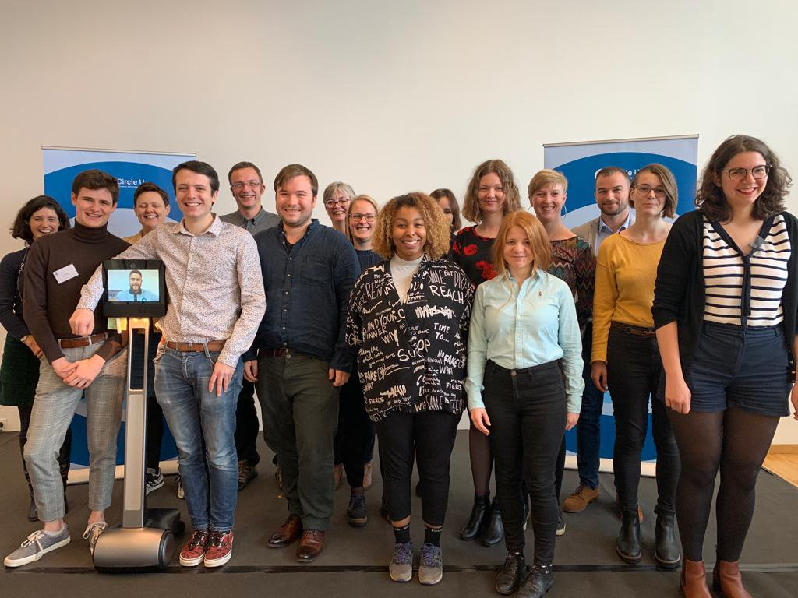
I fremtiden skal studentene:
være en del av en sømløs europeisk campus
ha felles studentkort og dele tjenester og tilbud
få tilgang til flere emner og ta nye europeiske fellesgrader
være mobile på mange flere og fleksible måter
jobbe på helt nye samarbeidsflater med partneruniversitetene og eksterne
Studentseminar i Louvain-la-Neuve 2019

Slide 7
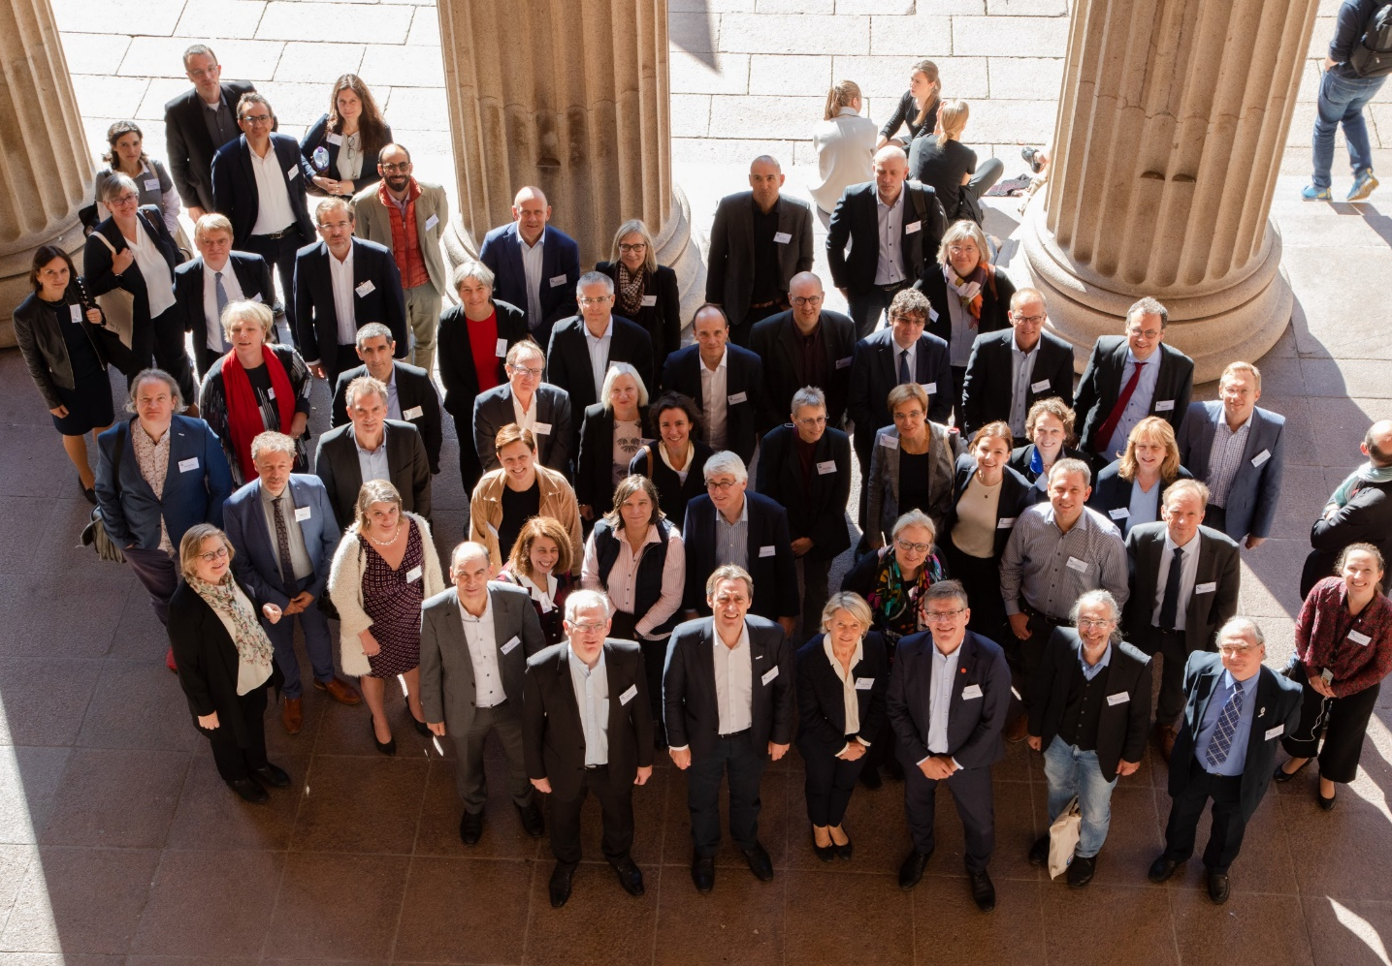
I fremtiden skal ansatte:
lettere samskape nye emner, programmer og fellesgrader på tvers av institusjonene
dele erfaringer og lære av hverandre
finne nye grunnlag for forskningssamarbeid og prosjekter
ha opphold hos hverandre gjennom blant annet Circle U. Chairs programmet
ha en arena, gjennom Circle U. tankesmien, for å utvikle og påvirke europeisk høyere utdanningspolitikk og -praksis
Academic Leader seminar Oslo 2019

Slide 8

På kortere sikt: Sprint
European Universities pilotprosjekt
3 år
Alliansene skal teste ulike konsepter for samarbeid og mobilitet
Det er lov å prøve og feile
Målet er å legge grunnlaget for en langsiktig strategi

Slide 9
Pilotprosjektet (3 år)
Forenkle og muliggjøre
Utvikle og teste konsepter
WP 1: General Management and Coordination
(Oslo)
WP 3: Circle U. Academic Chair Programme
(King’s)
WP 4: Student Led Sustainable Innovation
(Beograd)
WP 2: Creating an Inclusive European University Ecosystem
(Aarhus)
WP 6: Shaping the Future of Higher Education in a Changing World
(Paris)
WP 5: Socially-engaged Education and Research
(Humboldt)
WP 7: Sustainability and Dissemination
(UC Louvain)

Slide 10

Hva har vi fått til på ett år?

Slide 11
35 Academic Chairs fra 9 universiteter
…..empower our students through entrepreneurial learning
7 Chairs studentinnovasjon
…..to solve the societal issues with external stakeholders
24 Chairs med 3 knowledge hubs og open school of public governance
8 Chairs i felles tankesmie med tema fremtidens høyere utdanning
Notes:
The Circle U. Academic Chair Programme will ensure strong and sustainable connections across our universities, between research and teaching, between students and staff, and between universities and society. Academic Chairs will be recruited among the permanent staff and dedicate 20 percent of their working time to Circle U., while remaining employed by their home institution. By creating this web of collaborations, students and professors will be exposed to diverse and innovative academic, social and cultural learning environments. The Academic Chairs, one from each university, will be working together in networks, and will be the driving forces in the Knowledge Hubs, in the Open School of Public Governance, in the Student Led Sustainable Innovation and in the Think and Do Tank (see Figure D). The programme is an important backbone of the Circle U. infrastructure, tying several activities together and will be an enabler for cooperation and dissemination across our universities. Being entirely funded by our member universities, the Academic Chair Programme will also safeguard the sustainability of our cooperation beyond the pilot project phase, irrespective of external funding. By 2025, a total of 126 Academic Chairs will be actively involved in various activities across Circle U. campuses.
Fire chairs skal jobbe tverrfaglig med å utvikle nye studietilbud på tvers av institusjonene, teste/vurdere muligheter for forskningssamarbeid og utvikle nye samarbeidsflater med associated partners
Chairs-ene i tankesmien skal gjennom arbeidet belyse viktige utdanningspolitiske/ policy spørsmål i Europa og i de ulike landene, og bidra til kunnskapsgrunnlaget for politiske beslutninger nasjonalt og i Europa
I treårsperioden skal 35 Chairs på plass og til sammen utgjør de et Chairs-akademi
The Circle U. Academic Chair Programme will ensure strong and sustainable connections across our universities, between research and teaching, between students and staff, and between universities and society.
Academic Chairs have been recruited among the permanent staff and will dedicate 20 percent of their working time to Circle U., while remaining employed by their home institution. By creating this web of collaborations, students and professors will be exposed to diverse and innovative academic, social and cultural learning environments.
The Academic Chairs will be working together in networks, and will be the driving forces in the Knowledge Hubs, in the Open School of Public Governance, in the Student Led Sustainable Innovation and in the Think and Do Tank.
The programme is an important backbone of the Circle U. infrastructure, tying several activities together and will be an enabler for cooperation and dissemination across our universities. Being entirely funded by our member universities, the Academic Chair Programme will also safeguard the sustainability of our cooperation beyond the pilot project phase, irrespective of external funding.
By 2025, a total of 126 Academic Chairs will be actively involved in various activities across Circle U. campuses. 5 Chairs per university
By the end of the pilot project the 35 Chairs will be in place and together constitute a Chairs Academy
35 Chairs in the pilot phase, then expand gradually to 126 Chairs over a 10-year period.

Slide 12
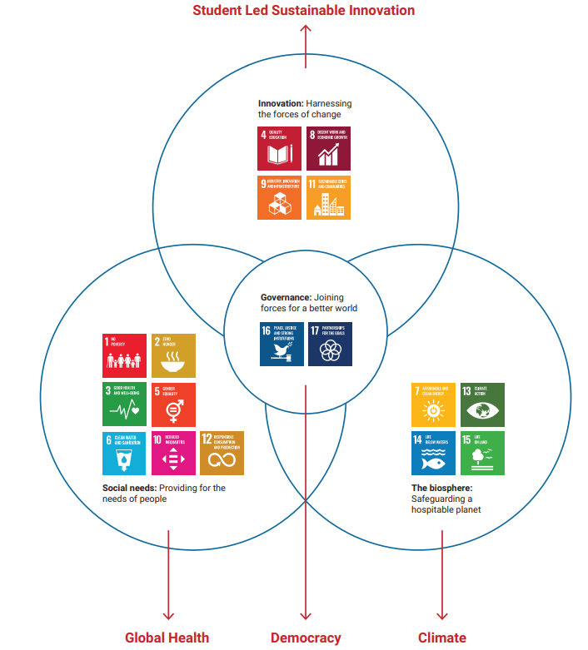
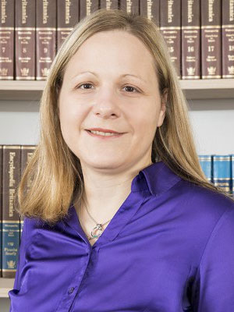

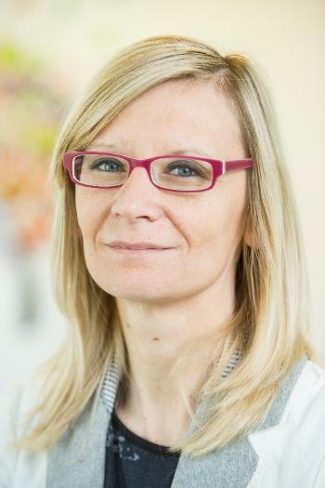

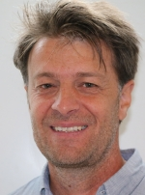

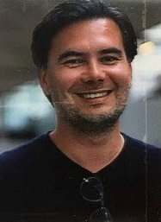
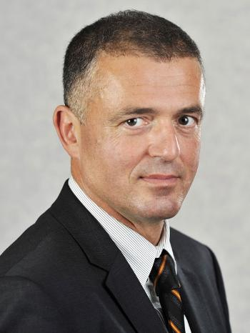


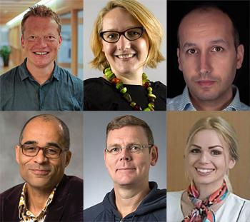

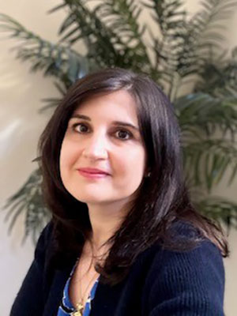
Circle U Knowledge hubs
Climate
Global health
Democracy
Notes:
The Knowledge Hubs are physical and virtual spaces for students and staff to co-create knowledge and solutions across disciplines with external stakeholders and find new ways of working together.
The Circle U. Knowledge Hubs will be physical and virtual spaces for students and staff to co-create knowledge and solutions across disciplines with external stakeholders and find new ways of working together.
As a first step, we have identified three thematic areas where we will pool our existing strengths within education, research and innovation, to make substantial impact:
Circle U. Climate Hub
Circle U. Democracy Hub
Circle U. Global Health Hub
About
Students will solve societal problems in student teams, and benefit from knowledge from other sectors, disciplines and national contexts. The Knowledge Hubs will also form the basis on which courses, summer schools and degree programmes will be developed.
We will support bottom-up joint initiatives embedding learning co-creation, virtual mobility and exchanges across all our universities and in cooperation with our associated partners. To stimulate engagement, we will set up seed fund mechanisms for academic or student led initiatives to co-create joint and innovative learning activities.
As our cooperation deepens, we will support bottom up initiatives to create new Knowledge Hubs that engage even greater areas of university life over time.
Addressing the wide range of complex global challenges highlighted by the Sustainable Development Goals requires a strong commitment from universities. Comprehensive universities with a proven ability to couple education, research, innovation and service to society can contribute with integrated approaches to address these complex challenges. These are features and strengths shared by the Circle U. partners.
Building on the 2018 European Commission BOHEMIA strategic foresight study (Transitions on the Horizon: Perspectives for the European Union’s future research and innovation policies, see Figure A) and in consultation with our academic staff and students, we have identified three thematic areas where we can pool our existing strengths within education, research, innovation and service to society to make a substantial impact on the sustainability agenda: Climate, Global Health and Democracy.
Across all three topics, we will closely collaborate with external stakeholders. We received overwhelming support from our city and/or regional authorities, our linked hospitals, civil society and businesses to join Circle U. as associated partners.

Slide 13

What to do in 2022-2023
Some highlights:
Interdisciplinary summer schools
Circle U. Challenge targeting student teams – fra april 2022
Developing joint courses
Designing the “Open School of Public Governance”
Stimulating student mobility within the alliance

Slide 14


Følg med!
Circle-u.eu
Nyhetsbrev – abonner!
Twitter
Circle U Cafè Oslo

Slide 15


