Slide 1
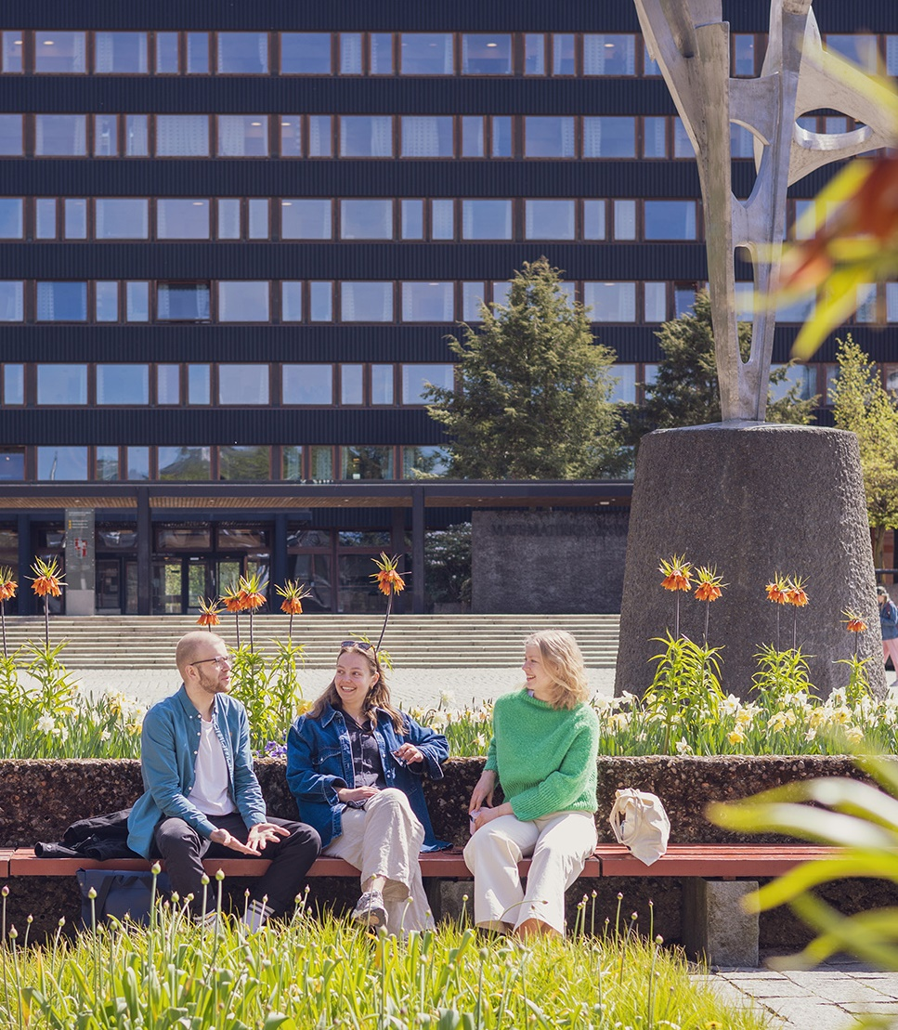
A leading European university
Photo: Jarli & Jordan

Slide 2
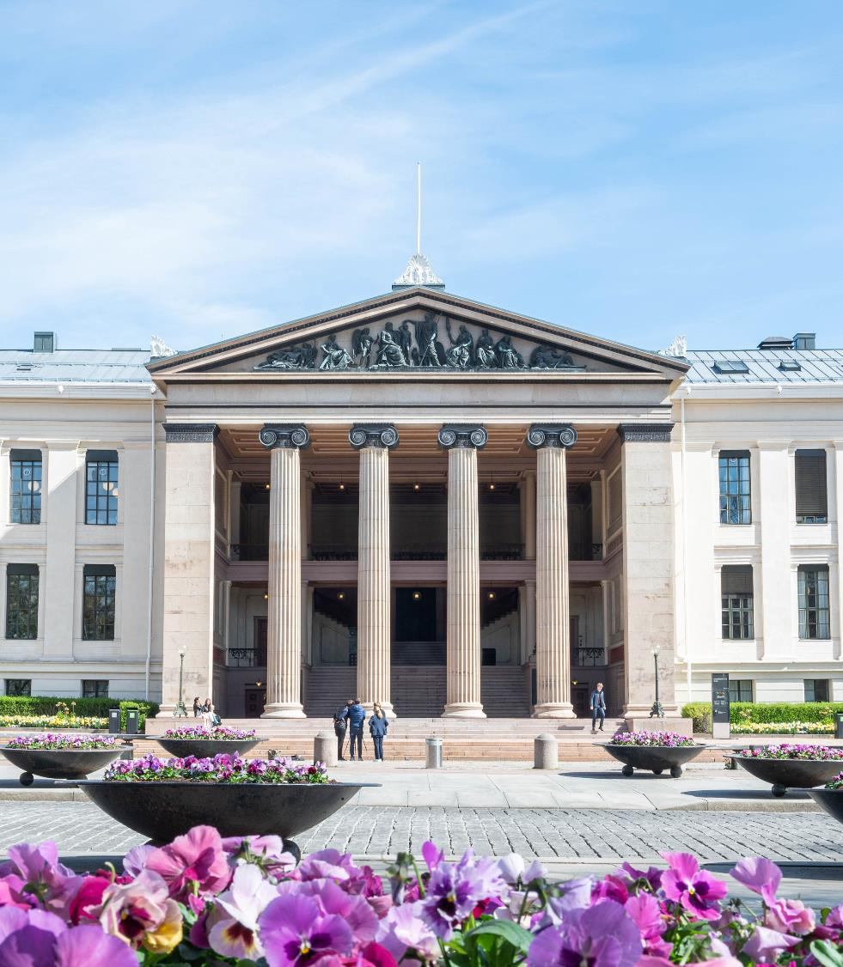

Norway’s oldest institution for research and higher education
Education, research, dissemination and innovation since 1811
Photo: Maylinn Hovengen Byrknes/UiO
Notes:
UiO’s history: https://www.uio.no/english/about/facts/history/index.html

Slide 3

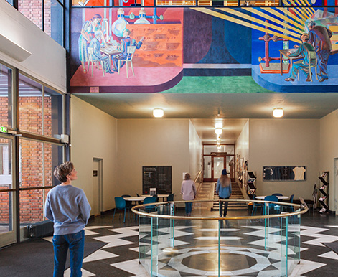


University of Oslo today
World´s 73rd best research university (Shanghai Ranking)
5 Nobel Prize Laureates
8 faculties
2 museums
Illustration: AART Architects
Photo: Jarli & Jordan/UiO
241 study programs
30 centres of excellence
105 ERC projects
7 200 employees
26 100 students
Photo: Jarli & Jordan/UiO
Photo: Jarli & Jordan/UiO
Notes:
UiO is involved in a total of 30 centres of excellence (research, education, innovation, environment-friendly energy-research).
UiO is project owner/host for 16 excellent centres.
48 active ERC projects per 31.12.2023. UiO has been awarded 105 ERC projects in total.
Nobel Prize Winners: https://www.uio.no/english/about/facts/nobel-prize/

Slide 4



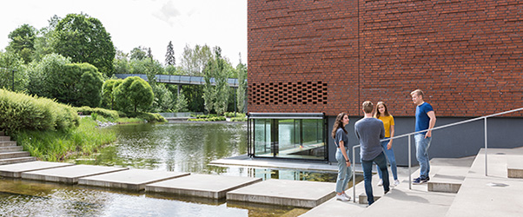
Campuses
Blindern
Tøyen
Photo: Jarli & Jordan/UiO
Photo: Fara Mohri
Centre of Oslo
Oslo Science Park
Photo: Jarli & Jordan/UiO
Photo: Jarli & Jordan/UiO

Slide 5

Strategy 2030
Our ambitions
Promote independent, ground-breaking, long-term research
Educate students with the knowledge, ability and willingness to create a better world
Strengthen the dialogue with the outside world and work to ensure that knowledge is put to use
Be an innovative organisation and an attractive place of work and study
Photo: Jarli & Jordan/UiO
Notes:
Strategy 2030: https://www.uio.no/english/about/strategy/strategy-2030/index.html

Slide 6
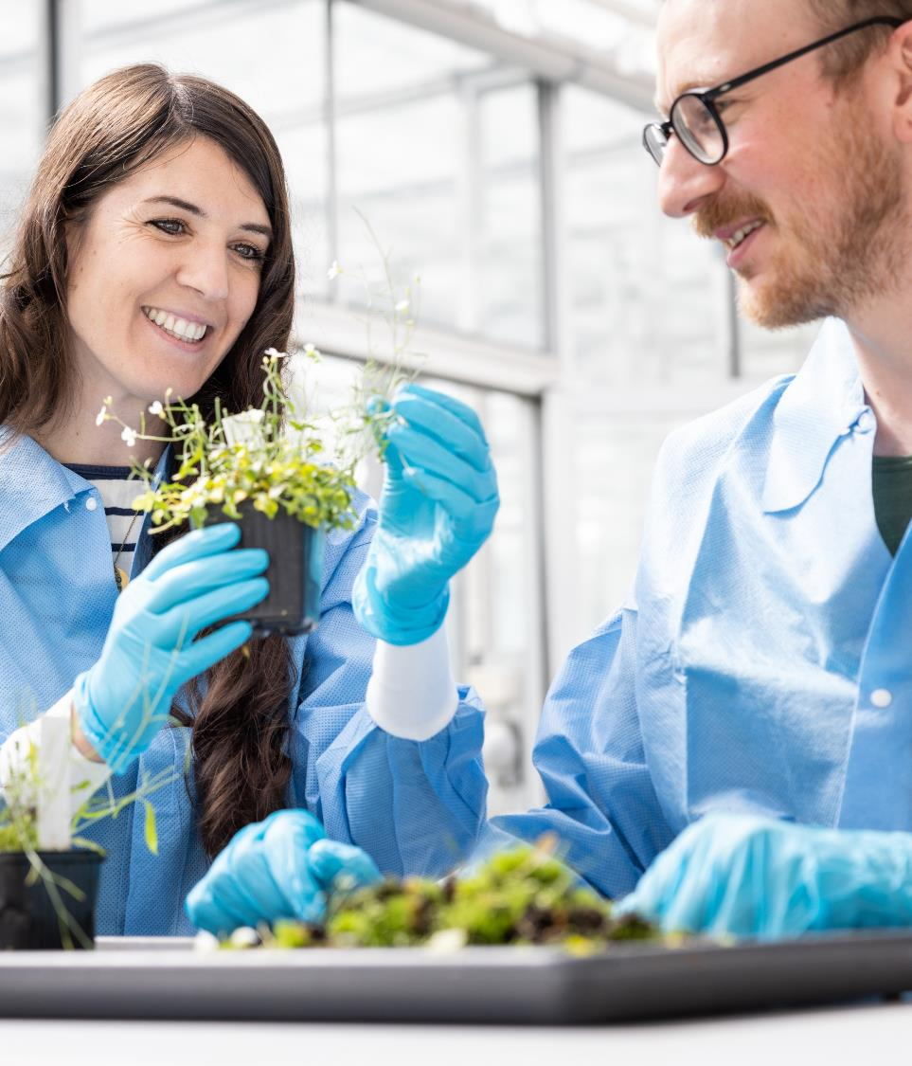
Comprehensive climate and environmental strategy
Our ambitions
Offer education related to climate, environment and sustainability for all students
Strengthen interdisciplinary research within the fields of climate, environment and sustainability
Reduce our climate footprint and further develop a «green campus»
Photo: Jarli & Jordan/UiO
Notes:
UiO’s Comprehensive Climate and Environmental Strategy: https://www.uio.no/english/about/strategy/climate-and-environment/index.html

Slide 7
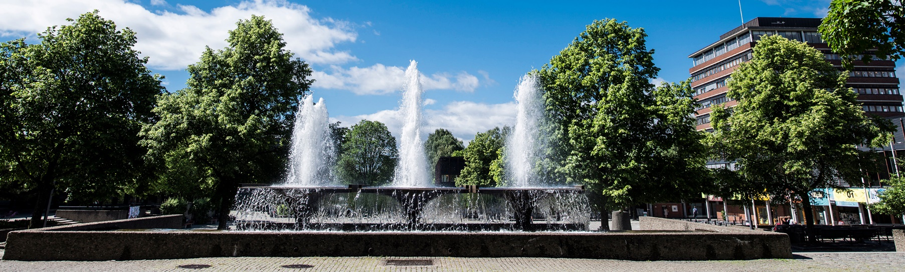
Income
Total income
University of Oslo:
9530 million NOK
Foto:Anders Lien/UiO
6421 million NOK
basic funding
2652 million NOK
result-based funding
European Research Council, Norwegian Research Council, other contributions and assignments
457 million NOK
other income
Notes:
Numbers from annual report 2023
Result-based funding includes 356 million NOK from the European Research Council, 1236 million NOK from the Norwegian Research Council, 1060 million NOK
in othe contributions and assignments
"Other income": Gifts NOK 70 million, sales and rental income NOK 287 million, other income NOK 27 million.

Slide 8
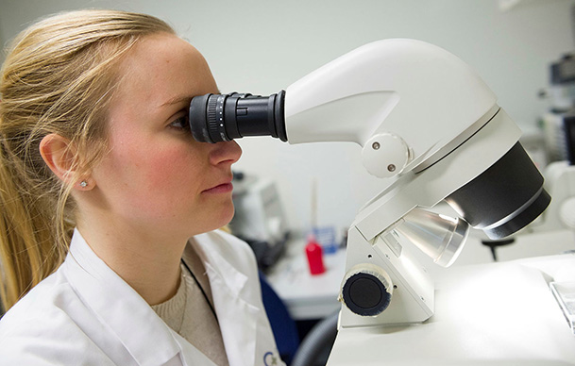

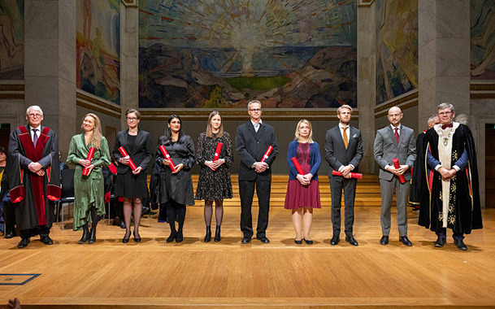
A research-intensive university
Photo: Øyvind Horgmo
Photo: Jarli & Jordan/UiO
Photo: Jarli & Jordan/UiO
30 centres for excellent research, education, innovation, environment-friendly energy research
105 European Research Council projects
427 doctorates awarded (2023)
57 percent international co-publications
Notes:
UiO is involved in 30 excellent centres and project owner/host of 16:
10 centres for excellent research
4 centres for excellent education
1 centre for environment-friendly energy research
1 centres for research-based innovation
The number of international scientific co-publications UiO had in 2023 is 3,593. This corresponds to 57% of a total of 6,195 reported publications.

Slide 9

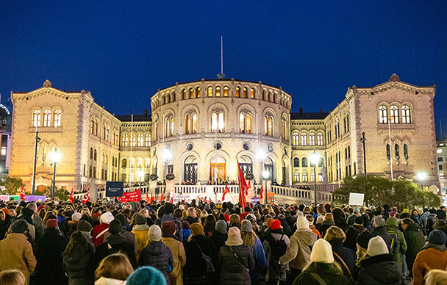
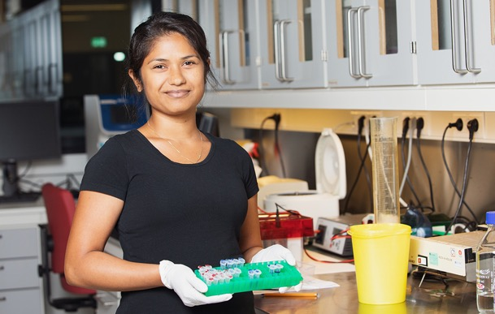
Interdisciplinary strategic research areas
Photo: Getty stock image
Photo:Audum Braastad/NTB
Photo: Jarli & Jordan/UiO
UiO:Energy and Environment
Strengthening interdisciplinary research in sustainable energy, climate and environment
UiO:Democracy
Strengthening interdisciplinary research within the field of democracy
UiO:Life Science
Strengthening interdisciplinary research within the fields of health and environment
Notes:
UiO’s interdisciplinary strategic research areas: https://www.uio.no/english/research/strategic-research-areas/

Slide 10

Global UiO
International collaboration
Close research cooperation across all continents
Program cooperation with the Nordic countries, Europe, India, Brazil, South Africa, China, Japan and the United States.
Research
Student exchange
Capacity building
Sett inn bilde her
Photo: Colourbox
Notes:
UiO’s international collaborations: https://www.uio.no/english/about/global/

Slide 11
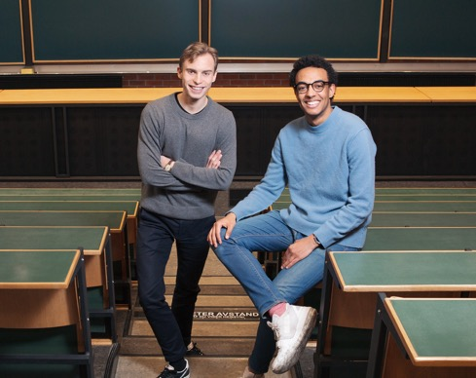



Education
26 128
students
4 921
students graduated
High satisfaction
with academic content
(Study Barometer 2023)
Photo: Jarli & Jordan/UiO
Photo: Jarli & Jordan/UiO
26 570
qualified students with UiO as first choice
Goal of
50 percent
student exchange
Photo: Jarli & Jordan/UiO
Photo: Jarli & Jordan/UiO

Slide 12


Circle U.
European university alliance consisting of 9 universities
Aims at facilitating for students and staff to study and collaborate across national borders
Photo: Circle U.
Photo: Circle U.
Notes:
The aim is to establish an inclusive, research-intensive and interdisciplinary European university.
Collaboration across institutions, between staff, between students, and between students and staff.
Establishment of research projects and new study programmes.
Members: University of Oslo, Aarhus University, Humboldt-Universität zu Berlin, King's College London, Univerzitet u Beogradu, Université catholique de Louvain, Université Paris Cité, Università di Pisa, Universität Wien.

Slide 13


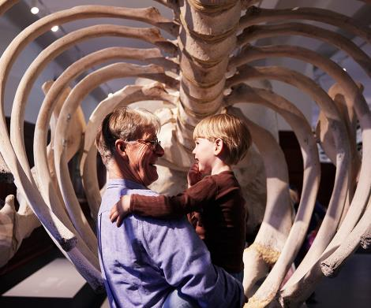
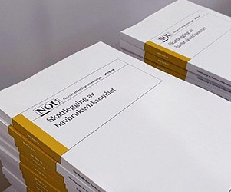
Knowledge put to use
Climate House
Domus Bibliotheca
Photo: Jarli & Jordan/NHM
Photo: Malin A. Gylvik/UiO
Natural History
Museum
Museum of
Cultural History
Official Norwegian Reports (NOUs)
Photo: Lars Petter Pettersen/NHM
Photo: Anders Furuset/Intrafish
Notes:
The museums at UiO: https://www.uio.no/om/kultur/museer/
UiO contributes to a knowledge-based public debate through extensive dissemination activities in the media, meetings and events, museums, and in Domus Bibliotheca: https://www.uio.no/om/aktuelt/arrangementer/domus-bibliotheca/
Many researchers participate in various investigative activities such as Norway's public investigations, are in dialogue with business and the public sector and contribute to more knowledge in a number of areas in society.

Slide 14
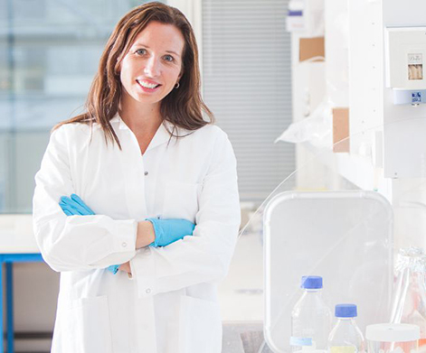



From basic research to innovation
Pharmaceuticals
and methods of treatment
New legislation
and regulations
Photo: Nykode
Photo: Kim Halvorsen, Havforskningsinstituttet
Computer technology
Education
Photo: NTB/Thomas Brun
Photo: Colourbox
Notes:
Basic research is long-term research that aims to lead to new insights, without necessarily providing immediate benefits in terms of economy, knowledge, or use. Many of the products and services we take for granted today could not have been imagined just a few years ago. Innovation often originates from basic research, whether it's about medications, vaccines, computer technology, teaching methods, language models, or new policies, laws, and regulations.
Three examples:
Tar norsk vaksineteknologi ut i verden – Forskningsparken
Hummerens sexliv skaper behov for større reservater - Titan.uio.no
World Wide Web runder 30 år - Titan.uio.no

Slide 15
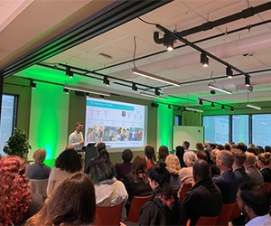


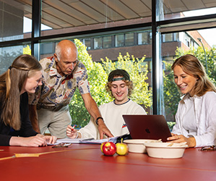
Oslo Science Park
Inven2
Oslo Tech
UiO Growth House
SPARK Life Science and SPARK
Social Innovation
Photo: Veksthuset
Photo: Jarli & Jordan/UiO
StartupLab
Share-lab
Student inovation
Photo: Jarli & Jordan/UiO
Photo: Jarli & Jordan/UiO
Notes:
Tools for innovation:
Innovation at UiO – knowledge in use: https://www.uio.no/om/innovasjon/
Inven2 – Technology Transfer Office – UiO together with Oslo University Hospital
Announcement of programmes, lab space, arranging for student innovation activities etc.

Slide 16

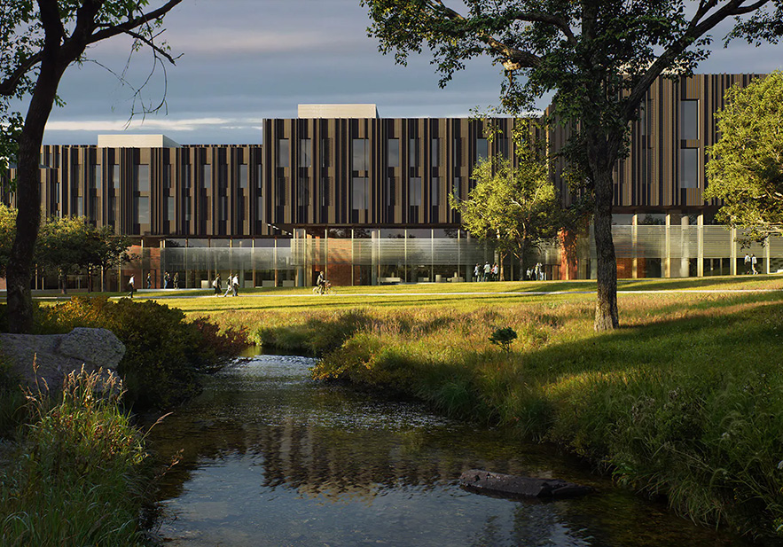
Innovation District
Oslo Science City
Life Science Building
Illustration: Playtie/BIG
Illustration: Ratio Arkitekter/MIR
Notes:
Oslo Science City, Norway´s first innovation district, is being established in the area Majorstua, Marienlyst, Blindern, Gaustad, Ullevaal og Campus Radium Hospital:
https://www.oslosciencecity.no/en/
The Life Science Building will be a workplace for about 1 600 staff and 1 600 students who will engage in research and education within life science, medicine, chemistry and pharmacy. The building will be finished in 2026/27. https://www.uio.no/tjenester/eiendom/vare-byggeprosjekter/livsvitenskapsbygget/

Slide 17
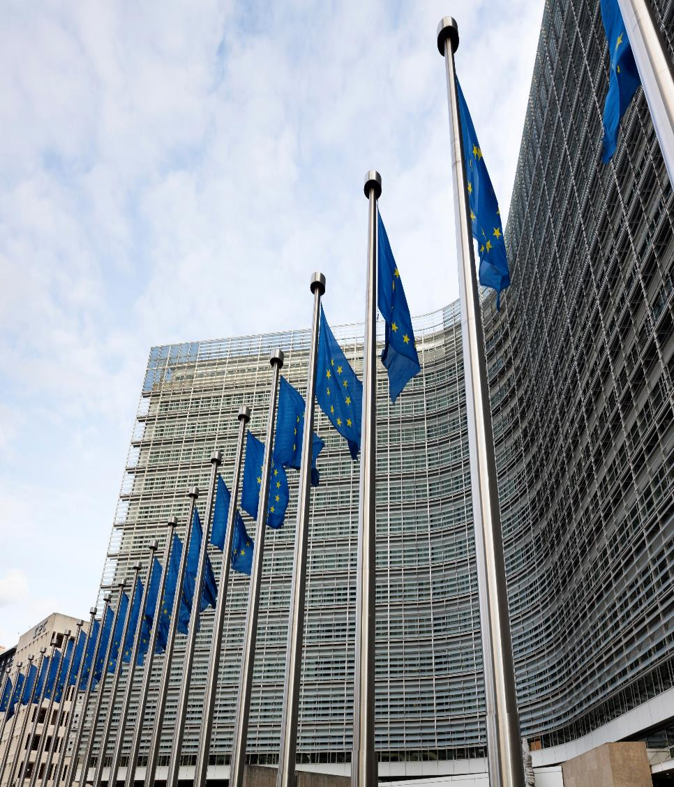
The Guild of European Research-Intensive Universities
22 research-intensive universities from 16 European countries
Works with research and education policy as well as influencing EU programmes
Photo: imageBROKER/Wilfried Wirth
Notes:
For UiO, having influence on the European arena is important, given Norwegian universities' dependence of the facility on EU policies, programs and calls, in addition to the fact that the research and education policy that is designed in Brussels largely influences national policy.
About The Guild: https://www.uio.no/om/internasjonalt/the-guild/

Slide 18
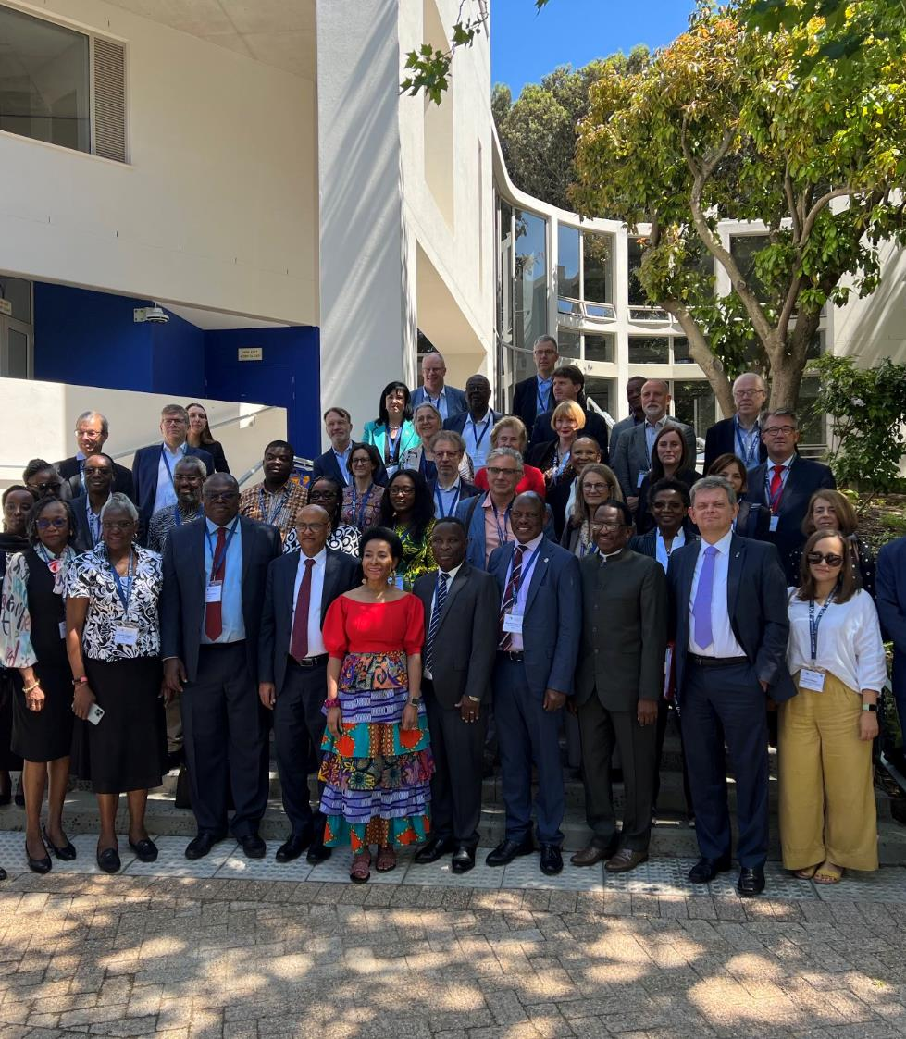
ARUA
African Research-Universities Alliance
Strengthening research, innovation and higher education at African universities
Close collaboration with the Guild, including 20 Africa-Europe Clusters of Research Excellence
From development aid towards capacity building and equal partnerships
Photo: University of Cape Town
Notes:
The Guild also works to set the agenda for public conversation. In this, cooperation with the African university network ARUA to strengthen the research capacity of African universities is central.
ARUA-Guild Clusters of Research Excellence: UiO co-leads two clusters, partner in three. More information: https://www.uio.no/om/aktuelt/aktuelle-saker/2023/nyskapende-forskningssamarbeid-med-afrikanske-univ.html
About ARUA – African Research-Universities Alliance: https://arua.org.za/

Slide 19


