Slide 1
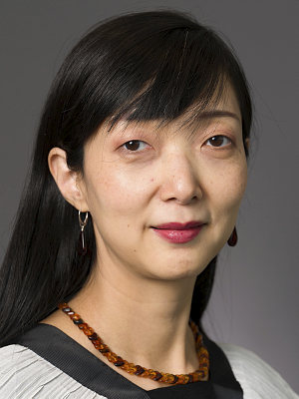
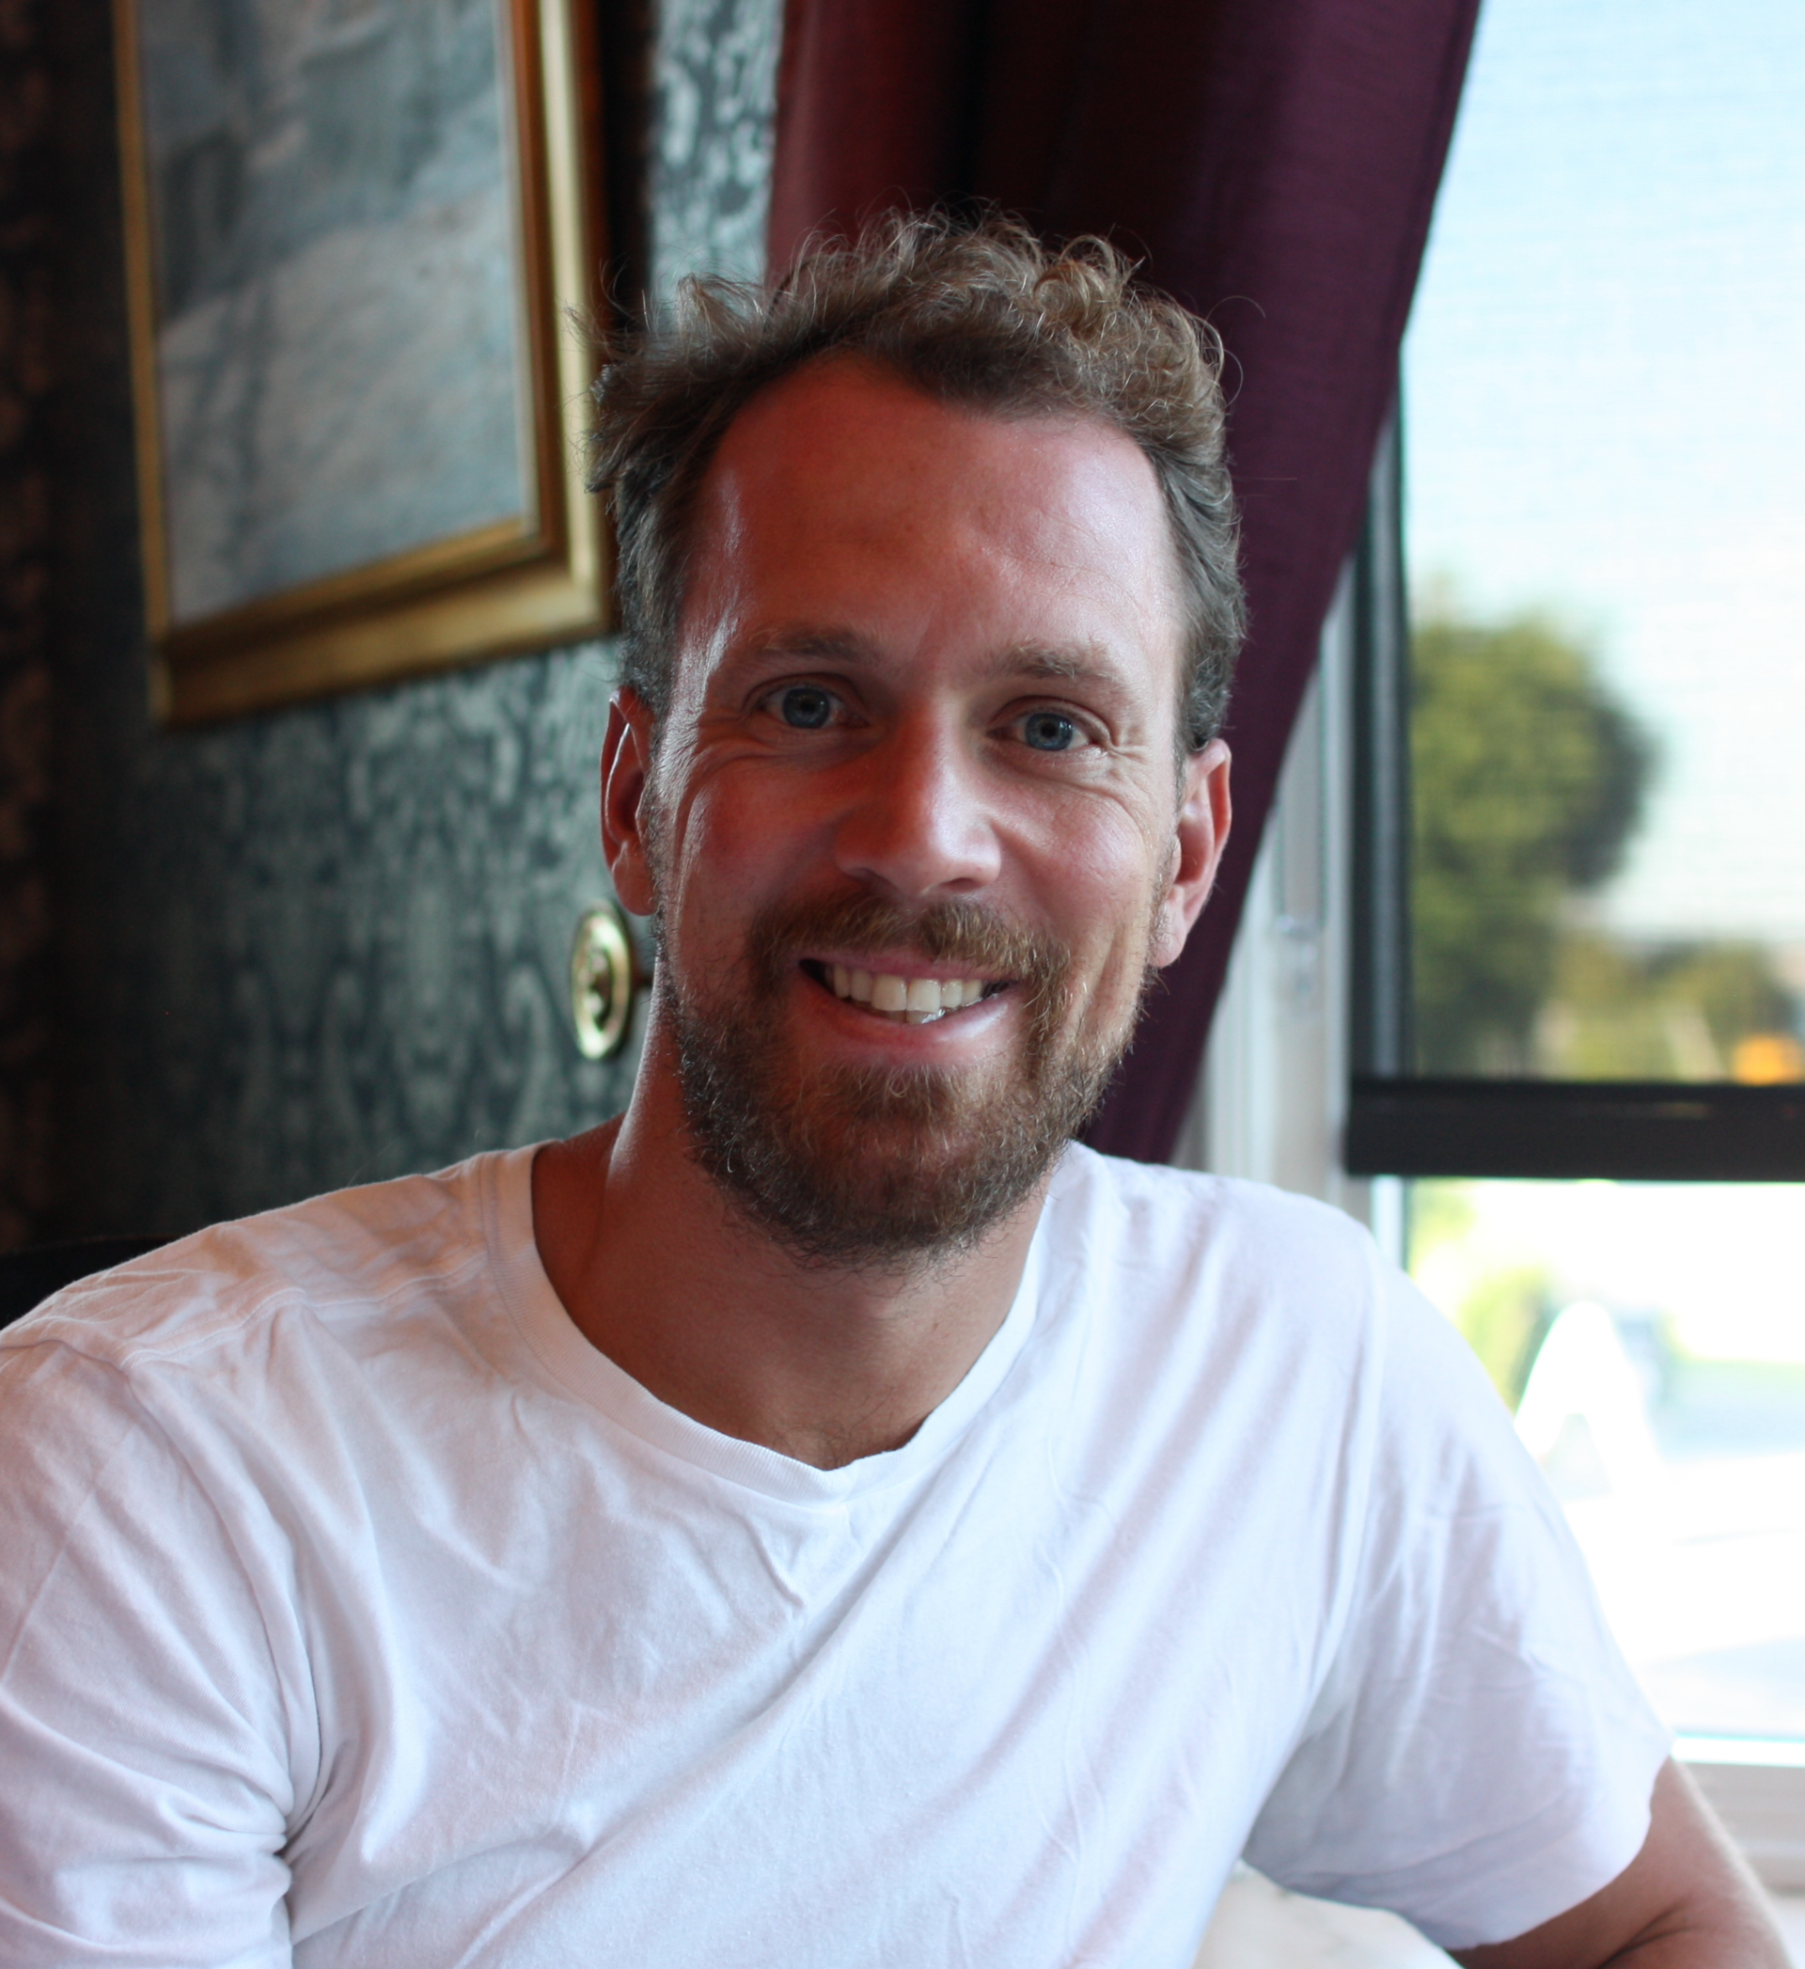
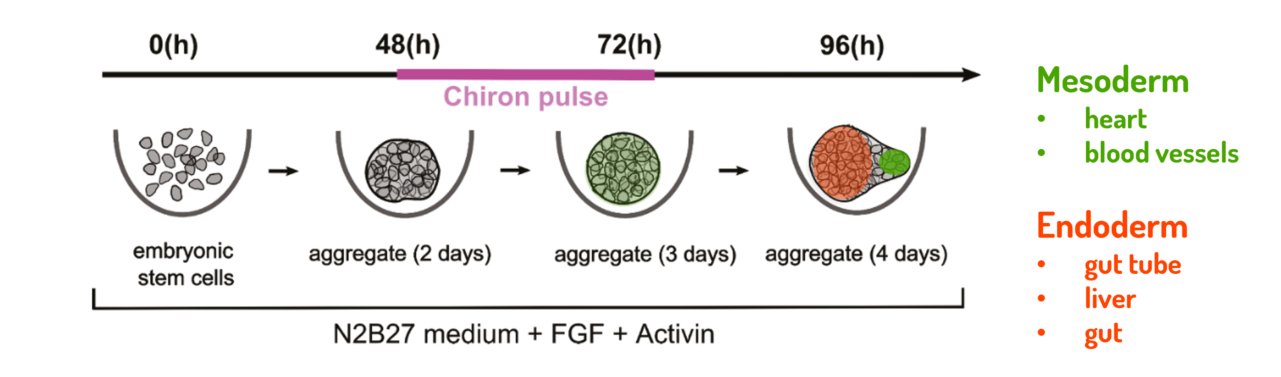
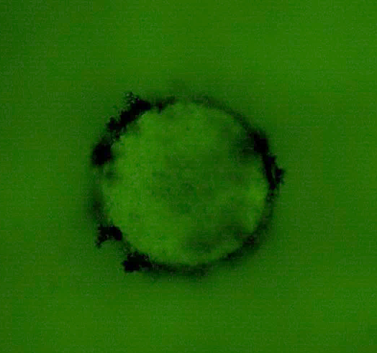
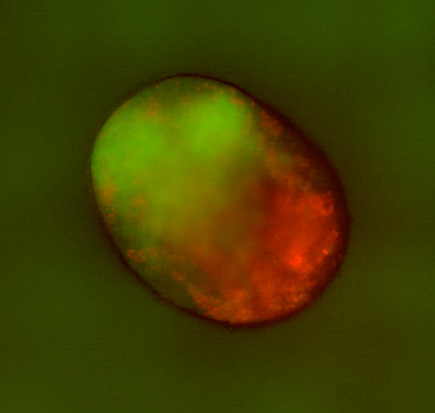
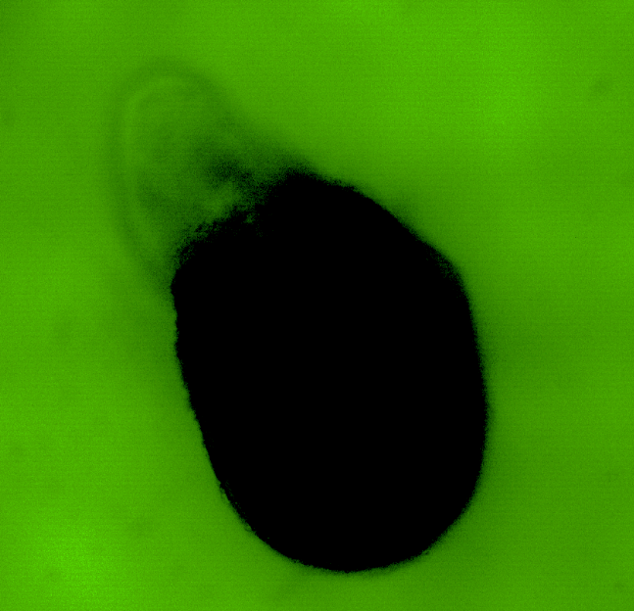
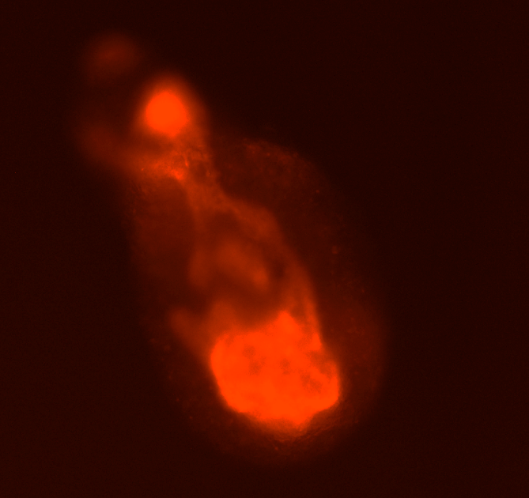
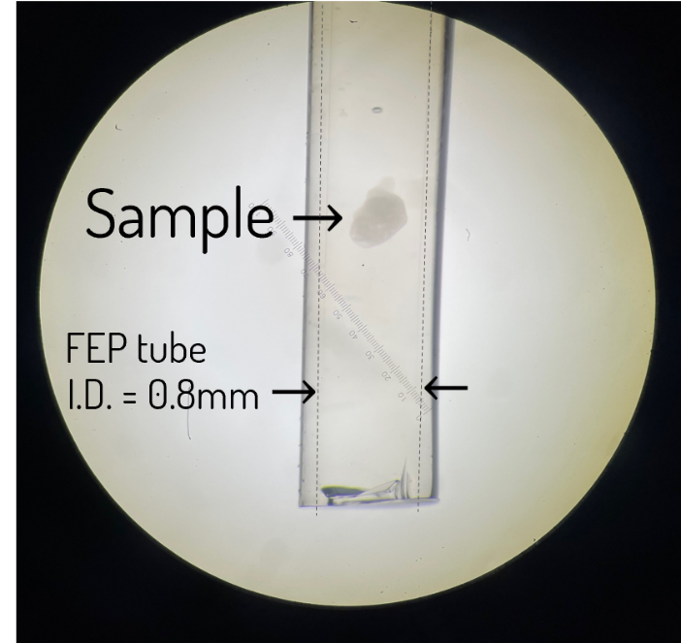
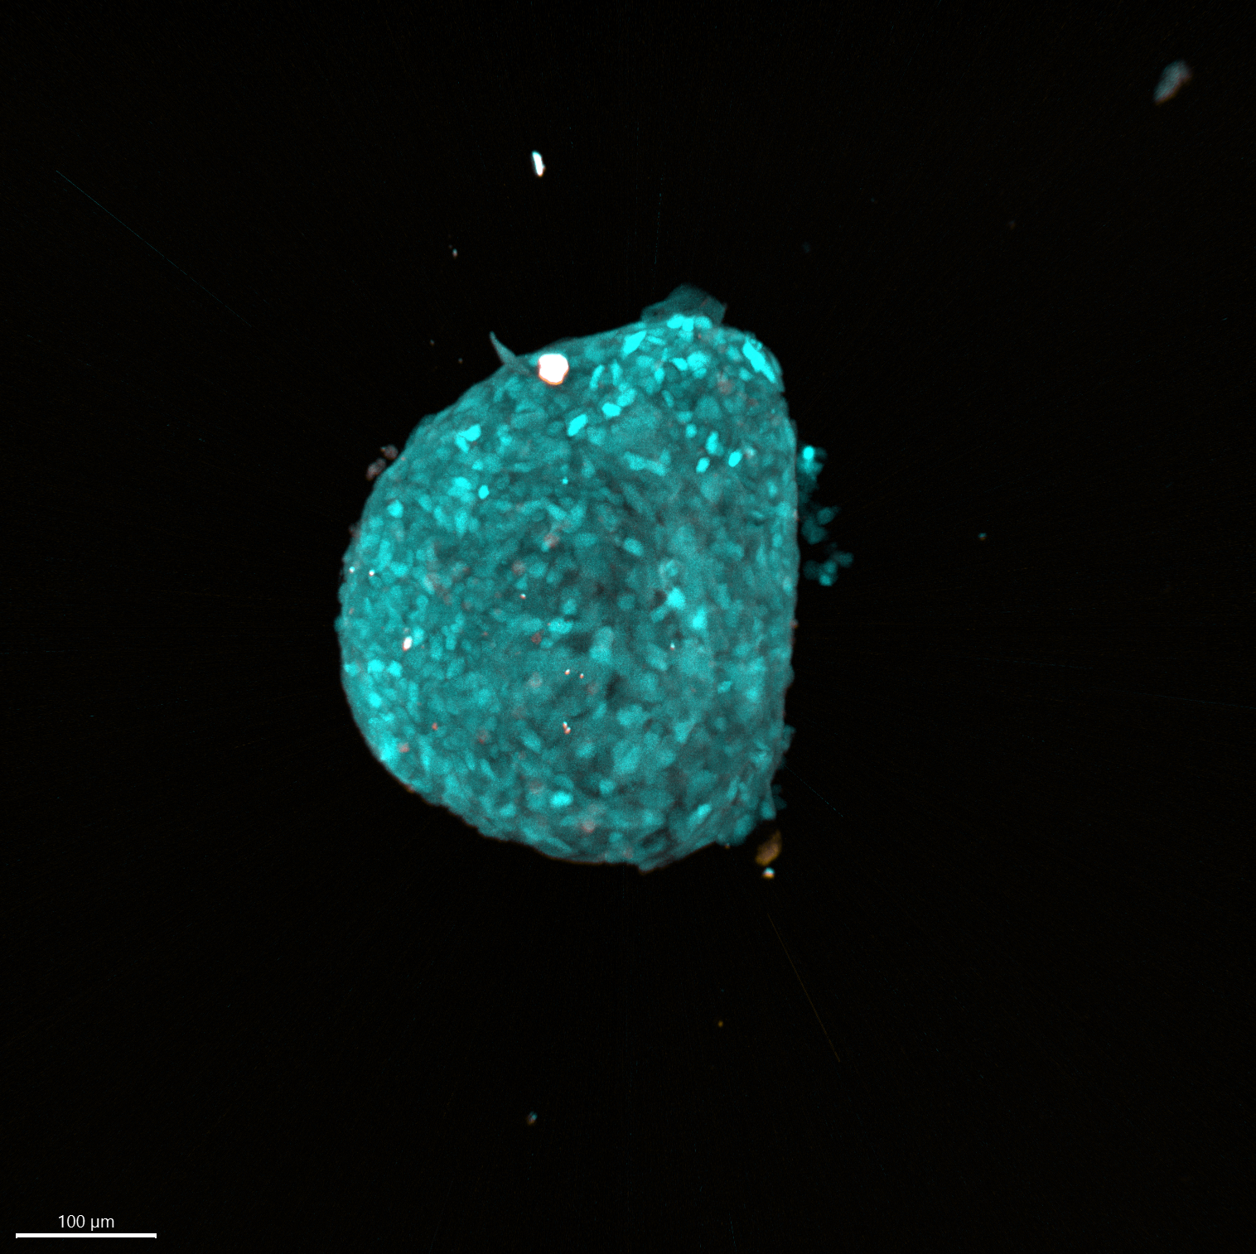
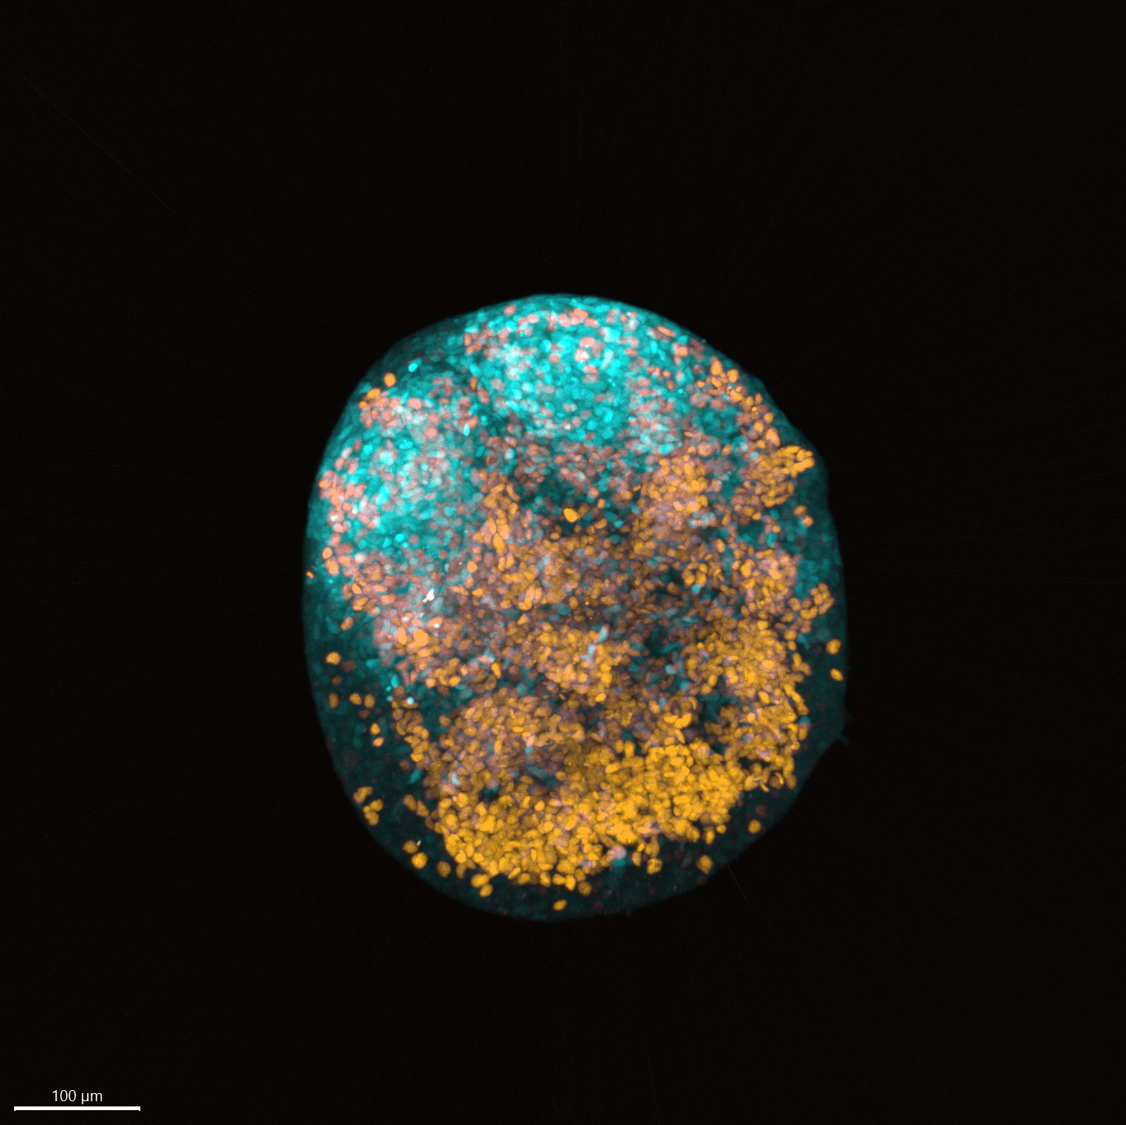
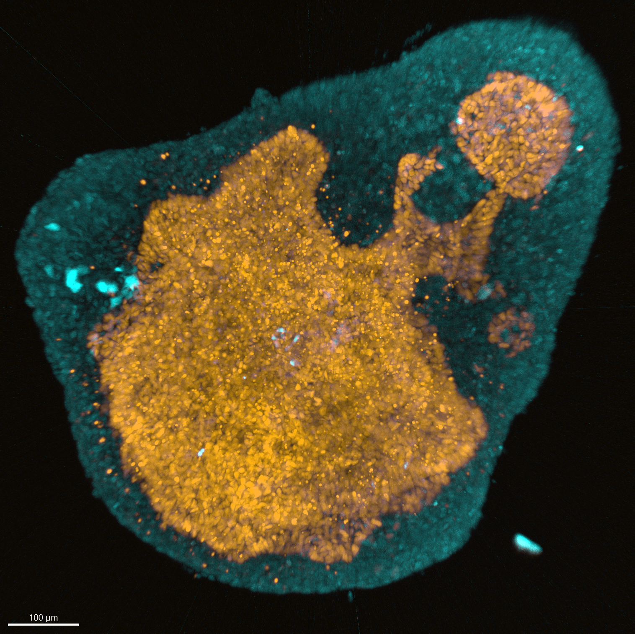
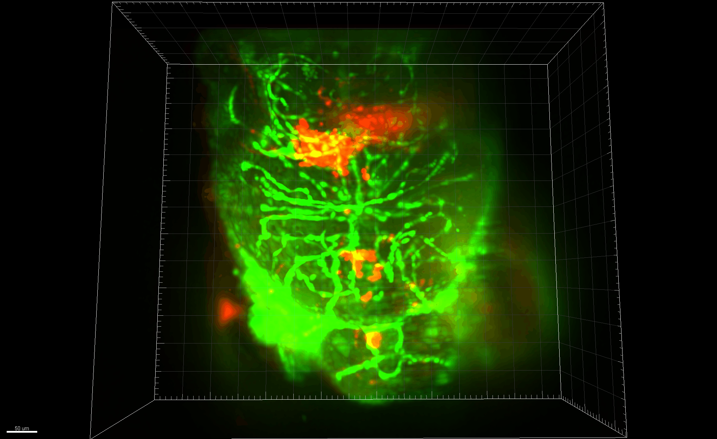






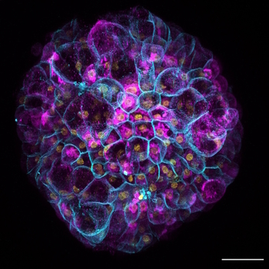


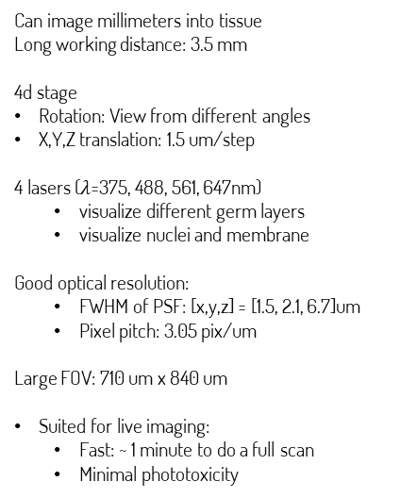
Light-sheet microscopy:
Opening a window into early mammalian development
Light Sheet Microscopy Workshop,
Aarhus University 19-22 Aug, 2024
Edna (Xian) Hu
University of Oslo
Joachim Mossige
University of Oslo
Goals:
Characterize early organ formation using mammalian embryo models (cardiovascular gastruloids).
Unravel how cells self-organize to
form tissue.
Hashmi, A., et al. (2022). Elife, 11, e59371.
3-day gastruloid (2D image)
4 days
P
5 days
P
5 days
Posterior
T/Bra GFP
Sox17 RFP
Anterior
A
A
3-day gastruloid (3D image)
4 days
5 days
100 um
100 um
100 um
Additional study: Cell invasion in a zebrafish brain
50 um
Blood vessels GFP
Cells RFP
Can image millimeters into tissue
Long working distance: 3.5 mm
4d stage
Rotation: View from different angles
X,Y,Z translation: 1.5 um/step
4 lasers ($λ$=375, 488, 561, 647nm)
  visualize different germ layers
  visualize nuclei and membrane
Good optical resolution:
  FWHM of PSF: [x,y,z] = [1.5, 2.1, 6.7]um
  Pixel pitch: 3.05 pix/um
Large FOV: 710 um x 840 um
Suited for live imaging:
  Fast: ~ 1 minute to do a full scan
  Minimal phototoxicity
Acknowledgements: Gastruloid samples provided by Sergei Ponomartcev and Natalia Smirnova, Hybrid Technology Hub, Univ. Oslo. Thanks to Sunny Dai and Jana Harizanova at CFIM for clearing the gastruloids (EZ Clear) and for producing the 3D gastruloid images using their LS7 microscope. Zebrafish provided by Wietske van der Ent, Chemical Neuroscience, Univ. Oslo.

