Slide 1
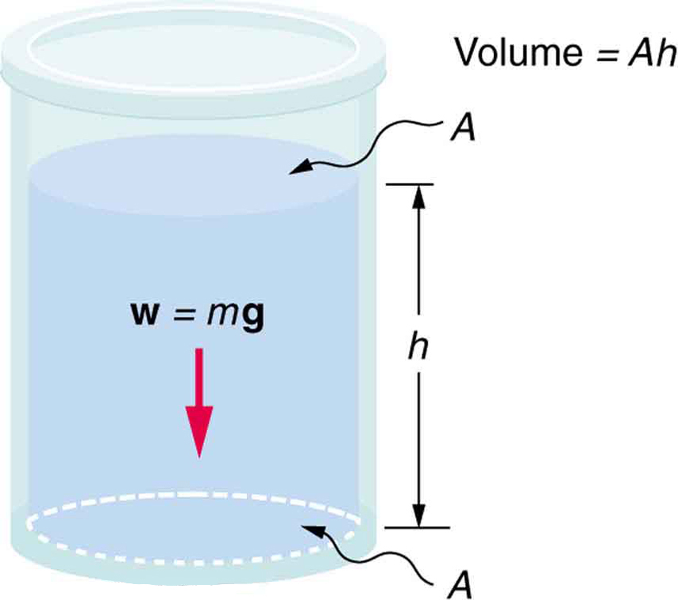
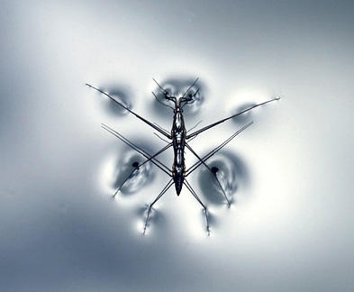
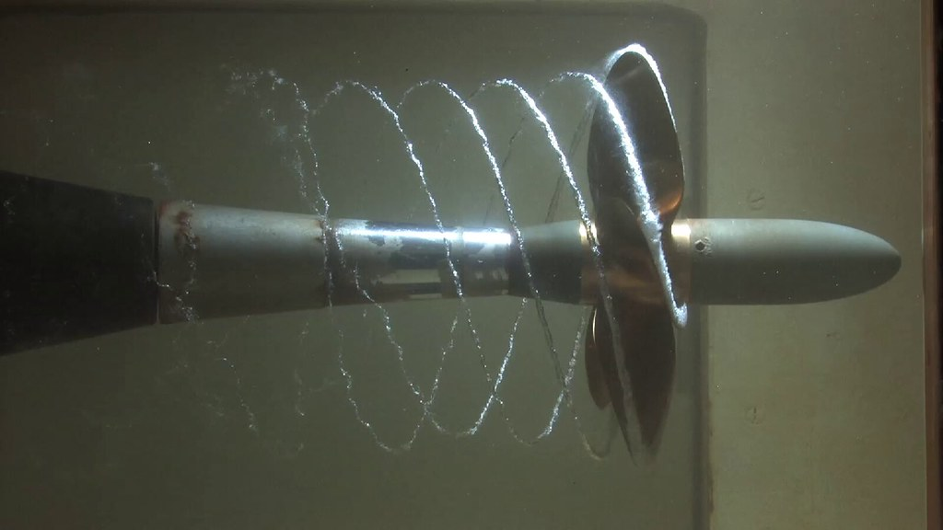
31-1-22: 2nd lecture in fluid mechanics
Pressure?
Surface tension
EFM 2.6
Credit: USGS.gov
Hydrostatic pressure
Without flow (EFM 3.1-3.2)
Credit: Creative Commons
Cavitation is flowing systems
Pressure due to to flow (EFM 2.7)

Slide 2
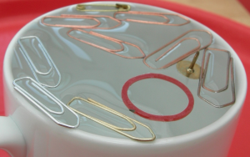
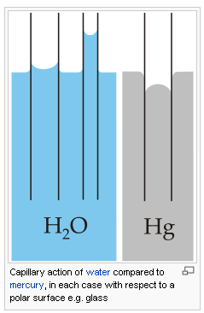
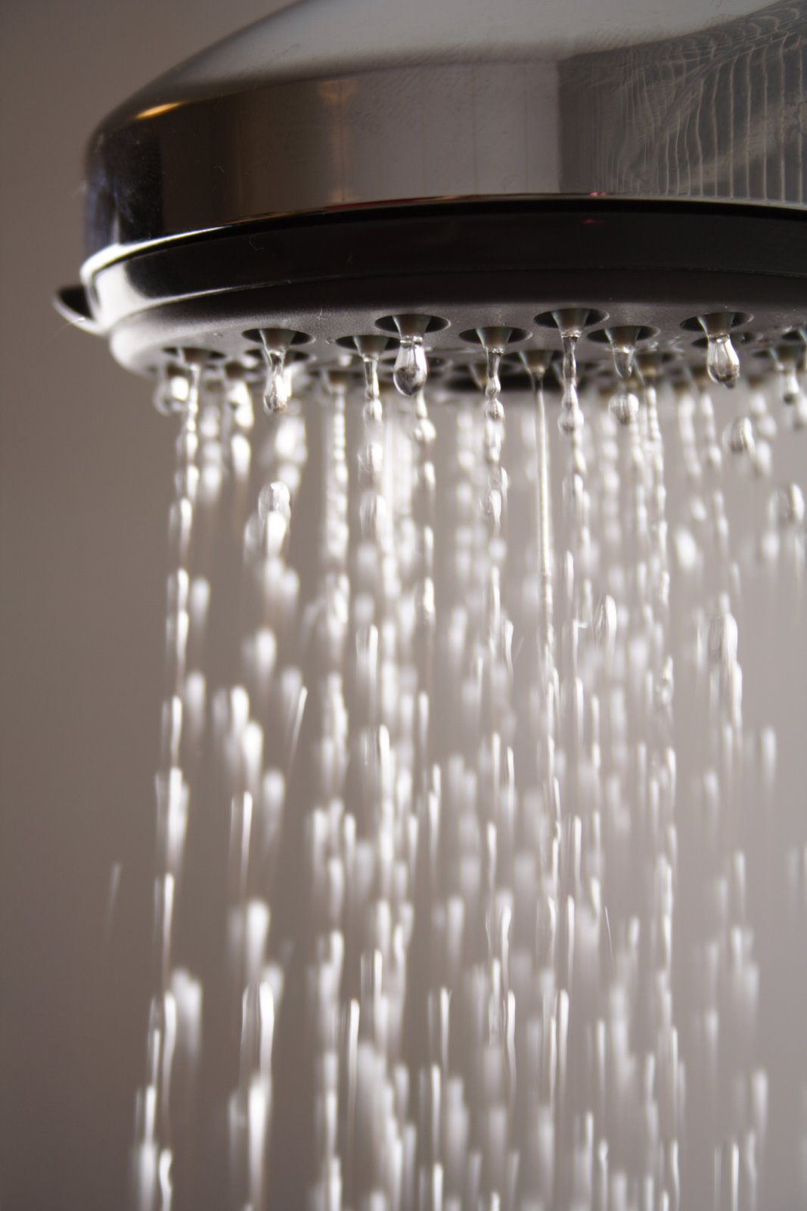

Manifestations of surface tension (EFM 2.6)
Surface tension controls wetting phenomena
Floating objects
Surface tension controls size and shape of raindrops
Surface tension controls
jetting-dripping transition
Capillary rise
All images from Creative Commons. Licensed under CC BY-SA-NC
Notes:
Surface tension minimizes surface area

Slide 3
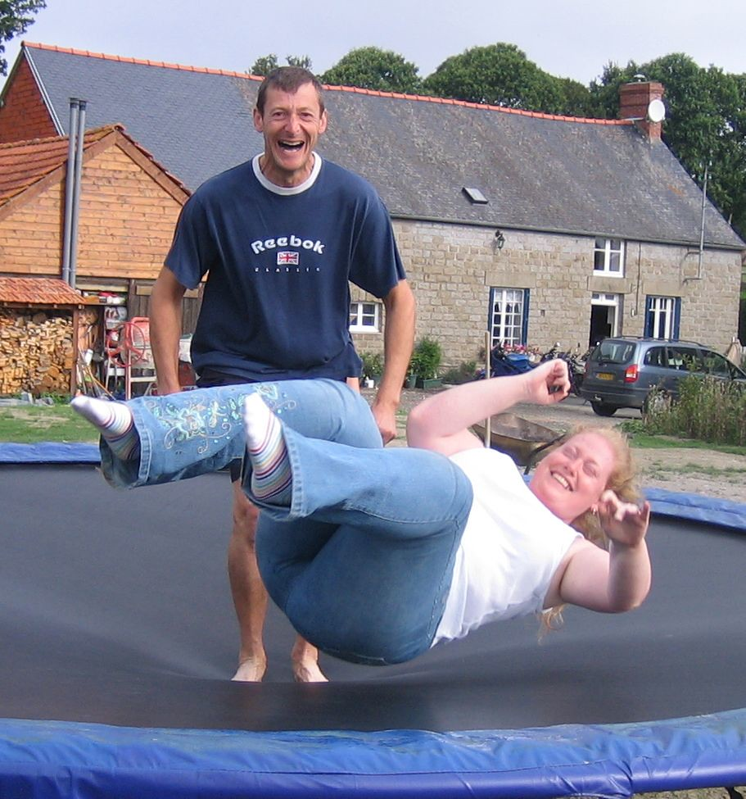
Surface tension makes a liquid surface behave like a stretched membrane
tension
Weight of man equals tension
All images from Creative Commons. Licensed under CC BY-SA-NC
Notes:
Like barn leker best/likt løser likt, så vannmolekylene tiltrekker seg andre vannmolekyler. Inni væsken trekker et vannmolekyl like mye I alle retninger, men et vannmolekyl på overflaten har ingen vannmolekyler over seg å trekke på; dermed trekker den hardere på molekylene på siden av seg og danner såkalte hydrogenbindinger, som er det som gir overflatespenningen.

Slide 4
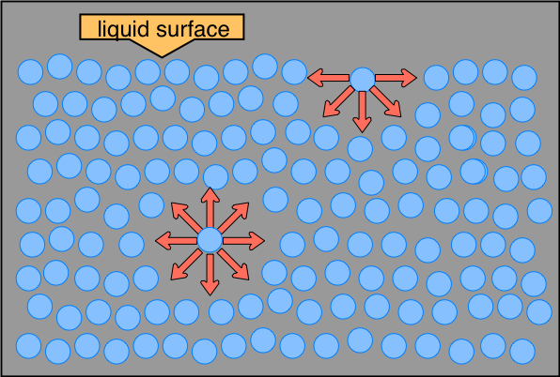
Surface tension makes a liquid surface behave like a stretched membrane
Cohesive force
tension
Weight of man equals tension
Cohesive force = attraction force between like molecules
(tiltrekningskraft mellom like molekyler)
All images from Creative Commons. Licensed under CC BY-SA-NC
Notes:
Like barn leker best/likt løser likt, så vannmolekylene tiltrekker seg andre vannmolekyler. Inni væsken trekker et vannmolekyl like mye I alle retninger, men et vannmolekyl på overflaten har ingen vannmolekyler over seg å trekke på; dermed trekker den hardere på molekylene på siden av seg og danner såkalte hydrogenbindinger, som er det som gir overflatespenningen.

Slide 5
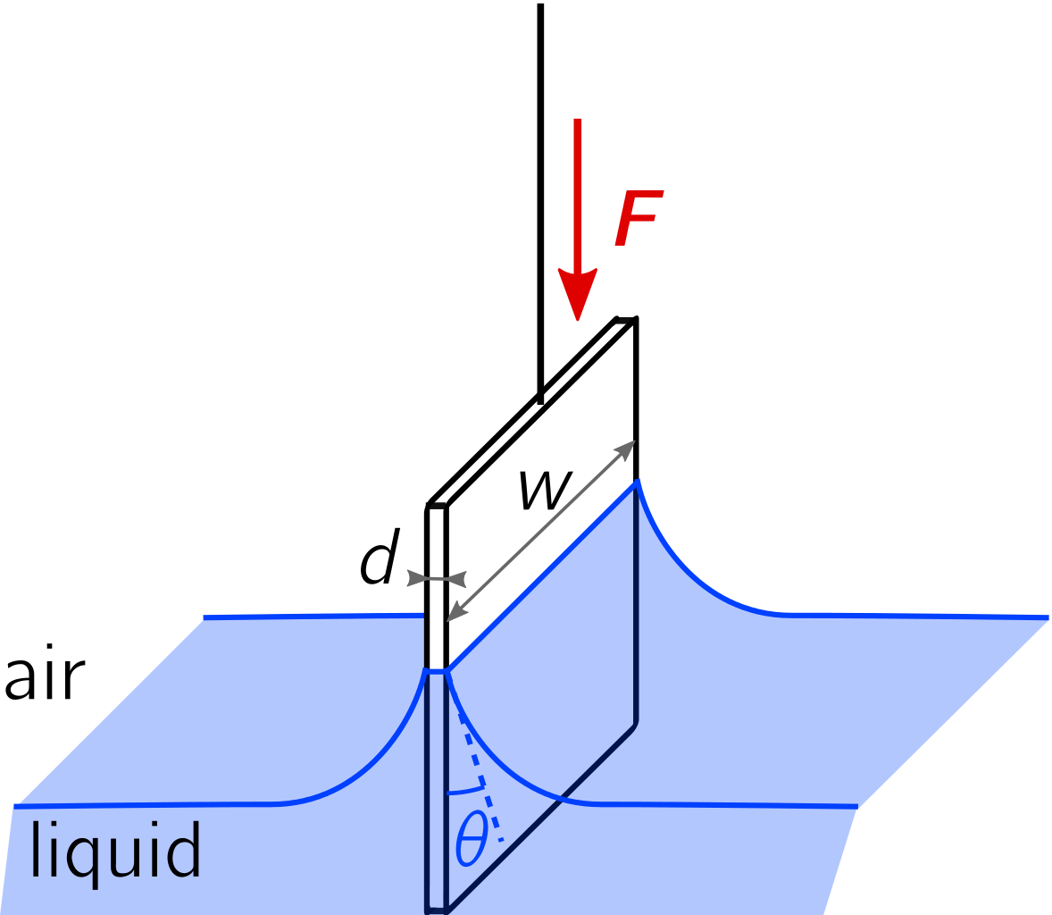
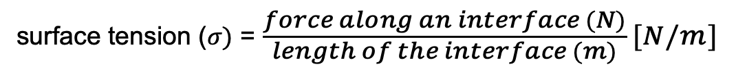
Surface tension is a force along a fluid surface
surface tension ($σ)$ = $\frac{force along an interface (N)}{length of the interface (m)} [N/m]$
All images from Creative Commons. Licensed under CC BY-SA-NC
Notes:
Definition of surface tension

Slide 6
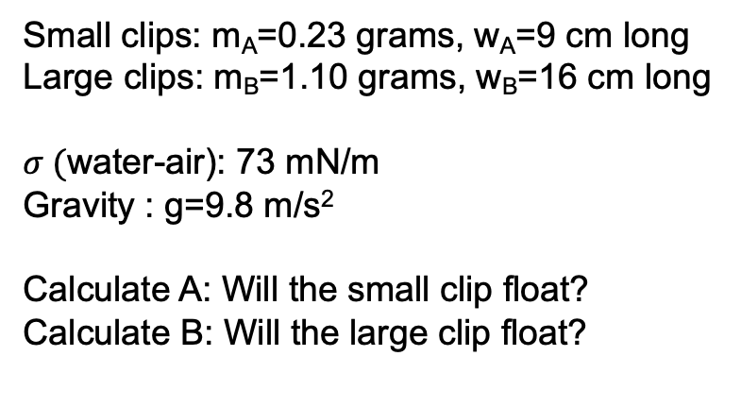
Individual Exercise (5 min): Will it float?
Paper clips on water
Small clips: m_{A}=0.23 grams, w_{A}=9 cm long
Large clips: m_{B}=1.10 grams, w_{B}=16 cm long
$σ ($water-air): 73 mN/m
Gravity : g=9.8 m/s²
Calculate A: Will the small clip float?
Calculate B: Will the large clip float?
surface tension ($σ)$ = $\frac{force along an interface (N)}{length of the interface (m)} [N/m]$
All images from Creative Commons. Licensed under CC BY-SA-NC
Notes:
Next: Discuss with partner (2 min)

Slide 7
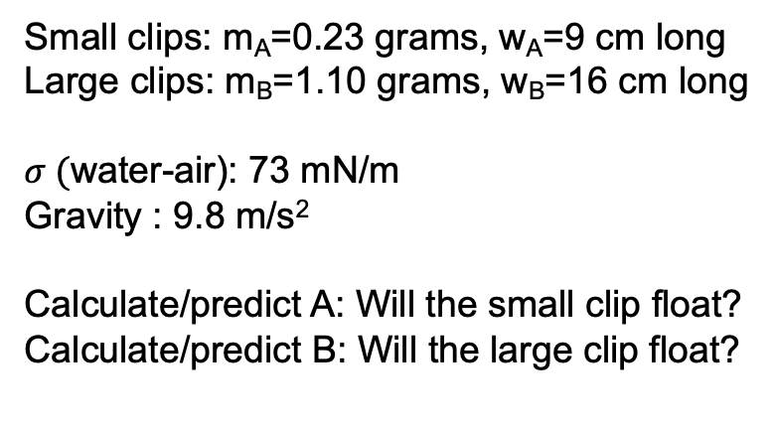
Discuss with partner (2 min): Will it float?
Paper clips on water
Small clips: m_{A}=0.23 grams, w_{A}=9 cm long
Large clips: m_{B}=1.10 grams, w_{B}=16 cm long
$σ ($water-air): 73 mN/m
Gravity : 9.8 m/s²
Calculate/predict A: Will the small clip float?
Calculate/predict B: Will the large clip float?
surface tension ($σ)$ = $\frac{force along an interface (N)}{length of the interface (m)} [N/m]$
All images from Creative Commons. Licensed under CC BY-SA-NC

Slide 8
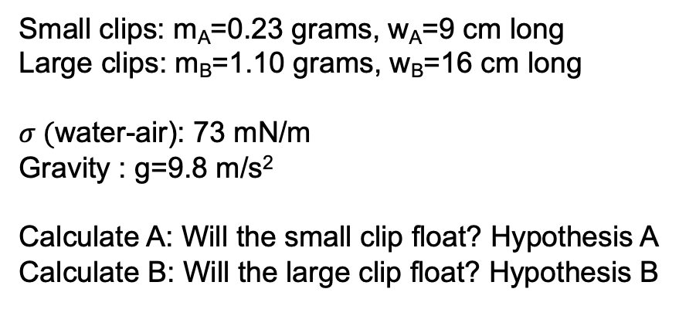
Poll A: Will the small clip float?
Small clips: m_{A}=0.23 grams, w_{A}=9 cm long
Large clips: m_{B}=1.10 grams, w_{B}=16 cm long
$σ ($water-air): 73 mN/m
Gravity : g=9.8 m/s²
Calculate A: Will the small clip float? Hypothesis A
Calculate B: Will the large clip float? Hypothesis B
surface tension ($σ)$ = $\frac{force along an interface (N)}{length of the interface (m)} [N/m]$
All images from Creative Commons. Licensed under CC BY-SA-NC

Slide 9
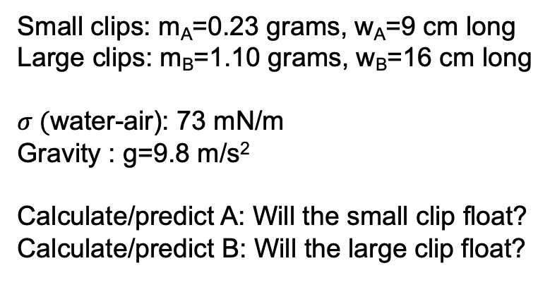
Poll B: Will the large clip float?
Small clips: m_{A}=0.23 grams, w_{A}=9 cm long
Large clips: m_{B}=1.10 grams, w_{B}=16 cm long
$σ ($water-air): 73 mN/m
Gravity : g=9.8 m/s²
Calculate/predict A: Will the small clip float?
Calculate/predict B: Will the large clip float?
surface tension ($σ)$ = $\frac{force along an interface (N)}{length of the interface (m)} [N/m]$
All images from Creative Commons. Licensed under CC BY-SA-NC

Slide 10
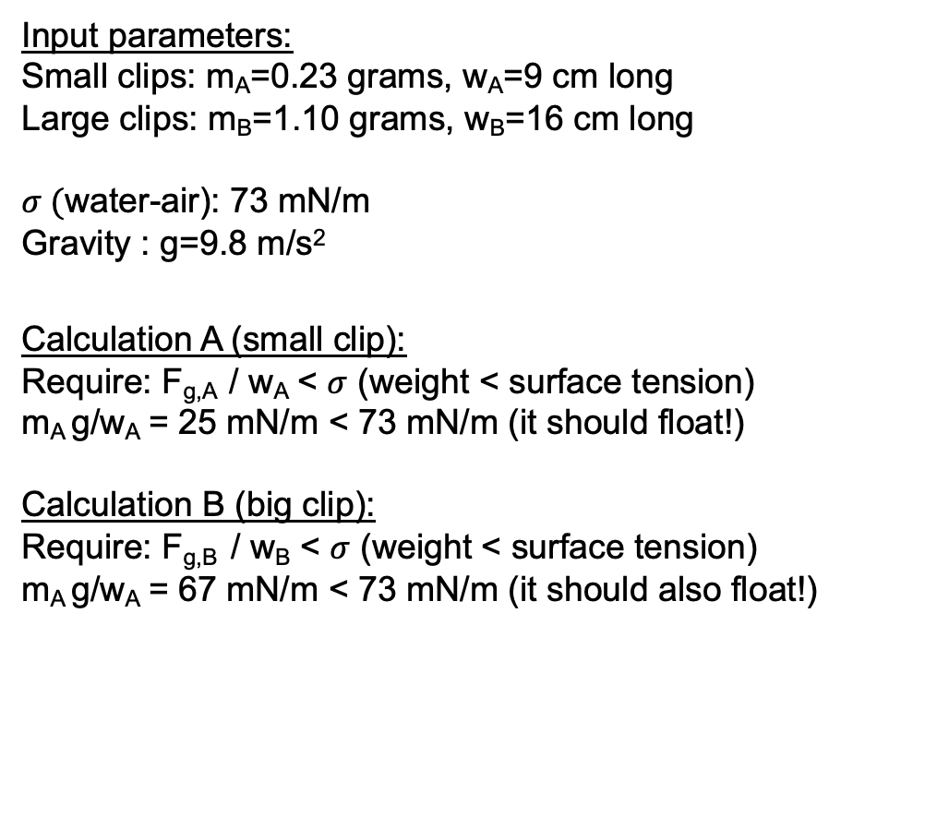
Calculation: Force balance on a paper clip floating on water
Input parameters:
Small clips: m_{A}=0.23 grams, w_{A}=9 cm long
Large clips: m_{B}=1.10 grams, w_{B}=16 cm long
$σ ($water-air): 73 mN/m
Gravity : g=9.8 m/s²
Calculation A (small clip):
Require: F_{g,A} / w_{A} < $σ$ (weight < surface tension)
m_{A} g/w_{A} = 25 mN/m < 73 mN/m (it should float!)
Calculation B (big clip):
Require: F_{g,B} / w_{B} < $σ$ (weight < surface tension)
m_{A} g/w_{A} = 67 mN/m < 73 mN/m (it should also float!)
surface tension ($σ)$ = $\frac{force along an interface (N)}{length of the interface (m)} [N/m]$
All images from Creative Commons. Licensed under CC BY-SA-NC

Slide 11
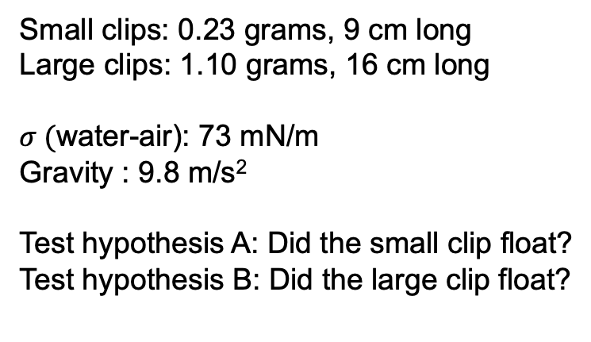
In-class experiment (2 min): Pair with partner.
Grab a large or a small clip
Small clips: 0.23 grams, 9 cm long
Large clips: 1.10 grams, 16 cm long
$σ ($water-air): 73 mN/m
Gravity : 9.8 m/s²
Test hypothesis A: Did the small clip float?
Test hypothesis B: Did the large clip float?
surface tension ($σ)$ = $\frac{force along an interface (N)}{length of the interface (m)} [N/m]$
All images from Creative Commons. Licensed under CC BY-SA-NC

Slide 12
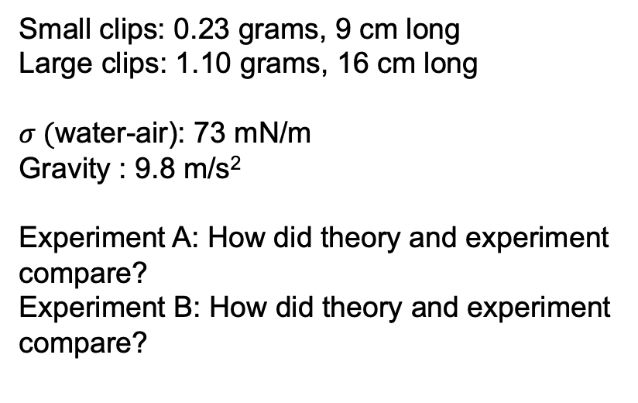
In-class discussion:
Did your experiment confirm your hypothesis?
Small clips: 0.23 grams, 9 cm long
Large clips: 1.10 grams, 16 cm long
$σ ($water-air): 73 mN/m
Gravity : 9.8 m/s²
Experiment A: How did theory and experiment
compare?
Experiment B: How did theory and experiment
compare?
surface tension ($σ)$ = $\frac{force along an interface (N)}{length of the interface (m)} [N/m]$
All images from Creative Commons. Licensed under CC BY-SA-NC
Notes:
At-home exercise: Add a drop of soap to see what happens

Slide 13
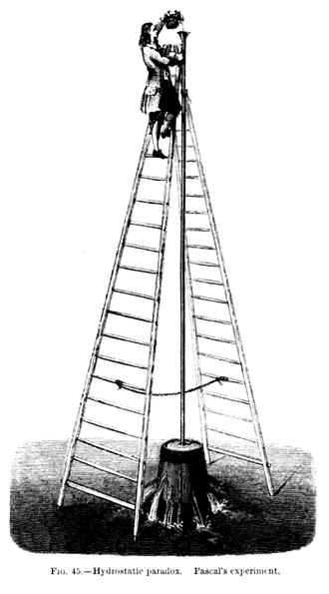
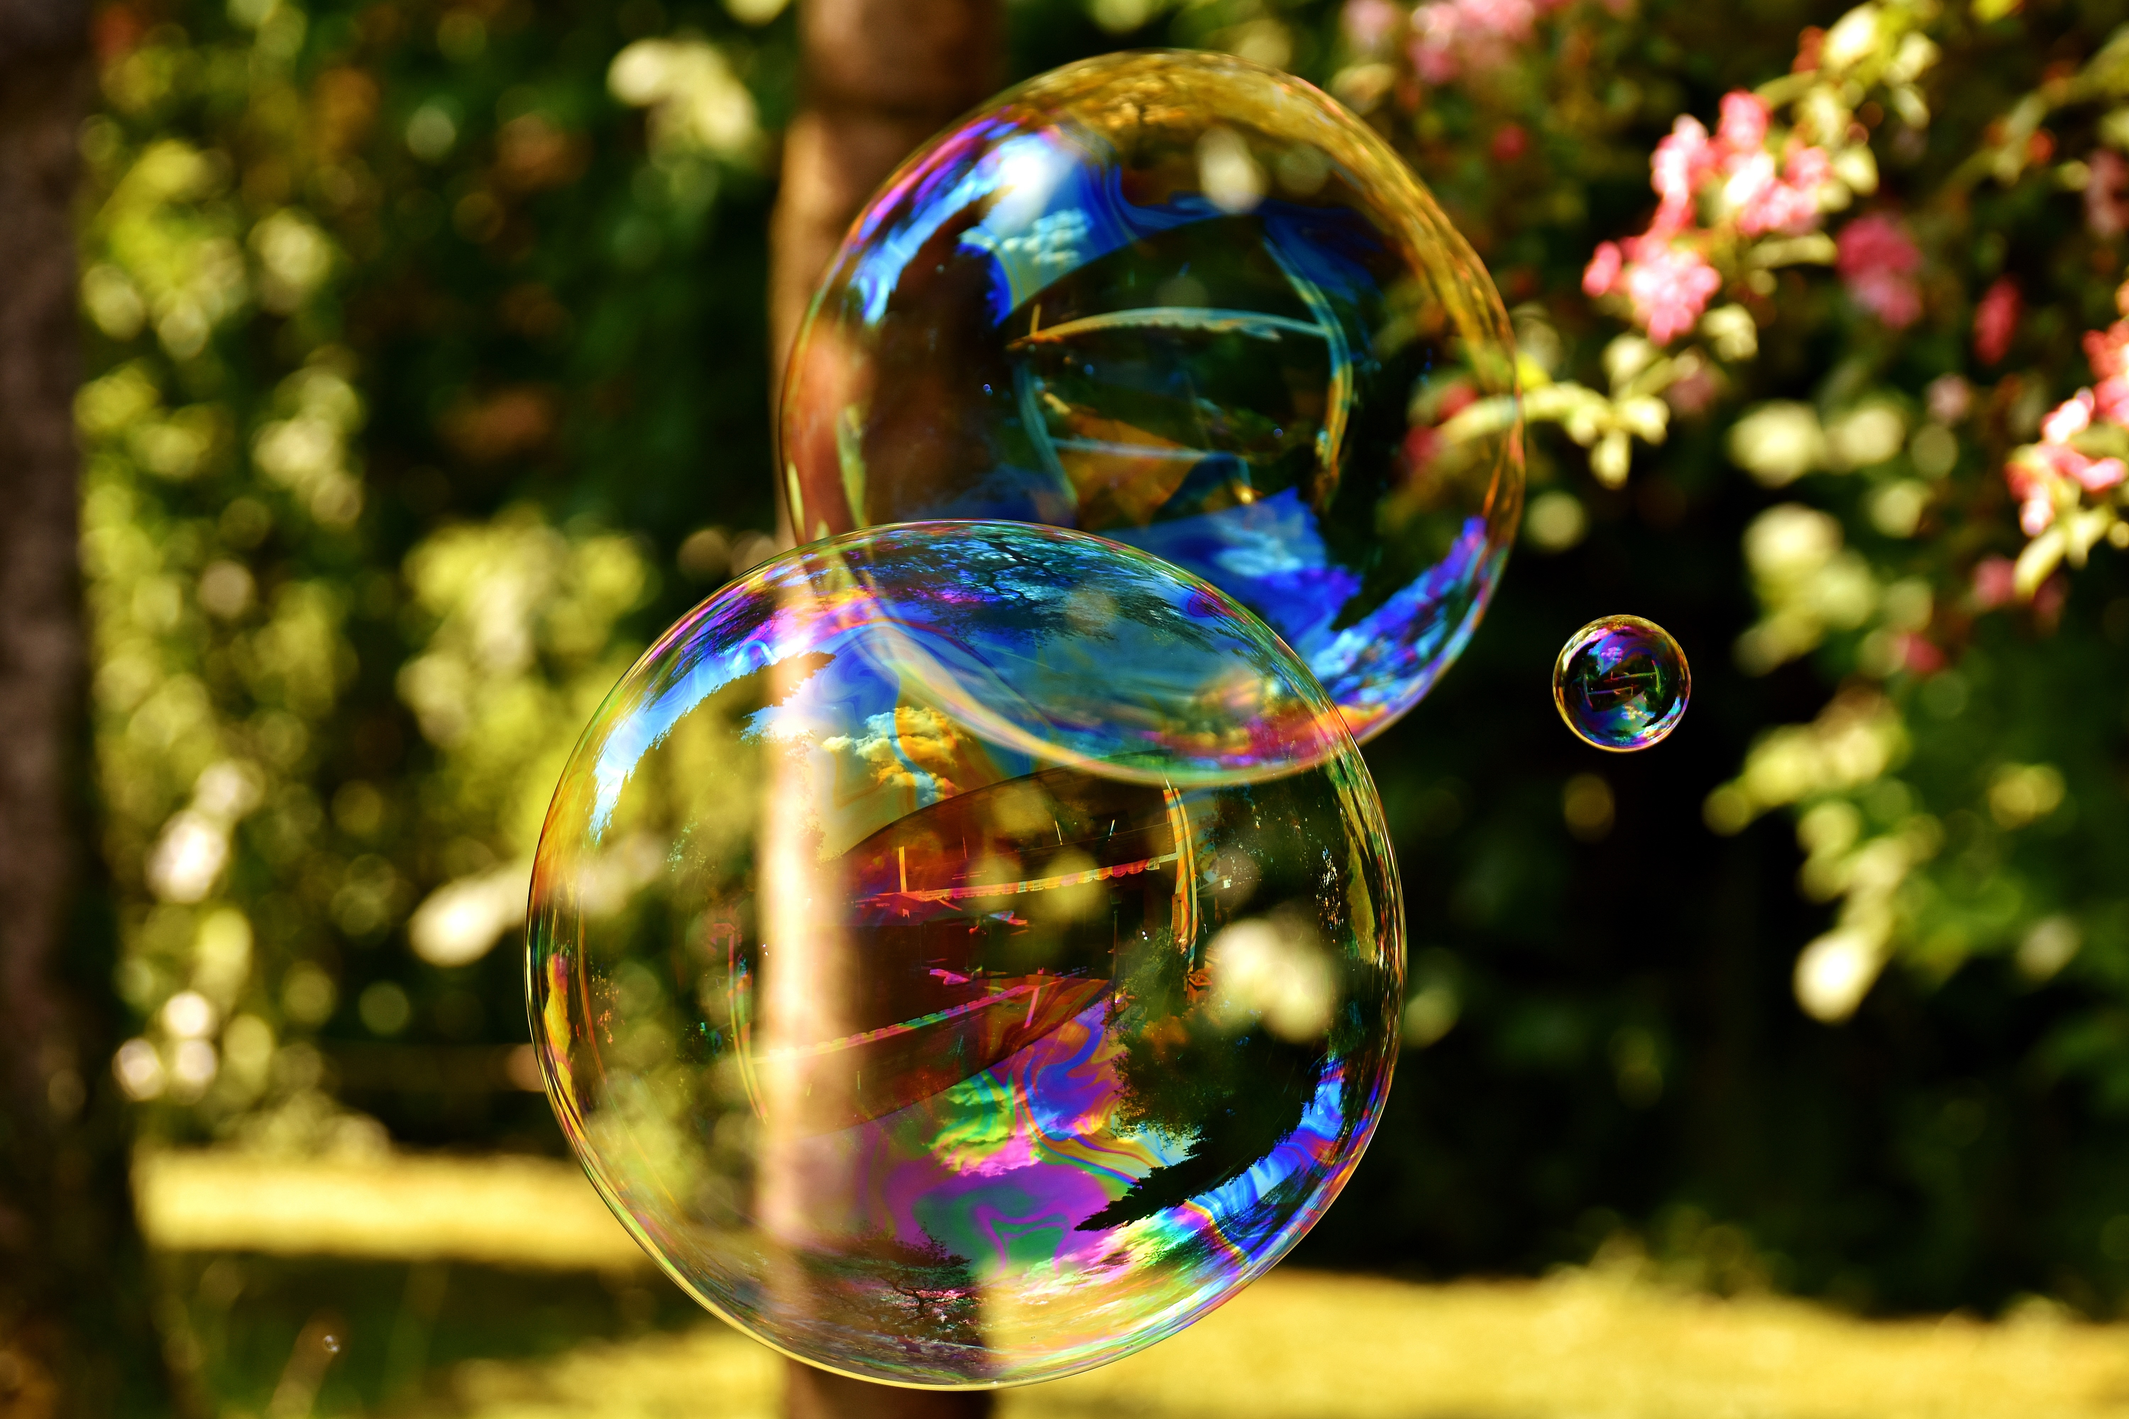
Pressure is a force per unit area (EFM 2.7,3.1-3.2)
Pressure [=] N/m²
Capillary pressure
Pressure inside a bubble is higher than pressure outside (Ex. 2.3, EFM 2.7)
Static pressure (no flow)
Pascal’s exploding bucket
Flow can induce cavitation by bringing pressure below vapor pressure
All images from Creative Commons. Licensed under CC BY-SA-NC
Vapor pressure = damptrykk
Notes:
Siste før pausen: Labassistentene informerer!
Etter pausen: trykk! Trykk en en normalkraft fordelt på et areal. Tegnestift (same kraft, ulikt areal). Barometer: 1 bar = 100kPa (1 atm = 1.01 bar = weight of the atmosphere at sea level at 25 ºC ). Hydrostatisk trykk: p = rho(T)*g*h (Pascals prinsipp. Experiment: Pascal’s barrel).
Strømning:
Undertrykk (vacuum pressure) = differansen mellom et referansetrykk og et lavere trykk i systemet : prinsippet for vacuumpumper, seiling (mot vinden), helikoptere?, …
Differensialtrykk $Δ$p(differential pressure): p_{A} – p_{B} > 0. Damptrykk:
We live submerged at the bottom of an ocean of the element air, which by unquestioned experiments is known to have weight. (Evangelista Torricelli, 1608-1647)
In Aerodynamics, L.J. Clancy[7] writes: "To distinguish it from the total and dynamic pressures, the actual pressure of the fluid, which is associated not with its motion but with its state, is often referred to as the static pressure, but where the term pressure alone is used it refers to this static pressure."

Slide 14
Four main types of static pressures:
Capillary, hydrostatic, gauge, and absolute pressure
(EFM 2.7, 3.1-3.2)
Pressure?
Hydrostatic pressure
Pressure due to the weight of a column of fluid
All images from Creative Commons. Licensed under CC BY-SA-NC
Vapor pressure = damptrykk
Notes:
Siste før pausen: Labassistentene informerer!
Etter pausen: trykk! Trykk en en normalkraft fordelt på et areal. Tegnestift (same kraft, ulikt areal). Barometer: 1 bar = 100kPa (1 atm = 1.01 bar = weight of the atmosphere at sea level at 25 ºC ). Hydrostatisk trykk: p = rho(T)*g*h (Pascals prinsipp. Experiment: Pascal’s barrel).
Strømning:
Undertrykk (vacuum pressure) = differansen mellom et referansetrykk og et lavere trykk i systemet : prinsippet for vacuumpumper, seiling (mot vinden), helikoptere?, …
Differensialtrykk $Δ$p(differential pressure): p_{A} – p_{B} > 0. Damptrykk:
We live submerged at the bottom of an ocean of the element air, which by unquestioned experiments is known to have weight. (Evangelista Torricelli, 1608-1647)
In Aerodynamics, L.J. Clancy[7] writes: "To distinguish it from the total and dynamic pressures, the actual pressure of the fluid, which is associated not with its motion but with its state, is often referred to as the static pressure, but where the term pressure alone is used it refers to this static pressure."

Slide 15
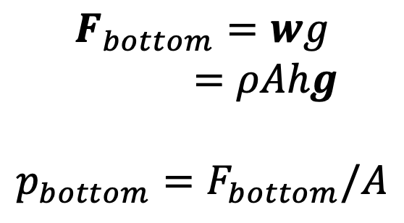
Static pressures: Hydrostatic pressure is the pressure due to the weight of a column of fluid (EFM 3.1-3.2)
$$F_{bottom}=wg$$
$=ρAhg$
$$p_{bottom}=F_{bottom}/A$$
Pressure?
Hydrostatic pressure
Pressure due to the weight of a column of fluid
All images from Creative Commons. Licensed under CC BY-SA-NC
Vapor pressure = damptrykk
Notes:
Siste før pausen: Labassistentene informerer!
Etter pausen: trykk! Trykk en en normalkraft fordelt på et areal. Tegnestift (same kraft, ulikt areal). Barometer: 1 bar = 100kPa (1 atm = 1.01 bar = weight of the atmosphere at sea level at 25 ºC ). Hydrostatisk trykk: p = rho(T)*g*h (Pascals prinsipp. Experiment: Pascal’s barrel).
Strømning:
Undertrykk (vacuum pressure) = differansen mellom et referansetrykk og et lavere trykk i systemet : prinsippet for vacuumpumper, seiling (mot vinden), helikoptere?, …
Differensialtrykk $Δ$p(differential pressure): p_{A} – p_{B} > 0. Damptrykk:
We live submerged at the bottom of an ocean of the element air, which by unquestioned experiments is known to have weight. (Evangelista Torricelli, 1608-1647)
In Aerodynamics, L.J. Clancy[7] writes: "To distinguish it from the total and dynamic pressures, the actual pressure of the fluid, which is associated not with its motion but with its state, is often referred to as the static pressure, but where the term pressure alone is used it refers to this static pressure."

Slide 16
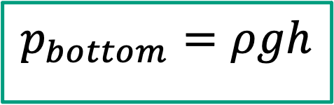
Static pressures: Hydrostatic pressure is the pressure due to the weight of a column of fluid (EFM 3.1-3.2)
$$F_{bottom}=wg$$
$=ρAhg$
$$p_{bottom}=F_{bottom}/A$$
Pressure?
$$p_{bottom}=ρgh$$
Hydrostatic pressure
Pressure due to the weight of a column of fluid
All images from Creative Commons. Licensed under CC BY-SA-NC
Vapor pressure = damptrykk
Notes:
Siste før pausen: Labassistentene informerer!
Etter pausen: trykk! Trykk en en normalkraft fordelt på et areal. Tegnestift (same kraft, ulikt areal). Barometer: 1 bar = 100kPa (1 atm = 1.01 bar = weight of the atmosphere at sea level at 25 ºC ). Hydrostatisk trykk: p = rho(T)*g*h (Pascals prinsipp. Experiment: Pascal’s barrel).
Strømning:
Undertrykk (vacuum pressure) = differansen mellom et referansetrykk og et lavere trykk i systemet : prinsippet for vacuumpumper, seiling (mot vinden), helikoptere?, …
Differensialtrykk $Δ$p(differential pressure): p_{A} – p_{B} > 0. Damptrykk:
We live submerged at the bottom of an ocean of the element air, which by unquestioned experiments is known to have weight. (Evangelista Torricelli, 1608-1647)
In Aerodynamics, L.J. Clancy[7] writes: "To distinguish it from the total and dynamic pressures, the actual pressure of the fluid, which is associated not with its motion but with its state, is often referred to as the static pressure, but where the term pressure alone is used it refers to this static pressure."

Slide 17
Excercise: Individual (2 min) + pair wise (1 min): What is the hydrostatic pressure 10 meters below sea level in bars?
Useful info:
1 bar = 100 kPa
Seawater is heavier than
freshwater due to dissolved salt ions
$$F_{bottom}=wg$$
$=ρAhg$
$$p_{bottom}=F_{bottom}/A$$
Pressure?
$$p_{bottom}=ρgh$$
Hydrostatic pressure
Pressure due to the weight of a column of fluid
All images from Creative Commons. Licensed under CC BY-SA-NC

Slide 18
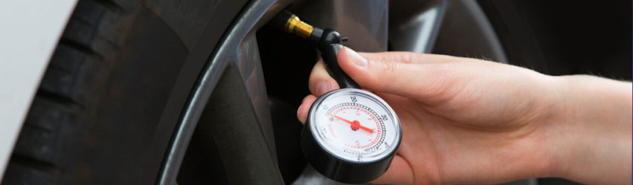
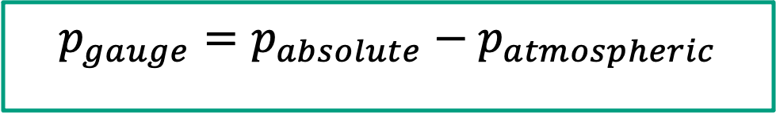
Static pressures: Gauge pressure is the pressure relative to the ambient atmospheric pressure
The tire pressure is a gauge pressure and is measured relative to the atmospheric pressure
The absolute pressure is the actual pressure inside the tire
$$p_{gauge}=p_{absolute}−p_{atmospheric}$$
Gauge pressure = overtrykk
All images from Creative Commons. Licensed under CC BY-SA-NC

Slide 19
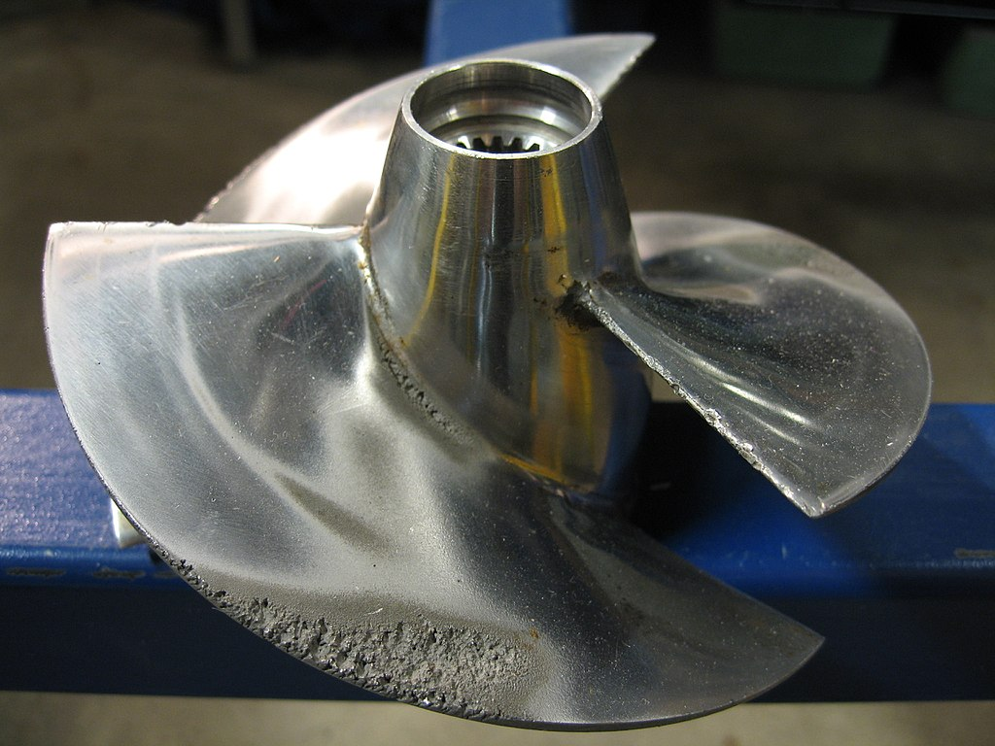
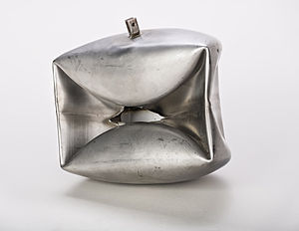
Fluid flow leads to a pressure reduction which can induce boiling. This, in turn, leads to cavitation and water hammers
Cavitation in rotating machinery
Implosion induced by a
water hammer
All images from Creative Commons. Licensed under CC BY-SA-NC

Slide 20
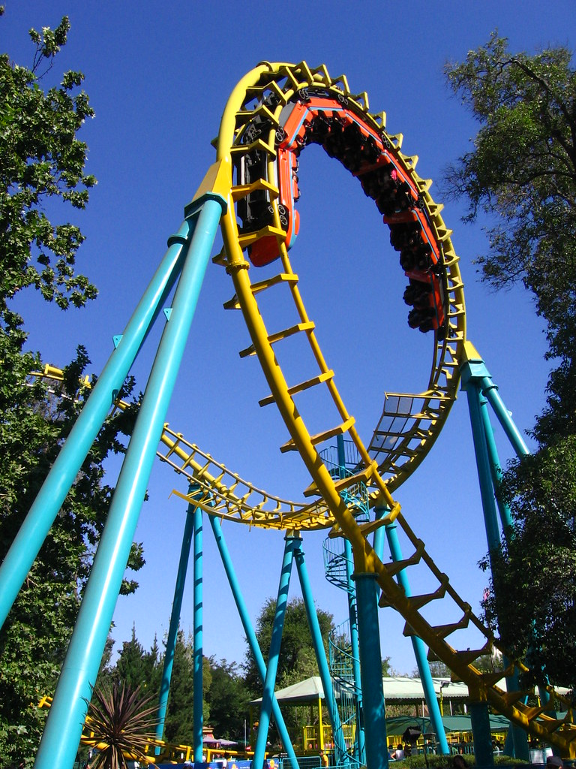
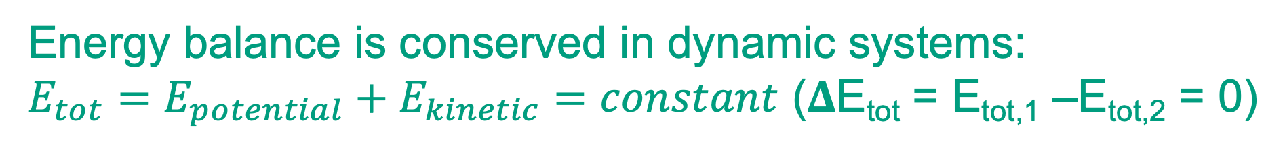
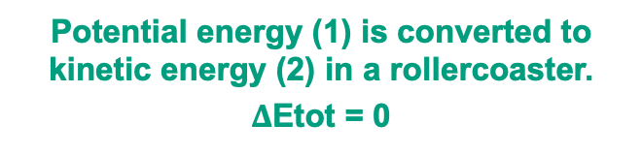
Energy balance is conserved in dynamic systems:
$E_{tot}=E_{potential}+E_{kinetic}=constant$ ($Δ$E_{tot} = E_{tot,1} –E_{tot,2} = 0)
(1): E_{potential} = mgh
h
(2): E_{kinetic}=1/2mu²
Potential energy (1) is converted to kinetic energy (2) in a rollercoaster.
$Δ$Etot = 0
All images from Creative Commons. Licensed under CC BY-SA-NC

Slide 21
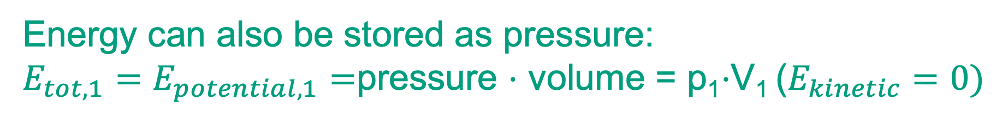
Energy can also be stored as pressure:
${E_{tot,1}=E}_{potential,1}=$pressure $⋅$ volume = p₁$⋅$V₁ ($E_{kinetic}=0)$
(1): E_{potential} = mgh
p
p₁
p_{ref} = 0
h
Pressure p₁ inside a close container with volume V₁
_{Kinetic energy is zero}
(2): E_{kinetic}=1/2mu²
Potential energy (1) is converted to kinetic energy (2) in a rollercoaster
All images from Creative Commons. Licensed under CC BY-SA-NC

Slide 22
Energy can also be stored as pressure:
${E_{tot,1}=E}_{potential,1}=$pressure $⋅$ volume = p₁$⋅$V₁ ($E_{kinetic}=0)$
(1): E_{potential} = mgh
p
p₁
p_{ref} = 0
h
What is we punch a hole in the wall between the containers?
Pressure p₁ inside a close container with volume V₁
_{Kinetic energy is zero}
(2): E_{kinetic}=1/2mu²
Potential energy (1) is converted to kinetic energy (2) in a rollercoaster
All images from Creative Commons. Licensed under CC BY-SA-NC

Slide 23
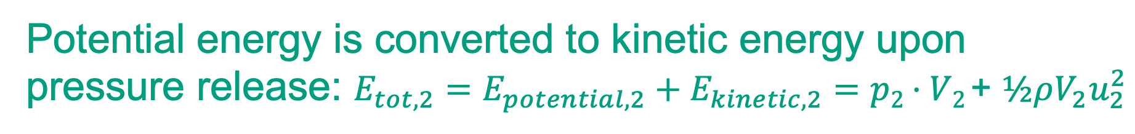
Potential energy is converted to kinetic energy upon pressure release: ${E_{tot,2}=E}_{potential,2}+E_{kinetic,2}=$ $p2⋅V2$+ $½ρV_{2}u_{2}^{2}$
(1): E_{potential} = mgh
p
p₂< p₁
p₂< p₁
h
Kinetic flow energy: 1/2mu²
(2): E_{kinetic}=1/2mu²
Potential energy (1) is converted to kinetic energy (2) in a rollercoaster
All images from Creative Commons. Licensed under CC BY-SA-NC

Slide 24

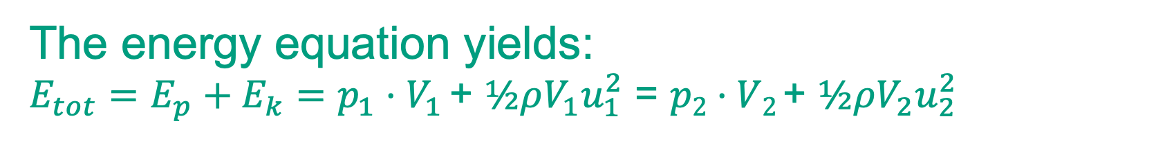

The energy equation yields:
${E_{tot}=E}_{p}+E_{k}=$ $p_{1}⋅V_{1}$+ $½ρV_{1}u_{1}^{2}$ = $p2⋅V2$+ $½ρV_{2}u_{2}^{2}$
$$E_{p,1}+E_{k,1}$$
$$E_{p,2}+E_{k,2}$$
(1): E_{potential} = mgh
p
p₂< p₁
p₂< p₁
h
Kinetic flow energy: 1/2mu²
(2): E_{kinetic}=1/2mu²
Potential energy (1) is converted to kinetic energy (2) in a rollercoaster
All images from Creative Commons. Licensed under CC BY-SA-NC

Slide 25

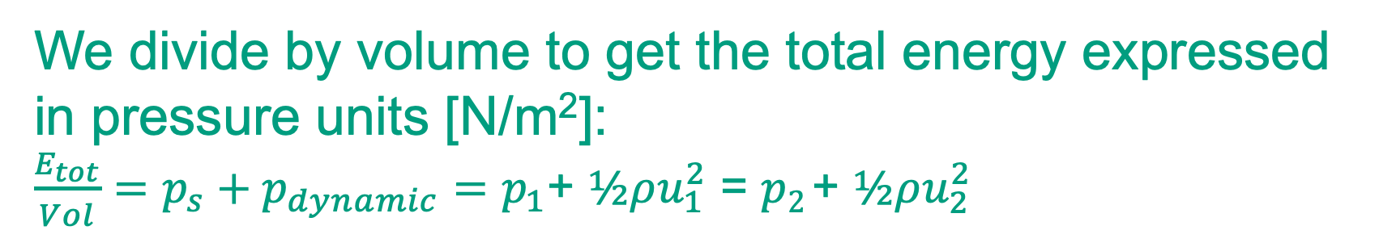

We divide by volume to get the total energy expressed in pressure units [N/m²]:
${\frac{E_{tot}}{Vol}=p}_{s}+p_{dynamic}=$ $p_{1}$+ $½ρu_{1}^{2}$ = $p2$+ $½ρu_{2}^{2}$
$$p_{s,1}+p_{dyn,1}$$
$$E_{p,2}+E_{k,2}$$
(1): E_{potential} = mgh
p
p₂< p₁
p₂< p₁
h
Kinetic flow energy: 1/2mu²
(2): E_{kinetic}=1/2mu²
Potential energy (1) is converted to kinetic energy (2) in a rollercoaster
All images from Creative Commons. Licensed under CC BY-SA-NC

Slide 26
We divide by volume to get the total energy expressed in pressure units [N/m²]:
${\frac{E_{tot}}{Vol}=p}_{s}+p_{dynamic}=$ $p_{1}$+ $½ρu_{1}^{2}$ = $p2$+ $½ρu_{2}^{2}$
$$p_{s,1}+p_{dyn,1}$$
$$E_{p,2}+E_{k,2}$$
(1): E_{potential} = mgh
In words: When the velocity goes up,
the pressure goes down (and vice-versa).
p
h
p₂
Flow energy: 1/2mu²
(2): E_{kinetic}=1/2mu²
Potential energy (1) is converted to kinetic energy (2) in a rollercoaster
All images from Creative Commons. Licensed under CC BY-SA-NC

Slide 27
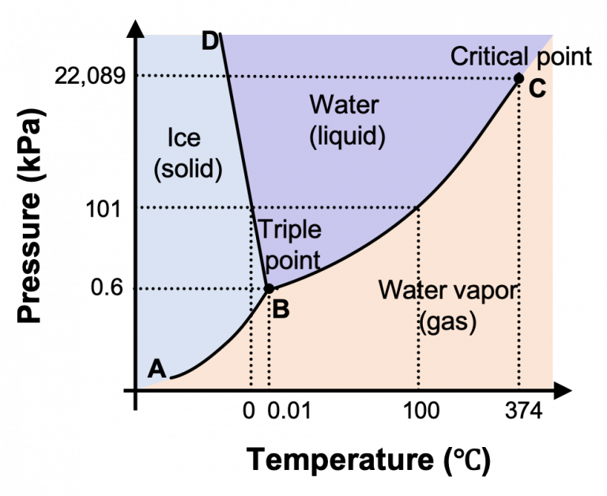
EFM 2.7: Vapor pressure is the pressure at which the liquid and vapor phase are in thermal equilibrium
Cavitation: Boiling at low pressure
Pressure < vapor pressure
Phase diagram for water
What’s the phase for a given T, p?
All images from Creative Commons. Licensed under CC BY-SA-NC
Vapor pressure = damptrykk
Notes:
Siste før pausen! Summen av statisk og dynamisk trykk er konstant (langs en strømlinje) i en tapsfri strømning (dvs. hvor vi kan se bort fra friksjon, i.e. høye Re). Means: The vapor and liquid phase coexist at a fixed temperature (there is no exchange of energy within the system).

