Slide 1
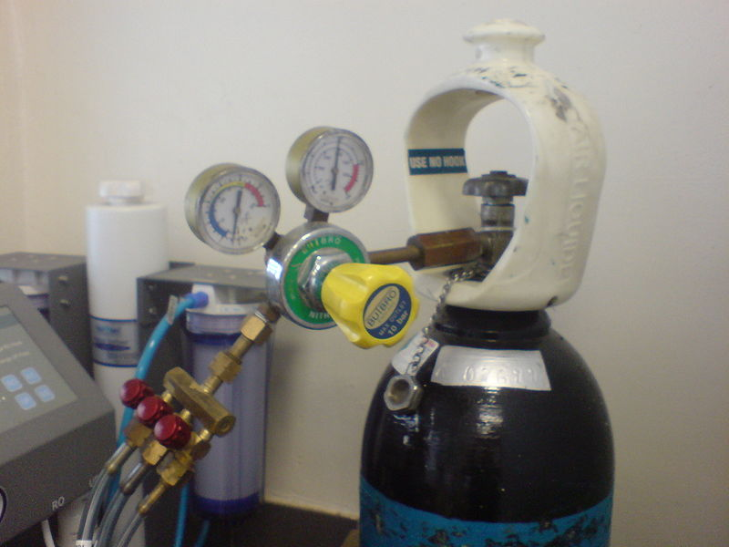
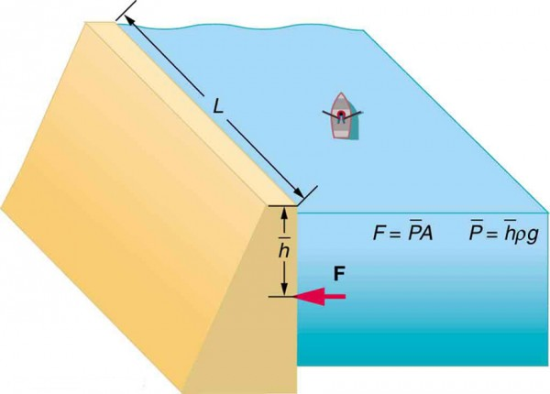
Feb 2nd 2022: 3rd lecture in fluid mechanics
Measuring pressure
EFM 3.3 + 3.2
Credit: Creative Commons
The pressure force on a flat surface (EFM 3.4)
Credit: Creative Commons

Slide 2
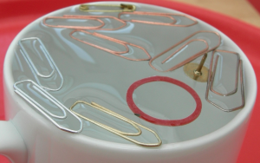

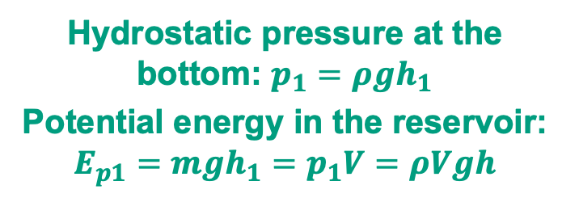
We can store energy as a hydrostatic pressure in a reservoir filled with a liquid (EFM 3.2)
Floating objects
$$density: ρ$$
h₁
Volume: V₁
Hydrostatic pressure at the bottom: $p_{1}=ρgh_{1}$
Potential energy in the reservoir: $E_{p1}=mgh_{1}=p_{1}V=ρVgh$
Notes:
Surface tension minimizes surface area

Slide 3

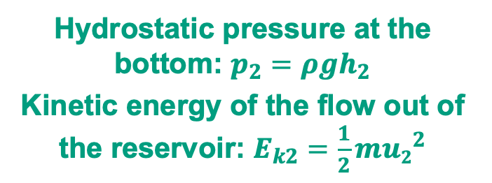
We convert potential energy to kinetic (flow) energy when we release the pressure (EFM 3.2)
Floating objects
$$density: ρ$$
$$density: ρ$$
h₁
h₂
Volume: V₁
Volume: V₂
Hydrostatic pressure at the bottom: $p_{1}=ρgh_{1}$
Potential energy in the reservoir: $E_{p1}=mgh_{1}=p_{1}V=ρVgh$
Hydrostatic pressure at the bottom: $p_{2}=ρgh_{2}$
Kinetic energy of the flow out of the reservoir: $E_{k2}=\frac{1}{2}m{u2}^{2}$
Flow
velocity: u₂
Notes:
Surface tension minimizes surface area

Slide 4
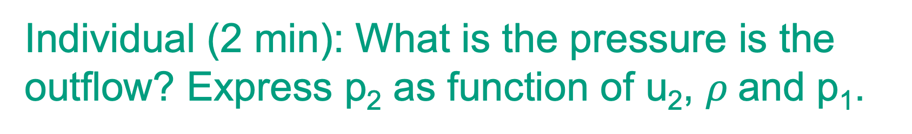
Individual (2 min): What is the pressure is the outflow? Express p₂ as function of u₂, $ρ$and p₁.
Floating objects
$$density: ρ$$
$$density: ρ$$
What’s the
pressure here
(p₂)?
h₁
h₂
Volume: V₁
Volume: V₂
Hydrostatic pressure at the bottom: $p_{1}=ρgh_{1}$
Potential energy in the reservoir: $E_{p1}=mgh_{1}=p_{1}V=ρVgh$
Hydrostatic pressure at the bottom: $p_{2}=ρgh_{2}$
Kinetic energy of the flow out of the reservoir: $E_{k2}=\frac{1}{2}m{u2}^{2}$
Flow
velocity: u₂
Notes:
Surface tension minimizes surface area

Slide 5
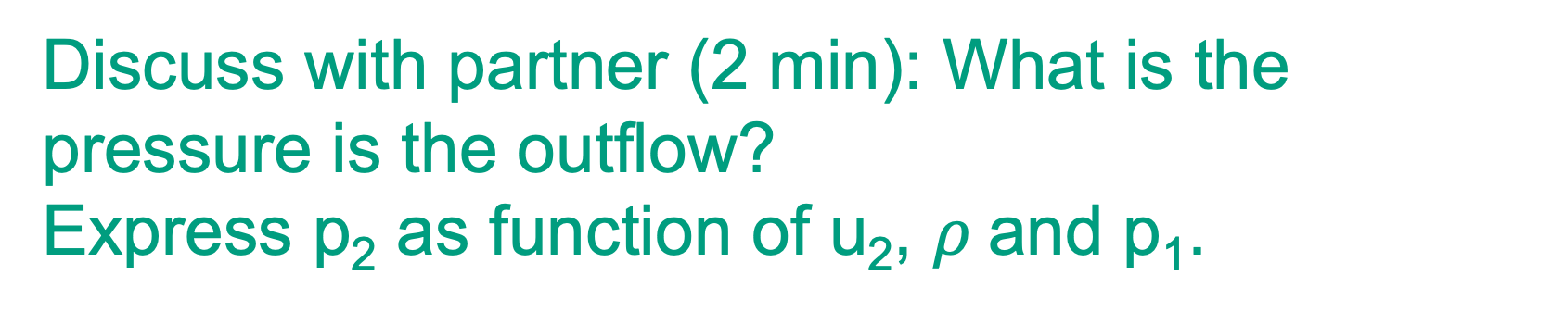
Discuss with partner (2 min): What is the pressure is the outflow?
Express p₂ as function of u₂, $ρ$and p₁.
Floating objects
$$density: ρ$$
$$density: ρ$$
What’s the
pressure here
(p₂)?
h₁
h₂
Volume: V₁
Volume: V₂
Hydrostatic pressure at the bottom: $p_{1}=ρgh_{1}$
Potential energy in the reservoir: $E_{p1}=mgh_{1}=p_{1}V=ρVgh$
Hydrostatic pressure at the bottom: $p_{2}=ρgh_{2}$
Kinetic energy of the flow out of the reservoir: $E_{k2}=\frac{1}{2}m{u2}^{2}$
Flow
velocity: u₂
Notes:
Surface tension minimizes surface area

Slide 6

Kahoot!: What is the pressure p₂ in the outflow, expressed as function of u₂, $ρ$and p₁?
Floating objects
Notes:
Surface tension minimizes surface area

Slide 7
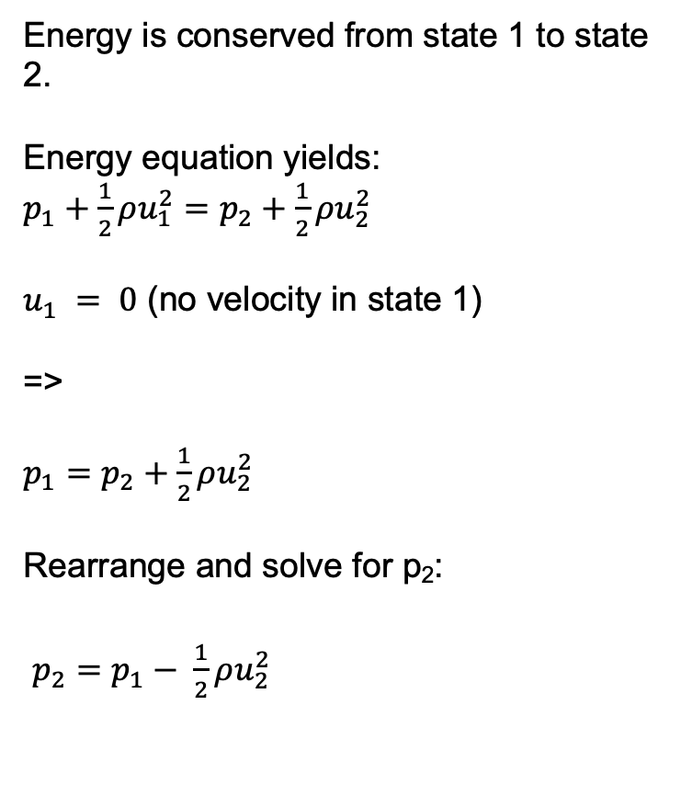
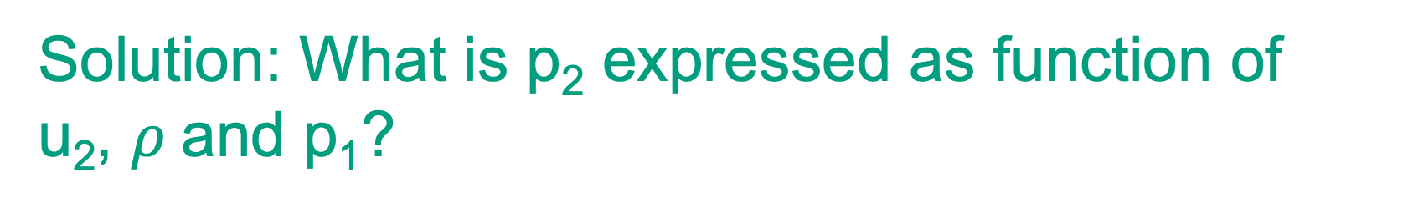
Solution: What is p₂ expressed as function of u₂, $ρ$and p₁?
Floating objects
Energy is conserved from state 1 to state 2.
Energy equation yields:
$p_{1}+\frac{1}{2}ρu_{1}^{2}=p_{2}+\frac{1}{2}ρu_{2}^{2}$
$u_{1} = 0$ (no velocity in state 1)
=>
$p_{1}=p_{2}+\frac{1}{2}ρu_{2}^{2}$
Rearrange and solve for p₂:
$p_{2}=p_{1}− \frac{1}{2}ρu_{2}^{2}$
$$density: ρ$$
What’s the
pressure here
(p₂)?
h₂
Volume: V₂
Hydrostatic pressure at the bottom: $p_{2}=ρgh_{2}$
Kinetic energy of the flow out of the reservoir: $E_{k2}=\frac{1}{2}m{u2}^{2}$
Flow
velocity: u₂
Notes:
Surface tension minimizes surface area

Slide 8
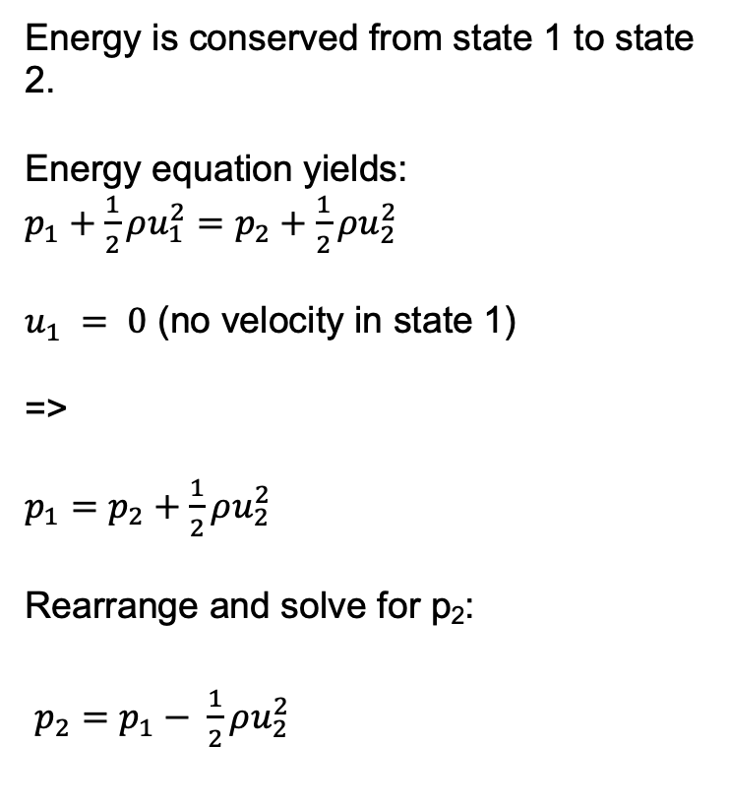
Floating objects
Discuss in class: How would you measure u₂?
Energy is conserved from state 1 to state 2.
Energy equation yields:
$p_{1}+\frac{1}{2}ρu_{1}^{2}=p_{2}+\frac{1}{2}ρu_{2}^{2}$
$u_{1} = 0$ (no velocity in state 1)
=>
$p_{1}=p_{2}+\frac{1}{2}ρu_{2}^{2}$
Rearrange and solve for p₂:
$p_{2}=p_{1}− \frac{1}{2}ρu_{2}^{2}$
$$density: ρ$$
What’s the
velocity here
(u₂)?
h₂
Volume: V₂
Hydrostatic pressure at the bottom: $p_{2}=ρgh_{2}$
Kinetic energy of the flow out of the reservoir: $E_{k2}=\frac{1}{2}m{u2}^{2}$
Flow
velocity: u₂
How would you measure the velocity u₂?
Notes:
Surface tension minimizes surface area

Slide 9
Floating objects
Individual (2 min): How would you measure p₂
if you don’t know p₁? Hint: you may modify the geometry
at the outlet and use the hydrostatic pressure balance ☺
$$density: ρ$$
What’s the
pressure here
(p₂)?
h₂
Volume: V₂
Hydrostatic pressure at the bottom: $p_{2}=ρgh_{2}$
Kinetic energy of the flow out of the reservoir: $E_{k2}=\frac{1}{2}m{u2}^{2}$
Flow
velocity: u₂
Notes:
Surface tension minimizes surface area

Slide 10
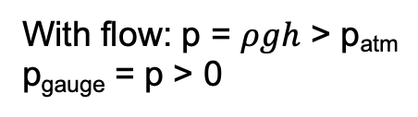
Floating objects
Solution: If you don’t know p₁ you could
measure p₂ with a piezometer (EFM 3.3)
p_{atm}
No flow: p = p_{atm}
p_{gauge} = 0
$$density: ρ$$
What’s the
pressure here
(p₂)?
h₂
Volume: V₂
h
p_{atm}
Hydrostatic pressure at the bottom: $p_{2}=ρgh_{2}$
Kinetic energy of the flow out of the reservoir: $E_{k2}=\frac{1}{2}m{u2}^{2}$
Flow
velocity: u₂
With flow: p = $ρgh$ > p_{atm}
p_{gauge} = p > 0

Slide 11
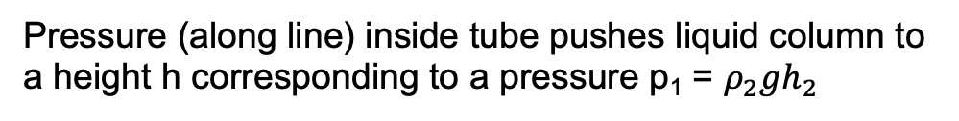



Floating objects
But what if you flow a gas instead of a liquid
through the pipe? Use a U-tube manometer (EFM 3.3)
$$density: ρ$$
What’s the
pressure here
(p₂)?
p₁ = $ρ_{2}gh_{2}$
$${Gas: ρ}_{1}≪ρ_{2}$$
h₂
h
Volume: V₂
$$ρ_{2}$$
h₂
Hydrostatic pressure at the bottom: $p_{2}=ρgh_{2}$
Kinetic energy of the flow out of the reservoir: $E_{k2}=\frac{1}{2}m{u2}^{2}$
Flow
velocity: u₂
Pressure (along line) inside tube pushes liquid column to
a height h corresponding to a pressure p₁ = $ρ_{2}gh_{2}$

Slide 12

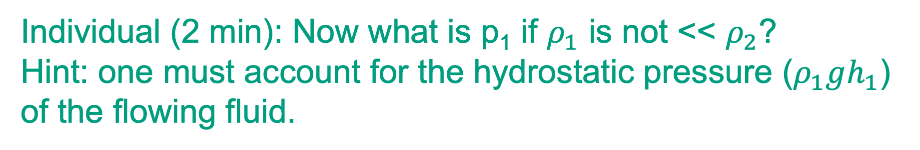


Floating objects
Individual (2 min): Now what is p₁ if $ρ_{1}$ is not << $ρ_{2}$?
Hint: one must account for the hydrostatic pressure ($ρ_{1}gh_{1}$)
of the flowing fluid.
Measurement point
$$density: ρ$$
What’s the
pressure here
(p₂)?
p₁ = $?$
.
$${Fluid: ρ}_{1}≈ρ_{2}$$
h₂
h
Volume: V₂
h₁
$$ρ_{2}$$
h₂
Hydrostatic pressure at the bottom: $p_{2}=ρgh_{2}$
Kinetic energy of the flow out of the reservoir: $E_{k2}=\frac{1}{2}m{u2}^{2}$
Flow
velocity: u₂
What is the pressure p₁ if $ρ_{1}≈ρ_{2}$?

Slide 13
Floating objects
Hint: The pressure is the same along the horizontal line
Measurement point
$$density: ρ$$
What’s the
pressure here
(p₂)?
p₁ = $?$
.
$${Fluid: ρ}_{1}≈ρ_{2}$$
h₂
h
Volume: V₂
h₁
$$ρ_{2}$$
h₂
Hydrostatic pressure at the bottom: $p_{2}=ρgh_{2}$
Kinetic energy of the flow out of the reservoir: $E_{k2}=\frac{1}{2}m{u2}^{2}$
Flow
velocity: u₂
What is the pressure p₁ if $ρ_{1}≈ρ_{2}$?

Slide 14
Floating objects
The pressure force on a flat surface (EFM 3.4) and
what it can do to dams….
Hydrostatic forces
Notes:
https://www.youtube.com/watch?v=KNOhSoeEJqw (start: 0:0 end 1:30)

Slide 15
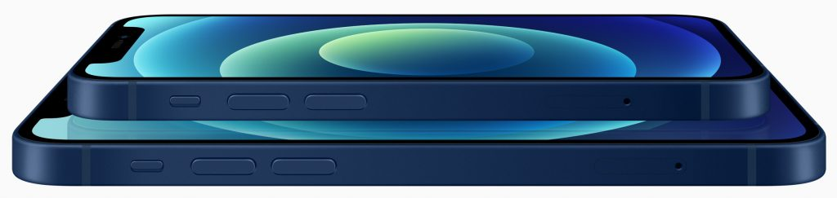
Floating objects
Quiz1: A cell phone lies on the bottom of a glass of
water (oooops!). What’s the right pressure distribution?
p
p
(a)
(b)
p
p
(c)
Image credit: Creative Commons
(d)
Notes:
https://www.youtube.com/watch?v=KNOhSoeEJqw (start: 0:0 end 1:30)

Slide 16
Floating objects
Quiz2: The pressure force, F_{p}, acts in the center of
pressure (CP). What’s the direction and location of F_{p}?
F_{p}
F_{p}
(a)
(b)
F_{p}
F_{p}
(c)
Image credit: Creative Commons
(d)

Slide 17
Floating objects
Quiz3: True or false? For a uniform pressure
distribution, the pressure force is F_{p.} The value of F_{p}=pA.
Image credit: Creative Commons

Slide 18
Floating objects
Quiz4: What type of pressure is F_{p} = pA for the
submerged phone?
Atmospheric pressure
Hydrostatic pressure
(a)
(b)
Gauge pressure
Osmotic pressure
(c)
Image credit: Creative Commons
(d)

Slide 19
Floating objects
How was your score? Class-assessment: Quiz 1 to 4

Slide 20
Floating objects
How was your score? Class-assessment: Quiz 1
Quiz 1: What’s the pressure distribution on the cell phone on the bottom (right answer: a):
p
Explanation:
The pressure acts normal to the surface (cell phone) and is uniform
Image credit: Creative Commons

Slide 21
Floating objects
How was your score? Class-assessment: Quiz 2
Quiz 1: What’s the pressure distribution on the cell phone on the bottom (right answer: a):
Quiz 2: What’s the direction and location of the force from pressure in Quiz 1 (right answer: a):
p
F_{p}
Explanation:
The pressure acts normal to the surface (cell phone) and is uniform
Explanation:
-The pressure is uniform so that the center of pressure is located at the centroid of the panel.
-The direction of the pressure force is normal to the panel.
Image credit: Creative Commons

Slide 22
Floating objects
How was your score? Class-assessment: Quiz 3 + 4
Quiz 1: What’s the pressure distribution on the cell phone on the bottom (right answer: a):
Quiz 2: What’s the direction and location of the force from pressure in Quiz 1
(right answer: a):
Quiz 3: The pressure force for a uniform pressure is F_{p}=pA
(right answer: True!)
Quiz 4: What type of pressure is Fp = pA for the submerged phone?
(right answer: (a) Hydrostatic and (b) Gauge)
p
F_{p}
Explanation:
The pressure acts normal to the surface (cell phone) and is uniform
Explanation:
-The pressure is uniform so that the center of pressure is located at the centroid of the panel.
-The direction of the pressure force is normal to the panel.
Image credit: Creative Commons

Slide 23
Floating objects
Quiz5: What’s the right pressure distribution here?
p
p
(a)
(b)
p
p
(c)
Image credit: Creative Commons
(d)

Slide 24
Floating objects
Quiz6: The pressure force F_{p} acts at the center of
pressure (CP). What’s the location and direction of F_{p}?
F_{p}
F_{p}
(a)
(b)
F_{p}
F_{p}
(c)
Image credit: Creative Commons
(d)

Slide 25

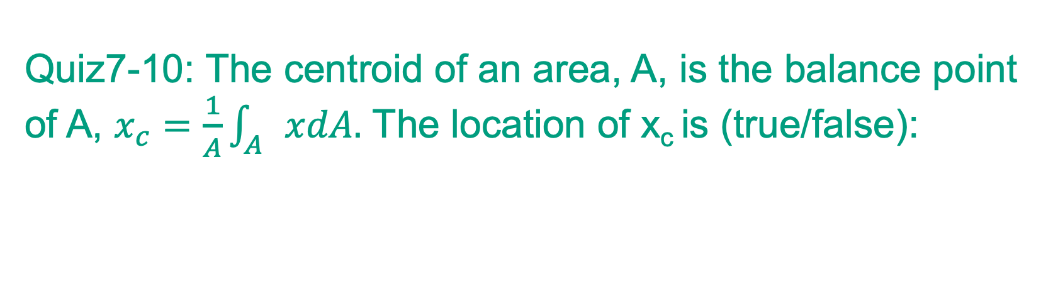
Floating objects
Quiz7-10: The centroid of an area, A, is the balance point
of A, $x_{c}=\frac{1}{A}\int_{A}{xdA.}$ The location of x_{c} is (true/false):
+
+
+
Quiz 9
Quiz 7
Quiz 8
F_{p}
+
Quiz 10
(c)
Image credit: Creative Commons

Slide 26
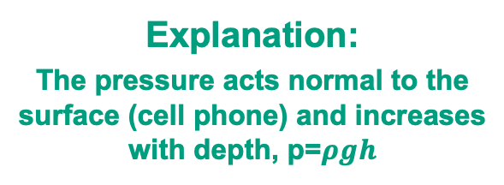
Floating objects
How was your score? Class-assessment: Quiz 5
Quiz 5: What’s the pressure distribution on a slanted and submerged object (right answer: d):
p
Explanation:
The pressure acts normal to the surface (cell phone) and increases with depth, p=$ρgh$
Image credit: Creative Commons

Slide 27
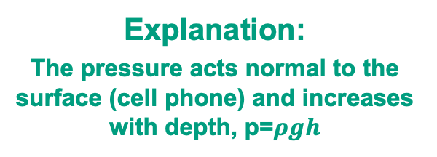
Floating objects
How was your score? Class-assessment: Quiz 6
Quiz 5: What’s the pressure distribution on a slanted and submerged object (right answer: d):
Quiz 6: What’s direction and location of the associated pressure force (right answer: c):
p
F_{p}
Explanation:
The pressure acts normal to the surface (cell phone) and increases with depth, p=$ρgh$
Explanation:
The center of pressure is located so that the torque due to Fp is exactly equal to the torque due to the pressure distribution.
Image credit: Creative Commons

Slide 28

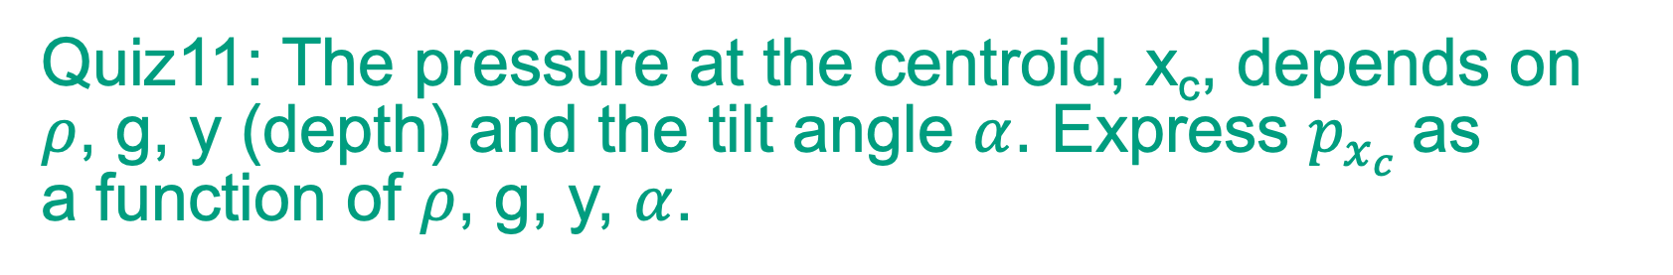
Floating objects
Quiz11: The pressure at the centroid, x_{c}, depends on
$ρ$, g, y (depth) and the tilt angle $α$. Express $p_{x_{c}}$as
a function of $ρ$, g, y, $α$.
p
+
$$α$$
Image credit: Creative Commons

Slide 29

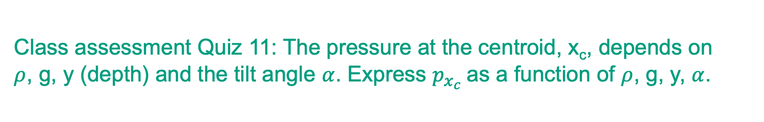
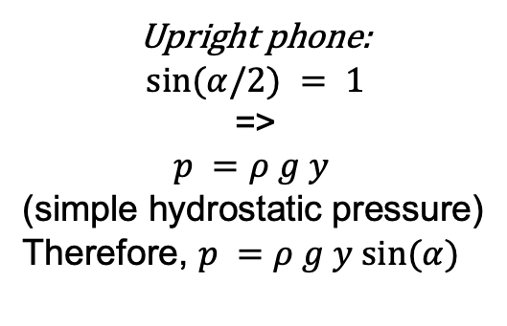

Floating objects
Class assessment Quiz 11: The pressure at the centroid, x_{c}, depends on
$ρ$, g, y (depth) and the tilt angle $α$. Express $p_{x_{c}}$as a function of $ρ$, g, y, $α$.
p
$$α=$$
$$π/2$$
$$α$$
Upright phone:
$$sin⁡(α/2) = 1$$
=>
$$p =ρ g y$$
(simple hydrostatic pressure)
Therefore, $p =ρ g y sin(α)$
F_{p}
Image credit: Creative Commons

