Slide 1
FYS 4250
Repetition part 1-8

Slide 2
Biopotential amplifiers:
High input impedance (avoid loading -> affecting electrode characteristics)
Must provide protection of the organism
Must operate in that portion of the frequency spectrum in which the biopotentials that they amplify exists (Limit the bandwith to optimise SNRs)
High common mode rejection ratio (for differential amplifiers)
Quick calibration possible
Notes:
Biopotential amplifiers
High input impedance (avoid loading -> affecting electrode characteristics)
Must provide protection of the organism
Must operate in that portion of the frequency spectrum in which the biopotentials that they amplify exists (Limit the bandwith to optimise SNRs)
High common mode rejection ratio (for differential amplifiers)
Quick calibration possible

Slide 3
FYS 4250
Lecture 1 Highlights

Slide 4
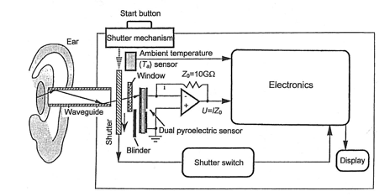
Infrared ear thermometer
Image: Harsanyi, 2000, p 102
Application of radiation thermometry, determines core body temperature by measuring the magnitude of infrared radiation emitted from tympanic membrane and surrounding ear canal. (Tympanic membrane and hypothalamus are perfused by the same vasculature -> Hypothalamus is the body thermostat
Notes:
Application of radiation thermometry, determines core body temperature by measuring the magnitude of infrared radiation emitted from tympanic membrane and surrounding ear canal. (Tympanic membrane and hypothalamus are perfused by the same vasculature -> Hypothalamus is the body thermostat

Slide 5
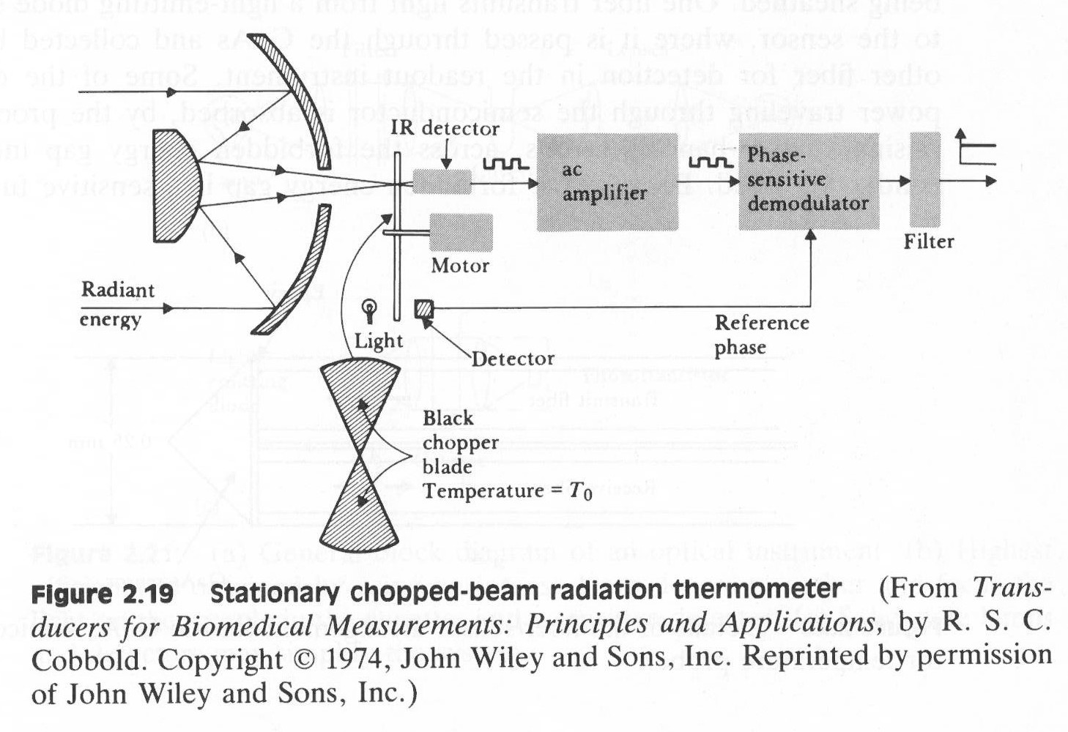
Radiation thermometer
Notes:
Mirror focuses radiation on detector. Black chopper interrupts the radiation beam at a constant rate. -> Pulse train
Amplitude dependent on the strength of the radiation source. AC signal. Ac-signal is amplified, while the drifting mean is blocked. Signal is then filtered to provide a dc signal proportional to target temperature.
Thympanic

Slide 6
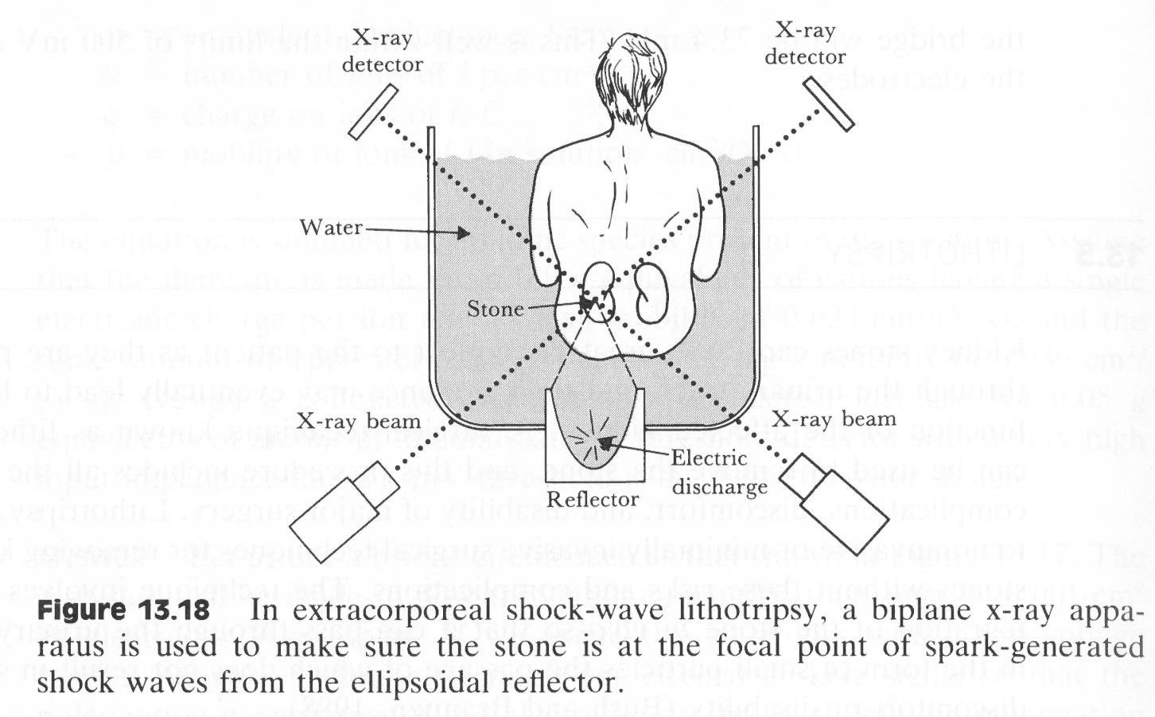
Kidney stone crusher
Notes:
Kidney stones cause great discomfort, may lead to loss of function of the affected kidney. Can be removed surgically, better with lithotripsy. Mechanical shock waves or ultrasonic transducers. Up to 2000 shocks can be necessary

Slide 7
Cochlea implants

Slide 8
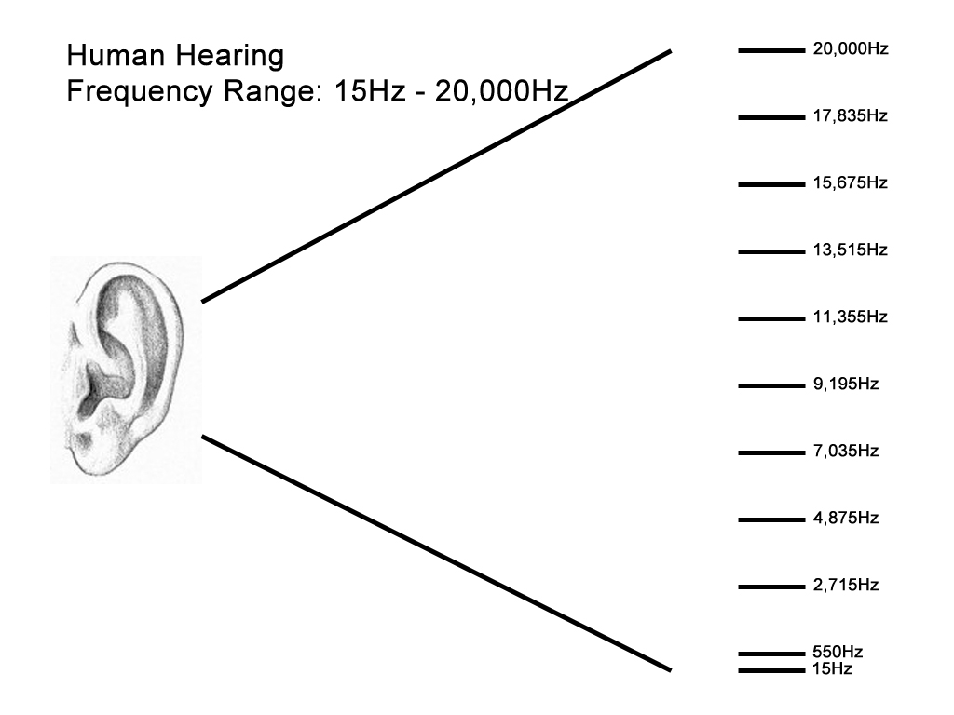
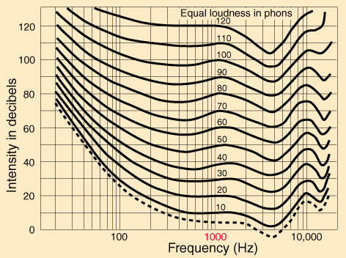
Hearing frequency range
Sound intensity I(dB) = 10log (I/I (0)) = sound power per unit area (watts/m*m)
Sound Loudness is a subjective term describing the strength of the ears perception of a sound. Closely related but not identical to sound intensity. The sound intensity must be factored by he ear's sensitivity to the particular frequencies contained in the sound.
http://www.iigwest.com/investigations/meier/images/Meier_Audio_Hearing.jpg
http://www.nu9n.com/images/fletcher.jpg
Notes:
Sound intensity I(dB) = 10log (I/I (0)) = sound power per unit area (watts/m*m)
Sound Loudness is a subjective term describing the strength of the ears perception of a sound. Closely related but not identical to sound intensity. The sound intensity must be factored by he ear's sensitivity to the particular frequencies contained in the sound.

Slide 9
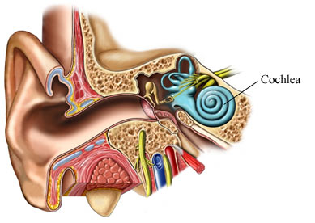
The Cochlea
The cochlea is divided into an upper duct called the scala vestibuli and a lower duct, called the scala tympani, by a thin bony shelf called the osseous spiral lamina. It is a narrow shelf of bone arising from the modiolar side of the cochlea.
http://www.odec.ca/projects/2007/park7r2/AQ00008_cochlea.jpg
This division is completed by the membranous cochlear duct or scala media. Its floor is formed by the basilar membrane. The vestibular membrane, or Reissner’s membrane, forms the roof of the scala media.

Slide 10
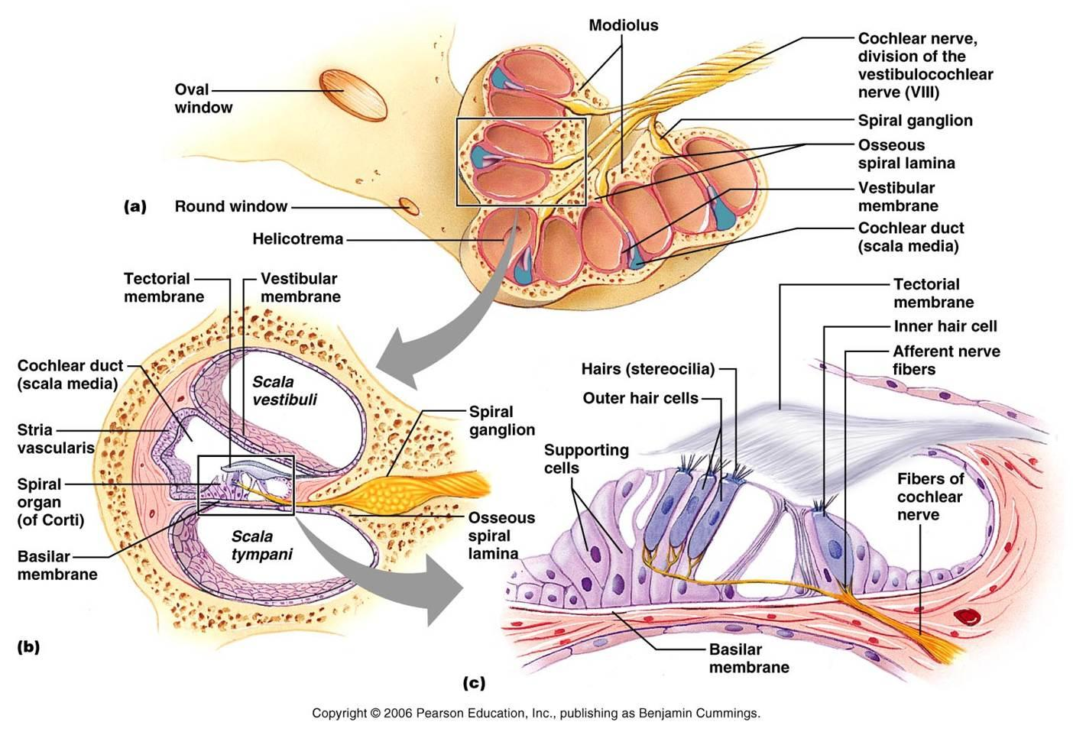

Slide 11
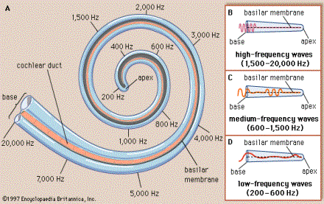

Slide 12
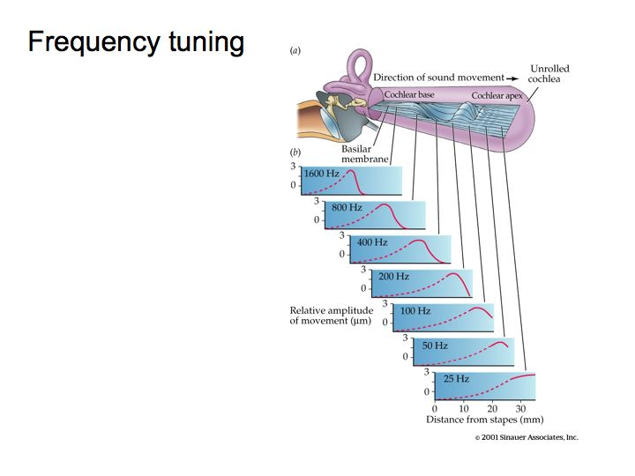

Slide 13
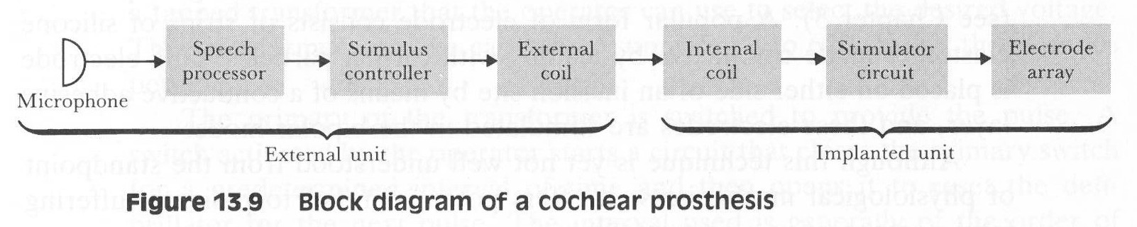
Cochlear implant
For deaf patients whose hearing impairment results from dysfunction of the sound-transducing elements of the middle and inner ear.
Speech processor = determines what specific characteristics will be used to control stimulating electrodes (Set of bandpass filters)
Stimulus controller = takes information from SP and uses it to determine when a stimulus pulse should be applied to a particular set of electrodes
Electrode array = array placed on a flecible structure that can assume spiral shape of the cochlea in contact with the cochlea-nerves (very small)
Notes:
For deaf patients whose hearing impairment results from dysfunction of the sound-transducing elements of the middle and inner ear.
Speech processor = determines what specific characteristics will be used to control stimulating electrodes (Set of bandpass filters)
Stimulus controller = takes information from SP and uses it to determine when a stimulus pulse should be applied to a particular set of electrodes
Electrode array = array placed on a flecible structure that can assume spiral shape of the cochlea in contact with the cochlea-nerves (very small)

Slide 14
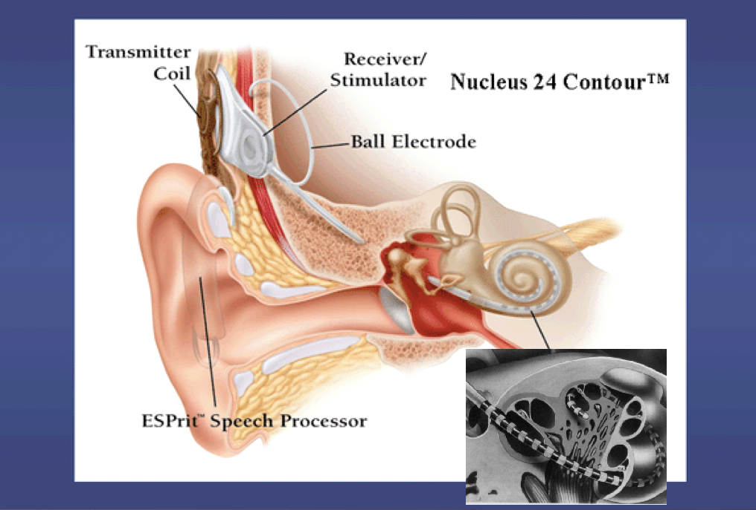
Source: ESPrit

Slide 15
The CI-amplifier
Understanding speech is the ultimate goal, and at the same time a very complex task. Normal speech consists of a number of different frequencies, small shades and sounds that has to be perceived and combined in the brain in order to understand what is said. Deaf patients will typically have a 70-80 dB hearing loss, reaching a dynamic range of approximately 15-25 dB. At the same time very loud sounds have to be attenuated, a general fixed gain will be unpleasant for the patient. Requirements:
Low power consumption
Speed,
A minimum of 60 dB dynamic range
Variable gain
The processor needs powerful algorithms to balance the gain and the electrode output

Slide 16
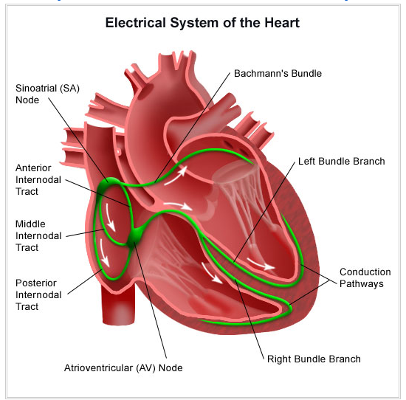
Conduction pathway
Source: St. Jude Medical

Slide 17
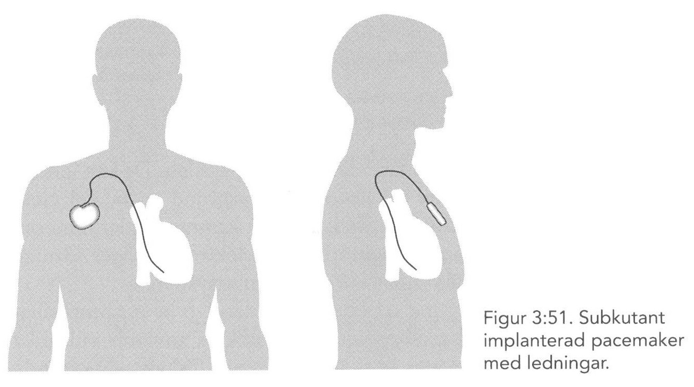
Active implant: pacemaker
Notes:
Pacemaker = electric stimulator that produces periodic electric pulses that are conducted to electrodes located on the surface of the heart (epicardium), within the heart muscle (the myocardium) or within the cavity of the heart or the lining of the heart (the endocardium).
Stimulus causes a contraction -> important when the heart is not stimulated at a proper rate on its own (Heart block

Slide 18
Unipolar vs Bipolar
 | Unipolar | Bipolar
Advantages | Smaller diameter Easier to implant Large spike | No pocket stimulation Less susceptible to EMI Programming flexibility
Disadvantages | Pocket stimulation Far-field oversensing No programming flexibility | Larger diameter Stiffer lead body Small spike Higher impedance Voltage threshold is 30% higher
Source: www.Cardiologycmc.in
Notes:
“When it comes to unipolar versus bipolar leads, there are pros and cons to both types. Unipolar leads are smaller in diameter because they only have one coil; this makes them more reliable (or at least, that is the perception based on the fact that one coil is more robust than two) and the smaller size makes them easier to implant. Most clinicians prefer the big spike that unipolar devices make on an ECG. However, the large unipolar antenna that creates that spike can stimulate the surrounding tissue (pocket stimulation). Sometimes a unipolar lead is “picked up” by the opposite chamber, for instance a ventricular pacing spike is sensed by the atrial lead and inappropriately interpreted as an intrinsic atrial event (this phenomenon is sometimes call far-field oversensing, far-field R-wave sensing, far R, or crosstalk). Finally, a unipolar lead can only ever be a unipolar lead; it is not possible to program a unipolar lead to a bipolar pacing or sensing configuration because the lead only has one electrode to work with.
Bipolar leads have a smaller antenna, which produces both a smaller pacing spike (hard to see on some ECGs) but less pocket stimulation. The small antenna makes the bipolar lead less susceptible to electromagnetic interference (EMI). The presence of two electrodes on the leads means that the clinician can reprogram a bipolar lead to a unipolar configuration, if desired. The main drawbacks to a bipolar lead are the fact that the lead is usually thicker in diameter and the dual coils can make the lead seem more rigid and harder to implant.”
Source: http://docslide.us/documents/basics-of-pacemaker.html

Slide 19
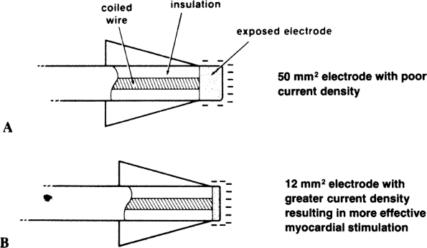
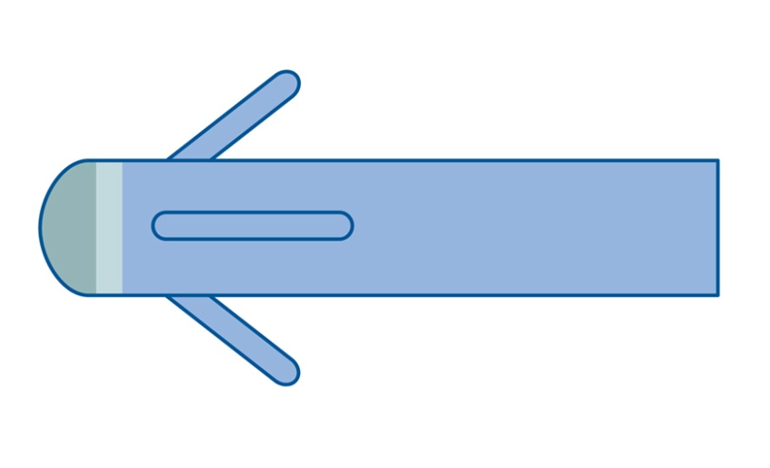
Impedance and electrodes
Large electrode tip
  Threshold ↑
  Impedance ↓
  Polarization ↓
Small electrode tip
  Threshold ↓
  Impedance ↑
  Polarization ↑

Slide 20
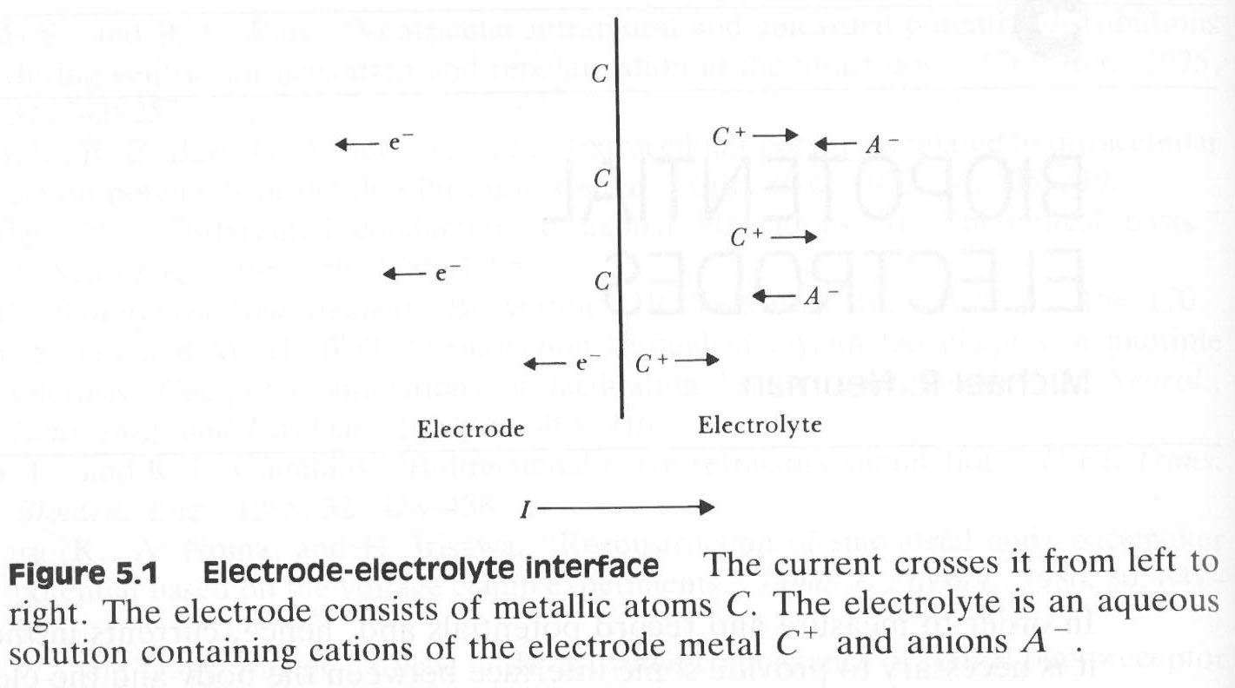
Metal /
electrolyte
=
electron /
ion
transitions
A half-cell is a structure that contains a conductive electrode and a surrounding conductive electrolyte separated by a naturally occurring Helmholtz double layer. Chemical reactions within this layer momentarily pump electric charges between the electrode and the electrolyte, resulting in a potential difference between the electrode and the electrolyte
Notes:
A half-cell is a structure that contains a conductive electrode and a surrounding conductive electrolyte separated by a naturally occurring Helmholtz double layer. Chemical reactions within this layer momentarily pump electric charges between the electrode and the electrolyte, resulting in a potential difference between the electrode and the electrolyte

Slide 21
Half-cell potential is described for non-current situations
Current will alter the half-cell potential -> due to the polarization of the electrode
Overpotential = Diff betw observed half cell potential and the equilibrium zero-current half-cell potential
Three basic components:
Ohmic overpotential: Resistance of the electrolyte, voltage drop along current path in the electrolyte
Concentration overpotential: Due to changes in distribution of ions in the electrolyte in the vicinity of the electrode-electrolyte interface. The difference between current induced half-cell potential and equilibrium half-cell potentia = concentration overpotential
Activation overpotential: Charge-transfer process in oxidation-reduction reaction are not entirely reversible. (Energy barrier in order to start reaction). Current direction decides if oxidation or reduction predominates and thus the energy barrier = difference in voltage between electrode and electrolyte
All three mechanisms are additive
Theoretically two types of electrodes: Perfectly polarizable and perfectly non-polarizable
PP: no actual charge cross electrode electrolyte interface when current applied. (Behaves as a capacitor) (Platium, noble metals)
PNP: Current passing freely across electrode-electrolyte interface (Ag/Agcl, slightly soluble in water = stable)

Slide 22
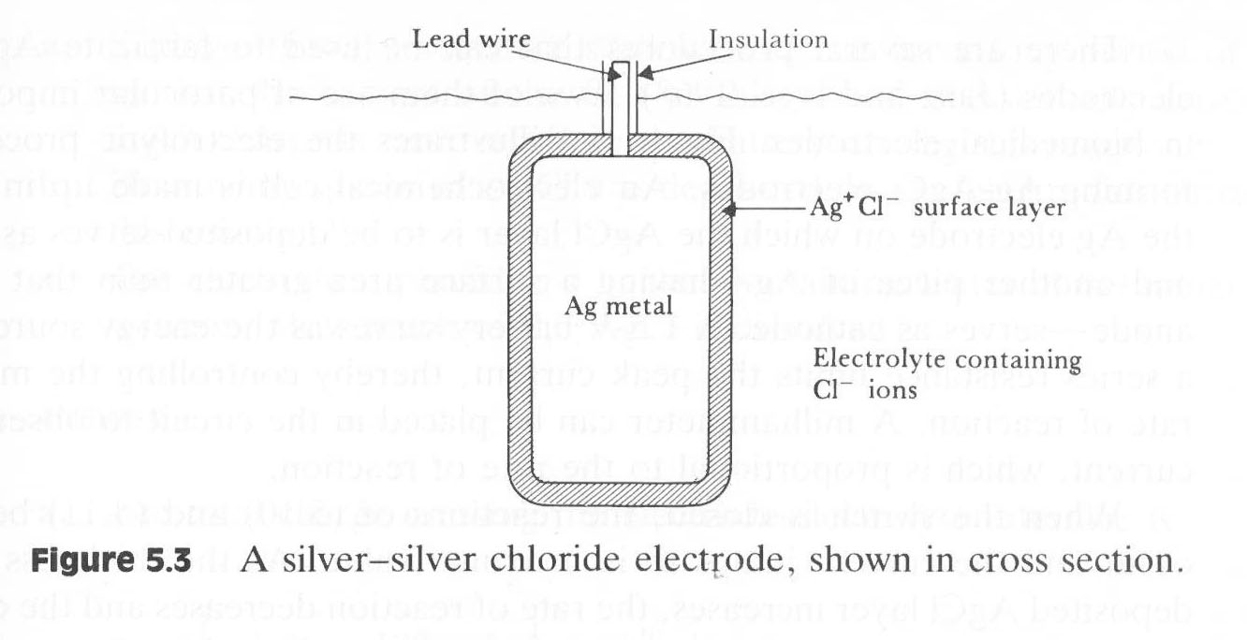
Half-cell potential
Ag / AgCl
Non-polarizable electrode
Notes:
Half-cell potential is described for non-current situations
Current will alter the half-cell potential -> due to the polarization of the electrode
Overpotential = Diff betw observed half cell potential and the equilibrium zero-current half-cell potential
Three basic components:
Ohmic overpotential: Resistance of the electrolyte, voltage drop along current path
Concentration overpotential: Due to changes in distribution of ions in the electrolyte in the vicinity of the electrode-electrolyte interface. The difference between current induced half-cell potential and equilibrium half-cell potentia = concentration overpotential
Activation overpotential: Charge-transfer process in oxidation-reduction reaction are not entirely reversible. (Energy barrier in order to start reaction). Current decides oxidation or reduction predominates -> energy barrier = difference in voltage between electrode and electrolyte
All three mechanisms are additive
Theoretically two types of electrodes: Perfectly polarizable and perfectly non-polarizable
PP: no actual charge cross electrode electrolyte interface when current applied. (Behaves as a capacitor) (Platium, noble metals)
PNP: Current passing freely across electrode-electrolyte interface (Ag/Agcl, slightly soluble in water = stable)

Slide 23
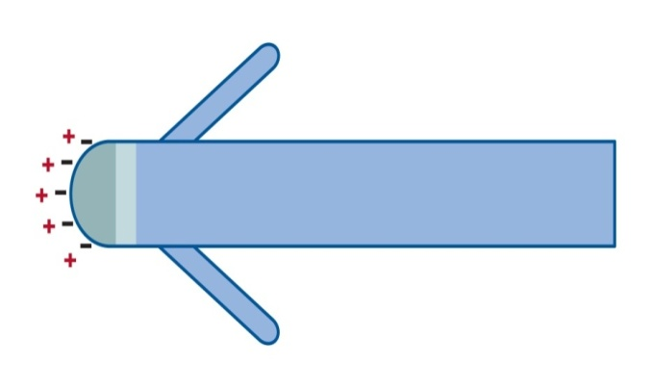
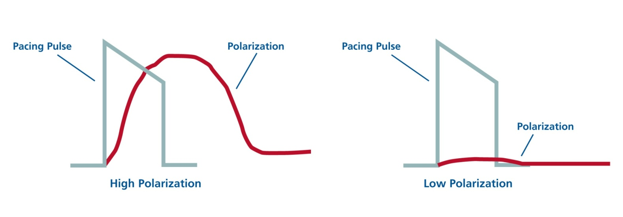
Polarization
After an output pulse, positively charged particles gather near the electrode.
The amount of positive charge is
  Directly proportional to pulse duration
  Inversely proportional to the functional electrode size
  (i.e. smaller electrodes offer higher polarization)
Polarization effect may represent 30–40% of the total pacing impedances as high as 70% for smooth surface, small surface area electrodes
Source: www.Cardiologycmc.in

Slide 24
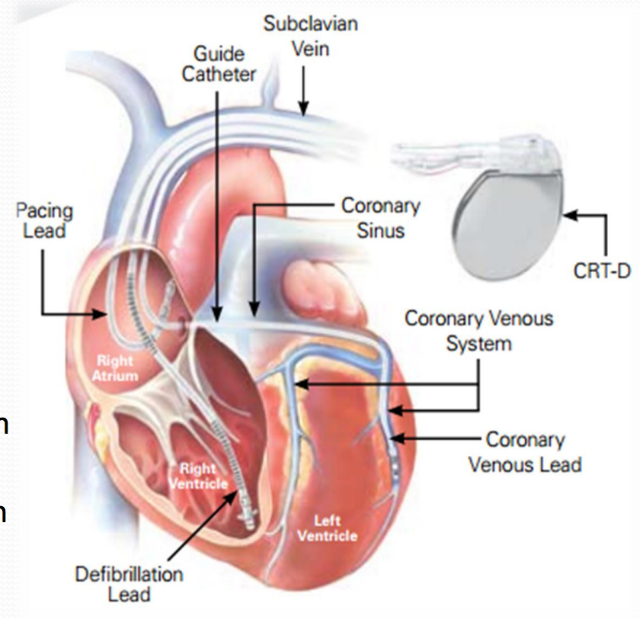
Implantable cardioverter defibrillator
Main aims:
To synchronize stimulation of both ventricles
To synchronize contraction of both ventricles
Combination of a pacemaker and a defibrillator, and it is implantable
Source: Clevelandclinic.org

Slide 25
FYS 4250
Lecture 2 Highlights

Slide 26
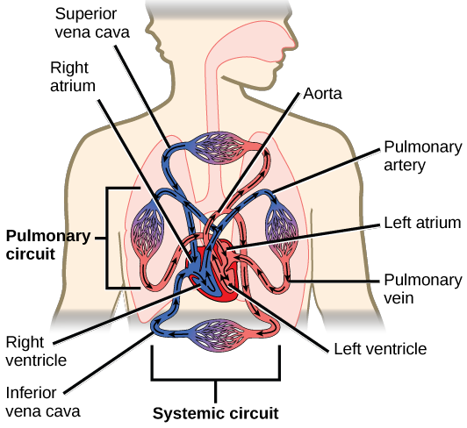
Case 1
Electrocardiogram, ECG = measuring the electrical activity of the heart
cnx.org

Slide 27
Case 1
Electrocardiogram, ECG = measuring the electrical activity of the heart
cnx.org
- How is the electrical activity generated?

Slide 28
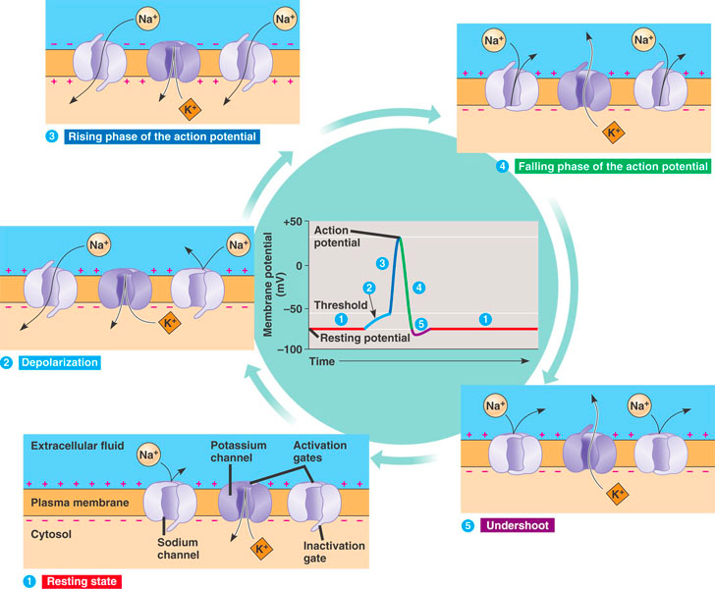
Action potential of a single heart cell
Kvhs.nbed.nb.ca
Notes:
Ion-pump
Nerve-cells and heart-cells
Voltage controlled gates
Delayed K+ gates both opening and closing

Slide 29
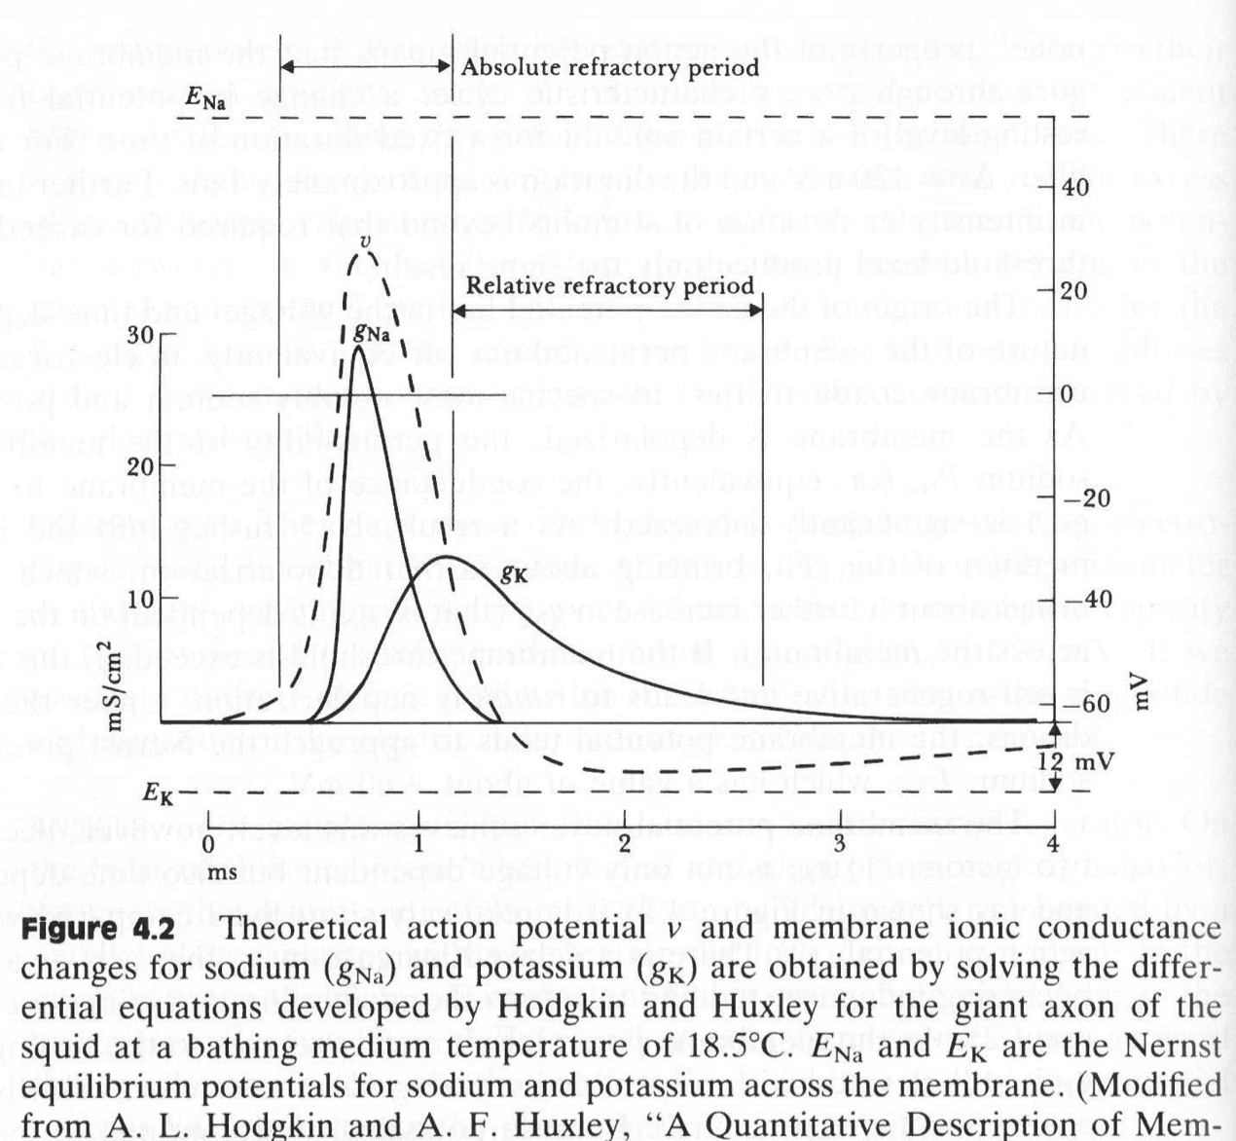
Action potential of a single heart cell
Notes:
Squid = blekksprut, Octopus = 8-armet
Adequate stimulus, treshold potential
All or none, duration 1 ms

Slide 30
ECG-Basics
(ECGpedia.org)

Slide 31
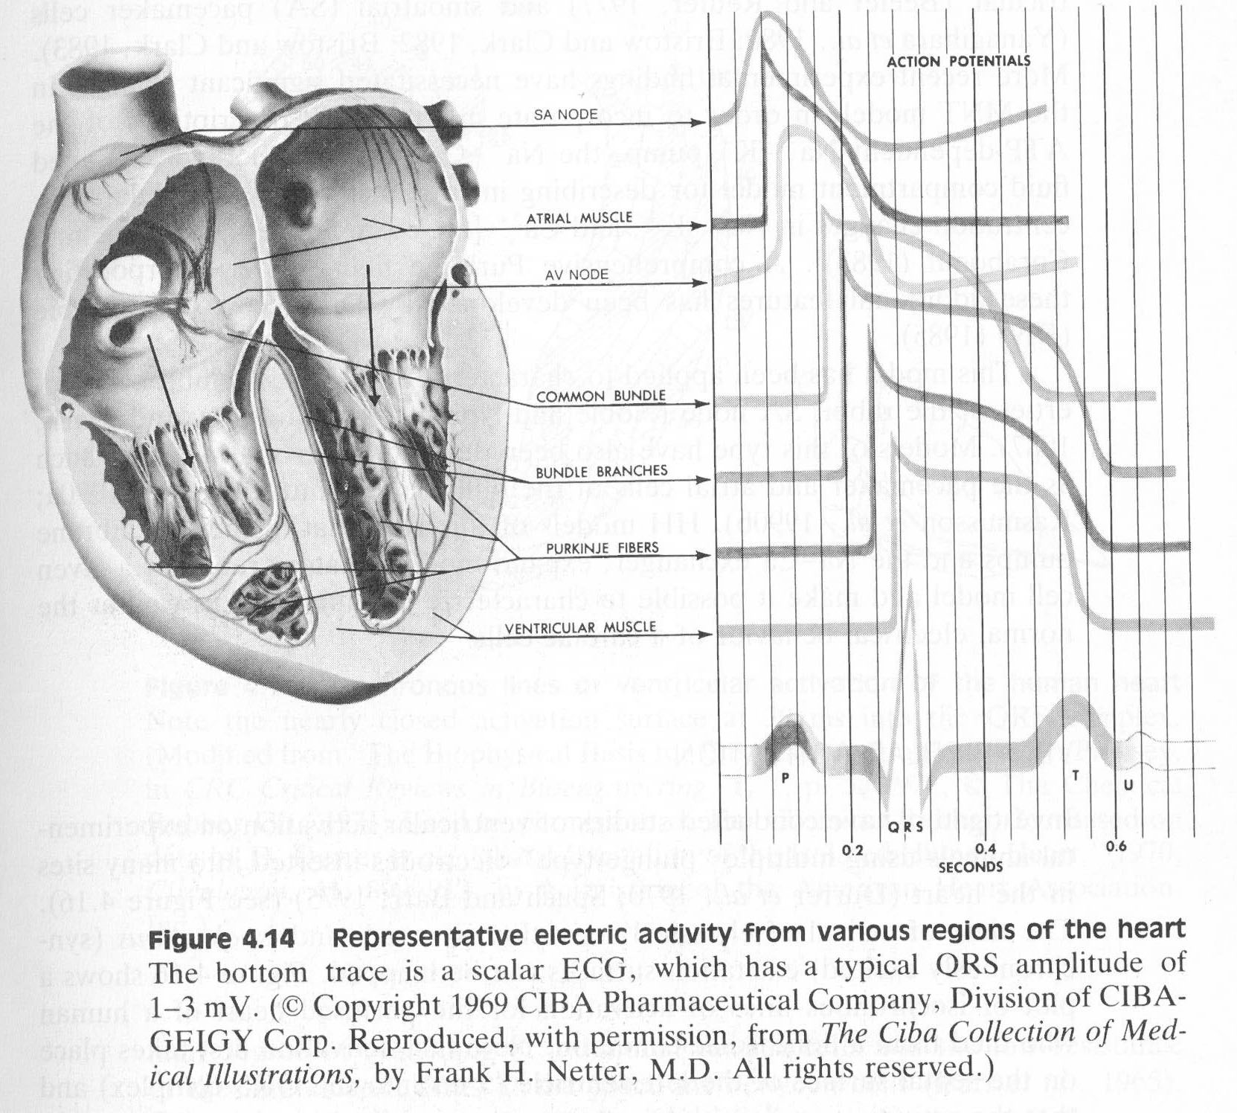
Regional electric activity
- What does the final signal look like?
Notes:
Intercalated disc

Slide 32
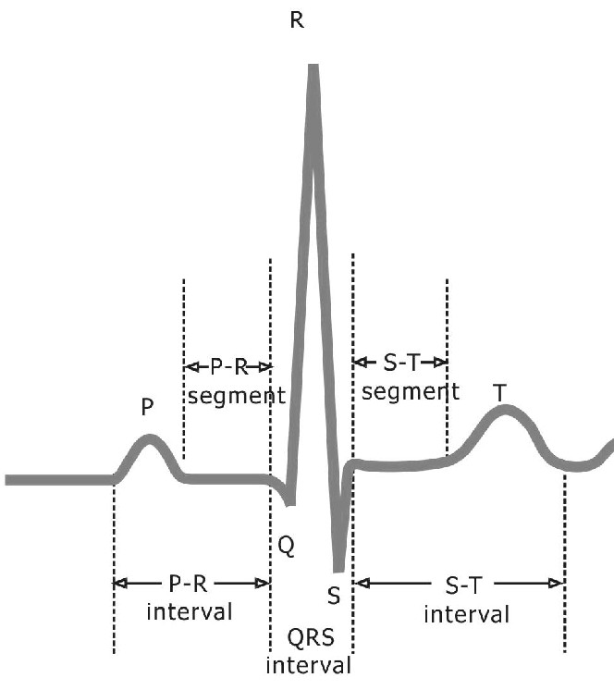
The ECG-complex
P-wave = atrial depolarisation
PR-segment = impulse from atria to ventricles
QRS-complex = ventricular depolarisation
ST-segment = isoelectric – part of repolarisation
T-wave = ususally same direction as QRS – ventricular repolarisation
QT-interval = This interval spans the onset of depolarisation to the completion of repolarization of the ventricles
- How can we obtain this signal?

Slide 33
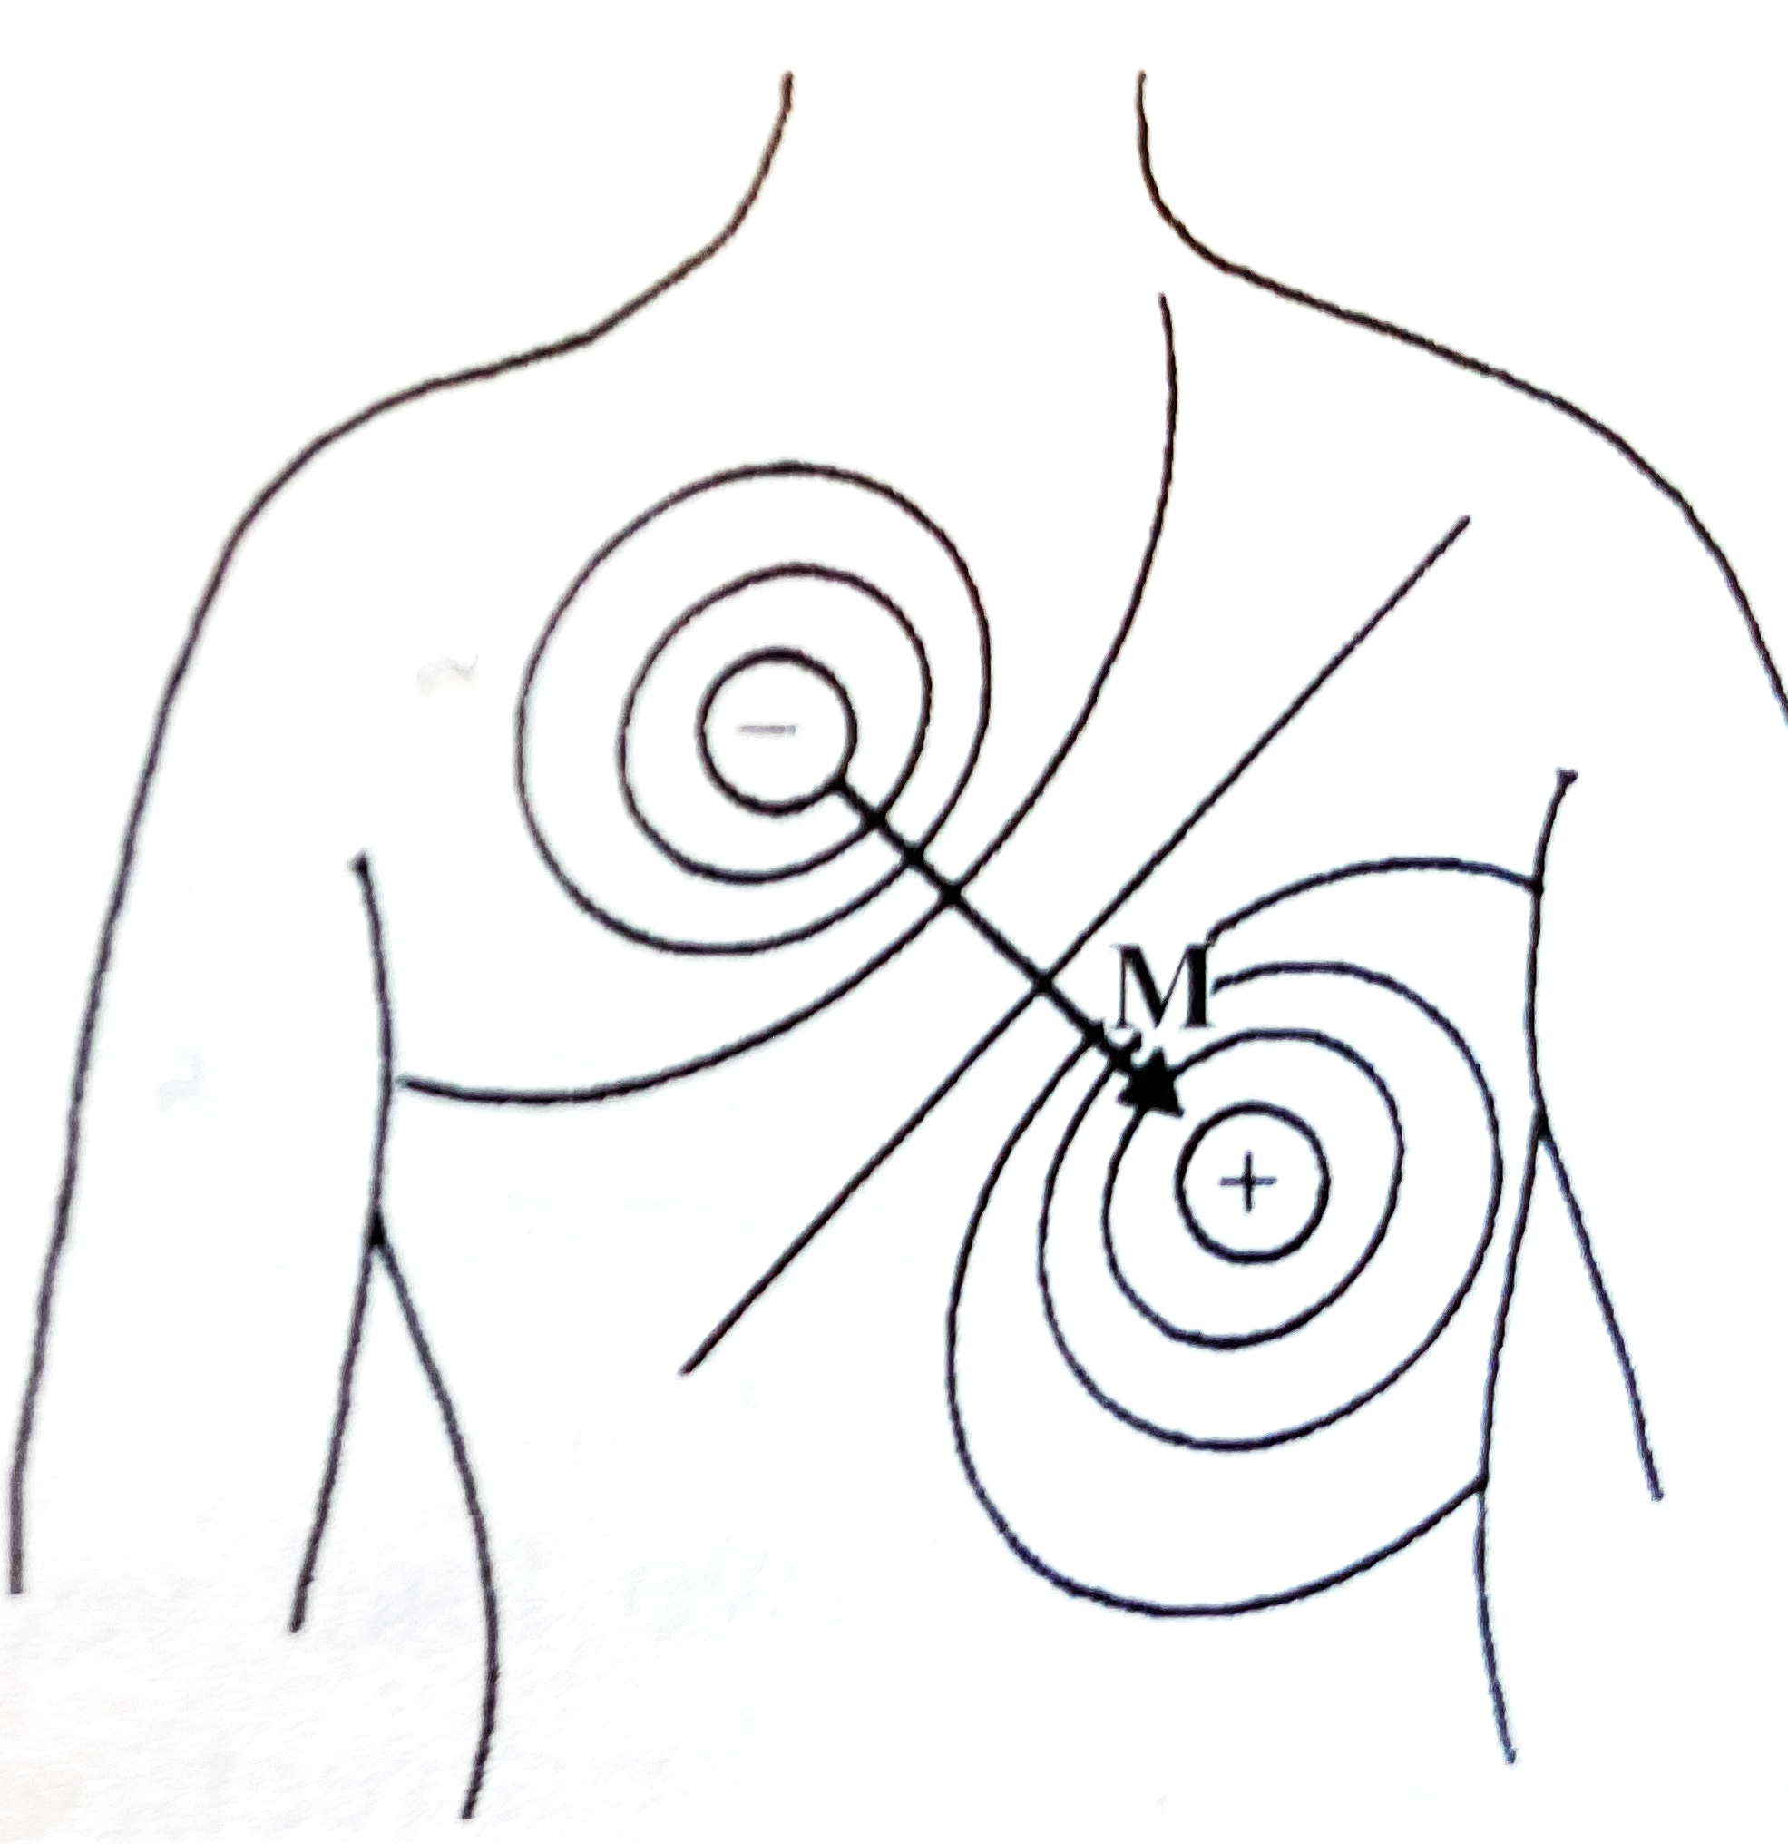
The cardiac dipole vector
The electrical activity can be represented as a vector quantity = must know location of signals and time dependence of the amplitude
Simplified model – The heart consists of an electrical dipole from sternum to apex
Easy to represent quite a complex elctrophysiological entity with a vector from the negative charge to the positive charge, the magnitude is proportional to the amount of charge
The dipole vector is represented as M
The electrid potentials generated by the heart appear throughout the body and on its surface
Can be measured with electrodes, trying to minimize the current flow (Why?)

Slide 34
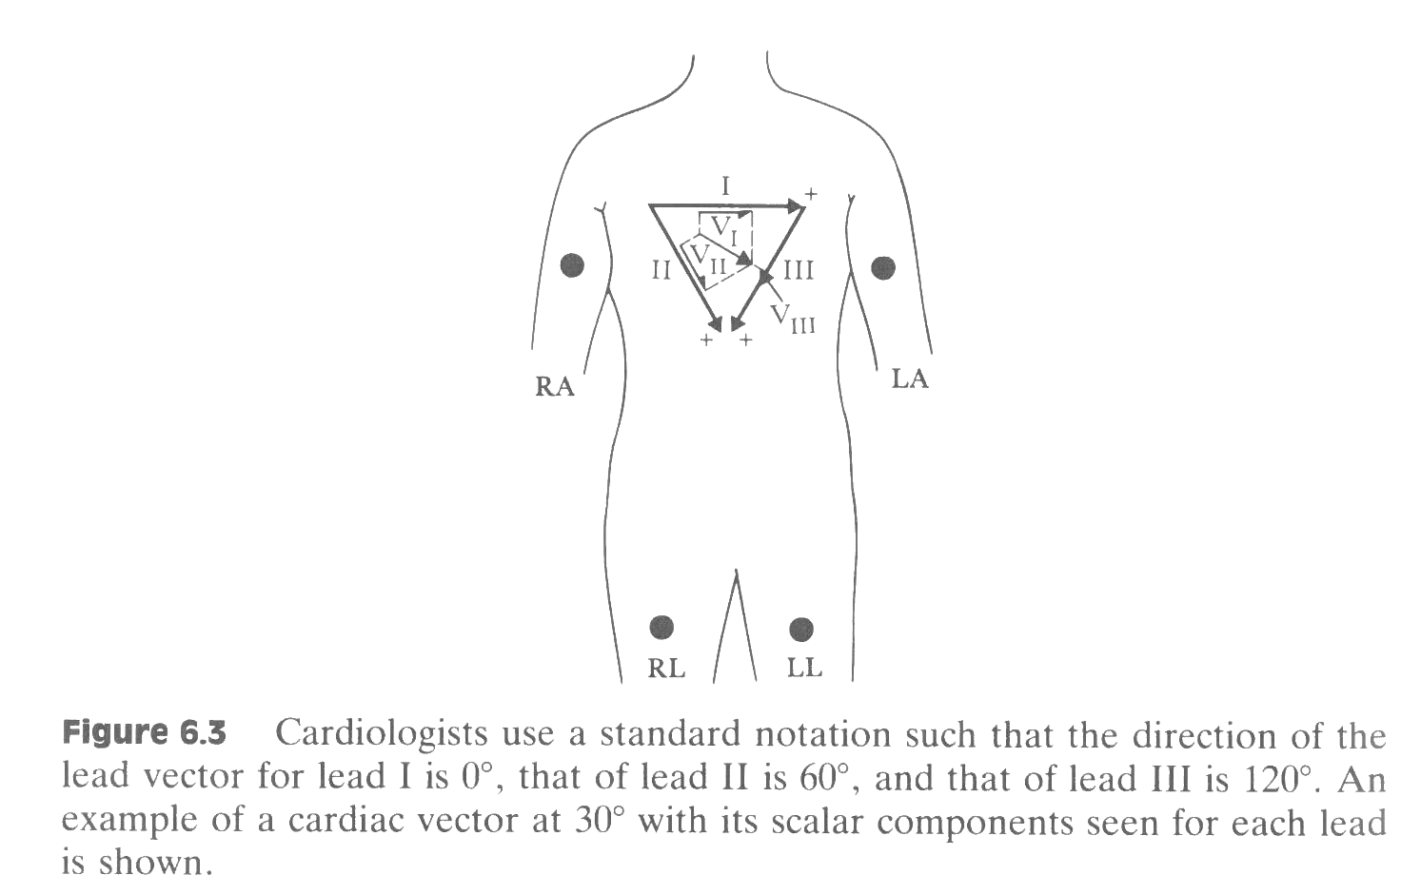
The Einthoven triangle, placement of bipolar electrodes. Kirchhof says: I+III=II
Lead axis is the direction of electrical depolarisation
- How can we obtain this signal?

Slide 35
Limb Lead Electrode placement
Preferred site of electrodes is slightly proximal to wrist and ankles
Can also use upper arms and legs, but must be consistent
Best over flat, fleshy tissue, avoid muscle and bony areas (why?)
Image: heart.org

Slide 36
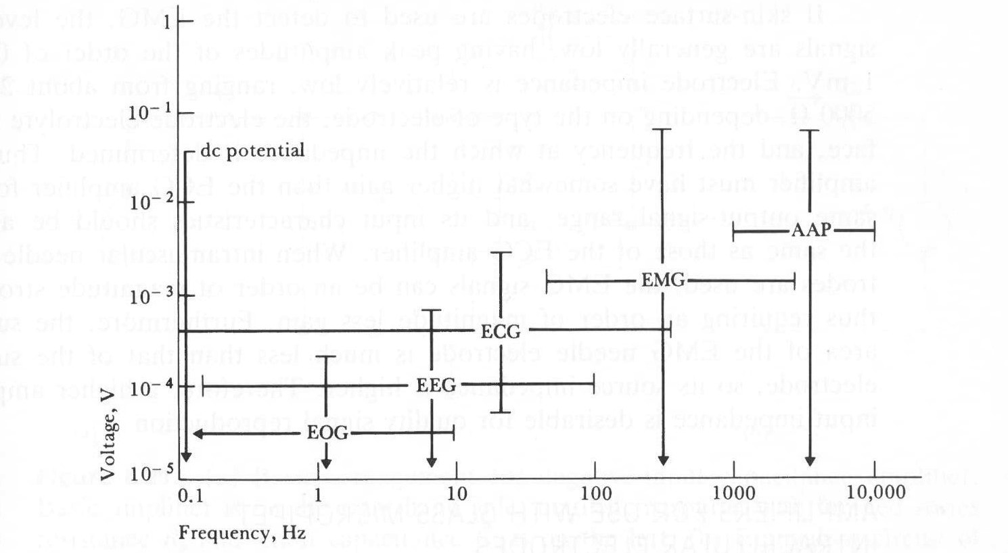
The ECG-signals are very weak

Slide 37
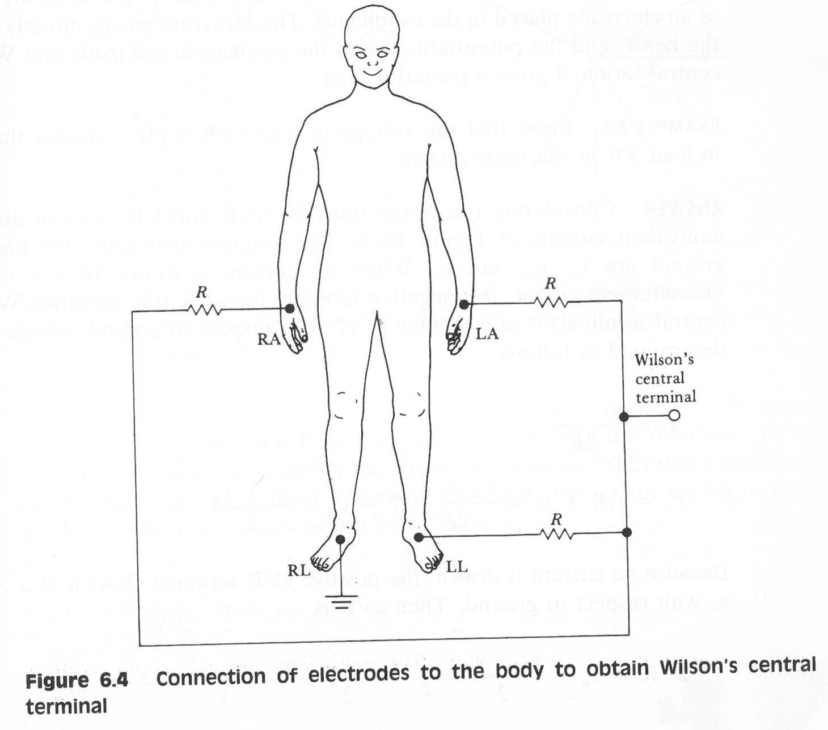
Wilson central terminal, unipolar electrodes
- Still a small, noisy signal. What to do?

Slide 38
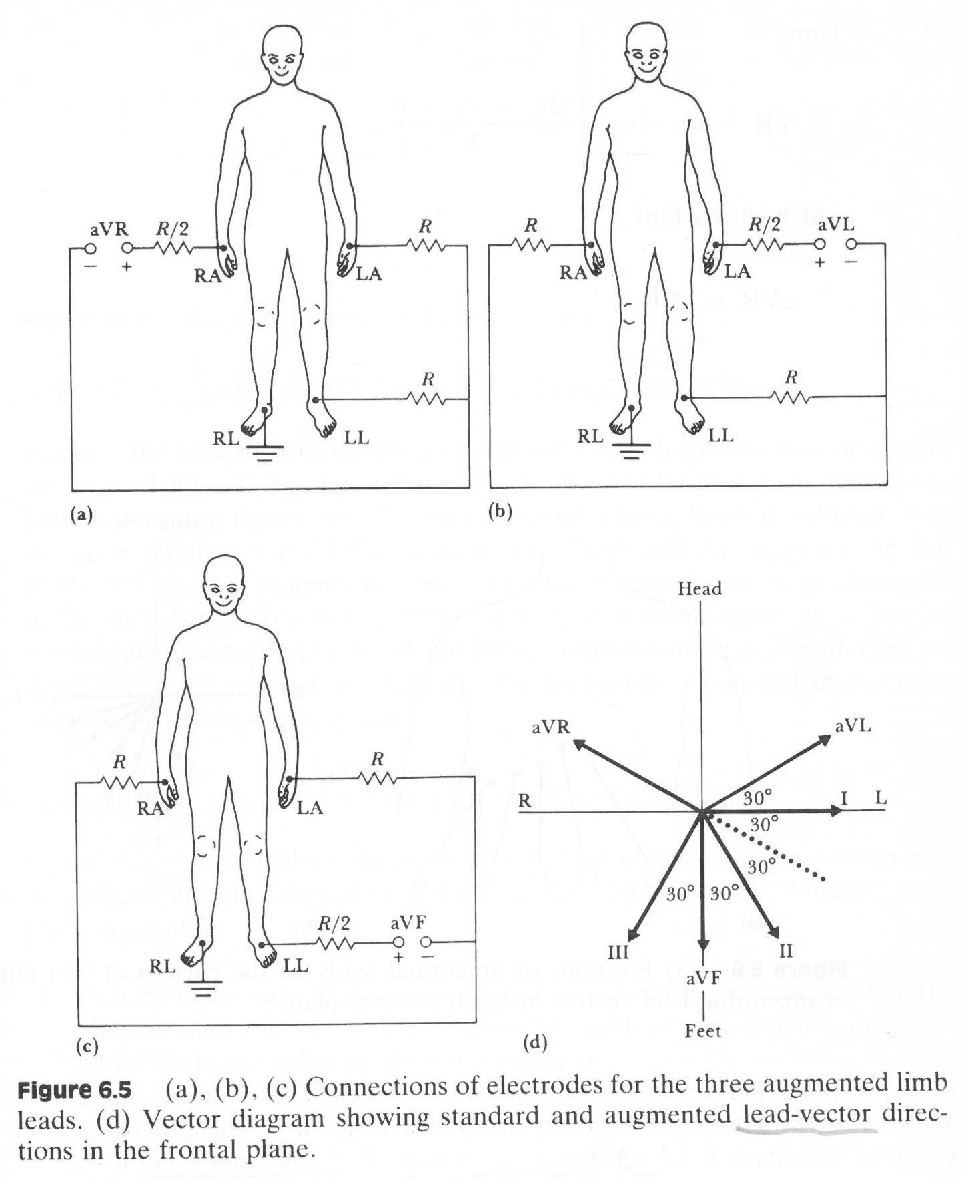
Augmented leads: 50% increased amplitude
- Still too much noise, what to do?
Notes:
Removing the connection between the limb being measured and the central terminal = augmented leads

Slide 39
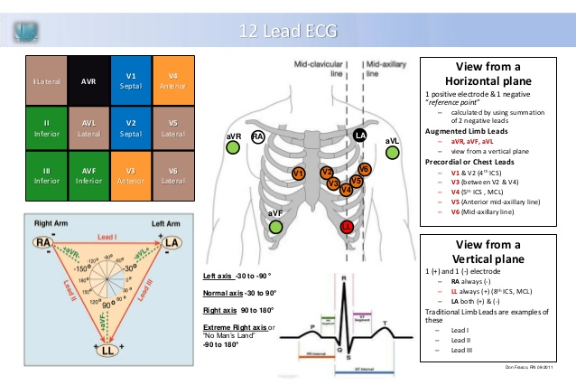
12-lead ECG
http://image.slidesharecdn.com/12-lead-ecg-hss-student-handout-ed-08-2011-2-121121182917-phpapp01/95/12-lead-handout-1-638.jpg?cb=1353522589
Notes:
The term "lead" in electrocardiography refers to the 12 different vectors along which the heart's depolarization is measured and recorded. There are a total of six limb leads and augmented limb leads arranged like spokes of a wheel in the coronal plane (vertical) and six precordial leads that lie on the perpendicular transverse plane (horizontal). In medical settings, the term leads is also sometimes used to refer to the ten electrodes themselves, although this is not technically a correct usage of the term.
Each of these leads represents the electrical potential difference between two points. For each lead, the positive pole is one of the ten electrodes. In bipolar leads, the negative pole is a different one of the electrodes, while in unipolar leads, the negative pole is a composite pole known as Wilson's central terminal.[20] Wilson's central terminal V_{W} is produced by averaging the measurements from the electrodes RA, LA, and LL to give an average potential across the body:
In a 12-lead ECG, all leads except the limb leads are unipolar (aVR, aVL, aVF, V₁, V₂, V₃, V₄, V₅, and V₆)

Slide 40
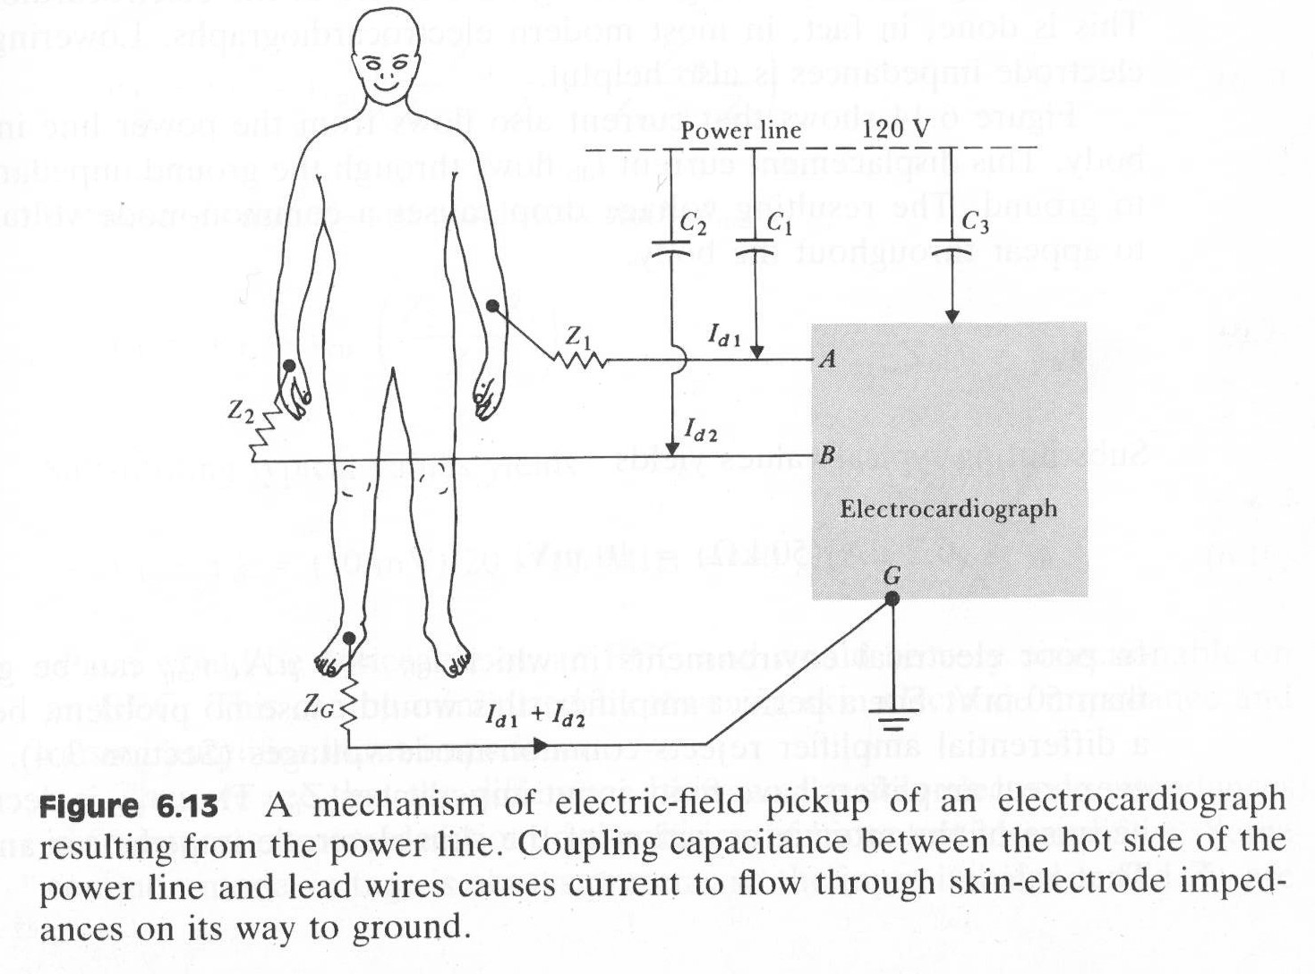
Alternative 1, electric field pickup

Slide 41
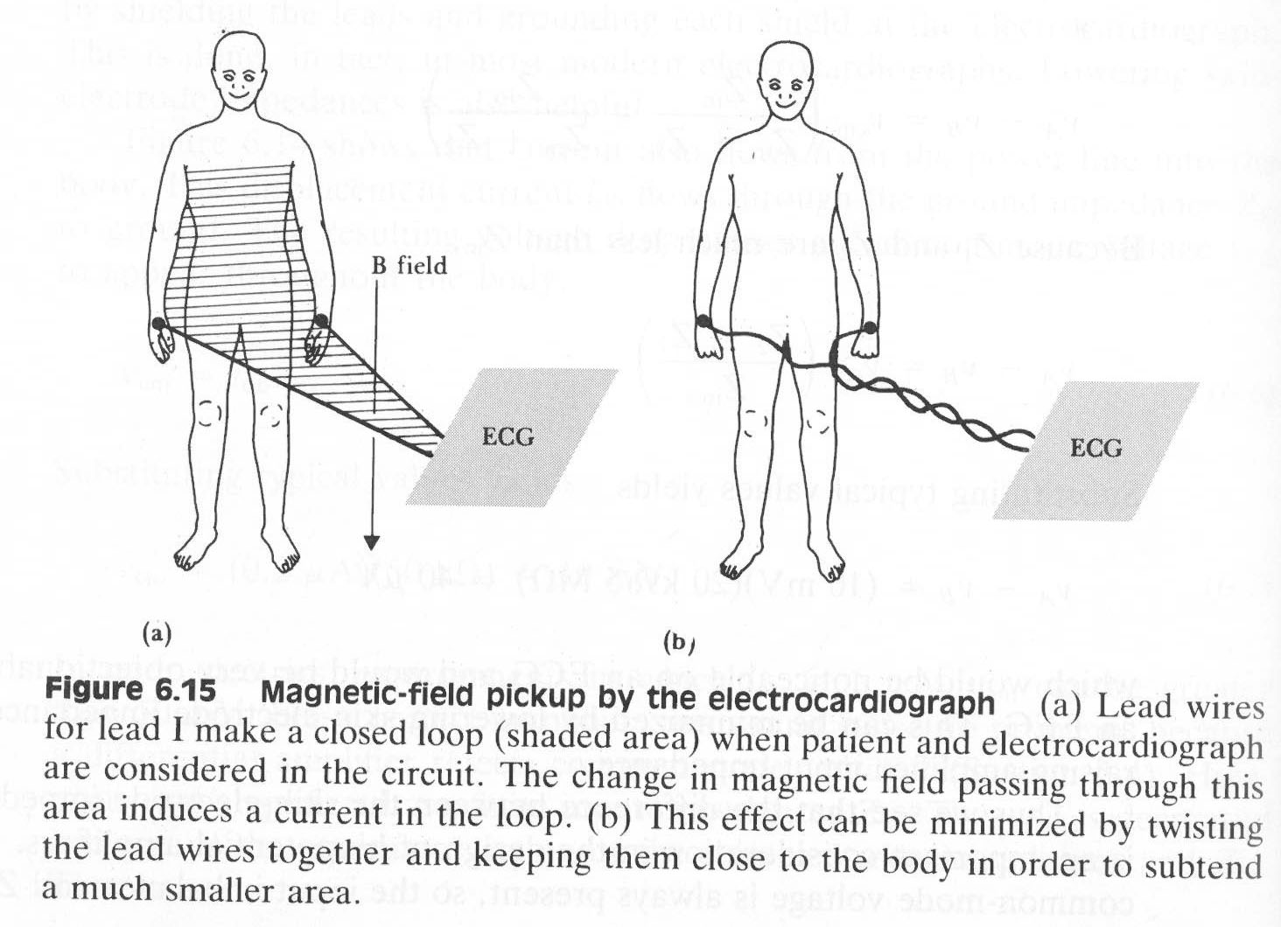
Alternative 2, magnetic field pickup

Slide 42
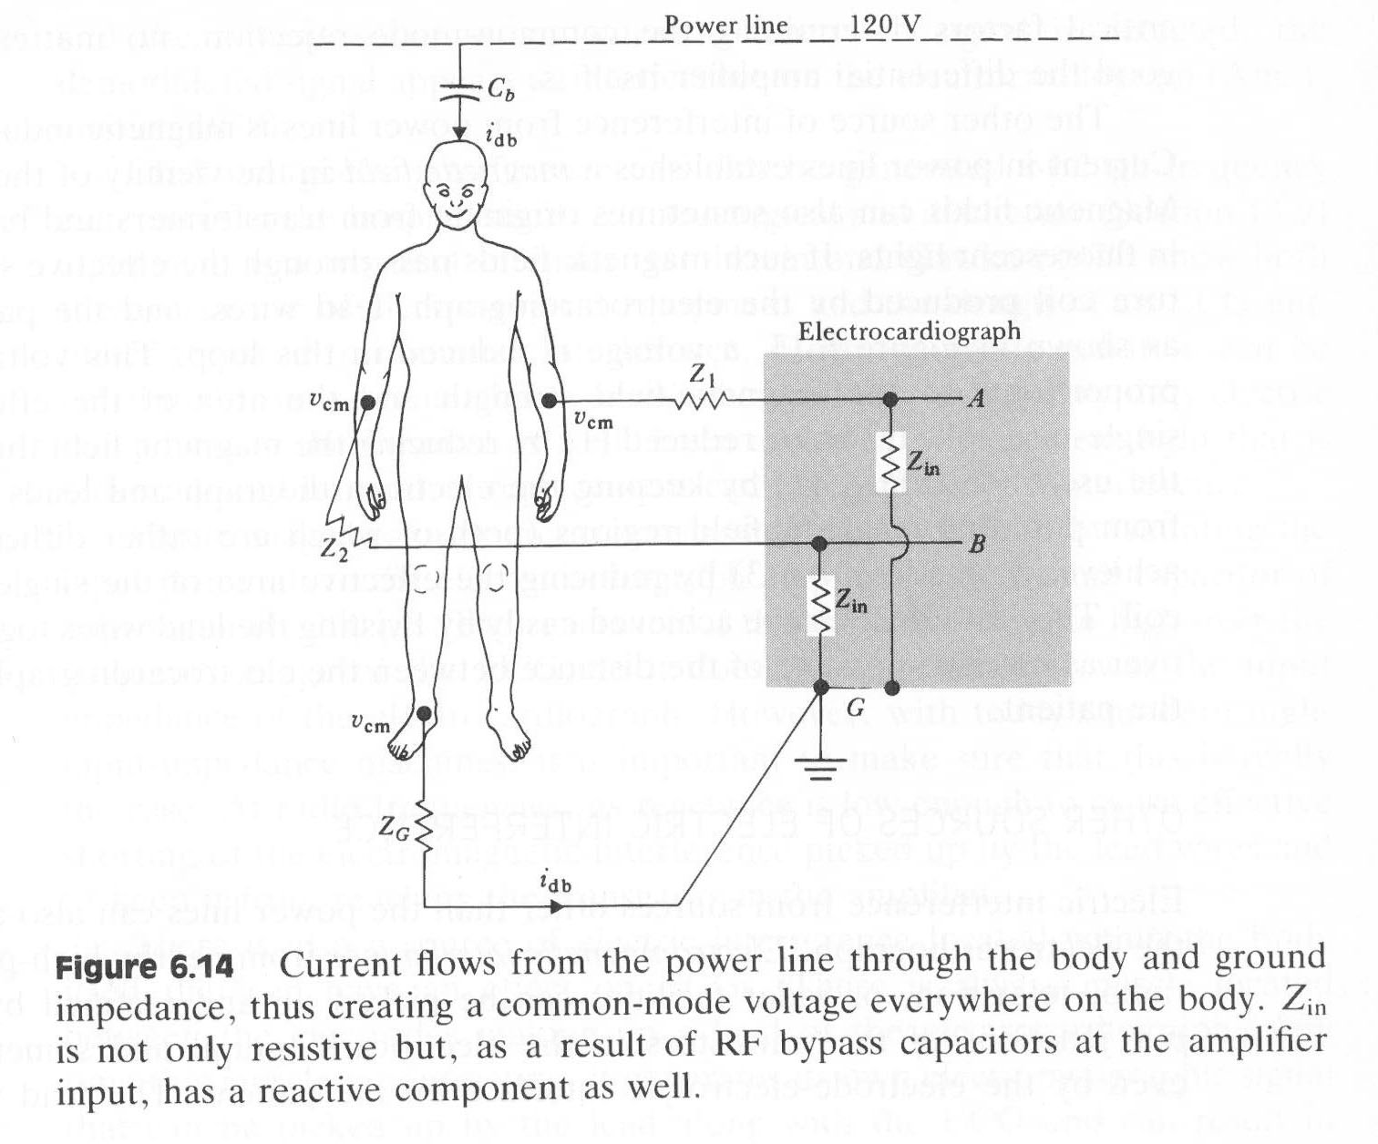
Alternative 3, common mode voltage
Notes:
CMV – 20 Vol

Slide 43
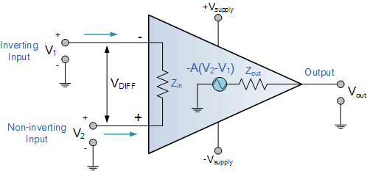
Introducing the ideal operational amplifier
Infinite open loop gain
Infinite input impedance
Zero output impedance
Zero offset voltage
Infinite bandwith

Slide 44
The ideal operational amplifier can be summed up in two golden rules:
The output attempts to do whatever is necessary to make the voltage difference between the inputs zero
The input draws no current
www.dummies.com

Slide 45
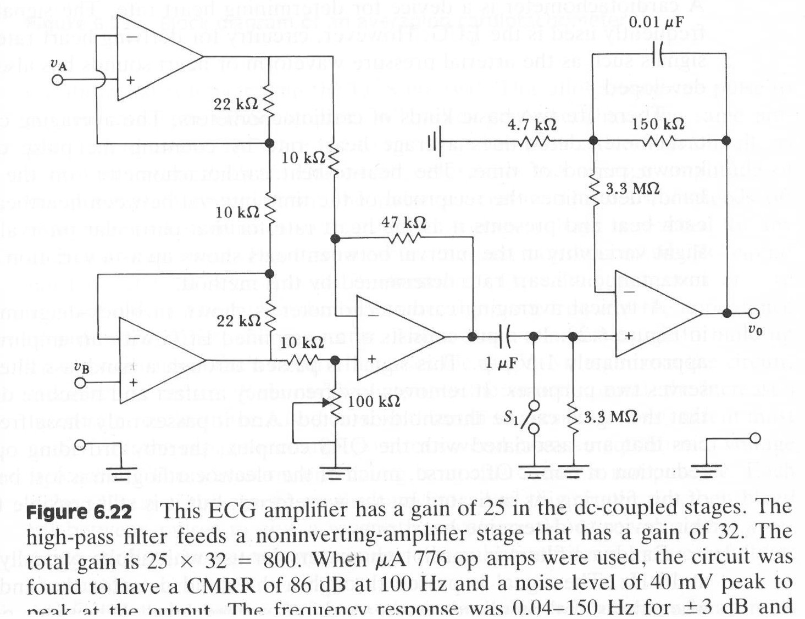
How to build an ECG-amplifier
V_{AA}
V_{BB}
Notes:
Electrode offset up to 0,3V, to prevent saturation only gain of 25
Polarization overpotential -> large dc offset voltage

Slide 46
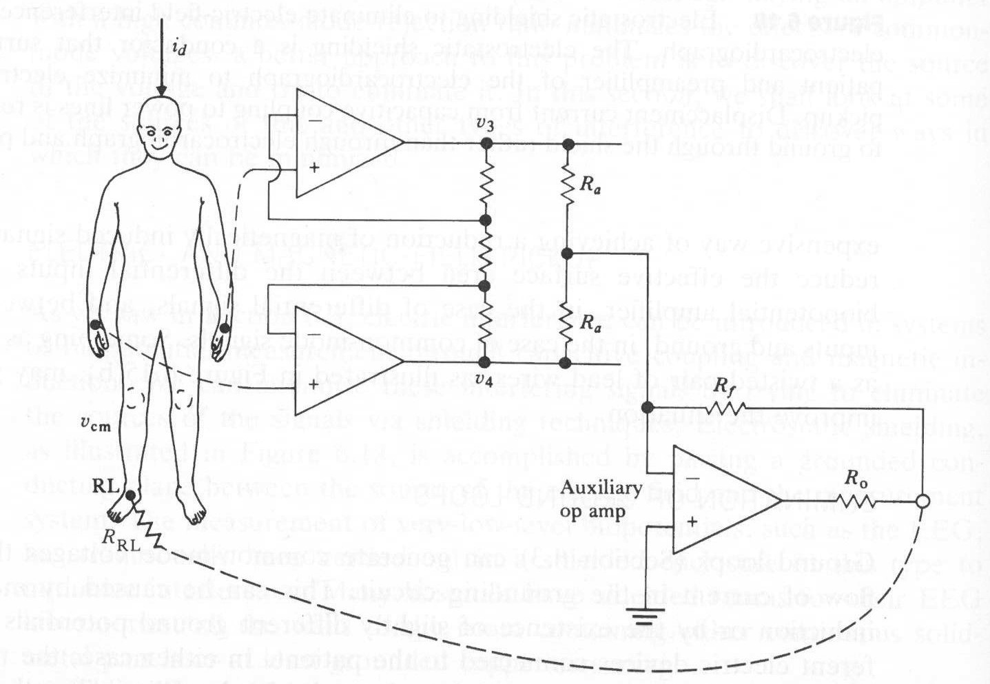
Driven right leg is the practical solution

Slide 47
FYS 4250
Lecture 3 Highlights

Slide 48
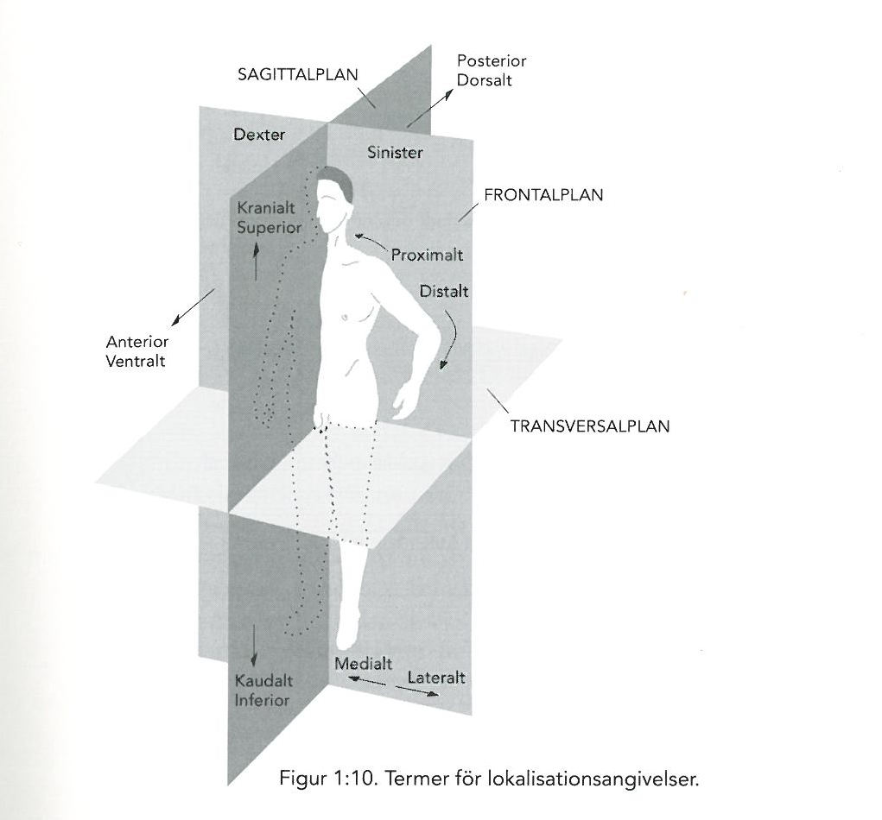
https:// https://no.pinterest.com/pin/537546905501628162/ -sagittal-plane-anatomy-and-physiology.jpg
Notes:
Dyspnea = breathing difficulties
PND = Attacks of severe shortness of breath that awakens the patient
Bruit = Noise, bouldering

Slide 49
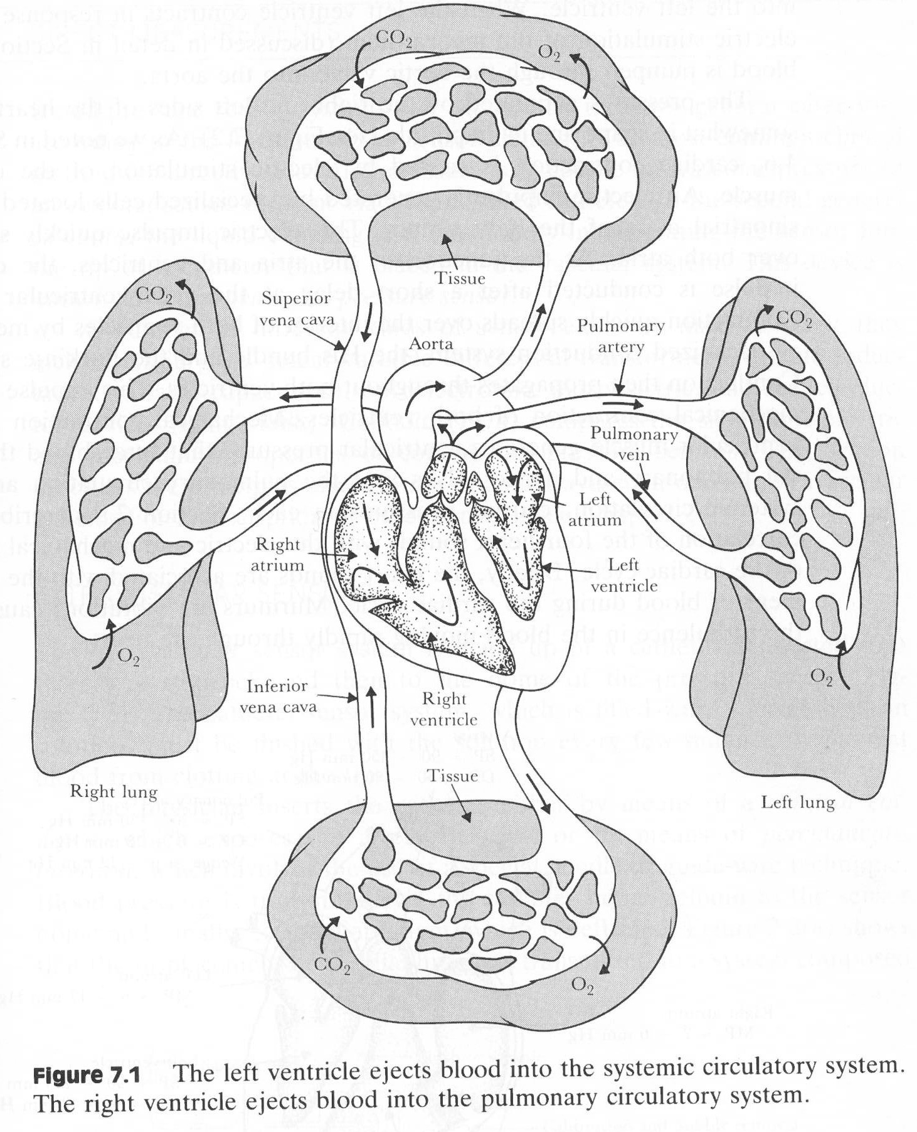
First of all, a short repetition of the circulatory system

Slide 50
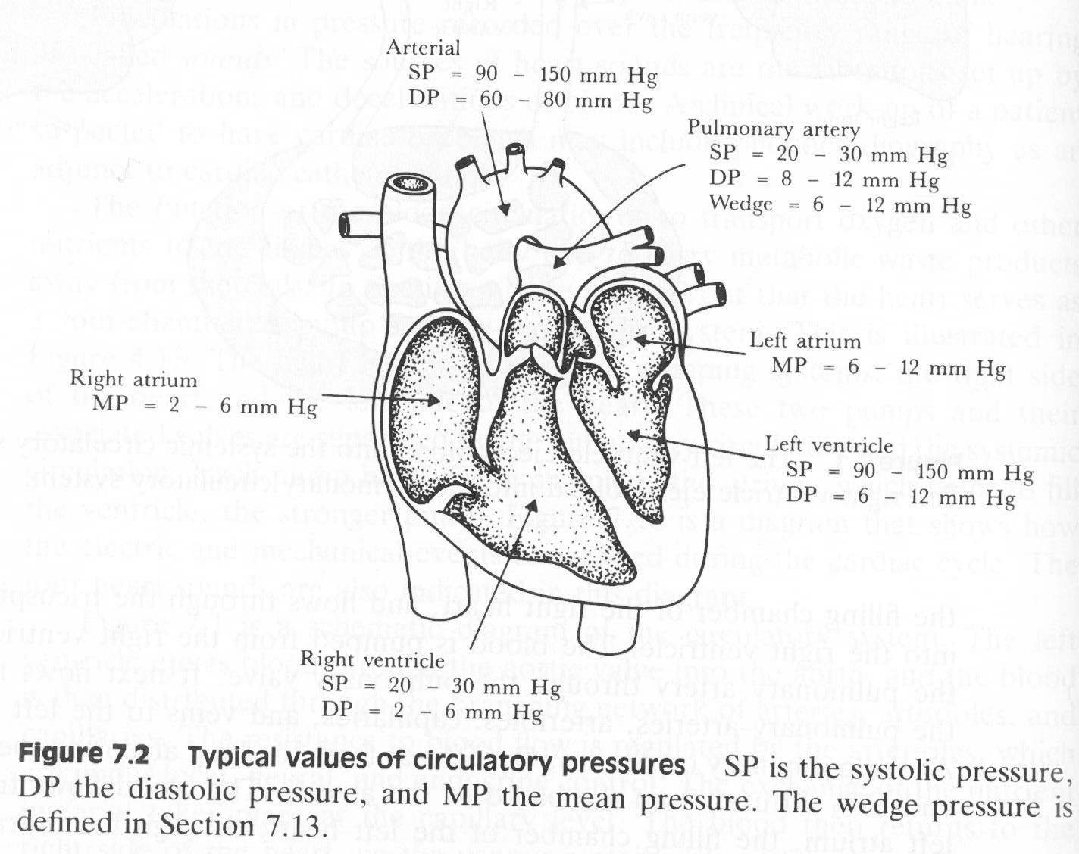
Typical pressures, 1kPa = 7,5 mmHg

Slide 51
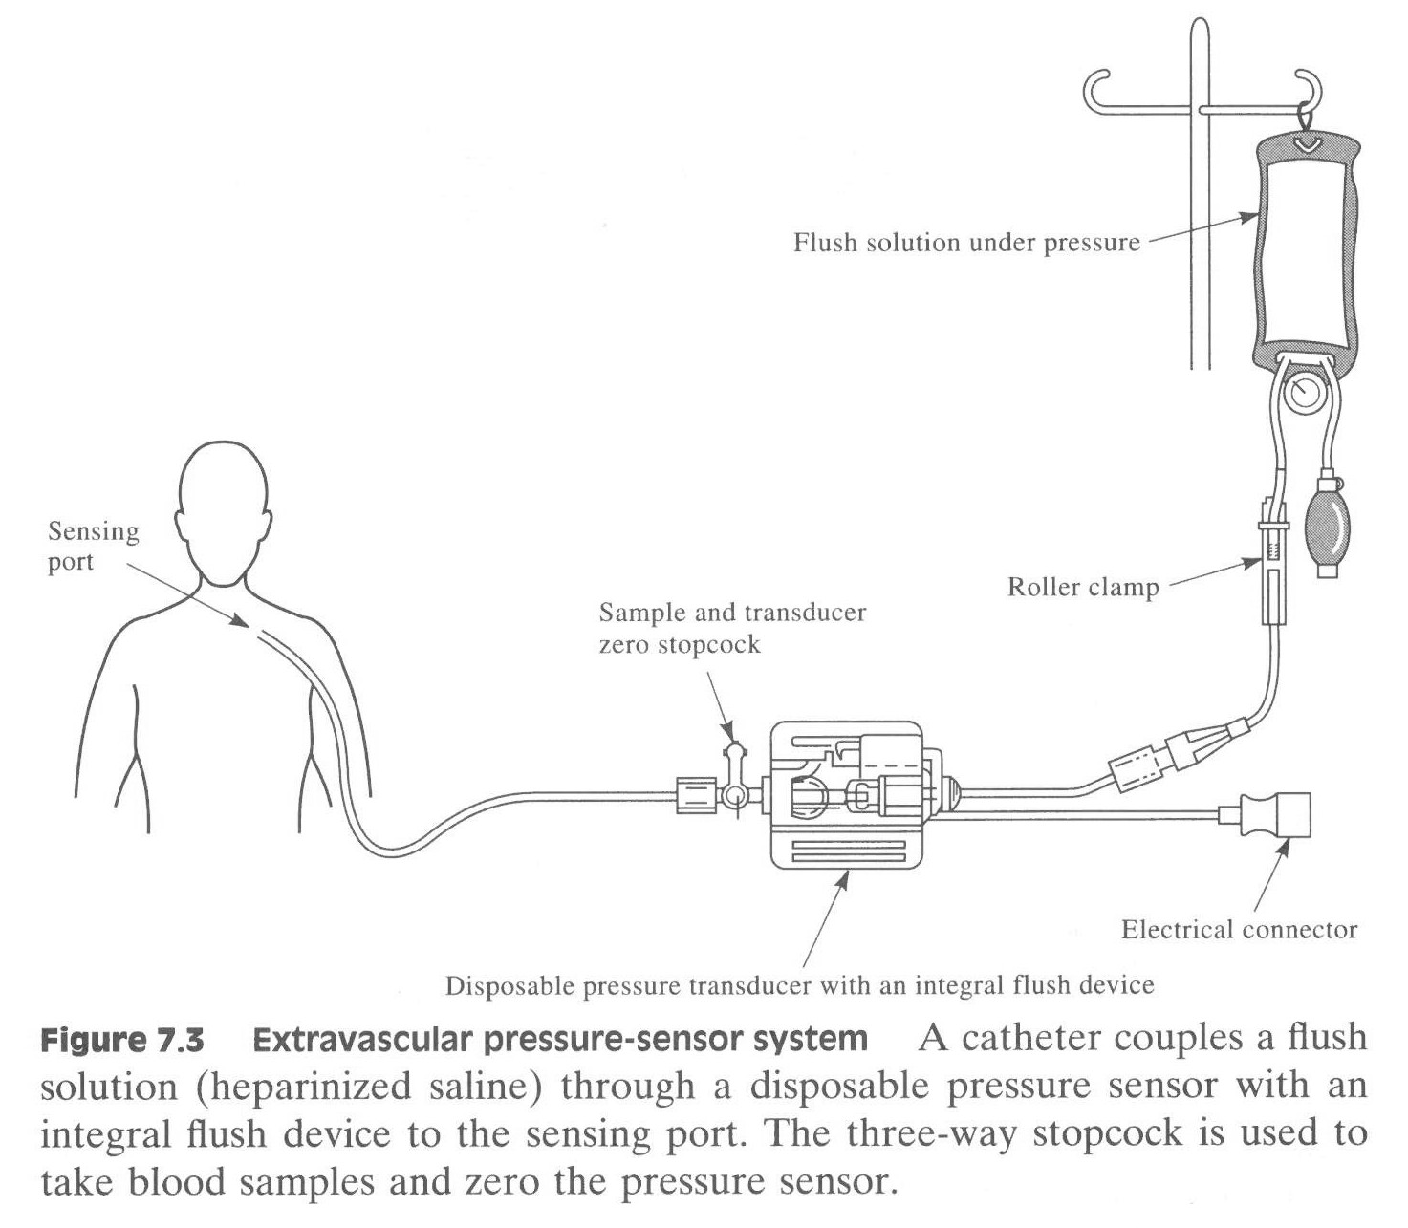
Invasive methods
Extra-vascular pressure sensor
Relative pressure or absolute pressure?
www.Thatsfit.com

Slide 52
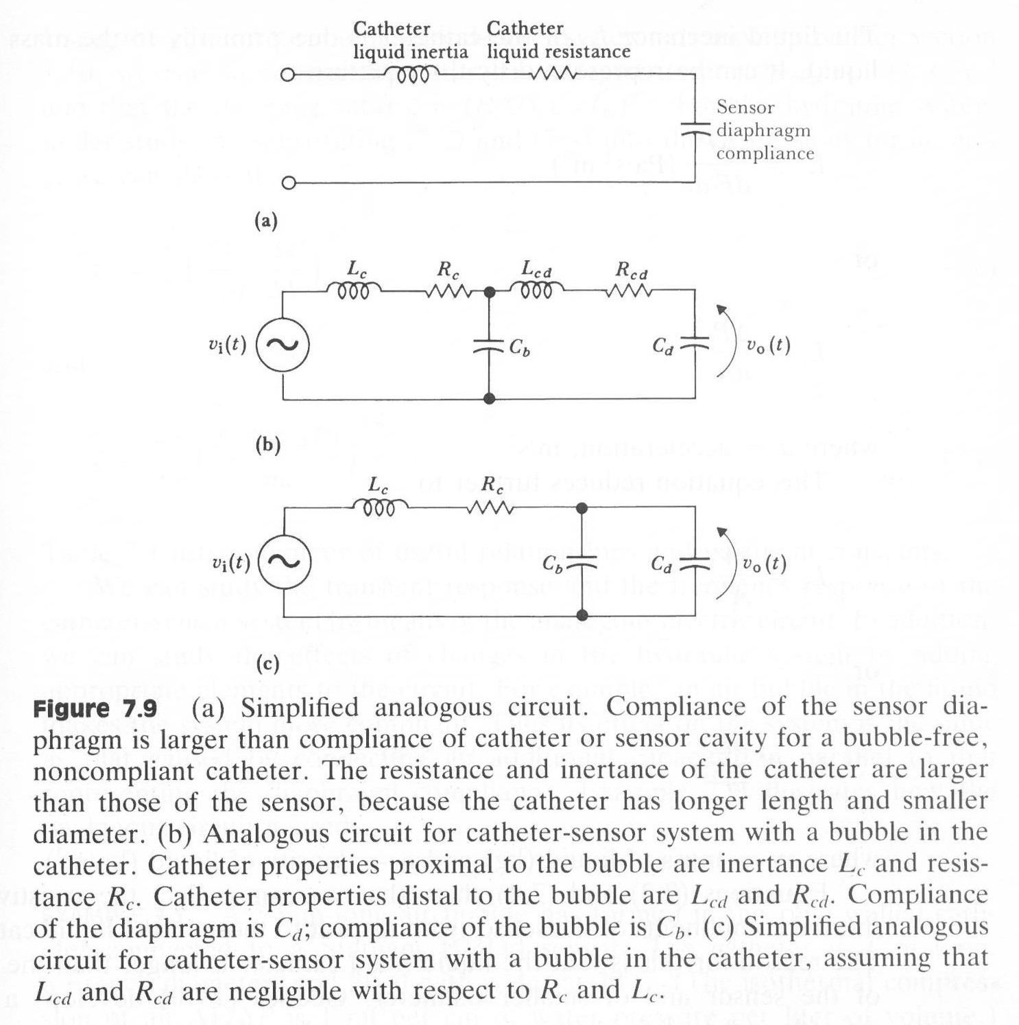
www.Thatsfit.com

Slide 53
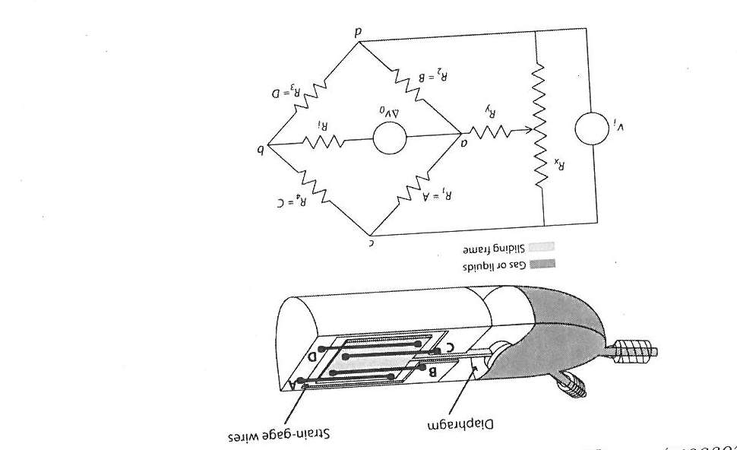
Extra-vascular pressure sensor
Strain-gages
Wheatstone bridge, balanced
Four times amplification
Temperature compensation
When balanced, R2/R1 = R3/R4
Notes:
Temperaturavhengighet, la en være løs. Wheatstone har innebygget temperaturkompensasjon
Fire gangers forsterkning.
Tidligere brukt for å finne ukjent motstand, nå brukt for å måle milli-ohm motstander

Slide 54
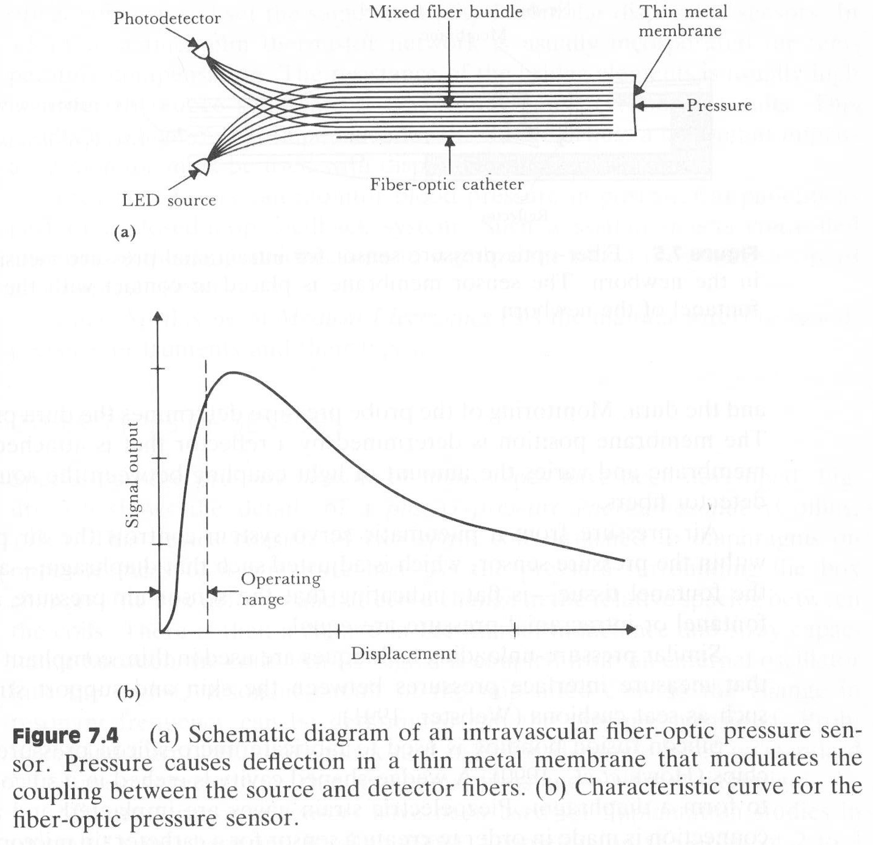
Intra-vascular pressure sensor
Relative pressure or absolute pressure?

Slide 55
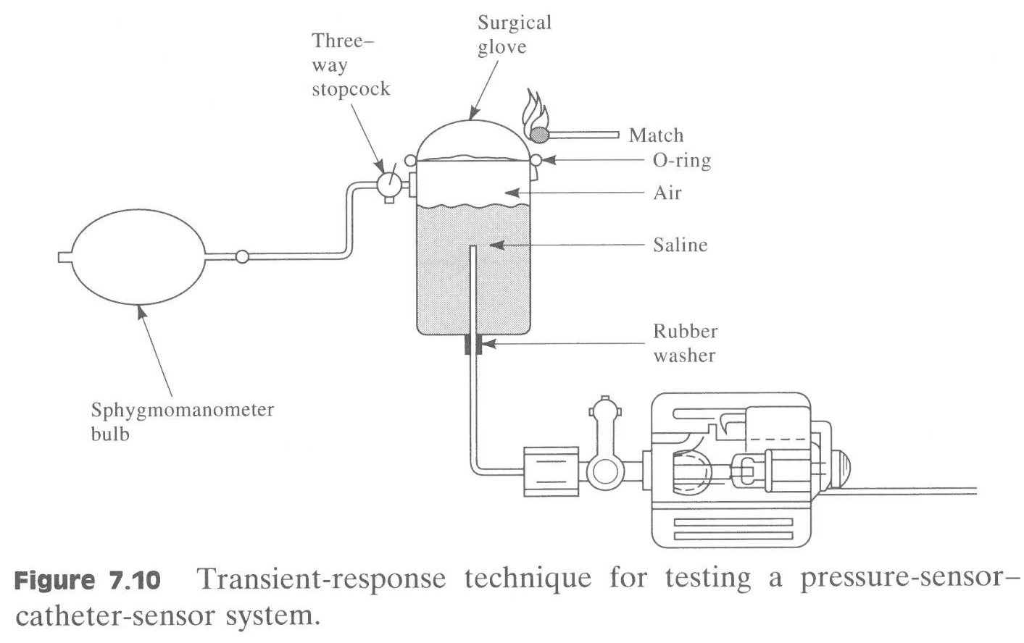
Measuring transient step-response for describing the systems characteristics

Slide 56
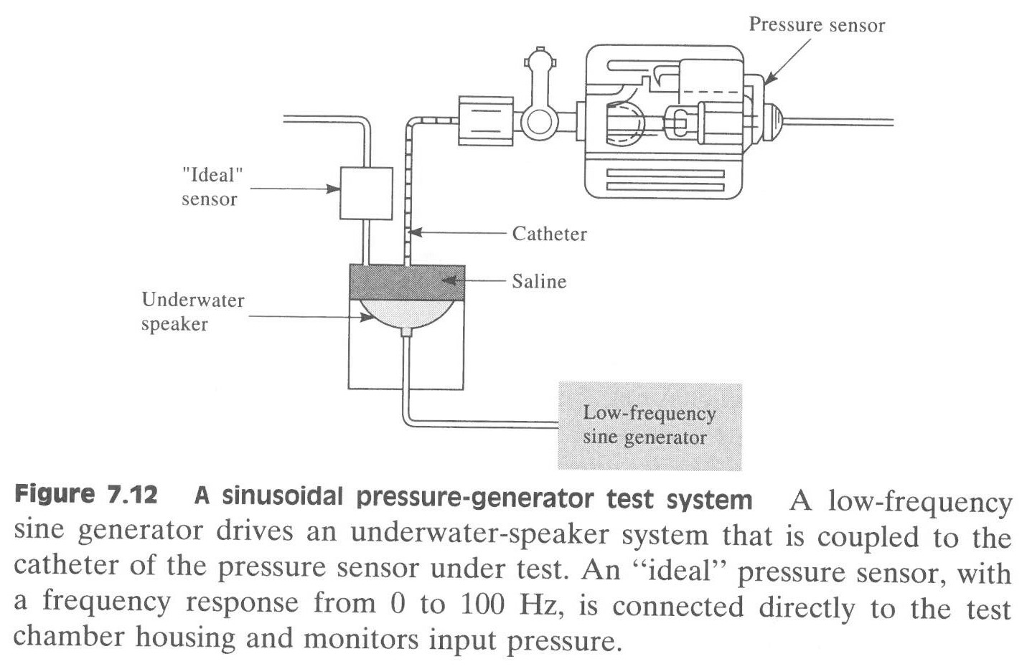
Frequency response testsystem, sine wave

Slide 57
Non-invasive methods
Notes:
Frequency response
Higher damping coefficient = higher damping of the pressure signa
Lowering of fn = distortion problems with higher harmonics of the blood pressure waveform

Slide 58
Wrist blood pressure monitors
https://www.youtube.com/watch?v=BlJbcJ14iF0#action=share

Slide 59
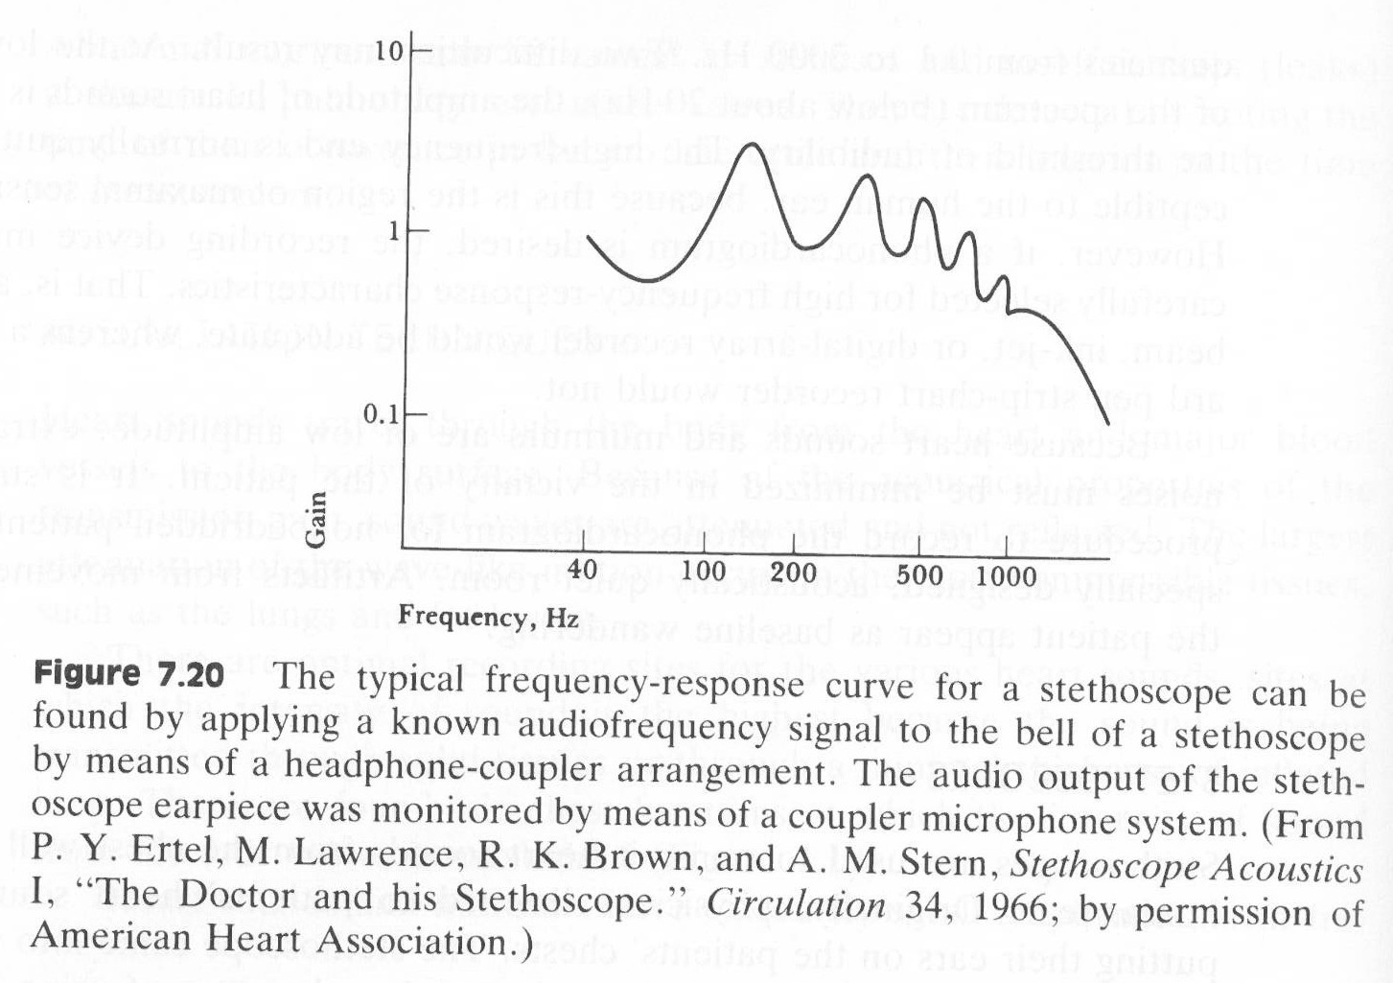
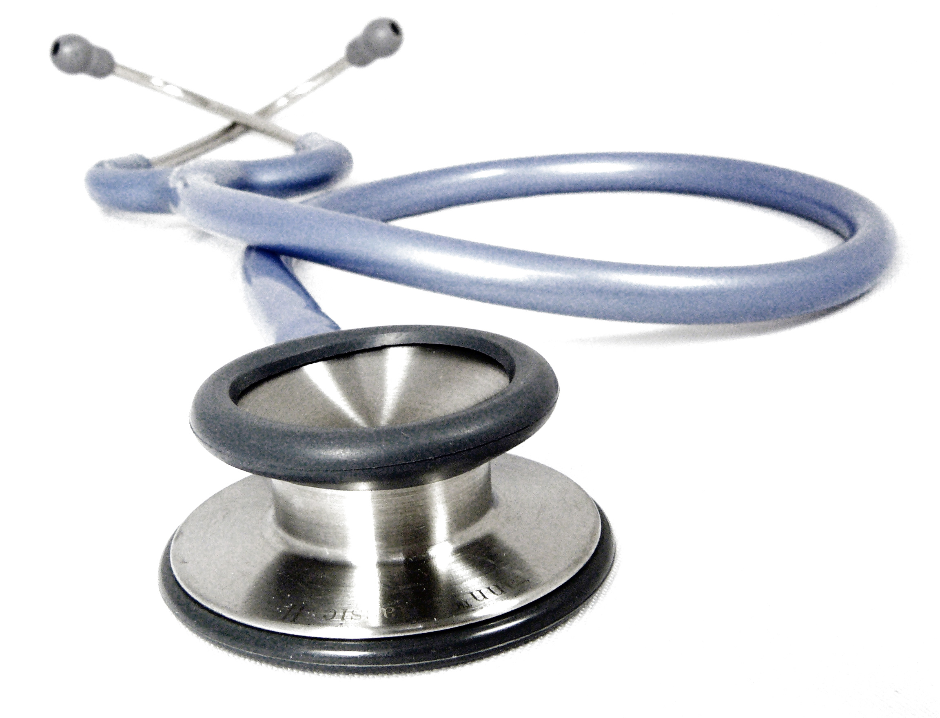
Stethoscope
- Why isn’t digital stethoscopes a success?
Notes:
Transmit heart sounds from the chest wall to the human ear
Amplifies sound due to a standing-vawe phenomenon that occurs every quarter wavelengths of the sound.
Uneven frequency response curve with many resonance peaks
Critical sounds may be lost by an attenuation as little as 3dB
Electronic stethoscopes have flopped => physicians are unfamiliar with the sounds

Slide 60
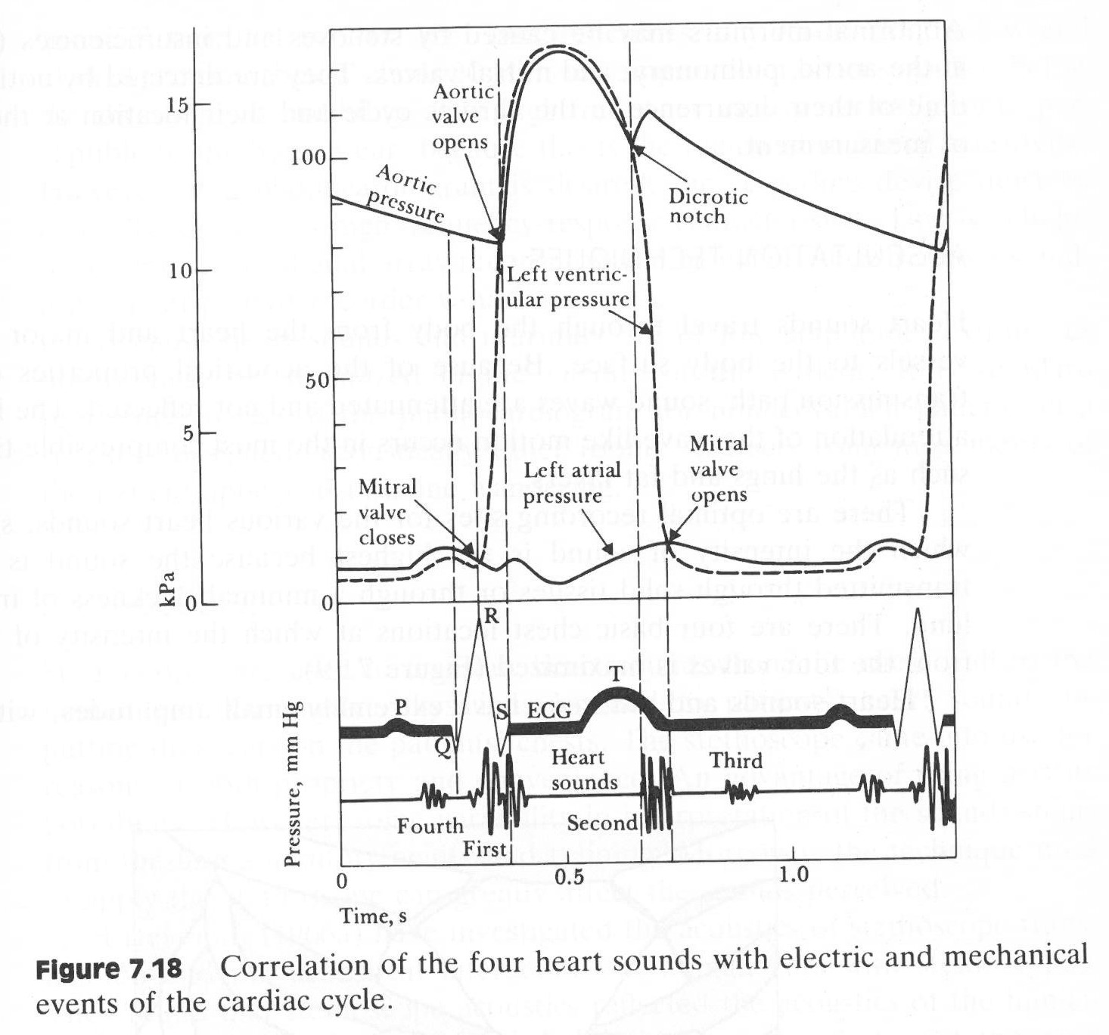
Heart sounds
Movement of blood during ventricular systole. Oscillations of blood between the descending root of aorta and ventricle and blood turbulence at the aortic and pulmonary valves
Low frequency vibration associated with the deceleration and reversal of flow in the aorta and pulmonary artery and closure of semilunar valves
Sudden termination of the rapid filling phase of the ventricles from the atria and the associated vibration of the ventricular muscle walls which are relaxed
Not audible, atria contraction
Notes:
Auscultation of the heart = valuable information
Relationship between heart sounds and mechanical and electric events of the cardiac cycle = phonocardiography
We don’t know exactly the origin of heart sounds
Movement of blood during ventricular systole. Oscillations of blood between the descending root of aorta and ventricle and blood turbulence at the aortic and pulmonary valves
Low frequency vibration associated with the deceleration and reversal of flow in the aorta and pulmonary artery and closure of semilunar valves
Sudden termination of the rapid filling phase of the ventricles from the atria and the associated vibration of the ventricular muscle walls which are relaxed
Not audible, atria contraction
Murmurs, abnormal = stenoses and insufficiences (leaks) at the valves

Slide 61
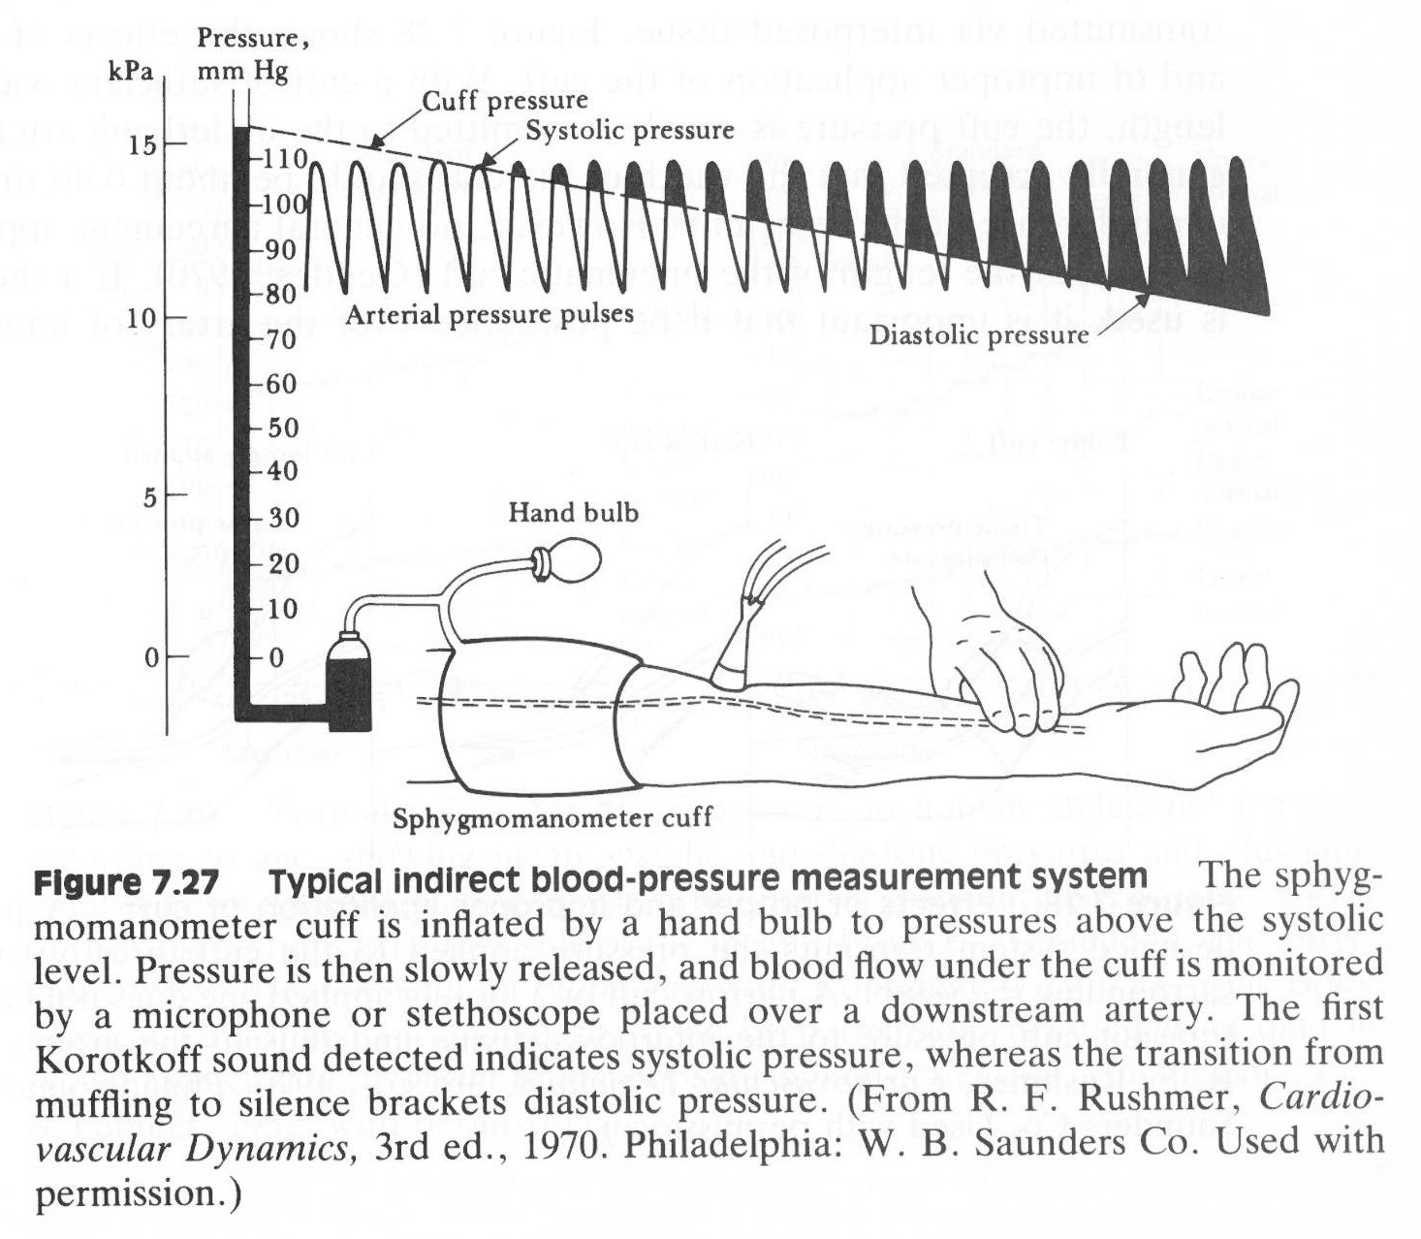
Sphygmomanometer

Slide 62

Case 3
Oscillometric
Notes:
easure amplitude of oscillations created by expansion of the arterial wall
Maximum at the mean pressure
Disadv: No clear transition to identify the diastolic pressure => algorithms to estimate diastolic
Adv: Precise measurement of mean pressure

Slide 63

Ultrasound
Notes:
Difference in frequency between transmitted and received signal = wall motion and blood velocity
Advantage: Can be used with infants and hypotensive individuals and in high noise environments
Disadvantage: Body movements change ultrasonic path between sensor and blood vessel

Slide 64

Microphone
Source: www.nasa.gov

Slide 65
Case 3
Tonometry, the classical way (Schiøtz tonometer)
How do we know that we apply the right pressure?
https://www.alpfmedical.info/visual-acuity/pupil.html
Notes:
Difference

Slide 66

Flattening diameter = 3.06 mm
Contact tonometry, automized
Prerequisitions: Cornea is infinitely thin, perfectly elastic, perfectly flexible
Internal pressure can be calculated by measuring the necessary force F that can flatten a certain area (A) of the sphere p=F/A
Best correction if the flattened area has a diameter of 3.06 mm
Notes:
Internal pressure can be calculated by measuring the necessary force F that can flatten a certain area (A) of the sphere p=F/A
Best correction if the flattened area has a diameter of 3.06 mm

Slide 67

Non-contact tonometry
Air pulse deforms and flattens central cornea
Collimator A
Linear relationship between intra-ocular pressure and the time interval to applanation
Notes:
Principle: When a pressureized vessel is partly collapsed by an external object, circumferential stresses in the vessel wall are removed and the internal and external pressures are equal.
Air pulse deforms and flattens central cornea
Collimator A
Linear relationship between intra-ocular pressure and the time interval to applanation
Perfect for detection of Glaucoma

Slide 68
FYS 4250
Lecture 4 Highlights

Slide 69

Case 4, the pH electrode
Normal value: 7.36 – 7.44
Notes:
pH = -log(10)[H+] normal range <7.38, 7.44>
Decreased pH = respiratory acidosis (metabolic/respiratoric)
Generates an electrical potential when solutions of differing pH are placed on the two sides of the membrane. (Reacts only to specific ion)
Approach of Hydrogen outside -> positive charges inside ionic solution
60 mV pr pH unit (Nernst equation) -> pH range of only 0.06 units -> measure changes of 0.1 mV
Known pH inside (HCl)
Salt bridge to prevent chemical constituents of the specimen from affecting the voltage of the reference electrode
pH meter -> exremely high input impedance (internal impedance of the pH electrode is in the 10 to 100 Mohm range

Slide 70

Case 4, pH
Fluorescent dyesensor
Notes:
Irreversible reactions -> long-lasting reagent
Cellulose matrix
Fluorescent dyes emit light energy at a wavelength different from that of the excitation wavelength, which they absorb

Slide 71

Case 4, the pCO₂ electrode (Severinghaus)
Notes:
Relationship between log pCO2 and pH is linear over the range of 1.3 to 12 kPa = range of clinical interest
One specimen chamber and one pH electrode chamber
Only a proportional relationship -> calibrate the instrument before each use

Slide 72

Case 4, the pO₂ electrode (Clark)
Notes:
Oxidation at the reference electrode: 4Ag + 4Cl- -> 4AgCl + 4e-
Reduction at cathode: O2 + 2H2O+4e- ->2H2O2 + 4e- -> 4OH-
4OH- + 4KCl -> 4KOH + 4Cl-
The relating current is linearly proportional to the number of O2 molecules in solution
PO2 level is zero = background current -> part of the calibration procedure
Consumes O2 - depleting of oxygen near the electrodes - > stirring effect when moved -> have to wait for stagnant equilibrium
Sensitive to temperature

Slide 73

Saturation
A relative measure of the amount of oxygen that is carried in blood by hemoglobin
Notes:
Optical absorption spectra for oxyhemoglobin
805 nm independent of degree of oxygenation = isobestic wavelength (infrared)

Slide 74

Pulse oximetry
PULSE oximetry, Lambert-Beer Law
Notes:
Analyzing the AC component with two wavelengths. DC component is used to normalize AC signals
Absorbance or reflection
2.5% accuracy within 50-100%
Saturation < 76% is life threatening

Slide 75

Termistorbridge velocity meter
Notes:
Two problems of constant current sensor circuit:
Time constant of the sensor embedded in the probe is a few tenths of a second, too long for the desired frequency respons of 0 to 25 Hz
To achieve reasonable sensitivity at high velocities -> high sensor current -> lack of cooling when flow stops -> increased temp (5 deg above body temp) ->fibrin coats the sensor
Constant temperature sensor overcomes problems:
Ru is heated. Velocity increases -> Ru cools and resistance increases -> more positive voltage on the pos terminal -> increased vb -> increased bridge power -> increased Ru -> cooling is counteracted
High-gain negative feedback -> bridge is always in balance -> constant temp at Ru
High gain negative feedback divides sensor time constant by a factor equal to the loop gain = improved frequency response
Varying blood temperature -> Rt (temperature compensating thermistor)

Slide 76

Plethysmography
Notes:
Measures changes in volume

Slide 77

Plethysmography curve

Slide 78


Impedance-plethysmography
Notes:
Blood volume changes/lung volume changes, impedance will change.
Swansons model require three assumptions:
Expansion of the arteries is uniform
Resistivity of blood does not change
Lines of current are parallel to arteries
Frequency of about 100 kHz because:
Desirable with a current greater than 1 mA to achieve adequate SNR. Low frequencies will cause an unpleasant shock -> frequencies above 20 kHz is used to avoid perception of the current
High frequencies are used to decrease both skin-electrode impedance and motion changes in impedance
Freq > 100 kHz will be vulnerable to low impedance stray capacitances

Slide 79
FYS 4250
Lecture 5 Highlights

Slide 80

Figure 9
One-way
small portable
resuscitation
system
Notes:
Pressure in bag will not raise proportionally to its filling
Tubes are of a spiralled type so that they do not collapse at low pressures

Slide 81

Lung volumes
http://www.frca.co.uk/images/lung_vol.gif

Slide 82

Figure 23
Servocontrolled ventilator
shown in the inspiration cycle
Notes:
Reservoir setting the maximum pressure

Slide 83
Pressure vs Volume controlled ventilation
Pressure controlled | Volume controlled
Advantages
Reduction of peak pressure and risk of barotrauma | Maintains constant tidal volume
Improved gas exchange due to decelerating flow | Better control of partial pressure of carbon dioxide in arterial blood
More homogeneous ventilation in cases of distribution disorders
Compensates for system leaks
Disadvantages
Hypoventilation secondary to changes in lung compliance and resistance | Potential for high airway pressures and acute lung injury
 | Inability to compensate for leaks
http://www.frca.co.uk/images/vent-fig4.jpg

Slide 84

Figure 11
Sidestream sampling
to a multigas analyzer
Notes:
Important properties:
Response time
Selectivity
Calibration

Slide 85

Figure 12
Mainstream sampling
Notes:
Real time
Difficult to realize multigas analysis in one sensor head
No thin tube to be obstructed
Sensor head optics must be cleaned frequently
Sensor head increase dead space
Sensor head heavy, fragile and warm

Slide 86

Figure 14
Multigas spectrophotometric gas analyzer
with rotating filter wheel
Notes:
The better optical system, the better selectivity.

Slide 87

Hemodialysis

Slide 88

Peritoneal dialysis
Notes:
Use the abdominal cavity as a membrane

Slide 89
FYS 4250
Lecture 6 Highlights

Slide 90

Spatial resolution of imaging modalities
Bushberg et al, The essential physics of medical imaging

Slide 91

X-ray tube
What is the minimum wavelength?
Electron hits target -> all kinetic energy converted into a photon
Work done on each electron when accelerated to the anode is eV
hf = eV
Fmax=eV/h
Thus Landa (min) = hc/eV
Notes:
What is the minimum wavelength?
Electron hits target -> all kinetic energy converted into a photon
Work done on each electron when accelerated ont the anode is eV
hf = eV
Fmax=eV/h
Thus Landa (min) = hc/eV

Slide 92

X-ray tube
Bushberg et al, The essential physics of medical imaging

Slide 93

Attenuation as a function of x-ray energy
Bushberg et al, The essential physics of medical imaging

Slide 94

Fotonspectrum X-ray tubes
Two mechanisms => Bremsstrahlung (deceleration of arriving electron) and characteristic radiation (electrons fill holes)
Characteristic radiation
58 keV = l-shell electron filling up hole in k-shell
68 = distant electron filling up hole in k-shell
Less than 1% of the energy supplied is converted into x-radiation, rest is heating of the object.
Notes:
Two mechanisms => Bremsstrahlung (deceleration of arriving electron) and characteristic radiation (electrons fill holes)
Characteristic radiation
58 keV = l-shell electron filling up hole in k-shell
68 = distant electron filling up hole in k-shell
Less than 1% of the energy supplied is converted into x-radiation, rest is heating of the object.

Slide 95

Compton-spread: photon vs free electron
Secondary radiation,two mechanisms:
Photoelectric effect, characteristic radiation
Compton spread
Secondary radiation has always lower energy than the primary
Notes:
Secondary radiation,two mechanisms:
Photoelectric effect, characteristic radiation
Compton spread
Secondary radiation has always lower energy than the primary

Slide 96

X-ray system
Electrons are colliding with metal, releasing energy. (Knocking electrons out of shell, outer electrons drop down to fill the vacancy -> emitting x-ray photons)
Electron beam is controlled by adjusting the filament current
Notes:
Electrons are colliding with metal, releasing energy. (Knocking electrons out of shell, outer electrons drop down to fill the vacancy -> emitting x-ray photons)
Electron beam is controlled by adjusting the filament current

Slide 97

Field coverage and focal spot
Effective focal length = actual focal length x sin ⍬
Large focal spot allows greater x-ray beam intensity, but loss of spatial resolution
that increases with the distance between object and receptor
High x-ray output allows short exposure times

Slide 98

Source of error: Width of focal source

Slide 99

Geometrical resolution
Notes:
X-ray travels in straight lines
Not deflected by electric field or magnetic field
High penetrating power

Slide 100

Modulation transfer function (MTF)
Notes:
MTF = modified form of spatial-frequency response of an element or entire imaging system = a way of describing the system performance
Measuring amplitude response as a function of spatial frequency

Slide 101

Notes:
Assume that amplitude is zero past the first phase rotation (crossover)
Sinusoidal test object = difficult -> square bar pattern
Fourier transformed
Low frequency contrast is assumed to be the amplitude value of the MTF at 0.1 lp/mm

Slide 102

Resolution
Image = surface with a spatial resolution expressed in terms of line pairs per millimileter
Using a scanner
Pixel = a space on the image surface having a dimension of one-half cycle of bandwith on the horizontal axis and the same dimension on the vertical axis.
Pixel defines the smallest size of an object for which amplitude information can be preserved
Notes:
Image = surface with a spatial resolution expressed in terms of line pairs per millimileter
Using a scanner
Pixel = a space on the image surface having a dimension of one-half cycle of bandwith on the horizontal axis and the same dimension on the vertical axis.
Pixel defines the smallest size of an object for which amplitude information can be preserved

Slide 103

Subtraction image
Two pictures, one with inverted contrast is subtracted, and voila.
Notes:
Two pictures, one with inverted contrast is subtracted, and voila.

Slide 104

Computertomograph (CT)

Slide 105
What is the CT?
Mathematical transform to the measured data.
Reconstruct n dimension function (image)
=> projection data of n – 1 dimension
Radon Transform (1917)
“Two dimension and three dimension object can be reconstructed from the infinite set of projection data”.
The First CT: 1973 in the U.S.
4 minutes scan, thickness of 10mm

Slide 106

Rapidscanner
Notes:
Faster than 30 images per second. Insted of rotating 200 kg mass, the electron beam strices a cirkular anode with the patient inside the circle. Stationary detectors.

Slide 107

1., 2. and 3. generation scanner
Linear translation + rotation
Circular scanning
Volume scanning

Slide 108







Concept of CT
・Getting the shape by back projection of the projection data.
・For example, outward view is the quadrangle => it is the cylinder
CT
Algorithm

Slide 109
Basic principle of CT
-Reconstruction of 2 dimensional image-
Projection Data
curvilinear integral of absorption coefficient regarding Y
y
y
X-ray detector array
X
Y
X
object
x
x
X
X-ray
tube
Data Acquisition field
Reconstruction field
Blur
Simple Backprojection

Slide 110

Image reconstruction
Notes:
The two dimensional function is determined by its projections in all directions.
Two mathematical methods:
Iterative = An initial guess about the two-dimensional pattern of x-ray is made. Projection data predicted by this guess are then calculated and used for comparison with the measured results. Discrepancies between the measured and the modelpredictions are employed in a conetinuous iterative improvement of the model array
Analytic = image is reconstructed directly from the projection data without any recourse to comparison between the measured data and the reconstructed model.

Slide 111

Back-
projection
(1)

Slide 112

Back-
projection
(2)

Slide 113
Basic principle of CT
-Reconstruction of 2 dimensional image-
Projection Data
x
y
＊
Filtered Projection data
Reconstruction Filter
X
x
x
ω
or
Multidirectional
Backprojection
x
Filtered Backprojection

Slide 114

Iterative techniques - CT
https://en.wikipedia.org/wiki/Iterative_reconstruction#/media/File:Heart-direct-vs-iterative-reconstruction.png

Slide 115

Iterative = An initial guess about the two-dimensional pattern of x-ray is made. Projection data predicted by this guess are then calculated and used for comparison with the measured results. Discrepancies between the measured and the modelpredictions are employed in a conetinuous iterative improvement of the model array
Radiology 2015

Slide 116

Iterative process
Imagine views are collected from 4 angles, 0, 45, 90 and 135. Each measurement is represented as the sum of voxel attenuations. This leads to six equations:
X₁= U₁ + U₃ and so on, 6 equations with 4 unknown. Can be solved mathematically, but timeconsuming when the matrix is getting large.
The iterative algortihm (ART = Algebraic Reconstruction Technique) is demonstrated for a 2x2 matrix
The last estimate match all measurments -> accepted
What is the weakness? Due to random error, no iteration will match perfectly
Lee Goldman. J Nucl Med Technol 2007; 35:115–128

Slide 117

CT x-ray tube
Bushberg et al, The essential physics of medical imaging

Slide 118

Voxels
Bushberg et al, The essential physics of medical imaging

Slide 119

Detector

Slide 120

Detector array

Slide 121

Cardiac CT

Slide 122

Cardiac CT

Slide 123

Multislice CT
Several rings of detectors for multiple scanning of several layers.
Time efficiant, a 4 slice multislice CT is up to 8 times faster than a single slice CT
Possible monitoring of a beating heart ++

Slide 124
FYS 4250
Lecture 7 Highlights

Slide 125

Electrosurgery

Slide 126

fra Grimnes&Martinsen: ”Kirurgisk diatermi”

Slide 127

Bipolar electrosurgery
14 Grimnes & Martinsen: Kirurgisk Diatermi
Fig 1.7 Bipolar mode. No return electrode
Notes:
Bipolar teknikk uten N-PLAT
Kort STRØMVEG
LAVERE effekt mindre støy
Men bare hel lokalt
ikke de fordeler Mono-p gir

Slide 128


Elektromagnetic flowmeter
Notes:
Faraday’s law of induction
Blood moves through a magnetic field, electromotoric force is induced
B = magnetic flux
L = Length between electrodes
U = velocity of blood
Uniform magnetic field B and uniform velocity profile u and orthogonal components => e=Blu
Otherwise e= Integral from 0 to L1 u X B dL
Can measure instant flow, indicator dilution will only measure average flow

Slide 129

Sensitivity of the electrodes
Notes:
Best measurements with electrodes outside the vessel
Measures correctly for a uniform flow profile, otherwise only correct for average flow velocity
Sources of error:
Asymmetric velocity profile
High velocity generates higher incr. Emfs = circulating currents in the transverse plane = varying drops in resistance within the conductive blood and tissue
Conductivity varies with HCT
Extravascular fluid has greater conductivity = shunting of flow signal
Magnetic flux density is not uniform along the axos => circulating currents in axial direction

Slide 130

Electromagnetic flowmeter waveforms
Notes:
DC floweters are useless:
Voltage across electrode interface is in series with the flow signal. Even with nonpolarizable electrodes, random drift of this voltage is of the same order as the flow signal -> impossible to separate
ECG has a waveform and frequency content similar to the flow signal = interference
In the frequency reange 0 to 30 Hz, noise in the amp. Is large = poor SNR
AC flowmeters are much better
Operating at 400 Hz. < gives bulky sensors, > stray capacitance problems
Transformer voltage = Shaded loop in previous picture is not exactly parallel to B field -> induction of transformer voltage prop to dB/dt in the output voltage. (Many times larger than fllow voltage)
Solution:
Separate one elctrode in two in the axial direction=> tilt the shaded loop to exactly parallel to B field
Measure when the transformer voltage is zero. (Undesired phase shifts may cause large errors and drifts
Use Quadrature suppression circuit

Slide 131

Quadrature-suppression flowm.
Notes:
Magnitude of voltage from amplifier is detected by quadrature demodulator
What is a demodulator? Conventional method of finding deviation from nominal freq = convert to phase and detect change. In quadr shift signal 90 deg at the center frequency, depending on the direction of deviation this shift is either greater or less than 90 deg -> Can be detected. (extracting amplitude and phase information from a carrier wave)
Quad generator produce a signal proportional to the transformer voltage => balancing out transformer voltage at the input. (Reducing TFV by a factor 50)
Low noise FET for amplifier input stagen, proper turns ratio on the step up transformer and full-wave demodulators = Excellent SNR
Low pass filter => dc output

Slide 132

What is the magic with the quadrature demodulator?
Think about a TV or radio signal, you need to extract the information from the carrier wave to produce the original TV/radio signal
The simplest demodulator is a high-pass filter
Converting a signal from a frequency to a voltage
The RF signal is multiplied with the local oscillator and the 90 degrees shifted signal
The low-pass filter is needed to suppress the high-frequency content associated with the spectrum centered around 2fc (carrier frequency)
https://www.allaboutcircuits.com/textbook/radio-frequency-analysis-design/radio-frequency-demodulation/understanding-quadrature-demodulation/

Slide 133



Cell saver
Recycled blood
Anticoagulant
Blood
Anti coag
Anticoagulant and blood from the wound is mixed
Red blood cells are collected and reinfused into circulation
Anticoagulant and blood are stored in a reservoir, if necessary a vacuum pump is inserted in the circuit
Sterile saline
Sterile
Saline
Centrifuge
Then the solution is flowing into a centrifuge together with saline, separating red blood cells from plasma, WBC, platelets, anticoagulant, fat, and free plasma HGB
Waste
Notes:
Why do you need a second blood bag?

Slide 134

Laparoscopy
Started early in 1900, first diagnosis, then therapy
Necessary equipment
- Camera and monitor
- Three-chip high definition videocamera (700 lines per inch)
- High definition monitor
- Light source
- Xenon light source
- Fiberoptic cables
- High-flow insufflator
- CO2 gas (pressure 10-15 mmHg)
- Laparascope
- Surgical instruments

Slide 135

Minimal invasive surgery

Slide 136
FYS 4250
Lecture 8 Highlights

Slide 137

Swan-Ganz Catheter (Pulmonary artery catheter)

Slide 138


Fick’s
method,
cardiac
Output
(Continuous)
Notes:
Indicator-dilution method that uses continuous infusion
Adv: nontoxic
Disadv: Unpleasant for the patient, requires image guiding, must be placed in pulmonary artery due to different O2 concentrations in the atrium. Exhaled CO2 absorbed in a soda-lime canister -> O2 consumption is indicated directly by the net gas-flow rate. (Inaccurate). Inconvenient
Flow = change in volume per time = change in quantity m of indicator per time divided by incremental increase in concentration
Dm/dt = consumption of O2
Delta C = Ca-Cv concentration of O2 liters

Slide 139


Doppler flowmeter, sinewave
Notes:
Low pass filtered to produce an output proportional to the velocity of blood
No sense of direction
Sources of error:
Carrier signal is larger than the doppler signal
Some of the RF signal is directly coupled to the reciever through an electric field
Some carrier signal travels a direct acoustic way to the reciever through side lobes
Doppler signal = 0.1% of the received signal
Not a single frequency:
Cells move at different velocities
A cell remains within the beam for a short time => time-gate function => band of frequencies
Side lobes causes different frequency shifts
Tumbling of cells and local velocities resulting from turbulence cause differend D. Shifts
A high gain would be desirable, but due to the strong carrier signal saturation must be avoided
Frequency deviation is only 0,001 of the carrier frequency
High pass filter to remove slow motion of walls -> loose slow cell velocities near the wall
Zero crossing detector = convert AF frequency to a proportional analog output signal -> emitting a constant area pulse for each crossing of the zero axis

Slide 140

Quadrature-phase detector
Notes:
Phase shift network splits the carrier into two components that are in quadrature (90 deg apart)

Slide 141


Directional flowmeter waveforms
Notes:
If the blood flow is toward the transducer, doppler frequency is higher than the carrier frequency, doppler vector rotates counter clockwise. (Dashed waves)
Sign of the phase will determine the direction
Doppler frequency is in-phase but will affect the amplitude
Important: The velocity is in the frequency, the direction in the phase

Slide 142


Cerebral oximetry
http://www.perfusion.com/cgi-bin/absolutenm/articlefiles/chen2008/chen2008.pdf

Slide 143

Cerebral oximetry
http://www.perfusion.com/cgi-bin/absolutenm/articlefiles/chen2008/chen2008.pdf

Slide 144

Ultrasoundsurgery

Slide 145
Electrosurgery vs Ultrasoundsurgery
Adv. Ultrasoundsurgery
Can cut through thicker tissue
Greater precision
Less toxic surgical smoke
Less lateral thermal damage
Disadv. Ultrasoundsurgery
Takes more time to cut and coagulate
Can only coagulate as it cuts

Slide 146

Intraoperative Navigation
1st step: Preoperative Scan
Utilization of preoperative scans – no navigation scan necessary
No fiducials necessary
Benefit: Reduction of radiation dose for patient
Source: Brainlab

Slide 147



Intraoperative Navigation
2nd step: Intraoperative preparation – Patient reference star
Non-invasive referencing with headband - generally used for sinus surgery in ENT
Minimal invasive referencing in bone structure - generally used for skull base surgery, lateral indications or CMF cases
Benefit: Referencing according to needs and indication.
Source: Brainlab

Slide 148


Intraoperative navigation
3rd step: intraoperative registration
Surface scanning with a laser
No given registration points or registration routes
Registration accomplished in one minute
Registration possible in a sterile environment
Benefit: Touchless registration saves sterile environment.
Source: Brainlab

Slide 149

Intraoperative Navigation
4th step: Navigation
Benefit: Time saving setup and workflow as well as advanced functionalities
Source: Brainlab

Slide 150
7 things to remember
The intention of this course is to give you the big overview of the field of medical technology. Don’t get lost in details! (Although you’ll need some details to get the best results)
A good sketch can tell more than thousand words
Find the principles and make sure you’re able to explain them
Try to be able to compare different technologies doing the same things. Find sources of error, advantages and disadvantages for each and compare them
Medical terms are not a part of this course, they are used so that you should be more familiar with some of them. However, you should now some of the diseases that is closely connected to the technology. (E.g. why do we measure pressure inside the eye? = glaucoma)
Physiology and technology complement each other. You’ll need some basic physiology to understand the technology
Before your exam, try to explain some of the topics for persons that are not familiar with the topic

Slide 151

Good luck!

