Slide 1
Practical info for the site visit at Rikshospitalet, Tuesday 18.11.25

Slide 2
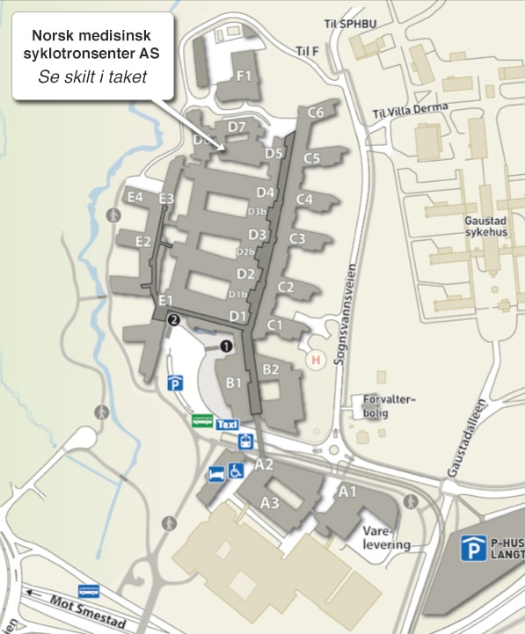
NB! Meet at Rikshospitalet Tuesday 18.11.2025 at. 14.15
Meet at Rikshospitalet, Medisinsk-teknologisk avdeling (MTA), entry from D2, 3. floor
Main entrance
Walk in the main entrance, then you end up in the «glass corridor» (glassgaten), because of the glass roof. Take right and follow the glass corridor to entrance D2. Take the elevator up to the third floor. Take right when you walk out of the elevator, and into a long corridor, you’ll see the name «Medisinsk-teknologisk avdeling» over the door to the corridor.
At the end of the corridor, take right and keep going till you see some chairs and a coffe-machine. Take a chair and relax!.
If lost, call Jan Olav på telephone: +47 979 56 729

Slide 3
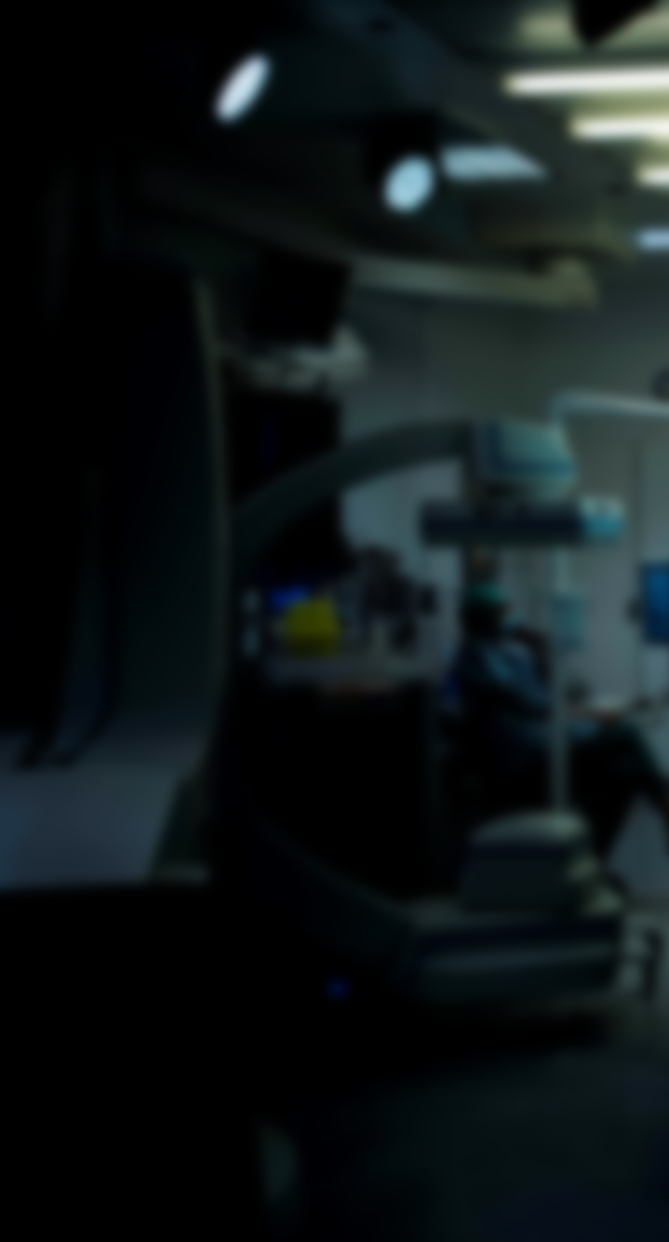
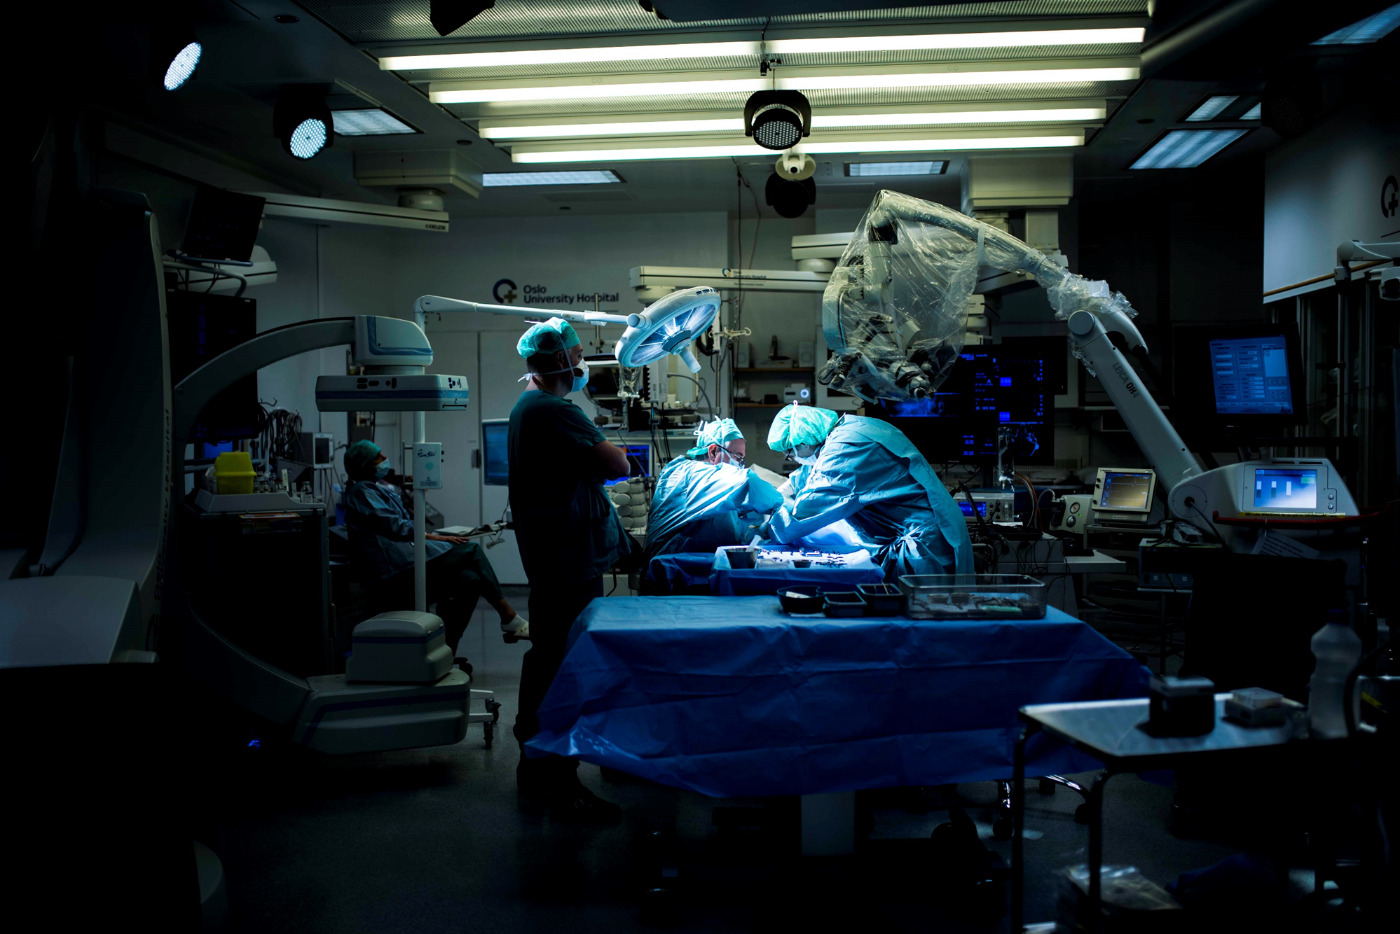
«The two areas that are changing... are information technology and medical technology. Those are the things that the world will be very different 20 years from now, than it is today».
Bill Gates
Welcome to Rikshopsitalet tomorrow!

