Slide 1
Light microscopy
Lysmikroskopi
Optical microscopy
MENA3100,OBK, 27.01.16

Slide 2
28th. January
What?
Crystallography
Where?
Ø467

Slide 3
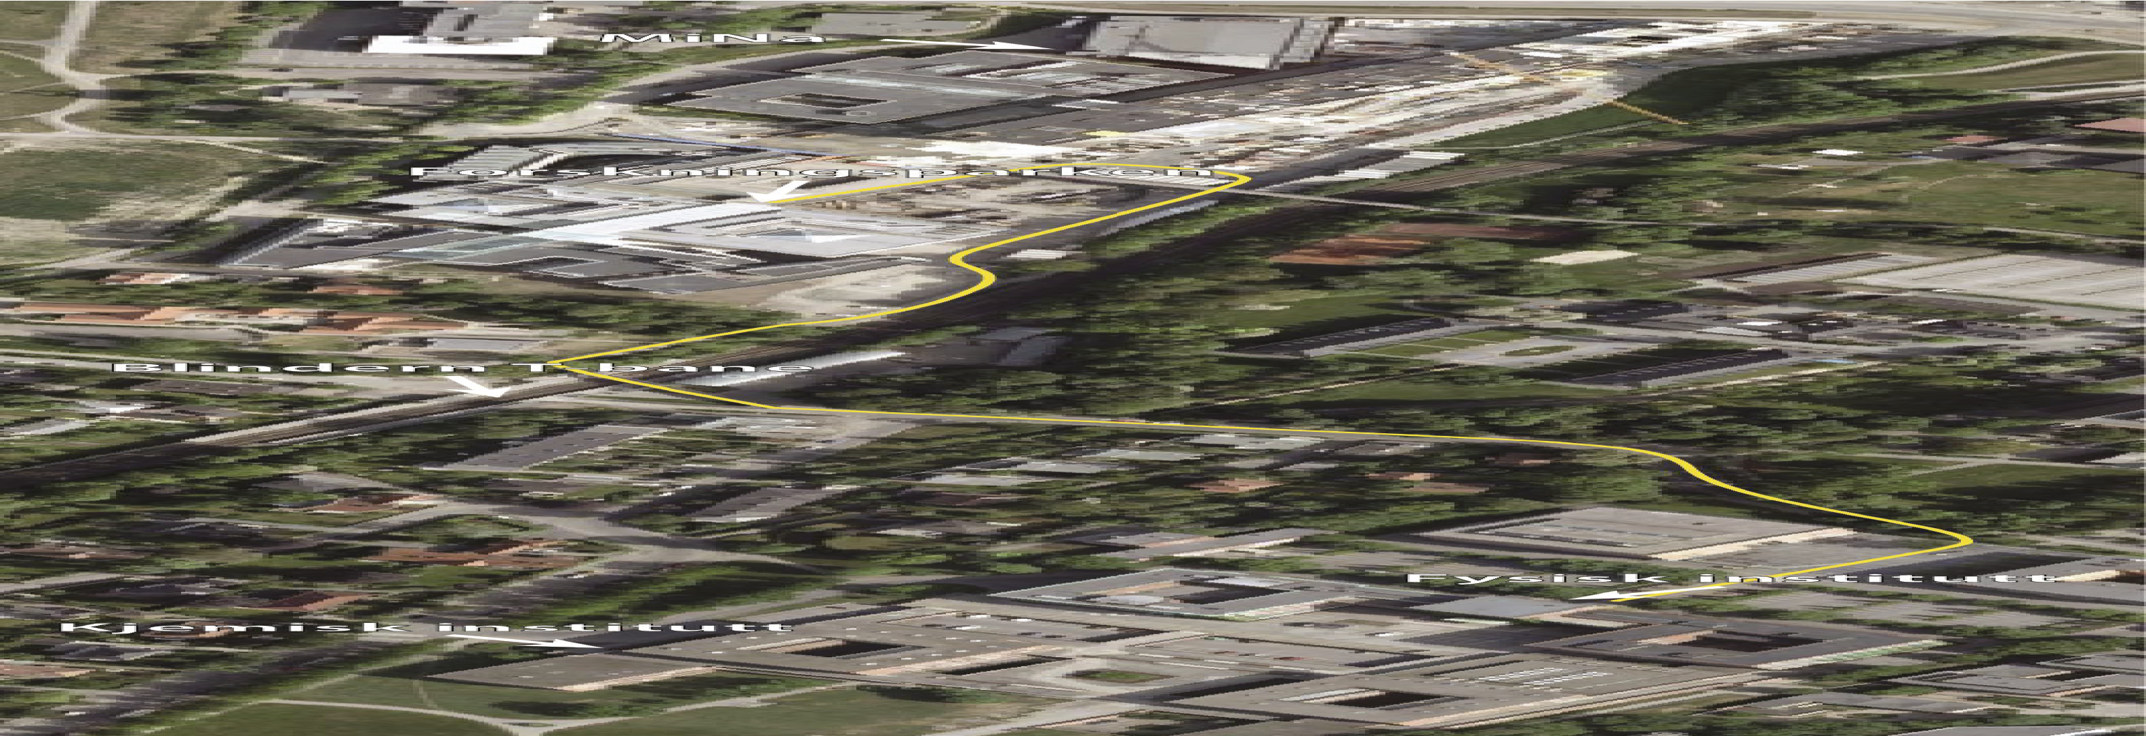
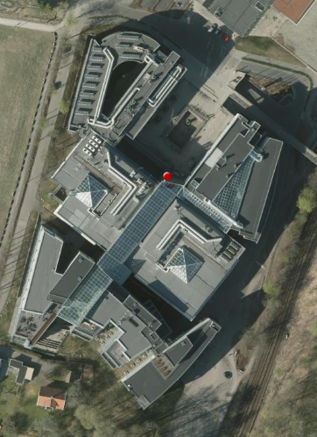
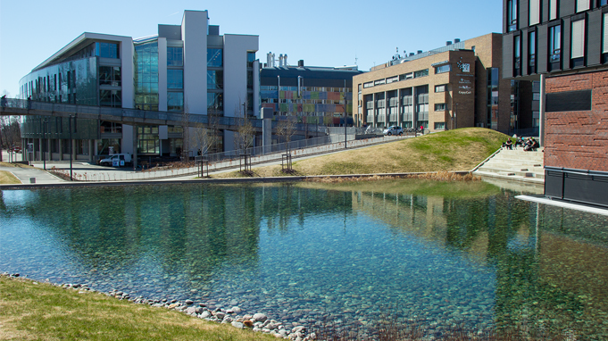
Groups next week:
Forskningsparken
Gaustadalleen 21

Slide 4
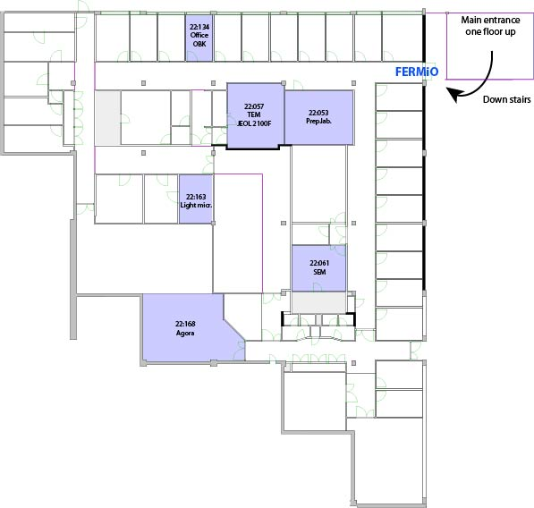
FERMiO

Slide 5
Lectures next week:
What?
Scanning electron microscope
SEM
Where?
At the Physics building
Who?
Sarmad Saeed

Slide 6
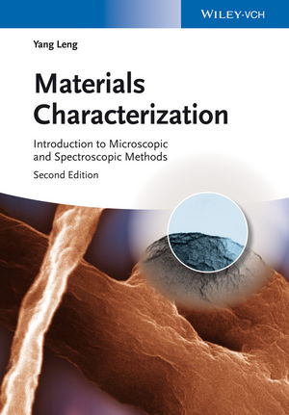
Today chapter 1: Light Microscopy
The following parts can be considered cursory:
1.3, 1.4.2, 1.4.4, 1.4.5 and 1.5
Cursory: from Latin cursorius ‘of a runner’
rapidly and often superficially performed or produced

Slide 7
Evaluation
“
Ved semesterstart skal emneansvarlig a) gå igjennom forrige gangs
«konklusjon» av emneevalueringen med studentene på forelesning.
b) orientere om hvordan emnet skal evalueres (stud.rep.gruppe,
midtveisevaluering, slutteveluering i form av Dialogmøte) b) informere
studentene om at de bør finne 1-2 studentrepresentanter som skal være
med på dialogmøtet i slutten av semesteret (dersom de ikke klarer å finne
noen som vil stille, så vil evalueringen foregå uten studentene).
”
Tillitsmann/tillitskvinne

Slide 8
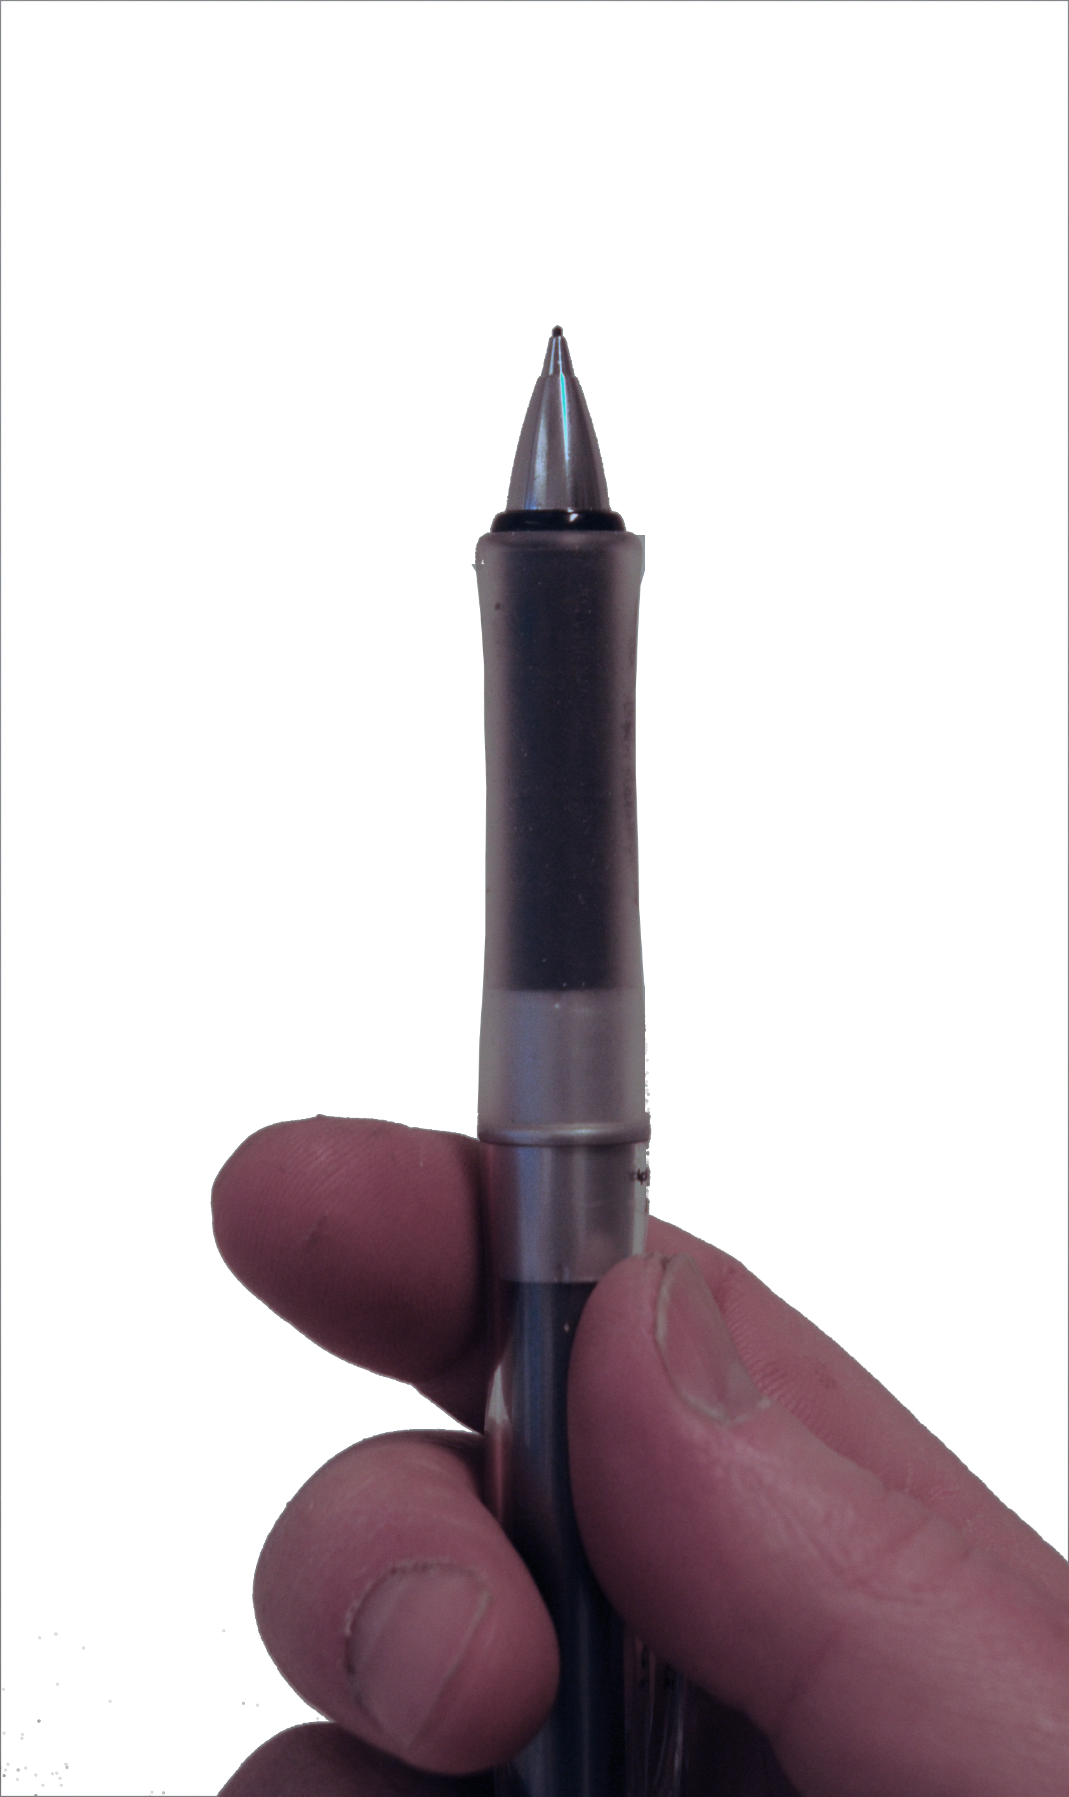

Slide 9
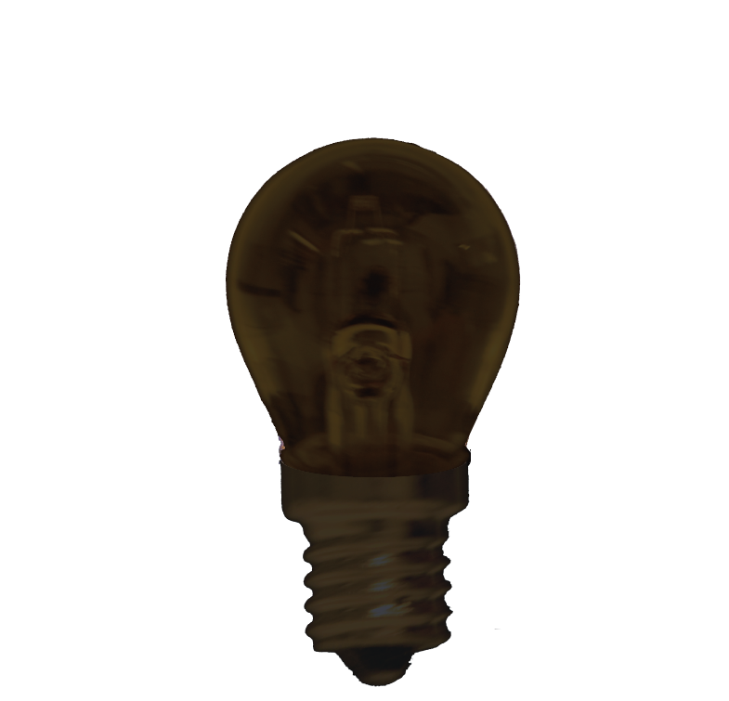
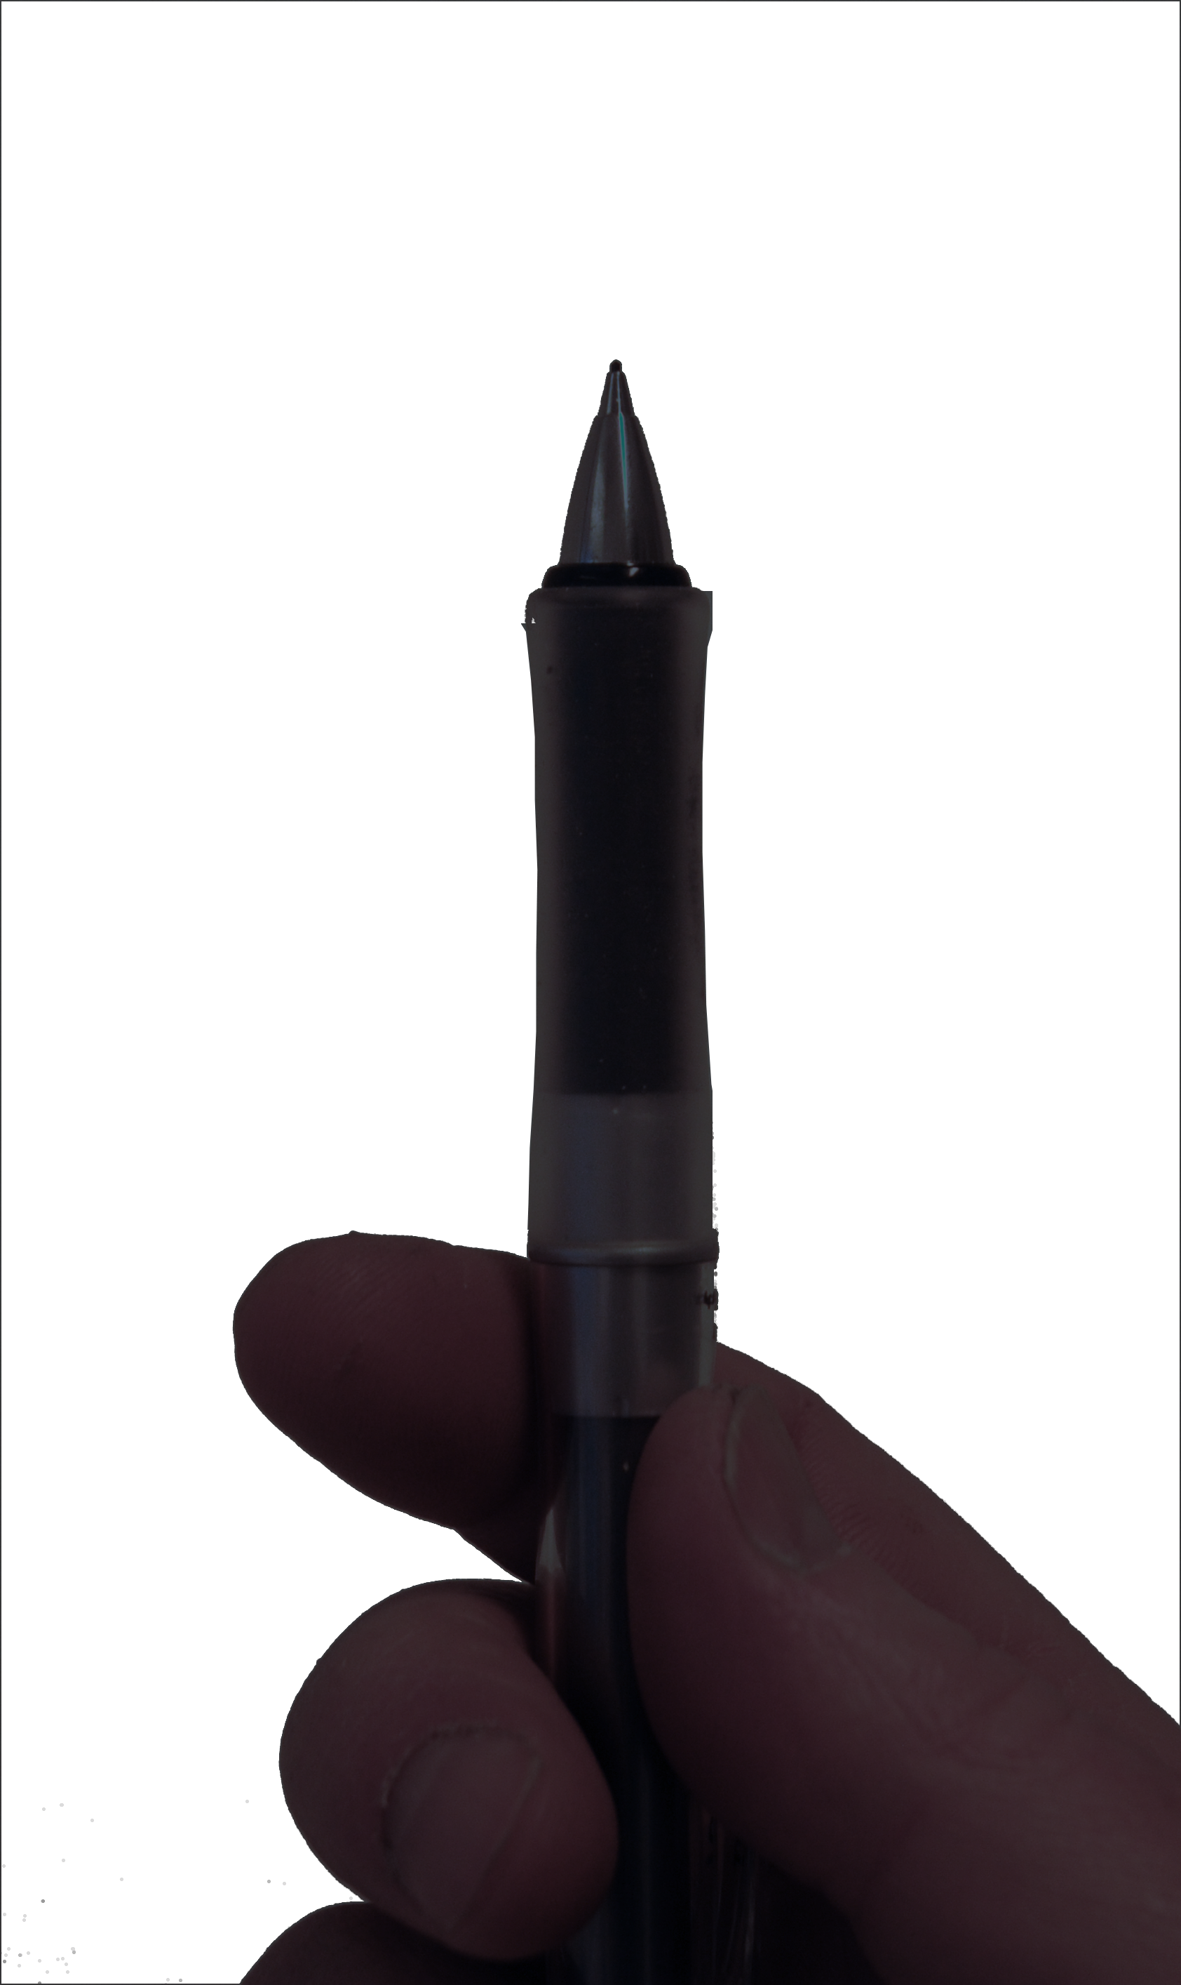

Slide 10
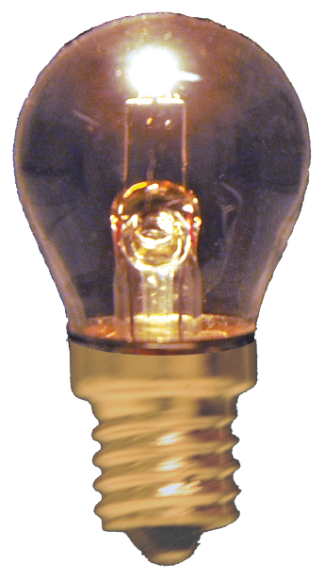

Slide 11
Only draw the ones
that are ”important”

Slide 12


One lense
Thin lense
Projection

Slide 13
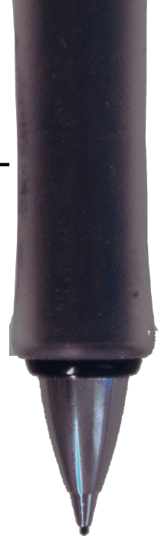
Through the centre is not deflected
Parallell to the optical axis goes
through back focal plane
(Through focal plane before lense
becomes parallel optical axis.)
f
f
Optical axis
OBS!
The image of the pencil has
of cause no width in the
direction parallell the optical
axis!
Projected onto a screen
Distance one to two focal lengths

Slide 14
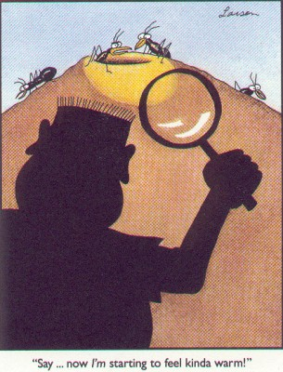
Focal plane

Slide 15
s (= v)
s’
f
s’
v − f
M =
s
M =
f
f
f
Optical axis

Slide 16
s (= v)
s’
f
2f > s > f
Magnified, real image
f
f

Slide 17
s (= v)
s’
f
s > 2f
Demagnified, real image
f
f

Slide 18
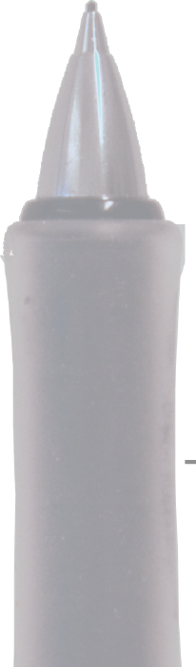

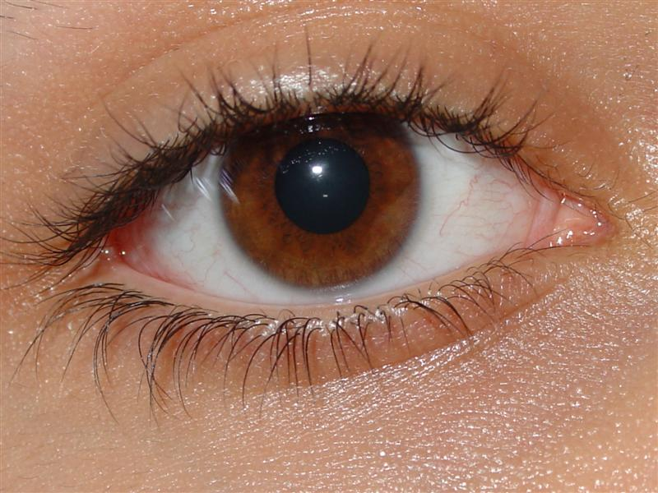
s (= v)
s’
f
s < f
Magnefied, virtual image
f
f
Magnifying glass (forstørrelsesglass, lupe)

Slide 19
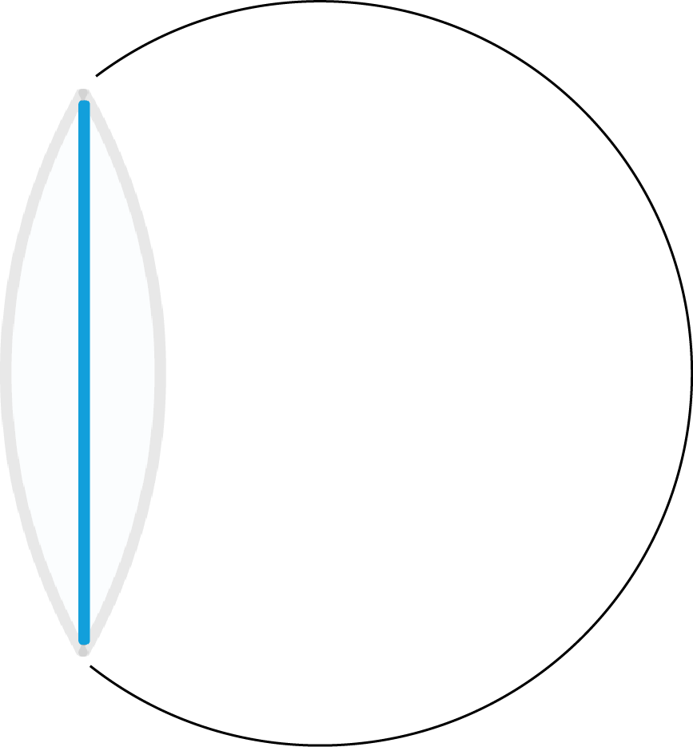
s (= v)
s’
f
f
f

Slide 20
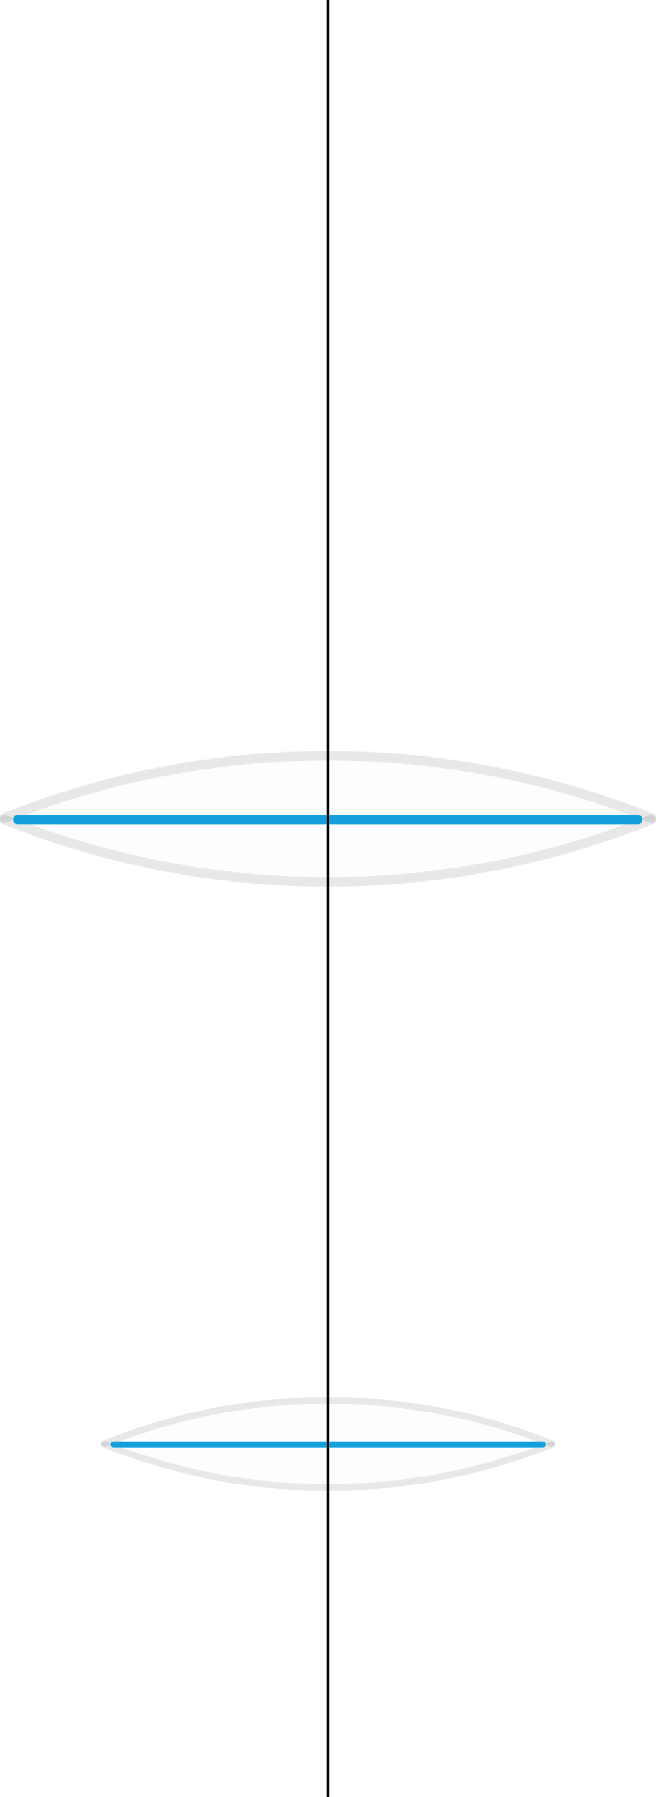
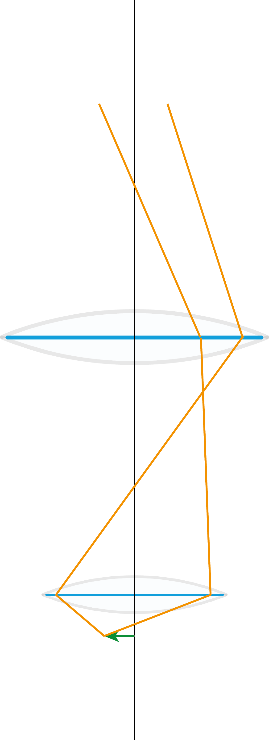
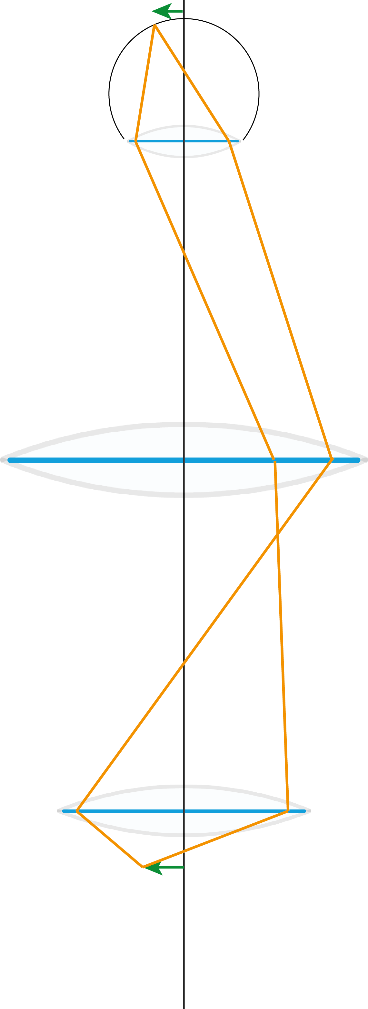
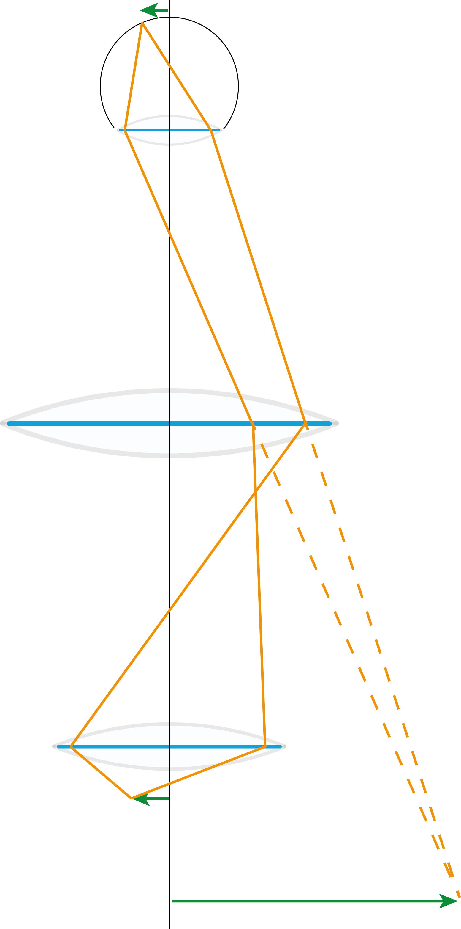
Real image
on retina
Compound microscope
Det sammensatte mikroskop
Eyepiece
Okular
Real image
(Primary image)
OBS! Error in figure
Objective
Object
Usually corrected to «infinite» tubus
Virtuell image

Slide 21
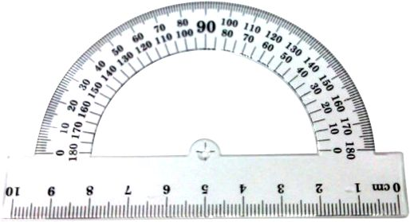
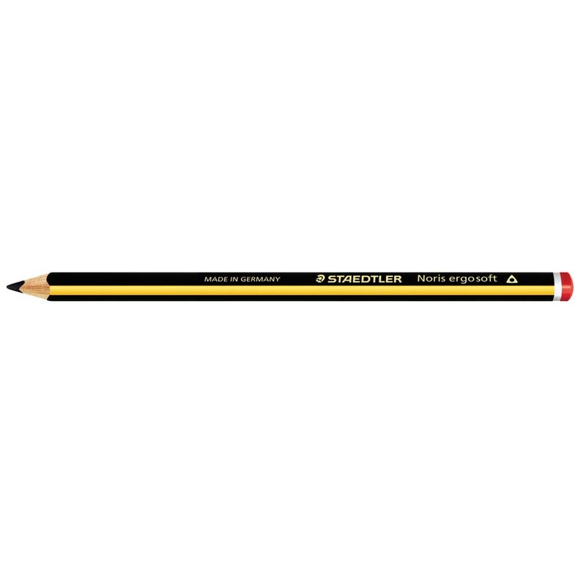
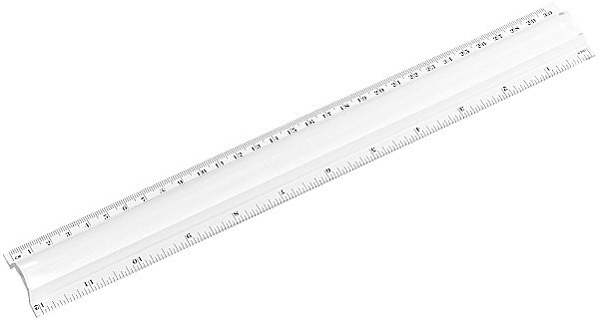
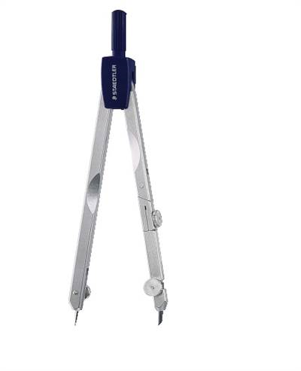
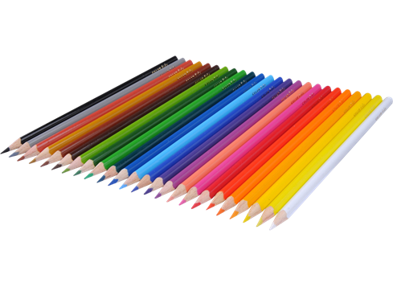

Slide 22
All rays spread in the same
direction are collected here
Image plane
Diffraction plane
Fourier plane
All rays originated from the
same point are collected here

Slide 23
Fourier transformation
Read the text from Johan Taftø

Slide 24
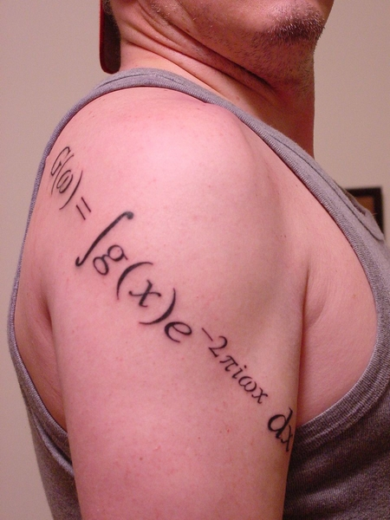
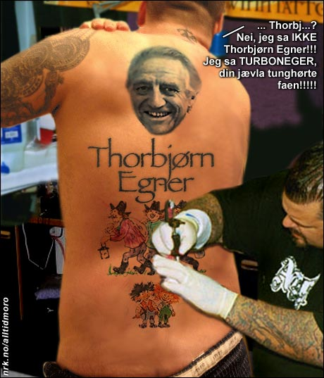

Slide 25
Optical microscope
Light microscope
Magnification (Forstørrelse)
Resolution (Oppløsningsevne)
Contrast
We want to see more details

Slide 26
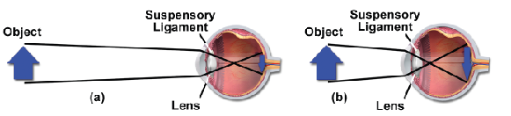
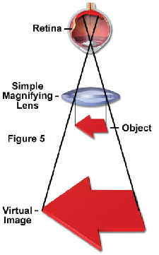
Simple microscope
Magnifying glass (forstørrelsesglass, lupe)
Virtual image
Virtual:
: very close to being something without actually being it
: existing or occurring on computers or on the Internet

Slide 27
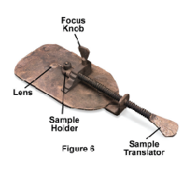
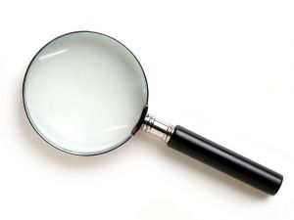
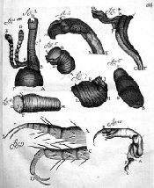
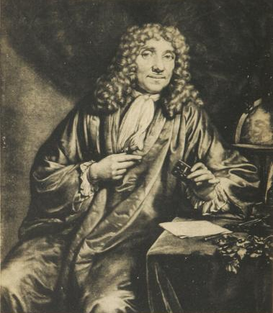
Magnifying glass
Antony van Leeuwenhoek
(1632−1723)

Slide 28
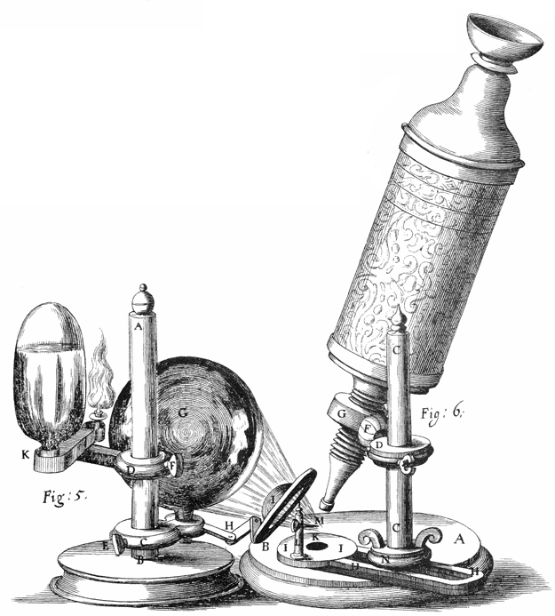
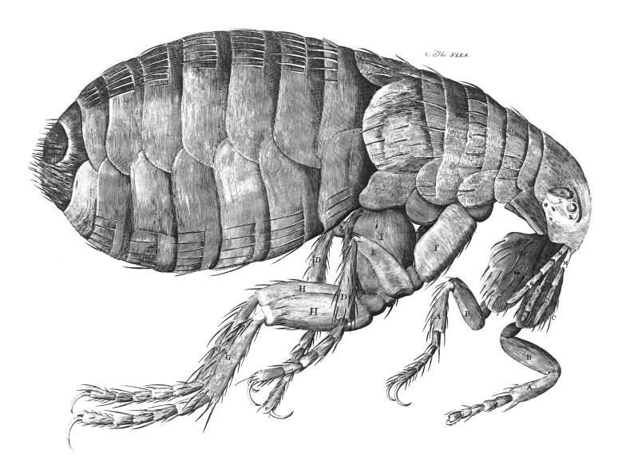
The compound microscope
Det sammensatte mikroskop
ca. 1595 Hans Janssen
Robert Hooke
(1635−1703)
Micrographia, 1664

Slide 29
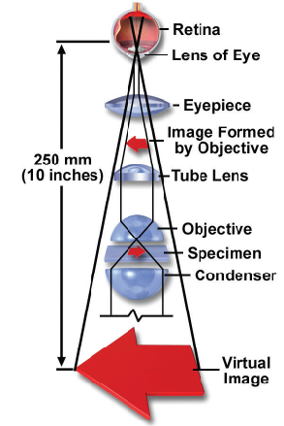

Slide 30
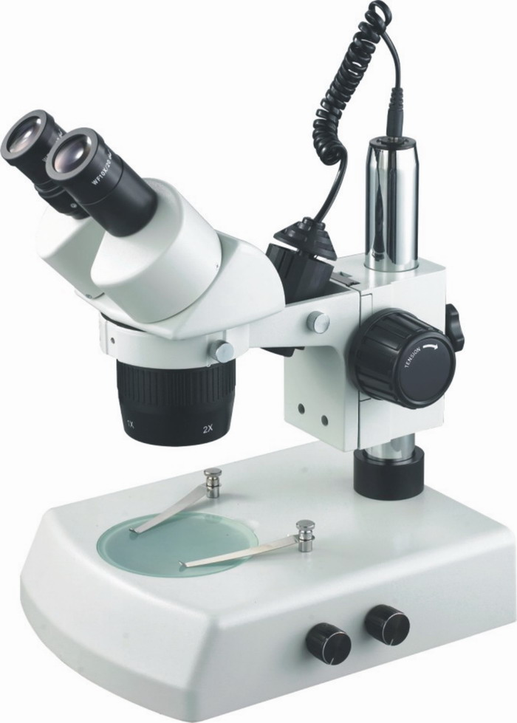
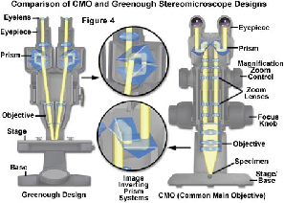
Stereo mikroskope

Slide 31
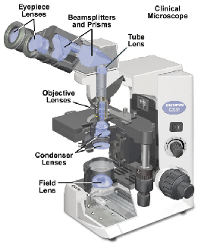
Compound microscope
for transmitted light
Microscope for transmitted light

Slide 32
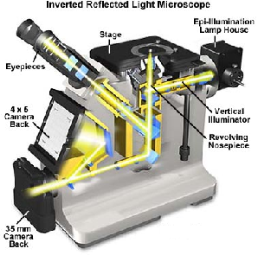
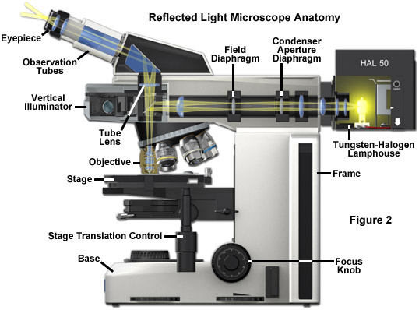
Mikroskope for reflected light

Slide 33
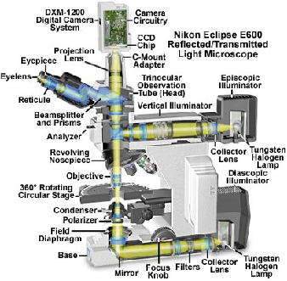

Slide 34
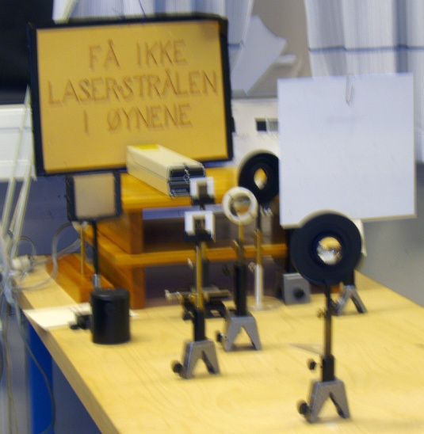
s (= v)
s’
f
f
f

Slide 35
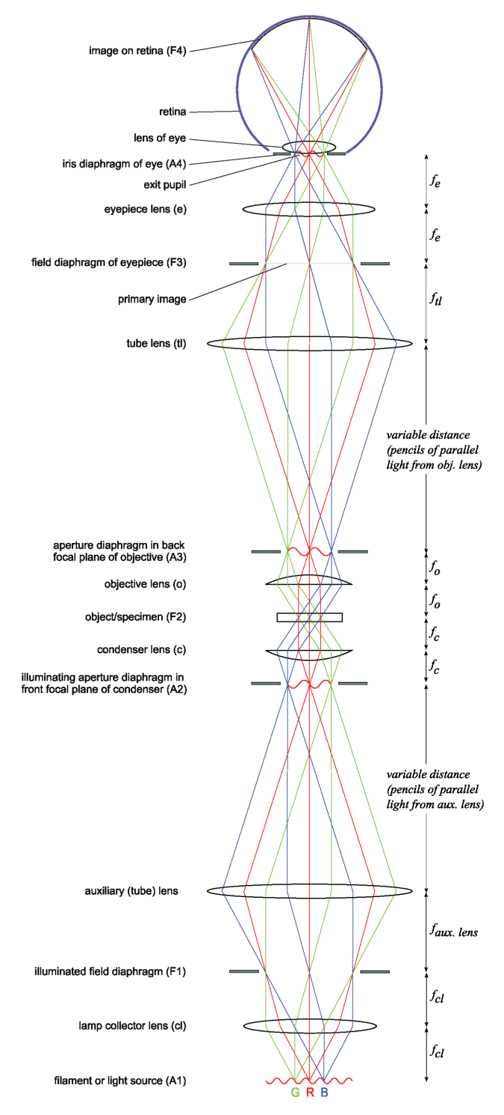
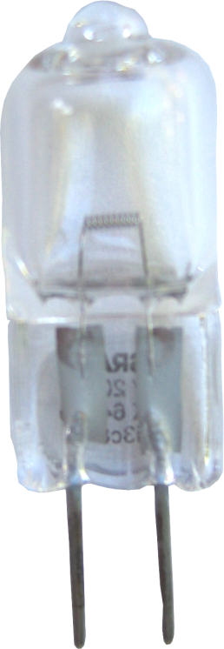
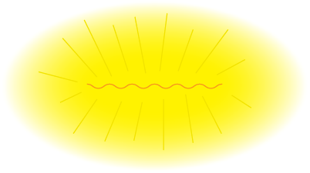
www.microscopy-analysis.com/files/
jwiley_microscopy/2006_Sept_Hammond.pdf

Slide 36
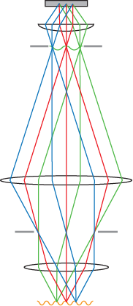
Illuminating system
Prøve
Kondensorlinse
Aperturblender
Aperture diaphragm
Feltblender
Field diaphragm
Filament

Slide 37
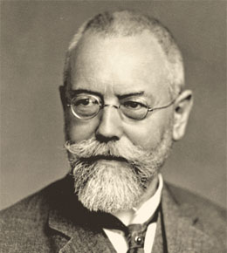
Belysningssystemet
Prøve
Kondensorlinse
Aperturblender
August Köhler
1866─1948
Köhler-belysning
Jevn belysning av prøven
Feltblenderen
Bestemmer det belyste
området
Feltblender
Aperturblenderen
Bestemmer vinkelen på
lyskjeglen som treffer
prøven
Filament

Slide 38
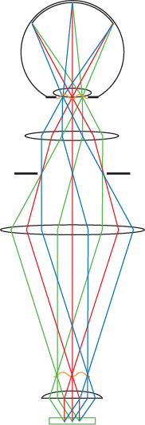
Avbildningssystemet
Eyepiece
Okular
”Tube lens”
Objektiv
Prøve

Slide 39
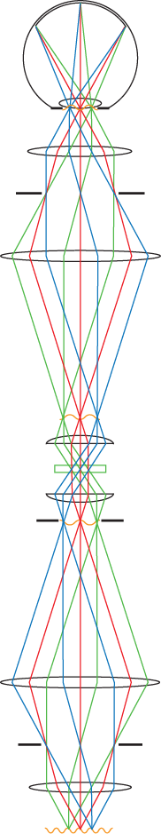
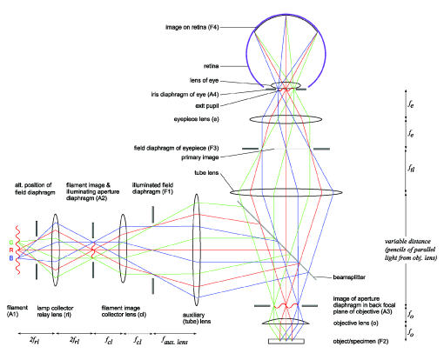
Primært bilde

Slide 40
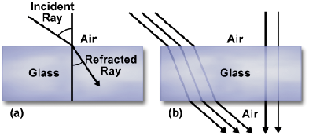
Refraction
Refraksjon ─ lysbrytning
ϕ₁
θ₂
Snell’s law:
Sin ϕ ₁
n₂
v₁
=
=
Sin ϕ ₂
n₁
v₂

Slide 41



Chromatic aberation

Slide 42

Spherical aberasjon
+ astigmatisme, koma, fortegning ...

Slide 43



Correcsions
Objective
Acromate: Chromatic for red and blue,
spherical for green
Semi-acromate (fluorite)
Apochromate: Chromatic for red,
green, blue and dark
blue, spherical for green
and blue

Slide 44




More are needed than just the objective
Kondensorsystem
Eyepice
Okular (ocular)

Slide 45



The limiting factor: Diffraction
Resolution (Oppløsning)
R = 0,61λ/NA
Rayleigh criterion

Slide 46

Abbe: ”A microscope image is the interferense effect
of a diffraction phenomena”

Slide 47



Slide 48


Numerical aperture (NA)
NA = nsinα
Resolution
Oppløsning
R = 0,61λ/NA

Slide 49


Slide 50

Objectives for oil immersion

Slide 51



Eric Betzig
Stefan W. Hell
William E. Moerner
The Royal Swedish Academy of Sciences has decided toawardErik Betzig, StefanW.Hell and W. E.Moernerthe Nobel Prize in Chemistry 2014 for the development of super-resolution fluorescence microscopy.

Slide 52


Fluorescence microscopy
Confocal microscopy

Slide 54



Optical anisotropy
Calcite

Slide 55
Optically active crystals in the microscope

Slide 56

Optically active crystals in the microscope

Slide 57
Remember that geologists often call their book on microscopy on thin sections for
optical crystallography, and microscopy with reflected light is ore microscopy (malmmikroskopi).
Some web sites:
http://www.olympusmicro.com/primer/ Not there ☹
http://www.microscopyu.com/
http://www.micro.magnet.fsu.edu/ Not there ☹
http://www.micro.magnet.fsu.edu/primer/pdfs/basicsandbeyond.pdf Not there ☹

