Slide 1
An overview
An overview ?
MENA3100,OBK, 20.01.16

Slide 2

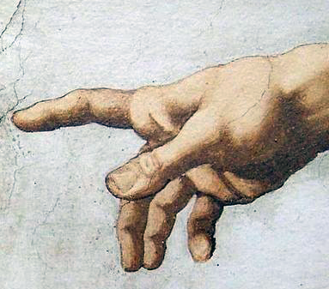

To examine something
We need a probe

Slide 3

Light as a probe

Slide 4
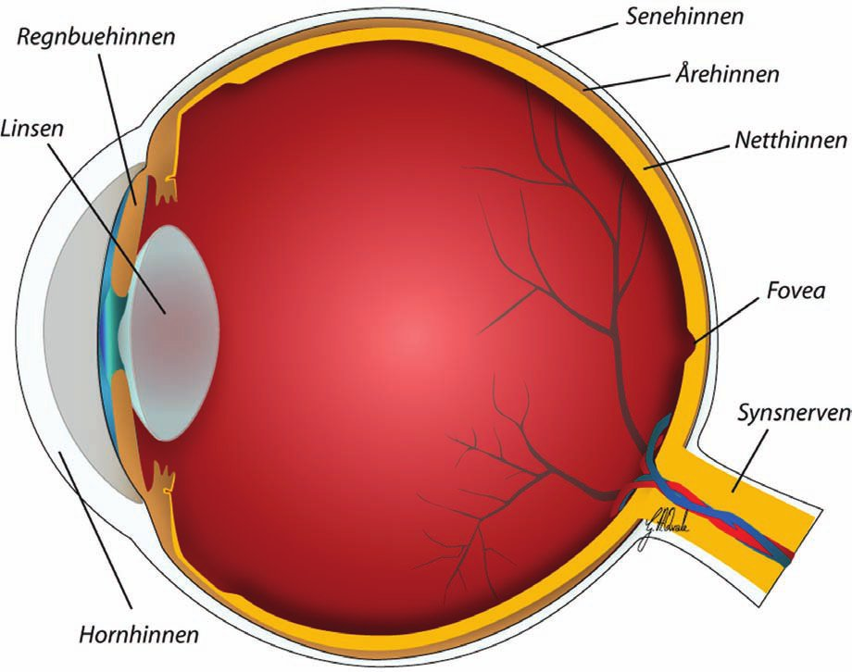
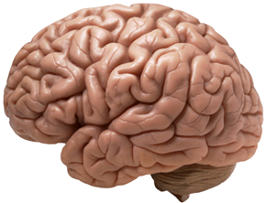
Detector

Slide 5

Aids

Slide 6

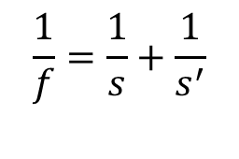
s (= v)
s’
f
s’
s’ − f
M =
s
M =
f
f
f
Real image
Lens formula:

Slide 7
s (= v)
s’
f
f
f
Virtual image

Slide 8
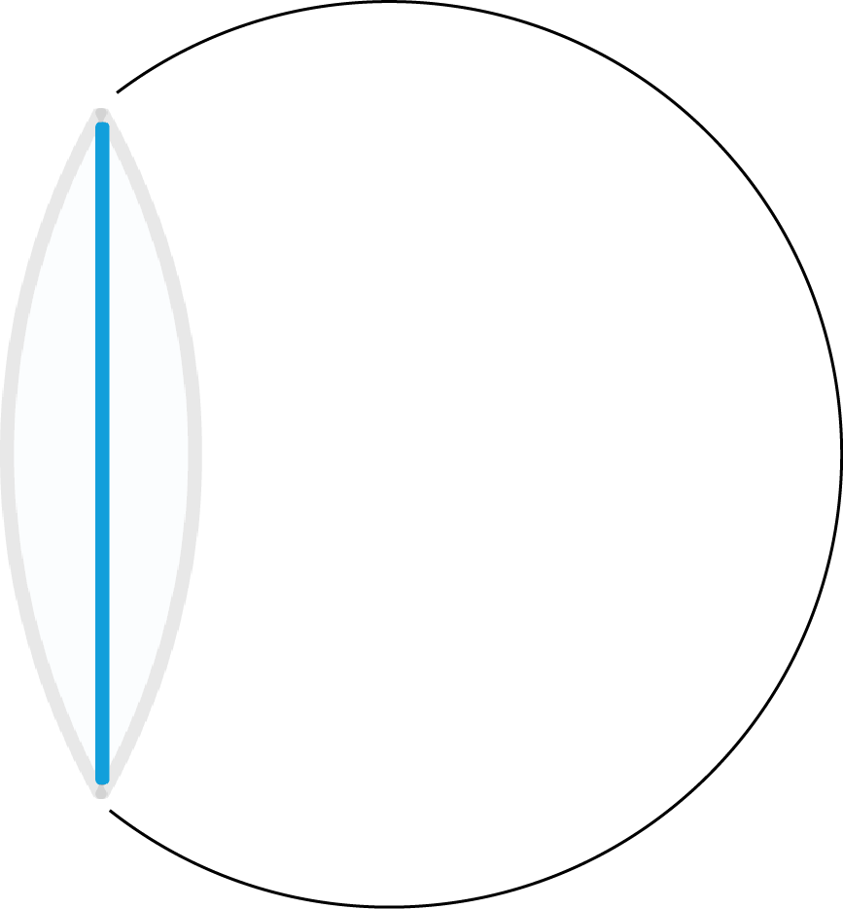
s (= v)
s’
f
f
f

Slide 9
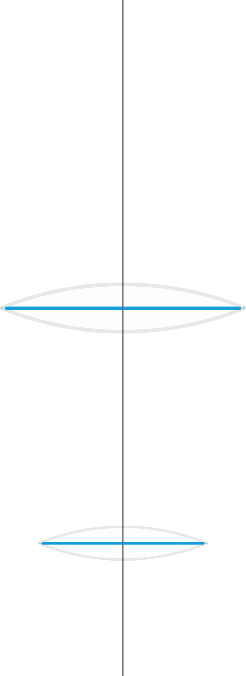
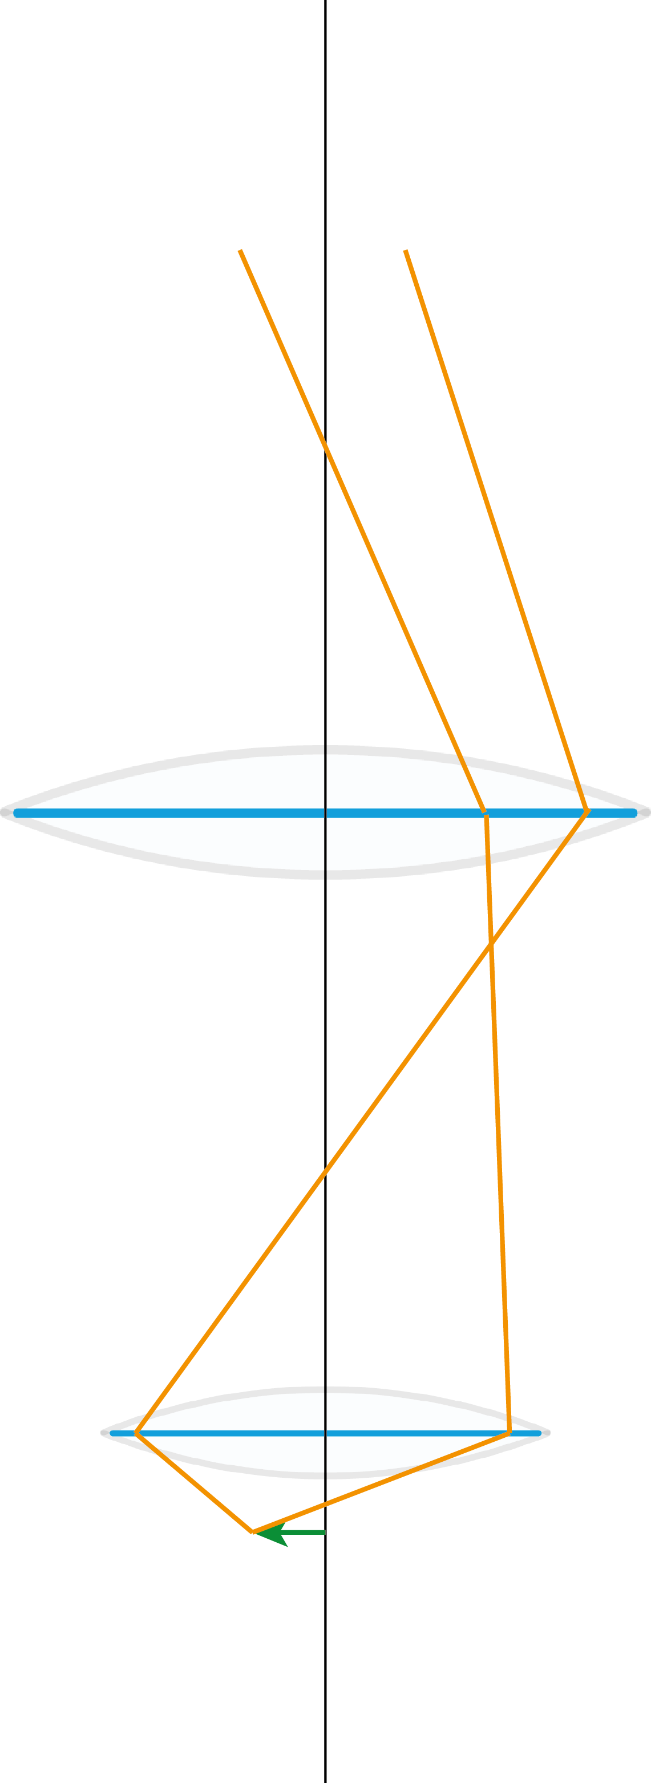
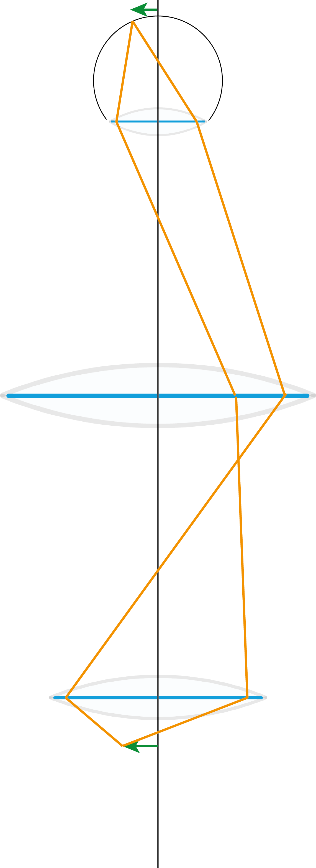
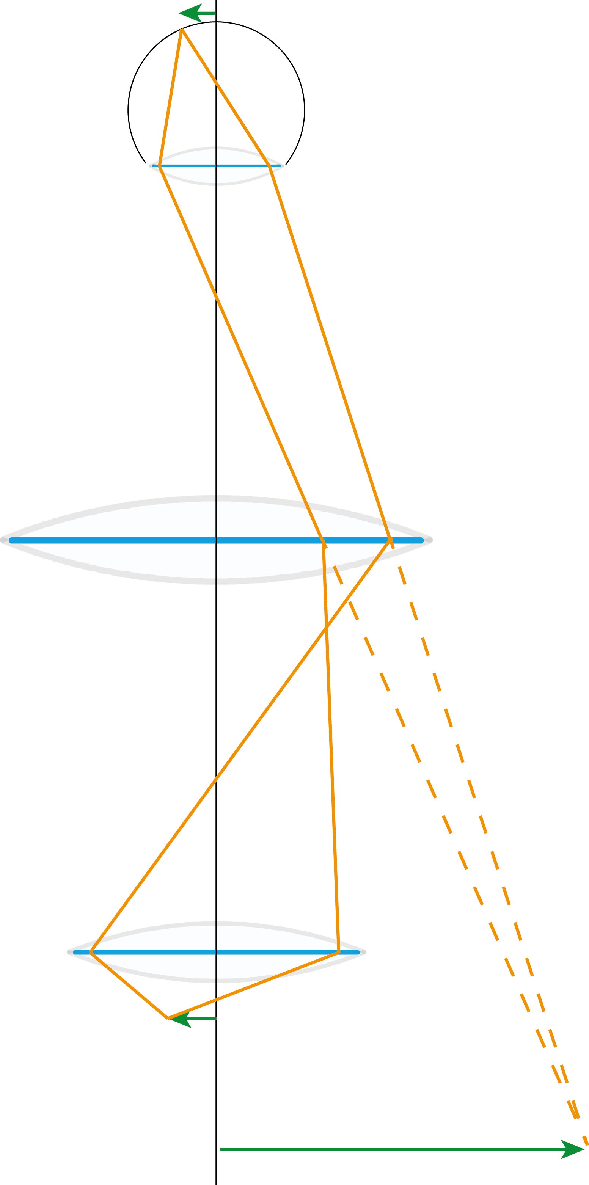
Real image
On retina
Real image
(Primary image)
Object
Virtual image

Slide 10

Wavelength ca. 400−800 nm

Slide 11
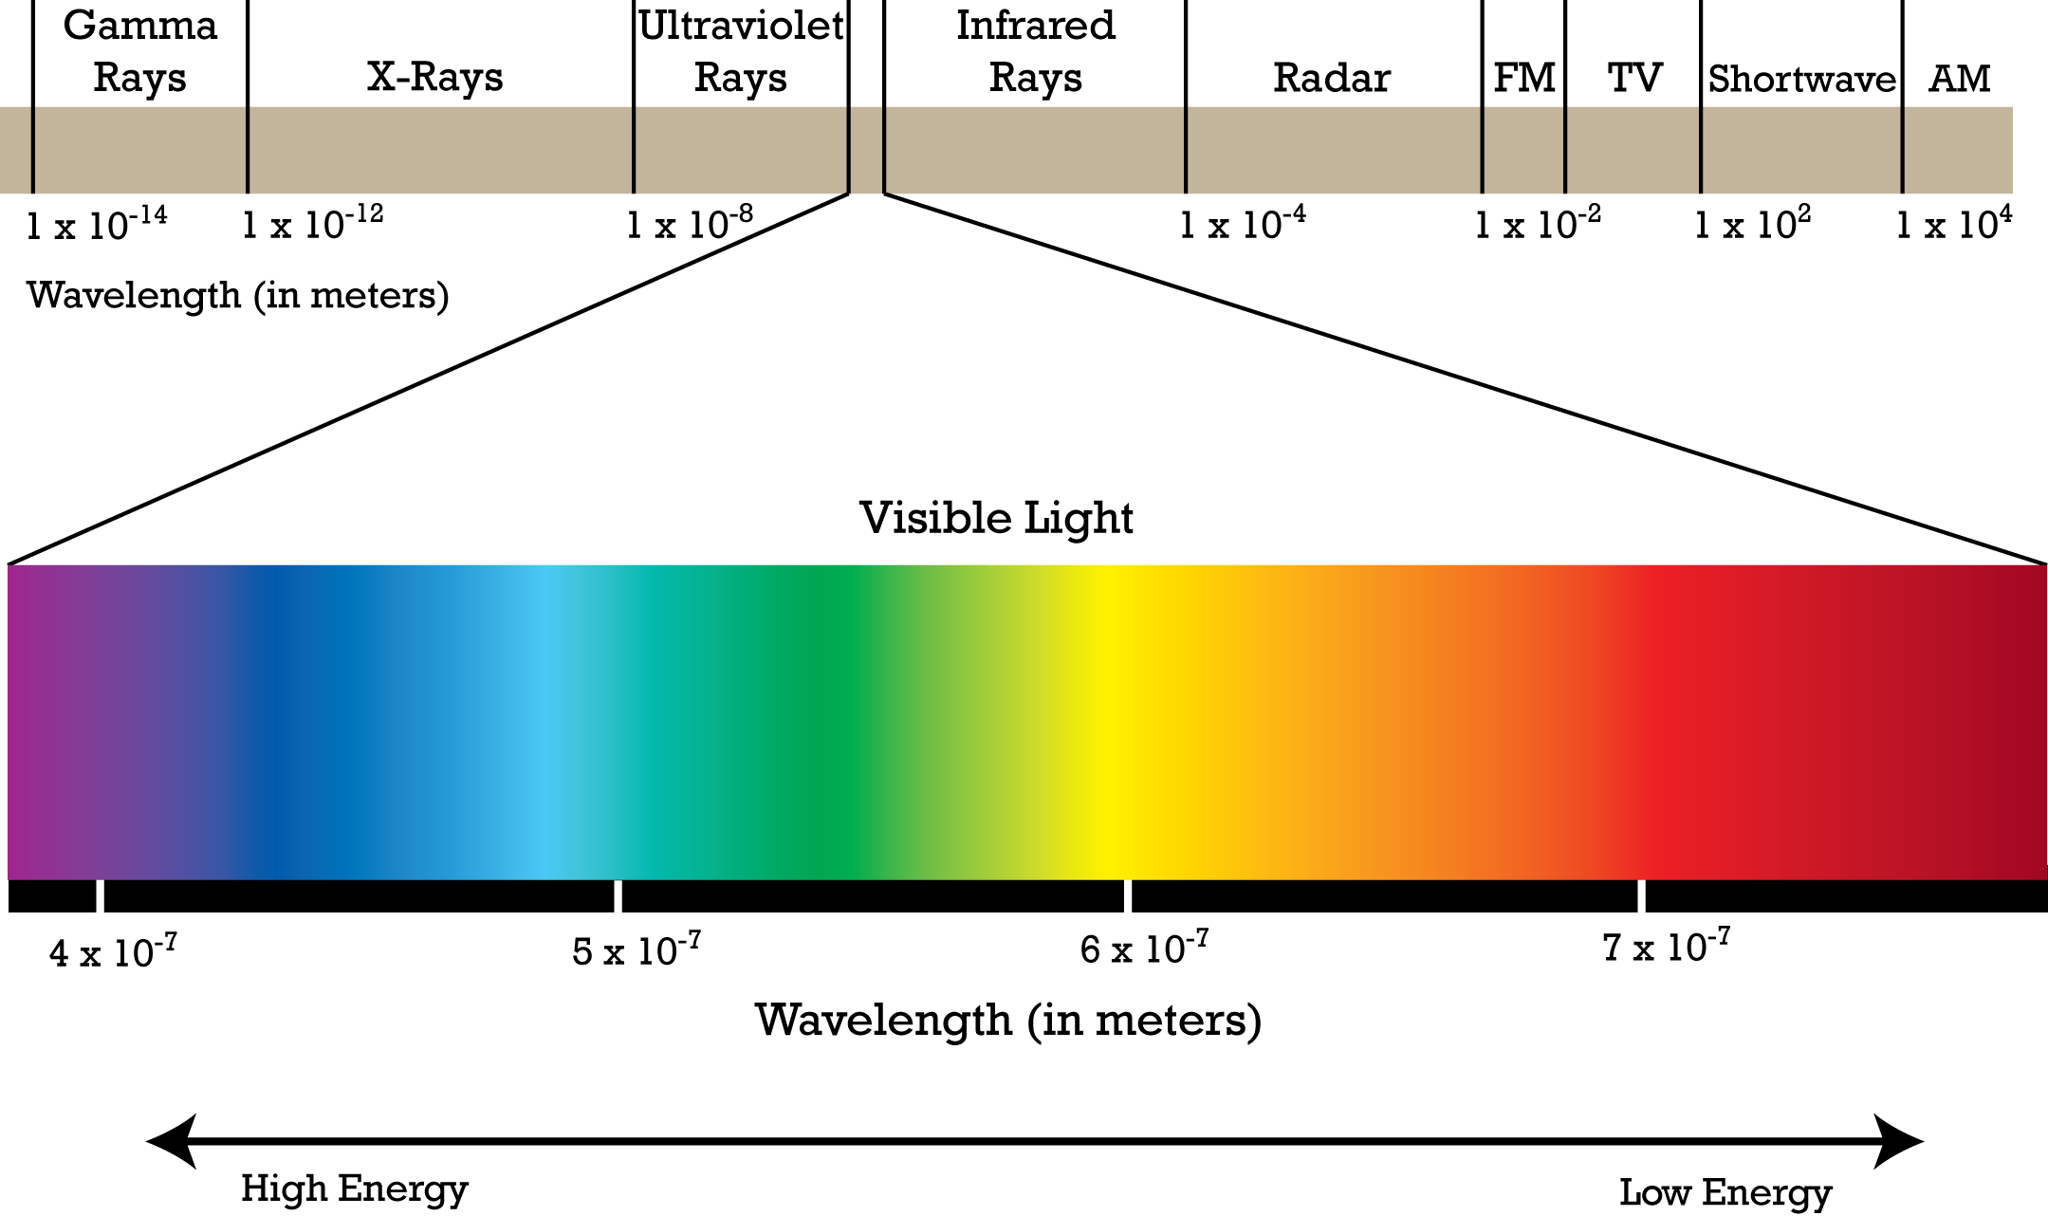
Elektromagnetic radiation
X-rays: 10⁻³−10¹ nm
«No» lenses for X-rays

Slide 12
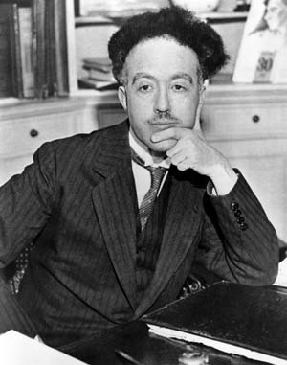

Wave-particel duality
Louis de Broglie
The wave nature of electrons

Slide 13
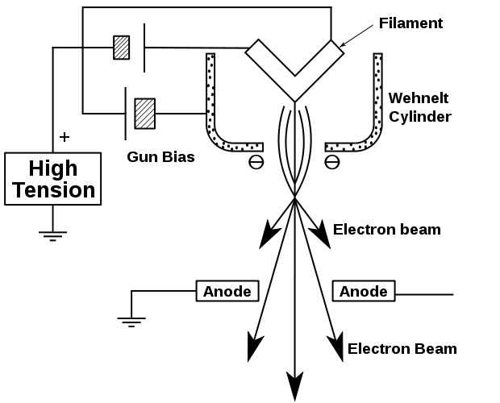
Scanning elektron mikroscope (SEM)
2−30 kV
15 kV → 0,083 nm
Transmision elektron mikroscope (TEM)
60−300 kV
200 kV → 2,5 pm

Slide 14
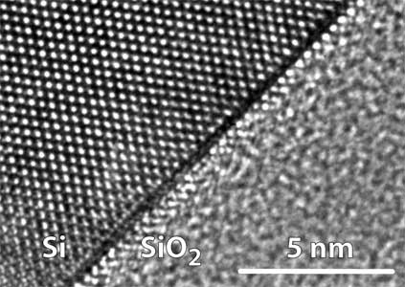

Slide 15
Imaging vs. diffraction
All rays going in
the same direction
Image plane
Diffraction plane
Fourier plane
All rays originated
from the same point

Slide 16

Diffraction from a lattice
Often monochromatic radiation

Slide 17
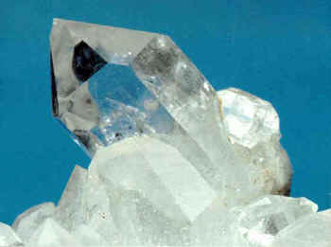
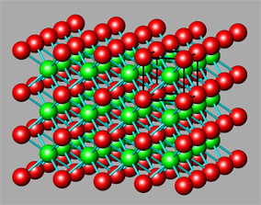
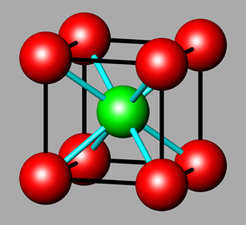
Crystals
Unit cell

Slide 18
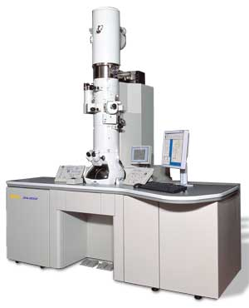
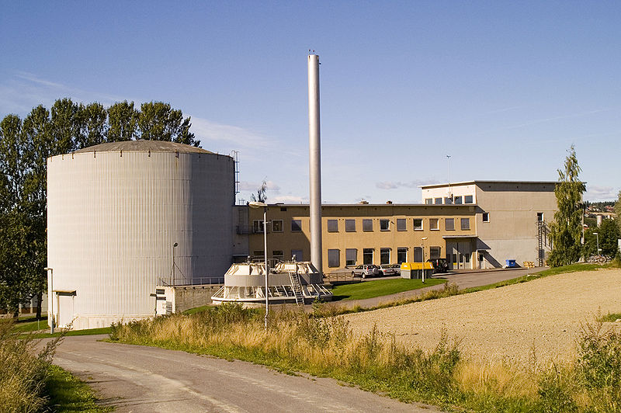
X-ray diffraction
Elektron diffraction
Neutron diffraction

Slide 19
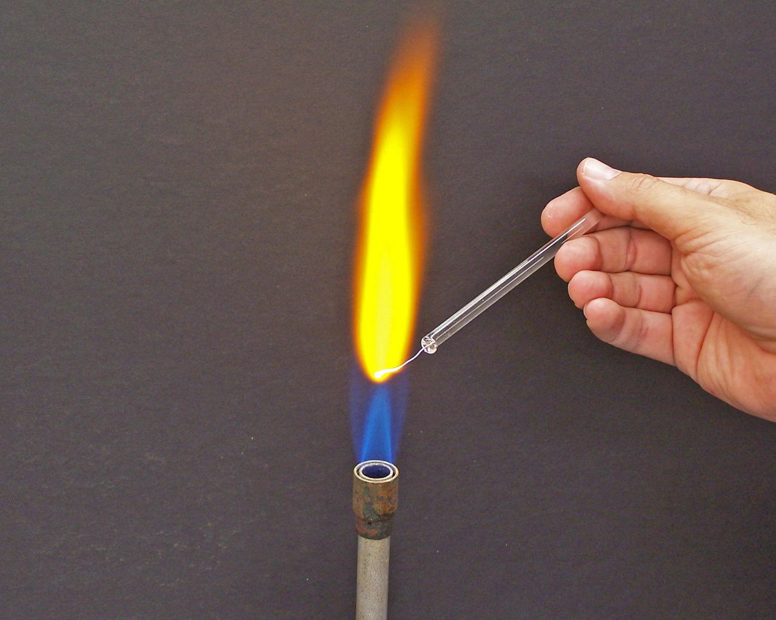
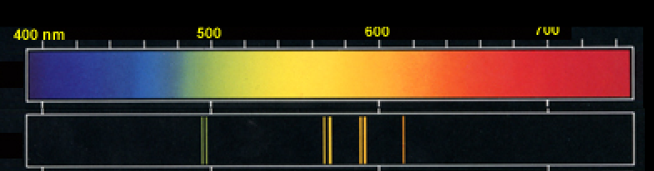
Spektroscopy
Sodium

Slide 20
