Slide 1
X-ray diffraction
XRD
Røntgendiffraksjon
Repetition, exercises and more
MENA3100,OBK, 21.04.16

Slide 2
2.4: Wide-angle X-ray diffraction and scattering
Out

Slide 3
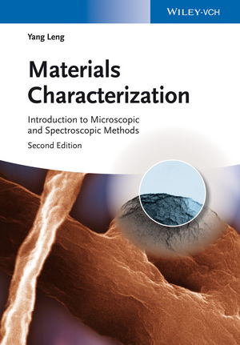
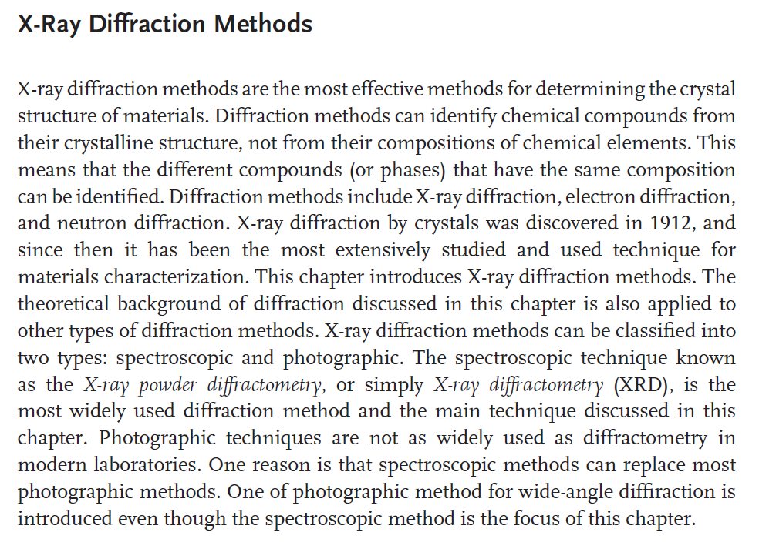
hm ...

Slide 4
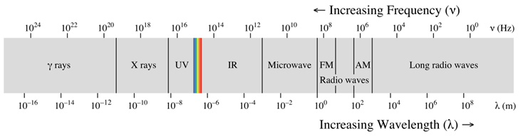



X-rays
Røntgenstråling
λ ≈ 0.01 to 10 nm
(0.1 to 100 Å)
3×10¹⁶ Hz to 3×10¹⁹ Hz
100 eV to 100 keV
1 eV = 1.6021766208(98)×10⁻¹⁹ J

Slide 5
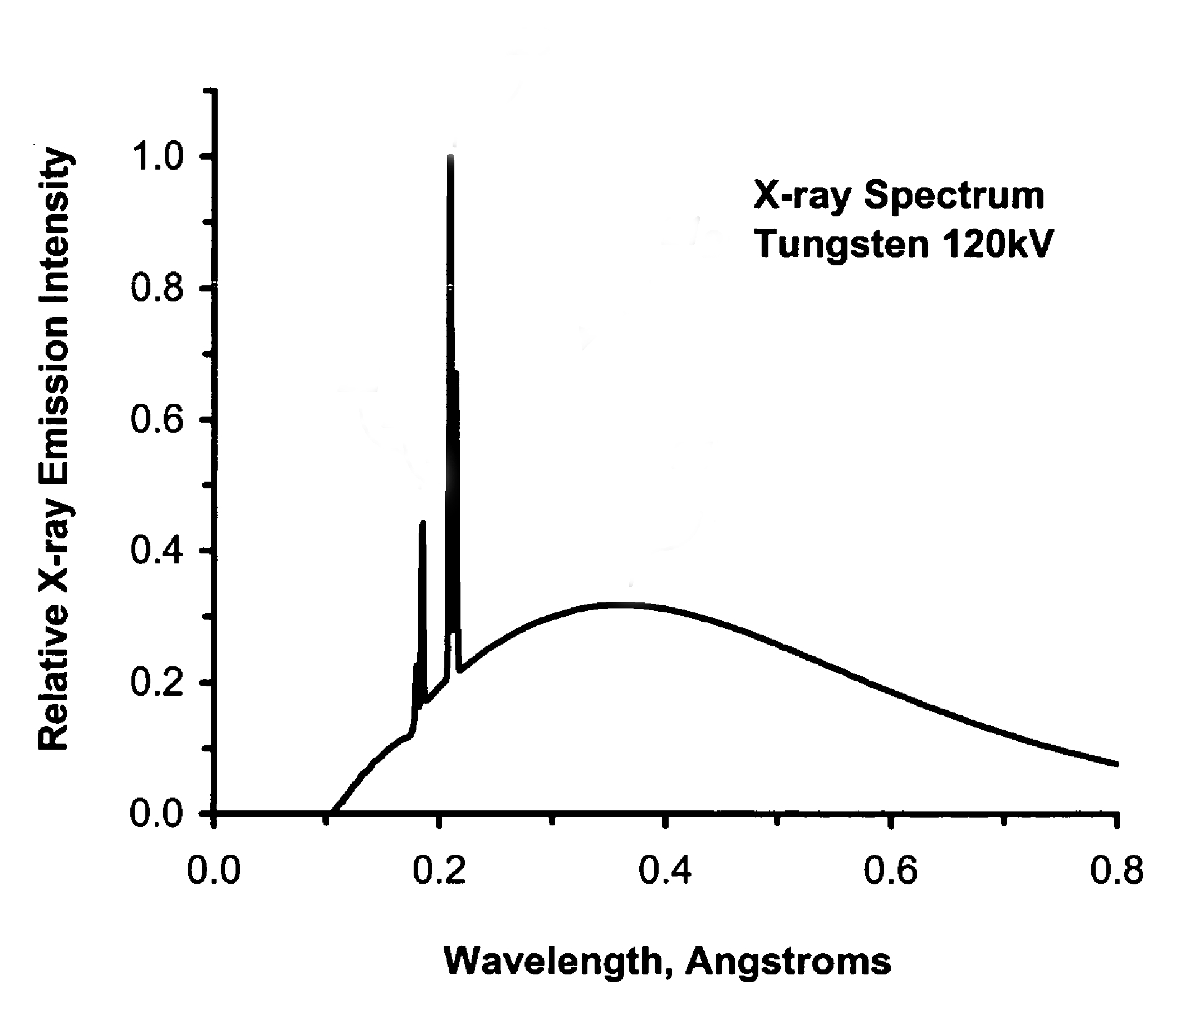
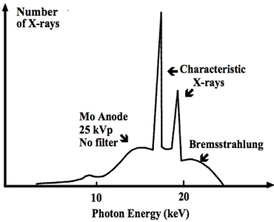
(cf. electron microscopes)

Slide 6
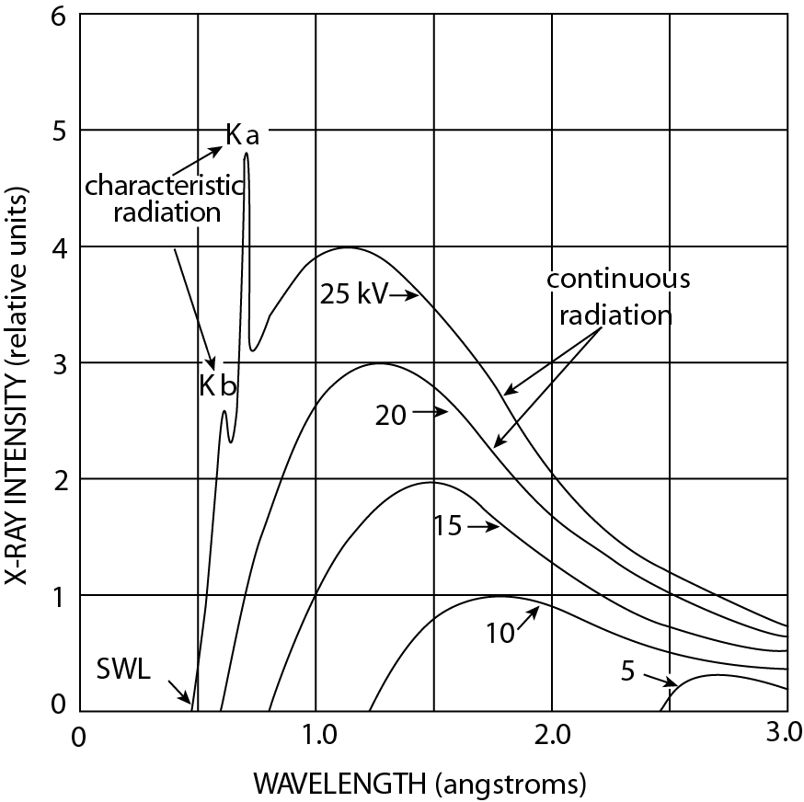
Kα ≈ 0.7 Å
= 18 eV
Kβ
Kα
36 Kr
37 Rb
38 Sr
39 Y
40 Zr
41 Nb
42 Mo
43 Tc
44 Ru
14.113
14.962
15.836
16.737
17.662
18.623
19.608
20.619
21.656
12.650
13.396
14.166
14.958
15.770
16.615
17.479
18.367
19.279

Slide 7
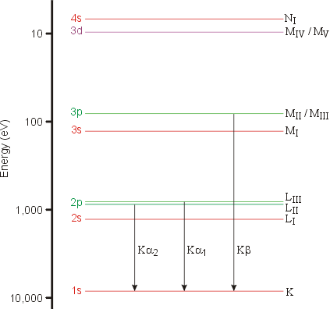
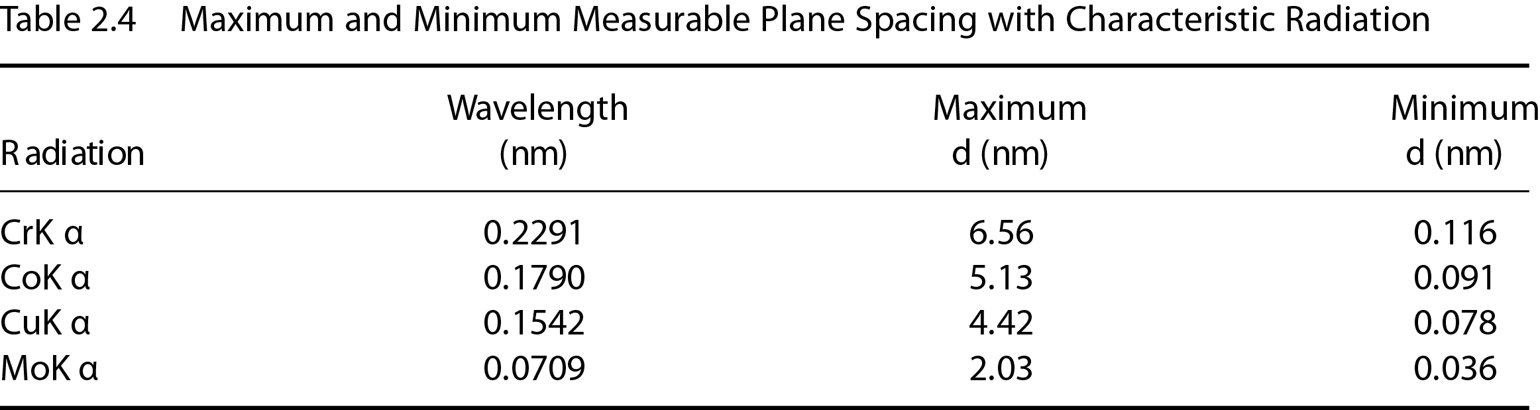
Wavelength
CuKα₁ = 1.54056 Å
CuKα₂ = 1.54433 Å
I(CuKα₁) = 2·I(CuKα₂)
CuKα = 1.5418 Å

Slide 8
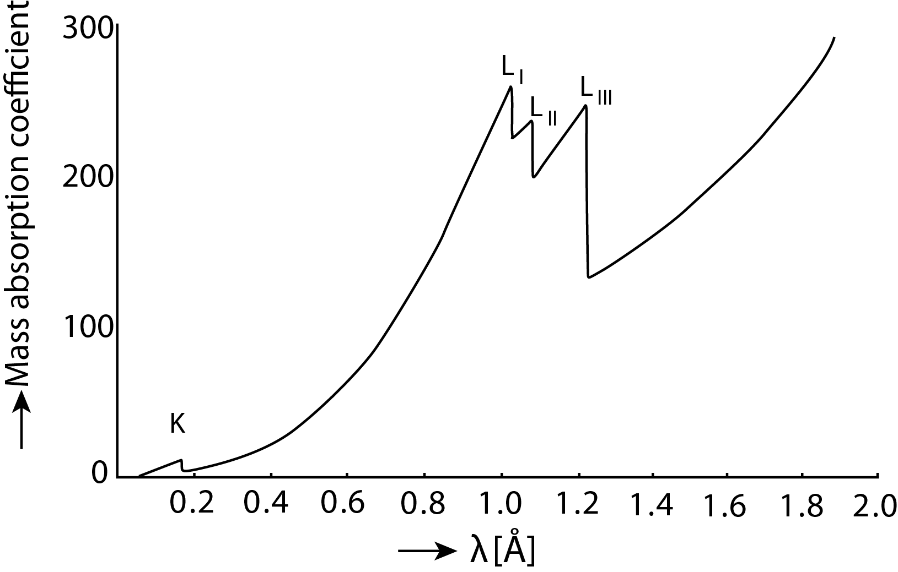
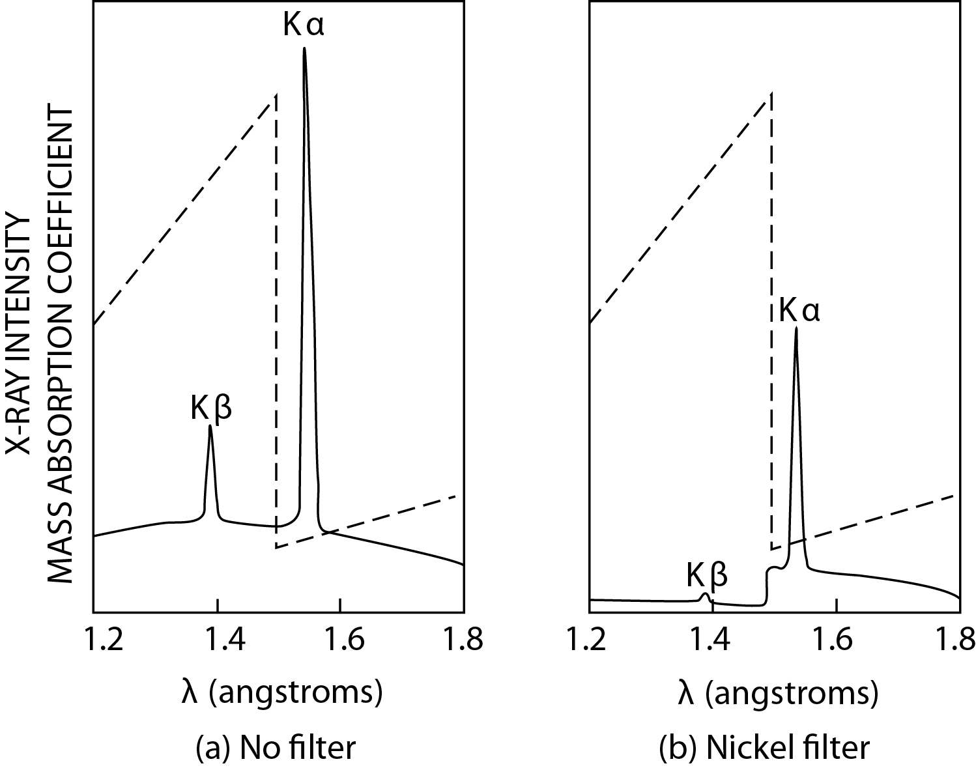
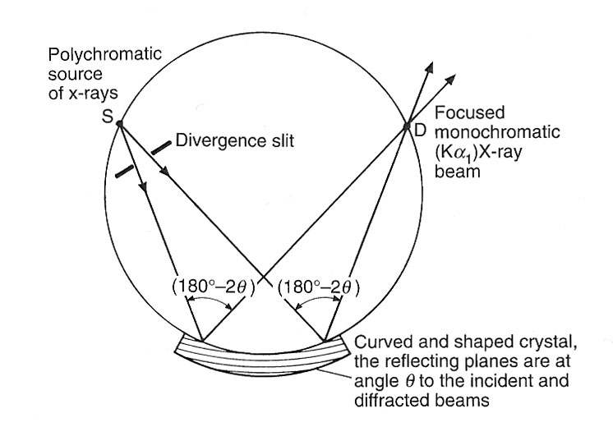
Filters
(cf. EELS)
(cf. ZAF)
Monochromators
(cf. microprobe
(mikrosonde) with WDS)
(And cf. XRD!)

Slide 9

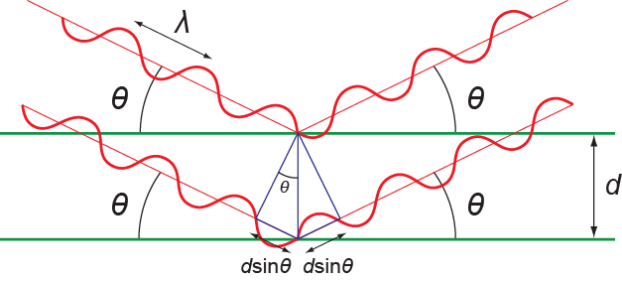
!
Bragg’s law

Slide 10
Brief run-through of reciprocal space, Ewald sphere
and intensities first hour next week

Slide 11
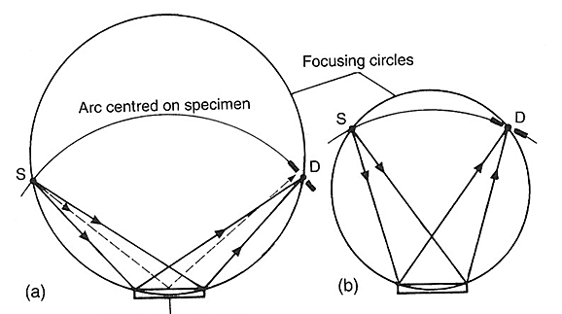
Diffractometers
Bragg-Brentano-geometry

Slide 12
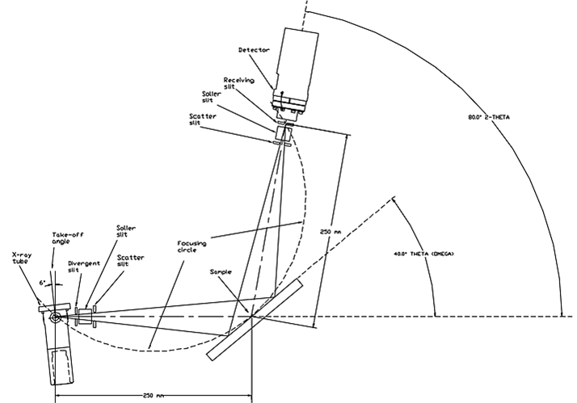
Diffractogram

Slide 13
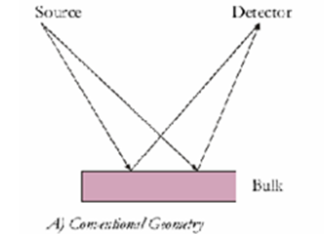
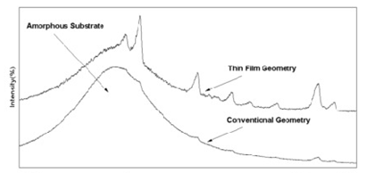
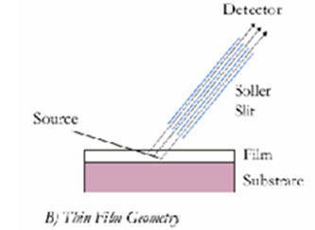
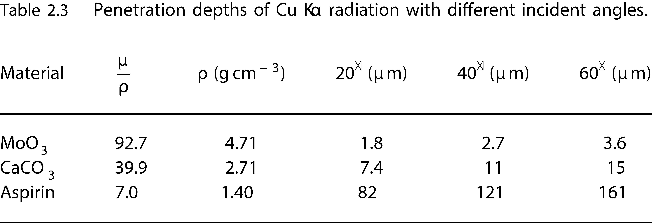
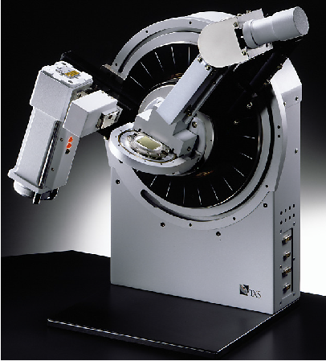
Grazing incidence diffraction
Thin films

Slide 14
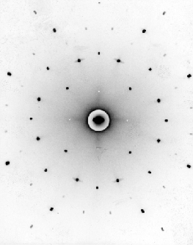
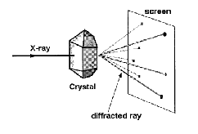
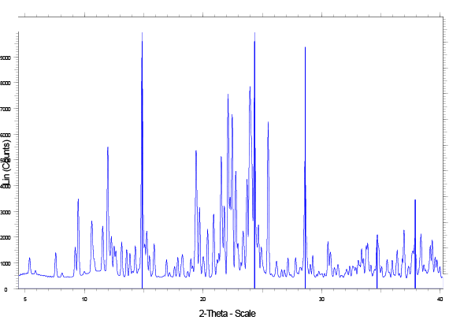
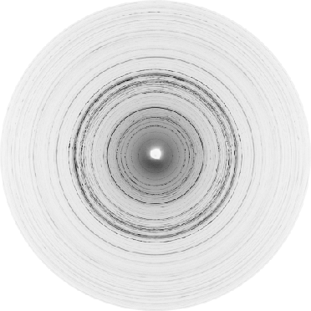
Powder X-ray diffraction
Single crystal diffraction
(énkrystall)

Slide 15
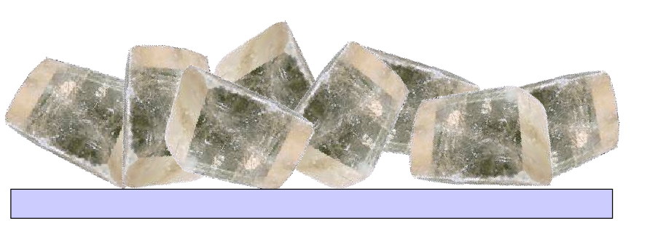
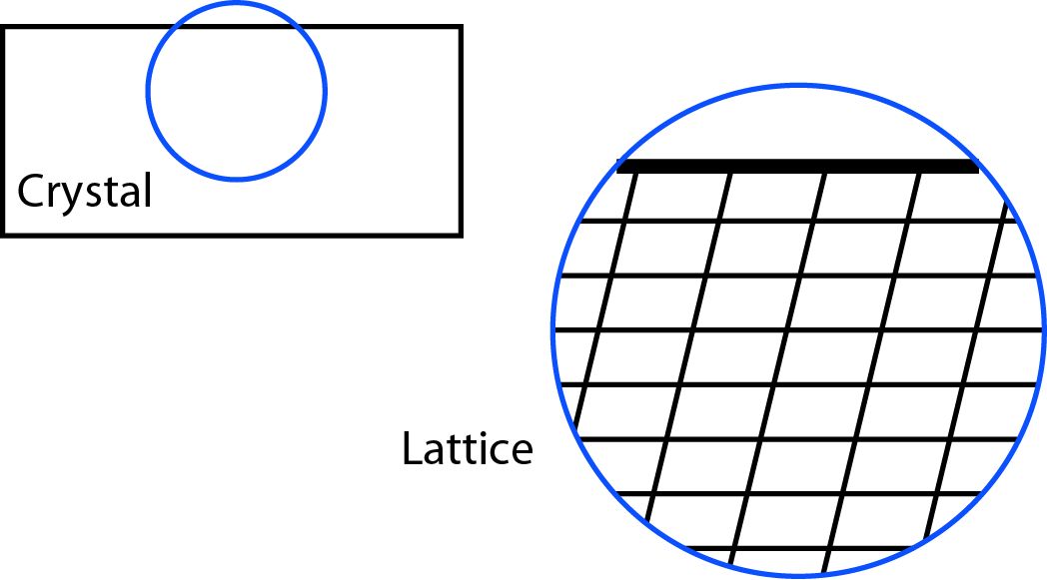
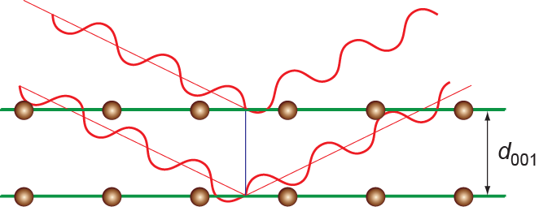
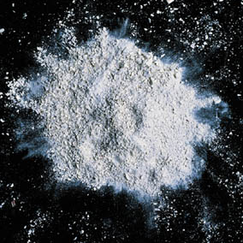
Bragg-Brentano geometry
Powder X-ray diffraction
Random orientation

Slide 16
Preferred orientation (foretrukken orientering)

Slide 17
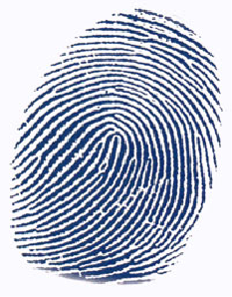
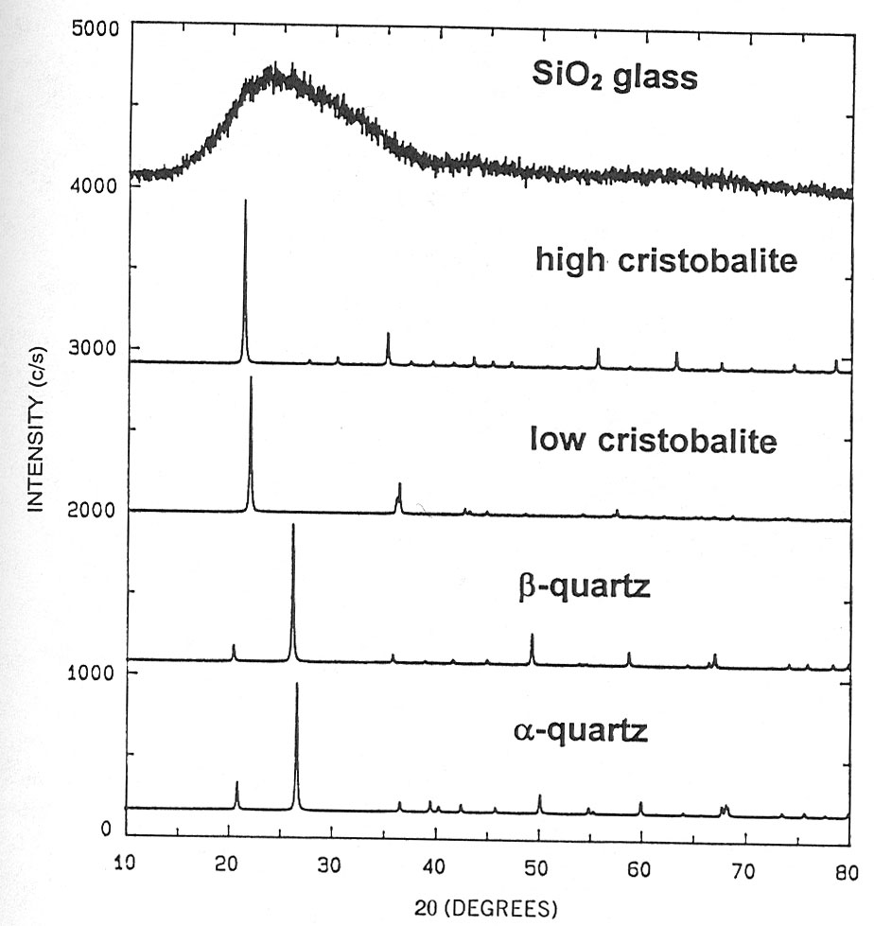
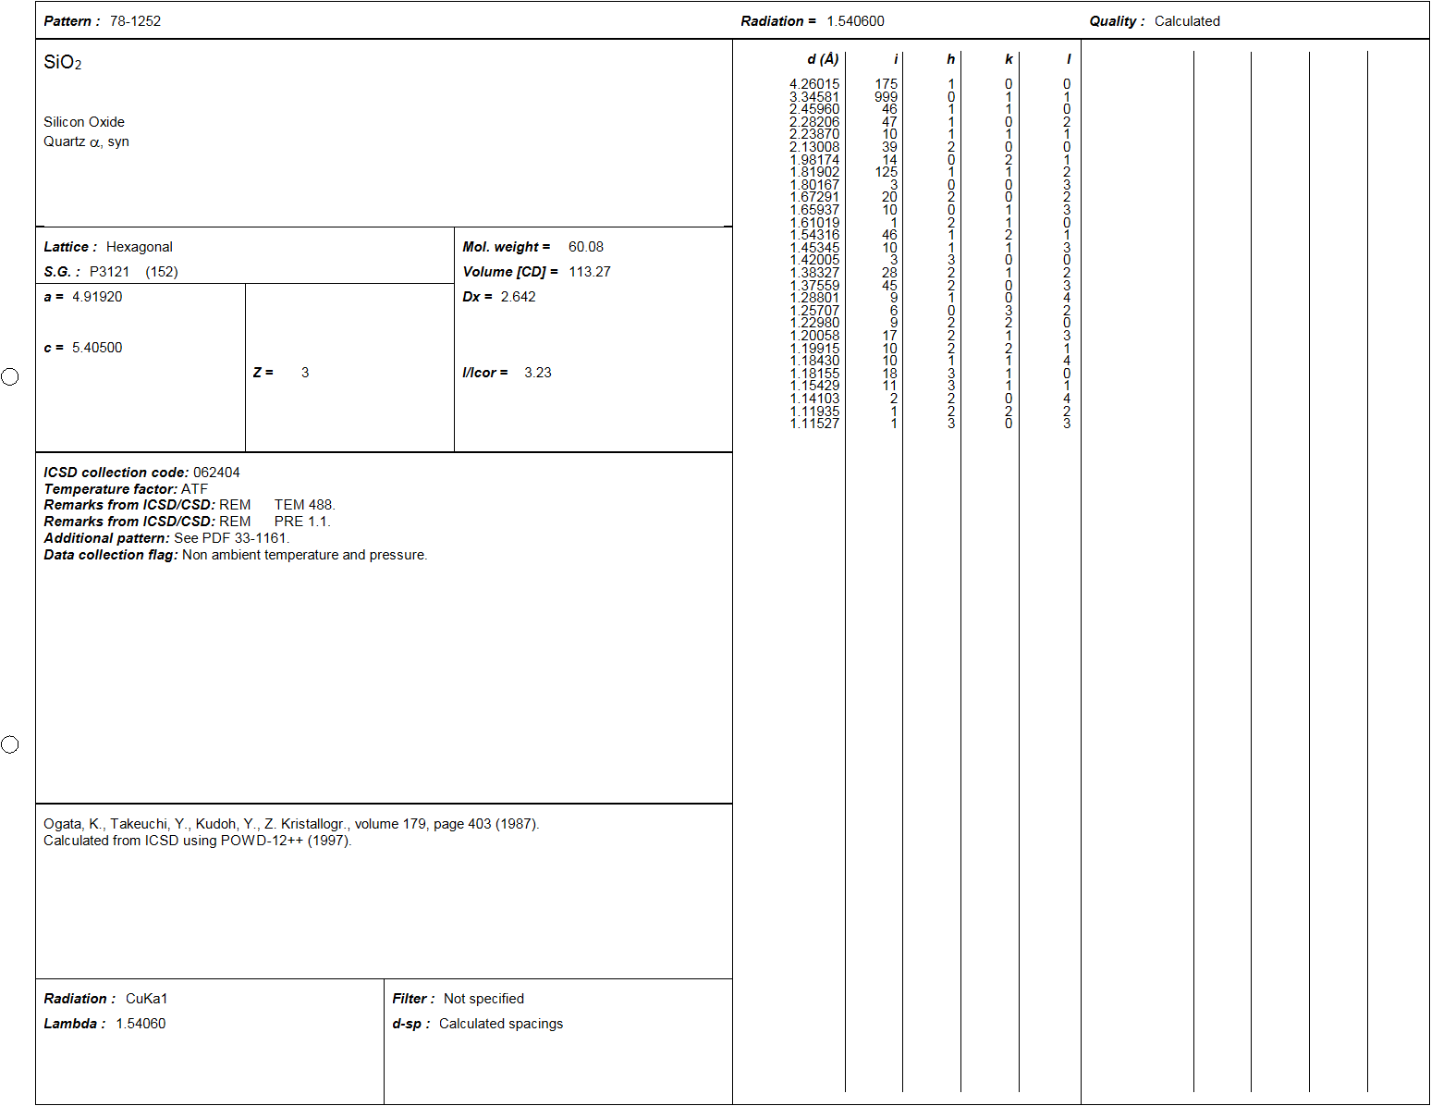
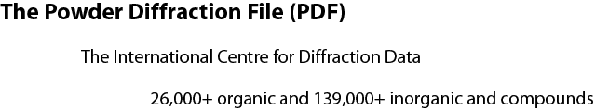
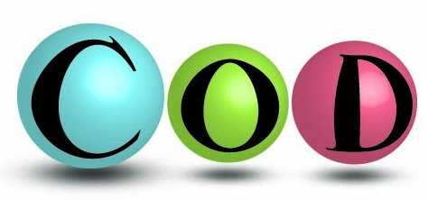
Why?
Crystallography Open Database

Slide 18
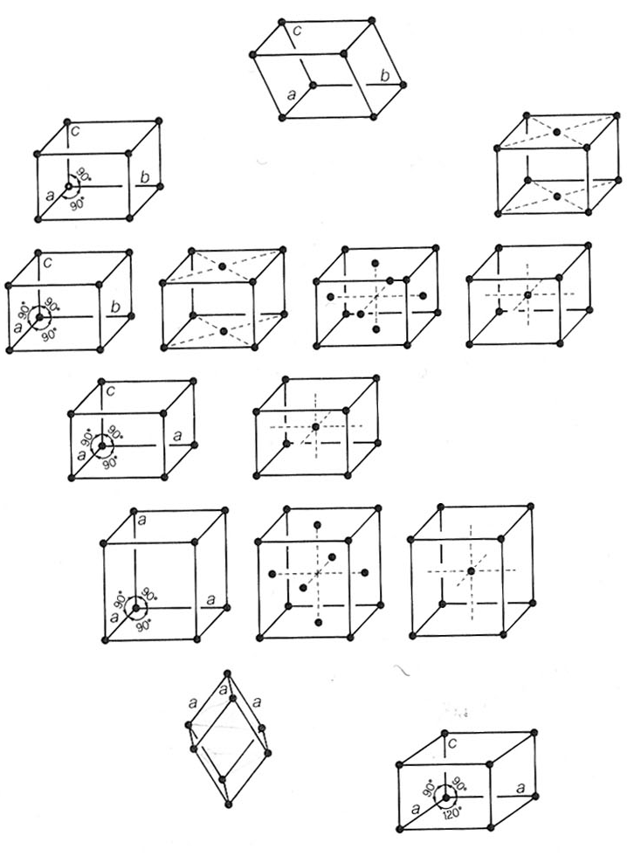
Indexing

Slide 19
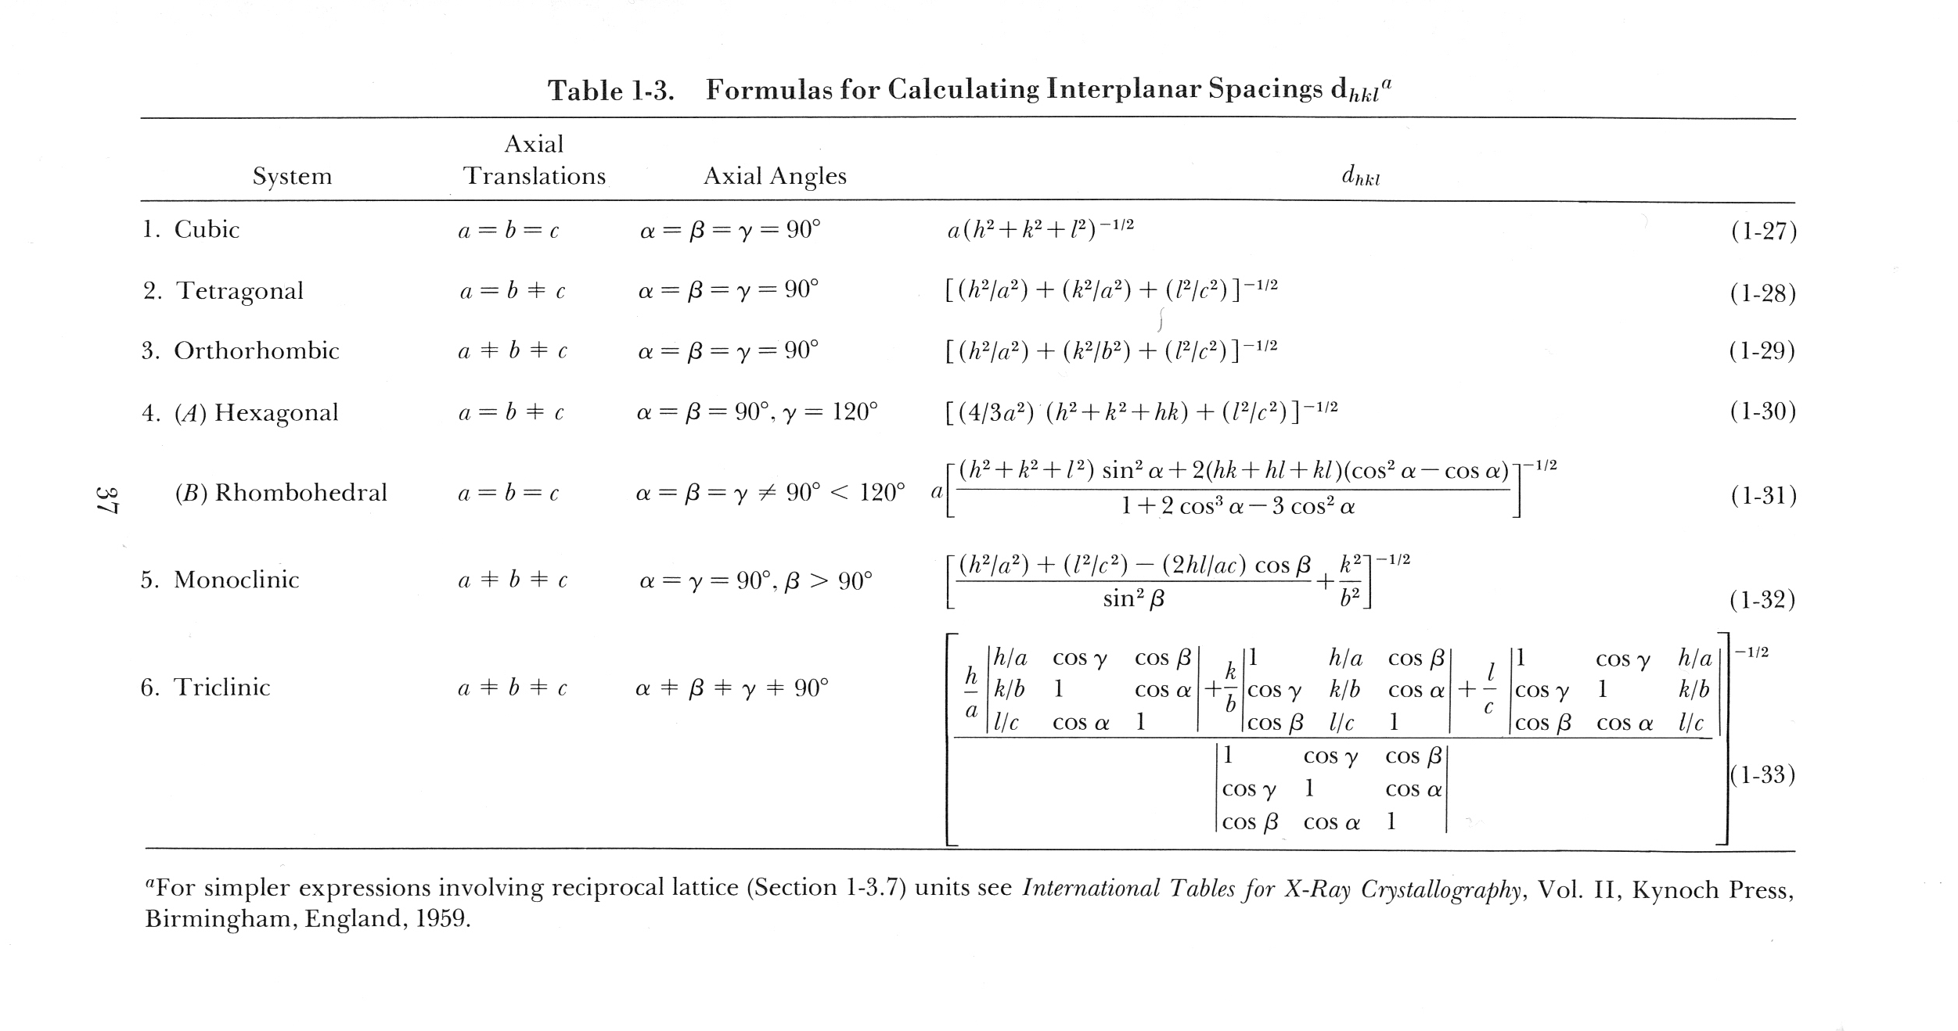

Slide 20
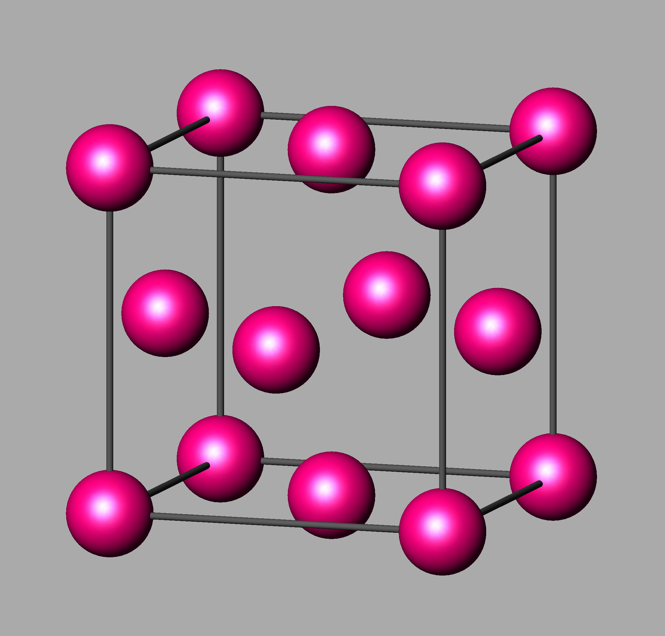

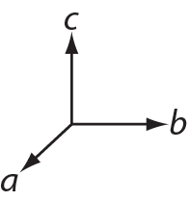
Extinction
Utslukning
Example: Cubic face centered
Special example: Cubic close packed

Slide 21
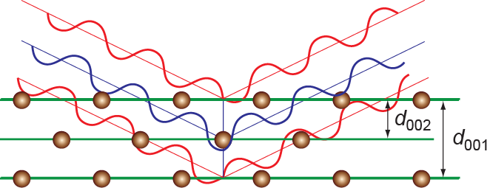
Extinction
Utslukning
Example: Cubic face centered
Special example: Cubic close packed

Slide 22
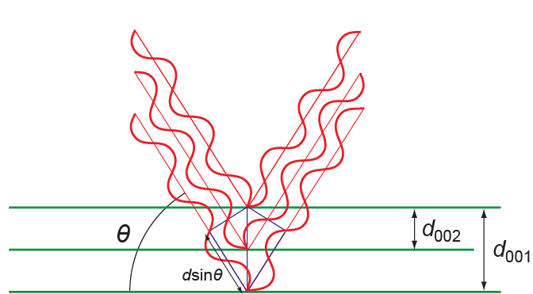
But don’t mix up with ...

Slide 23
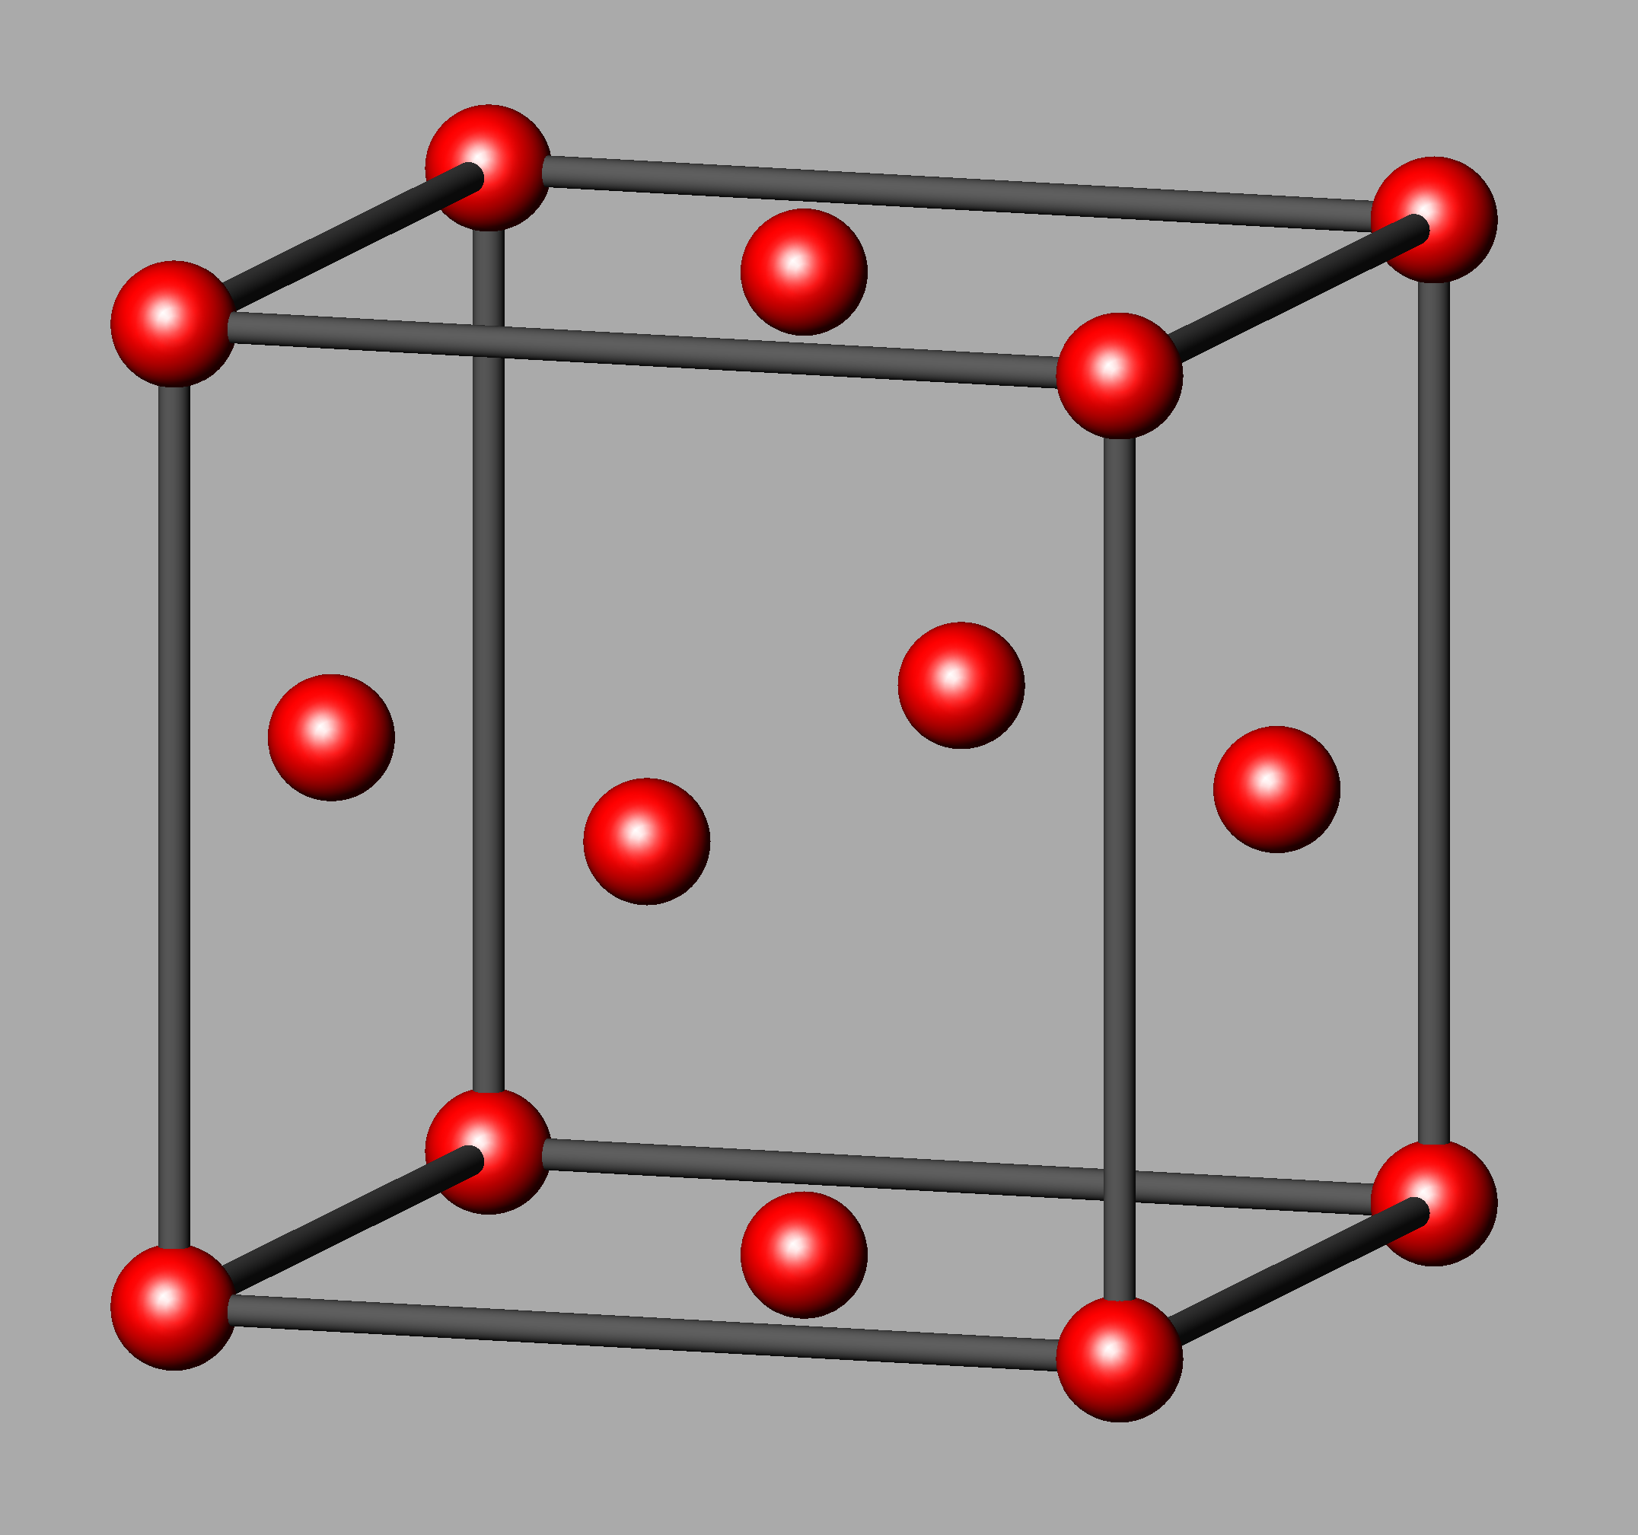
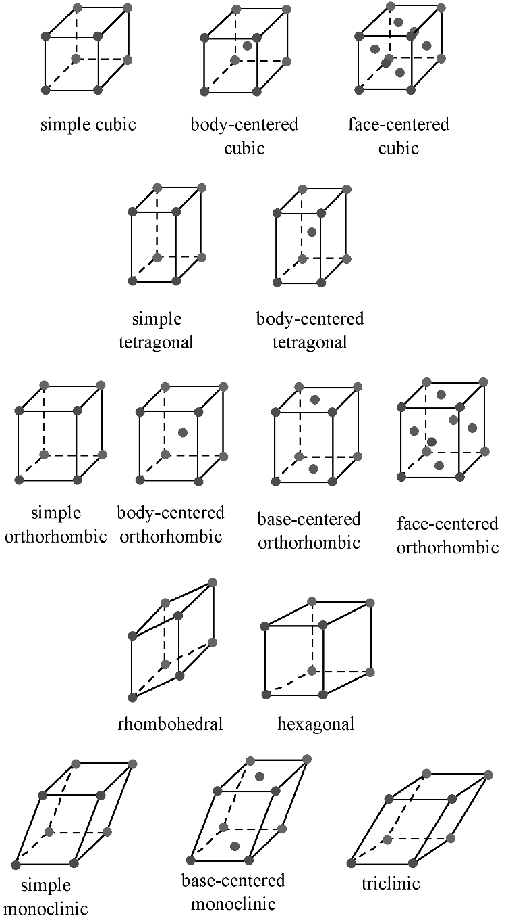
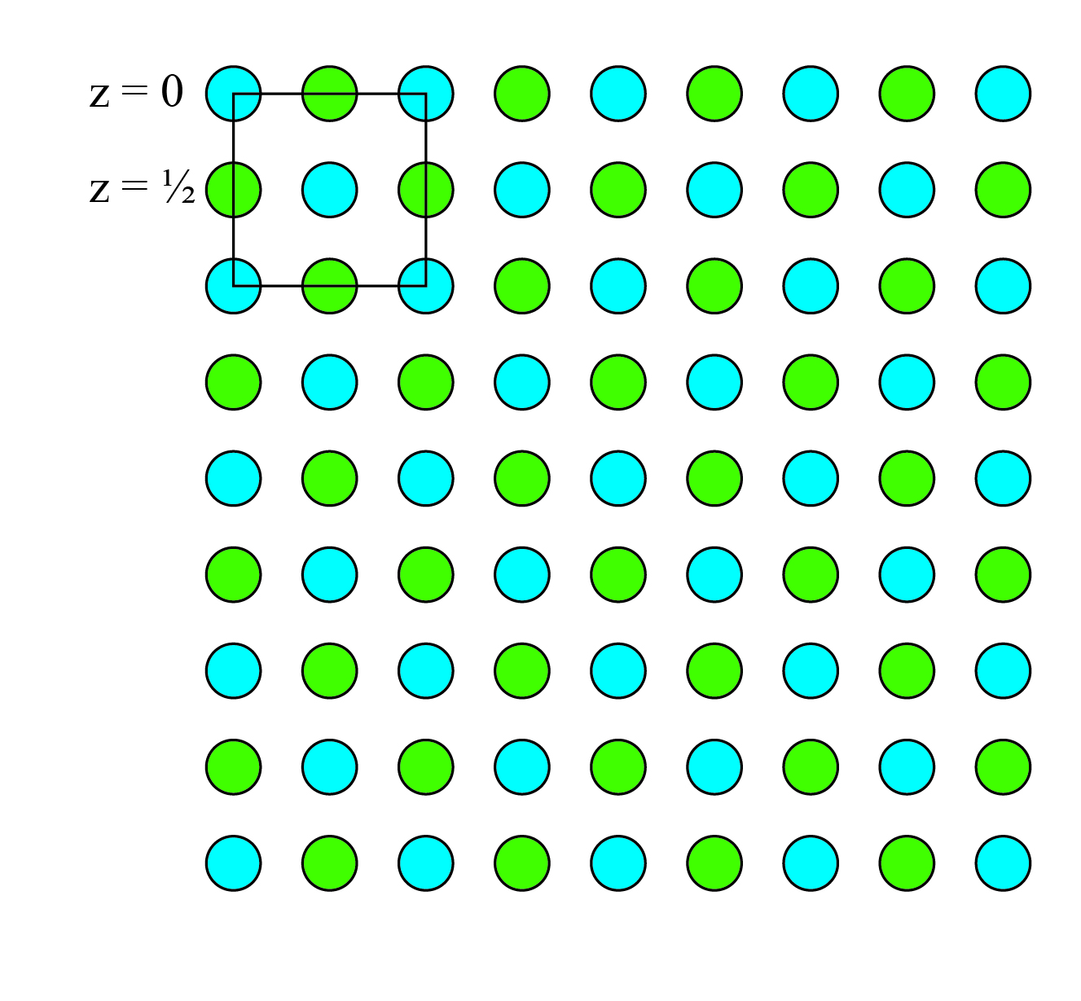
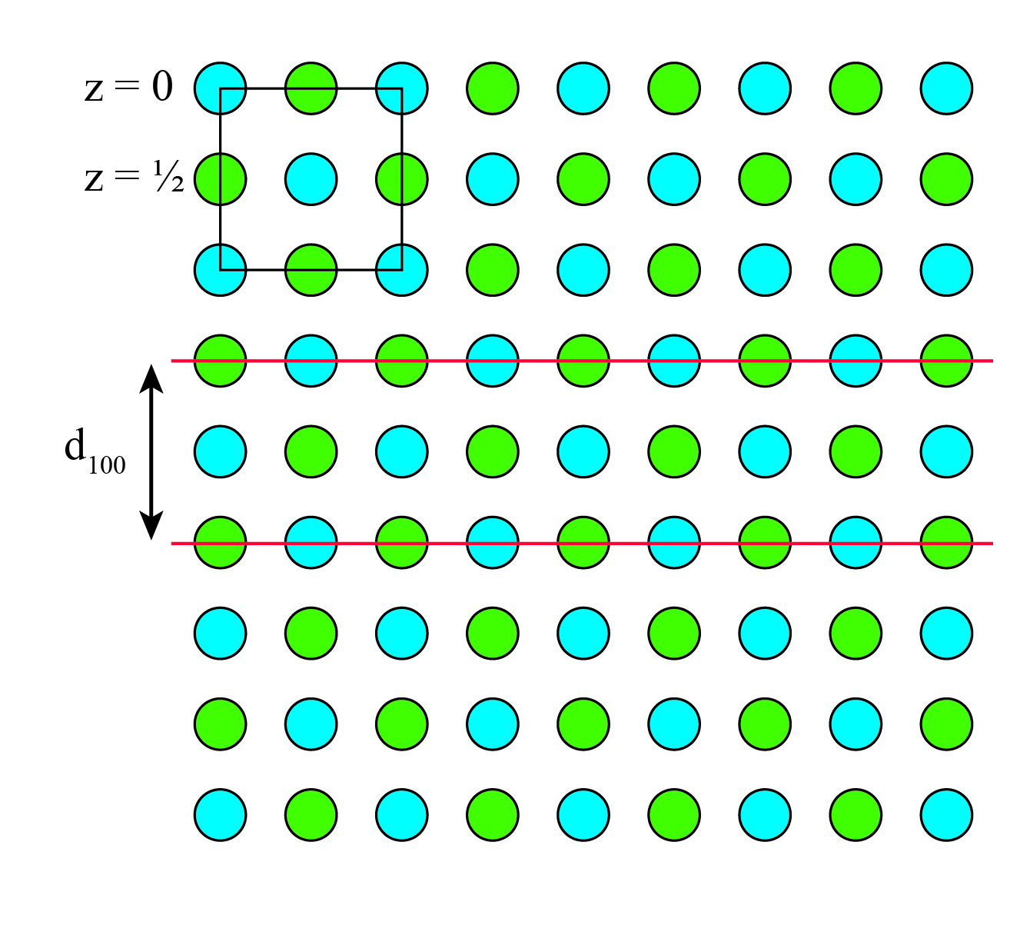
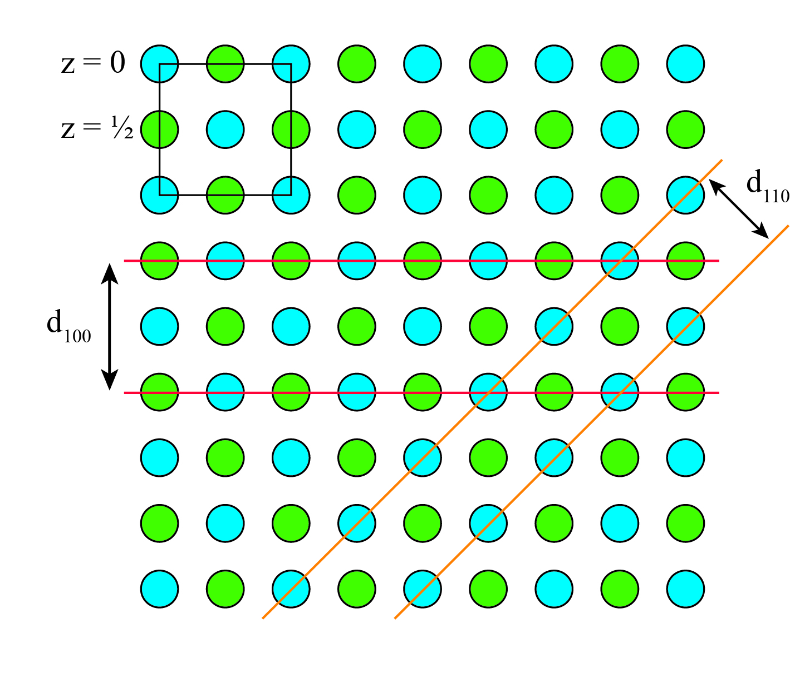
Cubic face-centred
Allowed reflexes for fcc:
111, 200, 220, 311, 222, ...
All odd or all even
Centred lattices gives rice to extinction
Alle partall eller oddetall
h + k = 2n, h + l = 2n, k + l = 2n

Slide 24
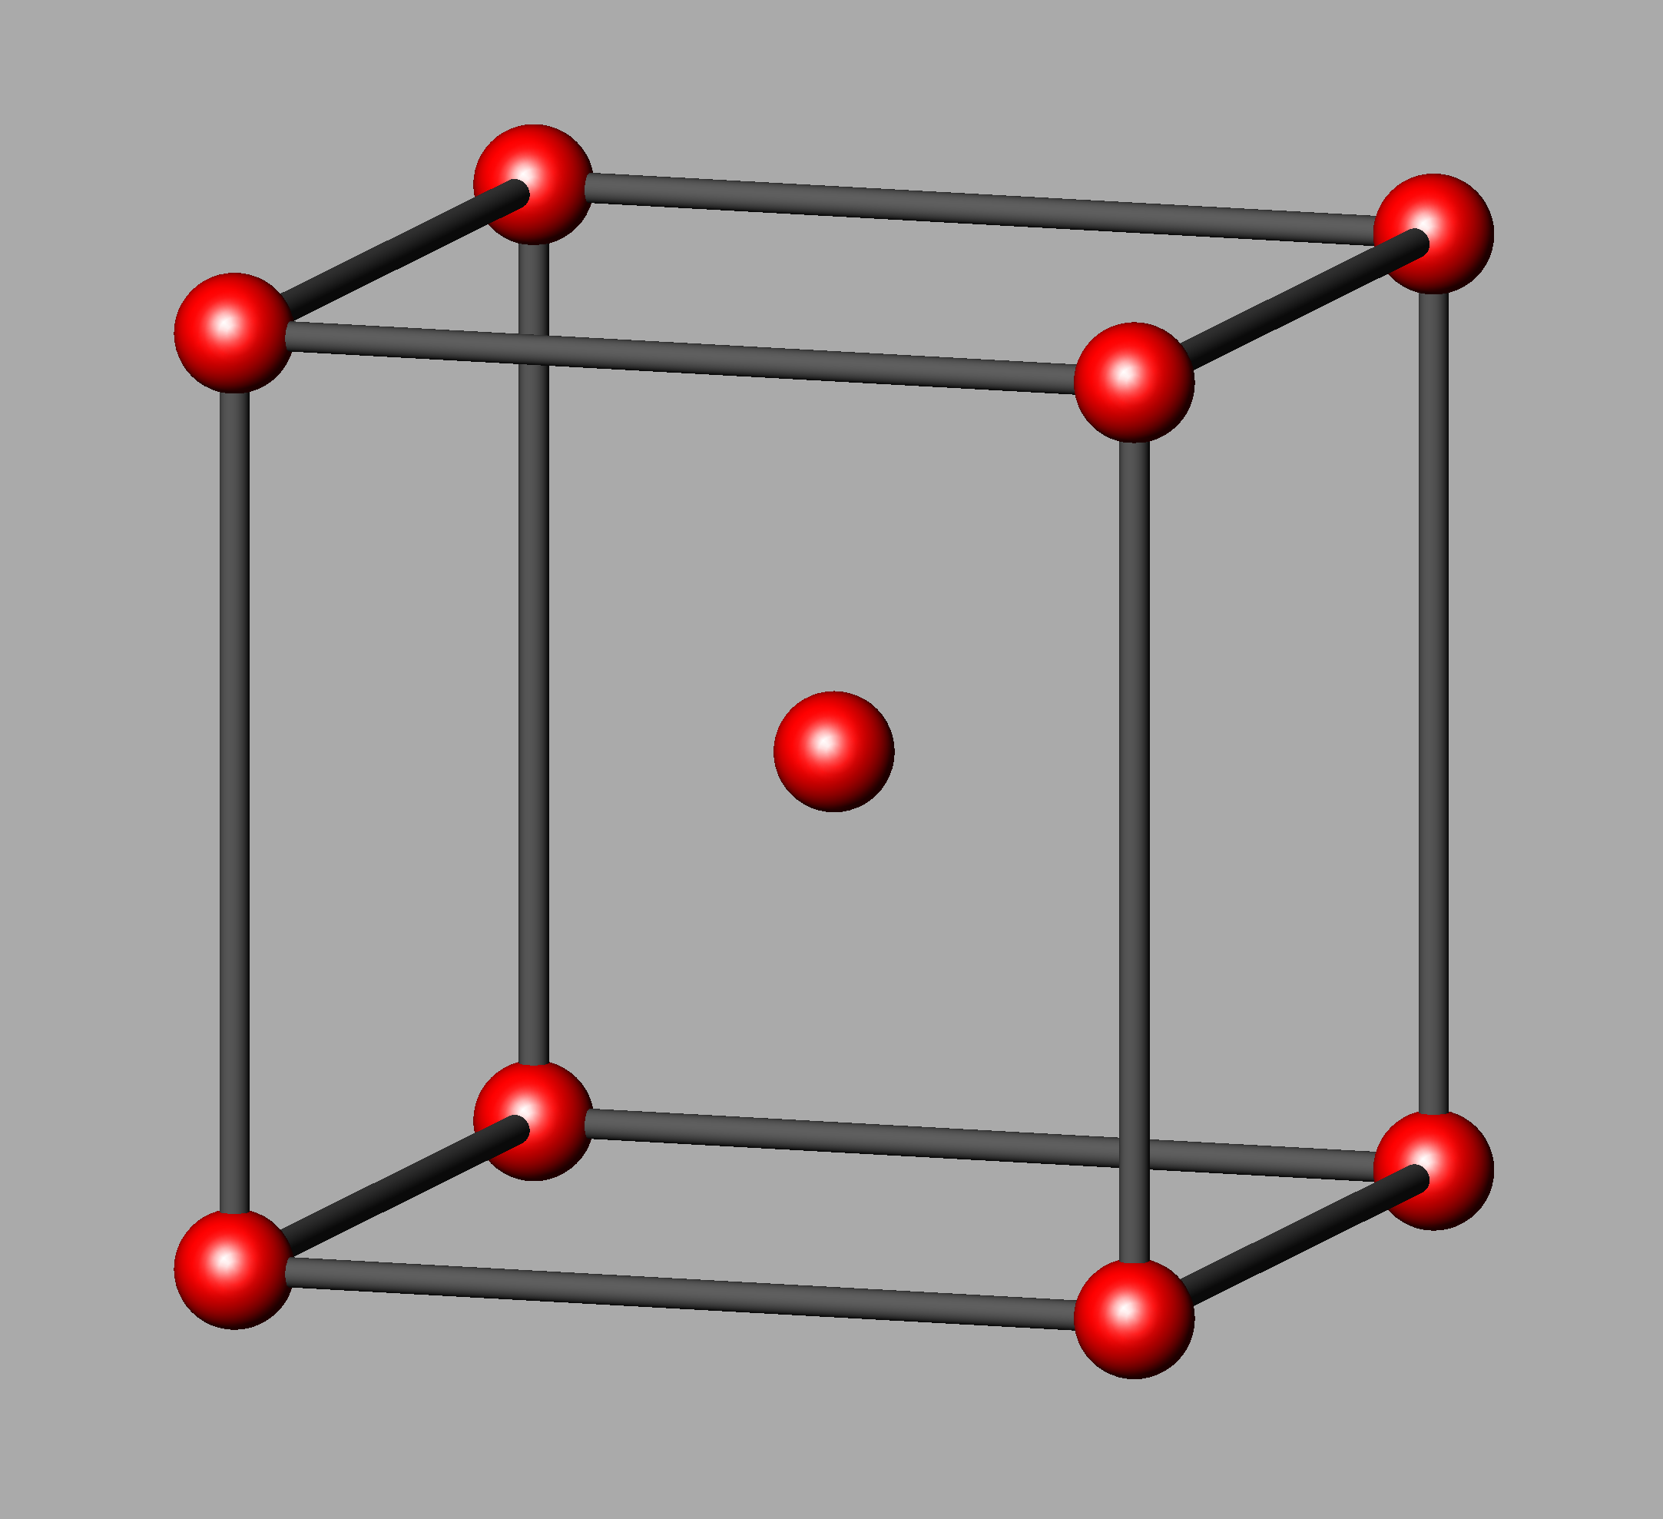
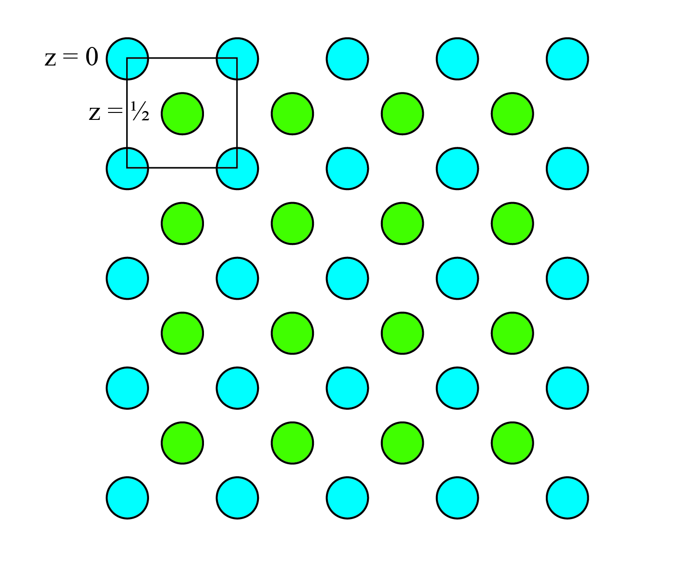
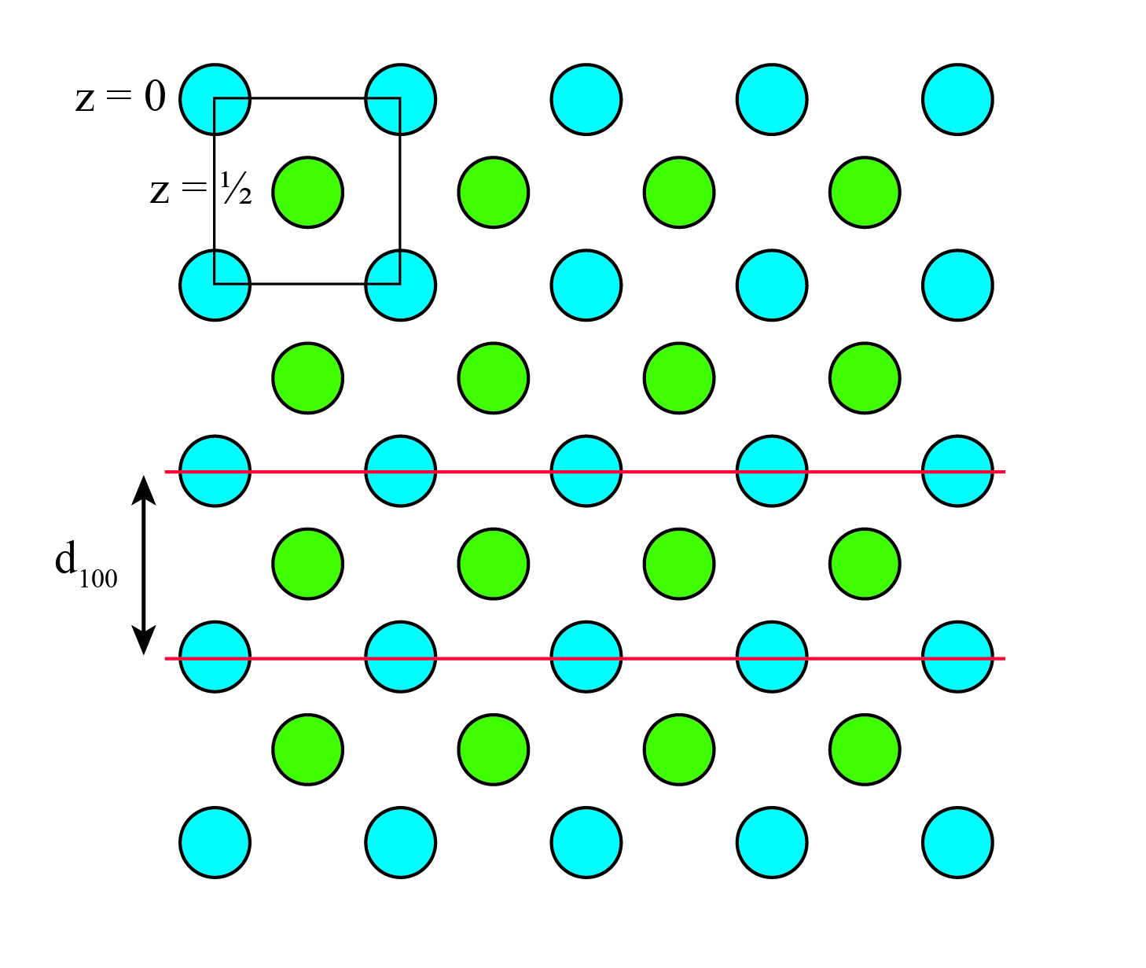
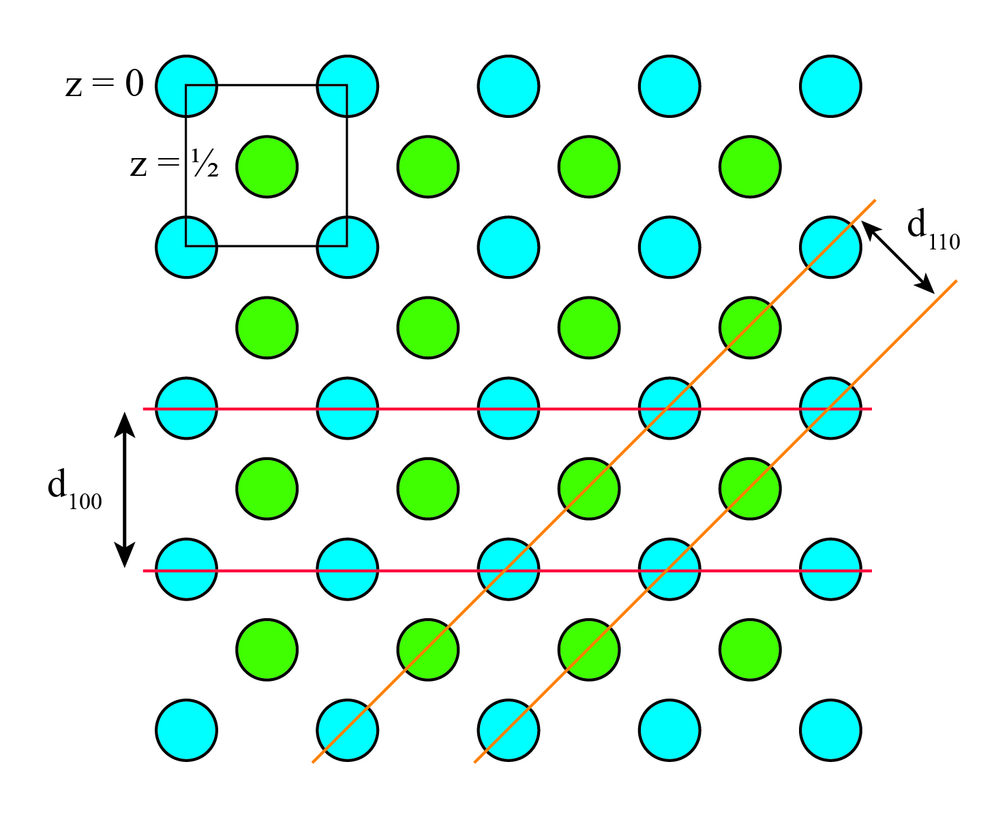
Cubic body-centred
Allowed reflexes for bcc:
110, 200, 211, 220, 310, ...
Centred lattices gives rice to extinction
h + k + l = 2n

Slide 25
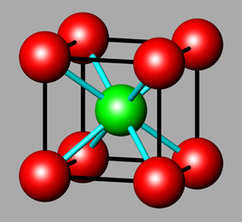
Cesiumklorid

Slide 26
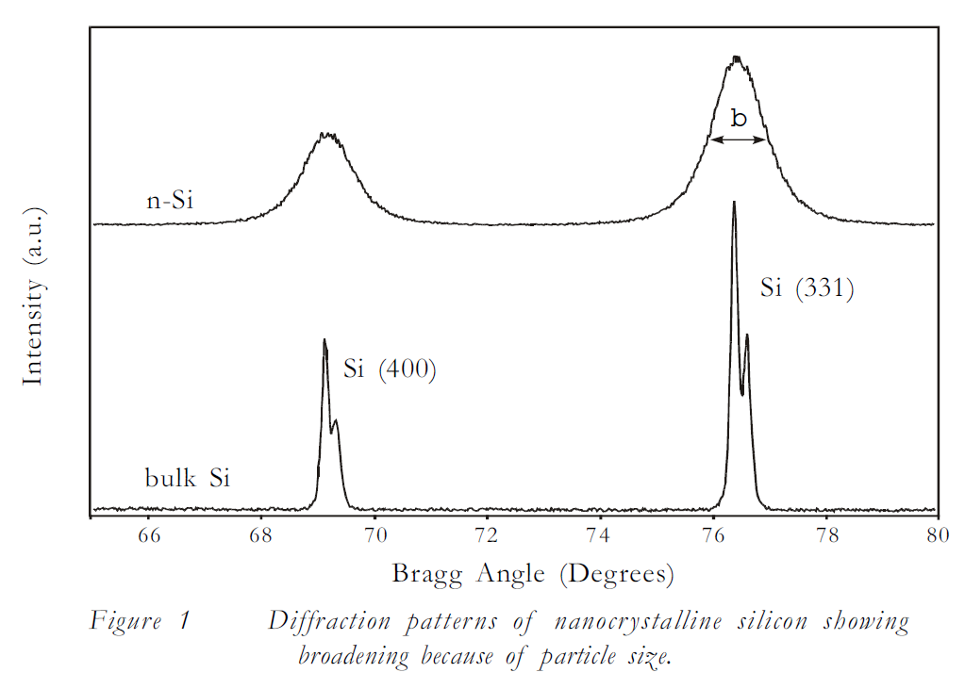
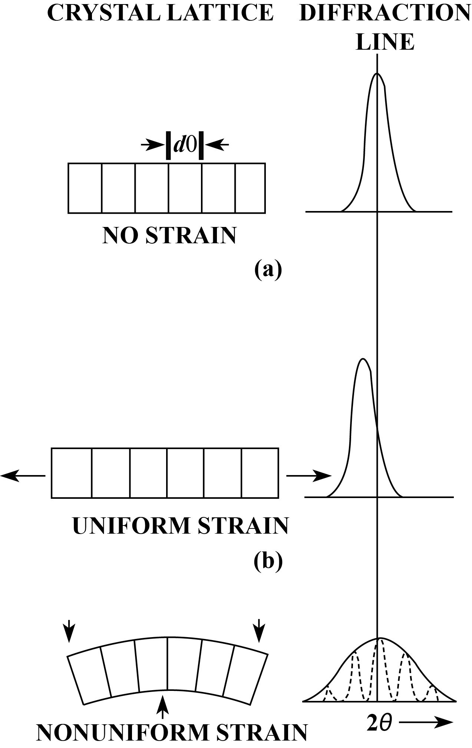


Particle size
Deformation
Scherrer’s equation

Slide 27



Rietveld refinement
Refinement of atomic positions
Amount of phases

