Slide 1



MENA 3200 Energy Materials
Materials for Electrochemical Energy Conversion
Fuel cells – Electrolysers - Batteries
Truls Norby

Slide 2
Overview of this part of the course
What is electrochemistry?
Types of electrochemical energy conversion devices
  Fuel cells, electrolysers, batteries
General principles of materials properties and requirements
  Electrolyte, electrodes, interconnects
  Conductivity
  Catalytic activity
  Stability
  Microstructure
Examples of materials and their properties
  SOFC, PEMFC, Li-ion batteries

Slide 3
What is electrochemistry?
R
4e⁻
+
4H⁺
Redox chemistry – reduction and oxidation
  Example: Homogeneous redox reaction
  2H₂ + O₂ = 2H₂O
Electrochemistry is redox chemistry where reduction and oxidation take place at different locations:
  Cathode: O₂ + 4H⁺ + 4e⁻ = 2H₂O | 1
  Anode: 2H₂ = 4H⁺ + 4e⁻ | 1
  Total: 2H₂ + O₂ = 2H₂O
The two locations must thus be connected with pathways for ions and electrons
O₂
2H₂O
2H₂
Proton conducting fuel cell
4e⁻
4H⁺
O₂
2H₂O
2H₂
Hydrogen membrane

Slide 4
Electrochemical energy conversion
R
4e⁻
4H⁺
+
O₂
2H₂O
Reaction:
  Cathode: O₂ + 4H⁺ + 4e⁻ = 2H₂O | 1
  Anode: 2H₂ = 4H⁺ + 4e⁻ | 1
  Total: 2H₂ + O₂ = 2H₂O
If we have different pathways for ions and electrons,
  electrolyte for ions,
  electrodes + wire for electrons,
we can
  extract electrical energy from a spontaneous reaction (e.g. fuel cell or discharging battery),
  supply electrical energy to drive a non-spontaneous reaction (e.g. electrolyser cell or charging battery).
2H₂
Proton conducting fuel cell
+
U
4e⁻
4H⁺
O₂
2H₂O
2H₂
Proton conducting electrolyser

Slide 5
Electrochemical processes without electrodes
4e⁻
4H⁺
O₂
2H₂O
If the ions and electrons go in the same material – a mixed conductor – we cannot get or use electrical energy, but we can for instance get chemical processes, gas separation, or heat.
We may get or use work other than electrical – for instance pumping.
In this course we will however mostly disregard these processes, and concentrate on devices with electrolytes and electrodes.
2H₂
Hydrogen membrane
M
MO_{z/2}
ze⁻
M^{z+}
z/4 O₂
Oxidising (corroding) metal

Slide 6
Electrochemical cells
R
4e⁻
-
4H⁺
+
Reduction: A + xe⁻ = A^{x-} | y
Oxidation: B = B^{y+} + ye⁻ | x
Total: yA + xB = yA^{x-} + xB^{y+}
In text, we often represent cells by a diagram of the type
B | B^{y+} || A^{x+} | A
Multiple components in one phase are separated by comma
Phase borders: single lines
Half cell border (salt bridge): double line
Electrode where oxidation takes place is called anode.
Electrode where reduction takes place is called cathode.
Anode Oxidation (both start with vowels)
Cathode Reduction (both start with consonants)
Definition of anode and cathode thus not defined by sign of voltage, but on whether process consumes or releases electrons.
O₂
2H₂O
2H₂
Anode -
Cathode +
Proton conducting fuel cell
-
+
U
4e⁻
4H⁺
O₂
2H₂O
2H₂
Cathode -
Anode +
Proton conducting electrolyser

Slide 7
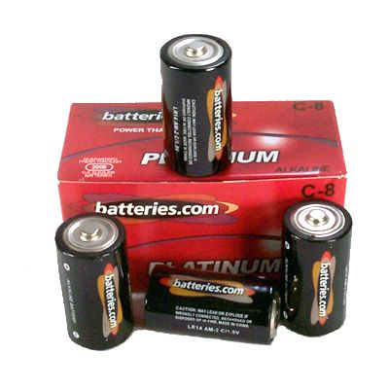
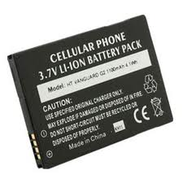
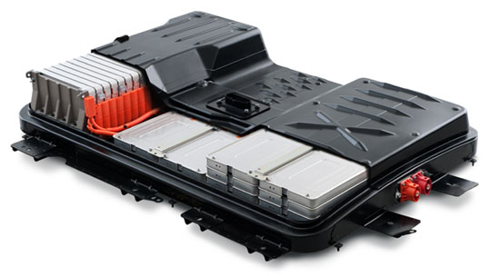
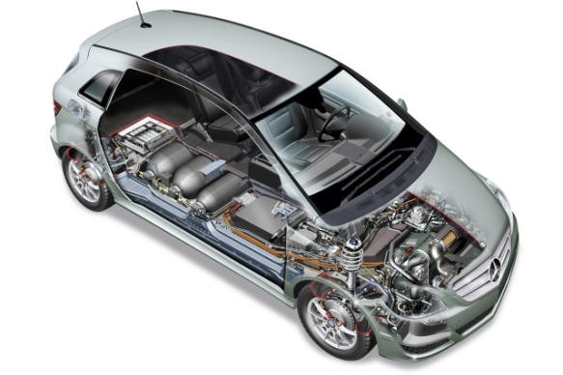
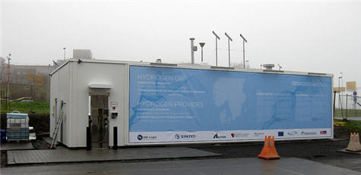
Batteries, fuel cells, and electrolysers
Primary batteries
  Factory charged
  Single discharge
Secondary batteries - accumulators
  Rechargeable
  Multiple discharges and recharges
  All chemical energy stored
“Ternary batteries” – fuel cells
  Fuel continuously supplied from external source
Electrolysers
  Reversed fuel cells
  Fuel generated continuously and stored externally

Slide 8
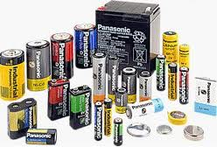
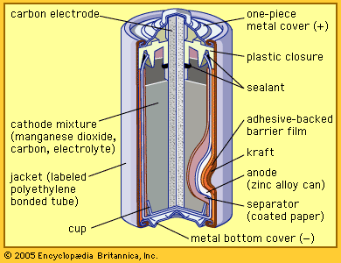
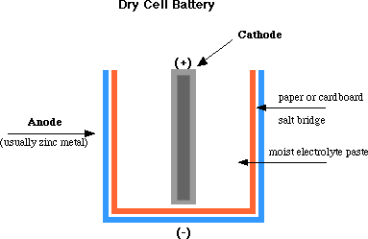
Primary battery
Example: “Dry cell”/Alkaline battery. Discharge:
Anode (-): Zn + 2OH⁻ = Zn(OH)₂ + 2e⁻
Cathode (+): MnO₂ + H₂O + e⁻ = MnOOH + OH⁻
Electrolyte: KOH

Slide 9
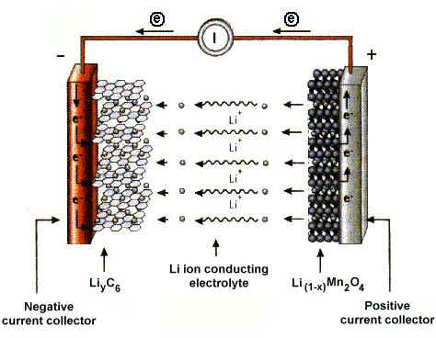
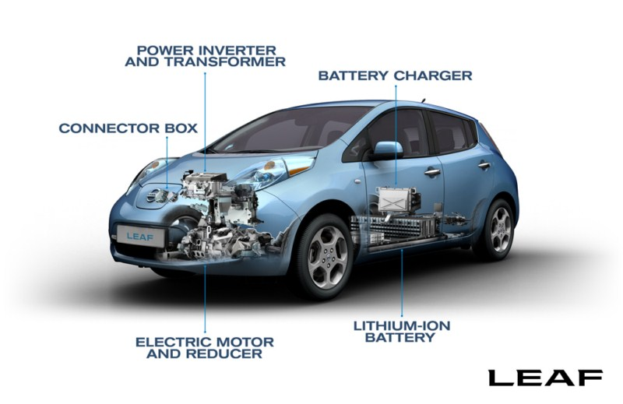
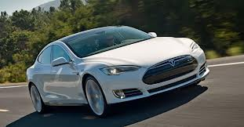
Secondary battery (rechargeable, accumulator)
Example: Li-ion battery. Discharge:
Anode(-): Li = Li⁺ + e⁻
Cathode(+): Li⁺ + 2MnO₂ + e⁻ = LiMn₂O₄
Electrolyte: Aqueous, polymer, or solid state Li⁺ ion conductor

Slide 10
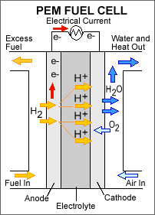
Fuel cell
  Polymer Electrolyte Membrane Fuel Cell (PEMFC):
  Anode(-): 2H₂ = 4H⁺ + 4e⁻
  Cathode(+): O₂ + 4H⁺ + 4e⁻ = 2H₂O
  Solid Oxide Fuel Cell (SOFC)
    If necessary, first reforming of carbon-containing fuels:
    CH₄ + H₂O = CO + 3H₂
  Anode(-): 2H₂ + 2O²⁻ = 2H₂O + 4e⁻
  Cathode(+): O₂ + 4e⁻ = 2O²⁻

Slide 11
Electrolysers
Supplied with low energy H₂O (or CO₂) and electrical energy
PEM: Produces H₂ from H₂O
  Cathode(-): 4H⁺ + 4e⁻ = 2H₂
  Anode(+): 2H₂O = O₂ + 4H⁺ + 4e⁻
SOEC: Produces H₂ from steam (or syngas CO+H₂, or a liquid fuel)
  Cathode(-): 2H₂O + 4e⁻ = 2H₂ + 2O²⁻
  Anode(+): 2O²⁻ = O₂ + 4e⁻
Materials otherwise as for fuel cells

Slide 12
Main materials classes and requirements
Electrolyte
Electrodes
Interconnects

Slide 13
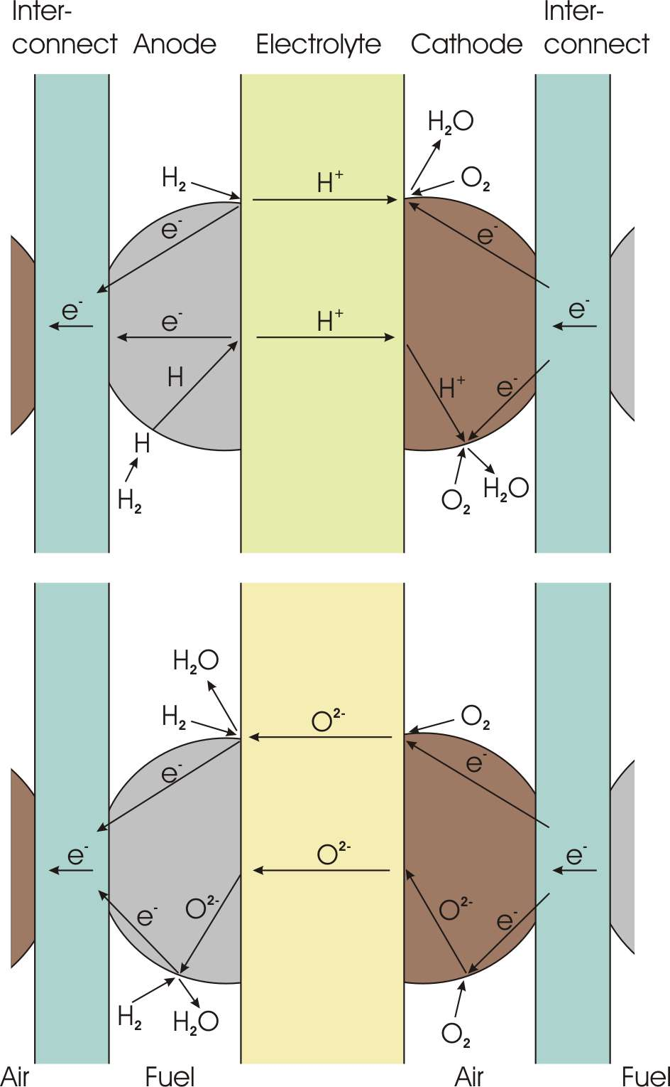
Main materials classes
Solid state electrochemical energy conversion devices contain three main functional materials classes
We will use Proton Ceramic Fuel Cells (PCFCs) and Solid Oxide Fuel Cells (SOFCs) as examples
Electrolyte
  Conducts ions only
Electrodes
  Conducts electrons
    Anode
    Cathode
Interconnect
  Conducts electrons only
R
4e⁻
+
4H⁺
2O₂
2H₂O
Why?
2H₂
Proton conducting fuel cell
Why?

Slide 14
Exercise - I
Concentrate on the upper half of the PCFC case
What reactants flow to the anode (fuel) and what exits in the exhaust from it?
What reactants flow to the cathode (air) compartment and what exits from it?
Does this type of cell have any advantages and disadvantages in terms of the above?
R
4e⁻
+
4H⁺
O₂
2H₂O
2H₂
Proton conducting fuel cell

Slide 15
Exercise - II
Now concentrate on the upper half of the SOFC case
What reactants flow to the anode (fuel) and what exits in the exhaust from it?
What reactants flow to the cathode (air) compartment and what exits from it?
Does this type of cell have any advantages or disadvantages as compared to the PCFC?

Slide 16
Electrolyte
The job of the electrolyte is to conduct ions
High band gap, point defects
PCFC
  Proton H⁺ conductor
  E.g. hydrated Y-substituted BaZrO₃ (BZY)
SOFC
  Oxide ion O²⁻ conductor
  E.g. Y-substituted ZrO₂ (YSZ)
What is the effect if the electrolyte conducts also electrons?

Slide 17
Electrodes
The main job of the electrode is to conduct electrons.
Low band gap or metal
PCFC
  Anode:
    H₂(g) = 2H⁺ + 2e⁻
  Cathode:
    4H⁺ + O₂(g) + 4e⁻ = 2H₂O(g)
SOFC
  Anode:
    H₂(g) + O²⁻ = H₂O(g) + 2e⁻
  Cathode:
    O₂(g) + 4e⁻ = 2O²⁻

Slide 18
Electrodes exercise
The main job of the electrode is to conduct electrons
Concentrate on the upper halves of either of the cells
What is a secondary important job of the electrode material?
Where the reactants and products of the electrochemical reactions meet are called triple-phase boundaries (3pb)
Point out the 3pb’s. What are the three phases?
What is the dimensionality of these 3pb’s?

Slide 19
Electrodes with mixed transport
Now concentrate on the lower halves of either of the cells
The cathodes and the SOFC anode are shown with transport of the relevant ion in addition to electrons
  The electrodes have mixed conduction
  Example cathode: Sr-doped LaMO₃ (M = Mn, Fe, Co)
  Example anode: Ni + YSZ cermet
Where does the electrochemical reaction take place now?
What is the dimensionality of this location?
The PCFC anode is shown with transport of atomic H
  Example: Ni
What happens at the surface of the anode?
Where does charge transfer take place now?

Slide 20
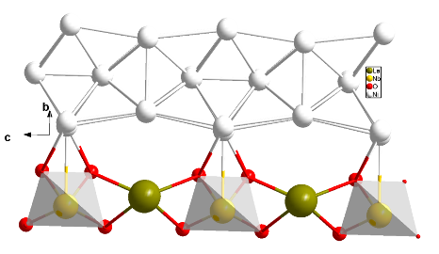
Just a distraction…
DFT and TEM of Ni-LaNbO₄ electrode interface

Slide 21
Interconnects
Alternative name: Bipolar plates
The jobs of the interconnects are to
  Conduct electrons from one cell to the next so as to connect the cells in series
  Separate the fuel and oxidant gases
The interconnect must conduct only electrons
Low band gap or metal – no point defects
What is the effect if the interconnect also conducts ions?

Slide 22
Dense or porous?
    Electrolyte?
    Electrodes?
    Interconnect?

Slide 23
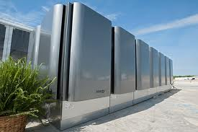
Solid Oxide Fuel Cells (SOFCs)

Slide 24
Solid Oxide Fuel Cell (SOFC)
R
4e⁻
+
2O²⁻
“oxide” reflects that the electrolyte is an oxide and that it conducts oxide ions
Electrode reactions
  Anode(-): 2H₂ + 2O²⁻ = 2H₂O + 4e⁻
  Cathode(+): O₂ + 4e⁻ = 2O²⁻
Operating temperature: 600-1000°C
Fuel: H₂ or reformed carbon-containing fuels
Potential advantages:
  Fuel flexibility and tolerance
  Good kinetics – no noble metals needed
  High value heat
Current problems:
  High cost
  Lifetime issues
2H₂
2H₂O
O₂
Solid Oxide Fuel Cell (SOFC)

Slide 25
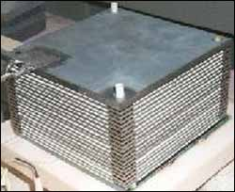
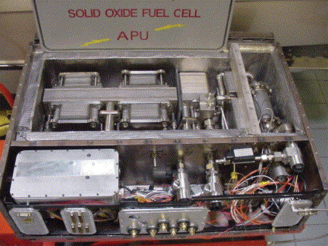
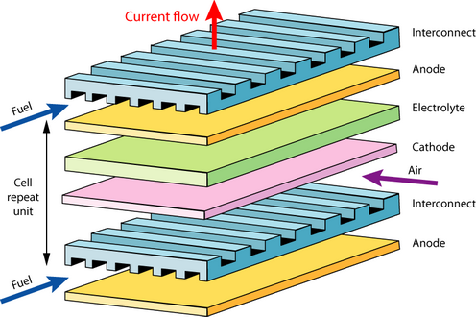
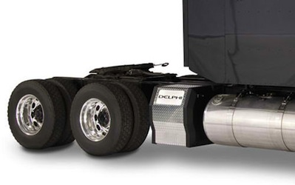
Typical SOFC designs
SOFCs for vehicle auxiliary power units

Slide 26
SOFC electrolyte material requirements
Oxide ion conductivity > 0.01 S/cm
  Film of <10 μm gives <0.1 Ωcm² of resistance or <0.1 V loss at 1 A/cm²
Ionic transport number >0.99
Gastight
Tolerate both reducing (H₂) and oxidising (air/O₂) atmospheres
Be compatible with both electrodes (TEC and chemistry)

Slide 27
Oxide ion conductors
Oxygen vacancies
  Obtained by acceptor dopants
    Y-doped ZrO₂ (YSZ), Sc-doped ZrO₂
    Gd-doped CeO₂ (GDC)
    Sr+Mg-doped LaGaO₃ (LSGM)
Disordered inherent oxygen deficiency
    Example: δ-Bi₂O₃
Oxygen interstitials
    No clearcut examples…

Slide 28
Y-stabilised zirconia; YSZ
Doping ZrO₂ with Y₂O₃
Stabilises the tetragonal and cubic structures
  Higher symmetry and oxygen vacancy mobilities
Provides oxygen vacancies as charge compensating defects
Oxygen vacancies trapped at Y dopants
8 mol% Y₂O₃ (8YSZ): highest initial conductivity
10 mol% Y (10YSZ): highest long term conductivity
Metastable tetragonal zirconia polycrystals (TZP) of 3-6 mol% Y₂O₃ (3YSZ, 6YSZ) gives transformation toughened zirconia – better mechanical properties but lower conductivity
Partially replacing Y with Sc and Yb gives less trapping and better strength

Slide 29
SOFC anode materials requirements
Electronic conductivity > 100 S/cm
Ionic transport as high as possible to spread the reaction from 3pb to the entire surface
Porous
Tolerate reducing (H₂) atmospheres
Be compatible with electrolyte and interconnect (TEC and chemistry)
Catalytic to electrochemical H₂ oxidation
For carbon-containing fuels:
  Be moderately catalytic to reforming and catalytic to water shift
  Not promote coking
  Tolerant to typical impurities, especially S

Slide 30
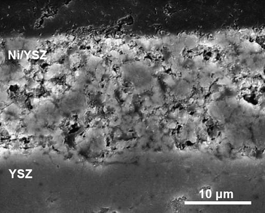
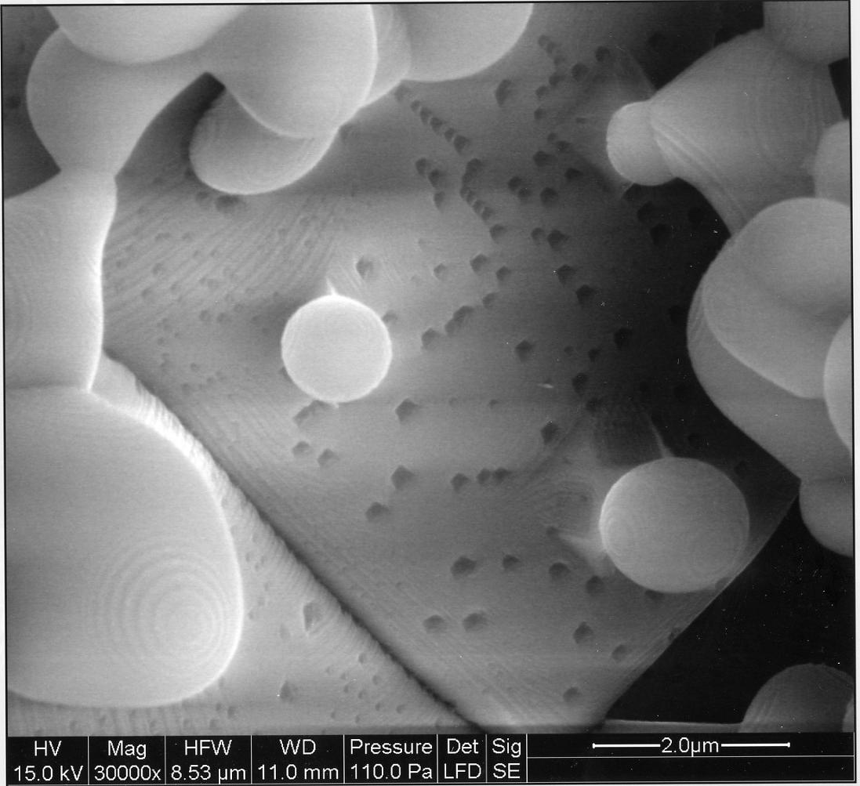
SOFC anodes: Ni-electrolyte cermet
Made from NiO and e.g. YSZ
NiO reduced in situ to Ni
Porous
All three phases (Ni, YSZ, gas) of approximately equal volume fractions and form three percolating networks.
  Electrons
  Ions
  Gas
In addition, Ni is permeable to H, further enhancing the spreading of the reaction sites
  Electrochemical oxidation of H₂ is very fast
Problems
  Mechanical instability by redox and thermal cycles
  Sulphur intolerance
  Too high reforming activity. Tendency of coking
Remedies
  Oxide anodes? (Donor doped n-type conductors)

Slide 31
SOFC cathode materials requirements
Electronic conductivity > 100 S/cm
Ionic transport as high as possible to spread the reaction from 3pb to the entire surface
Porous
Tolerate oxidising (air/O₂) atmospheres
Be compatible with electrolyte and interconnect (TEC and chemistry)
Catalytic to electrochemical O₂ reduction
Must tolerate the CO₂ and H₂O-levels in ambient air
  Too basic materials (high Sr and Ba contents) may decompose under formation of carbonates or hydroxides

Slide 32
SOFC cathodes: Sr-doped LaMnO₃ (LSM)
For example La_{0.8}Sr_{0.2}MnO₃ (LSM)
p-type electronic conductor: [Sr_{La}/] = [h.]
Active layer is a “cercer” composite with electrolyte
Porous
All three phases (LSM, YSZ, gas) of approximately equal volume fractions and form three percolating networks.
  Electrons
  Ions
  Gas
In addition, LSM is somewhat permeable to O (by mixed O²⁻ and e⁻ conduction), further enhancing the spreading of the reaction sites
Problems and remedies
  Sensitive to Cr positioning from interconnect; coat interconnect and reduce operating temperature
  Too little mixed conductivity; replace Mn with Co; LaCoO₃ has more oxygen vacancies than LaMnO₃.

Slide 33
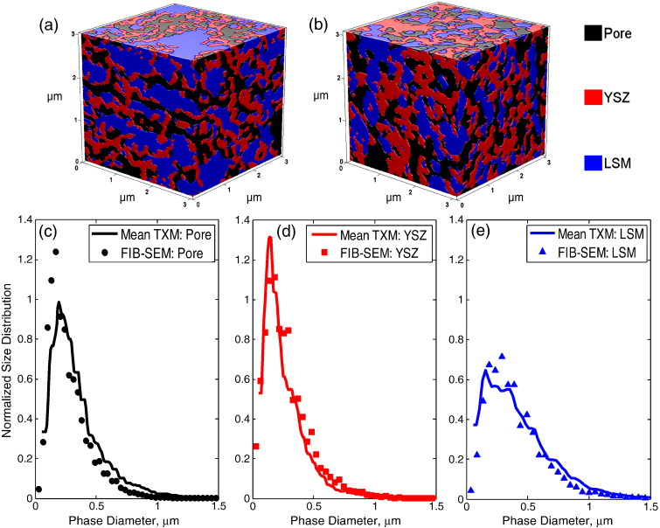
Tomography of the three percolating phases
G.C. Nelson et al., Electrochem. Comm., 13 (2011) 586–589.

Slide 34
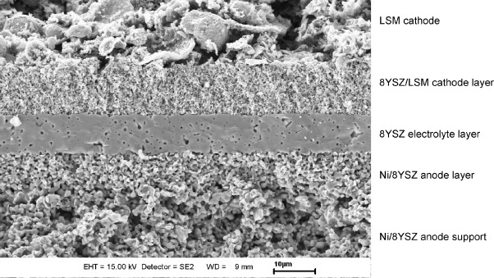
Anode-supported SOFC membrane electrode assembly (MEA)
T. Van Gestel, D. Sebold, H.P. Buchkremer, D. Stöver, J. European Ceramic Society, 32 [1] (2012) 9–26.

Slide 35
SOFC interconnect materials requirements
Electronic conductivity > 100 S/cm
Ionic transport number < 0.01 to avoid chemical shortcut permeation
Gas tight
Tolerate both reducing (H₂) and oxidising (air/O₂) atmospheres
Be compatible with anode and cathode electrode materials (TEC and chemistry)
Mechanical strength

Slide 36
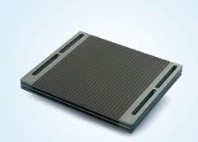
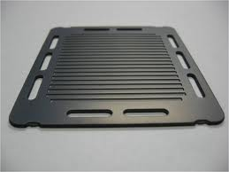
SOFC interconnects
Ceramic interconnects
  Sr-doped LaCrO₃
  p-type conductor: [Sr_{La}/] = [h.]
  Problems:
    Very hard to sinter and machine; expensive
    Non-negligible O²⁻ and H⁺ conduction; H₂ and O₂ permeable
Metallic interconnects
  Cr-Fe superalloys, stainless steels; Cr₂O₃-formers
  Very good electrical and heat conduction
  Mechanically strong
  Problems:
    Oxidation, Cr-evaporation
  Remedies:
    Reduce operation temperature

Slide 37
Polymer Electrolyte Membrane Fuel Cells (PEMFCs)

Slide 38
Polymer Electrolyte Membrane (PEM)
Proton Exchange Membrane (PEM)
PEM Fuel Cell (PEMFC)
Electrode reactions
  Anode(-): 2H₂ = 4H⁺ + 4e⁻
  Cathode(+): O₂ + 4H⁺ + 4e⁻ = 2H₂O
Operating temperature: 80°C
Fuel: Pure H₂
Advantages:
  Robust materials
Challenges:
  High cost of membrane and Pt catalyst
  Carbon oxidation
  Low value heat – heat exchange / cooling difficult
  Water management

Slide 39
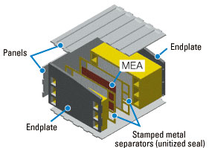
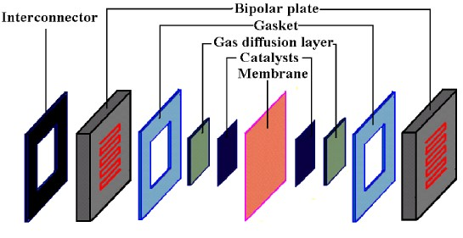
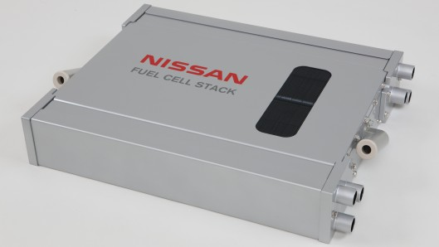
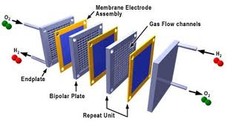
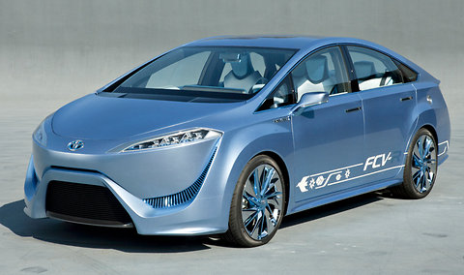
Typical PEMFC designs

Slide 40
PEMFC electrolyte material requirements
Proton conductivity > 0.1 S/cm
Ionic transport number >0.99
Gastight
Tolerate both reducing (H₂) and oxidising (air/O₂) atmospheres

Slide 41
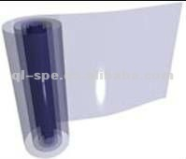
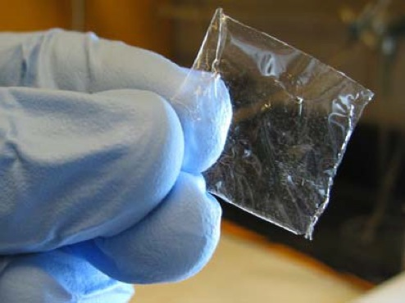
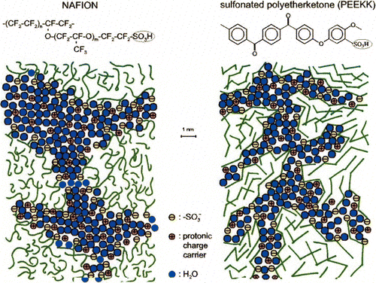
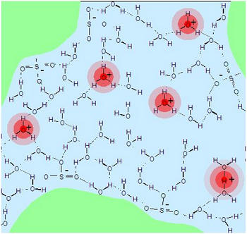
Polymer proton conductors
Nafion®
  Perfluorinated backbone
  Grafted
  Sulfonated
  Neutralised by NaOH; Na⁺
  Proton exchanged; H⁺
  Swelled with water
  Hydrophobic framework
  Channels with hydrophilic walls
  Protolysis to form H₃O⁺ in the water phase
  Transport of H⁺ drags ca. 6 H₂O molecules
  Backdraft of water

Slide 42
PEMFC electrode materials requirements
Electronic conductivity
Catalytic activity at largest possible electrode-electrolyte interface
Porous to allow gas access
Tolerate reducing (H₂, anode) and oxidising (O₂, cathode) conditions

Slide 43
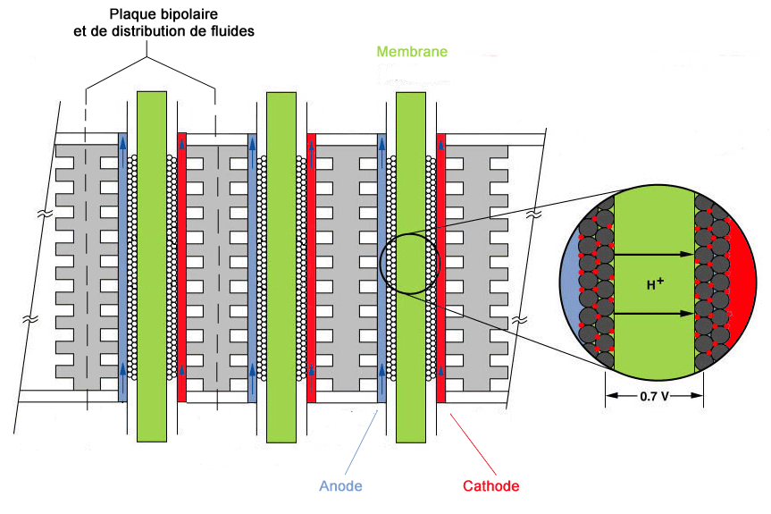
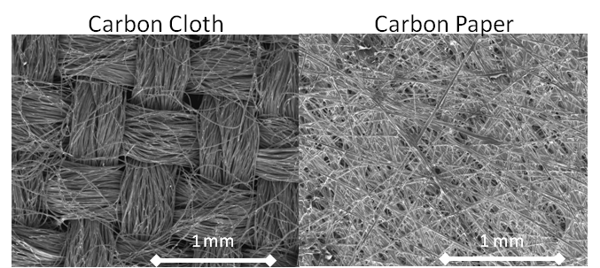
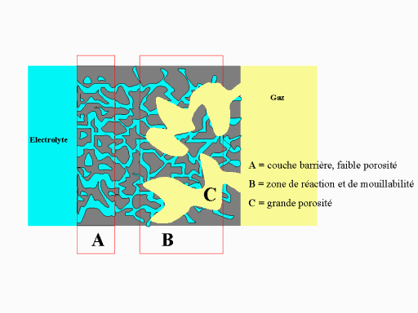
PEMFC electrode materials and structures
Carbon papers
Graphite
Carbon nanoparticles
Catalyst nanoparticles
Soaked with electrolyte
Porous gas diffusion layer

Slide 44
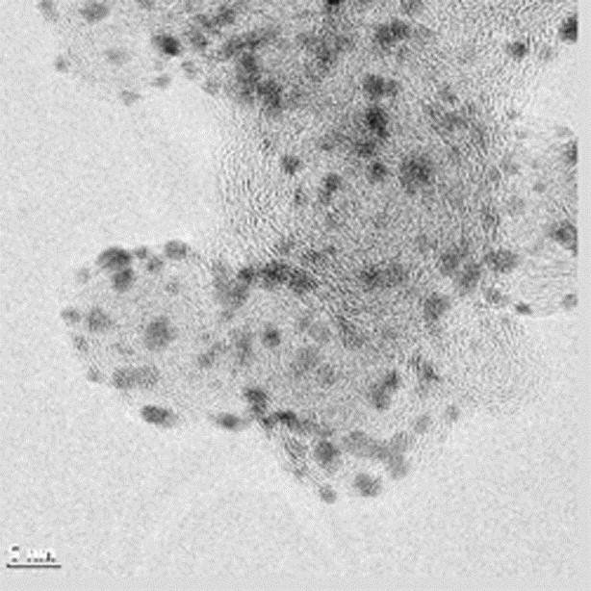
PEM electrode materials and structures
Noble metal nanoparticles dispersed on nanostructured carbon supports
Decreases noble metal loading
Challenge: Agglomeration of nanoparticles reduces activity
Challenge: Cathode carbon is oxidised by O₂ if no current is drawn.

Slide 45
PEMFC interconnect materials requirements
Electronic conductivity > 100 S/cm
Ionic transport number < 0.01 to avoid chemical shortcut permeation
Gas tight
Tolerate both reducing (H₂) and oxidising (air/O₂) atmospheres
Be compatible with electrode and electrolyte materials, notably acidity of electrolyte
Mechanical strength

Slide 46
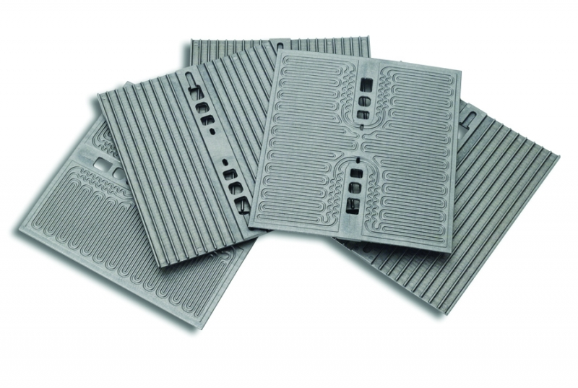
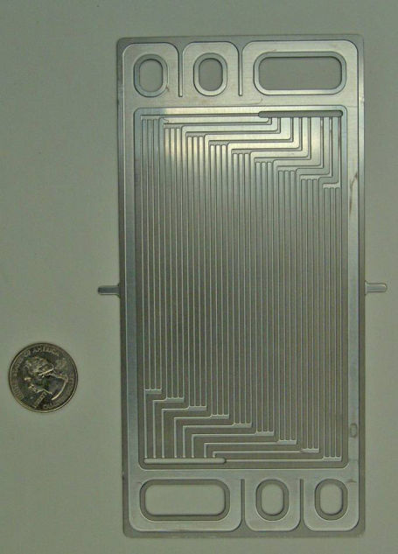
PEMFC interconnects
Graphite interconnects
  Pure graphite
  Composites
  Light weight
Metallic interconnects
  Commercial stainless steels
  Very good electrical and heat conduction
  Inexpensive
  Mechanically strong
  Problems:
    Oxidation in contact with electrolyte

Slide 47
Electrolysers vs fuel cells
R
4e⁻
4H⁺
+
In an electrolyser, the product of a fuel cell (H₂O, possibly also CO₂) is fed…
…the process forced backwards to produce primarily H₂ and O₂
H₂ may in turn reduce CO₂ to form CO…
The same materials and structures may be used, but:
  In a fuel cell, the chemical potential gradient is decreased due to losses – less severe materials requirements compared to equilibrium
  In an electrolyser, the chemical potential gradient is increased to overcome the losses – more severe materials requirements compared to equilibrium; more reducing and oxidising conditions
O₂
2H₂O
2H₂
Proton conducting fuel cell
+
U
4e⁻
4H⁺
O₂
2H₂O
2H₂
Proton conducting electrolyser

Slide 48

Secondary batteries (rechargeable, accumulator)
Li-ion batteries
M. Stanley Whittingham (1941-) proposed the first Li ion battery in the 1970s.

Slide 49

Example of a Li ion battery
Discharge:
Anode(-): LiC₆ = Li⁺ + 6C + e⁻
Cathode(+): Li⁺ + 2MnO₂ + e⁻ = LiMn₂O₄
Electrolyte: Li⁺ ion conductor
Charge: Reverse reactions
John B. Goodenough (1922-) developed the first modern 4 V Li ion batteries in 1979 by introducing LaCoO2 as cathode

Slide 50
Rechargeable battery
High chemical energy stored in one electrode
Discharged by transport to the other electrode as ions (in the electrolyte) and electrons (external circuit; load/charger)
Charging: reverse signs and transport back to first electrode
Electrolyte: Transport the ions
Electrodes and circuit: Transport the electrons

Slide 51
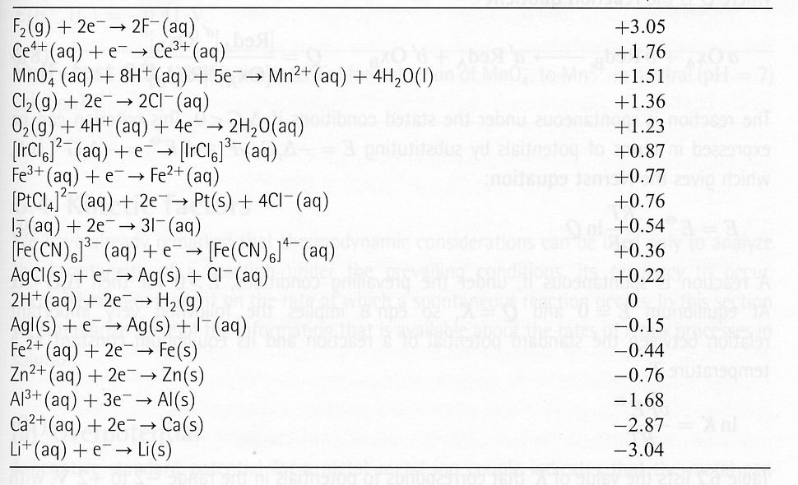
Electrodes
Two electrodes: Must share one ion with the electrolyte
The reduction potential of one charged half cell minus the reduction potential of the other one gives the voltage of the battery.
  Typically 3.2 – 3.7 V

Slide 52
Requirements of the electrolyte
Conduct Li ions
Must not react with electrodes
Must not be oxidised or reduced (electrolysed) at the electrodes
  Must tolerate > 4 V
These requirements are harder during charge than discharge

Slide 53
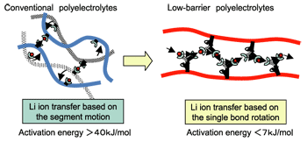
Liquid Li ion conducting electrolytes
Aqueous solutions cannot withstand 4 V
  Water is electrolysed
  Li metal at the anode reacts with water
Li ion electrolytes must be non-aqueous
  Li salts
    E.g. LiPF₆, LiBH₄, LiClO₄
  dissolved in organic liquids
    e.g. ethylene carbonate
    possibly embedded in solid composites with
    PEO or other polymers of high molecular weight
    Porous ceramics
Conductivity typically 0.01 S/cm, increasing with temperature
http://www.sci.osaka-u.ac.jp

Slide 54
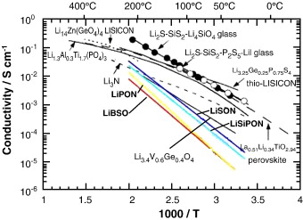
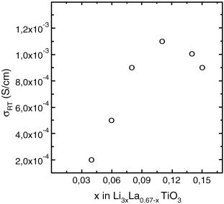
Solid Li ion electrolytes
Example: La_{2/3}TiO₃ doped with Li₂O; La_{0.51}Li_{0.34}TiO_{2.94}
Li⁺ ions move on disordered perovskite A sites
Ph. Knauth, Solid State Ionics, 180 (2009) 911–916

Slide 55
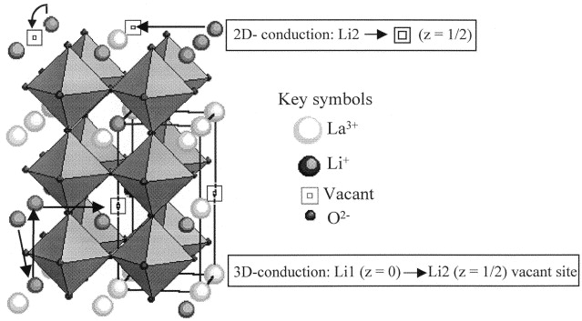
Transport paths in La-Li-Ti-O electrolytes
A.I. Ruiz et al., Solid State Ionics, 112 (1998) 291–297

Slide 56
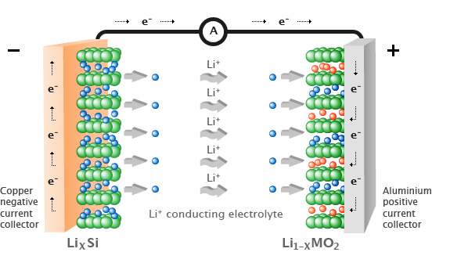
Li ion battery anodes
Requirements:
Mixed transport of Li and electrons
Little volumetric change upon charge and discharge
Negative electrode during discharge
Charging: Li from the Li⁺ electrolyte is intercalated into graphite
Discharge: Deintercalation
New technologies:
  Carbon nanomaterials
  Li alloys nanograined Si metal

Slide 57
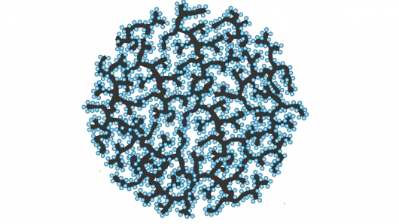
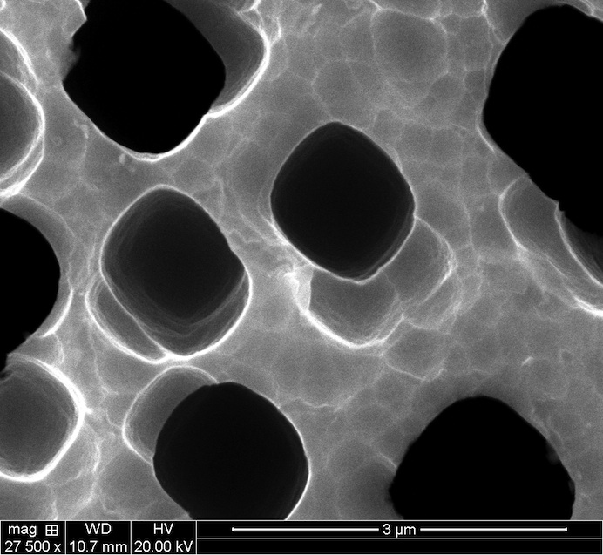
Novel developments examples
Si-C nanocomposites
Si sponges hold room to expand

Slide 58
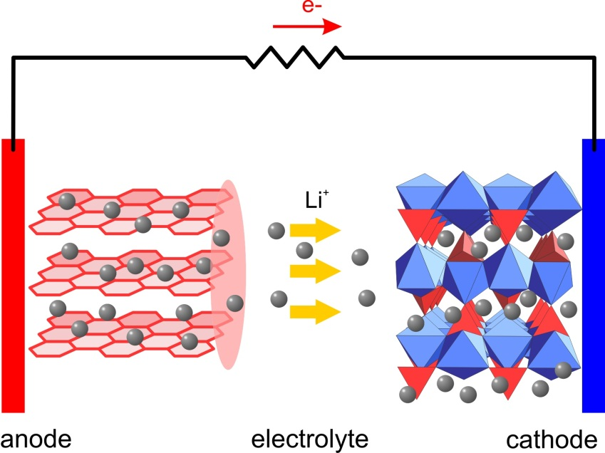
Li ion battery cathodes
Requirements:
Mixed transport of Li and electrons
Little volumetric change upon charge and discharge
Positive electrode during discharge
Charging: Li⁺ ions deintercalates from cathode; oxidises cathode material
Discharging: Li⁺ ions are intercalated into cathode; reduces cathode material
Cathode materials
  MO₂ forming Li_{x}M₂O₄ spinels upon charging (M = Mn, Co, Ni…)
  FePO₄ and many others

Slide 59
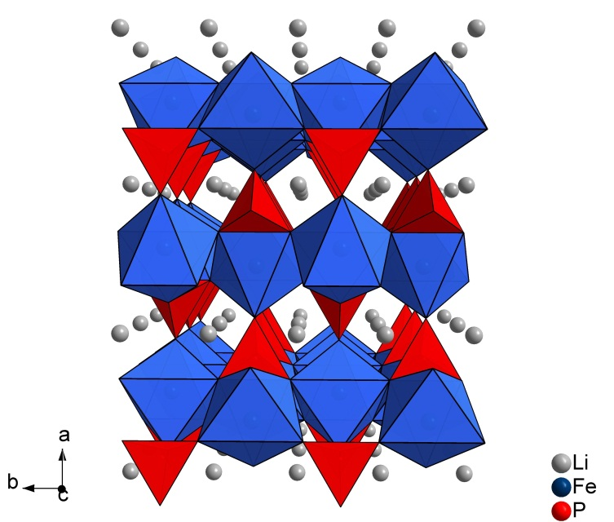

LiFePO₄
John B. Goodenough

Slide 60

Li in FePO₄

Slide 61

Discharge curves
What do they reflect?
What can they be used for?

Slide 62


Thin film Li ion batteries

Slide 63
Summary Li ion batteries
High voltage. Light weight. High energy density.
Some safety concerns
Fairly abundant elements – acceptable price and availability
Need very stable electrolyte
Development: Liquid → polymer/composite → solid
Electrodes: Nanograined mixed conducting intercalation (layered) compounds
Charged: Intercalation of Li metal in Li_{y}(C+Si) anode
Discharged: Intercalation of Li⁺ ions in Li_{y}FePO₄ or Li_{y}M₂O₄ spinels

