Slide 1
Green Informatics
Michael Welzl
IN1030
13. 02. 2025

Slide 2
Outline
Context, overview
A closer look
What can we do?

Slide 3
Context, overview

Slide 4
Context
"Green":
environmental sustainability in a broad sense
  Only environmental: e.g., "connecting the unconnected" is also "Informatics + sustainability"
Footprint: the harm done
  E.g., CO₂ emissions from compute electricity
  E.g., water wastage from cooling a data center
Handprint: the opposite
  E.g., improving Oslo air quality, or fjord water quality
  E.g., actions to reduce CO₂ emissions

Slide 5
Focus of this talk: ICT CO₂ emissions
... because Informatics students should know
  There is a lot of nonsense in the media; you should know better!
... because some things are counter-intuitive and surprising
... because otherwise, we could talk forever
  General environmental footprint and handprint are immensely broad
  (but we'll get back to the handprint a little bit)

Slide 6
ICT CO2 emissions: two questions
Question 1: what can we do, as responsible citizens?
Question 2: what can we do, as Informatics professionals?
Let's see if you can answer question 1 in the end!

Slide 7
Emotions vs. facts: magnitudes matter
Saving the planet needs a big change
  Politicians can achieve that: via policy, and by "educating" citizens
  E.g., if we all stop driving fossil cars, the impact is huge
    This begins with every individual
    Hence, "every little bit matters" ("alle monner drar") is a part of politics, society, culture & upbringing, and also connected to feelings
    Yes it's great if we all do tiny things! But, this is the faculty of mathematics & natural sciences: we care about facts, not feelings!
We must understand: what is an "ant" vs. a "whale"
  Everything we do emits CO2: every piece of bread we eat
  As ICT professionals, we should invest time in things that matter!

Slide 8
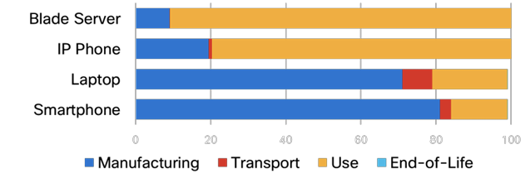
So, what's the magnitude?
2020: ICT: ~4% of global electricity use, ~1.4% of CO₂ emissions
[ https://doi.org/10.1016/j.telpol.2023.102701 ]
  Approximately CO₂ emissions of a country like Malaysia or Pakistan
Telecommunications: ~ 0.6 – 0.8 % of CO₂ emissions
  Approximately CO₂ emissions of a country like the UK
Not the biggest spenders, but definitely significant!
For all of ICT, embodied emissions represent 36% of the total
“Embodied = approx. 1/3 of ICT emissions” is probably reasonable
  Note: very device dependent
  e.g., Smartphone: 60-80kg CO₂
  70kg = driving ~400 km with a
  petrol car
https://8billiontrees.com/carbon-offsets-credits/carbon-footprint-of-iphone/
https://ourworldindata.org/travel-carbon-footprint
Source: Cisco (2020), via IAB E-impact mailing list (Carlos Pignataro)

Slide 9
AI and data centers
AI may have totally changed these numbers:
25.9.2024 news item: "OpenAI asked US to approve energy-guzzling 5GW data centers, report says" [ https://tinyurl.com/mvuc939v ]
  "Bloomberg reviewed an OpenAI document outlining the plan, reporting that 5 gigawatts 'is roughly the equivalent of five nuclear reactors' and warning that each data center will likely require 'more energy than is used to power an entire city or about 3 million homes.' "
I don't have such new CO₂ numbers
  The following excludes this craziness
Note: AI operations are usually in data centers
  Good: energy efficient, good cooling, often run with "green" energy...
  Bad: may have a significant environmental footprint other than CO₂
These things change so fast! E.g. DeepSeek is much less resource-intensive

Slide 10
Yearly CO₂ emissions in Norway
“40.8 million tons CO₂-equivalents (2022)”
  https://ourworldindata.org/co2-and-greenhouse-gas-emissions
“46,7 million tons CO₂-equivalents in Norway, 2023”
  https://www.ssb.no/natur-og-miljo/forurensning-og-klima/statistikk/utslipp-til-luft
Let's say: around 50 million tons in 2024
  Quite roughly

Slide 11
Personal footprint vs. global ICT
ICT, globally: around 764 million tons of CO₂-equivalents
  So, approximately 15 ganger Norway (all of it, not just ICT)
  Norway has 5.55 million citizens
  50 M CO₂ / 5.55 M people = my personal footprint: around 9 t
This means: if I reduce my footprint by 90%
… then it's about 0.000001% of ICT's global footprint
What if we could reduce the global ICT-footprint by 1% ?
… that would be around 850,000 Norwegians

Slide 12
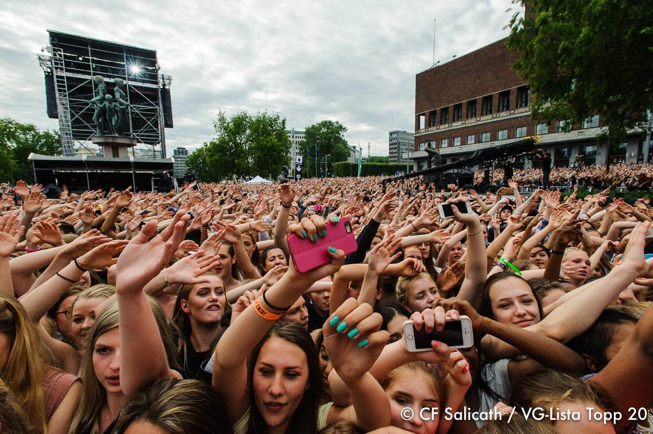
850,000 is 17 times VG lista…
… imagine the noise!

Slide 13
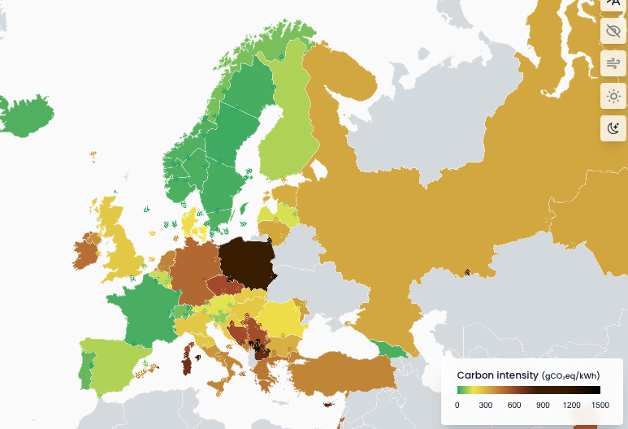
Therefore, it is important to reduce the ICT CO₂ footprint
But where?
At least for
operational
energy, ideally
not in Norway.
CO₂-impact of reducing energy use in Norway:
1/10 of UK
1/20 of Germany
1/34 of Poland
https://app.electricitymaps.com/map 8.5.2024

Slide 14

=> Question 2 matters more for you!
(as future ICT professionals!)
With ICT, we can change the world!
E.g., OO programming is used everwhere.
  The foundation was created here (Simula language)
So many other
ICT "things" are
everywhere now!
  Just look at the apps
  on your phone...
  Turing award 2001 ( “Nobel prize” of Informatics)

Slide 15
A closer look

Slide 16
Misconceptions
Numbers and comparisons in the media are often wrong
  It does not really matter how many emails we send (yes of course the effect is more than zero... just as with eating bread)
  ICT is not like aviation (different numbers for CO₂, GHG, warming)
Tempting, even among scientists, even in research papers, to use numbers and statements that suit the personal narrative
Please stop believing these two narratives:
  Exponential ICT growth => exponential CO₂ emission growth
  Every single contribution matters, we must be less "wasteful"
  ( = fewer bytes)
  For ICT, these are both wrong.
  (The second: not completely wrong, but mostly – it's just not that simple.)
E.g.: "watch less Netflix"

Slide 17
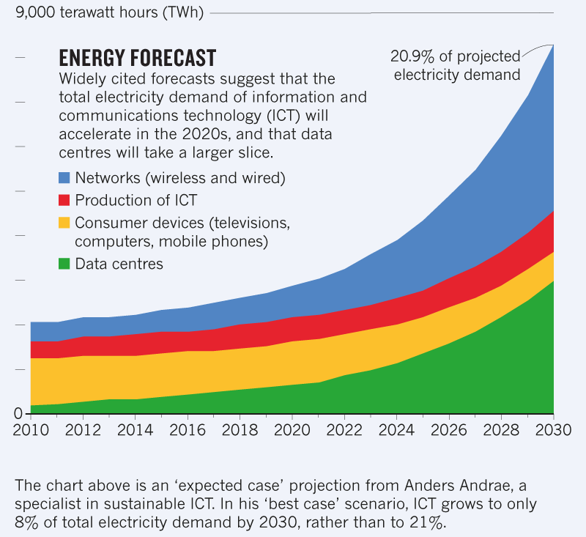
Narrative 1: exponential growth
Diagram to the right:
often quoted as
"Nature"
This is correct, but:
  "news feature":
  not peer-reviewed!
  Instead, "written or commissioned by the journal editors."
Keep in mind, it's a prediction until 2030
  Made in 2015!
https://www.nature.com/articles/d41586-018-06610-y
Knowledge

Slide 18
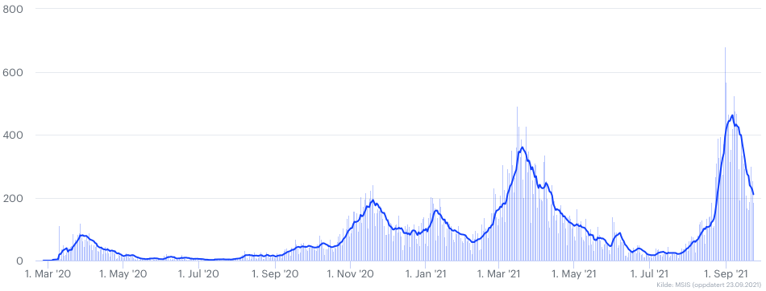
More about this diagram
Source and history
  Nature editors have published this in 2018, and taken it (referenced) from a 2015 paper: https://doi.org/10.3390/challe6010117
  Criticized in this 2018 paper: https://doi.org/10.3390/su10093027
  2020 article by the original author: "New perspectives on internet electricity use in 2030" corrects the data (downward): https://www.doi.org/10.30538/psrp-easl2020.0038
Haven't we all
recently learned that
exponential growth
may not last
forever?
Still, people use the diagram. Perhaps because of the nice colours?

Slide 19
More about narrative 1
Moore’s law: chip densities double every two years
  Side effect: Koomey’s law: “at a fixed computing load, the amount of battery you need will fall by a factor of two every year and a half” [Wikipedia]
Moore’s law has been slowing down
  Koomey’s law [Wikipedia]: “in 2011, Koomey re-examined this data and found that after 2000, the doubling slowed to about once every 2.6 years”
Internet traffic, number of users: exponential & no sign of slowing down
  Could this make the Internet a huge CO2 contributor one day?

Slide 20
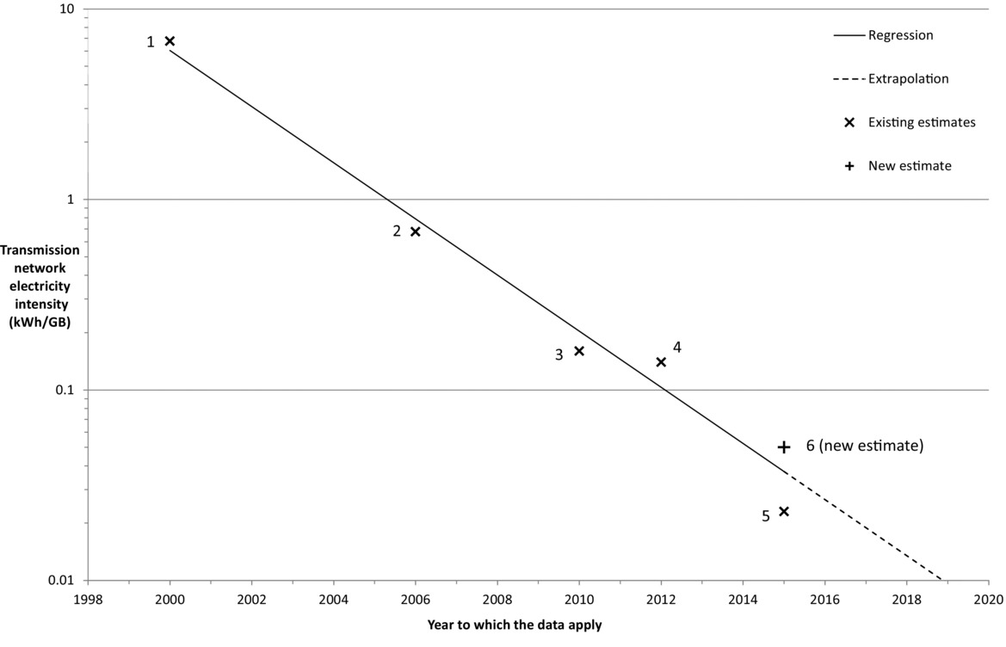
The energy efficiency of telecom hardware
  J. Aslan, K. Mayers, J. G. Koomey, and C. France. Electricity intensity of internet data transmission: Untangling the estimates. Journal of Industrial Ecology, 22(4):785–798, 2018

Slide 21
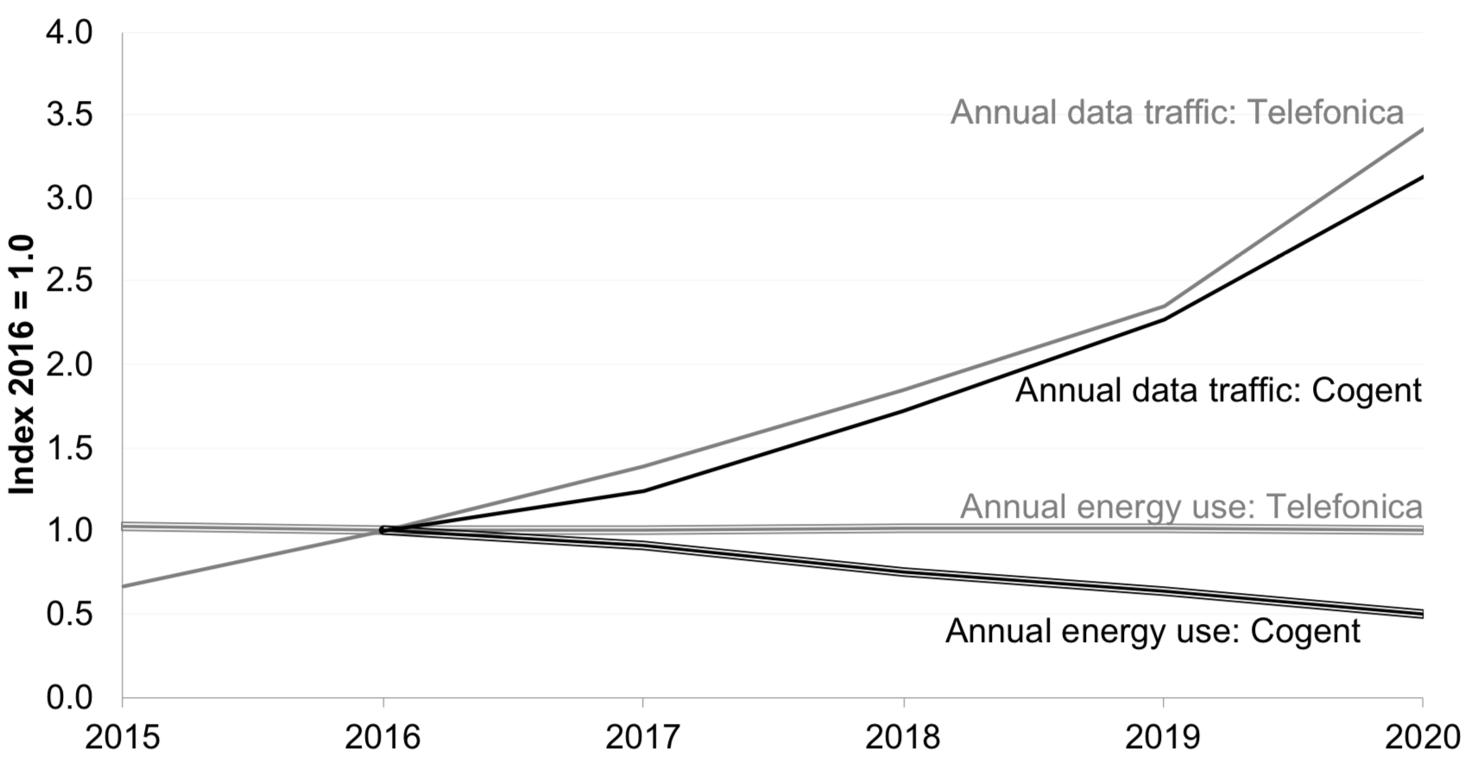
Real ISP energy use
Note, though: ChatGPT was released in 2022
Source: https://www.koomey.com/post/654896139332616192
In contrast, the entire ICT sector’s emissions have slightly grown:
about 5% from 2015 to 2020 [ https://doi.org/10.1016/j.telpol.2023.102701 ].

Slide 22
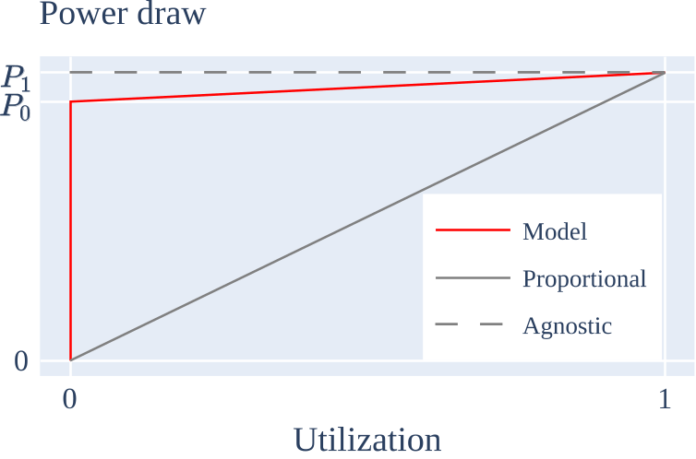
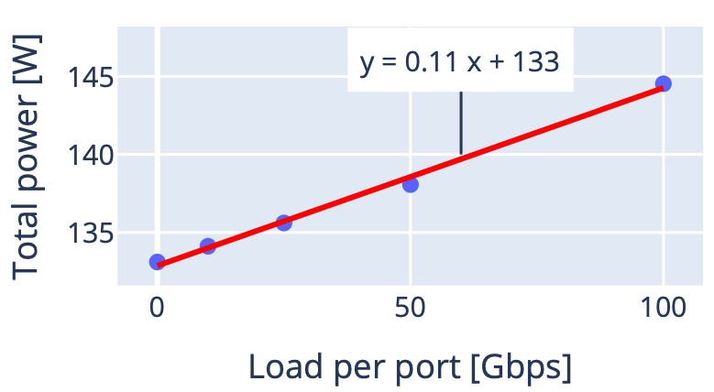
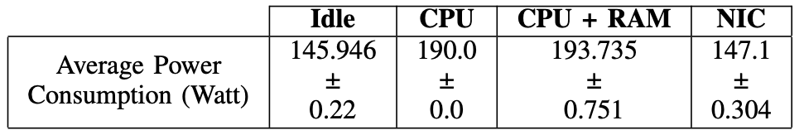
Narrative 2: every single contribution...
... only true for power proportional hardware.
General model (many equipment types)
Measurements: Tofino network switch
Power draw
Romain Jacob and Laurent Vanbever. 2023. The Internet of Tomorrow Must Sleep More and Grow Old. SIGENERGY Energy Inform. Rev. 3, 3 (October 2023), 27–32.
Romain Jacob, Jackie Lim, and Laurent Vanbever. 2023. Does rate adaptation at daily timescales make sense? In Proceedings of the ACM 2nd Workshop on Sustainable Computer Systems (HotCarbon '23).
0 bit/s data transmission
10 Gbps data transmission
Measurements: server
Kristjon Ciko, Michael Welzl, Peyman Teymoori: "Going Dark: A Software "Light Switch" for Internet Servers", IEEE 29th International Symposium on Local and Metropolitan Area Networks (LANMAN 2023), 10-11 July 2023, London, UK.

Slide 23
What about wireless systems?
Cellular: energy has always been important, and is a major part of 5G and 6G; power proportionality (sleep cycling) is definitely also a part of it
WiFi: access points are somewhat power proportional
  But their total system power is quite small
  How much? 2023 EU document: "Code of Conduct on Energy Consumption of Broadband Equipment" ... "sets the (maximum) electricity consumption for broadband equipment sold in the EU and manufactured or procured by participating companies." https://tinyurl.com/ysmkrary Table 14, p.30: 1.9 - 5.0 W range
End systems: wireless transmission somewhat power proportional

Slide 24
Should we optimize for phones?
Phone charger: usually ~5 W; assume: approx. 1h to fully charge, every day: 1.8 kWh / year.
  This is very, very rough (e.g., as phones age, they need longer)
  https://www.fortum.com: modern dishwasher: 0.6-1.5 kWh / cycle
  Remember: a phone's emissions are primarily from manufacturing
So, I wondered, how about TVs? They must need more power, and they receive a large amount of data over WiFi
  When I enable WiFi on my TV, I get a message:
  “Are you sure? This could cost more energy.”

Slide 25

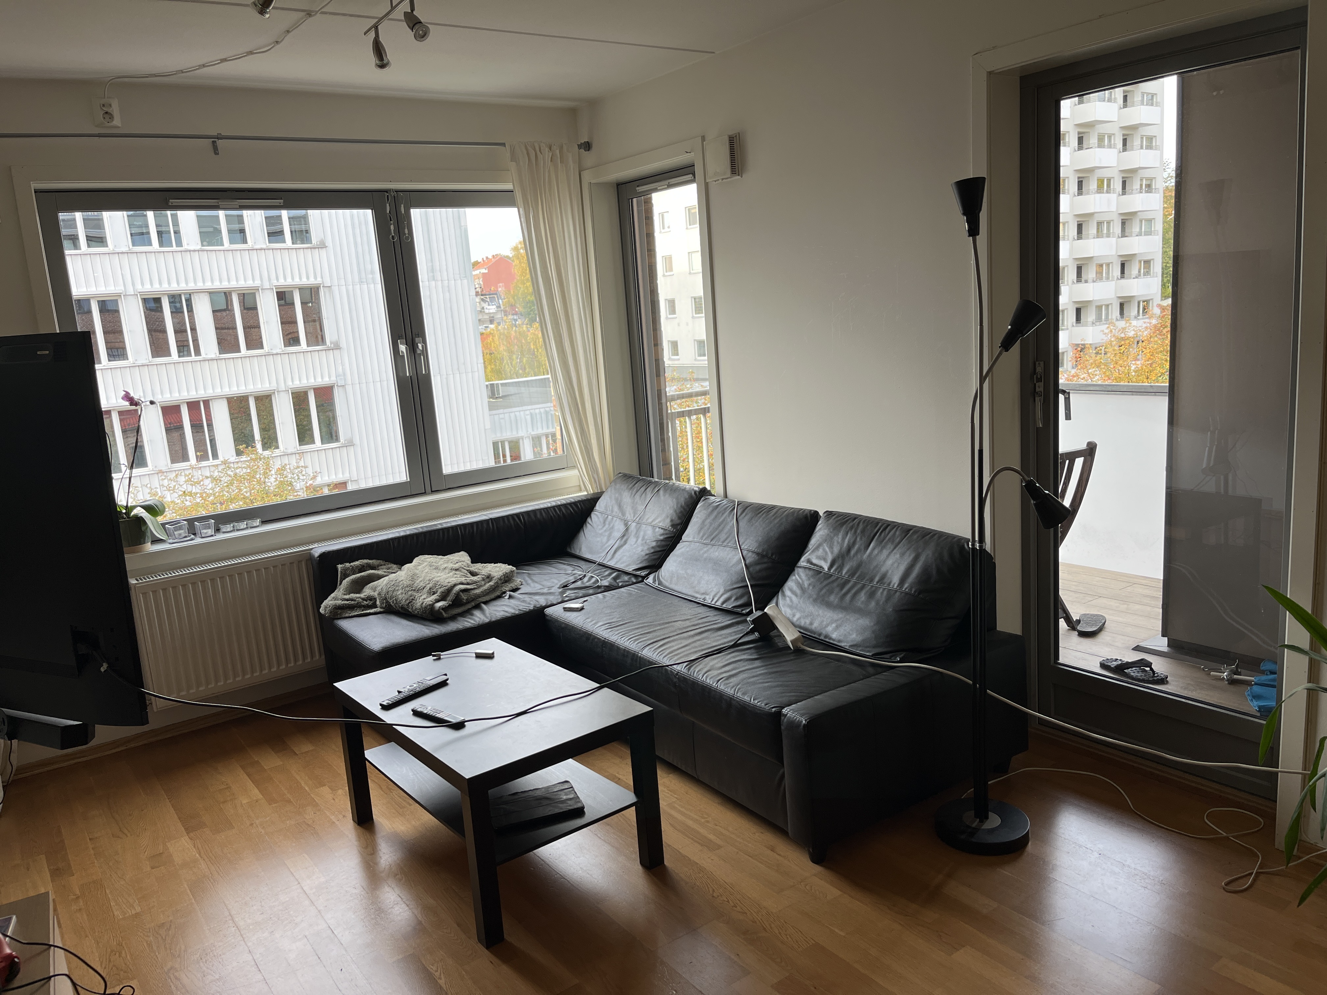
I measured my TV
TCL 65'' 4K MiniLED TV, model name 65C935
  Android TV software version 11 (5.12.2022),
  kernel version 4.19.116+
  Everything set to default
  Energy measurements using GUDE Expert Power Control 1105
8 Watts in standby
240 Watts when showing the home screen
  Moving across the icons in the home screen
  makes the energy usage fluctuate in the order
  of tens of Watts
Mostly black “no signal” screen for an
unconnected HDMI port: 48-49 Watts.

Slide 26
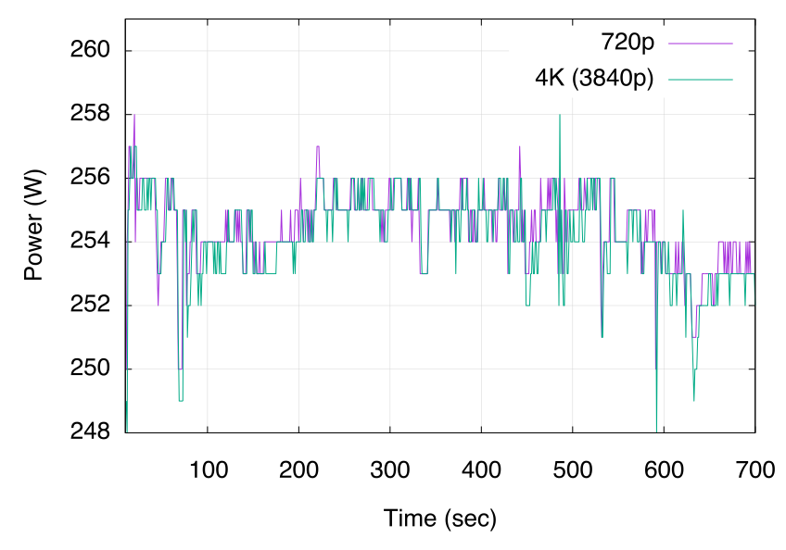
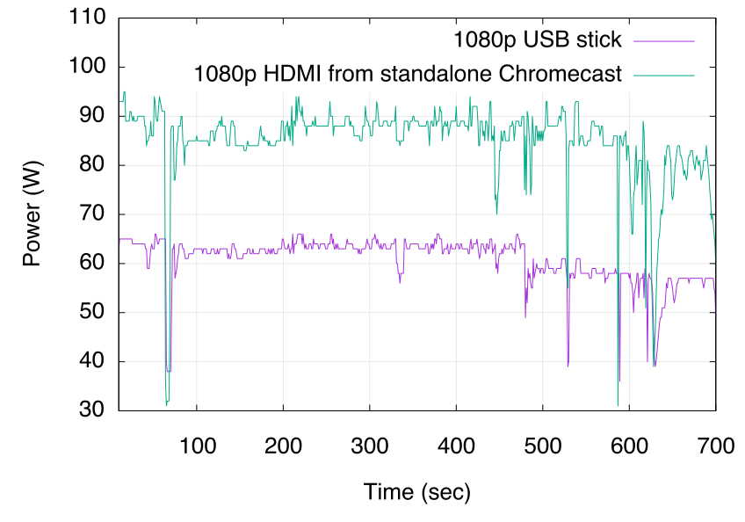
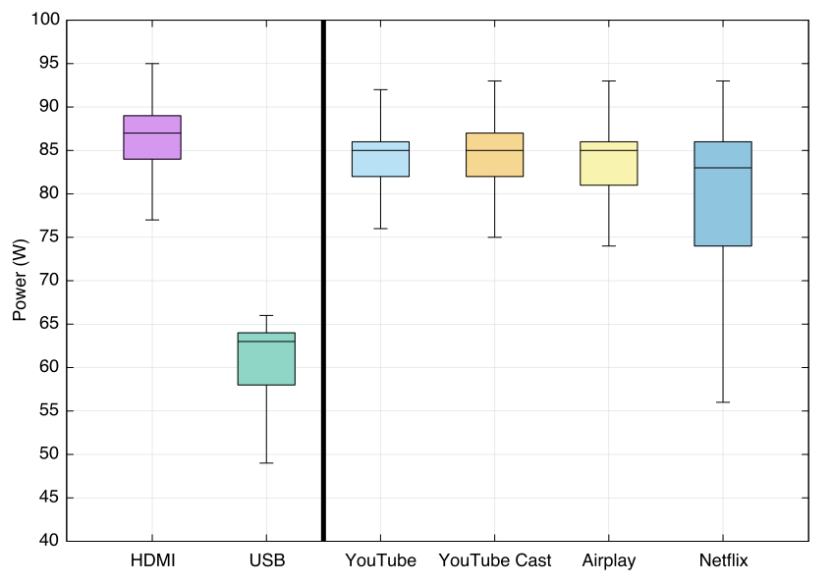
Now let’s watch “Tears of Steel”
( Common test movie from https://mango.blender.org )
HDMI laptop: video quality doesn’t matter
Standalone Chromecast (3rd generation): idle 1 W, streaming 2 W
All tests on the right: 1080p, except Airplay (1920p) and Netflix (3840p).
Take-away: HDMI cable is worst, much worse than WiFi; and watching HQ Netflix over WiFi is much better than leaving the TV on and idle.
=> My TV really shouldn’t warn me about WiFi.
From laptop via TV’s native Chromecast

Slide 27
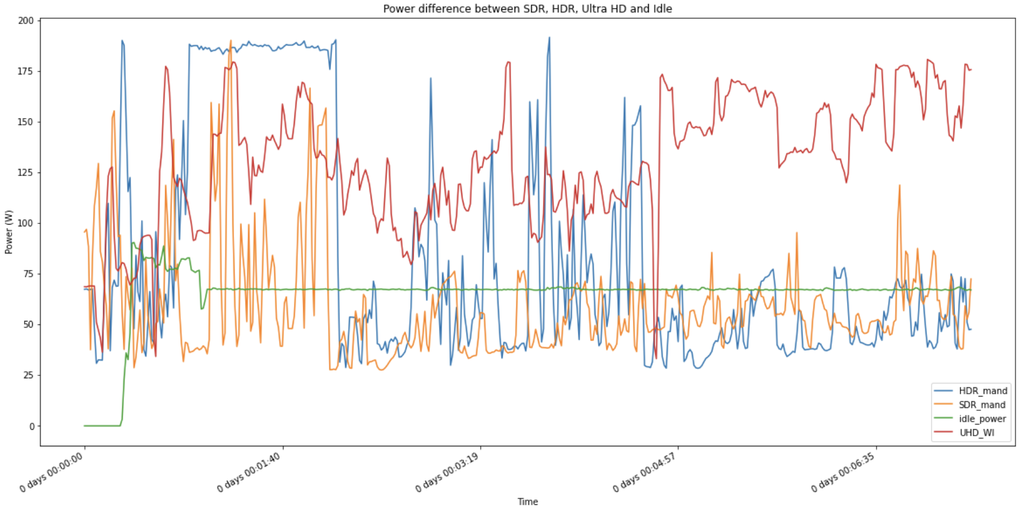
A different TV
Samsung Q88, comparing SRD, HDR (Mandalorian, 1080p), UHD (BBC nature doc) and idle
27

Slide 28
What can we do?

Slide 29
... to reduce ICT CO₂, as responsible citizens? (question 1)
Some answers:
Embodied energy:
( maybe generally more important in Norway )
  Think twice about hardware upgrades:
  do you really need them?
    E.g. more Internet capacity may not even yield a "real" benefit
    Small devices (phone, tablet)
Operational energy:
  Save energy by completely turning off unused devices
  Watch movies on a phone or tablet rather than a TV
    and if possible, measure!
  I'm not sure about "don't use ChatGPT"; maybe?

Slide 30
... as an Informatics professional?
Make ICT equipment more energy efficient ?
  Jevons paradox, 1865 ("rebound effect"):
  Coal use increased with technological improvements
  In general: efficiency could reduce usage, but efficiency also reduces cost => resource demand grows, use increases, emissions increase.
Does this logic work for everything?
  Wikipedia once said:
  “5G is far more energy efficient than 4G. However, the lower cost will lead to more internet use, which in turn may result in an increase of energy consumption.”
  ... but this statement was removed. - and: is this really true?
Anyway, ICT CO2 contributions are small, compared to many other things (e.g., transport, agriculture, heating, other power use, ..).
  Perhaps the handprint matters more?

Slide 31
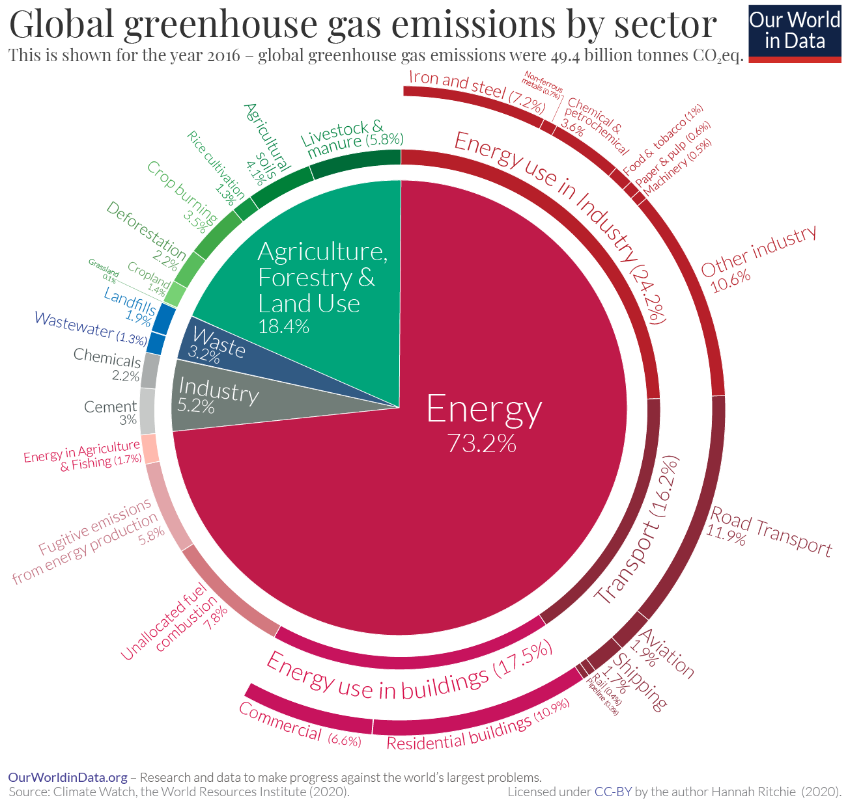
ICT in general has a positive impact on many of these factors (e.g., travel reduction)
Remember, ICT itself: ~1.4%
Notes:
“energy” here contains heating, electricity, transport
Relationships quite constant 1990-2021

Slide 32

An example: Google's Project Contrails https://sites.research.google/contrails/
Reduces contrails by about 54%:
avoids flying through moist air
Air traffic contributes about 4% to
global warming, of which ~35% is due to contrails
54% of 35% = 19% of the air traffic contribution
... and hence ~ 0.8% of the global problem
...which is approx. half of ICTs global contribution !
If this uses, for example, a whole datacenter, this datacenter's negative effect is completely minimal in relation to the gain it achieves
  and this is just one project

Slide 33
Thank you!
Questions?

Slide 34
Backup slides

Slide 35
Email
“A typical office worker sends and receives around 140 emails per day, which, over the course of a year, creates as much CO₂ as flying from London to Bruges or watching 955 movies”
https://www.cwjobs.co.uk/insights/environmental-impact-of-emails/
“Sending 65 emails is roughly equivalent to driving 1km in a car. (..) Globally, the world’s email usage generates as much CO₂ as having an extra seven million cars on the roads.”
https://www.sciencefocus.com/planet-earth/the-thought-experiment-what-is-the-carbon-footprint-of-an-email/
This cannot make sense: what is an "average" email? Sent over which servers, where? Carbon-efficient energy or not? What are the end systems involved? Is a phone the same as a desktop?
  Also, these numbers just don't add up, and a London-Bruges
  flight doesn't even exist.
This email stuff is everywhere. Where does it come from?

Slide 36
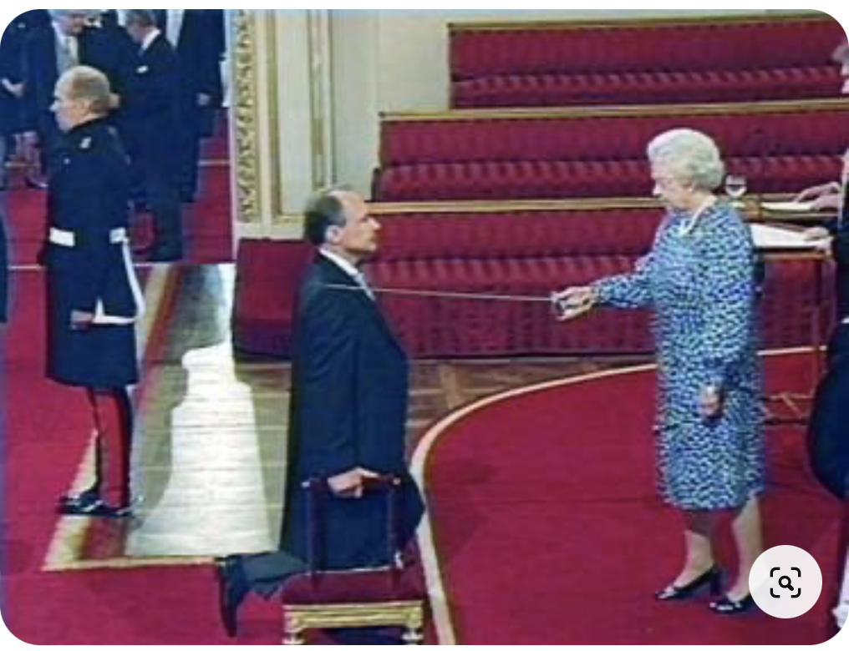
It comes from the media, of course!
Knighting of Tim Berners-Lee, the "inventor of the WWW", by Queen Elizabeth II
NOT generated with AI !
https://www.pinterest.com/pin/552535448023449857/
His brother, Mike Berners-Lee, is a professor at Lancaster University, and he has written popular books about climate change
Could it be that the media find this family interesting?

Slide 37
Mike Berners-Lee talked to the media
(..) the footprint of an email also varies dramatically, from 0.3g CO₂ for a spam email to 4g (..) CO₂ for a regular email and 50g (..) CO₂ for one with a photo or hefty attachment, according to Mike Berners-Lee, a fellow at Lancaster University who researches carbon footprints. These figures, however, were crunched by Berners-Lee 10 years ago. Charlotte Freitag, a carbon footprint expert at Small World Consulting, the company founded by Berners-Lee, says the impact of emailing may have gone up.
https://www.bbc.com/future/article/20200305-why-your-internet-habits-are-not-as-clean-as-you-think
With new data in hand, Berners-Lee estimates that an individual email can be anywhere from from 0.03g CO₂ to 26g CO₂.
https://sedna.com/whats-the-carbon-footprint-of-your-email/
1 email = 1g carbon = 0.000001 tonnes CO₂ per email
(Source: Mike Berners-Lee)
https://www.ovoenergy.com/ovo-newsroom/press-releases/2019/november/think-before-you-thank-if-every-brit-sent-one-less-thank-you-email-a-day-we-would-save-16433-tonnes-of-carbon-a-year-the-same-as-81152-flights-to-madrid.html
Mike Berners-Lee, a respected professor on the topic whose research was used in the Ovo Energy work, told the Financial Times it was based on "back-of-the-envelope" maths from 2010 - and while useful to start conversations, there were bigger questions.
https://www.bbc.com/news/technology-55002423

Slide 38
He Shall Be Forgiven!
Informing the public = a part of our job description
  https://www.uio.no/english/about/regulations/personnel/core/uio-salary-policy.html
  "Assessment of the salary level for the individual employee shall be based on the principles described under item 1 General principles of the salary policy; see in particular paragraphs 5 and 6. In addition, the following criteria shall be used:"
  Item 4: "dissemination, profiling and publicising of research-based knowledge"
You know this especially well if you ever wrote a project proposal or even led a project
  The EU calls it "communication" (as opposed to "dissemination")
But: think twice about what you tell the media.

Slide 39
Netflix reported CO₂ emission numbers
Netflix ESG Report 2023, https://tinyurl.com/22859b5e
2022: Corporate 38%, production 59%, streaming 3%
2023: Corporate 61%, production 35%, streaming 5%
  2023 production decline due to strikes
Streaming breakdown:
  1% data center (encoding)
  10% ISPs (Content Distribution Network (CDN) )
  89% user premises
    46% screen
    43% home routers & peripherals

Slide 40
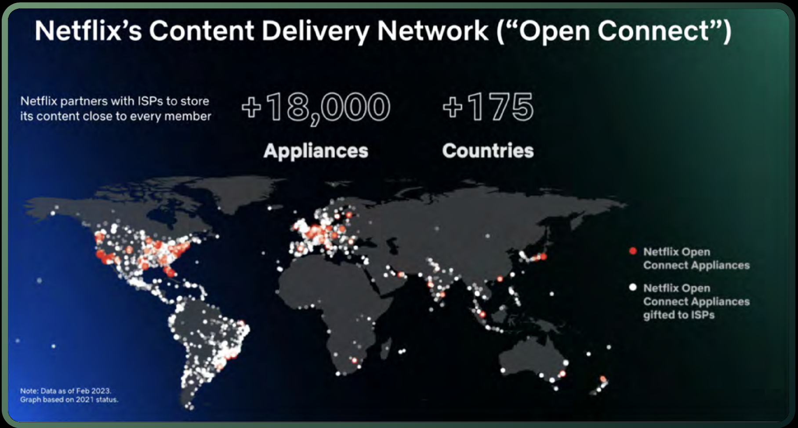
Netflix' net
10% of 3 - 5%
About the 10% ISP
  It's about CDN
  servers,
  not about
  transmission
  bitrate
  Netflix adapts bitrate to the device: TVs ~ 10 x mobile phones
  Restricting video resolution (as in pandemic) does not reduce energy consumption or emissions by the wired network
    Perhaps an effect in the wireless last hop, but very small
CDN also offers an opportunity to adapt to carbon efficiency
  Transmitting packets is more efficient than transmitting power

Slide 41
Video streaming in absolute terms
"Researchers at the University of Bristol spent a decade developing a tool to calculate the carbon footprint of streaming and other everyday internet uses, such as browsing news stories (..). The calculator uses the latest scientific protocols to measure emissions (i.e., lifecycle assessments) and data directly from the entertainment and media companies who rely on streaming delivery themselves, compared to the generic estimations of past studies."
https://www.carbontrust.com/our-work-and-impact/guides-reports-and-tools/carbon-impact-of-video-streaming
1h streaming in Europe: approx. 55 gCO2e
  = microwaving 4 bags of popcorn, or three boils in an electric kettle in the UK.
  "Previous guesswork profiled in the media had this figure as high as 3200 gCO2e, or as much as microwaving 200 bags of popcorn."
  Attributional reasoning:
  If you stream 1h less tonight, you do not directly save 55 gCO2e!

