Slide 1
Operating Systems:
Processes &
CPU Scheduling
IN2140:
Introduction to Operating Systems and Data Communication
Pål Halvorsen

Slide 2
Overview
Processes
  primitives for creation and termination
  states
  context switches
  (processes vs. threads)
CPU scheduling
  classification
  timeslices
  algorithms

Slide 3
Processes

Slide 4


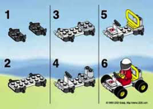

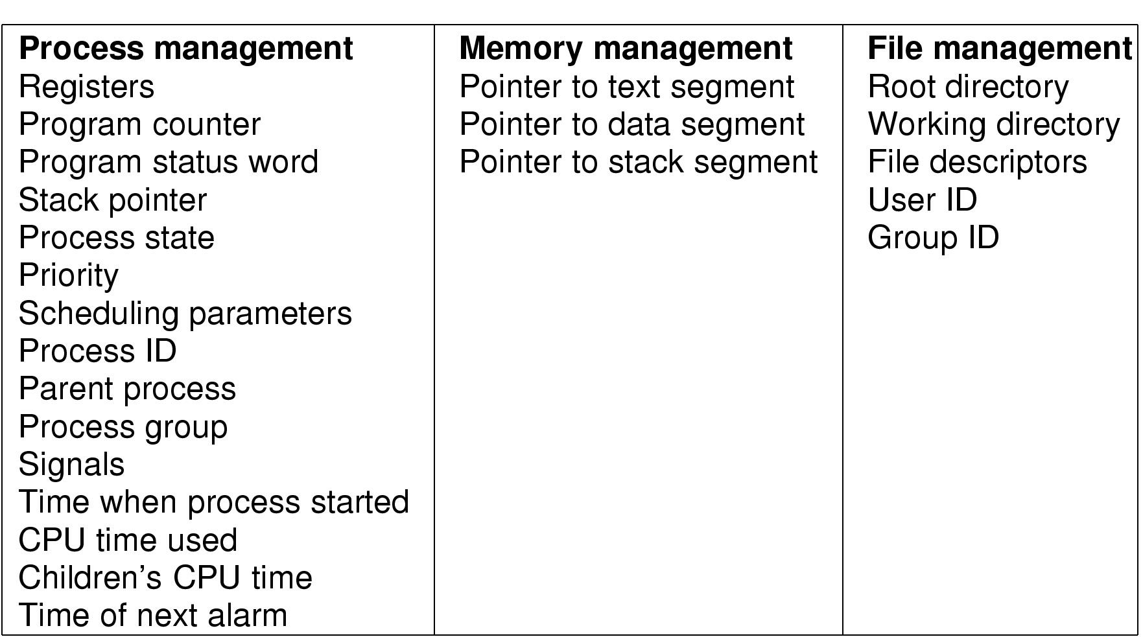
Processes
What is a process?
The "execution" of a program is often called a process
Process table entry (process control block, PCB):
Process
Program
vs.
Notes:
Process vs. program
- program often part of process
- program can specify the process to fork several processes

Slide 5
Process Creation
A process can create another process using the
pid_t fork(void) system call (see man 2 fork) :
  makes a duplicate of the calling process including a copy of the
  virtual address space, open file descriptors, etc…
  (only PIDs are different – locks and signals are not inherited)
  both processes continue in parallel
  returns
    … if parent: child process’ PID when successful, -1 otherwise
    … if child: 0 (if successful - if not, there will not be a child)
Other possibilities include
  int clone(…) – shares memory, descriptors, signals (see man 2 clone)
  pid_t vfork(void) – suspends parent in clone() (see man 2 vfork)
Notes:
clone: unlike fork, the new process share parts of execution environment like memory, table of file descriptors and signals handlers. Main use for threads
vfork: special case of clone, parent is suspended until child “exits” or calls “execve”

Slide 6








Process Creation – fork()
Prosess 1
Prosess 2
right after fork()
How is it possible to get different results?
(the processes do run the same program!!)
after termination
(or any later time)
right after fork()
Process control block (process descriptor)
PID
address space (text, data, stack)
state
allocated resources
…
make_sandwich()
if ((pid = fork()) == -1) {printf("Failure\n"); exit(1);}
if (pid != 0) {
/* Parent: pid != 0 */
… do something …
} else {
/* Child: pid == 0 */
… do something else …
}
make_burger()
make_small_cake()
fork()
make_coffee()
make_big_cake()
buy_champagne()
Notes:
Return value of FORK….

Slide 7


Program Execution
To make a process execute a program, one might use the
int execve(char *filename, char *params[], char *envp[])
system call (see man 2 execve):
  executes the program pointed to by filename (binary or script) using the parameters given in params and in the environment given by envp
  returns
    no return value on success, actually no process to return to
    -1 is returned on failure (and errno set)
Many other versions (frontends to execve) exist, e.g.,
execl, execlp, execle, execv and execvp (see man 3 exec)
fork(..)
execve(..)
process 1:
process 2:
Notes:
DESCRIPTION
execve() executes the program pointed to by filename. filename must be either a binary executable, or a script starting with a line of the form "#! interpreter [arg]". In the latter case, the interpreter must be a valid pathname for an executable which is not itself a script, which will be invoked as interpreter [arg] filename.
execve() does not return on success, and the text, data, bss, and stack of the calling process are overwritten by that of the program loaded. The program invoked inherits the calling process's PID, and any open file descriptors that are not set to close-on-exec. Signals pending on the calling process are cleared. Any signals set to be caught by the calling process are reset to their default behaviour. The SIGCHLD signal (when set to SIG_IGN) may or may not be reset to SIG_DFL.
RETURN VALUE On success, execve() does not return, on error -1 is returned, and errno is set appropriately.
argv is an array of argument strings passed to the new program.
Envp is an array of strings, conventionally of the form key=value, which are passed as environment to the new program.
Both argv and envp must be terminated by a null pointer. The argument vector and environment can be accessed by the called program's main function, when it is defined as int main(int argc, char *argv[], char *envp[]).

Slide 8
Process Waiting
To make a process wait for another process, one can use the
pid_t wait(int *status) system call (see man 2 wait):
  waits until any of the child processes terminates (if there are running child processes)
  returns
    -1 if no child processes exist
    PID of the terminated child process and puts the status of the process in status
  see also
    waitpid – adds parameter pid which can be any, group or a particular pid
    wait3, wait4 – also returns resource usage
fork(..)
wait(..)
process 1:
process 2:
Notes:
SIGCHLD is sent to parent when child exits.
WAIT / WAITPID:
DESCRIPTION
All of these system calls are used to wait for state changes in a child of the calling
process, and obtain information about the child whose state has changed. A state change
is considered to be: the child terminated; the child was stopped by a signal; or the
child was resumed by a signal. In the case of a terminated child, performing a wait
allows the system to release the resources associated with the child; if a wait is not
performed, then terminated the child remains in a "zombie" state (see NOTES below).
If a child has already changed state, then these calls return immediately. Otherwise
they block until either a child changes state or a signal handler interrupts the call
(assuming that system calls are not automatically restarted using the SA_RESTART flag of
sigaction(2)). In the remainder of this page, a child whose state has changed and which
has not yet been waited upon by one of these system calls is termed waitable.
wait() and waitpid()
The wait() system call suspends execution of the current process until one of its chil-
dren terminates. The call wait(&status) is equivalent to:
waitpid(-1, &status, 0);
The waitpid() system call suspends execution of the current process until a child speci-
fied by pid argument has changed state. By default, waitpid() waits only for terminated
children, but this behaviour is modifiable via the options argument, as described below.
The value of pid can be:
< -1 meaning wait for any child process whose process group ID is equal to the absolute
value of pid.
-1 meaning wait for any child process.
0 meaning wait for any child process whose process group ID is equal to that of the
calling process.
> 0 meaning wait for the child whose process ID is equal to the value of pid.
The value of options is an OR of zero or more of the following constants:
WAIT4:
DESCRIPTION
The wait3() and wait4() system calls are similar to waitpid(2), but additionally return
resource usage information about the child in the structure pointed to by rusage.
Other than the use of the rusage argument, the following wait3() call:
wait3(status, options, rusage);
is equivalent to:
waitpid(-1, status, options);
Similarly, the following wait4() call:
wait4(pid, status, options, rusage);
is equivalent to:
waitpid(pid, status, options);
In other words, wait3() waits of any child, while wait4() can be used to select a spe-
cific child, or children, on which to wait. See wait(2) for further details.
If rusage is not NULL, the struct rusage to which it points will be filled with account-
ing information about the child. See getrusage(2) for details.

Slide 9
Process Termination
A process can terminate in several different ways:
  no more instructions to execute in the program –
  unknown status value
  a function in a program finishes with a return –
  parameter to return the status value
  the system call void exit(int status)–
  terminates a process and returns the status value (see man 3 exit)
  the system call int kill(pid_t pid, int sig)–
  sends a signal to a process to terminate it (see man 2 kill, man 7 signal)
Usually, a status value of 0 indicates success,
other values indicate errors
Notes:
Depends on language, C usually spesifies EXIT_SUCCESS/EXIT_FAILURE (0/1)
main in c may be defined as void or int
4) SIGHUP, SIGINT, SIGQUIT, SIGKILL, …

Slide 10





Process States
running
process termination
process blocks for input
scheduler stops process
scheduler starts process
blocked
ready
external event finished
process creation

Slide 11
Context Switches
Context switch: the process of switching one running process to another
  stop running process 1
  store the state (like registers, instruction pointer) of process 1 (usually on stack or PCB)
  restore state of process 2
  resume operation on program counter for process 2
  essential feature of multi-tasking systems
  computationally intensive, important to optimize the use of context switches
  some hardware support, but usually only for general purpose registers
Possible causes:
  scheduler switches processes (and contexts) due to algorithm and time slices
  interrupts
  required transition between user-mode and kernel-mode

Slide 12
Processes vs. Threads
Processes: resource grouping and execution
Threads (light-weight processes)
  enable more efficient cooperation among execution units
  share many of the process resources (most notably address space)
  have their own state, stack, processor registers and program counter
Process
Process
- address space
- registers
- program counter
- stack
- …
information global to
all threads in a process
- address space
- other global process data
- address space
- registers
- program counter
- stack
- …
- state
- registers
- program counter
- stack
- state
- registers
- program counter
- stack
threads
threads
information local
to each thread
...

Slide 13
Processes vs. Threads
Processes: resource grouping and execution
Threads (light-weight processes)
  enable more efficient cooperation among execution units
  share many of the process resources (most notably address space)
  have their own state, stack, processor registers and program counter
  no memory address switch
  thread switching is much cheaper
  parallel execution of concurrent tasks within a process
No standard, several implementations (e.g., Win32 threads, Pthreads, C-threads)
(see man 3 pthreads)
Example: time using futex to suspend and resume processes (incl. systemcall overhead):
Intel 5150: ~1900ns/process switch, ~1700ns/thread switch
Intel E5440: ~1300ns/process switch, ~1100ns/thread switch
Intel E5520: ~1400ns/process switch, ~1300ns/thread switch
Intel X5550: ~1300ns/process switch, ~1100ns/thread switch
Intel L5630: ~1600ns/process switch, ~1400ns/thread switch
Intel E5-2620: ~1600ns/process switch, ~1300ns/thread switch
http://blog.tsunanet.net/2010/11/how-long-does-it-take-to-make-context.html
Process
- address space
- other global process data
- state
- registers
- program counter
- stack
- state
- registers
- program counter
- stack
threads
threads
...
Notes:
The last example Intel E5-2620 =
A dual Intel Sandy Bridge-EP, 2Ghz - a hexa-core with HyperThreading = total of 12 cores, or 24 "hardware threads". Kernel: 3.4.24 x86_64.
The futex() system call
provides a method for a program to wait for a value at a given address to change, and a method to wake up anyone waiting on a particular address (while the addresses for the same memory in separate processes may not be equal, the kernel maps them internally so the same memory mapped in different locations will correspond for futex() calls).
Note that it is also including systemcall overhead!!! Takes from x00 – x000 cycles itself depending on architecture/call/etc.

Slide 14
Example – multiple processes
#include <stdio.h>
#include <stdlib.h>
#include <sys/types.h>
#include <sys/wait.h>
#include <unistd.h>
int main(void){
pid_t pid, n;
int status = 0;
if ((pid = fork()) == -1) {printf("Failure\n"); exit(1);}
if (pid != 0) { /* Parent */
printf("parent PID=%d, child PID = %d\n", (int) getpid(), (int) pid);
printf("parent going to sleep (wait)...\n");
n = wait(&status);
printf("returned child PID=%d, status=0x%x\n",
(int)n, status);
return 0;
} else { /* Child */
printf("child PID=%d\n", (int)getpid());
printf("executing /store/bin/whoami\n");
execve("/store/bin/whoami", NULL, NULL);
exit(0); /* Will usually not be executed */
}
}
[vizzini] > ./testfork
parent PID=2295, child PID=2296
parent going to sleep (wait)...
child PID=2296
executing /store/bin/whoami
paalh
returned child PID=2296, status=0x0
[vizzini] > ./testfork
child PID=2444
executing /store/bin/whoami
parent PID=2443, child PID=2444
parent going to sleep (wait)...
paalh
returned child PID=2444, status=0x0
Two concurrent processes
running, scheduled differently
Why???

Slide 15
CPU Scheduling

Slide 16
Scheduling
A task is a schedulable entity/something that can run
(a process/thread executing a job, e.g.,
a packet through the communication system or
a disk request through the file system)
In a multi-tasking system, several
tasks may wish to use a resource
simultaneously
A scheduler decides which task
that may use the resource,
i.e., determines order
by which requests are serviced,
using a scheduling algorithm
requests
scheduler
resource
Finally, the dispatcher “moves” the selected process to the CPU
Notes:
The difference between scheduler and dispatcher is that the scheduler selects a process out of several processes to be executed while the dispatcher allocates the CPU for the selected process by the scheduler.

Slide 17

Why Spend Time on Scheduling?
Scheduling is complex and takes time – RT vs NRT example (support priorities or not…)

Slide 18
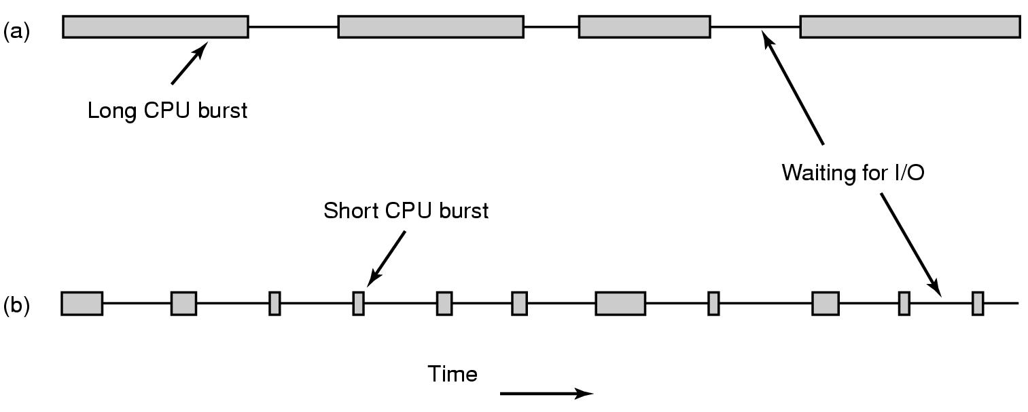
Why Spend Time on Scheduling?
Optimize the system to the given goals
  e.g., CPU utilization, throughput, response time, fairness, …
Example: CPU-bound vs. I/O-bound Processes:
  Bursts of CPU usage alternate with periods of I/O wait

Slide 19


Why Spend Time on Scheduling?
Example: CPU-bound vs. I/O-bound processes (cont.) – observations:
  schedule all CPU-bound processes first, then I/O-bound
  schedule all I/O-bound processes first, then CPU-bound?
  possible solution:
  mix of CPU-bound and I/O-bound: overlap slow I/O devices with fast CPU
CPU
DISK

Slide 20
Many Algorithms Exist
First In First Out (FIFO)
Round-Robin (RR)
Shortest Job First
Shortest Time to Completion First
Shortest Remaining Time to Completion First (a.k.a. Shortest Remaining Time First)
Lottery
Fair Queuing
…

Slide 21
FIFO and Shortest Job First (SFJ)
FIFO: First in, First Out
SFJ: Select first tasks with shortest processing requirement (completion time)
Example: Arrival order:processing requirement - A:8, B:2, C:4
  FIFO:
    Average wait time: 6
    Average finishing time: 10,67
    simple
    fair?
    long waiting and finishing times
  SJF:
    Average wait time: 2,67
    Average finish time: 7,33
    simple
    better average times compared to FIFO
    hard to determine processing requirement
    potentially huge finishing times and starvation (new shorter jobs arrive)
A
B
C
 | Requirement | Wait | Finish
A | 8 | 0 | 8
B | 2 | 8 | 10
C | 4 | 10 | 14
B
C
A
 | Requirement | Wait | Finish
A | 8 | 6 | 14
B | 2 | 0 | 2
C | 4 | 2 | 6

Slide 22
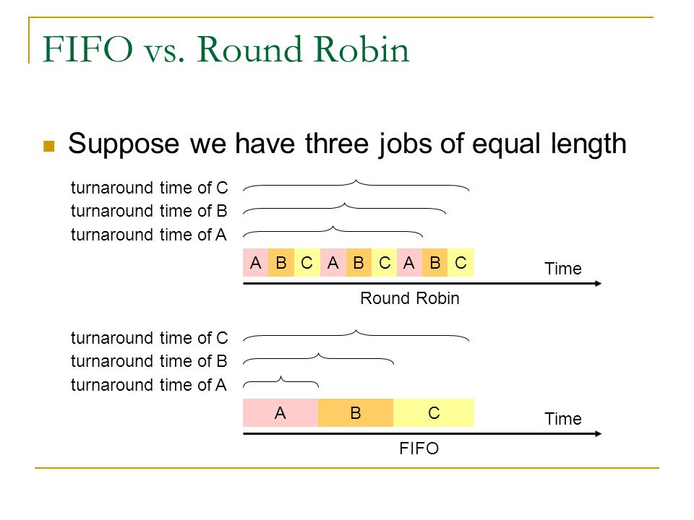
FIFO and Round Robin
FIFO:
Run
  to completion (old days)
  until blocked, yield or exit
Advantages
  simple
Disadvantage
  long waiting times
Round-Robin (RR):
FIFO queue
Each process runs a given time
  each process gets 1/n of the CPU
  in max t time units per round
  the preempted process is put back
  in the queue

Slide 23
FIFO and Round Robin
Example: 10 jobs and each takes 100 seconds, assuming no overhead (!?)
FIFO – the process runs until finished
  start: job1: 0s, job2: 100s, ... , job10: 900s → average 450s
  finished: job1: 100s, job2: 200s, ... , job10: 1000s → average 550s
  some get long waiting time, but some are lucky
RR – time slice of 1s
  start: job1: 0s, job2: 1s, ... , job10: 9s → average 4.5s
  finished: job1: 991s, job2: 992s, ... , job10: 1000s → average 995.5s
  fair, but no one is lucky
Comparisons
  FIFO better for long CPU-intensive jobs (there is overhead in switching!!)
  but RR much better for interactivity!
But, how to choose the right time slice??

Slide 24
Case: Time Slice Size
Resource utilization example
  A and B run forever, and each uses “100%” CPU
  C loops forever (1 ms CPU and 10 ms disk)
  (assume no switching overhead)
Long or short time slices?
  100% of CPU utilization regardless of size
  Time slice 100 ms: nearly 5% of disk utilization with RR
  [per round: A:100 + B:100 + C:1 → 201 ms CPU vs. 10 ms disk ]
  Time slice 1 ms: nearly 91% of disk utilization with RR
  [per round: 5x (A:1 + B:1) + C:1 → 11 ms CPU vs. 10 ms disk ]
What do we learn from this example?
  The right time slice (in this case shorter) can improve overall utilization, but note - context switches do cost!
  CPU bound: benefits from having longer time slices (>100 ms)
  I/O bound: benefits from having shorter time slices (≤10 ms)
Notes:
Typical values are 1-100 ms in existing systems.
Windows: 20 milliseconds
Linux: 1-6 ms vanlig, 100 RR/batch

Slide 25
Scheduling: goals
A variety of (contradicting) factors to consider
  treat similar tasks in a similar way
  no process should wait forever
  short response times ( time _{response given} - time _{request submitted} )
  maximize throughput
  maximum resource utilization (100%, but 40-90% normal)
  minimize overhead
  predictable access
  …
Several ways to achieve these goals, …
…but hard (impossible?) to achieve all …
…but which criteria is most important, most reasonable?

Slide 26




Scheduling: goals
“Most reasonable” criteria depend on who you are
  Kernel
    Resource management
      processor utilization, throughput, fairness
  User
    Interactivity
      response time
      (Example: when playing a game, we will not accept
      waiting 10s each time we use the joystick)
    Predictability
      identical performance every time
      (Example: when using the editor, we will not accept
      waiting 5s one time and 5ms another time to get echo)
“Most reasonable” criteria depend on environment
  Server vs. end-system
  Stationary vs. mobile
  …
vs.
vs.

Slide 27



Scheduling: goals
“Most reasonable” criteria depend on target system
  Most/All types of systems
    fairness – giving each process a fair share
    balance – keeping all parts of the system busy
  Batch systems
    turnaround time – minimize time between submission and termination
    throughput – maximize number of jobs per hour
    (CPU utilization – keep CPU busy all the time)
  Interactive systems
    response time – respond to requests quickly
    proportionality – meet users’ expectations
  Real-time systems
    meet deadlines – avoid loosing data
    predictability – avoid quality degradation in multimedia systems

Slide 28
Scheduling classification
Scheduling algorithm classification:
  dynamic
    makes scheduling decisions at run-time
    flexible to adapt
    considers only the actual task requests and execution time parameters
    large run-time overhead finding a schedule
  static
    makes scheduling decisions off-line (also called pre-run-time)
    generates a dispatching table for the run-time dispatcher at compile time
    needs complete knowledge of the task before compiling
    small run-time overhead
  preemptive
    running tasks may be interrupted (preempted) by higher priority processes
    preempted process continues later at the same state
    overhead of contexts switching
  non-preemptive
    running tasks will be allowed to finish its time-slot (higher priority processes must wait)
    reasonable for short tasks like sending a packet (used by disk and network cards)
    less frequent switches

Slide 29
Preemption
Tasks waits for processing
Scheduler assigns priorities
Task with highest priority will be scheduled first
Preempt current execution if
  a higher priority (more urgent) task arrives
  timeslice is consumed
  …
Real-time and best effort priorities
  real-time processes have higher priority
  (if such processes exist, they will run)
To kinds of preemption:
  preemption points
    predictable overhead
    simplified scheduler accounting
  immediate preemption
    needed for hard real-time systems
    needs special timers and fast interrupt and context switch handling
requests
scheduler
preemption
resource

Slide 30
Priority & Preemption
RT vs NRT example:
RT process
delay
request
no-priority,
non-preemtive
process 1
process 2
process 3
process 4
…
process N
RT process
RT process
request
delay
priority,
non-preemtive
process 1
process 2
RT process
process 3
process 4
…
process N
RT process
request
only delay of switching and interrupts
priority,
preemtive
process 1
p 1
RT process
p 1
process 2
process 2
p 1
process 3
process 3
process 2
process 4
process 4
process 3
…
…
process 4
process N
process N
…
process N

Slide 31

Many Algorithms Exist
First In First Out (FIFO)
Round-Robin (RR)
Shortest Job First
Shortest Time to Completion First
Shortest Remaining Time to Completion First (a.k.a. Shortest Remaining Time First)
Lottery
Fair Queuing
…
Earliest Deadline First (EDF)
Rate Monotonic (RM)
…

Slide 32
Rate Monotonic (RM) Scheduling
Classic algorithm for hard real-time systems with one CPU
Pre-emptive scheduling based on static task priorities
Optimal:
no other algorithms with static task priorities can schedule tasks that cannot be scheduled by RM
Assumptions:
  requests for all tasks with deadlines are periodic
  the deadline of a task is equal to the end on its period (starting of next)
  independent tasks (no precedence)
  run-time for each task is known and constant
  context switches can be ignored
  any non-periodic task has no deadline

Slide 33
Rate Monotonic (RM) Scheduling
shortest period,
highest priority
Process priority based on task periods
  task with shortest period gets
  highest static priority
  task with longest period gets
  lowest static priority
  dispatcher always selects task requests with highest priority
Example:
priority
longest period,
lowest priority
period length
P_{i} = period for task i
p₁
Task 1
p₂
P₁ < P₂
→ Task₁ highest priority
Task 2
Dispatching

Slide 34
Earliest Deadline First (EDF)
Preemptive scheduling based on dynamic task priorities
Task with closest deadline has highest priority (dynamic)
→ stream priorities vary with time
Dispatcher selects the highest priority task
Optimal:
if any task schedule without deadline violations exits, EDF will find it
Assumptions:
  requests for all tasks with deadlines are periodic
  the deadline of a task is equal to the end on its period (starting of next)
  independent tasks (no precedence)
  run-time for each task is known and constant
  context switches can be ignored

Slide 35
Earliest Deadline First (EDF)
Example:
priority A < priority B
priority A > priority B
Task A
deadlines
Task B
time
Dispatching

Slide 36
EDF Versus Fixed priorities (RM)
It might be impossible to prevent deadline misses in a strict, fixed priority system:
Task A
deadlines
Task B
time
deadline miss
Fixed priorities,
A has priority, no dropping
waste of time
deadline miss
Fixed priorities,
A has priority, dropping
waste of time
deadline miss
Fixed priorities,
B has priority, no dropping
waste of time
deadline miss
Fixed priorities,
B has priority, dropping
Earliest deadline first
RM may give some
deadline violations
which is avoided by EDF
deadline miss
Rate monotonic (as the first)

Slide 37
EDF Versus Fixed priorities (RM)
It might be impossible to prevent deadline misses in a strict, fixed priority system:
Task A
deadlines
Task B
time
deadline miss
Fixed priorities,
A has priority
waste of time
deadline miss
Fixed priorities,
B has priority
waste of time
Earliest deadline first
RM may give some
deadline violations
which is avoided by EDF
deadline miss
Rate monotonic (as the first)

Slide 38

Many Algorithms Exist
First In First Out (FIFO)
Round-Robin (RR)
Shortest Job First
Shortest Time to Completion First
Shortest Remaining Time to Completion First (a.k.a. Shortest Remaining Time First)
Lottery
Fair Queuing
…
Earliest Deadline First (EDF)
Rate Monotonic (RM)
…
Today, the same machine performs various tasks
→ most systems use some kind of priority scheduling

Slide 39
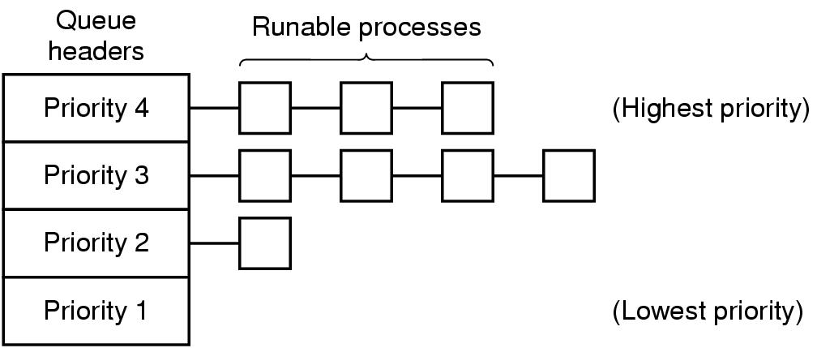
Priority Scheduling
Assign each process a priority
Run the process with highest priority in the ready queue first
Multiple queues,
often RR in each
Advantage
  (Fairness)
  Different priorities according
  to importance
Disadvantage
  Starvation: so maybe use dynamic priorities?

Slide 40
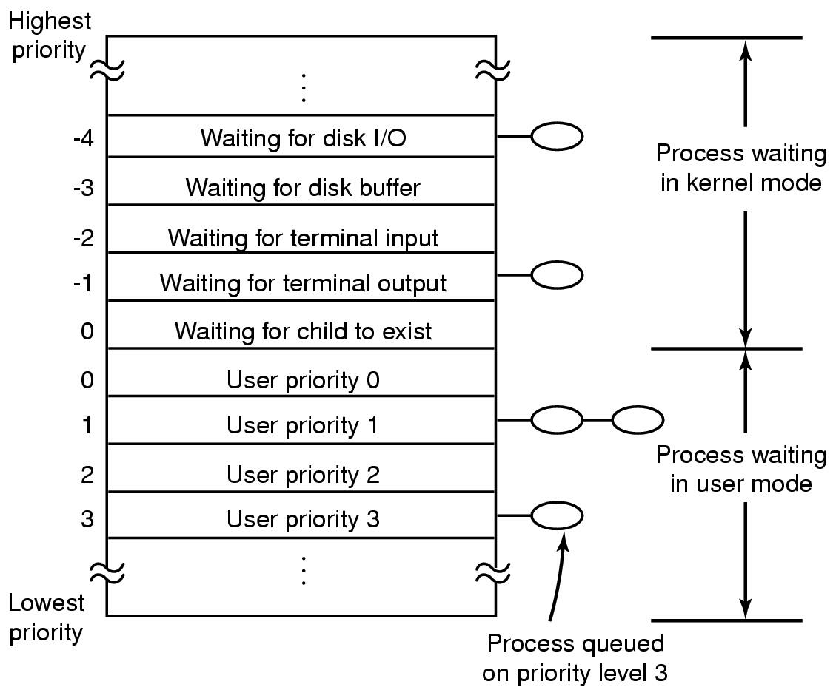
Traditional scheduling in UNIX
Many versions
User processes have positive
priorities, kernel negative
Schedule lowest priority first
If a process uses the whole time
slice, it is put back at the end of
the queue (RR)
Each second the priorities are
recalculated:
priority =
  CPU_usage (average #ticks)
  nice (± 20)
  base (priority of last corresponding kernel process)

Slide 41
Scheduling in Windows 2000, XP, …
Preemptive kernel
Schedules threads individually
Time slices given in quantums
  3 quantums = 1 clock interval (length of interval may vary)
  defaults:
    Win2000 server: 36 quantums
    Win2000 workstation: 6 quantums (professional)
  may manually be increased between threads (1x, 2x, 4x, 6x)
  foreground quantum boost (add 0x, 1x, 2x):
  an active window can get longer time slices (assumed need for fast response)

Slide 42
Scheduling in Windows 2000, XP, …
32 priority levels:
Round Robin (RR) within each level
Interactive and throughput-oriented
  “Real time” – 16 system levels
    fixed priority
    may run forever
  Variable – 15 user levels
    priority may change:
    thread priority = process priority ± 2
    decrease: much CPU usage
    increase: user interactions, I/O completions
  Idle/zero-page thread – 1 system level
    runs whenever there are no other processes to run
    clears memory pages for memory manager
Real Time (system thread)
31
30
...
17
16
Variable (user thread)
15
14
...
2
1
Idle (system thread)
0

Slide 43
Scheduling in Windows 8/10 (…server 2008, 7)
http://msdn.microsoft.com/en-us/
library/windows/desktop/
ms681917(v=vs.85).aspx
Still 32 priority levels, 6 process classes - RR within each:
  REALTIME_PRIORITY_CLASS
  HIGH_PRIORITY_CLASS
  ABOVE_NORMAL_PRIORITY_CLASS
  NORMAL_PRIORITY_CLASS (default)
  BELOW_NORMAL_PRIORITY_CLASS
  IDLE_PRIORITY_CLASS
  each class has 7 thread priority levels with different base priorities
  (IDLE, LOWEST, BELOW NORMAL, NORMAL, ABOVE NORMAL, HIGHEST, TIME_CRITICAL)
  thread base priority depends on priority class and priority level
Dynamic priority (only for 0-15, can be disabled):
  switch background/foreground
  window receives input (mouse, keyboard, timers, …)
  unblocks
  if increased, drop by one level every timeslice until back to default
Support for user mode scheduling (UMS)
  each application may schedule own threads
  application must implement a scheduler component
Support for multimedia class scheduler services (MMCSS)
  ensure time-sensitive processing receives prioritized access to the CPU
Real Time (system thread)
31
30
...
17
16
Variable (user thread)
THREAD PRIORITY LEVEL: PROCESS PRIORITY CLASS: | IDLE | LOWEST | BELOW NORMAL | NORMAL | ABOVE NORMAL | HIGHEST | TIME_CRITICAL
REALTIME_PRIORITY | 16 | 22 | 23 | 24 | 25 | 26 | 31
HIGH_PRIORITY | 1 | 11 | 12 | 13 | 14 | 15 | 15
ABOVE_NORMAL_PRIORITY | 1 | 8 | 9 | 10 | 11 | 12 | 15
NORMAL_PRIORITY | 1 | 6 | 7 | 8 | 9 | 10 | 15
BELOW_NORMAL_PRIORITY | 1 | 4 | 5 | 6 | 7 | 8 | 15
IDLE_PRIORITY | 1 | 2 | 3 | 4 | 5 | 6 | 15
15
14
...
2
1
Zero-page thread (system)
0
Notes:
See
http://msdn.microsoft.com/en-us/library/windows/desktop/ms681917(v=vs.85).aspx
https://docs.microsoft.com/en-us/windows/win32/procthread/scheduling
The values for the levels depend on the class
Only the zero-page thread can have a priority of zero. (The zero-page thread is a system thread responsible for zeroing any free pages when there are no other threads that need to run.)

Slide 44
Scheduling in Windows 8/10 (…server 2008, 7)
FOR HANDOUT
Still 32 priority levels, with 6 classes - RR within each:
  REALTIME_PRIORITY_CLASS
  HIGH_PRIORITY_CLASS
  ABOVE_NORMAL_PRIORITY_CLASS
  NORMAL_PRIORITY_CLASS (default)
  BELOW_NORMAL_PRIORITY_CLASS
  IDLE_PRIORITY_CLASS
  each class has 7 thread priority levels with different base priorities
  (IDLE, LOWEST, BELOW NORMAL, NORMAL, ABOVE NORMAL, HIGHEST, TIME_CRITICAL)
  thread base priority depends on priority class and priority level
Dynamic priority (only for 0-15, can be disabled):
  switch background/foreground
  window receives input (mouse, keyboard, timers, …)
  unblocks
  if increased, drop by one level every timeslice until back to default
Support for user mode scheduling (UMS)
  each application may schedule own threads
  application must implement a scheduler component
Support for multimedia class scheduler services (MMCSS)
  ensure time-sensitive processing receives prioritized access to the CPU
Real Time (system thread)
31
30
...
17
16
Variable (user thread)
15
14
...
2
1
Zero-page thread (system)
0
Notes:
See http://msdn.microsoft.com/en-us/library/windows/desktop/ms681917(v=vs.85).aspx
The values for the levels depend on the class
Only the zero-page thread can have a priority of zero. (The zero-page thread is a system thread responsible for zeroing any free pages when there are no other threads that need to run.)

Slide 45
Scheduling in Linux
Preemptive kernel
Threads and processes used to be equal,
but Linux uses (from 2.6) thread scheduling
SCHED_FIFO
  may run forever, no timeslices
  may use it’s own scheduling algorithm
SCHED_RR
  each priority in RR
  timeslices of 10 ms (quantums)
SCHED_OTHER
  ordinary user processes
  uses “nice”-values: 1≤ priority≤40
  timeslices of 10 ms (quantums)
Threads with highest goodness are selected first:
  realtime (FIFO and RR):
  goodness = 1000 + priority
  timesharing (OTHER):
  goodness = (quantum > 0 ? quantum + priority : 0)
Quantums are reset when no ready
process has quantums left (end of epoch):
quantum = (quantum/2) + priority
SCHED_FIFO
0
1
...
98
99
SCHED_RR
0
1
...
98
99
nice
-20
-19
...
18
19
SCHED_OTHER
default (20)
Notes:
NICE: The priority can be adjusted over a range of -20 (the highest) to 20 (the lowest).
Negative values require SUPER-user

Slide 46
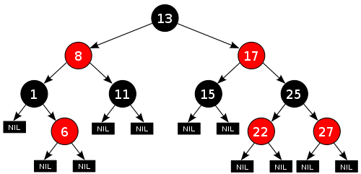
Scheduling in Linux
https://www.linuxjournal.com/node/10267
The current kernels (v.2.6.23+) use the Completely Fair Scheduler (CFS)
  addresses unfairness in desktop and server workloads – all given a fair amount
  uses extensible hierarchical scheduling classes
    SCHED_RR and SCHED_FIFO (SCHED_RT) - remain more or less as before - use priorities 1 - 99
    SCHED_IDLE – very low priority jobs (weaker than “nice -19”)
    SCHED_DEADLINE – deadline tasks (highest user-controllable priorities, earliest-deadline-first sorted)
    SCHED_NORMAL (OTHER) – the default desktop scheduler
    SCHED_BATCH – similar to SCHED_OTHER, but assumes CPU intensive workloads (slightly disfavored)
  uses ns granularity, does not rely on jiffies or HZ details
  no run-queues, a red-black tree -based timeline
  of future tasks based on virtual runtime
  does not directly use priorities,
  but instead uses them as a decay factor for the time a task is permitted to execute
  group scheduling – fair between users
Notes:
CFS mainly addresses non-real-time processes, and the RT scheduler remains more or less the same as before – used only for NORMAL/BATCH
Priorities and CFS
CFS doesn't use priorities directly but instead uses them as a decay factor for the time a task is permitted to execute. Lower-priority tasks have higher factors of decay, where higher-priority tasks have lower factors of delay. This means that the time a task is permitted to execute dissipates more quickly for a lower-priority task than for a higher-priority task. That's an elegant solution to avoid maintaining run queues per priority.
SCHED_RR quantum is 100 seconds, but adjustable
SCHED_OTHER – time slice is between sysctl_sched_min_granularity and sysctl_sched_latency, which are defaults to 0.75 ms and 6 ms respectively and defined in kernel/sched/fair.c.
“timeslice” proportional to its weight divided by total weight of all runnable processes.
Find smallest virtual runtime using the tree - actual runtime (the amount of time spent running) weighted by the number of runnable processes and the niceness
Vruntime grows according to nice value, and updated as vruntime += number of ns a task has run (weighted by task niceness)
Group scheduling: fair to the group and then individual in the group, i.e. 50% to ser A and 50% to user B. Thus for A, the allocated 50% of A will be divided fairly among A’s 20 tasks. For B, the allocated 50% will be divided fairly among B’s 5 tasks
https://opensource.com/article/19/2/fair-scheduling-linux
http://linux.die.net/man/2/sched_setscheduler
http://kerneltrap.org/node/8059

Slide 47





When to Invoke the Scheduler?
Process creation
Process termination
Process blocks
Interrupts occur
Clock interrupts
in the case of
preemptive systems

Slide 48


Some complicating factors …

Slide 49



Multicore
So far, one single core…
… multiple cores/CPUs
  1 single queue
    potential bottleneck?
    locking/contention on the single queue
  Multiple queues
    potential bottleneck?
    load balancing
  Load balancing
    Linux checks every 200 ms
    But where to place a new process?
    And where to wake up a blocked process?

Slide 50
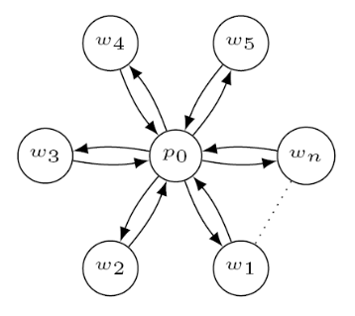
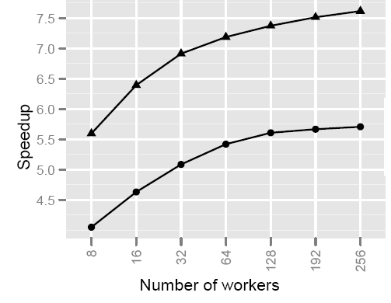
Multicore: Effect of placement (on Work Stealing)
Scheduling mechanism in the Intel Tread Building Block (TBB) framework
LIFO queues (insert and remove from beginning of queues)
One master thread (CPU)
  new processes are placed here
  awaken processes are placed here
If own queue is empty, STEAL:
  select random CPU_{x}
  if CPU_{x} queue not empty
    steal from the back of the queue
    place first in own queue
Importance of process placement?
  change CPU of where wake up a process
  Small experiment: scatter-gather workload
  (100 μs work per thread, 12500 iterations,
  8 over 1 CPU speedup)
⇨ 300.000 more steal attempts per second
Notes:
http://home.ifi.uio.no/paalh/publications/files/mucocos2010.pdf

Slide 51
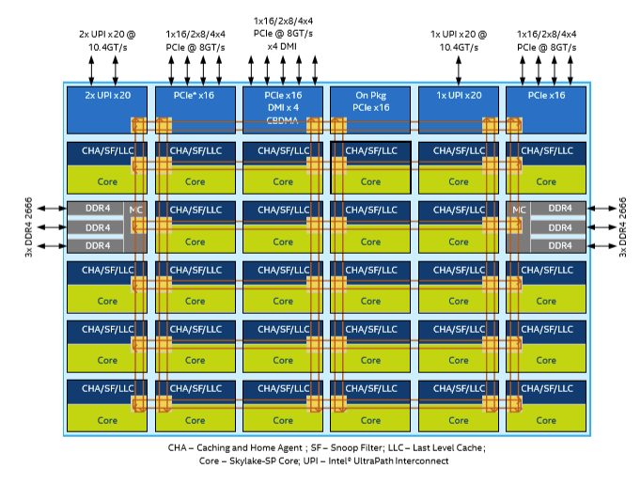
Future Chips: Something to think about!?
Intel’s Single-chip Cloud Computer (SCC)
http://techresearch.intel.com/ProjectDetails.aspx?Id=1
memory controller
memory controller
memory controller
memory controller
Skylake
P54C core
L2 cache
L1 cache
mesh interface unit
router
P54C core
L2 cache
L1 cache
message passing buffer
Notes:
The SCC chip (2009), 24 P54C Pentium cores in 4x6 mesh, terminated by Intel → see Xeon Phi instead
SCC is similar to Skylake: aug. 2015, succeeding Broadwell

Slide 52
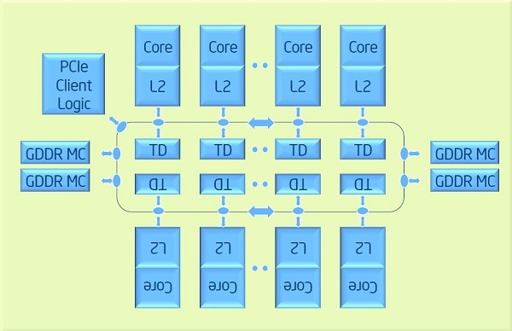
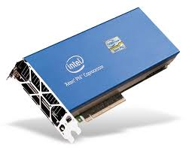
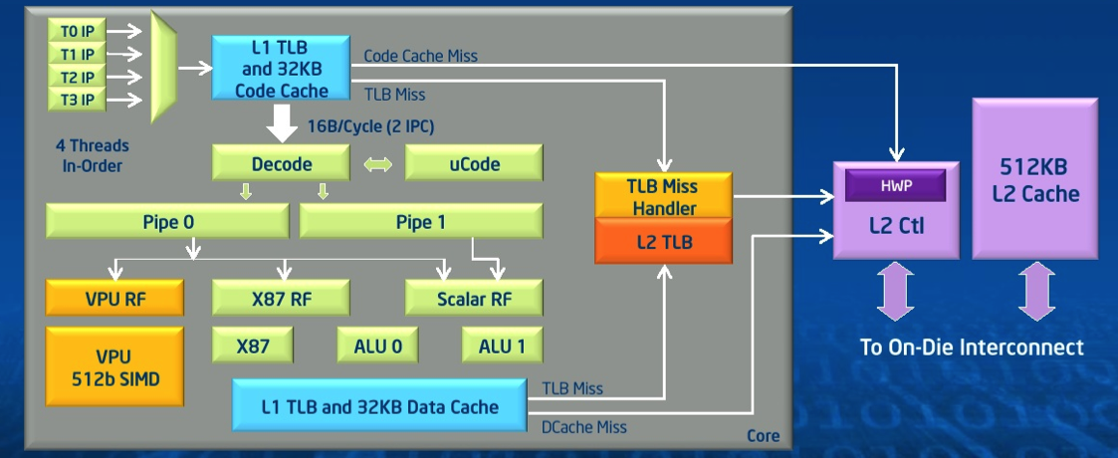
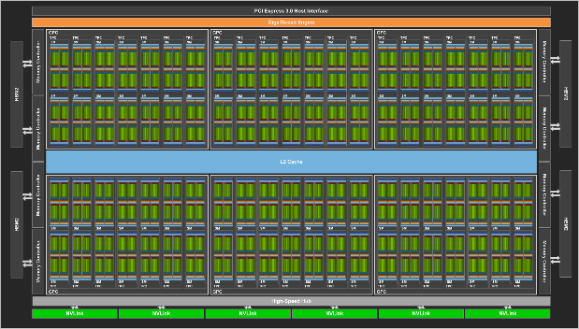
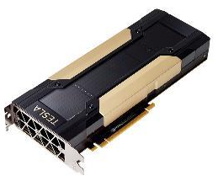
New Chips: Something to think about!?
Intel’s Xeon Phi
  up to 61 cores
  8 memory controllers
  High Performance
  On-Die
  Bidirectional
  Interconnect
  …
nVidia GPUs, e.g., Volta:
  5120 CUDA cores
  32 GB memory
  …
What does such processors
mean in terms of scheduling?
  many cores
  different capabilities
  different memory access latencies
  different connectivity
  affinity
  … (more in later courses)

Slide 53

Summary
Processes are programs under execution
Scheduling performance criteria and goals are
dependent on environment
The right timeslice can improve overall utilization
There exists several different algorithms targeted for various systems
Traditional OSes like Windows, UniX, Linux, MacOS ...
usually use a priority-based algorithm

