Slide 1
Operating Systems:
Storage: Disks & File Systems
IN2140:
Introduction to Operating Systems and Data Communication

Slide 2
Overview
(Mechanical) Disks
Disk scheduling
Memory/buffer caching
File systems
Some trends and “new” technologies …

Slide 3

Disks
tertiary storage
(tapes)
Disks ...
  are used to have a persistent system
  are cheaper compared to main memory
  have more capacity
  are orders of magnitude slower
Two resources of importance
  storage space
  I/O bandwidth
We must look closer on how to manage disks, because...
  ...there is a large speed-mismatch (ms vs. ns) compared to main memory
  ...disk I/O is often the main performance bottleneck
secondary storage
(disks)
main memory
cache(s)

Slide 4
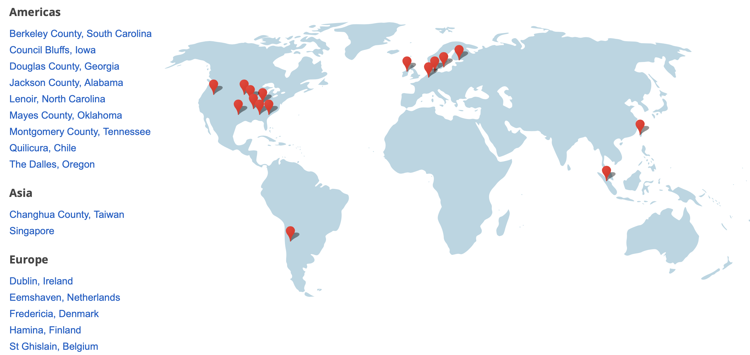

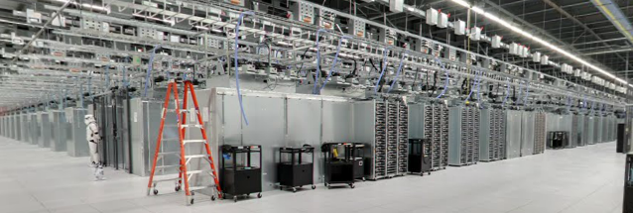


Why spend a lecture talking about HDDs?
SSDs are persistent and
  “almost like memory”
  (no mechanical parts)
  much faster
  (ms vs µs)
  but, more expensive
  (price per byte, but also shorter lifetime)
Many devices:
  Google 2012
  417,600 servers - Douglas County, USA
  204,160 servers - The Dalles, USA
  241,280 servers - Council Bluffs, USA
  139,200 servers – Lenoir, USA
  250,560 servers - Moncks Corner, USA
  296,960 servers - St. Ghislain, Belgium
  116,000 servers - Hamina, Finland
  125,280 servers - Mayes County, USA
  Google Early 2013
  46,400 servers - Profile Park, Dublin, Ireland
  200,000 servers - Jurong West, Singapore (projected estimate)
  200,000 servers - Kowloon, Hong Kong (projected estimate)
  139,200 servers - Mayes County, USA
  Estimated grand total: 2,376,640
  (early 2013 – 3 more centers in 2019)
  one 0.5 TB SSD in each
    Seagate HDD at Komplett: 1.4 billion NOK
    Intel P3700 SSD: 17.7 billion NOK
  one 4 TB in each
    Seagate HDD at Komplett: 4.1 billion NOK
    Samsung SSD at komplett: 17.8 billion NOK (2 TB)
    Intel P3608 SSD: 160 billion NOK
Google data center locations (2019):
Mechanical HDDs will exist for a long time….!
~10x price
Notes:
HDD Komplett 0.5 TB (2015) = 579 NOK
4 TB (2015) = 1749 NOK
The highest endurance Intel P3700 drive is priced at around $3/GB (2014) → 17.7 miliarder NOK hvis hver bare har 1 disk ++ alt arbeidet
Komplett 2015: Samsung 850 EVO 2TB SSD → 7500 NOK → 17,8 milliarder NOK
The intel P3608, 4 TB : $8,759 → 20 milliarder DOLLAR = 160 B NOK
Picture is from MAYES COUNTY, OKLAHOMA
https://www.google.com/about/datacenters/inside/locations/index.html
In 2011, Google had 1 Mill servers
In 2013: Microsoft had 1 Mill servers

Slide 5
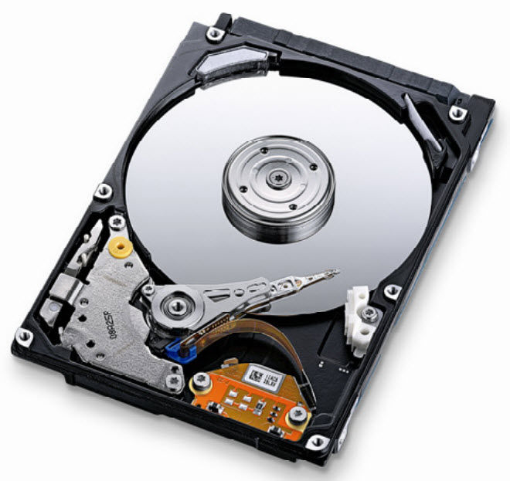
Mechanics of Disks

Slide 6

Mechanics of Disks
Spindle
of which the platters
rotate around
Tracks
concentric circles
on a single platter
Platters
circular platters covered with
magnetic material to provide
nonvolatile storage of bits
Disk heads
read or alter the magnetism (bits) passing under it. The heads are attached to an arm enabling it to move across the platter surface
Sectors
segment of the track circle –
usually each contains 512 bytes –
separated by non-magnetic gaps.
The gaps are often used to identify
beginning of a sector
Cylinders
corresponding tracks on the different
platters are said to form a cylinder
Notes:
Some new drives have sectors of 4096

Slide 7
Disk Capacity
The size (storage space) of the disk is dependent on
  the number of platters
  whether the platters use one or both sides
  number of tracks per surface
  (average) number of sectors per track
  number of bytes per sector
Example (Cheetah X15.1):
  4 platters using both sides: 8 surfaces
  18497 tracks per surface
  617 sectors per track (average)
  512 bytes per sector
  Total capacity = 8 x 18497 x 617 x 512 ≈ 4.6 x 10¹⁰ = 42.8 GB
  Formatted capacity = 36.7 GB
Note:
there is a difference between formatted and total capacity. Some of the capacity is used for storing checksums, spare tracks, etc.
Notes:
Some new drives have sectors of 4096 B

Slide 8
Disk Access Time
How do we retrieve data from disk?
  position head over the cylinder (track) on which the block (consisting of one or more sectors) is located
  read (or write) the data block as the sectors are moved under the head when the platters rotate
The time between the moment issuing a disk request and the time the block is resident in memory is called disk latency or disk access time

Slide 9
Disk Access Time
I want
block X
block x
in memory
Disk platter
Disk access time =
Disk head
Seek time
+ Rotational delay
+ Transfer time
Disk arm
+ Other delays

Slide 10
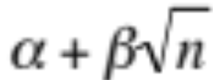
Disk Access Time: Seek Time
Seek time is the time to position the head
  time is used for actually moving the head –
  roughly proportional to the number of cylinders traveled
  time to start and stop moving the head
  time to move head:
number of tracks
seek time constant
fixed overhead
Time
“Typical” average:
10 ms → 40 ms (old)
7.4 ms (Barracuda 180)
5.7 ms (Cheetah 36)
3.6 ms (Cheetah X15)
~ 10x - 20x
x
Cylinders Traveled
1
N

Slide 11
Disk Access Time: Rotational Delay
Time for the disk platters to rotate so the first of the required sectors are under the disk head
head here
Average delay is 1/2 revolution
“Typical” average:
8.33 ms (3.600 RPM)
5.56 ms (5.400 RPM)
4.17 ms (7.200 RPM)
3.00 ms (10.000 RPM)
2.00 ms (15.000 RPM)
block I want
Notes:
15.000 RPM = 250 RPS = 4 ms per rotasjon → 2 ms gjennomsnittlig rotasjonsforsinkelse

Slide 12
Disk Access Time: Transfer Time
Time for data to be read by the disk head, i.e., time it takes the sectors of the requested block to rotate under the head
Transfer time is dependent on data density and rotation speed
Transfer rate =
Transfer time = =
Transfer rate example
  Barracuda 180:
  406 KB per track x 7.200 RPM ≈ 47.58 MB/s
  Cheetah X15:
  306 KB per track x 15.000 RPM ≈ 77.15 MB/s
If we have to change track, time must also be added for moving the head
amount of data per track
time per rotation
amount of data to read
transfer rate
amount of data to read * time per rotation
amount of data per track
Note:
one might achieve these transfer rates reading continuously on disk, but time must be added for seeks, etc.

Slide 13
Disk Access Time: Other Delays
There are several other factors which might introduce additional delays:
  CPU time to issue and process I/O
  contention for controller, bus, memory
  verifying block correctness with checksums (retransmissions)
  waiting in scheduling queue
  ...
Typical values: “0”
(maybe except from waiting in the scheduling queue)

Slide 14
Disk Specifications
Note 1:
disk manufacturers usually
denote GB as 10⁹ whereas
computer quantities often are
powers of 2, i.e., GB is 2³⁰
Some existing (Seagate) disks:
 | Barracuda 180 | Cheetah 36 | Cheetah X15.3
Capacity (GB) | 181.6 | 36.4 | 73.4
Spindle speed (RPM) | 7200 | 10.000 | 15.000
#cylinders | 24.247 | 9.772 | 18.479
average seek time (ms) | 7.4 | 5.7 | 3.6
min (track-to-track) seek (ms) | 0.8 | 0.6 | 0.2
max (full stroke) seek (ms) | 16 | 12 | 7
average latency (ms) | 4.17 | 3 | 2
internal transfer rate (Mbps) | 282 – 508 | 520 – 682 | 609 – 891
Note 2:
there is a difference between internal and formatted transfer rate. Internal is only between platter. Formatted is after the signals interfere with the electronics (cabling loss, interference, retransmissions, checksums, etc.)
Note 3:
there is usually a trade off between speed and capacity
Notes:
http://www.seagate.com/files/docs/pdf/datasheet/disc/cheetah-15k.7-ds1677.3-1007us.pdf :
X15.7 has more capasity and higher transfer rates, but almost the same seek/rotation latencies (3.4 / 0.2 / 2)

Slide 15
Writing and Modifying Blocks
A write operation is analogous to read operations
  must potentially add time for block allocation
  a complication occurs if the write operation has to be verified –
  must usually wait another rotation and then read the block again
  Total write time ≈ read time (+ time for one rotation)
A modification operation is similar to read and write operations
  cannot modify a block directly:
    read block into main memory
    modify the block
    write new content back to disk
  Total modify time ≈ read time (+ time to modify) + write time

Slide 16
Disk Controllers
To manage the different parts of the disk, we use a disk controller, which is a small processor capable of:
  controlling the actuator moving the head to the desired track
  selecting which head (platter and surface) to use
  knowing when the right sector is under the head
  transferring data between main memory and disk

Slide 17
Efficient Secondary Storage Usage
Must take into account the use of secondary storage
  large gaps in access times between disks and memory,
  i.e., a disk access will probably dominate the total execution time
  huge performance improvements if we reduce the number of disk accesses
  a “slow” algorithm with few disk accesses will probably outperform
  a “fast” algorithm with many disk accesses
Several ways to optimize .....
  block size - 4 KB
  disk scheduling - SCAN derivate
  file management / data placement - various
  memory caching / replacement algorithms - LRU variant
  prefetching - read-ahead
  multiple disks - a specific RAID level
  …

Slide 18
Disk Scheduling

Slide 19


Disk Scheduling
How to most efficiently fetch the parcels I want?
Notes:
Indiana Jones – Hangar 51

Slide 20
Disk Scheduling
Seek time is the dominant factor of the total disk I/O time
IDEA: Let the operating system or disk controller choose which request
to serve next depending on the head’s current position and
requested block’s position on disk (disk scheduling)
Note that disk scheduling ≠ CPU scheduling
  a mechanical device – hard to determine (accurate) access times
  disk accesses can/should not be preempted – run until they finish
General goals
  short response time
  high overall throughput
  fairness (equal probability for all blocks to be accessed in the same time)
Tradeoff: seek efficiency vs. maximum response time

Slide 21
Disk Scheduling
Several traditional algorithms
  First-Come-First-Serve (FCFS)
  Shortest Seek Time First (SSTF)
  SCAN (and variations)
  Look (and variations)
  …
A LOT of different algorithms exist depending on expected access pattern

Slide 22
First–Come–First–Serve (FCFS)
FCFS (FIFO) serves the first arriving request first:
Long seeks
“Short” response time for all
incoming requests (in order of arrival, denoted by cylinder number):
12
14
2
7
21
8
24
cylinder number
scheduling
queue
1
5
10
15
20
25
12
14
2
7
21
8
24
time

Slide 23
Shortest Seek Time First (SSTF)
SSTF serves closest request first:
short seek times
longer maximum response times – may even lead to starvation
incoming requests (in order of arrival):
12
14
2
7
21
8
24
12
14
2
7
21
8
24
cylinder number
1
5
10
15
20
25
scheduling
queue
arrived first,
served last
time
Notes:
køen går av seg selv fra og med 7

Slide 24
SCAN
SCAN (elevator) moves head edge to edge and serves requests on the way:
bi-directional
compromise between response time and seek time optimizations
incoming requests (in order of arrival):
12
14
2
7
21
8
24
12
14
2
7
21
8
24
cylinder number
1
5
10
15
20
25
scheduling
queue
time

Slide 25
SCAN vs. FCFS
incoming requests (in order of arrival):
12
14
2
7
21
8
24
Disk scheduling makes a difference!
In this case, we see that SCAN requires much less head movement compared to FCFS
  here 37 vs. 75 tracks
  imagine having
    20.000++ tracks
    many users
    many files
    …
cylinder number
1
5
10
15
20
25
FCFS
time
SCAN
time

Slide 26
C–SCAN
Circular-SCAN moves head from edge to edge
optimization of SCAN
serves requests on one way – uni-directional
improves response time (fairness)
incoming requests (in order of arrival):
12
14
2
7
21
8
24
cylinder number
1
5
10
15
20
25
8
scheduling
queue
7
2
24
21
14
12
time

Slide 27
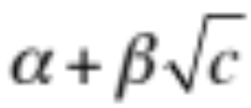



SCAN vs. C–SCAN
Why is C-SCAN in average better in reality than SCAN when both service the same number of requests in two passes?
  modern disks must accelerate (speed up and
  down) when seeking
  head movement formula:
time
number of cylinders
seek time constant
fixed overhead
cylinders traveled
SCAN | C-SCAN
bi-directional | uni-directional
requests: n avg. dist: 2x (spread over both directions) total cost: | requests: n avg. dist: x (over one direction only + one full pass) total cost:
if n is large:

Slide 28
LOOK and C–LOOK
LOOK (C-LOOK) is a variation of SCAN (C-SCAN):
same schedule as SCAN
does not run to the edges
stops and returns at outer- and innermost requests
increased efficiency
SCAN vs. LOOK example:
incoming requests (in order of arrival):
12
14
2
7
21
8
24
cylinder number
1
5
10
15
20
25
2
scheduling
queue
7
8
24
21
14
12
time

Slide 29
V–SCAN(R)
V-SCAN(R) combines SCAN (or LOOK) and SSTF
  define an R-sized unidirectional SCAN window, i.e., C-SCAN, and use SSTF outside the window
  Example: V-SCAN(0.6)
    makes a C-SCAN window over 60 % of the cylinders
    uses SSTF for requests outside the window
  V-SCAN(0.0) equivalent with SSTF
  V-SCAN(1.0) equivalent with C-SCAN
  V-SCAN(0.2) is supposed to be an appropriate configuration
cylinder number
1
5
10
15
20
25

Slide 30


Modern Disk Scheduling
Disk used to be simple devices and disk scheduling used to be performed by OS (file system or device driver) only…
… but, new disks are more complex
  hide their true layout, e.g.,
    only logical block numbers
    different number of surfaces, cylinders, sectors, etc.
OS view
real view

Slide 31

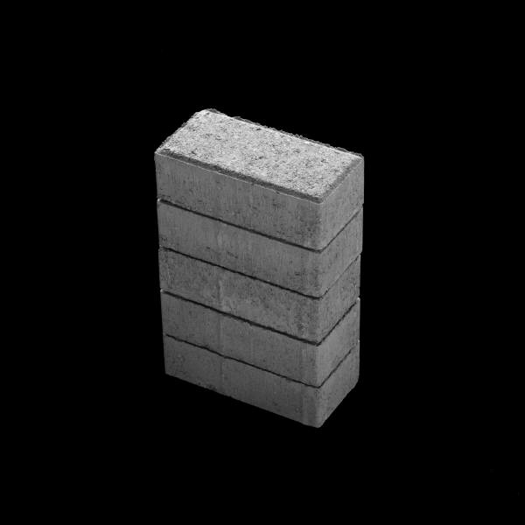

Modern Disk Scheduling
Disk used to be simple devices and disk scheduling used to be performed by OS (file system or device driver) only…
… but, new disks are more complex
  hide their true layout
  transparently move blocks to spare cylinders
    e.g., due to bad disk blocks
OS view
real view

Slide 32
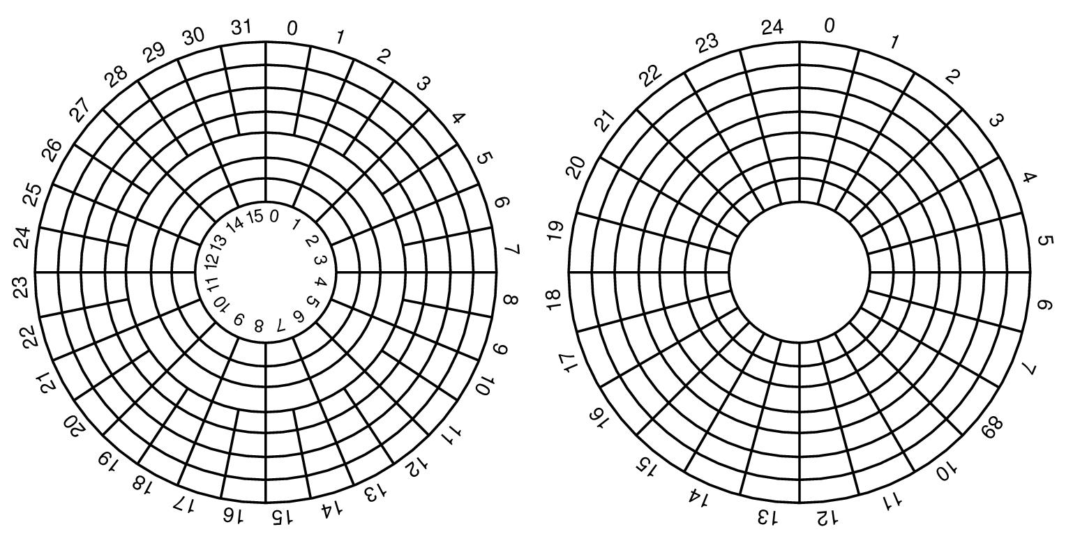
Modern Disk Scheduling
Seagate X15.3:
Zone | Cylinders per Zone | Sectors per Track | Zone Transfer Rate (MBps) | Sectors per Zone | Efficiency | Formatted Capacity (MB)
1 | 3544 | 672 | 890,98 | 19014912 | 77,2% | 9735,635
2 | 3382 | 652 | 878,43 | 17604000 | 76,0% | 9013,248
3 | 3079 | 624 | 835,76 | 15340416 | 76,5% | 7854,293
4 | 2939 | 595 | 801,88 | 13961080 | 76,0% | 7148,073
5 | 2805 | 576 | 755,29 | 12897792 | 78,1% | 6603,669
6 | 2676 | 537 | 728,47 | 11474616 | 75,5% | 5875,003
7 | 2554 | 512 | 687,05 | 10440704 | 76,3% | 5345,641
8 | 2437 | 480 | 649,41 | 9338880 | 75,7% | 4781,506
9 | 2325 | 466 | 632,47 | 8648960 | 75,5% | 4428,268
10 | 2342 | 438 | 596,07 | 8188848 | 75,3% | 4192,690
Disk used to be simple devices and disk scheduling used to be performed by OS (file system or device driver) only…
… but, new disks are more complex
  hide their true layout
  transparently move blocks to spare cylinders
  have different zones
OS view
real view
Constant angular velocity (CAV) disks
  constant rotation speed
  equal amount of data in each track
  thus, constant
  transfer time
Zoned CAV disks
  constant rotation speed
  zones are ranges of tracks
  typical few zones
  the different zones have different amount of data, i.e., more better on outer tracks
  thus, variable transfer time

Slide 33
Modern Disk Scheduling
For handouts
Disk used to be simple devices and disk scheduling used to be performed by OS (file system or device driver) only…
… but, new disks are more complex
  hide their true layout
  transparently move blocks to spare cylinders
  have different zones
OS view
real view
Constant angular velocity (CAV) disks
  constant rotation speed
  equal amount of data in each track
  thus, constant
  transfer time
Zoned CAV disks
  constant rotation speed
  zones are ranges of tracks
  typical few zones
  the different zones have different amount of data, i.e., more better on outer tracks
  thus, variable transfer time

Slide 34
Modern Disk Scheduling
Disk used to be simple devices and disk scheduling used to be performed by OS (file system or device driver) only…
… but, new disks are more complex
  hide their true layout
  transparently move blocks to spare cylinders
  have different zones
  head accelerates – most algorithms assume linear movement overhead
Time
~ 10x - 20x
x
Cylinders Traveled
1
N

Slide 35
Modern Disk Scheduling
Disk used to be simple devices and disk scheduling used to be performed by OS (file system or device driver) only…
… but, new disks are more complex
  hide their true layout
  transparently move blocks to spare cylinders
  have different zones
  head accelerates – most algorithms assume linear movement overhead
  on device buffer caches may use read-ahead prefetching
disk
buffer
disk

Slide 36
Modern Disk Scheduling
Disk used to be simple devices and disk scheduling used to be performed by OS (file system or device driver) only…
… but, new disks are more complex
  hide their true layout
  transparently move blocks to spare cylinders
  have different zones
  head accelerates – most algorithms assume linear movement overhead
  on device buffer caches may use read-ahead prefetching
  “smart” with build-in low-level scheduler (usually SCAN-derivate)
  we cannot fully control the device (black box)
OS could (should?) focus on high level scheduling only!??

Slide 37
Schedulers today (Linux)?
Elevator – SCAN
NOOP
  FCFS with request merging
Deadline I/O
  C-SCAN based
  3 queues: 1 sorted (elevator) queue, and 2 deadline queues (one for read and one for write)
Anticipatory
  same queues as in Deadline I/O
  delays decisions to be able to merge more requests
Completely Fair Queuing (CFQ)
  1 queue per process (periodic access, but period length depends on load)
  gives time slices and ordering according to priority level
  (real-time, best-effort, idle)
  selects requests from queues in RR for the final elevator sorting
  work-conserving
$> more /sys/block/sda/queue/scheduler
noop deadline [cfq]
Notes:
Deadline:
read priority over write,
respective deadlines are 0.5 and 5 seconds
if no deadlines have expired, select a batch from SCAN
Anticipatory;
http://www.linux-mag.com/id/7724/ :
It has been observed that the Apache web server may achieve up to 71% more throughput using the anticipatory IO scheduler. On the other hand, it has been observed that the anticipatory scheduler has caused up to a 15% slowdown on a database run.
The anticipatory IO schduler was a mixed bag overall, helping some workloads and hurting others. In the 2.6.33 kernel, Linus decided that the CFQ (Completely Fair Queue) Scheduler had a broad range of capabilities beyond the desktop to include servers, so the anticipatory scheduler was removed from the 2.6.33 kernel.

Slide 38
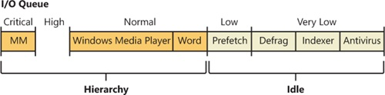

Schedulers today (Windows)?
Well, a bit hard to say, but…
I/O priorities
  individual I/O operations
    FIFO within each queue
    to avoid low-priority starvation, a timer enforce ONE I/O per time unit (.5 sec)
  reservations
  many special functions: fast I/O, I/O boosts and bumps, …
https://www.microsoftpressstore.com/articles/article.aspx?p=2201309&seqNum=3
Notes:
https://www.microsoftpressstore.com/articles/article.aspx?p=2201309&seqNum=3
Without I/O priority, background activities like search indexing, virus scanning, and disk defragmenting can severely impact the responsiveness of foreground operations. A user launching an application or opening a document while another process is performing disk I/O, for example, experiences delays as the foreground task waits for disk access. The same interference also affects the streaming playback of multimedia content like music from a disk.
Windows includes two types of I/O prioritization to help foreground I/O operations get preference: priority on individual I/O operations and I/O bandwidth reservations.
5 levels of priorities supported, 3 used. As each application generates I/Os, I/O request packets (IRPs) are put on different I/O queues based on their priority, and the hierarchy strategy decides the ordering of the operations.
FIFO queue for each.
Windows I/O bandwidth reservation support is useful for applications that desire consistent I/O throughput. Using the SetFileBandwidthReservation call, a media player application asks the I/O system to guarantee it the ability to read data from a device at a specified rate. The I/O system won’t service other I/Os unless it can satisfy the requirements of applications that have made reservations on the target storage device.
A few other subtle modifications to normal I/O paths are used by Windows to avoid starvation, inversion, or otherwise unwanted scenarios when I/O priority is being used. Typically, these modifications are done by boosting I/O priority when needed.

Slide 39
Cooperative user-kernel space scheduling
Some times the kernel does not have enough information to make an efficient schedule
File tree traversals
  processing one file after another
  tar, zip, …
  recursive copy (cp -r)
  search (find)
  …
Only application knows
access pattern
  use ioctl FIEMAP (FIBMAP)
  to retrieve extent/block locations
  sort in user space
  send I/O request according to
  sorted list
GNU/BSD Tar vs. QTAR

Slide 40
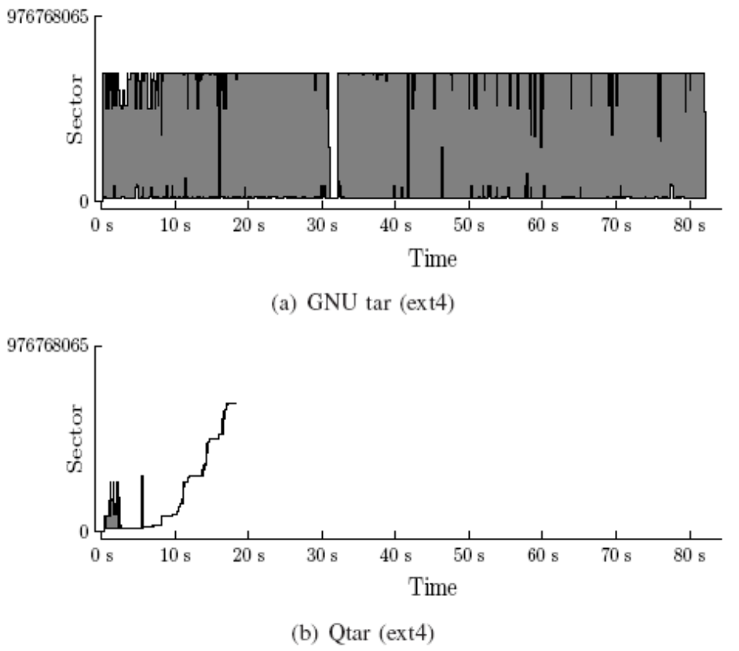
Cooperative user-kernel space scheduling
Some times the kernel does not have enough information to make an efficient schedule
File tree traversals
  processing one file after another
  tar, zip, …
  recursive copy (cp -r)
  search (find)
  …
Only application knows
access pattern
  use ioctl FIEMAP (FIBMAP)
  to retrieve extent/block locations
  sort in user space
  send I/O request according to
  sorted list
GNU/BSD Tar vs. QTAR
So, schedule your disk
requests wisely….!
→ it does matter

Slide 41
Cooperative user-kernel space scheduling
For handouts
Some times the kernel does not have enough information to make an efficient schedule
File tree traversals
  processing one file after another
  tar, zip, …
  recursive copy (cp -r)
  search (find)
  …
Only application knows
access pattern
  use ioctl FIEMAP (FIBMAP)
  to retrieve extent/block locations
  sort in user space
  send I/O request according to
  sorted list
GNU/BSD Tar vs. QTAR

Slide 42
Data Placement

Slide 43
Data Placement on Disk
Interleaved placement tries to store blocks from a file with a fixed number of other blocks in-between each block
  minimal disk arm movement reading the files A, B and C
  (starting at the same time)
  fine for predictable workloads reading multiple files
  no gain if we have unpredictable disk accesses
Non-interleaved (or even random) placement can be used for highly unpredictable workloads
file A
file B
file C

Slide 44
Data Placement on Disk
Contiguous placement stores disk blocks contiguously on disk
  minimal disk arm movement reading the whole file (no intra-file seeks)
  pros/cons
    within a file, head must not move between reads - no seeks / rotational delays
    can approach theoretical transfer rate
    but usually we read other files as well (giving possible large inter-file seeks)
  real advantage
    whatever amount to read, at most track-to-track seeks are performed within one request
  no inter-operation gain if we have unpredictable disk accesses
  (but still not worse than random placement)
file A
file B
file C

Slide 45
Data Placement on Disk
Organ-pipe placement consider the ‘average’ disk head position
  place most popular data where head is most often
  center of the disk is in average “closest” to the head
  but, a bit outward for zoned disks (modified organ-pipe)
innermost
outermost
disk:
head
organ-pipe:
modified organ-pipe:
Note:
skew dependent on
tradeoff between
zoned transfer time
and storage
capacity vs.
seek time
block access probability
block access probability
cylinder number
cylinder number

Slide 46
Memory Caching

Slide 47
Data Path (Intel Hub Architecture)
application
Pentium 4
Processor
file system
communication
system
registers
disk
network card
cache(s)
RDRAM
file system
memory
controller
hub
RDRAM
RDRAM
application
RDRAM
I/O
controller
hub
PCI slots
PCI slots
PCI slots
disk

Slide 48
Buffer Caching
How do we manage a cache?
how much memory to use?
how much data to prefetch?
which data item to replace?
how to do lookups quickly?
…
application
caching possible
cache
file system
communication
system
expensive
disk
network card

Slide 49
Buffer Caching: Windows (XP ++)
An I/O manager performs caching
  centralized facility to all components (not only file data)
I/O request processing:
process
  I/O request from process
  I/O manager forwards to cache manager
in cache:
  cache manager locates and copies data
  to process buffer via VMM
  VMM notifies process
on disk:
  cache manager generates a page fault
  VMM makes a non-cached service request
  I/O manager makes request to file system
  file system forwards to disk
  disk finds data
  reads into cache
  cache manager copies data to process buffer via VMM
  VMM notifies process
I/O
manager
virtual memory
manager (VMM)
file system
cache
drivers
manager
disk
drivers
Kernel
Notes:
See also:
https://www.microsoftpressstore.com/articles/article.aspx?p=2201309&seqNum=3
https://docs.microsoft.com/en-us/windows-hardware/drivers/kernel/overview-of-the-windows-i-o-model
https://docs.microsoft.com/en-us/windows-hardware/drivers/kernel/the-life-of-an-i-o-request

Slide 50
Buffer Caching: Linux / Unix
A file system performs caching
  caches disk data (blocks) only
  may hint on caching decisions
  prefetching
I/O requests processing:
Process
Kernel
  I/O request from process
  virtual file system forwards to local file system
  local file system finds requested block number
  requests block from buffer cache
  data located…
    … in cache:
      return buffer memory address
    … on disk:
      make request to disk driver
      data is found on disk and transferred to buffer
      return buffer memory address
  file system copies data to process buffer
  process is notified
virtual file
system
FAT32
Linux ext2fs
HFS
(Windows)
(Macintosh)
buffers
disk
drivers

Slide 51
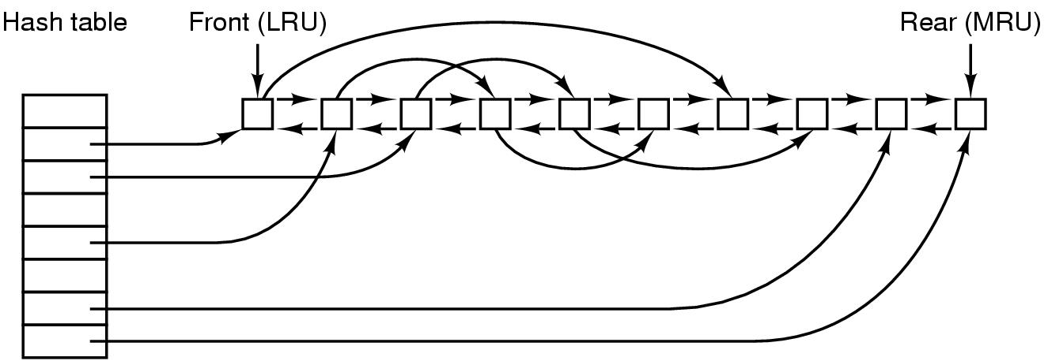
Buffer Caching Structure
Many different algorithms for replacement,
similar to page replacement…

Slide 52
File Systems

Slide 53
Files??
A file is a collection of data – often for a specific purpose
  unstructured files, e.g., Unix and Windows
  structured files, e.g., early MacOS (to some extent) and MVS
In this course, we consider unstructured files
  for the operating system, a file is only a sequence of bytes
  it is up to the application/user to interpret the meaning of the bytes
  simpler file systems
Notes:
MVS (Multiple Virtual Storage) is IBM's best-known operating system for mainframe and large server computers (successors: OS/390 and z/OS.)

Slide 54
File Systems
File systems organize data in files and manage access regardless of device type:
  storage management (bottom-up view) –
  allocating space for files on secondary storage
  file management (top-down view) –
  mechanisms for files to be stored, referenced, shared, secured, …
    file integrity mechanisms – ensuring that information is not corrupted, intended content only
    access methods – provide methods to access stored data

Slide 55
Organizing Files - Directories
A system usually has a large number of different files
To organize and quickly locate files, file systems use directories
  contain no data itself
  file containing name and locations of other files
  several types
    single-level (flat) directory structure
    hierarchical directory structure

Slide 56
Single-level Directory Systems
Root directory
Four files
CP/M
  Microcomputers
  Single user system
VM
  Host computers
  “Minidisks”: one partition per user

Slide 57
Hierarchical Directory Systems
Tree structure
  nodes = directories
  root node = root directory
  leaves = files
Directories
  stored on disk
  attributes just like files
To access a file
  must (often) test all directories in path for
    existence
    being a directory
    permissions
  similar tests on the file itself
/
/

Slide 58
Hierarchical Directory Systems
Windows: one tree per partition or device
Device C
Device D
\
\
WINNT
EXPLORER.EXE
Complete filename example:
C:\WinNT\EXPLORER.EXE

Slide 59
Hierarchical Directory Systems
Unix: single acyclic graph
spanning several devices
/
cdrom
/
doc
Howto
Complete filename example:
/cdrom/doc/Howto

Slide 60
File & Directory Operations
File:
  create
  delete
  open
  close
  read
  write
  append
  seek
  get/set attributes
  rename
  link
  unlink
  …
Directory:
  create
  delete
  opendir
  closedir
  readdir
  rename
  link
  unlink
  …

Slide 61
Example: open(), read() and close()
#include <stdio.h>
#include <stdlib.h>
int main(void)
{
int fd, n;
char buffer[BUFSIZE];
char *buf = buffer;
if ((fd = open( “my.file” , O_RDONLY , 0 )) == -1) {
printf(“Cannot open my.file!\n”);
exit(1); /* EXIT_FAILURE */
}
while ((n = read(fd, buf, BUFSIZE) > 0) {
<<USE DATA IN BUFFER>>
}
close(fd);
exit(0); /* EXIT_SUCCESS */
}
Notes:
int
open( const char *path , int oflag, ...);
oflag – reading/writing/create/locks/blocking, etc
mode – umask / chmod premissions

Slide 62

Open
BSD example
open(name,oflags,mode)
system call handling as described earlier
Operating System
sys_open() → vn_open():
  Check if valid call
  Allocate file descriptor
  If file exists, open for read (remember O_RDONLY).
  Must get directory inode (?). May require disk I/O.
  Set access rights, flags and pointer to vnode (?)
  Return index to file descriptor table
fd
fd
user
kernel
control block
control block
control block
Notes:
inodes later…

Slide 63
Example: open(), read() and close()
#include <stdio.h>
#include <stdlib.h>
int main(void)
{
int fd, n;
char buffer[BUFSIZE];
char *buf = buffer;
if ((fd = open( “my.file” , O_RDONLY , 0 )) == -1) {
printf(“Cannot open my.file!\n”);
exit(1); /* EXIT_FAILURE */
}
while ((n = read(fd, buf, BUFSIZE) > 0) {
<<USE DATA IN BUFFER>>
}
close(fd);
exit(0); /* EXIT_SUCCESS */
}
Notes:
ssize_t
read(int fildes, void *buf, size_t nbyte);

Slide 64
Read
BSD example
buffer
read(fd, *buf, len)
system call handling as described earlier
Operating System
sys_read() → dofileread() → (*fp_read==vn_read)():
  Check if valid call and mark file as used
  Use file descriptor as index in file descriptor table
  to find corresponding file pointer
  Use data pointer in file structure to find vnode
  Find current offset in file
  Call local file system
VOP_READ(vp,len,offset,..)

Slide 65
Read
VOP_READ(...) is a pointer to a read function in the
corresponding file system, e.g., Fast File System (FFS)
READ():
  Find corresponding inode
  Check if valid call: len + offset ≤ file size
  Loop and find corresponding blocks
    find logical blocks from inode, offset, length
    do block I/O, fill buffer structure
    e.g., bread(...) → bio_doread(...) → getblk()
    return and copy block to user
Operating System
VOP_READ(vp,len,offset,..)
getblk(vp,blkno,size,...)

Slide 66
Read
A | B | C | D | E | F | G | H | I | J | K | L
Operating System
getblk(vp,blkno,size,...)
M
Search for block in buffer cache, return if found
(hash vp and blkno and follow linked hash list)
Get a new buffer (LRU, age)
Call disk driver - sleep or do something else
Reorganize LRU chain and return buffer
VOP_STRATEGY(bp)

Slide 67
Read
Operating System
VOP_STRATEGY(...) is a pointer to the corresponding
driver depending on the hardware,
e.g., SCSI - sdstrategy(...) → sdstart(...)
Check buffer parameters, size, blocks, etc.
Convert to raw block numbers
Sort requests according to SCAN - disksort_blkno(...)
Start device and send request
VOP_STRATEGY(bp)

Slide 68
Read
file attributes
...
data pointer
data pointer
data pointer
data pointer
data pointer
...
...
Operating System
M

Slide 69

Read
Interrupt to notify end of disk IO
Kernel may awaken sleeping process
M
A | B | C | D | E | F | G | H | I | J | K | L
M
Operating System
Search for block in buffer cache, return if found
(hash vp and blkno and follow linked hash list)
Get a new buffer (LRU, age)
Call disk driver - sleep or do something else
Reorganize LRU chain and return buffer
M

Slide 70
Read
buffer
READ():
  Find corresponding inode
  Check if valid call - file size vs. len + offset
  Loop and find corresponding blocks
    find logical blocks from inode, offset, length
    do block I/O,
    e.g., bread(...) → bio_doread(...) → getblk()
    return and copy block to user
Operating System
M

Slide 71
Example: open(), read() and close()
#include <stdio.h>
#include <stdlib.h>
int main(void)
{
int fd, n;
char buffer[BUFSIZE];
char *buf = buffer;
if ((fd = open( “my.file” , O_RDONLY , 0 )) == -1) {
printf(“Cannot open my.file!\n”);
exit(1); /* EXIT_FAILURE */
}
while ((n = read(fd, buf, BUFSIZE) > 0) {
<<USE DATA IN BUFFER>>
}
close(fd);
exit(0); /* EXIT_SUCCESS */
}

Slide 72
Management of File Blocks
file attributes
...
data pointer
data pointer
data pointer
data pointer
data pointer
...
...

Slide 73
Management of File Blocks
Many files consist of several blocks
  relate blocks to files
  how to locate a given block
  maintain order of blocks
Approaches
  chaining in media
  chaining in a map
  table of pointers
  extent-based allocation

Slide 74
Chaining in the Media
Metadata
File blocks
Metadata points to chain of used file blocks
Free blocks may also be chained
nice if you only read sequentially from the start
expensive to search (random access)
must read block by block

Slide 75
Chaining in a Map
Metadata
Map
File blocks

Slide 76
Chaining in a Map: FAT Example
FAT: File Allocation Table
Versions FAT12, FAT16, FAT32
  number indicates number of bits used to identify blocks in partition (2¹²,2¹⁶,2³²)
  FAT12: Block sizes 512 bytes – 8 KB: max 32 MB partition size
  FAT16: Block sizes 512 bytes – 64 KB: max 4 GB partition size
  FAT32: Block sizes 512 bytes – 64 KB: max 2 TB partition size
Boot
sector
FAT1
FAT2
(backup)
Root
directory
Other directories and files
…
0001
0000
empty
File1
File1
File1
File2
File2
0002
0003
0003
0004
0004
FFFF
File3
File2
empty
empty
empty
empty
0005
0006
0006
0008
0007
FFFF
0008
FFFF
empty
empty
empty
empty
empty
empty
0009
0000
…
Notes:
FAT32, with cluster values held in a 32-bit field, of which 28 bits are used to hold the cluster number, for a maximum of approximately 268 million (228) clusters. This allows for drive sizes of up to 8 terabytes with 32KB clusters, but the boot sector uses a 32-bit field for the sector count, limiting volume size to 2 TB on a hard disk with 512 byte sectors.
https://www.pjrc.com/tech/8051/ide/fat32.html

Slide 77
Kom hit!

Slide 78
Table of Pointers
Metadata
Map
File blocks
inefficient search in the map

Slide 79
Table of Pointers
Metadata
Table of pointers
File blocks
good random and sequential access
main structure small, extra blocks if needed
uses one indirect block regardless of size
can be too small for large files

Slide 80
Unix/Linux Example: FFS, UFS, …
inode
Flexible block size
e.g. 4KB
mode
Data block
Data block
owner
…
Data block
Direct block 0
Data block
Direct block 1
1024 entries
per index block
…
Direct block 10
Data block
Data block
Direct block 11
Single indirect
index
Double indirect
Data block
Triple indirect
Data block
Data block
index
index
Data block
index
Data block
Data block
index
index
index
index
index
Data block
Data block
Notes:
direkte = 4kb * 12 = 48 kb
1.indirekte = 4kb * 1024 (+ direkte) = 4 MB
2.indirekte = 4kb * 1024 * 1024 (+ direkte/indirekte) = 4 GB
3.indirekte = 4kb * 1024 * 1024 * 1024 (+ direkte/indirekte) = 4 TB

Slide 81
Extent-based Allocation
Observation:
indirect block reads introduce disk I/O and break access locality
Metadata
List of extents
File blocks
1
3
2
faster block allocation (many at a time)
higher performance reading large data elements
less file system meta data
reduce number of lookups reading a file

Slide 82
Linux Example: XFS, JFS, EXT4…
Count-augmented address indexing in the extent sections
Introduce a new inode structure
  add counter field to original direct
  entries
    direct points to a disk block
    count indicated how many other
    blocks is following the first block
    (contiguously)
inode
attributes
direct 0
count 0
3
data
data
data
direct 1
count 1
direct 2
count 2
…
…
direct 10
count 10
direct 11
count 11
single indirect
double indirect
triple indirect

Slide 83
ext4_inode
struct ext4_inode {
__le16 i_mode; /* File mode */
__le16 i_uid; /* Low 16 bits of Owner Uid */
__le32 i_size; /* Size in bytes */
__le32 i_atime; /* Access time */
__le32 i_ctime; /* Inode Change time */
__le32 i_mtime; /* Modification time */
__le32 i_dtime; /* Deletion Time */
__le16 i_gid; /* Low 16 bits of Group Id */
__le16 i_links_count; /* Links count */
__le32 i_blocks; /* Blocks count */
__le32 i_flags; /* File flags */
...
__le32 i_block[EXT4_N_BLOCKS];/* Pointers to blocks */
__le32 i_generation; /* File version (for NFS) */
__le32 i_file_acl; /* File ACL */
__le32 i_dir_acl; /* Directory ACL */
__le32 i_faddr; /* Fragment address */
...
__le32 i_ctime_extra; /* extra Change time (nsec << 2 | epoch) */
__le32 i_mtime_extra; /* extra Modification */
__le32 i_atime_extra; /* extra Access time */
__le32 i_crtime; /* File Creation time */
__le32 i_crtime_extra; /* extra */
};
i_block [15]
inode
attributes
direct 0
count 0
3
data
data
data
direct 1
count 1
direct 2
count 2
…
…
direct 10
count 10
direct 11
count 11
Notes:
#define EXT4_N_BLOCKS 12 +1+1+1 = 15 (60 bytes)

Slide 84
ext4_inode
...
__le16 eh_depth;
...
Tree of extents organized
using an HTREE
ext4_extent_header
ext4_extent
ext4_extent
ext4_extent
ext4_extent
i_block [NUM]
struct ext4_extent {
__le32 ee_block; /* first logical block extent covers */
__le16 ee_len; /* number of blocks covered by extent */
__le16 ee_start_hi; /* high 16 bits of physical block */
__le32 ee_start; /* low 32 bits of physical block */
};
4
Theoretically, each extent can have 2¹⁶ - 1 continuous blocks, i.e., 64 GB data using a 4KB block size,
but limited to 128 MB
Max size of 4 x 128 = 512 MB files?
What about fragmented disks??
Notes:
ext4_inode has i_block array (60 bytes total).
The first 12 bytes store ext4_extent_header;
the remainder stores an array of 4 of ext4_extent.
#define EXT4_N_BLOCKS 12 +1+1+1 = 15 (60 bytes)
An HTREE is a specialized tree data structure for directory indexing, similar to a B-tree. They are constant depth of either one or two levels, have a high fanout factor, use a hash table of the filename, and do not require balancing.
Htree indexes are used in the ext3 and ext4 Linux filesystems

Slide 85
ext4_inode
ext4_extent_header
ext4_extent_idx
ext4_extent_idx
ext4_extent_idx
ext4_extent_idx
i_block [NUM]
struct ext4_extent_idx {
__le32 ei_block; /* index covers logical blocks from 'block' */
__le32 ei_leaf; /* pointer to the physical block of the next * * level. leaf or next index could be there */
__le16 ei_leaf_hi; /* high 16 bits of physical block */
__u16 ei_unused;
};
...
__le16 ee_len;
__le16 ee_start_hi;
__le32 ee_start;
 one 4 KB can hold 340 ext4_extents(_idx)
 first level can hold 170 GB
 second level can hold 56 TB (limed to 16 TB, 32 bit pointer)
4
Notes:
NOTE: first level CAN hold 170 GB IF all extents are full

Slide 86
Windows Example: NTFS
Each partition contains a master file table (MFT)
  a linear sequence of 1 KB records
  each record describes a directory or a file (attributes and disk addresses)
info about data blocks
record header
standard info
data header
file name
1st extension
run 1
run 2
2nd extension
run 3
run 1
run k
MFT 26
…data…
20
4
30
MFT 27
2
74
10
7
2
run 2, run 3, …, run k-1
78
3
unused
27 - second extension record
26 - first extension record
24 - base record
A file can be …
stored within the record (immediate file, < few 100 B)
represented by disk block addresses (which hold data):
runs of consecutive blocks (<addr, no>, like extents)
use several records if more runs are needed
first 16 reserved for
NTFS metadata

Slide 87
Recovery & Journaling
When data is written to a file, both metadata and data must be updated
  metadata is written asynchronously, data may be written earlier
  if a system crashes, the file system may be corrupted and data is lost
Journaling file systems provide improved consistency and recoverability
  makes a log to keep track of changes
  the log can be used to undo partially completed operations
  e.g., ReiserFS, JFS, XFS and Ext3 (all Linux)
  NTFS (Windows) provide journaling properties where all changes to MFT and file system structure are logged

Slide 88
Multiple Disks

Slide 89
Parallel Access
Disk controllers and busses manage several devices
One can improve total system performance by replacing one large disk with many small accessed in parallel
Several independent heads can read simultaneously
Two disks:
Single disk:
Note:
the single disk might be faster, but as seek time and rotational delay are the dominant factors of total disk access time, the two smaller disks might operate faster together performing seeks in parallel...

Slide 90
Striping
A reason to use multiple disks is when one disk cannot deliver requested data rate
In such a scenario, one
might use several disks
for striping:
  bandwidth disk: B_{disk}
  required bandwidth: B_{consume}
  B_{disk} < B_{consume}
  read from n disks in parallel: n B_{disk} > B_{consume}
Advantages
  higher transfer rate compared to one disk
Drawbacks
  can’t serve multiple clients in parallel
  positioning time increases
  (i.e., reduced efficiency)
Client1
Client2
Client3
Client4
Client5
Server

Slide 91
Interleaving (Compound Striping)
Full striping usually not necessary today:
  faster disks
  better compression algorithms
Interleaving lets each client be serviced
by only a set of the available disks
  make groups
  ”stripe” data in a way such that a consecutive
  request arrive at next group
  one disk group example:
Client1
Client2
Client3
Server

Slide 92
Interleaving (Compound Striping)
Divide traditional striping group into sub-groups, e.g.,
staggered striping
Advantages
  multiple clients can still be served in parallel
  more efficient disks operations
  potentially shorter response time
Potential drawback/challenge
  load balancing (all clients access same group)
X_{0,0}
X_{0,1}
X_{1,0}
X_{1,1}
X_{2,0}
X_{2,1}
X_{3,1}
X_{3,0}
X_{4,0}
X_{4,1}

Slide 93
Mirroring
Multiple disks might do come in the situation where all requests are for one of the disks and the rest lie idle
In such cases, it might make sense to have replicas of data on several disks – if we have identical disks, it is called mirroring
Advantages
  faster response time
  survive crashes – fault tolerance
  load balancing by dividing the requests for the data on the same disks equally among the mirrored disks
Drawbacks
  increases storage requirement
  more expensive write operations

Slide 94
Redundant Array of Inexpensive Disks
The various RAID levels define different disk organizations to achieve higher performance and more reliability
  RAID 0 - striped disk array without fault tolerance (non-redundant)
  RAID 1 - mirroring
  RAID 2 - memory-style error correcting code (Hamming Code ECC)
  RAID 3 - bit-interleaved parity
  RAID 4 - block-interleaved parity
  RAID 5 - block-interleaved distributed-parity
  RAID 6 - independent data disks with two independent distributed parity schemes (P+Q redundancy)
  RAID 10 - striped disk array (RAID level 0) whose segments are mirrored (RAID level 1)
  RAID 0+1 - mirrored array (RAID level 1) whose segments are RAID 0 arrays
  RAID 03 - striped (RAID level 0) array whose segments are RAID level 3 arrays
  RAID 50 - striped (RAID level 0) array whose segments are RAID level 5 arrays
  RAID 53, 51, …

Slide 95
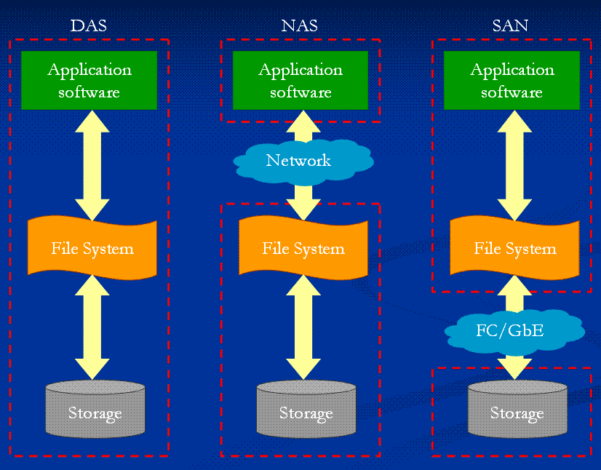
DAS vs. NAS vs. SAN??
How will the introduction of network
attached disks influence storage?
Direct attached storage
Network attached storage
  uses some kind of file-based protocol to attach remote devices non-transparently
  NFS, SMB, CIFS
Storage area network
  transparently attach remote storage devices
  iSCSI (SCSI over TCP/IP), iFCP (SCSI over Fibre Channel), HyperSCSI (SCSI over Ethernet), ATA over Ethernet

Slide 96


Example: Network File System (NFS)
Distributed file system – allowing a client to access a file over a network
local
network attached
system call layer
system call layer
virtual file system
virtual file system
virtual file system
local file system
NFS client
NFS server
local file system
RPC client stub
RPC server stub
UDP,TCP / IP
UDP,TCP / IP
network
Notes:
NFS v2 – udp, stateless, v3 – udp+tcp, stateless, v4 – statefull, compound requests, … (performance, security, …)
RPC Sequence of events
The client calls the client stub. The call is a local procedure call, with parameters pushed on to the stack in the normal way.
The client stub packs the parameters into a message and makes a system call to send the message. Packing the parameters is called marshalling.
The client's local operating system sends the message from the client machine to the server machine.
The local operating system on the server machine passes the incoming packets to the server stub.
The server stub unpacks the parameters from the message. Unpacking the parameters is called unmarshalling.
Finally, the server stub calls the server procedure. The reply traces the same steps in the

Slide 97
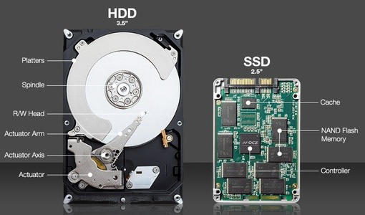
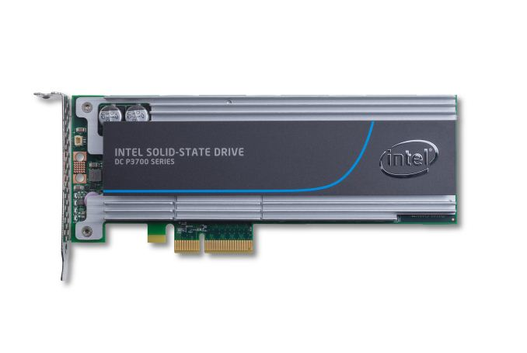
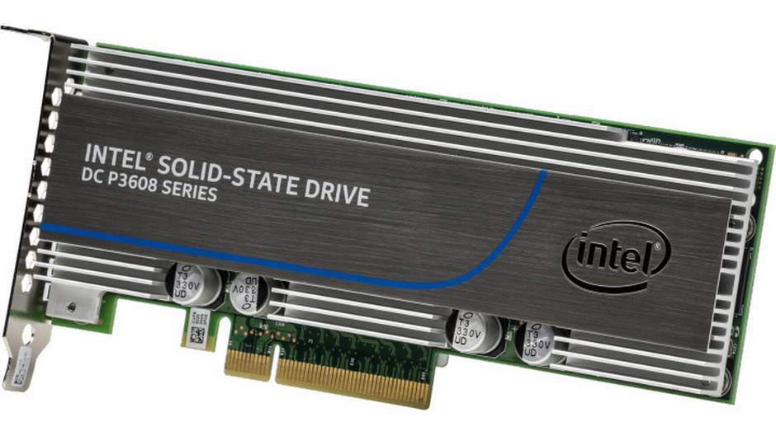
Mechanical Disks vs. Solid State Disks???
How will the introduction of
SSDs influence storage?
 | Storage capasity (GB) | Average (seek) time / latency (ms) | Sustained transfer rate (MBps) | Interface (Gbps)
Seagate Cheetah X15.6 (3.5 inch) | 450 | 3.4 (track to track 0.2) | 110 - 171 | SAS (3) FC (4)
Seagate Savvio 15K (2.5 inch) | 73 | 2.9 (track to track 0.2) | 29 - 112 | SAS (3)
Sagate Barracuda Pro | 14000 | 8.5 (track to track 1.0) | 250 | SATA (6)
Intel X25-E (extreme) | 64 | 0.075 | 250 | SATA (3)
Intel Drive 910 Series | 800 | < 0.065 | 2000 | SAS (6)
Intel DC S3700 Series | 2000 | 0.020 | 2000 | PCIe, v3
Intel DC P3608 | 4000 | 0.020 | 5000 | PCIe, v3
Komplett.no ~5 KNOK (2019):
Standard HDD: 12 TB
Standard SSD: 2 TB
2017 Price?
$ 8.999
2019 (3.2TB ) = 80 KNOK
Notes:
https://www.intel.com/buy/us/en/product/components/intel-dc-p3608-4000gb-485298
DC P3608 - seq read: 850 000 IOPS, 5GB/s, 20 microsec latency
4 TB : $8,759 (2017 price)
3.2 TB : 80.000 NOK ( )
PCIe, v3 (7.8/lane)
FC = fibre channel
SAS = serial attached SCSI
SATA = Serial ATA (Advanced Technology Attachment)

Slide 98

Mechanical Disks vs. Solid State Disks???
How will the introduction of
SSDs influence storage?
Speed
SSD or HDD
 | Storage capasity (GB) | Average (seek) time / latency (ms) | Sustained transfer rate (MBps) | Interface (Gbps)
Seagate Cheetah X15.6 (3.5 inch) | 450 | 3.4 (track to track 0.2) | 110 - 171 | SAS (3) FC (4)
Seagate Savvio 15K (2.5 inch) | 73 | 2.9 (track to track 0.2) | 29 - 112 | SAS (3)
Sagate Barracuda Pro | 14000 | 8.5 (track to track 1.0) | 250 | SATA (6)
Intel X25-E (extreme) | 64 | 0.075 | 250 | SATA (3)
Intel Drive 910 Series | 800 | < 0.065 | 2000 | SAS (6)
Intel DC S3700 Series | 2000 | 0.020 | 2000 | PCIe, v3
Intel DC P3608 | 4000 | 0.020 | 5000 | PCIe, v3
Life-time
Type of
machine
Latency
Capacity
Price
Data & operations
Notes:
https://www.intel.com/buy/us/en/product/components/intel-dc-p3608-4000gb-485298
DC P3608 - seq read: 850 000 IOPS, 5GB/s, 20 microsec latency
4 TB : $8,759 (2017 price)
PCIe, v3 (7.8/lane)
FC = fibre channel
SAS = serial attached SCSI
SATA = Serial ATA (Advanced Technology Attachment)
https://www.extremetech.com/extreme/210492-extremetech-explains-how-do-ssds-work

Slide 99
The End:
Summary

Slide 100

Summary
Disks are the main persistent secondary storage device
The main bottleneck is often disk I/O performance due to disk
mechanics: seek time and rotational delays
Much work has been performed to optimize disks performance
  scheduling algorithms try to minimize seek overhead (most systems use SCAN derivates)
  memory caching can save disk I/Os
  additionally, many other ways (e.g., block sizes, placement, prefetching, striping, …)
  world today more complicated (both different access patterns, unknown disk characteristics, …)
  → new disks are “smart”, we cannot fully control the device
File systems provide
  file management – store, share, access, …
  storage management – of physical storage
  access methods – functions to read, write, seek, …
  …
New non-mechanical storage may change the way of thinking…!!??

