Slide 1
Routing and Switching
IN2140:
Introduction to Operating Systems and Data Communication
End-to-end delivery on layer 3
in TCP/IP terms

Slide 2

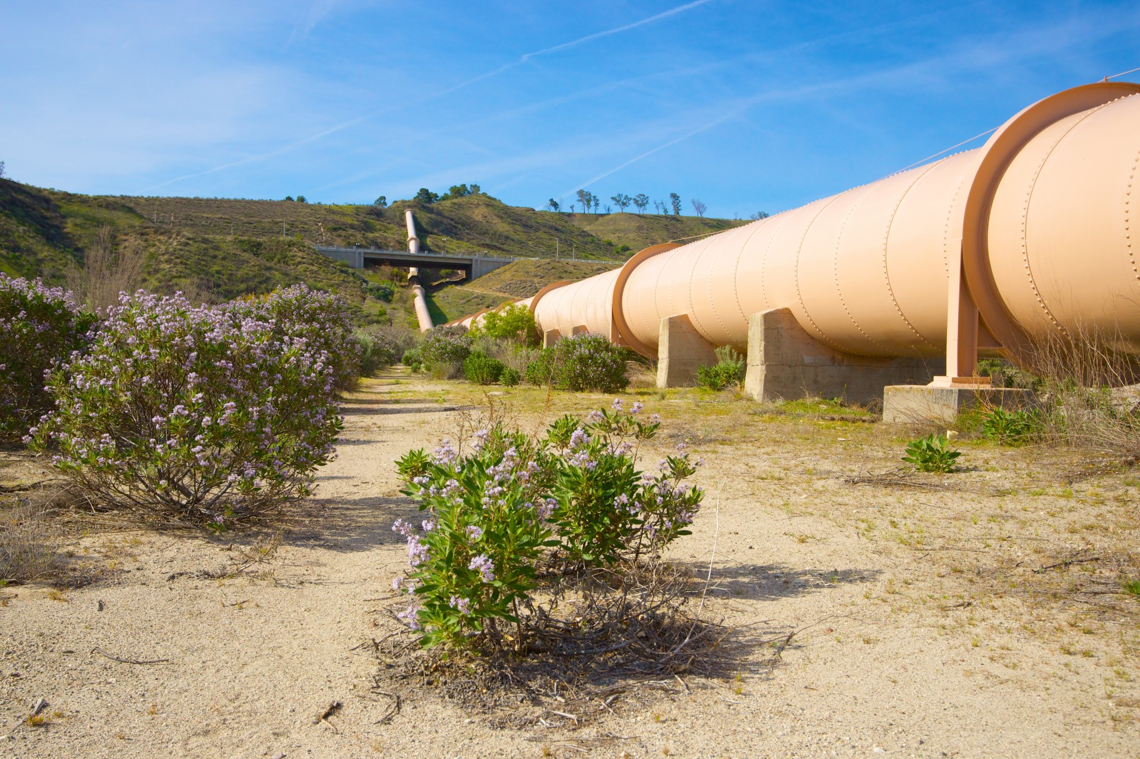
Network Layer
Primary task from a layer model perspective
  To provide service to the transport layer
    Connectionless or connection-oriented service

Slide 3
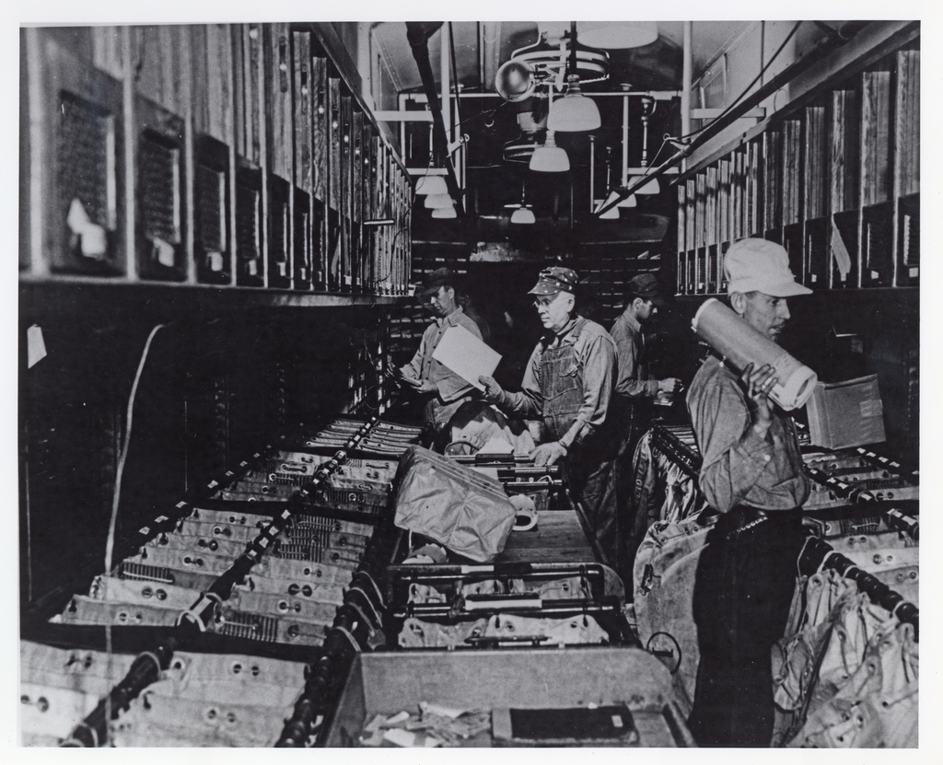
Network Layer
Primary task from a layer model perspective
  To provide service to the transport layer
    Connectionless or connection-oriented service
    Uniform addressing
    Internetworking: provide transitions between networks
[unknown, 1920]

Slide 4
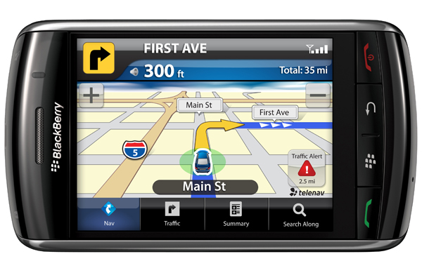
Network Layer
Primary task from a layer model perspective
  To provide service to the transport layer
    Connectionless or connection-oriented service
    Uniform addressing
    Internetworking: provide transitions between networks
    Routing

Slide 5
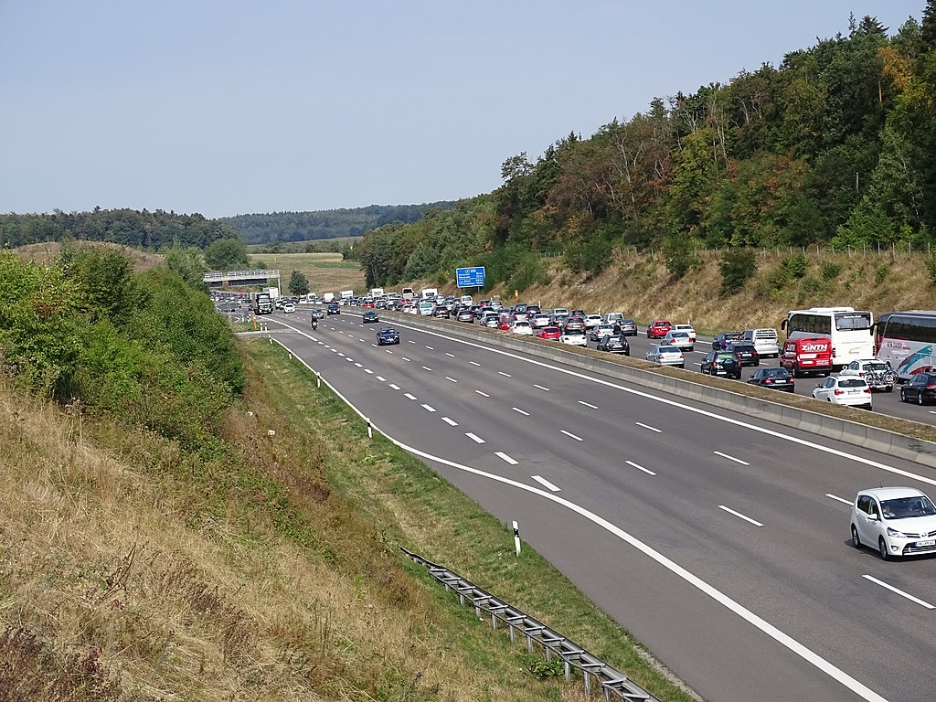
Network Layer
Primary task from a layer model perspective
  To provide service to the transport layer
    Connectionless or connection-oriented service
    Uniform addressing
    Internetworking: provide transitions between networks
    Routing
    Congestion control
[Giftzwerg 88@wikipedia, CC BY-SA 4.0]

Slide 6
Network Layer
Primary task from a layer model perspective
  To provide service to the transport layer
    Connectionless or connection-oriented service
    Uniform addressing
    Internetworking: provide transitions between networks
    Routing
    Congestion control
    Quality of Service (QoS)
Inside the network layer
Layer | Data entity
Transport | …
Network | Packet
Data link | Frame
Physical | Bit/byte (bit stream)

Slide 7
Inside the Network Layer
An L3 packet includes
for connection-oriented service:
route label
(2) headers and trailer to specify service requirements
in particular:
information required by intermediate systems for forwarding
OR
for connectionless service:
end system address of the destination
QoS requirements
IPv6 Header
Version
DSCP
ECN
Flow label
Payload length
Next header
Hop Limit
(1) payload from the transport layer
Source address
(128 bit)
Destination Address
(128 bit)
L4 Data
Notes:
HEADER & TRAILER må inneholde informasjonen som Entitetene på alle noder trenger for å levere tjenesten lovet til L4.
IP har ikke trailer.
Det meste av en IP-pakke består av payload, dvs. L4 data.
DSCP - differentiated services code point
ECN - early congestion notification support indicator (0=no,1,2,3)
Next header - lots of stuff, optional in payload block

Slide 8
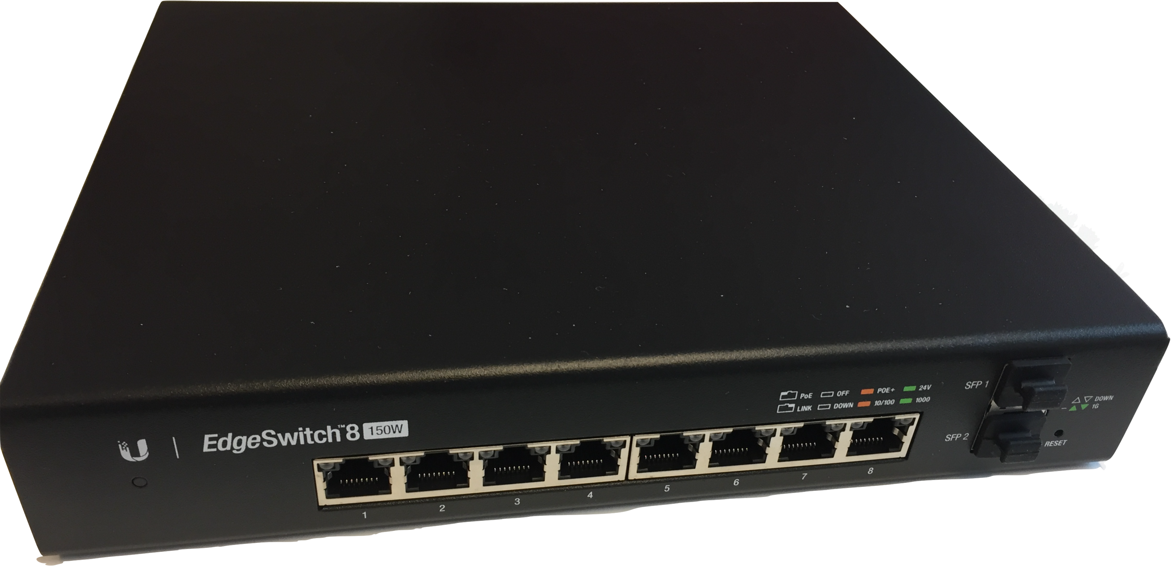
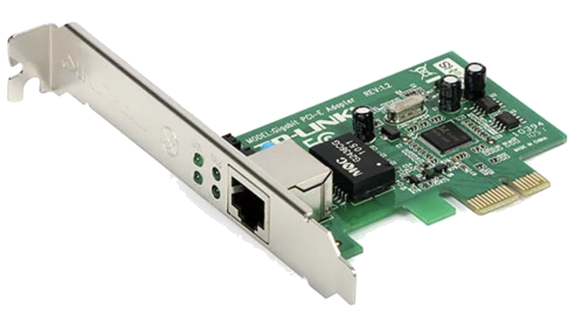
Inside the Network Layer
An L3 packet includes
  Payload from the transport layer
  Headers and trailers
    End system address or route label
    QoS requirements
Knowledge required by intermediate
system
  Subnetwork topology
  Address / localization of the end system
  Packet / data stream communication
  requirements (Quality of Service)
  Network status (utilization,...)
Intermediate system can then route or switch packets
IPv6 Header
Version
DSCP
ECN
Flow label
Payload length
Next header
Hop Limit
Source address
(128 bit)
Destination Address
(128 bit)
L4 Data

Slide 9
Routing and Switching: Terminology
The general ideas apply in many fields, including route planning for cars or supplying electricity
We stick to Internet terminology where that is possible
Routing and Switching have one thing in common:
  a packet arrives at an IS, and the IS (if it is not the target) decides choose the right interface for forwarding it
In the Internet, there is a strong historical association of
switching with L2 and routing with L3
In packet-based networks like the Internet, we call something …
  … routing, when an IS reads a destination address from an arriving packet,
  computes which of its direct neighbors is best suited for reaching that destination,
  and sends the packet to the neighbor.
  … switching, when an IS reads an identifier from an arriving packet, looks it up in a pre-filled mapping table that translates the identifier to a direct neighbor,
  and sends the packet to the neighbor.
Notes:
Note that these can overlap massively:
- choose the destination address as identifier
- precompute the routing table to create a map
- and if you do both, they become identical
Of course, a full routing table is too large to map every destination IP, but
a minor IS may only know a few destinations and use a default interface for everything else.

Slide 10
Routing and Switching
IN2140:
Introduction to Operating Systems and Data Communication
End-to-end delivery:
general concepts

Slide 11
Routing and switching
network
The main L3 task is
  enable data transfer from
  end system to end system
    several hops, (heterogeneous) subnetworks
    compensate for differences between end systems during transmission
The provided services are
  Standardized for end systems
is sub-network
(subnet) of
network
end system
intermediate
system
  Independent from network technology
  Independent from number, type and topology of the subnetworks
Subnetworks (ISO definition)
  A multiple of one or several intermediary systems that provide switching functionalities and through which open end systems can establish network connections
Those Intermediate Systems are often called routers
Notes:
The ISO definition is a bit weird for an Internet person: it comes from a telco world that was used to a concept called “circuit switching”
-> so let’s look at all those switching terms
Routing: finding a path

Slide 12
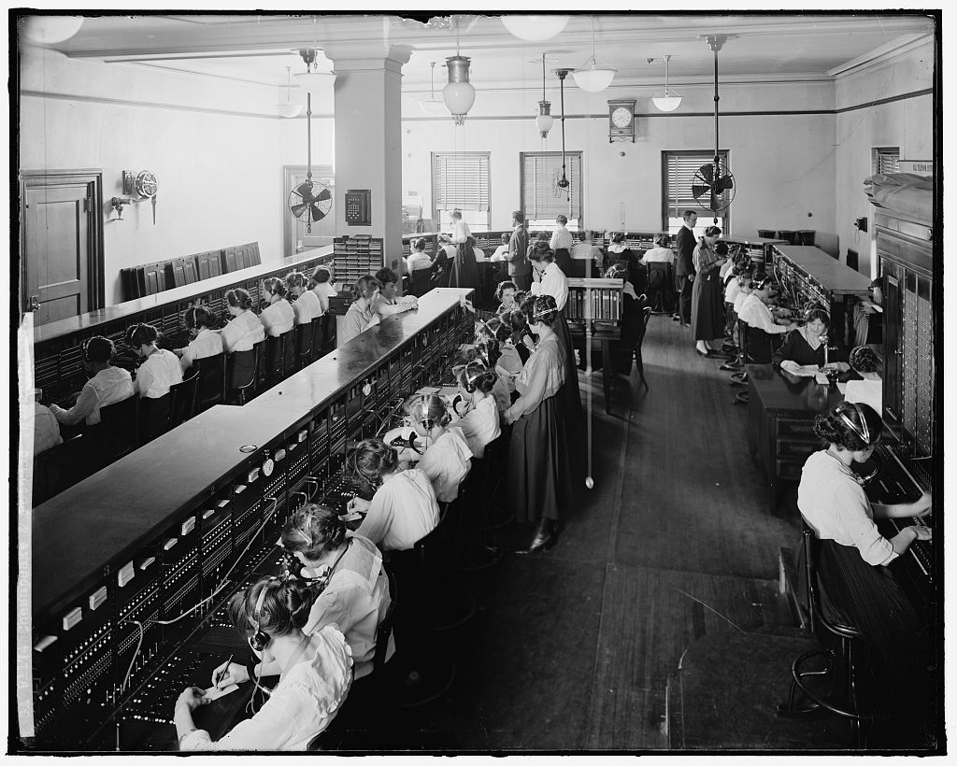
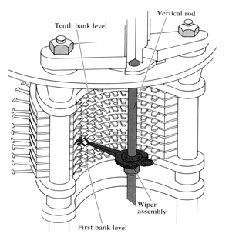

Circuit switching
[Harris & Ewing, 1905]
Principle
Connection exists physically for the duration of the conversation
Refers to
  Switching centers
  Connections between switching centers
  (frequency spectrum, dedicated ports)
Implementation examples
  Historically: on switching boards
  Mechanical positioning of the dialers

Slide 13
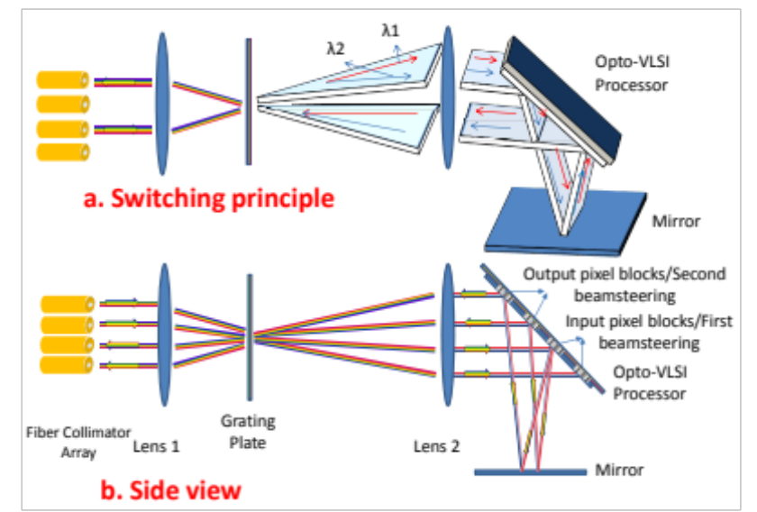
Circuit switching
Principle
Connection exists physically for the duration of the conversation
Refers to
  Switching centers
  Connections between switching centers
  (frequency spectrum, dedicated ports)
Implementation examples
  Historically: on switching boards
  Mechanical positioning of the dialers
  Today: optical networks (e.g. WDM)
  Setting coupling points in circuits
[from “Opto-VLSI-based N × M wavelength selective switch”, DOI 10.1364/OE.21.018160]

Slide 14
Circuit switching
Principle
Connection exists physically for the duration of the conversation
Refers to
  Switching centers
  Connections between switching centers
  (frequency spectrum, dedicated ports)
Implementation examples
  Historically: on switching boards
  Mechanical positioning of the dialers
  Today: optical networks (e.g. WDM)
  Setting coupling points in circuits
Properties
  Connection has to occur before transmission
  Establishing a connection takes time
  Resource allocation is rigid (possibly waste of resources)
  Once connection is established it cannot be blocked anymore

Slide 15
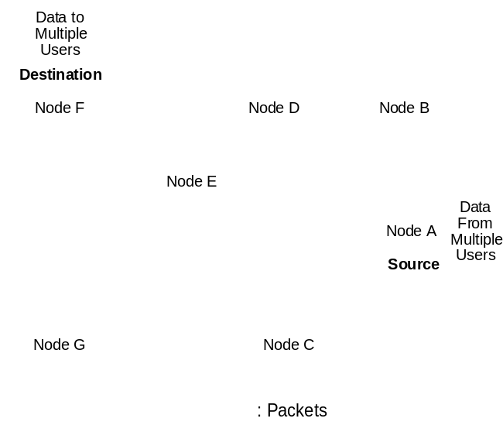
Packet Switching
Principle
Packets of limited size
Dynamic route search (no connect phase)
No dedicated path from source to destination
Example: Internet
Properties
  Possibly only reservation of average bandwidth (static reservation)
  Possibility of congestion
  High utilization of resources

Slide 16
Comparison: Circuit and Packet Switching
Circuit switching
  Connection establishment can take a long time
  Bandwidth is reserved
    No danger of congestion
    Possibly poor bandwidth utilization (burst traffic)
Packet switching
  No connect phase
  No allocation of bandwidth
    Danger of congestion
    Potentially 100% bandwidth utilization
  constant transmission time
  all data is transmitted over the same path
  varying transmission time
  packets between same end systems may use different paths

Slide 17
Virtual Circuit Switching
Principle
Setup path from source to destination for entire duration of call
  Using state information in nodes but no physical connection
  Connection setup: defines data path
  Messages: as in packet switching, but:
    No routing decision per packet
    Simpler addressing: associate with virtual circuit instead of destination
Properties
  Possible to ensure Quality of Service
  Possible to maintain order of packets
IPv6 Header
Version
DSCP
ECN
Flow label
Flow label for virtual circuit
identification:
shorter than destination address
received earlier than destination address
Payload length
Next header
Hop Limit
Source address
(128 bit)
Destination Address
(128 bit)
L4 Data

Slide 18
Comparison: Virtual Circuit and Packet Switching
Virtual circuit switching
  Connection establishment can take a long time
  Bandwidth can be reserved
    Provider can guarantee loss probability of package losses and probability of waiting times
    Better bandwidth utilization than circuit switching
Packet switching
  No connect phase
  No allocation of bandwidth
    Danger of congestion
    Potentially 100% bandwidth utilization
  varying transmission time
  all data is transmitted over the same path
  varying transmission time
  packets between same end systems may use different paths

Slide 19
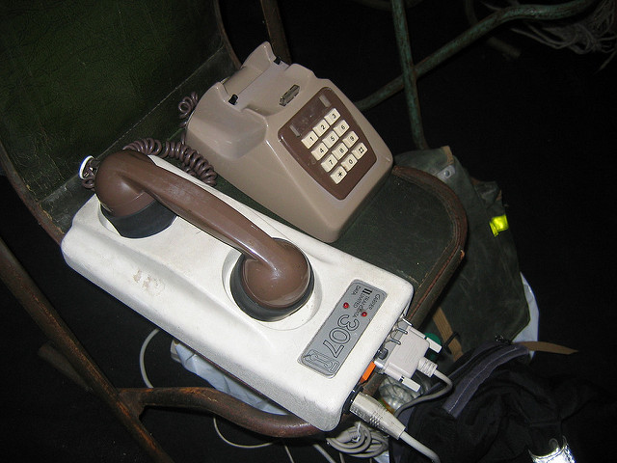
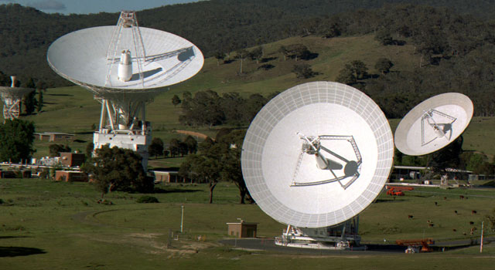
Message Switching
very rare at L3 today:
just for completeness
some applications on L5
operate like this
Principle
All data to be sent are treated as a "message"
“Store and forward" network:
in each node the message is handled as follows:
  Accepted (L2 frames are collected until L3 message
  is complete)
  Treatment of possible errors
  Stored
  Forwarded (divide into several L2 frames for
  sending to the next node)
Ancient history
  dial-up networks
  and its protocol UUCP – Unix to Unix Copy
Recent research
  delay-tolerant networks, e.g. NASA Deep Space Network
Properties
  High memory requirements at the node (switching centers)
    message size is unlimited
    usually stored on secondary repository (harddisk)
  Node may be used to its full capacity over a longer period of time by one message
[secretlondon123@flickr, CC BY SA 2.0]
[NASA/JPL-Caltech]

Slide 20
Switching
IN2140:
Introduction to Operating Systems and Data Communication
more on
Virtual Circuit Switching

Slide 21
Virtual Circuits
Connection set-up phase
  select a path
  assign a VC identifier (VC number)
  IS stores path information
  network reserves all resources required for the connection
Data transfer phase: all packets follow the selected path
  every packet contains VC number
    identification of connection, no address information
  IS uses stored path information to determine next node
  maybe update VC number in packet
Disconnect phase:
  IS releases reserved resources
  IS forgets the VC

Slide 22
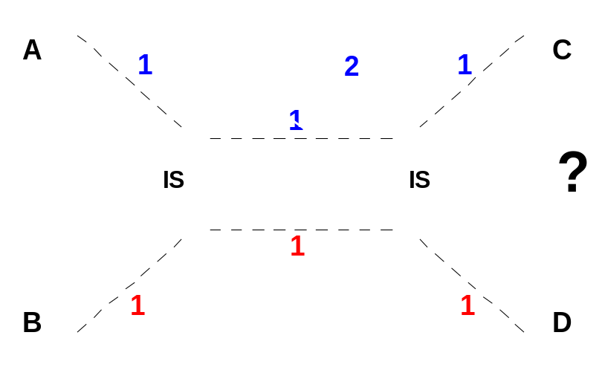
Implementation Virtual Circuit
ES allocates VC number independently (no negotiation)
Problem: the same VC identifiers may be allocated to different paths
Solution: allocate VC numbers for virtual circuit segments
  IS differentiates between incoming and outgoing VC-number
    IS receives incoming VC number in CONNECT message from previous node
    IS creates outgoing VC number
    (unique between IS and successor (IS))
    IS sends outgoing VC number in CONNECT message to next node

Slide 23
Implementation Virtual Circuit
IS
ES
H
H
B
C
H
A
D
H
B
A
0
C
0
C
E
F
H
0
C
1
H
H
H
1
A
0
B
0
D
0
A
A
1
F
0
B
1
D
1
H
2
F
1
E
0
H
0
IN
OUT
F
0
H
0
E
1
D
2
D
H
0
B
0
H
1
E
0
C
0
H
0
8 Simplex virtual circuits
B
0
E
1
C
1
H
1
H
2
B
1
F
0
H
2
Originating at A | Originating at B
H
3
E
2
F
1
H
3
H
4
E
3
C
2
F
0
E
F
A
0
F
0
E
0
D
0
0 - ABCD
0 - BCD
A
1
H
0
B
0
D
1
A
2
C
0
B
1
H
0
A
3
C
1
D
0
B
0
1 - AEFD
1 - BAE
2 - ABFD
2 - BF
3 - AEC
4 - AECDFB

Slide 24
Implementation Packet Switching
Packet passes through the network as an isolated unit
  has complete source and destination addresses
  individual route selection for each packet
  generally no resource reservation
  correct sequence not guaranteed

Slide 25
Packet Switching vs. Virtual Circuit
Packet Switching: IS routing table specifies possible path(s)
  No connection setup delay
  Less sensible to IS and link failures
  Route selection for each packet: quick reaction to failures
but
  Each packet contains the full destination and source address
  Route selection for each packet: overhead
  QoS guarantees hardly possible
Virtual Circuit: destination address defined by connection
  Packets contain short VC-number only
  Low overhead during transfer phase
  “Perfect" channel throughout the net
  Resource reservation: "Quality of Service" guarantees possible
but
  Overhead for connection setup
  Memory for VC tables and state information needed in every IS
  Sensible to IS and link failures
  Resource reservation: potentially poor utilization

