Slide 1
Operating Systems:
Introduction
IN2140:
Introduction to Operating Systems and Data Communication
Pål Halvorsen

Slide 2
Overview
Basic execution environment – an Intel example
(why do you need an operating system (OS), or need to know anything about it)
What is an OS?
OS components and services
(extended in later lectures)
Interrupts and system calls
Booting, protection, kernel organization

Slide 3
Hardware
Central Processing Units (CPUs)
Memory
(cache(s), RAM, ROM, Flash, …)
I/O Devices
(network cards, disks, CD, keyboard, mouse, …)
Links
(interconnects, busses, …)

Slide 4
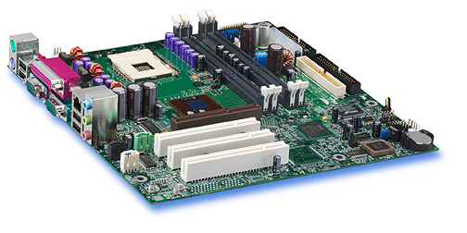
An easy, old example:
Intel Hub Architecture (850 Chipset)
Intel D850MD Motherboard:
Source: Intel® Desktop Board D850MD/D850MV Technical Product Specification

Slide 5
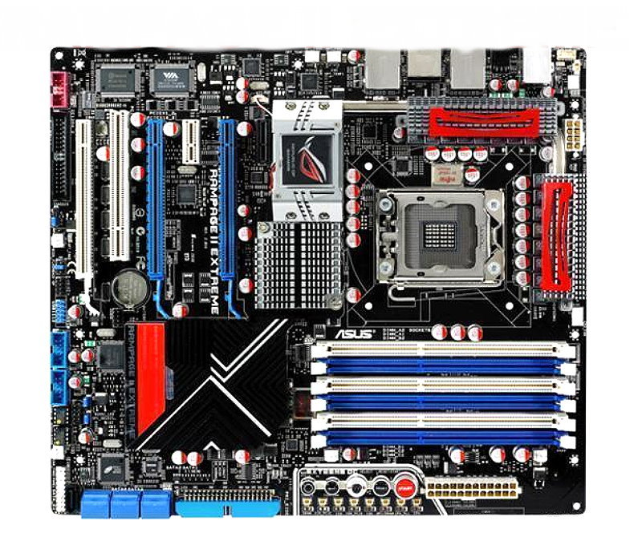
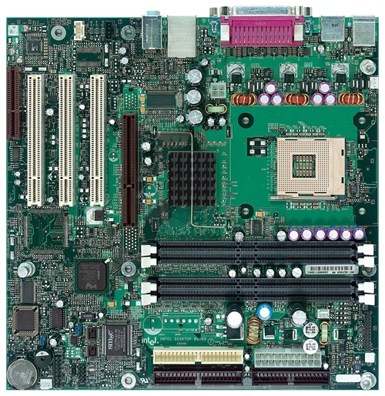
An easy, old example:
Intel Hub Architecture
i7 motherboard
Intel D850MD Motherboard:
Source: Intel® Desktop Board D850MD/D850MV Technical Product Specification
mouse, keyboard, parallel, serial, network and USB connectors
Video
PCI Connectors (slots)
Memory Controller Hub
AGP slot
system bus
Pentium 4 socket
hub
interface
RDRAM
interface
I/O Controller Hub
PCI
bus
RAMBUS RDRAM –
2 banks (4 slots)
Firmware Hub – including BIOS
Power connector
Speaker
Diskette connector
Battery
IDE drive connectors

Slide 6
An easy, old example:
Intel Hub Architecture
application
Pentium 4
Processor
file system
registers
cache(s)
disk
system bus
(64-bit, 400/533 MHz
→~24-32 Gbps)
RDRAM
memory
controller
hub
RAM interface
(two 64-bit, 200 MHz
→ ~24 Gbps)
RDRAM
RDRAM
RDRAM
hub interface
(four 8-bit, 66 MHz
→ 2 Gbps)
I/O
controller
hub
PCI slots
PCI bus
(32-bit, 33 MHz
→ 1 Gbps)
PCI slots
PCI slots
disk
Notes:
Talk about bottlenecks

Slide 7

A slightly newer example:
Intel Platform Controller Hub Architecture
Sandy Bridge, Core i7
Core i7
integrated
memory
controller
Pentium 4
Processor
cache(s)
registers
PCIe
registers
cache(s)
Direct Media Interface (DMI) /
QuickPath Interconnect (QPI)
RDRAM
memory
controller
hub
PCH
Platform
Controller
Hub
RDRAM
Peripherals
RDRAM
RDRAM
I/O
controller
hub
PCI slots
PCIe slots
PCI slots
PCIe slots
PCI slots
PCIe slots
Notes:
PCIe – ×1, ×4, ×8, ×16, ×32 , version1 = 2 Gb/s, v2 = 4Gb, v3 = 8Gb, v4 = 16Gb per lane, both directions
QPI = 12.8 GBytes/s each way (26.6) → 100 Gb/s each way
I9 very similar:
https://www.intel.com/content/dam/www/public/us/en/documents/datasheets/6th-gen-x-series-datasheet-vol-1.pdf

Slide 8
Example:
IBM POWER 4
application
POWER 4 chip
Note:
Again, data touching operations add movement operations
CPU
CPU
file system
communication
system
L1
L1
core interface switch
disk
network card
L2
fabric controller
(chip-chip fabric + multi-chip module)
(four 64-bit, 400 MHz → ~95 Gbps)
(eight 32-bit, 400 MHz → ~95 Gbps)
(four 64-bit, 400 MHz → ~95 Gbps)
L3
memory
controller
RAM
file system
GX
controller
L3 controller
RAM
communication system
RAM
application
GX bus
(two 32-bit, 600 MHz → ~35 Gbps)
PCI busses
(32/64-bit, 33/66 MHz → 1-4 Gbps)
PCI slots
network card
remote I/O
(RIO)
bridge
PCI
host bridge
PCI-PCI
bridge
PCI slots
disk
PCI
host bridge
PCI-PCI
bridge
RIO bus
(two 8-bit, 500 MHz → ~7 Gbps)
Notes:
Fabric controller:
Multichip modules can connect 4 ”POWER 4 chips” → ”4 chip, 2-way SMP”
Multichip modules can again be connected up to 4 times giving a maximum of 4x4 chip, 2way SMPs → 32-way SMP using the chip-chip fabric
Memory access penalty of up to 10% in the multi-multichipmodule configuration

Slide 9
Example:
IBM POWER 4
POWER 4 chip
POWER 4 chip
POWER 4 chip
CPU
CPU
CPU
CPU
CPU
CPU
L1
L1
L1
L1
L1
L1
core interface switch
core interface switch
L2
L2
core interface switch
fabric controller
fabric controller
L3
memory
controller
RAM
L3
memory
controller
RAM
L2
GX
controller
L3
controller
RAM
GX
controller
L3
controller
RAM
RAM
RAM
fabric controller
(chip-chip fabric + multi-chip module)
L3
memory
controller
RAM
GX
controller
L3 controller
POWER 4 chip
POWER 4 chip
RAM
CPU
CPU
CPU
CPU
L1
L1
L1
L1
RAM
core interface switch
core interface switch
L2
L2
fabric controller
fabric controller
GX
controller
L3
controller
L3
memory
controller
RAM
GX
controller
L3
controller
L3
memory
controller
RAM
RAM
RAM
RAM
RAM
Multichip modules in fabric controller can connect
4 chips into a 4 chip, 2-way SMP → 8-way MP
Notes:
SMP -- Symmetric multiprocessing
Fabric controller:
Multichip modules can connect 4 ”POWER 4 chips” → ”4 chip, 2-way SMP”
Multichip modules can again be connected up to 4 times giving a maximum of 4x4 chip, 2way SMPs → 32-way SMP using the chip-chip fabric
Memory access penalty of up to 10% in the multi-multichipmodule configuration
Power 4 is from 2001 --- Systems using POWER10 are expected to be available in 2020.

Slide 10
Example:
IBM POWER 4
POWER 4 chip
POWER 4 chip
POWER 4 chip
POWER 4 chip
POWER 4 chip
CPU
POWER 4 chip
CPU
CPU
CPU
CPU
L1
CPU
CPU
CPU
L1
L1
CPU
L1
L1
L1
L1
L1
core interface switch
CPU
core interface switch
CPU
CPU
core interface switch
L1
core interface switch
L2
L1
L2
L1
L1
L2
fabric controller
L2
fabric controller
fabric controller
fabric controller
core interface switch
core interface switch
GX
controller
L3
controller
L3
memory
controller
RAM
GX
controller
L3
controller
L3
memory
controller
RAM
GX
controller
L3
controller
L3
memory
controller
RAM
GX
controller
L3
controller
L3
memory
controller
RAM
RAM
RAM
RAM
RAM
L2
L2
RAM
RAM
RAM
RAM
fabric controller
fabric controller
GX
controller
L3
controller
L3
memory
controller
RAM
POWER 4 chip
GX
controller
L3
controller
L3
memory
controller
RAM
POWER 4 chip
POWER 4 chip
RAM
CPU
CPU
POWER 4 chip
RAM
CPU
CPU
CPU
CPU
L1
L1
CPU
CPU
L1
L1
L1
L1
RAM
core interface switch
L1
L1
RAM
core interface switch
core interface switch
L2
core interface switch
L2
L2
fabric controller
L2
fabric controller
fabric controller
fabric controller
GX
controller
L3
controller
L3
memory
controller
RAM
GX
controller
L3
controller
L3
memory
controller
RAM
GX
controller
L3
controller
L3
memory
controller
RAM
GX
controller
L3
controller
L3
memory
controller
RAM
RAM
RAM
RAM
RAM
RAM
RAM
RAM
RAM
POWER 4 chip
POWER 4 chip
POWER 4 chip
POWER 4 chip
POWER 4 chip
CPU
POWER 4 chip
CPU
CPU
CPU
CPU
L1
CPU
CPU
CPU
L1
L1
CPU
L1
L1
L1
L1
L1
core interface switch
CPU
core interface switch
CPU
CPU
core interface switch
L2
core interface switch
L2
L2
L1
L2
fabric controller
L1
fabric controller
L1
L1
fabric controller
fabric controller
core interface switch
core interface switch
GX
controller
L3
controller
L3
memory
controller
RAM
GX
controller
L3
controller
L3
memory
controller
RAM
GX
controller
L3
controller
L3
memory
controller
RAM
GX
controller
L3
controller
L3
memory
controller
RAM
RAM
RAM
RAM
RAM
L2
L2
RAM
RAM
RAM
RAM
fabric controller
fabric controller
L3
memory
controller
RAM
POWER 4 chip
L3
memory
controller
RAM
POWER 4 chip
GX
controller
L3
controller
GX
controller
L3
controller
POWER 4 chip
CPU
CPU
POWER 4 chip
CPU
CPU
CPU
CPU
L1
L1
CPU
CPU
RAM
L1
L1
L1
L1
RAM
core interface switch
L1
L1
RAM
core interface switch
core interface switch
RAM
L2
core interface switch
L2
L2
fabric controller
L2
fabric controller
fabric controller
fabric controller
GX
controller
L3
controller
L3
memory
controller
RAM
GX
controller
L3
controller
L3
memory
controller
RAM
GX
controller
L3
controller
L3
memory
controller
RAM
GX
controller
L3
controller
L3
memory
controller
RAM
RAM
RAM
RAM
RAM
RAM
RAM
RAM
RAM
Chip-chip fabric in fabric controller can connect 4 multi-chips into a
4x4 chip, 2-way SMP → 32-way MP
Notes:
Fabric controller:
Multichip modules can connect 4 ”POWER 4 chips” → ”4 chip, 2-way SMP”
Multichip modules can again be connected up to 4 times giving a maximum of 4x4 chip, 2way SMPs → 32-way SMP using the chip-chip fabric
Memory access penalty of up to 10% in the multi-multichipmodule configuration

Slide 11
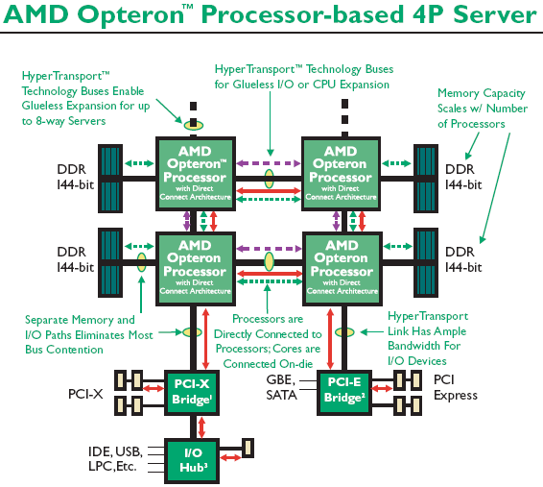
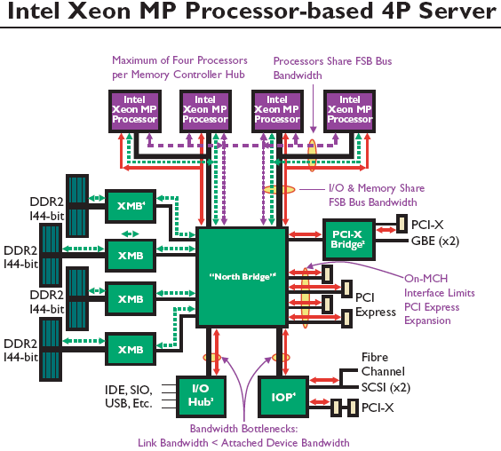
Other examples:
AMD Opteron & Intel Xeon
Intel Xeon MP Processor-based 4P
Different hardware may have different bottlenecks
==> nice to have an operating system to control the HW?

Slide 12
Different Hardware
Application program
Application program
Operating System
Application
Application
Operating System
Hardware X
Hardware Y

Slide 13

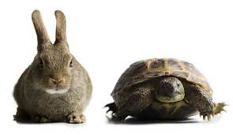
Intel 32-bit Architecture (IA32): Basic Execution Environment
16-bit vs. 32-bit vs. 64 bit vs. … ?
A big difference between 32-bit processors and
64-bit processors the size/width of the hardware. This affects the amount of data processed per second – the speed at which they can complete tasks. Otherwise, a lot of similarities…
… using 32-bit for easier explanations!
Notes:
General data registers
All of the four following registers may be used as general purpose registers. However each has some specialized purpose as well. Each of these registers also have 16-bit or 8-bit subset names.
EAX (At 000) Dedicated accumulator which is used for all major calculations.
ECX (At 001) The universal loop counter which has a special interpretation for loops.
EDX (At 010) The data register, which is an extension to the accumulator, stores data relevant to the operation applied to the accumulator.
EBX (At 011) Currently used for free storage but was originally used as a pointer in 16-bit mode
General address registers
Used only for address pointing. They have 16-bit subset names, but no 8-bit subsets.
ESP (At 100) Stack pointer. Is used to hold the top address of the stack.
EBP (At 101) Base pointer. Is used to hold the address of the current stack frame. It is also sometimes used as free storage.
ESI (At 110) Source index. Commonly used for string operations. It has a one-byte opcode for loading data from memory to the accumulator.
EDI (At 111) Destination index. Commonly used for string operations. Has a one-byte STOS instruction to write data out of the accumulator.
EIP Instruction pointer. Holds the current instruction address
STACK-FRAME BASE POINTER
The stack is typically divided into frames. Each stack frame can then contain local variables,
parameters to be passed to another procedure, and procedure linking information. The stackframe
base pointer (contained in the EBP register) identifies a fixed reference point within the
stack frame for the called procedure. To use the stack-frame base pointer, the called procedure
typically copies the contents of the ESP register into the EBP register prior to pushing any local
variables on the stack. The stack-frame base pointer then permits easy access to data structures
passed on the stack, to the return instruction pointer, and to local variables added to the stack by
the called procedure.

Slide 14
Intel 32-bit Architecture (IA32): Basic Execution Environment
Address space: 1 – 2³⁶ (64 GB),
each process may have a linear address space of 4 GB (2³²)
Basic program execution registers:
  8 general purpose registers (data: EAX, EBX, ECX, EDX, address: ESI, EDI, EBP, ESP)
  6 segment registers (CS, DS, SS, ES, FS and GS)
  1 flag register (EFLAGS)
  1 instruction pointer register (EIP)
Stack – a continuous array of memory locations
  Current stack is referenced by the SS register
  ESP register – stack pointer
  EBP register – stack frame base pointer (fixed reference)
  PUSH – stack grows, add item (ESP decrement)
  POP – remove item, stack shrinks (ESP increment)
Several other registers like Control, MMX/FPU (MM/R),
Memory Type Range Registers (MTRRs),
SSEx (XMM), AVX (YMM), performance monitoring, …
GPRs:
X
PUSH %eax
EAX:
EBX:
ECX:
EDX:
ESI:
EDI:
EBP:
ESP: see arrow
PUSH %ebx
Y
<do something>
POP %ebx
POP %eax
STACK:
...
0x0...
Y
X
ESP pointer:
0xfff...
Notes:
General data registers
All of the four following registers may be used as general purpose registers. However each has some specialized purpose as well. Each of these registers also have 16-bit or 8-bit subset names.
EAX (At 000) Dedicated accumulator which is used for all major calculations.
ECX (At 001) The universal loop counter which has a special interpretation for loops.
EDX (At 010) The data register, which is an extension to the accumulator, stores data relevant to the operation applied to the accumulator.
EBX (At 011) Currently used for free storage but was originally used as a pointer in 16-bit mode
General address registers
Used only for address pointing. They have 16-bit subset names, but no 8-bit subsets.
ESP (At 100) Stack pointer. Is used to hold the top address of the stack.
EBP (At 101) Base pointer. Is used to hold the address of the current stack frame. It is also sometimes used as free storage.
ESI (At 110) Source index. Commonly used for string operations. It has a one-byte opcode for loading data from memory to the accumulator.
EDI (At 111) Destination index. Commonly used for string operations. Has a one-byte STOS instruction to write data out of the accumulator.
EIP Instruction pointer. Holds the current instruction address
STACK-FRAME BASE POINTER
The stack is typically divided into frames. Each stack frame can then contain local variables,
parameters to be passed to another procedure, and procedure linking information. The stackframe
base pointer (contained in the EBP register) identifies a fixed reference point within the
stack frame for the called procedure. To use the stack-frame base pointer, the called procedure
typically copies the contents of the ESP register into the EBP register prior to pushing any local
variables on the stack. The stack-frame base pointer then permits easy access to data structures
passed on the stack, to the return instruction pointer, and to local variables added to the stack by
the called procedure.

Slide 15
Intel 32-bit Architecture (IA32): Basic Execution Environment
Hidden example with register updates – run yourself…
Example:
code segment:
…
…
8048314 <main>:
8048314: push %ebp
8048315: mov %esp,%ebp
8048317: sub $0x18,%esp
804831a: and $0xfffffff0,%esp
804831c: mov $0x0,%eax
8048322: sub %eax,%esp
8048324: movl $0x4,0xfffffffc(%ebp)
804832b: movl $0x2,0xfffffff8(%ebp)
8048332: movl $0x0,0xfffffff4(%ebp)
8048339: mov 0xfffffff8(%ebp),%eax
804833c: add 0xfffffffc(%ebp),%eax
804833f: mov %eax,0xfffffff4(%ebp)
8048342: leave
8048343: ret
main (void)
{
int a = 4, b = 2, c = 0;
c = a + b;
}
objdump -d
insert value 4 in variable a on stack:
0xfffffffc = -(0xffffffff – 0xfffffffc) = -0x4
a’s memory address = EBP - 4
stack:
0x0...
...
...
...
sub 24 (0x18) bytes
(add space for 24 bytes)
alignment – sub "X" (here 8) bytes
0
6
2
4
old EBP
EAX:
6
EBP:
0
Accumulator for operands and results data
2
???
0xfffffff0
Pointer to data on stack (base)
ESP:
EPI:
0xffffffd8
0xffffffd0
0xfffffff4
0xfffffff0
804832b
8048314
8048315
8048317
8048322
8048324
8048332
8048339
8048342
8048343
804831a
804831c
804833c
804833f
0xfff...
Stack pointer
…
Pointer to next instruction to be executed
Notes:
0xfffffff – notation used to better handle negative numbers… 2-compliment….

Slide 16
C Function Calls & Stack
int add (int a, int b)
{
return a + b;
}
main (void)
{
int c = 0;
c = add(4 , 2);
}
A calling function (main) does
  push the parameters into stack in reverse order
  push return address (current EIP value) onto stack
When called, a C function (add) does
  push frame pointer (EBP) into stack - saves frame pointer register and gives easy return if necessary
  let frame pointer point at the stack top, i.e., point at the saved stack pointer (EBP = ESP)
  shift stack pointer (ESP) upward (to lower addresses) to allocate space for local variables
When returning, a C function (add) does
  put return value in the return value register (EAX)
  copy frame pointer into stack pointer - stack top now contains the saved frame pointer
  pop stack into frame pointer (restore), leaving the return program pointer on top of the stack
  the RET instruction pops the stack top into the program counter register (EIP), causing the CPU to execute from the "return address" saved earlier
When returned to calling function, it (main) does
  copy the return value (EAX) into right place
  pop parameters – restore the stack

Slide 17
C Function Calls & Stack
int add (int a, int b)
{
return a + b;
}
main (void)
{
int c = 0;
c = add(4 , 2);
}
code segment:
Example:
…
...
8048314 <add>:
8048314: push %ebp
8048315: mov %esp,%ebp
8048317: mov 0xc(%ebp),%eax
804831a: add 0x8(%ebp),%eax
804831d: pop %ebp
804831e: ret
804831f <main>:
804831f: push %ebp
8048320: mov %esp,%ebp
8048322: sub $0x18,%esp
8048325: and $0xfffffff0,%esp
8048328: mov $0x0,%eax
804832d: sub %eax,%esp
804832f: movl $0x0,0xfffffffc(%ebp)
8048336: movl $0x2,0x4(%esp)
804833e: movl $0x4,(%esp)
8048345: call 8048314 <add>
804834a: mov %eax,0xfffffffc(%ebp)
804834d: leave
804834e: ret
804834f: nop
Wouldn't it be nice if this could be automatically managed!!??
→ operating system
objdump -d
Pop return instruction pointer
into the EIP register
Release parameters (ESP)
Resume caller execution
stack:
0x0...
...
...
“main” EBP
804834a
4
insert value 0 in variable a on stack:
0xfffffffc = -(0xffffffff – 0xfffffffc) = -0x4
c’s memory address = EBP - 4
2
Push EIP register
Loads the offset of the called
procedure in the EIP register
Begin execution
6
0
old EBP
??
2
6
EAX:
0
0xfff...
Notes:
0xfffff… notation used for more efficient handling of negative numbers – 2-compliment.

Slide 18
C Function Calls & Stack
extra copy
for handout
int add (int a, int b)
{
return a + b;
}
main (void)
{
int c = 0;
c = add(4 , 2);
}
code segment:
…
...
8048314 <add>:
8048314: push %ebp
8048315: mov %esp,%ebp
8048317: mov 0xc(%ebp),%eax
804831a: add 0x8(%ebp),%eax
804831d: pop %ebp
804831e: ret
804831f <main>:
804831f: push %ebp
8048320: mov %esp,%ebp
8048322: sub $0x18,%esp
8048325: and $0xfffffff0,%esp
8048328: mov $0x0,%eax
804832d: sub %eax,%esp
804832f: movl $0x0,0xfffffffc(%ebp)
8048336: movl $0x2,0x4(%esp)
804833e: movl $0x4,(%esp)
8048345: call 8048314 <add>
804834a: mov %eax,0xfffffffc(%ebp)
804834d: leave
804834e: ret
804834f: nop
Pop return instruction pointer
into the EIP register
Release parameters (ESP)
Resume caller execution
stack:
0x0...
“main” EBP
...
...
804834a
4
insert value 0 in variable a on stack:
0xfffffffc = -(0xffffffff – 0xfffffffc) = -0x4
c’s memory address = EBP - 4
2
Push EIP register
Loads the offset of the called
procedure in the EIP register
Begin execution
6
0
old EBP
0xfff...

Slide 19
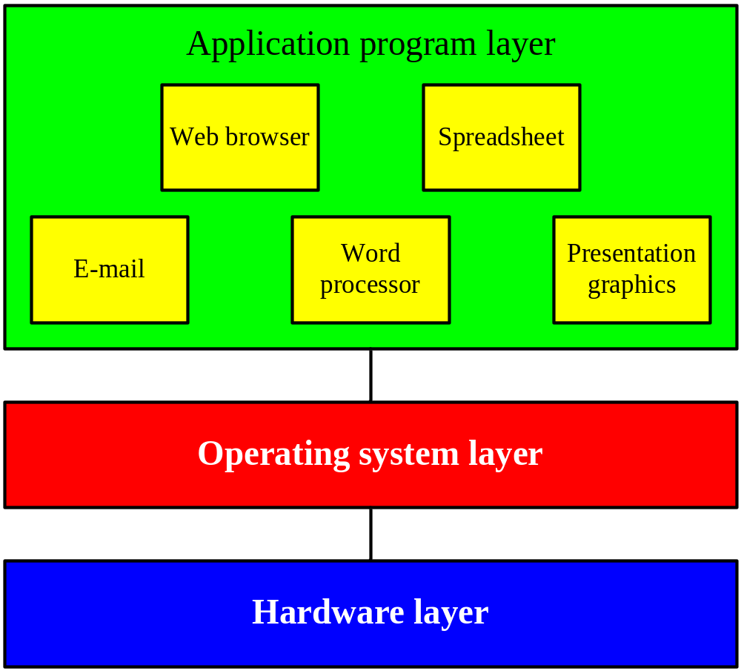



Many Concurrent Tasks
Better use & utilization
  many concurrent processes
    performing different tasks
    using different parts of the machine
  many concurrent users
Challenges
  “concurrent” access
  protection/security
  fairness
  …
Operating System Layer
Notes:
Bedre utnyttelse av maskinen ved at
Man kjører flere programmer samtidig
Skriver i en teksteditor samtidig som
mailsystemet sjekker om det er mail til deg, og
Klokken på skjermen oppdateres hvert sekund
...
Flere brukere på samme maskin
Flere kan være logget inn på ”mjollnir” samtidig
Hver av disse kan kjøre flere programmer
Flere prosesser på samme maskin
En som trenger mye diskIO (Web-server), og
en som trenger mye CPU-kapasitet (f.eks. vitenskapelige beregninger)
De forskjellige former for samtidighet gir tilleggsproblemer
Hvordan kjøre flere programmer ”samtidig” på en CPU?
Hvordan sørge for at de forskjellige programmene ikke går i bena på hverandre (overskriver hverandres data f.eks.)
Hvordan kontrollere de forskjellige programmenes tilgang til skjerm, disk, skriver, nettverk?

Slide 20
Many Concurrent Tasks
extra copy
for handout
Better use & utilization
  many concurrent processes
    performing different tasks
    using different parts of the machine
  many concurrent users
Challenges
  “concurrent” access
  protection/security
  fairness
  …
Operating System Layer

Slide 21
What is an Operating System (OS)?
“An operating system (OS) is a collection of programs that acts as an intermediary between the hardware and its user(s), providing a high-level interface to low level hardware resources, such as the CPU, memory, and
I/O devices. The operating system provides various facilities and services that make the use of the hardware convenient, efficient and safe”
Lazowska, E. D.: Contemporary Issues in Operating Systems , in: Encyclopedia of Computer Science, Ralston, A., Reilly, E. D. (Editors), IEEE Press, 1993, pp.980
It is an extended machine (top-down view)
  Hides the messy details
  Presents a virtual machine, easier to use
It is a resource manager (bottom-up view)
  Each program gets time/space on the resource
user
application
operating system
hardware

Slide 22



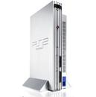


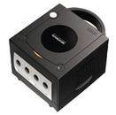

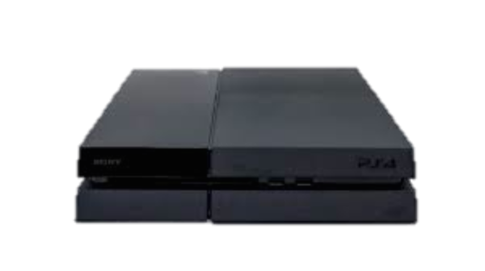


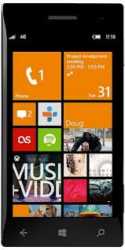
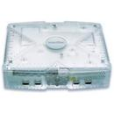

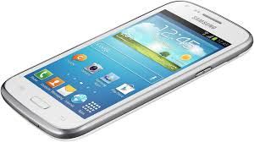


Where do we find OSes?
Phones
Game Boxes
Computers
Cars
cameras,
other vehicles/crafts,
set-top boxes,
watches,
sensors,
… → EVERYWHERE

Slide 23
Operating System Categories
Single-user, single-task:
historic, and rare (only a few old PDAs use this)
Single-user, multi-tasking:
PCs and workstations may be configured like this (typically, phones today)
Multi-user, multi-tasking:
used on large, old mainframes; and handhelds, PCs, workstations and servers today
Distributed OSes:
support for administration of distributed resources
Real-time OSes:
support for systems with real-time requirements like cars, nuclear reactors, etc.
Embedded OSes:
built into a device to control a specific type of equipment like cellular phones,
microwaves, washing machines, etc.

Slide 24
History
OSes have evolved over the last 60 years
Early history (’40s and early ’50s):
  first machines did not include OSes
  programmed using mechanical switches or wires
Second generation (’50s and ’60s):
  transistors introduced in mid-’50s
  batch systems
  card readers

Slide 25
History
Third generation (mid-’60s to the ’80s)
  integrated circuits and simple multiprogramming
  timesharing
  graphical user interface
  UNIX (’69-’70)
  BSD (’77)
Newer times (’80s to present)
  personal computers & workstations
  MS-DOS (’82), SunOS (’82), Mac System Software (’84), Win (’85), Minix (’87), OS/2 (’87)
  Linux (’91), Solaris (’92), WinNT (’93), Win95, MacOS (’96), MacOS 9 (’99)
  Linux 2.4 (’01), Mac OS X (’01), Linux 2.6 (’03), WinVista (’06), Win7 (’09)
  Linux 3.0 (’11), Win8 (’12), , MacOS X Yosemite (’14), Win10 (’15) ,
  Linux 4.0 (’15), MacOS X El Capitan (’15)
  ….

Slide 26
So, why study OSes?
“I will never write an operating system from scratch,
nor even touch a line of code in the kernel”
“Operating systems have existed for decades, what more can be added?”
“I just need to know the API to give the system commands in order to store my data and run my programs”
“Writing programs in Java or Python is very easy, and I do not need to know anything about operating systems to make it work”
Consider the following example, does it matter which one to use?:
int data[15000][15000];
for (j = 0; j < 15000; j++)
for (i = 0; i < 15000; i++)
data[i][j] = i*j;
int data[15000][15000];
for (j = 0; j < 15000; j++)
for (i = 0; i < 15000; i++)
data[j][i] = i*j;
 | on my mac: datasize
3.9s | 15.000 | 1.2s
12.2s | 25.000 | 3.5s
22.1s | 30.000 | 4.7s
49.3s | 40.000 | 10.1s
Notes:
Example:
same result – YES
same number of loops – YES
same speed – NO, memory operations
Yes the program will segfault if the array is larger than the max array size in C…
Data [i] [j] – i velger rad, j velger kollonne.

Slide 27

So, why study OSes?
Failing to meet the Technical Challenges…
… results in low quality pictures, video artifacts, hiccups, etc.
… giving annoyed users!

Slide 28

So, why study OSes?
Failing to meet the Technical Challenges…
… influence the game experience
… giving annoyed users – latency can kill!

Slide 29

So, why study OSes?
Failing to meet the Technical Challenges…
… influence the your everyday life
– latency can literally kill!

Slide 30
So, why study OSes?
To do things right and efficient, one must know how computers and operating systems work (and networks and …)
  operating systems provide magic to provide “infinite” CPU cycles, “endless” memory, transparent access to devices, networked computing, etc.
  operating systems manage concurrency and sharing
  understand the tradeoffs between performance and functionality,
  division of labor between HW and SW
OSes are found everywhere and
are therefore key components in many systems

Slide 31
Primary Components
"Visible" to user
  Shell
  File system
  Device management
"(Semi)Transparent"
  Processor management
  Memory management
  Communication services
Application program layer
Operating system layer
User interface
File
Device
(shell)
management
management
Processor
Memory
Communication
(or process)
management
services
management
Hardware layer
Notes:
Visible / transparent depend on the level…

Slide 32
Primary Components
File Management (file system):
provides a mechanism for the user to
create, delete, modify and manipulate files
Application program layer
User Interface:
provides a mechanism for user and
application to communicate with OS
and use the machine resources
Operating system layer
Device Management:
provides the system with means to
control the systems peripheral devices
like keyboard, display, printer and disk
User interface
File
Device
(shell)
management
management
Processor
Management of processes:
provides a mechanism for the system
to efficiently and fair manage the
machine CPU cycles for the running
processes
Memory
Communication:
provides a mechanism for the system
communicate with other processes (on
same or another machine)
(or process)
Communication
management
management
services
Hardware layer
Memory Management:
provides a mechanism for the system
to efficiently manage the system’s
memory recourses – allocating space
to processes

Slide 33
Device Management
The OS must be able to control pheripal devices such as disks, keyboard, network cards, screen, speakers, mouse, memory sticks, camera,
DVD/Blu-Ray, michrophone, printers, joysticks, ...
  large diversity
  varying speeds
  different access modes
Device
Device
controller
Device
driver
Rest of the
operating
system
Device
Device
controller
Device
driver
.
.
.
.
.
.
Device
Device
controller
Device
driver
Device

Slide 34
Device Management
Device controllers often have
registers to hold status, give commands, …
  port I/O – special instructions to talk to device memory
  memory mapped I/O – registers mapped into regular memory
Each device may be different and require device-spesific software
The software talking to the controller and giving commands is called a device driver
  usually running within the kernel
  usually provided by the device vendors
  translating device-independent commands, e.g.,
  read from file on disk: logical block number → device interface (device, cylinder, head, sector)
A huge amount of code (50-95% of the OS code!!??)
Device
Device
controller
Device
driver
Rest of the
operating
system
Device
Device
controller
Device
driver
.
.
.
.
.
.
Device
Device
controller
Device
driver
Device
Notes:
https://hostingtribunal.com/blog/linux-statistics/#content-9
The latest release of Linux kernel is version 5.1.4, launched on May 12, 2019.
Linux 5.1 contained 17.8 million LOC.
Back in 2012 it had over 5 million lines just for drivers.
IN 2014, Linux 3.13 had about 12 million → 7 million LOC in drivers
https://www.linuxcounter.net/statistics/kernel:
2003 - Linux 2.6.0 had 4.700.000lines of code
2015 – Linux 4 has 15.500.000 lines of code

Slide 35
Device Management
extra copy
for handout
Device controllers often have
registers to hold status, give commands, …
  port I/O – special instructions to talk to device memory
  memory mapped I/O – registers mapped into regular memory
Each device may be different and require device-spesific software
The software talking to the controller and giving commands is often called a device driver
  usually running within the kernel
  usually provided by the device vendors
  translating device-independent commands, e.g.,
  read from file on disk: logical block number → device, cylinder, head, sector(s)
A huge amount of code (50-95% of the OS code!!??)

Slide 36
Interfaces
A point of connection between components
The OS incorporates logic that support interfaces with both hardware and applications, e.g.,
  command line interface, e.g., a shell
  graphical user interface (GUI)
    interface consisting of windows, icons, menus and pointers
    often not part of the OS (at least not kernel), but an own program
  …
Example: X (see man X)
  network transparent window system running on most ANSI C and POSIX (portable OS interface for UNIX) compliant systems
  uses inter-process communication to get input from and send output to various client programs
  xdm (X Display Manager) – usually set by administrator to run automatically at boot time
  xinit – manually starting X (startx, x11, xstart, …)

Slide 37
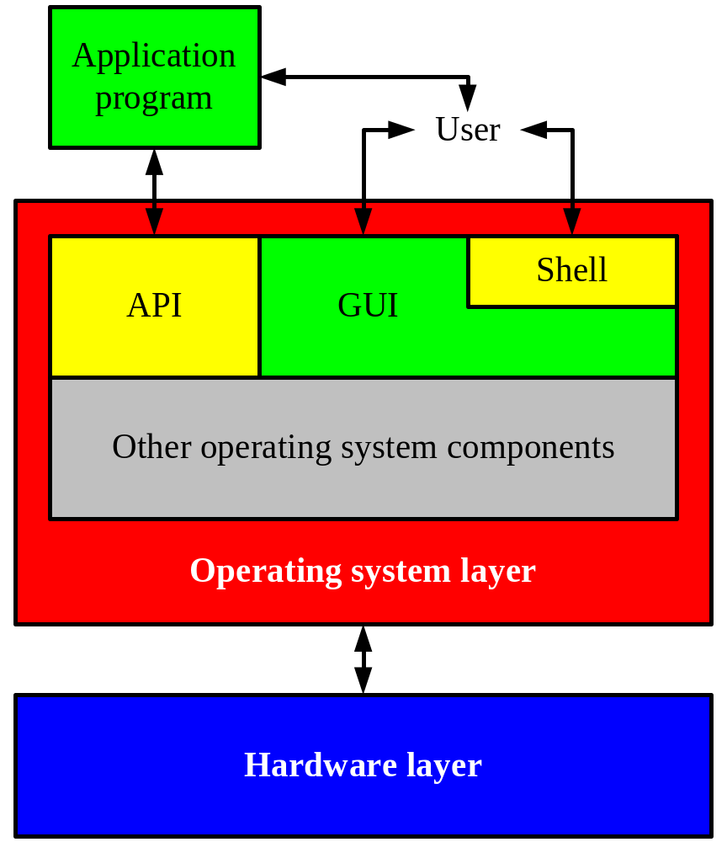
Windows Interfaces
The GUI incorporates a
command line shell similar
to the MS-DOS interface
Applications access HW
through the API consisting of
a set of routines, protocols and
other tools

Slide 38
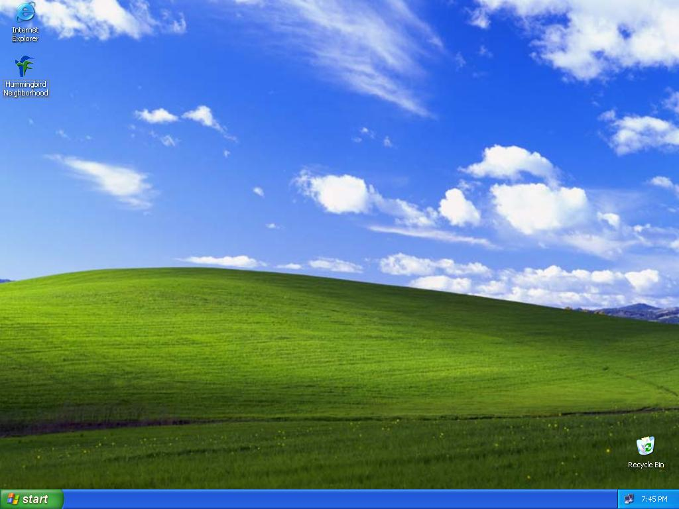
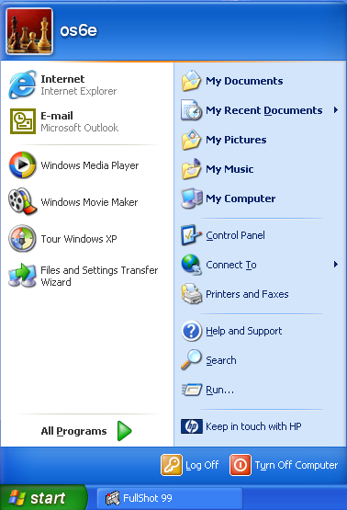
The WinXP Desktop Interface
Start button
Taskbar
Notification area

Slide 39
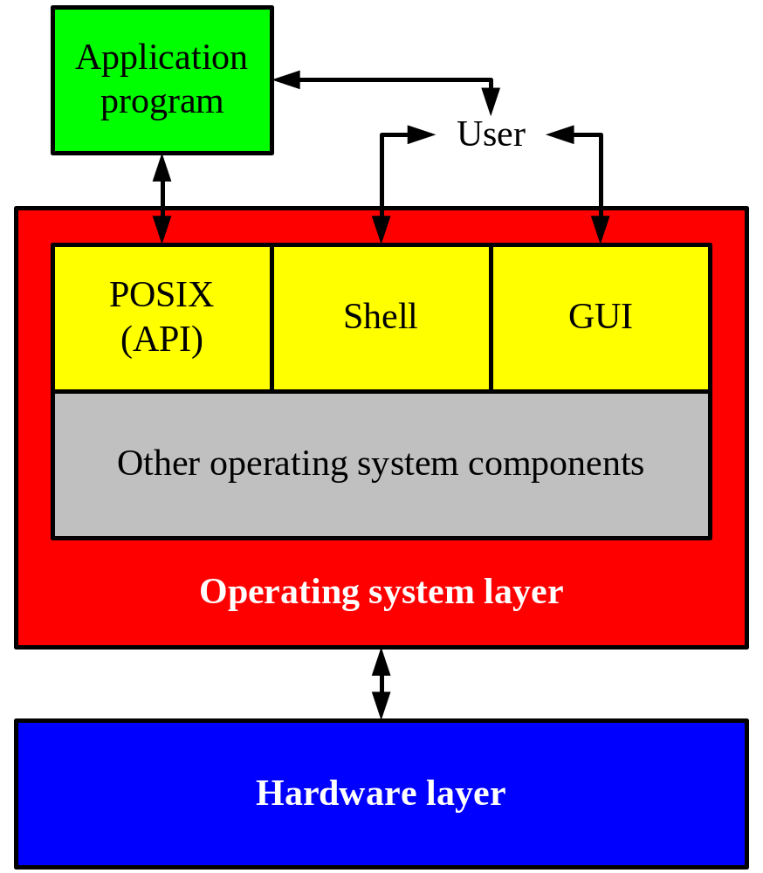
UNIX Interfaces
Applications access HW through
an API consisting of a set of routines,
protocols and other tools
(e.g., POSIX – portable OS interface for UNIX)
A user can interact with the system
through the application interface or
using a command line prosessed by
a shell (not really a part of the OS)
A plain command line interface may
be hard to use. Many UNIX systems
therefore have a standard graphical
interface (X Windows) which can run
a desktop system
(like KDE, Gnome, Fvwm, Afterstep, …)
Windows is more or less similar…

Slide 40
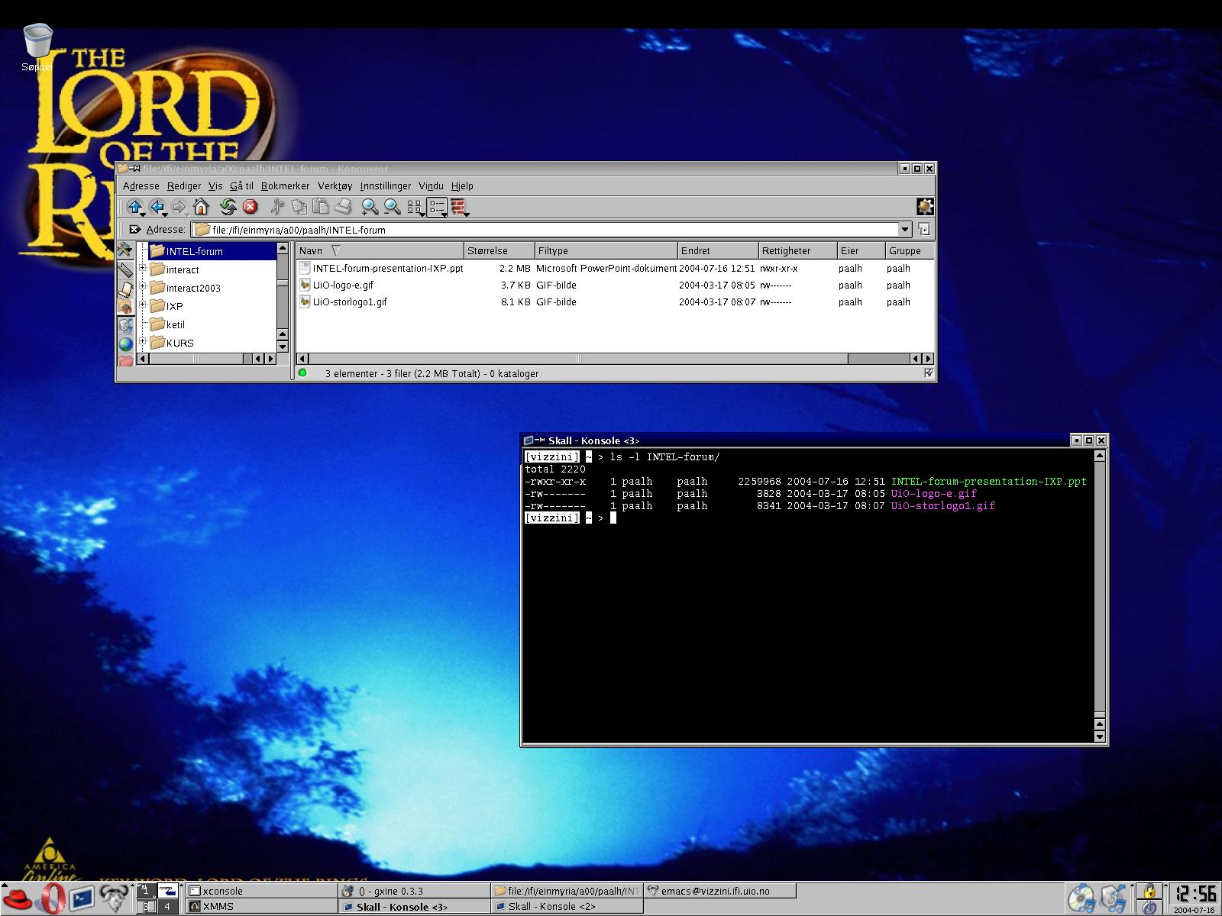
A Linux (KDE) Desktop Interface
Desktop
Application Starter
Virtual Desktops
Panel
Taskbar

Slide 41
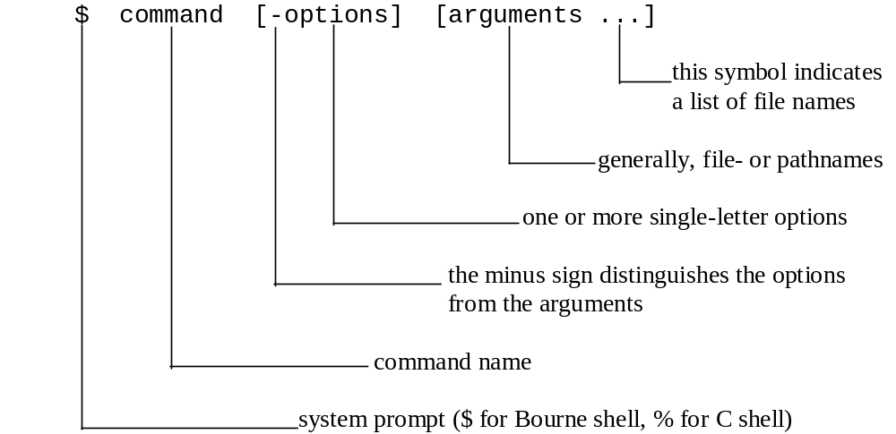
Typical (UNIX) Line Commands

Slide 42
System Calls
The interface between the OS and users is defined by a set of system calls
Making a system call is similar to a procedure/function call, but system calls enter the kernel:
Linux:
x86 v2.4.19 entry.S → 242
x86 v3.0-rc4 syscall_table_32.S → 347
x86 v3.16.2 syscall_32.tbl → 353
FreeBSD:
v9 syscalls.c → 531
application
application
application
user space
kernel space
system call interface
OS components
Notes:
According to Wikipedia:
Windows 7 has close to 700
NetBsd 500-
OpenBSD 300+

Slide 43

System Calls: read
C example:
count = read(fd,buffer,nbyte)
push parameters on stack
call library code
put system call number in register
call kernel (TRAP)
  kernel examines system call number
  finds requested system call handler
  execute requested operation
return to library and clean up
  increase instruction pointer
  remove parameters from stack
resume process
read library
procedure
register
X (read)
count = read (fd , buffer , nbytes)
application
memory (stack)
buffer
nbytes
buffer
user space
kernel space
fd
system call
handler
X
sys_read()

Slide 44
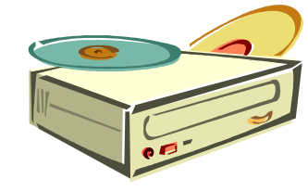








Interrupt Program Execution
CPU
We may use “polling”…!?

Slide 45
Interrupts
Interrupts are electronic signals that (usually) result in a forced transfer of control to an interrupt handling routine
  alternative to polling
  caused by asynchronous events like finished disk operations, incoming network packets, expired timers, …
  an interrupt descriptor table (IDT) associates each interrupt with a code descriptor (pointer to code segment)
  can be disabled or masked out

Slide 46
Exceptions
Another way for the processor to interrupt program
execution is exceptions
  caused by synchronous events generated when the processor detects a predefined condition while executing an instruction
  TRAPS: the processor reaches a condition the exception handler can handle (e.g., overflow, break point in code like making a system call, …)
  FAULTS: the processor reaches a fault the exception handler can correct (e.g., division by zero, wrong data format, …)
  ABORTS: terminate the process due to an unrecoverable error
  (e.g., hardware failure) which the process itself cannot correct
  the processor responds to exceptions (i.e., traps and faults) essentially as for interrupts

Slide 47





Interrupt (and Exception) Handling
The IA-32 has an interrupt description table (IDT) with 256 entries for interrupts and exceptions
  32 (0 - 31) predefined and reserved
  224 (32 - 255) is "user" (operating system) defined
Similar to system calls, each interrupt is associated with a code segment through the IDT and a unique index value giving management like this:
  process running while interrupt occur
  capture state, switch control
  and find the right interrupt handler
  execute the interrupt handler
  restore interrupted process
  continue execution
user
kernel
interrupt (x=DISK)
IDT:
Interrupt routines:

Slide 48
Booting
Memory is a volatile, limited resource: OS usually on disk
Most motherboards contain a basic input/output system (BIOS) chip (often flash RAM) – stores instructions for basic HW initialization and management, and initiates the …
... bootstrap: loads the OS into memory
  read the boot program from a known location on secondary storage typically first sector(s), often called master boot record (MBR)
  run boot program
    read root file system and locate file with OS kernel
    load kernel into memory
    run kernel
Notes:
BIOS is a non-volatile firmware used to perform hardware initialization during the booting process (power-on startup), and to provide runtime services for operating systems and programs. The BIOS firmware comes pre-installed on the system board, and it is the first software to run when powered on.

Slide 49
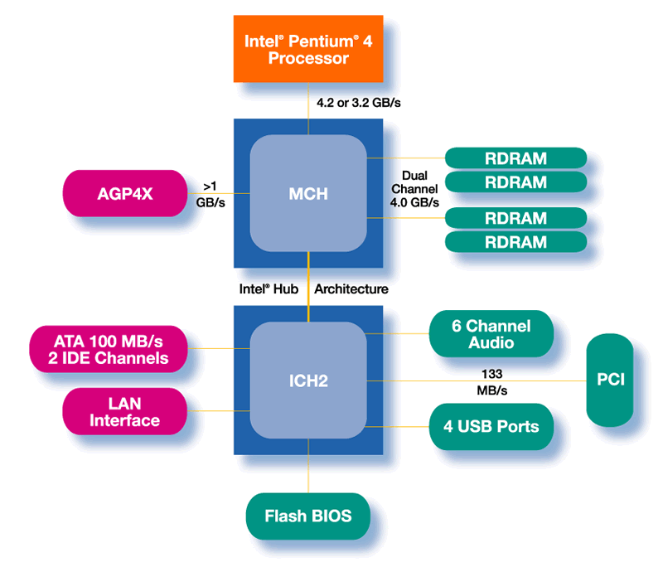

Booting
Gather HW information and set up system
Load data from boot sector
Execute boot program an CPU
Load OS from disk
Run OS
boot
OS
boot
OS

Slide 50
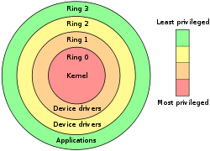
User Level vs. Kernel Level (Protection)
Many OSes distinguish user and kernel level,
i.e., due to security and protection
Usually, applications and many sub-systems
run in user mode (level 3)
  protected mode
  not allowed to access HW or device drivers
  directly, only through an API
  access to assigned memory only
  limited instruction set
OSes run in kernel mode
(under the virtual machine abstraction, level 0)
  real mode
  access to the entire memory
  all instructions can be executed
  bypass security

Slide 51
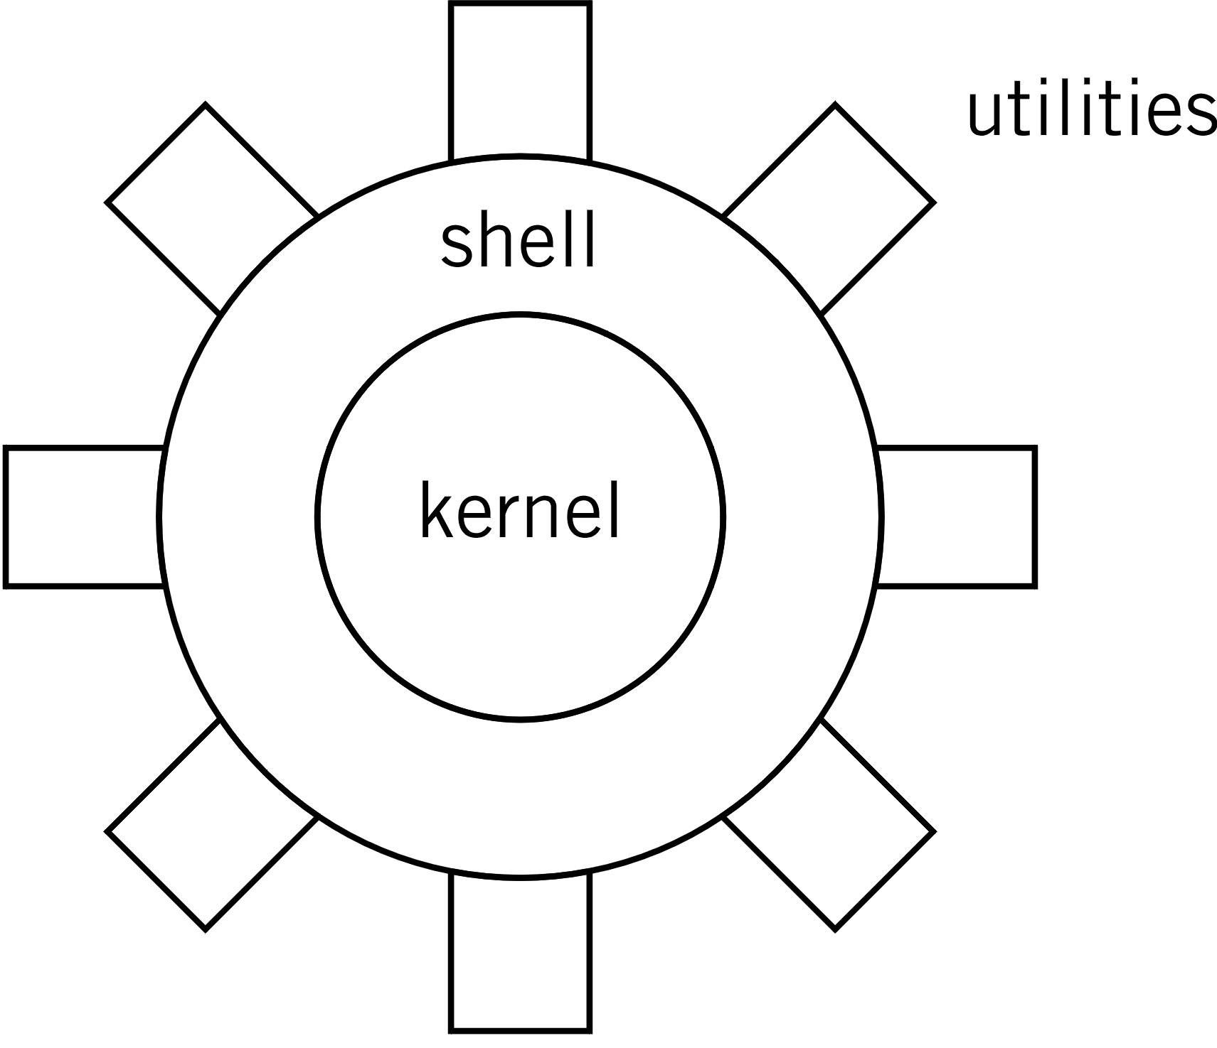
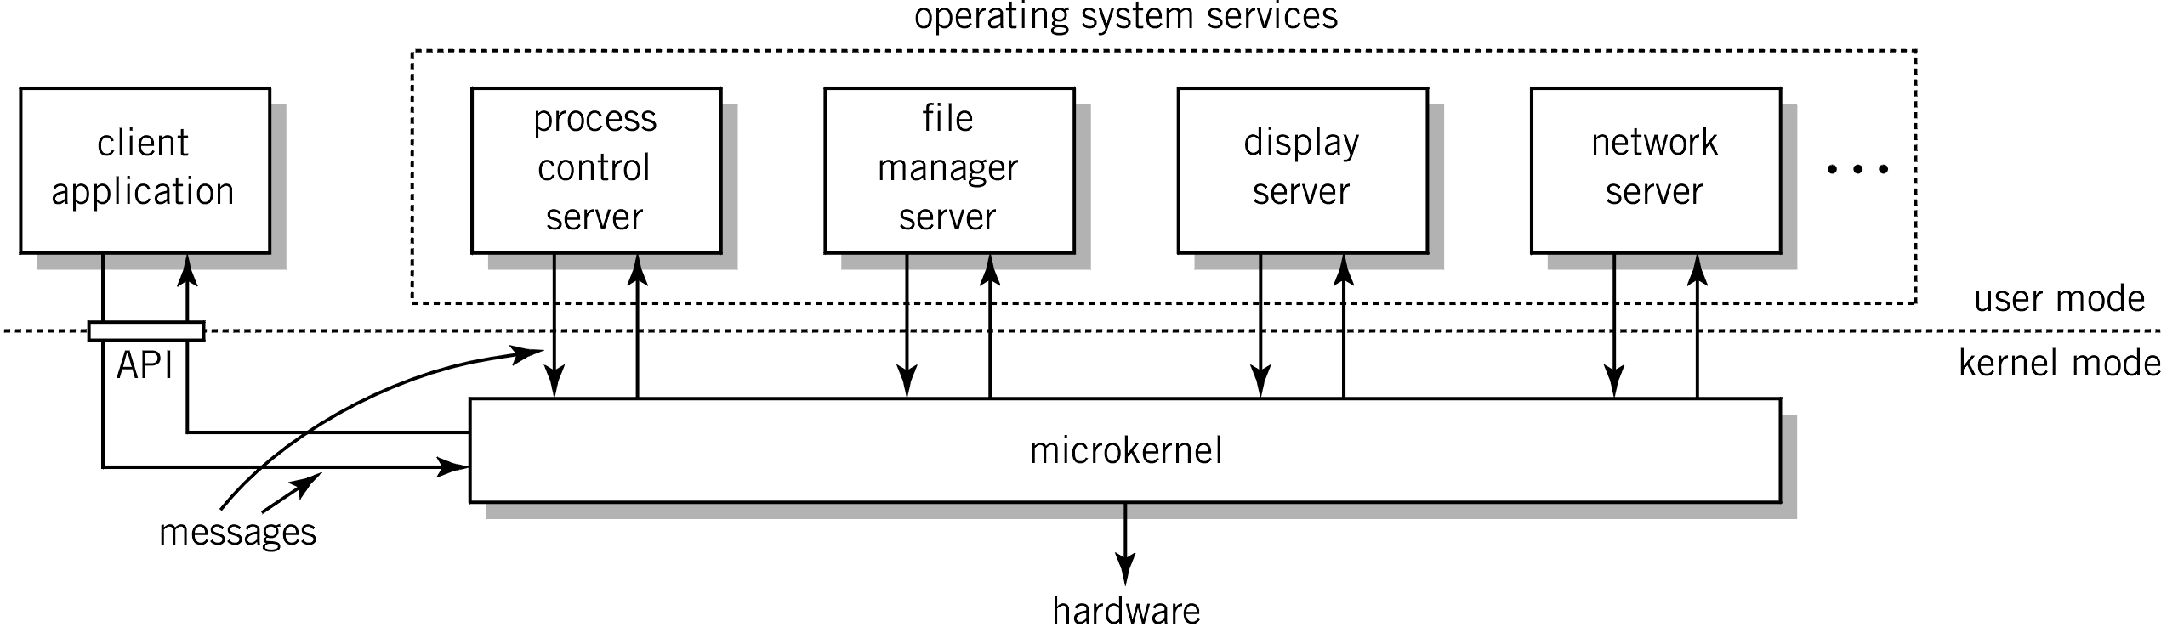
OS Organization
No standard describing how to organize a kernel (as it is for compilers, communication protocols, etc.) and several approaches exist, e.g.:
Monolithic kernels (“the big mess”):
  written as a collection of functions linked into a single object
  usually efficient (no boundaries to cross)
  large, complex, easy to crash
  UNIX, Linux, Windows 7 (++), …
Micro kernels
  kernel with minimal functionality (managing interrupts, memory, processor)
  other services are implemented in server processes running in user space
  used in a client-server model
  lot of message passing
  (inefficient)
  small, modular,
  extensible, portable, …
  MACH, L4, Chorus,
  Windows NT, …

Slide 52
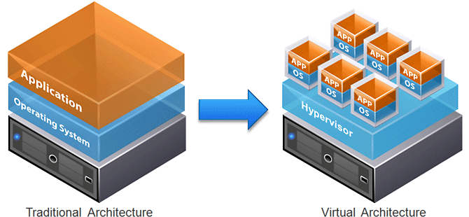
Virtualization
People would like to save money, save energy,
reduce the number of machines, be secure, easily
move services, etc.… and still run multiple OSes, applications, etc…
Virtualization
  many types of virtualization – server/machine virtualization
  partitioning a physical server into several virtual servers, or machines
  interact independently/isolated with other devices, applications, data and users
Sandboxing scfss
App
App
App
App
App
Guest OS
Guest OS
Guest OS
Guest OS
Guest OS
App
App
App
App
App
App
Hypervisor
App
Hypervisor
Host OS
Sandboxing
Host OS
Hardware
Hardware
Hardware
Type 1 Hypervisor
VMWare ESX, XEN, Hyper-V
Type 2 Hypervisor
KVM, VirtualBox, VMWare Workstation
Sandboxing
sandboxie, bufferzone, libcontainer, runc, cgroups
Notes:
Type 1 hypervisor interacts directly with hardware, independent from OS, boots before the OS, full control of HW – often called “native” or “bare-metal” hypervisors
Type 2 sits on top of OS, dependent on OS, boots after OS, if OS crash – all users are affected, not full control of HW
a sandbox is a security mechanism for separating running programs - executing the software in a restricted operating system environment, thus controlling the resources
These concepts address different problems: When we virtualize, we are hiding physical limitations of the machine. Sandboxing, on the other hand, set s artificial limits on access across a machine. Sandboxing means isolation only, when virtualization usually means simulating of some sort of hardware (virtual machine). Virtualization can happen with or without sandboxing.

Slide 53
System Structures
Monolithic kernel | Micro kernels | Virtual Machines
Performance Easy to share resources | Flexible, modular Failure isolation | Flexibility Many virtual computers - consolidation Isolation
Unstructured – big mess One failure kills it all (everything is in real (privileged) mode) | Performance ? – multiple boundary crossings (but claim switching and IPC just cost some 10s-100s cycles) | Performance ? - multiple boundary crossings Complexity ?
Notes:
Monolithic:
(external) faulty drivers can crash the system (>75% of a modern OS are drivers).
Flexibility: Low - but flexible with loadable kernel modules

Slide 54

Summary
OSes are found “everywhere” and provide
virtual machines and work as a resource managers
Many components provide different services
Users access the services using an interface like system calls
In the next lectures, we look closer at some of the main components and abstractions in an OS
  processes management
  memory management
  storage management
  local inter-process communication
  inter-computer network communication is covered in the
  last part of the course

