Slide 1
Transport layer
IN2140:
Introduction to Operating Systems and Data Communication
Introduction to
Congestion Control

Slide 2
Congestion
Traffic
  All traffic from all sources
Persistent congestion
  Router stays congested for a long time
  Excessive traffic offered
Transient congestion
  Congestion occurs for a while
  Router is temporarily overloaded
  Often due to burstiness
Notes:
DRAW A TOKEN BUCKET!!!

Slide 3
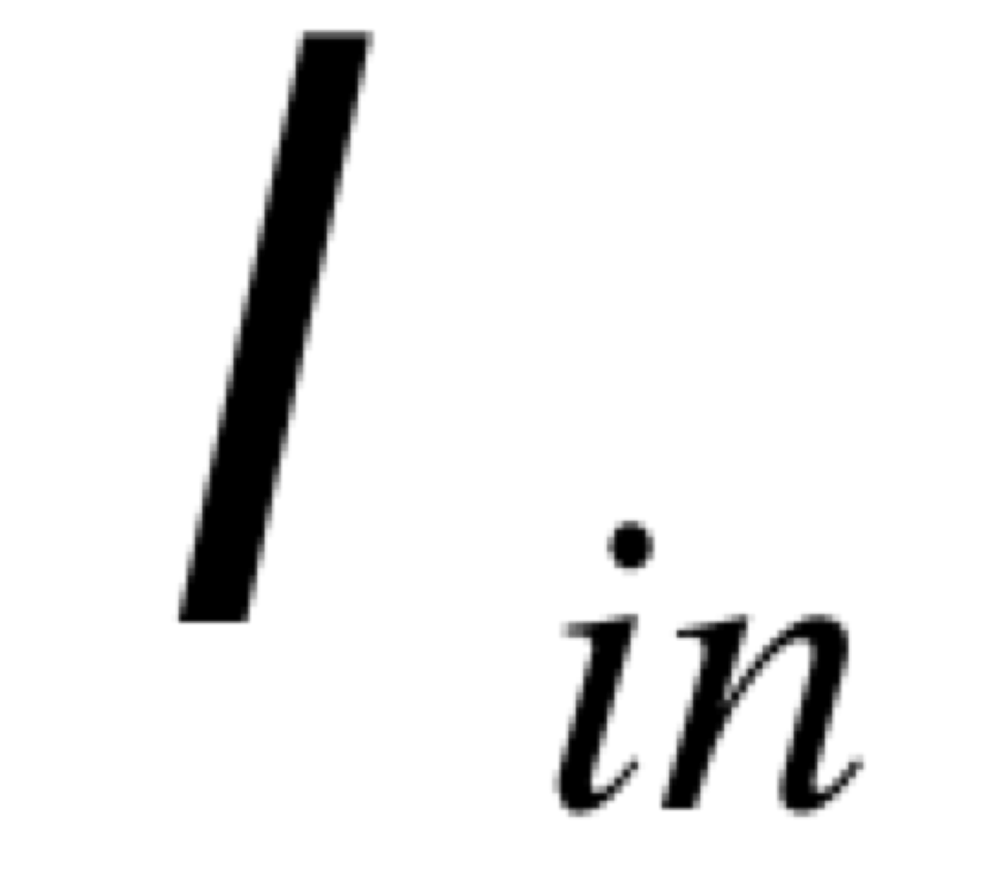
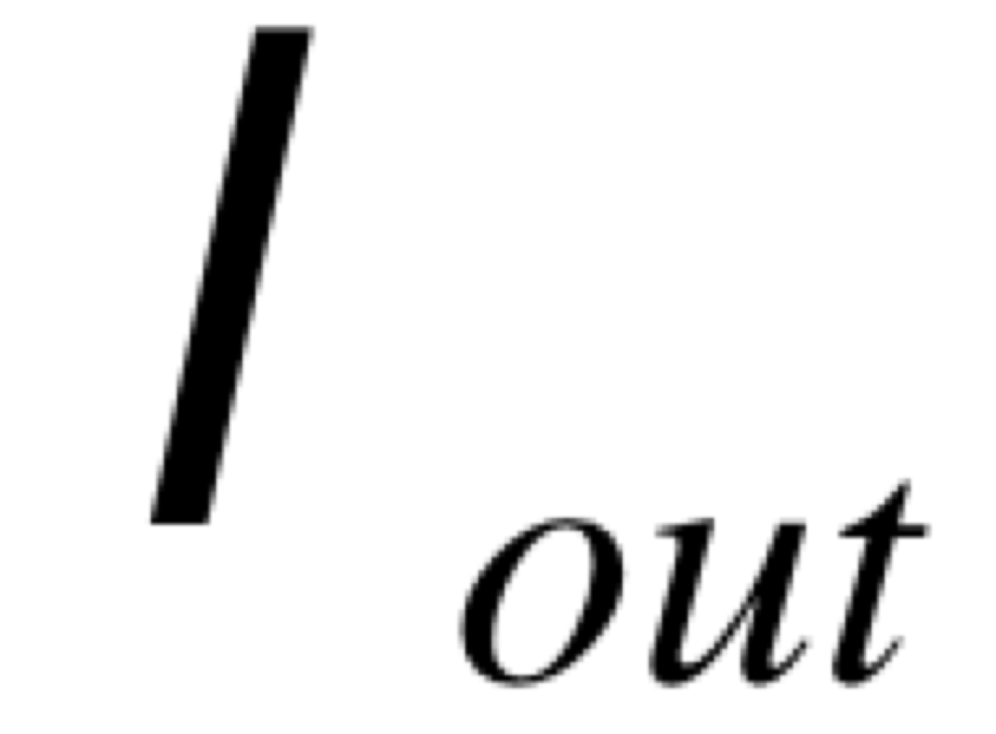

Reasons for congestion
Two senders, two receivers
One router, infinite buffers
No retransmissions
C
C/2
Router with infinite buffers
packets/second
receveived by I_{iout}
packets/second sent from I_{in}
C/2
Maximum utilization of the networks
Very long delays in case of congestion
$$∞$$
long term
avg delay
Average delay becomes ∞
because queue keeps growing forever
packets/second sent from I_{in}

Slide 4
Reasons for congestion
Two senders, two receivers
One router, finite buffers
No retransmissions
C
C/2
packets/second
receveived by I_{out}
Router with finite buffers
When ∑I_{in} exceeds C, I_{out} is missing some data
packets/second sent from I_{in}
no packet losses, empty queue
queue fills up, packets get lost
queue is full
C/2
long term
avg delay
delay
example
queue is filling up
packets/second sent from I_{in}
time

Slide 5
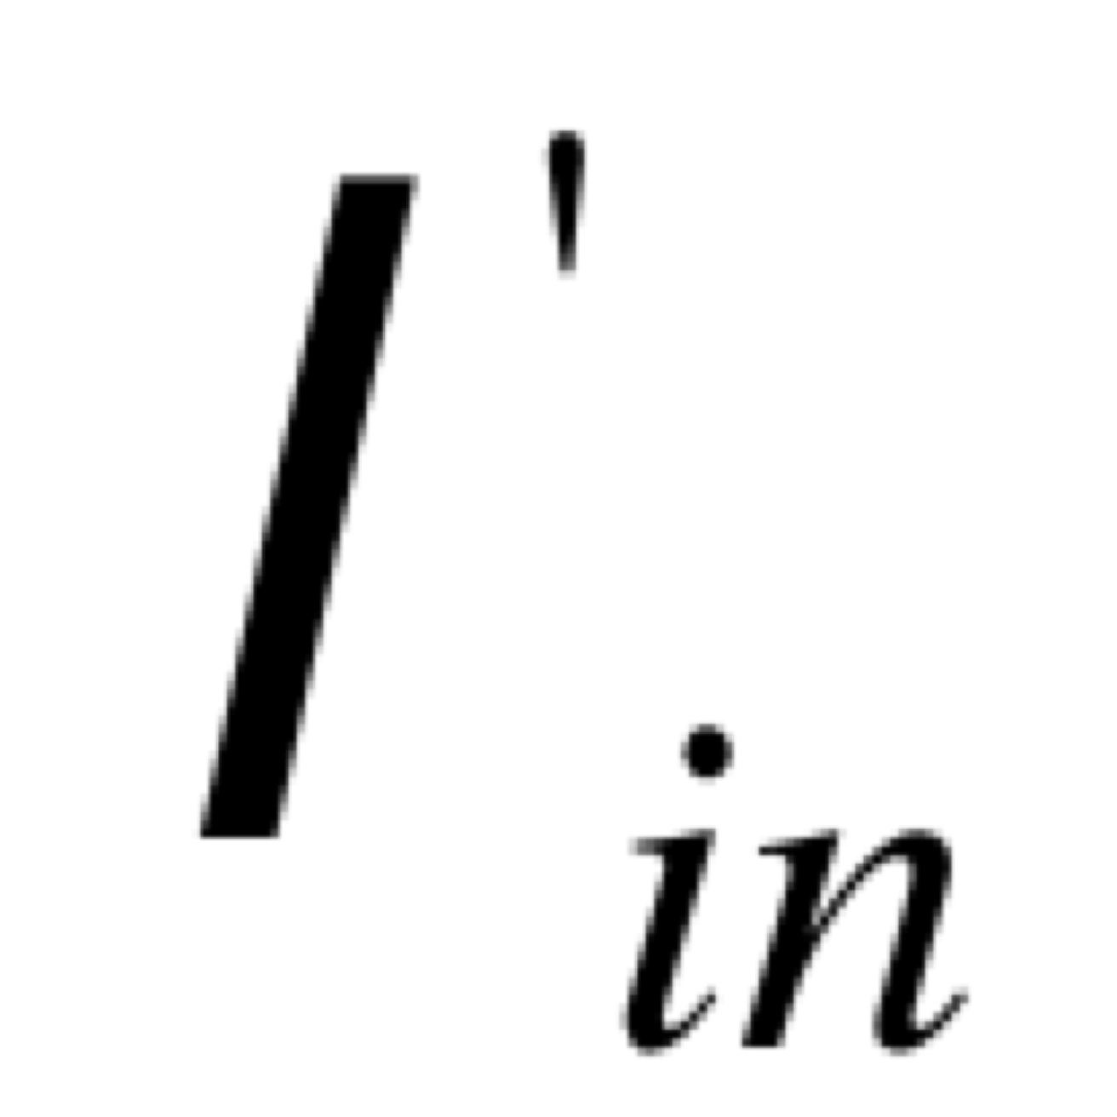
Reasons for congestion
Two senders, two receivers
One router, finite buffers
Retransmission of lost packets
C
Router with finite buffers
Data rate sent by the application
Higher data rate sent by the transport layer including retransmissions

Slide 6
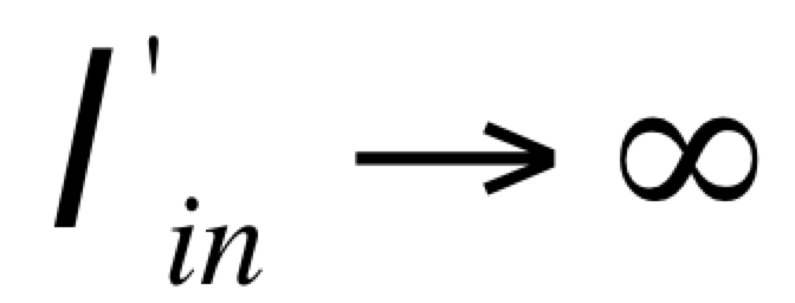

Reasons for congestion
Retransmission means that I_{out} receives all data that I_{in} sends
When there is loss, retransmission is happening, and I’_{in} > I_{out}
Retransmission of delayed (but not lost) packets increases I’_{in} above the perfect value, without increasing I_{out}
“Cost of congestion”:
  More work (retransmissions) for a desired throughput
  Useless retransmissions, some links transmit several copies of the same packet
Constant bitrate (non-bursty) traffic
other rates for I_{n}
C/2
I_{n}
no congestion
persistent
congestion
C/2
time
$${I′}_{n}=I_{n}$$
Notes:
ASK QUESTIONS
BLACKBOARD !!!!!!!!!

Slide 7

Reasons for congestion
Retransmission means that I_{out} receives all data that I_{in} sends
When there is loss, retransmission is happening, and I’_{in} > I_{out}
Retransmission of delayed (but not lost) packets increases I’_{in} above the perfect value, without increasing I_{out}
“Cost of congestion”:
  More work (retransmissions) for a desired throughput
  Useless retransmissions, some links transmit several copies of the same packet
Bursty traffic
ideal line
C/2
C/2
I_{n}
transient congestion
$${I′}_{n}$$
time
The share of retransmissions grows

Slide 8
Conclusion
Protocols should implement congestion control
Congestion control algorithms:
  algorithms to adapt the offered load (I’_{n})
  to the capacity at the bottleneck router
There are quite many algorithms that can achieve this
  at several layers
We are going to look mainly at TCP’s approach to congestion control

Slide 9
Transport layer
IN2140:
Introduction to Operating Systems and Data Communication
Congestion Control in TCP

Slide 10
Global congestion collapse
Craig Partridge, Research Director for the Internet Research Department at BBN Technologies:
  Bits of the network would fade in and out, but usually only for TCP. You could ping. You could get a UDP packet through. Telnet and FTP would fail after a while. And it depended on where you were going (some hosts were just fine, others flaky) and time of day (I did a lot of work on weekends in the late 1980s and the network was wonderfully free then).
  Around 1pm was bad (I was on the East Coast of the US and you could tell when those pesky folks on the West Coast decided to start work...).
  Another experience was that things broke in unexpected ways - we spent a lot of time making sure applications were bullet-proof against failures. (..)
  Finally, I remember being startled when Van Jacobson first described how truly awful network performance was in parts of the Berkeley campus. It was far worse than I was generally seeing. In some sense, I felt we were lucky that the really bad stuff hit just where Van was there to see it.

Slide 11
Internet congestion control: history
around 1986: first congestion collapse
1988: "Congestion Avoidance and Control" (Jacobson)
Combined congestion/flow control for TCP
(also: variation change to RTO calculation algorithm)
Idea: packet loss = congestion, so throttle the rate; increase otherwise
Goal: stability - in equilibrum, no packet is sent into the network until an old packet leaves
  ack clocking, “conservation of packets“ principle
  made possible through window based stop+go - behaviour
Superposition of stable systems = stable →
network based on TCP with congestion control = stable

Slide 12
TCP Congestion Control
TCP limits sending rate as a function of perceived network congestion
  little traffic – increase sending rate
  much traffic – reduce sending rate
Congestion algorithm has three major “components”:
  additive-increase, multiplicative-decrease (AIMD)
  slow-start
  reaction to timeout events

Slide 13
TCP Congestion Control Algorithms
TCP Westwood+
TCP BIC
TCP Westwood
TCP Cubic
the original TCP had no congestion control
TCP New Reno
Compound TCP
TCP Vegas
TCP PRR
TCP
TCP Reno
TCP BBR
TCP Tahoe
TCP Prague
0
1
2
3
4
5
6
7
8
9
0
1
2
3
4
5
6
7
8
9
0
1
2
3
4
5
6
7
8
9
0
1
2
3
4
5
6
7
8
9
0
1
2
3
4
5
6
7
8
9
197x
198x
199x
200x
201x

Slide 14
TCP Congestion Control
Basic terms:
congestion window (cwnd)
  largest amount of data (of a connection) that can be in the network at a time
maximum segment size [MSS]
  largest number of bytes that a TCP entity sends at once
  always in IPv6 and usually in IPv4: largest payload that fits into an IP packet behind the TCP header
  TCP header size is minimal 20 bytes
  with options maximal 60 bytes
Testing for available bandwidth
  Ideally: send as fast as possible (cwnd as large as possible) without loss
  Increase cwnd until you have loss
  If loss, reduce cwnd, try increasing again

Slide 15
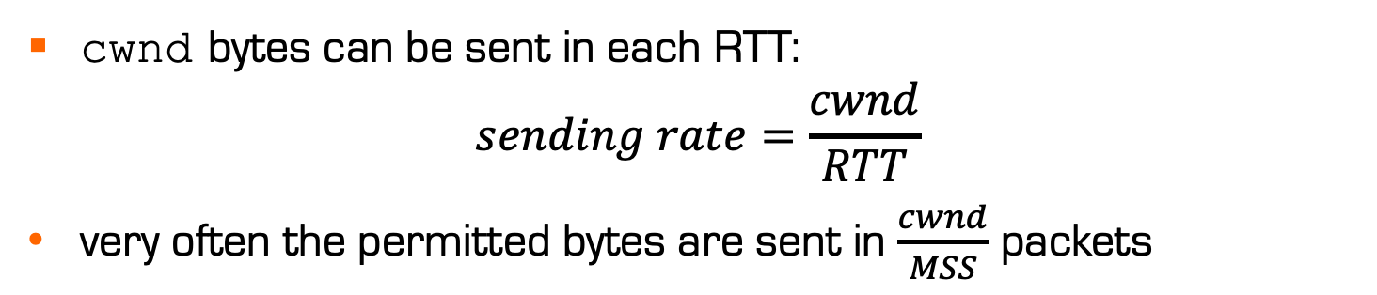
TCP Congestion Control
End-to-end control (no support from the network layer)
Send rate is limited by the size of a congestion window, cwnd (counted in bytes)
already
ack’d
sendable, not
sent yet
sent, not
ack’d yet
not sendable
yet
cwnd
cwnd bytes can be sent in each RTT:
$$sending rate=\frac{cwnd}{RTT}$$
very often the permitted bytes are sent in $\frac{cwnd}{MSS}$ packets

Slide 16
TCP Congestion Control
sender
receiver
Initially, cwnd size is a few MSS
in this example: 1 MSS
round 1
Then, the size increases by 1 for each
received ACK (until threshold ssthresh is reached or an ACK is missing)
sent packets
per round
(cwnd)
round 2
16
round 3
8
4
round 4
2
1
time

Slide 17
TCP Congestion Control
Historically, initial ssthresh was 65 K, now in Linux it starts with ∞
Losing a packet (TCP Tahoe):
ssthresh drops to half cwnd
cwnd back to 1
sent packets
per round
(cwnd)
80
Losing a single packet (TCP Reno):
ssthresh drops to half cwnd
cwnd back to new threshold
75
70
65
ssthresh
16
60
55
50%
50
45
40
35
ssthresh
8
30
25
20
4
15
2
10
1
5
time
Notes:
Why infinite ssthresh – try to get networking to work with a wide variety of bandwidth: 64 kbps modem in bad phone or countryside houses -> 10 GBps at IFI
Get to the right speed quickly !

Slide 18
TCP Congestion Control
Slow Start
TCP will always return to a slow start when a packet loss is detected by timeout (instead of duplicate ACKs). That means that it starts from scratch with only one segment per RTT, then 2, then 4, etc.
sent packets
per round
(congestion window)
80
75
Congestion avoidance
phase
70
65
ssthresh
60
55
50
45
40
Slow-start phase
35
ssthresh
30
Additive Increase
One more segments sent after 1 RTT without loss in congestion avoidance phase
25
Today smallest
cong. window can
be as big as 10
(thanks to Google)
20
15
Multiplicative Decrease
Performed when loss is detected in slow-phase and in congestion avoidance phase
10
5
time

Slide 19
TCP Fairness
Goal of fairness
  When N TCP streams share a bottleneck,
  each TCP stream should receive an n^{th} of the bottleneck bandwidth
more realistic demand
  When N TCP streams with the same RTT and loss rate share a bottleneck,
  and they are infinitely long,
  each TCP stream receives an n^{th} of the bottleneck bandwidth
but the approximation is in many cases good

Slide 20
TCP Congestion Control
How does the AIMD algorithm achieve congestion control?
  interpret every packet loss as a congestion signal
  force TCP entities to slow down when loss is experienced
available bandwidth
same share of bandwidth
throughput of stream 2
stream 1 has experienced loss
backs off,
stream 2 can increase BW consumption
stream 1 can increase BW consumption
stream 2 is backing off
consumes less than its share
throughput of stream 1

Slide 21
CUBIC: a new shape
IN2140:
Introduction to Operating Systems and Data Communication
use a cubic function for probing

Slide 22
TCP New Reno
classical
«sawtooth pattern» in
Additive increase multiplicative decrease phase
cwnd
time

Slide 23
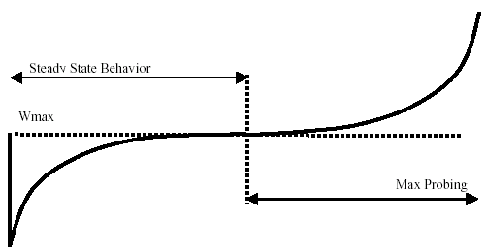
TCP CUBIC

Slide 24
TCP CUBIC
initial W_{max} : slow start like in New Reno
Concave region
Convex region

Slide 25
TCP CUBIC
The Window is a cubic function of the time since the last congestion event
CUBIC does not rely on receiving ACKs to increase window size
  Depends on on last congestion event
  CUBIC is better for long-distance connections, not for short-distance ones
  Use TCP New Reno behaviour for short-distance ones

Slide 26


TCP CUBIC
cwnd grows rapidly
cwnd grows slowly
cwnd grows rapidly
C is a scaling factor
t is the elapsed time from the last window reduction
β is a constant multiplication decrease factor

Slide 27
TCP CUBIC
cwnd grows rapidly
cwnd grows slowly
cwnd grows rapidly
Good for scaling
Good for stability
But: CUBIC converges slower than New Reno when flows appear or disappear

Slide 28
Transport above transport
IN2140:
Introduction to Operating Systems and Data Communication
QUIC
Quick UDP Internet Connections

Slide 29
QUIC’s mission
Replace HTTP over TCP as the main protocol for web traffic
TCP’s problems
  Head of line blocking
  3-way handshake
  Small initial congestion window and slow start
  Large backoff caused by packet loss
  Small socket buffer
  NAT timeout and IP roaming
  TCP buffer block
  Security: TLS (transport layer security) is expensive

Slide 30
QUIC’s mission
Ecryption, authentication
HTPP
TLS
QUIC
TCP
UDP
IPv4/v6
Session establishment,
flow control, error correction,
congestion control

Slide 31
QUIC goals
Deploy in today’s Internet
Transport layer tasks
Low latency
  In connect and responses
Reliable stream support
  Like TCP
  But without head-of-line blocking
Better congestion avoidance than TCP
  Keep experimenting!
  This is in user space
Session layers tasks
Privacy and security comparable to TLS
  Always end-to-end connection
  No benefits from caching
Mobile interface migration

Slide 32
QUIC protocol header
0 1 2 3
0 1 2 3 4 5 6 7 8 9 0 1 2 3 4 5 6 7 8 9 0 1 2 3 4 5 6 7 8 9 0 1
+-+-+-+-+-+-+-+-+-+-+-+-+-+-+-+-+-+-+-+-+-+-+-+-+-+-+-+-+-+-+-+-+
|S| Unused | Version |
+-+-+-+-+-+-+-+-+-+-+-+-+-+-+-+-+-+-+-+-+-+-+-+-+-+-+-+-+-+-+-+-+
| Version | DstCon ID len | Dest Conn ID 0-2040 bytes |
+-+-+-+-+-+-+-+-+-+-+-+-+-+-+-+-+-+-+-+-+-+-+-+-+-+-+-+-+-+-+-+-+
...
+-+-+-+-+-+-+-+-+-+-+-+-+-+-+-+-+-+-+-+-+-+-+-+-+-+-+-+-+-+-+-+-+
| SrcCon ID len | Sec Conn ID 0-2040 bytes |
+-+-+-+-+-+-+-+-+-+-+-+-+-+-+-+-+-+-+-+-+-+-+-+-+-+-+-+-+-+-+-+-+
...
+-+-+-+-+-+-+-+-+-+-+-+-+-+-+-+-+-+-+-+-+-+-+-+-+-+-+-+-+-+-+-+-+
| Payload ...
+-+-+-+-+-+-+-+-+-+-+-+-+-+-+-+-+-+-+-+-+-+-+-+-+-+-+-+-+-+-+-+-+
Very long and very flexible header
It is an application-layer protocol specifically targeting Chrome and Google servers
It can change every day on both sides

Slide 33
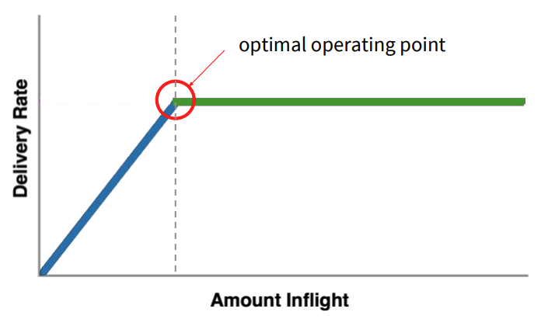
QUIC’s congestion control: BBR
Searching for the ideal bandwidth
Assume that there is no competion
(ignore the competition)

Slide 34
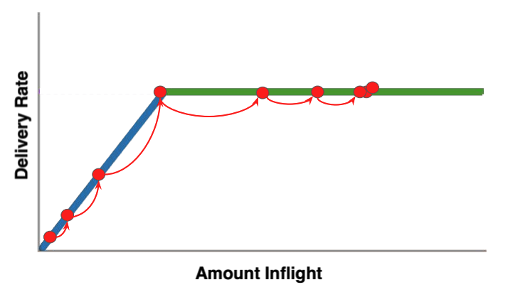
QUIC’s congestion control: BBR
Searching for the ideal bandwidth
Exponential search for good bandwidth

Slide 35
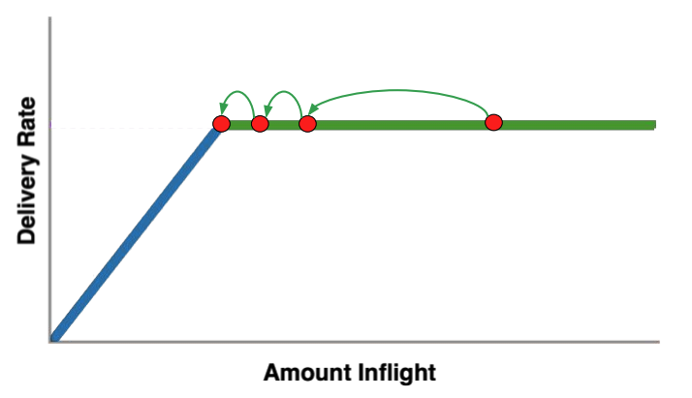
QUIC’s congestion control: BBR
Searching for the ideal bandwidth
Drain excessive queue created during search

Slide 36
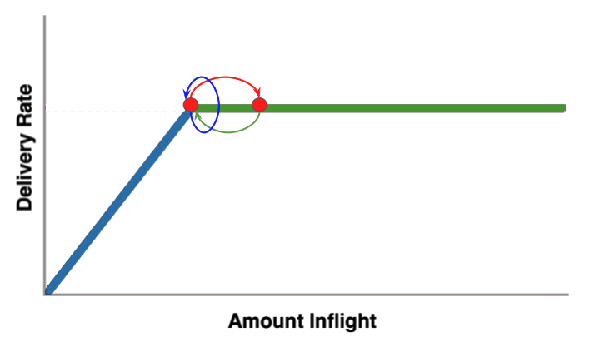
QUIC’s congestion control: BBR
Searching for the ideal bandwidth
Loop: explore if more BW available, drain queue

Slide 37
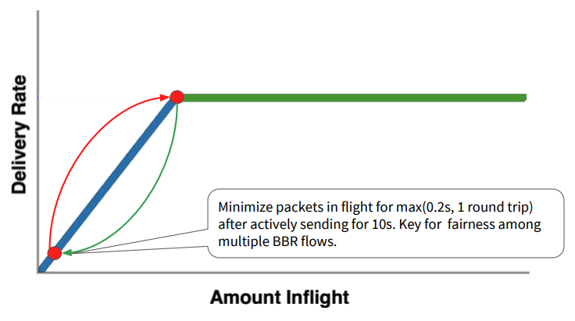
QUIC’s congestion control: BBR
Searching for the ideal bandwidth
Send really little for a short time
Give other flows a chance

