Slide 1
Introduction to programming in C
IN2140
Plenum 1
Kristoffer Robin Stokke
Principal Software Engineer, PhD
University of Oslo, Institute of Informatics

Slide 2
The “plenum” lectures
In these lessons, we go from theory to practice
  These lessons do not teach C on a tutorial basis
  Go to group lectures for more direct assistance with C
Your job is to shape these lessons!
  Ask questions with Menti or just raise your hand!
What we’ll do today
  Go through some topics from the Tuesday lecture
  Meet an old friend☺
  Simple C examples
  Live coding!

Slide 3
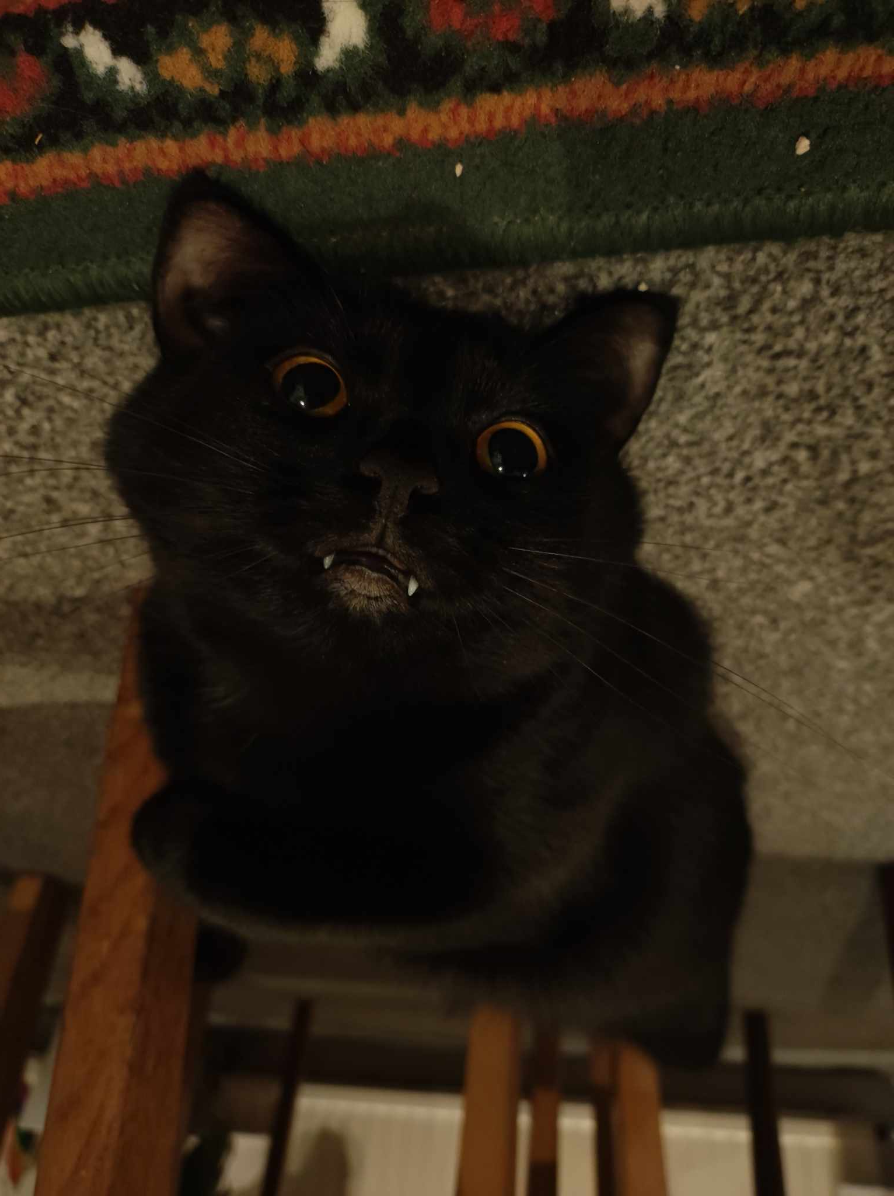


About me
Work at Huddly
  ISP, audio, bringup, debugging
Course work at IFI
  IN3151 (Operating Systems)
  IN5050 (ARM / CUDA)
  IN1020 (Assembler / Dig.Res.)
12 years of experience in C
  No less bugs per hour
Also work with VHDL, C++ and Python
  And some occasional assembler

Slide 4
An easy, old example:
Intel Hub Architecture
application
Pentium 4
Processor
file system
registers
cache(s)
disk
system bus
(64-bit, 400/533 MHz
→~24-32 Gbps)
RDRAM
memory
controller
hub
RAM interface
(two 64-bit, 200 MHz
→ ~24 Gbps)
RDRAM
RDRAM
RDRAM
Example:
Disk vs. RAM
hub interface
(four 8-bit, 66 MHz
→ 2 Gbps)
I/O
controller
hub
PCI slots
PCI bus
(32-bit, 33 MHz
→ 1 Gbps)
PCI slots
PCI slots
disk
Notes:
Talk about bottlenecks

Slide 5
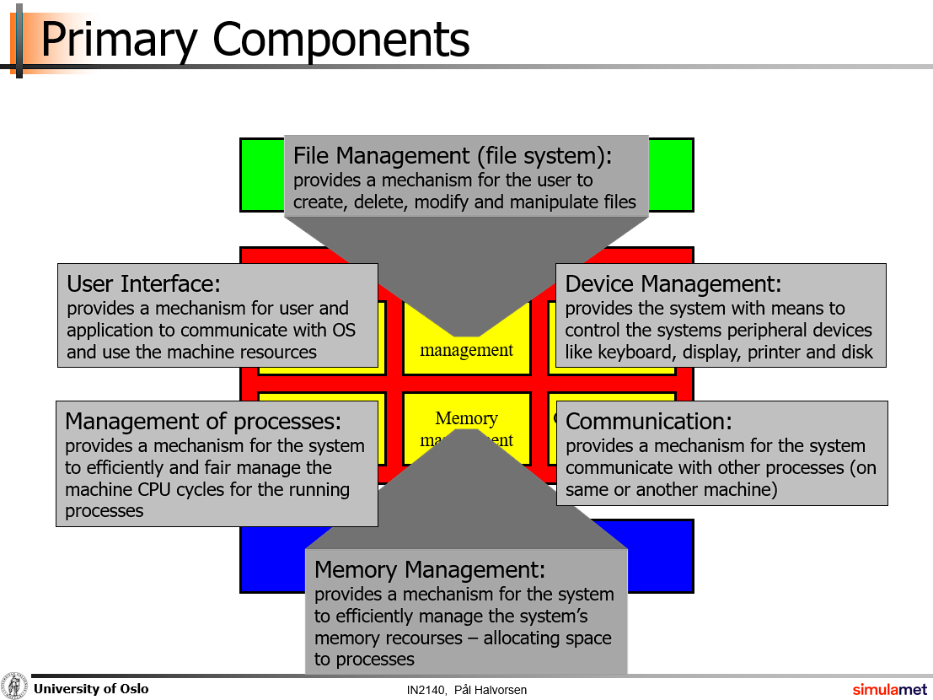
We just saw..
The user interface
  Shell
File management
  ls – listing files in a shell
  cp – copy files around
  dd – “data destroyer” to generate a large file
  mount – setup disks in folders
  sudo – with great power comes great responsibility
Communication
  ssh into guanin.ifi.uio.no

Slide 6
Operating System Categories
Single-user, single-task:
historic, and rare (only a few old PDAs use this)
Single-user, multi-tasking:
PCs and workstations may be configured like this (typically, phones today)
Multi-user, multi-tasking:
used on large, old mainframes; and handhelds, PCs, workstations and servers today
Distributed OSes:
support for administration of distributed resources
Real-time OSes:
support for systems with real-time requirements like cars, nuclear reactors, etc.
Embedded OSes:
built into a device to control a specific type of equipment like cellular phones,
microwaves, washing machines, etc.

Slide 7
The last OS type
Bare metal operating systems
20 software developers with no operating system abstractions, no standard drivers, no processes, no memory protection and a buggy debugger, fighting over those same 2 MB of fast RAM on a chip for eight years.

Slide 8
Why learn C, OS etc?

Slide 9
What is our first program (nearly) always called?
Example:
Hello, world

Slide 10

Hello, world!
Compilation with gcc
Headers (stdio.h)
  Forward declares functions like fprintf
Manual pages (man fprintf)
  Golden
Standard output file descriptors
  stdout (buffered) and stderr (unbuffered)
Strings “Hello, world!\n”
  Sequence of characters.
Function skeleton
return statement
A forward declaration is a way of saying that something (like a function or variable) does exist, without having to specify the implementation.
Empty argument list
function name
int main(){
}
Return type
Scope of the function
- Code
- Data

Slide 11

That was actually too modern and complex...
To learn how this works..
..we need to take a step back to an old friend first.

Slide 12
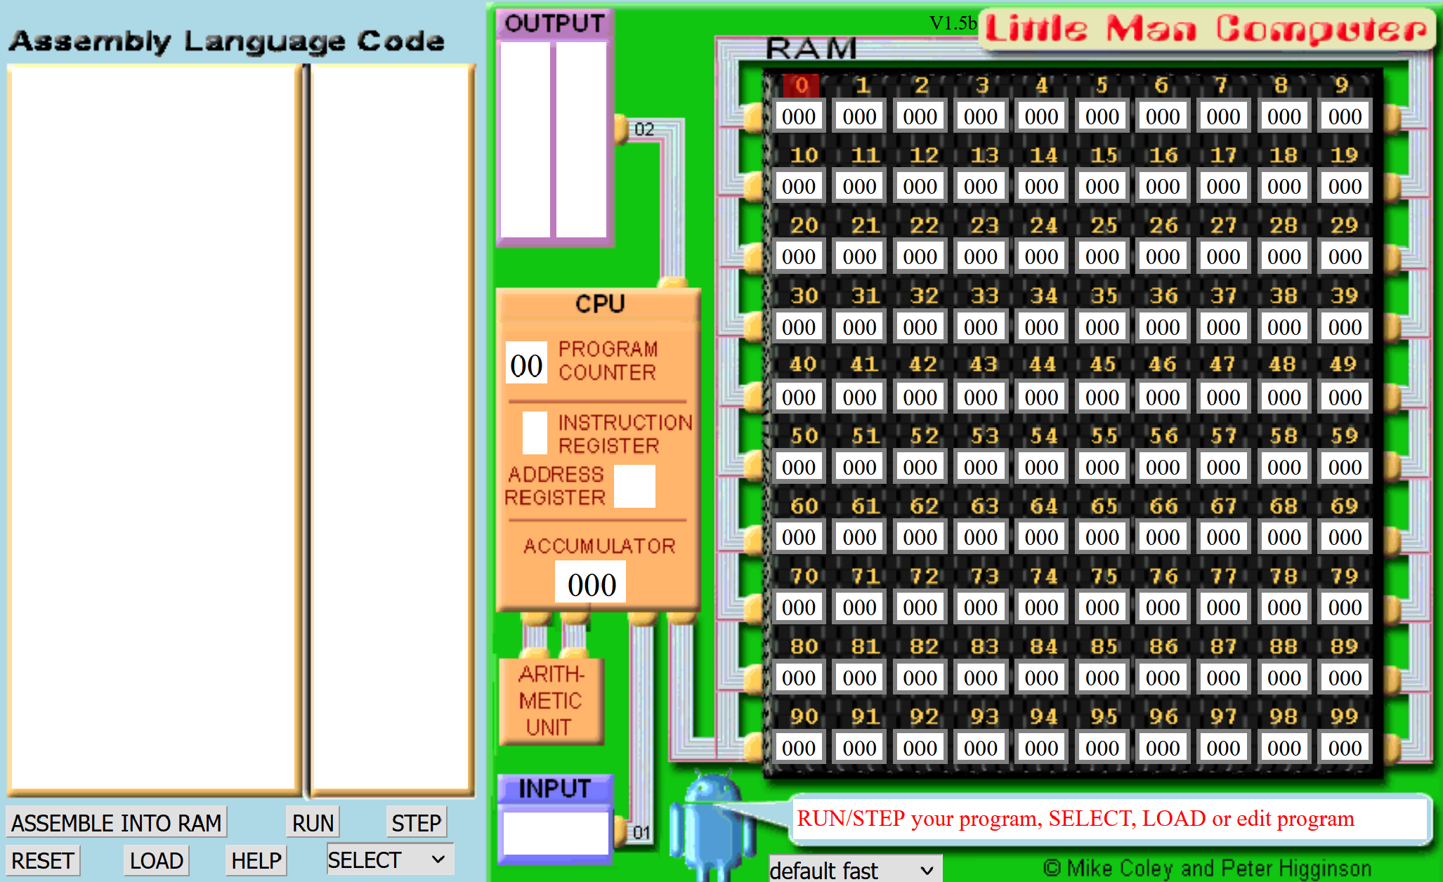
What about this old relative?
Instruction | Description
HLT | Halt.
ADD | Addition.
SUB | Subtraction.
STA | Store accumulator.
LDA | Load accumulator.
BRA | Branch.
BRZ | Branch if zero.
BRP | Branch if positive.
INP | Input number.
OUT | Output number.
OTC | Output character.
Example:
- LMC Hello!
- C equivalent

Slide 13
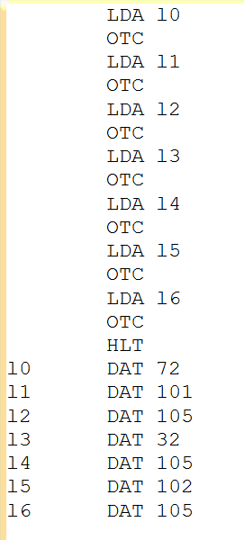

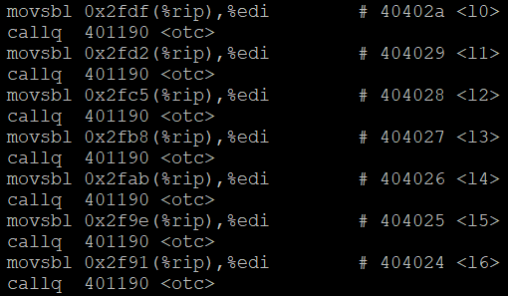
C versus Assembler
C code
x86 assembler

Slide 14
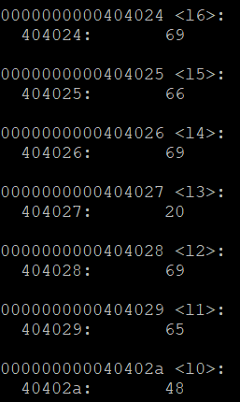
C versus Assembler
Data cells containin ascii characters

Slide 15
C versus Assembler
objdump –D
  Dump assembler code of a binary executable
objdump –D | less
  Pipe output to less to search through the output

Slide 16
The end of printing?
Is this it? Is printing characters sorted for eternity now?
What if we have very large strings? Say, a text of one million characters?
Should we label every one of them?
  And write LDA + OTC for every single one?

Slide 17
In LMC, can we...
..add characters to be printed, without adding code?
Self-modifying code.
Example:
- LMC hello v.2

Slide 18

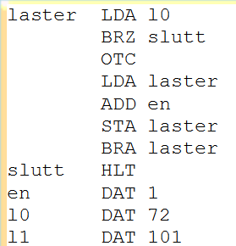

How does it work?
Loads the number in label “l0”, which is address 9.
If the number is zero, stop.
Output accumulator as ASCII character.
Increment the address field of the “laster” instruction by 1.
Repeat from “laster”.
Arbitrarily long string follows

Slide 19
Working With Addresses
1
1
1
0
1
2
5
0
9
“Load accumulator”
Instruction 5
1
3
Address part of an LMC instruction
Instead of manually inserting LDA / OTC instructions..
We increment the address part of an LDA instruction in a tight loop
Thus, we can add more characters to the string, but we don’t have to add code.

Slide 20
Pointers
It is not reasonable to label absolutely every variable in your program
You cannot always know in advance how long an array is
  For example, what about the arguments given to your program?
You may want a function to give more output than just a single return value
All APIs and libraries use pointers in one way or the other
Correct use of pointers is THE challenge in C programming
  You will have bugs.
  C strings, check for 0?

Slide 21
Pointers!
You can write C code that works with addresses.
This is called “working with pointers”.
A pointer points to an address in memory.
We can use arithmetic on pointers like we just saw for LMC.
  But in C, we do not have self-modifying code!
Let’s see what it looks like!

Slide 22
Pointers!
{
char a = ‘r’;
char b;
char *pointer;
pointer = &a;
b = *pointer;
}
A char ‘a’ initialised to ‘r’.
A char ‘b’, uninitialized.
A pointer (*) to a char, called ‘pointer’, also left uninitialized.
Declaring a pointer (TYPE * NAME).
Initialize ‘pointer’ to the address of (&) a.
Address of variable (& NAME).
Example:
Hello with pointer
Initialize b to the value pointed to by ‘pointer’.
Dereferencing a pointer (VAR = *NAME).

Slide 23
Pointer thinking chart
If you see..
TYPE * NAME
  Think “NAME is a pointer of TYPE.”
&something
  Think “Address of <something>.”
*something
  Think “Value of <something>.”

Slide 24
A Not-So-Final Word on Pointers
The concept of pointers is extremely powerful in C.
  Saving code space is just one use case.. To show you one concrete example.
Pointers are non-optional. In fact, you saw your first pointer in “Hello, world!”.
One example is not enough to understand pointers.
  It takes a lot of practice, and even experts will create bugs for themselves sometimes.
Don’t fret if you did not understand these slides.
  Try the code for yourself.
  We will help you as best we can ☺

Slide 25
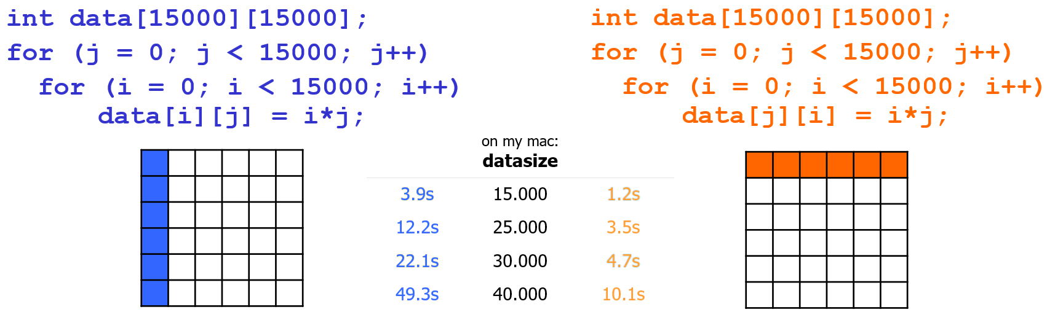
Learn how CPUs work by learning C
Example:
Performance

Slide 26
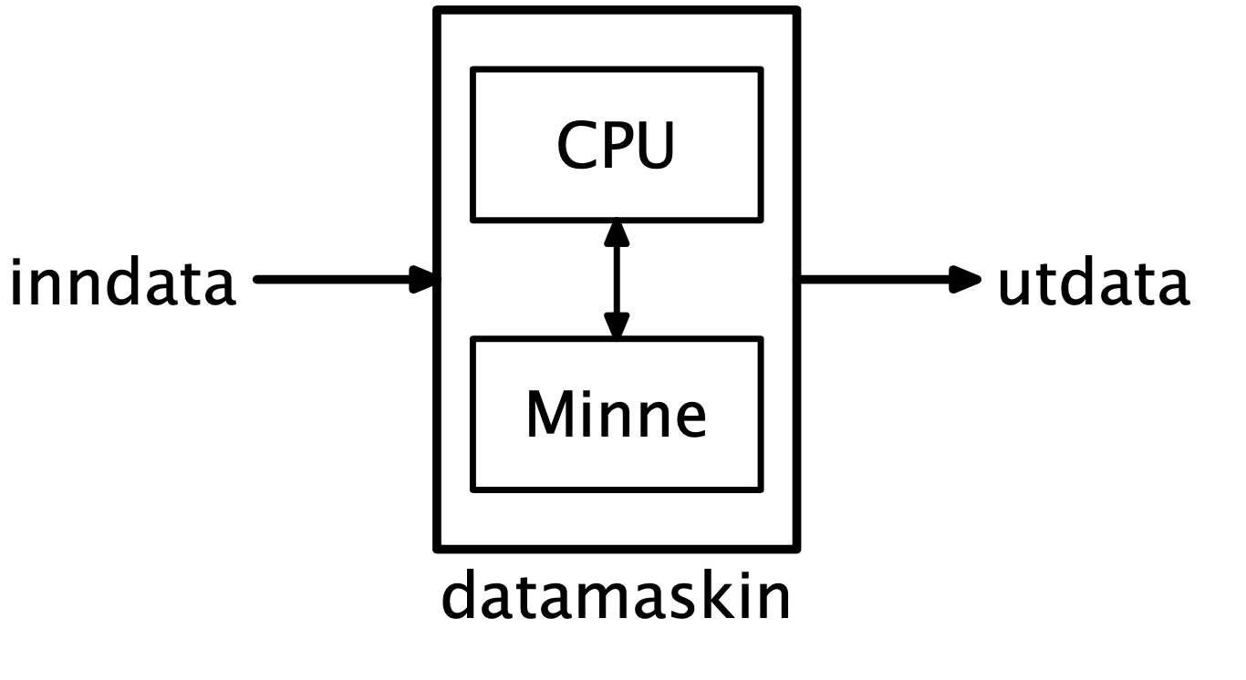
Learn how CPUs work by learning C
time <bash command> measures time with millisecond precision
  real : total elapsed
  user : userspace! elapsed
  sys : kernel space! elapsed
The CPU cache is limited in size
  kBs – tens of MBs
The CPU cache is faster than RAM
When we access the array in column-major order..
  We evict old data to make room for newly accessed data
  We no longer utilize the cache at all, and must fetch and store data in RAM
Cache

Slide 27

Interrupts
Interrupts are electronic signals that (usually) result in a forced transfer of control to an interrupt handling routine
  alternative to polling
  caused by asynchronous events like finished disk operations, incoming network packets, expired timers, …
  an interrupt descriptor table (IDT) associates each interrupt with a code descriptor (pointer to code segment)
  can be disabled or masked out
CPU
Example:
Signals
How do we stop this guy?

Slide 28
Interrupting a process
CTRL+C sends a SIGINT on Linux, to the process running in the shell.
We can decide what to do when receiving SIGINT with signal(..)
  What if we don’t care?
Various tools to list running processes
  top / htop -> more interactive
  ps aux | grep <name_of_binary>
kill <pid>
  Brutally kills a running executable
  Add -9 to really kill hard
CPU

Slide 29
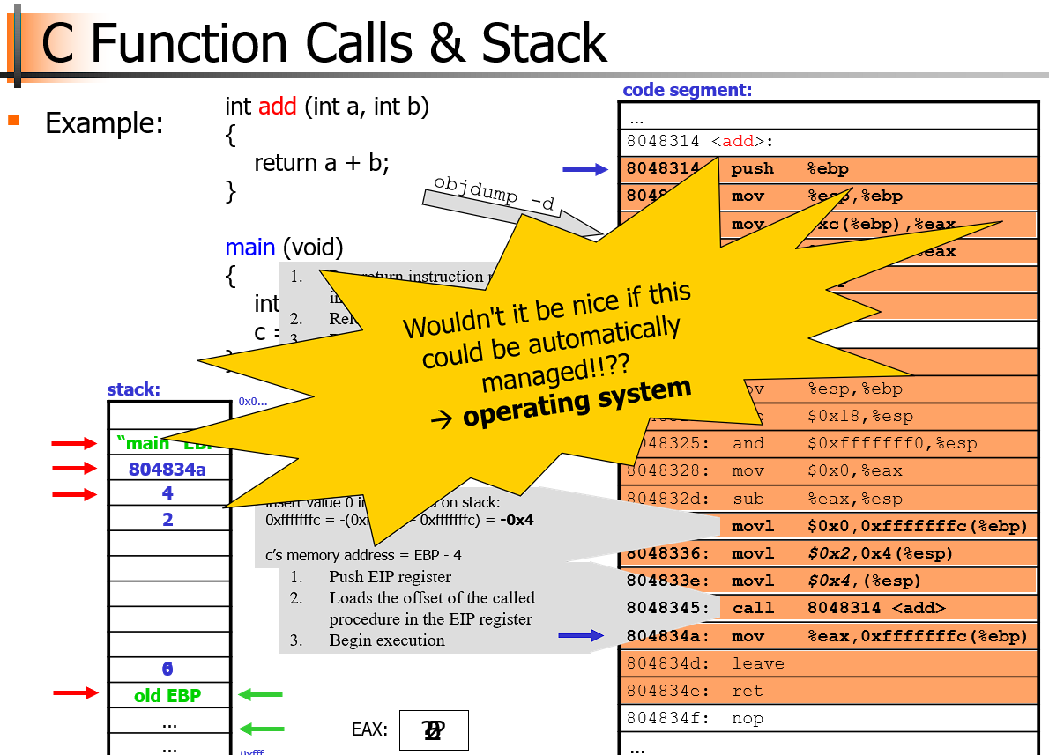
The stack
Does it REALLY matter?
Example:
Weird call chain,
scope declarations

Slide 30
The stack matters: Intrinsic Uses in C
Functions are implemented in scopes {}
  Any variables in the scope are actually on the stack
Function calls [x86_64, not true for ARM]
  The caller of a function pushes the return address on the stack.
  The function pops the return address off the stack when returning.
Function parameters are copy-by-value
  Function parameters are copied onto the stack
void main(){
}
The scope is between the { and }

Slide 31
The stack matters
* Somewhere in RAM, there is a region reserved for the stack.
0xFFFFFFFF
One byte
THE STACK
* The stack grows as we call functions, pass parameters to them, and reserve space for variables in their scopes.
THE STACK
THE STACK
Okay; but what is it???
This is all the RAM in your machine. It starts at address 0, and increases to address 0xFFFFFFFF.
* The more nested function calls we call..
- main calls
funca calls
funcb calls
func c calls
....
The larger it grows.
The stack starts at the stack pointer, which is a register in the processor, and grows downwards.
* As functions return..
- func c returns to
func b, returns to
func a
....
The stack shrinks.
One byte
0x3
One byte
0x2
One byte
0x1
One byte
0x0

Slide 32
Standard memory view of a process
0xFFFFFFFF
THE STACK
THE STACK
THE STACK
Can the stack grow into the code?
CODE
DATA
0x0

Slide 33
The stack matters
So whenever you create variables on the scope{}, you allocate data on the stack.
  Data exists from then..
  And through any nested scopes..
  And all the way until you go out of the scope!
The stack is therefore used for local, temporary variables only necessary under the current function.
I would say the stack is also important for recursive functions.
  It is very easy to allocate temporary data in this way.
Example:
Variables on the stack

Slide 34
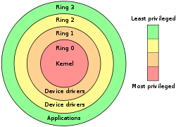
User Level vs. Kernel Level (Protection)
Many OSes distinguish user and kernel level,
i.e., due to security and protection
Usually, applications and many sub-systems
run in user mode (level 3)
  protected mode
  not allowed to access HW or device drivers
  directly, only through an API
  access to assigned memory only
  limited instruction set
OSes run in kernel mode
(under the virtual machine abstraction, level 0)
  real mode
  access to the entire memory
  all instructions can be executed
  bypass security
What is it that we don’t want “users sharing a machine” to do, for example?

Slide 35
Which of these instructions should be “privileged”?
Instruction | Description
HLT | Halt.
ADD | Addition.
SUB | Subtraction.
STA | Store accumulator.
LDA | Load accumulator.
BRA | Branch.
BRZ | Branch if zero.
BRP | Branch if positive.
INP | Input number.
OUT | Output number.
OTC | Output character.
Imagine several users concurrently using the LMC.

Slide 36
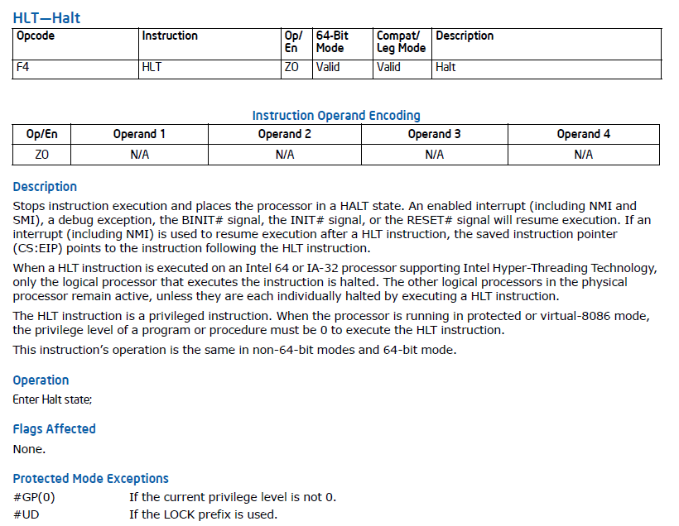
Privileged instructions: HALT!
Example:
Let’s try to HALT one of IFI’s machines! And create havoc for the other users!
https://www.intel.com/content/www/us/en/developer/articles/technical/intel-sdm.html

Slide 37

Sometimes it’s hard to protect users from each other.
Fork bombing!
Has happened before.

Slide 38
Any questions or things you want me to go through?
Linux command line tools?
Pointers?
Stacks?
Other topics?

