Slide 1
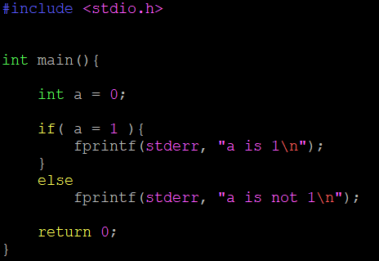
Let’s warm up
What is printed?

Slide 2
From Theory to Practice
IN2140
Plenum 1
Kristoffer Robin Stokke
Principal Software Engineer, PhD
University of Oslo, Institute of Informatics

Slide 3


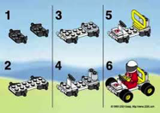
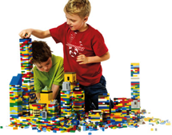
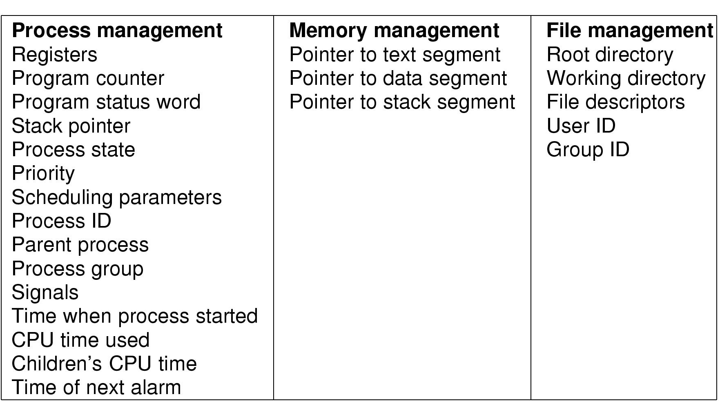
Processes
What is a process?
The "execution" of a program is often called a process
Process table entry (process control block, PCB):
Process
Program
vs.
Notes:
Process vs. program
- program often part of process
- program can specify the process to fork several processes

Slide 4
The “plenum” lectures
In these lessons, we go from theory to practice
  We don’t force you to learn C or to use Linux.
  This is just a way to explain the theory that you learn.
  There are many ways to learn theory, and you can choose whichever method you want.
Your job is to shape these lessons!
  No menti today; please interrupt!! me or come to the podium in the break
What we’ll do today
  Go through some topics from the Tuesday lecture
  Meet an old friend☺
  Simple C examples
  Live coding!

Slide 5
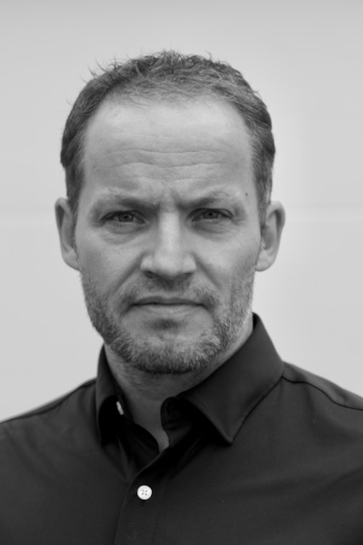
So I met with ifi-drift after last week’s lecture
“There was an alarming number of sudo attempts on the login cluster during your lecture”

Slide 6
Any questions or things you want me to go through?
Linux command line tools?
Pointers?
Stacks?
Other topics?

Slide 7
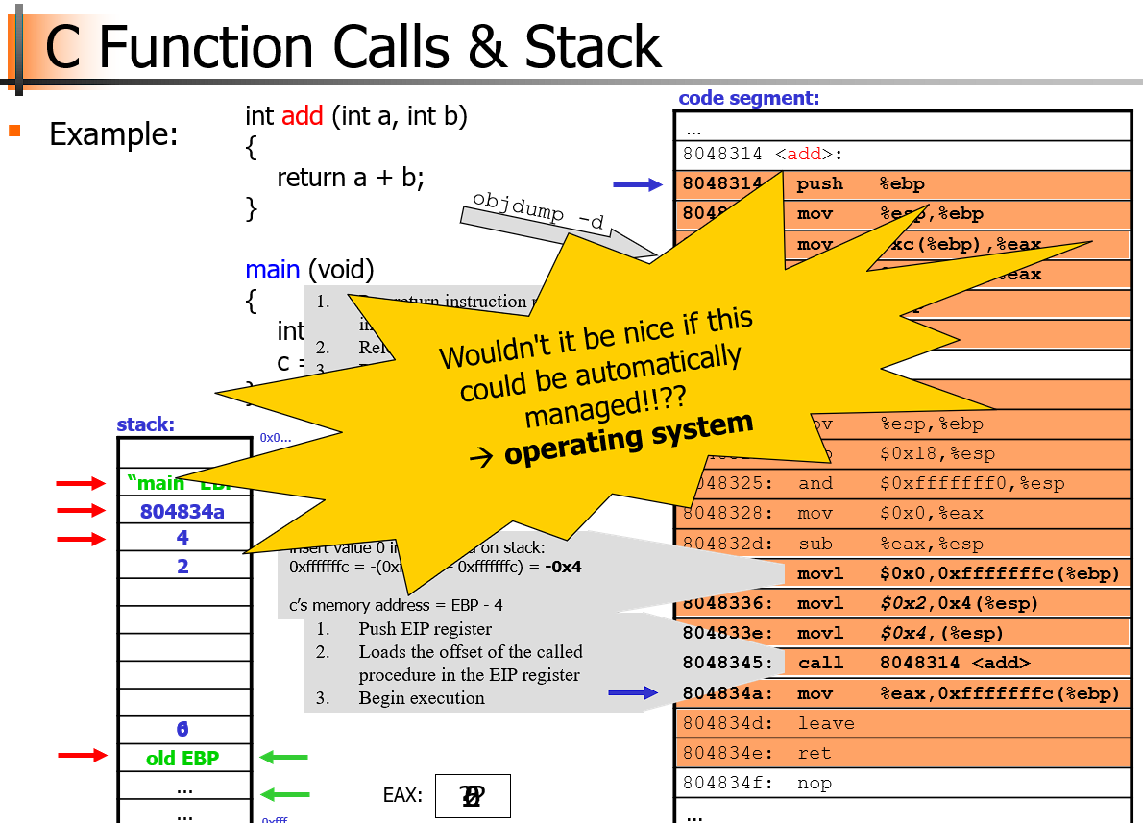
The stack
Does it REALLY matter?
Example:
Weird call chain,
scope declarations

Slide 8
The stack matters: Intrinsic Uses in C
void main(){
}
Function calls [x86_64, not true for ARM]
  The caller of a function pushes the return address on the stack.
  The function pops the return address off the stack when returning.
Function arguments and return values..
  Can be put on the stack (can also be put in registers until we have no more registers)
  And function parameters and return value are copy-by-value
Functions are implemented in scopes {}
  Any variables in the scope are actually on the stack
The scope is between the { and }
Example:
Variables on the stack

Slide 9
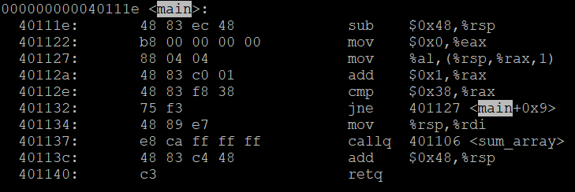
Variable Allocation on the Stack
Every function starts by subtracting from the stack pointer, to allocate space for the variables on the scope
%rsp is a register that points to the stack memory region
Our loop which initialises the array in the main() scope
The stack pointer rsp is a pointer to the array on main() scope, which is here put on a register before we call sum_array()
The point here is that, the larger we set the array on main() scope to be, the more space is subtracted here, allocating more space on the stack

Slide 10
The stack matters
So whenever you create variables on the scope{}, you allocate data on the stack.
  Data exists from then..
  And through any nested scopes..
  And all the way until you go out of the scope!
The stack is therefore used for local, temporary variables only necessary under the current function.
I would say the stack is also important for recursive functions.
  It is very easy to allocate temporary data in this way.

Slide 11
This means the same in my mind, you will encounter both
SCOPE = FRAME
(or STACK FRAME)

Slide 12
The stack matters
* Somewhere in RAM, there is a region reserved for the stack.
0xFFFFFFFF
One byte
THE STACK
* The stack grows as we call functions, pass parameters to them, and reserve space for variables in their scopes.
THE STACK
THE STACK
Okay; but what is it???
This is all the RAM in your machine. It starts at address 0, and increases to address 0xFFFFFFFF.
* The more nested function calls we call..
- main calls
funca calls
funcb calls
func c calls
....
The larger it grows.
The stack starts at the stack pointer, which is a register in the processor, and grows downwards.
* As functions return..
- func c returns to
func b, returns to
func a
....
The stack shrinks.
One byte
0x3
One byte
0x2
One byte
0x1
One byte
0x0

Slide 13
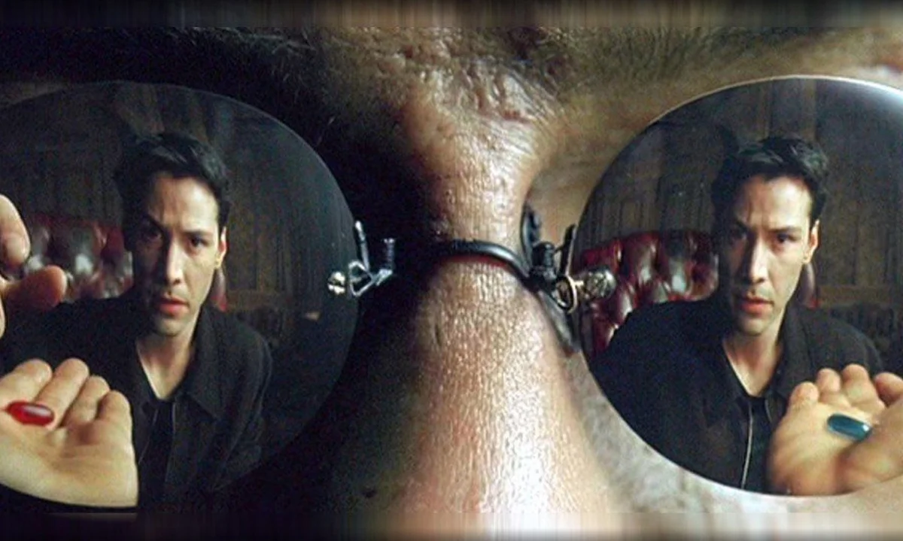
Standard memory view of a process
0xFFFFFFFF
THE STACK
THE STACK
THE STACK
Can the stack grow into the code?
CODE
DATA
0x0

Slide 14
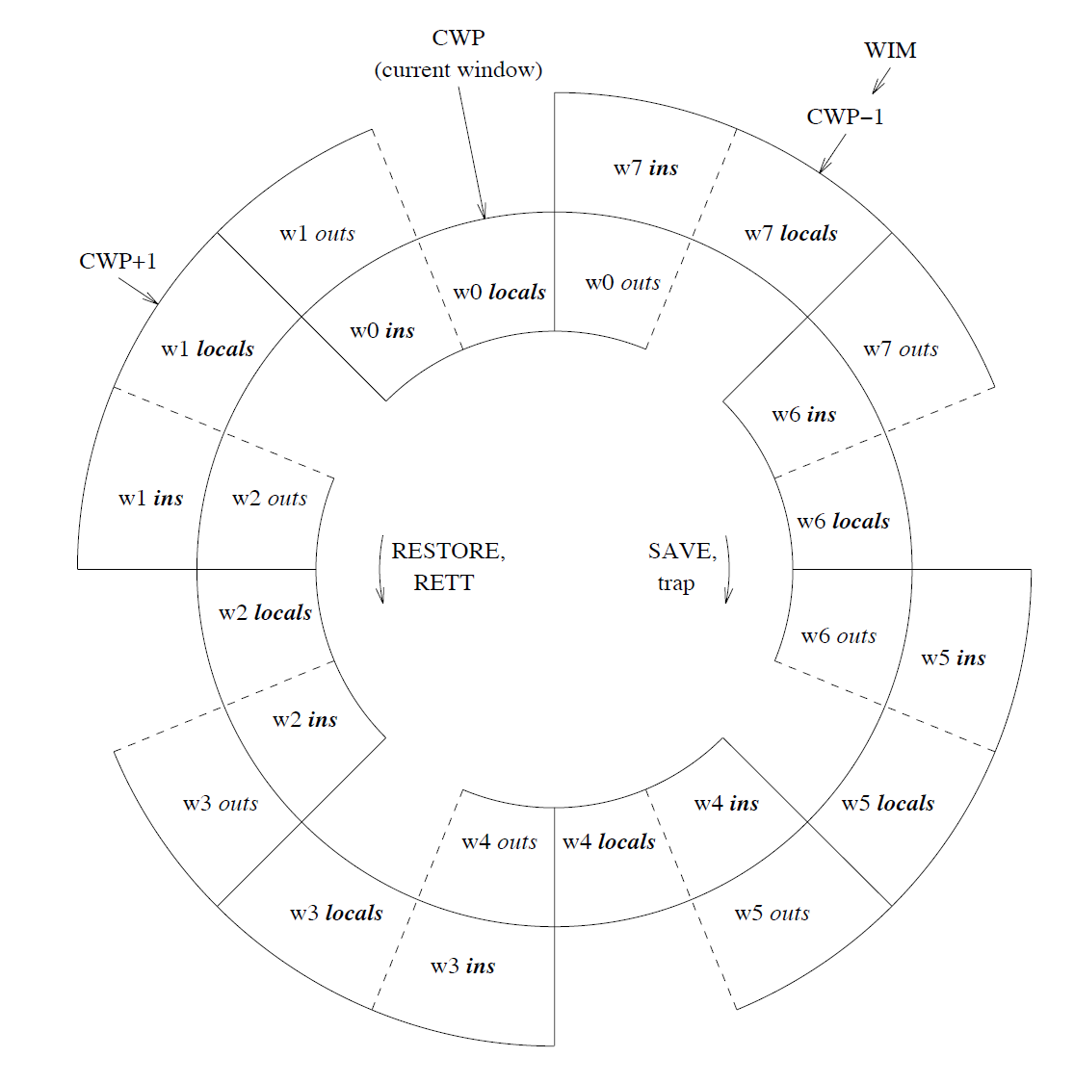
The SPARCv8 Architecture
x86 just has a lot of registers
Sparcv8 has a wheel of registers
  Output registers “outs” become input registers “ins” when calling function
  The wheel “spins” as we call functions..
  And it spins the other way as we return from functions..
  What happens when the wheel has spun all the way around?

Slide 15
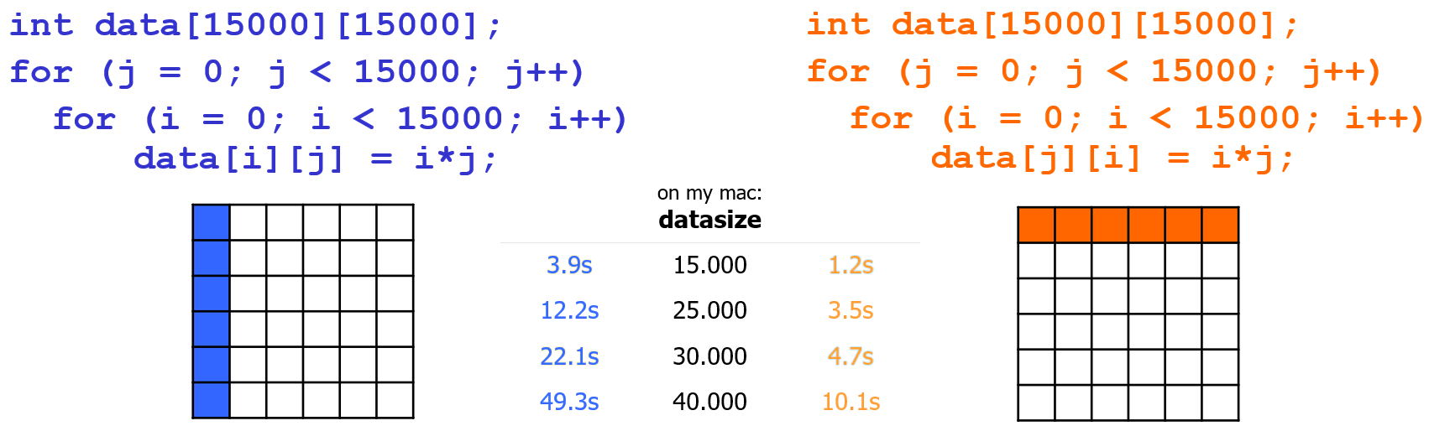
Learn how CPUs work by learning C
Example:
Performance

Slide 16
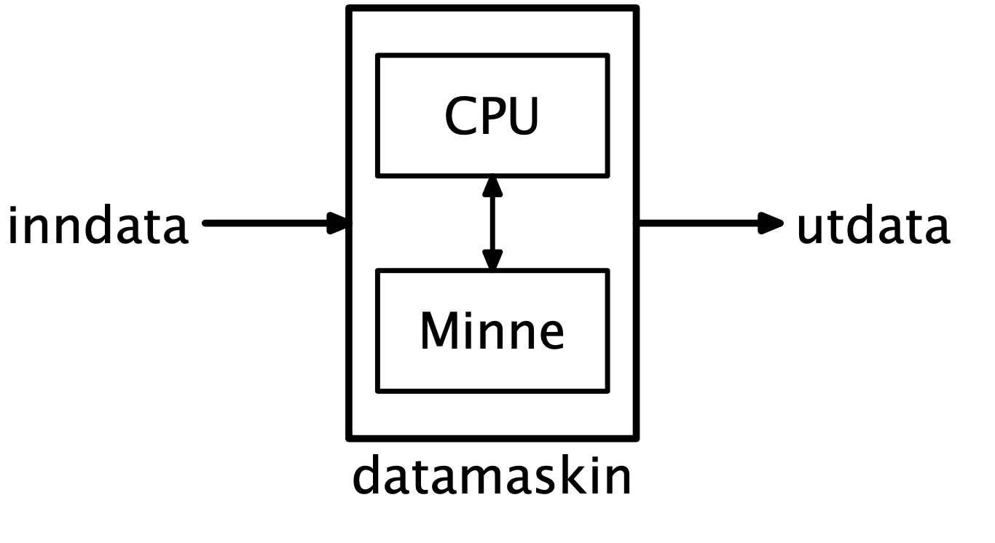
Learn how CPUs work by learning C
time <bash command> measures time with millisecond precision
  real : total elapsed
  user : userspace! elapsed
  sys : kernel space! elapsed
The CPU cache is limited in size
  kBs – tens of MBs
The CPU cache is faster than RAM
When we access the array in column-major order..
  We evict old data to make room for newly accessed data
  We no longer utilize the cache at all, and must fetch and store data in RAM
Cache

Slide 17
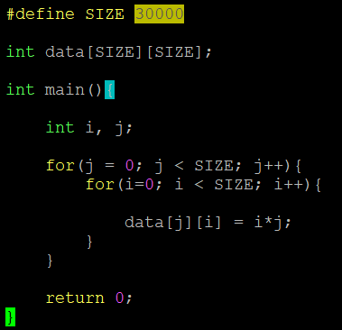
Standard memory view of a process
0xFFFFFFFF
THE STACK
Data declared like this (outside functions) just ends up in a data section in the computer’s memory. It will live there as long as the process exists
THE STACK
THE STACK
CODE
DATA
int i, j are variables in main() scope, so they are on the stack
Code goes in code section
0x0

Slide 18
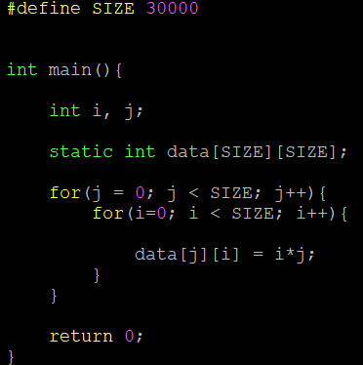
The “static” keyword
=

Slide 19
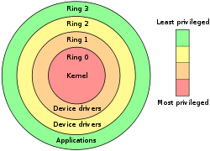
User Level vs. Kernel Level (Protection)
Many OSes distinguish user and kernel level,
i.e., due to security and protection
Usually, applications and many sub-systems
run in user mode (level 3)
  protected mode
  not allowed to access HW or device drivers
  directly, only through an API
  access to assigned memory only
  limited instruction set
OSes run in kernel mode
(under the virtual machine abstraction, level 0)
  real mode
  access to the entire memory
  all instructions can be executed
  bypass security
What is it that we don’t want “users sharing a machine” to do, for example?

Slide 20
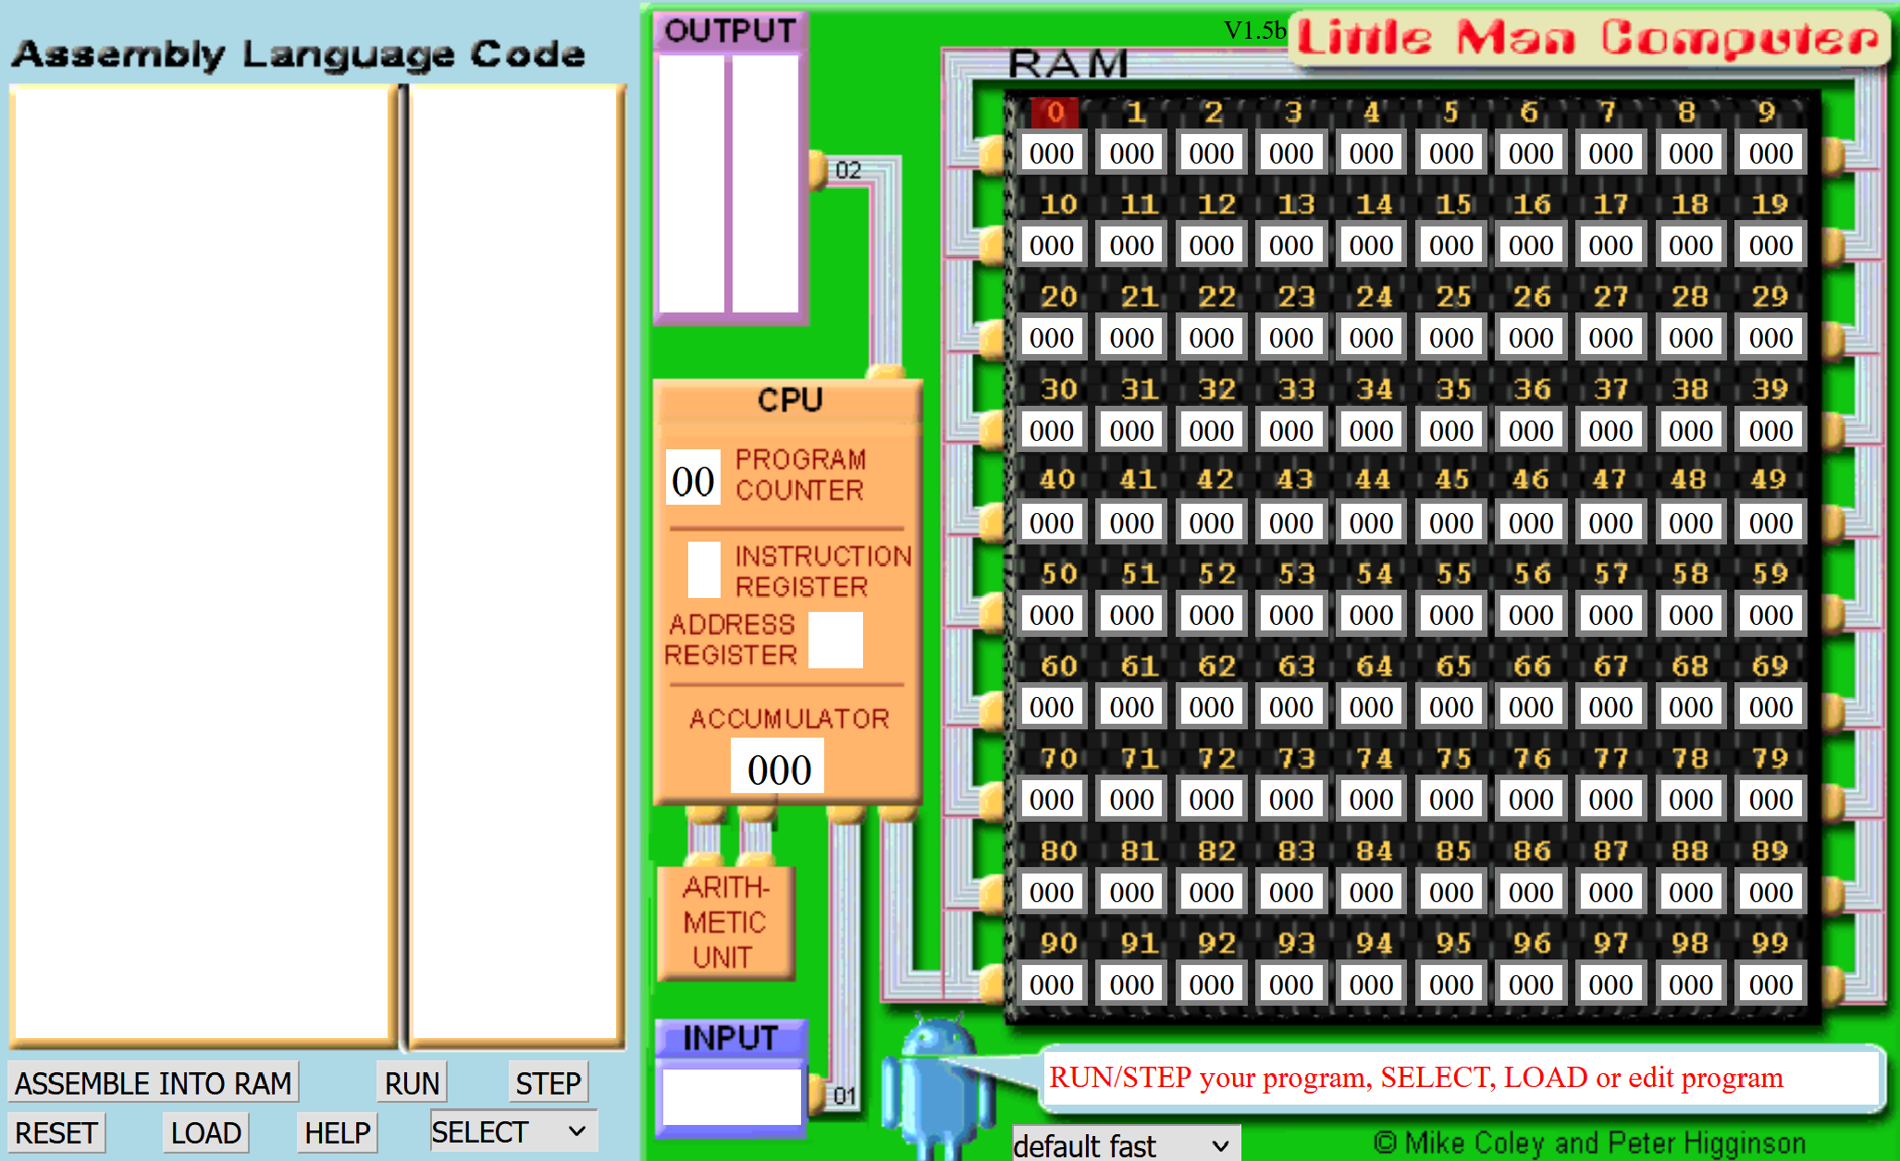
Which of these instructions should be “privileged”?
Instruction | Description
HLT | Halt.
ADD | Addition.
SUB | Subtraction.
STA | Store accumulator.
LDA | Load accumulator.
BRA | Branch.
BRZ | Branch if zero.
BRP | Branch if positive.
INP | Input number.
OUT | Output number.
OTC | Output character.
Imagine several users concurrently using the LMC.

Slide 21
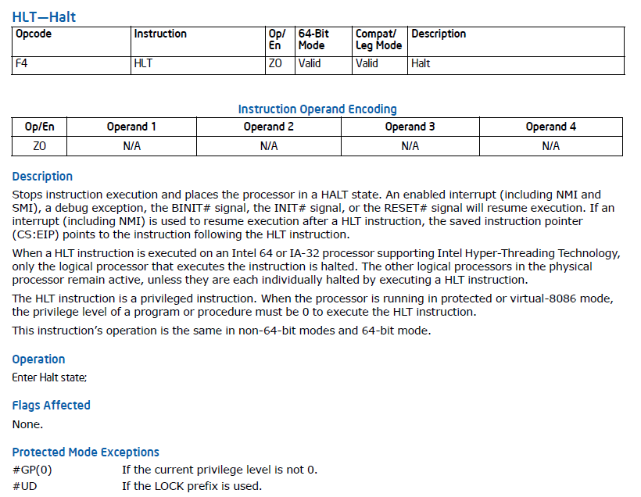
Privileged instructions: HALT!
Example:
Let’s try to HALT one of IFI’s machines! And create havoc for the other users!
https://www.intel.com/content/www/us/en/developer/articles/technical/intel-sdm.html

Slide 22
Process Creation
A process can create another process using the
pid_t fork(void) system call (see man 2 fork) :
  makes a duplicate of the calling process including a copy of the
  virtual address space, open file descriptors, etc…
  (only PIDs are different – locks and signals are not inherited)
  both processes continue in parallel
  returns
    … if parent: child process’ PID when successful, -1 otherwise
    … if child: 0 (if successful - if not, there will not be a child)
Other possibilities include
  int clone(…) – shares memory, descriptors, signals (see man 2 clone)
  pid_t vfork(void) – suspends parent in clone() (see man 2 vfork)
Example:
Simple fork
Notes:
clone: unlike fork, the new process share parts of execution environment like memory, table of file descriptors and signals handlers. Main use for threads
vfork: special case of clone, parent is suspended until child “exits” or calls “execve”

Slide 23
What does fork do?
Process
fork()
Process
Process
fork()
fork()
Process
Process
Process
Process
fork()
For how long?
P
P
P
P
P
P
P
P

Slide 24
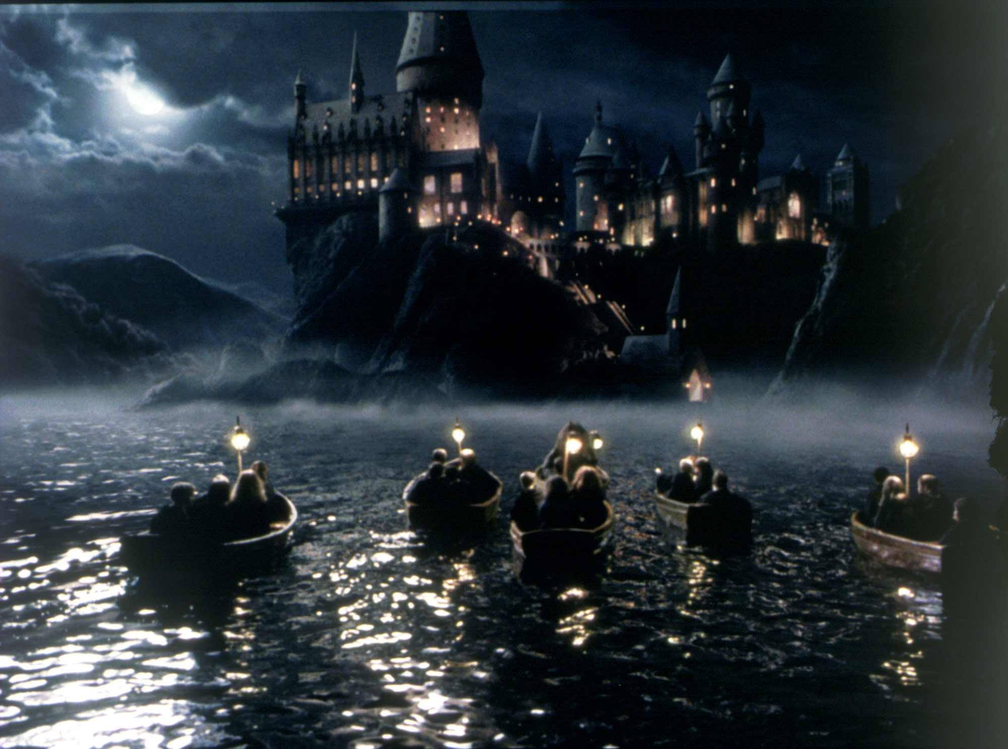
Sometimes it’s hard to protect users from each other.
Fork bombing!
Has happened before.

Slide 25
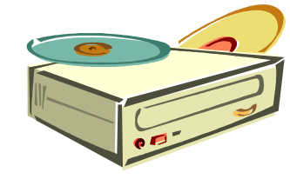









Interrupt Program Execution
CPU
We may use “polling”…!?
Example:
Signals and polling

Slide 26
Interrupting a process
CTRL+C sends a SIGINT on Linux, to the process running in the shell.
We can decide what to do when receiving SIGINT with signal(..)
  What if we don’t care?
Various tools to list running processes
  top / htop -> more interactive
  ps aux | grep <name_of_binary>
kill <pid>
  Brutally kills a running executable
  Add -9 to really kill hard
CPU

Slide 27
CPU Scheduling
Why should you care?

Slide 28
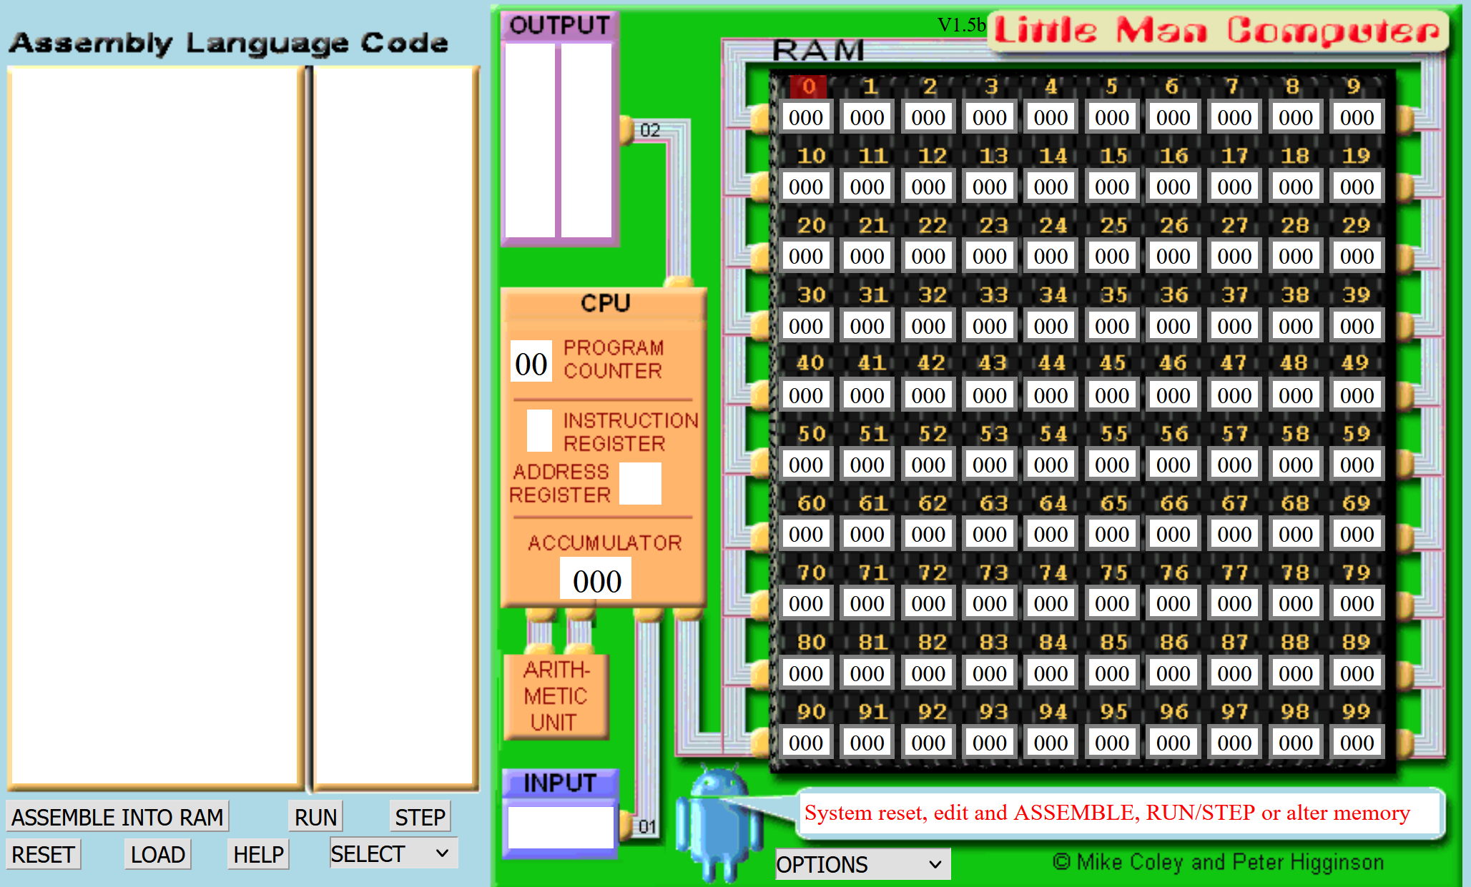
Can several “processes” share this machine?

Slide 29
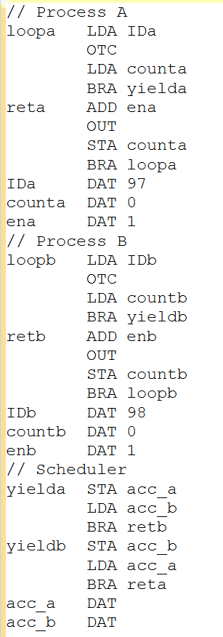
LMC Scheduler
Process A does its thing, then “yields” by “calling” the scheduler
The method you saw is based on
  Voluntary relinquishing control of the CPU
  yielda/yieldb
Why do we need to store the accumulator?
Process A
Process B does its thing, then “yields” by “calling” the scheduler
Process B
PROCESS A FLOW
PROCESS B FLOW
Then, scheduler “returns” to process B
SCHEDULER FLOW
Store process B’s accumulator, load process A’s accumulator
Store process A’s accumulator, load process B’s accumulator
Scheduler

Slide 30
Scheduling
A task is a schedulable entity/something that can run
(a process/thread executing a job, e.g.,
a packet through the communication system or
a disk request through the file system)
In a multi-tasking system, several
tasks may wish to use a resource
simultaneously
A scheduler decides which task
that may use the resource,
i.e., determines order
by which requests are serviced,
using a scheduling algorithm
requests
Scheduling is about sharing something, like how processes share a processor, and how the OS does it (the scheduling algorithm)
scheduler
resource
Finally, the dispatcher “moves” the selected process to the CPU
Notes:
The difference between scheduler and dispatcher is that the scheduler selects a process out of several processes to be executed while the dispatcher allocates the CPU for the selected process by the scheduler.

Slide 31
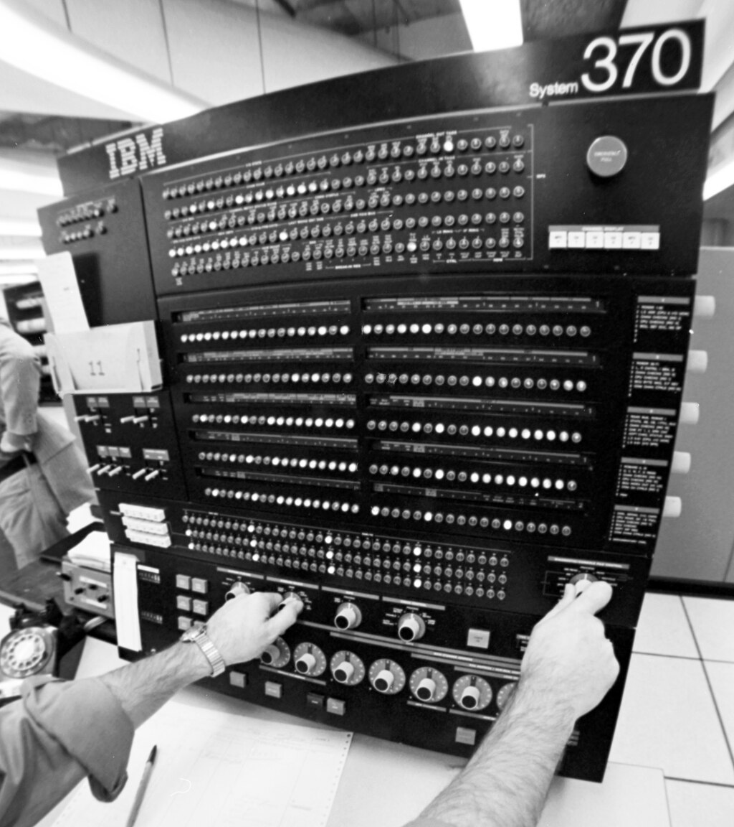
IBM System 370 (1970s)
Multiple users can share the machine
Each user “sees” a virtual machine that looks as if it was a real machine

Slide 32
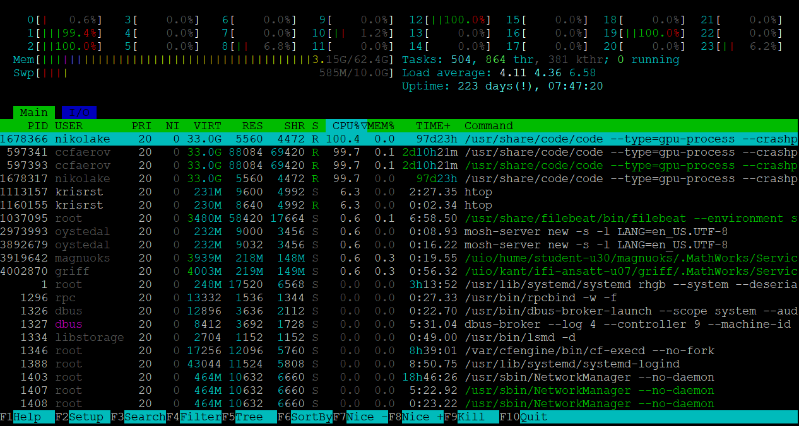
HTOP
CPU & MEMORY Usage
CPU activity
runtime
user
Nice value!
command line
Memory usage
PID
For later
A process
Example:
Count with fork
sched_yield
3) Nice value

Slide 33



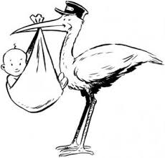

Process States
running
process termination
process blocks for input
scheduler stops process
Example:
Blocking IO
scheduler starts process
blocked
ready
external event finished
process creation

Slide 34
Processes
What is a process?
The "execution" of a program is often called a process
Process table entry (process control block, PCB):
Process
Program
vs.
Notes:
Process vs. program
- program often part of process
- program can specify the process to fork several processes

Slide 35
Thanks for today!

