Slide 1

In memory of
Per Stokke
4/2-1936 to 8/2-2025

Slide 2
From Theory to Practice
IN2140
Plenum 3
Kristoffer Robin Stokke
Principal Software Engineer, PhD
University of Oslo, Institute of Informatics

Slide 3
Pentium Memory Lookup
Incoming virtual address (CR2)
(0x1802038, 20979768)
Page frame PF:
Save pointer to instruction
Move linear address to CR2
Generate a PF exception – jump to handler
Programmer reads CR2 address
Upper 10 CR2 bits identify needed PT
Use middle 10 CR2 bit to determine entry
in PT – holds a mass storage address
Allocate a new page – write back if dirty
Read page from storage device
Insert new page frame base address into
page table entry
Return and restore faulting instruction
Resume operation reading the same
page directory entry and page table entry
again – both now P = 1
31 |  |  |  |  |  |  |  |  | 22 | 21 |  |  |  |  |  |  |  |  | 12 | 11 |  |  |  |  |  |  |  |  |  |  | 0
0 | 0 | 0 | 0 | 0 | 0 | 0 | 1 | 1 | 0 | 0 | 0 | 0 | 0 | 0 | 0 | 0 | 0 | 1 | 0 | 0 | 0 | 0 | 0 | 0 | 0 | 1 | 1 | 1 | 0 | 0 | 0
Index to page directory
(0x6, 6)
Index to page table
(0x2, 2)
31 |  |  | 12 |  |  |  | 7 | 6 | 5 | 4 | 3 | 2 | 1 | 0
0...01010101111 |  |  |  | ... |  |  |  |  |  |  |  |  |  | 1
0...01111111000 | ... |  |  |  |  |  |  |  | 0
0...01110000111 | ... |  |  |  |  |  |  |  | 0
0...00001010101 | ... |  |  |  |  |  |  |  | 1
0...01111000101 | ... |  |  |  |  |  |  |  | 0
0...00000000100 | ... |  |  |  |  |  |  |  | 1
......
Page table:
CR3:
31 |  |  | 12 |  |  |  | 7 | 6 | 5 | 4 | 3 | 2 | 1 | 0
0...01010101111 |  |  |  | ... |  |  |  |  |  |  |  |  |  | 1
0...01010100000 |  |  |  |  |  |  |  |  |  |  |  |  |  | 0
0...01100110011 |  |  |  |  |  |  |  |  |  |  |  |  |  | 1
0...00010000100 |  |  |  |  |  |  |  |  |  |  |  |  |  | 1
......
Page Directory Base Address

Slide 4
Plenum 3
Finish “blocking” and “interrupt” examples
Talk about the Tuesday lecture
Unfortunately, there’s not too much code today.
Do you have any coding questions or topics that you would want me to visit instead?

Slide 5





Process States
running
process termination
process blocks for input
scheduler stops process
Example:
Blocking IO
scheduler starts process
blocked
ready
external event finished
process creation

Slide 6
Why would we not want to block, wasting CPU time spinning?

Slide 7
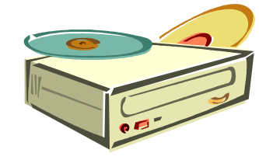









Interrupt Program Execution
CPU
We may use “polling”…!?
Example:
Signals and polling

Slide 8
Interrupting a process
CTRL+C sends a SIGINT on Linux, to the process running in the shell.
We can decide what to do when receiving SIGINT with signal(..)
  What if we don’t care?
Various tools to list running processes
  top / htop -> more interactive
  ps aux | grep <name_of_binary>
kill <pid>
  Brutally kills a running executable
  Add -9 to really kill hard
CPU

Slide 9
Makefiles
Anyone want a quick introduction?

Slide 10
Makefiles
hello :
echo “Hello, world” > hello
A set of rules of the form:
  “to make this file” : “you need this or these files”
Make uses timestamps to figure out if it needs to rebuild files.
The first rule is the default one.
Large makefiles grow complex and hard to read, but they are very fast
The world’s simplest makefile?

Slide 11

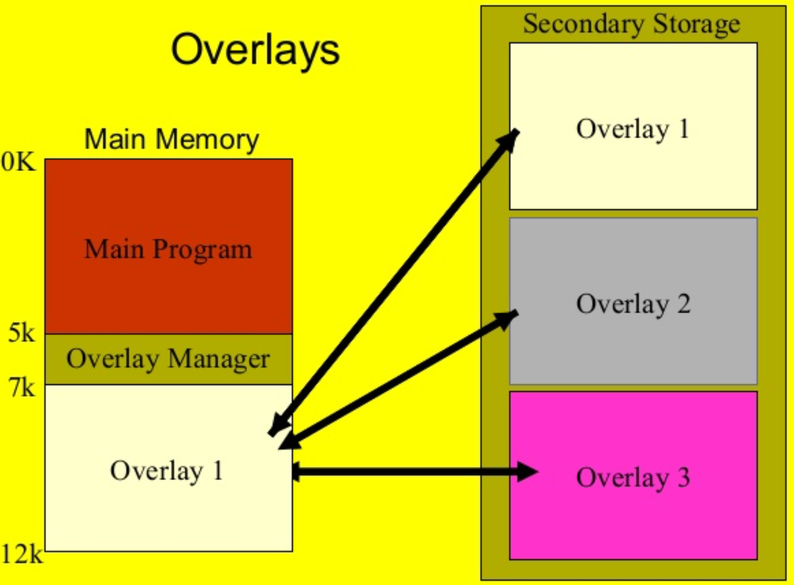
Memory Management for Multiprogramming
Use of secondary storage
  keeping all programs and their data in memory may be impossible
  move (parts of) a process from memory
Swapping: remove a process from memory
  with all of its state and data
  store it on a secondary medium
  (disk, flash RAM, … , historically also tape)
Overlays: manually replace parts of code/data
  programmer’s rather than OS’s work
  only for very old and memory-scarce systems
Segmentation/paging: remove parts of a process from memory
  store it on a secondary medium
  sizes of such parts are usually fixed

Slide 12
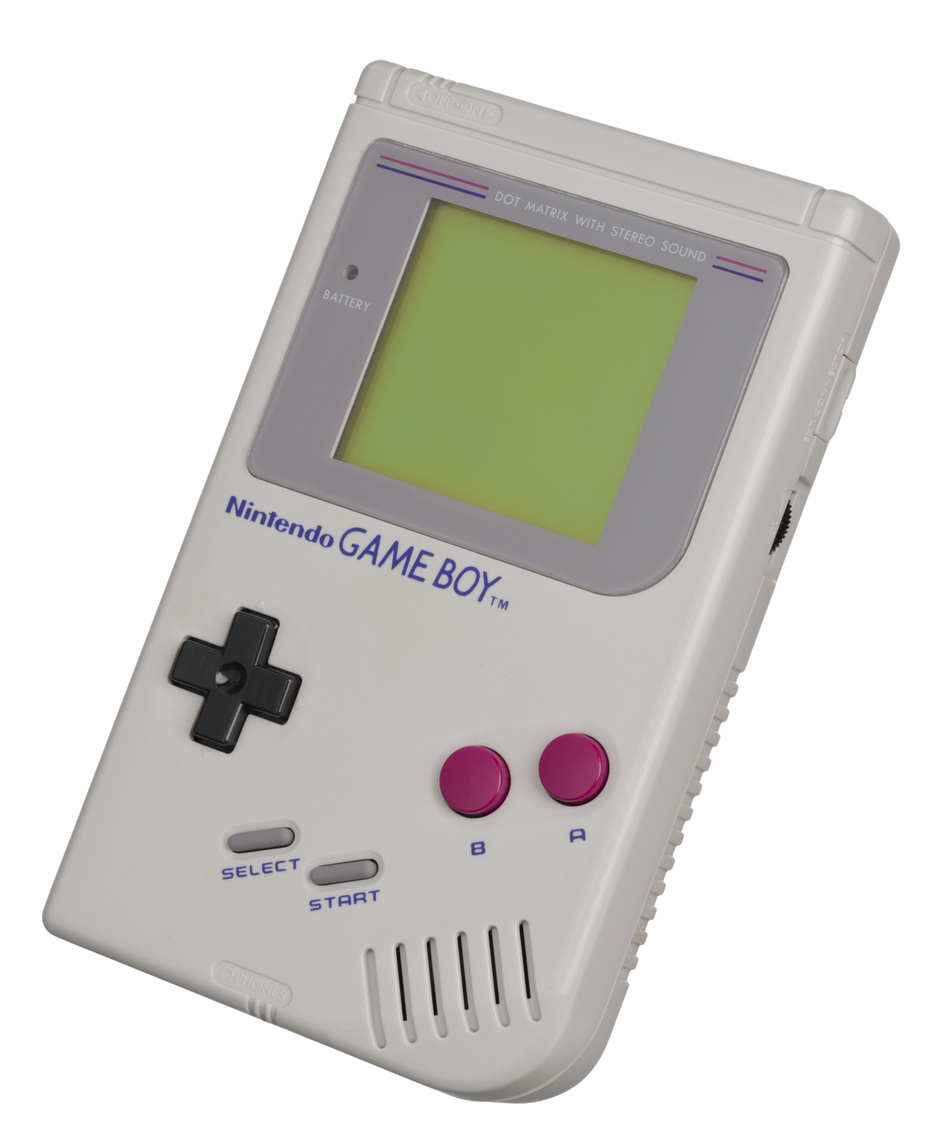
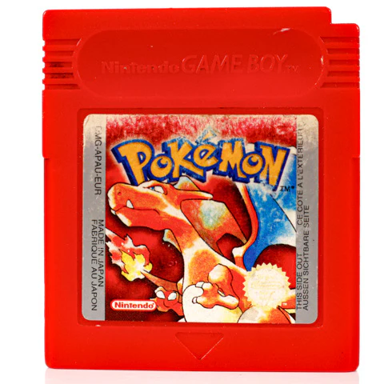
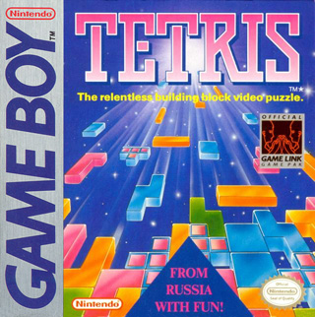
Overlays & Secondary Storage to “Swap” Memory

Slide 13
Game boy architecture
16kB
bank
16kB
bank
Memory
(ROM)
0x3FFF
8-bit
CPU
Memory bank controller
16kB
bank
Only 16 kB!
0x0000
16kB
bank
Up to 2 MB of game code could be accessed in this way.
Cartridge side
Game boy console side

Slide 14
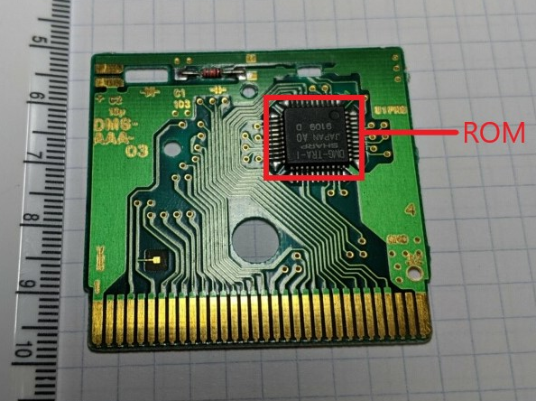
Tetris
https://b13rg.github.io/Gameboy-Bank-Switching/

Slide 15
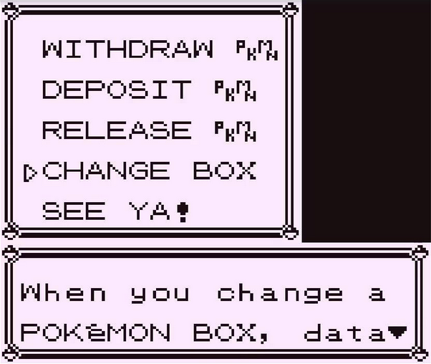
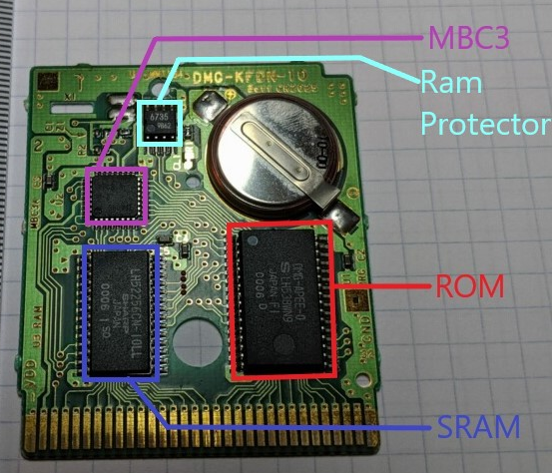
What about game saves?
Remember how each box held only 20 pokemon, and you had 16 boxes you had to switch between?

Slide 16
Game boy architecture
Bank0: Halle of fame
Bank1: Player name, party, current box
Bank2: Pokemon box 1-6
Bank3: Pokemon box 7-12
8kB
8kB
8kB
0xBFFF
8kB
MBC
RAM 8k
0xA000
8-bit
CPU
16kB
16kB
MBC
ROM 16k
0x3FFF
0x0000
Cartridge side
Game boy console side
https://retrocomputing.stackexchange.com/questions/13237/what-technological-limitations-required-the-box-system-in-gen-1-pok%C3%A9mon-games

Slide 17
To change boxes
Copy the current box (from “main” bank1) to storage (bank2 or bank3)
Copy the desired box (from bank2 or bank3) to “main” bank 1
The notion of boxes in pokemon stems from this limitation..
  And it has consequences for the game even today
So actually, many of you are actually familiar with secondary storage and swapping out memory!

Slide 18
Memory Management for Multiprogramming
Use of secondary storage
  keeping all programs and their data in memory may be impossible
  move (parts of) a process from memory
Swapping: remove a process from memory
  with all of its state and data
  store it on a secondary medium
  (disk, flash RAM, … , historically also tape)
Overlays: manually replace parts of code/data
  programmer’s rather than OS’s work
  only for very old and memory-scarce systems
Segmentation/paging: remove parts of a process from memory
  store it on a secondary medium
  sizes of such parts are usually fixed

Slide 19
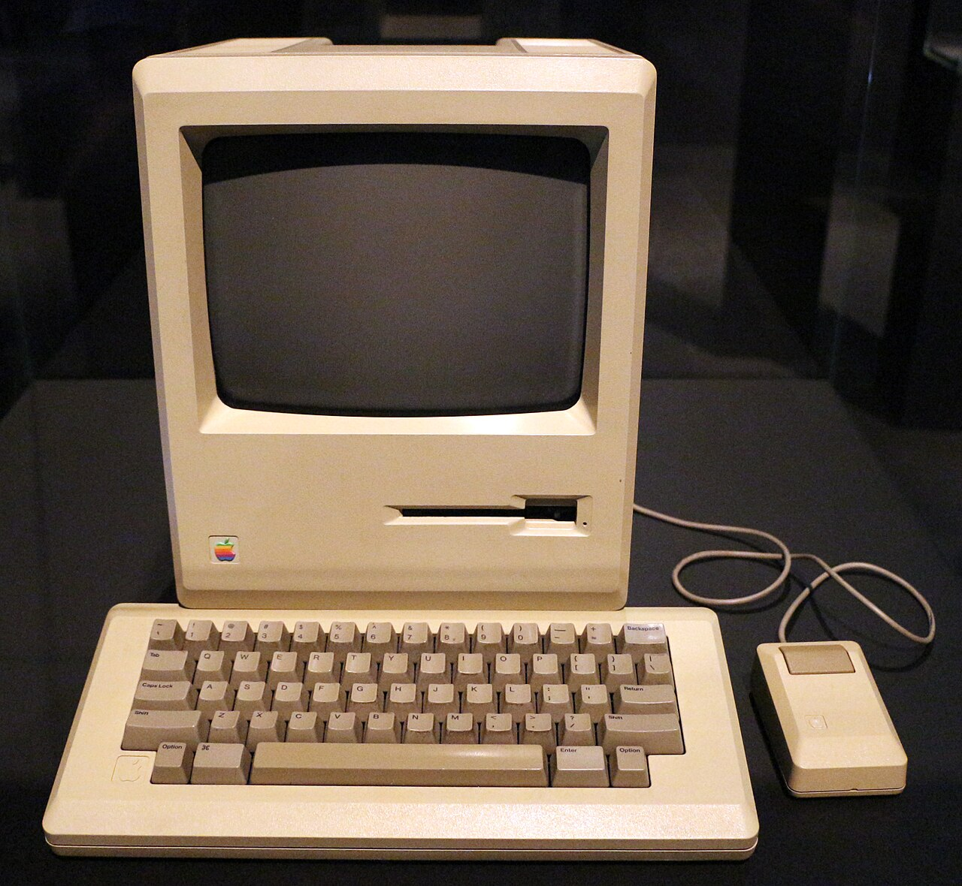
Macintosh 128k
Just one floppy drive
  No hard drive etc
Floppy applications..
  Are copied to RAM
Swap application floppies..
  To run different applications..
Data floppies
  For save data (remove application floppy first!)

Slide 20

Memory Management for Multiprogramming
Reducing memory usage
(move unused data to store)
Use of secondary storage
  keeping all programs and their data in memory may be impossible
  move (parts of) a process from memory
Swapping: remove a process from memory
  with all of its state and data
  store it on a secondary medium
  (disk, flash RAM, … , historically also tape)
Overlays: manually replace parts of code/data
  programmer’s rather than OS’s work
  only for very old and memory-scarce systems
Segmentation/paging: remove parts of a process from memory
  store it on a secondary medium
  sizes of such parts are usually fixed
Processes primitively share a machine (floppy)
Reducing memory usage (move unused data to store)
The future
(will get back to this)

Slide 21
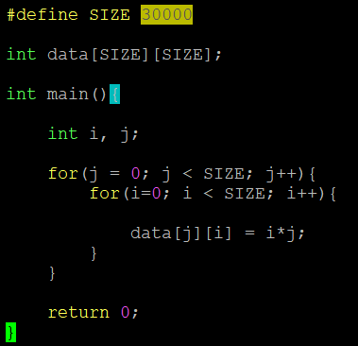
Standard memory view of a process
0xFFFFFFFF
THE STACK
THE STACK
THE STACK
CODE
DATA
0x0

Slide 22
What about a program that does this:
?
A program
A sequence of numbers in ascii
(1234)
Prints the sum of all the numbers
(10 in this case)
INPUT
OUTPUT

Slide 23
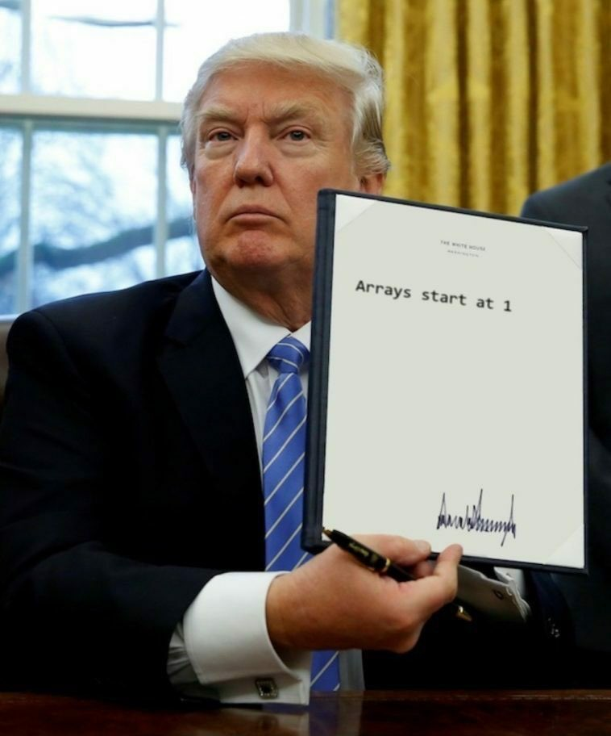
In the news:

Slide 24
Heap Allocations
The required memory size is not always known in advance
  E.g., the number of characters in a string from a user.
We can dynamically allocate an arbitrary number of bytes
  pointer = malloc( <size in bytes> );
Remember to free your memory
  free( pointer );
Is your program large and you’re not sure you free’d everything?
  valgrind –leak-check=full <executable> <arguments>
or just lazy?

Slide 25
The standard process view – final! (?)
0xFFFFFFFF
STACK
THE STACK
THE STACK
Temporary data in each scope
Code (read-only)
CODE
DATA
Data (static + heap allocations)
0x0

Slide 26
Do you HAVE to have malloc() and free()?

Slide 27
Fixed Partitioning
Divide memory into static partitions
at system initialization time
(boot or earlier)
Advantages
  easy to implement
  can support swapping of processes
Equal-size partitions
  large programs cannot be executed
  (unless parts of a program are loaded from disk)
  small programs don't use the entire partition
  (problem called “internal fragmentation”)
Unequal-size partitions
  large programs can be loaded at once
  less internal fragmentation
  require assignment of jobs to partitions
  one queue or one queue per partition
  …but, what if only small or large processes?
Equal sized:
Unequal sized:
Operating system
8MB
Operating system
8MB
8MB
2MB
4MB
8MB
6MB
8MB
8MB
8MB
8MB
12MB
8MB
8MB
16MB
8MB

Slide 28
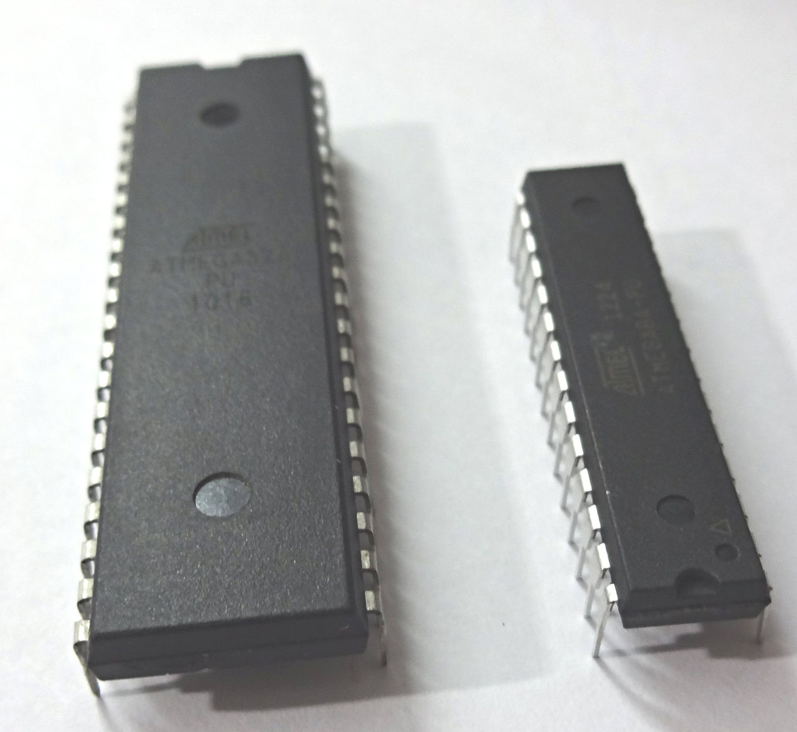

Fixed (Static) Partitioning
Very commonplace in µcs today!
Example tasks:
  UART / Command line interface
  GPIO
  I2C communication
  Sensor readings
    Gyro, GPS, Magnetometer..
No heap! No malloc(..)
  All data allocated compile-time
No Operating System
  Thin C libary
  Thin drivers (UART, Interrupts, I2C)
AT Mega microcontollers
Applications “yield” to the next application.
NON-PREEMPTIVE SCHEDULING
UART
CLI
GPIO
I2C
Sensor
Application layer
Support Libraries (C/C++) and Drivers
I2C
UART
I2C
GPIO
Hardware units
GPS
Magnetometer
Off-chip units
µc >> Please enter command.
µc >> help!

Slide 29

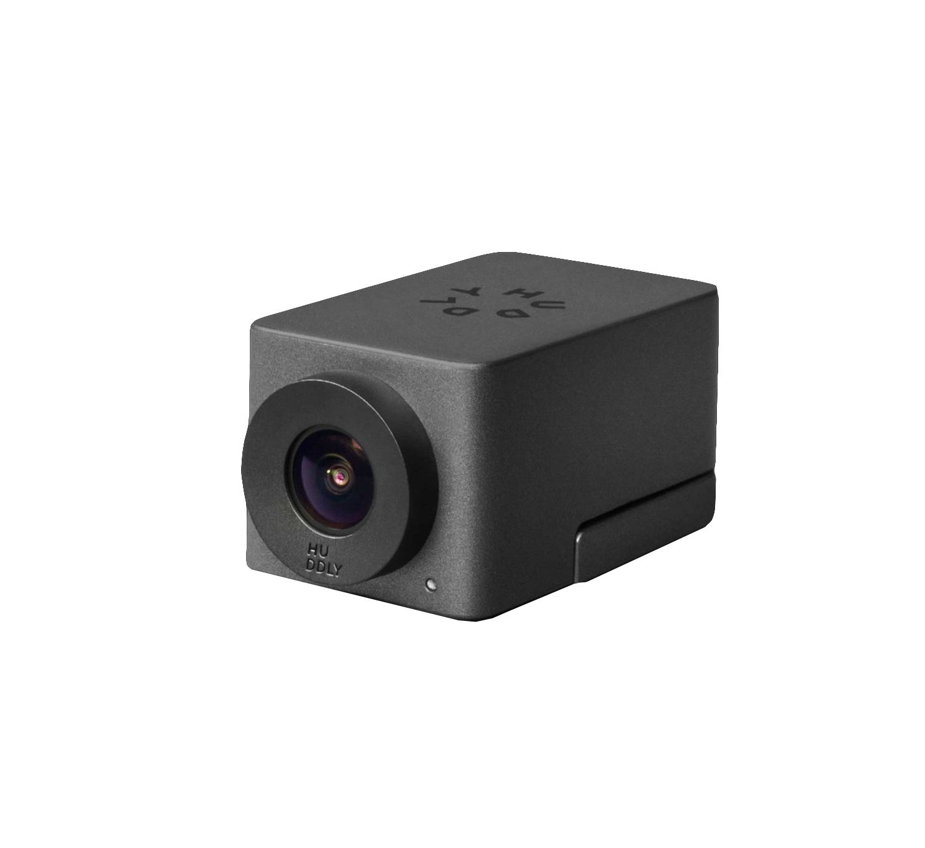
Actually..
Even for relatively complex applications, it can make sense NOT to use heap allocations like malloc(..).
Why?
  Pointers creates bugs, even for experienced programmers.
You can get away with statically allocating everything..
  And testing like crazy

Slide 31
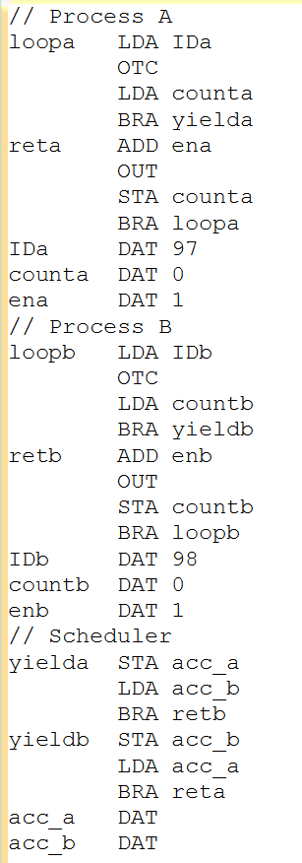
Process A & B Share the LMC
They relinquish control of the CPU:
  “Calling” yield()
They share memory
  “Static allocations” – Just take some cells
Process A
Process B
PROCESS A
PROCESS B
Scheduler
SCHEDULER

Slide 32
LMC Scheduler: Weaknesses
One process can..
  HLT the machine entirely
  BRA into the other process’ code
  Starve the other process by not yield()’ing
  Use LDA and STA to mess up the other process’ counting
Process A
Process B
Example: pointer sharing
PROCESS A
PROCESS B
Scheduler
SCHEDULER

Slide 33
So in summary, we have the following (RAM) challenges:
Conserving RAM (memory) usage
  Not everything needs to be in RAM at all times.
  Some of it could be on a disk.
Sharing RAM between processes
  Several processes must be able to utilize available RAM
  Processes may even share RAM to communicate
Protecting processes from each others’ RAM
  Accidental or malicious attempts to write each others’ memory
CONSERVING
SHARING
PROTECTING

Slide 34
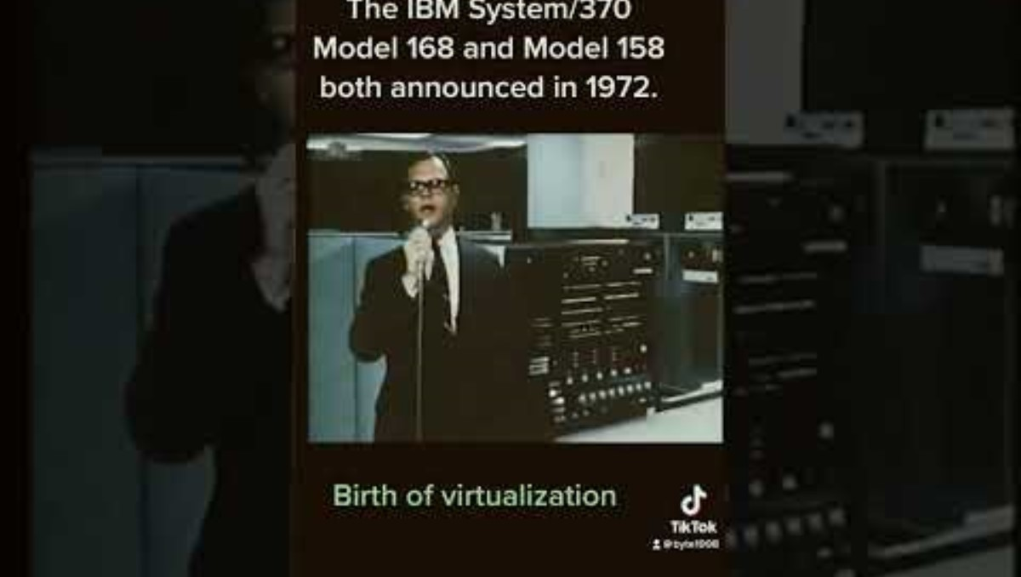

Slide 35
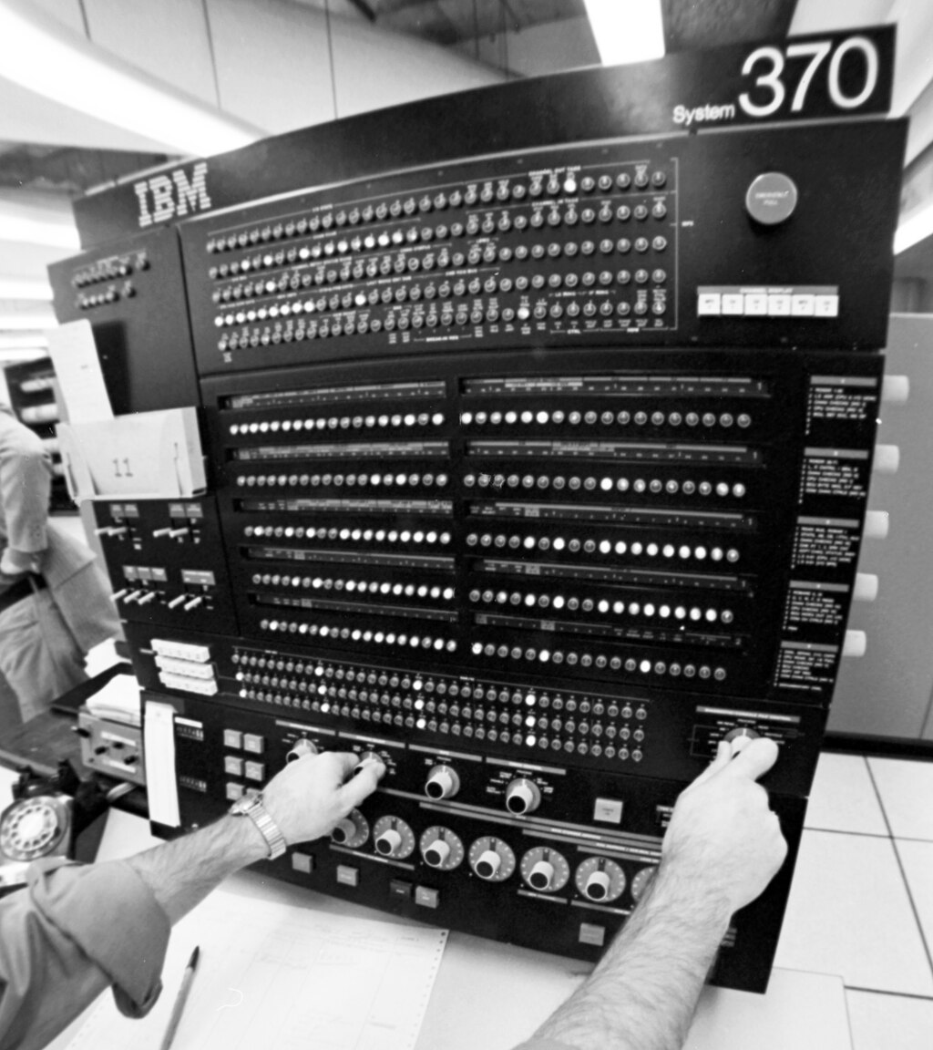
IBM System 370 (1970s)
“The bank previously had nine computers running 2,000 different programs. By switching to System/370, it was able to run all its programs on a single mainframe.”
“By fully utilizing virtual storage, System/370 enabled programmers to use more memory than might be physically available.”
“Part of System/370’s success can be attributed to the fact that it was among the first computers to include full support for virtual memory”
SHARING
CONSERVING
https://www.ibm.com/history/system-370

Slide 36
You are ready for the truth!

Slide 37
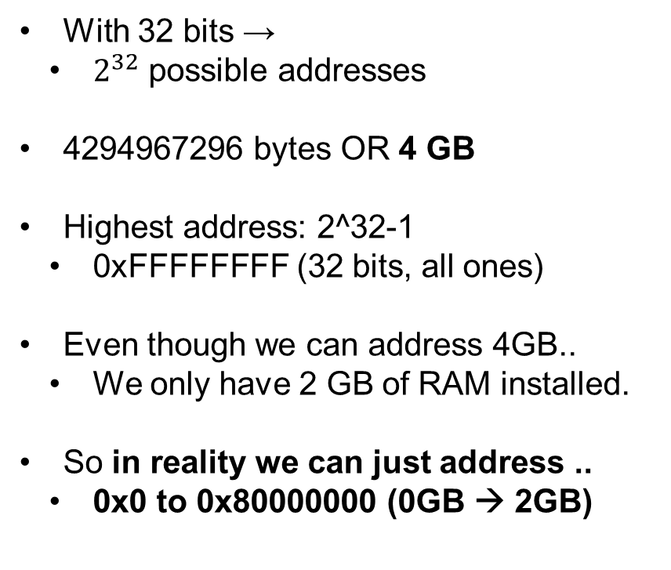
A very simple 32-bit machine with 2 GB of RAM.
0xFFFFFFFF
With 32 bits →
  $2^{32}$ possible addresses
4294967296 bytes OR 4 GB
Highest address: 2^32-1
  0xFFFFFFFF (32 bits, all ones)
Even though we can address 4GB..
  We only have 2 GB of RAM installed.
So in reality we can just address ..
  0x0 to 0x80000000 (0GB → 2GB)
FULL ADDRESSABLE SPACE
0x80000000
INSTALLED RAM
0x0

Slide 38
Next, consider our process running in our machine.
0xFFFFFFFF
0xFFFFFFFF
STACK
THE STACK
THE STACK
???
The stack is all the way up here
0x80000000
0x80000000
CODE
INSTALLED RAM
Something is odd, isn’t it?
DATA
How can the stack be in this part of RAM, where there is no actual RAM installed?
0x0
0x0

Slide 39
How can this be?

Slide 40
Virtual and physical addresses
STACK
The stack, code and data regions of our process are actually located somewhere else in PHYSICAL RAM.
ADDRESS TRANSLATION
INSTALLED RAM
CODE
CODE
DATA
DATA
STACK

Slide 41
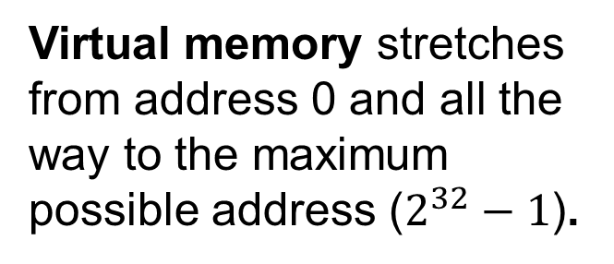
This is Virtual Memory
0xFFFFFFFF
STACK
The memory addresses that a process “sees” is called virtual memory.
Virtual memory stretches from address 0 and all the way to the maximum possible address ($2^{32}−1$).
CODE
DATA
0x0

Slide 42
This is Physical Memory
Physical memory is the actual addressable range of memory, that depends on how much is installed.
In our case, it stretches from 0x0 to 0x80000000 (2GB).
0x80000000
INSTALLED RAM
Accessing physical memory outside this region yields undefined behaviour.
0x0

Slide 43
Virtual and physical memory
STACK
INSTALLED RAM
CODE
DATA
Virtual memory
Physical memory

Slide 44
Let’s make it simpler
0xFFFFFFFF
STACK
Process A
CODE
DATA
0x0

Slide 45
Let’s make it simpler
0xFFFFFFFF
Process A
0x0

Slide 46
And a little more complex... Two processes
0xFFFFFFFF
Each process has its own “virtual memory” from the minimum (0x0) to the maximum (0xFFFFFFFF) address range.
Process A
0x0
0xFFFFFFFF
Process B
0x0

Slide 47
Now for the mapping
0xFFFFFFFF
Notice how process A and process B seem to share the same memory ranges (upper part of memory); however, they are actually mapped to completely unique physical addresses.
Process A
0x0
ADDRESS TRANSLATION
INSTALLED RAM
0xFFFFFFFF
Process B
0x0

Slide 48
The great revelation
0xFFFFFFFF
Each process runs as if it owns the entire address space, while in reality, it is shared with other processes.
In this way, processes are protected from each other, and we share the physical RAM.
Process A
0x0
ADDRESS TRANSLATION
INSTALLED RAM
0xFFFFFFFF
Process B
PROTECTING
SHARING
0x0

Slide 49
This is called Virtual Memory.

Slide 50
Where is the magic in Virtual Memory?
0xFFFFFFFF
Process A
0x0
ADDRESS TRANSLATION
INSTALLED RAM
0xFFFFFFFF
Process B
0x0

Slide 51
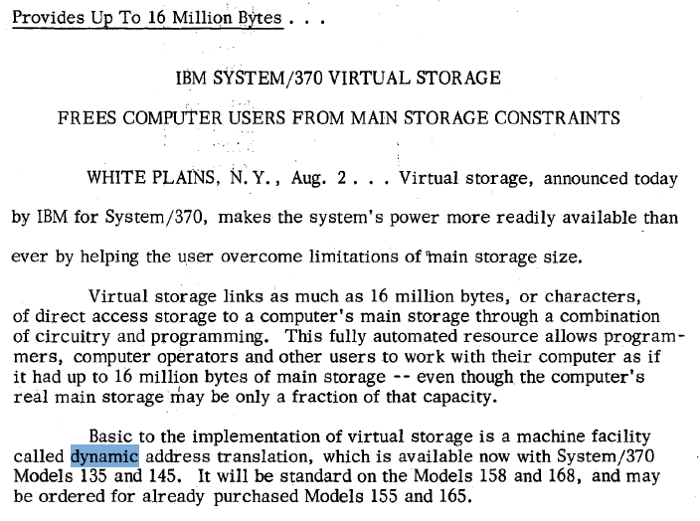
On IBM 370, this was called “Dynamic Address Translation”
https://www.google.com/url?sa=t&source=web&rct=j&opi=89978449&url=https://www.vm.ibm.com/history/50th/370info.pdf

Slide 52
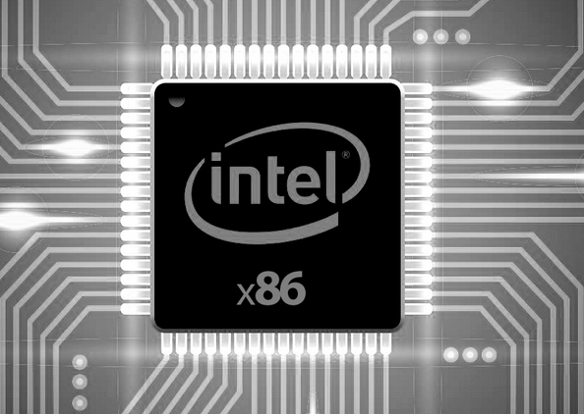
On x86, this is called the Memory Management Unit (MMU)
0xFFFFFFFF
Process A
0x0
MMU
INSTALLED RAM
0xFFFFFFFF
Process B
0x0

Slide 53
Address Translation
How is it done?

Slide 54
Address Translation
Let’s say that a process tries to read from virtual address 0x00c03010
The MMU’s goal is now:
  Translate virtual addresses into a physical process.
  Such that the value from that address can be fetched.
mov 0x00c03010, rax
RAM
CPU
0x00c03010
MMU
???

Slide 55
IN1020 Background Knowledge
0x00c03010
The virtual address that the CPU reads
00000000110000000011000000010000
The first 10 bits is 3
The next 10 bits is 3
The last 12 bits is 8

Slide 56
You’re good to go!

Slide 57
Each process has its own page directory in RAM
A process’ page directory

Slide 58
The first 10 bits of the address points to an entry
I.e., the first ten bits point to entry 3 of the page directory
First 12 bits =
000000000011
which is 3
A process’ page directory
0x00c03010

Slide 59
That entry points to a page table, which is also in RAM
A process’ page directory
A page table
0x00c03010

Slide 60
The next 10 bits of the address points to an entry in the page table
A process’ page directory
A page table
I.e., the first ten bits point to entry 3 of the page table
0x00c03010
Next 12 bits =
0000000011
which is 3

Slide 61
Finally, the page table entry contains the first 20 bits of the physical address
For illustrative purposes I choose this number
RAM
0xff000
+
A process’ page directory
A page table
0x00c03010
Add the last 12 bits of the virtual address to get the physical address: 0xff000010

Slide 62
This is how the MMU translates virtual to physical addresses.
For x86 (32-bit).
mov 0x00c03010, rax
0x00c03010
0xff000010
RAM
CPU
MMU
PROTECTING
SHARING

Slide 63
Page Directory & Page Table Entries are 32 bit Long
The first 20 bits of an address
11 bits that are not vital to our discussion
P
If present is 1:
Can point to:
-> A page table
-> A physical address
PRESENT: Important!
1: Page is present in RAM
0: Page is no present in RAM
If present is 0:
Can point to:
-> Anything you like
-> A disk sector?
CONSERVING

Slide 64
If the present bit is not set during lookup, a page fault is generated
DISK
The CPU must handle the fault, and move the desired memory from the disk and to the RAM.
PAGE FAULT!
0xff000010
RAM
mov 0x00c03010, rax
0x00c03010
P != 1
CPU
MMU
PROTECTING
SHARING

Slide 65
Thanks for today!

