Slide 1
The Course
IN2140:
Introduction to Operating Systems and Data Communication
An overview of IN2140
Tuesday, January 21, 2025

Slide 2
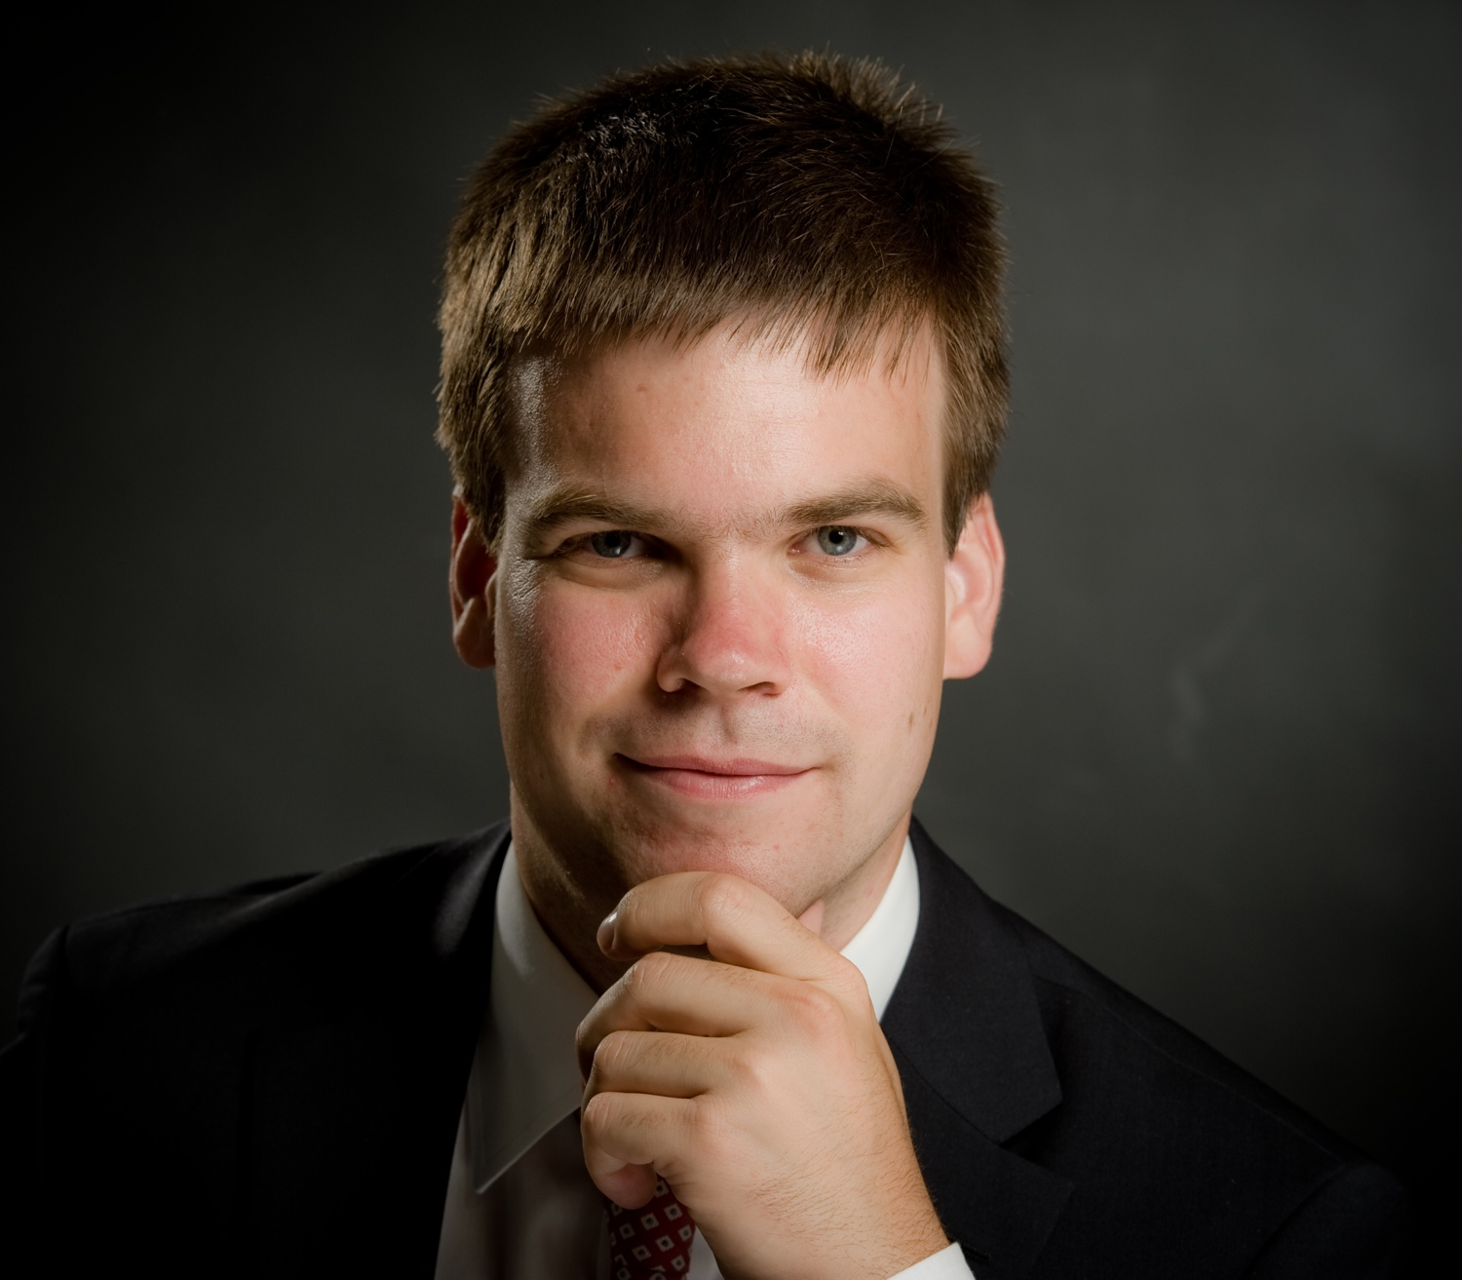


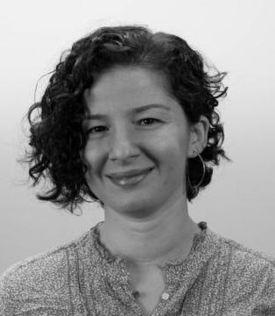
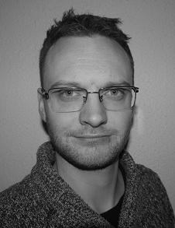
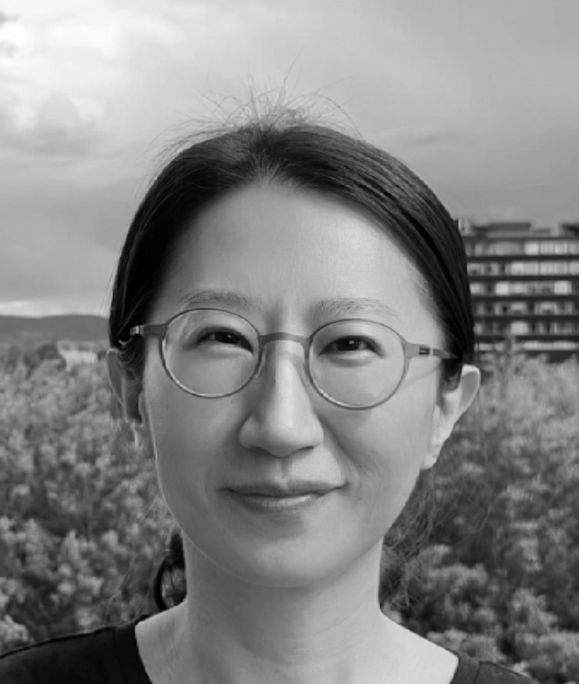
People
Lecturers
  Carsten Griwodz
  griff @ ifi
  Pål Halvorsen
  paalh @ ifi
  Özgü Alay
  ozgua@ifi
  Kristoffer Robin Stokke
  krisrst@ifi
  Jie Bian
  jiebi @ ifi
Group teachers
  Philip Høeg Eriksen, philipe
  Jasuhan Yoganathan, jasuhany
  Sondre Sundby Rosslund, sondrsro
  Ka Thas, kavint
  Lars Nøvik, larsnov
  Birk Bergerud-Nygård, birkb
Administrative questions by email

Slide 3

Learning Outcome
Course content
  an introduction to operating systems (OS),
  viewed from both the user’s and machine’s point of view
    have basic knowledge of the most important components of an operating system
    be able to develop small applications that call OS services
    know algorithms, don’t program the operating system kernel (that is IN3000)
  insight into how data communication is taking place
    be able to choose between algorithms that enable today's data communication in the Internet
    be able to develop programs with processes that communicate –
    within the computer and over a network
  understanding theory through practice by programming
    experience implementing algorithms for operating systems and data communication without the protective cover provided by runtimes and interpreters
    experience programming in C

Slide 4
Learning Outcome: OS
    have basic knowledge of the most important components of an operating system
    be able to develop small applications that call OS services
    know algorithms
Why?
  Know that operating systems hide hardware complexity for you
  Know about kernel space and user space, and how they interact
  Learn typical algorithms for the most important operations performed by the operating system for you
  Understand that different algorithms are good for different workloads
  Understand when software is wasting performance unnecessarily
  Select the right hardware, services and algorithms when you build complex systems
  Need-to-know for advanced courses in operating systems, compilers, distributed systems, parallel programming, HPC, ...

Slide 5
Learning Outcome: Datacom
    be able to choose between algorithms that enable today's data communication in the Internet
    be able to develop programs with processes that communicate – within the computer and over a network
Why?
  Know how data and information are moved over a network
  Understand how networks are structured
  Know those parts of the network that you can change yourself
  Write simple networked and distributed applications
  Make the right choices when programming networked and distributed applications
  Understand and change basic network configurations
  Understand the cost of distributing applications
  Understand the performance of complex distributed applications
  Need-to-know for advanced courses in networks, distributed systems, parallel programming, HPC, security, ...
Notes:
"... can change yourself" - Jeg mener: ikke som nettverksadmin, du må ta flere kurs for dette. Men hvis du er admin av din egen maskin.

Slide 6
Learning Outcome: C
    experience implementing algorithms for operating systems and data communication
    without the protective cover provided by runtimes and interpreters
    experience programming in C
Why?
  Understand memory and memory addresses in much more detail than from theory
  Understand how operating systems are related to computer architecture
  Understand that networks do not know about data structures and program structures
  C brings you very close to the computer’s architecture and OS
  Most importantly
    C allows you to easily interpret every (accessible and readable) byte
    in the computer as you like
    Most programming languages make that very hard or impossible
    You cannot write an OS without re-interpreting memory
  C is the (grand-) parent of C++, Objective C, Java, C#, Scala, Python, PHP, Perl, Ruby, …
  C is not the final word in OS writing, but so far, all others failed. Will Rust succeed?

Slide 7
Connecting the dots
OS: Introduksjon
OS: prosesser og CPU scheduling
Datakom: addresser
på L2 og L3
Datakom: namer
på L4 og DNS
Datakom: forbindelseso. & -løst
Datakom: metningskontroll
OS: minne
OS: lagring
OS: IPC
Datakom: introduksjon
Datakom: Flytkontroll
Datakom: ruting
Oblig: get started
Oblig: filer/ -system
HE: praksis
FE: teori
Basistypene, string, adresser, pekere
avanserte datatyper, aksess uten peker, dereferensering
grafer, serialisering, minnelayout
håndtering av bits, boolske operatorer
Pipe, fork, relasjon til serialisering
sockets, getaddrinfo, klienter og servere
Filer, minnelayout
Forbindelsesløst & -orientert

Slide 8
Teaching structure
theory
transfer
praxis
Lecture
Plenum
Group session
After Easter: Comprehension tasks
Before Easter: Programming tasks
Understand theory
Understand by programming
understanding
experience

Slide 9
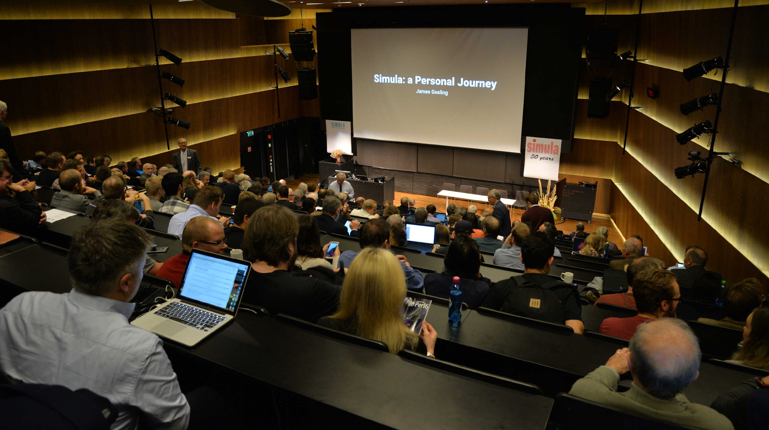
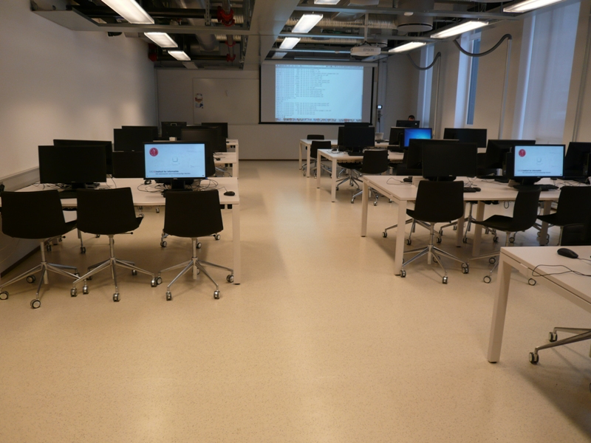
Teaching structure
    Theory
Input
  Weekly lectures
  Weekly slides
  Tanenbaum’s books
    From theory to practice
Input
  Live weekly, unrecorded sessions
  From theory to code
    Practice
Input
  C programming education
  Assignment help
  Weekly exercises

Slide 10
Teaching structure
    Theory
    Practice
Voluntary
Attend «lecture» session
Ask theory questions
Voluntary
Attend «group» session
Solve programming tasks
Ask for help
4-hour exam,
mostly multiple choice
Examination
2x semester mandatory programming exercise
deliver in groups
Mandatory
3-week home exam,
solving a programming task
deliver in groups
Examination
    From theory to practice
Attend «plenum» session
Get a practical look at theory
Ask theory & programming questions
Voluntary

Slide 11


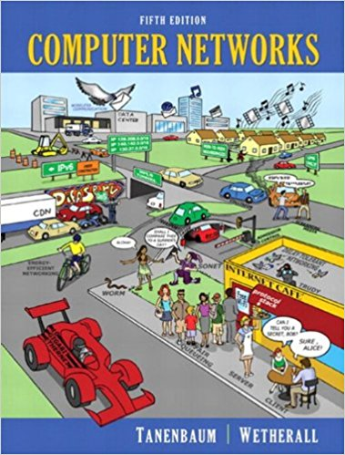
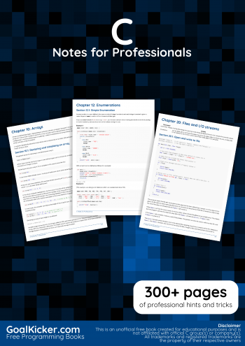
Pensum
Topics taught in the videos, slides and live sessions
together with the given slides and exercises constitute the “pensum”
Supporting books
  Modern Operating Systems:
  Andrew S. Tanenbaum
  Computer Networks:
  Andrew S. Tanenbaum
  C Notes for Professionals book:
  editor: web@petercv.com
  Other useful C books:
    The C programming Language:
    Brian Kernighan and Dennis Ritchie
    C: A Reference Manual:
    Samuel P. Harbison and Guy L. Steele

Slide 12
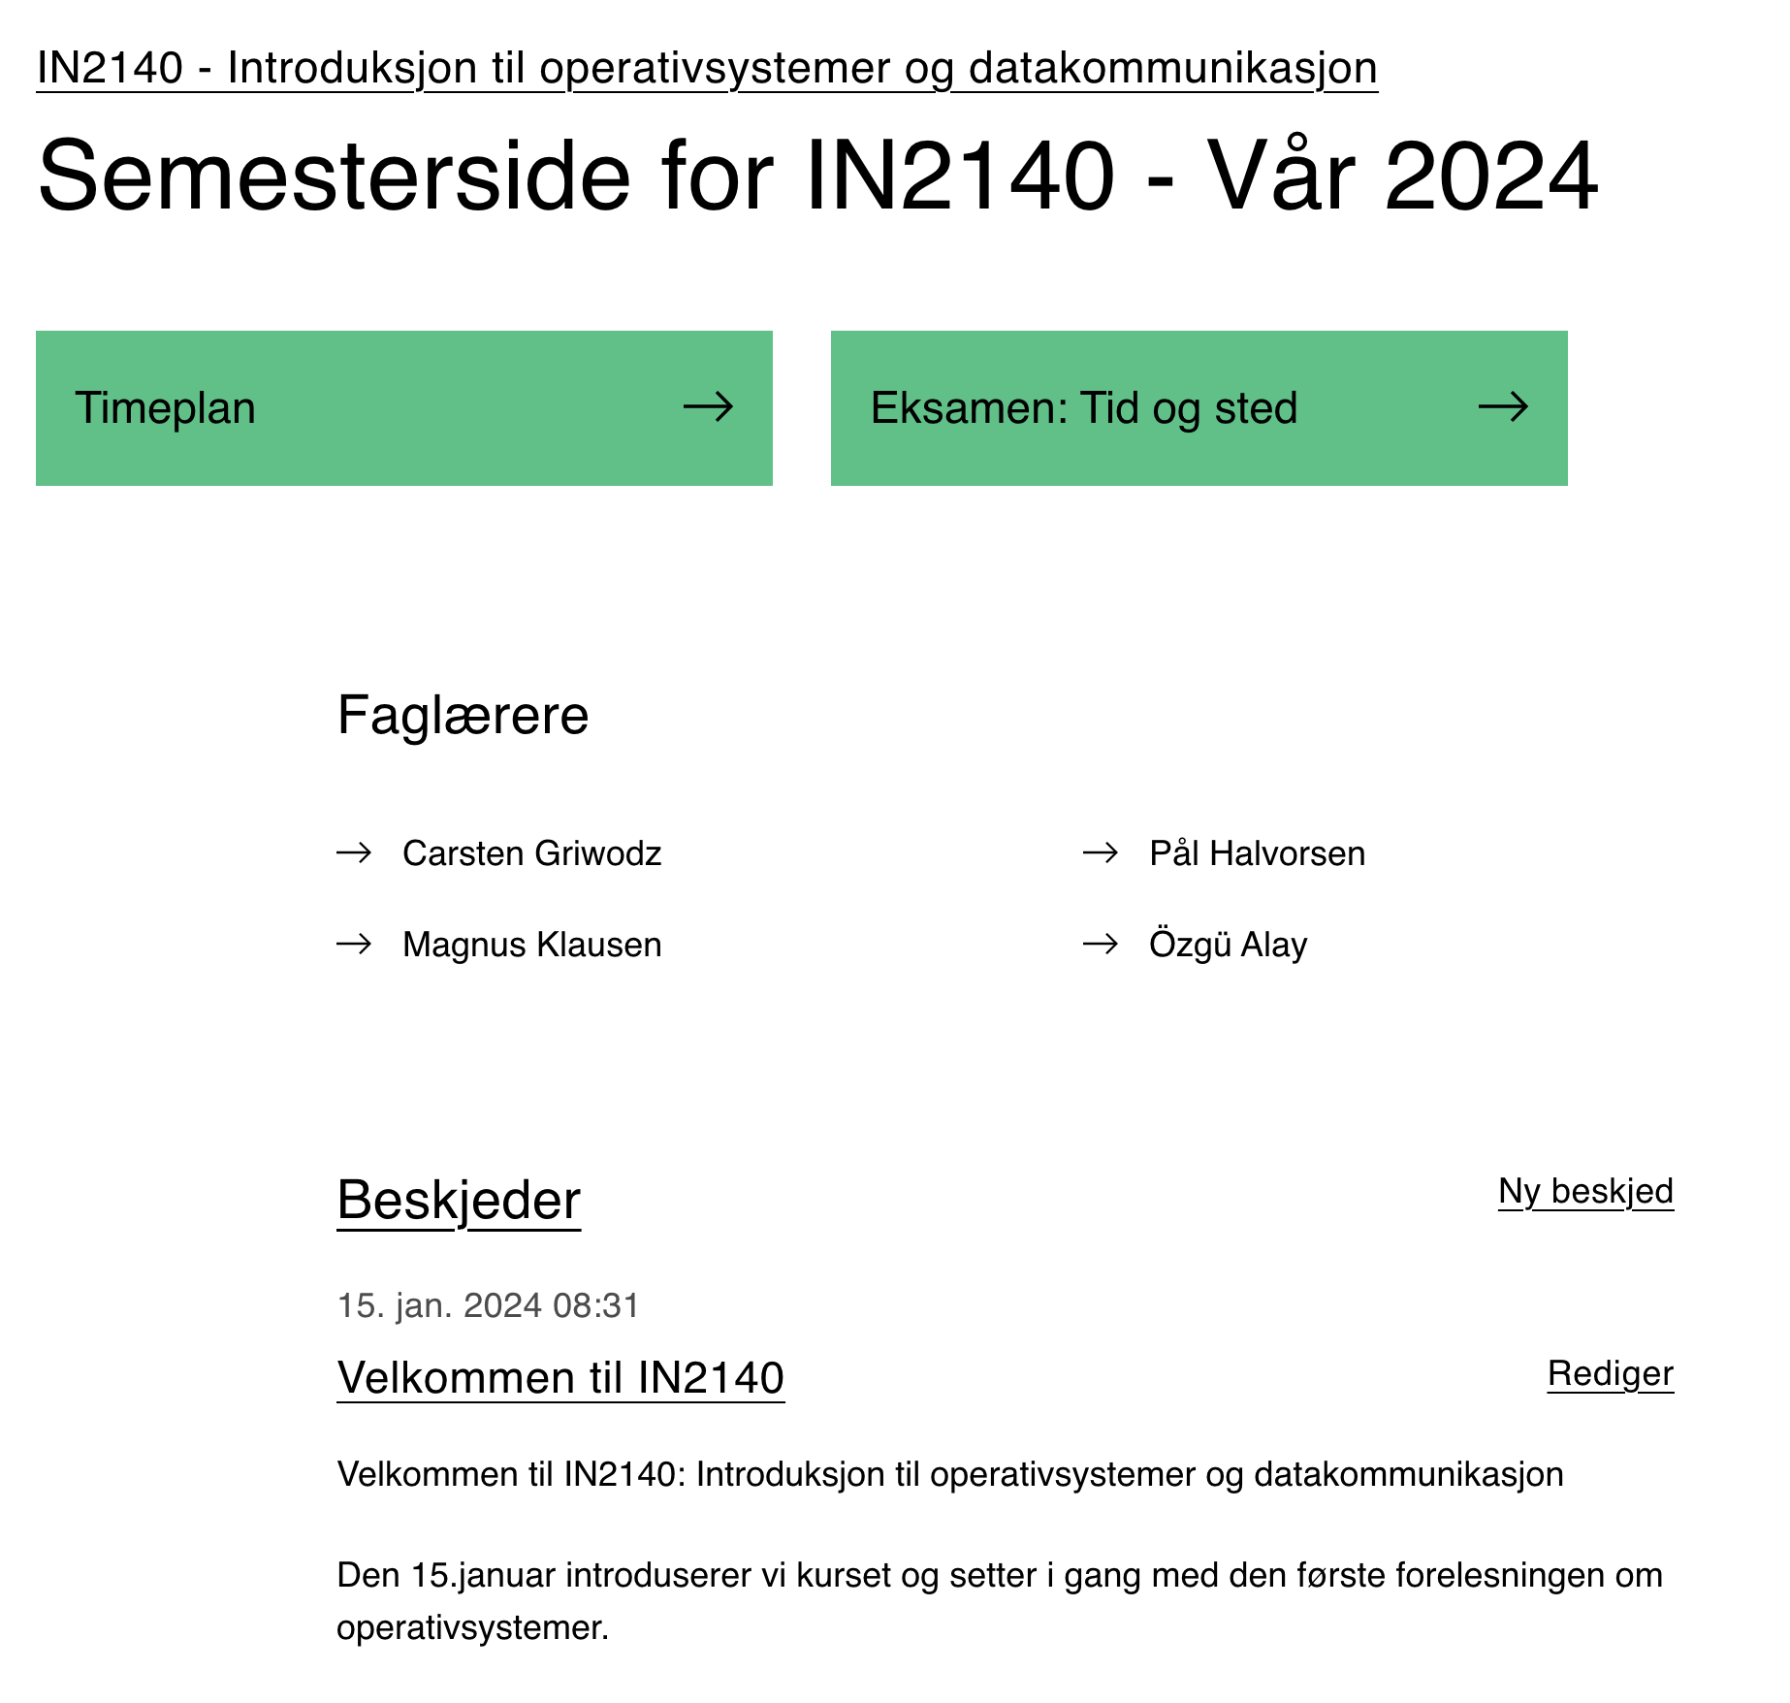
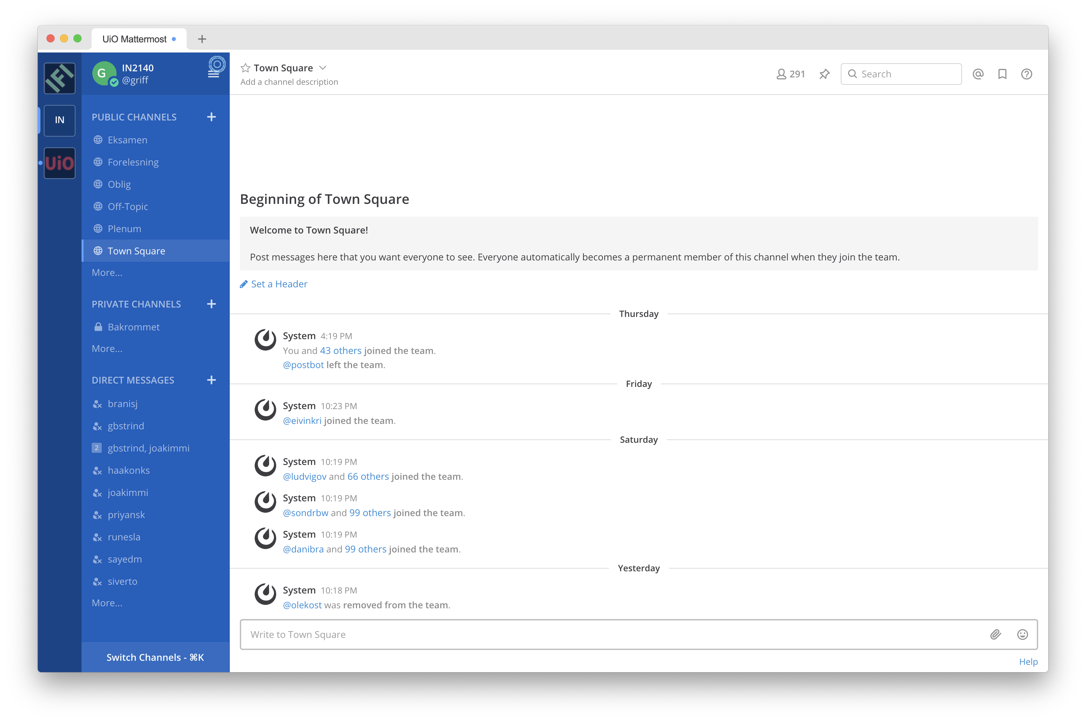
Information
Course homepage in Vortex
  your starting point
  messages & news
  schedule
  videos in Panopto
  Mattermost for discussions
Devilry
  for submitting your responses to mandatory assignment
Inspera
  for both exams

Slide 13

Exams and Mandatory Exercises
Mandatory exercises
  two C programming exercises
    getting started with C
    preparation for home exam
  tentative dates: delivery 11.02. + 11.03.
One home exam
  focus on programming and documenting
  one concept related to OS and DataCom
  tentative dates: delivery 29.04.
Final exam
  focus on the concepts, not programming
  date 30.05.
  4 hours, 9:00-13:00
Note:
spring 2025 exams are similar to spring 2024 exams

Slide 14
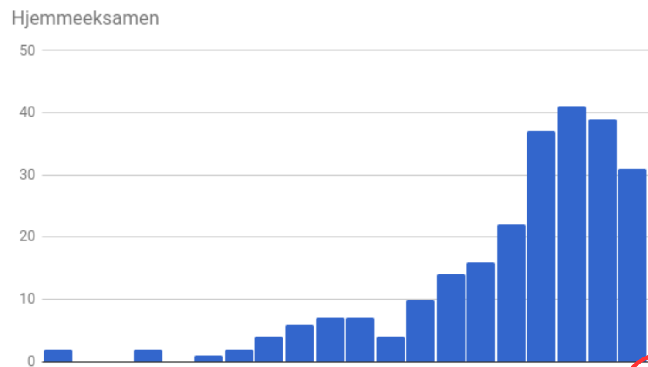
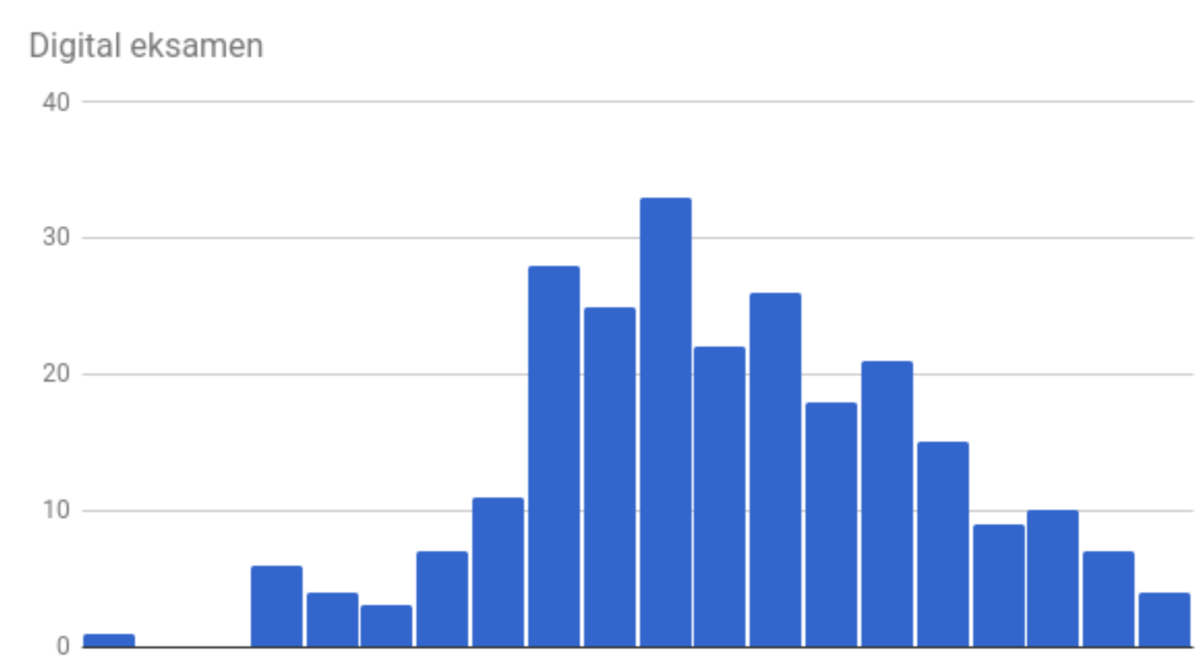
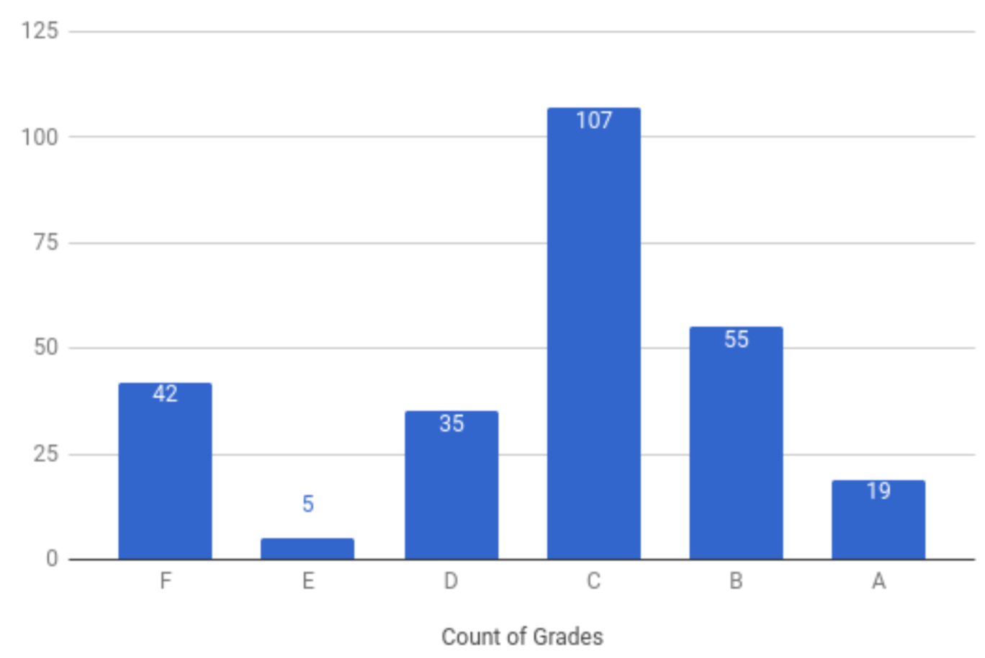
Evaluation and grading
Passing the mandatory assignments is a prerequisite for
admission to the theory exam
  Passing mandatory assignments in early years qualifies for taking the exams.
  Both exams must be taken in the same semester.
Grading:
  40% homeexam
  60% final exam
Both exams count
+
=
programming is fun, but counts only for 40% of the final grade

Slide 15

Questions?

