Slide 1
An overview of IN2140
IN2140:
Introduction to Operating Systems and Data Communication
Özgü Alay
ozgua@ifi.uio.no
Room: 4159
Tuesday, January 20, 2026

Slide 2
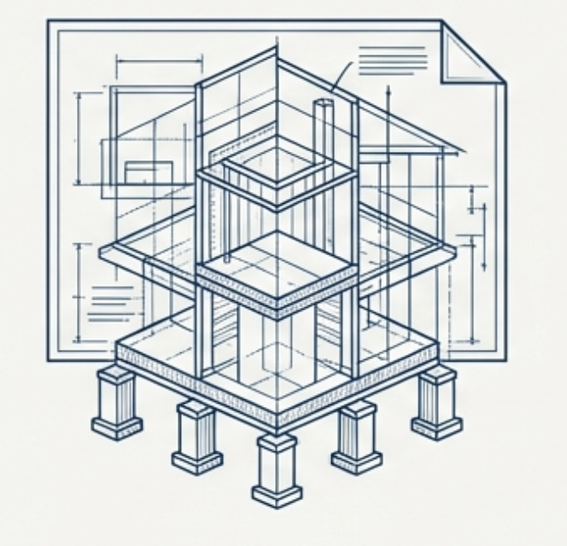


IN2140 Course Content
an introduction to operating systems (OS), viewed from both the user’s and machine’s point of view
  have basic knowledge of the most important components of an operating system
  be able to develop small applications that call OS services
  know algorithms, don’t program the operating system kernel (that is IN3000)
insight into how data communication is taking place
  be able to choose between algorithms that enable today's data communication in the Internet
  be able to develop programs with processes that communicate – within the computer and over a network
understanding theory through practice by programming
  experience implementing algorithms for operating systems and data communication without the protective cover provided by runtimes and interpreters
  experience programming in C

Slide 3





Learning Outcome: OS
See beyond the code: How operating systems hide hardware complexity for you? What are kernel space and user space, and how they interact?
Learn different algorithms: What are the typical algorithms for the most important operations performed by the operating system for you? Which algorithm to choose for different workloads?
Build smarter systems: When does software waste performance unnecessarily? What is the right choice of hardware, services and algorithms when you build complex systems?
Enable Future knowledge: Prerequisite for advanced courses in operating systems, compilers, distributed systems, parallel programming, HPC, ...

Slide 4

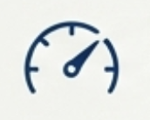
Learning Outcome: Datacom
Map the internet: How are data and information moved over a network? How are networks structured? What parts of the network you can change yourself?
Build distributed applications: How to write simple networked and distributed applications? What are the right choices when programming networked and distributed applications?
Performance matters: What is the cost of distributing applications? What impacts the performance of complex distributed applications?
Enable Future knowledge: Prerequisite for advanced courses in networks, distributed systems, parallel programming, HPC, security, ...
Notes:
"... can change yourself" - Jeg mener: ikke som nettverksadmin, du må ta flere kurs for dette. Men hvis du er admin av din egen maskin.

Slide 5



Learning Outcome: C
Direct memory control: How memory and memory addresses work in practice?
Better system understanding: How operating systems are related to computer architecture? Do networks know about data structures and program structures?
Closer to the architecture and OS:
  C allows you to easily interpret every (accessible and readable) byte in the computer as you like
  Most programming languages make that very hard or impossible
  You cannot write an OS without re-interpreting memory
C is the (grand-) parent of C++, Objective C, Java, C#, Scala, Python, PHP, Perl, Ruby, …
C is not the final word in OS writing, but so far, all others failed. Will Rust succeed?

Slide 6
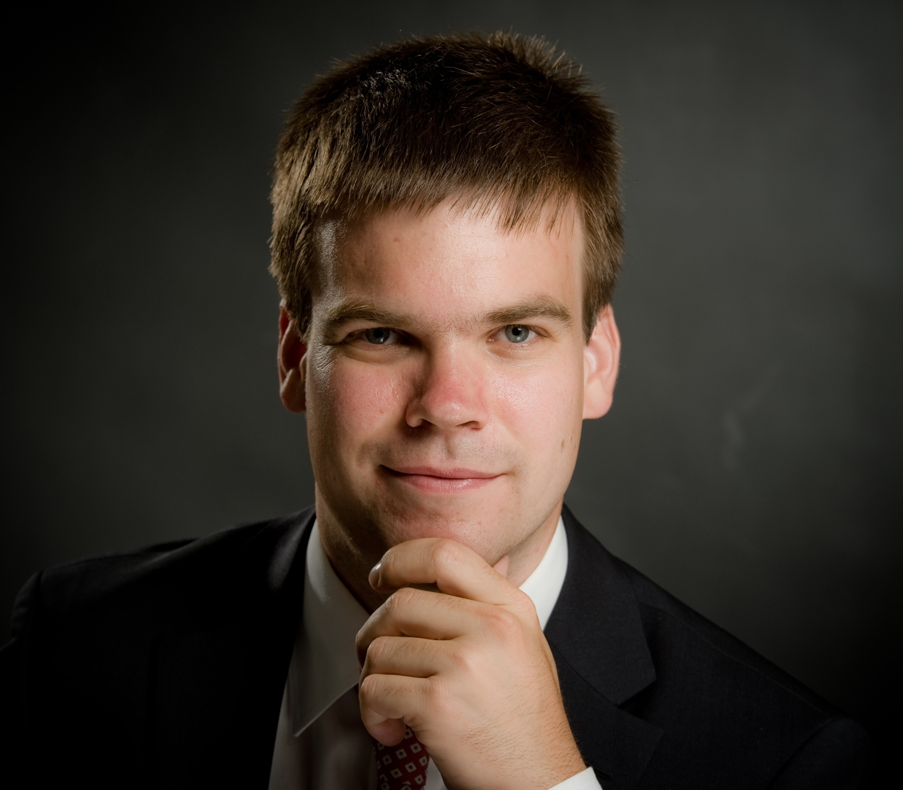

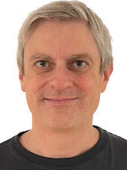
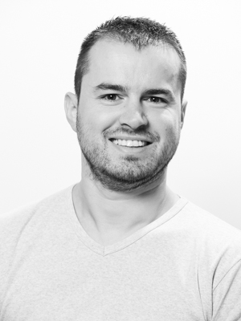
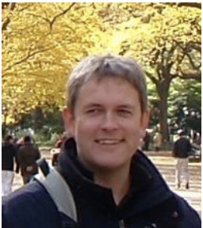
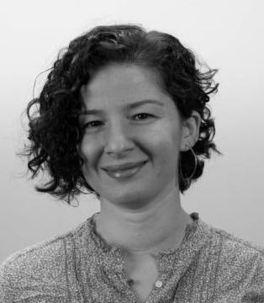
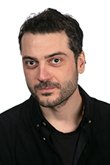
People
Lecturers
  Pål Halvorsen
  paalh @ ifi
  Michael Welzl
  michawe @ ifi
  Kristjon Ciko
  kristjoc@uio.no
  Carsten Griwodz
  griff @ ifi
  Özgü Alay
  ozgua@ifi
  Cagri Erdem
  cagrie @ ifi
Group teachers
Andreas Marelius Stachnik Hansen
Birk Bergerud-Nygård
Alexander Gran Makarov
Sondre Sundby Rosslund
William Henrik Behn
Lars Nøvik
Administrative questions by email

Slide 7
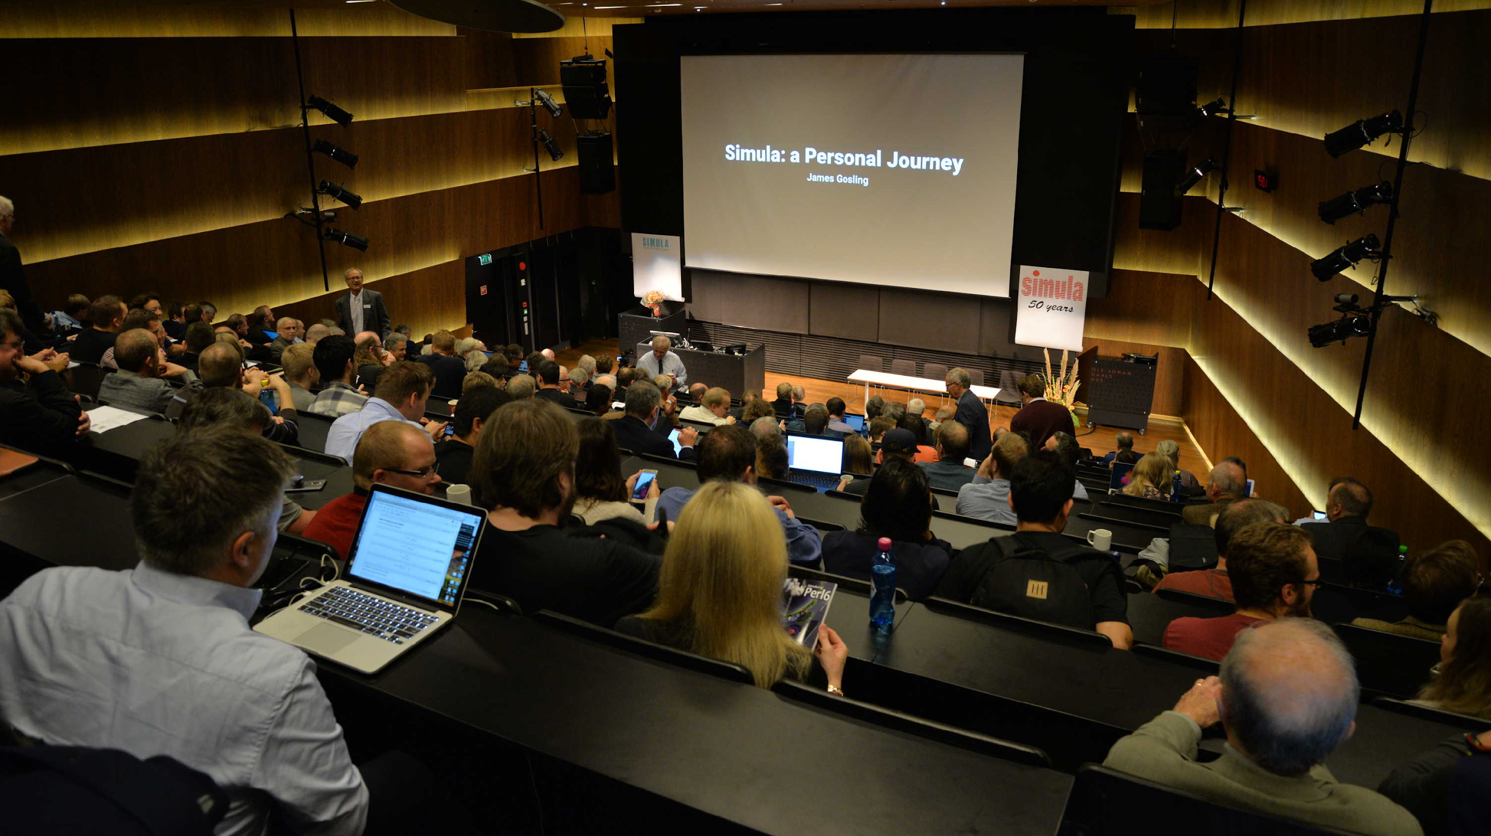
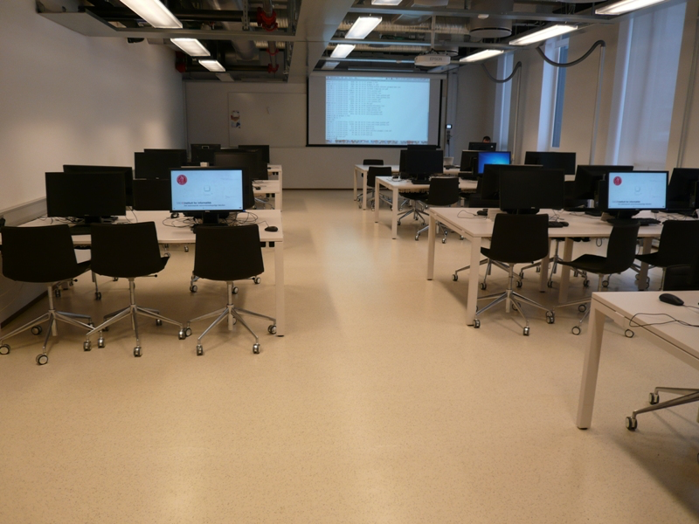
Teaching structure
    Theory
Input
  Weekly lectures
  Weekly slides
  Tanenbaum’s books
    Practice
Input
  C programming education
  Assignment help
  Weekly exercises

Slide 8
Connecting the dots
    Theory
C Programmering Basis
OS: prosesser og CPU scheduling
Datakom: addresser
på L2 og L3
Datakom: namer
på L4 og DNS
Datakom: forbindelseso. & -løst
Datakom: flyt/metningskontroll
OS: minne
Datakom: ruting
OS: lagring
OS: IPC
Oblig: get started
Oblig: filer/ -system
FE: teori og programmering
    Practice
avanserte datatyper, aksess uten peker, dereferensering
Basistypene, string, adresser, pekere
grafer, serialisering, minnelayout
håndtering av bits, boolske operatorer
Pipe, fork, relasjon til serialisering
sockets, getaddrinfo, klienter og servere
Filer, minnelayout
Forbindelsesløst & -orientert

Slide 9
Teaching structure
    Theory
    Practice
Voluntary
Attend «lecture» session
Ask theory questions
Voluntary
Attend «group» session
Solve programming tasks
Ask theory & programming questions
Ask for help
Mandatory
2x semester mandatory programming exercise
deliver individually
4-hour exam, both theory (mostly no-free text questions) and programming (mostly comprehension) questions
Examination

Slide 10


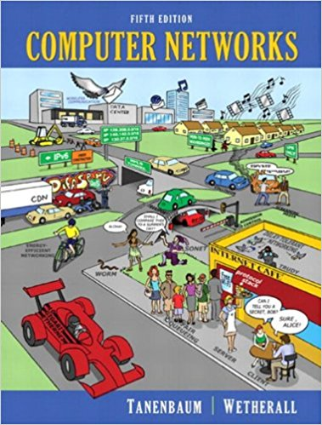
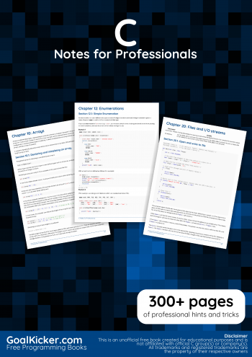
Pensum
Topics taught in the videos, slides and live sessions
together with the given slides and exercises constitute the “pensum”
Supporting books
  Modern Operating Systems:
  Andrew S. Tanenbaum
  Computer Networks:
  Andrew S. Tanenbaum
  C Notes for Professionals book:
  editor: web@petercv.com
  Other useful C books:
    The C programming Language:
    Brian Kernighan and Dennis Ritchie
    C: A Reference Manual:
    Samuel P. Harbison and Guy L. Steele

Slide 11
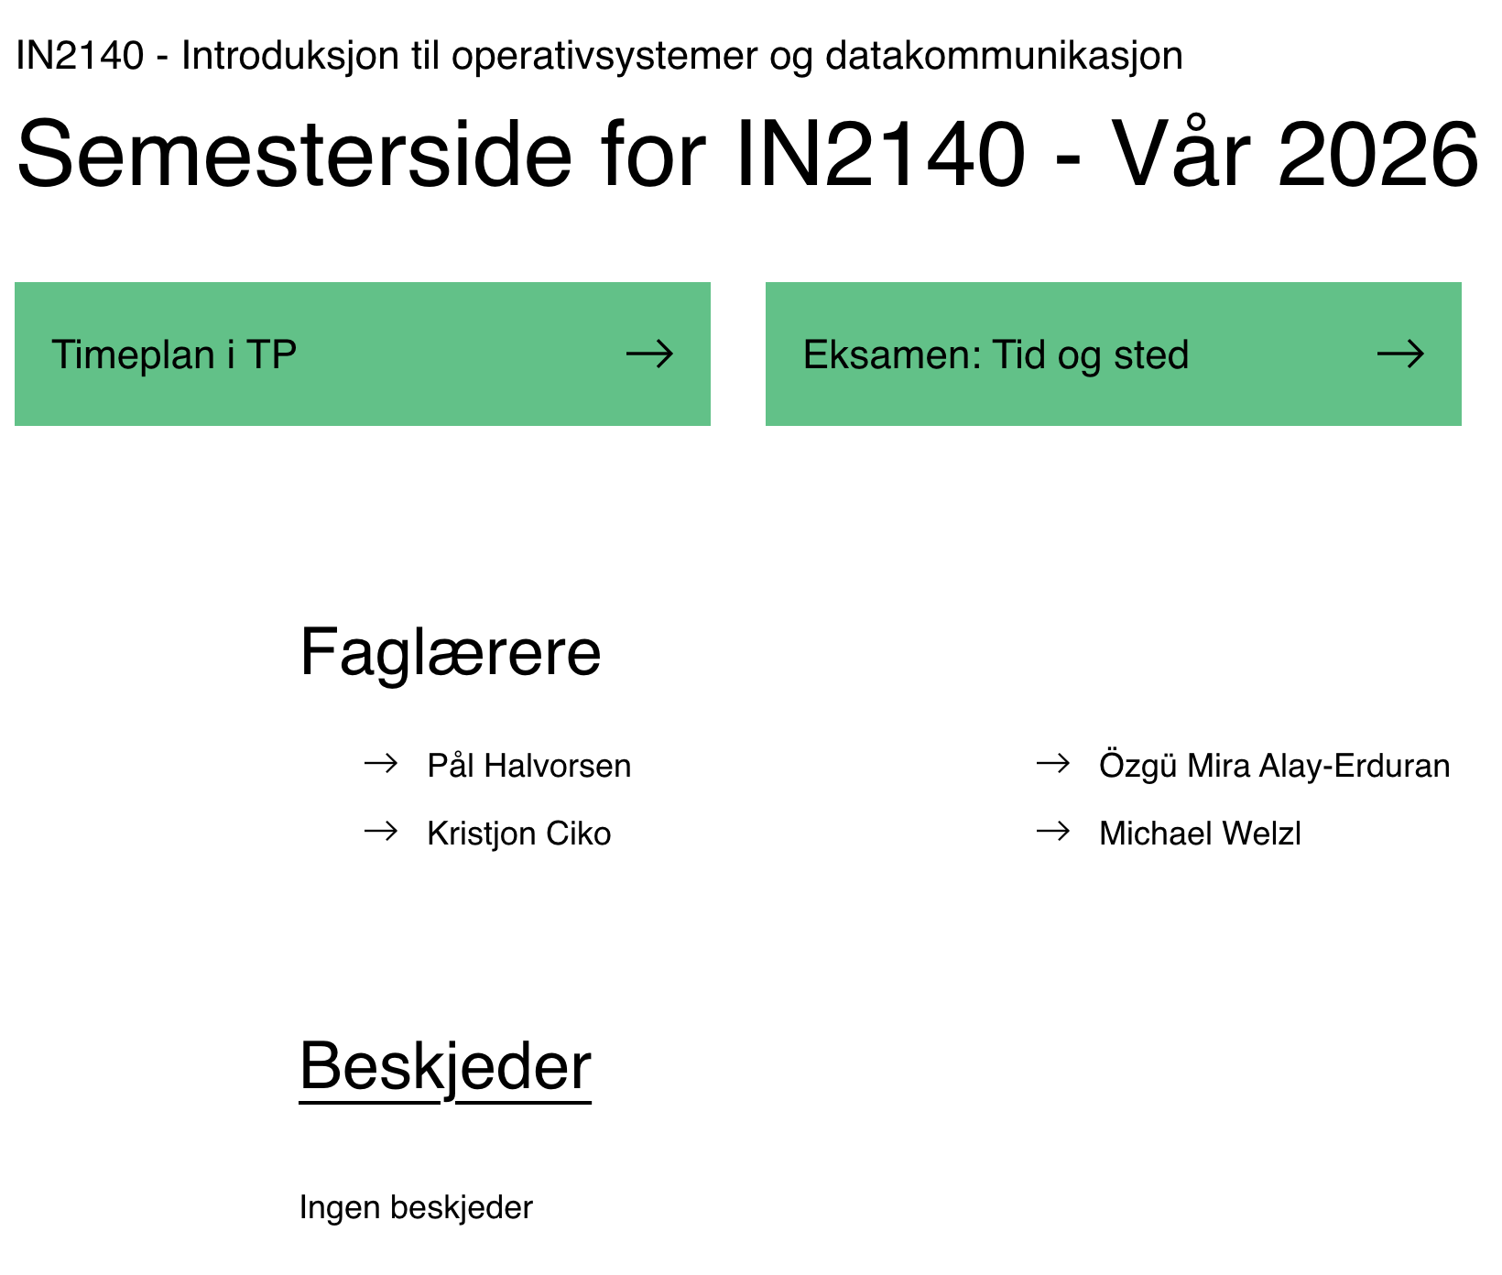
Information
Course homepage in Vortex
  your starting point
  messages & news
  schedule
  videos in Panopto
Devilry
  for submitting your responses to mandatory assignment
Inspera
  for final exam (theory + programming)

Slide 12

Exams and Mandatory Exercises
Mandatory exercises
  two C programming exercises
    getting started with C
    Learning the basic concepts
  tentative dates: delivery 09.02. + 09.03.
Final exam
  focus on the concepts as well as programming
  date 27.05.
  4 hours, 15:00-19:00

Slide 13
Evaluation and grading
Passing the mandatory assignments is a prerequisite for admission to the final exam
  Passing mandatory assignments in early years qualifies for taking the exam.
Grading:
  No homeexam in 2026!
  Final exam: around 70% theory and 30% programming

Slide 14

Questions?

