Slide 1
Data Communication:
Network structures
IN2140:
Introduction to Operating Systems and Data Communication

Slide 2
Programming the network
import urllib.request
contents = urllib.request.urlopen(
urllib.request.Request(
"https://www.uio.no/studier/emner/matnat/ifi/IN2140/v25/index.html")
).read()
print(contents.decode(’utf-8’))

Slide 3
Programming the network
<!DOCTYPE html>
<html lang="no">
<head>
<meta charset="utf-8" >
<meta http-equiv="X-UA-Compatible" content="IE=edge" />
<meta id="viewport" name="viewport" content="width=device-width, initial-scale=1" />
<meta name="format-detection" content="telephone=no">
<meta name="generator" content="Vortex" />
<title>Semesterside for IN2140 - – Universitetet i Oslo</title>
<meta property="og:title" content="Semesterside for IN2140 - – Universitetet i Oslo" />
<meta name="twitter:card" content="summary" />
<meta name="twitter:site" content="@unioslo" />
<meta name="twitter:title" content="Semesterside" />
<meta name="twitter:description" content="Les denne saken på UiOs nettsider." />
<meta name="twitter:image" content="https://www.uio.no/vrtx/dist/resources/uio2/css/images/social/uio-twitter-share-1000x1000.jpg" />
<meta name="twitter:url" content="https://www.uio.no/studier/emner/matnat/ifi/IN2140/v25/index.html" />
<meta property="og:url" content="https://www.uio.no/studier/emner/matnat/ifi/IN2140/v25/index.html" />
<meta property="og:type" content="website" />
<meta property="og:description" content="Les denne saken på UiOs nettsider." />
<meta property="og:image" content="https://www.uio.no/vrtx/dist/resources/uio2/css/images/social/uio-share-1200x630.jpg" />
<meta property="og:image:width" content="1200" />
<meta property="og:image:height" content="630" />
<meta property="og:updated_time" content="1741591281" />
<link rel="shortcut icon" href="/vrtx/dist/resources/uio2/css/images/favicon/favicon.png">
import urllib.request
contents = urllib.request.urlopen(
urllib.request.Request(
"https://www.uio.no/studier/emner/matnat/ifi/IN2140/v25/index.html")
).read()
print(contents.decode(’utf-8’))

Slide 4
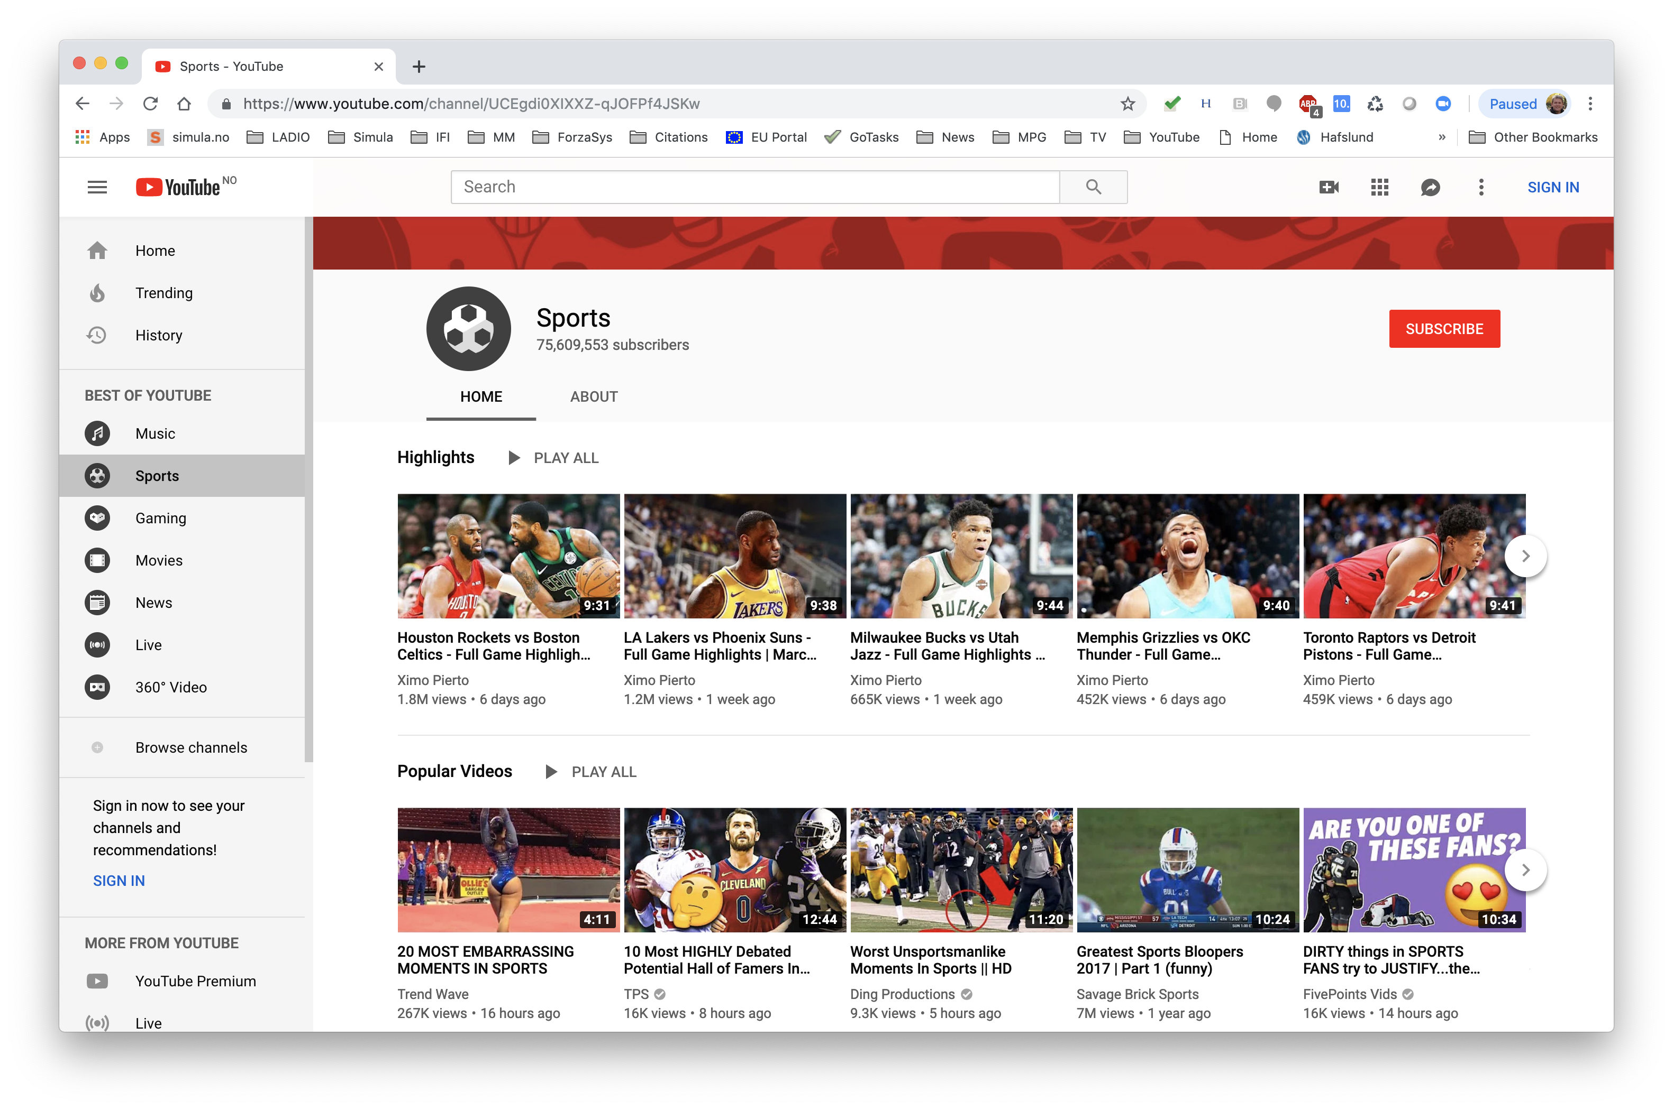
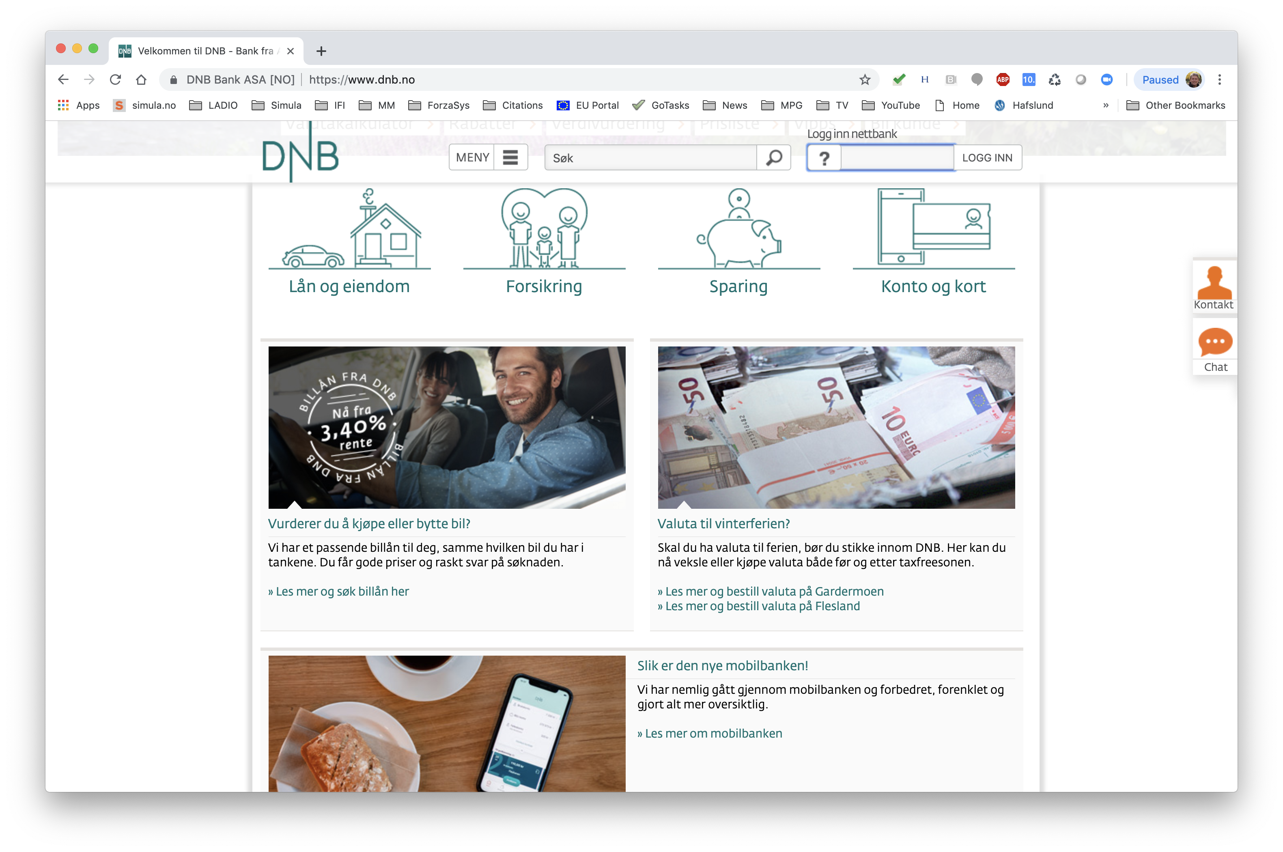
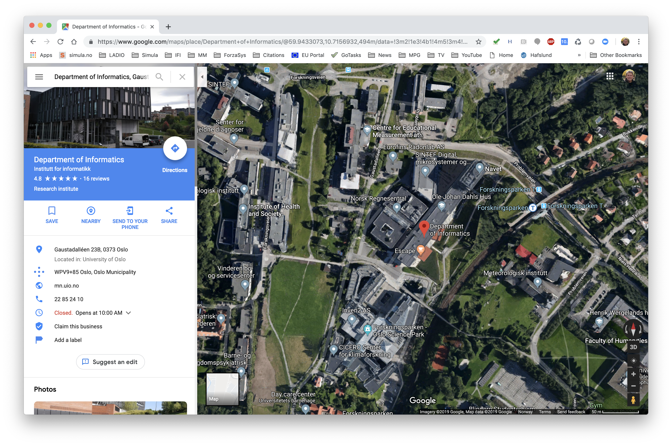
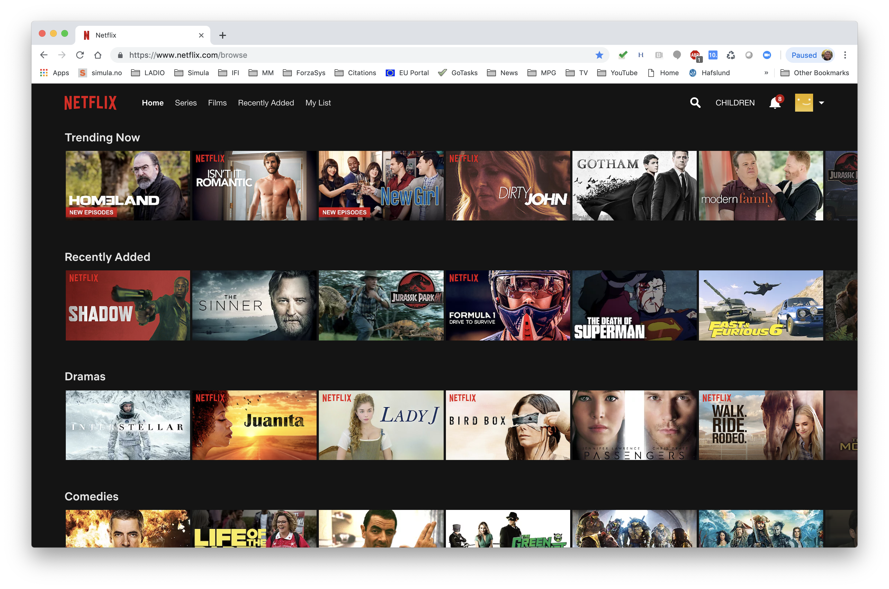
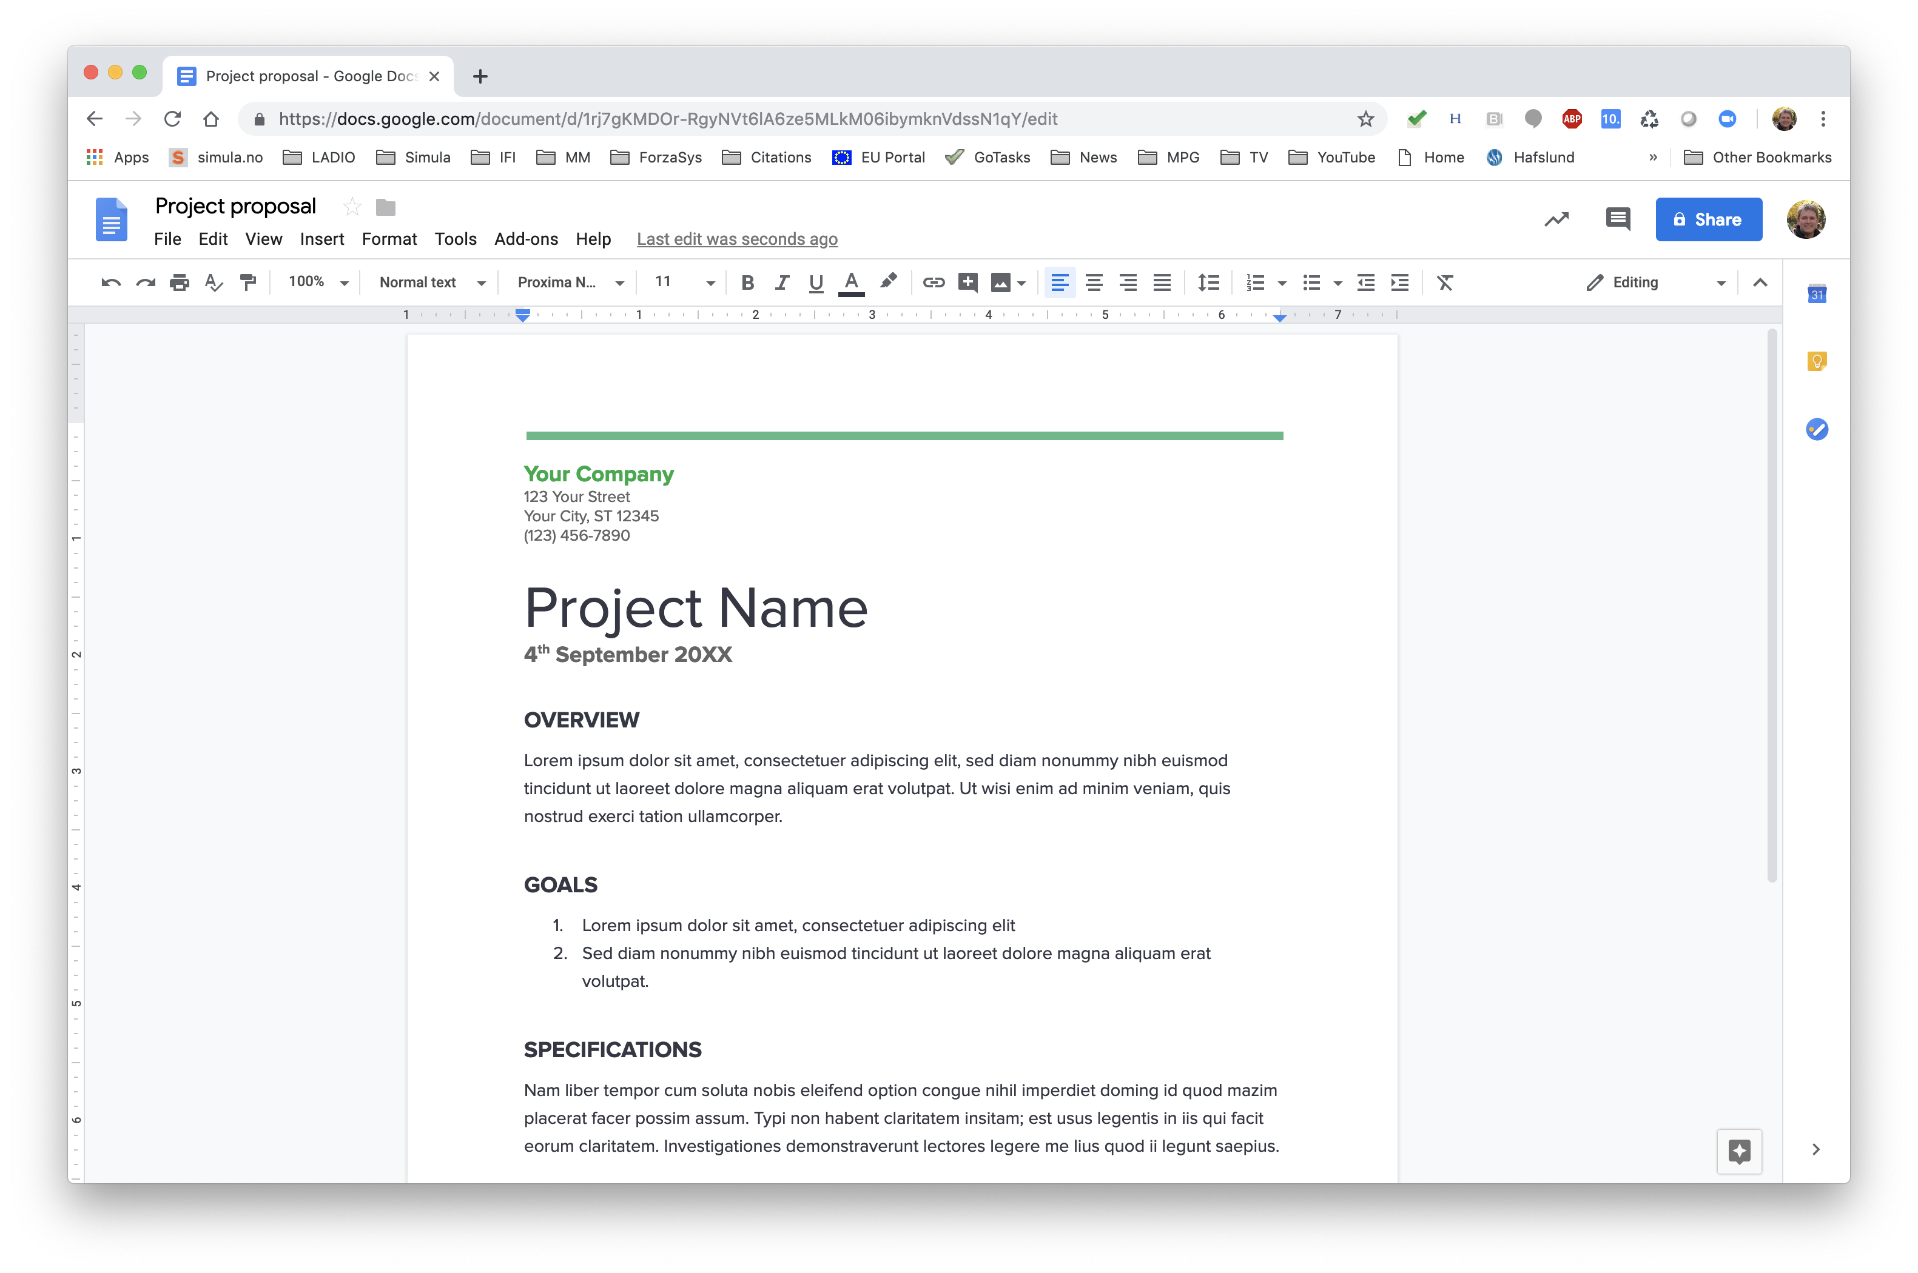
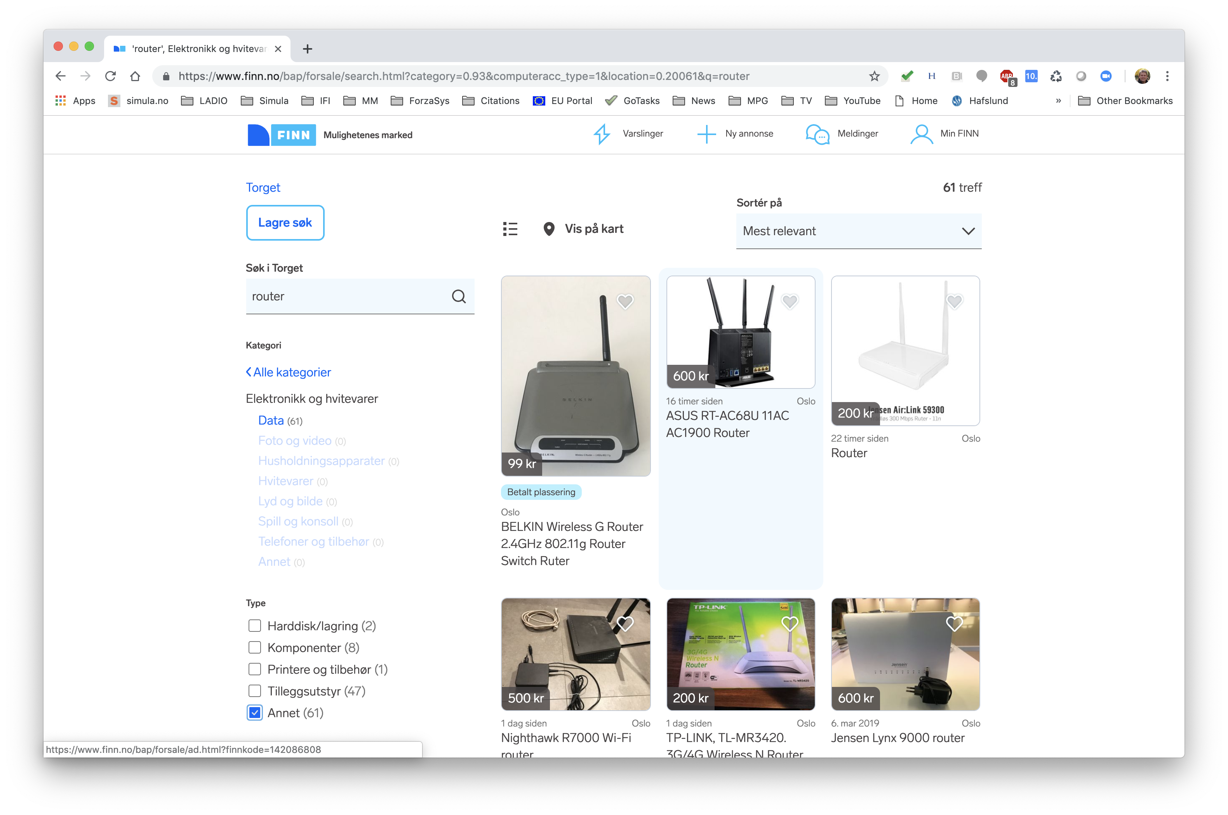
Web-based software
Video
Banking
Navigation
TV
Office tools
Shopping

Slide 5
Isn’t this enough?
In everyday live,
the network and network functions are black boxes,
language is very inaccurate … and that is only fair
applications
applications
the net
the cloud
But we – as software designers, architects, developers or researchers – must understand more

Slide 6
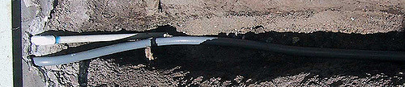
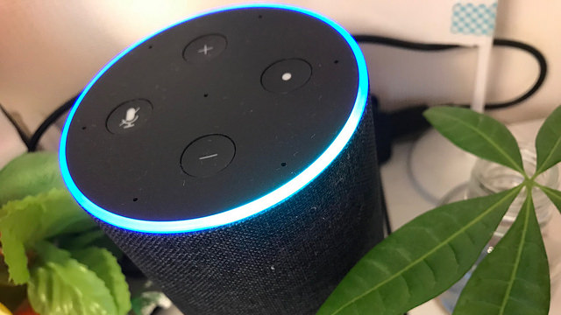
Is this the whole story?
How do you get from a cable in the ground to a virtual home assistant?
Notes:
badthings@flickr
Masaki Tokutomi@flickr

Slide 7
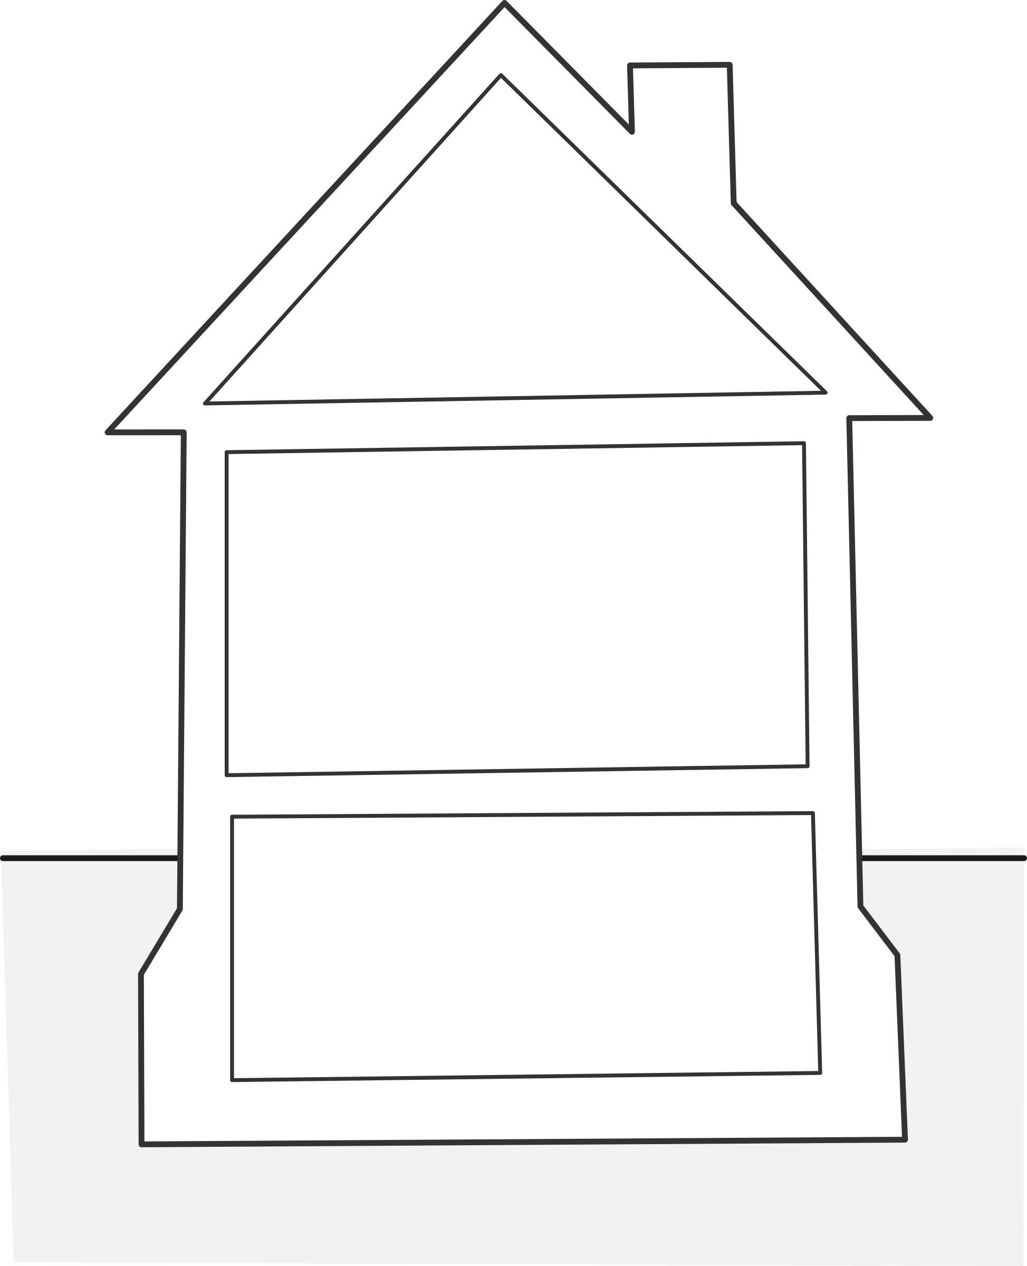
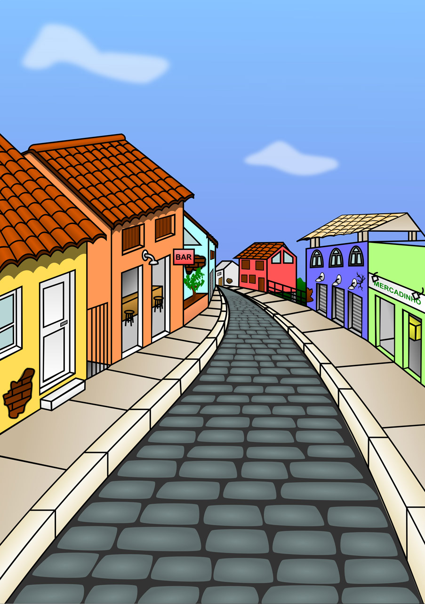
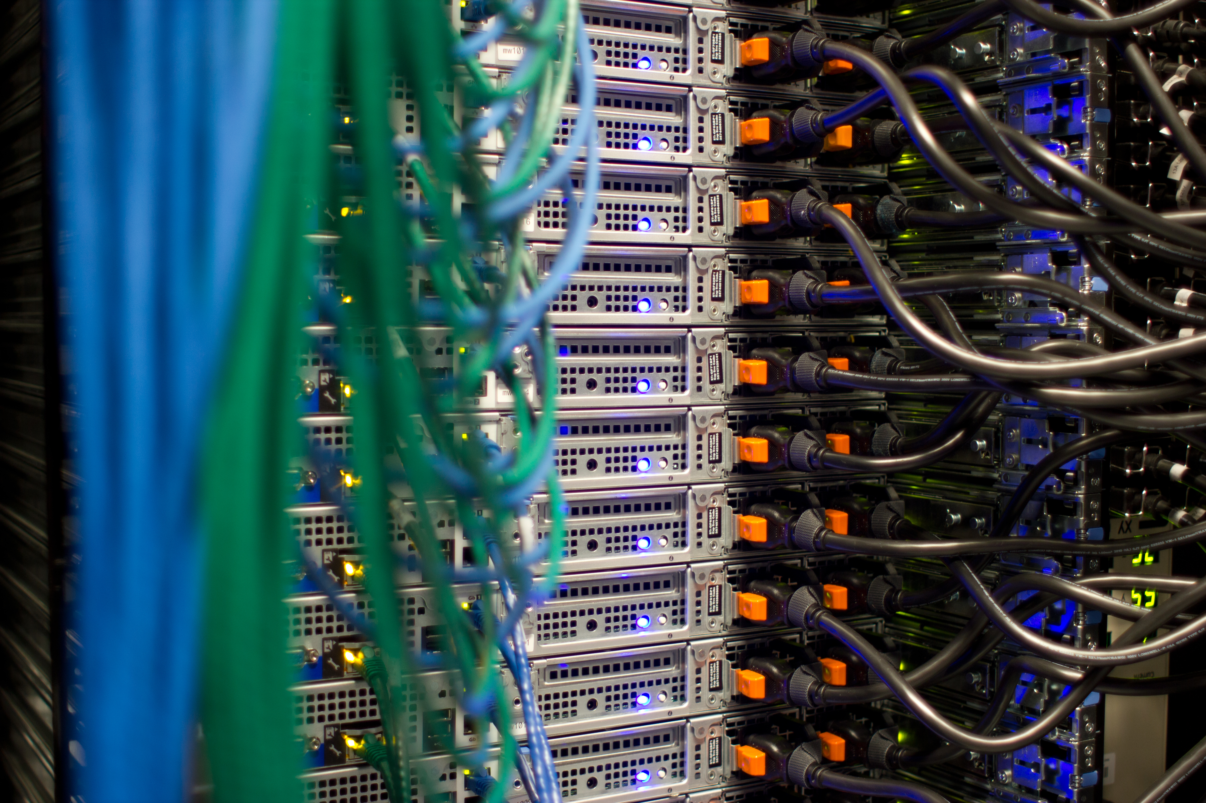


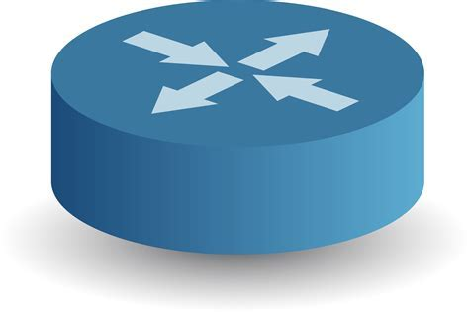

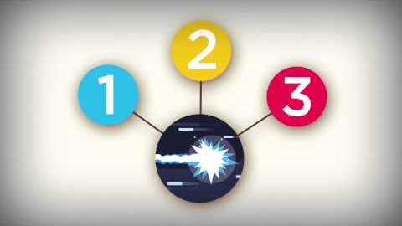
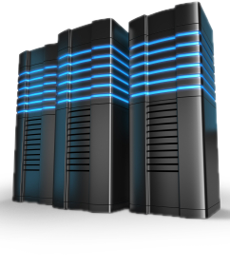

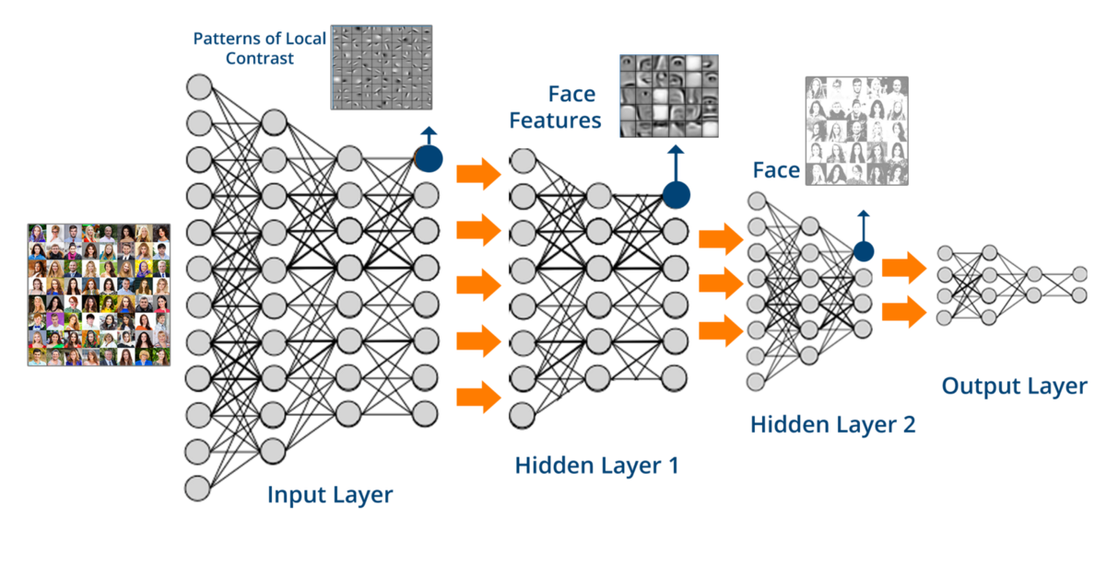
A possible communication path
cable
modem
telco company
router
cable
headend
home
assistant
fiber
node
modem
pool
https://youtu.be/F1a-eMF9xdY
tier 1
provider
Home
automation
?
tier 1
provider
tier 2
provider
Oslo
compute
cluster
tier 1
provider
Copenhagen?
assistant
London?
= ”Alexa”?
AI software
compute
cluster
Dublin
Notes:
This morning: 42ms from my desktop to Dublin (www.computing.dcu.ie)

Slide 8
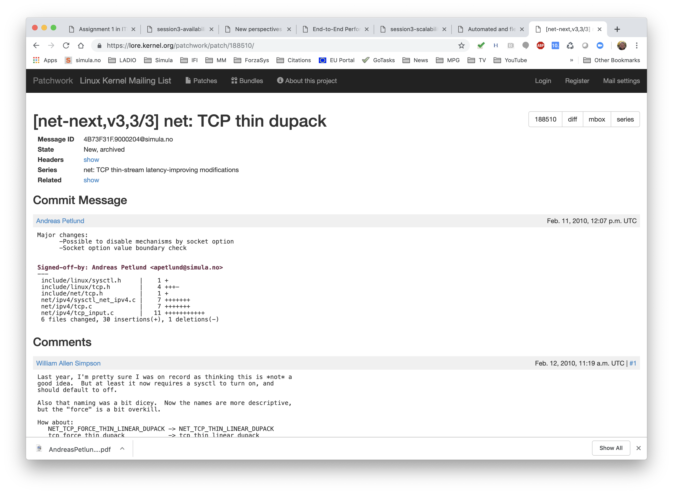
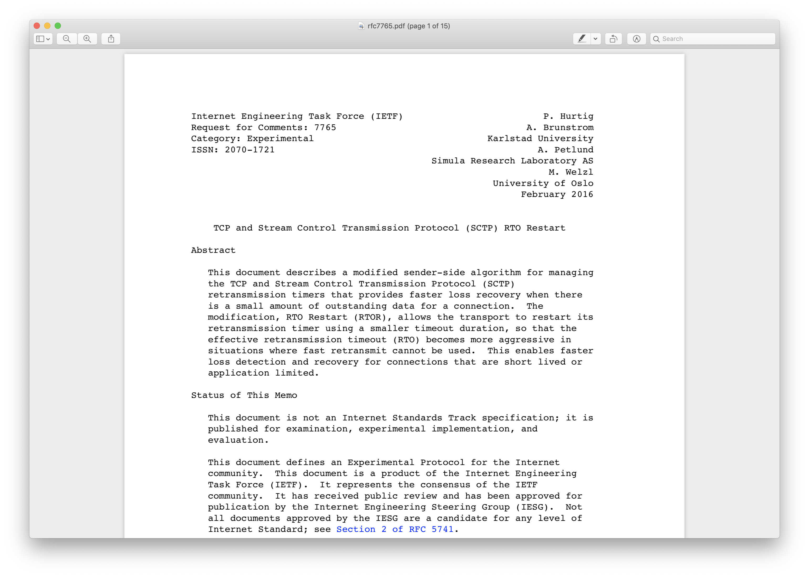
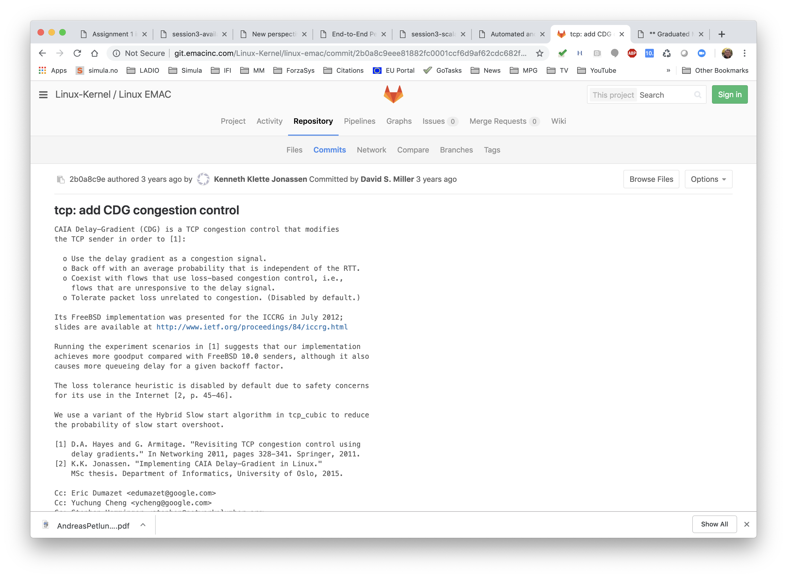
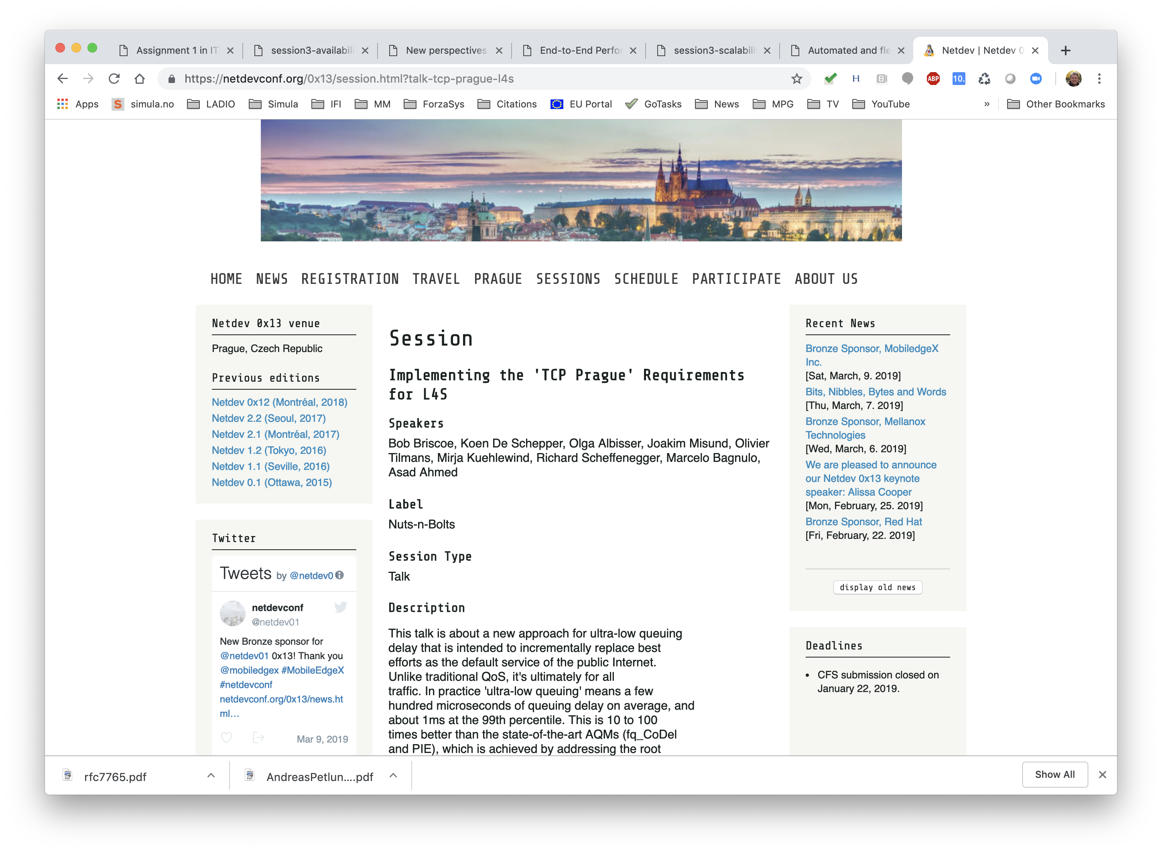
But does it matter if we understand it?
Linux
contributions
the net
Standards
contributions

Slide 9
Network structures
Structures
IN2140:
Introduction to Operating Systems and Data Communication

Slide 10
Network Components
network
is sub-network
(subnet) of
network
intermediate
system
end system
ES - End system
end systems are “at the edge” of a network
examples: computer, mobile phone, tablet, smart watch, printer, TV, smoke detector, weather station, lamp, door opener, fridge, traffic light …
IS - Intermediate system
examples:
  router, switch
  base station, modem
  gateway: web proxy, firewall, NAT gateway
  repeater, bridge
node

Slide 11
Network Structures
without the lines showing network boundaries,
this looks like a typical graph
there are nodes, and edges connecting pairs of nodes to each other
a specific arrangement of nodes and edges is called a topology
the terminology implies that edges are network connections
Notes:
but it looks chaotic
on the large scale, it is chaotic
on the small scale, we have much more structure
it is called a topology especially when is has a sensible structure

Slide 12
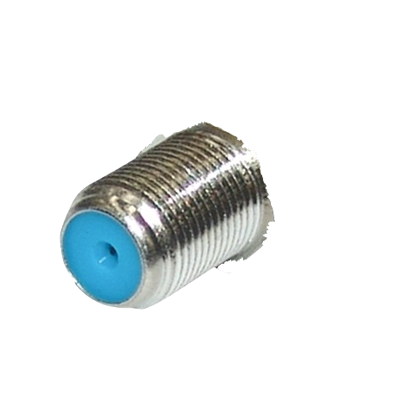
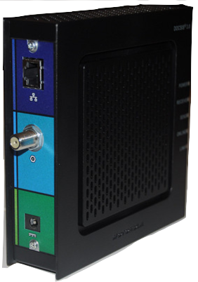
Network Structures
Point-to-point channels
Docsis (cable modems)
  star topology
Notes:
give an example of a new 10GB Ethernet, show old FDDI/TokenRing, show how to arrange Ethernets in a tree
DOCSIS modem -> clearest point-to-point
full mesh: a few supercomputers, Torus
DOCSiS modem photo: Mike Cohen @ Flickr

Slide 13
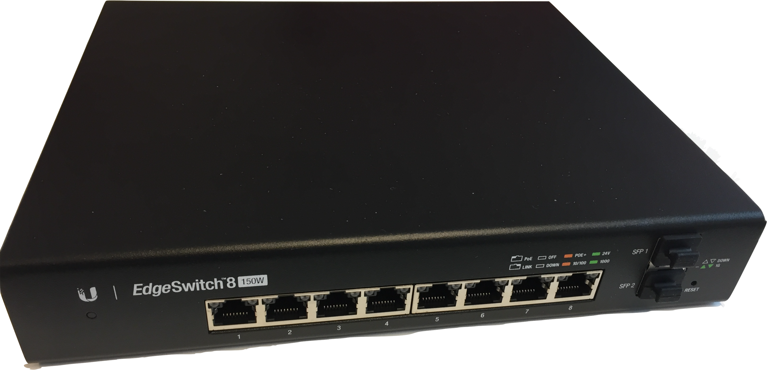
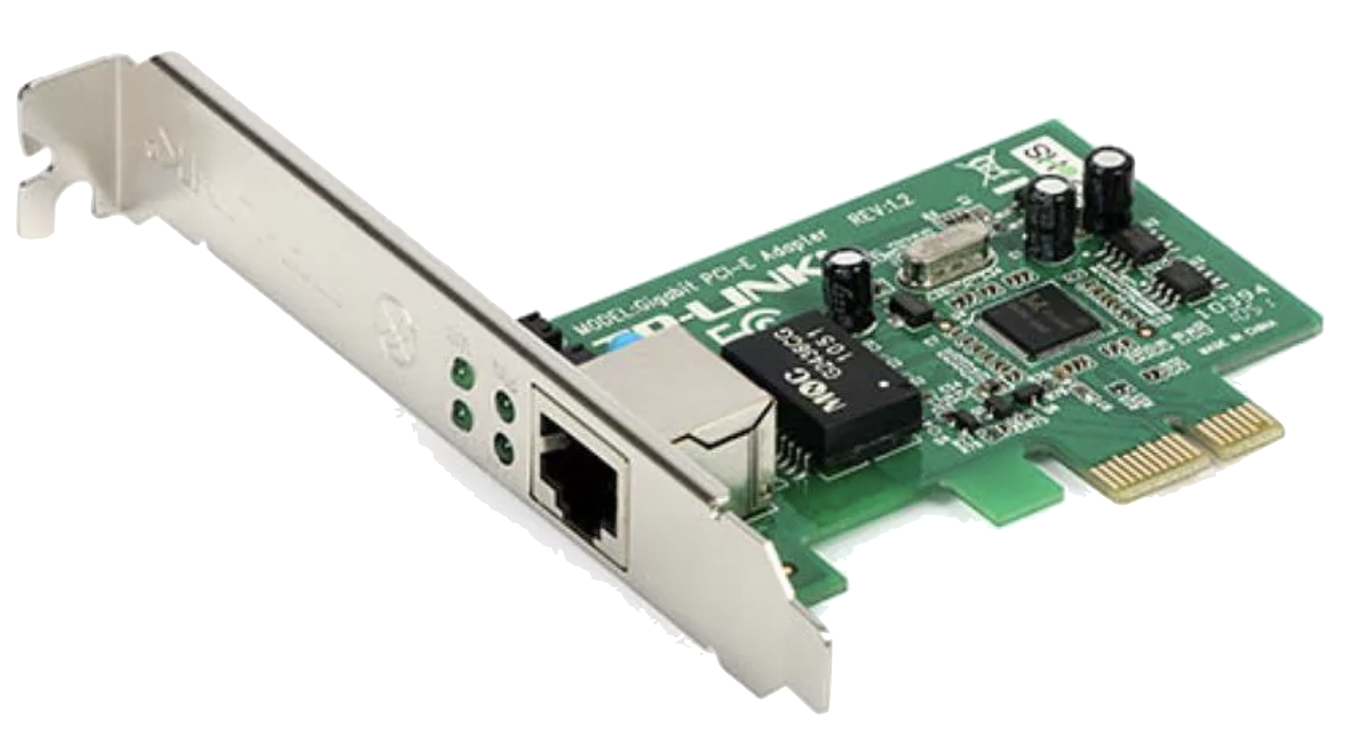
Network Structures
Point-to-point channels
Docsis (cable modems)
  star topology
Gigabit Ethernet (“1GB Ethernet”)
  star or tree topology
Notes:
give an example of a new 10GB Ethernet, show old FDDI/TokenRing, show how to arrange Ethernets in a tree
DOCSIS modem -> clearest point-to-point
full mesh: a few supercomputers, Torus
ethernet switch: mine
ALSO INSIDE A COMPUTER: PCIe

Slide 14
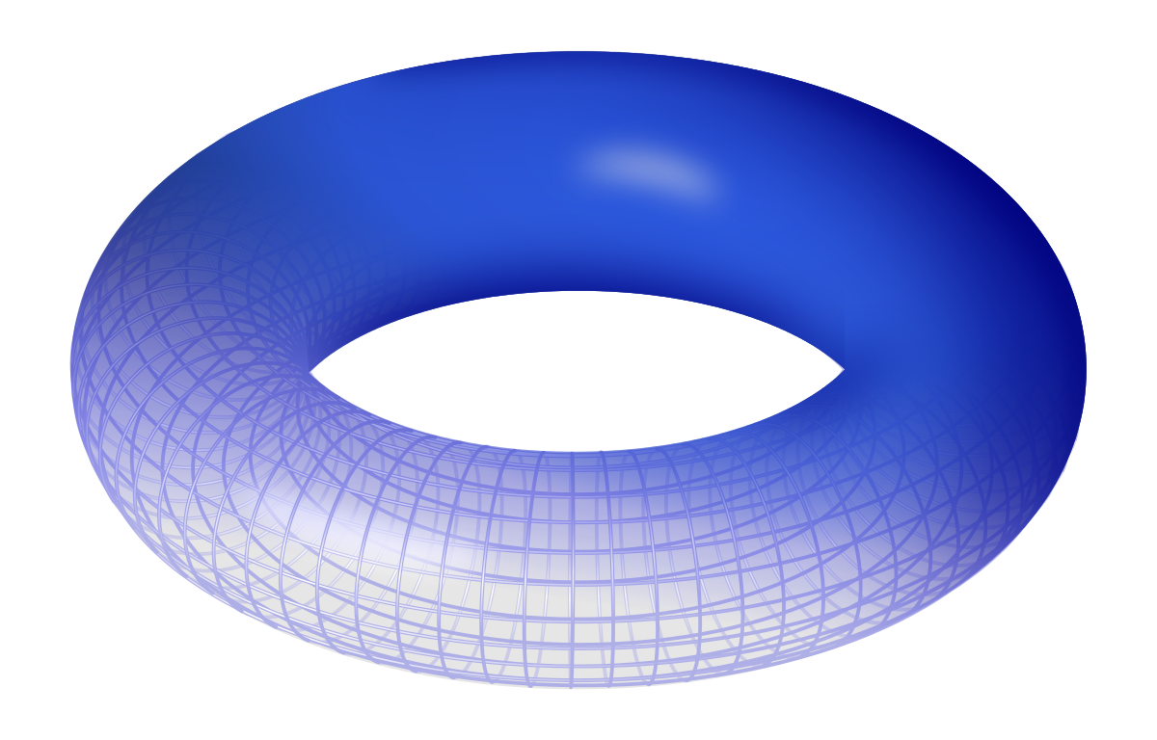
Network Structures
Point-to-point channels
Docsis (cable modems)
  star topology
Gigabit Ethernet (“1GB Ethernet”)
  star or tree topology
IEEE 802.5 “TokenRing” (outdated)
  ring topology
Some supercomputers use
  full mesh topology
  hypercube topology
  torus topology
  fat tree topology
ring
full mesh
hypercube
fat tree
torus
Notes:
give an example of a new 10GB Ethernet, show old FDDI/TokenRing, show how to arrange Ethernets in a tree
DOCSIS modem -> clearest point-to-point
full mesh: a few supercomputers, Torus
ethernet switch: mine

Slide 15
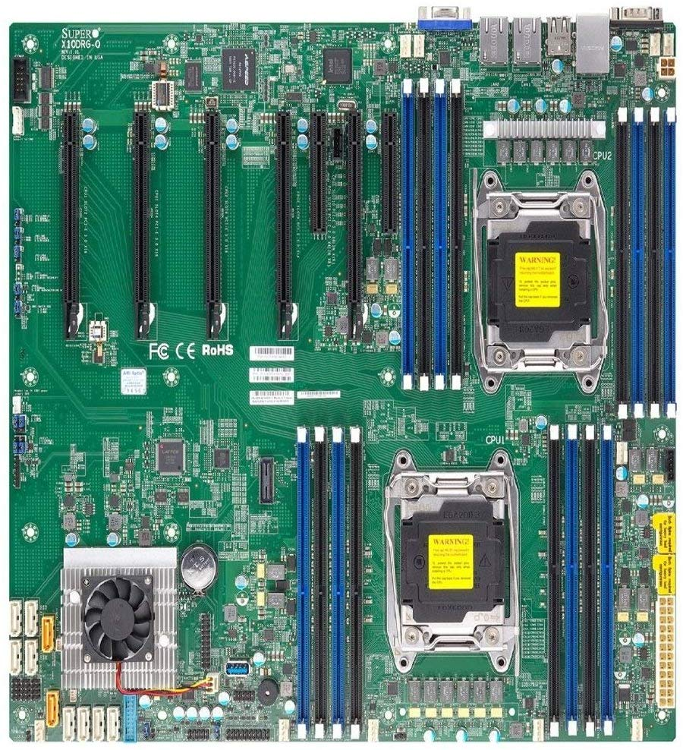
Questions
The majority of computers today use
PCI Express (PCIe) for connectivity between devices
Q: Which topology do most desktops use between devices today?

Slide 16
Questions
Q: Which topology do most desktops use between devices today?
star
tree
ring
A
B
C
full mesh
hypercube
D
E
Notes:
A tree

Slide 17
Questions
The connectivity between CPUs and RAM banks is solved by a network.
Names of recent technologies are
Hypertransport
QuickPath Interconnect
Ultra Path Interconnect
Q: Which topology do computers with several CPUs use for connecting to RAM today?

Slide 18
Questions
Q: Which topology do computers with several CPUs use
for connecting to RAM today?
star
tree
ring
A
B
C
full mesh
hypercube
D
E
Notes:
A hypercube

Slide 19
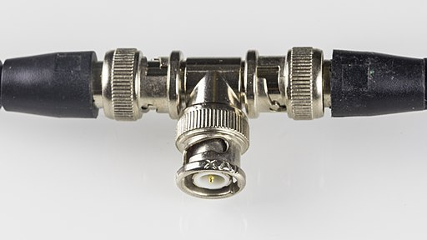
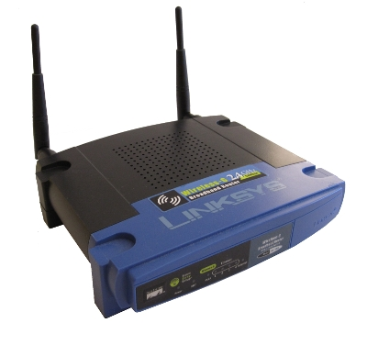
Network Structures
Broadcasting channels
Cable
  old-fashioned Ethernet
Radio
  Aloha (first wireless data transmission)
  WiFi (IEEE 802.11)
  mobile: 3G, 4G, 5G
  satellites
Properties
  when one node sends, potentially many nodes can hear it
Notes:
WIFI image from gcg2009@flickr
I made an Ethernet star once – didn’t work so well at the time

Slide 20
Network Structures
Broadcasting channels
Cable
  old-fashioned Ethernet
Radio
  Aloha (first wireless data transmission)
  WiFi (IEEE 802.11)
  mobile: 3G, 4G, 5G
  satellites
Properties
  when one node sends, potentially many nodes can hear it
  when two nodes send, both messages are potentially ruined
  error detection is important
  coordination is desirable
Notes:
give an example of a new 10GB Ethernet, show old FDDI/TokenRing, show how to arrange Ethernets in a tree
DOCSIS modem -> clearest point-to-point
full mesh: a few supercomputers, Torus
ethernet switch: mine

Slide 21
Network Structures
Broadcasting channels
Cable
  old-fashioned Ethernet
Radio
  Aloha (first wireless data transmission)
  WiFi (IEEE 802.11)
  mobile: 3G, 4G, 5G
  satellites
Properties
  when one node sends, potentially many nodes can hear it
  when two nodes send, both messages are potentially ruined
  error detection is important
  coordination is desirable

Slide 22
Network structures
Network’s tasks
IN2140:
Introduction to Operating Systems and Data Communication

Slide 23
A lot of tasks
knowing how to
find the reverse way
knowing
which process
to contact on that ES
knowing which
ES to contact
knowing the way
from one IS to another

Slide 24
A lot of tasks
Should we have dinner?
knowing how to
find the reverse way
knowing
which process
to contact on that ES
knowing which
ES to contact
我们应该吃晚餐吗
coding the data
in a comprehensible
manner
knowing the way
from one IS to another

Slide 25
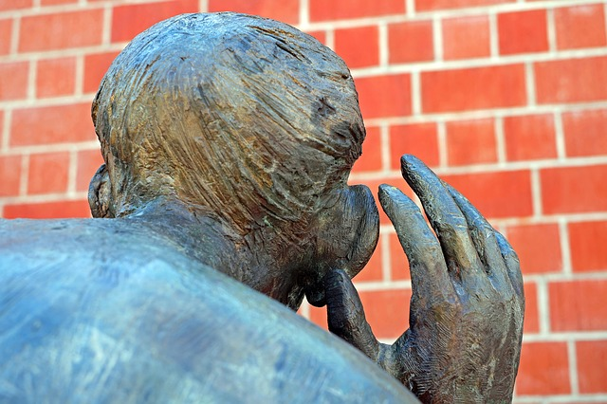
A lot of tasks
dealing with
networking problems
knowing how to
find the reverse way
knowing
which process
to contact on that ES
knowing which
ES to contact
maintaining
privacy
coding the data
in a comprehensible
manner
knowing the way
from one IS to another
maintaining
security

Slide 26



A lot of tasks
dealing with
networking problems
knowing how to
find the reverse way
support
high traffic
knowing
which process
to contact on that ES
avoiding
high delays
knowing which
ES to contact
maintaining
privacy
coding the data
in a comprehensible
manner
knowing the way
from one IS to another
maintaining
security

Slide 27
A lot of tasks
There are a lot of aspects to worry about
the application
applications
determine
requirements
knowing the way
from one IS to another
knowing which
ES to contact
knowing
which process
to contact on that ES
knowing how to
find the reverse way
coding the data
in a comprehensible
manner
dealing with
networking problems
support
high traffic
avoiding
high delays
maintaining
security
maintaining
privacy

Slide 28
A lot of tasks
There are a lot of aspects to worry about
the application
applications
determine
requirements
knowing the way
from one IS to another
knowing which
ES to contact
knowing
which process
to contact on that ES
knowing how to
find the reverse way
coding the data
in a comprehensible
manner
dealing with
networking problems
support
high traffic
avoiding
high delays
maintaining
security
maintaining
privacy

Slide 29
the application
applications
determine
requirements
dealing with
networking problems
support
high traffic
avoiding
high delays

Slide 30

the application
File download and Web browsing
Internet
avoiding
high delays
uncritical
support
high traffic
uncritical
dealing with
networking problems
critical

Slide 31
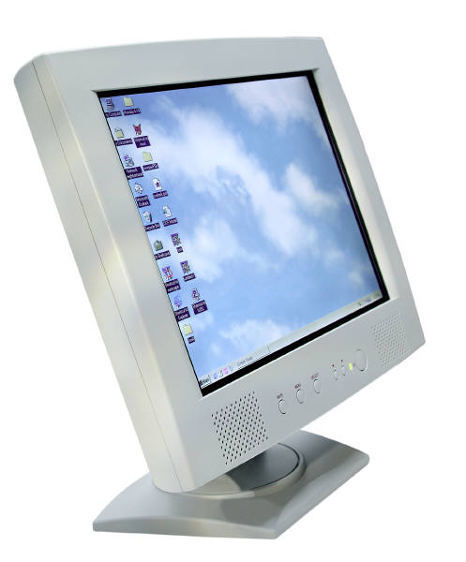
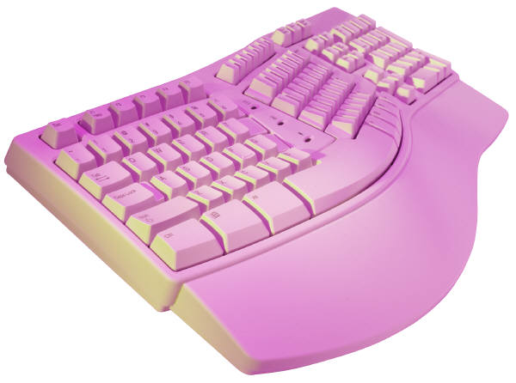
Textual commands and textual chat
Internet
avoiding high delays
uncritical
support high traffic
uncritical
dealing with networking problems
critical
Notes:
delay: human reading speed

Slide 32


Live and on-Demand Streaming
avoiding high delays
some ok
support high traffic
critical
dealing with networking problems
some ok
Internet
Notes:
packet loss: acceptable (some)

Slide 33
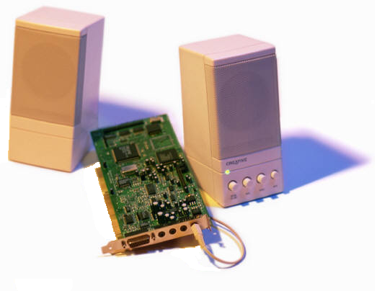


AV chat and AV conferencing
avoiding high delays
some ok
support high traffic
important
dealing with networking problems
some ok
Internet

Slide 34

Haptic Interaction
Internet
avoiding high delays
critical
support high traffic
uncritical
dealing with networking problems
some ok
Notes:
add oculus on one side!

Slide 35
The Internet must support all of them
Internet

Slide 36
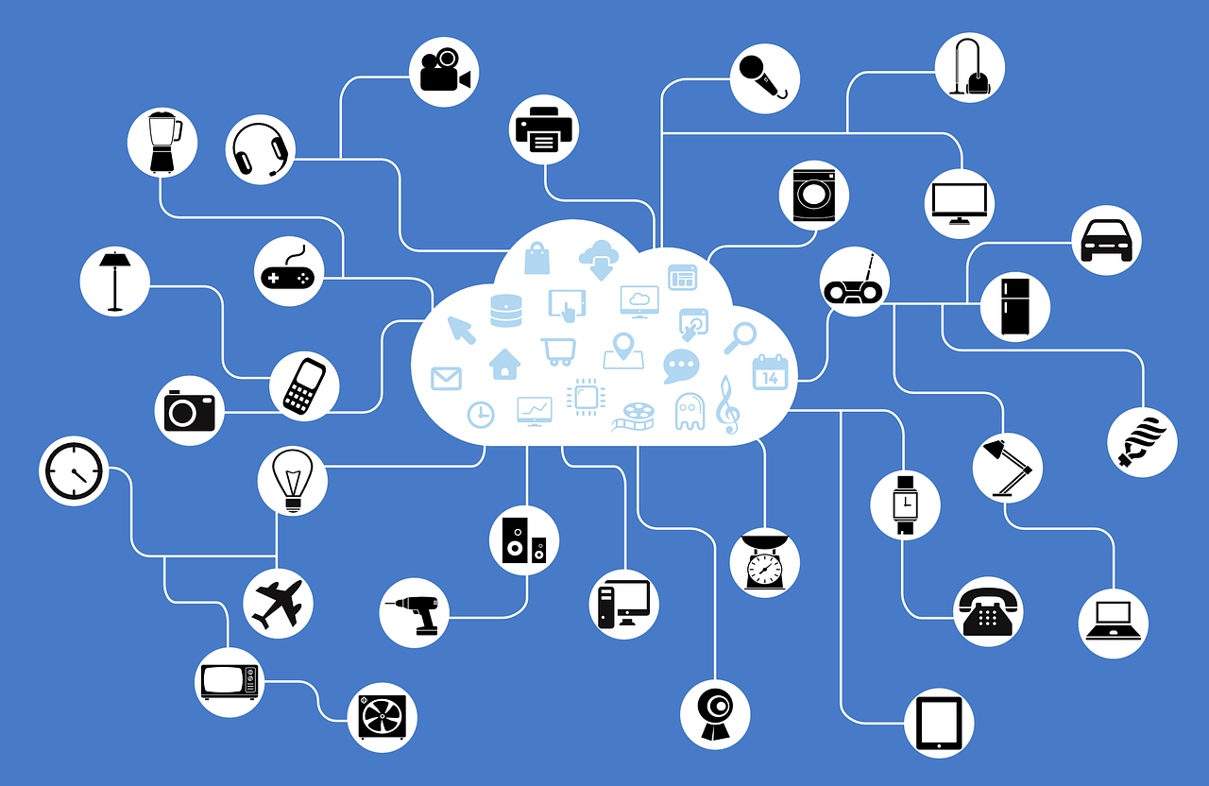
Questions
The previous slides showed some examples of applications that must be supported by the Internet. But some really important ones are missing.
Q: Can you give an example of an important kind of application that was missing?
Notes:
My additional ideas:
Web 2.0 (Facebook)
Cloud gaming
Peer-to-peer networking
Live interaction with AIs

Slide 37
Network structures
Structuring the tasks
IN2140:
Introduction to Operating Systems and Data Communication

Slide 38
Questions
It is impossible for a single person to solve all of these challenges for all intermediate systems, end systems and applications in the entire world.
Collaboration and coordination is necessary.
Many ideas have been proposed.
Q: How would you structure all of these tasks?
find out how tasks depend on each other, solve the most basic ones first, and build the next most important on top of them, etc
create a large toolbox of standard algorithms, and put them together as required
solve local challenges locally, use that to solve them for a longer distances, repeat for even longer distances, etc … recursively
knowing the way
from one IS to another
maintaining
security
knowing how to
find the reverse way
knowing which
ES to contact
coding the data
in a comprehensible
manner
support
high traffic
knowing
which process
to contact on that ES
avoiding
high delays
dealing with
networking problems
maintaining
privacy

Slide 39
Approaches to structure the tasks
layered approach: arrange tasks in layers
choose common encoding
advantages:
clear interfaces
clear assignment of responsibilities
develop layers independently
establish connections
find a process
transfer longer distances
transfer between neighbors, adapt speed
find neighbours
disadvantages:
not perfectly suited for all jobs
similar problems are solved several times
build data units from bits
encode bits, choose speed, fix errors
specify hardware

Slide 40
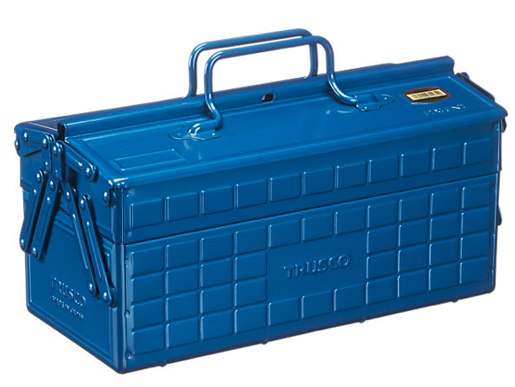




Approaches to structure the tasks
component approach: interacting components
advantages:
possible to avoid duplicated functions
possible to choose perfect network behaviour for every application
recovery
algorithms
speed ctrl
algorithms
location
algorithms
disadvantages:
must negotiate choice of every piece with all nodes
toolbox must be complete on all nodes
needs flexible interfaces
encoding
algorithms

Slide 41
Approaches to structure the tasks
recursive approach: handle challenges locally
advantages:
reuse the concept of inter-process communication on all levels
concepts are repeated at every level
all challenges can be solved as local as possible
disadvantages:
more negotiations and setup than layered
unclear how to best share resources

Slide 42

Questions
Layers
Components
Recursion
These three ways of structuring the tasks of networks are frequently discussed, as well as used. The reality is a mixture, but one of them dominates how we think about task structuring.
Q: Which of these three approaches is the dominant one?
Notes:
The answer is layering

Slide 43
Network structures
Layering model
IN2140:
Introduction to Operating Systems and Data Communication

Slide 44
Approaches to structure the tasks
Right now, the layered models dominate
ISO OSI (Open Systems Interconnection) Reference Model
and
TCP/IP Reference Model Internet Architecture
layers are easy to understand
interfaces are clearly defined
not every node must implement every layer
…

Slide 45
Reference Model for Open Systems Interconnection
ISO OSI (Open Systems Interconnection) Reference Model
model for layered communication systems
defines fundamental concepts and terminology
defines 7 layers and their functionalities
7
Application layer
6
Presentation layer
5
Session layer
4
Transport layer
3
Network layer
2
Data link layer
1
Physical layer

Slide 46
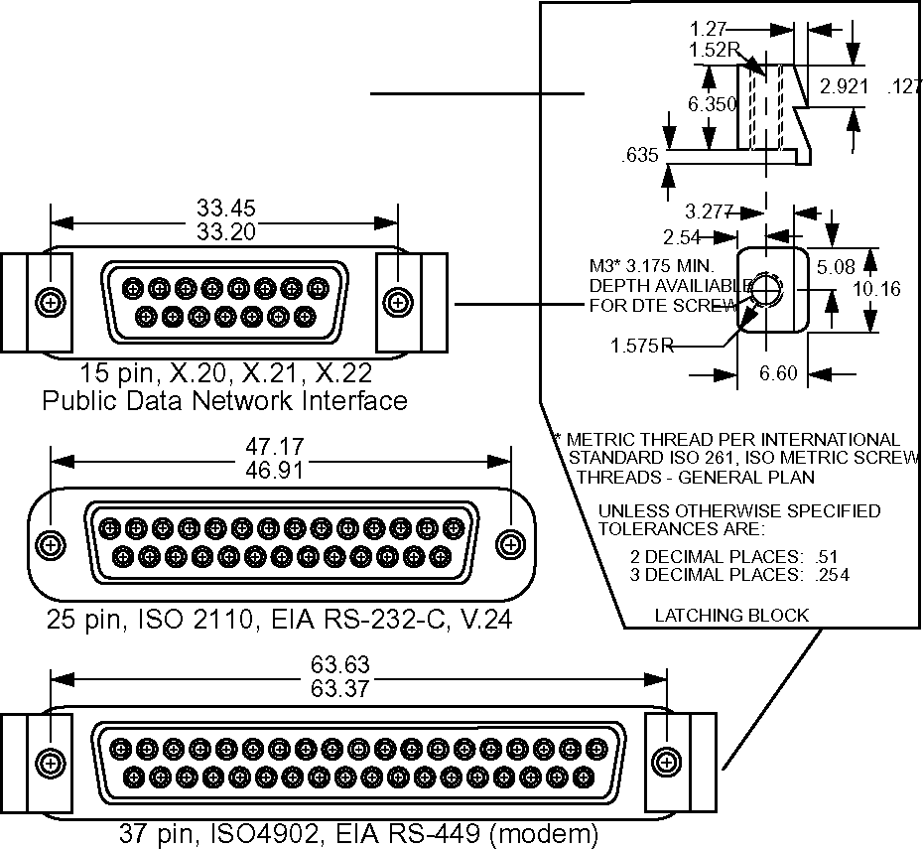
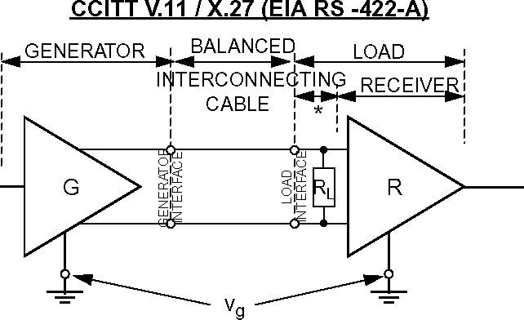
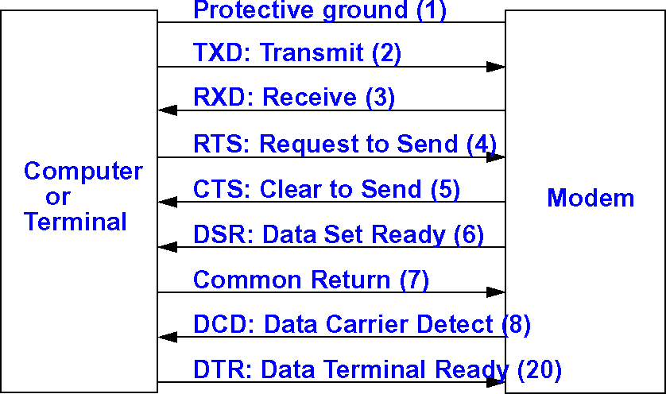
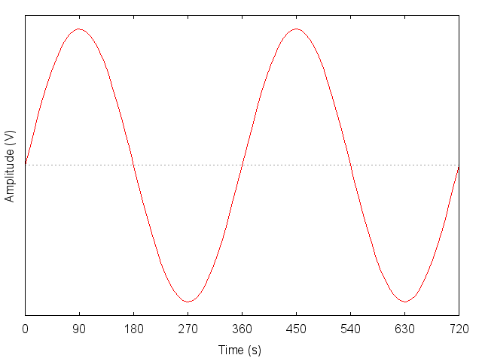
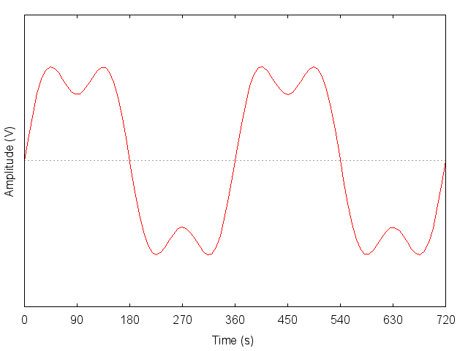
Layer functions: physical layer
Responsibility: insecure bitstream between adjacent systems
  mechanics
  electronics
  procedural
encoding and
decoding of
bits
1
Physical layer

Slide 47
Layer functions: data link layer
Responsibility: error-recovering frame stream, adjacent systems
Reliable data transfer between adjacent stations with frames
create data frames from bits
handle speed differences between nodes
handle several L3 protocols
translate between different MAC layers
SOF
DATA
CHK SUM
EOF
Logical Link
error detection
start of frame
e.g. 01111110
end of frame
e.g. 01111101
Control (LLC)
Medium Access
access to medium
Control (MAC)
where to send? → MAC address
when to send? → wait for silence, wait for token
correct frame? → check for bit errors and repair
2
Data link layer

Slide 48
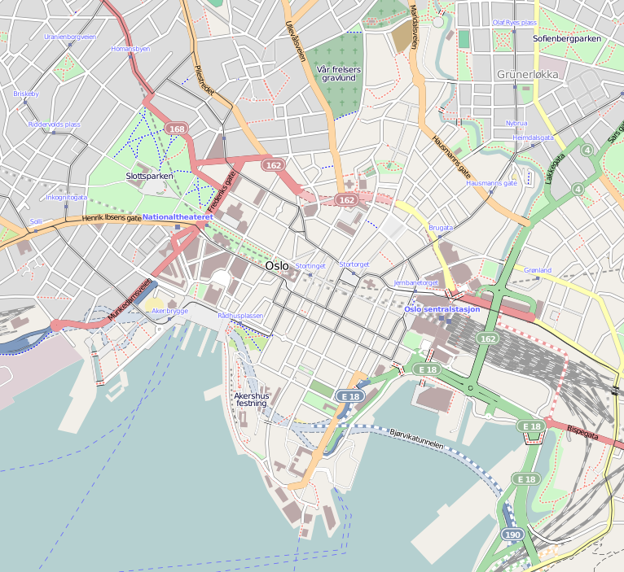
Layer functions: network layer
Responsibility: packet stream between end systems
end-to-end transport of packets
ability to address source and target nodes
routing from source node to target node
3
Network layer
Notes:
map of Oslo: Dr Blofeld@Wikimedia via OpenStreetMap

Slide 49
Layer functions: network layer
Responsibility: packet stream between end systems
end-to-end transport of packets
ability to address source and target nodes
routing from source node to target node
find routes
choose between alternative routes
determine best packet size for a route
translate addresses
prevent or handle congestion
multiplexing of L4 packets
3
Network layer
Notes:
map of Oslo: Dr Blofeld@Wikimedia via OpenStreetMap

Slide 50
Layer functions: transport layer
Responsibility: end-to-end message stream between processes
wide range of services offered to L5:
end-to-end transport of packets
connection establishment
no connection
ability to address source and target processes
hide L3 packet size limitations
limit L4 packet size to L3 packet’s
establish process-to-process relation
multiplex traffic
end-to-end flow control
(handles speed differences)
end-to-end error correction
error correction
no error correction
ensure order of received packets
deliver packets as the arrive
adapt sending speed to receiver
send as fast as possible
4
Transport layer

Slide 51
Layer functions: session layer
Responsibility: structured dialogue
support a “session” over a longer period
session management
establishing identities
assigning writes
tracking identities (cookies)
token management
passing permission to speak in a (large) tele-conference
write-locking of networked files
transaction management in databases
checkpointing
make program snapshots to disk
restart after crash
Google OT (operation transformation) allows Google Docs to work
user identify when multiple devices are used
several inputs on the same document at the same time
conflict resolution when writing to the same location
synchronization
lip synchronization of speech and video in tele-conferencing
show live football concurrently on all devices
5
Session layer

Slide 52
Layer function: presentation layer
Responsibility: exchange of data (semantics!)
encoding of int
big endian
little endian
XML (as string)
ASN.1 (shortest possible big endian bit sequence)
XDR (4-byte big endian)
encoding of structs (“serialization”)
ASN.1
XDR
XML
JSON
Java serialization
Google protocol buffers
file name representation
/mnt/user/n.txt
m:\user\n.txt
image formats
JPG, PNG
compression
zip, gzip, bzip2
encoding of strings
ASCII
UTF-8
Unicode
EBCDIC
encoding of date
seconds since 1.1.1970
nanoseconds since 1.1.1601
string “12 March 2019 13:32:54 UTC”
encryption methods
PGP, S/MIME
semantics
NOK, EUR, USD
6
Presentation layer
Notes:
Extended Binary Coded Decimal Interchange Code (EBCDIC)

Slide 53

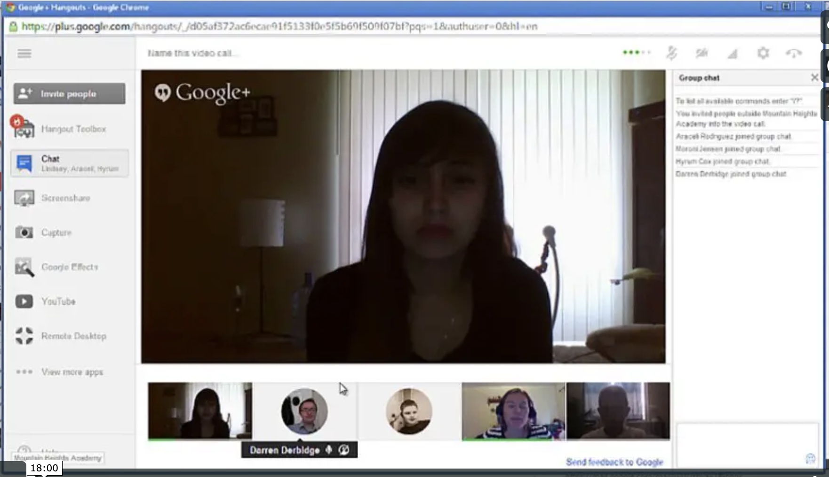
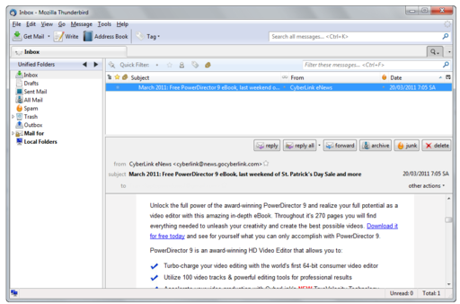
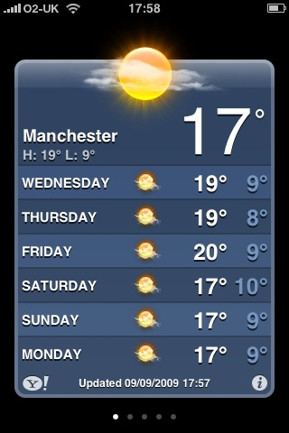
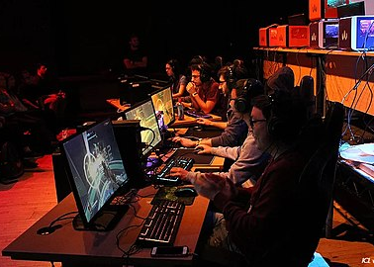
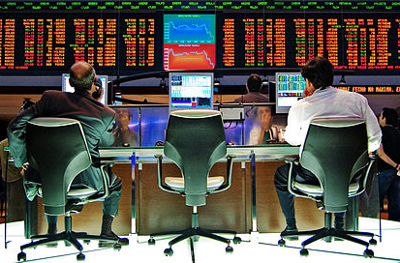
Layer functions: application layer
Responsibility: cooperating entities
7
Application layer
Notes:
texting: Wonderlane@Flickr
Thunderbird: Mozilla Foundation
Weather: Daniel Nisbet@Flickr
Hangouts: OHSU Teacher@Vimeo
ESports: EsportsNews@Wikimedia
High Speed Trading: Rafael Matsunaga@Flickr via Wikimeddia

Slide 54
Architecture
Data flow between two adjacent systems
End system
End system
Application
peers
7
Presentation
peers
6
Session
peers
5
Transport
peers
4
Network
peers
3
Data link
peers
2
Physical
peers
1

Slide 55
Architecture
Data flow between two non-adjacent systems
End system
End system
7
peers
7
6
peers
6
5
peers
5
4
peers
4
3
peers
3
peers
3
2
peers
2
peers
2
1
peers
1
peers
1
Intermediate system

Slide 56
Data Units
Application level “messages” are processed as data units.
Following notions for data units have become common:
  packet: “unit of transportation” (may contain fragments)
  datagram: instead of packet if sent individually (connectionless)
  frame: with final envelope, ready to send (next to lowest layer)
  cell: small packet (or packet fragment) of fixed size
OSI terminology: „message“ is a PDU
  PDU: Protocol Data Unit
  SDU: Service Data Unit = payload - optionally carried in PDU for user
    (N)-PDU: semantics understood by peer entities of (N)-service
    (N)-PDU = (N)-information plus (N)-SDU
    (N)-SDU = (N-1)-information plus (N-1)-SDU
© Ralf Steinmetz, Technische Universität Darmstadt
Notes:
56
ENVELOP: KONVOLUTT

Slide 57
Network structures
TCP/IP model
IN2140:
Introduction to Operating Systems and Data Communication

Slide 58
Five Layer Reference, Internet Reference Model and a Comparison
OSI Reference Model
TCP/IP Reference Model Internet Architecture
  ISO-OSI presentation, session and application layer merged
  ISO-OSI data link layer and physical layer merged to form Network Interface
7
Application layer
5
Application layer
6
Presentation layer
4
5
Session layer
3
4
Transport layer
some people use:
3
Network layer
2
1
2
Data link layer
1/2
Network interface layer
1
Physical layer

Slide 59
TCP/IP Layering considerations
Why no clear separation of upper layers?
layers 1-4 are essential for co-existence on the Internet
  e.g. different congestion control mechanisms on different hosts can lead to strong congestion
session and presentation layer functions provide mostly application support
Layers 3 and 4 are not clearly separated
transport protocol (TCP, UDP, others) and network protocol IP
sometimes hard to draw a clear line where TCP ends and IP begins
example:
  Explicit Congestion Notification (ECN) capability is indicated on layer 3 and congestion is indicated on layer 3
  sender is told about receiver’s reception of congestion signal on layer 4
Notes:
59
Sidenote: 7-layer model has been extended… :-)
Layer 8: Financial layer
Layer 9: Political layer

Slide 60
Internet Protocol Stack
Application
layer
SMTP
HTTP
SCP
SSH
NFS
SRTP
Transport
layer
TCP
UDP
Network
layer
IPv4 + IPv6
+ ICMP
+ ARP
Data link and
Physical layer
WANs
LLC & MAC
LANs
ATM
physical
MANs
Nickname: “Hourglass Model”
Notes:
TIMEGLASS model

