Slide 1
Data Communication:
Naming
IN2140:
Introduction to Operating Systems and Data Communication
Layer encapsulation

Slide 2
Five Layer Reference
Q
TCP/IP Reference Model Internet Architecture
  ISO-OSI presentation, session and application layer merged
  ISO-OSI data link layer and physical layer merged to form Network Interface
7
Application layer
5
Application layer
6
Presentation layer
5
Session layer
4
Transport layer
3
Network layer
2
Data link layer
1/2
Network interface layer
1
Physical layer
Notes:
Q: Does anyone remember why everything above the transport layer is application, although the tasks from the ISO session and presentation layers are important?

Slide 3
Layers in General (OSI terminology)
(N+1)-layer
(N+1)-entity
(N+1)-entity
(N)-SAP
(N)-layer
(N)-entity
(N)-entity
(N)-protocol
(N)-Layer
  abstraction level with defined tasks
(N)-Entity
  active elements within a layer
  process or intelligent I/O module
  peer entities: corresponding entities on different systems
(N)-Service Access Point, (N)-SAP
  service identification
  describes how layer N provides a service for layer N+1
  an Entity can offer several services
(N)-Protocol
  a multitude of rules for transferring data between peers
Notes:
N-layer: et lag på tvers av forskjellige datamaskiner, nett, ansvarsområder osv.
entity – egentlig “enhet”, bruker heller entity, peer – ikke fra engelsk “adelsmann”, men fra likemann, likeverdig person / jevnbyrdig person
tilbyr tjeneste
tilbyr abstraskjon (lag N+1 må bare vite hva det er som N kan levere, ikke hvordan)

Slide 4
Protocol: Communication between same Layers
(N)-layer
(N)-entity
(N)-entity
(N)-protocol
Definition of protocol
A protocol defines
  the format
  the order of messages
  exchanged between two or more communicating entities
  as well as the actions taken on transmission and/or reception of a message or other event
It does not define
  the services offered to layer N+1
  the services used (N-1-SAP)
Protocol
Protocol syntax: rules for formatting
Protocol semantics: rules for actions in case of a message or event
Note: semantics must be defined as behaviour of all communicating peers
Messages have lots of names
protocol data unit (PDU)
frame, packet, message, datagram
symbol
Notes:
Ramme, Pakke, Melding, Datagramm

Slide 5
Internet Protocol Stack
Application
layer
SMTP
HTTP
FTP
SSH
NFS
RTP
Transport
layer
TCP
UDP
Network
layer
IPv4 + IPv6
+ ICMP
+ ARP
Data link and
Physical layer
WANs
LLC & MAC
LANs
ATM
physical
MANs
Nickname: “Hourglass Model”
Notes:
TIMEGLASS model

Slide 6

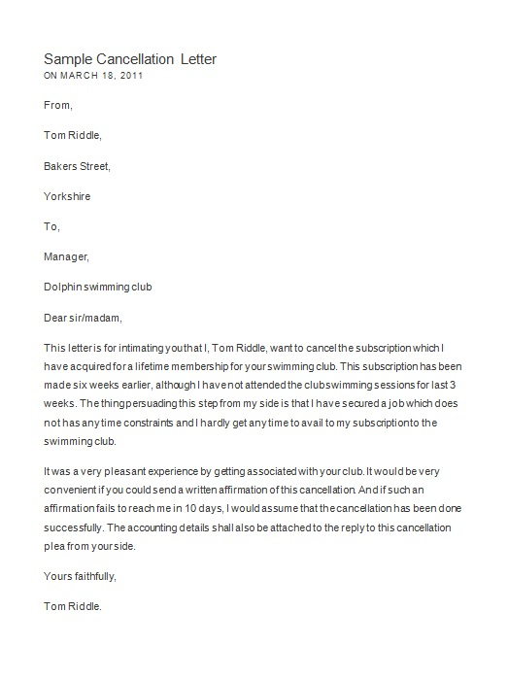
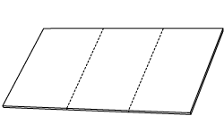



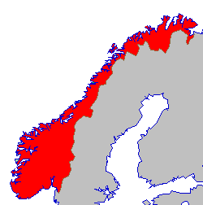



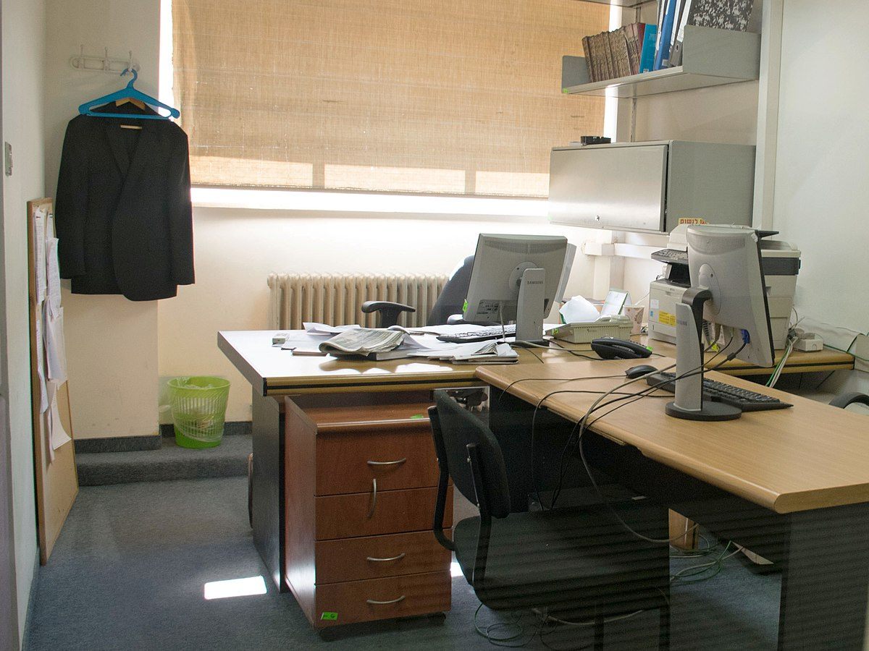
How to send packets
To: Carsten
IFI, UiO
Oslo, Norway
urgent letter from Pål
to IFI
signature needed !
To: IFI
To: IFI, UiO
Oslo, Norway
To: Oslo
analogy fails a little bit because in the Internet we don’t wait, collect, and bundle very often
analogy is right in the sense that we have some content to send, wrappers are put around it for sending, and repacking happens a lot
To: Norway

Slide 7
Data flow through the network
7
peers
7
4
peers
4
3
peers
3
peers
3
1/2
peers
1/2
peers
1/2
End system
Intermediate system
End system
address of next node
address of remote machine
address of remote process
data from application
Each sending N-entity at layer N adds N-protocol information
… which is important for its peer N-entity
… and the receiving N-entity removes it before passing the data to layer N+1

Slide 8
Transport layer header: UDP example
Q
shown as 32 bits per line
Source port
Destination port
UDP header
Packet length
Checksum
Data
port
the term in Internet protocol for the address of a process on an end system
the transport layer address
Note: there are several transport layer protocols in the TCP/IP world, UDP is shown because it has the smallest header
Notes:
Q: Is this really enough for all processes in the world?
Tegninger som denne finner dere i protokollbeskrivelser for Internet-protokoller. I mange IETF RFCer er prokoller beskrivet som her.
Man ser en sekvens av bits. For å lese, starter man på den øverste linjen, leser bittene til høyre, så begynne man på linje 2 osv.
Bitten som er øverst på den venstre siden sendes først på over nettet, neste bit kommer etterpå osv.

Slide 9
Network layer headers: IPv4 and IPv6
shown as 32 bits per line
Version
IHL
DSCP
Type of service
Total length
ECN
Identification
D
M
Fragment offset
Time to live
Protocol
Header checksum
IPv4 Header
Source address (32 bit)
Destination Address (32 bit)
Data
shown as 32 bits per line
Version
DSCP
ECN
Flow label
Payload length
Next header
Hop Limit
Source address
(128 bit)
IPv6 Header
Destination Address
(128 bit)
Data

Slide 10
Data link layer headers: Ethernet example
shown as 32 bits per line
Ethernet Header
Dest MAC address (48 bits)
Dest MAC addr (cont)
Source MAC addr (48 bits)
Source MAC address (cont)
length
data
data
Ethernet Trailer
data
checksum
checksum

Slide 11
Network byte order
Why do we use
Big Endian
numbers in layers 2 – 4 ?

Slide 12
Big vs Little Endian
Representing numbers
  the decimal number 36
  can be seen as 1*32 + 0*16 + 0*8 + 1*4 + 0*2 + 0*1
  is identical to binary 100100
    we prefer to think in whole bytes, and may write 00100100
  is identical to hexadecimal 24 = 2*0x10 + 4*0x1
    for clarity we write 0x24
  it is hard to transform directly from decimal to binary
  but easy to transform from hexadecimal to binary
    00100100
    ⇔ 0010 : 0100
    ⇔ 0*8 + 0*4 + 1*2 + 0*1 : 0*8 + 1*4 + 0*2 + 0*1
    ⇔ 2 : 4
    ⇔ 0x24
sufficient to think about
4 bits at a time!

Slide 13
Big vs Little Endian
when we want a bigger number than 255 = 0xff ,
we need more than 8 bits = 1 byte to store it
1 byte
  0 - 0xff
  0 - 255
2 bytes
  0 - 0xffff
  0 - 65.535
4 bytes
  0 - 0xffffffff
  0 - 4.294.967.295
8 bytes
  0 - 0xffffffffffffffff
  0 - 18.446.744.073.709.551.615

Slide 14
Big vs Little Endian
Q
It is very natural to write
  “Hello”
  and expect that it looks like this in code:
    char buf[6];
    buf[0]=‘H’; buf[1]=‘e’; buf[2]=‘l’; buf[3]=‘l’; buf[4]=‘o’; buf[5]=‘\0’;
    printf(“%s “,buf); }
  let’s create a number from its byte-sized pieces!
  when we use memory like this:
    unsigned char byte[4];
    byte[0]=0x0; byte[1]=0x0; byte[2]=0x2; byte[3]=0x14;
    for( int i=0; i<4; i++ ) { printf(“%x “,byte[i]); }
    printf(“\n”);
    int* ptr;
    ptr = (int*)&byte[0];
    printf(“hex %x\n”,*ptr);
H e l l o
00 00 02 14
on Intel
hex 14020000
on Sparc
hex 214
Notes:
Q: have you experienced computers with big endian architectures?

Slide 15
Argument for Big Endian
compatible with western-world writing direction
  but when we use memory like this:
    unsigned char byte[8];
    byte[0] = 0x81;
    for( int i=1; i<8; i++ ) byte[i] = 0;
    unsigned char* ptr1 = (unsigned char*)&byte[0];
    printf(“%x\n”, 1 + *ptr1);
    unsigned short* ptr2 = (unsigned short*)&byte[0];
    printf(“%x\n”, 1 + *ptr2);
    unsigned int* ptr3 = (unsigned int*)&byte[0];
    printf(“%x\n”, 1 + *ptr3);
    unsigned long long* ptr4 = (unsigned long long*)&byte[0];
    printf(“%llx\n”, 1 + *ptr4);
81 00 00 00 00 00 00 00
Big Endian
82
8101
81000001
8100000000000001

Slide 16

Argument for Little Endian
easy to transform
  when we use memory like this:
    unsigned char byte[8];
    byte[0] = 0x81;
    for( int i=1; i<8; i++ ) byte[i] = 0;
    unsigned char* ptr1 = (unsigned char*)&byte[0];
    printf(“%x\n”, 1 + *ptr1);
    unsigned short* ptr2 = (unsigned short*)&byte[0];
    printf(“%x\n”, 1 + *ptr2);
    unsigned int* ptr3 = (unsigned int*)&byte[0];
    printf(“%x\n”, 1 + *ptr3);
    unsigned long long* ptr4 = (unsigned long long*)&byte[0];
    printf(“%llx\n”, 1 + *ptr4);
cheap and easy to change the number of bytes used for an integer value
81 00 00 00 00 00 00 00
Little Endian
82
82
82
82
harder for the human mind
but faster to process

Slide 17
Bonus for Big Endian
Q
L5 sends bytes to L4
L4 passes packets to L3
L3 adds a header for routing (and more)
L3 passes frame content to L2
L2 adds frame header for addressing (and more)
L2 passes bits to L1
L1 transfers bits
L1 transfer starts at low memory addresses
then continuing to high memory addresses
speed matters
headers are in front to process before all bits have arrived
Notes:
Q: Why is this order important for networks? Couldn’t we just send reverse data???

Slide 18
Bonus for Big Endian
analogue in telephone numbers
0
0
1
7
3
2
5
6
2
8
6
2
9
wait for more
ringing
country: North America
area: Central New Jersey
city: Piscataway
IEEE office
0
0
4
9
6
1
5
1
2
9
1
0
0
wait for more
ringing
country: Germany
city: Darmstadt
research group KOM
process first values that are sent first
because only last provider knows interpretation !
Notes:
Telenor directs call to AT&T for travel to US
AT&T directs call to Verizon in New Jersey
Verizon connects to the specific phone

Slide 19
Bonus for Big Endian
my lab machine in our lab network
129.240.66.59
  this is called “dotted decimal notation”
  this style is the usual way of writing the old IPv4 address
0x81 F0 42 3B
  hexadecimal representation of the 4 bytes of the address
10000001 11110000 01000010 00111011
  binary representation of the 4 bytes

Slide 20
Bonus for Big Endian
my lab machine in our lab network
129.240.66.59
0x81 F0 42 3B
1
0
0
0
0
0
0
1
1
1
1
1
0
0
0
0
0
1
0
0
0
0
1
0
0
0
1
1
1
0
1
1
1
0
0
0
0
0
0
1
1
1
1
1
0
0
0
0
0
1
0
0
0
0
1
0
0
0
1
1
1
0
1
1
University of Oslo
lab network
my lab machine
University of Oslo
decides the number of bits for each internal subnet
most significant for finding a computer
(covering the long distances)
least significant for finding a computer
(covering the short distances)

Slide 21
Bonus for Big Endian
my lab machine in our lab network
129.240.66.59
0x81 F0 42 3B
these are 4 bytes, they are often represented as a long in programs
most significant byte
least significant byte
but building this address on a Little Endian machine is dangerous

Slide 22
Bonus for Big Endian
but building this address on a Little Endian machine is dangerous:
int main()
{
int a = ( 0x81 << 24 );
int b = ( 0xf0 << 16 );
int c = ( 0x42 << 8 );
int d = 0x3b;
int addr = a | b | c | d;
unsigned char* ptr =
(unsigned char*)&addr;
printf("%x\n",addr);
printf("%x ",ptr[0]);
printf("%x ",ptr[1]);
printf("%x ",ptr[2]);
printf("%x\n",ptr[3]);
}
81000000
00f00000
00004200
0000003b
81f0423b
81f0423b
3b 42 f0 81

Slide 23
Addressing
MAC addresses
in the TCP/IP model

Slide 24
Addressing
network
is sub-network
(subnet) of
network
intermediate
system
end system

Slide 25
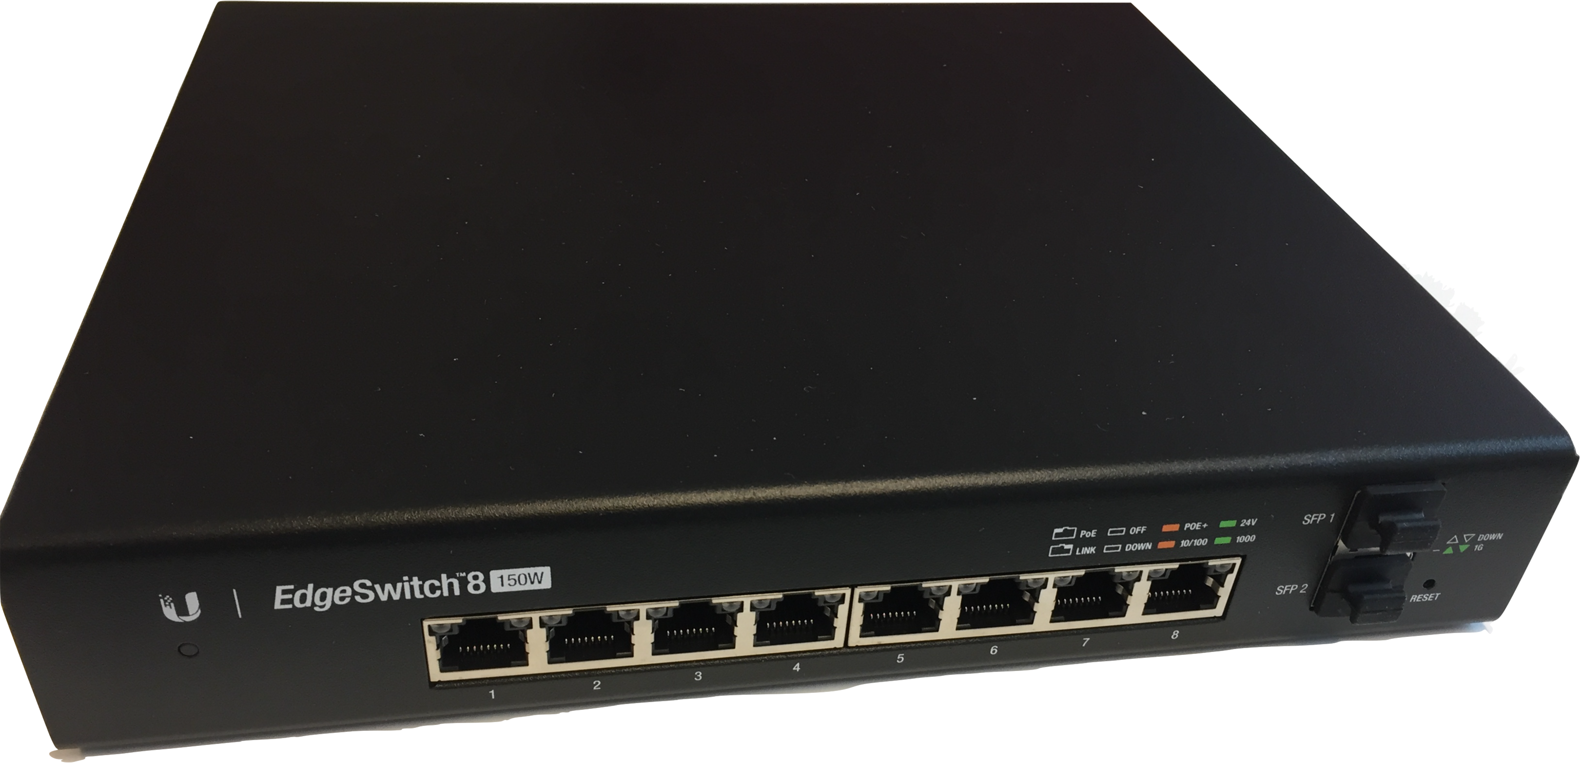
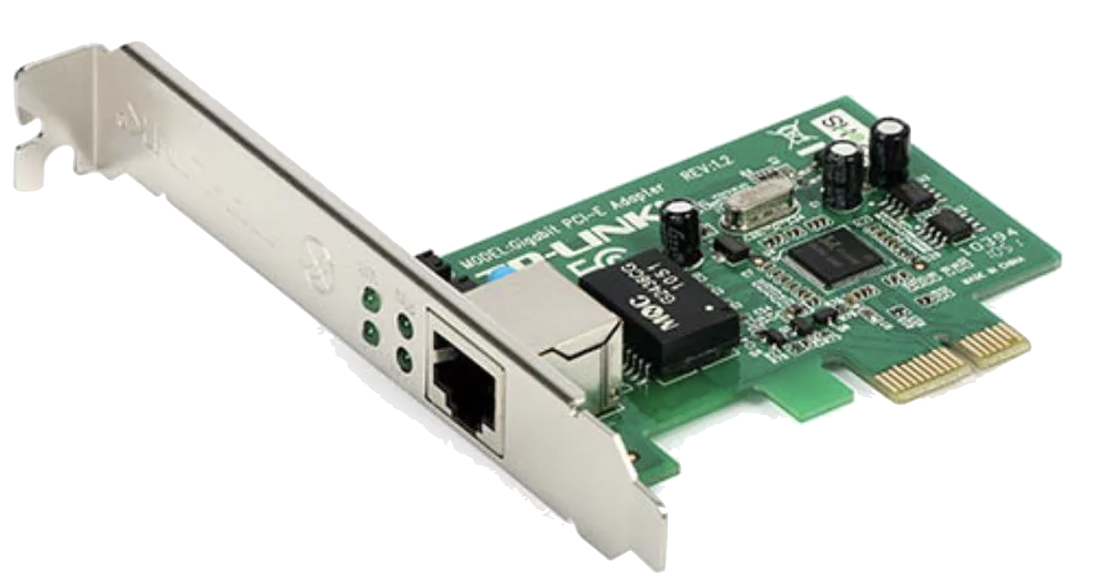
Addressing
Q
end system
network
intermediate system
Point-to-point channels
Gigabit Ethernet (“1GB Ethernet”)
Notes:
Q: What is the role of MAC addresses here? Please reflect!

Slide 26
Addressing
end system
network
intermediate system
Point-to-point channels
Gigabit Ethernet (“1GB Ethernet”)
MAC addresses
are not required in a
true point-to-point network
when L2 passes frames to the correct L1 entity,
the unique peer L1 entity will receive it

Slide 27
Addressing
end systems
network
intermediate system
MAC addresses
are important in a
true broadcast network
Broadcasting channels
Cable
  old-fashioned Ethernet
Radio
  WiFi (IEEE 802.11)
Challenge
MAC addresses have only local meaning
nodes on the “other side” of an IS may not know them

Slide 28
Addressing
end systems
network
intermediate system
Point-to-point channels
Gigabit Ethernet (“1GB Ethernet”)
Broadcasting channels
Cable
  old-fashioned Ethernet
Actually, Gigabit Ethernet behaves like old-fashioned Ethernet. 2 good reasons:
backward compatibility
no management needed when a PC is unplugged in one place and
plugged back in elsewhere

Slide 29
Address resolution
end systems
network
intermediate system
given a packet with an L3 address,
an IS must find the correct L2 address for this packet quickly
what are the options?

Slide 30
Address resolution
end systems
network
intermediate system
Internet address
e.g. 129.31.65.7
?
Netadapter address
e.g. Ethernet address 00:08:74:35:2b:0a
Problem
  Potentially every link can use a different L2 protocol
NRK
server
Telenor
router
DSL modem
WiFi router
desk-top
10GB Eth
DSL
1GB Eth
WiFi
ES
IS
IS
IS
ES
  Different L2 protocols have different address styles
  IP address must be mapped onto the MAC address
  48 bit for Ethernet and WiFi, DSL may use 20 or 48 bits

Slide 31
Address resolution: Ethernet example
Ethernet Header
Dest address (48 bits)
Dest addr (cont)
Source addr (48 bits)
Source address (cont)
length
data
data
Ethernet Trailer
data
checksum
checksum
MAC address structure
  Ethernet and WiFi are L2 layers using “EUI-48”:
  Extended Unique Identifier with 48 bits
  6 bytes, written like this: f2:18:98:3a:b8:97
  to recognize easily that the text is supposed to mean a MAC address
Ethernet MAC addresses should be globally unique

Slide 32
Address resolution: Ethernet example
Ethernet Header
Dest address (48 bits)
Dest addr (cont)
Source addr (48 bits)
Source address (cont)
length
data
data
Ethernet Trailer
data
checksum
checksum
IANA and IEEE decide how to split the address space
  first 3 bytes explain whether an address is special
  OR
  first 3 bytes determine who owns the address range
  e.g.:
    F0:18-98 : Apple, Inc.
    78:45:C4: Dell Inc.
    00:50:56: VMWare, Inc.
    B8:AC:6F: Dell Inc.
IANA - Internet Assigned Number Authority
IEEE - Institute of Electrical and Electronics Engineers
Notes:
IANA – Internet Assigned Number Authority
IEEE - Institute of Electrical and Electronics Engineers

Slide 33
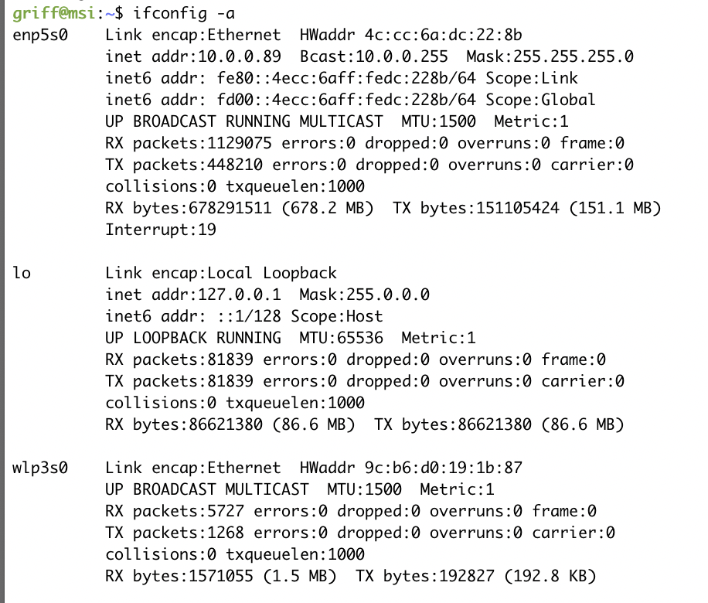
Addresses
my lab machine’s MAC addresses:
Ethernet MAC
(Micro-Star, Taiwan)
WiFi MAC
(Rivet Networks, USA)

Slide 34
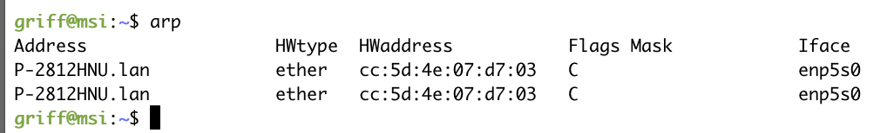
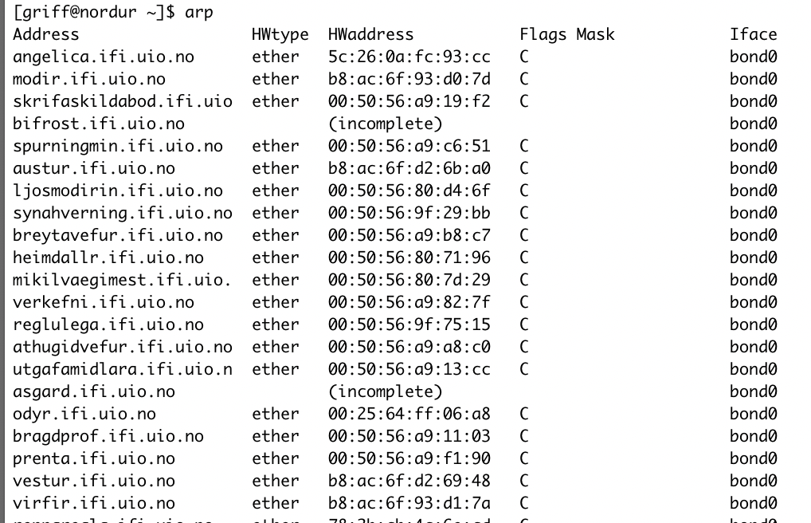
Addresses
MAC addresses known to my lab machine
DSL Modem’s
Ethernet MAC
MAC addresses know to nordur, one of the login.ifi.uio.no machines, in 2024 (incomplete)

Slide 35
Address Resolution
1st idea: direct mapping
shown as 32 bits per line
the 32 bit destination IP address
would fit into
the 48 bit destination MAC
address
Dest address (48 bits)
Dest addr (cont)
Source addr (48 bits)
Source address (cont)
length
data
Data
Version
IHL
Type of service
PRE
ToS
Total length
Identification
D
M
Fragment offset
data
checksum
but:
there is a new MAC address
for every pair of direct
neighbours
need to re-write the destination IP address on every IS
but IP addresses are globally unique
does not work for the Internet
Time to live
Protocol
Header checksum
checksum
Source address (32 bit)
Destination Address (32 bit)
Data

Slide 36
Address Resolution
2nd idea: mapping table
end systems
network
intermediate system
every node maintains a table that maps
IP address ⟷ MAC address
for every network interface and
for every directly reachable node (L2 neighbour)
idea 2.1: manually maintained by people
a lot of work, but not unrealistic – IFI allows only well-known MAC addresses in well-known network plugs – could be used for this but is not
idea 2.2: established by broadcasts from stations

Slide 37
Address Resolution
3nd idea: address resolution protocol
end systems
network
intermediate system
node with a packet to deliver:
if a local cache contains IP address ⟷ MAC address
  send packet & update cache removal timeout
else
  send broadcast to all stations
  “Who has IP address?”
  if one node responds
    add IP address ⟷ MAC address mapping to cache
    set timeout for removal from cache to some minutes
    send packet
  else
    drop packet

Slide 38
Address Resolution Protocol (ARP)
Q
H
H
H
H
H
H
ARP Request
source
@IP: 9.228.50.8
@HW: 0xaa
target
@IP: 9.228.50.3
@IP: 9.228.50.3
@HW:
@HW: 0xa3e
ARP Response
source
@IP: 9.228.50.3
@HW: 0xa3e
target
@IP: 9.228.50.8
@HW: 0xaa
Notes:
Q: AT START: What do we know about the computer we search? What do we have to send?

Slide 39
Address Resolution Protocol (ARP)
Process
  Broadcast ARP request datagram on LAN
    including receiver’s IP address (desired value)
    sender’s physical (HW) and IP address (IP)
  Every machine on LAN receives this request and checks address
  Reply by sending ARP response datagram
    machine which has requested address responses
    including the physical address
  Enter the pair (IP,MAC) into buffer for future requests
Refinement
  The receiver of the ARP request stores the sender’s (IP,MAC) pair in its cache
  Send own table during the boot process (but may be too old)
  Entries in ARP cache should time out after some time (few minutes)

Slide 40
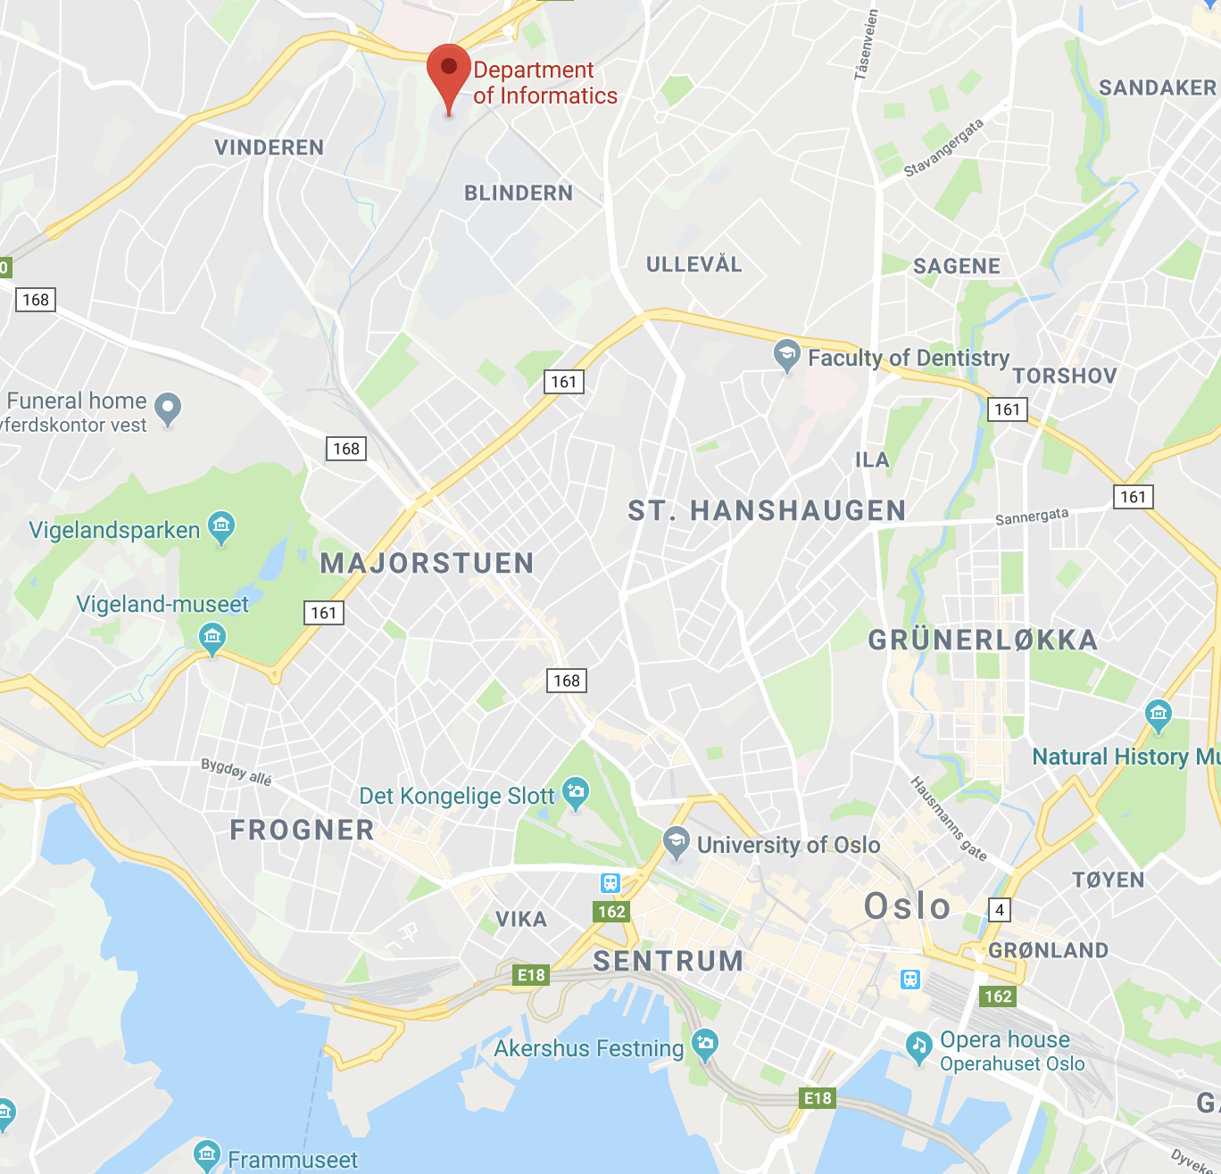
Address Resolution Protocol (ARP)
ES 1
End system not directly reachable by broadcast
Example: ES 1 to ES 2
  ARP would not receive a response
    Ethernet broadcast is not rerouted over a router
1GB Ethernet
1GB Ethernet
UNINETT’s
N x 10GB Ethernet
1GB Ethernet
ES 2
L2 solution: proxy ARP
  the local router knows all remote networks with their respective routers
    responds to local ARP
  local ES 1 sends data for ES 2 always to the local router, this router forwards the data (by interpreting the IP address contained in the data)
L3 solution: remote network address is known
  local ES 1 sends data to the appropriate remote router
  local router forwards packets

Slide 41
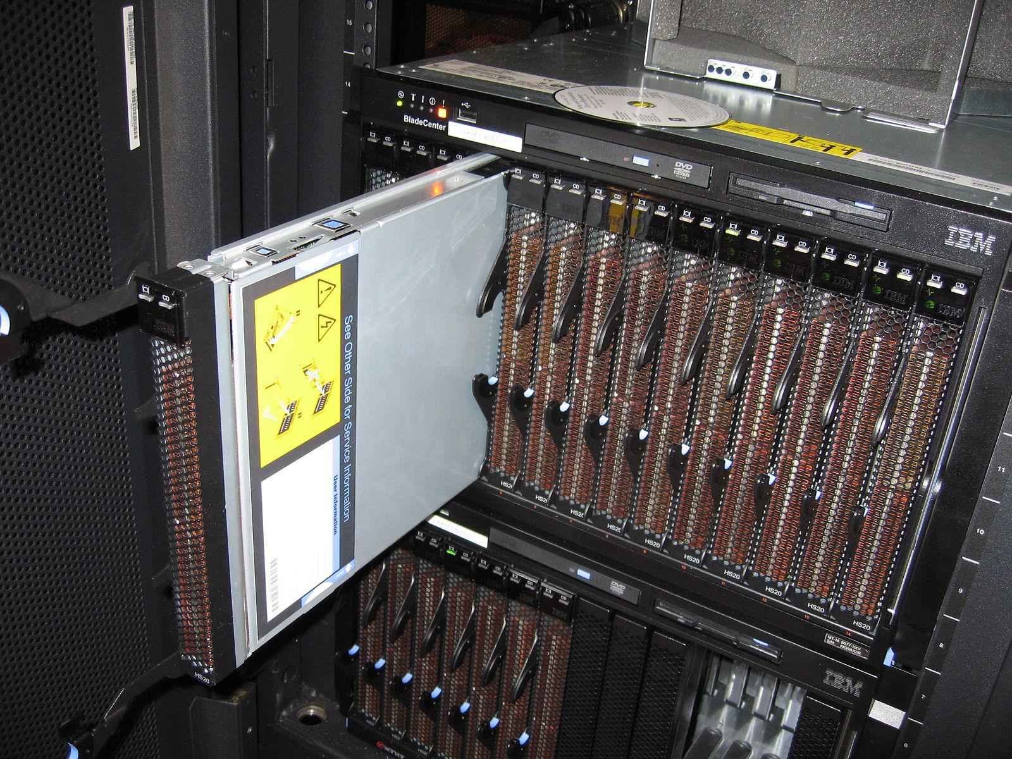
Reverse Address Resolution Protocol (RARP)
Retrieve Internet address from knowledge of hardware address
H
H
H
H
H
H
@IP: unknown
RARP Request
@HW: 0xaa
source
Application today:
blades in large clusters
are physically moved
@IP:
@HW: 0xaa
target
@IP: 9.228.50.3
@IP:
@HW: 0xa3e
@HW: 0xaa
RARP server responds
RARP server has to be available on the LAN
RARP Response
source
@IP: 9.228.50.3
@HW: 0xa3e
for other uses mostly replaced by newer
protocols BOOTP and
DHCP
target
@IP: 9.228.50.8
@HW: 0xaa
Notes:
blade server image by Gennaro Prota @ WikiMedia

Slide 42
Addressing
IP addresses
in the TCP/IP model

Slide 43
Internet Addresses and Internet Subnetworks
Original global addressing concept for the Internet
  For addressing end systems and intermediate systems
  each network interface (not ES) has its own unique address
  5 classes
7
24
A
0
Network
Host
14
16
B
1
0
Network
Host
21
8
C
1
1
0
Network
Host
28
1
1
1
0
Multicast address
28
1
1
1
1
Reserved
ICANN (Internet Corporation for Assigned Numbers and Names)
  manages network numbers
  delegates parts of the address space to regional authorities
Notes:
A: 128 * 16.777.216
B: 16.384 * 65.536
C: 2.097.153 * 256

Slide 44
Internet Addresses and Internet Subnetworks
Original global addressing concept for the Internet
  For addressing end systems and intermediate systems
  each network interface (not ES) has its own unique address
  5 classes
128
16777216
7
24
A
0
Network
Host
14
16
16384
B
1
0
Network
Host
65536
21
8
C
1
1
0
Network
Host
28
2097152
1
1
1
0
Multicast address
256
28
1
1
1
1
Reserved
ICANN (Internet Corporation for Assigned Numbers and Names)
  manages network numbers
  delegates parts of the address space to regional authorities

Slide 45
Internet Addresses and Internet Subnetworks
B
A
B
Network addresses define only
who belongs to a network,
not how networks are
connected
C
A
C
C
C
for the path between them: routing
in another lecture

Slide 46
Internet Address and Internet Subnetworks
Networks grow and should be somehow structured
  several networks instead of one preferable
  but getting several address areas is hard
    since address space is limited
    e.g., university may have started with class B address, doesn’t get second one
Problem
  class A, B, C refer to one network, not collection of LANs
⇒ Allow a network to be split into several parts
  for internal use
  still looks like single network to outside world

Slide 47
Internet Addresses and Internet Subnetworks
B
A
B
Network addresses define only
who belongs to a network,
not how networks are
connected
C
A
C
C
C
for the path between them: routing
in another lecture

Slide 48
Internet Addresses and Internet Subnetworks
A
for the path inside one of them: also routing
but how can we carve subnets out of the class A, B or C network?

Slide 49
Internet Address and Internet Subnetworks
Q
Idea
  local decision for subdividing host share
  into subnetwork portion and end system portion
14
16
6
10
e.g. address
129.8.7.2:
1
0
Network
Host
Subnet
Host
To write down subnet address
with subnet mask use either
129.8.4.0/255.255.252.0
or
129.8.4.0/22
1
&
0
0
0
0
0
0
1
0
0
0
0
1
0
0
0
0
0
0
0
0
1
1
&
1
0
0
0
0
0
0
1
0
Subnet mask:
1
1
1
1
1
1
1
1
1
1
1
1
1
1
1
1
1
1
1
1
1
1
0
0
0
0
0
0
0
0
0
0
Subnet address:
1
0
0
0
0
0
0
1
0
0
0
0
1
0
0
0
0
0
0
0
0
1
0
0
0
0
0
0
0
0
0
0
Use “subnet mask” to distinguish network and subnet part from host part
Routing with 3 levels of hierarchy
  Algorithm in router
  (by masking bits: AND between address and subnet mask):
    packet to another network (AND network != 0: then to main router)
    packet to local end system (AND network and subnet == 0: yes, then deliver packet)
    packet to other subnetwork (AND network == 0, subnet != 0: then reroute to appropriate router)
Notes:
Q: How would you implement this in a computer?

Slide 50
CIDR: Classless InterDomain Routing
Subnetting not good enough
  Too many organizations require addresses
    in principle many addresses due to 32-bit address space
    but inefficient allocation due to class-based organization
      class A network with 16 million addresses too big for most cases
      class C network with 256 addresses is too small
      most organizations are interested in class B network, but there are only 16384 (in reality, class B too large for many organizations)

Slide 51
Internet Addresses and Internet Subnetworks
A

Slide 52
Internet Addresses and Internet Subnetworks
A

Slide 53
CIDR: Classless InterDomain Routing
Q
Subnetting not good enough
  Too many organizations require addresses
    in principle many addresses due to 32-bit address space
    but inefficient allocation due to class-based organization
      class A network with 16 million addresses too big for most cases
      class C network with 256 addresses is too small
      most organizations are interested in class B network, but there are only 16384 (in reality, class B too large for many organizations)
⇒ Introduction of CIDR (Classless InterDomain Routing) (RFC1519)
CIDR Principle
  to allocate IP addresses in variable-sized blocks
    (without regard to classes)
  e.g., a request for 2000 addresses would lead to
    assignment of 2048 address block starting on 2048 byte boundary
but, dropping classes makes forwarding more complicated
Large number of networks leads to large routing tables
Notes:
QUESTION: WHY on a 2048 boundary????

Slide 54
CIDR: Classless InterDomain Routing
Search for longest matching prefix
  if several entries with different subnet mask length may match
    then use the one with the longest mask
  i.e., AND operation for address & mask must be done for each table entry
Entries may be aggregated to reduce routing tables
194.24.0.0/21
Router
194.24.8.0/22
Router
194.24.0.0/19
Router
Unassigned 194.24.12.0/22
194.24.16.0/20
Router

