Slide 1
Transport Protocols in the Internet
IN2140:
Introduction to Operating Systems and Data Communication
Introduction to TCP

Slide 2
TCP - Transmission Control Protocol
TCP is the main transport protocol of the Internet
TCP provides
  Reliable end-to-end byte stream over an unreliable network service
Motivation: network with connectionless service
  Packets and messages may be
    duplicated, in wrong order, faulty
    i.e., with such service only, each application would have to provide recovery
      error detection and correction
  Network or service can
    impose packet length
    define additional requirements to optimize data transmission
    i.e., application would have to be adapted

Slide 3
TCP Characteristics
Data stream oriented
  TCP transfers serial byte stream
  Maintains sequential order
Unstructured byte stream
  Application often has to transmit more structured data
  TCP does not support such groupings into (higher) structures within byte stream

Slide 4
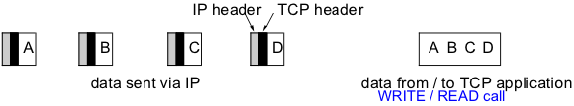
TCP Characteristics
Data stream oriented
  TCP transfers serial byte stream
  Maintains sequential order
Unstructured byte stream
  Application often has to transmit more structured data
  TCP does not support such groupings into (higher) structures within byte stream
Buffered data transmission
  Byte stream not message stream: message boundaries are not preserved
    no way for receiver to detect the unit(s) in which data were written
  For transmission the sequential data stream is
    Divided into segments
    Delayed if necessary (to collect data)

Slide 5
TCP Characteristics
Virtual connection
  Connection established between communication parties before data transmission
Two-way communications (fully duplex)
  Data may be transmitted simultaneously in both directions over a TCP connection
Point-to-point
  Each connection has exactly two endpoints

Slide 6
TCP State machine
CLOSED
Timeout
Recv SYN
Send SYN ACK
LISTEN
Send SYN
Recv RST
Send SYN
SYN RCVD
Recv SYN Send SYN ACK
SYN SENT
Recv SYN ACK
Send ACK
Recv ACK
Send FIN
ESTABLISHED
CLOSE WAIT
LAST ACK
Recv FIN
Send ACK
Send FIN
Send FIN
FIN WAIT 1
Recv FIN Send ACK
CLOSING
Recv FIN ACK
Send ACK
Recv ACK
Recv ACK
Timeout
FIN WAIT 2
TIME WAIT
Recv FIN Send ACK

Slide 7
Typical State Sequence of a TCP Client
CLOSED
LISTEN
Send SYN
SYN RCVD
SYN SENT
Recv SYN,ACK
Send ACK
ESTABLISHED
CLOSE WAIT
LAST ACK
Send FIN
FIN WAIT 1
CLOSING
Recv ACK
Recv FIN, Send ACK
Timeout
FIN WAIT 2
TIME WAIT

Slide 8
Typical State Sequence of a TCP Server
CLOSED
Timeout
LISTEN
Recv SYN
Send SYN,ACK
SYN RCVD
SYN SENT
Recv ACK
ESTABLISHED
CLOSE WAIT
LAST ACK
Recv FIN,
Send ACK
Send FIN
FIN WAIT 1
CLOSING
FIN WAIT 2
TIME WAIT

Slide 9
TCP: Message Format
TCP/IP Header Format
Version
IHL
Type of service
PRE
ToS
Total length
Identification
D
M
Fragment offset
Time to live
Protocol
Header checksum
IP header
Source address
Destination Address
Options
Source port
Destination port
Sequence number
Piggyback acknowledgement
TCP header
THL
unused
U
A
P
R
S
F
Window
Checksum
Urgent pointer
Options (0 or more 32 bit words)
Data
Used for demultiplexing:
identifies connection
Used for demultiplexing:
service address for connection setup

Slide 10
TCP Characteristics
Virtual connection
  Connection established between communication parties before data transmission
Two-way communications (fully duplex)
  Data may be transmitted simultaneously in both directions over a TCP connection
Point-to-point
  Each connection has exactly two endpoints
Reliable
  Fully ordered, fully reliable
    Sequence maintained
    No data loss, no duplicates, no modified data

Slide 11
TCP in Use & Application Areas
Benefits of TCP
Reliable data transmission
  Efficient data transmission despite complexity
  Can be used with LAN and WAN for
    low data rates (e.g. interactive terminal) and
    high data rates (e.g. file transfer)
Disadvantages when compared with UDP
Higher resource requirements
  buffering, status information, timer usage
Connection set-up and disconnect necessary
  even with short data transmissions
Applications
everything on the Web including video-on-demand (http)
File transfer (scp, ftp)
Interactive terminal (ssh, telnet)
E-mail (smtp, imap)
X-Windows

Slide 12
Transport layer
IN2140:
Introduction to Operating Systems and Data Communication
Terminology

Slide 13
Terminology: bandwidth (1/2)
Mirriam-Webster online ( http://www.m-w.com ):
Main Entry: band*width, Pronunciation: 'band-"width
Function: noun, Date: circa 1937
  1 : a range within a band of wavelengths, frequencies, or energies; especially : a range of radio frequencies which is occupied by a modulated carrier wave, which is assigned to a service, or over which a device can operate
  2 : the capacity for data transfer of an electronic communications system <graphics consume more bandwidth than text does>; especially : the maximum data transfer rate of such a system
Unit: definition 1 - “Hz“, definition 2 - “bit/s“ (bps)
Common terminology in computer network context:
How many bits/sec can be transferred = “how thick is the pipe”
Traditional, “real“ definition!
“Information rate“

Slide 14
Terminology: bandwidth (2/2)
Various wooly “bandwidth“ terms
  Nominal bandwidth: Bandwidth of a link when there is no traffic
  Available bandwidth: (Nominal bandwidth - traffic) ... during a specific interval
  Bottleneck bandwidth: smallest nominal bandwidth along a path, but sometimes also smallest available bandwidth along a path
Throughput: bandwidth seen by the receiver
Goodput: bandwidth seen by the receiving application
  e.g. TCP: goodput != throughput
  Difference is not only message headers - more required to ensure reliability, ordering, flow control, congestion control, ...
Notes:
Nominell – tilgjengelig – flaskehals
Flytkontroll - metningkontroll

Slide 15
Terminology: delay
Propagation delay - time to transfer a bit
Latency = propagation delay
+ msg_length / bottleneck bandwidth
+ queuing delay
  just a rough measure; e.g., processing delay can also
  play a role, esp. in core routers (CPU = scarce resource!)
Jitter - delay fluctuations, very critical for most real-time applications
End-to-end delay – time a message needs from a sending entity to a receiving entity
  end-to-end delay on the application layer includes TCP retransmissions
  end-to-end delay on the transport layer does not
Round-trip time (RTT) - time a messages needs to go from sender to receiver and back

Slide 16
Transport layer
IN2140:
Introduction to Operating Systems and Data Communication
TCP reliability

Slide 17
TCP Reliability
TCP/IP has only two tools for ensuring reliable transfer:
  detecting duplicate byte ranges
  retransmitting data that has not arrived and not arrived correctly

Slide 18
TCP Reliability
TCP/IP Retransmits segments until they are acknowledged
ACK field is used for that
Version
IHL
Type of service
PRE
ToS
Total length
Identification
D
M
Fragment offset
Time to live
Protocol
Header checksum
IP header
Source address
Destination Address
Options
Source port
Destination port
Sequence number
Piggyback acknowledgement
TCP header
THL
unused
U
A
P
R
S
F
Window
Checksum
Urgent pointer
Options (0 or more 32 bit words)
Data
Acknowledgement:
Next expected byte
Indicator:
Is the ACK field in use

Slide 19
TCP ACK and Reliability
Timer
start
Seq=92, 8 bytes data
Seq=92, 8 bytes data
ACK=100
Seq=100, 20 bytes data
Loss!
X
Timer for 92
Timer for 100
ACK=100
ACK=120
Timeout!
Seq=92, 8 bytes data
Seq=92,
8 bytes data
Timeout!
ACK=100
Seq=120, 10 bytes data
ACK=120
time
time
time
time
Timeout retransmission
Spurious retransmission
In modern TCP implementations,
a lot is done to suppress spurious retransmissions.
The reason is that timeouts have another meaning: congestion
Notes:
Spurious = uberettiget

Slide 20
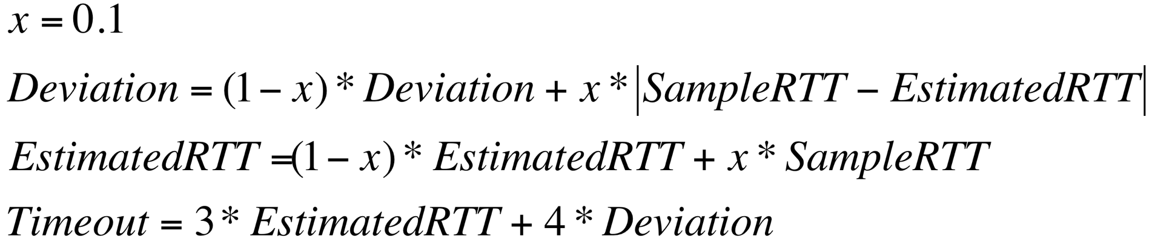
TCP Round trip time and timeout
How to set the retransmission timer?
  Must be longer than round-trip time (RTT)
  Too short: many spurious retransmissions
  Too long: slow reaction, flow control buffer fills up
Idea
  Estimated RTT
    Use a SampleRTT: Measure time from segment sending and ACK received
    Compute EstimatedRTT as a floating average
    Increase the EstimatedRTT with a safety margin that is big when SampleRTT changes a lot
      (because fewer timeouts are considered better)
TCP standard says 1 here, but lower-bound with 1 second. Variations exist...

Slide 21
Transport layer
IN2140:
Introduction to Operating Systems and Data Communication
Flow Control

Slide 22
Flow Control on Transport Layer
Fast sender shall not flood slow receiver
Application
Layer
Transport
Layer
Network
Layer
Data Link
Layer
Link layer
Few connections
(one per host)
Short distances
Physical
Layer
Transport layer
Potentially many connections
(several per application)
Potentially long distances
Flow control mechanisms:
Stop-and-wait
Sliding window
  Go-back-N / no buffer allocation
  Selective repeat / static buffer allocation
  Credit mechanism / dynamic buffer allocation

Slide 23
Flow control and error treatment
Problem
sender can send faster than receiver can receive
Without flow control
receiver loses packets despite error-free transmission
With flow control
sender can adapt to receiver’s abilities by feedback
Comment
error control and flow control are usually interlinked
rate control
  controls sending speed as well
  but defines sequencing of send operations
  whereas flow control defines conditions for next send operation
© Ralf Steinmetz, Technische Universität Darmstadt

Slide 24
Transport layer
IN2140:
Introduction to Operating Systems and Data Communication
Flow Control: stop-and-wait

Slide 25


Flow control: Stop-and-Wait
sender
receiver
packet
Needed:
(A) a receiving buffer
(B) bi-directional communication
ACK
packet
ACK

Slide 26
Flow control: Stop-and-Wait
Packets can get lost
sender
receiver
sender
receiver
packet
packet
ACK
ACK
packet
Features required by Stop-and-Wait:
fix the loss
distinguish packet loss and ACK loss

Slide 27
Flow control: Stop-and-Wait
(a) fix the loss
sender
receiver
start a timer
packet
timer expired
send packet again
start new timer
packet
ACK
ACK arrived
cancel timer
Timeout interval:
Too short: unnecessary sending of packets
Too long: unnecessary long wait in case of error

Slide 28
Flow control: Stop-and-Wait
(b) distinguish packet loss and ACK loss
sender
receiver
sender
receiver
packet 0
packet 0
packet 0
expected
packet 0
expected
ACK
packet 0 or
packet 1?
packet 0 or
packet 1?
packet 1 expected
ACK
ACK
packet 1 expected

Slide 29
Flow control: Stop-and-Wait
Distinguish cases by sequence number: single bit with value 0 and 1
sender
receiver
sender
receiver
packet 0
expected
packet 0 expected
packet
0
packet
0
packet 1 expected
received 0
ACK
0
packet
0
packet
0
packet 1
expected
packet 1 expected
received
discard 0
ACK
0
ACK
0
packet
1
packet
1
packet 0
expected
packet 0 expected
received
received 1
ACK
1
ACK
1

Slide 30
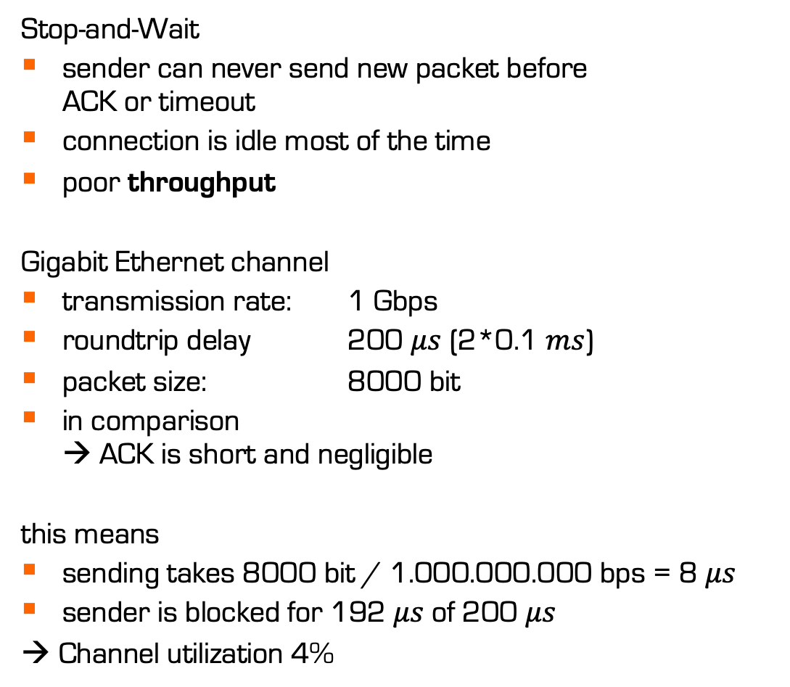


Flow control: Stop-and-Wait
Stop-and-Wait
sender can never send new packet before
ACK or timeout
connection is idle most of the time
poor throughput
Gigabit Ethernet channel
transmission rate: 1 Gbps
roundtrip delay 200 $μs$ (2*0.1 $ms$)
packet size: 8000 bit
in comparison
→ ACK is short and negligible
this means
sending takes 8000 bit / 1.000.000.000 bps = 8 $μs$
sender is blocked for 192 $μs$of 200 $μs$
→ Channel utilization 4%
sender
receiver
$8 μ$s
packet
$200 μ$s
ACK

Slide 31
Transport layer
IN2140:
Introduction to Operating Systems and Data Communication
Flow Control: sliding window

Slide 32
Flow control: Sliding Window
Improve utilization: pipelining
Flow control: sliding window mechanism
sender
receiver
packet 0
packet 1
packet 2
ACK 0
ACK 1
ACK 2
packet 8
ACK 8

Slide 33
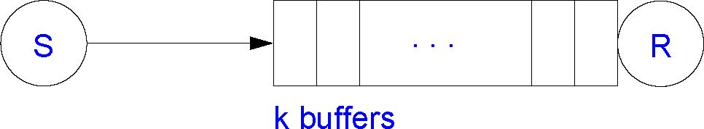
Sliding Window: Concept
1st goal of link flow control:
receiver buffer must not overflow
Assumptions:
each buffer can contain one packet
Two windows per communication relationship
Sender Window (or Send Window)
packets that were sent but not yet acknowledged
Receiver Window (or Receive Window)
packets that can be accepted
packets are identified
by sequence numbers
but the packets keep coming
and these numbers will
wrap eventually
send
w
e
s
e
n
d
s
o
m
e
d
a
t
a
f
r
o
m
t
h
e
t
o
p
buffers that fit into the current send window can be
in flight at the same time
(“in flight”: sent but not acknowledged)
s
d
n
recv
w
e
s
e
packets that fit into the current receive window
are considered valid and are acknowledged on arrival
Notes:
flood : overflomme

Slide 34
Sliding Window: Concept
Example:
SeqNo: [0..7]
Window Size (WS): 3
Sender side
LB
0
lower bound
0
2 variables
UB
0
upper bound
0
7
0
LB: oldest seqno that is still unconfirmed
UB: next seqno to be sent
if LB==UB :
nothing is in flight
sender is idle
Sender
6
1
5
2
4
3
advancing sender seqno (modulo 8)
LB: when ACK is received
UB: when sending a packet

Slide 35
Sliding Window: Concept
Example:
SeqNo: [0..7]
Window Size (WS): 3
Sender side
LB
1
lower bound
0
2 variables
UB
3
0
1
upper bound
2
7
0
LB: oldest seqno that is still unconfirmed
UB: next seqno to be sent
if LB==UB :
nothing is in flight
sender is idle
Sender
6
1
5
2
4
3
increase UB (modulo 8 !)
when sending a packet
increase LB (modulo 8 !)
when receiving an ACK
send packet(0) packet(1) packet(2) WS=3
recv ACK(0): WS=2

Slide 36
Sliding Window: Concept
Example:
SeqNo: [0..7]
Window Size (WS): 3
Sender side
LB
1
2
3
lower bound
4
2 variables
3
4
5
UB
7
upper bound
6
7
0
LB: oldest seqno that is still unconfirmed
UB: next seqno to be sent
if LB==UB :
nothing is in flight
sender is idle
Sender
6
1
5
2
4
3
increase UB (modulo 8 !)
when sending a packet
increase LB (modulo 8 !)
when receiving an ACK
send packet(0) packet(1) packet(2) WS=3
recv ACK(0): WS=2
send packet(3) WS=3
recv ACK(1), ACK(2), ACK(3) WS=0
send packet(4) packet(5) packet(6) WS=3

Slide 37
Sliding Window: Concept
Example:
SeqNo: [0..7]
Window Size (WS): 3
Receiver side
LB
0
lower bound
1
2 variables
3
upper bound
UB
4
7
0
LB: lowest valid seqno that should be ACKed
UB: lowest invalid seqno
if UB==LB: buffer full
if UB==(LB+3)%8: nothing to ACK
Receiver
6
1
5
2
4
3
increase LB (modulo 8 !)
when receiving a packet
increase UB (modulo 8 !)
when sending an ACK
recv packet(0) … WS=2
send ACK(0) WS=3

Slide 38
Sliding Window: Concept
Example:
SeqNo: [0..7]
Window Size (WS): 3
Receiver side
LB
3
1
2
lower bound
4
2 variables
7
6
5
upper bound
UB
4
7
0
LB: lowest valid seqno that should be ACKed
UB: lowest invalid seqno
if UB==LB: buffer full
if UB==(LB+3)%8: nothing to ACK
Receiver
6
1
5
2
4
3
increase LB (modulo 8 !)
when receiving a packet
increase UB (modulo 8 !)
when sending an ACK
recv packet(0) … WS=2
send ACK(0) WS=3
recv packet(1) packet(2) packet(3) WS=0
send ACK(1) ACK(2) ACK(3) WS=3

Slide 39
Transport layer
IN2140:
Introduction to Operating Systems and Data Communication
Flow Control: cumulative ACK

Slide 40
Sliding Window: Concept
Example:
SeqNo: [0..7]
Window Size (WS): 3
Feature: Cumulative ACK
sender
receiver
LB
0
LB
0
packet 0
1
packet 1
0
3
UB
3
packet 2
ACK 0
UB
4
7
0
7
0
Sender
Receiver
6
1
6
1
5
2
5
2
4
3
4
3

Slide 41
Sliding Window: Concept
Example:
SeqNo: [0..7]
Window Size (WS): 3
Feature: Cumulative ACK
sender
receiver
LB
0
3
LB
3
packet 0
3
packet 1
3
4
UB
packet 2
ACK 0
UB
6
ACK 0
7
0
ACK 1
7
0
Sender
ACK 2
Receiver
6
1
6
1
5
2
5
2
4
3
4
3

Slide 42
Sliding Window: Concept
Example:
SeqNo: [0..7]
Window Size (WS): 3
Feature: Cumulative ACK
sender
receiver
LB
0
3
LB
3
6
packet 0
3
packet 1
UB
6
packet 2
UB
6
ACK 0
7
0
ACK 1
7
0
Sender
ACK 2
packet 3
Receiver
6
1
packet 4
6
1
packet 5
5
2
5
2
4
3
4
3

Slide 43
Sliding Window: Concept
Example:
SeqNo: [0..7]
Window Size (WS): 3
Feature: Cumulative ACK
With cumulative ACKs:
ACK 5 confirms everything up to 5
sender
receiver
LB
0
3
LB
3
4
6
packet 0
6
packet 1
3
6
7
1
UB
packet 2
UB
0
ACK 0
7
0
ACK 1
7
0
Sender
ACK 2
packet 3
Receiver
6
1
packet 4
6
1
packet 5
5
2
ACK 3
ACK 4
5
2
4
3
4
3
ACK 5
Without cumulative ACKs:
timeout & retransmission

Slide 44
Sliding Window
Stored packets at the sender
the sender must store all unacknowledged packets and be able to retransmit
maximum number defined by sender’s window size (here 3)
the packets not yet acknowledged by the receiver
Stored packets at the receiver
not necessary to store any packets
  receive buffer must hold at least one packet, but can be passed to next layer right away
not useful to store more than one receiver window size
ACK sent by receiver only if the packet
has been identified as being correct
can be transmitted correctly to the application
  correct includes “in the right order”
  correct includes usually: free from detected bit errors

Slide 45
Transport layer
IN2140:
Introduction to Operating Systems and Data Communication
Flow Control: retransmission

Slide 46
Sliding Window
Retransmission approaches
sender
receiver
packet 1
packet 0
This approach is called
Go-Back-N
Receiver accepts packets only in order
Advantages:
receiver only needs buffer for 1 packet
if the network usually loses >1 packets in a row, this fixes the problem quickly
packet 2
ACK 0
discard 2
packet 3
discard 3
packet 1
packet 2
packet 3
ACK 1
ACK 2
ACK 3
packet 4

Slide 47
Sliding Window
Retransmission approaches
sender
receiver
sender
receiver
packet 1
packet 0
packet 1
packet 0
packet 2
packet 2
ACK 0
ACK 0
keep 2
packet 3
ACK 0
packet 3
keep 3
packet 1
packet 1
packet 2
ACK 0
packet 3
ACK 1
ACK 3
ACK 2
ACK 3
packet 4
packet 4

Slide 48
Sliding Window
Retransmission approaches
sender
receiver
This approach is called
Selective Repeat
Receiver buffers packets that arrive out of order but in window
Advantages:
less traffic
if the network usually loses only 1 packet in a row, this uses bandwidth better
packet 1
packet 0
packet 2
ACK 0
keep 2
ACK 0
packet 3
keep 3
packet 1
ACK 0
ACK 3
packet 4

Slide 49
Transport layer
IN2140:
Introduction to Operating Systems and Data Communication
Flow Control

Slide 50
Flow Control on Transport Layer
Fast sender shall not flood slow receiver
Application
Layer
Transport
Layer
Network
Layer
Data Link
Layer
Link layer
Few connections
(one per host)
Short distances
Physical
Layer
Transport layer
Potentially many connections
(several per application)
Potentially long distances
Flow control mechanisms:
Stop-and-wait
Sliding window
  Go-back-N / no buffer allocation
  Selective repeat / static buffer allocation
  Credit mechanism / dynamic buffer allocation

Slide 51
Transport layer
IN2140:
Introduction to Operating Systems and Data Communication
Flow Control:
sequence number space

Slide 52
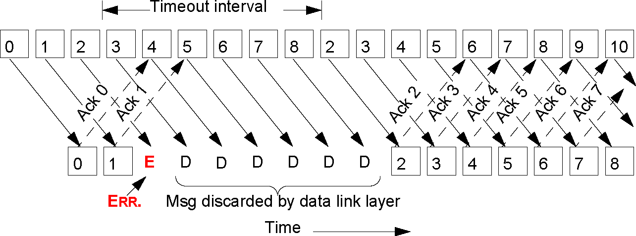
Sliding Window: Go-Back-N
Example: sender: error detection by timeout
© Ralf Steinmetz, Technische Universität Darmstadt

Slide 53
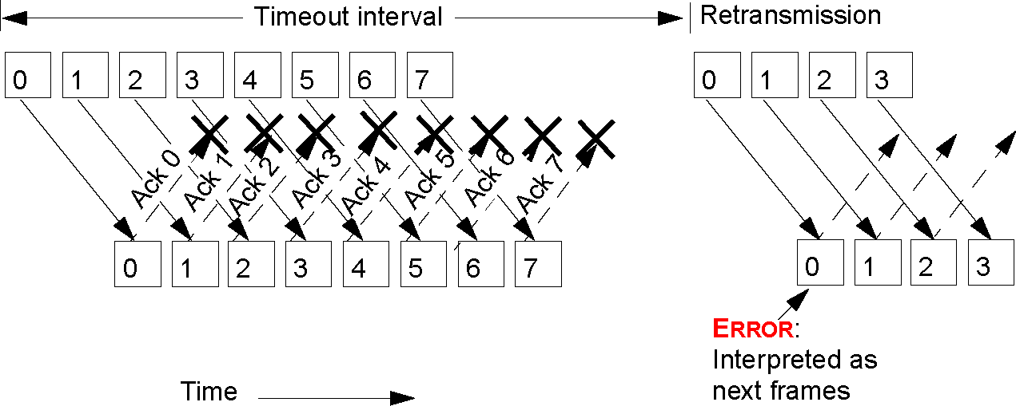
Sliding Window: Go-Back-N
Correlation between
window size and
number of possible sequence numbers
→ at least max. window size strictly less than range of sequence numbers
Example for incorrect window size:
  amount of sequence numbers 8
  window size 8
  all ACKs lost

Slide 54
Sliding Window: Go-Back-N
Correlation between
window size and
number of possible sequence numbers
at least max. window size strictly less than range of sequence numbers
Example for correct window size:
amount of sequence numbers 8
window size 7
all ACKs lost
sender
receiver
LB
UB
seq 0
0
7
seq 1
seq 2
seq 3
ACK 0
1
seq 4
ACK 1
2
0
seq 5
ACK 2
3
1
seq 6
ACK 3
4
2
ACK 4
5
3
ACK 5
6
4
ACK 6
7
5
Timeout
6
seq 0
ACK 0
7
6
receiver discards packet 0 and resends ACK 0
everything OK

Slide 55
Sliding Window: Go-Back-N
Correlation between
window size and
number of possible sequence numbers
at least max. window size strictly less than range of sequence numbers
Example for incorrect window size:
amount of sequence numbers 8
window size 8
all ACKs lost
sender
receiver
LB
UB
seq 0
0
0
seq 1
seq 2
seq 3
ACK 0
1
seq 4
ACK 1
2
1
seq 5
ACK 2
3
2
seq 6
ACK 3
4
3
seq 7
ACK 4
5
4
ACK 5
6
5
ACK 6
7
6
Timeout
ACK 7
0
7
0
seq 0
ACK 0
1
1
receiver accepts new packet 0, sends ACK 0 for a ”new” packet with sequence number 0

Slide 56
Sliding Window: Selective Repeat
Timeout
0
1
2
3
4
5
6
7
X
0
Correlation between
window size and
number of possible sequence numbers
→ max. window size <= 1/2 range of sequence numbers
Example for incorrect window size:
  amount of sequence numbers 8
  window size 5
  all ACKs are lost, and the packet that has been lost last is the first one to arrive at the receiver again

Slide 57
Sliding Window: Selective Repeat
Timeout
0
1
2
3
4
5
6
7
X
X
0
1
Correlation between
window size and
number of possible sequence numbers
→ max. window size <= 1/2 range of sequence numbers
Example for incorrect window size:
  amount of sequence numbers 8
  window size 5
  all ACKs are lost, and the packet that has been lost last is the first one to arrive at the receiver again

Slide 58
Sliding Window: Selective Repeat
Timeout
0
1
2
3
4
5
6
7
X
X
X
0
1
2
Correlation between
window size and
number of possible sequence numbers
→ max. window size <= 1/2 range of sequence numbers
Example for incorrect window size:
  amount of sequence numbers 8
  window size 5
  all ACKs are lost, and the packet that has been lost last is the first one to arrive at the receiver again

Slide 59
Sliding Window: Selective Repeat
Timeout
0
1
2
3
4
5
6
7
X
X
X
X
0
1
2
3
Correlation between
window size and
number of possible sequence numbers
→ max. window size <= 1/2 range of sequence numbers
Example for incorrect window size:
  amount of sequence numbers 8
  window size 5
  all ACKs are lost, and the packet that has been lost last is the first one to arrive at the receiver again

Slide 60
Sliding Window: Selective Repeat
Timeout
no ACKs arrived at the sender
must wait for timeout
0
1
2
3
4
5
6
7
X
X
X
X
X
0
1
2
3
4
Correlation between
window size and
number of possible sequence numbers
→ max. window size <= 1/2 range of sequence numbers
Example for incorrect window size:
  amount of sequence numbers 8
  window size 5
  all ACKs are lost, and the packet that has been lost last is the first one to arrive at the receiver again

Slide 61
Sliding Window: Selective Repeat
no values have been ACKed, so they are all retransmitted
Timeout
Timeout
Timeout
0
1
2
3
4
5
6
7
0
1
2
3
4
0
1
window has slid 5 steps, so new values 0 and 1 fit into the tail although old values 0 and 1 were never successfully ACKed
Correlation between
window size and
number of possible sequence numbers
→ max. window size <= 1/2 range of sequence numbers
Example for incorrect window size:
  amount of sequence numbers 8
  window size 5
  all ACKs are lost, and the packet that has been lost last is the first one to arrive at the receiver again

Slide 62
Sliding Window: Selective Repeat
Timeout
0
1
2
3
4
5
6
7
X
X
X
0
1
2
3
4
5
6
0
1
Correlation between
window size and
number of possible sequence numbers
→ max. window size <= 1/2 range of sequence numbers
Example for incorrect window size:
  amount of sequence numbers 8
  window size 5
  all ACKs are lost, and the packet that has been lost last is the first one to arrive at the receiver again

Slide 63
Go-back-N vs Selective Repeat – a clear choice?
Burst errors are rare
  Selective Repeat repeats exactly the missing/bad packet
  Go-back-N discards lots of safely arrived packets
Burst errors are frequent
  Selective Repeat waits for a timeout for every packet separately
  Go-back-N recovers quickly after the first timeouts
Error-free transmission
  Selective Repeat senders must wait after sending ½ sequence number space packets
  Go-back-N senders must wait after sending sequence number space-1 packets

Slide 64
Transport layer
IN2140:
Introduction to Operating Systems and Data Communication
Flow Control:
credit mechanism

Slide 65
Credit Mechanism
Flow control
  Credit mechanism
Buffer reservation
  Receiver allocates buffers dynamically for the connections
  Allocation depends on the actual situation
Principle
  Sender requests required buffer amount
  Receiver reserves as many buffers as the actual situation permits
  Receiver returns ACKs and buffer-credits separately
    ACK: confirmation only (does not imply buffer release)
    CREDIT: buffer allocation
  Sender is blocked when all credits are used up

Slide 66
Credit Mechanism
Dynamic adjustment to
  Buffer situation
  Number of open connections
  Type of connections
    high throughput: many buffers
    low throughput: few buffers

Slide 67
Credit Mechanism
Sender: A
Receiver: B
A wants 8 buffers
A has 3 buffers left
<req 8 buffers>
B grants messages 0-3 only
<cred=4>
A has 2 buffers left
<seq=0, data=m0>
Message lost
<seq=1, data=m1>
Message lost but A thinks it has 1 left
<seq=2, data=m2>
B acknowledges 0 and 1
permits 2-4
<ack=1, cred=3>
A has 1 buffer left
<seq=3, data=m3>
Everything acknowledged
but no free buffers
<seq=4, data=m4>
A has 0 buffer left, must stop
A times out and retransmits
<seq=2, data=m2>
B found a new buffer
somewhere
<ack=4, cred=0>
A still blocked
<ack=4, cred=1>
<ack=4, cred=2>
A may now send next msg.
<seq=5, data=m5>
A has 1 buffer left
<seq=6, data=m6>
B acks everything but has
no buffer
<ack=6, cred=0>
A is now blocked again
<ack=6, cred=4>
A still blocked
time
time

Slide 68
Transport layer
IN2140:
Introduction to Operating Systems and Data Communication
Flow Control:
TCP

Slide 69
TCP Flow Control
Variable window sizes (credit mechanism)
  Implementation
    The actual window size is also transmitted with each acknowledgement
    Permits dynamic adjustment to existing buffer
Version
IHL
Type of service
Sequence number and
acknowledgements
PRE
ToS
Total length
Identification
D
M
Fragment offset
Time to live
Protocol
Header checksum
Source address
Destination Address
Credit
Options
Source port
Destination port
Sequence number
THL – TCP header length
U: URG – urgent
A: ACK – acknowledgement
P: PSH – push
R: RST – reset
S: SYN – sync
F: FIN – finalize
Piggyback acknowledgement
THL
unused
U
A
P
R
S
F
Window
Checksum
Urgent pointer
Options (0 or more 32 bit words)
Data

Slide 70
TCP Flow Control
“Sliding window” mechanism
Sequence number space is limited
sequence number up to 2³² bytes
window up to 2¹⁶ units
  originally: units = bytes
  today: Window Scale Option, multiply window with scale factor 2^{N} bytes, with 0 ≤ N ≤ 14
Acknowledgement and sequence number
  Acknowledgments refer to byte positions
  Sequence numbers refer to the byte position of a TCP connection
Positive acknowledgement
  Cumulative acknowledgements
    Byte position in the data stream up to which all data has been received correctly
    Reduces overhead and adds tolerance to ACK loss
Notes:
Make a formula for the number of bytes that can be in flight.
Use a second slide for it.

Slide 71
TCP Flow Control
Sender
Receiver
Application does
a 2K write
4K buffer
2K / SEQ=0
Sender is blocked
ACK=2048 WIN=2048
2K
Application does
a 2K write
2K / SEQ=2048
Sender is blocked
ACK=4096 WIN=0
Application reads 2K
ACK=4096 WIN=2048
2K
Sender could send 2K
but application does
only a 1K write
1K / SEQ=4096
time
time
1K
2K

