Slide 1
Network layer
IN2140:
Introduction to Operating Systems and Data Communication
Routing

Slide 2
Network layer
IN2140:
Introduction to Operating Systems and Data Communication
Routing - repetition

Slide 3
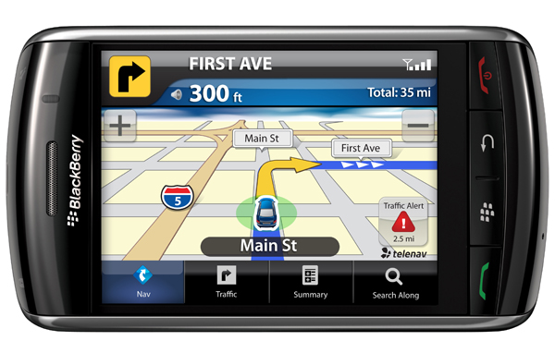
Network Layer
Primary task from a layer model perspective
  To provide service to the transport layer
    Connectionless or connection-oriented service
    Uniform addressing
    Internetworking: provide transitions between networks
    Routing
    Congestion control
    Quality of Service (QoS)

Slide 4
Routing
The main L3 task is
  enable data transfer from
  end system to end system
    several hops, (heterogeneous) subnetworks
    compensate for differences between end systems during transmission
The Intermediate Systems are often called Routers
routing depends on actual connections between intermediate systems (routers)
in many cases, the organization into subnetworks coincides with routing borders and provides clues
but it is not essential for routing
network
is sub-network
(subnet) of
network
end system
intermediate
system
routing algorithms work on graphs

Slide 5
Inside the Network Layer
An L3 packet includes
for connection-oriented service:
route label
headers and trailer to specify service requirements
in particular:
information required by intermediate systems for forwarding
OR
for connectionless service:
end system address of the destination
IPv6 Header
virtual circuits require routing during connection setup
route label is used later
packet switching requires routing for every packet
destination address is used for every packet
Version
DSCP
ECN
Flow label
Payload length
Next header
Hop Limit
Source address
(128 bit)
Destination Address
(128 bit)
L4 Data

Slide 6
Network layer
IN2140:
Introduction to Operating Systems and Data Communication
Routing - foundations

Slide 7
Routing: Foundations
Task
  To define the route of packets through the network
    From the source
    To the destination system
Routing algorithm
  Defines on which outgoing line an incoming packet will be transmitted
Route determination
  Packet
    Routing algorithm makes individual decision for each packet
  Virtual circuit
    Routing algorithm runs only during connect (session routing)

Slide 8
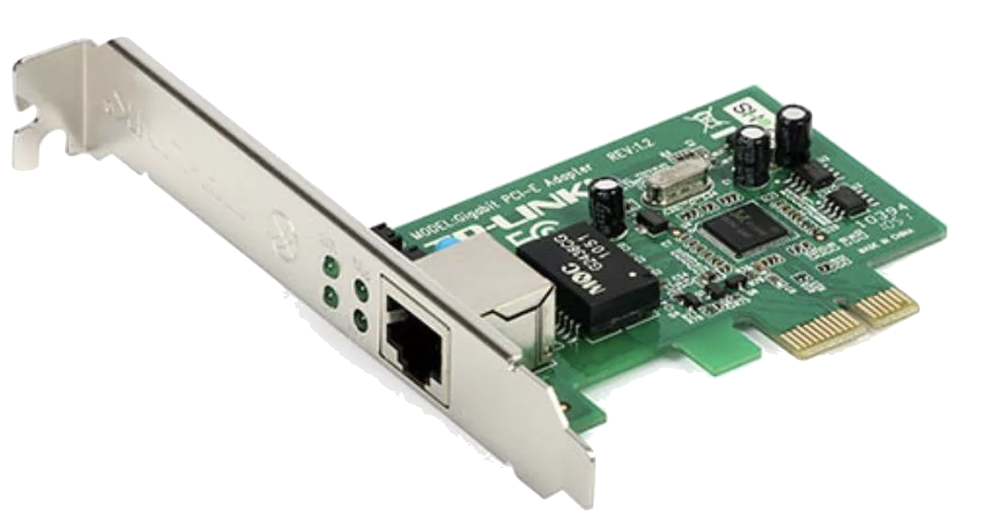
Routing: Routing and Forwarding
selecting an outgoing line
Router
Incoming
lines
Outgoing
lines
ES
IS
ES
ES
ES

Slide 9
Routing: Routing and Forwarding
Distinction can be made
  Routing: makes decision which route to use
  Forwarding: what happens when a packet arrives
Topology, link utilization, etc.
information
Router
Routing
Process
desti-
nation
link
A
0
Routing
table
Fills & Updates
B
2
C
1
Uses & Looks up
D
2
Data packets
Incoming
lines
Forwarding
Process
Outgoing
lines

Slide 10
Good Properties for Routing Algorithms
Correctness
Simplicity
  Minimize load of ISes
Robustness
  Compensation for IS and link failures
  Handling of topology and traffic changes
Stability
  Consistent results
  No volatile adaptations to new conditions
Optimality
  For some criteria… most common: minimum number of hops

Slide 11
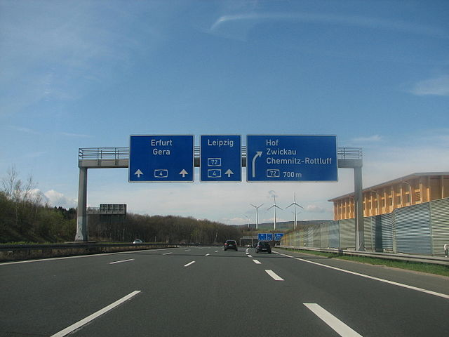
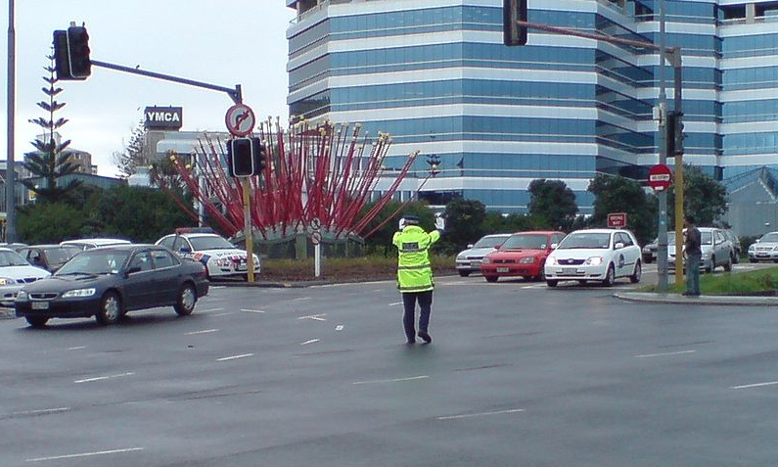
Classes of Routing Algorithms
Class: Non-adaptive Algorithms
  Current network state not taken into consideration
    Assume average values
    All routes are defined off-line before the network is put into operation
    No change during operation (static routing)
  With knowledge of the overall topology
    Spanning tree
    Flow-based routing
  Without knowledge of the overall topology
    Flooding
  Decisions are based on current network state
    Measurements / estimates of the topology and the traffic volume
  Further sub-classification into
    Centralized algorithms
    Isolated algorithms
    Distributed algorithms
[Inkowik@wikipedia, CC BY SA 2.0]
Class: Adaptive Algorithms
[Ingolfsson@wikipedia]
Notes:
Inkowik@wikipedia -

Slide 12
Optimality Principle and Sink Tree
Starting idea: using a route has a cost
  number of hops, delay, …
General statement about optimal routes
  if router J is on the optimal path from router I to router K
  then the optimal path from router J to router K uses the same route
Idea of the proof
  best route from I to K is like this:
    r1: from I to J, then
    r2: from J to K
  then r2 is also the best route from J to K
  if better route r3 from J to K
  would exist
    then concatenation of r1 and r3 would improve route from I to K
Set of optimal routes
  from all sources
  to a given destination
  form a tree rooted at the destination: Sink Tree
r2
r1
I
J
K
r3

Slide 13
Sink Tree
Sink Tree for Destination B
B
0
A
1
B
C
1
B
A
C
F
2
C
D
2
D
E
D
E
I
2
J
G
J
J
2
F
F
I
N
3
I
H
N
E
3
L
H
N
L
H
3
K
K
G
3
K
3
M
O
M
O
L
4
O
4
M
4

Slide 14
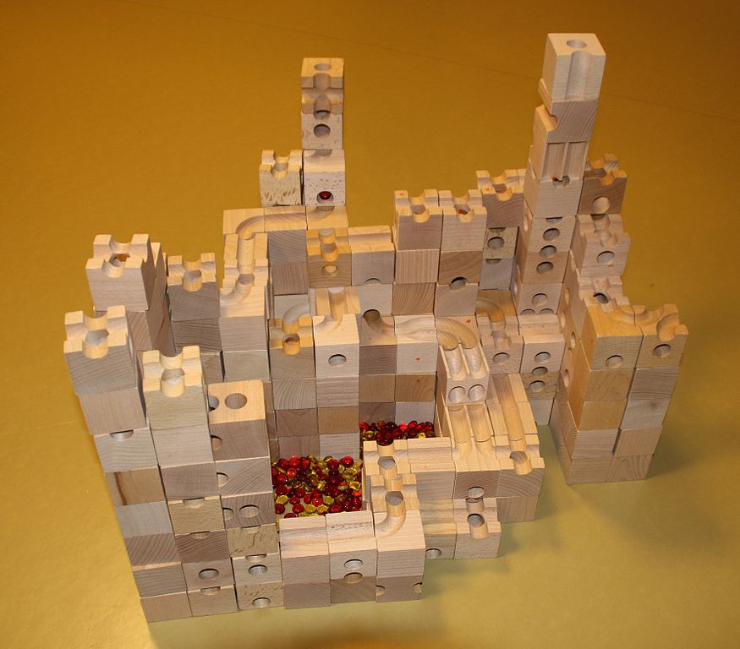
Sink Tree
Sink Tree for Destination B
B
[Adrian Michael@Wikipedia, CC BY 3.0]

Slide 15
Sink Tree
B
B
A
C
C
D
E
D
E
J
Sink Tree for
Destination B
F
G
J
F
I
I
H
N
L
H
N
L
K
K
M
O
M
O
Comments
tree: no loops
  each optimal route is finite with bounded number of hops
not necessarily unique
  other trees with same path lengths may exist
Goal of all routing algorithms
discover and use the Sink Trees for all routers
Not realistic to use Sink Trees as real-life routing algorithm
need complete information about topology
Sink Tree is only a benchmark for routing algorithms

Slide 16
Methodology & Metrics
Compute the shortest path between a given pair of routers
Different metrics for path lengths can be used
  can lead to different results
  sometimes even combined
Metrics for the «ideal» route
e.g. A «short» route
Number of hops
Geographical distance
Bandwidth
Average data volume
Cost of communication
Delay in queues
...

Slide 17
Network layer
IN2140:
Introduction to Operating Systems and Data Communication
The Dijkstra Algorithm
or
Dijkstra’s Shortest Path First Algorithm

Slide 18
Non-Adaptive Routing
Shortest Path Routing

Slide 19
Non-Adaptive Shortest Path Routing
Static Procedure
  Network operator generates tables
  Tables
    Are loaded when IS operation is initiated and
    Will not be changed any more
Characteristics
    Simple
    Good results with relatively consistent topology and traffic
  But
    Poor performance if traffic volume or topologies change over time

Slide 20
Non-Adaptive Shortest Path Routing
Spanning Tree and Optimized Route
  Information about the entire network has to be available
    i. e. application actually as a benchmark comparison
Example
  Link is labeled with distance / weight
  Node is labeled with distance from source node along best known path (in parentheses)
  Find the shortest path from A to D
B
B (●,-)
C
7
C (●,-)
2
E
3
2
E (●,-)
3
A
A
D
2
D (●,-)
F
1
F (●,-)
6
2
2
G
4
G (●,-)
H
H (●,-)

Slide 21
Non-Adaptive Shortest Path Routing
Procedure: e. g. according to Dijkstra
Find the shortest path from A to D
  Labels may be permanent or tentative
  Initially, no paths are known
    All nodes are labeled with infinity (tentative)
  Discover the labels that represent shortest possible path from source to any node
  Make those labels permanent
  1. Node A labeled as permanent (filled-in circle)
  2. Relabel all directly adjacent nodes with the distance to A
  (path length, nodes adjacent to source)
  3. Examine all tentatively labeled nodes, make the node with the smallest label permanent
  4. This node will be the new working node for the iterative procedure
  (i.e., continue with step 2.)

Slide 22
Non-Adaptive Shortest Path Routing
B (●,-)
B (2,A)
7
C (●,-)
2
E (●,-)
3
A
2
3
D (●,-)
1
2
F (●,-)
6
2
2
G (●,-)
4
G (6,A)
H (●,-)
Procedure: e. g. according to Dijkstra
Find the shortest path from A to D:
  A flagged as permanent (filled-in circle)
  Relabel all directly adjacent nodes with the distance to A
    (path length, IS adjacent to the source):

Slide 23
Non-Adaptive Shortest Path Routing
B (2,A)
7
C (●,-)
2
E (●,-)
3
A
2
3
D (●,-)
1
2
F (●,-)
6
2
2
G (6,A)
4
H (●,-)
Procedure: e. g. according Dijkstra
Find the shortest path from A to D:
  ...
  Compare all recent, not firmly flagged IS;
    flag the one with the lowest number as fixed
  This IS is the origin of the iterative procedure
    (i. e. continue with item 2.)

Slide 24
Non-Adaptive Shortest Path Routing
B (2,A)
C (9,B)
7
C (●,-)
2
E (4,B)
3
2
E (●,-)
3
A
2
D (●,-)
1
F (●,-)
6
2
2
G (6,A)
4
H (●,-)
Procedure: e.g., according to Dijkstra
Find the shortest path from A to D:
  Node B has been labeled as permanent (filled-in circle)
  relabel all directly adjacent nodes with the distance to B
  (path length, nodes adjacent to source):
    A (does not apply, because it is the origin),

Slide 25
Non-Adaptive Shortest Path Routing
B (2,A)
7
C (9,B)
2
E (4,B)
3
A
2
3
D (●,-)
2
D (10,H)
F (●,-)
1
F (6,E)
6
2
2
G (5,E)
4
G (6,A)
H (●,-)
H (9,G)
H (8,F)
Procedure: e.g., according to Dijkstra
find the shortest path from A to D:
  …
  …
  examine all tentatively labeled nodes;
    make the node with the smallest label permanent
  this node will be the new working node for the iterative procedure ...

Slide 26
Non-Adaptive Shortest Path Routing
An alternative approach to Dijkstra’s algorithm
A
B
C
D
E
F
G
H
A
0_{A}
2_{A}
6_{A}
B
B
C
7
C
B
9_{B}
4_{B}
2
E
3
2
E
3
E
6_{E}
5_{E}
A
A
D
2
D
F
1
F
6
2
2
G
6_{E}
9_{G}
G
4
G
H
H
F
9_{B}
8_{F}
H
9_{B}
10_{H}
C
10_{H}

Slide 27
Non-Adaptive Shortest Path Routing
An alternative approach to Dijkstra’s algorithm
A
B
C
D
E
F
G
H
A
0_{A}
2_{A}
6_{A}
B
9_{B}
4_{B}
E
6_{E}
5_{E}
G
6_{E}
9_{G}
F
9_{B}
8_{F}
H
9_{B}
10_{H}
C
10_{H}

Slide 28
Non-Adaptive Shortest Path Routing
An alternative approach to Dijkstra’s algorithm
A
B
C
D
E
F
G
H
A
0_{A}
2_{A}
6_{A}
B
C
B
9_{B}
4_{B}
E
6_{E}
5_{E}
E
A
D
G
6_{E}
9_{G}
F
F
9_{B}
8_{F}
G
H
H
9_{B}
10_{H}
C
10_{H}

Slide 29
Non-Adaptive Shortest Path Routing
Build individual routing tables from tree
Y reaches X through <cell>
X
Y
A
B
C
D
E
F
G
H
B
C
B
C
A
A
B
B
B
B
B
B
B
{C}
B
-
B
C
E
E
E
E
E
{D,E,F,G,H}
E
E
C
-
-
C
-
-
-
-
-
{D,F,H}
A
A
{D,H}
D
D
-
-
-
D
-
-
-
-
{B,C,D,E,F,G,H}
F
F
{G}
E
-
-
-
F
E
F
G
F
{D}
F
-
-
-
H
-
F
-
H
G
H
G
-
-
-
-
-
-
G
-
Perform a Depth First Search
leading to this visit sequence
C D H F G E B A
H
-
-
-
D
-
-
-
H

Slide 30
Network layer
IN2140:
Introduction to Operating Systems and Data Communication
Distributed Routing:
Link State Routing

Slide 31
Link State Routing
A very frequently use routing protocol
  IS-IS (Intermediate System-Intermediate System)
  OSPF (Open Shortest Path First)
Basic principle
  IS measures the "distance" to the directly adjacent IS
  Distributes information
  Calculates the ideal route
Procedure
  Determine the address of adjacent IS
  Measure the "distance" (delay, ...) to neighbouring IS
  Organize the local link state information in a packet
  Distribute the information to all IS
  Calculate the route based on the information of all IS

Slide 32
Link State Routing
1. Phase: gather information about the adjacent intermediate systems
Physical topology
Routing graph
H
H
D
E
G
D
E
G
B
I
B
I
A
C
F
A
C
F
LAN

Slide 33
Link State Routing
1. Phase: gather information about the adjacent intermediate systems
Physical topology
Routing graph
H
H
D
E
G
D
E
G
B
I
B
I
A
C
F
A
C
F
LAN
N
Initialization procedure
New IS
  Sends a HELLO message over each L2 channel
Adjacent IS
  Responds with its own address, unique within the network

Slide 34
Link State Routing
2. Phase: measure the "distance"
Definition of distance needed
  E.g., 1: will minimize number of hops
  E.g., delay
    Where to measure?
Topology, link utilization, etc.
information
Router
Routing
Process
desti-
nation
link
Routing
table
When to start timer?
A
0
Fills & Updates
B
3
C
1
Uses & Looks up
D
4
Data packets
Queues
ECHO
Forwarding
Process
HELLO
Incoming
lines
Outgoing
lines

Slide 35
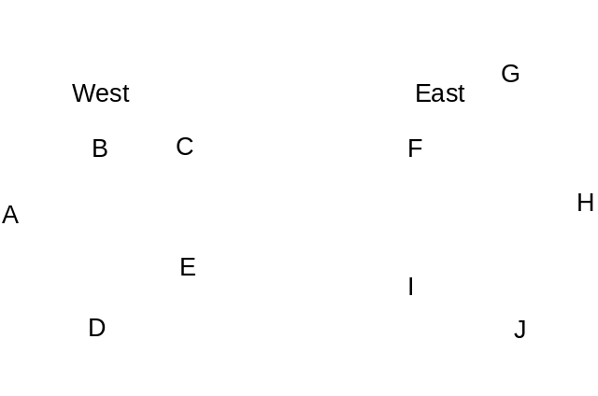
Link State Routing
2. Phase: measure the "distance“
Queuing delay
  Measuring without does not take load into account
  Measuring with does ⇒ usually better
But
  Possibility for oscillations (route flapping)
  Once per routing table update

Slide 36
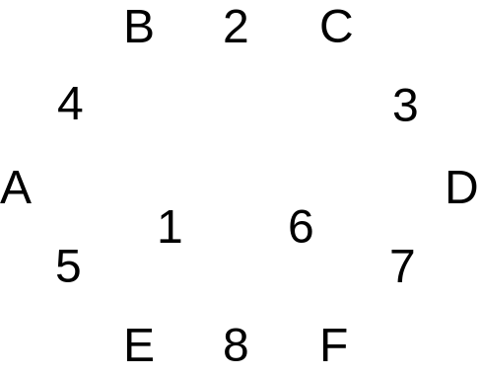
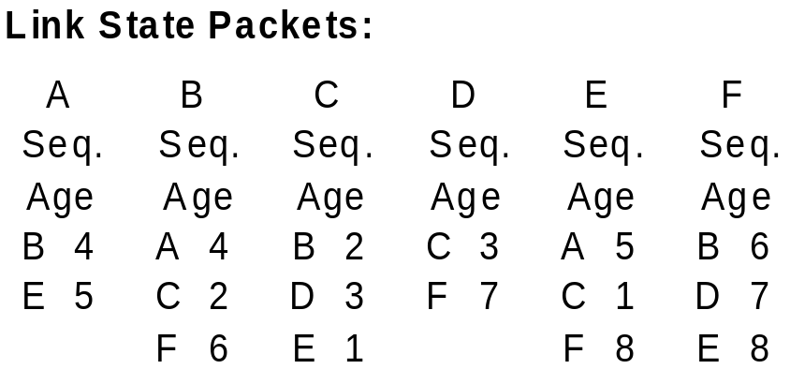
Link State Routing
3. Phase: organizing the information as link state packet
Including own address, sequence number, age, "distance"
Timing problems: validity and time of sending
  Periodically
  In case of major changes

Slide 37
Link State Routing
4. Phase: Distributing the local information to all IS
By applying the flooding procedure
  Therefore, sequence number in packets
Problem: inconsistency
  Varying states simultaneously available in the network
  Indicate and limit the age of packet,
  i. e. IS removes packets that are too old
5. Phase: Computing new routes
Each IS for itself
Possibly larger amount of data available
Very robust
But does not scale to large networks
Dijkstra’s algorithm is a popular choice

Slide 38
Link State Routing
Phase: gather information about the adjacent intermediate systems
Phase: measure the "distance“
Phase: organizing the information as link state packet
Phase: Distributing the local information to all IS
Phase: Computing new routes

Slide 39
Network layer
IN2140:
Introduction to Operating Systems and Data Communication
Distributed Routing:
Distance Vector Routing

Slide 40
Distance Vector Routing
Principle
every IS maintains a table (i.e., vector) stating
  best known distance to destinations
  and line to be used
ISes update tables
  by exchanging routing information with their neighbors

Slide 41
Distance Vector Routing
Each IS
  maintains routing table with one entry per router in the subnet
  is assumed to know the distances to each neighbor
  sends list with estimated distances to each destination periodically to its neighbors
X receives list E(Z) from neighbor Y
  Distance X to Y: e
  Distance Y to Z: E(Z)
  Distance X to Z via Y: E(Z)+e
IS computes new routing table from the received lists
containing
  Destination IS
  Preferred outgoing path
  Distance
Y’s Estimate of its own distance to Z
X’s measurement of its own distance to Y

Slide 42
Distance Vector Routing
A
B
C
D
A
I
H
K
line
A
0
24
20
21
8
A
B
12
36
31
28
20
A
G
C
25
18
19
36
28
I
E
H
F
D
40
27
8
24
20
H
E
14
7
30
22
17
I
F
23
20
19
40
30
I
I
J
K
L
G
18
31
6
31
18
H
H
17
20
0
19
12
H
I
21
0
14
22
10
I
J
9
11
7
10
0
-
K
24
22
22
0
6
K
L
29
33
9
9
15
K
delay
JA
8
JI
10
JH
12
JK
6
Previous routing table will not be taken into account
  Reaction to deteriorations

Slide 43
Distance Vector Routing
Fast route improvement
Fast distribution of information about new short paths (with few hops)
Example
  initially A unknown
  later: A connected with distance 1 to B, this will be announced
  Distribution proportional to topological spread
  Synchronous (stepwise) update is a simplification
A
B
C
D
E
∞
∞
∞
∞
1
∞
∞
∞
1
2
∞
∞
1
2
3
∞
1
2
3
4

Slide 44
Distance Vector Routing
Slow distribution of information about new long paths (with many hops)
“Count to Infinity” problem of DVR
Example: deterioration
  Here: connection destroyed
  A was previously known, but is now detached
  The values are derived from (incorrect) connections of distant IS
Comment
  Limit "infinite" to a finite value, depending on the metrics, e.g.
    ‘infinite’ = maximum path length+1
A
B
C
D
E
1
2
3
4
3
2
3
4
3
4
3
4
5
4
5
6
5
6
5
6
7
6
7
6
7
8
7
8
∞
∞
∞
∞

Slide 45
Distance Vector Routing
Variant: ‘Split Horizon Algorithm’
Objective: improve the "count to infinity" problem
Principle
  In general, to publicize the "distance" to each neighbour
  If neighbor Y exists on the reported route,
  X reports the response "false" to Y
    distance X (via Y) according to arbitrary i: ∞
A
B
C
D
E
1
2
3
4
Example: deterioration (connection destroyed)
  B to C: A = ∞ (real),
  C to B: A = ∞ (because B is on path to A), ...
But: still poor, depending on topology, example
  Connection CD is removed
  A receives "false information" via B
  B receives "false information" via A
    Slow distribution (just as before)
∞
2
3
4
∞
∞
3
4
∞
∞
∞
4
∞
∞
∞
∞
A
C
D
B

