Slide 1
Repetition: Dynamics + Control Theory
IN3140: Oscar Hæstad Bjørnstad
Kristian Roa Gran

Slide 2
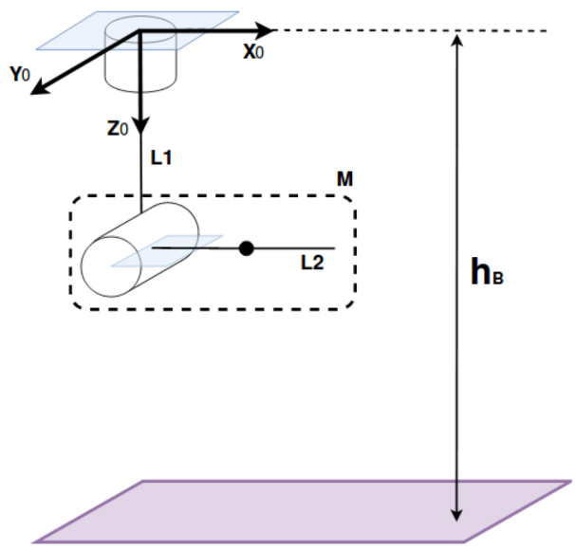
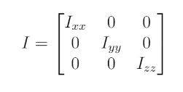
2019 Dynamics task
The system only has one mass: M
  The mass of the second link
  Uniformly distributed
Distance from ground to the base is h_{B}
Inertia tensor:

Slide 3
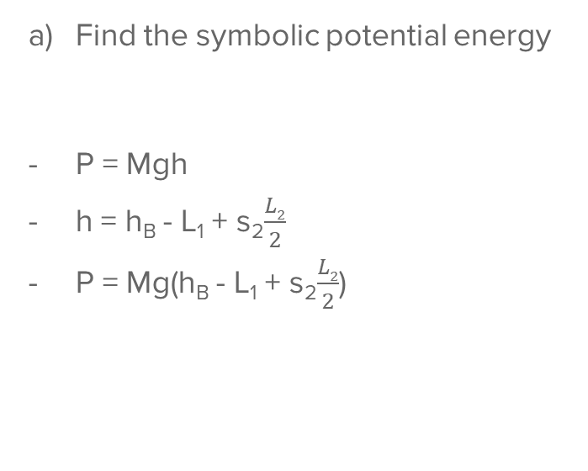
2019 Dynamics task
Find the symbolic potential energy
P = Mgh
h = h_{B} - L₁ + s₂$\frac{L2}{2}$
P = Mg(h_{B} - L₁ + s₂$\frac{L2}{2}$)

Slide 4
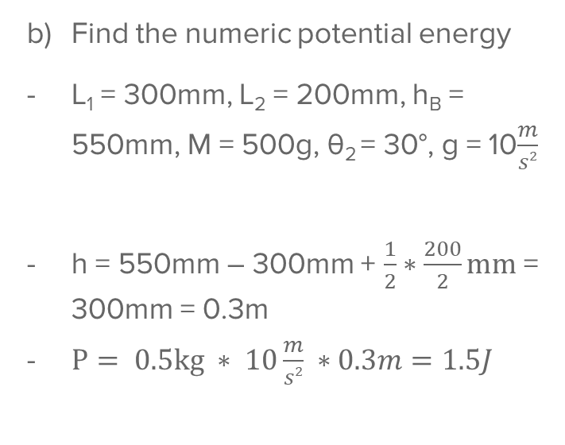
2019 Dynamics task
Find the numeric potential energy
L₁ = 300mm, L₂ = 200mm, h_{B} = 550mm, M = 500g, θ₂ = 30°, g = 10$\frac{m}{s2}$
h = 550mm – 300mm + $\frac{1}{2}∗\frac{200}{2}mm$ = 300mm = 0.3m
$P= 0.5kg ∗ 10\frac{m}{s2} ∗0.3m=1.5J$

Slide 5
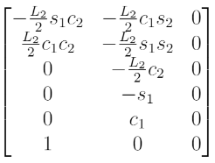
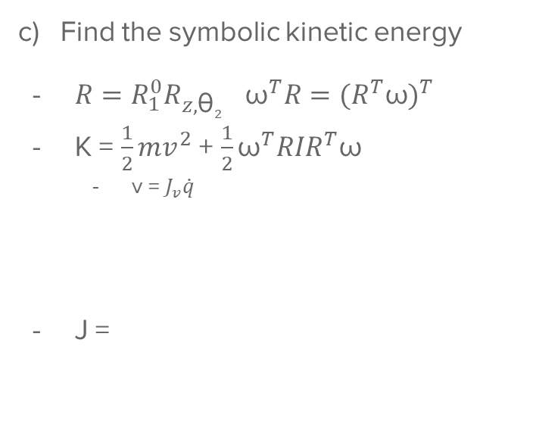
2019 Dynamics task
Find the symbolic kinetic energy
$R=R_{1}^{0}R_{z,\text{θ}2}$ ${\text{ω}}^{T}R={(R^{T}\text{ω})}^{T}$
K = $\frac{1}{2}mv^{2}$ + $\frac{1}{2}{\text{ω}}^{T}RIR^{T}\text{ω}$
  v = $J_{v}\dot{q}$
J =

Slide 6
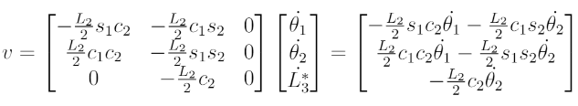
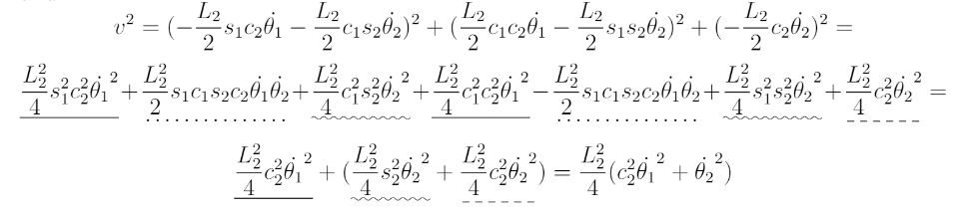
2019 Dynamics task
Find the symbolic kinetic energy

Slide 7
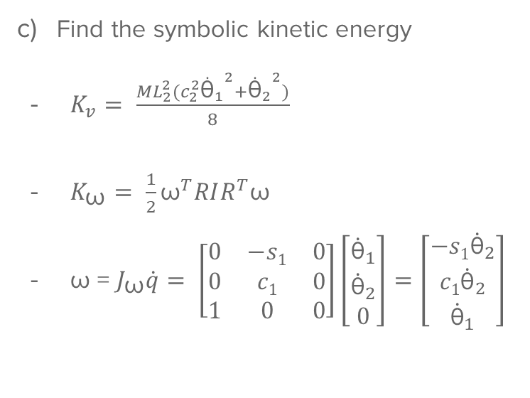
2019 Dynamics task
Find the symbolic kinetic energy
$K_{v}= \frac{ML_{2}^{2}(c_{2}^{2}{{\dot{\text{θ}}}_{1}}^{2}+{{\dot{\text{θ}}}_{2}}^{2})}{8}$
$K_{\text{ω}}= \frac{1}{2}{\text{ω}}^{T}RIR^{T}\text{ω}$
$\text{ω} \text{= }J_{\text{ω}}\dot{q}= \left[\begin{matrix}0 & −s1 & 0 \\ 0 & c1 & 0 \\ 1 & 0 & 0\end{matrix}\right]\left[\begin{matrix}{\dot{\text{θ}}}_{1} \\ {\dot{\text{θ}}}_{2} \\ 0\end{matrix}\right]=\left[\begin{matrix}{−s1\dot{\text{θ}}}_{2} \\ {c1\dot{\text{θ}}}_{2} \\ {\dot{\text{θ}}}_{1}\end{matrix}\right]$

Slide 8
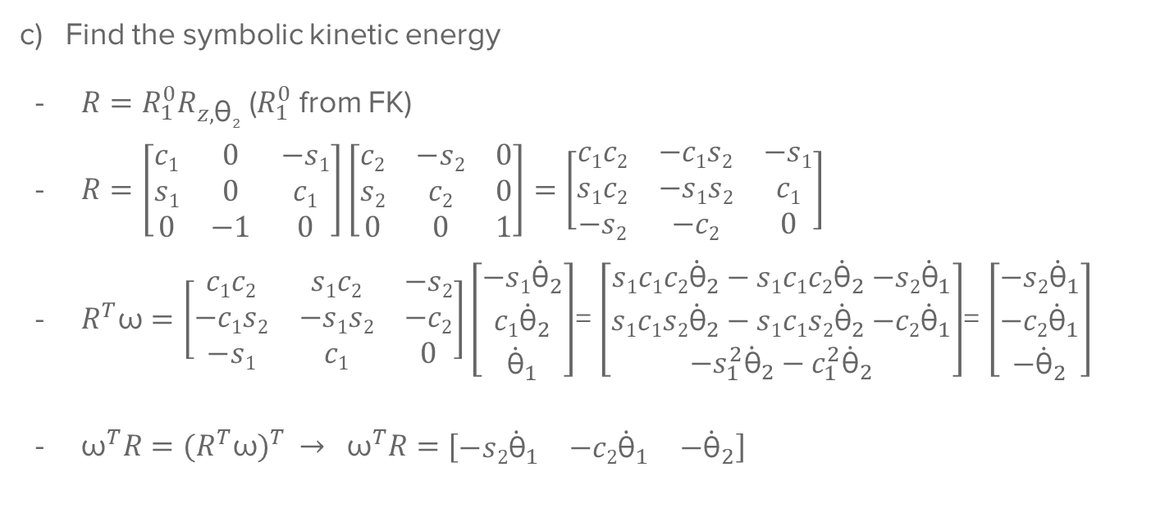
2019 Dynamics task
Find the symbolic kinetic energy
$R=R_{1}^{0}R_{z,\text{θ}2}$ ($R_{1}^{0}$ from FK)
$R=\left[\begin{matrix}c1 & 0 & −s1 \\ s1 & 0 & c1 \\ 0 & −1 & 0\end{matrix}\right]\left[\begin{matrix}c2 & −s2 & 0 \\ s2 & c2 & 0 \\ 0 & 0 & 1\end{matrix}\right]=\left[\begin{matrix}c1c2 & −c1s2 & −s1 \\ s1c2 & −s1s2 & c1 \\ −s2 & −c2 & 0\end{matrix}\right]$
$R^{T}\text{ω}=\left[\begin{matrix}c1c2 & s1c2 & −s2 \\ −c1s2 & −s1s2 & −c2 \\ −s1 & c1 & 0\end{matrix}\right]\left[\begin{matrix}{−s1\dot{\text{θ}}}_{2} \\ {c1\dot{\text{θ}}}_{2} \\ {\dot{\text{θ}}}_{1}\end{matrix}\right]$= $\left[\begin{matrix}s1c1c2{\dot{\text{θ}}}_{2}−s1c1c2{\dot{\text{θ}}}_{2}{−s2\dot{\text{θ}}}_{1} \\ s1c1s2{\dot{\text{θ}}}_{2}−s1c1s2{\dot{\text{θ}}}_{2}{−c2\dot{\text{θ}}}_{1} \\ −s_{1}^{2}{\dot{\text{θ}}}_{2}−c_{1}^{2}{\dot{\text{θ}}}_{2}\end{matrix}\right]$= $\left[\begin{matrix}{−s2\dot{\text{θ}}}_{1} \\ {−c2\dot{\text{θ}}}_{1} \\ −{\dot{\text{θ}}}_{2}\end{matrix}\right]$
${\text{ω}}^{T}R={(R^{T}\text{ω})}^{T} → {\text{ω}}^{T}R=[\begin{matrix}{−s2\dot{\text{θ}}}_{1} & {−c2\dot{\text{θ}}}_{1} & −{\dot{\text{θ}}}_{2}\end{matrix}]$

Slide 9
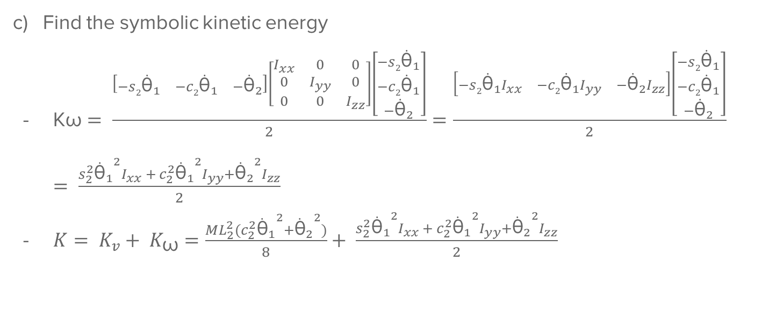
2019 Dynamics task
Find the symbolic kinetic energy
$\text{K}\text{ω}= \frac{\left[\begin{matrix}{−s2\dot{\text{θ}}}_{1} & {−c2\dot{\text{θ}}}_{1} & −{\dot{\text{θ}}}_{2}\end{matrix}\right]\left[\begin{matrix}I_{xx} & 0 & 0 \\ 0 & I_{yy} & 0 \\ 0 & 0 & I_{zz}\end{matrix}\right]\left[\begin{matrix}{−s2\dot{\text{θ}}}_{1} \\ {−c2\dot{\text{θ}}}_{1} \\ −{\dot{\text{θ}}}_{2}\end{matrix}\right]}{2}=\frac{\left[\begin{matrix}{−s2\dot{\text{θ}}}_{1}I_{xx} & {−c2\dot{\text{θ}}}_{1}I_{yy} & −{\dot{\text{θ}}}_{2}I_{zz}\end{matrix}\right]\left[\begin{matrix}{−s2\dot{\text{θ}}}_{1} \\ {−c2\dot{\text{θ}}}_{1} \\ −{\dot{\text{θ}}}_{2}\end{matrix}\right]}{2} = = \frac{{s_{2}^{2}{{\dot{\text{θ}}}_{1}}^{2}I}_{xx} + {c_{2}^{2}{{\dot{\text{θ}}}_{1}}^{2}I}_{yy}+{{\dot{\text{θ}}}_{2}}^{2}I_{zz}}{2}$
${K= K}_{v}+ K_{\text{ω}}=\frac{ML_{2}^{2}(c_{2}^{2}{{\dot{\text{θ}}}_{1}}^{2}+{{\dot{\text{θ}}}_{2}}^{2})}{8}+ \frac{{s_{2}^{2}{{\dot{\text{θ}}}_{1}}^{2}I}_{xx} + {c_{2}^{2}{{\dot{\text{θ}}}_{1}}^{2}I}_{yy}+{{\dot{\text{θ}}}_{2}}^{2}I_{zz}}{2}$

Slide 10
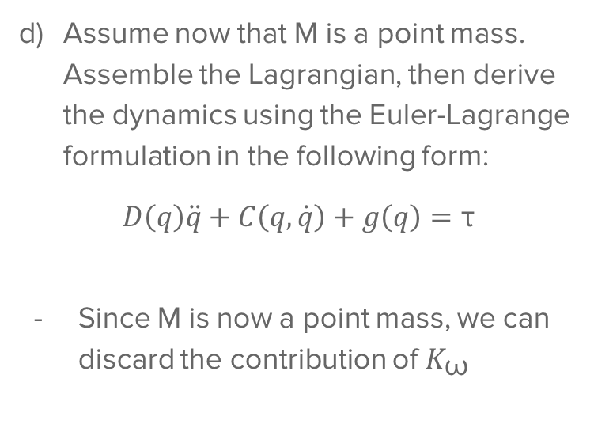
2019 Dynamics task
Assume now that M is a point mass. Assemble the Lagrangian, then derive the dynamics using the Euler-Lagrange formulation in the following form:
$$D\left(q\right)\ddot{q}+C\left(q, \dot{q}\right)+g\left(q\right)=\text{τ}$$
Since M is now a point mass, we can discard the contribution of $K_{\text{ω}}$

Slide 11
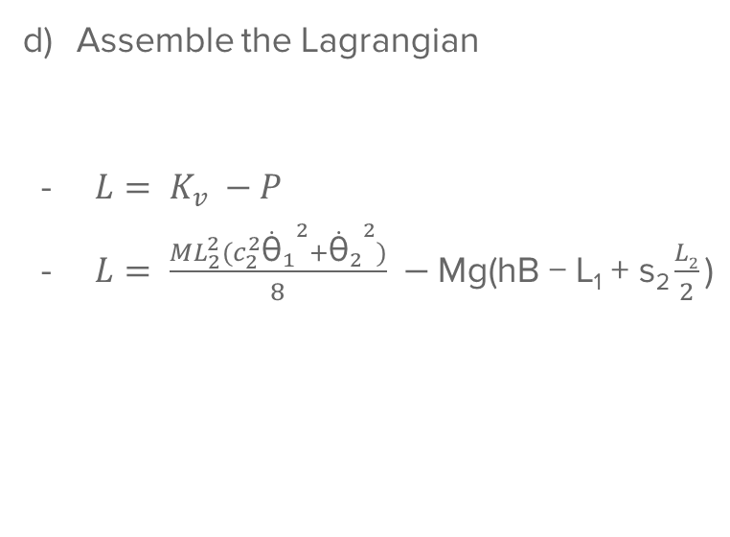
2019 Dynamics task
Assemble the Lagrangian
$L= K_{v} −P$
$L= \frac{ML_{2}^{2}(c_{2}^{2}{{\dot{\text{θ}}}_{1}}^{2}+{{\dot{\text{θ}}}_{2}}^{2})}{8} −\text{Mg}\text{(}\text{hB} \text{− }\text{L}\text{1} \text{+ }\text{s}\text{2}\frac{L2}{2}\text{)}$

Slide 12
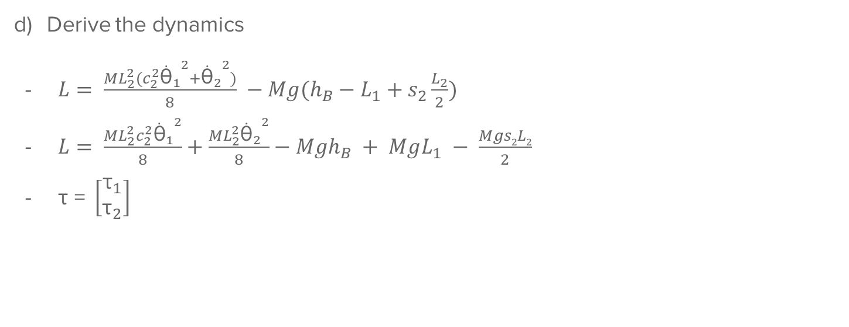
2019 Dynamics task
Derive the dynamics
$L= \frac{ML_{2}^{2}(c_{2}^{2}{{\dot{\text{θ}}}_{1}}^{2}+{{\dot{\text{θ}}}_{2}}^{2})}{8} −Mg(h_{B}−L_{1}+s_{2}\frac{L_{2}}{2})$
$L= \frac{ML_{2}^{2}c_{2}^{2}{{\dot{\text{θ}}}_{1}}^{2}}{8}+\frac{ML_{2}^{2}{{\dot{\text{θ}}}_{2}}^{2}}{8}−Mgh_{B} + MgL_{1} − \frac{Mgs2L2}{2}$
$\text{τ} \text{= }\left[\begin{matrix}{\text{τ}}_{1} \\ {\text{τ}}_{2}\end{matrix}\right]$

Slide 13
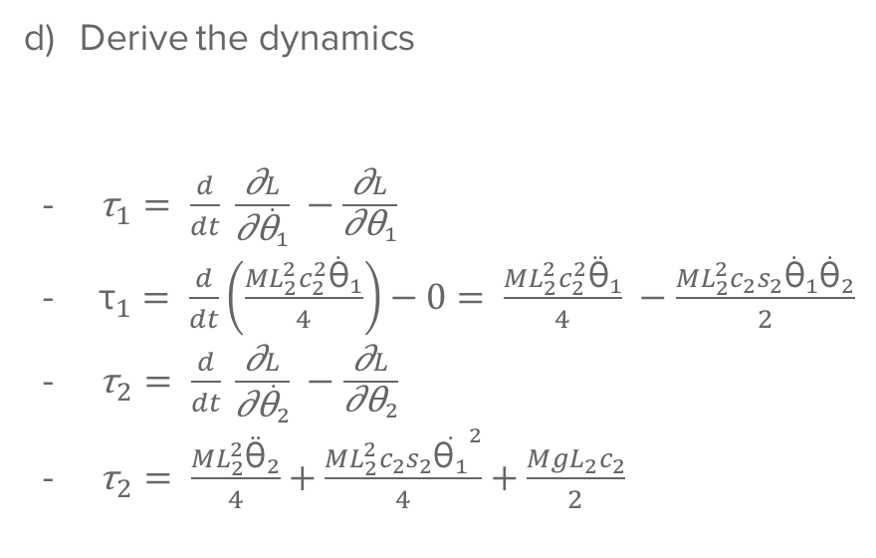
2019 Dynamics task
Derive the dynamics
${\text{τ}}_{1}= \frac{d}{dt} \frac{\text{∂}L}{\text{∂}\dot{{\text{θ}}_{1}}} −\frac{\text{∂}L}{\text{∂}{\text{θ}}_{1}}$
${\text{τ}}_{1}= \frac{d}{dt}\left(\frac{ML_{2}^{2}c_{2}^{2}{\dot{\text{θ}}}_{1}}{4}\right)−0= \frac{ML_{2}^{2}c_{2}^{2}{\ddot{\text{θ}}}_{1}}{4} −\frac{ML_{2}^{2}c_{2}s_{2}{\dot{\text{θ}}}_{1}{\dot{\text{θ}}}_{2}}{2}$
${\text{τ}}_{2}= \frac{d}{dt} \frac{\text{∂}L}{\text{∂}\dot{{\text{θ}}_{2}}} −\frac{\text{∂}L}{\text{∂}{\text{θ}}_{2}}$
${\text{τ}}_{2}= \frac{ML_{2}^{2}{\ddot{\text{θ}}}_{2}}{4}+\frac{ML_{2}^{2}c_{2}s_{2}{\dot{{\text{θ}}_{1}}}^{2}}{4}+\frac{MgL_{2}c_{2}}{2}$

Slide 14
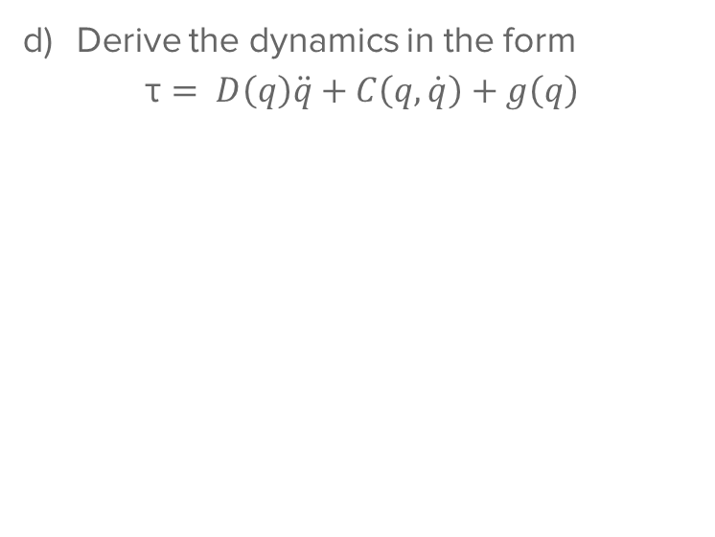
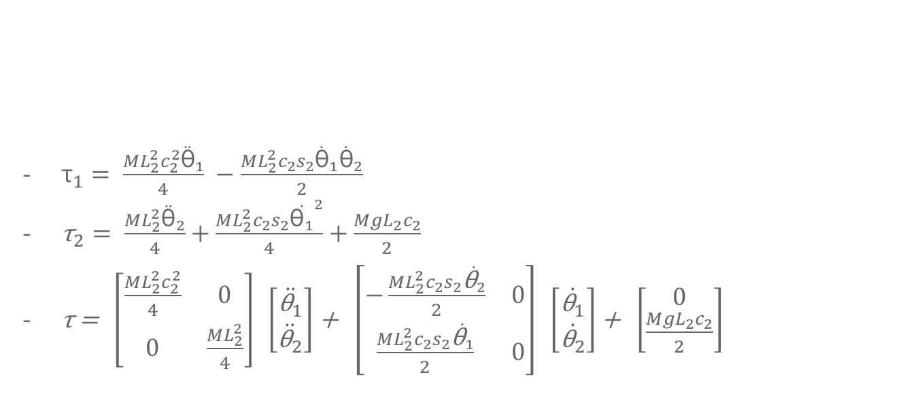
2019 Dynamics task
${\text{τ}}_{1}= \frac{ML_{2}^{2}c_{2}^{2}{\ddot{\text{θ}}}_{1}}{4} −\frac{ML_{2}^{2}c_{2}s_{2}{\dot{\text{θ}}}_{1}{\dot{\text{θ}}}_{2}}{2}$
${\text{τ}}_{2}= \frac{ML_{2}^{2}{\ddot{\text{θ}}}_{2}}{4}+\frac{ML_{2}^{2}c_{2}s_{2}{\dot{{\text{θ}}_{1}}}^{2}}{4}+\frac{MgL_{2}c_{2}}{2}$
$\text{τ}\text{ = }\left[\begin{matrix}\frac{ML_{2}^{2}c_{2}^{2}}{4} & 0 \\ 0 & \frac{ML_{2}^{2}}{4}\end{matrix}\right] \left[\begin{matrix}\ddot{{\text{θ}}_{1}} \\ \ddot{{\text{θ}}_{2}}\end{matrix}\right]$ + $\left[\begin{matrix}−\frac{ML_{2}^{2}c_{2}s_{2}\dot{{\text{θ}}_{2}}}{2} & 0 \\ \frac{ML_{2}^{2}c_{2}s_{2}\dot{{\text{θ}}_{1}}}{2} & 0\end{matrix}\right] \left[\begin{matrix}\dot{{\text{θ}}_{1}} \\ \dot{{\text{θ}}_{2}}\end{matrix}\right]$ + $\left[\begin{matrix}0 \\ \frac{MgL_{2}c_{2}}{2}\end{matrix}\right]$
Derive the dynamics in the form
$\text{τ}= D\left(q\right)\ddot{q}+C\left(q, \dot{q}\right)+g\left(q\right)$

Slide 15
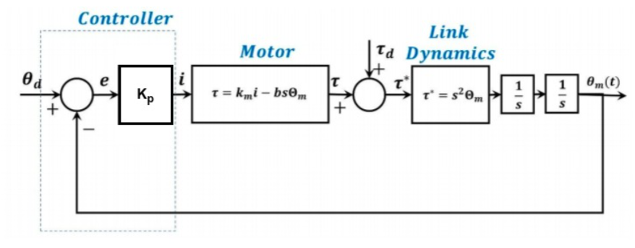
2021 Control Theory

Slide 16
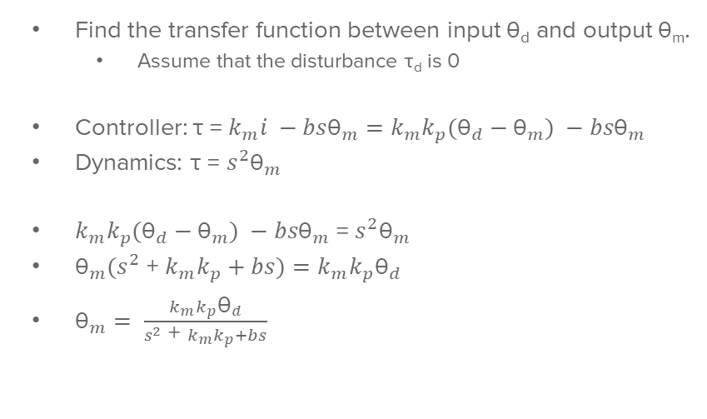
2021 Control Theory
Find the transfer function between input $\text{θ}$_{d} and output $\text{θ}$_{m}.
  Assume that the disturbance $\text{τ}$_{d} is 0
Controller: $\text{τ} \text{= }k_{m}i −bs{\text{θ}}_{m}=k_{m}k_{p}({\text{θ}}_{d}−{\text{θ}}_{m}) −bs{\text{θ}}_{m}$
Dynamics: $\text{τ} \text{= }{s^{2}\text{θ}}_{m}$
$k_{m}k_{p}({\text{θ}}_{d}−{\text{θ}}_{m}) −bs{\text{θ}}_{m}$ = ${s^{2}\text{θ}}_{m}$
${\text{θ}}_{m}(s^{2}$ + $k_{m}k_{p}+bs)=k_{m}k_{p}{\text{θ}}_{d}$
${\text{θ}}_{m}= \frac{k_{m}k_{p}{\text{θ}}_{d}}{s^{2}\text{ + }k_{m}k_{p}+bs}$

Slide 17
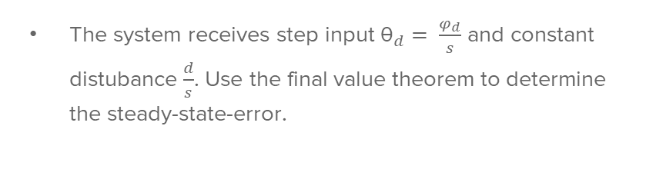
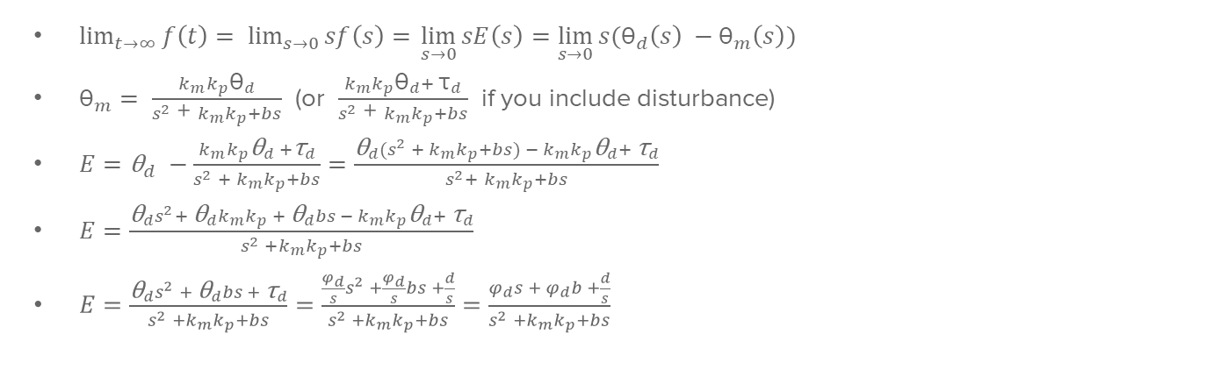
2021 Control Theory
The system receives step input ${\text{θ}}_{d}= \frac{φ_{d}}{s}$ and constant distubance $\frac{d}{s}$. Use the final value theorem to determine the steady-state-error.
$\lim_{t→∞}{f\left(t\right)= \lim_{s→0}{sf\left(s\right)= }\lim_{s→0}{sE\left(s\right)=\lim_{s→0}{s({\text{θ}}_{d}\left(s\right) −{\text{θ}}_{m}\left(s\right)) }}}$
${\text{θ}}_{m}= \frac{k_{m}k_{p}{\text{θ}}_{d}}{s^{2}\text{ + }k_{m}k_{p}+bs}$ (or $\frac{k_{m}k_{p}{\text{θ}}_{d}+ {\text{τ}}_{d}}{s^{2}\text{ + }k_{m}k_{p}+bs}$ if you include disturbance)
$E={\text{θ}}_{d} −\frac{k_{m}k_{p}{\text{θ}}_{d} +{\text{τ}}_{d}}{s^{2} + k_{m}k_{p}+bs}=\frac{{\text{θ}}_{d}(s^{2} + k_{m}k_{p}+bs) − k_{m}k_{p}{\text{θ}}_{d}+ {\text{τ}}_{d}}{s^{2}+ k_{m}k_{p}+bs}$
$E=\frac{{\text{θ}}_{d}s^{2}+{ {\text{θ}}_{d}k}_{m}k_{p} + {\text{θ}}_{d}bs − k_{m}k_{p}{\text{θ}}_{d}+ {\text{τ}}_{d}}{s^{2} +k_{m}k_{p}+bs}$
$E=\frac{{\text{θ}}_{d}s^{2} + {\text{θ}}_{d}bs + {\text{τ}}_{d}}{s^{2} +k_{m}k_{p}+bs}=\frac{\frac{φ_{d}}{s}s^{2} +\frac{φ_{d}}{s}bs +\frac{d}{s}}{s^{2} +k_{m}k_{p}+bs}=\frac{φ_{d}s + φ_{d}b +\frac{d}{s}}{s^{2} +k_{m}k_{p}+bs}$

Slide 18
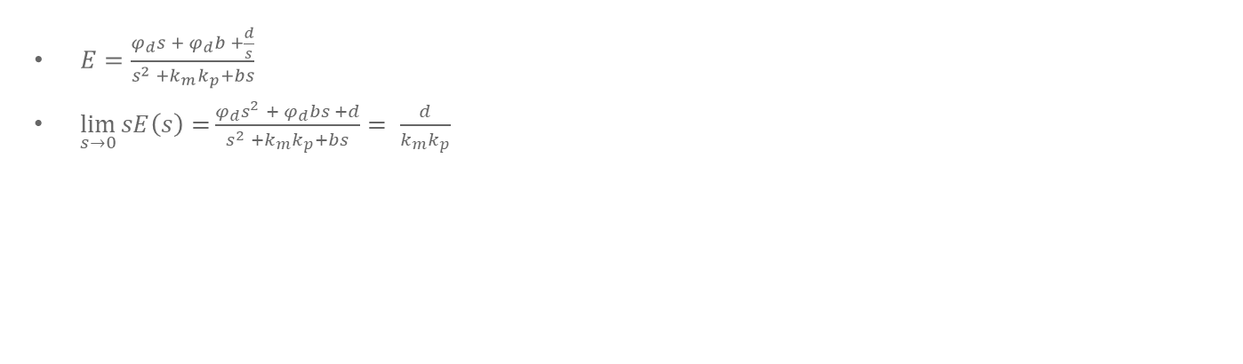
2021 Control Theory
The system receives step input ${\text{θ}}_{d}= \frac{φ_{d}}{s}$ and constant distubance $\frac{d}{s}$. Use the final value theorem to determine the steady-state-error.
$E=\frac{φ_{d}s + φ_{d}b +\frac{d}{s}}{s^{2} +k_{m}k_{p}+bs}$
$\lim_{s→0}{sE\left(s\right)=}\frac{φ_{d}s^{2} + φ_{d}bs +d}{s^{2} +k_{m}k_{p}+bs}= \frac{d}{k_{m}k_{p}}$

Slide 19
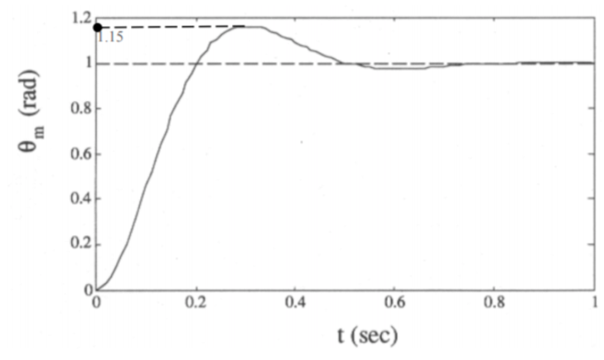
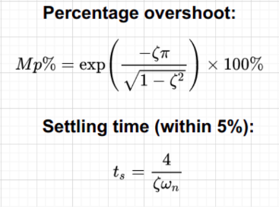
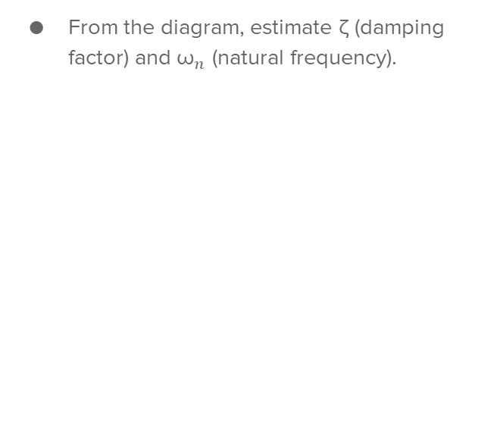
2021 Control Theory
From the diagram, estimate ζ (damping factor) and ${\text{ω}}_{n}$ (natural frequency).

Slide 20
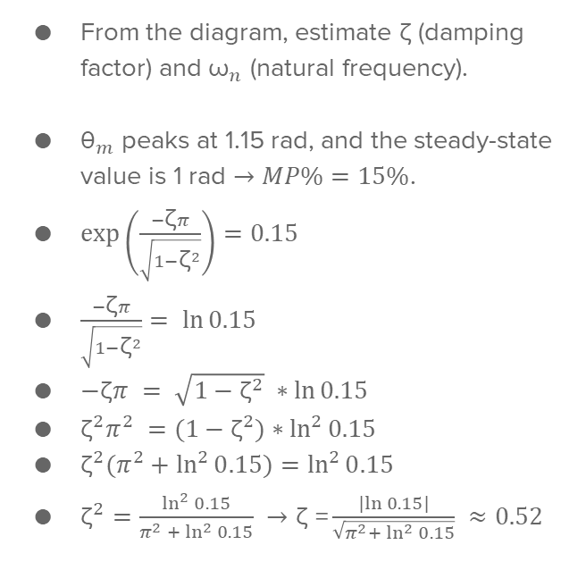
2021 Control Theory
From the diagram, estimate ζ (damping factor) and ${\text{ω}}_{n}$ (natural frequency).
${\text{θ}}_{m}$ peaks at 1.15 rad, and the steady-state value is 1 rad $→MP\%=15\%$.
$\exp\left(\frac{−\text{ζ}π}{\sqrt{1−{\text{ζ}}^{2}}}\right)=0.15$
$\frac{−\text{ζ}π}{\sqrt{1−{\text{ζ}}^{2}}}= \ln{0.15}$
$−\text{ζ}π = \sqrt{1−{\text{ζ}}^{2}} ∗\ln{0.15}$
${\text{ζ}}^{2}π^{2} =(1−{\text{ζ}}^{2})∗\ln^{2}{0.15}$
${\text{ζ}}^{2}(π^{2}+\ln^{2}{0.15})=\ln^{2}{0.15}$
${\text{ζ}}^{2}=\frac{\ln^{2}{0.15}}{π^{2} + \ln^{2}{0.15}} →\text{ζ} \text{=}\frac{|ln{0.15|}}{\sqrt{π^{2}+ \ln^{2}{0.15}}} ≈0.52$

Slide 21
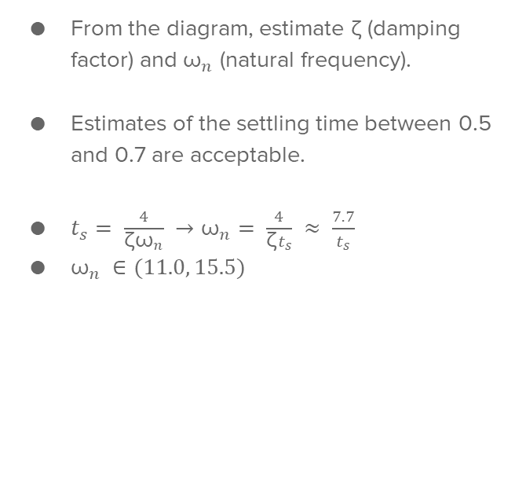
2021 Control Theory
From the diagram, estimate ζ (damping factor) and ${\text{ω}}_{n}$ (natural frequency).
Estimates of the settling time between 0.5 and 0.7 are acceptable.
$t_{s}= \frac{4}{\text{ζ}{\text{ω}}_{n}} →{\text{ω}}_{n}= \frac{4}{\text{ζ}t_{s}} ≈ \frac{7.7}{t_{s}}$
${\text{ω}}_{n} ∈(11.0, 15.5)$

