Slide 1
Department of Informatics
Networks and Distributed Systems (ND) group
IN 3230 / IN 4230
Networking principles
Michael Welzl

Slide 2
University education
“When I took Electrical Engineering, I didn’t learn how Sony builds amplifiers, I learned Maxwell.“
- John Day
Engineering training (job preparation):
ok to focus on what and how
  You’re going to use it, you must know how it works
University education: should explain why
  You’re going to design future systems, you need to understand why things are how they are, and what is good or bad about them

Slide 3
Next: communication principles
Building networking from scratch
  Starting with IPC in a single host
Several slides taken/adapted from John Day
For more details:
  John Day, “Patterns in Network Architecture: A Return to Fundamentals”. Prentice Hall, 2007.
First and foremost, a different way to think about layers

Slide 4
Two application processes on one system
Application
Processes
A
B
Application
Flow
Port
Ids
IPC Facility
Inter Process Communication (IPC) within
a Single Processing System
This establishes the API: the application should not be able to distinguish a slow correspondent from operating over the Network.

Slide 5
Two systems: how?
Application
Processes
Port
Ids
Distributed
IPC Facility
EFCP
EFCP
Management needed to find the other application
To do that, and then transfer data: need some sort of error and flow control protocol (EFCP) to transfer information between the two systems
  What are the functions this protocol needs?

Slide 6
Functions of a Protocol
Delimiting
Frag/Reassembly
Ordering
Data Corruption Detection
Data Corruption Detection/Correction – Making sure that the bits in the packet are correct (within some probability)
Delimiting – Packing SDUs into the User Data of PDUs and Marking the boundaries of an SDU, so we can find them again.
Fragmentation/Reassembly; Combining/Separation – Last Step of Delimiting, Creating User-Data fields of the PDUs
Ordering/Sequencing – Putting the PDUs in order, or putting sequence numbers on them for sending.
Loss and Duplicate Detection – Detecting entire lost PDUs, or duplicates due to retransmission.

Slide 7
Functions of a Protocol /2
State
Vector
Delimiting
Allocation
Synchronization
Frag/Reassembly
Ordering
Data Corruption Detection
Re-transmission
Control
Flow Control
Retransmission Control (Acknowledgement) – Recovering from lost PDUs.
Flow Control – Keeping the sender from overrunning the receiver, using either a Sliding Window or Rate-based.
These two are feedback mechanisms, therefore we need:
Synchronization – Ensuring that the sender and receiver maintain consistent state relative to each other.
Allocation/Deallocation – Allocating/Deallocating ports and creating and terminating synchronization.

Slide 8
More than one application per system at the same time
Requires two new
capabilities
EFCP must be able
to distinguish one
flow from another
  Typically use the
  port-ids of the source and destination
Will also need an application to manage multiple users of a single resource
EFCP
EFCP
EFCP
EFCP
EFCP
EFCP
Mux
Mux
Connection-id
Dest-port
Src-port
Op
Seq #
CRC
Data

Slide 9
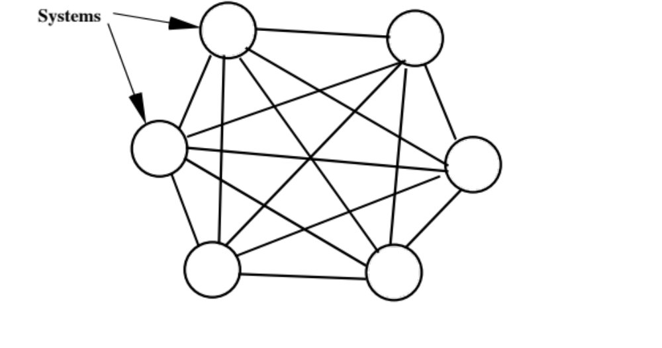
Communication with N systems

Slide 10
Communication with N systems /2:
A little re-organizing
A Virtual IPC Facility?
Res
Alloc
Finder
Dir
We now have a Distributed IPC Facility (DIF) for each Interface, and to maintain the API we need an application over all of them.
  The user shouldn’t have to figure out which wire to use
But this will not scale, and it will get expensive fast.
We need a cheaper way to do this.

Slide 11
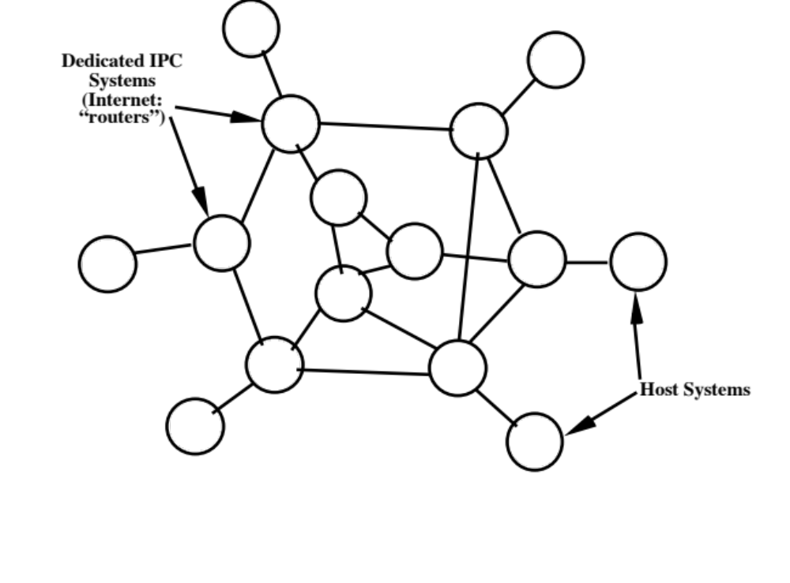
Communication with N systems /3
Dedicate systems to IPC: since not everyone talks to everyone else the same amount, can reduce the number of lines required and even out usage.

Slide 12
Communication with N systems /4
Relaying systems over a wider scope requires carrying addresses
Creates more problems: e.g., can’t avoid transient congestion and bit errors in relay memories; what about message order? etc.
  Will have to have an EFCP operating over the relays
EFCP
EFCP
Dest Addr
Src Addr
Common Relaying and Multiplexing Application Header
Relaying
Application
Relaying
PM
Interface
IPC
Processes
Interface
IPC
Processes

Slide 13
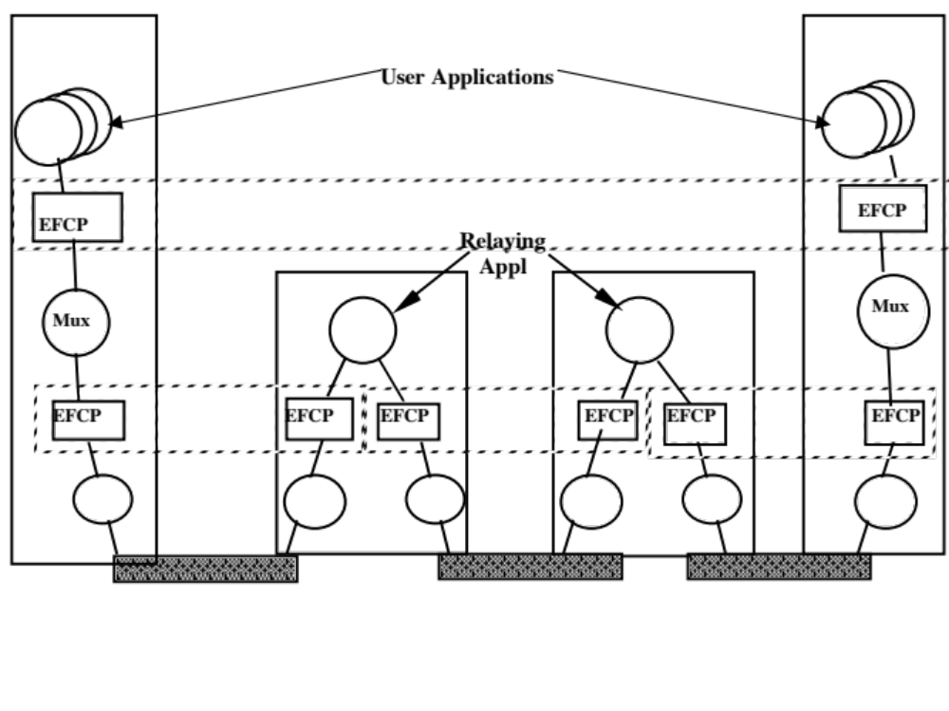
A recursive structure!
Distributed IPC Facilities

Slide 14
Implications
The essential role of layers is not to be a collection of a specific set of functions but instead to define a communication scope
  Different from what OSI and DoD models say!
Some essential functions exist at every layer, although they might be instantiated differently depending on the environment
  Even if the functions are exactly the same, it's not a repetition: they only occur once per scope
Layers can be stacked as needed, there should be no dependencies and there can always be the same interfaces between layers

Slide 15
Layers
Networks have loci of distributed shared state with different scopes
At the very least, differences of scope require different layers
If layers have the same scope, their functions should be completely independent
Does this picture show the Internet?
Host or End System
Increasing
Scope
Router
Notes:
15

Slide 16
The Internet
Host or End System
Application layer
Transport layer
Network layer
Link layer
Physical layer
Router
Remember the IP fragmentation problem from intro lecture?
  Dependencies between functions of layers with the same scope
What does the recursive structure tell us, what can we learn?
  Next: an example of functionality: flow + congestion control
Notes:
16

Slide 17
Developing flow + congestion control
S₁
R₁
A₁
DIF
A₂
Sender
Receiver
How fast can we send?
  Vertical interface should probably include a “rate”
  EFCP should implement flow control
Or something similar...e.g. a credit (window)

Slide 18
Developing flow + congestion control /2
S₁
R₁
A₁
A₂
DIF
A₃
1
2
1
1
Sender
Relay
Receiver
How fast can we send?
  Vertical interface should probably include a “rate”
  EFCP should implement flow control

Slide 19
Developing flow + congestion control /3
Multiple senders / receivers
S₁
S₂
R₁
R₂
A₁
A₂
DIF
A₃
1
2
1
1
Sender
Relay
Receiver
How fast can we send?
  Vertical interface should probably include a “rate”
  Layer ("DIF") should implement flow + congestion control

Slide 20
Developing flow + congestion control /4
S₁
S₂
R₁
R₂
B₁
2-DIF #2
B₂
B₁
2-DIF #1
B₂
A₁
A₂
1-DIF
A₃
How fast can we send?
  Vertical interface should probably include a “rate”
  2-DIFs EFCP should (at least) implement flow control, and 1-DIF EFCP should (at least) implement congestion control

Slide 21
Developing flow + congestion control /5
Multiple senders / receivers
S
R
C₁
3-DIF
C₂
B₁
B₂
2-DIF
B₃
A₁
1-DIF
#1
A₂
A₁
1-DIF
#2
A₂
A₃
Sender
Relay 1
Relay 2
Receiver
How fast can we send?
  Vertical interface should probably include a “rate”
  Every layer should probably implement some form of
  flow control, and congestion control when there are relays serving multiple flows

Slide 22
And the Internet?
TCP etc. implement congestion control
Even here we don't easily learn "how fast" !
S
R
No info about speed; only queue management
C₁
Transport layer
C₂
Down/up: just buffers
B₁
B₂
Network layer
B₃
Down/up: just buffers
A₁
WiFi
A₂
A₁
Ether-
net
A₂
A₃
Sender
IP router
Ethernet switch
Receiver
MAC algorithms implement overload control
How fast can we send?
  Who’s deciding what, what are the interfaces?
Notes:
Strictly speaking, the 4 addresses in WiFi are two layers with the relay occurring in the upper WiFi layer to Ethernet, so in this figure there is no relaying in the Network Layer.

Slide 23
E.g. Linux
Useful TCP "speed"
feedback: "low water mark"
  Patch with
  "TCP_NOTSENT_LOWAT"
  socket option, 2013
  Apple computers also offer this
L4
L3
From:
C. A. Grazia, N. Patriciello,
T. Høiland-Jørgensen,
M. Klapez, M. Casoni and
J. Mangues-Bafalluy,
"Adapting TCP Small Queues
for IEEE 802.11 Networks,"
PIMRC 2018, Bologna.
L2

Slide 24
Addresses
Host or End System
Increasing
Scope
Router
Network 1.
Addresses could be:
A, B, C, D, ...
Network 2.
Addresses could be:
1, 2, 3, 4, ...
Addresses could be:
129.240.118.130
Network 1 is completely unaware of addresses of type 1, 2, 3,..
  Networks and their addresses could dynamically be registered (attached)
  This is also more secure
Notes:
24

Slide 25

Internet addresses
Host or End System
Application layer
Transport layer
Network layer
Link layer
Physical layer
Router
No intermediate layer of smaller scope
  IP addresses are long, routers need to store a lot of information
Also, running out of addresses: IPv6 is the solution
Network Address (and Port) Translators (NA(P)Ts): more practical
  Store mapping: “local IP address + TCP port ⬄ global IP address + TCP port”
  Problem because depends on transport protocol, inside the network... e.g., need to send keep-alives to keep state up
  Peer-to-peer communication, both peers behind NATs: how to talk?
  Complex solutions (STUN, TURN, ICE protocols)
Notes:
25

Slide 26
IP mobility
Long ago, I moved from Bogstadveien to Thorvald Meyers Gate
  I registered to have mail forwarded for a month for free
  (postens flyttehjelp)
  This gave me time to inform everyone about my new address
  (posten offers an easy service to do that)
  After this month, I had no more business with the old address
Imagine a world without addresses
  But where, instead, my name is Bogstadveien
  Moving: use “postens flyttehjelp” forever!
One of the Internet's solutions: Multipath TCP (MPTCP)
  Applications should bind to names, not IP addresses
  MPTCP can switch without interruption
or 129.240.118.130, for example...
Mobile IP does exactly this.

Slide 27
Routing
Host or End System
Increasing
Scope
Router
Network 1.
Addresses could be:
A, B, C, D, ...
How would one route between the addresses on network 1?
Next: an example with multi-homing and link failure
Notes:
27

Slide 28
Using node addresses
B
4
1
F
2
1
A
2
3
2
3
1
D
2
H
1
1
1
3
2
2
C
E
2
1
2
3
1
3
G
Since we want to emphasize that we are naming nodes, lets just use the letters for addresses. But we still have to say which wire to send them on.
  There are two cases in general:
    Point-to-point Wire: No need for lower layer addresses, use local identifiers.
    Multi-access wired or wireless: Here we need addresses, use MAC addresses.
  We have only wires, so lets assign small integers as the local interface identifiers.
Now lets say that A wants to send a PDU to H, so it goes to DNS and looks up the address and gets 9. Now these nodes have been running a routing algorithm and the route is A, B, D, F, H.
So what do the router tables look like? (see next slide)
Notes:
What is the first thing you notice about the routing tables?
They are much shorter. Previously we need 22 addresses, now we need 8. The more wires terminating on each node the more addresses we will need for interface addressing.
Remember point to point wires don’t need addresses so we can use local identifiers at each node to identify which wire we are sending it on. They don’t have to be unique.
So what happens when a PDU is sent?

Slide 29
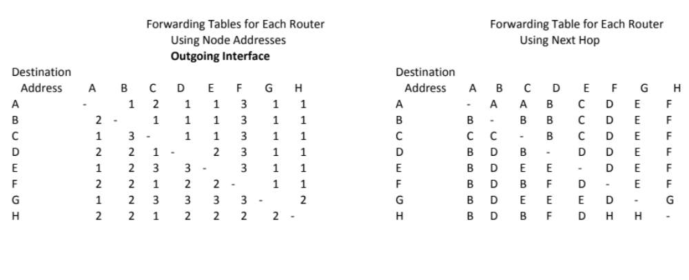

Slide 30
Sending a PDU from A to H
4
1
2
1
B
F
2
3
2
2
3
1
A
D
H
1
1
1
3
2
2
2
C
E
1
2
3
1
3
G
A has a PDU addressed to H:
  A consults its Forwarding Table and sends the PDU on interface 2 to B.
  B consults its Forwarding Table and sends the PDU on interface 2 to D.
  D consults its Forwarding Table and sends the PDU on interface 2 to F.
  F consults its Forwarding Table and sends the PDU on interface 2 to H.
Notes:
Sorry about that I didn’t intend for the interfaces to all turn out to have the same number! ;-) When I assigned them, I was trying to make sure it didn’t have the same number on both ends! ;-)

Slide 31
What happens when link F - H fails?
4
1
2
1
B
F
2
3
2
2
3
1
A
D
H
1
1
1
3
2
2
2
C
E
1
2
3
1
3
G
What happens if just after the PDU is sent the Link from F to H fails?
  In a few 10s of ms, a routing update is done, and a new Routing Table is generated.
  The PDU gets to D after the routing update has concluded and is delivered to H as if nothing happened.
  PDUs that might have been between B, D, and F might get re-routed. Only PDUs on the wire from F to H would be lost.
Notes:
Can you come up with the new Tables?

Slide 32
Internet routing
Host or End System
Application layer
Transport layer
Network layer
Link layer
Physical layer
Router
Always Between IP addresses
What if a node has multiple interfaces ( = is multihomed) ?
  Need to use an IP address per interface to distinguish them
  Hence, IP address identifies the interface, not the node
Next: example, using “normal” letters and numbers for clarity
Notes:
32

Slide 33
Internet multihoming
22
B
8
13
F
11
1
3
14
20
A
7
15
9
D
H
2
6
19
18
10
4
C
17
E
16
5
21
G
12
Internet addresses name the interfaces. Let’s see what this does
Assume: A wants to send a PDU to H, so it goes to DNS and looks up the address and gets 9. Now these nodes have been running a routing algorithm and the route is A, B, D, F, H.
So what do the router tables look like? (next slide)
Notes:
I used a very scientific algorithm. ;-) First I chose the path from A to H and pretended it was the optimal path chosen by a routing algorithm. Then for the forwarding tables, I assumed that even if it might be more hops, it was the preferred path. I also assumed nearest neighbors were always cheaper than going elsewhere (I think I did that). So if a Destination was more than one hop away but on the chosen path from A to H, I went to the nearest node on that path. That doesn’t really matter to what we are demonstrating.

Slide 34
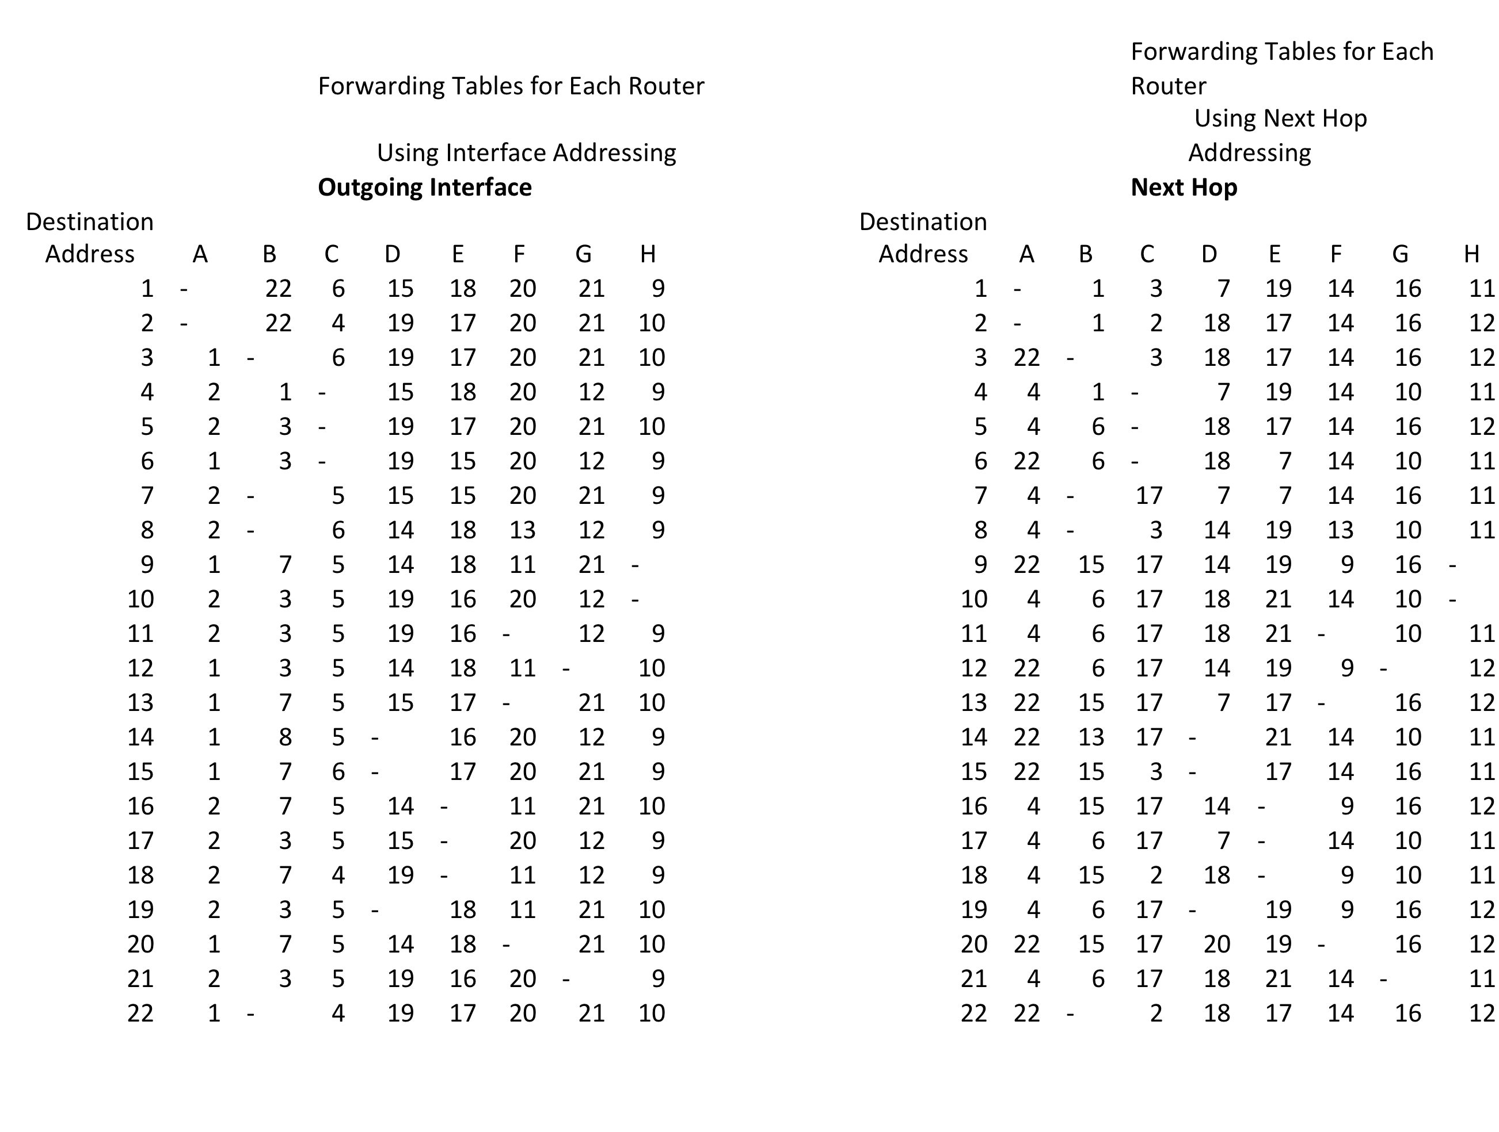

Slide 35
A PDU is sent with destination address 9 from A
22
B
8
13
F
11
1
3
14
20
A
7
15
9
D
H
2
6
19
18
10
4
C
17
E
16
5
21
G
12
A consults its Forwarding Table and sends it on outgoing address 1, next hop 22.
B consults its FT and sends it on outgoing address 7, next hop 15.
D consults its FT and sends it on outgoing address 14, next hop 20.
F consults its FT and sends it on outgoing address 11, next hop 9.
Now another PDU is sent from A to address 9, just after it leaves, the interface goes down.

Slide 36
What happens when link F - H fails?
B
8
13
F
11
1
3
14
20
A
22
7
15
9
D
H
2
6
19
18
10
4
C
17
E
16
5
21
G
12
What happens if the link with address 9 goes down?
  In a few 10s of ms, a routing update is done, and Addresses 9 and 11 are eliminated from the forwarding table.
  After several seconds and many retries, A determines that Address 9 is not responding,
  All TCP connections with Address 9 are terminated.
  All PDUs enroute to 9 are lost.
  Hopefully, there is a second DNS entry that lists H as also at Address 10.
  Connections are re-established using address 10. Several seconds have elapsed.

Slide 37
A modern Internet solution: MPTCP
22
B
8
13
F
11
1
3
14
20
A
7
15
9
D
H
2
6
19
18
10
4
C
17
E
16
5
21
G
12
A and H initially tell each other about all their addresses
(A: 1, 2; H: 9, 10)
MPTCP subflows are established; number depends on path manager configuration
  E.g. fullmesh: 4 subflows (1-9, 1-10, 2-9, 2-10)
  Then, normally: use all of them (schedule traffic, e.g. round-robin or preferring least-RTT path until cwnd full; “cautious” congestion control – be at most as aggressive as 1 TCP across a common bottleneck)
F-H link goes down: one subflow becomes unavailable, no TCP failure for application
This is done e.g. by iPhones since iOS 7: https://support.apple.com/en-us/HT201373

Slide 38
Architectural principles of the Internet
Yes, there are some...
Different from recursive principles laid out so far

Slide 39
Two important Internet rules
End-to-end ("e2e") argument
  Carefully consider trade-offs between implementing functions inside the network versus end systems
  Think twice before letting the network do it
  No application-specific functionality in the network
  Frequently interpreted too strictly:
  "keep the network dumb, put all logic in end systems"
Postel's robustness principle: "Be conservative in what you send, be liberal in what you accept"
  Ensures downward compatibility (e.g. "reserved" bits)

Slide 40
.. and problems with them
"Pervasive Monitoring is an Attack"
  RFC 7258
Also: ossification
  Middleboxes make assumptions, e.g. about TCP,
  break Postel's principle
Solution(?) encrypt everything, end-to-end !
  Also protocol headers (e.g. QUIC)
  Pure "e2e" restored - no more ossification; good?
  Also, no more control by ISPs... more control to Google?
Header field “greasing”
  Avoiding to create expectations like “this bit is always 0”
  (“Use it or lose it”)
Consider: intro slides multi-path transfer example

Slide 41
Critical thinking, applied to common Internet views
NATs are evil.
IPv6 should be deployed everywhere.
  Or... are NATs doing the right thing?
IP fragmentation is a bad idea
  or does it just highlight a design flaw?
Middleboxes are bad
  or are we just missing interfaces to cleanly make them a part of the architecture?

Slide 42
A final note about recursive networking
Recursive InterNetwork Architecture (RINA)
  By John Day
  More material: http://pouzinsociety.org
Research prototypes exist, ... but many issues and unresolved questions
  Just saying “everything is wrong” does not automatically solve it...
  So, again: this was about a way of thinking

Slide 43
Thank you!
Questions?

