Slide 1
Department of Informatics
Networks and Distributed Systems (ND) group
IN3230 / IN4230
The Internet transport layer
Michael Welzl

Slide 2
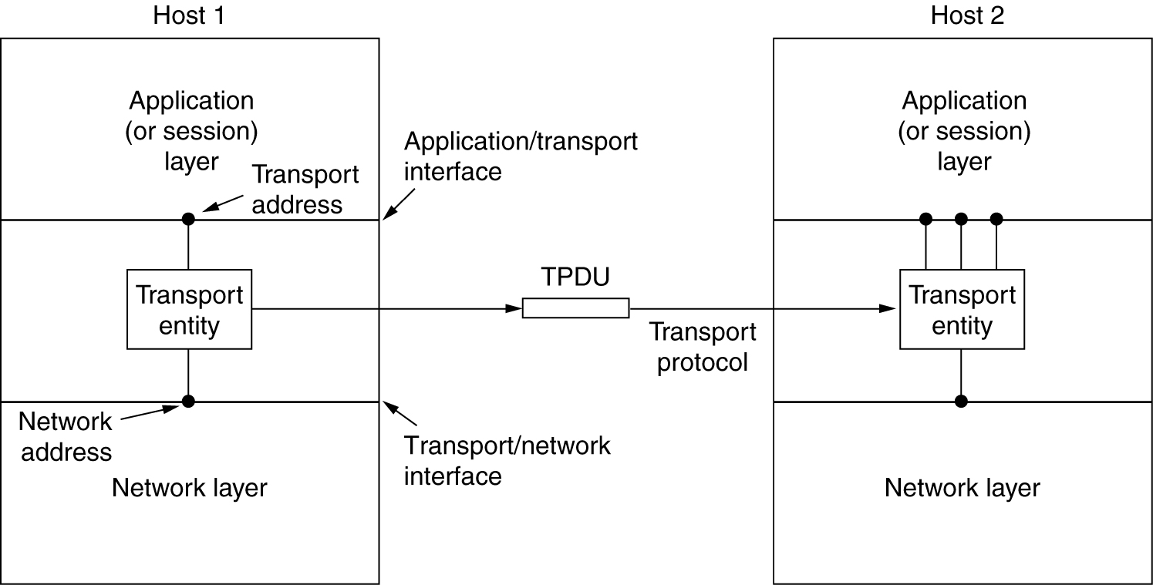
Where we are in the stack...

Slide 3
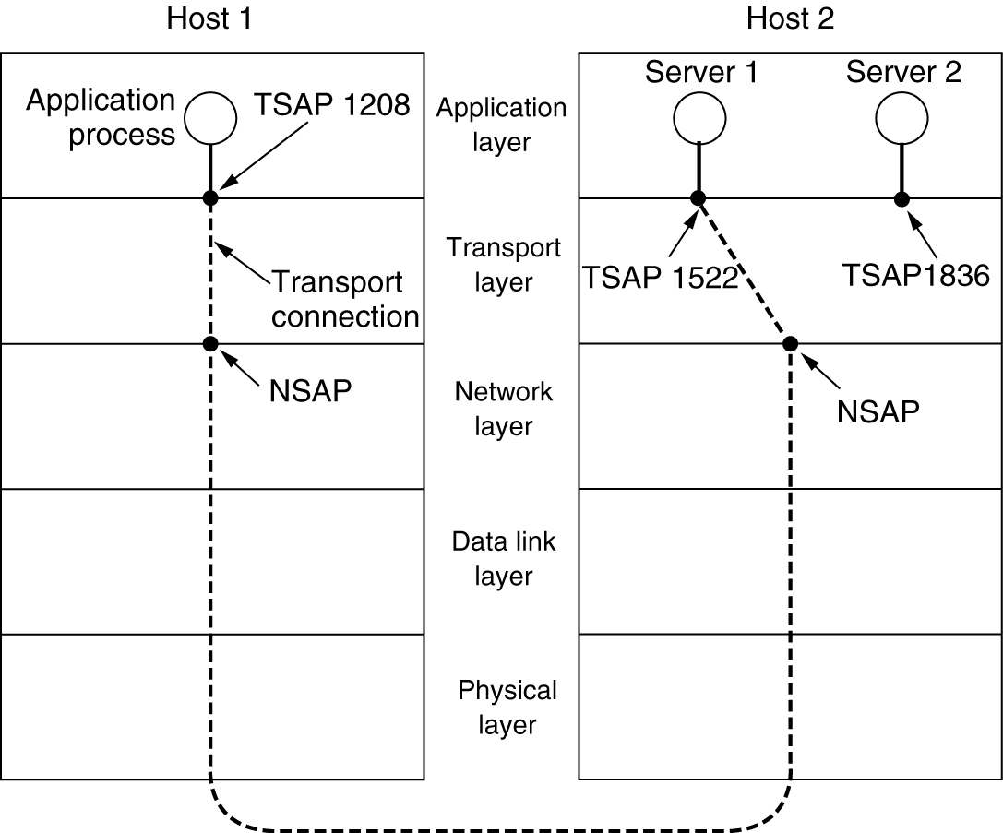
Addressing [Tanenbaum book]
TSAPs, NSAPs and transport connections

Slide 4
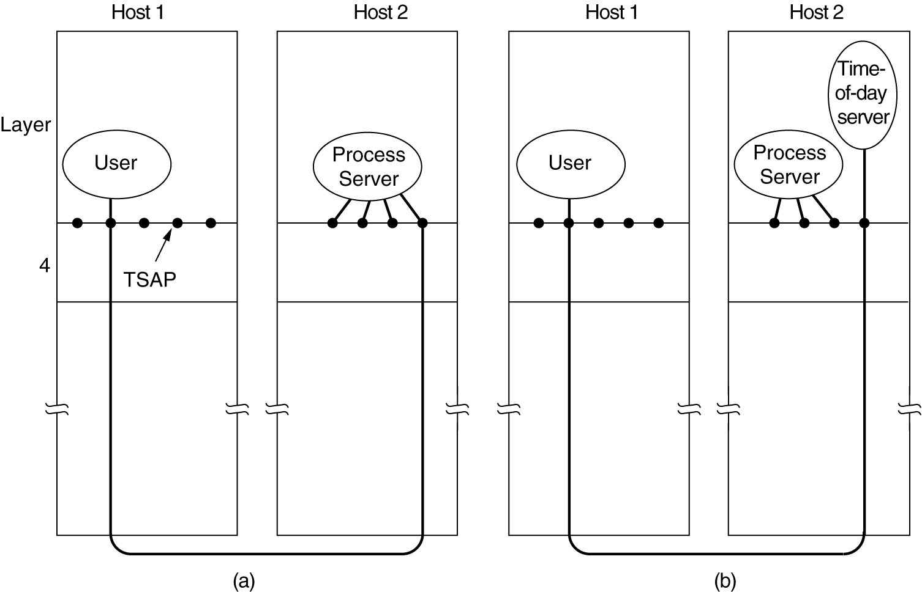
Conn. establishment [Tanenbaum book]
How a user process in host 1 could establish a connection with a time-of-day server in host 2

Slide 5
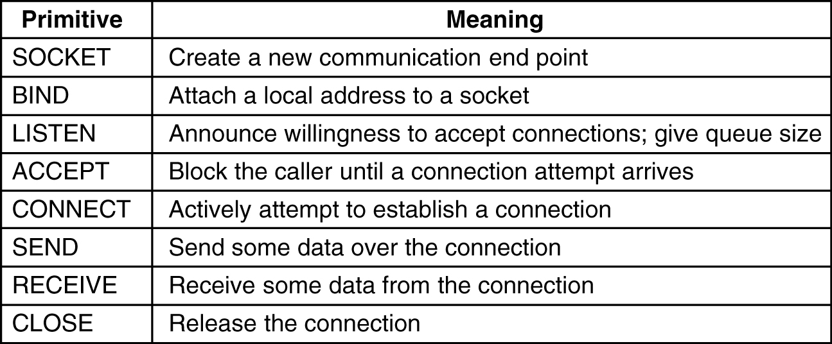
The Internet transport layer
Services are (mostly) defined by two protocols
  UDP (connectionless): sends a “datagram”
  TCP (connection oriented): transfers a reliable bytestream
Addressing: port numbers
  Choosing a service during connection establishment: well-known ports
Berkeley sockets:
TCP service primitives

Slide 6
Evolution of the Internet's transport layer
Only TCP and UDP... so long that it has become almost impossible to use something else. "Ossification”
  E.g., in-network devices make X/IP fail unless X != {TCP, UDP}
Try-a-different-protocol-else-fall-back hard to implement; thus, protocols now often developed in user space, over UDP, per app.
  Wheel re-invention: e.g. multi-streaming is in SCTP, Adobe's RTMFP, Google's QUIC, Apple's Minion...
  Think "TCP++" for these protocols. Good to understand TCP first!
IETF Transport Services (TAPS) WG:
new API that lets applications choose service instead of protocol
  Flexible protocol choice, try-else-fall-back complexity: all below the API
  New standard; Apple’s Network.Framework (since beta for iOS 12 and macOS Mojave, presented at WWDC 2018) conforms to TAPS
IFI research!

Slide 7
Internet terminology
PDU, SDU, etc.: OSI terminology
  Internet terminology: datagram, segment, packet
Theoretically, 1 TCP segment could be split into multiple IP packets
  hence different words used
In practice, this is inefficient and not often done
  hence segment = packet
  Except, (of course!): TCP segment does not contain IP header

Slide 8
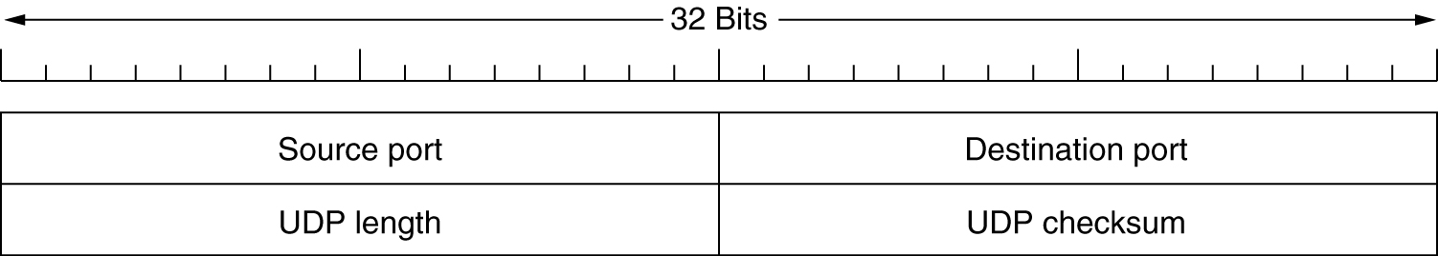
UDP
UDP = IP + 2 features:
  Ports: identify communicating instances with similar IP address
  (transport layer)
  Checksum: Adler-32 covering the whole packet
    checksum field = 0: no checksum at all
Usage of UDP: unreliable data transmission
(DNS, SNMP, real-time streams, ..)

Slide 9
TCP
How it really is today.
Skipping the very basic things that you should know from IN2140.

Slide 10
The beginning (1970s, up to 1981)
RFC 793, 1981, Jon Postel
  Front page says: "DARPA INTERNET PROGRAM PROTOCOL SPECIFICATION" and "prepared for Defense Advanced Research Projects Agency"
  Goal was obviously to make it super reliable:
  85 pages, covering
  many corner cases
Robustness is never a bad thing, so complexity has remained
  Some things slightly obscure: e.g., half-closed connections: after saying "FIN", host can still receive, with no time limit, until other host says "FIN".

Slide 11
Some old things are best forgotten
Push bit (PSH)
Urgent pointer (URG)
Brand new (08/2022) spec. available: RFC 9293
  Obsoletes RFC 793, RFC 879, RFC 2873, RFC 6093, RFC 6429, RFC 6528, RFC 6691
  Updates RFC 1011, RFC 1122, RFC 5961
Implementations diverge...

Slide 12
Later 80‘s, and 90‘s
FreeBSD was "reference" implementation
  Matches Stevens book [K.Fall, R. Stevens: TCP/IP Illustrated]
  patches over time were if-clauses in the code; later revamped
  Originally, much code written by people who also wrote the RFCs
  (Van Jacobson, Sally Floyd, Mark Allman, Matt Mathis, ..)
  Many of them also wrote ns-2 simulator code
  These people guided the design in the IETF
Van Jacobson "saved the Internet" after congestion collapse, with code + SIGCOMM 1988 paper about it: "Congestion Avoidance and Control"
Linux implementation also common and well known in IETF, completely different code (segment-, not byte-based)
  Focus of Google (more later)

Slide 13
Resulting IETF view
TCP has been working for a long time, so let‘s be careful
➔ making it more robust is okay.
  Note: WG is called "TCP Maintenance and Minor Extensions (TCPM)"
...and let‘s be careful about congestion control in particular.
Our "early heroes" did a great job, so never break their rules
➔ important congestion control principles:
  ACK clocking ("conservation of packets" principle)
  Timeout means that the network is empty
But, note: the IETF also tries to stay meaningful
  Voluntary, we have no "Internet police"
  We should be happy that companies such as Google (in case of TCP) keep coming to the IETF to tell us what they do
Keep them in mind

Slide 14
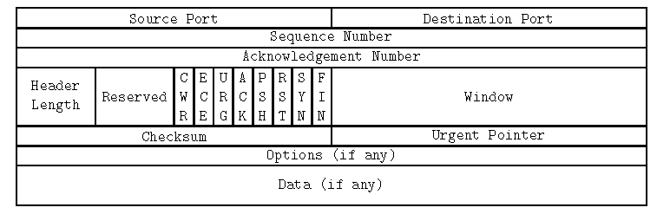
TCP Header
Flags indicate connection setup/teardown, ACK, ..
If no data: packet is just an ACK
Window = advertised window from receiver (flow control)
  Field size limits sending rate in today‘s high speed environments; solution:
  Window Scaling Option – both sides agree to left-shift the window value by N bit

Slide 15
The importance of Window Scaling
Local testbed
PlanetLab
(Austria => Brazil)
2007 measurements with Linux
  TCP BIC vs. TCP-Reno competition
OSes gradually increase factor
  SIGCOMM 2017 QUIC paper: 4.6% rwnd-limited TCP connections

Slide 16
Error control: Acknowledgement
ACK (“positive” Acknowledgement) serves multiple purposes:
  sender: throw away copy of data held for retransmit
  time-out cancelled
  msg-number can be re-used
TCP ACKs are cumulative
  ACK n acknowledges everything up to n-1
ACKs should be delayed (except when sending duplicates – why? later!)
  TCP ACKs are unreliable: dropping one does not cause much harm
  Enough with 1 ACK every 2 segments, or at least 1 every 500 ms (often: 200 ms)
TCP counts bytes; ACK carries “next expected byte“ (#+1)
  Sender sends them as "segments", ideally of size SMSS
  Nagle algorithm delays sending to collect bytes & avoid
  sending tiny segments (can be disabled)
Following slides: segment numbers for simplicity (imagine 1-byte segments)

Slide 17
Error control: Timeout
Remember: that's the first congestion signal. Back to square 1 (SS from cwnd=1).
Go-Back-N behavior in response to timeout
Retransmit Timeout (RTO) timer value difficult to determine:
  too long ➔ bad in case of msg-loss; too short ➔ risk of false alarms
  General consensus: too short is worse than too long; use conservative estimate
Calculation: measure RTT (Seg# ... ACK#) , then:
original suggestion in RFC 793: Exponentially Weighed Moving Average (EWMA)
  SRTT = (1-α) SRTT + α RTT
  RTO = min(UBOUND, max(LBOUND, β * SRTT))
Depending on variation, result may be too small or too large; thus, final algorithm includes variation (approximated via mean deviation)
  SRTT = (1-α) SRTT + α RTT
  δ = (1 - β) * δ + β * [SRTT - RTT]
  RTO = SRTT + 4 * δ
That's not how Linux does it

Slide 18
RTO calculation
Problem: retransmission ambiguity
  Segment #1 sent, no ACK received → segment #1 retransmitted
  Incoming ACK #2: cannot tell whether original or retransmitted segment #1 was ACKed
  Thus, cannot reliably calculate RTO!
Solution 1 [Karn/Partridge]: ignore RTT values from retransmits
  Problem: RTT calculation especially important when loss occurs; sampling theorem suggests that RTT samples should be taken more often
Solution 2: Timestamps option
  Sender writes current time into packet header (option)
  Receiver reflects value
  At sender, when ACK arrives, RTT = (current time) - (value carried in option)
  Problems: additional header space; historical: facilitates NAT detection
Note: because of how RTO is calculated, not much gain from sampling more than once per RTT

Slide 19
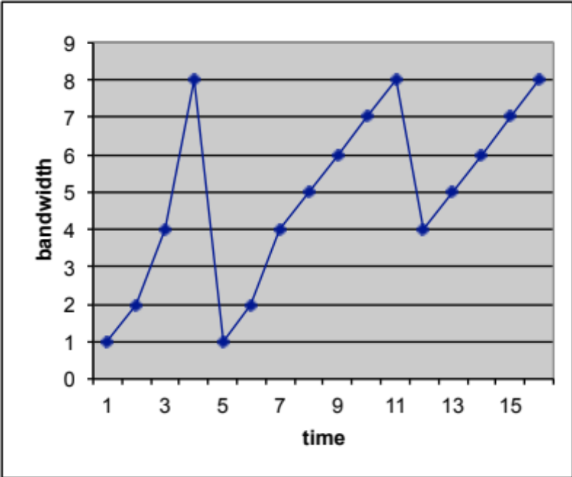
Fast Retransmit / Fast Recovery (FR/FR) (Reno)
Reasoning: slow start = restart; assume that network is empty
But even similar incoming ACKs indicate that packets arrive at the receiver!
Thus, slow start reaction = too conservative.
Upon reception of third duplicate ACK (DupACK):
ssthresh = FlightSize/2
Retransmit the lost segment (fast retransmit);
cwnd = ssthresh + 3*SMSS
("inflates" cwnd by the number of segments (three)
that have left the network and which the receiver
has buffered)
For each additional DupACK received: cwnd += SMSS
(inflates cwnd to reflect the additional segment that
has left the network)
Transmit a segment, if allowed by the new value of cwnd and rwnd
Upon reception of ACK that acknowledges new data (“full ACK“):
"deflate" window: cwnd = ssthresh (the value set in step 1)
Congestion Avoidance
Congestion Avoidance
Slow Start
Slow Start
Remember: goal is to quickly + correctly reach ssthresh

Slide 20
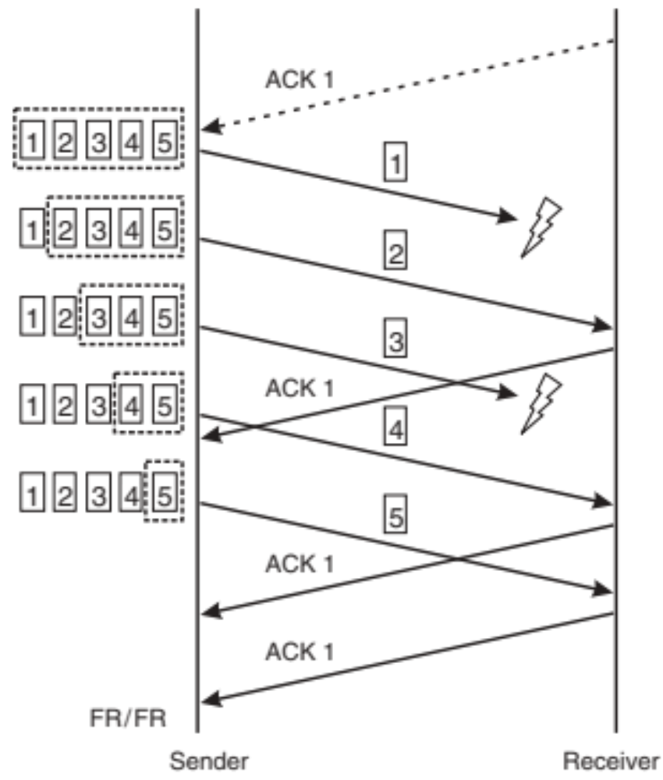
Multiple dropped segments
Sender cannot detect loss of multiple segments from a single window
  Insufficient information in DupACKs
NewReno:
  stay in FR/FR when partial ACK arrives after DupACKs
  retransmit single segment
  only full ACK ends process
Important to obtain enough ACKs to avoid timeout
  Limited transmit: also send new segments for first two DupACKs
  Early retransmit: resend old data if there's not enough to send

Slide 21
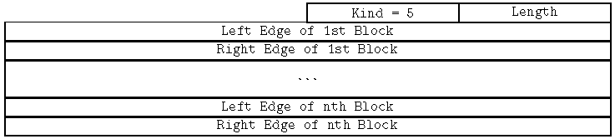
Selective ACKnowledgements (SACK)
Example on NewReno slide: send ACK 1, SACK 3, SACK 5 in response to segment #4
Better sender reaction possible
  (New)Reno can only retransmit 1 segment / RTT, SACK can retransmit more
  Particularly advantageous when window is large (long fat pipes)
Extension: DSACK informs the sender of duplicate arrivals
Reaction to SACK open to implementer, but must follow general CC rules
    Next: IETF-recommended "conservative" algorithm (RFC 6675)
    Other variant: FACK, optional in Linux; considers all "holes" as lost ➔ retransmit

Slide 22
SACK loss recovery: key aspects
(see extra slides for details)
Explicitly estimate #bytes in flight: "pipe"
  cwnd – pipe > 1 segment means: "allowed to send"
Determine the ideal next segment to send
  Retransmit only when we're really sure that a segment was lost
  Else transmit new segments, if possible... or just do something reasonable (better to retransmit less-sure-segments than nothing if we're allowed to send)
Maintain other existing TCP logic
  DupACK interpretation
  Limited Transmit
  ...

Slide 23
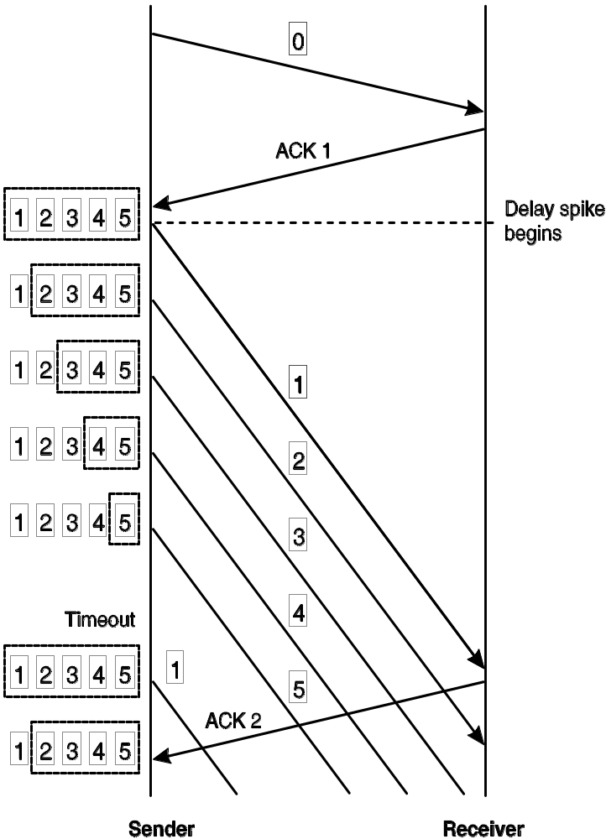
Spurious timeouts
Possible occurrence in e.g. wireless scenarios (handover): sudden delay spike
Can lead to timeout
→ slow start
  But: underlying assumption: “pipe empty“ is wrong!
  (“spurious timeout“)
  Old incoming ACK after timeout should be used to undo the error
Several methods proposed
Examples:
  Eifel Algorithm: use timestamps option to check: timestamp in ACK < time of timeout?
  DSACK: duplicate arrived
  F-RTO: after RTO, send one retransmit, then, if ACK advances the window, send new data; if new data gets ACKed, timeout was spurious

Slide 24
Appropriate Byte Counting
Increasing in Congestion Avoidance mode: common implementation (e.g. Jan’05 FreeBSD code): cwnd += SMSS*SMSS/cwnd for every ACK
(same as cwnd += 1/cwnd if we count segments)
  Problem: e.g. cwnd = 2: 2 + 1/2 + 1/ (2+1/2)) = 2+0.5+0.4 = 2.9
  thus, cannot send a new packet after 1 RTT
  Worse with delayed ACKs (cwnd = 2.5)
  Even worse with ACKs for less than 1 segment (consider 1000 1-byte ACKs)
  → too aggressive!
Solution: Appropriate Byte Counting (ABC)
  Maintain bytes_acked variable; send segment when threshold exceeded
  Works in Congestion Avoidance; but what about Slow Start?
    Here, ABC + delayed ACKs means that the rate increases in 2*SMSS steps
    If a series of ACKs are dropped, this could be a significant burst (“micro-burstiness“); thus, limit of 2*SMSS per ACK recommended

Slide 25
Proportional Rate Reduction (PRR)
Generalization (any back-off factor) of Linux' Rate-Halving
  Rate-halving avoids burst + pause behavior of FACK or RFC 6675 "conservative loss recovery" algorithm; "paces" segments
  Implements, for FR, common logic: Slow Start when cwnd<ssthresh
  Example from RFC6937 (X = lost, N = new, R = retransmit):
  RFC 6675
  ack# X 1 2 3 4 5 6 7 8 9 10 11 12 13 14 15 16 17 18 19
  cwnd: 20 20 11 11 11 11 11 11 11 11 11 11 11 11 11 11 11 11 11
  pipe: 19 19 18 18 17 16 15 14 13 12 11 10 10 10 10 10 10 10 10
  sent: N N R N N N N N N N N
  Rate-Halving (Linux)
  ack# X 1 2 3 4 5 6 7 8 9 10 11 12 13 14 15 16 17 18 19
  cwnd: 20 20 19 18 18 17 17 16 16 15 15 14 14 13 13 12 12 11 11
  pipe: 19 19 18 18 17 17 16 16 15 15 14 14 13 13 12 12 11 11 10
  sent: N N R N N N N N N N N

Slide 26
Next: measures to help short flows
Short flows are often interactive; latency matters
  Large bulk data transfer not usually latency-critical
Every packet matters:
drop ➔ retransmit ➔ user-perceived latency
  Good to send much, fast (speed up slow start)
  Shaving off round-trips: when all the data can be sent in e.g. 1 RTT, handshake latency = ½ of the time
  Tail loss: FR can't work when no more data to send, hence no more ACK arrives
Note: short flows ≈ application-limited flows
("thin streams") (also: rwnd-limited flows!)

Slide 27
Short flows are common
IFI research
6 minute Internet traffic traces from 12:59, 17. 1. 2019
  Center for Applied Internet Data Analysis (CAIDA): “equinix-nyc” high-speed network monitor node, located at the Equinix datacenter in New York and connected to an OC192 backbone link (9953 Mbps) of a Tier-1 ISP between New York, NY,and Sao Paulo, Brazil.
  Consider connections that terminate within this time interval
Statistics
  Server-client / client-server: 75% of connections shorter than 10 / 5 Kbit
  Total: 88042 connections, ~ 48.5 Gbyte
  Client to server: 3952 (4.49%) of connections had retransmissions
  Server to client: 2523 (2.86%) of connections had retransmissions
  Total: 6475 (7.35%) of connections had retransmissions
Similar results in Japanese MAWI dataset (15 mins per month from Jan/19 to Nov/21, ~2.5 M flows)
No retransmission ➔ no loss ➔ no capacity probing !

Slide 28
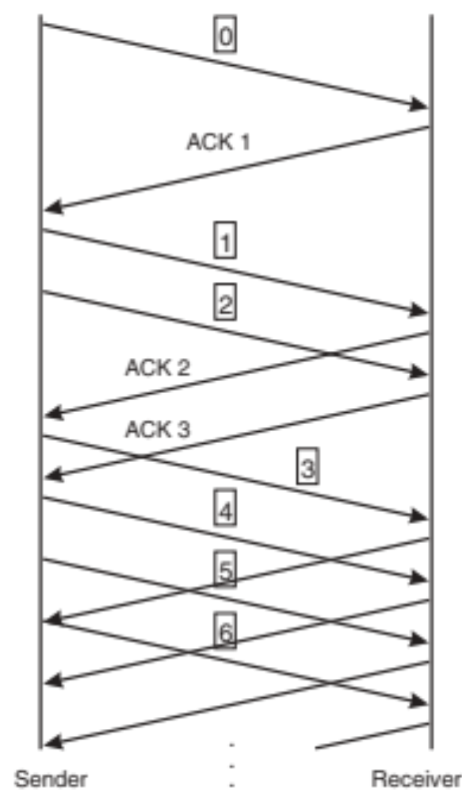
Increasing the Initial Window (IW)
Slow start: 3 RTTs for 3 packets = inefficient for very short transfers
  Example: HTTP Requests
Thus, initial window since ~2002:
IW = min(4*MSS, max(2*MSS, 4380 byte))
(typically 3)
Since ~2013:
IW = min (10*MSS, max (2*MSS, 14600))
(typically 10)
  Adopted in Linux as default since kernel 2.6.39
  (May 2011)
  Note: cwnd after timeout
  ("Loss Window" (LW)) still 1

Slide 29
TCP Fast Open (TFO)
Builds on T/TCP idea: allow HTTP GET on SYN, respond with data + SYN/ACK
  There, the problem was: DoS attack surface
Solution:
  First handshake like normal, server gives client cookie and remembers it (locally configurable time)
  Later handshakes: SYN + data + cookie
Remaining problem: server cannot tell original from retransmitted SYN ➔ application must be able to accept duplicate data (changes semantics, also API)
  Not a big problem for a web server

Slide 30
Tail loss
Consider the "tail" of a transmission
  e.g., segments 8, 9, 10 of a total 10-segment transfer
Segment 8 lost: we get 2 DupACKs
  If we have new data to send, Limited Transmit allows us to do that (which will give us another DupACK and we can enter FR, where we can retransmit)
  Else, Early Retransmit allows us to resend segment 8
Segment 10 lost: we get no more ACKs, only the RTO can help us...

Slide 31
RTO Restart (RTOR)
IFI research
RFC 7765
In some cases TCP/SCTP must use RTO for loss recovery
  e.g., if a connection has 2 outstanding packets and 1 is lost
However, the effective RTO often becomes RTO = RTO + t
  Where t ≈ RTT [+delACK]
The reason is that the timer is restarted on each incoming ACK (RFC 6298, RFC 4960)
RTOR rearms timer as:
RTO = RTO - t
Sender
Receiver
t
RTO Restart
RTO

Slide 32
Tail Loss Probe (TLP)
From draft-dukkipati-tcpm-tcp-loss-probe-01:
  "Measurements on Google Web servers show that approximately 70% of retransmissions for Web transfers are sent after the RTO timer expires, while only 30% are handled by fast recovery."
  "...distribution of RTO/RTT values on Google Web servers.
  [percentile, RTO/RTT]: [50th percentile, 4.3]; [75th percentile, 11.3];
  [90th percentile, 28.9]; [95th percentile, 53.9]; [99th percentile, 214]."
  "... typically caused by variance in measured RTTs..."
Idea: more aggressive timer allows to send one single packet ("probe") before RTO fires
  timer: 2*SRTT
  (+extra time for DelACK if FlightSize==1)
  new, if data available, else resend

Slide 33
Recent ACKnowledgment (RACK)
Main idea: use time instead of sequence numbers
(avoid basing logic on DupThresh)
  Multiple benefits: eliminates need for much loss recovery logic (drastic simplification!), works with every packet (also retransmits), ..
Packet A is lost if some packet B sent sufficiently later is (s)acked
  "Sufficiently later": later by at least a "reordering window"
  (RACK.reo_wnd, default min_rtt / 4)
  min_rtt calc. from RTTs per ACK; tried seeding with SRTT or most recent RTT, no major difference
Also: arm a timer to detect loss in case no ACK arrives
  TLP is a special case; merged with RACK [RFC 8985]
  Conceptually, RACK arms a (virtual) timer on every
  packet sent, times updated with new RTT samples
IFI research!

Slide 34
RACK examples: sender sends P1, P2, P3
(more than RACK.reo_wnd time in between them)
Example 1: P1 and P3 lost
  P2 SACK arrives ➔ P1 lost, retransmit (R1)
  R1 is cumulatively ACKed ➔ P3 lost, retransmit (R3)
  No timer needed
Example 2: P1 and P2 lost
  P3 SACK arrives ➔ P1, P2 lost, retransmit (R1, R2)
  R1 lost again but R2 SACKed ➔ R1 lost, retransmit
  Common with rate limiting from token bucket policers with large bucket depth and low rate limit
  Retransmissions often lost repeatedly because CC. requires multiple RTTs to reduce the rate below the policed rate
  No DupACK based solution can detect such losses!

Slide 35
Conclusion on TCP
Note, we focused on what was implemented
  We also skipped some things: header compression, authentication, sequence number attacks, implementation specifics (e.g. TCP_NOTSENT_LOWAT)...
RFC series documents many non-implemented (??) ideas from that time
  Being more robust to reordering (TCP-NCR)
  Doing congestion control for ACKs (ACK-CC)
  Reducing cwnd when the sender doesn't have data to send (CWV)
  Adjusting user timeout (when TCP says "it's over") at both ends (UTO)
  Avoiding Slow Start overshoot for large windows (Limited Slow-Start)
...and some old ideas "took off" later (e.g. T/TCP, ECN)
  Or not? Time will tell

Slide 36
QUIC: a high-level overview
Reliable data transfer over UDP, with multi-streaming
(MUXing over a connection without head-of-line blocking delay)
0-RTT connection setup
  TLS handshake + TCP handshake + first data, all together
Several details of TCP fixed / simplified
  E.g., strictly consecutive sequence numbers: no more ambiguity,
  no wrapping, etc. ...
  when the number exceeds the limit, create a new stream
Support for connection migration
Ability to upgrade part of the design
  Versioning
  Transport header encryption, and "greasing" to avoid ossification
HTTP over QUIC = HTTP/3

Slide 37
Thank you!

Slide 38
Extra slides
(not pensum)
RFC 6675 SACK loss recovery

Slide 39
SACK loss recovery: definitions
HighData: highest seqno transmitted
HighACK: seqno of highest cumulatively ACKed byte
HighRxt: highest seqno retransmitted in this loss recovery phase
Pipe: sender's estimate of the number of bytes outstanding in the network. Key variable for cc. because now this number is explicit.
DupAcks: # DupACKs received since last cumulative ACK
(DupACK = segment containing SACK block that identifies previously unacked and un-SACKed bytes between HighACK and HighData)
DupThresh: # DupACKs needed to trigger retransmission (normally 3)
Scoreboard: data structure to keep track of sequence number ranges
RescueRxt: highest seqno which has been optimistically retransmitted to prevent stalling of the ACK clock when there is loss at the end of the window and no new data is available for transmission.

Slide 40
SACK loss recovery: scoreboard functions
Update()
  Mark all cumulatively ACKed or SACKed bytes, record total # SACKed bytes
IsLost(SeqNo)
  True when either DupThresh discontiguous SACKed sequences have arrived above SeqNo, or more than (DupThresh - 1) * SMSS bytes with sequence No's > SeqNo have been SACKed
SetPipe()
  pipe = 0
  for(S1=HighACK; S1<=HighData; S1++)
    if(scoreboard[S1] unsacked)
      if !IsLost(S1):
        pipe++ // not SACKed, not lost ➔ in flight
      if S1 <= HighRxt:
        pipe++ // retransmitted, not lost ➔ 2* in flight
HighRXT
IsLost = True
1
2
X
4
5
X
7
8
HighACK
HighData
pipe++

Slide 41
SACK loss recovery: scoreboard functions /2
IsLost = True
NextSeg() (what to transmit next)
  if there exists S2 such that:
    S2 > HighRxt
    S2 < highest byte covered by
    any received SACK
    IsLost(S2) == true
    ... return max. SMSS sequence range starting with S2
  else, if there is unsent data and rwnd allows, return max. SMSS sequence range starting with HighData+1
  else, if there exists S3 for which 1a) and 1b) are true, return one segment of max. SMSS bytes starting with S3
  else, if HighACK > RescueRxt (or RescueRxt undefined), return one segment of max. SMSS bytes that includes the highest outstanding unSACKed seq.no, and set RescueRxt to RecoveryPoint (HighData). Do not update HighRxt.
  else fail (nothing returned)
Rules 3 and 4 are a retransmission "last resort"
HighRXT
1
2
X
4
5
X
7
8
HighACK
HighData
1. NextSeg
pipe++

Slide 42
When an ACK with SACK info arrives...
HighRXT
IsLost = True
Run Update()
Cumulative ACK? If so, DupAcks = 0
DupACK? If so, and not in FR yet:
  DupAcks++
  If DupAcks >= DupThresh, goto (4)
  If DupAcks < DupThresh but IsLost(HighACK + 1), goto (4)
  Send new segments (Limited Transmit):
    Set HighRxt to HighACK
    Run SetPipe ()
    If (cwnd - pipe) >= 1 SMSS, there exists previously unsent data, and rwnd allows, transmit up to 1 SMSS of data starting with the byte HighData+1 and update HighData to reflect this transmission, then return to (3.2)
    Terminate processing of this ACK
1
2
X
4
5
X
7
8
HighACK
HighData
pipe++

Slide 43
...cont'd: entering FR/FR (step 4)
Also upon timeout!
RecoveryPoint = HighData
ssthresh = cwnd = (FlightSize / 2)
(Segments sent as part of Limited Transmit not counted in FlightSize)
Retransmit the first data segment presumed dropped:
the segment starting with sequence number HighACK + 1.
To prevent repeated retransmission of the same data or a premature rescue retransmission, set both HighRxt and RescueRxt to the highest sequence number in the retransmitted segment.
Run SetPipe()
In order to take advantage of potential additional available cwnd, proceed to transmission step of FR algorithm (next)

Slide 44
FR algorithm
ACK arrives: Cumulative ACK for seqno > RecoveryPoint?
  yes: end FR; keep scoreboard info above HighACK
  no: run Update() and SetPipe()
cwnd-pipe >= 1 SMSS? transmit segments!
  Send based on NextSeg() (stop this if NextSeg() fails)
  If any of the bytes sent in 1) are below HighData, set HighRxt to the highest sequence number of the retransmitted segment unless NextSeg() rule (4) was invoked for this retransmission. (rescueRxt)
  If any of the bytes sent in 1) are above HighData, update HighData
  pipe += bytes transmitted in 1)
  If cwnd - pipe >= 1 SMSS, return to 1)

