Slide 1
Department of Informatics
Networks and Distributed Systems (ND) group
IN3230/4230
Wireless Communications - III
Özgü Alay
ozgua@ifi.uio.no

Slide 2
Outline
Mobile Broadband Networks
  Performance
  International Roaming
  Operations
Massive IoT
  NB-IoT
  LORAWAN
Paving the future
  5G and Beyond

Slide 3
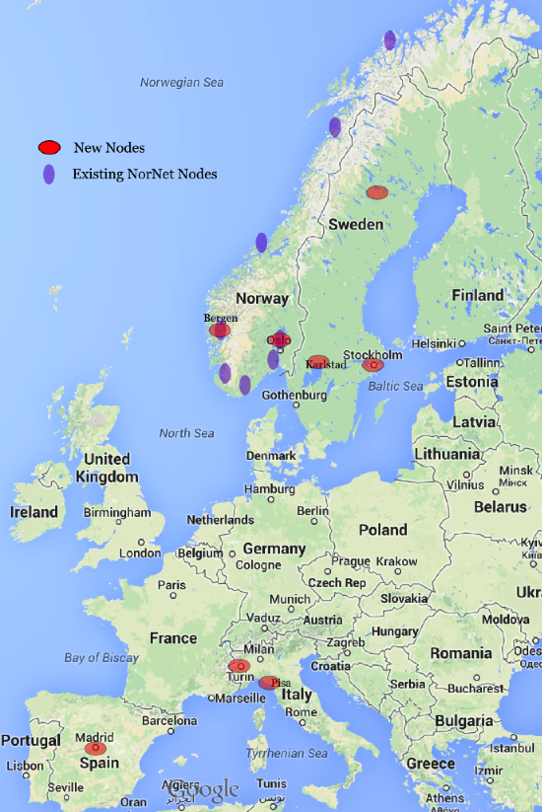
MONROE – Mobile Broadband Measurement Platform
Coverage in 4 European Countries (Norway, Sweden, Spain, Italy)
A set of 100 nodes equipped with Ethernet, WiFi and 3G/4G interfaces with commercial MBB subscriptions.
Under mobility (e.g., on-board of trains or buses) or in stationary scenarios (e.g., in laboratories, or hosted by volunteers in homes).

Slide 4
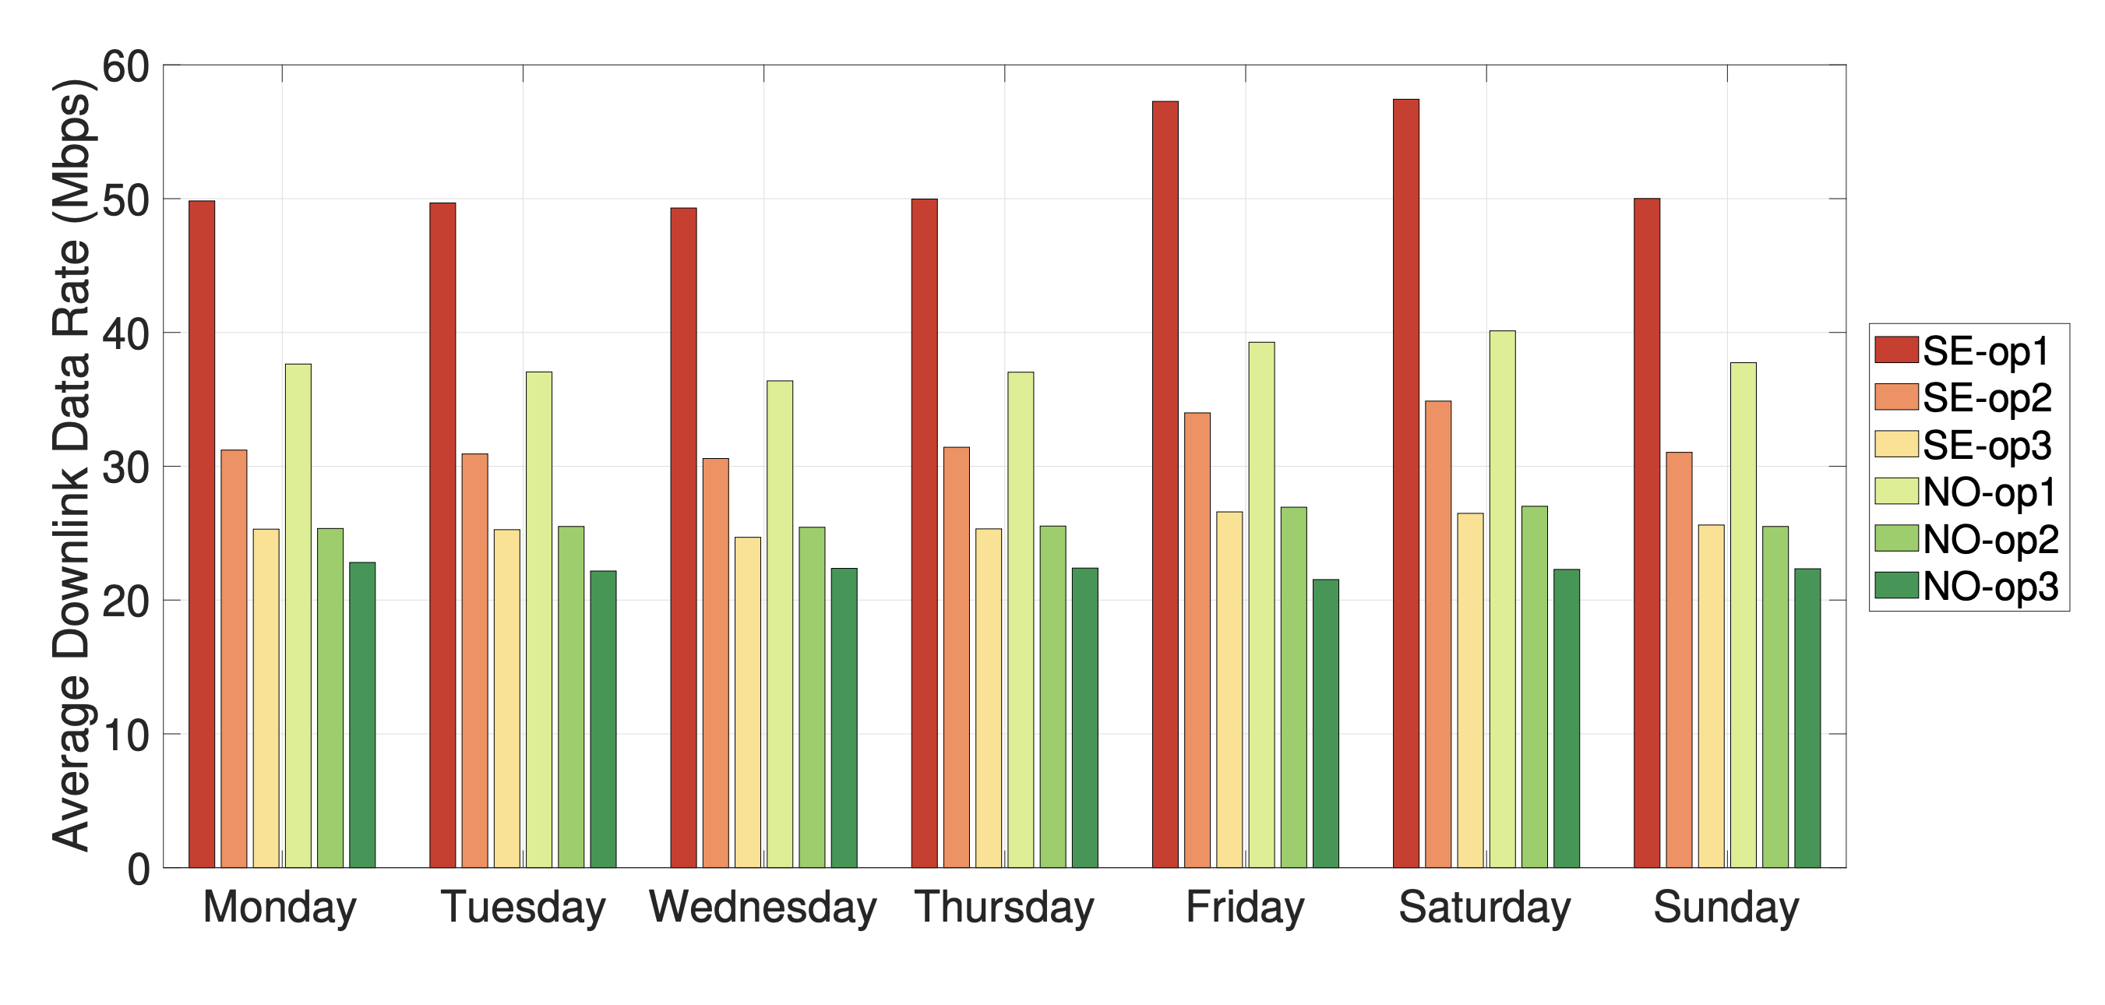
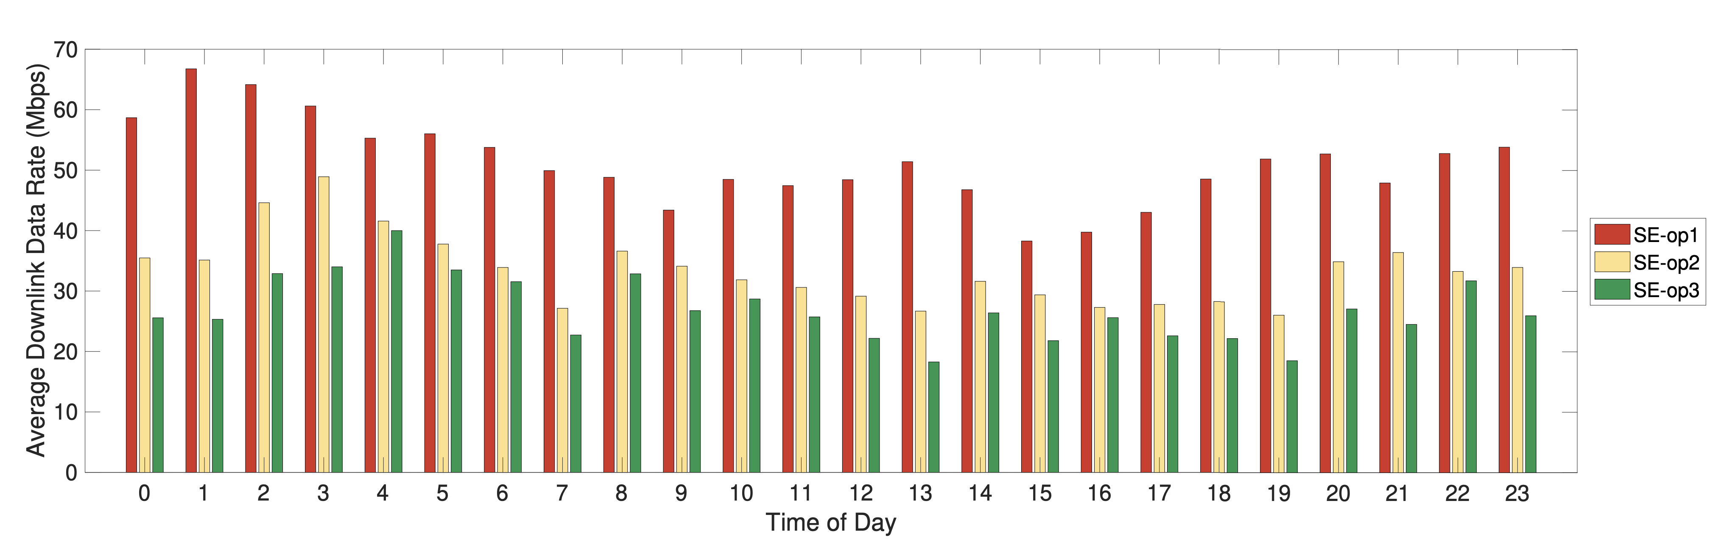
Hourly and Daily Patterns

Slide 5
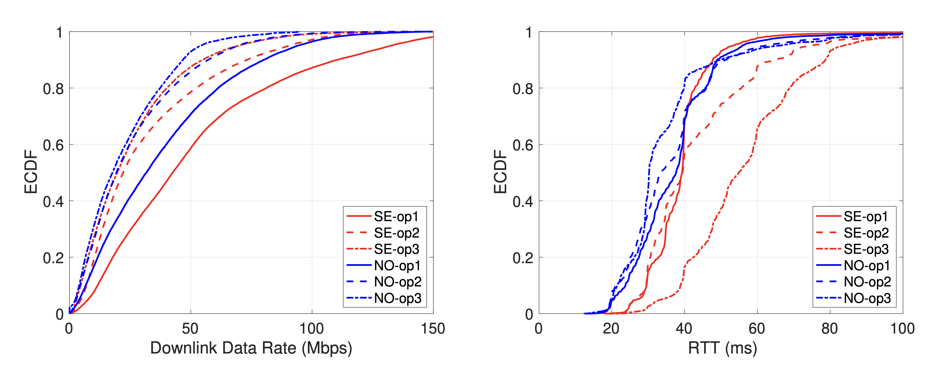
LTE performance: Data rate and RTT

Slide 6
Outline
Mobile Broadband Networks
  Performance
  International Roaming
  Operations
Massive IoT
  NB-IoT
  LORAWAN
Paving the future
  5G and Beyond

Slide 7
Free roaming in Europe

Slide 8
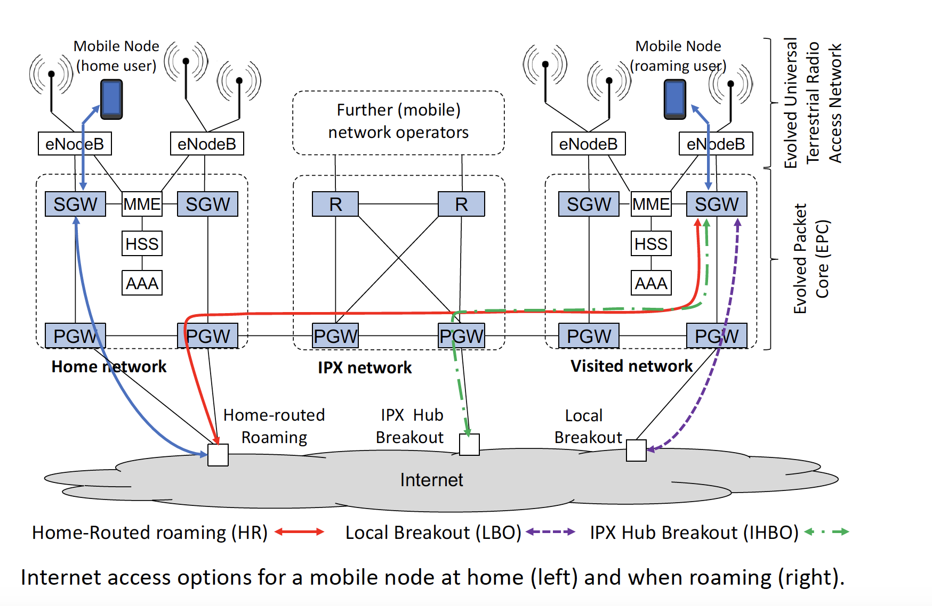
Roaming Infrastructure

Slide 9
Roaming Models
Home Routed (HR):
  The IP address of the roaming user is provided by the home network.
  All traffic to and from the mobile user is routed through the home network, for which a GTP tunnel is set up between the SGW of the visited network and the PGW of the home network (red path in the figure).
Local BreakOut (LBO):
  When LBO is used, the IP address of the roaming user is provided by the visited network.
  The GTP tunnel is terminated at the PGW of the visited network and IP-based services can be accessed directly from there (purple path in the figure).
IPX Hub Breakout (IHBO):
  The IP address of the roaming user is provided by the IPX network. The GTP tunnel from the SGW in the visited network terminates at a PGW in the IPX network (green path in the figure).
  There may be multiple PGWs so that latency and resource usage can be reduced by selecting one geographically close to the visited network.

Slide 10

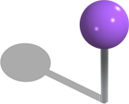
MONROE-Roaming Nodes
6 countries, 16 operators, each country has two nodes
One measurement server per country
Norway: Telia, Telenor
Sweden: Telenor, Tre, Telia
Spain: Orange, Vodafone, Movistar
Germany: Vodafone, O2, T-Mobile
UK: Vodafone, EE
Italy: Vodafone, TIM, WIND

Slide 11
Roaming Configuration
Home Routed (HR) Roaming was used by all 16 MNOs!
Why all traffic is sent back to home network?
  HR provides the home operators with all the accounting and billing information
  Operators want to have near real-time view of the customer traffic for accounting reasons
  More complex debugging if HR is not used, who is responsible if there is a problem?

Slide 12
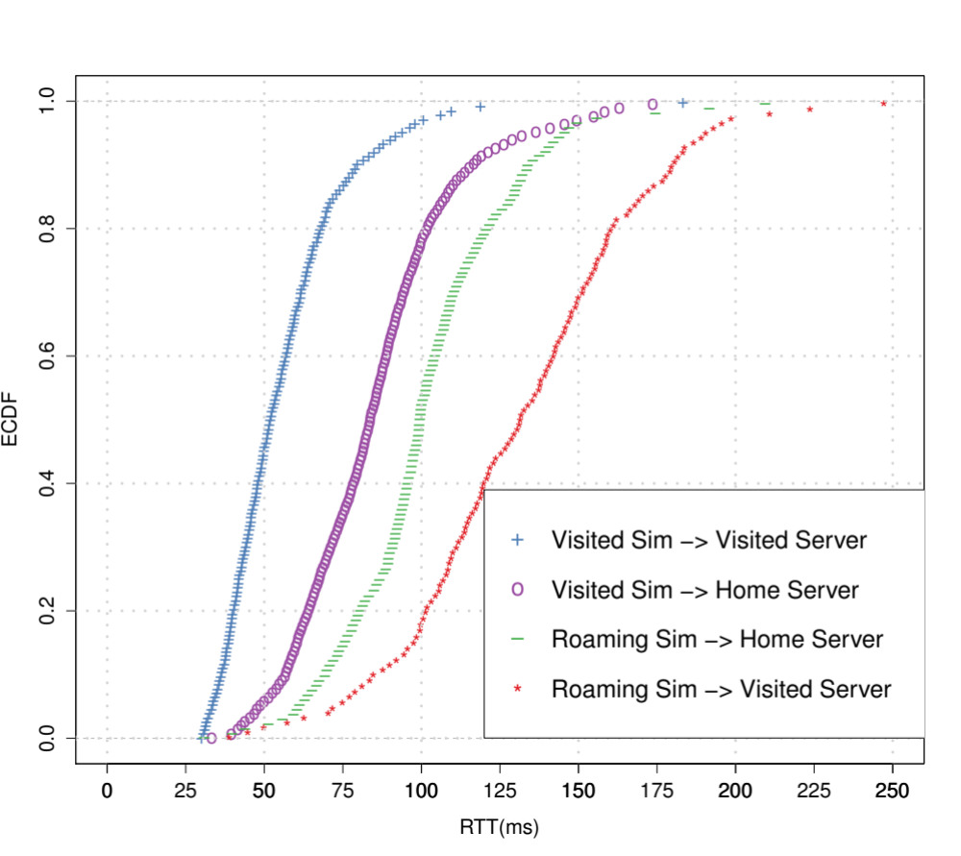
Delay penalty of home-routed roaming
Tunnel
vs
Internet
Packets go back and forth
Mimics LBO

Slide 13
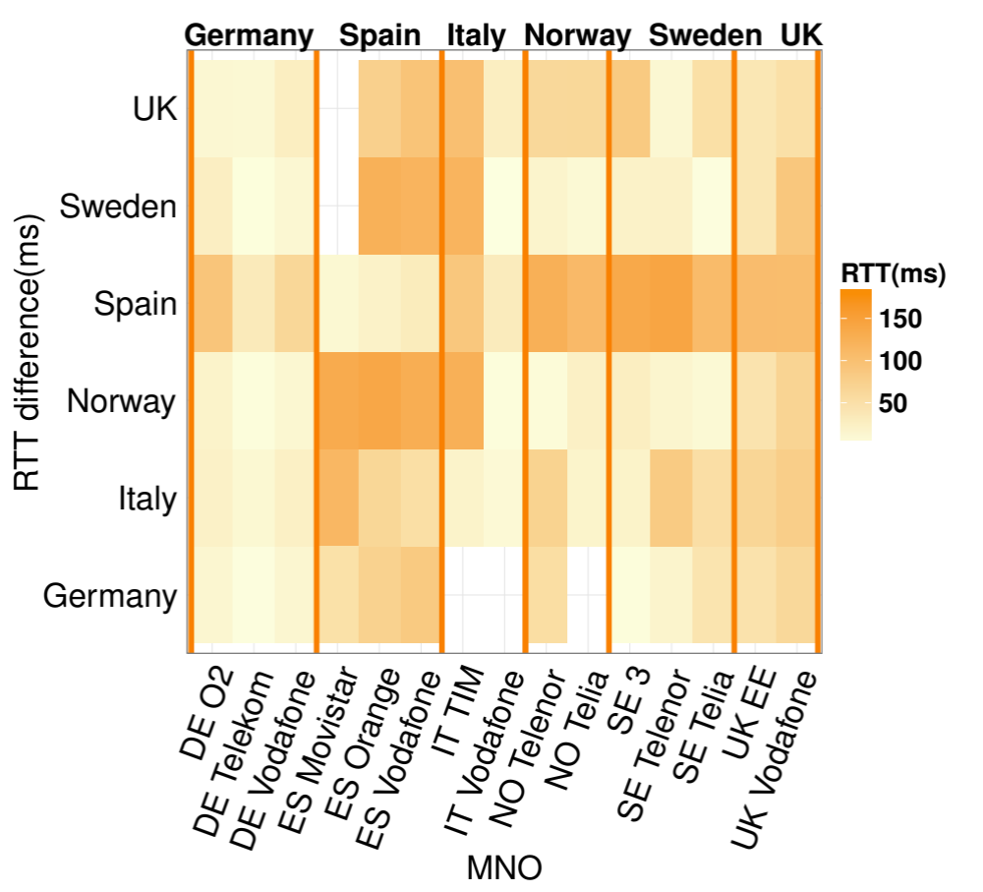
Delay penalty of home-routed roaming geographically
Germany is in a good position being in central Europe
South to North has the highest delays
RTT difference between the roaming SIM and the visited SIM

Slide 14
Outline
Mobile Broadband Networks
  Performance
  International Roaming
  Operations
Massive IoT
  NB-IoT
  LORAWAN
Paving the future
  5G and Beyond

Slide 15
Mobile Virtual Network Operators (MVNO)
MVNO is an entity that offers mobile network services to end-users, but does not own nor operate fully a cellular network. MVNOs lack of ownership of radio spectrum resources.
In order to operate, an MVNO needs to have agreements in place to access the network of at least one MNO.

Slide 16
MVNO Models
A "light" MVNO is a service provider that has its own customer support, marketing, sales and distribution operations, and has the ability to set its tariffs independently from the retail prices set by the host MNO.
The “full” MVNO have a core network implementation operating essentially the same technology as a mobile network operator, only missing their own radio network. They run their own core network and rely on at least one host MNO who can offer access to the radio resources.
Mobile Network Aggregator (MNA): Some full MVNOs exploit more than one single MNO, establishing the MNA operating model. Aggregating multiple MNOs allows the MNA's customers to dynamically change the MNO they are attached to based on the different factors, such as policy, coverage, performance, etc.

Slide 17
Outline
Mobile Broadband Networks
  International Roaming
Massive IoT
  NB-IoT
  LORAWAN
Paving the future
  5G and Beyond

Slide 18
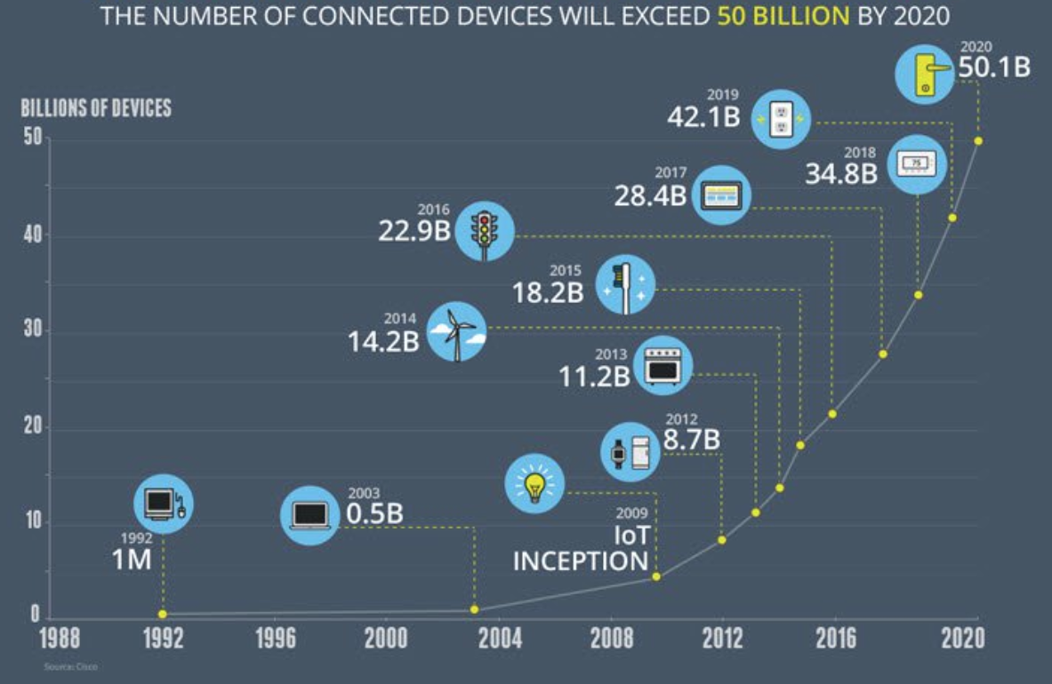
Growth in the number of connected devices

Slide 20
Key Challenges for Massive IoT
Battery life – many IoT devices will be battery-powered, and often the cost of replacing batteries in the field is not viable. (Battery life time of 10 years)
Coverage and Range – deep indoor connectivity is a requirement for many applications in the utility area. Regional (or even national or global) coverage is a prerequisite for many use cases, especially within the transport area. (5 –40 km in the open field)
Quality of Service – providing a certain low bitrate reliably is important for many applications while latency is not that critical. (Typically a few hundred bit/s or less)
Deployment and device cost – clearly a key enabler for high-volume, mass-market applications, enabling many of the use cases. Moreover, in order to enable a Massive IoT market, networks need to scale efficiently. (Device cost of a few Euros)

Slide 21
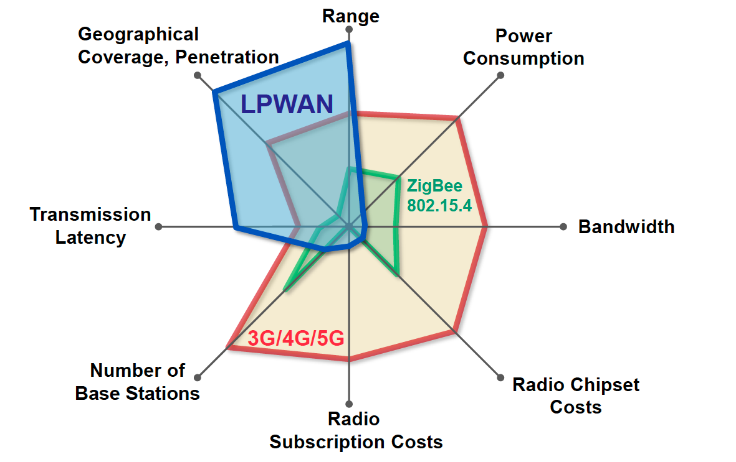
Low Power Wide Area Networks (LPWAN)

Slide 22

What is LORAWAN?
Low Power, Wide Area (LPWA) networking protocol for IoT
Provides bi-directional communication, end-to-end security, mobility and localization services
Open source standard
Unlicensed band (EU 868)
LORA Alliance (400+ industry partner)
The Things Network (TTN)*: “a global, crowdsourced, open, free and decentralized LoRaWAN IoT platform”
*https://www.thethingsnetwork.org/

Slide 23
LoRaWAN Architecture

Slide 24
LoRaWAN Specification
Spectrum | Unlicenced 863-870 MHz frequency bands (in Europe) 125/250 KHz channels
Modulation and Access | LoRa modulation (Chirp Spread Spectrum (CSS)) LORAWAN MAC (Aloha)
Data rate | 250bps-50kbps
UE Max Tx Power | 14 dBm
Range | 5 km (urban), 20 km (rural)
Energy Efficiency | Adaptive Data Rate (ADR)
Notes:
CSS used for Sonar and Radar

Slide 25
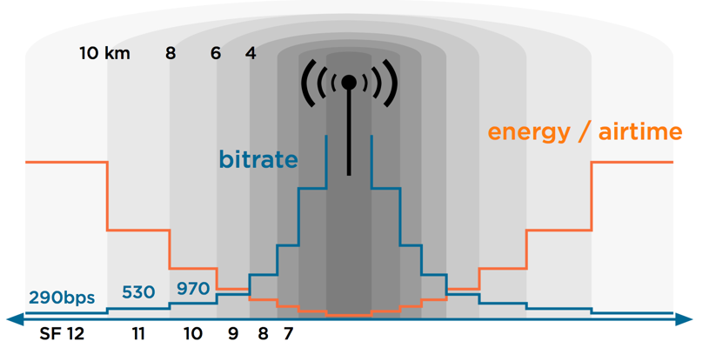
Adaptive Data Rate (ADR)
Adaptive Data Rate (ADR) is a mechanism for optimizing data rates, airtime and energy consumption in the network.
Spreading Factor (SF): is the duration of the chirp. LoRa operates with spread factors from 7 to 12. SF7 is the shortest time on air, SF12 will be the longest.
ADR triggers:
  SF increase (device-side): Improves message delivery in harsh radio conditions
  SF decrease (network-side): Improves data rate and power consumption

Slide 26
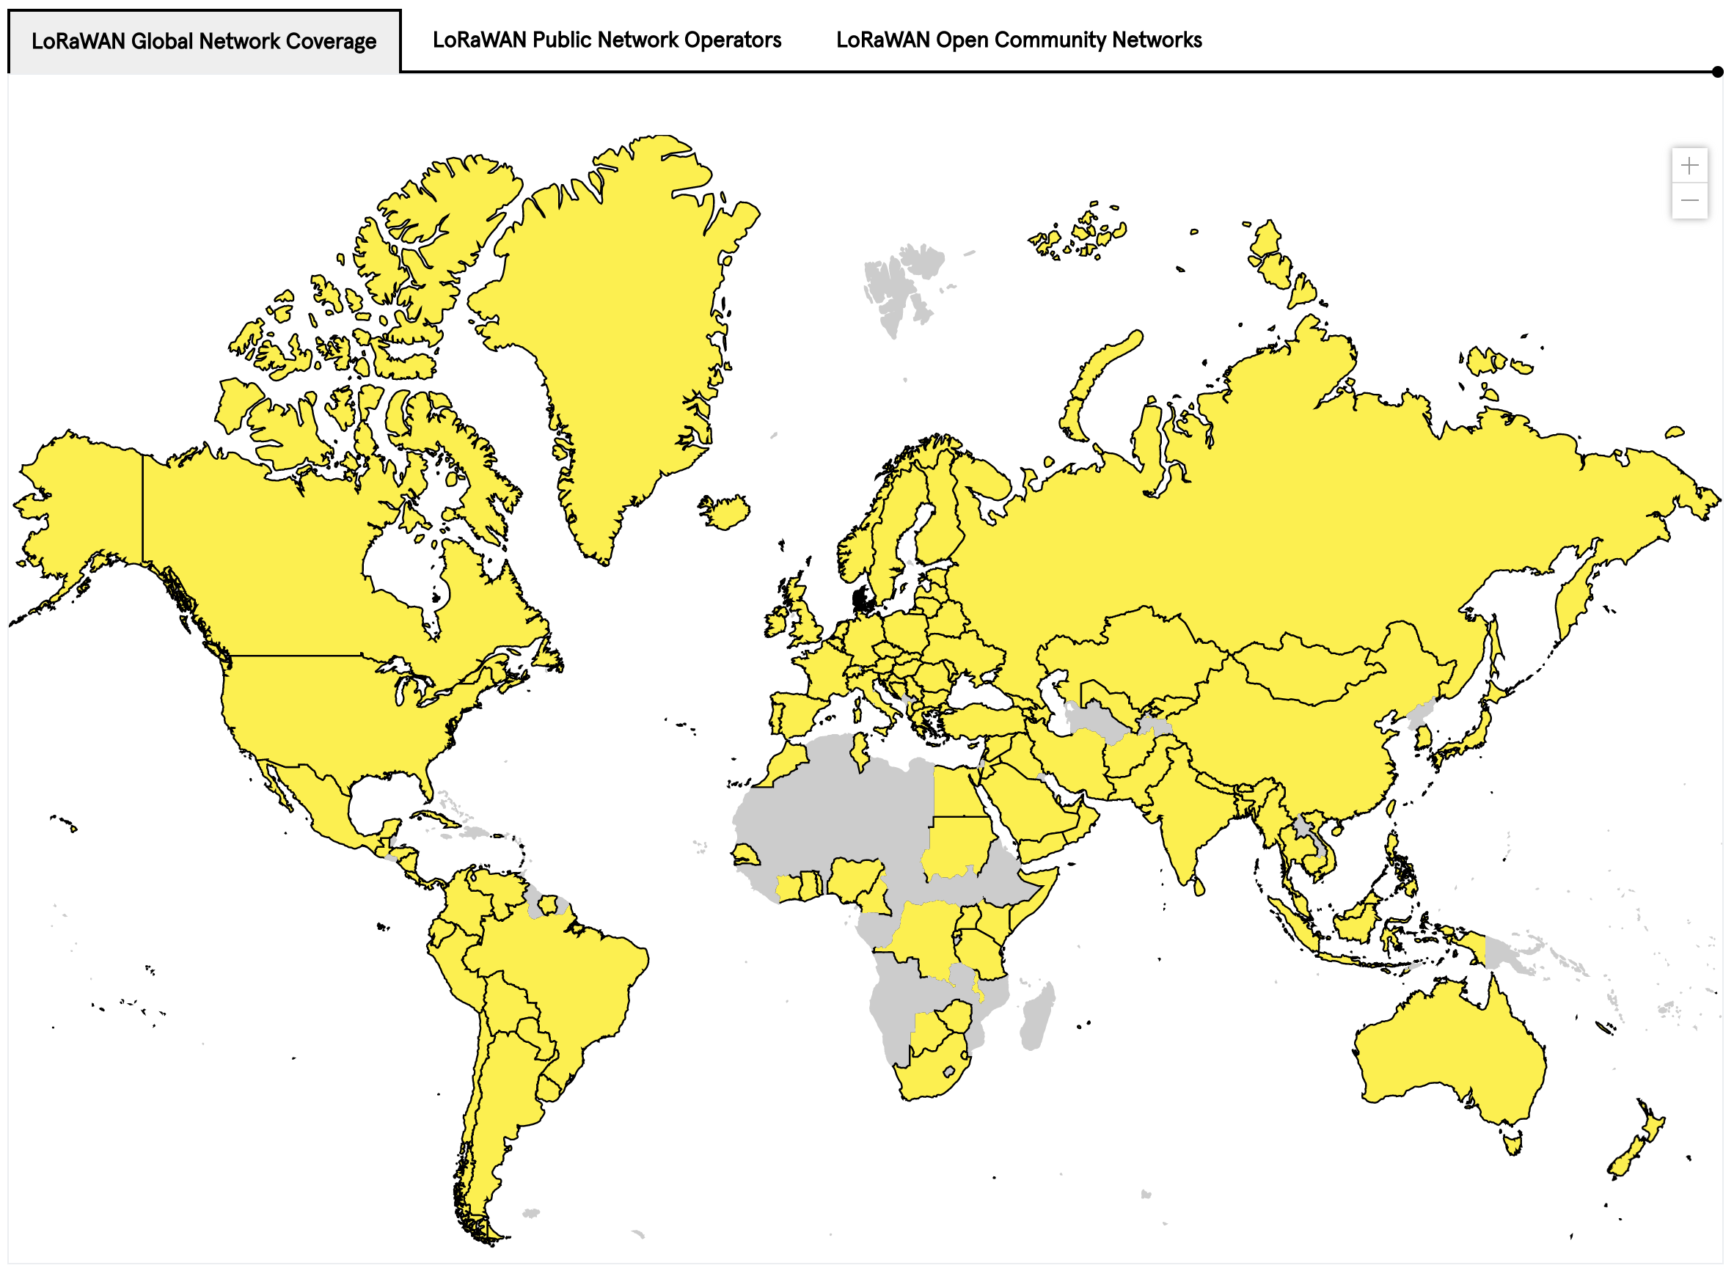
LORAWAN Network Coverage

Slide 27
What is NB-IoT?
LPWAN radio technology standard developed by 3GPP to meet IoT application requirements
Builds on the LTE ecosystem, and can be deployed as a simple addition of new software to existing LTE infrastructure
  leading to fast development, scalibility, and global roaming
Includes state-of-the-art LTE security
  Identity management
  Authentication and authorization (embedded SIM)
  End to end encription of device data and signalling
Future feature growth for MBB and NB-IoT use cases

Slide 28
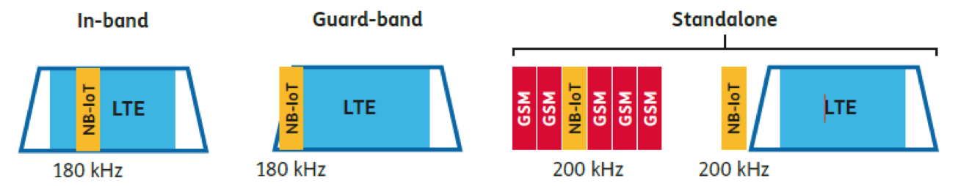
NB-IoT Specification
Spectrum Deployment
Modulation and Access | Modulation: BPSK/QPSK MAC: DL: OFDMA, UL: SC-FDMA
Peak data rate | DL: 250 kbps UL: 20 kbps
UE Max Tx Power | 23 dBm
Coverage enhancements | Power Spectral Density boost Repetitions
Range | 1 km (urban), 10 km (rural)
Energy Efficiency | Power Saving Mode (PSM) extended Discontinuous Reception (eDRx)
Rel-13

Slide 29
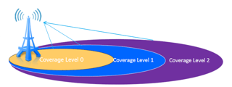
NB-IoT Coverage
Coverage Enhancement (CE) Techniques (w.r.t. LTE)
  Power Spectral Density boost: Tx power focused on smaller bands
  Repetitions: messages can be repeated up to 128 times
CE Level (CL) | # Repetitions
0 | [0-2]
1 | [4-16]
2 | [32-128]
CL0 = LTE coverage

Slide 30
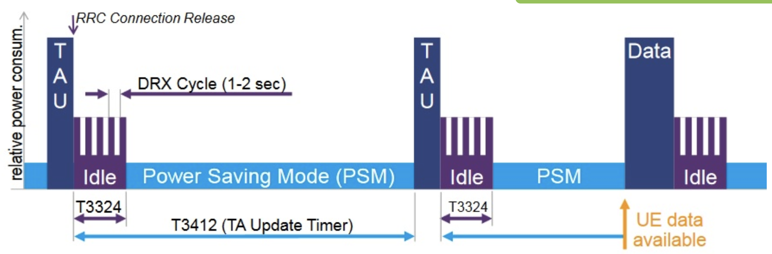
NB-IoT Power Savings
Power Saving Mode (PSM) is a power-off mode, in which the device nevertheless remains registered on the network
TAU: Tracking Area Update
RRC: Radio Resource Control
DRX: Discontinuous Reception

Slide 31
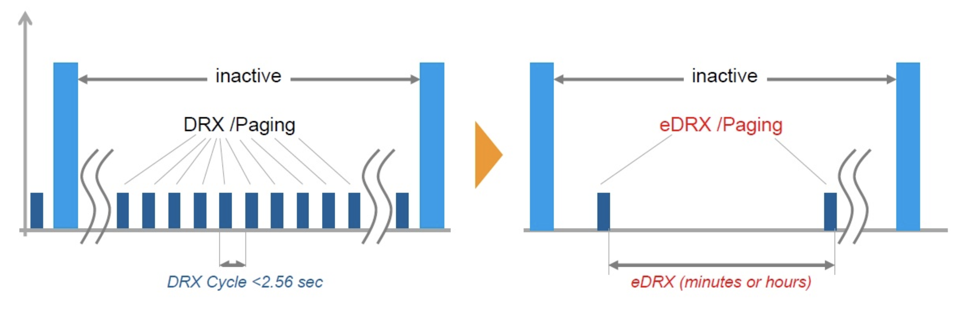
NB-IoT Power Savings
extended Discontinuous Reception (eDRx) mode allows you to significantly increase the period of time when the receiving path of the device is turned off.

Slide 32
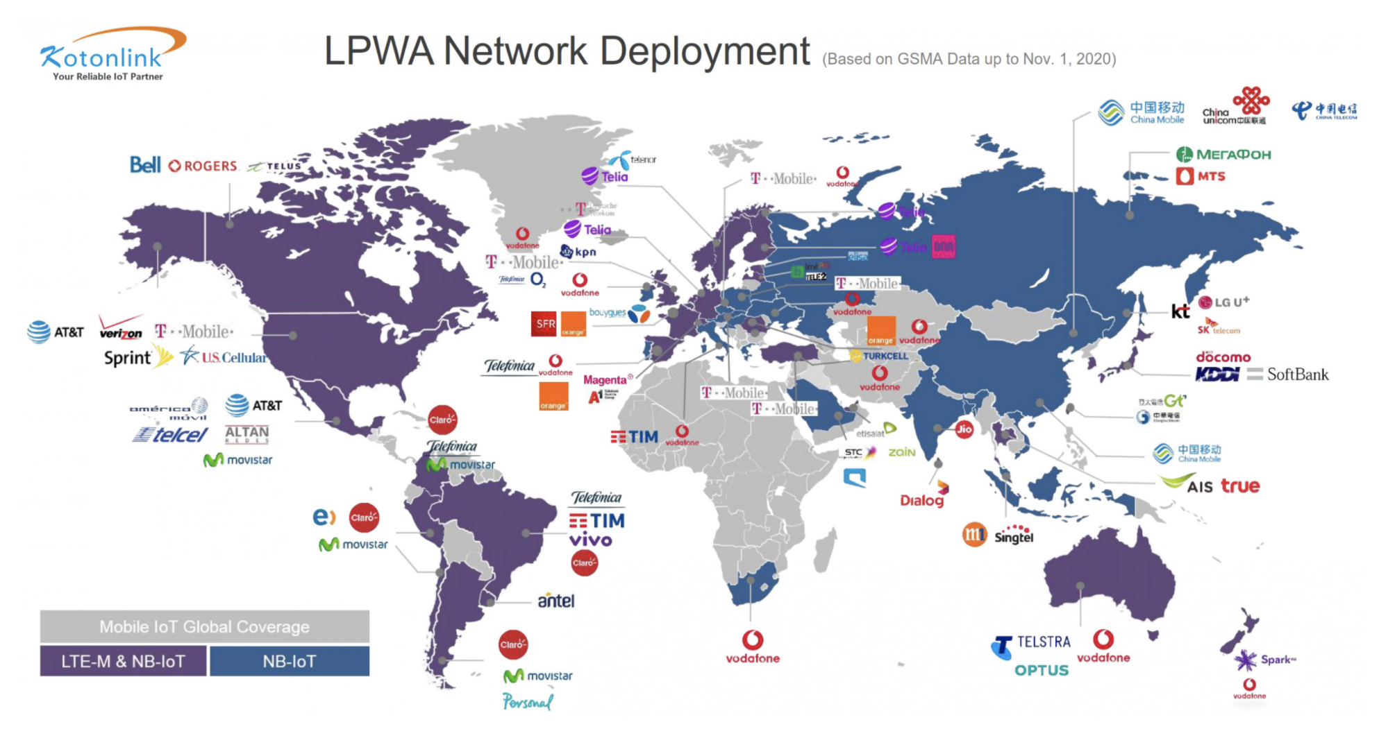
NB-IoT Deployment
*Source: https://www.kotonlink.com/NewsDetail/2434022.html

Slide 33
LORAWAN vs NB-IoT
Range and Penetration
Battery
Cost (deployment, spectrum, device)

Slide 34
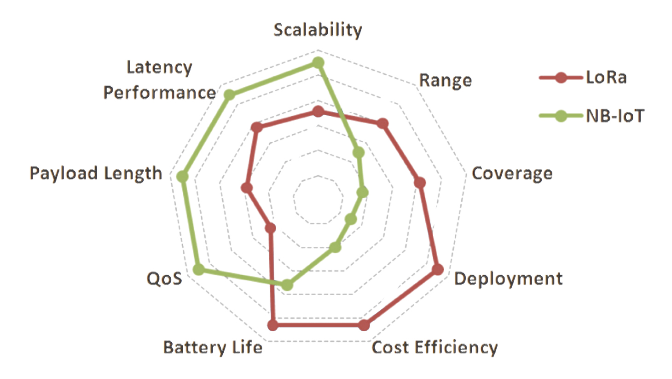
Overall LORAWAN vs NB-IoT

Slide 35
Outline
Mobile Broadband Networks
  International Roaming
Massive IoT
  NB-IoT
  LORAWAN
Paving the future
  5G and Beyond

Slide 36
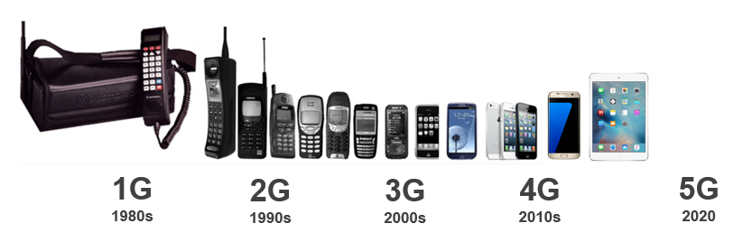
What is 5G?
5G is the 5th generation of mobile networks
Analogue
Digital
SMS
Multimedia
Video Calling
Mobile internet
Mobile Broadband
Enhanced Video
Mobile Connected World
Enhanced Mobile Broadband
Low latency applications
Internet of Things
Augmented and Virtual Reality (AR & VR)

Slide 37
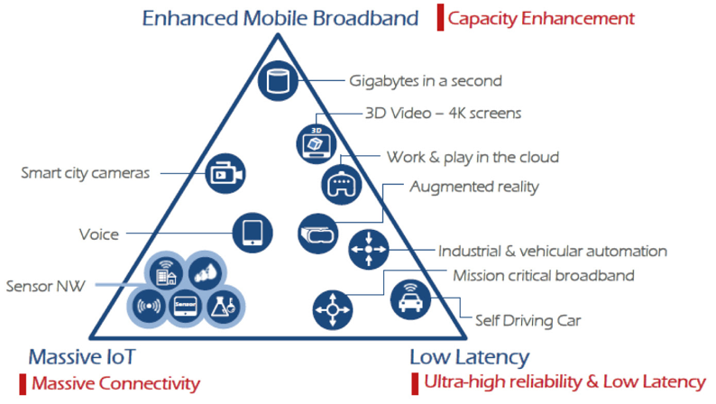
Different requirements for 5G applications and services

Slide 38
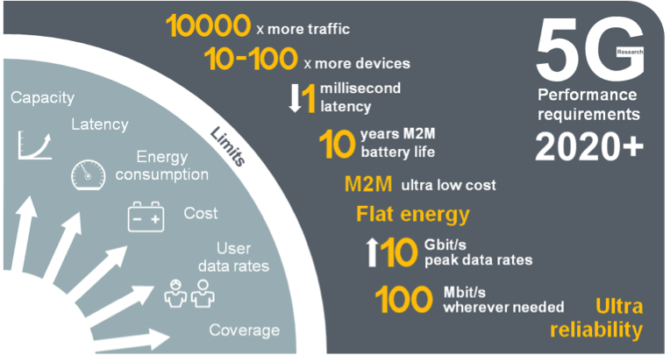
5G Mobile Network Expected Performance
Multi domain
performance
  Energy Performance
  Critical machine type
  of communications
  Global
  standard

Slide 39
Back in the day…

Slide 40
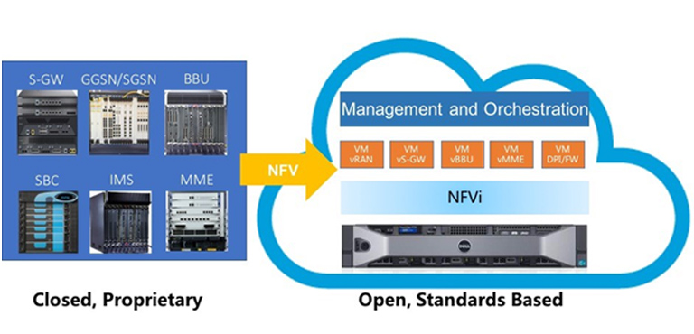
Network Flexibility: Virtualization

Slide 41
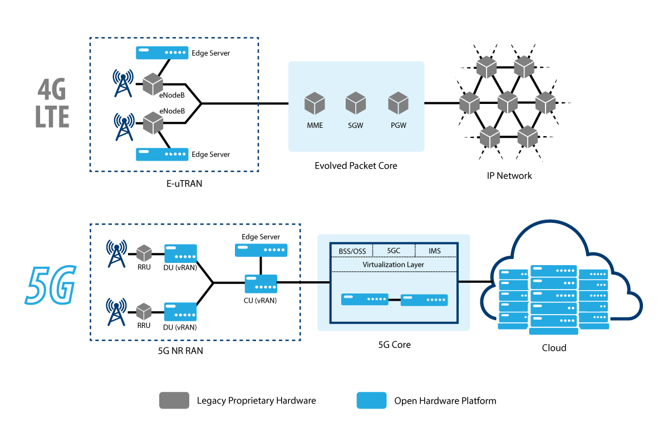

Slide 43
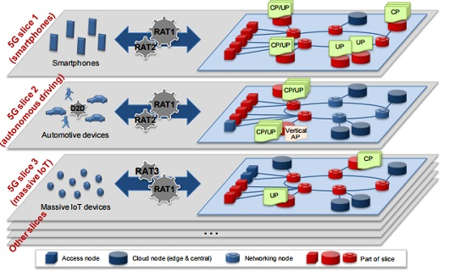
Network Slicing for diverse requirements

Slide 44
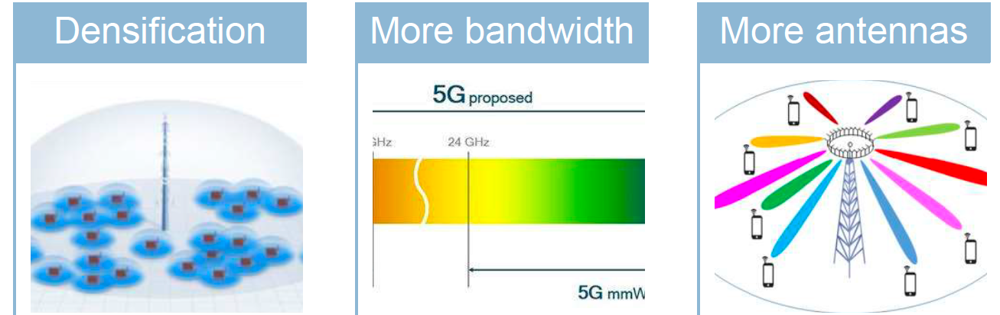
Capacity Enhancements
Small cells,
Relays, mobile
Relays and
Drones
new spectrum @ higher frequencies (above 6 GHz)
Massive MIMO
Spectrum sharing

Slide 45
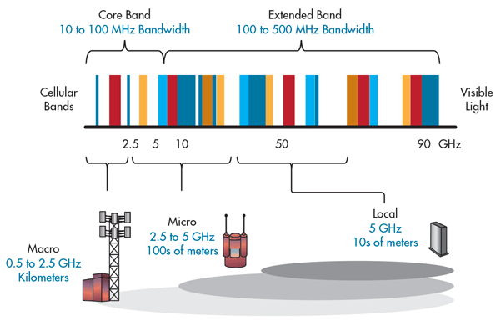
5G Bands and its impact on Cell size

Slide 46
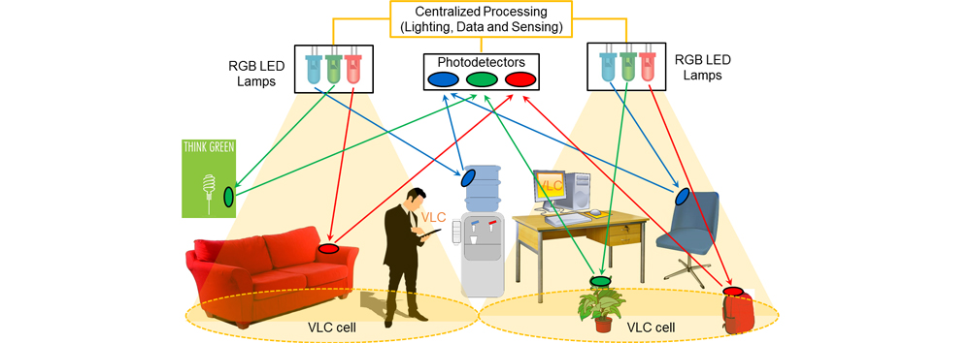
Visible Light Communications
https://attract-eu.com/showroom/project/vladimir/

Slide 47

Millimeter Wave Massive MIMO
B. Yang, Z. Yu, Y. Dong, J. Zhou and W. Hong, "Compact Tapered Slot Antenna Array for 5G Millimeter-Wave Massive MIMO Systems," in IEEE Transactions on Antennas and Propagation, vol. 65, no. 12, pp. 6721–6727, Dec. 2017.

Slide 48
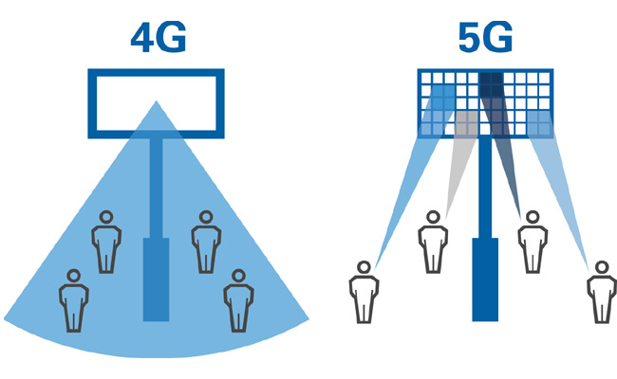
Multi-User MIMO Beamforming

Slide 49
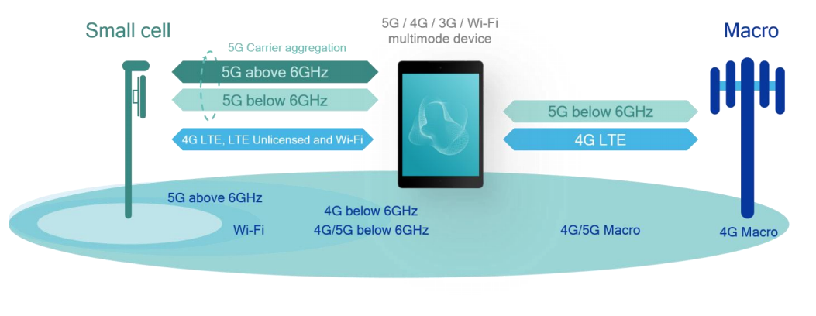
Spectrum Sharing: Multi-connectivity

Slide 50
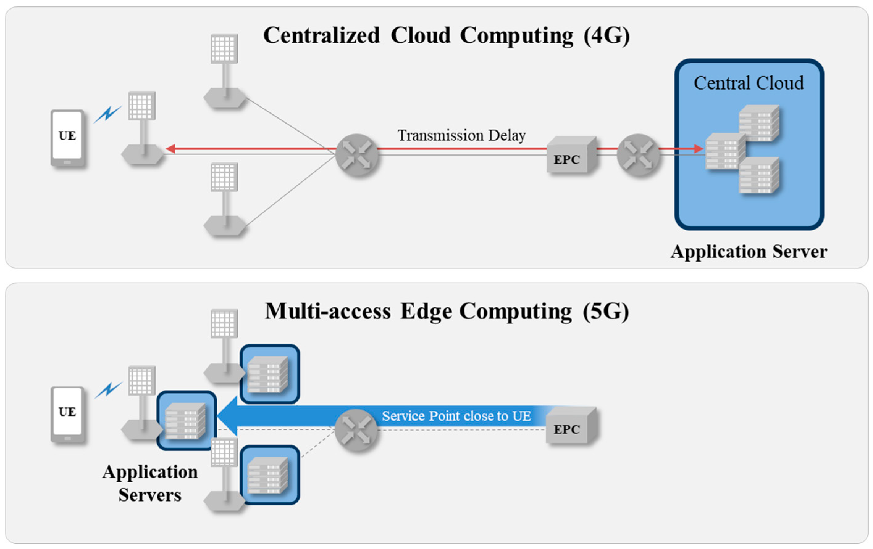
Ultra high reliability and Low Latency

Slide 51



From 4G to 5G Transition
Today – 4G Access
Device attaches to LTE/4G radio and Evolved Packet Core (EPC)
Early 5G – Non-Standalone
Device attaches to 5G-NR, which routes either via 4G Base Station to EPC, or direct to EPC
4G acts as control plane
5G Standalone
Device attaches to 5G-NR and 5G Core Network.
EPC
4G
5G-CN
5G

