Slide 1
Department of Informatics
Networks and Distributed Systems (ND) group
IN 3230 / IN 4230
Networking principles
Michael Welzl

Slide 2
University education
“When I took Electrical Engineering, I didn’t learn how Sony builds amplifiers, I learned Maxwell.“
- John Day, Boston University
Engineering training (job preparation):
ok to focus on what and how
  You’re going to use it, you must know how it works
University education: should explain why
  You’re going to design future systems, you need to understand why things are how they are, and what is good or bad about them

Slide 3
Next: communication principles
Several slides taken/adapted from John Day
For more details:
John Day, “Patterns in Network Architecture: A Return to Fundamentals”. Prentice Hall, 2007.
  First and foremost, a different way to think about layers
We start very simple and gradually build it

Slide 4
…but first: an OSI terminology reminder
PDU: Protocol Data Unit, SDU: Service Data Unit
Layer N+1
Layer N+1 PDU
Layer N
Layer N SDU
Layer N PDU
Common non-OSI terminology: header payload

Slide 5
Two application processes on one system
Application
Processes
A
B
Application
Flow
Port
Ids
IPC Facility
Inter Process Communication (IPC)
within a single system
The application should not be able to distinguish a slow local correspondent from operating over the network.

Slide 6
Two systems: how?
Application
Processes
Port
Ids
Distributed
IPC Facility
EFCP
EFCP
Communication over a network link: errors can occur
We need some sort of error and flow control protocol (EFCP)
  What are the functions this protocol needs?

Slide 7
Functions of a Protocol
Delimiting
Frag/Reassemb
Ordering
Data Corruption Detection
Data Corruption Detection/Correction – Making sure that the bits in the packet are correct (within some probability)
Delimiting – Packing SDUs into the User Data of PDUs and marking the boundaries of an SDU, so we can find them again
Fragmentation/Reassembly; Combining/Separation – Last step of Delimiting, creating User-Data fields of the PDUs
Ordering/Sequencing – Putting the PDUs in order, or putting sequence numbers on them for sending
Loss and Duplicate Detection – Detecting entire lost PDUs, or duplicates due to retransmission

Slide 8
Functions of a Protocol /2
State
Vector
Delimiting
Allocation
Synchronization
Frag/Reassemb
Ordering
Data Corruption Detection
Re-transmission
Control
Flow Control
Retransmission Control (Acknowledgement) – Recovering from lost PDUs.
Flow Control – Keeping the sender from overrunning the receiver, using either a Sliding Window or rate-based.
These two are feedback mechanisms, therefore we need:
Synchronization – Ensuring that the sender and receiver maintain consistent state relative to each other.
Allocation/Deallocation – Allocating/Deallocating ports and creating and terminating synchronization.

Slide 9
More than one application per system at the same time
Requires two new
capabilities
EFCP must be able
to distinguish one
flow from another
  Typically use the
  port-ids of the source and destination
EFCP
EFCP
EFCP
EFCP
EFCP
EFCP
Mux
Mux
Connection-id
Dest-port
Src-port
Op
Seq #
CRC
Data

Slide 10
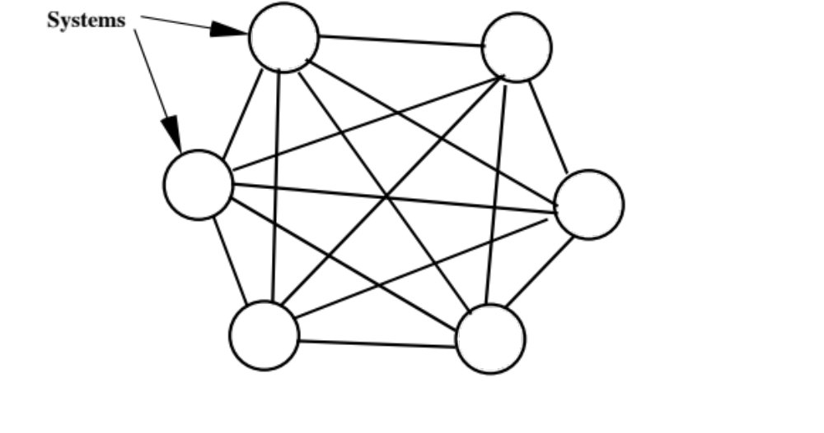
Communication with N systems

Slide 11
Communication with N systems /2:
A little re-organizing
A Virtual IPC Facility?
Res
Alloc
Finder
Dir
So we have a Distributed IPC Facility (DIF) for each interface, then to maintain the API we need an application over all of them.
  The user shouldn’t have to figure out which wire to use.
But this isn’t going to scale and get expensive fast. We need a cheaper way to do this.

Slide 12
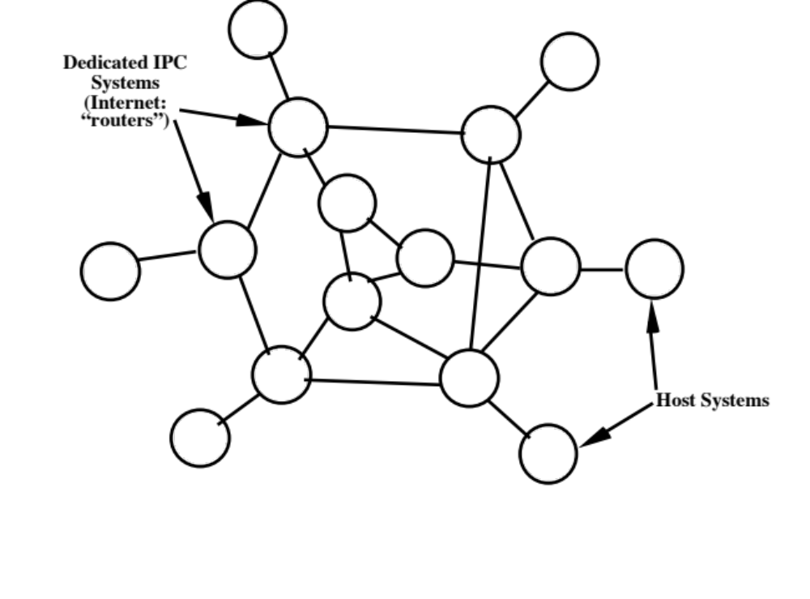
Communication with N systems /3
By dedicating systems to IPC, reduce the number of lines required and even out usage by recognizing that not everyone talks to everyone else the same amount.

Slide 13
Communication with N systems /4
Relaying systems over a wider scope requires carrying addresses
Creates more problems: e.g., can’t avoid transient congestion and bit errors in relay memories; what about message order? etc.
  Will have to have an EFCP operating over the relays
EFCP
EFCP
Dest Addr
Src Addr
Common Relaying and Multiplexing Application Header
Relaying
Application
Relaying
PM
Interface
IPC
Processes
Interface
IPC
Processes

Slide 14
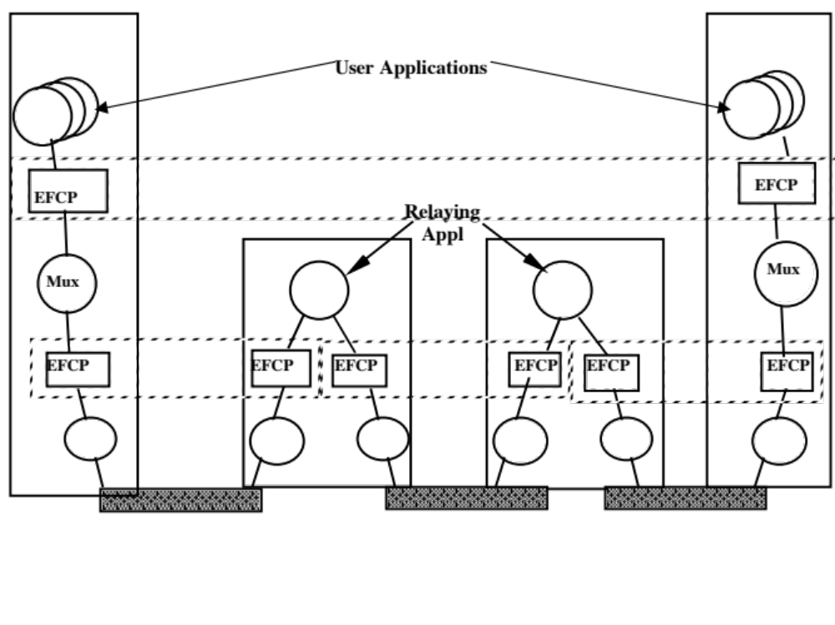
A recursive structure!
Distributed IPC Facilities

Slide 15
Implications
The essential role of layers is not to be a collection of a specific set of functions but instead to define a communication scope
  Different from what OSI and DoD models say!
Some essential functions exist at every layer, although they might be instantiated differently depending on the environment
  Even if the functions are exactly the same, it's not a repetition: they only occur once per scope
Layers can be stacked as needed, there should be no dependencies and there can always be the same interfaces between layers
“Cross-layer communication” is a hack that may be necessary when the vertical interfaces aren’t well enough defined

Slide 16
Layers
Networks have loci of distributed shared state with different scopes
At the very least, differences of scope require different layers
If layers have the same scope, their functions should be completely independent
Does this picture show the Internet?
Host or End System
Increasing
Scope
Router
Notes:
16

Slide 17
The Internet
Host or End System
Application layer
Transport layer
Network layer
Link layer
Physical layer
Router
What does the recursive structure tell us, what can we learn?
Next: examples
Notes:
17

Slide 18
Example problem: IP fragmentation
Dependencies between layers with the same scope
IP must get all fragments of a packet to reassemble
=> What if a fragment is lost?
  Early 70's: IP was split from TCP
  TCP’s retransmissions are distinct, not recognized by IP
  Must hold fragments for a long time, in vain => wastes buffer space
Fix: Path MTU Discovery (PMTUD)
  Disable fragmentation & find the largest possible packet that can be sent: start big, reduce size upon incoming ICMP error
  Actually this doesn’t work either: many nets filter ICMP
Solution: PAcketization Layer PMTUD (PLPMTUD)
  start small, assume ok when ACKs arrive
  ...can you see (layering) problems with this?

Slide 19
Developing flow + congestion control
S₁
R₁
A₁
DIF
A₂
Sender
Receiver
How fast can we send?
  Vertical interface should probably include a “rate”
  EFCP should implement flow control
Or something similar...e.g. a credit (window)

Slide 20
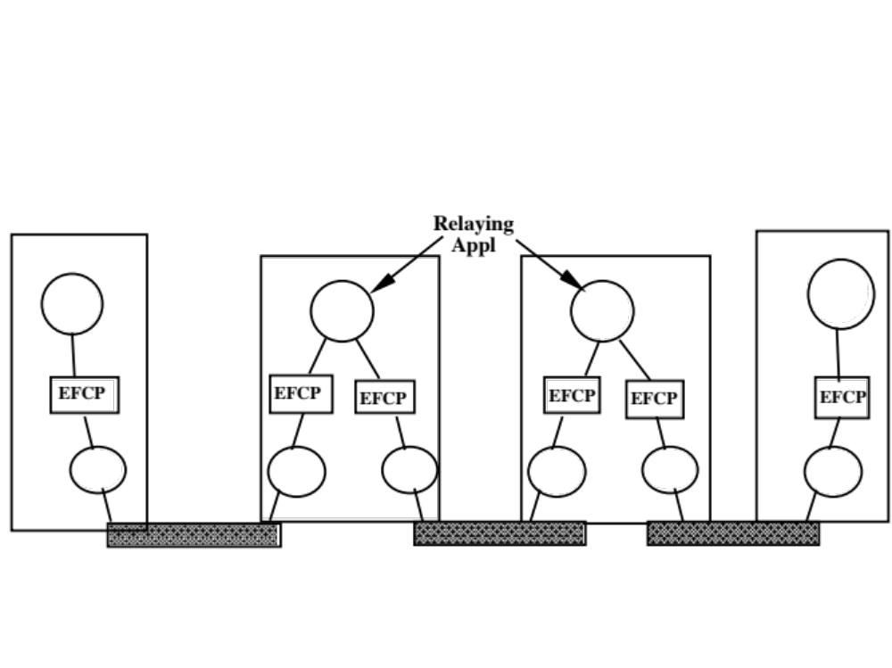
Developing flow + congestion control /2
How fast can we send?
  Vertical interface should probably include a “rate”
  EFCP should implement flow control

Slide 21
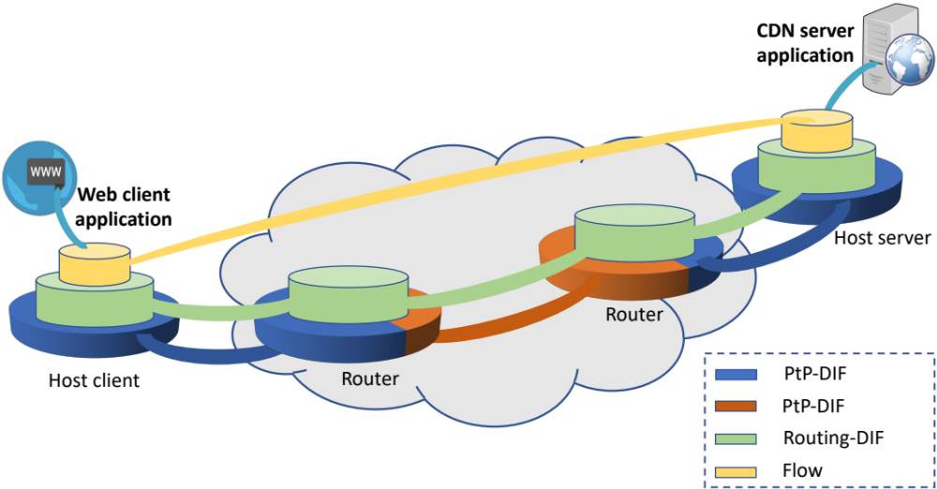
Developing flow + congestion control /3
Really: many hosts, many applications, …
How fast can we send?
  Vertical interface should probably include a “rate”
  EFCP should implement flow + congestion control !
  Probably at least in the green DIF, because this is where MUXing occurs (in hosts and routers)
  As we will see, Internet: really only in the yellow DIF…

Slide 22
Context switch: from RINA…
S
R
C₁
3-DIF
C₂
B₁
B₂
2-DIF
B₃
A₁
1-DIF
#1
A₂
A₁
1-DIF
#2
A₂
A₃
Sender
Relay 1
Relay 2
Receiver

Slide 23
… to the Internet
TCP etc. implement congestion control
Even here we don't easily learn "how fast" !
S
R
No info about speed; only queue management
C₁
Transport layer
C₂
Down/up: just buffers
B₁
B₂
Network layer
B₃
Down/up: just buffers
A₁
WiFi
A₂
A₁
Ether-
net
A₂
A₃
Sender
IP router
Ethernet switch
Receiver
MAC algorithms implement overload control
How fast can we send?
  Who’s deciding what, what are the interfaces?

Slide 24
E.g. Linux
Useful TCP "speed"
feedback: "low water mark"
  Patch with
  "TCP_NOTSENT_LOWAT"
  socket option, 2013
  Apple computers also offer this
L4
L3
From:
C. A. Grazia, N. Patriciello,
T. Høiland-Jørgensen,
M. Klapez, M. Casoni and
J. Mangues-Bafalluy,
"Adapting TCP Small Queues
for IEEE 802.11 Networks,"
PIMRC 2018, Bologna.
L2

Slide 25
Addresses
Host or End System
Increasing
Scope
Router
Network 1.
Addresses could be:
A, B, C, D, ...
Network 2.
Addresses could be:
1, 2, 3, 4, ...
Network 1 is completely unaware of addresses of type 1, 2, 3,..
  Networks and their addresses could dynamically be registered (attached)
  This is also more secure
Notes:
25

Slide 26

Internet addresses
Host or End System
Application layer
Transport layer
Network layer
Link layer
Physical layer
Router
No intermediate layer of smaller scope
  IP addresses are long, routers need to store a lot of information
Also, running out of addresses: IPv6 is the “solution”
Network Address (and Port) Translators (NA(P)Ts): more practical?
  Store mapping: “local IP address + TCP port ⬄ global IP address + TCP port”
  Problem because depends on transport protocol, inside the network... e.g., need to send keep-alives to keep state up
  Peer-to-peer communication, both peers behind NATs: how to talk?
  Complex solutions (STUN, TURN, ICE protocols)
Notes:
26

Slide 27
IP mobility
Long ago, I moved from Bogstadveien to Thorvald Meyers Gate
  I registered to have mail forwarded for a month for free
  (postens flyttehjelp)
  This gave me time to inform everyone about my new address
  (posten offers an easy service to do that)
  After this month, I had no more business with the old address
Imagine a world without addresses
  But where, instead, my name is Bogstadveien
  Moving: must use “postens flyttehjelp” forever!
How does the Internet solve this today?
  Multipath TCP (MPTCP): hosts share all their IP addresses with each other, can switch without interruption
  Applications should bind to names, not IP addresses
  (e.g., with the new Transport Services (TAPS) API)
or 129.240.118.130, for example...
Mobile IP does exactly this.

Slide 28
Routing
Host or End System
Increasing
Scope
Router
Network 1.
Addresses could be:
A, B, C, D, ...
How would one route between the addresses on network 1?
Next: an example with multi-homing and link failure
Notes:
28

Slide 29
Using node addresses
B
4
1
F
2
1
A
2
3
2
3
1
D
2
H
1
1
1
3
2
2
C
E
2
3
1
3
1
G
2
Since we want to emphasize that we are naming nodes, lets just use the letters for addresses. But we still have to say which wire to send them on.
  There are two cases in general:
    Point-to-point Wire: No need for lower layer addresses, use local identifiers.
    Multi-access wired or wireless: Here we need addresses, use MAC addresses.
  We have only wires, so lets assign small integers as the local interface identifiers.
Now lets say that A wants to send a packet to H, so it goes to DNS and looks up the address and gets H. Now these nodes have been running a routing algorithm and the route is A, B, D, F, H.
So what do the router tables look like? (see next slide)
Notes:
What is the first thing you notice about the routing tables?
They are much shorter. Previously we need 22 addresses, now we need 8. The more wires terminating on each node the more addresses we will need for interface addressing.
Remember point to point wires don’t need addresses so we can use local identifiers at each node to identify which wire we are sending it on. They don’t have to be unique.
So what happens when a PDU is sent?

Slide 30
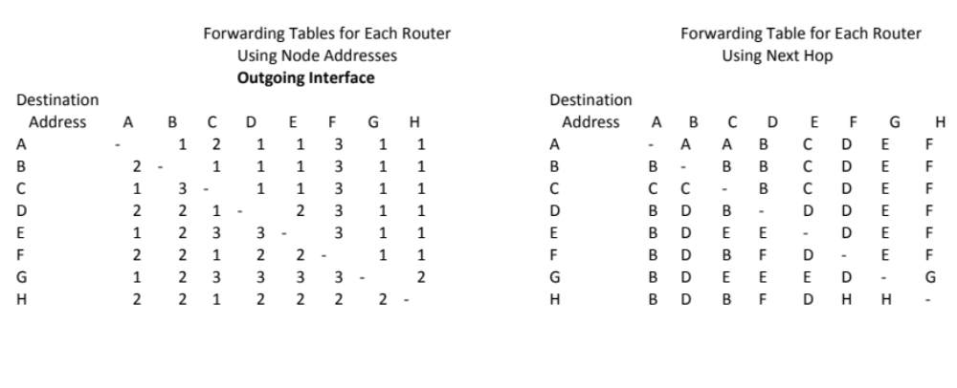

Slide 31
Sending a packet from A to H
4
1
2
1
B
F
2
3
2
2
3
1
A
D
H
1
1
1
3
2
2
2
C
E
3
1
3
G
1
2
A has a packet addressed to H:
  A consults its Forwarding Table and sends the packet on interface 2 to B.
  B consults its Forwarding Table and sends the packet on interface 2 to D.
  D consults its Forwarding Table and sends the packet on interface 2 to F.
  F consults its Forwarding Table and sends the packet on interface 2 to H.
Notes:
Sorry about that I didn’t intend for the interfaces to all turn out to have the same number! ;-) When I assigned them, I was trying to make sure it didn’t have the same number on both ends! ;-)

Slide 32
What happens when link F - H fails?
4
1
2
1
B
F
2
3
2
2
3
1
A
D
H
1
1
1
3
2
2
2
C
E
3
1
3
G
1
2
What happens if just after sending, the F-H link fails?
  In a few 10s of ms, a routing update is done, and a new routing table is generated.
  The packet gets to D after the routing update has concluded and is delivered to H as if nothing happened.
  Packets that might have been between B, D, and F might get re-routed. Only packets on the wire from F to H would be lost.
Notes:
Can you come up with the new Tables?

Slide 33
Internet routing
Host or End System
Application layer
Transport layer
Network layer
Link layer
Physical layer
Router
Always between IP addresses
What if a node has multiple interfaces ( = is multihomed) ?
  Need to use an IP address per interface to distinguish them
  Hence, IP address identifies the interface, not the node
Next: example, using “normal” letters and numbers for clarity
Notes:
33

Slide 34
Internet multihoming
22
B
8
13
F
11
1
3
7
15
14
20
9
A
D
H
2
6
19
18
10
4
C
17
E
16
21
5
G
12
Internet addresses name the interfaces. Let’s see what this does
Assume: A wants to send a packet to H, so it goes to DNS and looks up the address and gets 9. Now these nodes have been running a routing algorithm and the route is A, B, D, F, H.
So what do the router tables look like? (next slide)
Notes:
I used a very scientific algorithm. ;-) First I chose the path from A to H and pretended it was the optimal path chosen by a routing algorithm. Then for the forwarding tables, I assumed that even if it might be more hops, it was the preferred path. I also assumed nearest neighbors were always cheaper than going elsewhere (I think I did that). So if a Destination was more than one hop away but on the chosen path from A to H, I went to the nearest node on that path. That doesn’t really matter to what we are demonstrating.

Slide 35
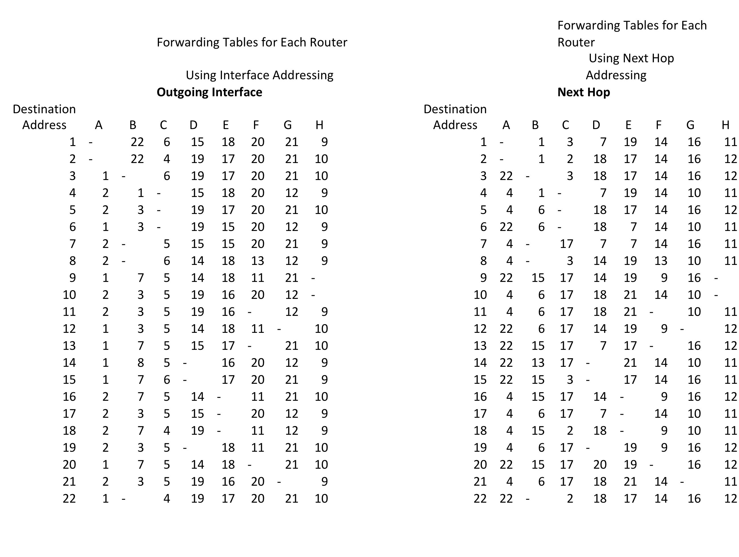

Slide 36
A packet is sent with destination address 9 from A
22
B
8
13
F
11
1
3
7
15
14
20
9
A
D
H
2
6
19
18
10
4
C
17
E
16
21
5
G
12
A consults its Forwarding Table and sends it on outgoing address 1, next hop 22.
B consults its FT and sends it on outgoing address 7, next hop 15.
D consults its FT and sends it on outgoing address 14, next hop 20.
F consults its FT and sends it on outgoing address 11, next hop 9.
Now another packet is sent from A to address 9, just after it leaves, the interface goes down.

Slide 37
What happens when link F - H fails?
22
B
8
13
F
11
1
3
7
15
14
20
9
A
D
H
2
6
19
18
10
4
C
17
E
16
21
5
G
12
What happens if the link with address 9 goes down?
  In a few 10s of ms, a routing update is done, and Addresses 9 and 11 are eliminated from the forwarding table.
  After several seconds and many retries, A determines that Address 9 is not responding,
  All TCP connections with Address 9 are terminated.
  All packets enroute to 9 are lost.
  Hopefully, there is a second DNS entry that lists H as also at Address 10.
  Connections are re-established using address 10. Several seconds have elapsed.

Slide 38
A modern Internet solution: MPTCP
B
8
13
F
11
1
22
3
7
15
14
20
9
A
D
H
2
6
19
18
10
4
C
17
E
16
21
5
G
12
A and H initially tell each other about all their addresses (A: 1, 2; H: 9, 10)
MPTCP subflows are established; number depends on path manager config.
  E.g. fullmesh: 4 subflows (1-9, 1-10, 2-9, 2-10)
  Then, normally: use all of them (schedule traffic, e.g. round-robin or preferring least-RTT path until cwnd full; “cautious” congestion control – be at most as aggressive as 1 TCP across a common bottleneck)
F-H link down: 1 subflow becomes unavailable, no TCP failure for application
This is done e.g. by iPhones since iOS 7
https://support.apple.com/en-us/HT201373

Slide 39
Architectural principles of the Internet
Yes, there are some...
Different from recursive principles laid out so far

Slide 40
Two important Internet rules
End-to-end ("e2e") argument
  Carefully consider trade-offs between implementing functions inside the network versus end systems
  Think twice before making the network do it
  No application-specific functionality in the network
  Frequently interpreted too strictly:
  "keep the network dumb, put all logic in end systems"
Postel's robustness principle: "Be conservative in what you send, be liberal in what you accept"
  Ensures downward compatibility (e.g. "reserved" bits)

Slide 41
.. and problems with them
E2E argument
  Devices in the network don’t seem to follow this…
  "Pervasive Monitoring is an Attack” [RFC 7258]
  Also: ossification: Middleboxes make assumptions, e.g. about TCP
  Solution: encrypt everything, end-to-end !
    Also protocol headers (QUIC)
    Visible header fields: “grease” them!
  Pure "e2e" restored; no more ossification; good?
  Also, no more control by ISPs... more control to Google?
Postel’s robustness principle
  Ignored “reserved” fields can be used as covert channels

Slide 42
Critical thinking, applied to common Internet views
NATs are evil.
IPv6 should be deployed everywhere.
  or... are NATs doing the right thing?
IP fragmentation is a bad idea
  or… does it just highlight a design flaw?
Middleboxes are bad
  Or… are we just missing interfaces to cleanly make them a part of the architecture?

Slide 43
A final note about recursive networking
Recursive InterNetwork Architecture (RINA)
  By John Day
  More material: http://pouzinsociety.org
Research prototypes exist, ... but various issues and unresolved questions
  Just saying “everything is wrong” does not automatically solve it...
  So, again: this was about a way of thinking

Slide 44
Thank you!
Questions?

