Slide 1
Department of Informatics
Networks and Distributed Systems (ND) group
IN3230/4230
Wireless Communications - II
Özgü Alay
ozgua@ifi.uio.no

Slide 2
Outline
Wireless Systems - Short Range
  Wifi
Mobile Broadband Networks
  Building Blocks
  Performance
  International Roaming
  Operations

Slide 3






Wireless LAN Architecture
wireless host communicates with access points (AP)
The owner of the AP becomes the operator
Basic Service Set (BSS) in infrastructure mode contains:
  wireless hosts
  access point (AP): base station
  ad hoc mode: hosts only
Internet
hub, switch
or router
BSS 1
BSS 2

Slide 4
802.11: Channels, association
spectrum divided into channels at different frequencies
  AP admin chooses frequency for AP
  interference possible: channel can be same as that chosen by neighboring AP!
arriving host: must associate with an AP
  scans channels, listening for beacon frames containing AP’s name (SSID) and MAC address
  selects AP to associate with
  then may perform authentication
  then typically run DHCP to get IP address in AP’s subnet
BSS

Slide 5


Wireless network characteristics (1)
Multiple wireless senders and receivers create additional problems (beyond multiple access):
A
B
C
A’s signal
strength
C’s signal
strength
space
Signal attenuation:
B, A hear each other
B, C hear each other
A, C can not hear each other interfering at B

Slide 6
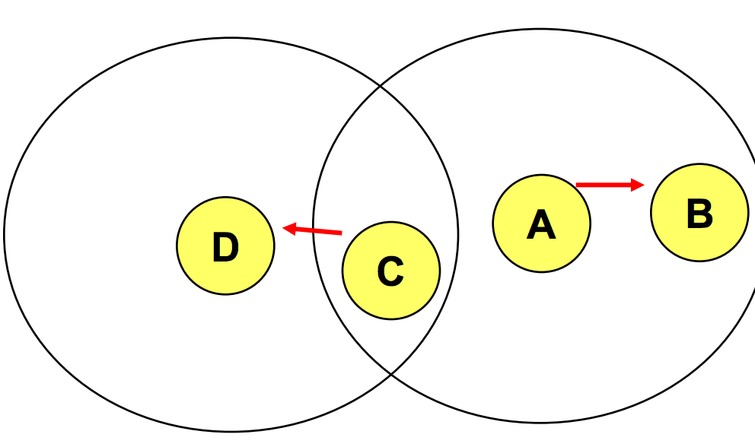
Wireless network characteristics (2)
Multiple wireless senders and receivers create additional problems (beyond multiple access):
C
B
A
Hidden terminal problem
B, A hear each other
B, C hear each other
A, C can not hear each other means A, C unaware of their interference at B
Exposed terminal problem
C wants to send D, A wants to send B
When A transmits to B, C waits
But D is outside of the range of A, so the wait is unnecessary

Slide 7
Carrier Sense Multiple Access (CSMA)
What happens if two senders do this?
Listen Before Talk (LBT):
  channel idle: transmit entire frame
  channel busy: defer transmission
    1-Persistent CSMA: retry immediately when channel becomes idle
    P-Persistent CSMA: retry immediately with probability p when channel becomes idle
    Non-persistent CSMA: retry after random interval
Human analogy: don’t interrupt others!
  Politicians are sometimes 1-Persistent…
Collisions
  sender 1 may not immediately see 2’s transmission (propagation delay)
  entire frame transmision time wasted

Slide 8
Avoiding collisions
Idea: allow sender to “reserve” channel rather than random access of data frames: avoid collisions of long data frames
sender first transmits small request-to-send (RTS) packets to BS using CSMA
  RTSs may still collide with each other (but they’re short)
BS broadcasts clear-to-send CTS in response to RTS
CTS heard by all nodes
  sender transmits data frame
  other stations defer transmissions
avoid data frame collisions completely
using small reservation packets!

Slide 9


Collision Avoidance: RTS-CTS exchange
A
B
AP
RTS(B)
RTS(A)
reservation collision
RTS(A)
CTS(A)
CTS(A)
DATA (A)
defer
time
ACK(A)
ACK(A)

Slide 10
802.11: advanced capabilities
Rate adaptation
base station, mobile dynamically change transmission rate (physical layer modulation technique) as mobile moves, SNR varies
10⁻¹
10⁻²
BER
10⁻³
10⁻⁴
10⁻⁵
10⁻⁶
10⁻⁷
10
20
30
40
SNR(dB)
1. SNR decreases, BER increase as node moves away from base station
QAM256 (8 Mbps)
QAM16 (4 Mbps)
BPSK (1 Mbps)
operating point
2. When BER becomes too high, switch to lower transmission rate but with lower BER

Slide 11
IEEE 802.11 Wireless LAN
802.11b
  2.4 GHz range
  up to 11 Mbps
802.11a
  5 GHz range
  up to 54 Mbps
802.11g
  2.4 GHz range
  up to 54 Mbps
802.11n: MIMO
  2.4/5 GHz range
  up to 600 Mbps
802.11ac: MU-MIMO
  5 GHz range
  up to 3.2 Gbps
802.11ad: mmWave
  2,4/5/60 GHz range
  up to 7 Gbps

Slide 12
Recap on different Types of MIMO
Space Time Transmit Diversity (STTD) - The same data is coded and transmitted through different antennas, which effectively doubles the power in the channel. This improves Signal Noise Ratio (SNR) for cell edge performance.
Spatial Multiplexing (SM) - SM delivers parallel streams of data by exploiting multi-path. It can double (2x2 MIMO) or quadruple (4x4) capacity and throughput. SM gives higher capacity when RF conditions are favorable and users are closer to the base station.

Slide 13

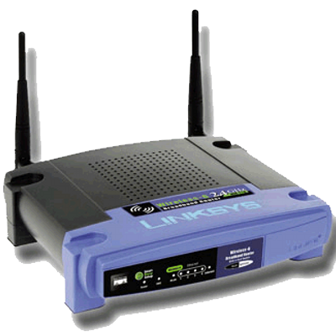
802.11n MIMO
The 802.11n standard enables spatial multiplexing, improving data rates and link robustness
Transmission to each of them sequentially—underutilizing the spatial resources available at the access point.

Slide 14
Recap on MIMO Beamforming
Beamforming is a signal processing technique used for directional signal transmission or reception.
Elements of an antenna array is combined in such a way that signals at particular angles experience constructive interference while others experience destructive interference.

Slide 15

Beamforming and Steering

Slide 16




802.11ac MIMO Beamforming
We can increase the link SNR by coherently beamforming with the antennas at the base station
Still limited to communications with one station at a time on a small number of spatial streams, resulting in an underutilization of spatial resources.

Slide 17
802.11ac Multi-User MIMO
Multi-user beamforming allows full utilization of available spatial resources by allowing simultaneous transmissions to multiple stations on the same channel.
And while fantastic, the increased spectral efficiency doesn’t come for free….
MU-MIMO Beamforming

Slide 18


How does mmWave work?
Most wireless operates in this range
Millimeter Wave Bands
0
10GHz
20GHz
30GHz
40GHz
50GHz
60GHz
70GHz
80GHZ
90GHz
100GHz
Frequency Spectrum
mmWave: High attenuation -> beamforming
Challenge: Beam alignment
Client
AP

Slide 19
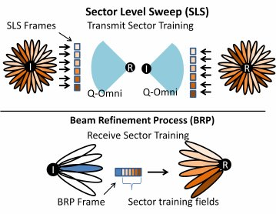
802.11ad mmWave
Beamforming Training in 802.11ad

Slide 20
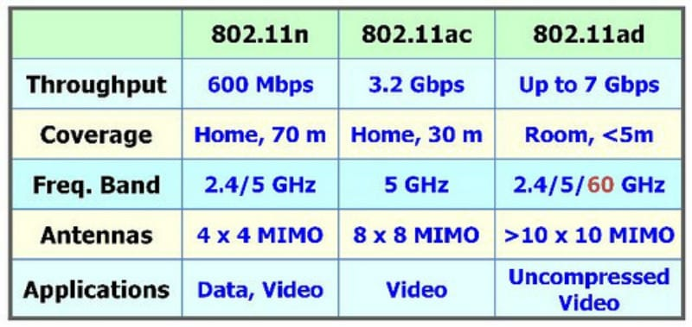
Summary of new 802.11 technologies

Slide 21
Outline
Wireless Systems - Short Range
  Wifi
Mobile Broadband Networks
  Building Blocks
  Performance
  International Roaming
  Operations

Slide 22

Mobile Broadband (MBB) Networks
Mobile cellular networks (e.g. 3G/4G)
  Underpins a lot of vital operations of the modern society
    Extended coverage
    Mobility
    Security

Slide 23
Mobile Broadband Networks
similarities to wired Internet
edge/core distinction, but both below to same carrier
global cellular network: a network of networks
widespread use of protocols we’ve studied: HTTP, DNS, TCP, UDP, IP, NAT, separation of data/control planes, SDN, Ethernet, tunneling
interconnected to wired Internet
differences from wired Internet
different wireless link layer
mobility as a 1st class service
user “identity” (via SIM card)
business model: users subscribe to a cellular provider
  strong notion of “home network” versus roaming on visited nets
  global access, with authentication infrastructure, and inter-carrier settlements

Slide 24
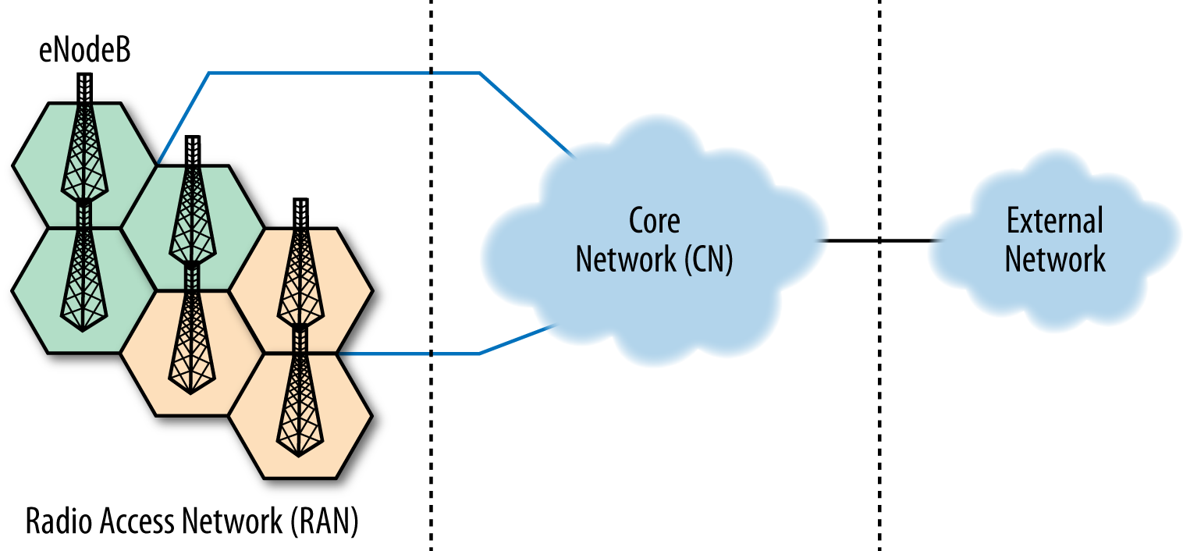
Macro View
Building Blocks of MBB Networks
  Radio Access Network
  Core Network

Slide 25
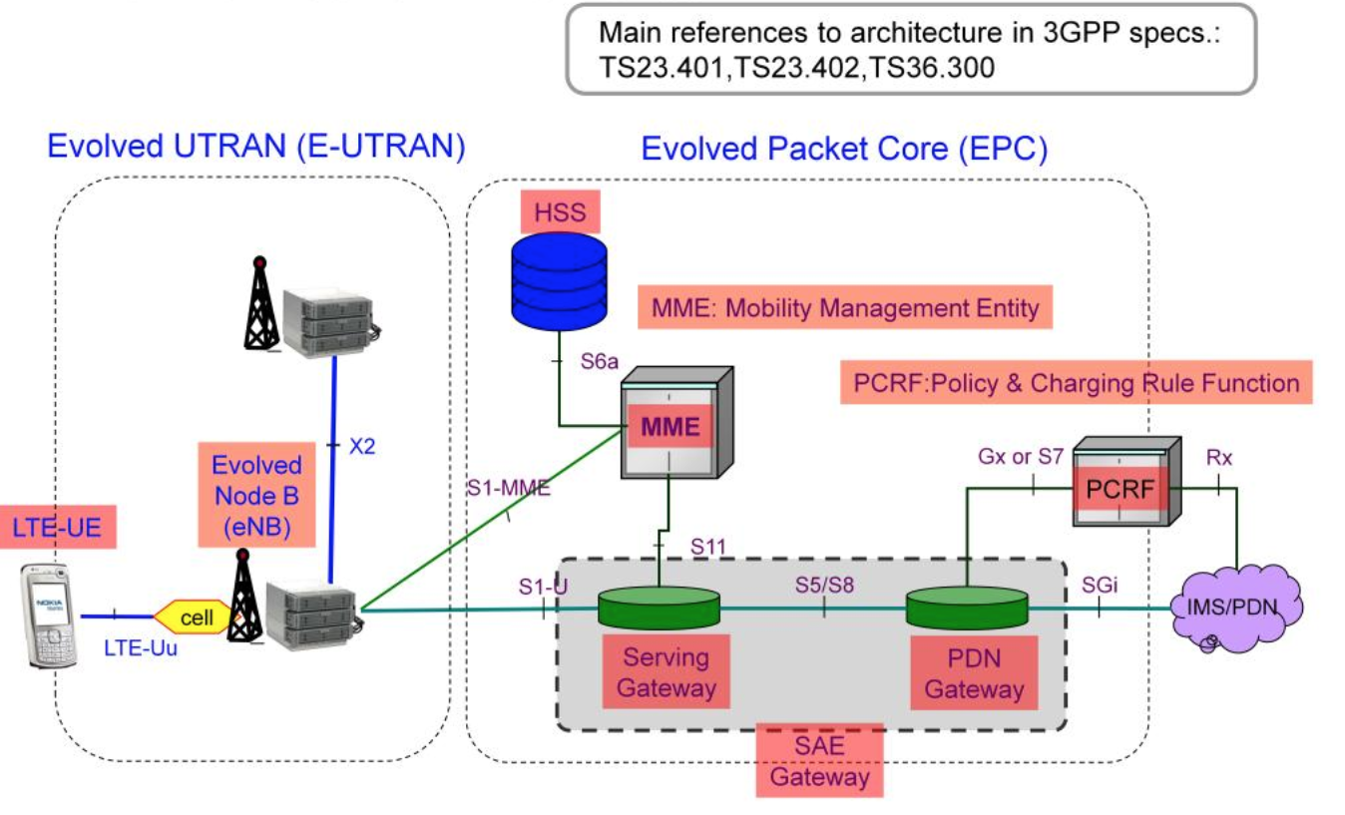
Closer look to LTE

Slide 26
Closer look to LTE
User and mobility management
Dynamic Air Interface Resource Allocation (Scheduler)
Interference management among base stations

Slide 27
Closer look to LTE
Handover management if target eNodeB is reachable
Inter-cell interference coordination

Slide 28
Closer look to LTE
Central database that contains the subscription related about all the network operators
Performs authentication and authorization of the user
Provides information about the subscriber’s location and IP

Slide 29
Closer look to LTE
Mobility Management: One of the most complex functions MME performs. Providing seamless inter-working has multiple use cases such as Inter-eNB and Inter-RAT, among others.
Radio Resource Management: MME works with the HSS and the RAN to decide the appropriate radio resource management strategy (RRM) that can be UE-specific.
UE Reachability: MME manages communication with the UE and HSS to provide UE reachability and activity-related information.

Slide 30
Closer look to LTE
Roaming Management: MME supports outbound and inbound roaming subscribers from other LTE/EPC systems and legacy networks.
Lawful Intercept: Since MME manages the control plane of the network, MME can provide the whereabouts of a UE to a law enforcement monitoring facility.

Slide 31
Closer look to LTE
Acts like a high level router: Routes and forwards data packets from eNodeBs to PDN-GW

Slide 32
Closer look to LTE
Point of exit and entry with the outside world
  policy enforcement
  packet filtering and screening per user
  lawful Interception

Slide 33
Closer look to LTE
Differentiation of subscribers and services
Charge subscribers based on their volume of usage or QoS guarantees
Limit app usage while a user is roaming
Throttle subscribers using heavy-bandwidth apps during peak usage times

Slide 34
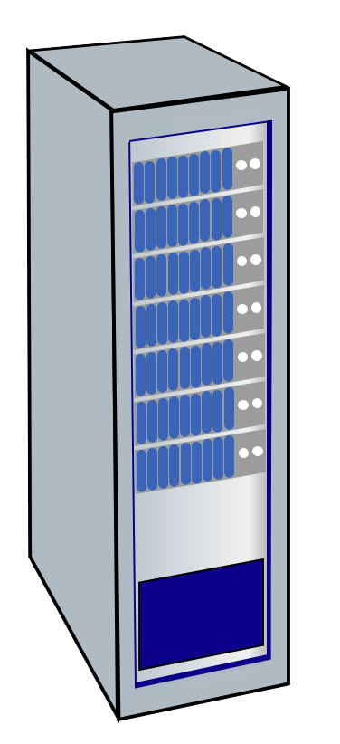


LTE: data plane control plane separation
HSS
control plane
new protocols for mobility management , security, authentication
base station
P-GW
MME
S-GW
data plane
new protocols at link, physical layers
base station
S-GW
P-GW
extensive use of tunneling to facilitate mobility
IP tunnels

Slide 35
LTE data plane: associating with a BS
1
2
3
data
plane
base station
S-GW
P-GW
1
BS broadcasts primary synch signal every 5 ms on all frequencies
BSs from multiple carriers may be broadcasting synch signals
2
mobile finds a primary synch signal, then locates 2nd synch signal on this freq.
mobile then finds info broadcast by BS: channel bandwidth, configurations; BS’s cellular carrier info
mobile may get info from multiple base stations, multiple cellular networks
3
mobile selects which BS to associate with (e.g., preference for home carrier)

Slide 36


A Simplified Data Flow with 4G…(1/2)
Herewith the IP Addresses
Reference :
TS 29.281
TS 23.401
TS 29.274
Attach request..
Herewith the info
5
1
3
HSS
DNS
MS
eNodeB
Get info for this subscriber
What is the S-GW IP Address ?
What is the P-GW IP Address ?
S1
2
4
I am attached to the network and want to browse to www.google.com
MME
Create Session Request with IP Address of S-GW and P-GW
S1u
6
Packet Data Network
e..g Internet
S11
11
Create Session Request response (Accept)
S-GW
P-GW
10
SGi
S5/S8
8
Create Session Request with IP Address of P-GW
7
Create Session Request response (Accept)
Create Session Request response (Accept)
9

Slide 37
A Simplified Data Flow with 4G… (2/2)
Reference :
TS 29.281
TS 23.401
TS 29.274
HSS
DNS
MS
eNodeB
S1
I am attached to the network and want to browse to www.google.com
MME
S1u
Packet Data Network
e..g Internet
S11
11
12
S-GW
P-GW
S5/S8
SGi
13
Internet DNS

Slide 38
What defines the mobile operator performance?
Deployment
Configuration
Subscription
Number of users
Mobility
How do we define mobile performance?

Slide 39
Outline
Wireless Systems - Short Range
  Wifi
Mobile Broadband Networks
  Building Blocks
  Performance
  International Roaming
  Operations

Slide 40
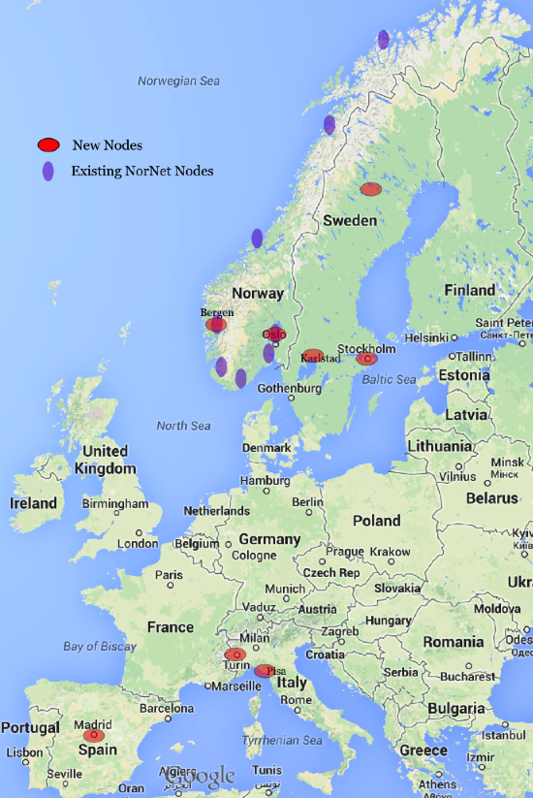
MONROE – Mobile Broadband Measurement Platform
Coverage in 4 European Countries (Norway, Sweden, Spain, Italy)
A set of 100 nodes equipped with Ethernet, WiFi and 4G interfaces with commercial MBB subscriptions.
Under mobility (e.g., on-board of trains or buses) or in stationary scenarios (e.g., in laboratories, or hosted by volunteers in homes).

Slide 41
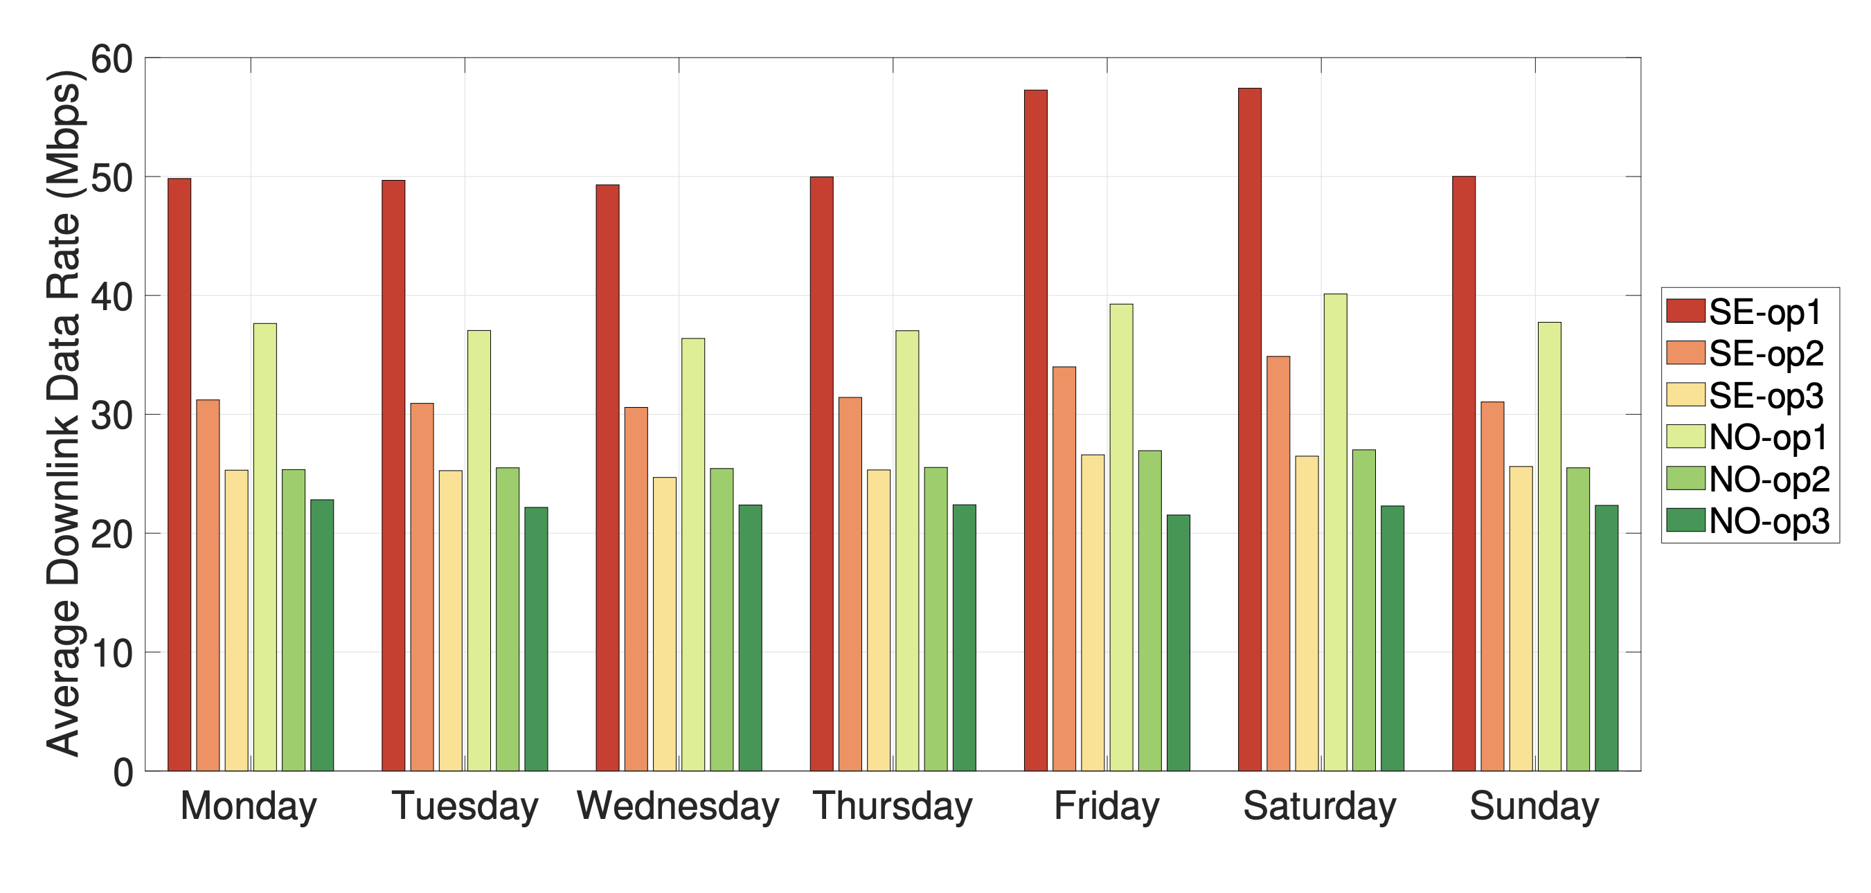
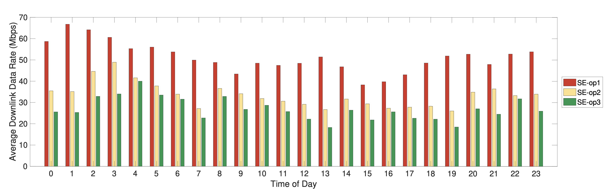
Hourly and Daily Patterns

Slide 42
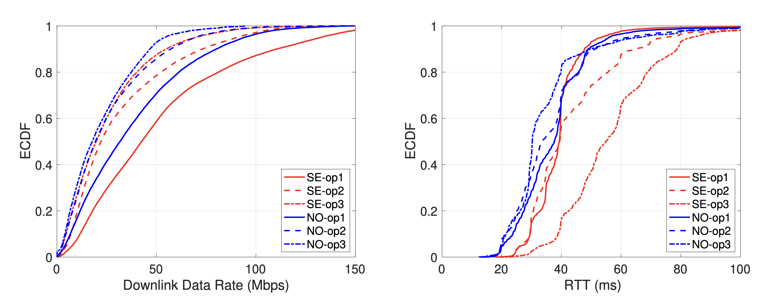
LTE performance: Data rate and RTT

Slide 43
Outline
Wireless Systems - Short Range
  Wifi
Mobile Broadband Networks
  Building Blocks
  Performance
  International Roaming
  Operations

Slide 44
Free roaming in Europe

Slide 45
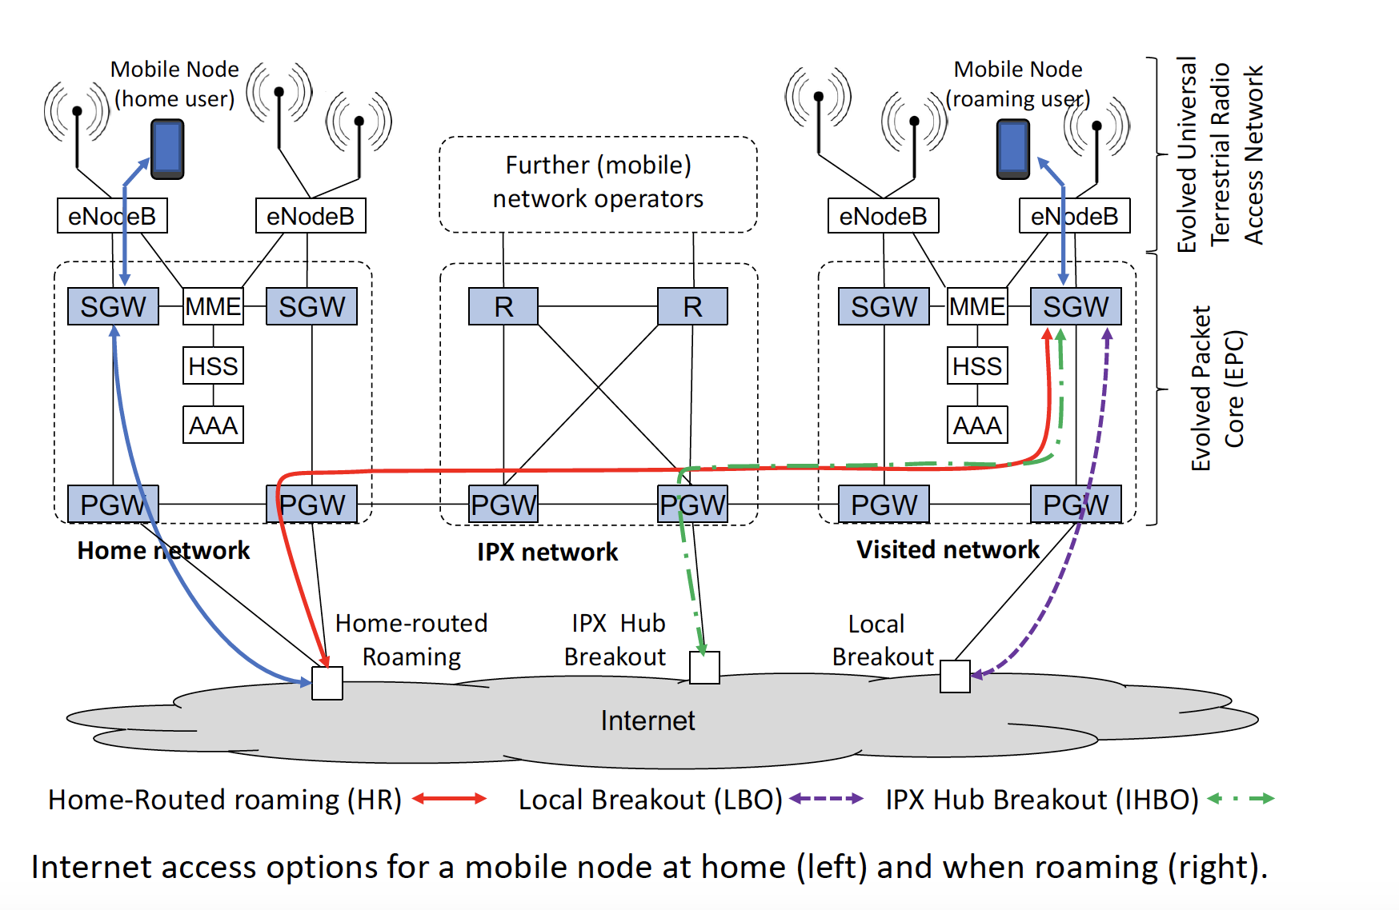
Roaming Infrastructure

Slide 46
Roaming Models
Home Routed (HR):
  The IP address of the roaming user is provided by the home network.
  All traffic to and from the mobile user is routed through the home network, for which a GTP tunnel is set up between the SGW of the visited network and the PGW of the home network (red path in the figure).
Local BreakOut (LBO):
  When LBO is used, the IP address of the roaming user is provided by the visited network.
  The GTP tunnel is terminated at the PGW of the visited network and IP-based services can be accessed directly from there (purple path in the figure).
IPX Hub Breakout (IHBO):
  The IP address of the roaming user is provided by the IPX network. The GTP tunnel from the SGW in the visited network terminates at a PGW in the IPX network (green path in the figure).
  There may be multiple PGWs so that latency and resource usage can be reduced by selecting one geographically close to the visited network.

Slide 47


MONROE-Roaming Nodes
6 countries, 16 operators, each country has two nodes
One measurement server per country
Norway: Telia, Telenor
Sweden: Telenor, Tre, Telia
Spain: Orange, Vodafone, Movistar
Germany: Vodafone, O2, T-Mobile
UK: Vodafone, EE
Italy: Vodafone, TIM, WIND

Slide 48
Roaming Configuration
Home Routed (HR) Roaming was used by all 16 MNOs!
Why all traffic is sent back to home network?
  HR provides the home operators with all the accounting and billing information
  Operators want to have near real-time view of the customer traffic for accounting reasons
  More complex debugging if HR is not used, who is responsible if there is a problem?

Slide 49
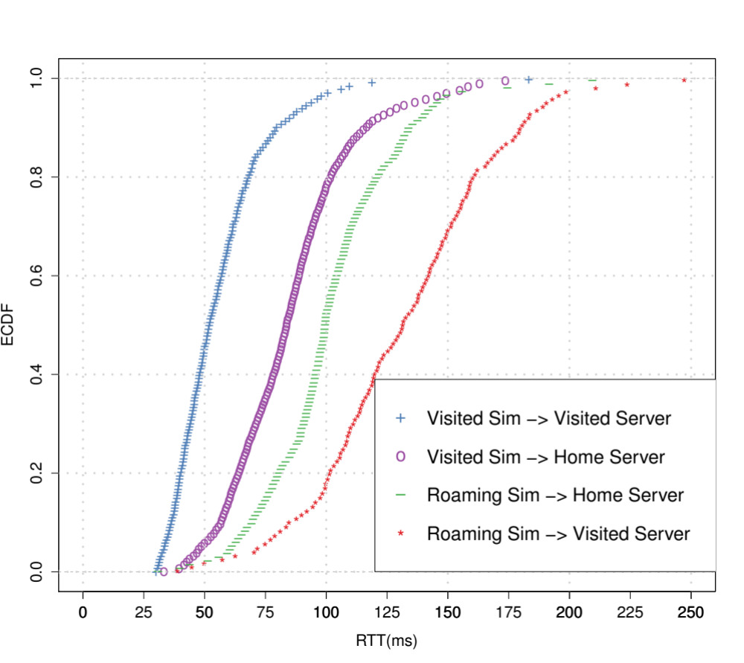
Delay penalty of home-routed roaming
Tunnel
vs
Internet
Packets go back and forth
Mimics LBO

Slide 50
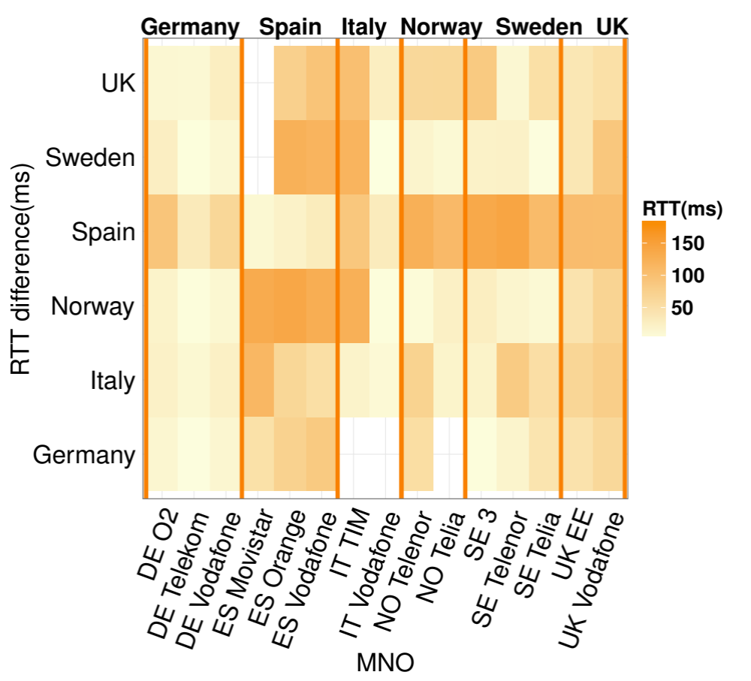
Delay penalty of home-routed roaming geographically
Germany is in a good position being in central Europe
South to North has the highest delays
RTT difference between the roaming SIM and the visited SIM

Slide 51
Outline
Wireless Systems - Short Range
  Wifi
Mobile Broadband Networks
  Building Blocks
  Performance
  International Roaming
  Operations

Slide 52
Mobile Virtual Network Operators (MVNO)
MVNO is an entity that offers mobile network services to end-users, but does not own nor operate fully a cellular network. MVNOs lack of ownership of radio spectrum resources.
In order to operate, an MVNO needs to have agreements in place to access the network of at least one MNO.

Slide 53
MVNO Models
A "light" MVNO is a service provider that has its own customer support, marketing, sales and distribution operations, and has the ability to set its tariffs independently from the retail prices set by the host MNO.
The “full” MVNO have a core network implementation operating essentially the same technology as a mobile network operator, only missing their own radio network. They run their own core network and rely on at least one host MNO who can offer access to the radio resources.

Slide 54






Mobile Network Aggregator (MNA):
  MNAs rely on the infrastructure of Mobile Network Operators (MNO) to provide services. However, instead of relying on a single base MNO (like Mobile Virtual Network Operator (MVNO)), MNAs can multiplex clients across multiple MNOs.
  MNAs operations benefit from the extensive global network infrastructure in multiple countries.
MNO
MNO
MNA
MVNO

Slide 55
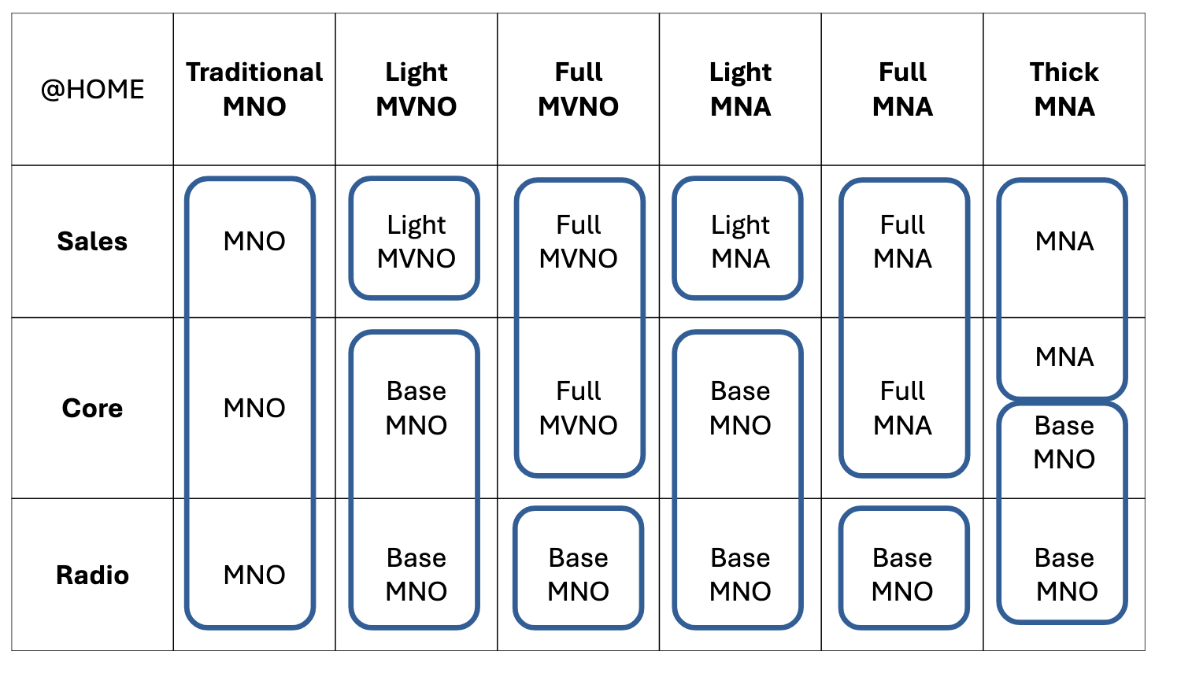
Mobile Ecosystem Summary

Slide 56
Experimental Setup
SIM
Orange
3 Network
Google Fi
Truphone
Twilio
MNO (ES)
MNO (EU)
Light MNA
Light MNA
Full MNA
Core runs in AWS cloud
Baseline
Built-in VPN
8 base MNO in different countries
Target IoT devices
Experiments are done in Spain
T-Mobile, US Cellular, Sprint (US);
3 Network (EU)
Orange (ES)
T-Mobile (US)

Slide 57
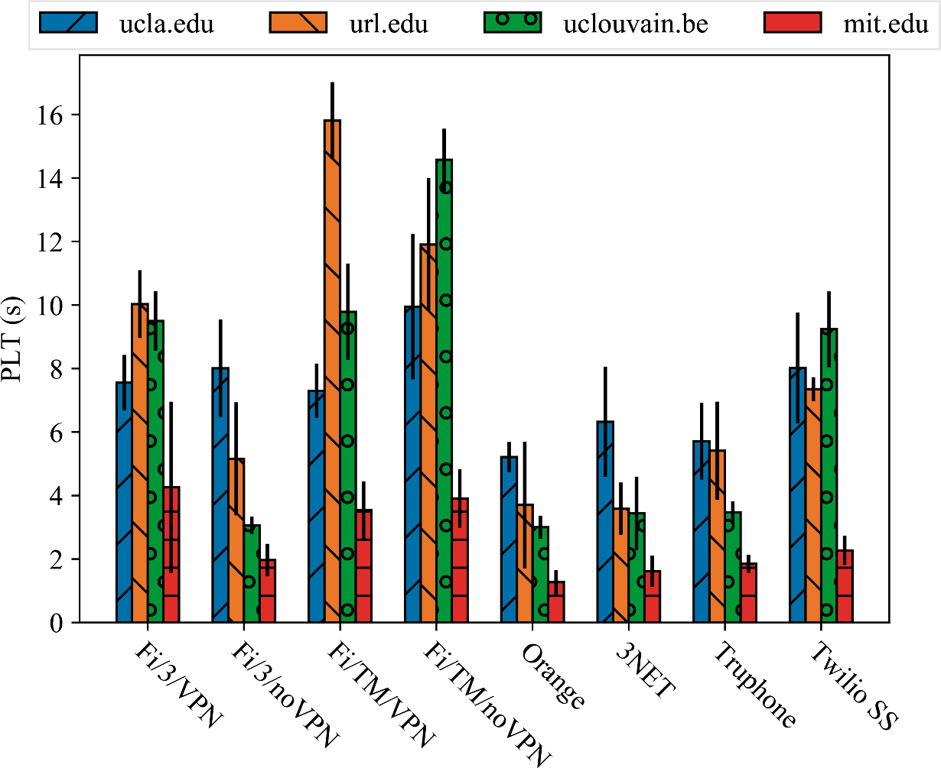
Web Performance
Name | Breakout
Fi/TM/VPN | USA
Fi/TM/noVPN | USA
Fi/3/VPN | USA
Fi/3/noVPN | UK
Truphone | Europe
Twilio_SS | USA
Orange | Spain
3NET | UK
For US breakout, large penalties accessing EU Webpages
Baseline
FI/3/NoVPN & Truphone have close performance to Orange
Low delay in CDN does not eliminates the differences in the PLT for the different configuration
Page Load Time (PLT): LoadEventStart – NavigationStart
https://developer.mozilla.org/en-US/docs/Web/Performance/Navigation_and_resource_timings

