Slide 1
Department of Informatics
Networks and Distributed Systems (ND) group
IN3230/4230
Wireless Communications - III
Özgü Alay
ozgua@ifi.uio.no

Slide 2
Outline
Massive IoT
  NB-IoT
  LORAWAN
Paving the future
  5G and Beyond

Slide 3
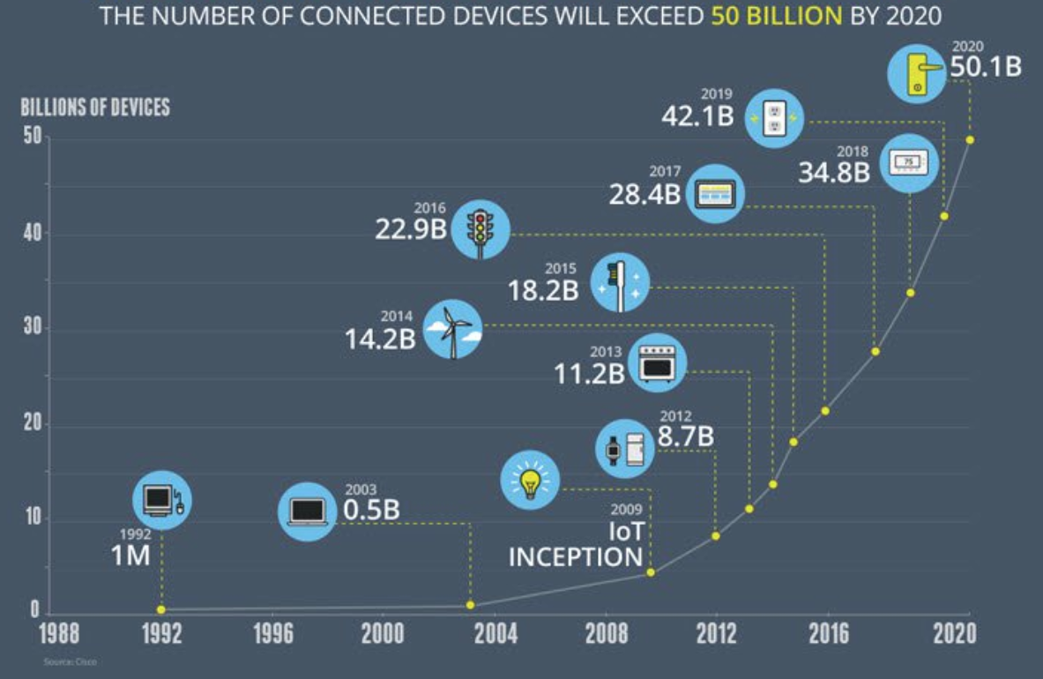
Growth in the number of connected devices

Slide 5
Key Challenges for Massive IoT
Battery life – many IoT devices will be battery-powered, and often the cost of replacing batteries in the field is not viable. (Battery life time of 10 years)
Coverage and Range – deep indoor connectivity is a requirement for many applications in the utility area. Regional (or even national or global) coverage is a prerequisite for many use cases, especially within the transport area. (5 –40 km in the open field)
Quality of Service – providing a certain low bitrate reliably is important for many applications while latency is not that critical. (Typically a few hundred bit/s or less)
Deployment and device cost – clearly a key enabler for high-volume, mass-market applications, enabling many of the use cases. Moreover, in order to enable a Massive IoT market, networks need to scale efficiently. (Device cost of a few Euros)

Slide 6
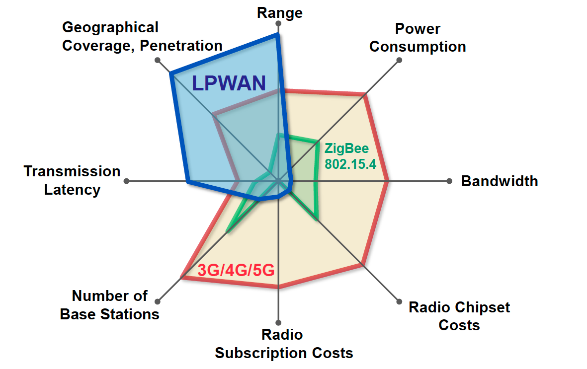
Low Power Wide Area Networks (LPWAN)

Slide 7
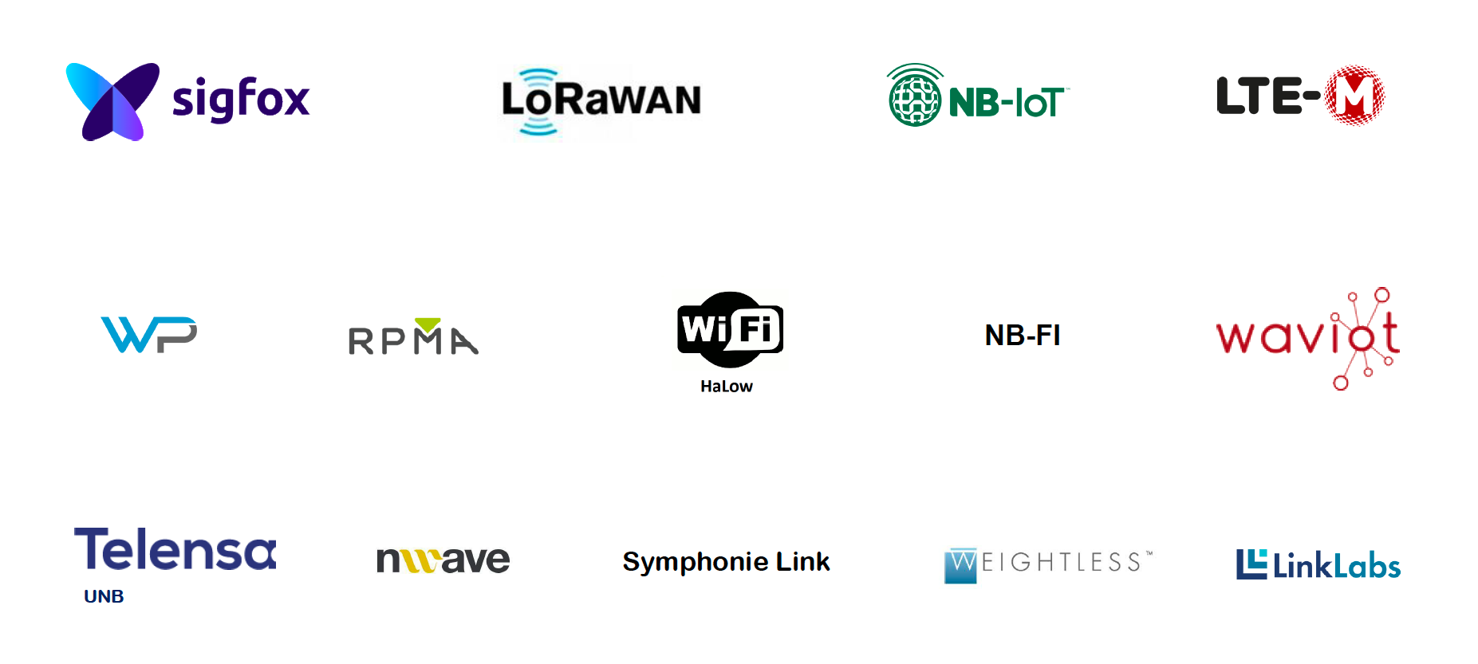
Current LPWA technologies

Slide 8
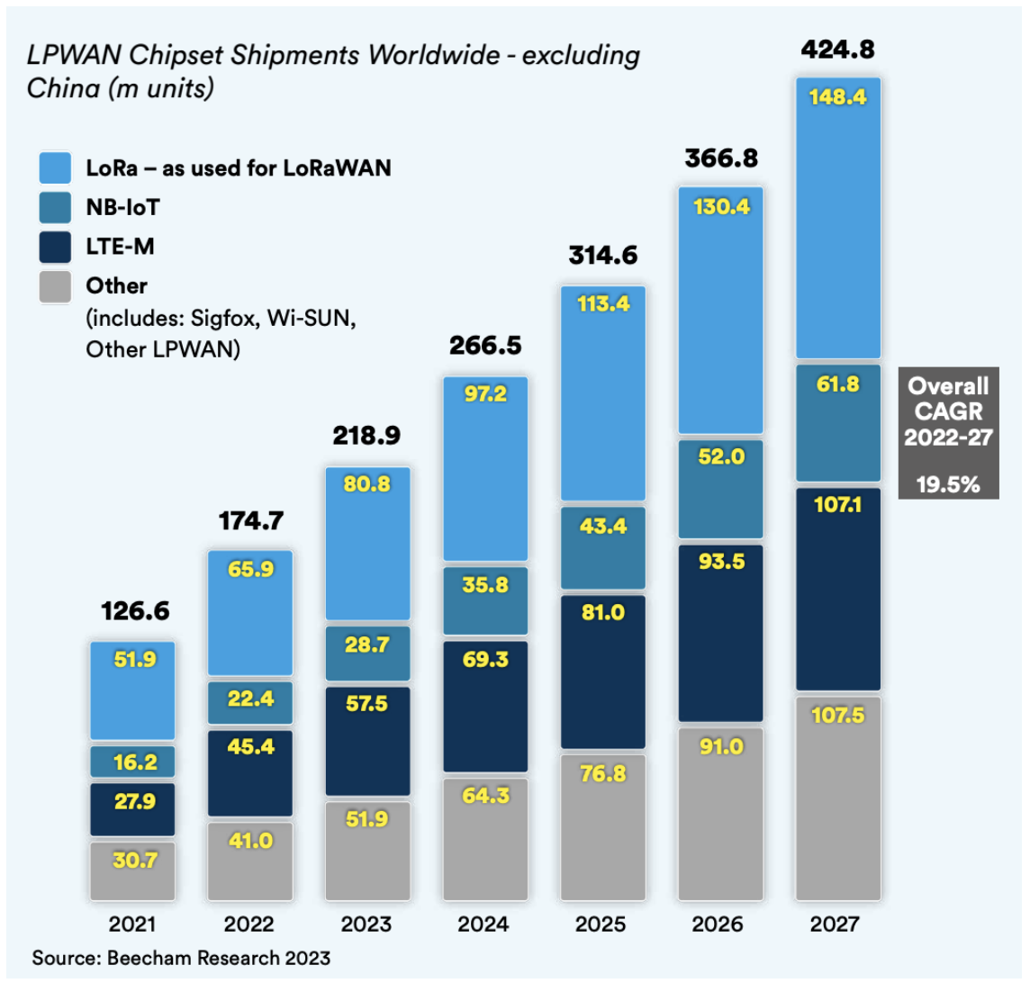
What is the most common technology?
*In China, specifically, the government has adopted NB-IoT as the standard for massive IoT applications in the country.

Slide 9

What is LORAWAN?
Low Power, Wide Area (LPWA) networking protocol for IoT
Provides bi-directional communication, end-to-end security, mobility and localization services
Open source standard
Unlicensed band (EU 868)
LORA Alliance (400+ industry partner)
The Things Network (TTN)*: “a global, crowdsourced, open, free and decentralized LoRaWAN IoT platform”
*https://www.thethingsnetwork.org/

Slide 10
LoRaWAN Architecture

Slide 11
LoRaWAN Specification
Spectrum | Unlicenced 863-870 MHz frequency bands (in Europe) 125/250 KHz channels
Modulation and Access | - LoRa modulation (Chirp Spread Spectrum (CSS)) Chirp: A sinusoidal signal whose frequency increases or decreases over time, often with a polynomial expression for the frequency variation. Spread Spectrum: Wideband linear frequency modulation (FM) is used to encode information, spreading the signal across a large bandwidth. - LORAWAN MAC (Aloha)
Data rate | 250bps-50kbps
UE Max Tx Power | 14 dBm
Range | 5 km (urban), 20 km (rural)
Energy Efficiency | Adaptive Data Rate (ADR)
Notes:
CSS used for Sonar and Radar

Slide 12
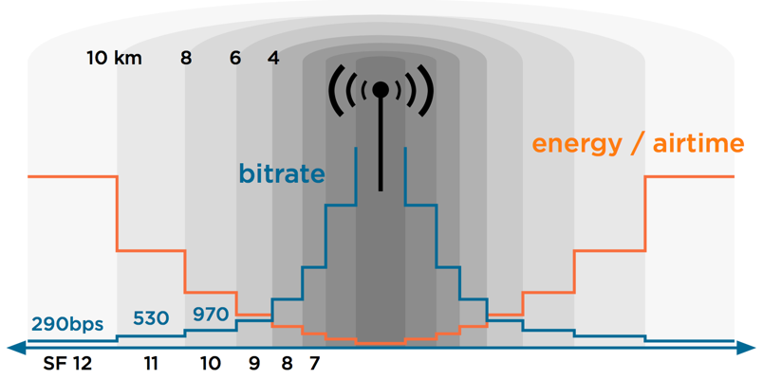
Adaptive Data Rate (ADR)
Adaptive Data Rate (ADR) is a mechanism for optimizing data rates, airtime and energy consumption in the network.
Spreading Factor (SF): is the duration of the chirp. LoRa operates with spread factors from 7 to 12. SF7 is the shortest time on air, SF12 will be the longest.
ADR triggers:
  SF increase (device-side): Improves message delivery in harsh radio conditions
  SF decrease (network-side): Improves data rate and power consumption

Slide 13
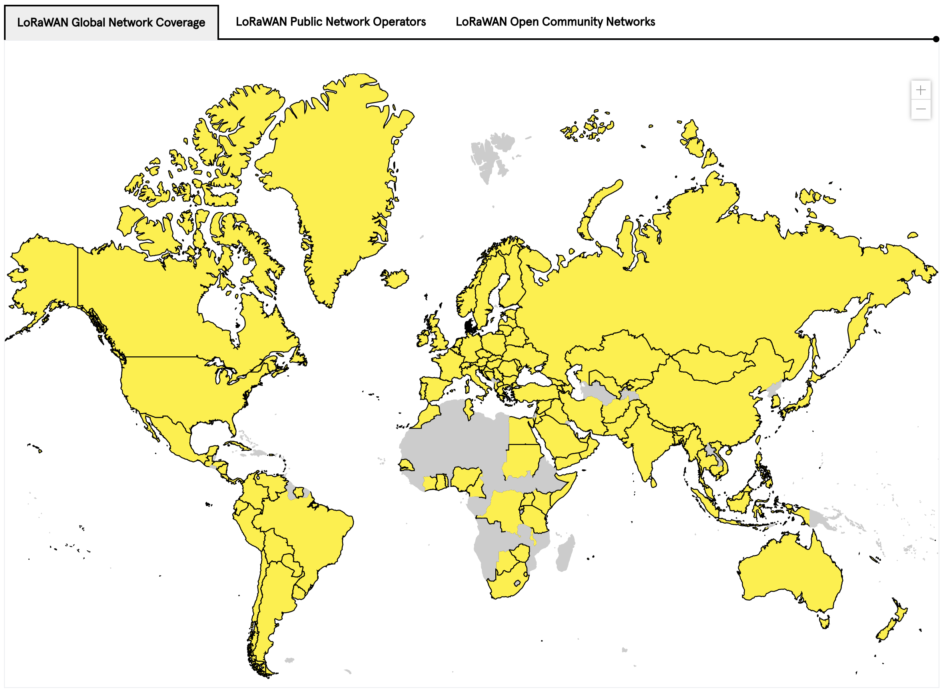
LORAWAN Network Coverage

Slide 14
What is NB-IoT?
LPWAN radio technology standard developed by 3GPP to meet IoT application requirements
Builds on the LTE ecosystem, and can be deployed as a simple addition of new software to existing LTE infrastructure
  leading to fast development, scalibility, and global roaming
Includes state-of-the-art LTE security
  Identity management
  Authentication and authorization (embedded SIM)
  End to end encription of device data and signalling
Future feature growth for MBB and NB-IoT use cases

Slide 15
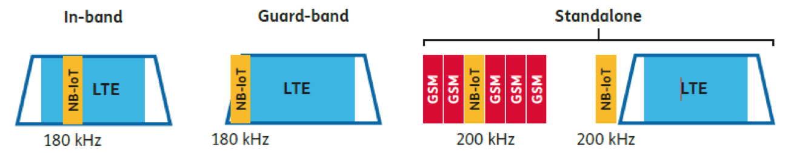
NB-IoT Specification
Spectrum Deployment
Modulation and Access | Modulation: BPSK/QPSK MAC: DL: OFDMA, UL: SC-FDMA
Peak data rate | DL: 250 kbps UL: 20 kbps
UE Max Tx Power | 23 dBm
Coverage enhancements | Power Spectral Density boost Repetitions
Range | 1 km (urban), 10 km (rural)
Energy Efficiency | Power Saving Mode (PSM) extended Discontinuous Reception (eDRx)
Rel-13

Slide 16
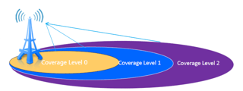
NB-IoT Coverage
Coverage Enhancement (CE) Techniques (w.r.t. LTE)
  Power Spectral Density boost: Tx power focused on smaller bands
  Repetitions: messages can be repeated up to 128 times
CE Level (CL) | # Repetitions
0 | [0-2]
1 | [4-16]
2 | [32-128]
CL0 = LTE coverage

Slide 17
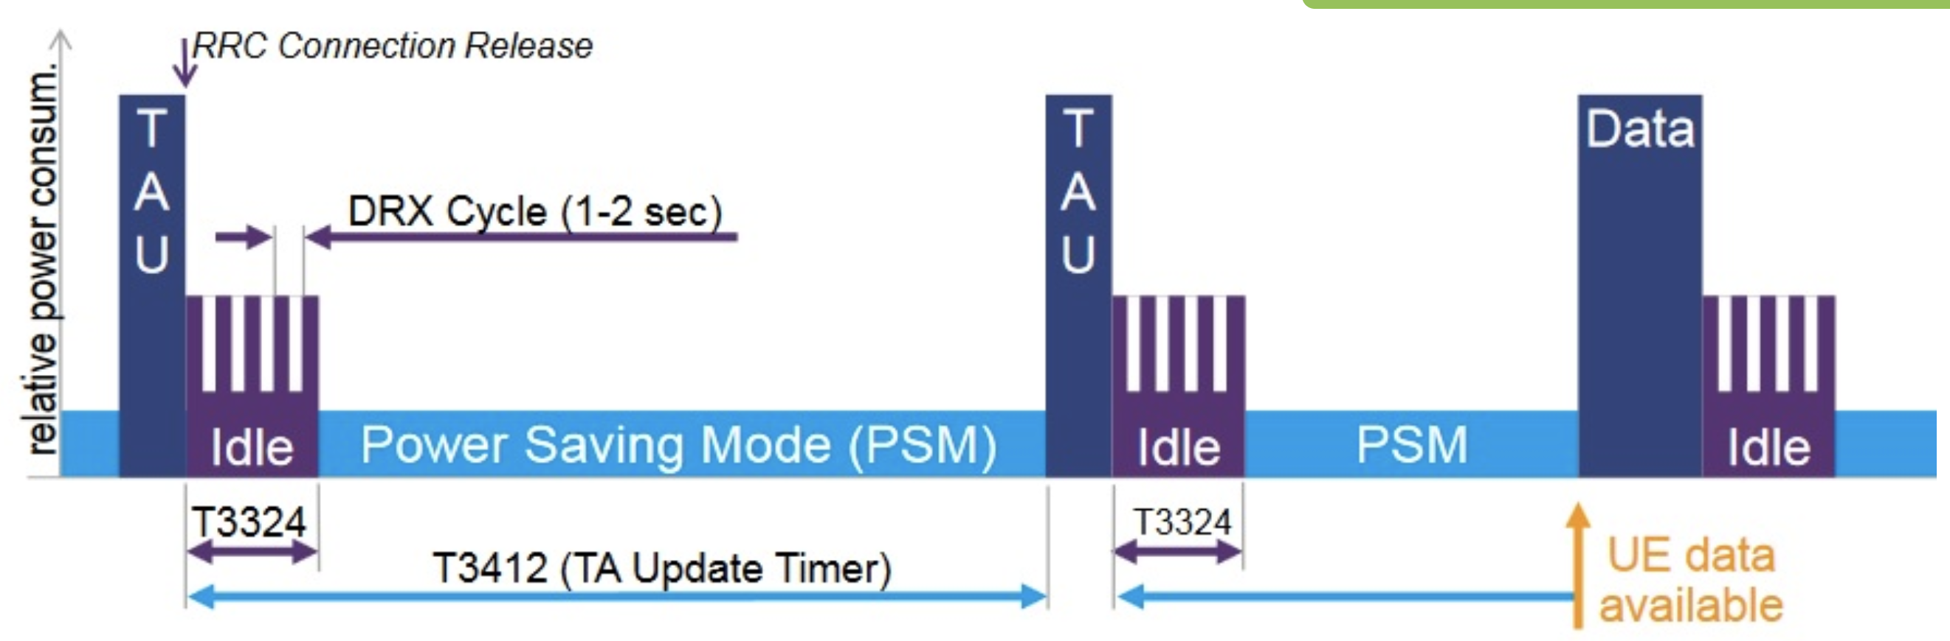
NB-IoT Power Savings
  Power Saving Mode (PSM)
    power-off mode (turns off most functions)
    the device nevertheless remains registered on the network
    only wakes up periodically to check for incoming messages
TAU: Tracking Area Update RRC: Radio Resource Control DRX: Discontinuous Reception

Slide 18
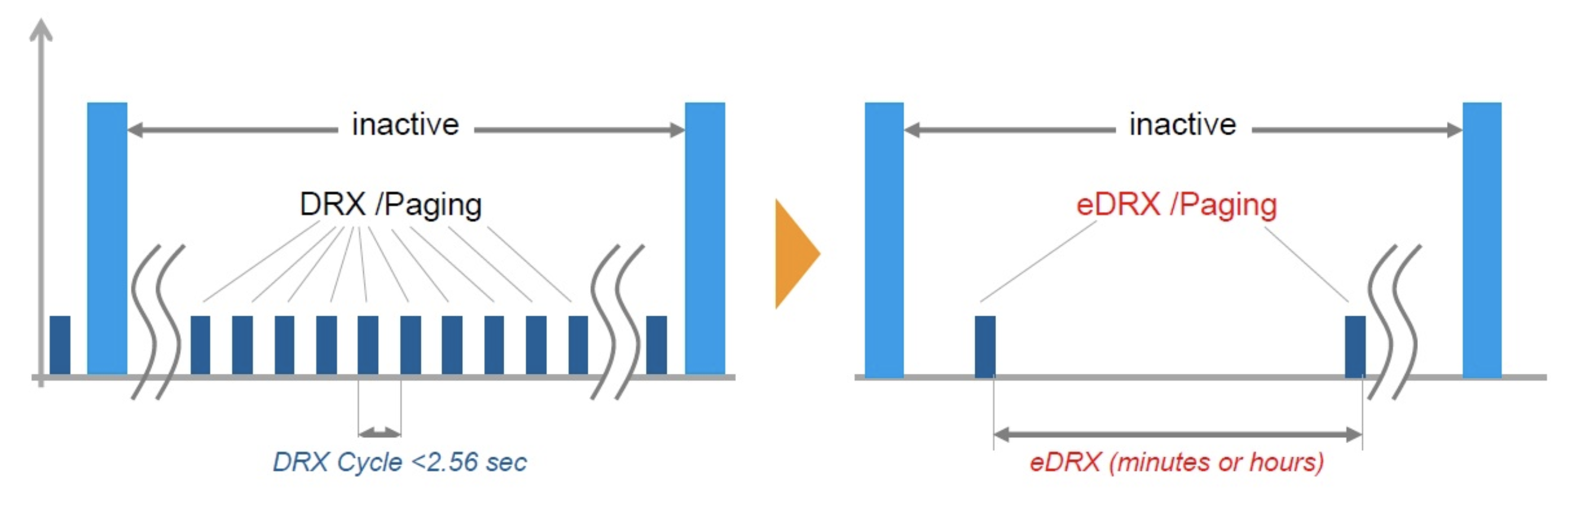
NB-IoT Power Savings
extended Discontinuous Reception (eDRx) mode allows you to significantly increase the period of time when the receiving path of the device is turned off.

Slide 19
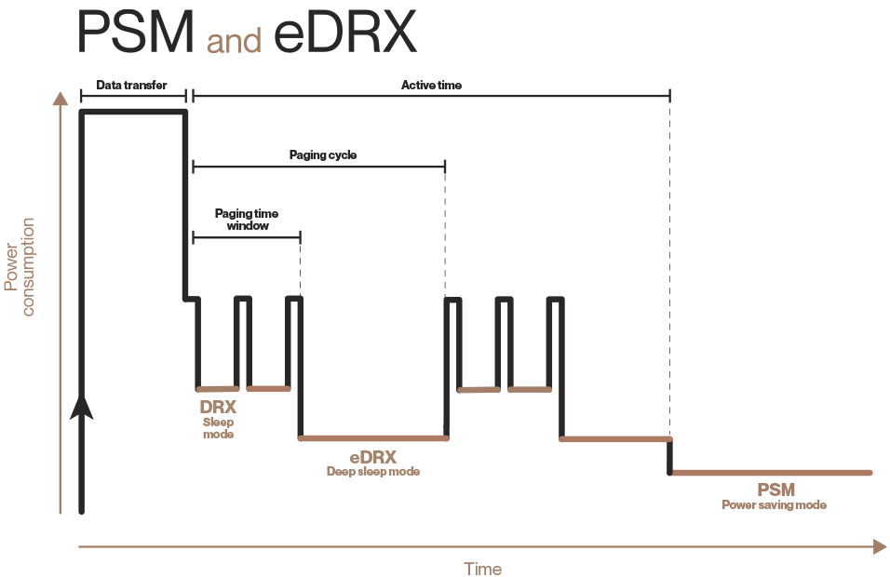
Power consumption with PSM and eDRX
Notes:
LTE paging is a mechanism that enables the network to notify a UE of specific events or messages while the UE is in an idle state, allowing it to wake up and initiate the necessary procedure.
The paging time window (PTW) is the period during which a UE is awake and monitoring the paging channel for incoming paging messages.

Slide 20
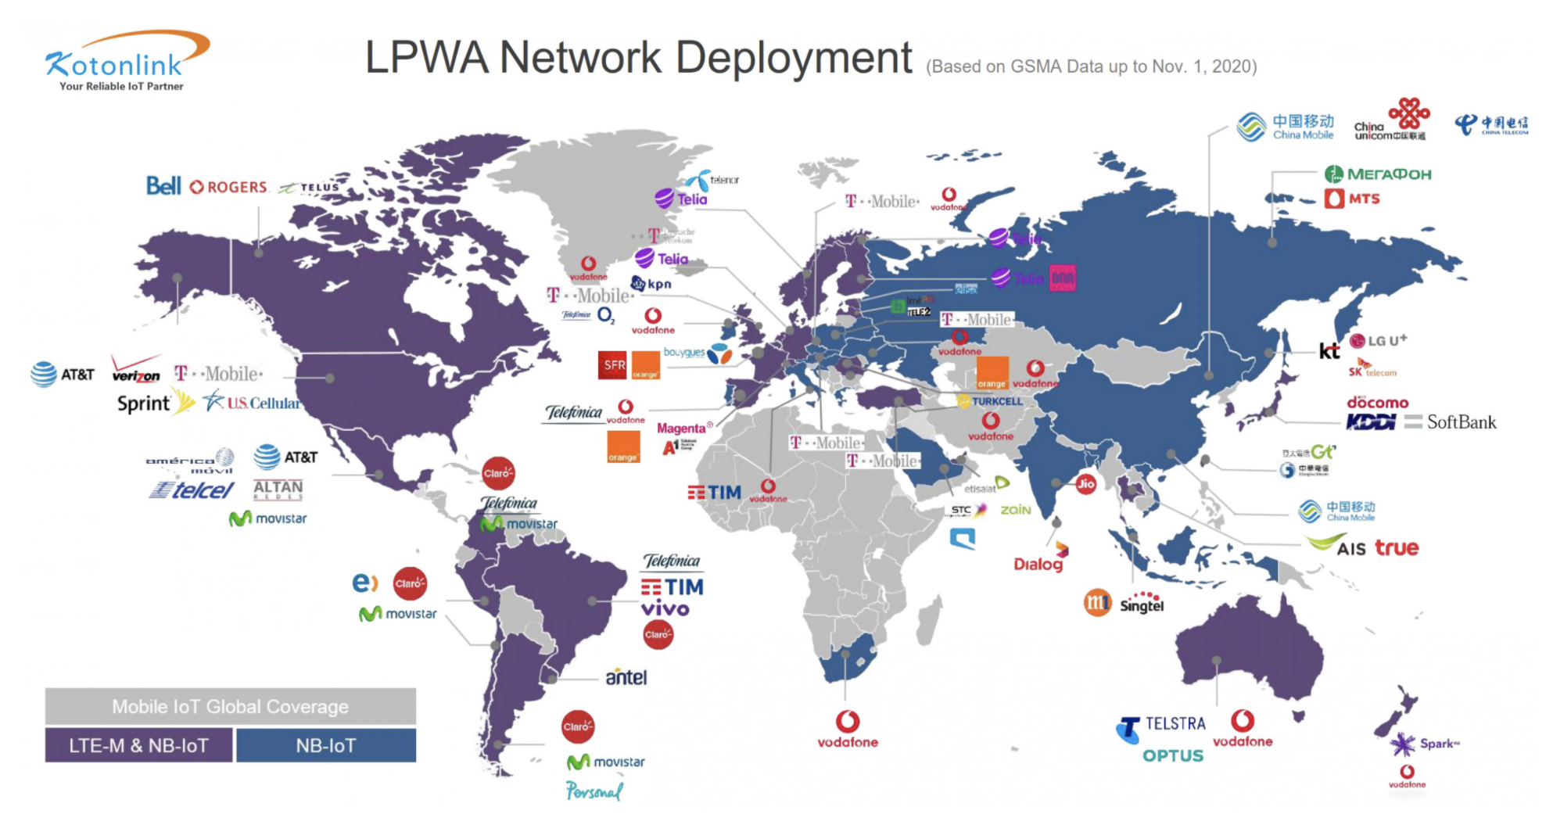
NB-IoT Deployment
*Source: https://www.kotonlink.com/NewsDetail/2434022.html

Slide 21
LORAWAN vs NB-IoT
Range and Penetration
Battery
Cost (deployment, spectrum, device)

Slide 22
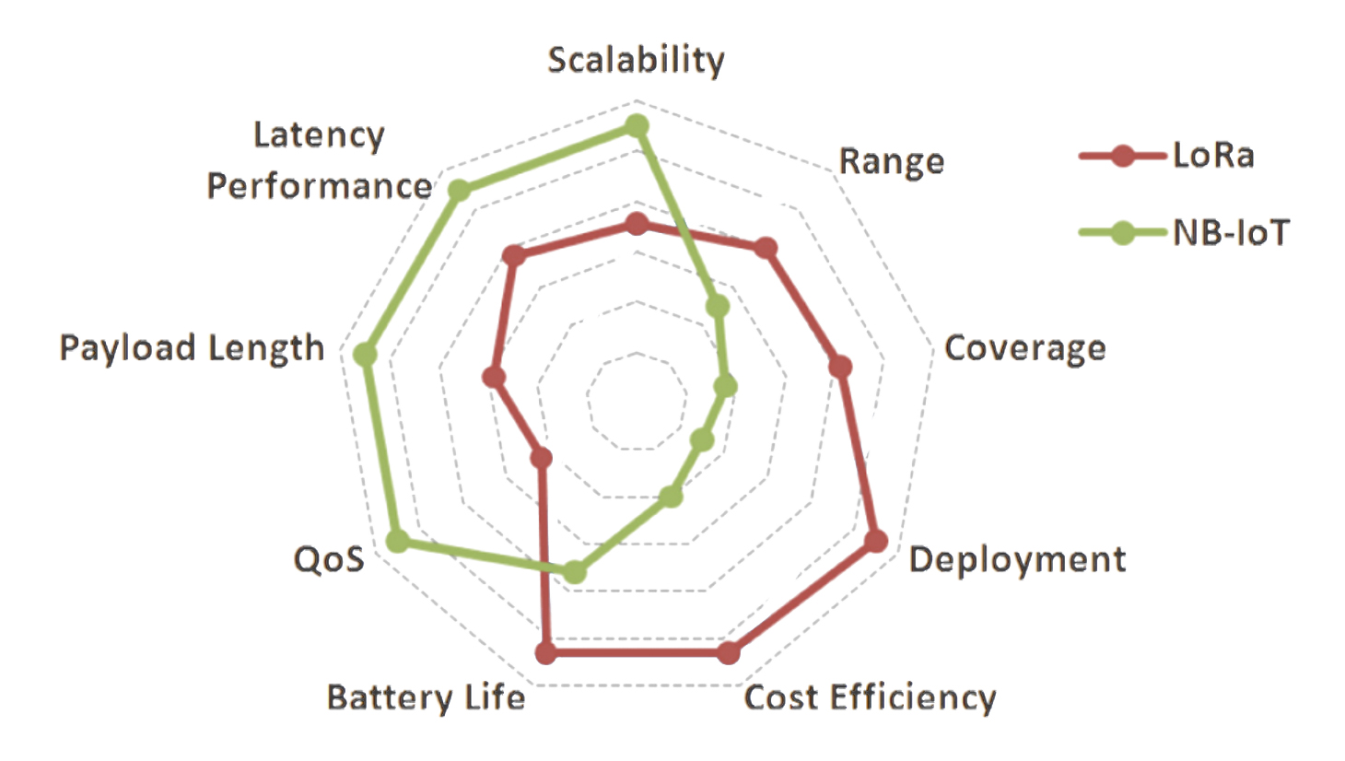
Overall LORAWAN vs NB-IoT

Slide 23
Coverage and Deployment Analysis of NB-IoT in the Wild
K. Kousias, G. Caso, O. Alay, A. Brunstrom, L. De Nardis, M-G. Di Benedetto and M. Neri,
IEEE Communications Magazine, 2020 [Open Data]

Slide 24
NB-IoT field trials and testing
NB-IoT entered the market and is being globally deployed
Field trials and testing: deployment validation, issues pinpoint, optimization towards Beyond 5G
A complete field trial: Passive + Active measurements
Passive Measurements | Active Measurements
Scanner-based | UE (prototype)-based
Non-intrusive experiments | On-purpose experiments
DL coverage and RF conditions | Connectivity (RACH) and DL/UL performance
Technology + Network-wide overview: Multiple BSs, operators, and technologies | Focus on the “serving” technology, operator and BS

Slide 25
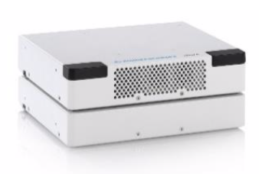

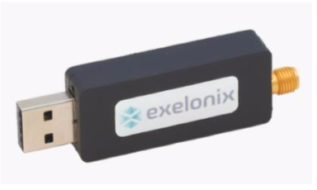
NB-IoT testing in Oslo
Extensive testing of NB-IoT deployment in Oslo
Passive + Active measurements under several conditions and scenarios, including:
  2 mobile network operators
  Indoor vs. Deep indoor
  Outdoor: Walking vs Driving
Analysis Focus
  NB-IoT and LTE coverage
  NB-IoT and LTE deployment
 | Scanner: R&S®TSMA6 System-in-a-box: PC and Scanner
 | UE: Exelonix NB-R410M Based on Qualcomm MDM9206 chipset

Slide 26
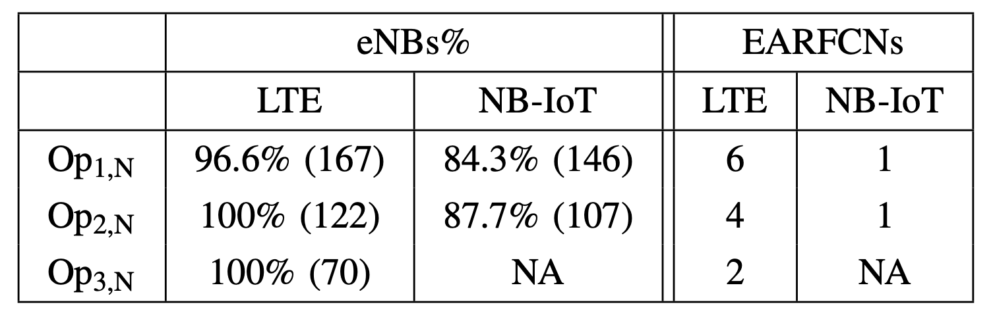
Network Deployment Strategy
Operators leverage the already existing LTE infrastructure for deploying NB-IoT, with no additional eNBs installed.
Nearly 86% of the detected LTE eNBs have been reconfigured for NB-IoT
Network deployment statistics with regard to number of eNBs per technology. eNBs% is defined as the ratio between the number of LTE/NB-IoT eNBs and the total number of eNBs. Absolute numbers are provided in parenthesis.

Slide 27
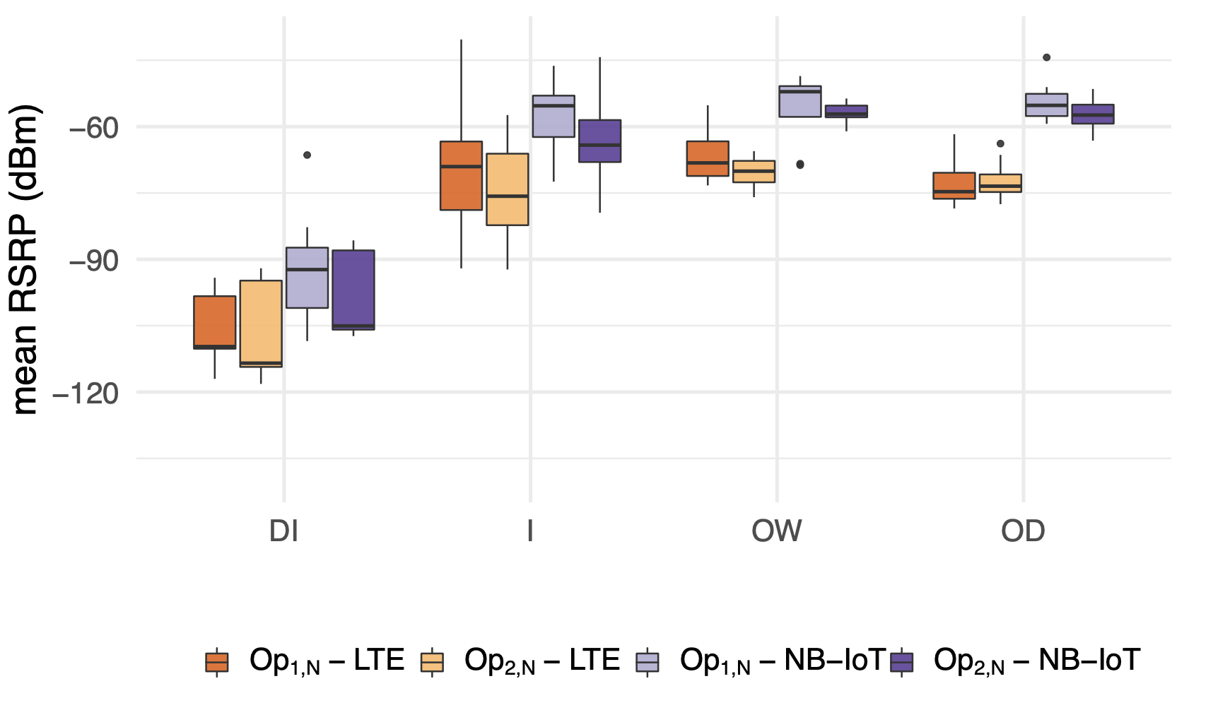
Radio Coverage
NB-IoT provides statistically significant RSRP boosts in line with the power boosting expected by 3GPP TS 36.104.
Op2,N has slightly lower RSRP compared to Op1,N.

Slide 28
Outline
Massive IoT
  NB-IoT
  LORAWAN
Paving the future
  5G and Beyond

Slide 29
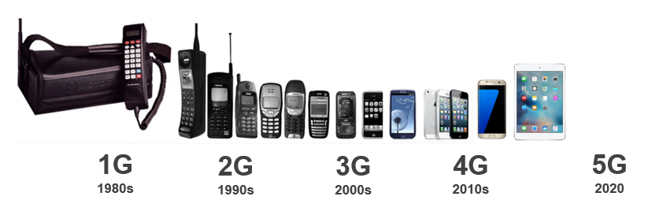
What is 5G?
5G is the 5th generation of mobile networks
Analogue
Digital
SMS
Multimedia
Video Calling
Mobile internet
Mobile Broadband
Enhanced Video
Mobile Connected World
Enhanced Mobile Broadband
Low latency applications
Internet of Things
Augmented and Virtual Reality (AR & VR)

Slide 30
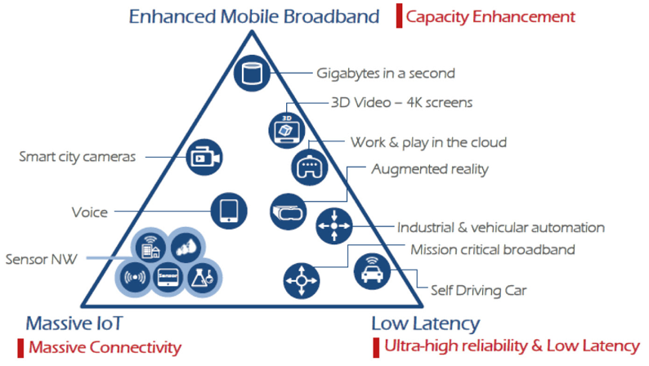
Different requirements for 5G applications and services

Slide 31
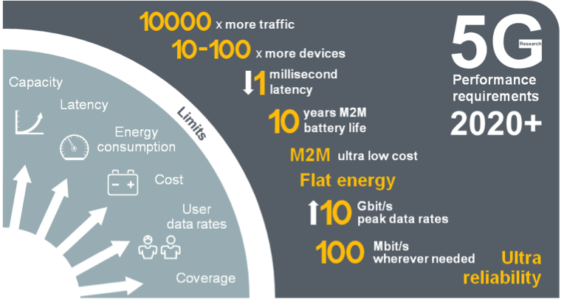
5G Mobile Network Expected Performance
Multi domain
performance
  Energy Performance
  Critical machine type
  of communications
  Global
  standard

Slide 32
Back in the day…

Slide 33
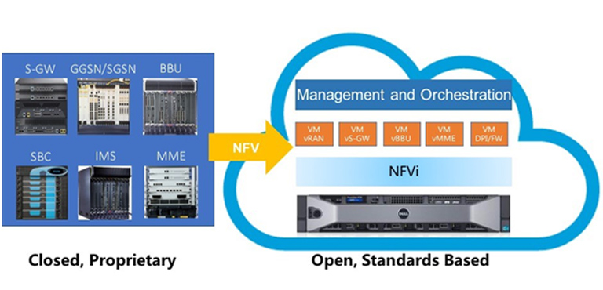
Network Flexibility: Virtualization

Slide 34
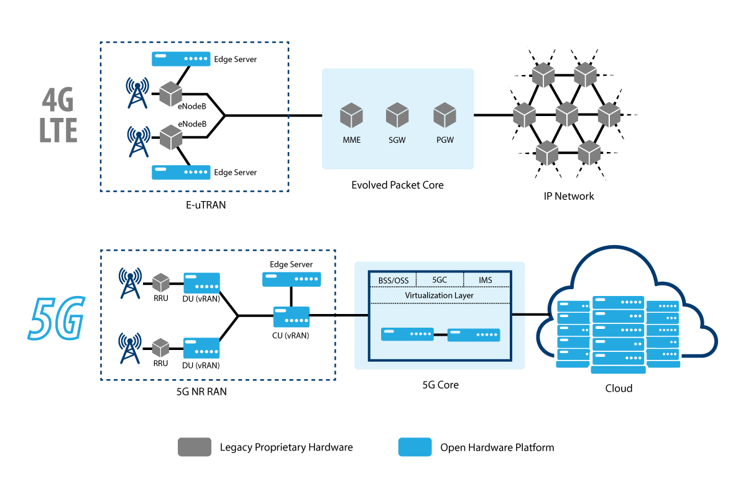

Slide 36
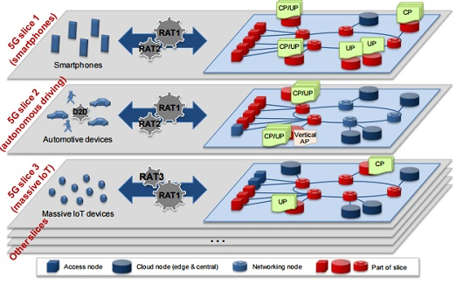
Network Slicing for diverse requirements

Slide 37
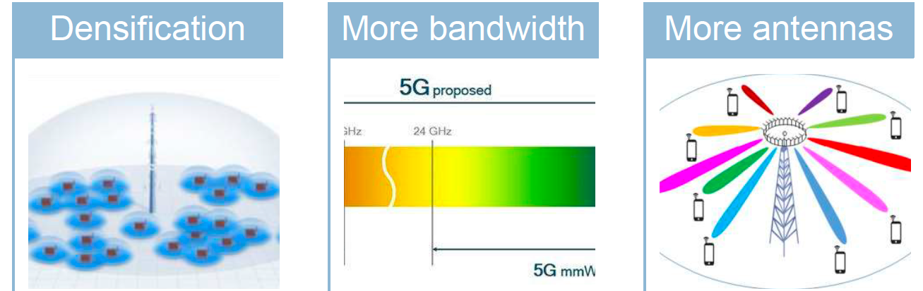
Capacity Enhancements
Small cells,
Relays, mobile
Relays and
Drones
new spectrum @ higher frequencies (above 6 GHz)
Massive MIMO
Spectrum sharing

Slide 38
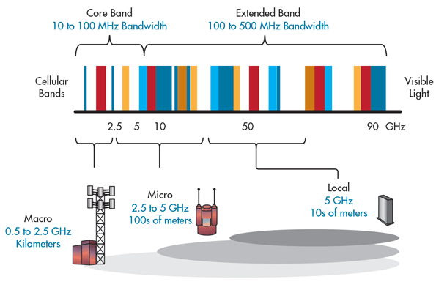
5G Bands and its impact on Cell size

Slide 39
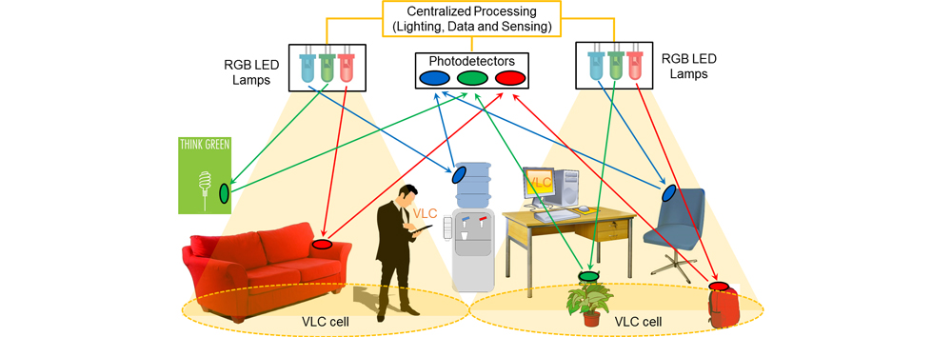
Visible Light Communications
https://attract-eu.com/showroom/project/vladimir/

Slide 40

Millimeter Wave Massive MIMO
B. Yang, Z. Yu, Y. Dong, J. Zhou and W. Hong, "Compact Tapered Slot Antenna Array for 5G Millimeter-Wave Massive MIMO Systems," in IEEE Transactions on Antennas and Propagation, vol. 65, no. 12, pp. 6721–6727, Dec. 2017.

Slide 41
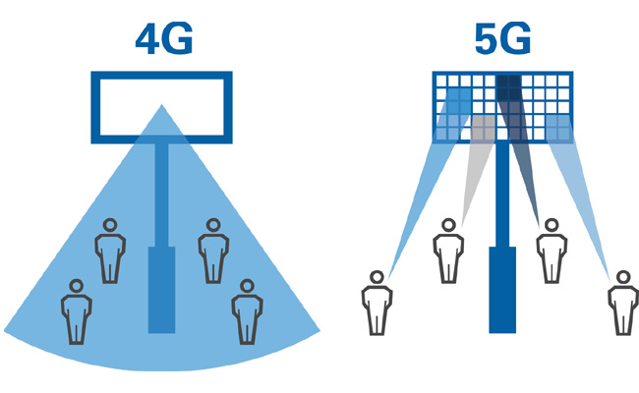
Multi-User MIMO Beamforming

Slide 42
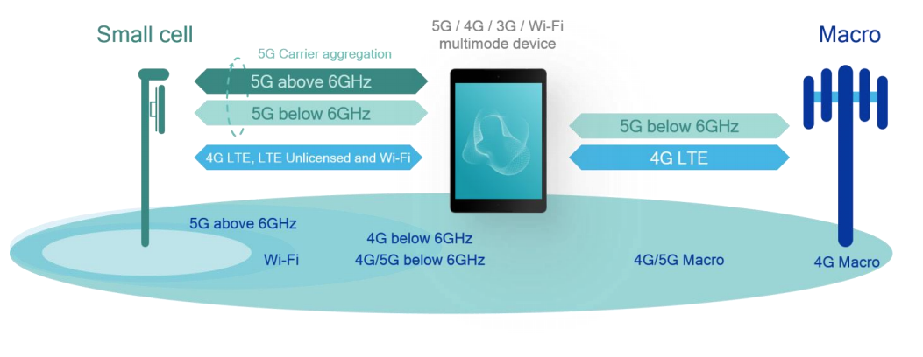
Spectrum Sharing: Multi-connectivity

Slide 43
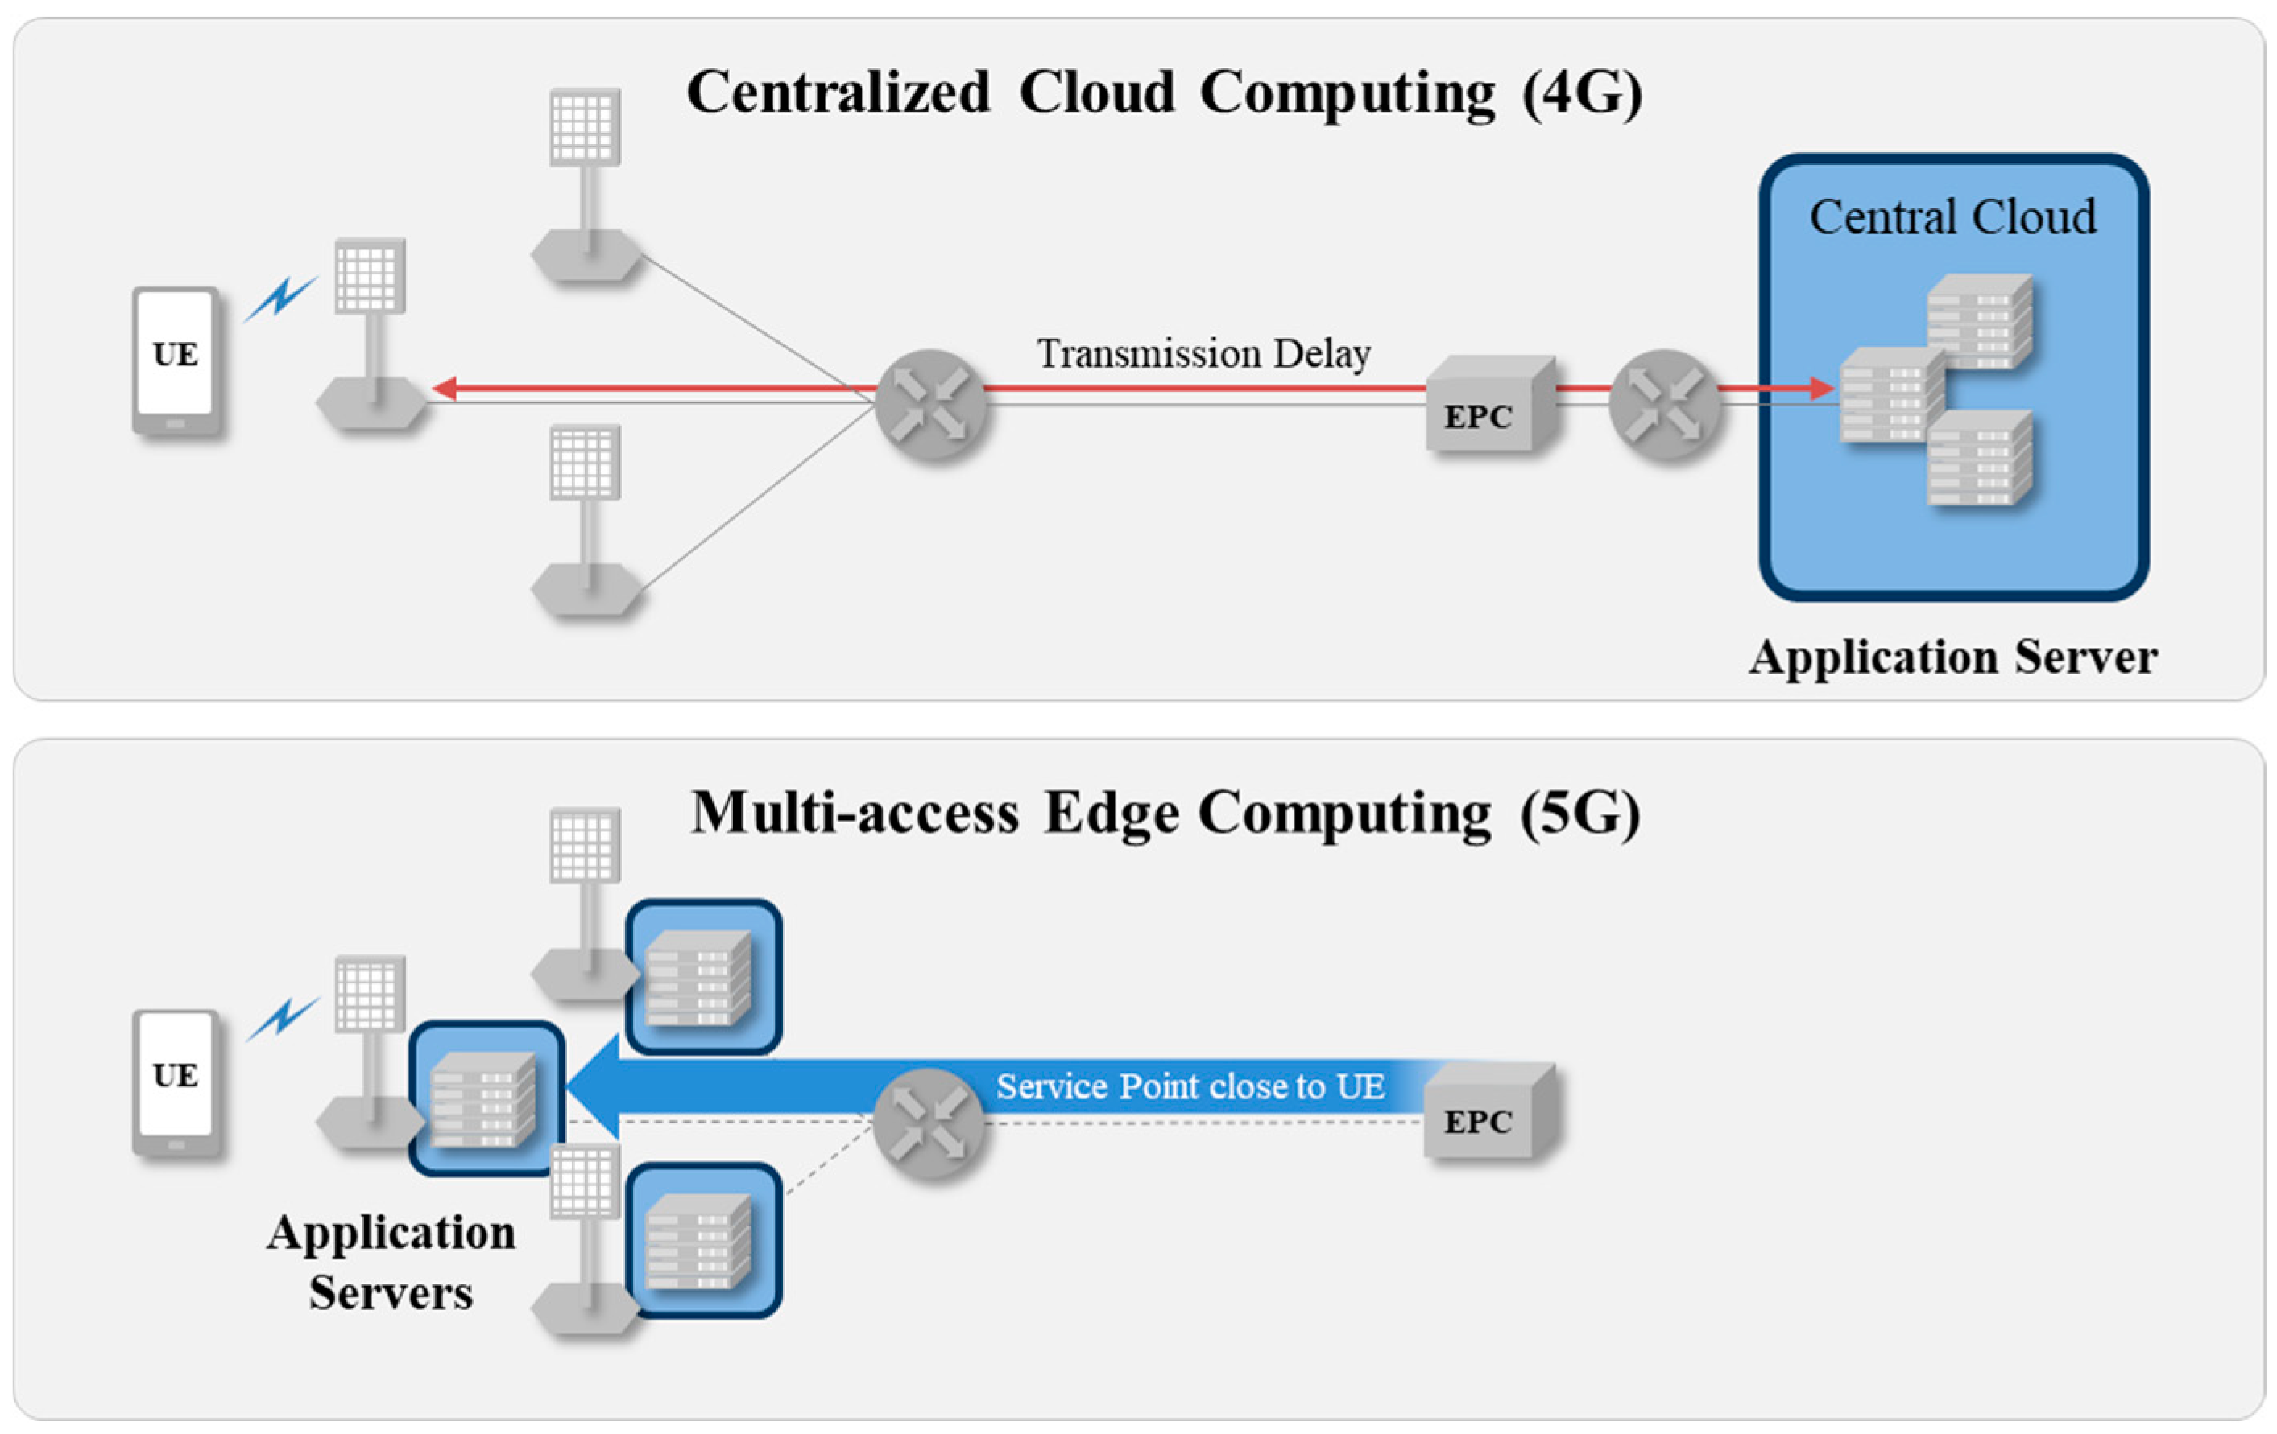
Ultra high reliability and Low Latency

Slide 44



From 4G to 5G Transition
Today – 4G Access
Device attaches to LTE/4G radio and Evolved Packet Core (EPC)
Early 5G – Non-Standalone
Device attaches to 5G-NR, which routes either via 4G Base Station to EPC, or direct to EPC
4G acts as control plane
5G Standalone
Device attaches to 5G-NR and 5G Core Network.
EPC
4G
5G-CN
5G

Slide 45
Coverage and Performance Analysis of 5G Non-Standalone Deployments
Konstantinos Kousias (Simula Research Laboratory), Mohammad Rajiullah (Karlstad University), Giuseppe Caso (Ericsson), Ozgu Alay (University of Oslo, Karlstad University), Anna Brunstrom (Karlstad University), Luca De Nardis (Sapienza University of Rome), Marco Neri (Rohde & Schwarz), Usman Ali (Sapienza University of Rome), Maria Gabriella Di Benedetto (Sapienza University of Rome)

Slide 46
Contributions
Large-scale measurement campaign on 5G NSA deployments for two Mobile Network Operators (MNOs) in Rome, Italy
  Investigation of the coverage and deployment for two large MNOs (Op₁ and Op₂) providing 4G and 5G service.
  Performance analysis in terms of eMBB (Speedtest) and URLLC-type (real-time online gaming) applications across different scenarios and MNOs.

Slide 47
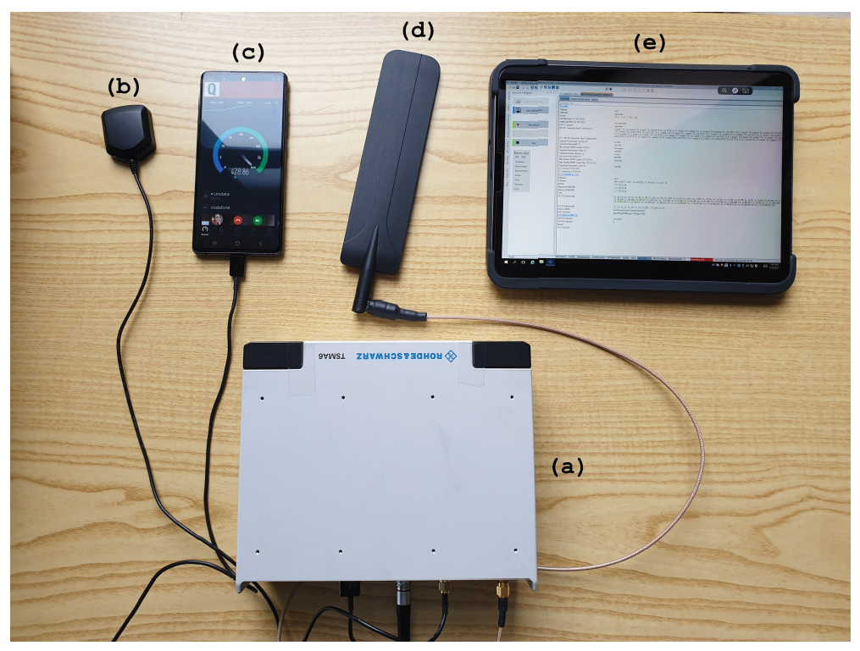
Measurement Design and Campaign
Measurements period: 7 weeks (12/2020 - 01/2021)
Measurement campaign organized in sub-campaigns
  Different day types (weekdays vs weekends),
  Different times of the day
  Different geographical areas and mobility scenarios
    Indoor Static (IS)
    Outdoor Walking (OW)
    Outdoor Driving (OD)
R&S TSMA6 scanner
GPS antenna
Commercial 5G UE
RF antenna
R&S ROMES SW

Slide 48
Passive Measurements
Coverage Analysis
Dataset Features:
  Spatial (Latitude, Longitude)
  Temporal (Time, Date)
  Carrier frequency and cell identifiers
  Signal strength and quality indicators
    (SS-)RSRP, (SS-)RSRQ, etc.
https://zenodo.org/record/7026073#.YwkNi-%20xBy3I

Slide 49
Active Measurements
Speedtest (eMBB) and real-time online gaming (URLCC) sessions*
Dataset Features
  DL/UL Throughput
  Median RTT
  Packet delay variation (PDV)
  Missed Packet Percentage (PLR)
  i-score = 𝑠𝑐𝑜𝑟𝑒_{𝑙𝑎𝑡𝑒𝑛𝑐𝑦} × 𝑠𝑐𝑜𝑟𝑒_{𝑃𝐷𝑉} × 𝑠𝑐𝑜𝑟𝑒_{𝑃𝐿𝑅} × 100%
Notes:
(PDV) is the difference in end-to-end one-way delay between selected packets in a flow with any lost packets being ignored
i-score: a QoE metric based on the above metrics

Slide 50
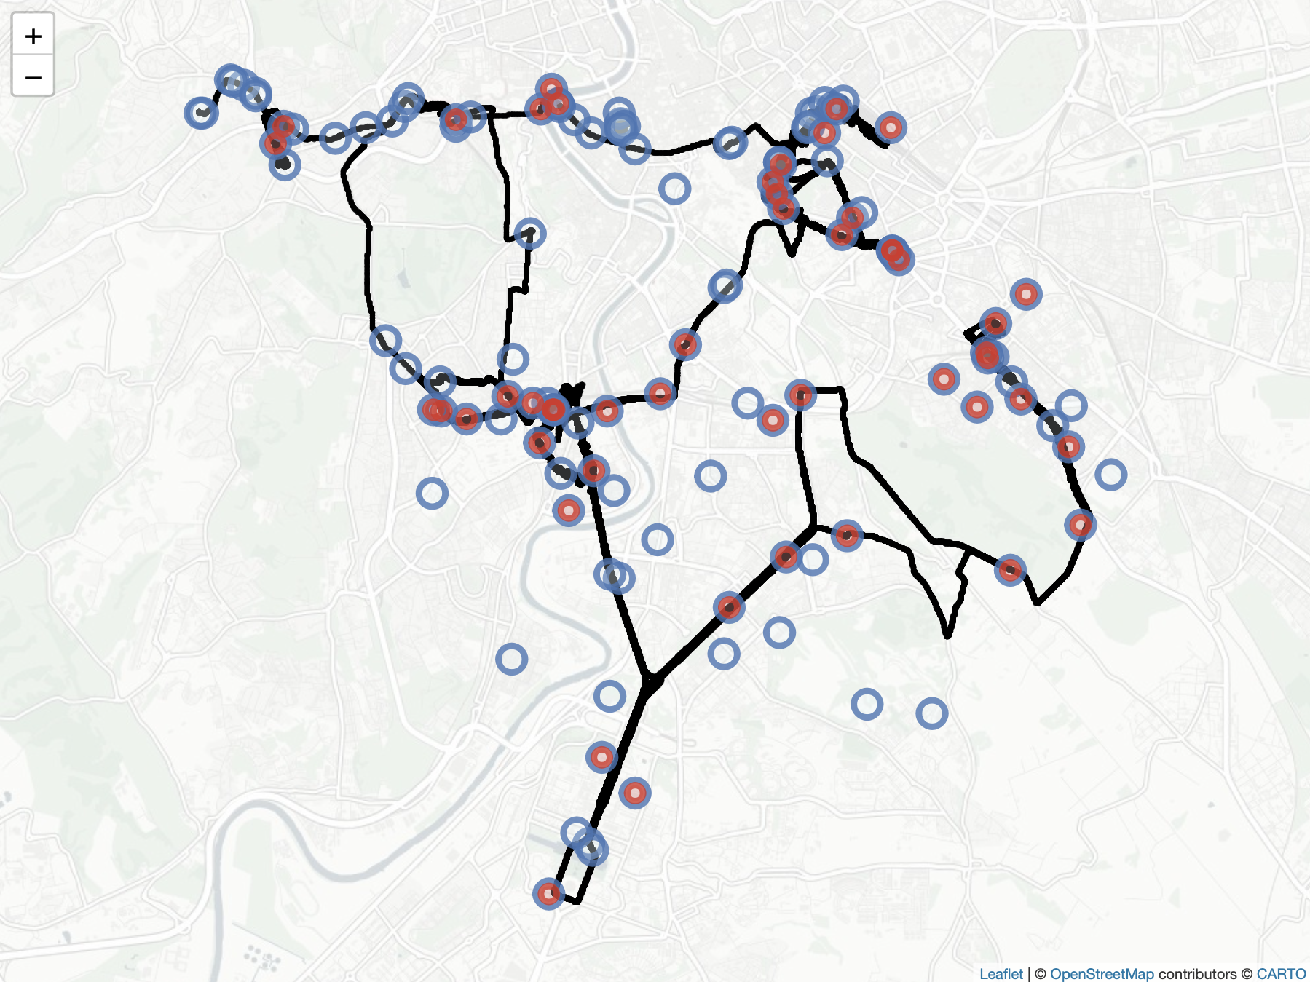
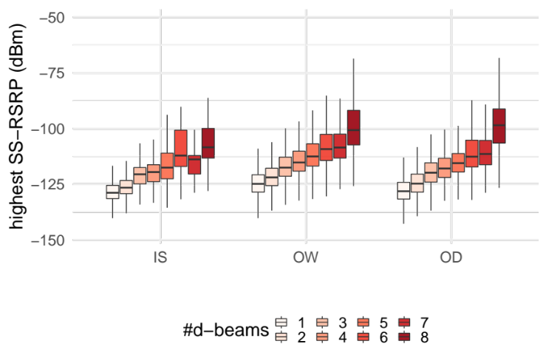
Network Deployment
Density
  4G: 313 (Op₁) and 407 (Op₂)
  5G: 162 (Op₁) and 158 (Op₂)
SSB beamforming strategies
  Op1: No beamforming
  Op2: Up to 8 SSB beams
MNOs using ≅30% of the available PCIs for 5G
Notes:
For each scenario, the median values follow an increasing trend as #d-beams increases, i.e., the probability of achieving a higher SS-RSRP increases when multiple SSB beams are detected

Slide 51
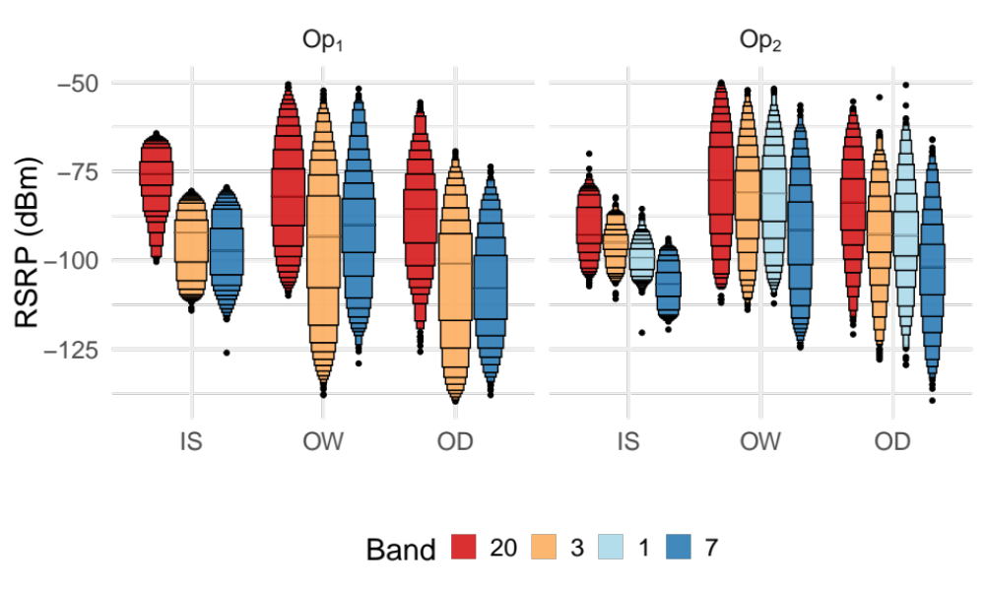
Radio Coverage - 4G
Radio coverage is defined as the highest (SS-)RSRP among all detected PCIs.
Decreasing pattern for RSRP as the frequency increases
Notes:
Across the available carrier frequencies, we observe a decreasing pattern for RSRP as the frequency increases.
Across the two MNOs, there exists a 6.6 dB difference for SS-RSRP in OD in favor of Op2, which ties back to the use of SSB beamforming and further highlights its effect on coverage.

Slide 52
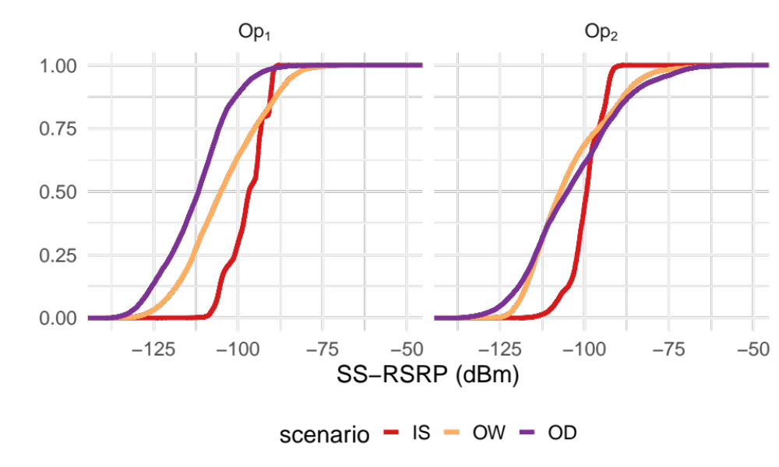
Radio Coverage - 4G
Radio coverage is defined as the highest (SS-)RSRP among all detected PCIs.
6.6 dB difference for SS-RSRP in OD in favor of Op2, which ties back to the use of SSB beamforming
Notes:
Across the available carrier frequencies, we observe a decreasing pattern for RSRP as the frequency increases.
Across the two MNOs, there exists a 6.6 dB difference for SS-RSRP in OD in favor of Op2, which ties back to the use of SSB beamforming and further highlights its effect on coverage.

Slide 53
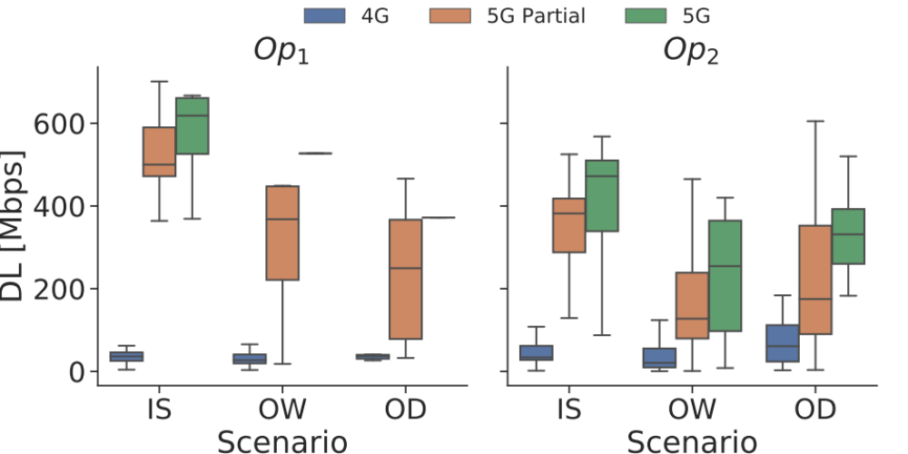
Speedtest Downlink (DL) Throughput
DL throughput decrease as the propagation conditions change (OW/OD)
NSA handover events can have a significant negative effect in throughput
Notes:
In the paper, we present additional results in terms of the allocated bandwidth, MCS, etc. and how they are correlated with throughput.

Slide 54
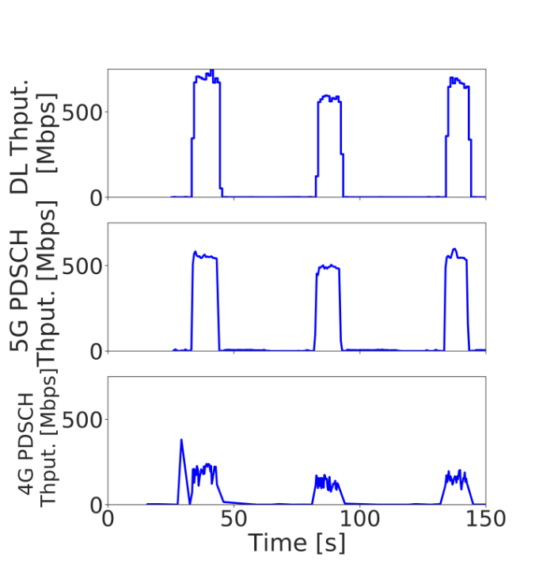
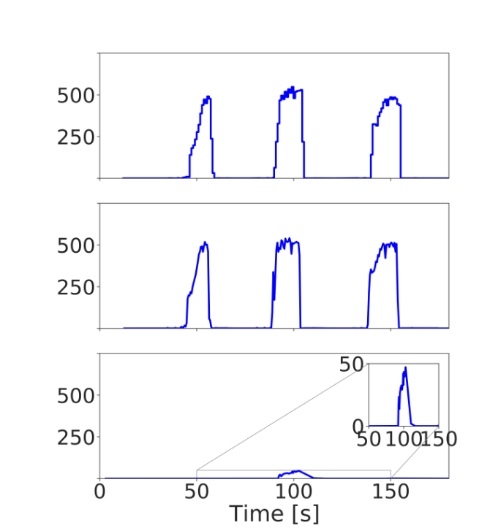
Deployment Strategies for Dual Connectivity (DC)
DC
No DC
Op₁ DC
Op₂ No DC
Notes:
Time series recorded during an IS campaign for both MNOs
(left) downlink throughput at the application layer (first subfigure) consists of the aggregation of throughput from both 5G and 4G (second and third subfigures).
(right) downlink throughput at the application layer (first subfigure) is lower

Slide 55
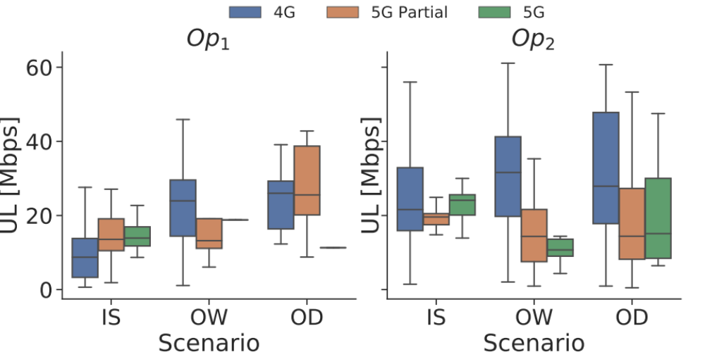
Speedtest Uplink (UL) Throughput
5G NSA uplink require further improvement!!!
Notes:
UL throughput in 5G NSA is not mature – metadata analysis is required
Refer back to the paper

Slide 56
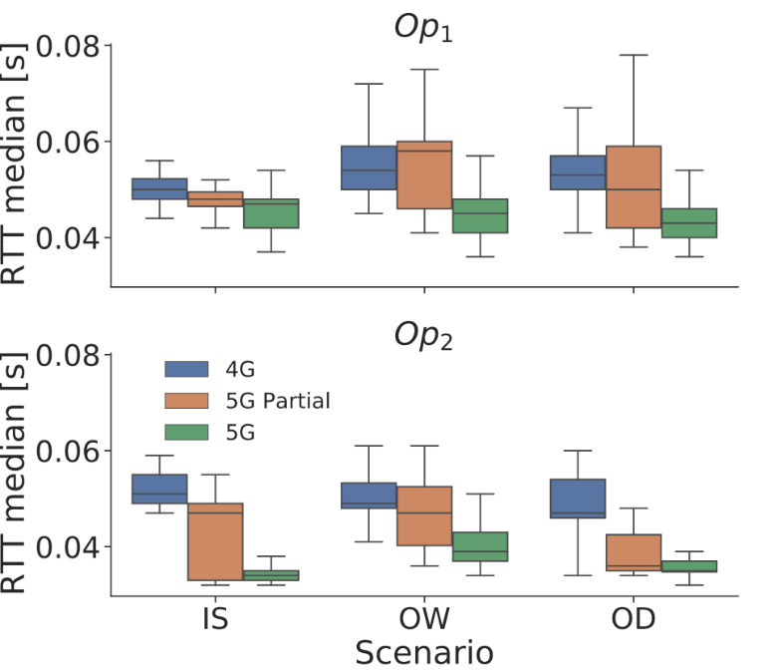
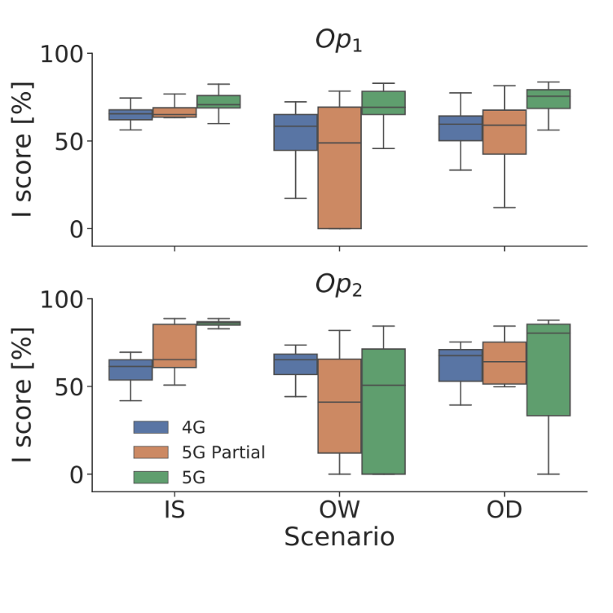
Performance of real time online gaming
5G provides the lowest median RTT and i-score across all scenarios and MNOs
Notes:
However, due to unstable 5G coverage, a high variability is observed for these KPIs in 5G Partial sessions, e.g., in OW/OD for Op₁
i-score

