Slide 1
Department of Informatics
Networks and Distributed Systems (ND) group
IN 3230 / IN 4230
Conclusion / Summary lecture

Slide 2
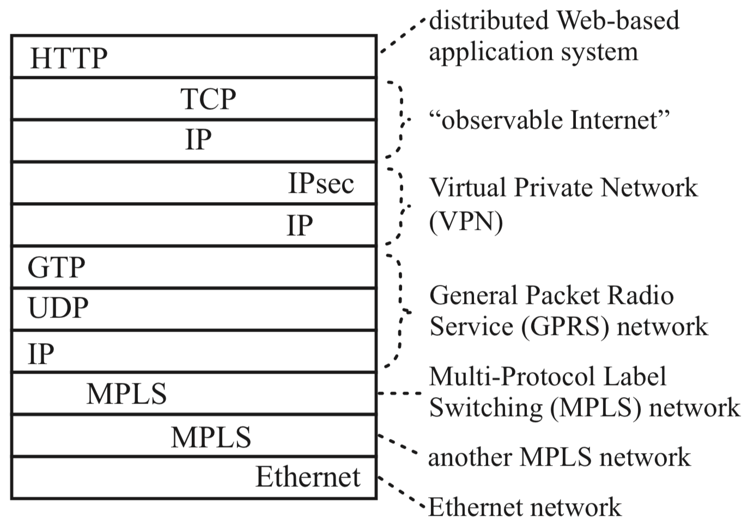
This is where we started
Typical packet from AT&T backbone network
Pamela Zave and Jennifer Rexford. 2019. The compositional architecture of the internet.
Commun. ACM 62, 3 (February 2019), 78-87. DOI: https://doi.org/10.1145/3226588

Slide 3
You have learned about...
Among other things:
TCP
Cellular networks (where GTP is used for tunneling)
MPLS (and VPNs based upon it)
Data centers
... so now, we can show you...
From this book: "Real Internet Architecture: Past, Present, and Future Evolution" by Pamela Zave & Jennifer Rexford, Princeton University Press, 2024, ISBN 9780691255804

Slide 4
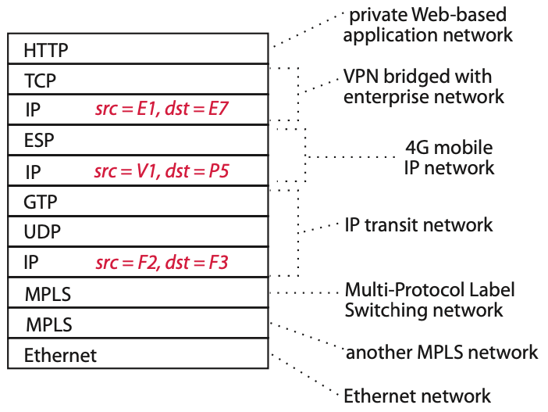
The packet again, but with addresses

Slide 5
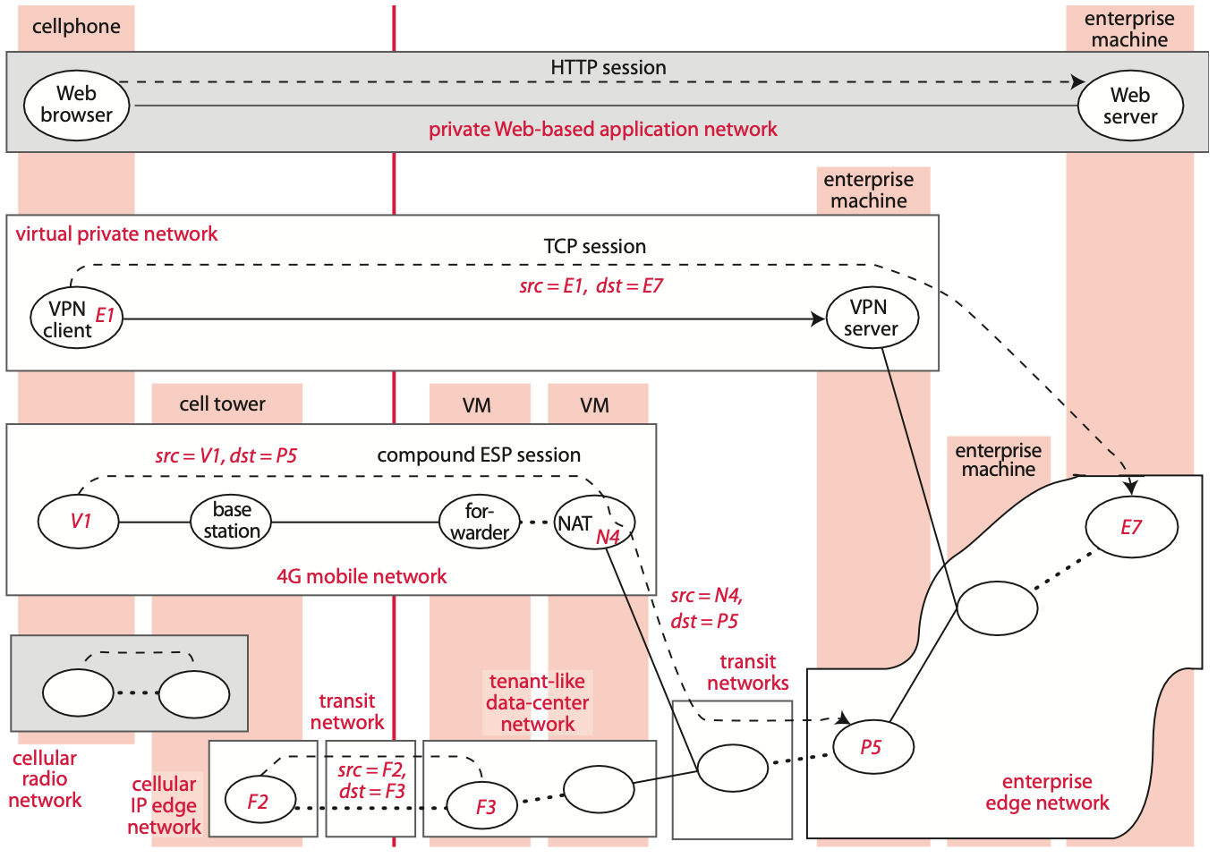

Slide 6
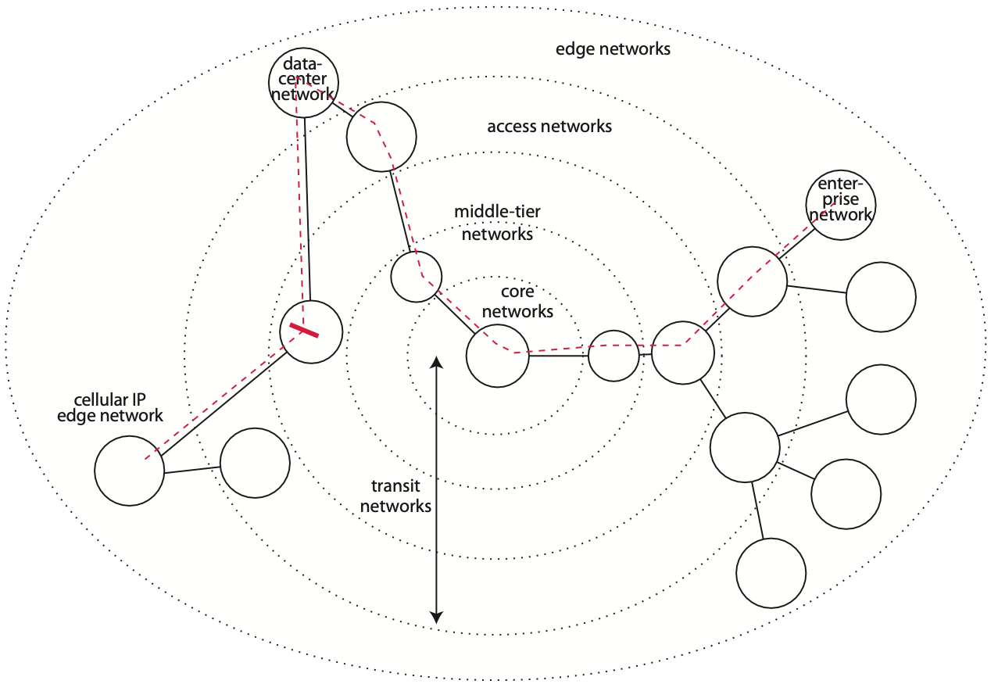
The Internet path of this packet

Slide 7
Thank you!

