Slide 1

Introduction to MPLS
Tor Skeie
University of Oslo, Department of informatics
This presentation is based on Santanu Dasgupta´s
slide series that describe the Multiprotocol Label Switching (MPLS) concept,
Santanu Dasgupta is a Distinguished Architect at Cisco

Slide 2
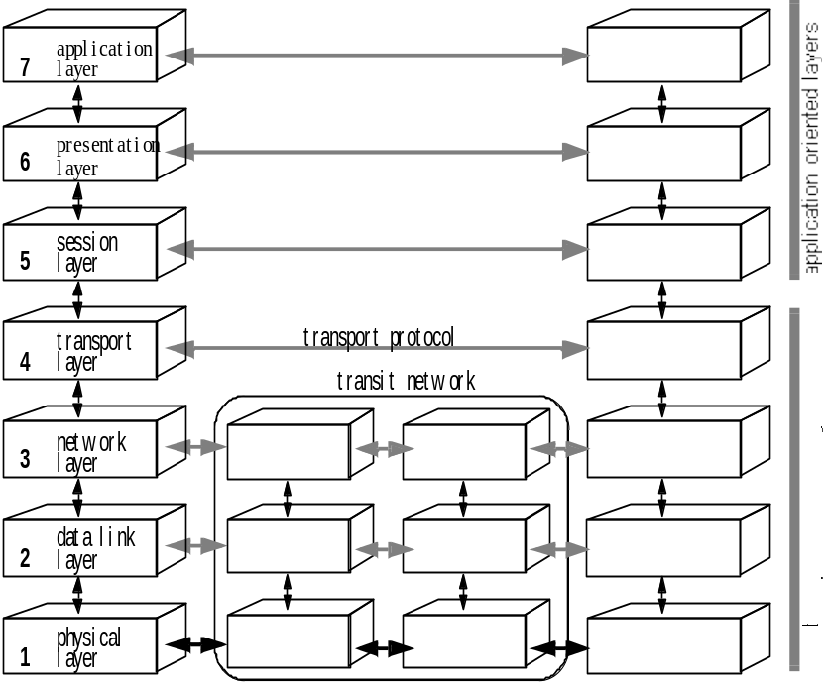
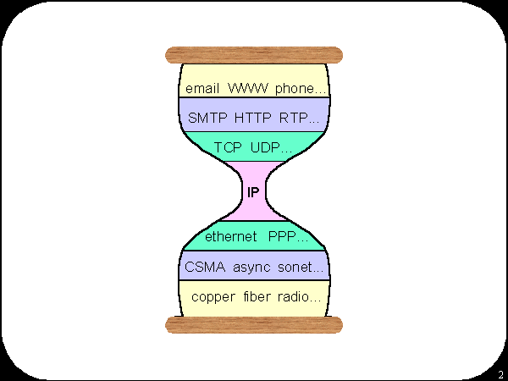
Theory
ISO/OSI model
DoD model
5. Application
4. Transport
3. Network
2. Link Layer

Slide 3
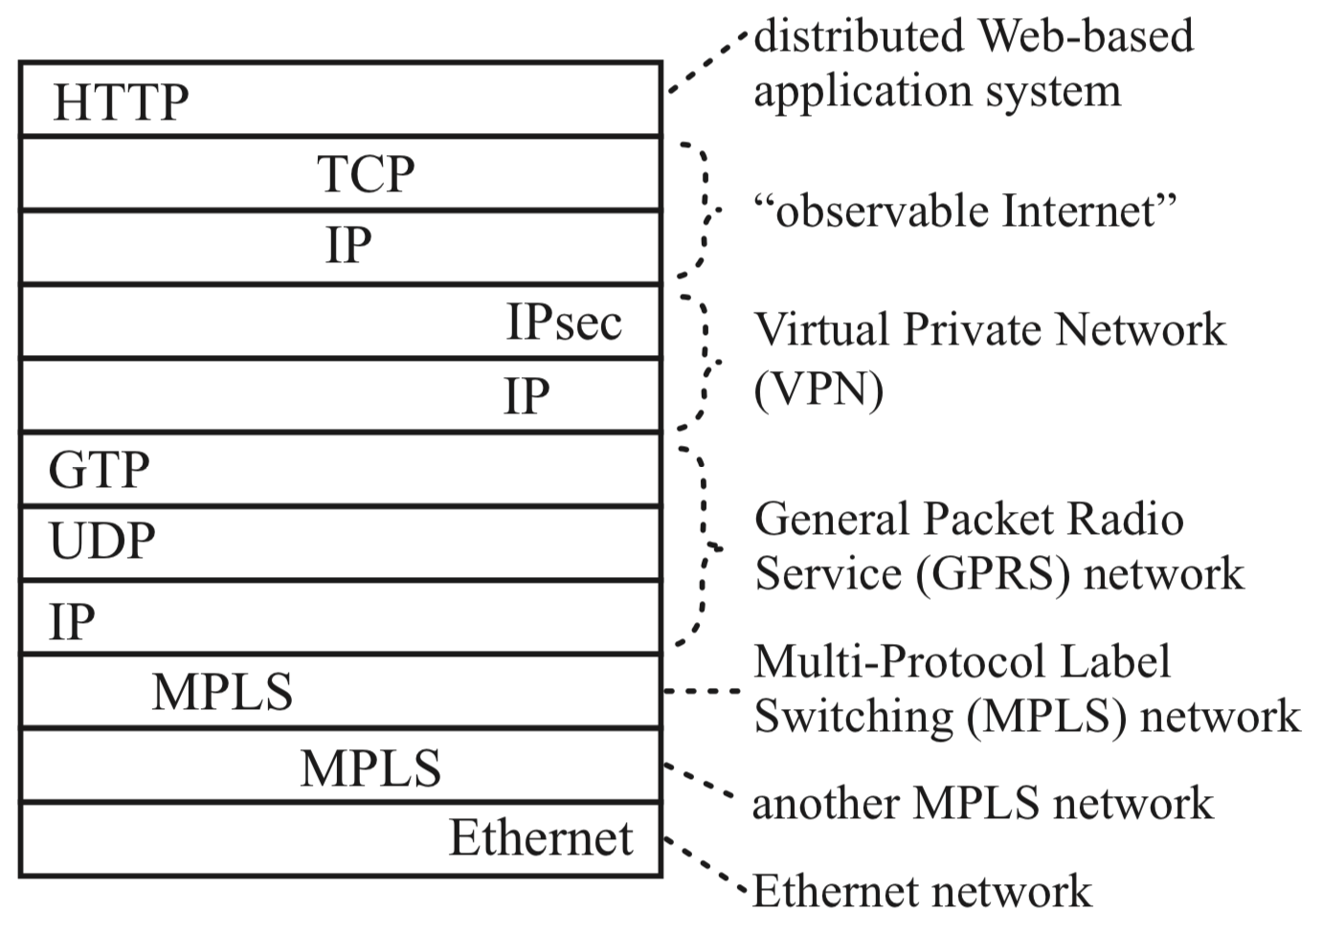
Reality
Typical packet from AT&T backbone network
Pamela Zave and Jennifer Rexford. 2019. The compositional architecture of the internet.
Commun. ACM 62, 3 (February 2019), 78-87. DOI: https://doi.org/10.1145/3226588

Slide 4
Introduction to MPLS
Santanu Dasgupta
sadasgup@cisco.com

Slide 5
Goals of this Lecture
Understand the “business” drivers for MPLS
  Understand the problems MPLS is addressing, herein learn about MPLS customer and market segments
  Understand benefits of deploying MPLS
Understand the major MPLS technology components
Understand typical applications of MPLS

Slide 6
Agenda
Introduction
MPLS Network Components
MPLS Traffic Engineering
MPLS VPNs
  MPLS Layer-3 VPNs
  MPLS Layer-2 VPNs
Summary
Core MPLS
MPLS Network
Services
End-to-end MPLS
Services

Slide 7
Introduction

Slide 8



The Big Picture
End-to-end MPLS VPN Services
End-to-end Services
Layer-3 VPNs
Layer-2 VPNs
MPLS in Core Network
End-to-end MPLS-enabled
Services
MPLS Network Services
Edge
Core
Core
Edge
Edge
MPLS Network Services
Edge
MPLS QoS
MPLS TE
MPLS OAM/MIBs
Layer-3 VPNs
Layer-2 VPNs
MPLS Signaling and Forwarding
Edge
Edge
MPLS QoS
MPLS TE
MPLS OAM/MIBs
Core MPLS
MPLS Signaling and Forwarding
Edge
Core
Core
Edge
MPLS Signaling and Forwarding
Network Infrastructure
Network Infrastructure

Slide 9
Why Multi Protocol Label Switching?
SP/Carrier perspective
  Reduce costs (CAPEX); consolidate networks
  Consolidated network for multiple Layer-2/3 services
  Support increasingly stringent SLAs
  Handle increasing scale/complexity of IP-based services
Enterprise/end-user perspective
  Campus/LAN
  Need for network segmentation (users, applications, etc.)
  WAN connectivity (connecting enterprise networks)
  Need for easier configuration of site-to-site WAN connectivity
Notes:
Carrier perspective
Reduce costs (CAPEX); need for collapsing separate (legacy) networks into a single converged network infrastructure
Need for support of both traditional layer-2 services (ATM, FR) and IP/Layer-3 IP-services over single network infrastructure
Increasingly stringent SLAs; need for ‘layer-2’-type traffic engineering, incl. bandwidth management, failure protection
Increasing scale of IP-based services; need for flexible and scalable service provisioning and maintenance capabilities

Slide 10
What Is MPLS Technology?
It’s all about labels …
Use the best of both worlds
  Layer-2 (ATM/FR): efficient forwarding and traffic engineering
  Layer-3 (IP): flexible and scalable
MPLS forwarding plane
  Use of labels for forwarding Layer-2/3 data traffic
  Labeled packets are being switched instead of routed
  Leverage layer-2 forwarding efficiency
MPLS control/signaling plane
  Use of existing IP control protocols extensions + new protocols to exchange label information
  Leverage layer-3 control protocol flexibility and scalability

Slide 11
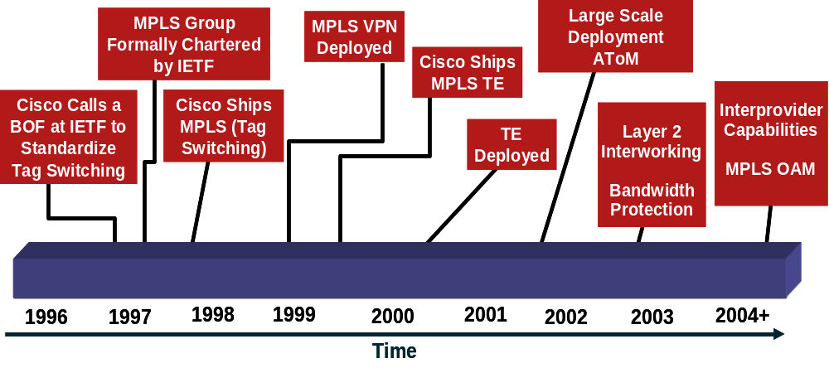
Evolution of MPLS
Evolved from tag switching in 1996 to full IETF standard, covering over 130 RFCs
Key application initially were Layer-3 VPNs, followed by Traffic Engineering (TE), and Layer-2 VPNs

Slide 12
Attractive MPLS Key Features …
For your
reference
only
Service
Providers
Enterprise Data
Center
Data center interconnects
EWAN
Edge
L2/L3VPN’s
TE/FRR
QoS
High Availability
VPN’s
TE/FRR
High Availability
VPN’s / VRF’s
VRF-Aware Security
High Availability
VPN’s / VRF’s
VRF Aware Security
High Availability
Key Features
Hosted Data centers
Data center interconnect
Segmentation for IT
Mergers, Acquisitions, spinoffs
Departmental segmentation
Service multiplexing
Security
Mergers, Acquisitions, spinoffs
Disaster Recovery
Vmotion support
Branch Interconnects
Internet Access
Branch Connectivity
Applications
Network Consolidation – Merging Multiple parallel networks into a shared infrastructure
Network segmentation – By user groups or business function
Service and policy centralization – Security policies and appliances at a central location
New applications readiness – Converged multi-service network
Increased network security – User groups segmentation with VPNs

Slide 13
Enterprise MPLS Customers
Two types of enterprise customers for MPLS technology
MPLS indirectly used as subscribed WAN service
  Enterprise subscribes to WAN connectivity data service offered by external Service Provider
  Data connectivity service implemented by Service Provider via MPLS VPN technology (e.g., layer-2 and layer-3 VPNs)
  VPN Service can be managed or unmanaged
MPLS used as part of self managed network
  Enterprise deploys MPLS in it’s own network
  Enterprise manages it’s own MPLS-based network

Slide 14
MPLS Technology Components
Basic building blocks of MPLS

Slide 15
MPLS Forwarding and Signaling
MPLS label forwarding and signaling mechanisms
Layer-3 VPNs
Layer-2 VPNs
MPLS QoS
MPLS TE
MPLS OAM/MIBs
Core MPLS
MPLS Signaling and Forwarding
Network Infrastructure

Slide 16
Basic Building Blocks
The big picture
  MPLS-enabled network devices
  Label Switched Paths (LSPs)
The internals
  MPLS labels
  Processing of MPLS labels
  Exchange of label mapping information
  Forwarding of labeled packets
Other related protocols to exchange label information
  Between MPLS-enabled devices

Slide 17
MPLS Network Overview
MPLS Domain
PE
P
P
PE
CE
CE
CE
CE
PE
P
P
PE
Label switched traffic
CE (Customer Edge) router
  Connects customer network to MPLS network
PE (Provider Edge) router = edge router (LSR)
  Imposes and removes MPLS labels
P (Provider) router = label switching router = core router (LSR)
  Switches MPLS-labeled packets

Slide 18
MPLS Label and Label Encapsulation
MPLS Label
0 1 2 3
0 1 2 3 4 5 6 7 8 9 0 1 2 3 4 5 6 7 8 9 0 1 2 3 4 5 6 7 8 9 0 1
Label # – 20bits
EXP
S
TTL-8bits
COS/EXP = Class of Service: 3 Bits; S = Bottom of Stack; TTL = Time to Live
MPLS Label Encapsulation
PPP Header
(Packet over SONET/SDH)
PPP Header
Label
Layer 2/L3 Packet
One or More Labels Appended to the Packet
(Between L2/L3 packet and link layer header)
LAN MAC Label Header
MAC Header
Label
Layer 2/L3 Packet

Slide 19
MPLS Label Operations
Label Imposition (Push)
Label Swap
Label Swap
Label Disposition (PoP)
L1
L1
L2
L2
L3
L3
L2/L3 Packet
PE
P
P
PE
CE
CE
CE
CE
PE
P
P
PE
Label imposition (Push)
  By ingress PE router; classify and label packets
Label swapping or switching
  By P router; forward packets using labels; indicates service class & destination
Label disposition (PoP)
  By egress PE router; remove label and forward original packet to destination CE

Slide 20
Forwarding Equivalence Class
Mechanism to map ingress layer-2/3 packets onto a Label Switched Path (LSP) by ingress PE router
  Part of label imposition (Push) operation
Variety of FEC mappings possible
  IP prefix/host address
  Groups of addresses/sites (VPN x)
  Used for L3VPNs
  Layer 2 circuit ID (ATM, FR, PPP, HDLC, Ethernet)
  Used for Pseudowires (L2VPNs)
  Tunnel interface
  Used for MPLS traffic engineering (TE)

Slide 21
Label Distribution Protocol
MPLS nodes need to exchange label information with each other
  Ingress PE node (Push operation)
    Needs to know what label to use for a given FEC to send packet to neighbor
  Core P node (Swap operation)
    Needs to know what label to use for swap operation for incoming labeled packets
  Egress PE node (Pop operation)
    Needs to tell upstream neighbor what label to use for specific FEC type - LDP used for exchange of label (mapping) information
Label Distribution Protocol (LDP)
  Defined in RFC 3035 and RFC3036; updated by RFC5036
  LDP is a superset of the Cisco-specific Tag Distribution Protocol
Note that, in addition LDP, also other protocols are being used for label information exchange
  Will be discussed later

Slide 22
Some More LDP Details
For your
reference
only
Assigns, distributes, and installs (in forwarding) labels for prefixes advertised by unicast routing protocols
  OSPF, IS-IS, EIGRP, etc.
Also used for Pseudowire/PW (VC) signaling
  Used for L2VPN control plane signaling
Uses UDP (port 646) for session discovery and TCP (port 646) for exchange of LDP messages
LDP operations
  LDP Peer Discovery
  LDP Session Establishment
  MPLS Label Allocation, Distribution, and Updating MPLS forwarding
Information repositories used by LDP
  LIB: Label Information Database (read/write)
  RIB: Routing Information Database/routing table (read-only)

Slide 23
LDP Operations
LDP startup
  Local labels assigned to RIB prefixes and stored in LIB
  Peer discovery and session setup
  Exchange of MPLS label bindings
Programming of MPLS forwarding
  Based on LIB info
  CEF/MFI updates
MPLS Node A
MPLS Node B
LDP Control Plane
RIB
Session Setup
RIB
LIB
LIB
Label Binding
Exchange
LDP Interactions
with
MPLS Forwarding
MPLS Forwarding
CEF/MFI
MPLS Forwarding
CEF/MFI
Notes:
This diagram depicts the most important interactions internal and external to a node.
LDP keeps local labels mapping and remote bindings learned from its peers in a data structure call the LIB (Label Information Base). The contents of LIB are kept up to date with interaction with RIB. On route up and down the contents are change as seen necessary. On the other hand the remote bindings are updated as peers go away, new peers come up, or a peer decides to use a different label for a specific prefix.
LDP also interacts with the MFI/CEF to ensure that if an mpls path is available for a route known by IGP, the incoming and outgoing label are made available. LDP is also responsible to update this information if there is a route change or a change by a peer dictates change in the forwarding.
The programming of the forwarding is normally done using the pull model. In other words when there is a change either in LDP control plane or igp, the forwarding infrastructure is asked to pull the label information from LDP and program into forwarding.

Slide 24
MPLS Control and Forwarding Plane
MPLS control plane
  Used for distributing labels
  and building label-switched
  paths (LSPs)
  Typically supported by LDP; also supported via RSVP and BGP
  Labels define destination
  and service
MPLS forwarding plane
  Used for label imposition, swapping, and disposition
  Labels separate forwarding
  from IP address-based routing
  MFI – MPLS Forwarding Infrastructure
Routing
Process
Routing
Updates/
Adjacencies
RIB
MPLS
Process
Label Binding
Updates/
Adjacencies
LIB
MFI
FIB
MPLS Traffic
Forwarding
IP Traffic
Forwarding

Slide 25

IP Packet Forwarding Example
FIB
FIB
FIB
Address
Prefix
I/F
Address
Prefix
I/F
Address
Prefix
I/F
128.89
0
128.89
1
128.89
0
171.69
1
171.69
1
171.69
1
…
…
…
128.89
0
0
128.89.25.4
Data
1
128.89.25.4
Data
1
128.89.25.4
Data
128.89.25.4
Data
Packets Forwarded Based on IP Address (via RIB lookup)
171.69
Notes:
Now when a packet comes into a router a look up is done based on the IP address in the packet, at match is obtained, and the packet is forwarded out the appropriate interface.
The packet follows the same process on a hop-by-hop bases through the network until it reaches its destination.

Slide 26
Step 1: IP Routing (IGP) Convergence
MFI/FIB
MFI/FIB
MFI/FIB
In
Label
Address
Prefix
Out
I’face
Out
Label
In
Label
Address
Prefix
Out
I’face
Out
Label
In
Label
Address
Prefix
Out
I’face
Out
Label
128.89
1
128.89
0
128.89
0
171.69
1
171.69
1
…
…
…
…
…
…
0
128.89
1
0
You Can Reach 128.89 Thru Me
You Can Reach 128.89 and
171.69 Thru Me
1
Routing Updates (OSPF, EIGRP, …)
You Can Reach 171.69 Thru Me
171.69
Notes:
Tag edge routers and tag switches use standard IP routing protocols to identify routes through the network. Theses fully interoperate with non-tag switching routers
So what tag switching does is it extends the forwarding table by adding a tag field. One for the incoming tag and one for the outgoing tag. Note the topology of the network is discovered using unmodified layer 3 protocols such as OSPF.

Slide 27
Step 2a: LDP Assigns Local Labels
MFI/FIB
MFI/FIB
MFI/FIB
In
Label
Address
Prefix
Out
I’face
Out
Label
In
Label
Address
Prefix
Out
I’face
Out
Label
In
Label
Address
Prefix
Out
I’face
Out
Label
-
128.89
1
4
128.89
0
9
128.89
0
-
-
171.69
1
5
171.69
1
…
…
…
…
…
…
…
…
…
…
…
…
0
128.89
1
0
1
171.69
Notes:
Tag routers and switches use the tables generated by the standard routing protocols to assign and distribute tag information via the tag distribution protocol (TDP). Tag routers receive the TDP information and build a forwarding database, which makes use of the tags.
TDP is then used to bind tags to routes and distribute this information to each routers upstream neighbor.

Slide 28
Step 2b: LDP Assigns Remote Labels
MFI/FIB
MFI/FIB
MFI/FIB
In
Label
Address
Prefix
Out
I’face
Out
Label
In
Label
Address
Prefix
Out
I’face
Out
Label
In
Label
Address
Prefix
Out
I’face
Out
Label
-
128.89
1
4
4
128.89
0
9
9
128.89
0
-
-
171.69
1
5
5
171.69
1
7
…
…
…
…
…
…
…
…
…
…
…
…
0
128.89
1
0
Use Label 9 for 128.89
Use Label 4 for 128.89 and
Use Label 5 for 171.69
1
Label Distribution Protocol (LDP)
(Downstream Allocation)
Use Label 7 for 171.69
171.69
Notes:
Tag routers and switches use the tables generated by the standard routing protocols to assign and distribute tag information via the tag distribution protocol (TDP). Tag routers receive the TDP information and build a forwarding database, which makes use of the tags.
TDP is then used to bind tags to routes and distribute this information to each routers upstream neighbor.

Slide 29
Step 3: Forwarding MPLS Packets
MFI/FIB
MFI/FIB
MFI/FIB
In
Label
Address
Prefix
Out
I’face
Out
Label
In
Label
Address
Prefix
Out
I’face
Out
Label
In
Label
Address
Prefix
Out
I’face
Out
Label
-
128.89
1
4
4
128.89
0
9
9
128.89
0
-
-
171.69
1
5
5
171.69
1
7
…
…
…
…
…
…
…
…
…
…
…
…
0
128.89
0
128.89.25.4
Data
1
9
128.89.25.4
Data
128.89.25.4
Data
4
128.89.25.4
Data
1
Label Switch Forwards Based on Label
171.69
Notes:
When we get to the first router, the one performing the tag imposition, there’s an IP look-up based on the IP prefix. It finds the forwarding table entry and it discovers that to get to the destination it should use tag x. It sticks that tag on the front of the packet and forwards it along to the next hop tag switch.
At this point the router can just do pure tag forwarding, gets in the packet with tag x, figures our that the outgoing interface is y, and the outgoing tag replaces the incoming tag. Note packet is forwarded based solely on the tag without re-analyzing the network layer header. This provides the essential separation of routing and forwarding referred to earlier.
The packet reaches the tag edge router at the egress point of the network ,where the tag is stripped off and the packet delivered.

Slide 30
Summary Steps For MPLS Forwarding
Each node maintains IP routing information via IGP (Interior Gateway Protocol)
  IP routing table (RIB) and IP forwarding table (FIB)
LDP leverages IGP routing information
LDP label mapping exchange (between MPLS nodes) takes place after IGP has converged
  LDP depends on IGP convergence
  Label binding information stored in LIB
Once LDP has received remote label binding information MPLS forwarding is updated
  Label bindings are received from remote LDP peers
  MPLS forwarding via MFI (MPLS Forwarding Infrastructure)

Slide 31
MPLS Network Protocols
MP-iBGP
OSPF, IS-IS,
EIGRP, EIGRP
PE
P
P
PE
CE
CE
LDP, RSVP
CE
CE
PE
P
P
PE
Label switched traffic
IGP: OSPF, EIGRP, IS-IS on core facing and core links
LDP on core and/or core facing links
MP-iBGP on PE devices (for MPLS services), MP-BGP: Multiprotocol Border Gateway Protocol, used for MPLS L3 VPN

Slide 32
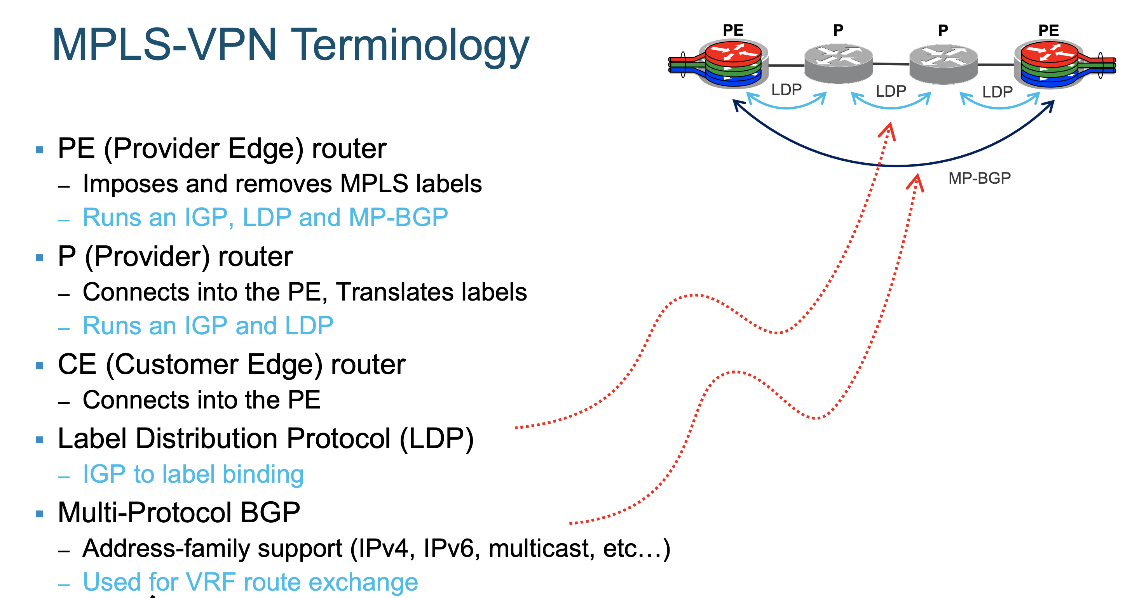
MPLS Network Protocols

Slide 33
Label Stacking
More than one label can be used for MPLS packet encapsulation
  Creation of a label stack
Recap: labels correspond to Forwarding Equivalence Class (FEC)
  Each label in stack used for different purposes
Outer label always used for forwarding MPLS packets in network
Remaining inner labels used to implement specific services/FECs, etc.
Last label in stack marked with EOS bit
Allows building services such as
  MPLS VPNs; LDP + VPN label
  Traffic engineering (FRR): LDP + TE label
  VPNs over TE core: LDP + TE + VPN label
  Any transport over MPLS: LDP + PW label
Outer Label
LDP Label
TE Label
VPN Label
Layer 2/3
Packet Header
Inner Label

Slide 34
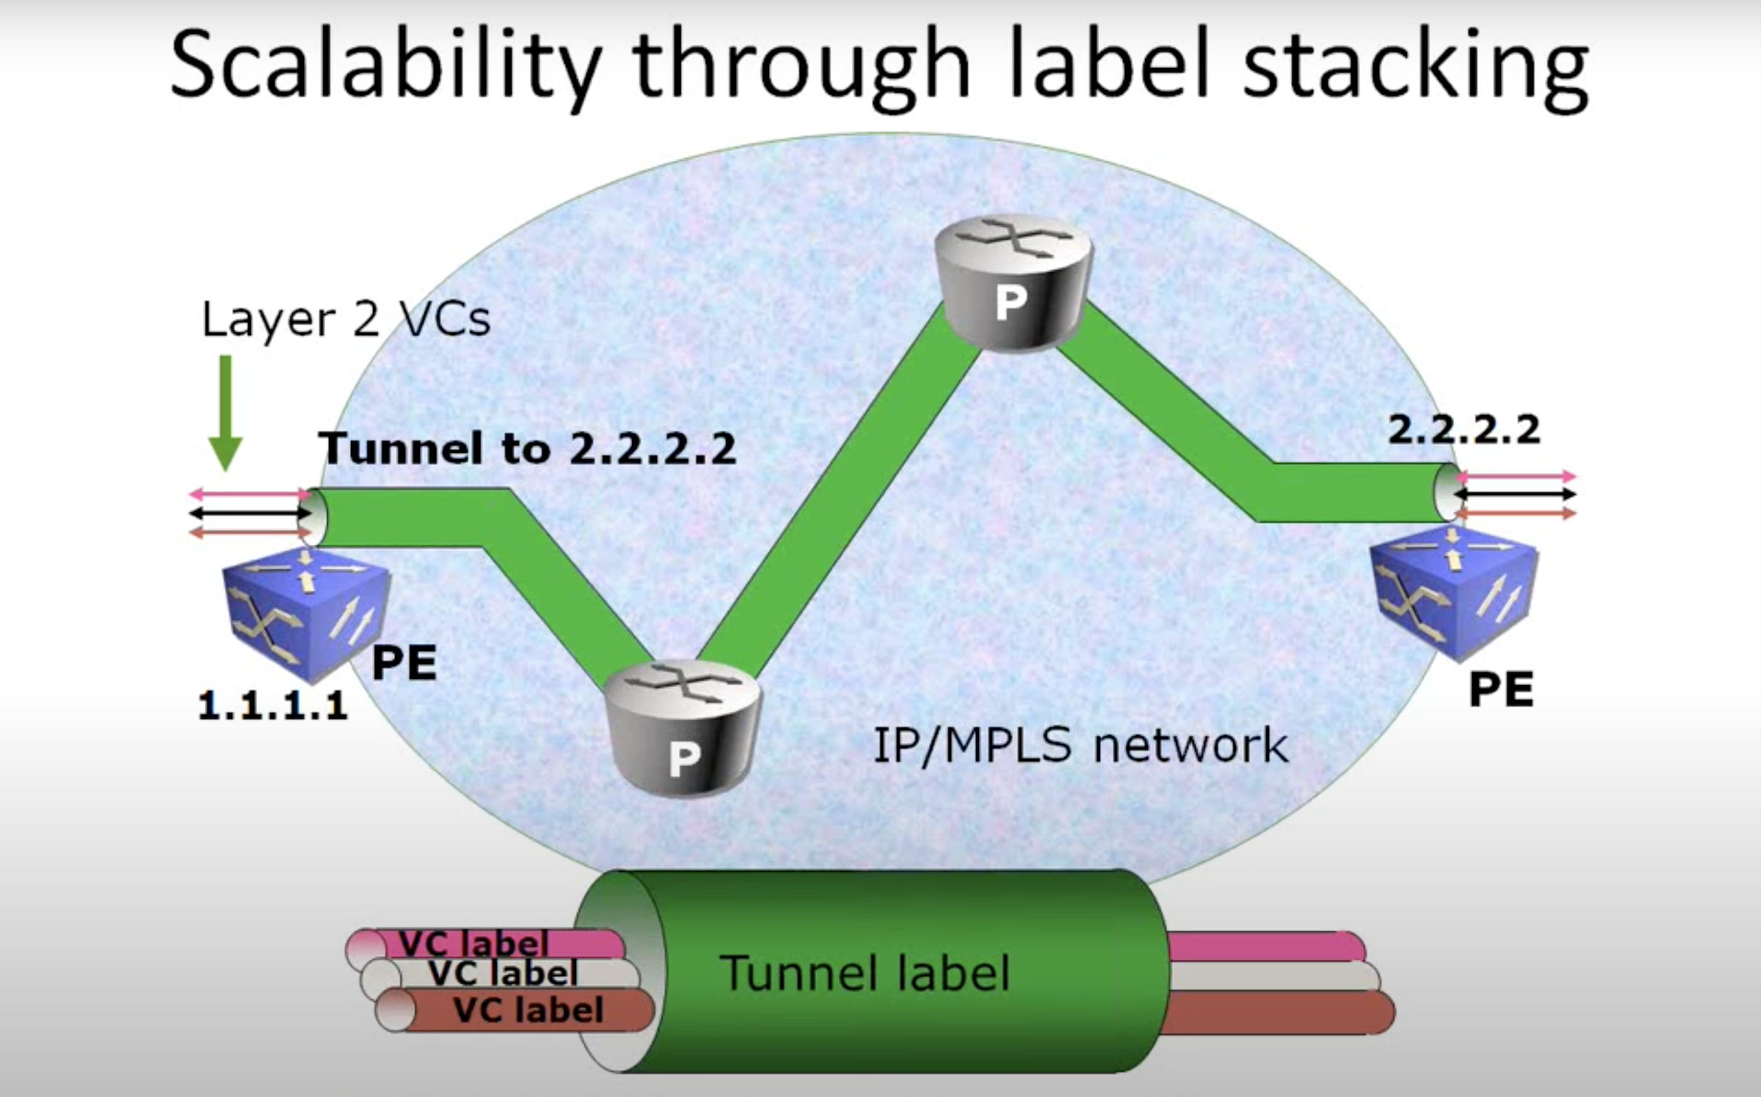
Tunnel (outer) label determines the path to remote edge
VC (inner) label designates connection at tunnel endpoint

Slide 35
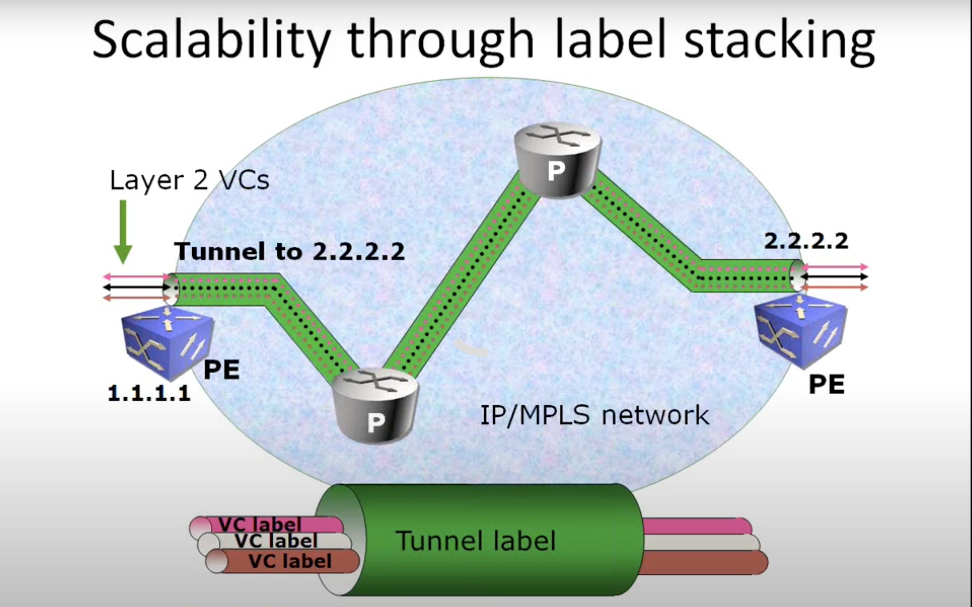
Tunnel (outer) label determines the path to remote edge
VC (inner) label designates connection at tunnel endpoint

Slide 36
Summary
MPLS uses labels to forward traffic
More than one label can be used for traffic encapsulation; multiple labels make up a label stack
Traffic is encapsulated with label(s) at ingress and at egress labels are removed in MPLS network
MPLS network consists of PE router at ingress/egress and P routers in the core
MPLS control plane used for signaling label mapping information to set up end-to-end Label Switched Paths
MPLS forwarding plane used for label imposition (PUSH), swapping, and disposition (POP) operation

Slide 37
MPLS Traffic Engineering
Technology Overview and Applications

Slide 38
MPLS Technology Framework
Traffic engineering capabilities for bandwidth management and network failure protection
Layer-3 VPNs
Layer-2 VPNs
MPLS QoS
MPLS TE
MPLS OAM/MIBs
MPLS Signaling and Forwarding

Network Infrastructure

Slide 39
Why Traffic Engineering?
Congestion in the network due to changing traffic patterns
  Election news, online trading, major sports events
Better utilization of available bandwidth
  Route on the non-shortest path
Route around failed links/nodes
  Fast rerouting around failures, transparently to users
  Like SONET APS (Automatic Protection Switching)
Build new services—virtual leased line services
  VoIP toll-bypass applications, point-to-point bandwidth guarantees
Capacity planning
  TE improves aggregate availability of the network

Slide 40
The Problem with Shortest-Path
IP (Mostly) Uses Destination-Based Least-Cost Routing Alternate Path Under Utilized
Node | Next-Hop | Cost
B | B | 10
C | C | 10
D | C | 20
E | B | 20
F | B | 30
G | B | 30
Some links are DS3 (45 Mbps), some are OC-3 (155 Mbps)
Router A has 40M of traffic for
router F, 40M of traffic for router G
Massive (44%) packet loss at router B→router E!
  Changing to A->C->D->E won’t help
Router B
Router F
OC-3
35 Mb Drops!
OC-3
Router A
Router E
DS3
80 Mb Traffic
Router G
OC-3
OC-3
DS3
Router C
DS3
Router D

Slide 41
How MPLS TE Solves the Problem
Router A sees all links
Router A computes paths on properties other than just
shortest cost; creation of 2 tunnels
No link oversubscribed!
Node | Next-Hop | Cost
B | B | 10
C | C | 10
D | C | 20
E | B | 20
G | Tunnel 0 | 30
F | Tunnel 1 | 30
Router B
Router F
OC-3
OC-3
Router A
Router E
DS3
40 Mb
Router G
40 Mb
OC-3
OC-3
DS3
Router C
DS3
Router C
Router D
Router D

Slide 42

How MPLS TE Works
Link information Distribution*
  ISIS-TE
  OSPF-TE
Path Calculation (CSPF)*
Path Setup
Forwarding Traffic
down Tunnel
  Auto-route
  Static
  PBR
  CBTS / PBTS
  Forwarding Adjacency
  Tunnel select
Head end
IP/MPLS
Mid-point
Tail end
TE LSP
* Optional

Slide 43
Link Information Distribution
For your
reference
only
Additional link characteristics
  Interface address
  Neighbor address
  Physical bandwidth
  Maximum reservable bandwidth
  Unreserved bandwidth
  (at eight priorities)
  TE metric
  Administrative group (attribute flags)
IS-IS or OSPF flood link information
TE nodes build a topology database
Not required if using off-line path computation
IP/MPLS
TE Topology database
http://www.cisco.com/go/mpls

Slide 44
Path Calculation
Find shortest path to R8 with 8Mbps
TE nodes can perform constraint-based routing
Constraints and topology database as input to path computation
Shortest-path-first algorithm ignores links not meeting constraints
Tunnel can be signaled once a path is found
IP/MPLS
R1
15
5
3
R8
10
10
10
8
10
TE Topology database
n
Link with insufficient bandwidth
n
Link with sufficient bandwidth
http://www.cisco.com/go/mpls

Slide 45
TE LSP Signaling
For your
reference
only
Tunnel signaled with TE extensions to RSVP
Soft state maintained with downstream PATH messages
Soft state maintained with upstream RESV messages
New RSVP objects
  LABEL_REQUEST (PATH)
  LABEL (RESV)
  EXPLICIT_ROUTE
  RECORD_ROUTE (PATH/RESV)
  SESSION_ATTRIBUTE (PATH)
LFIB populated using
RSVP labels allocated by RESV messages
Head end
IP/MPLS
L=16
Tail end
RESV
PATH
Input Label | Out Label, Interface
17 | 16, 0
TE LSP
http://www.cisco.com/go/mpls

Slide 46
MPLS TE FRR - Link Protection
Router A
Router B
Router D
Router E
Router X
Router Y
Router C
Primary tunnel: A → B → D → E
Backup tunnel: B → C → D (preprovisioned)
Recovery = ~ 50 ms
*Actual Time Varies—Well Below 50 ms in Lab Tests, Can Also Be Higher

Slide 47


Use Case 1: Tactical TE Deployment
Requirement: Need to Handle Scattered Congestion Points in the Network
Solution: Deploy MPLS TE on Only Those Nodes that Face Congestion
MPLS Traffic Engineering
Tunnel Relieves Congestion Points
Bulk of Traffic Flow
e.g. Internet Download
Internet
Service Provider
Backbone
Oversubscribed
Shortest Links

Slide 48


Use Case 2: 1-Hop Tunnel Deployment
Requirement: Need Protection Only — Minimize Packet Loss of Bandwidth in the Core
Solution: Deploy MPLS Fast Reroute for Less than 50ms Failover Time with 1-Hop Primary TE Tunnels and Backup Tunnel for Each
Service Provider
Backbone
VPN Site A
Primary 1-Hop TE Tunnel
Backup Tunnel
Physical Links
VPN Site B

Slide 49
MPLS TE Summary
MPLS TE can be used to implement traffic engineering to enable enhanced network availability, utilization, and performance
Enhanced network availability can be implemented via MPLS TE Fast Re-Route (FRR)
  Link, node, and path protection
  Automatically route around failed links/nodes; like SONET APS
Better network bandwidth utilization can be implemented via creation of MPLS TE tunnels using explicit routes
  Route on the non-shortest path
MPLS TE can be used for capacity planning by creation of bandwidth-specific tunnels with explicit paths through the network
  Bandwidth management across links and end-to-end paths

Slide 50
MPLS VPNs
Overviews

Slide 51
MPLS Technology Framework
End-to-end data connectivity services across MPLS networks (from PE to PE)
End-to-end Services
Layer-3 VPNs
Layer-2 VPNs
MPLS QoS
MPLS TE
MPLS OAM/MIBs

MPLS Signaling and Forwarding

Network Infrastructure

Slide 52
What Is a Virtual Private Network?
VPN is a set of sites or groups which are allowed to communicate with each other in a secure way
  Typically, over a shared public or private network infrastructure
VPN is defined by a set of administrative policies
  Policies established by VPN customers themselves (DIY)
  Policies implemented by VPN service provider (managed/unmanaged)
Different inter-site connectivity schemes possible
  Ranging from complete to partial mesh
Sites may be either within the same or in different organizations
  VPN can be either intranet or extranet
Site / user may be in more than one VPN
  VPNs may overlap
Not all sites have to be connected to the same service provider
  VPN can span multiple providers

Slide 53
MPLS VPN Example
CE-PE
Link
CE-PE
Link
VPN
PE
P
P
PE
CE
CE
CE
CE
PE
P
P
PE
Label switched traffic
CE-PE link
  Connect customer network to SP network; layer-2 or layer-3
VPN
  Dedicated secure connectivity over shared infrastructure

Slide 54
VPN Route Distribution
VPN Route Exchange
Customer
Route
Exchange
Customer
Route
Exchange
BGP RR
PE
P
P
PE
CE
VPN 1
CE
VRF
VRF
CE
VPN 2
CE
VRF
VRF
PE
P
P
PE
Label switched traffic
MP-iBGP Session
Full mesh of BGP sessions among all PE routers
  Typically BGP Route Reflector (RR) used for improved scalability

Slide 55
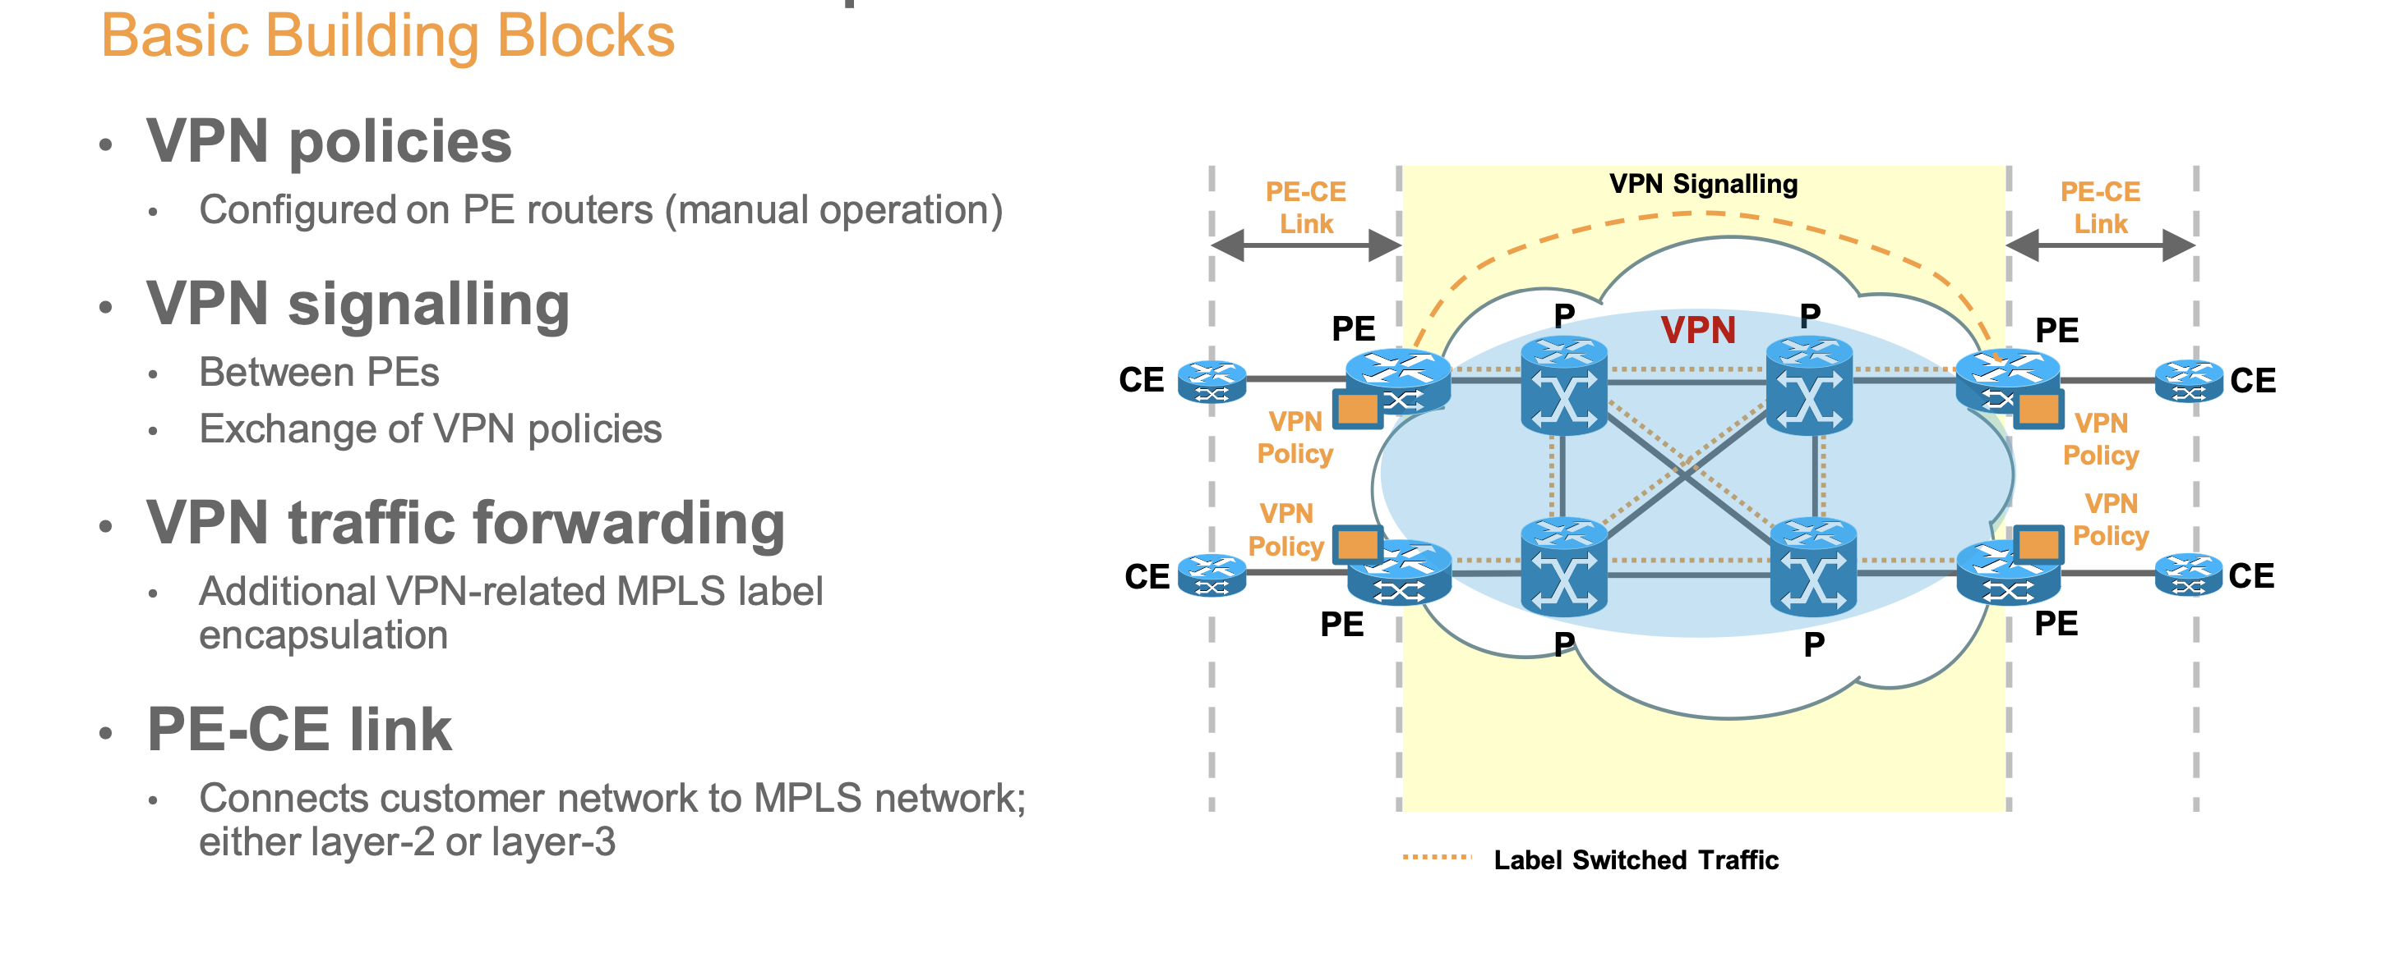
MPLS VPN Example

Slide 56
MPLS VPN Benefits
SP/Carrier perspective
  Reduce costs (CAPEX)
  Leverage same network for multiple services and customers
  Migrate legacy networks onto single converged network
  Reduce costs (OPEX)
  Easier service enablement; only edge node configuration
Enterprise/end-user perspective
  Enables site/campus network segmentation
  Allows for dedicated connectivity for users, applications, etc.
  Enables easier setup of WAN connectivity
  Easier configuration of site-to-site WAN connectivity (for L3VPN); only one WAN connection needed

Slide 57
MPLS VPN Options
MPLS VPN Models
Layer-2 VPNs
Layer-3 VPNs
CE connected to PE via IP-based connection (over any layer-2 type)
  Static routing
  PE-CE routing protocol; eBGP, OSPF, IS-IS
CEs peer with PE router
PE routers maintain customer-specific routing tables and exchange customer=specific routing information
Layer-3 VPN provider’s PE routers are part of customer routing
Point-to-Point
Layer-2 VPNs
Multi-Point
Layer-2 VPNs
CE connected to PE via p2p Layer-2 connection (FR, ATM)
CEs peer with each other (IP routing) via p2p layer-2 VPN connection
CE-CE routing; no SP involvement
CE connected to PE via Ethernet connection (VLAN)
CEs peer with each other via fully/partial mesh Layer-2 VPN connection
CE-CE routing; no SP involvement

Slide 58
MPLS Layer-3 VPNs
Technology Overview and Applications

Slide 59
MPLS L3 VPN Overview
Customer router (CE) has an IP peering connection with PE/edge router in MPLS network
  IP routing/forwarding across PE-CE link
MPLS VPN network responsible for distributing routing information to remote VPN sites
  MPLS VPN part of customer IP routing domain
MPLS VPNs enable full-mesh, hub-and-spoke, and hybrid connectivity among connected CE sites
MPLS VPN service enablement in MPLS networks only requires VPN configuration at edge/PE nodes
  Connectivity in core automatically established via BGP signaling

Slide 60
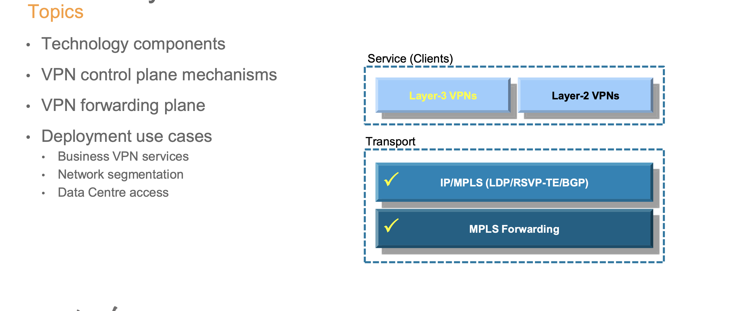
MPLS Layer-3 Virtual Private Networks

Slide 61
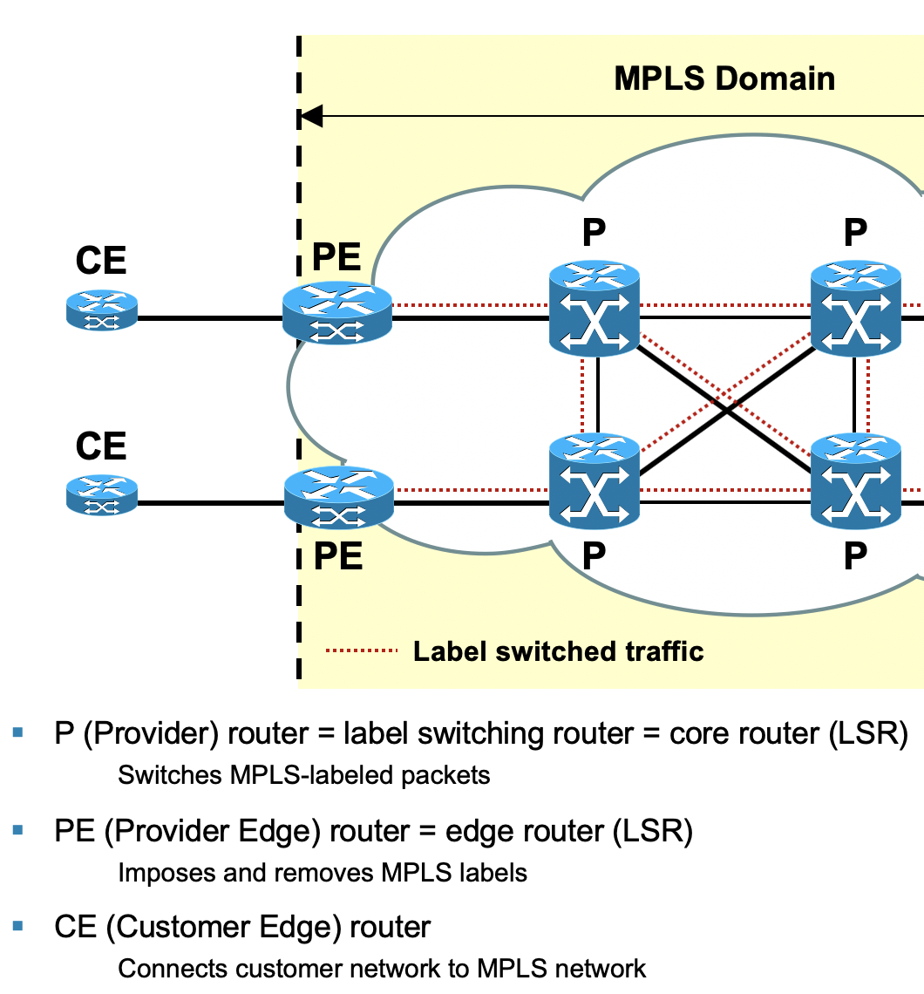
MPLS L3 VPN Technology Components
PE-CE link
  Can be any type of layer-2 connection (e.g., FR,
  Ethernet)
  CE configured to route IP traffic to/from adjacent PE
  Variety of routing options; static routes, eBGP, OSPF,
  IS-IS
MPLS L3VPN Control Plane
  Separation of customer routing via virtual VPN routing table
  In PE router: customer I/Fs connected to virtual routing table
  Between PE routers: customer routes exchanged via BGP
MPLS L3VPN Forwarding Plane
  Separation of customer VPN traffic via additional VPN label
  VPN label used by receiving PE to identify VPN routing table

Slide 62
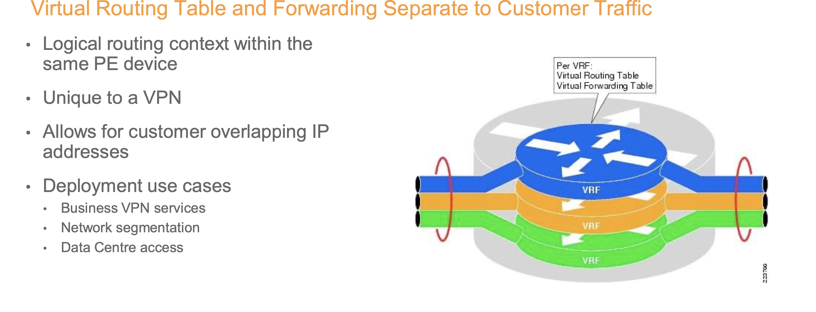
Virtual Routing and Forwarding Instance - VRF

Slide 63
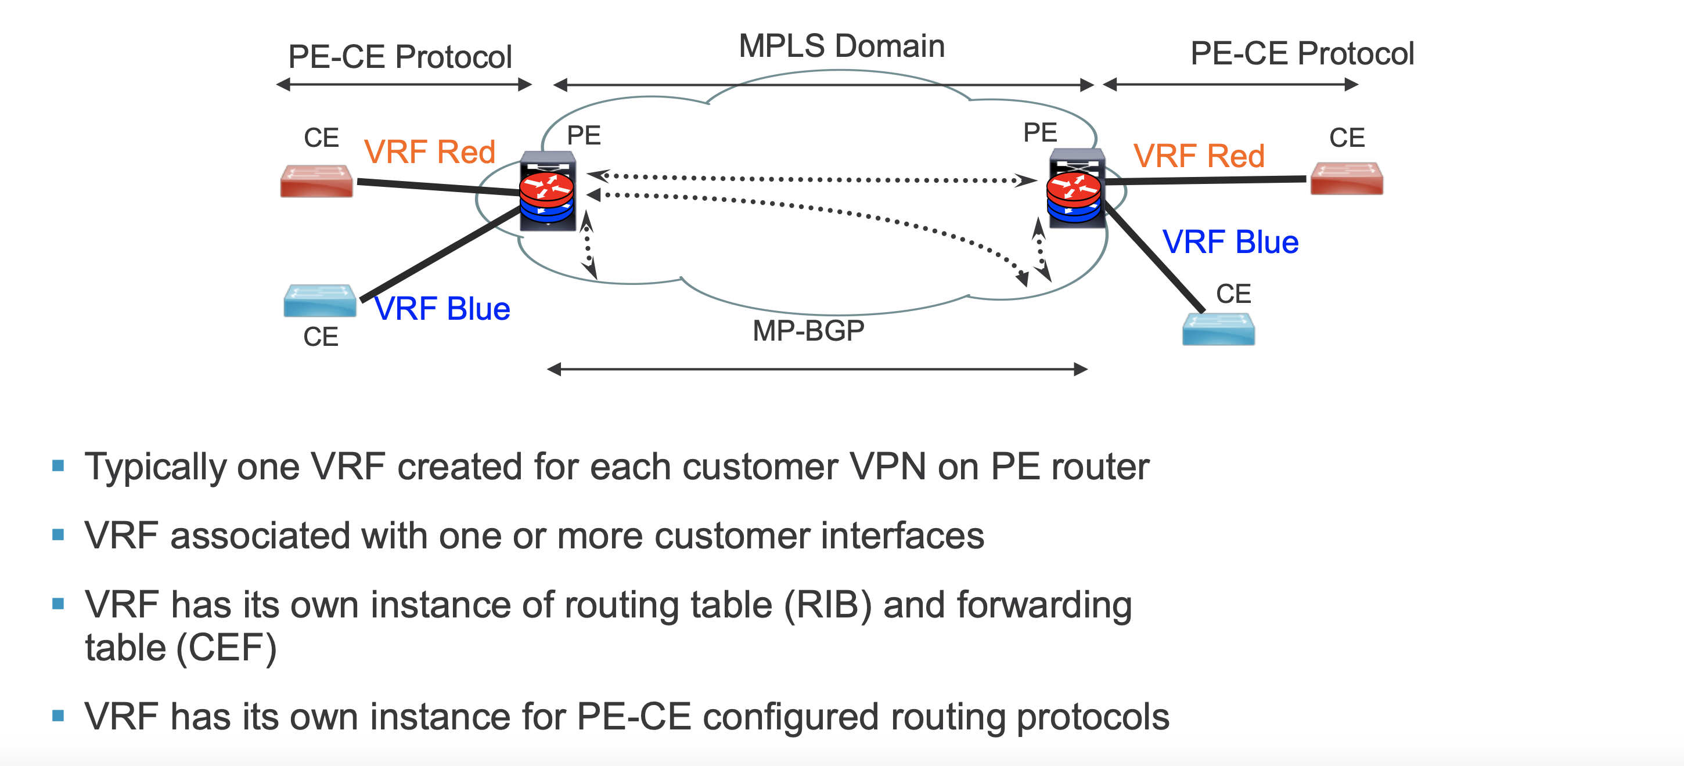
Virtual Routing and Forwarding Instance

Slide 64

Virtual Routing and Forwarding Instance
CE
VPN 1
VRF Green
PE
CE
MPLS Backbone IGP
VPN 2
VRF Blue
Virtual Routing and Forwarding Instance (VRF)
Typically one VRF created for each customer VPN on PE router
VRF associated with one or more customer interfaces
VRF has its own instance of routing table (RIB) and forwarding table (CEF)
VRF has its own instance for PE-CE configured routing protocols

Slide 65
VPN Route Distribution
VPN Route Exchange
Customer
Route
Exchange
Customer
Route
Exchange
BGP RR
PE
P
P
PE
CE
VPN 1
CE
VRF
VRF
CE
VPN 2
CE
VRF
VRF
PE
P
P
PE
Label switched traffic
MP-iBGP Session
Full mesh of BGP sessions among all PE routers
  Multi-Protocol BGP extensions (MP-iBGP)
  Typically BGP Route Reflector (RR) used for improved scalability

Slide 66
VPN Control Plane Processing
BGP advertisement:
VPN-IPv4 Addr = RD:16.1/16
BGP Next-Hop = PE1
Route Target = 100:1
Label=42
eBGP:
16.1/16
IP Subnet
eBGP:
16.1/16
IP Subnet
PE1
P
No VPN Routes
in core (P) nodes
P
PE2
CE1
CE2
VRF
VPN 1
VRF
ip vrf Green
RD 1:100
route-target export 1:100
route-target import 1:100
Make customer routes unique:
Route Distinguisher (RD): 8-byte field, VRF parameters; unique value assigned by a provider to each VPN to make different VPN routes unique
VPNv4 address: RD+VPN IP prefix
Processing Steps:
CE1 redistribute IPv4 route to PE1 via eBGP.
PE1 allocates VPN label for prefix learnt from CE1 to create unique VPNv4 route
PE1 redistributes VPNv4 route into BGP, it sets itself as a next hop and relays VPN site routes to PE2
PE2 receives VPNv4 route and, via processing in local VRF (green), it redistributes original IPv4 route to CE2.

Slide 67
VPN Forwarding Plane Processing
IPv4
IGP
Label C
VPNv4
Label
IPv4
IGP
Label B
VPNv4
Label
IPv4
IGP
Label A
VPNv4
Label
IPv4
IPv4
IPv4
Packet
PE1
P1
P2
PE2
IPv4
Packet
CE1
CE2
VRF
VPN 1
VRF
ip vrf Green
RD 1:100
route-target export 1:100
route-target import 1:100
Processing Steps:
CE2 forwards IPv4 packet to PE2.
PE2 imposes pre-allocated VPN label (learned via BGP) to IPv4 packet received from CE2.
PE2 imposes outer IGP label (learned via LDP) and forwards labeled packet to next-hop P-router P2.
P-routers P2 and P1 swap outer IGP label and forward label packet to PE1.
Router PE1 strips VPN label and forwards IPv4 packet to CE1.

Slide 68


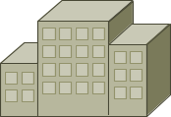




Use Case 1: Traffic Separation
Requirement: Need to ensure data separation between Aerospace, Cosmetics and Financial Services, while leveraging a shared infrastructure
Solution: Create MPLS VPN for each group
Central site - HQ
VRF instances created for each group at the edge
Remote Site 1
Financial
Services
Cosmetics
Aerospace
Cosmetics
Financial Services
VPN_Fin
VPN_Fin
VPN_Cos
VPN_Cos
VPN_Aero
MPLS Backbone
Remote Site 3
Remote Site 2
VPN_Aero
VPN_Cos
VPN_Fin
VPN_Aero
Aerospace
Financial
Services
Cosmetics
Aerospace

Slide 69
Use Case 2: Simplify Central Site Design
Requirement: To ease the scale and design of a central site
Solution: Implement MPLS Layer 3 VPNs, which reduces the number of routing peers of the central site
Without MPLS
With MPLS
Central Site
Central site has high number of routing peers – creates a complicated headend design
Central Site
Central site has
a single routing
peer – enhancing head-end design
MPLS Backbone
Remote Sites
Remote Sites

Slide 70
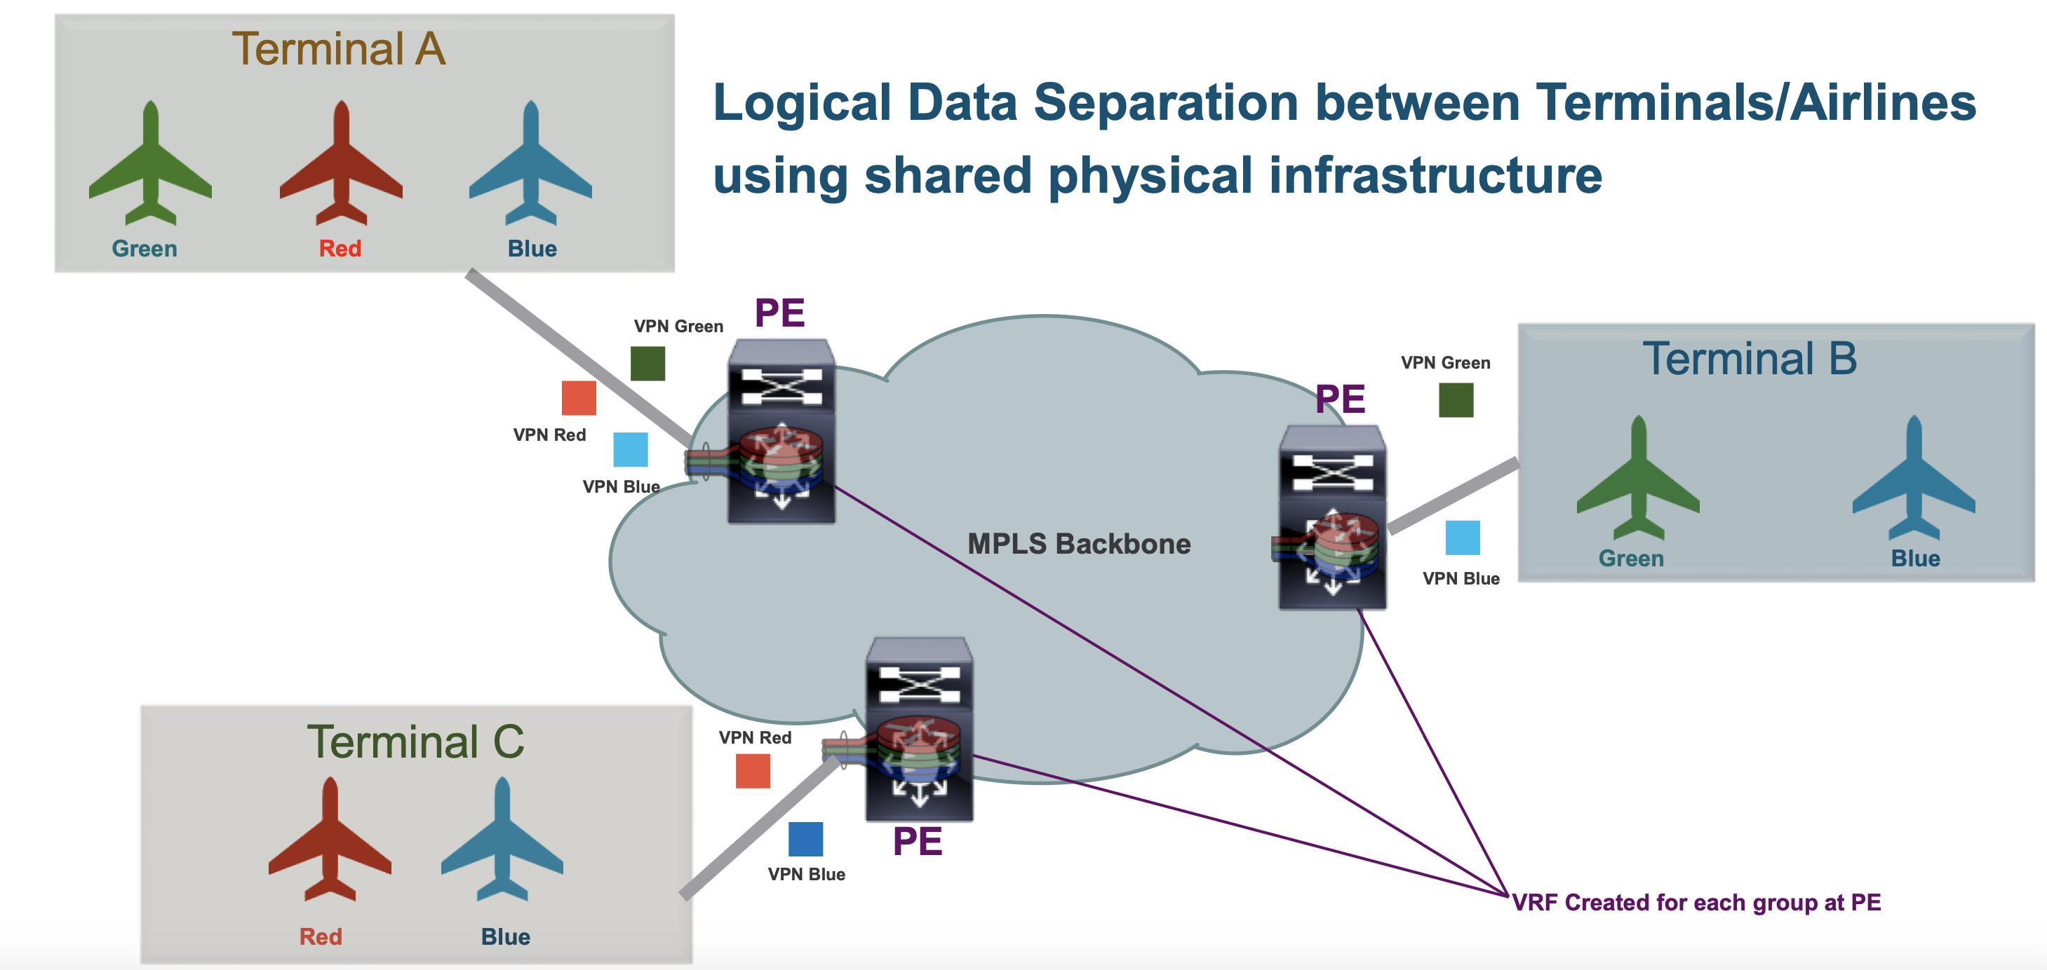
Use Case 3: Traffic Separation with L3 VPN in an Airport
Requirement: To ease the scale and design of head-end site
Solution: Implement MPLS Layer 3 VPNs, which reduces the number of routing peers of the central site

Slide 71
MPLS Layer-3 VPN Summary
Provide layer-3 connectivity among customer sites via Layer-3 VPN (and across PE-CE link)
Implemented via VRFs on edge/PE nodes providing customer route and forwarding segmentation
IP/BGP used for control plane to exchange customer VPN (VPNv4) routes between PE routers
MPLS VPNs enable full-mesh, hub-and-spoke, and hybrid IP connectivity among connected CE sites

Slide 72
MPLS Layer-2 VPNs
Technology Overview and Applications

Slide 73
L2VPN Options
L2VPN Models
VPWS
Virtual Private Wire Service
Point to Point
VPLS
Virtual Private LAN Service
Point to Multipoint
MPLS Core
L2TPv3
AToM
Ethernet
IP Core
MPLS Core
Ethernet
Ethernet
MPLS Layer-2 VPNs
Frame Relay
Frame Relay
ATM (AAL5 and Cell)
ATM (AAL5 and Cell)
PPP and HDLC
PPP and HDLC
Any Transport over MPLS: AToM

Slide 74
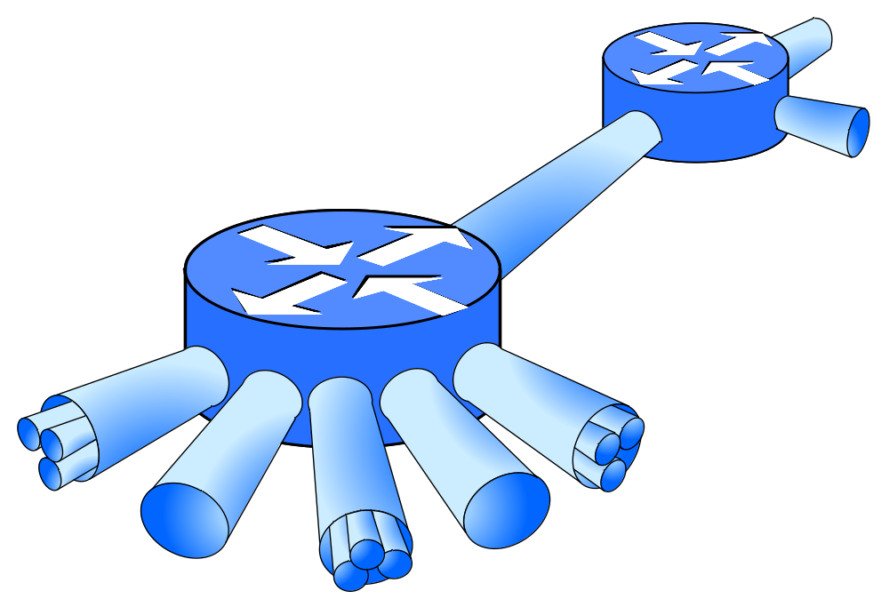
Layer-2 VPN Overview
Enables transport of any Layer-2 traffic over MPLS network
  Includes label encapsulation
  and translation
SP
Interconnection
PE Router
SP
Network
PE Router
Pseudo Wire
Many Subscriber Encapsulations Supportable
ATM
FR
PPP
HDLC
Ethernet

Slide 75



Any Transport over MPLS Architecture
Based on IETF’s Pseudo-Wire (PW) Reference Model
PW is a connection (tunnel) between 2 PE Devices, which connects 2 PW End-Services
  PW connects 2 Attachment Circuits (ACs)
  Bi-directional (for p2p connections)
  Use of PW/VC label for encapsulation
Customer2 Site1
Customer2 Site2
PWES
PSN Tunnel
PWES
Pseudo-Wires
Customer1 Site1
PE
PE
Customer1 Site2
PWES
PWES
Emulated Layer-2 Service

Slide 76
AToM Technology Components
PE-CE link
  Referred to as Attachment Circuit (AC)
  Can be any type of layer-2 connection (e.g., FR, Ethernet)
AToM Control Plane
  Targeted LDP (Label Distribution Protocol) Session
  Virtual Connection (VC)-label negotiation, withdrawal, error notification
AToM Forwarding Plane
  2 labels used for encapsulation
  Outer tunnel (LDP) label
  To get from ingress to egress PE using MPLS LSP
  Inner de-multiplexer (VC) label
  To identify L2 circuit (packet) encapsulated within tunnel label

Slide 77
AToM Control Plane Processing
4
Label Mapping Messages
5
5
2
3
LDP session
2
PE1
P
P
PE2
CE1
CE2
Layer-2
Connection
Layer-2
Connection
Processing Steps (for both P1 and P2):
CE1 and CE2 are connected to PE routers via layer-2 connections
Via CLI, a new virtual circuit cross-connect is configured, connecting customer interface to manually provided VC ID with target remote PE
New targeted LDP session between PE routers established, in case one
does not already exist
PE binds VC label with customer layer-2 interface and sends label-mapping message to remote PE over LDP session
Remote PE receives LDP label binding message and matches VC ID with local configured cross-connect

Slide 78
AToM Forwarding Plane Processing
L2
Tunnel
Label C
VC
Label
L2
Tunnel
Label B
VC
Label
L2
Tunnel
Label A
VC
Label
L2
L2
Layer-2
Packet
PE1
P1
P2
PE2
Layer-2
Packet
CE1
CE2
Processing Steps:
CE2 forwards layer-2 packet to PE2.
PE2 imposes VC (inner) label to layer-2 packet received from CE2 and optionally a control word as well (not shown).
PE2 imposes Tunnel outer label and forwards packet to P2.
P2 and P1 router forwards packet using outer (tunnel) label.
Router PE1 strips Tunnel label and, based on VC label, layer-2 packet is forwarded to customer interface to CE1, after VC label is removed
  In case control word is used, new layer-2 header is generated first.

Slide 79
Use Case: L2 Network Interconnect
Requirement: Need to create connectivity between remote customer sites, currently interconnected via Frame Relay WAN connectivity. Only point-to-point connectivity required.
Solution: Interconnect AToM PW between sites, enabling transparent Frame Relay WAN connectivity.
VC1 – Connects DLCI 101 to DLCI 201
Directed LDP
Label Exchange for VC1 – Label 10
PE1
101
10
50
101
10
90
PE2
DLCI 101
DLCI 201
Neighbor LDP– Label 50
Neighbor LDP– Label 90
CPE Router, FRAD
CPE Router, FRAD
MPLS Backbone

Slide 80
Layer-2 VPN Summary
Enables transport of any Layer-2 traffic over MPLS network
Two types of L2 VPNs; AToM for point-to-point and VPLS point-to-multipoint layer-2 connectivity
Layer-2 VPN forwarding based on Pseudo Wires (PW), which use VC label for L2 packet encapsulation
  LDP used for PW signaling
AToM PWs suited for implementing transparent point-to-point connectivity / service between Layer-2 end-points

