Slide 1

Cloud Computing
Tor Skeie
Based also on slides from
Professor Yogesh Simmhan, Indian Institute of Science

Slide 2

What is Cloud Computing ?
What do they say ?

Slide 3

Cloud Definitions
Definition from NIST (National Institute of Standards and Technology)
  Cloud computing is a model for enabling convenient, on-demand network access to a shared pool of configurable computing resources (e.g., networks, servers, storage, applications, and services) that can be rapidly provisioned and released with minimal management effort or service provider interaction.
  This cloud model promotes availability and is composed of five essential characteristics, three service models, and four deployment models.
Definition from NIST (National Institute of Standards and Technology)
  Cloud computing is a model for enabling convenient, on-demand network access to a shared pool of configurable computing resources (e.g., networks, servers, storage, applications, and services) that can be rapidly provisioned and released with minimal management effort or service provider interaction.
  This cloud model promotes availability and is composed of five essential characteristics, three service models, and four deployment models.

Slide 4
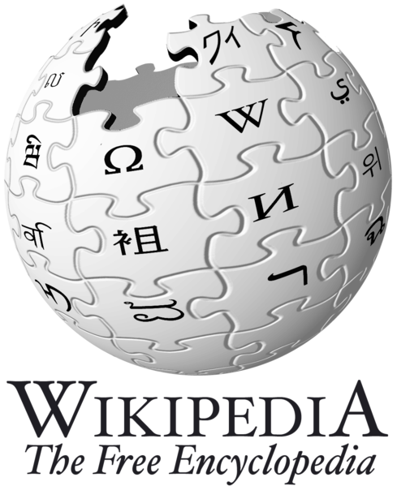
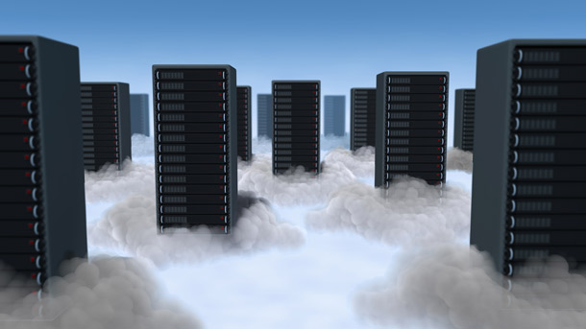
Cloud Definitions
Definition from Wikipedia
  Cloud computing is Internet-based computing, whereby shared resources, software, and information are provided to computers and other devices on demand, like the electricity grid.
  Cloud computing is a style of computing in which dynamically scalable and often virtualized resources are provided as a service over the Internet.
Definition from Wikipedia
  Cloud computing is Internet-based computing, whereby shared resources, software, and information are provided to computers and other devices on demand, like the electricity grid.
  Cloud computing is a style of computing in which dynamically scalable and often virtualized resources are provided as a service over the Internet.

Slide 5
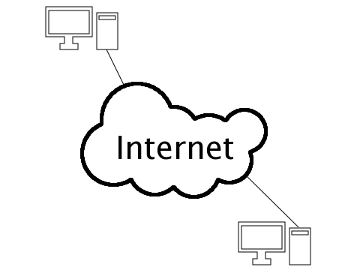
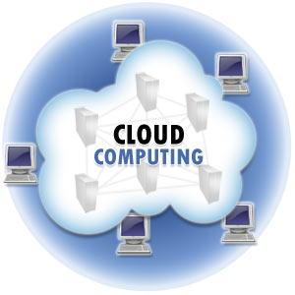
Cloud Definitions
Definition from Whatis.com
  The name cloud computing was inspired by the cloud symbol that's often used to represent the Internet in flowcharts and diagrams. Cloud computing is a general term for anything that involves delivering hosted services over the Internet.
Definition from Whatis.com
  The name cloud computing was inspired by the cloud symbol that's often used to represent the Internet in flowcharts and diagrams. Cloud computing is a general term for anything that involves delivering hosted services over the Internet.

Slide 6

Eye-Opening Facts About Cloud Computing
90% of companies are on the cloud
Cloud data centers processed 94% of workloads in 2024
Amazon Web Services is the leading cloud vendor with a 32% share
Cost optimization is the primary reason for 47% of enterprises’ cloud migration
Amazon, Microsoft, and Google combined accounted for 57% of the global cloud computing market in 2023
Cloud Types – What’s the Difference?
  Public cloud – this refers to the model with which the services are delivered across the Internet
  Private cloud – it’s designed for internal use by a single organization
  Hybrid cloud – this is when a company uses both a public and a private cloud
  Source:

Slide 7
Agenda
What is Cloud Computing ?
  Properties and characteristics
  Benefits from cloud computing
Service and deployment models
  Three service models
  Four deployment models

Slide 8
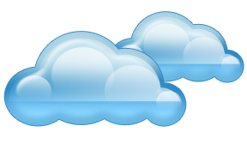
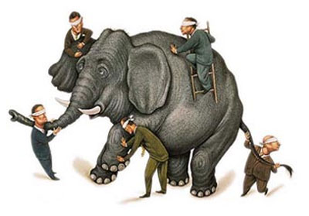
What is Cloud computing ?
Properties and characteristics

Slide 9

In Our Humble Opinion
Cloud computing is a paradigm of computing, a “new” way of thinking about IT industry, but not any specific technology as such
  Central ideas
    Utility Computing
    SOA - Service Oriented Architecture
    SLA - Service Level Agreement
  Properties and characteristics
    High scalability and elasticity
    High availability and reliability
    High manageability and interoperability
    High accessibility and portability
    High performance and optimization
  Enabling techniques
    Hardware virtualization
    Parallelized and distributed computing
    Web services / apps

Slide 10
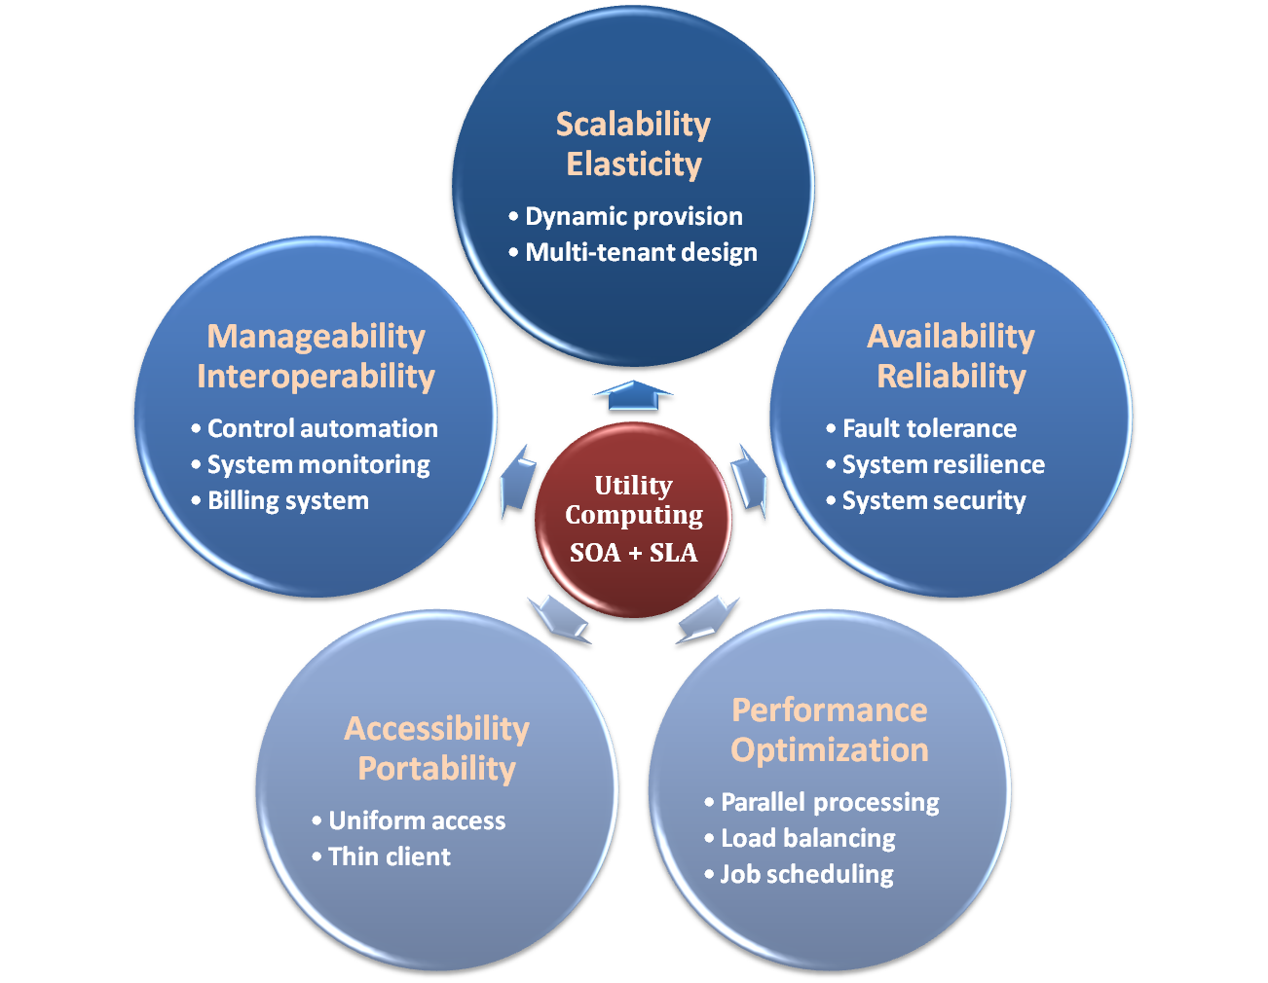

Properties and Characteristics

Slide 11

Central Ideas
Utility Computing
SOA + SLA
Don’t tell me details!!
I DON’T CARE!!

Slide 12

Central Ideas
Utility Computing
SOA + SLA
Perspective from user :
  Users do not care about how the works are done
    Instead, they only concern about what they can get
  Users do not care about what the provider actually did
    Instead, they only concern about their quality of service
  Users do not want to own the physical infrastructure
    Instead, they only want to pay as many as they used
What does the user really care
about?
  They only care about their “Service”
  and the cost

Slide 13
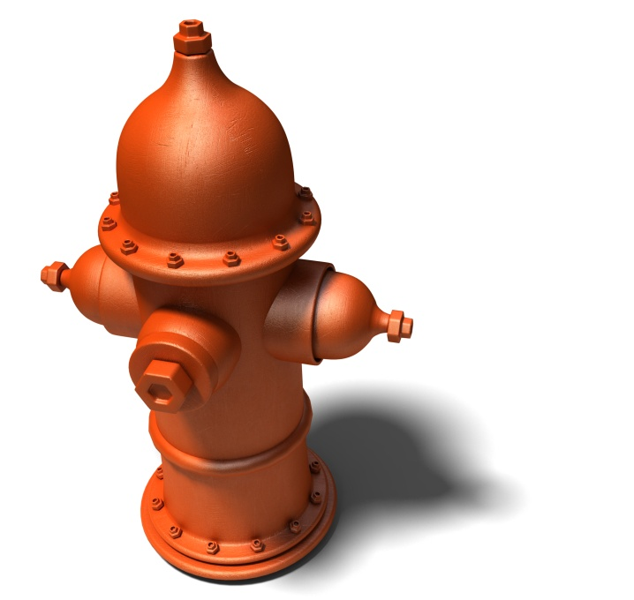
Utility Computing
Utility Computing
SOA + SLA
One service provisioning model
  Service provider makes computing resources and infrastructure management available to the customer as needed, and charges them for specific usage rather than a flat rate.
  Like other types of on-demand computing, the utility model seeks to maximize the efficient use of resources and/or minimize associated costs.

Slide 14
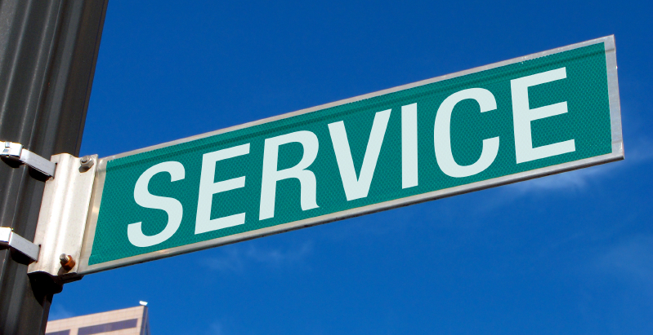
What Is Web Service?
Utility Computing
SOA + SLA
Definition :
  Web service is self-describing and stateless modules that perform discrete units of work and are available over the network
  Web service providers offer APIs that enable developers to exploit functionality over the Internet, rather than delivering full-blown applications
Web Services Description Language (WSDL) :
  WSDL is an XML-based interface description language that is used for describing the functionality offered by a web service, which includes both data type and messages

Slide 15
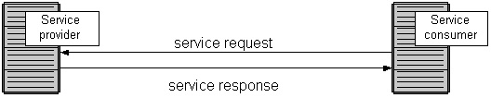
Service Oriented Architecture
Utility Computing
SOA + SLA
Definition
  Service Oriented Architecture (SOA) is essentially a collection of services which communicate with each other over a network
  Is a style of software design where services are provided to the other components as application components, through a communication protocol
  The basic principles of service-oriented architecture are independent of vendors, products and technologies
Approach
  Usually implemented by Web Service model

Slide 16

Service Level Agreement
Utility Computing
SOA + SLA
Definition
  A service-level agreement (SLA) is a contract between a network service provider and a customer that specifies, usually in measurable terms (QoS), what services the network service provider will furnish
Common content in contract
  Performance guarantee metrics
    Up-time and down-time ratio
    System throughput
    Response time
  Problem management detail
  Penalties for non-performance
  Documented security capabilities

Slide 17
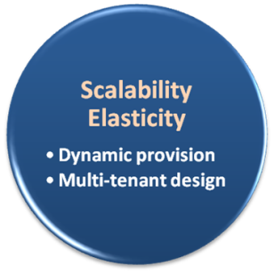

Scalability & Elasticity
Give me the world
without limitation!!

Slide 18
Scalability & Elasticity
What is scalability ?
  The ability to increase workload size within existing infrastructure (hardware, software, etc.) without impacting performance. The resources required to support this are usually pre-planned capacity with a certain amount of headroom built in to handle peak demand.
What is elasticity ?
  The ability to grow or shrink infrastructure resources dynamically as needed to adapt to workload changes in an autonomic manner, maximizing the use of resources. This can result in savings in infrastructure costs overall.
  Cloud elasticity is a popular feature associated with scale-out solutions (horizontal scaling), which allows for resources to be dynamically added or removed when needed.
But how to achieve these properties ?
  Dynamic provisioning
  Multi-tenant design

Slide 19
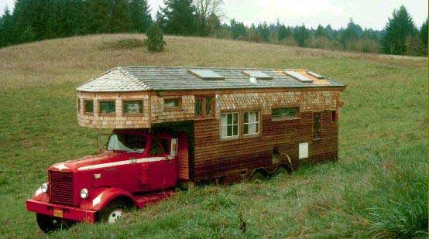
Dynamic Provisioning
What is dynamic provisioning ?
  Dynamic Provisioning is a way to explain a complex networked server computing environment where server computing instances are provisioned or deployed from a administrative console or client application by the server administrator, network administrator, or any other enabled user.

Slide 20
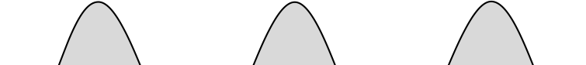
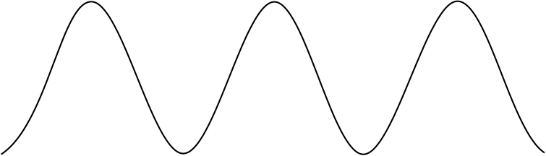
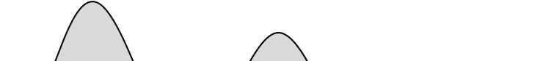

Static Provisioning
In traditional computing model, two common problems :
  Underestimate the system capacity which result in underprovision
Loss Revenue
Resources
Capacity
Resources
Demand
Capacity
1
2
3
Demand
Loss Users
Resources
Capacity
1
2
3
Time (days)
Demand
1
2
3

Slide 21
Static Provisioning
  Overestimate system capacity which result in low utilization
How to solve this problem ??
  Dynamically provision resources
Capacity
Resources
Unused resources
Demand
Time

Slide 22
Elasticity - Dynamic Provisioning
Cloud resources should be provisioned dynamically
  Meet seasonal demand variations
  Meet demand variations between different industries
  Meet burst demand for some extraordinary events
Resources
Capacity
Resources
Capacity
Demand
Demand
Time
Time

Slide 23
Multi-tenant Design
What is multi-tenant design ?
  Multi-tenant refers to a principle in software architecture where a single instance of the software runs on a server, serving multiple client organizations.
  With a multi-tenant architecture, a software application is designed to virtually partition its data including configuration, thus each client organization works with a customized virtual application instance.
Client oriented requirements :
  Customization
    Multi-tenant applications are typically required to provide a high degree of customization to support each target organization's needs.
  Quality of service
    Multi-tenant applications are expected to provide adequate levels of security and robustness.

Slide 24
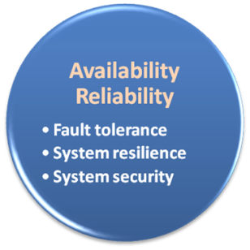

Availability & Reliability
Data Never Lost
Machine Never Fail

Slide 25
Availability & Reliability
What is availability ?
  A measure of how prepared a system, subsystem, or equipment is to function properly when a mission begins, even if the mission start time is unpredictable.
  Cloud systems usually require high availability
    Ex. “Five Nines” system would statistically provide 99.999% availability
What is reliability ?
  The ability of a system or component to perform its required functions under stated conditions for a specified period of time.
But how to achieve these properties ?
  Fault tolerant system
  Require system resilience
  Reliable system security

Slide 26
Fault Tolerance
What is fault tolerant system ?
  Fault-tolerance is the property that enables a system to continue operating properly in the event of the failure of some of its components.
  If its operating quality decreases at all, the decrease is proportional to the severity of the failure, as compared to a naively-designed system in which even a small failure can cause total breakdown.
Three basic characteristics :
  No single point of failure
  Fault detection and isolation of the failing component
  Fault containment to prevent propagation of the failure

Slide 27

Fault Tolerance
Single Point Of Failure (SPOF)
  A part of a system which, if it fails, will stop the entire system from working.
  The assessment of a potentially single location of failure identifies the critical components of a complex system that would provoke a total system failure in case of malfunction.
Preventing single point of failure
  If a system experiences a failure, it must continue to operate without interruption during the repair process.

Slide 28

Fault Tolerance
Fault Detection and Isolation (FDI)
  A subfield of control engineering which concerns itself with monitoring a system, identifying when a fault has occurred and pinpoint the type of fault and its location.
Isolate failing component
  When a failure occurs, the system
  must be able to isolate the failure
  to the offending component.

Slide 29
Fault Tolerance
Fault Containment
  Some failure mechanisms can cause a system to fail by propagating the failure to the rest of the system.
  Mechanisms that isolate a rogue transmitter or failing component to protect the system are required.
Available of reversion modes
  System should be able to maintain some check points which can be used in managing the state changes.

Slide 30
System Resilience
What is resilience ?
  Resilience is the ability to provide and maintain an acceptable level of service in the presence of faults that challenge normal operation.
  Resiliency pertains to the system's ability to return to its original state after encountering trouble. In other words, if a risk event knocks a system offline, a highly resilient system will return back to work and function as planned as soon as possible.
Examples of risk events
  If power is lost at a plant for some time, can our system recover ?
  If a key service is lost because a database corruption, can the business recover ?

Slide 31

System Resilience
Disaster Recovery
  Disaster recovery is the process, policies and procedures related to preparing for recovery or continuation of technology infrastructure critical to an organization after a natural or human-induced disaster.
Some common strategies :
  Backup
    Make data off-site at regular interval
    Replicate data to an off-site location
    Replicate whole system
  Preparing
    Local mirror systems
    Surge protector
    Uninterruptible Power Supply (UPS)

Slide 32
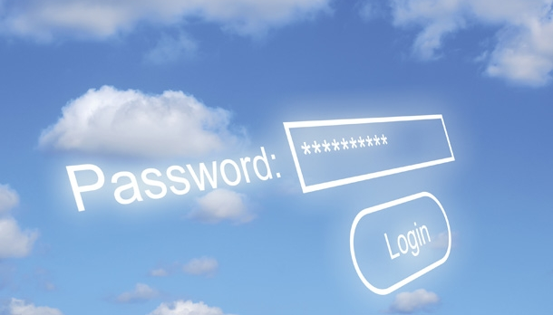
System Security
Security issue in Cloud Computing :
  Cloud security is an evolving sub-domain of computer security, network security, and, more broadly, information security.
  It refers to a broad set of policies, technologies, and controls deployed to protect data, applications, and the associated infrastructure of cloud computing.

Slide 33
System Security
Important security and privacy issues :
  Data Protection
    To be considered protected, data from one customer must be properly segregated from that of another.
  Application Security
    Cloud providers should ensure that applications available as a service via the cloud are secure.
  Privacy
    Cloud providers should ensure that all critical data are masked and that only authorized users have access to data in its entirety.

Slide 34
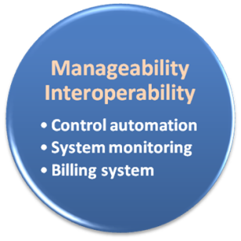

Manageability & Interoperability
I Want Full Control !!

Slide 35
Manageability & Interoperability
What is manageability ?
  Enterprise-wide administration of cloud computing systems. Systems manageability is strongly influenced by network management initiatives in telecommunications.
What is interoperability ?
  Interoperability is a property of a product or system, whose interfaces are completely understood, to work with other products or systems, present or future, without any restricted access or implementation.
But how to achieve these properties ?
  System control automation
  System state monitoring

Slide 36
Control Automation
What is Autonomic Computing ?
  Its ultimate aim is to develop computer systems capable of self-management, to overcome the rapidly growing complexity of computing systems management, and to reduce the barrier that complexity poses to further growth.
Architectural framework :
  Composed by Autonomic Components (AC) which will interact with each other.
  An AC can be modeled in terms of two main control loops (local and global) with sensors (for self-monitoring), effectors (for self-adjustment), knowledge and planer/adapter for exploiting policies based on self- and environment awareness.

Slide 37
Control Automation
Four functional areas :
  Self-Configuration
    Automatic configuration of components.
  Self-Healing
    Automatic discovery, and correction of faults.
  Self-Optimization
    Automatic monitoring and control of resources to ensure the optimal functioning with respect to the defined requirements.
  Self-Protection
    Proactive identification and protection from arbitrary attacks.

Slide 38
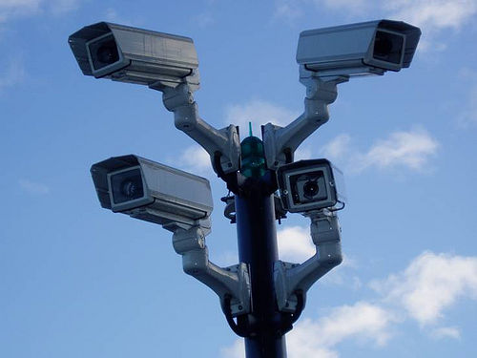
System Monitoring
What is system monitor ?
  A System Monitor in systems engineering is a process within a distributed system for collecting and storing state data.
What should be monitored in the Cloud ?
  Physical and virtual hardware state
  Resource performance metrics
  Network access patterns
  System logs
  … etc
Anything more ?
  Billing system

Slide 39

Billing System
Billing System in Cloud
  Users pay as many as they used.
  Cloud provider must first determine the list of service usage price.
  Cloud provider must record the resource or service usage of each user and then charge users by these records.
How can cloud provider know users’ usage ?
  Get those information by means of monitoring system.
  Automatically calculate the total
  amount of money which user
  should pay. And automatically
  request money from use’s banking
  account.

Slide 40
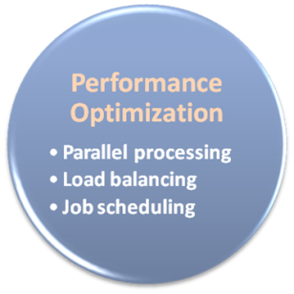

Performance & Optimization
High Performance
Improvement

Slide 41
Performance & Optimization
Performance guarantees ??
  Application performance should be guaranteed.
  Cloud providers make use of powerful infrastructure or other underlining resources to build up a highly performed and highly optimized environment, and then deliver the complete services to cloud users.
But how to achieve this property ?
  Parallel computing
  Load balancing
  Job scheduling

Slide 42
Parallel Processing
Parallel Processing
  Parallel processing is a form of computation in which many calculations are carried out simultaneously, operating on the principle that large problems can often be divided into smaller ones, which are then solved concurrently.
Parallelism in different levels :
  Bit level parallelism
  Instruction level parallelism
  Data level parallelism
  Task level parallelism

Slide 43
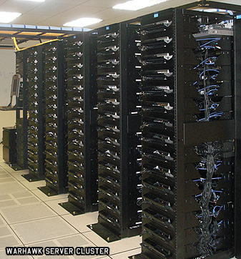
Parallel Processing
Hardware approaches
  Multi-core computer
  Symmetric multi-processor
  General purpose graphic processing unit (GPUs)
  Distributed heterogenous computing
    In cloud data centers or
    cluster-based computers
    High Performance Interconnects
    to offer HPC (as a service)
Software approaches
  Parallel programming language
  Automatic parallelization

Slide 44

Load Balancing
What is load balancing ?
  Load balancing is a technique to distribute workload evenly across two or more computers, network links, CPUs/GPUs, hard drives, or other resources, in order to get optimal resource utilization, maximize throughput, minimize response time, and avoid overload.
Why load balancing ?
  Improve resource utilization
  Improve system performance
  Improve energy efficiency
Unbalanced

Slide 45
Job Scheduling
What is job scheduler ?
  A job scheduler is a software application that is in charge of unattended background executions, commonly known for historical reasons as batch processing.
What should be scheduled in Cloud ?
  Computation intensive tasks
  Dynamic growing and shrinking tasks
  Tasks with complex processing dependency
How to approach ?
  Use pre-defined workflow
  System automatic configuration

Slide 46
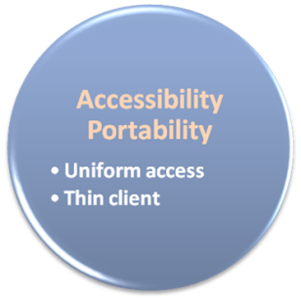

Accessibility & Portability
Anyone !
Anytime !
Anywhere !

Slide 47
Accessibility & Portability
What is accessibility ?
  Accessibility is a general term used to describe the degree to which a product, device, service, or environment is accessible to as many people as possible.
What is service portability ?
  Service portability is the ability to access services using any device, anywhere, continuously with mobility support and dynamic adaptation to resource variations.
But how to achieve these properties ?
  Uniform access
  Thin client

Slide 48
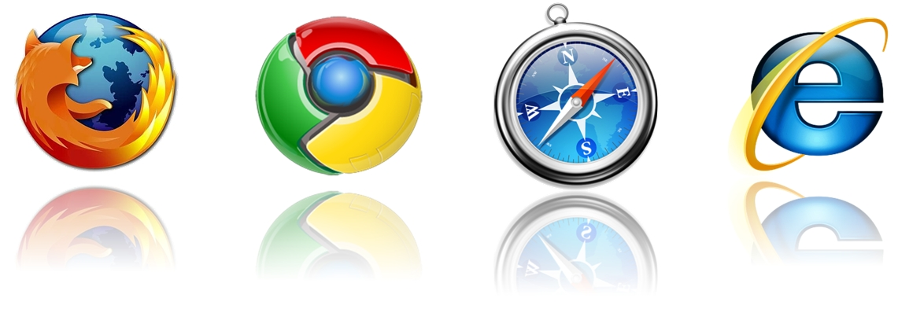
Uniform Access
How do users access cloud services ?
  Cloud provider should provide their cloud service by means of widespread accessing media. In other words, users from different operating systems or other accessing platforms should be able to directly be served.
  Nowadays, web browser technique is one of the most widespread platform in almost any intelligent electronic devices. Cloud service take this into concern, and delivery their services with web-based interface through the Internet.

Slide 49
Thin Client
What is thin client ?
  Thin client is a computer or a computer program which depends heavily on some other computer to fulfill its traditional computational roles. This stands in contrast to the traditional fat client, a computer designed to take on these roles by itself.
Characteristics :
  Cheap client hardware
    While the cloud providers handle several client sessions at once, the clients can be made out of much cheaper hardware.
  Diversity of end devices
    End user can access cloud service via plenty of various electronic devices, which include mobile phones and smart TV.
  Client simplicity
    Client local system do not need complete operational functionalities.

Slide 50

What is cloud computing ?
What can we gain from cloud ?

Slide 51

Benefits From Cloud
Cloud computing brings many benefits :
  For the market and enterprises
    Reduce initial investment
    Reduce capital expenditure
    Improve industrial specialization
    Improve resource utilization
  For the end user and individuals
    Reduce local computing power
    Reduce local storage power
    Variety of thin client devices in daily life
  And not least, being environmentally friendly 👍

Slide 52

For Market and Enterprises

Slide 53
Reduce Initial Investment
Traditional process of enterprises to initiate business :
  Survey and analysis the industry and market
  Estimate the quantity of supply and demand
  Purchase and deploy IT infrastructure
  Install and test the software system
  Design and develop enterprise specific business service
  Announce the business service to clients
Some drawbacks :
  The survey, analysis and estimation may not be 100% correct
  Infrastructure deployment is time consuming
  Enterprises should take the risk of wrong investment

Slide 54
Reduce Initial Investment
Initiate business with Cloud Computing services :
  Survey and analysis the industry and market
  Chose one cloud provider for enterprise deployment
  Design and develop business service upon cloud environment
  Announce the business service to clients
Some benefits :
  Enterprise do not need to own the infrastructure
  Enterprise can develop and deploy business service in short time
  Enterprise can reduce the business loss of wrong investment

Slide 55

Reduce Initial Investment
What does cloud computing achieve ?
 | Traditional | With Cloud Computing
Investment Risk | Enterprise takes the risk | Cloud reduces the risk
Infrastructure | Enterprise owns the infrastructure | Cloud provider owns the infrastructure
Time duration | Long deployment time | Fast to business ready

Slide 56
Reduce Capital Expenditure
Traditional capital expenditure of enterprises :
  Each enterprise should establish its own IT department
  IT department should handle the listed jobs
    Manage and administrate hardware and software
    Apply regular data backup and check point process
    Purchase new infrastructure and eliminate outdated one
    Always standby for any unexpected IT problems
Some drawbacks :
  Enterprise pays for IT investment which is not its business focus
  Enterprise should take the risk of hardware/software malfunction
  Replacing and updating infrastructure is time consuming and risky

Slide 57
Reduce Capital Expenditure
Capital expenditure with Cloud Computing service :
  Enterprise can almost dismiss its IT department
  The jobs of IT department can be achieved by cloud provider
    Dynamically update and upgrade hardware or software
    Dynamically provision and deploy infrastructure for enterprise
    Automatically backup data and check consistency
    Self-recover from disaster or system malfunction
Some benefits :
  Enterprise can shift effort to its business focus
  Enterprise can reconfigure its IT services in short time
  Enterprise pays to cloud provider as many as the service used

Slide 58

Reduce Capital Expenditure
What does cloud computing achieve ?
 | Traditional | With Cloud Computing
Business focus | Need to own its IT department | Cloud provider takes care everything
Payment | Pay for all investment and human resource | Enterprise pays as the service used
Time duration | Long establish time | Fast to business ready

Slide 59
Improve Industrial Specialization
Traditional industry and market :
  Every enterprise has to own its IT department
  IT resource is managed by enterprise themselves
  IT complexity should be well taken care by enterprise themselves
Some drawbacks :
  IT department is not the business focus of enterprise
  Most of enterprises do not well maintain their IT resources
  Enterprise seldom optimizes their IT resource usage

Slide 60
Improve Industrial Specialization
Collaboration with Cloud providers :
  Cloud providers centrally maintain IT infrastructure for clients
  Cloud providers employ experts for management and administration
  Cloud providers focus on providing reliable IT services
  Enterprises only rent the service they need and care
Some benefits :
  Industrial specialization will be improved
  IT service performance will be optimized
  Enterprise business focus will be enhanced
  IT resource waste will be reduced

Slide 61

Improve Industrial Specialization
What does cloud computing achieve ?
 | Traditional | With Cloud Computing
Collaboration | Enterprise needs to take care everything | Enterprise focuses on its own business
Management | Enterprise works with poor manageability | Cloud provider applies professional control
Relationship | Stand alone enterprise | Win-Win partnership

Slide 62
Improve Resource Utilization
Traditional industry and market :
  Enterprise seldom takes care about IT resource utilization
  Enterprise owns their IT resource without well management
  IT resource usually over invested for peak demand
Some drawbacks :
  Power and space utilization among enterprises are wasted
  IT resources across enterprises cannot be shared

Slide 63
Improve Resource Utilization
Collaboration with Cloud providers :
  IT resources are centrically managed and optimized
    Cloud provider builds performance optimized hardware
    Cloud provider builds consolidated cooling system
    Cloud provider will consider the geographic issues
    Cloud provider will consider legal policy issues
Some benefits :
  IT infrastructure can be shared among enterprises
  IT infrastructure performance and utilization can be optimized
  Large-scale integrated optimization can be applied

Slide 64

Improve Resource Utilization
What does cloud computing achieve ?
 | Traditional | With Cloud Computing
IT Resource Utilization | IT resources under utilized most of time | Share to improve utilization of IT resources
Power Consumption | Waste power and cooling system | Cloud system should be global optimized

Slide 65

For End User and Individual

Slide 66
Reduce Local Computing Power
Traditional local computing power requirement :
  One need to buy your own personal computer
  Buy powerful processor if you need intensive computing
  Buy large memory to meet application requirement
  Install a high number of applications in need
Some drawbacks :
  One can hardly replicate the same system environment
  One needs to regularly update or upgrade software and hardware
  One needs to reinstall all applications if you reinstall the OS

Slide 67
Reduce Local Computing Power
Using Cloud Computing services :
  One can utilize the remote computing power in the cloud
  One needs only basic computing power to connect to Internet
  Application in the cloud will automatically upgrade
Some benefits :
  One can access his/her applications anywhere through the Internet
  One can dynamically request for computing power on demand
  Application may need not to be reinstalled even reinstall the OS

Slide 68
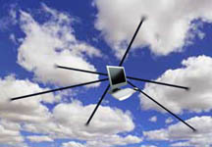
Reduce Local Computing Power
What does cloud computing achieve ?
 | Traditional | With Cloud Computing
Hardware Requirement | User needs to buy powerful hardware | Only basic hardware to connect to internet
Software Requirement | Install application in local computer | No local installation requirement
Portability | Hard to be portable | Natively portable

Slide 69
Reduce Local Storage Power
Traditional local storage power requirement :
  User programs and data files are stored in local devices
  User has to backup data regularly preventing hardware damage
Some drawbacks :
  Storage space may not enough for burst data requirement
  Storage space may be over needed which result in resource waste
  Data consistency is hard to maintain between computers
  Need to sacrifice part of storage space for data backup

Slide 70
Reduce Local Storage Power
Using Cloud Computing services :
  User programs and data files are stored in the cloud
  Cloud service provider will guarantee the data availability
Some benefits :
  One can dynamically allocate storage space on demand
  One can access data anywhere through the Internet
  No need to care about data consistency between computers
  No need to care about data loss due to hardware damage

Slide 71
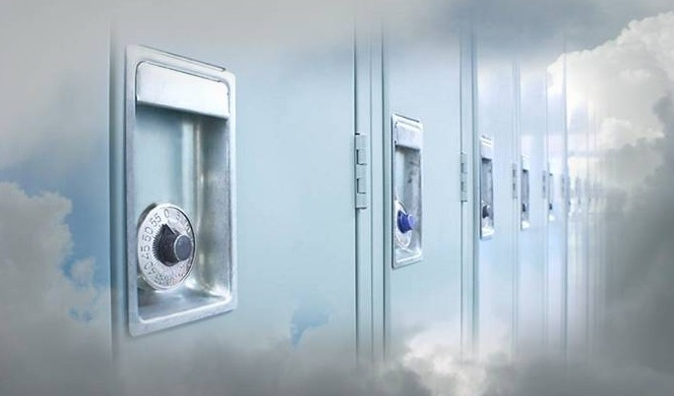
Reduce Local Storage Power
What does cloud computing achieve ?
 | Traditional | With Cloud Computing
Storage Space | Limited to local disk, may be underutilized | Storage space dynamically allocated on demand
Storage Data Consistency | Difficult to maintain data consistency | Data consistency maintained by cloud
Availability | Regular user backup | Cloud service guarantee

Slide 72
Variety of End Devices
Traditional computing resource :
  One can connect to the Internet by personal computer
  Only personal computer can deliver reasonable computing power
  Small devices cannot perform incentive computation due to their power and hardware limitation
Some drawbacks :
  Computing power is not portable
  Small devices can only perform simplified works

Slide 73
Variety of End Devices
Devices collaborate with Cloud services :
  Device connects to the Internet through wireless network
  Device accesses cloud services through web service interface
  Device sends computing incentive jobs into cloud and wait for results
Some benefits :
  User can easily access cloud service through small devices
  User can access almost unlimited computing power anywhere
  Small devices can be intelligently managed through cloud

Slide 74
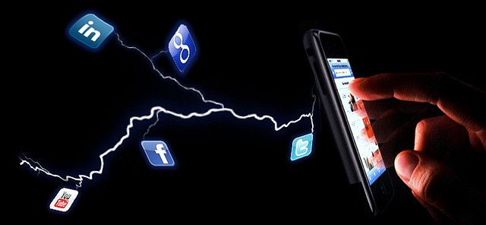
Variety of End Devices
What does cloud computing achieve ?
 | Traditional | With Cloud Computing
Computing Power | Only accessed through desktop computer | Accessed through small smart devices
Small Device Intelligence | Functionalities were limited due to their power consumption | Shift computing intensive jobs into cloud, and then wait for results

Slide 75
Agenda
What is Cloud Computing ?
  Properties and characteristics
  Benefits from cloud computing
Service and deployment models
  Three service models
  Four deployment models

Slide 76

Service Models
Choose the service you need.

Slide 77

A Simple Analogy
Say, you just moved to a city and you are looking for a place to live.

Slide 78

What is your choice ?
Build a new house ?
Buy an empty house ?
Live in a hotel ?

Slide 79
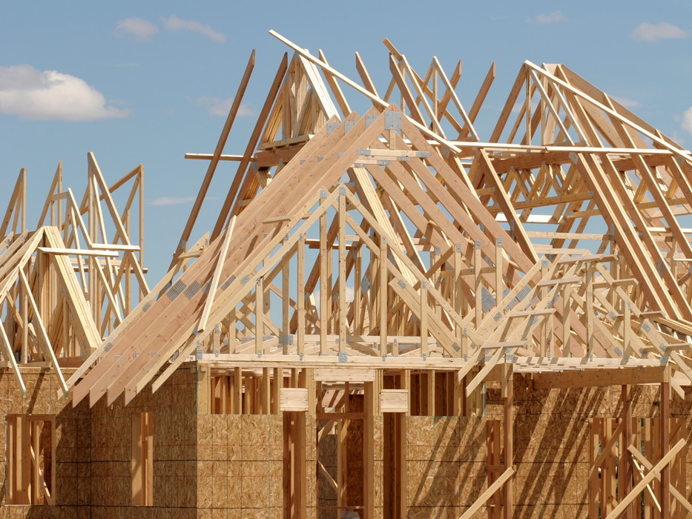
Let’s built a new house !!
You can fully control everything you like your new house to have. But that is a hard work …

Slide 80

If you buy an empty house ?
You can customize some part of your house. But never change the original architecture.

Slide 81

How about live in a hotel ?
Live in a hotel will be a good idea if the only thing you care of is to enjoy your life!! There is nothing you can do with the “house” except living in it.

Slide 82
Let’s translate this to
Cloud Computing !!

Slide 83
Service Models Overview
What if you want to have an IT “department” ?
  Similar to build a new house in previous analogy
    You can rent some virtualized infrastructure and build up your own IT system among those resources, which may be fully controlled.
    Technically speaking, use the Infrastructure as a Service (IaaS) solution.
  Similar to buy an empty house in previous analogy
    You can directly develop your IT system through one cloud platform, and do not care about any lower-level resource management.
    Technically speaking, use the Platform as a Service (PaaS) solution.
  Similar to live in a hotel in previous analogy
    You can directly use some existing IT system solutions, which are provided by some cloud application service provider, without knowing any detail technique about how these service was achieved.
    Technically speaking, use the Software as a Service (SaaS) solution.

Slide 84
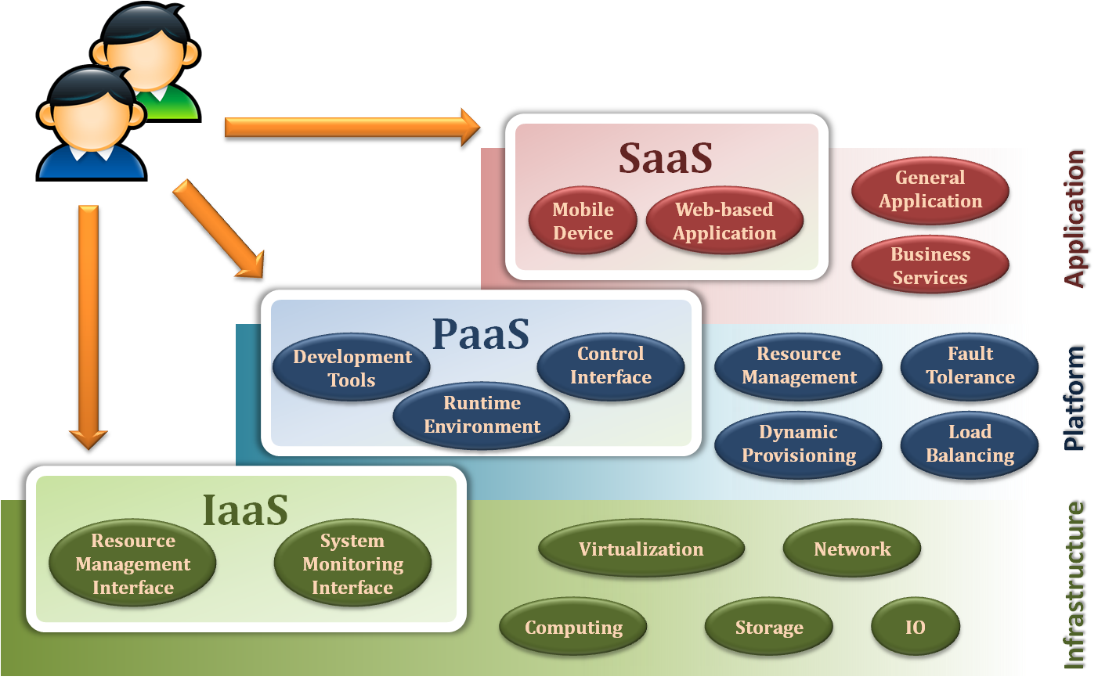
Service Model Overview

Slide 85
Service Models
Infrastructure as a Service
Platform as a Service
Software as a Service

Slide 86
Infrastructure as a Service
Infrastructure as a Service - IaaS
  The capability provided to the consumer to provision processing, storage, networks, and other fundamental computing resources where the consumer can develop, deploy, and run arbitrary software, which can include operating systems and applications.
  The consumer does not manage or control the underlying cloud infrastructure but has control over operating systems, storage, deployed applications, and possibly limited control of select networking components.
Examples :
  Amazon EC2
  Google Cloud
  Microsoft Azure
  OpenNebula
  … etc

Slide 87
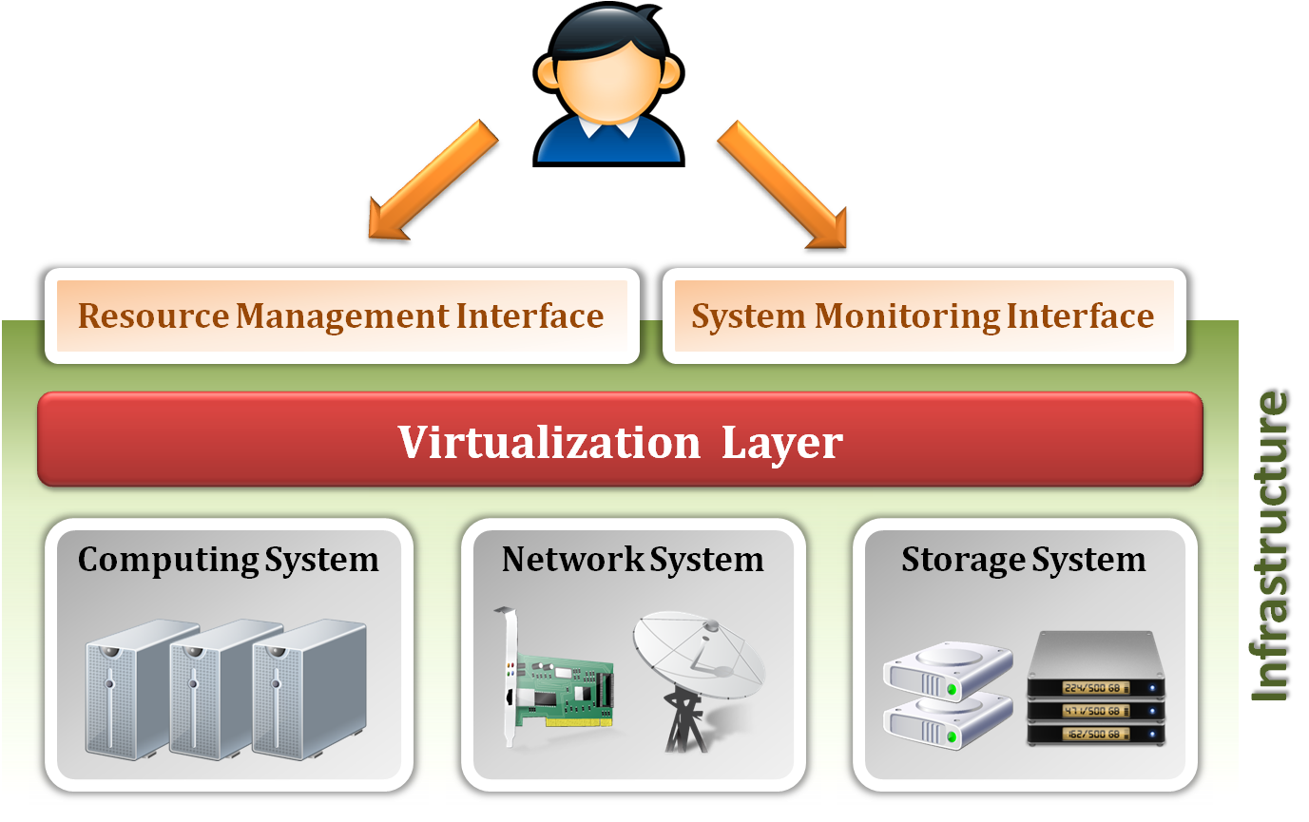
Infrastructure as a Service
System architecture :

Slide 88
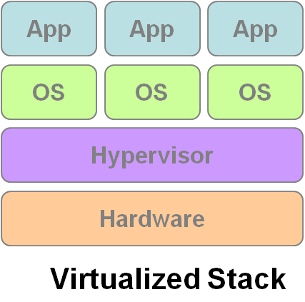
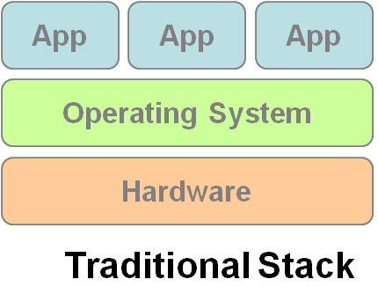
Infrastructure as a Service
Enabling technique - Virtualization
  Virtualization is an abstraction of logical resources away from underlying physical resources.
    Virtualization technique shifts OS onto hypervisor / virtual machines (VMs).
    Multiple OS (VMs) share the physical hardware and provide different services.
    Improve utilization, availability, security and convenience.
VM1
VM2
VM3

Slide 89
Motivation for virtualization
Cloud resource virtualization is important for:
  Performance isolation
    as we can dynamically assign and account for resources across different applications
  System security:
    as it allows isolation of services running on the same hardware
  Performance and reliability:
    as it allows applications to migrate from one platform to another
  The development and management of services offered by a provider

Slide 90
Virtualization
Virtualization simulates the interface to a physical object by:
  Multiplexing: creates multiple virtual objects from one instance of a physical object. Many virtual objects to one physical. Example: a processor is multiplexed among several processes or threads.
  Aggregation: creates one virtual object from multiple physical objects. One virtual object to many physical objects. Example: a number of physical disks are aggregated into a RAID disk.
  Emulation: constructs a virtual object of a certain type from a different type of a physical object. Example: a physical disk emulates a Random Access Memory (RAM).
  Multiplexing and emulation. Examples: virtual memory with paging multiplexes real memory and disk; a virtual address emulates a real address.

Slide 91
Layering and Virtualization
Layering – a common approach to manage system complexity:
  Simplifies the description of the subsystems; each subsystem is abstracted through its interfaces with the other subsystems
  Minimizes the interactions among the subsystems of a complex system
  With layering we are able to design, implement, and modify the individual subsystems independently
Layering in a computer system:
  Hardware
  Software
    Operating system
    Libraries
    Applications

Slide 92
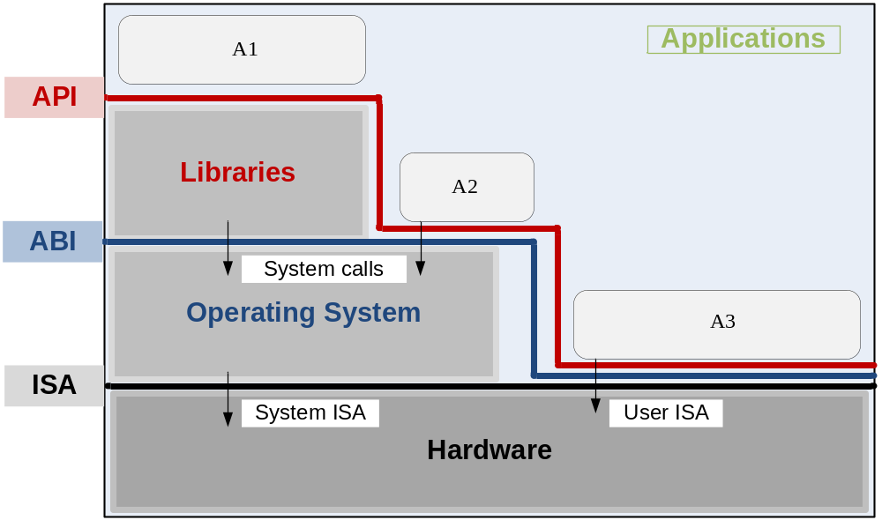
Layering and Interfaces
Application Programming Interface (API), Application Binary Interface (ABI), and Instruction Set Architecture (ISA). An application uses library functions (A1), makes system calls (A2), and executes machine instructions (A3)

Slide 93
Interfaces
Instruction Set Architecture (ISA) – at the boundary between hardware and software.
Application Binary Interface (ABI) – allows the ensemble consisting of the application and the library modules to access the hardware; the ABI does not include privileged system instructions, instead it invokes system calls.
Application Program Interface (API) - defines the set of instructions the hardware was designed to execute and gives the application access to the ISA; it includes high-level language (HLL) library calls which often invoke system calls

Slide 94
Code portability
Binaries created by a compiler for a specific ISA and a specific operating systems are not portable
It is possible, though, to compile a HLL program for a virtual machine (VM) environment where portable code is produced and distributed, and then converted by binary translators to the ISA of the host system
A dynamic binary translation converts blocks of guest instructions from the portable code to the host instruction and leads to a significant performance improvement, as such blocks are cached and reused

Slide 95
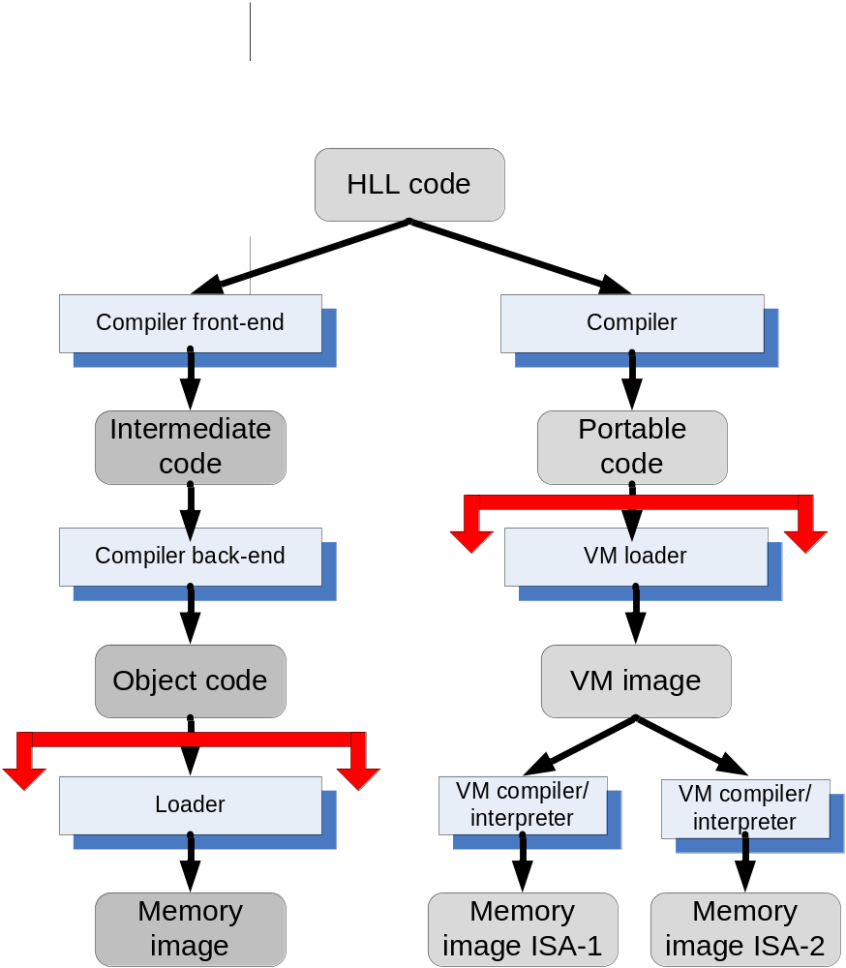
HLL Language Translations

Slide 96
History of Virtualization
(from “Modern Operating Systems” 4th Edition, p474 by Tanenbaum and Bos)
1960’s, IBM: CP/CMS control program: a virtual machine operating system for the IBM System/360 Model 67
2000, IBM: z-series with 64-bit virtual address spaces and backward compatible with the System/360
1974: Popek and Golberg from UCLA published “Formal Requirements for Virtualizable Third Generation Architectures” where they listed the conditions a computer architecture should satisfy to support virtualization efficiently. The popular x86 architecture that originated in the 1970s did not support these requirements for decades.
1990’s, Stanford researchers, VMware: Researchers developed a new hypervisor and founded VMware, the biggest virtualization company of today’s. First virtualization solution was is 1999 for x86.
Today many virtualization solutions: Xen from Cambridge, KVM, Hyper-V, …
IBM was the first to produce and sell virtualization for the mainframe. But, VMware popularized virtualization for the masses.

Slide 97
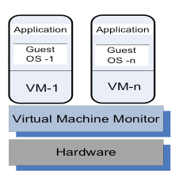
Virtual Machine Monitor (VMM / Hypervisor)
A virtual machine monitor (VMM/hypervisor) partitions the resources of computer system into one or more virtual machines (VMs). Allows several operating systems to run concurrently on a single hardware platform
A VM is an execution environment that runs an OS
VM – an isolated environment that appears to be a whole computer, but actually only has access to a portion of the computer resources
A VMM allows:
  Multiple services to share
  the same platform
  Live migration - the movement
  of a server from one platform to another
  System modification while maintaining
  backward compatibility with the original system
  Enforces isolation among the systems, thus
  security
A guest operating system is an OS that runs in a VM under the control of the VMM.

Slide 98
VMM Virtualizes the CPU and the Memory
A VMM (also hypervisor) (howto):
  Traps the privileged instructions executed by a guest OS and enforces the correctness and safety of the operation
  Traps interrupts and dispatches them to the individual guest operating systems
  Controls the virtual memory management
  Maintains a shadow page table for each guest OS and replicates any modification made by the guest OS in its own shadow page table. This shadow page table points to the actual page frame and it is used by the Memory Management Unit (MMU) for dynamic address translation.
  Monitors the system performance and takes corrective actions to avoid performance degradation. For example, the VMM may swap out a VM to avoid thrashing.

Slide 99
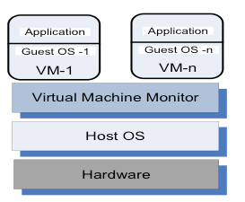
Type 1 and 2 Hypervisors
Type 1 Hypervisor
Type 2 Hypervisor
Taxonomy of VMMs:
  Type 1 Hypervisor (bare metal, native): supports multiple virtual machines and runs directly on the hardware (e.g., VMware ESX , Xen, Denali)
  Type 2 Hypervisor (hosted) VM - runs under a host operating system (e.g., user-mode Linux)

Slide 100
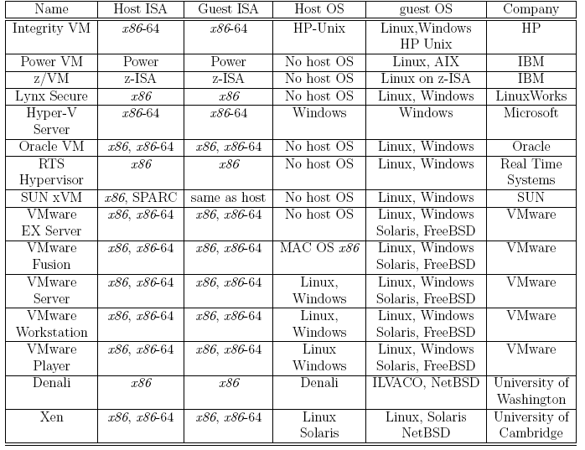
Examples of Hypervisors
Notes:
BREAK

Slide 101
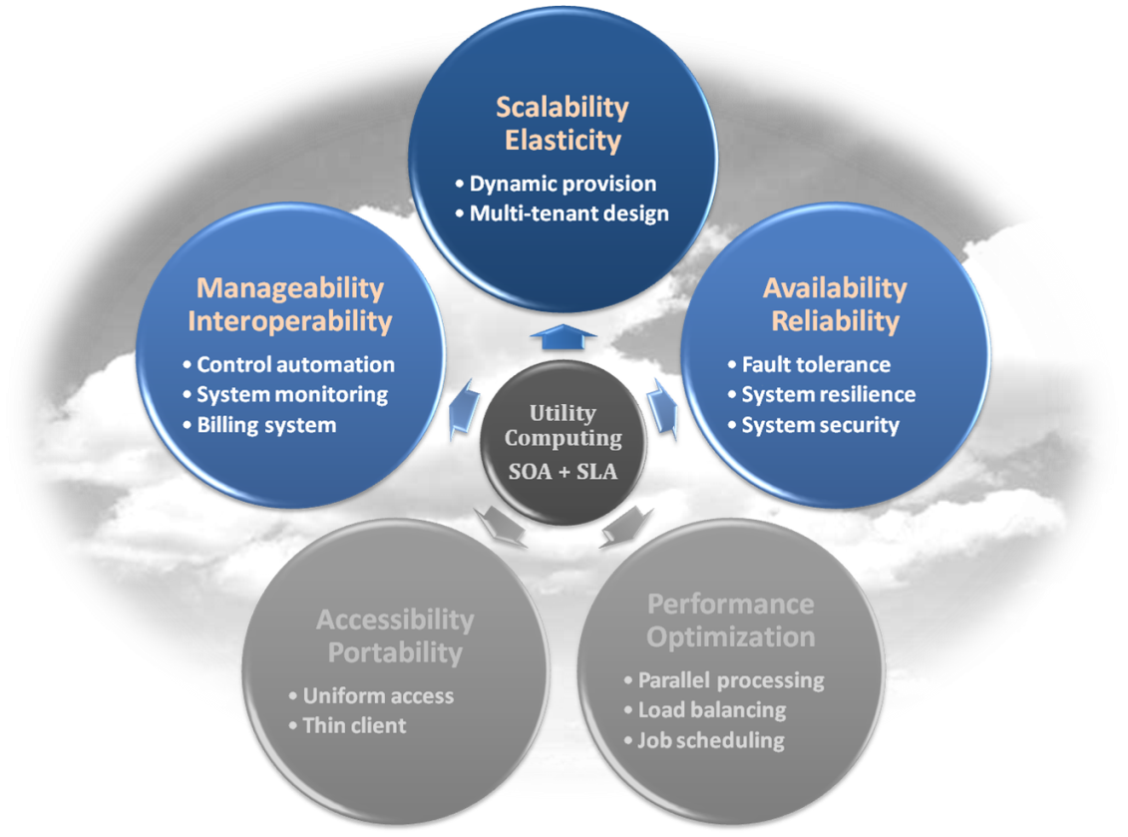
Infrastructure as a Service
Properties supported by virtualization technique :
  Manageability and Interoperability
  Availability and Reliability
  Scalability and Elasticity

Slide 102
Infrastructure as a Service
Provide service –Resource Management Interface
  Several types of virtualized resources :
    Virtual Machine – As an IaaS provider, we should be able to provide the basic virtual machine operations, such as creation, suspension, resumption and termination, …etc.
    Virtual Storage – As an IaaS provider, we should be able to provide the basic virtual storage operations, such as space allocation, space release, data writing and data reading, …etc.
    Virtual Network – As an IaaS provider, we should be able to provide the basic virtual network operations, such as IP address allocation, domain name register, connection establishment and bandwidth provision, …etc.

Slide 103
Infrastructure as a Service
Provide service – System Monitoring Interface
  Several types of monitoring metrics :
    Virtual Machine – As an IaaS provider, we should be able to monitor some system states of each virtual machine, such as CPU loading, memory utilization, IO loading and internal network loading, …etc.
    Virtual Storage – As an IaaS provider, we should be able to monitor some storage states of each virtual storage, such as virtual space utilization, data duplication and storage device access bandwidth, …etc.
    Virtual Network – As an IaaS provider, we should be able to monitor some network states of each virtual network, such as virtual network bandwidth, network connectivity and network load balancing, …etc.

Slide 104
IaaS - Summary
IaaS is the deployment platform that abstracts the infrastructure.
IaaS enabling technique
  Virtualization
    Server Virtualization
    Storage Virtualization
    Network Virtualization
IaaS provided services
  Resource Management Interface
  System Monitoring Interface

Slide 105
Service Models
Infrastructure as a Service
Platform as a Service
Software as a Service

Slide 106
Platform as a Service
Platform as a Service - PaaS
  The capability provided to the consumer is to deploy onto the cloud infrastructure consumer-created or acquired applications created using programming languages and tools supported by the provider.
  The consumer does not manage or control the underlying cloud infrastructure including network, servers, operating systems, or storage, but has control over the deployed applications and possibly application hosting environment configurations.
Examples :
  Microsoft Windows Azure
  Google App Engine
  Hadoop
  … etc

Slide 107
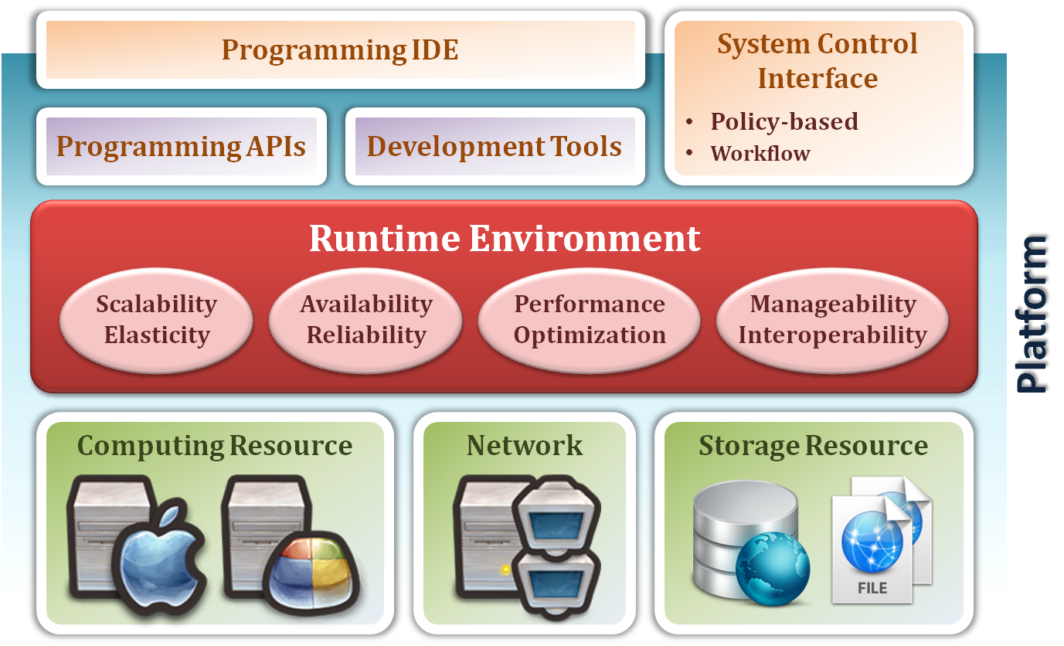
Platform as a Service
System architecture :

Slide 108
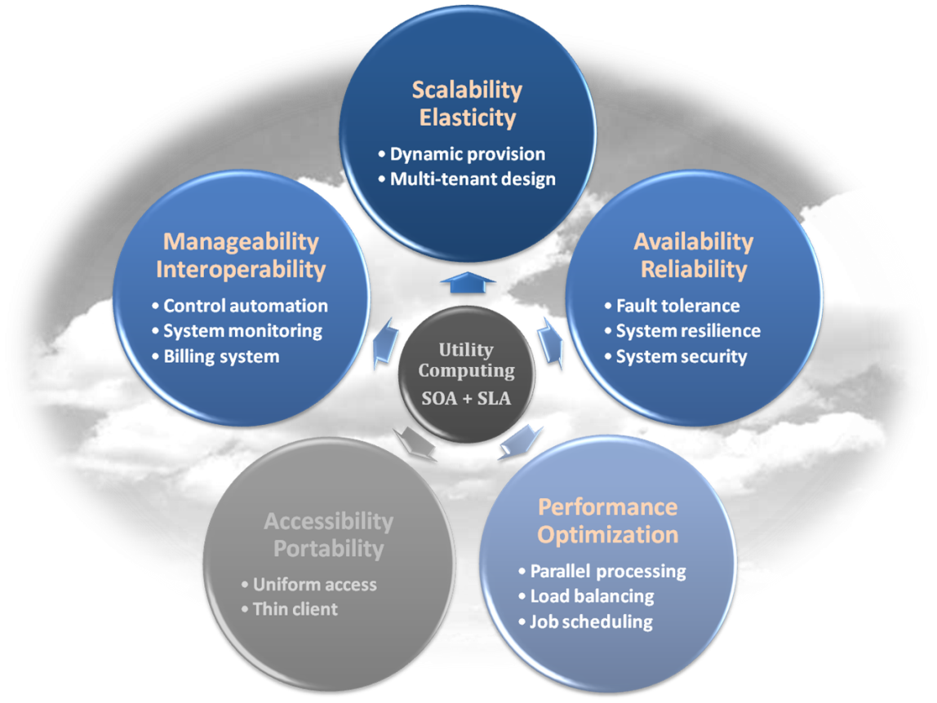
Platform as a Service
Enabling technique – Runtime Environment Design
  Runtime environment refers to collection of software services available. Usually implemented by a collection of program libraries.
Common properties in Runtime Environment :
  Manageability and Interoperability
  Performance and Optimization
  Availability and Reliability
  Scalability and Elasticity

Slide 109
Platform as a Service
Provided service – Programming IDE (Integrated Development Environment)
  Users make use of programming IDE to develop their service among PaaS.
    This IDE should integrate the full functionalities which supported from the underling runtime environment.
    This IDE should also provide some development tools, such as profiler, debugger and testing environment.
  The programming APIs supported by the runtime environment may vary among different cloud providers, but there are still some common operating functions.
    Computation, storage and communication resource operation

Slide 110
Platform as a Service
Provided service – System Control Interface
  Police-Based Control
    Typically described as a principle or rule to guide decisions and achieve rational outcome(s)
    Make the decision according to some requirements
  Workflow Control
    Describe the flow of installation and configuration of resources
    Workflow processing daemon delivers speedy and efficient construction and management of cloud resources

Slide 111
PaaS - Summary
PaaS is the development platform that abstracts the infrastructure, OS, and middleware to drive developer productivity.
PaaS enabling technique
  Runtime Environment
PaaS provide services
  Programming IDE
    Programming APIs
    Development tools
  System Control Interface
    Policy based approach
    Workflow based approach

Slide 112
Service Models
Infrastructure as a Service
Platform as a Service
Software as a Service

Slide 113
Software as a Service
Software as a Service - SaaS
  The capability provided to the consumer is to use the provider’s applications running on a cloud infrastructure. The applications are accessible from various client devices through a thin client interface such as a web browser (e.g., web-based email).
  The consumer does not manage or control the underlying cloud infrastructure including network, servers, operating systems, storage, or even individual application capabilities, with the possible exception of limited user-specific application configuration settings.
Examples :
  Google Apps (e.g., Gmail, Google Docs, Google sites, …etc)
  OpenAI, Microsoft Copilot, Google AI Studio, DeepSeek, …
  SalesForce.com
  EyeOS, etc.

Slide 114
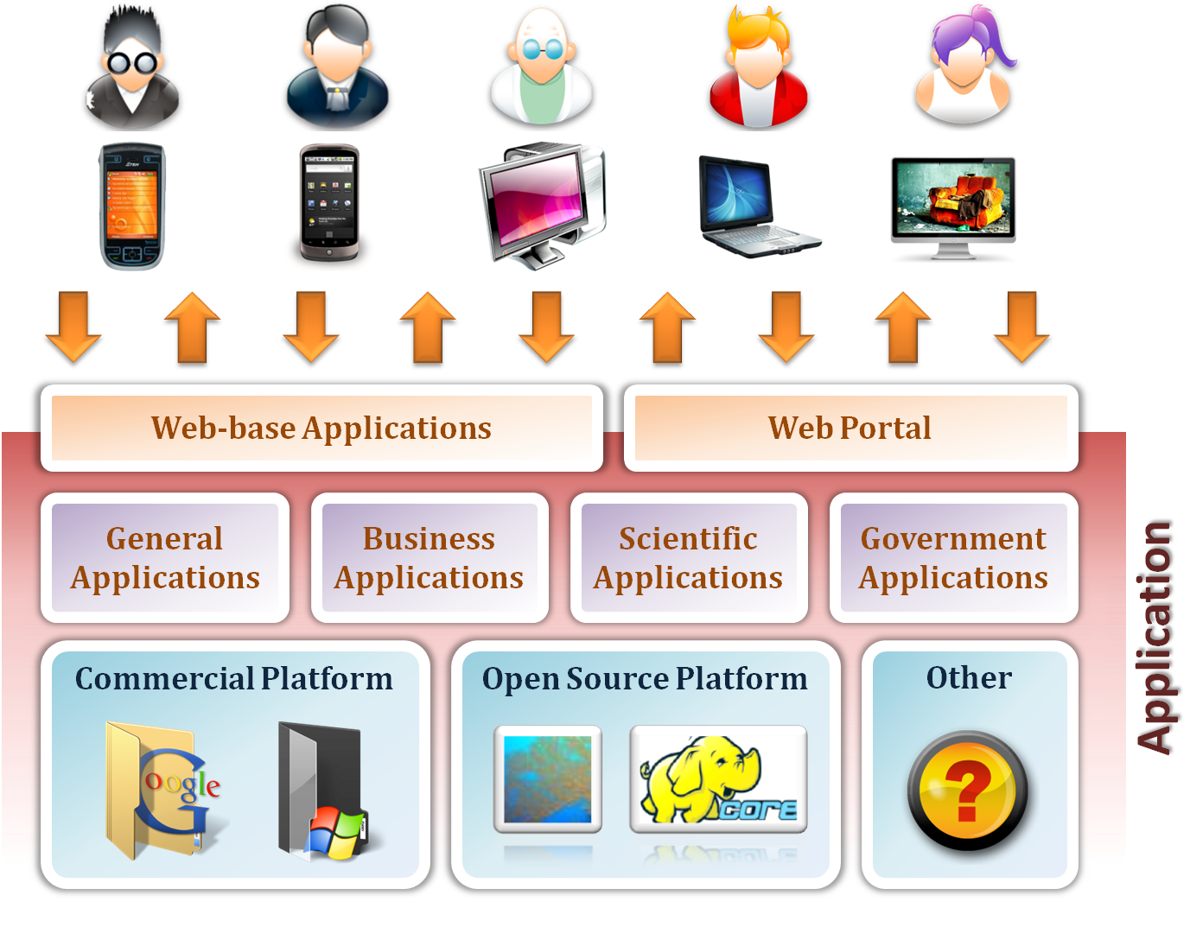
Software as a Service

Slide 115
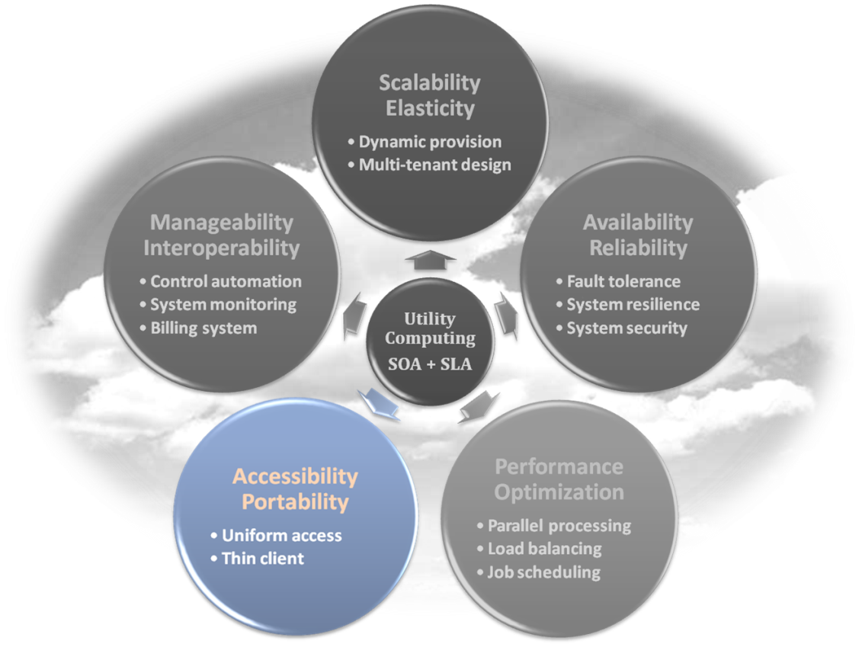
Software as a Service
Enabling Technique – Web Service
  Web 2.0 is the trend of using the full potential of the web
    Viewing the Internet as a computing platform
    Running interactive applications through a web browser
    Leveraging interconnectivity and mobility of devices
    Enhanced effectiveness with greater human participation
Properties provided by Internet:
  Accessibility and Portability

Slide 116
Software as a Service
Provide service – Web-based Applications
  Conventional applications should translate their access interface onto web-based platform.
  Applications in different domains
    General Applications – Applications which are designed for general propose, such as office suit, multimedia and instant message, …etc.
    Business Applications – Application which are designed for business propose, such as ERP, CRM and market trading system, …etc.
    Scientific Applications – Application which are designed for scientific propose, such as aerospace simulation and biochemistry simulation, …etc.
    Government Applications – Applications which are designed for government propose, such as national medical system and public transportation system service, …etc.

Slide 117
Software as a Service
Provided service – Web Portal
  Apart from the standard search engine feature, web portals offer other services such as e-mail, news, stock prices, information, databases and entertainment.
  Portals provide a way for enterprises to provide a consistent look and feel with access control and procedures for multiple applications and databases, which otherwise would have been different entities altogether.
  Some examples :
    iGoogle
    MSNBC
    Netvibes
    Yahoo!

Slide 118
SaaS - Summary
SaaS consists of “complete" applications that you rent and customize.
SaaS enabling technique
  Web Service
SaaS provide services
  Web-based Applications
    General applications
    Business applications
    Scientific applications
    Government applications
  Web Portal

Slide 119
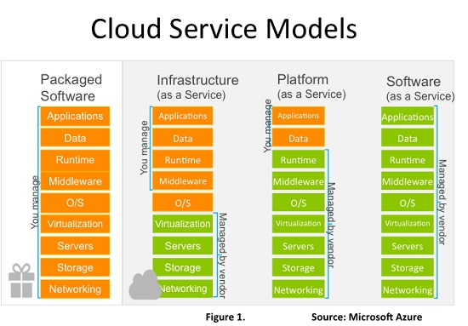
Service models - summary

Slide 120

Deployment models
How to deploy a cloud system ?

Slide 121
Deployment Model
There are four primary cloud deployment models :
  Public Cloud
  Private Cloud
  Community Cloud
  Hybrid Cloud
Each can exhibit the previously discussed characteristics; their differences lie primarily in the scope and access of published cloud services, as they are made available to service consumers.

Slide 122
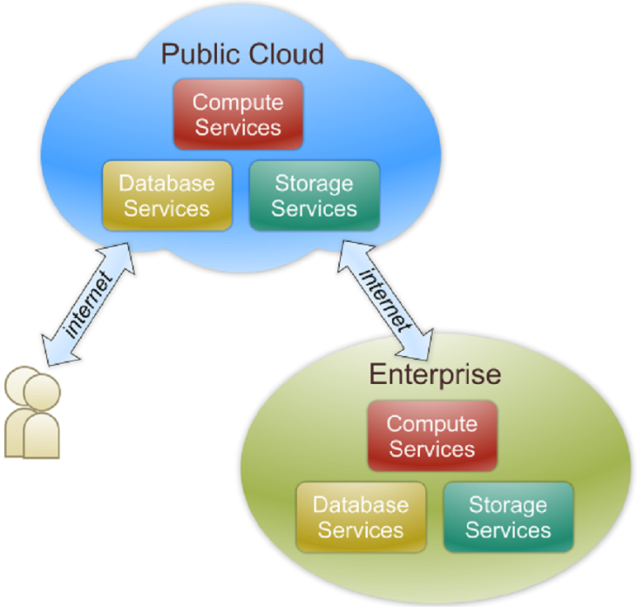
Public Cloud
Public cloud definition
  The cloud infrastructure is made available to the general public or a large industry group and is owned by an organization selling cloud services.
  Also known as external cloud or multi-tenant cloud, this model essentially represents a cloud environment that is openly accessible.
  Basic characteristics :
    Homogeneous infrastructure
    Common policies
    Shared resources and multi-tenant
    Leased or rented infrastructure
    Economies of scale

Slide 123
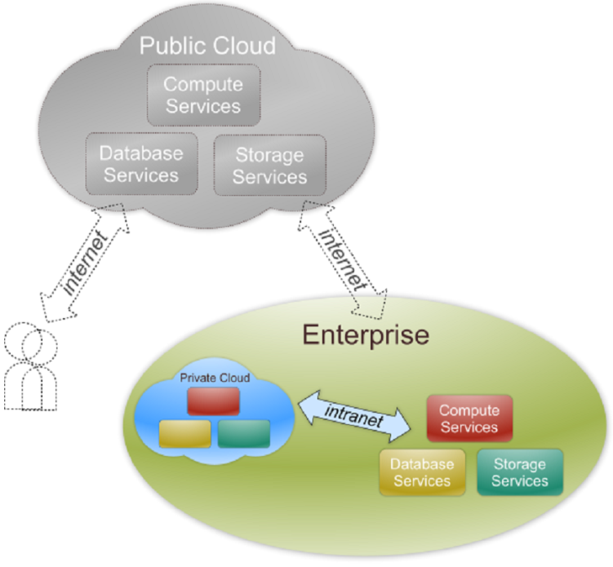
Private Cloud
Private cloud definition
  The cloud infrastructure is operated solely for an organization. It may be managed by the organization or a third party and may exist on premise or off premise.
  Also referred to as internal cloud or on-premise cloud, a private cloud intentionally limits access to its resources to service consumers that belong to the same organization that owns the cloud.
  Basic characteristics :
    Heterogeneous infrastructure
    Customized and tailored policies
    Dedicated resources
    In-house infrastructure
    End-to-end control

Slide 124
Public vs. Private
Comparison :
 | Public Cloud | Private Cloud
Infrastructure | Homogeneous | Heterogeneous
Policy Model | Common defined | Customized & Tailored
Resource Model | Shared & Multi-tenant | Dedicated
Cost Model | Operational expenditure | Capital expenditure
Economy Model | Large economy of scale | End-to-end control

Slide 125
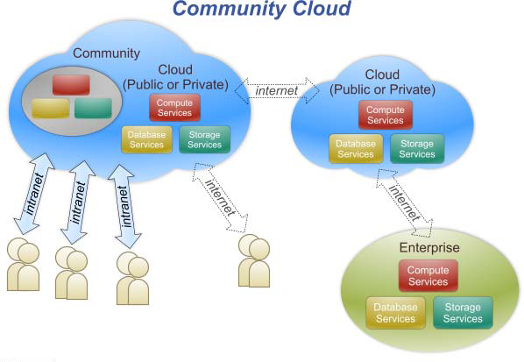
Community Cloud
Community cloud definition
  The cloud infrastructure is shared by several organizations and supports a specific community that has shared concerns (e.g., mission, security requirements, policy, and compliance considerations).

Slide 126
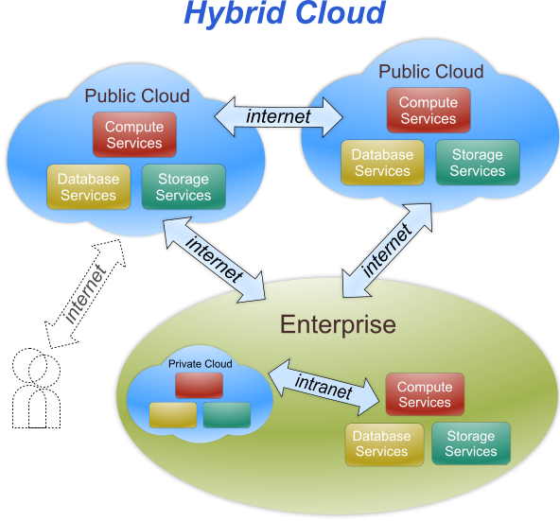
Hybrid Cloud
Hybrid cloud definition
  The cloud infrastructure is a composition of two or more clouds (private, community, or public) that remain unique entities but are bound together by standardized or proprietary technology that enables data and application
  portability (e.g., cloud bursting
  for load-balancing between
  clouds).

Slide 127
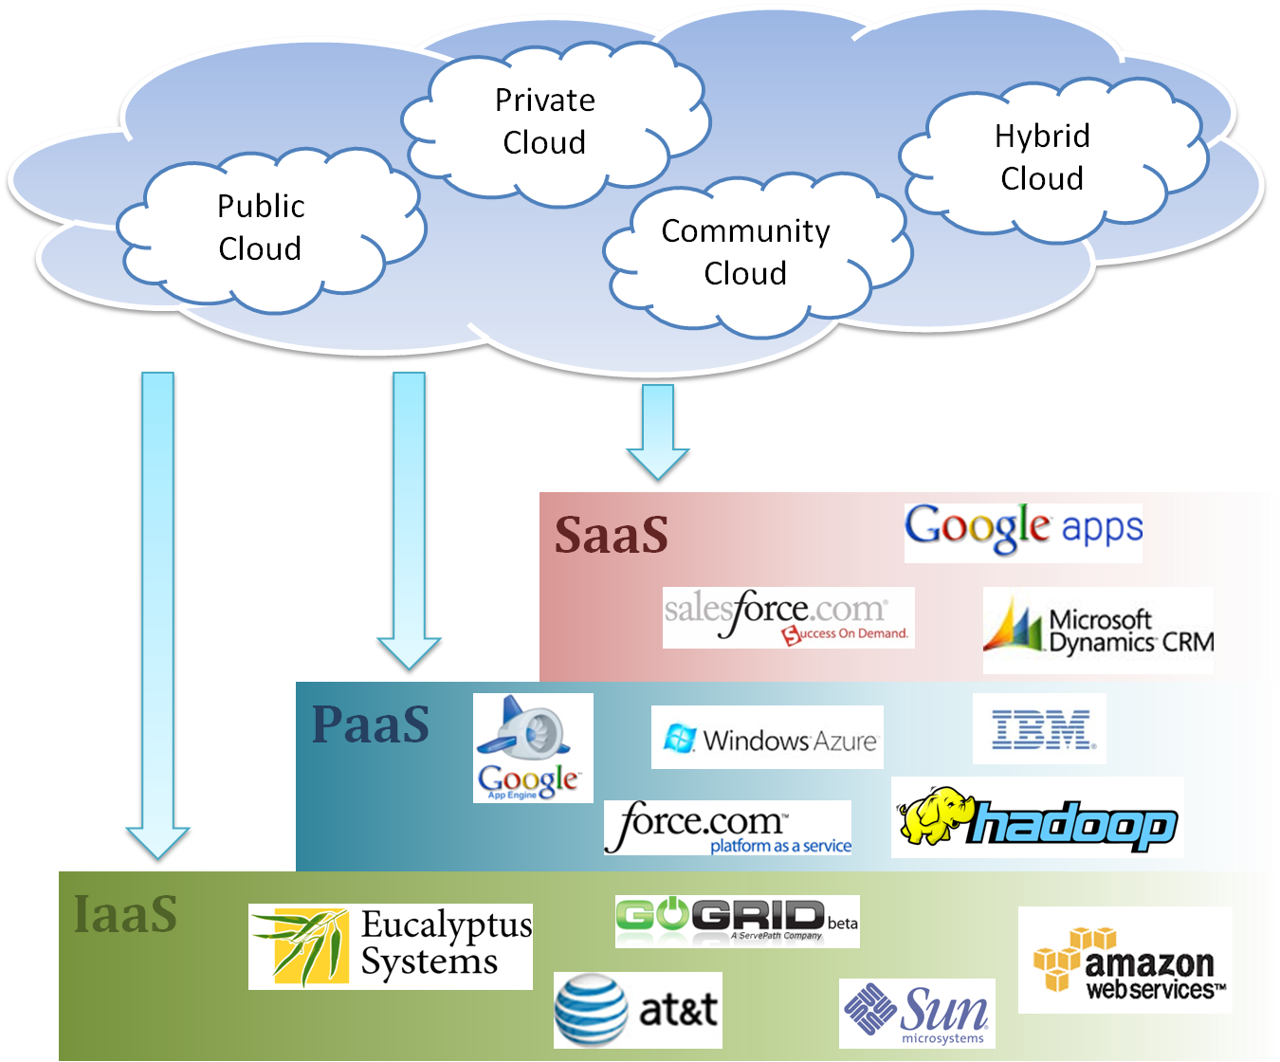
Cloud Ecosystem

Slide 128
Summary
What is cloud computing in your mind
  Clear or Cloudy?
Cloud computing is a paradigm shift of computing
Cloud computing can provide high quality of properties and characteristics based on essentially central ideas
Service models and deployment models provide services that can be used to
  Rent fundamental computing resources
  Deploy and develop customer-created applications on clouds
  Access provider’s applications over network (wired or wireless)

Slide 129
References
NIST (National Institute of Standards and Technology). http://csrc.nist.gov/groups/SNS/cloud-computing/
M. Armbrust et. al., “Above the Clouds: A Berkeley View of Cloud Computing,” Technical Report No. UCB/EECS-2009-28, University of California at Berkeley, 2009.
R. Buyya et. al., “Cloud computing and emerging IT platforms: Vision, hype, and reality for delivering computing as the 5th utility,” Future Generation Computer Systems, 2009.
Cloud Computing Use Cases. http://groups.google.com/group/cloud-computing-use-cases
Cloud Computing Explained. http://www.andyharjanto.com/2009/11/wanted-cloud-computing-explained-in.html
From Wikipedia, the free encyclopedia
All resources of the materials and pictures were partially retrieved from the Internet.

