Slide 1
Department of Informatics
Networks and Distributed Systems (ND) group
IN3230/4230
Wireless Communications - III
Özgü Alay
ozgua@ifi.uio.no

Slide 2
Outline
Massive IoT
  NB-IoT
  LORAWAN
Paving the future
  5G and Beyond

Slide 3
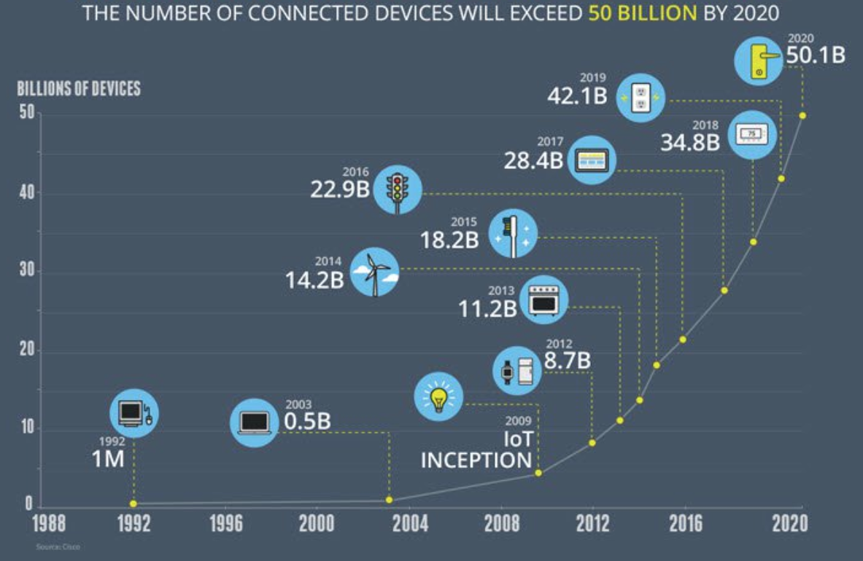
Growth in the number of connected devices

Slide 5
Key Challenges for Massive IoT
Battery life – many IoT devices will be battery-powered, and often the cost of replacing batteries in the field is not viable. (Battery life time of 10 years)
Coverage and Range – deep indoor connectivity is a requirement for many applications in the utility area. Regional (or even national or global) coverage is a prerequisite for many use cases, especially within the transport area. (5 –40 km in the open field)
Quality of Service – providing a certain low bitrate reliably is important for many applications while latency is not that critical. (Typically a few hundred bit/s or less)
Deployment and device cost – clearly a key enabler for high-volume, mass-market applications, enabling many of the use cases. Moreover, in order to enable a Massive IoT market, networks need to scale efficiently. (Device cost of a few Euros)

Slide 6
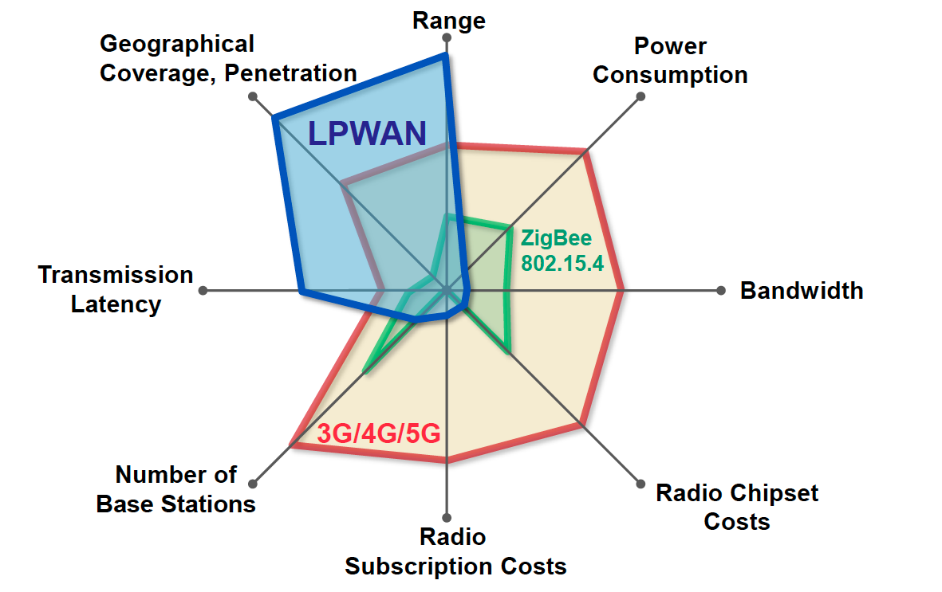
Low Power Wide Area Networks (LPWAN)

Slide 7
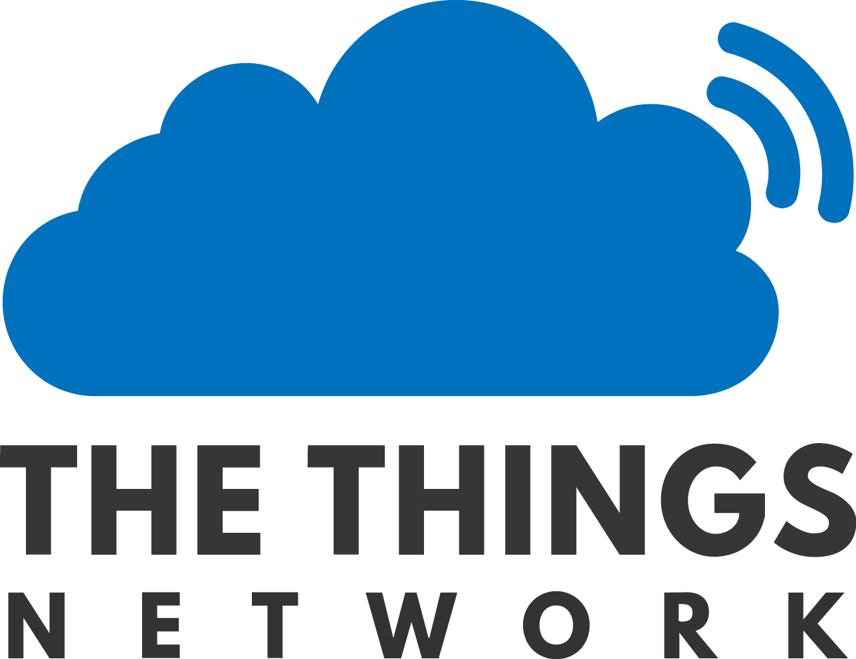
What is LORAWAN?
Low Power, Wide Area (LPWA) networking protocol for IoT
Provides bi-directional communication, end-to-end security, mobility and localization services
Open source standard
Unlicensed band (EU 868)
LORA Alliance (400+ industry partner)
The Things Network (TTN)*: “a global, crowdsourced, open, free and decentralized LoRaWAN IoT platform”
*https://www.thethingsnetwork.org/

Slide 8
LoRaWAN Architecture

Slide 9
LoRaWAN Specification
Spectrum | Unlicenced 863-870 MHz frequency bands (in Europe) 125/250 KHz channels
Modulation and Access | LoRa modulation (Chirp Spread Spectrum (CSS)) LORAWAN MAC (Aloha)
Data rate | 250bps-50kbps
UE Max Tx Power | 14 dBm
Range | 5 km (urban), 20 km (rural)
Energy Efficiency | Adaptive Data Rate (ADR)
Notes:
CSS used for Sonar and Radar

Slide 10
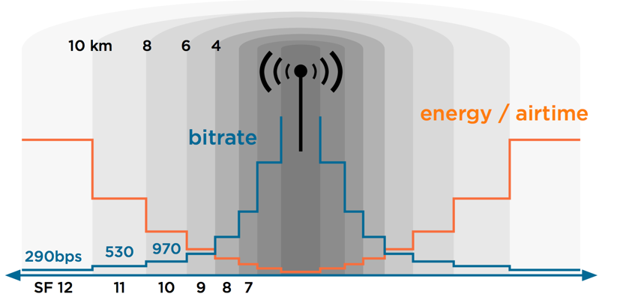
Adaptive Data Rate (ADR)
Adaptive Data Rate (ADR) is a mechanism for optimizing data rates, airtime and energy consumption in the network.
Spreading Factor (SF): is the duration of the chirp. LoRa operates with spread factors from 7 to 12. SF7 is the shortest time on air, SF12 will be the longest.
ADR triggers:
  SF increase (device-side): Improves message delivery in harsh radio conditions
  SF decrease (network-side): Improves data rate and power consumption

Slide 11
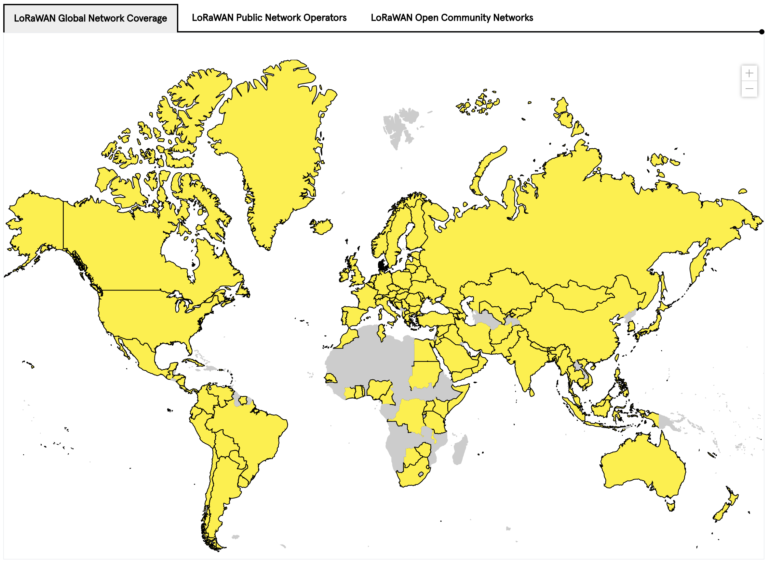
LORAWAN Network Coverage

Slide 12
What is NB-IoT?
LPWAN radio technology standard developed by 3GPP to meet IoT application requirements
Builds on the LTE ecosystem, and can be deployed as a simple addition of new software to existing LTE infrastructure
  leading to fast development, scalibility, and global roaming
Includes state-of-the-art LTE security
  Identity management
  Authentication and authorization (embedded SIM)
  End to end encription of device data and signalling
Future feature growth for MBB and NB-IoT use cases

Slide 13
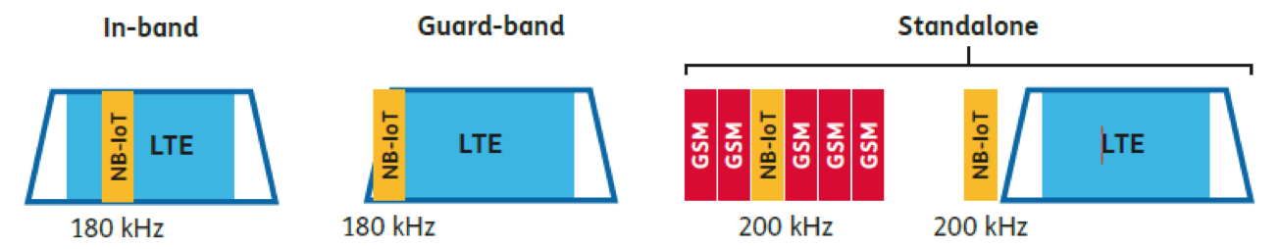
NB-IoT Specification
Spectrum Deployment
Modulation and Access | Modulation: BPSK/QPSK MAC: DL: OFDMA, UL: SC-FDMA
Peak data rate | DL: 250 kbps UL: 20 kbps
UE Max Tx Power | 23 dBm
Coverage enhancements | Power Spectral Density boost Repetitions
Range | 1 km (urban), 10 km (rural)
Energy Efficiency | Power Saving Mode (PSM) extended Discontinuous Reception (eDRx)
Rel-13

Slide 14
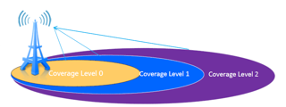
NB-IoT Coverage
Coverage Enhancement (CE) Techniques (w.r.t. LTE)
  Power Spectral Density boost: Tx power focused on smaller bands
  Repetitions: messages can be repeated up to 128 times
CE Level (CL) | # Repetitions
0 | [0-2]
1 | [4-16]
2 | [32-128]
CL0 = LTE coverage

Slide 15
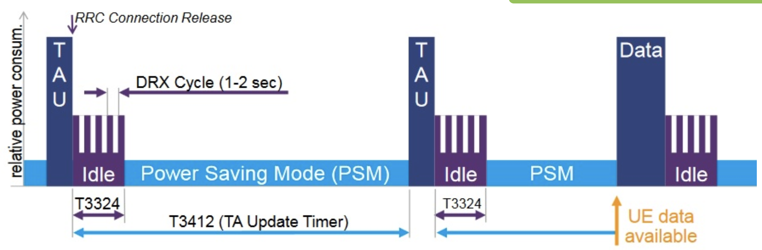
NB-IoT Power Savings
Power Saving Mode (PSM) is a power-off mode, in which the device nevertheless remains registered on the network
TAU: Tracking Area Update
RRC: Radio Resource Control
DRX: Discontinuous Reception

Slide 16
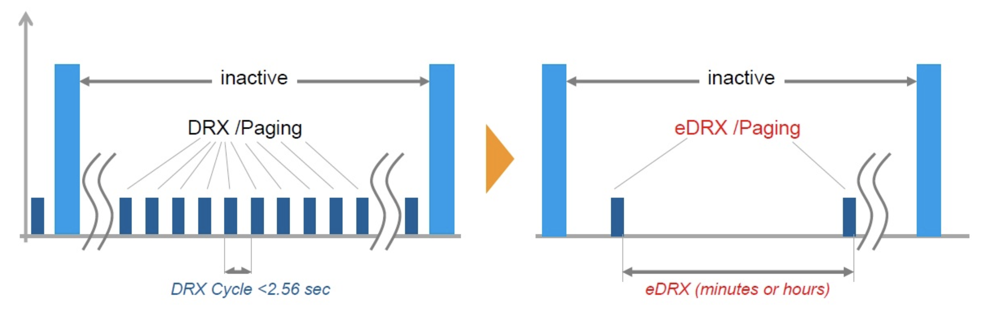
NB-IoT Power Savings
extended Discontinuous Reception (eDRx) mode allows you to significantly increase the period of time when the receiving path of the device is turned off.

Slide 17
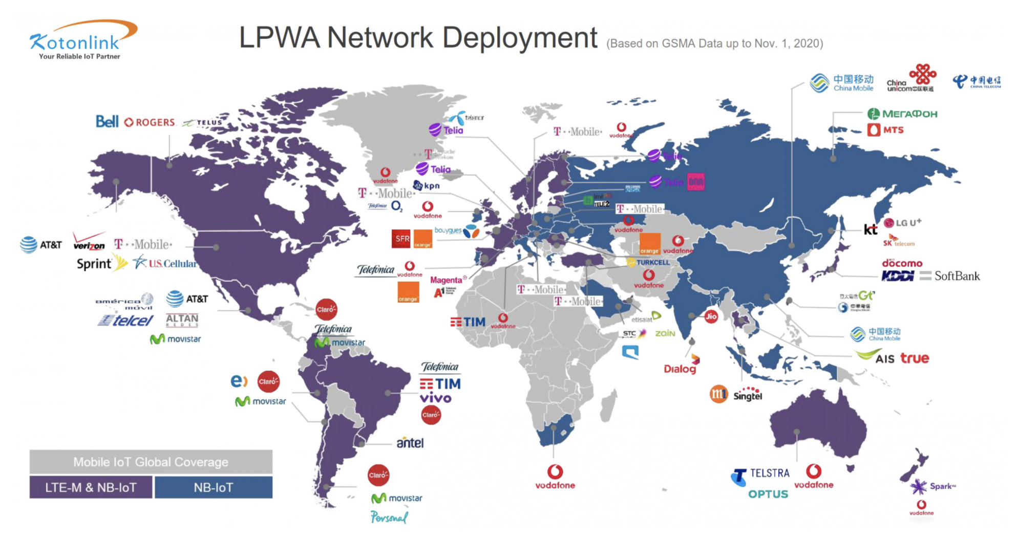
NB-IoT Deployment
*Source: https://www.kotonlink.com/NewsDetail/2434022.html

Slide 18
LORAWAN vs NB-IoT
Range and Penetration
Battery
Cost (deployment, spectrum, device)

Slide 19
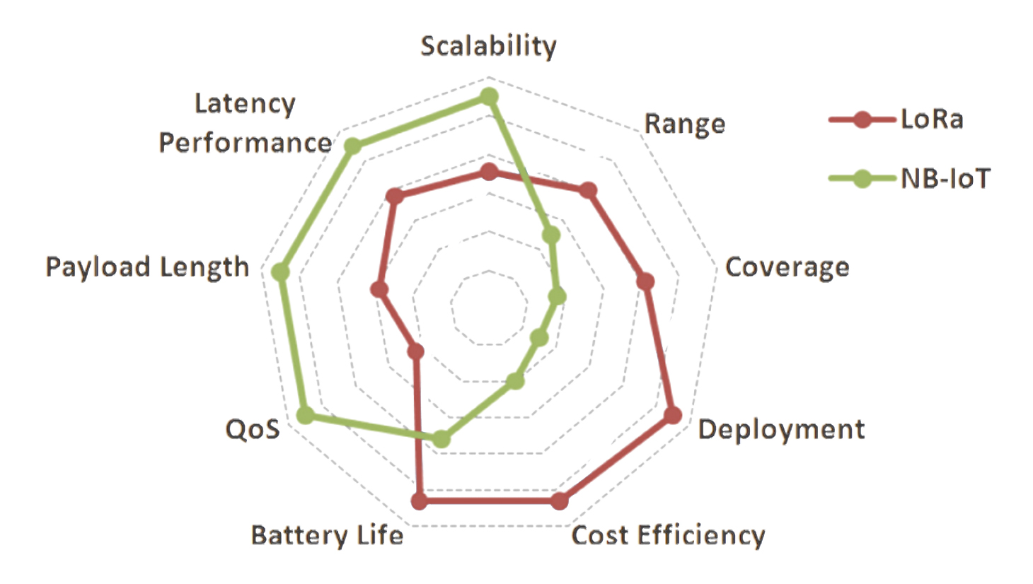
Overall LORAWAN vs NB-IoT

Slide 20
Outline
Massive IoT
  NB-IoT
  LORAWAN
Paving the future
  5G and Beyond

Slide 21
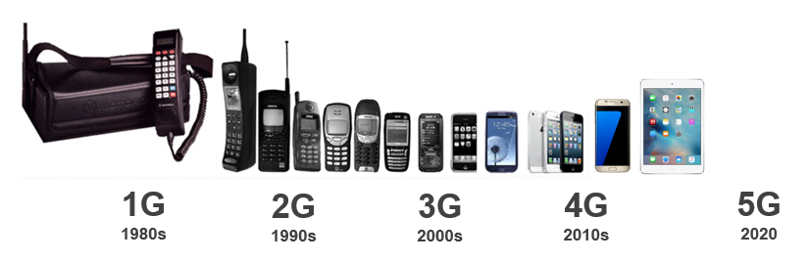
What is 5G?
5G is the 5th generation of mobile networks
Analogue
Digital
SMS
Multimedia
Video Calling
Mobile internet
Mobile Broadband
Enhanced Video
Mobile Connected World
Enhanced Mobile Broadband
Low latency applications
Internet of Things
Augmented and Virtual Reality (AR & VR)

Slide 22
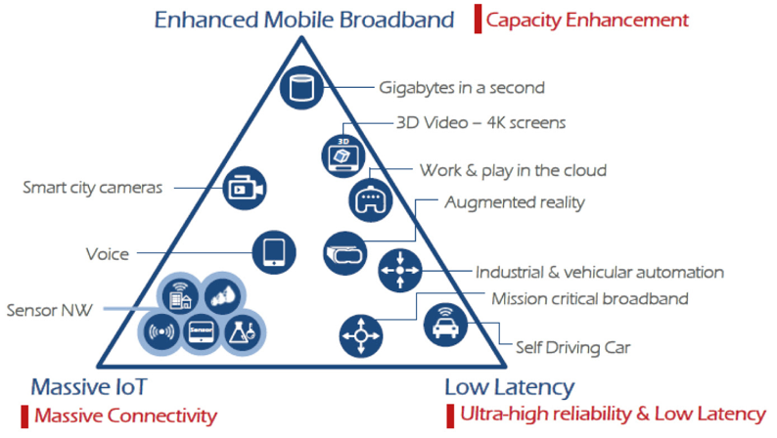
Different requirements for 5G applications and services

Slide 23
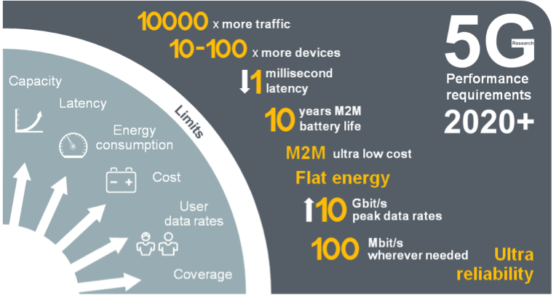
5G Mobile Network Expected Performance
Multi domain
performance
  Energy Performance
  Critical machine type
  of communications
  Global
  standard

Slide 24
Back in the day…

Slide 25
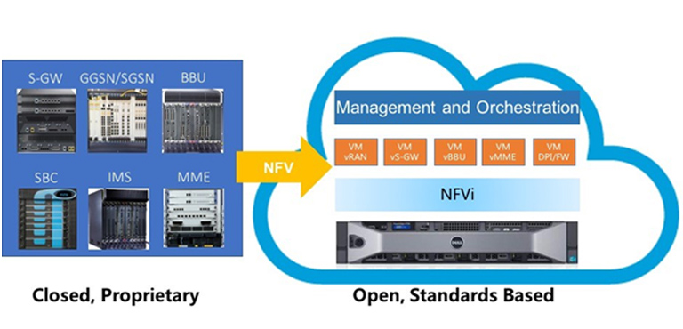
Network Flexibility: Virtualization

Slide 26
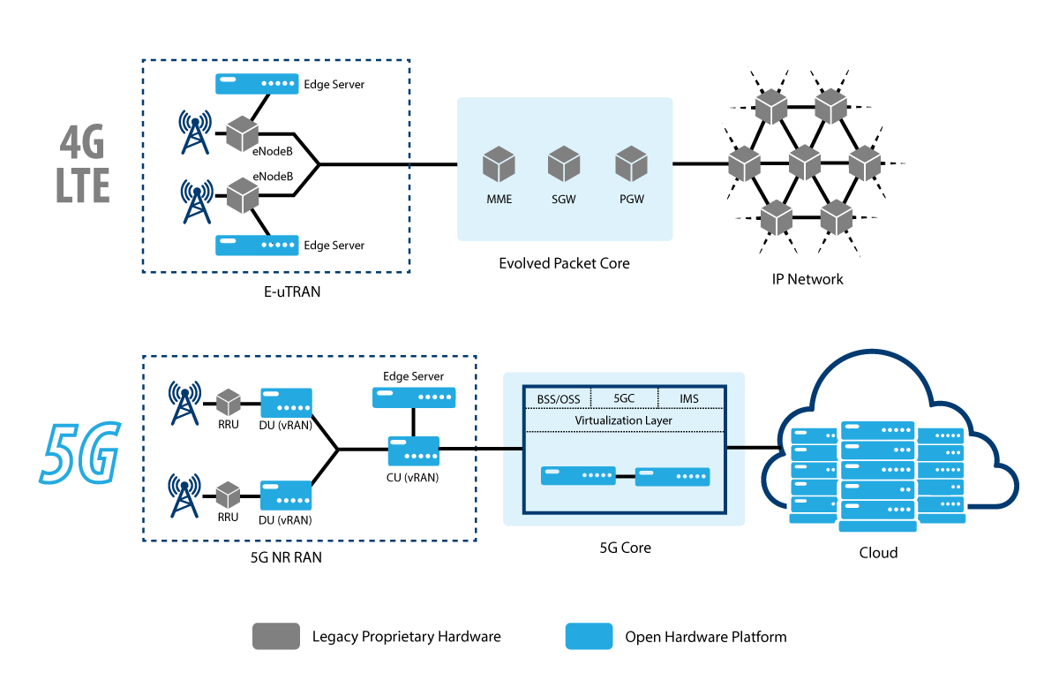

Slide 28
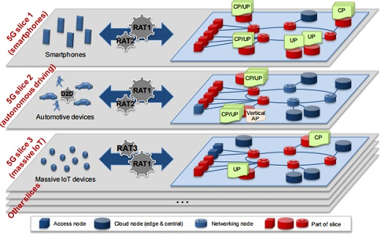
Network Slicing for diverse requirements

Slide 29
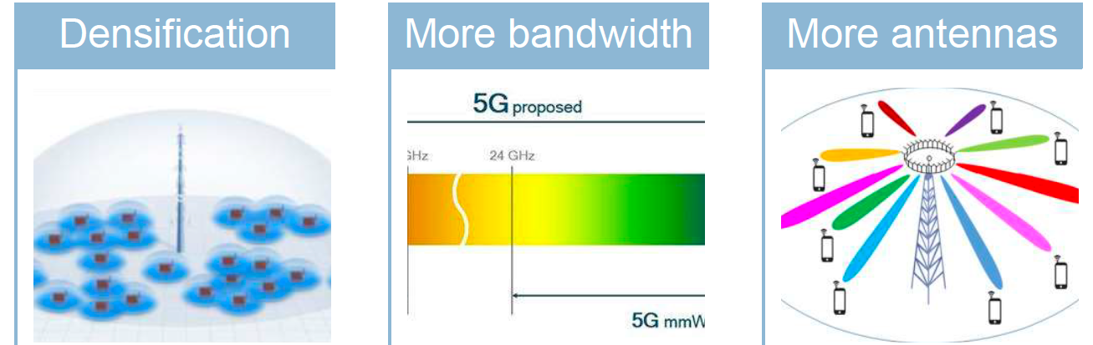
Capacity Enhancements
Small cells,
Relays, mobile
Relays and
Drones
new spectrum @ higher frequencies (above 6 GHz)
Massive MIMO
Spectrum sharing

Slide 30
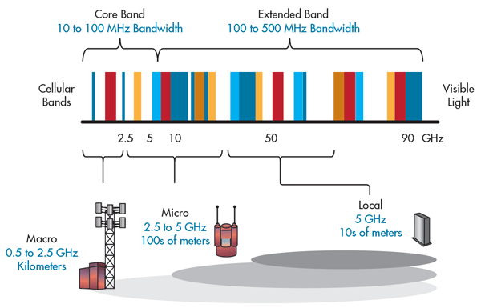
5G Bands and its impact on Cell size

Slide 31
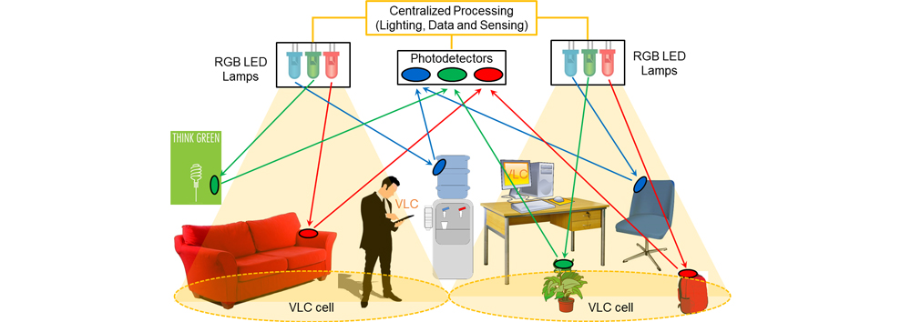
Visible Light Communications
https://attract-eu.com/showroom/project/vladimir/

Slide 32

Millimeter Wave Massive MIMO
B. Yang, Z. Yu, Y. Dong, J. Zhou and W. Hong, "Compact Tapered Slot Antenna Array for 5G Millimeter-Wave Massive MIMO Systems," in IEEE Transactions on Antennas and Propagation, vol. 65, no. 12, pp. 6721–6727, Dec. 2017.

Slide 33
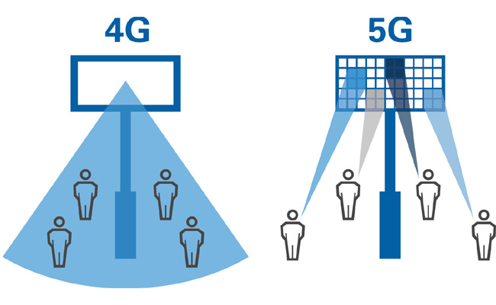
Multi-User MIMO Beamforming

Slide 34
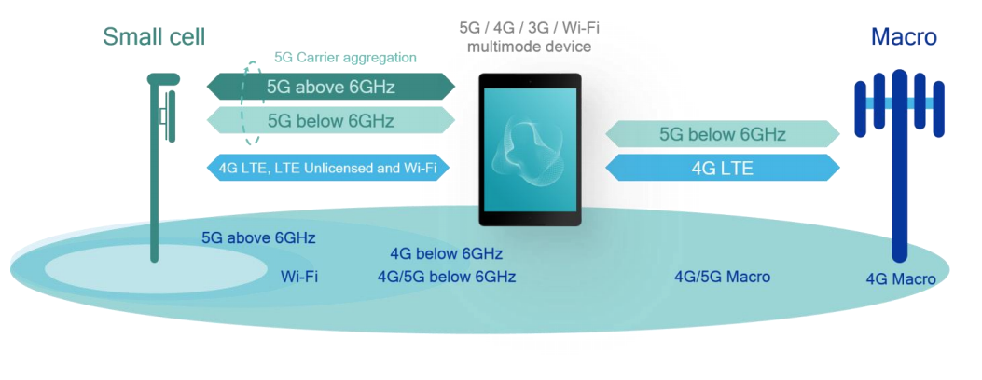
Spectrum Sharing: Multi-connectivity

Slide 35
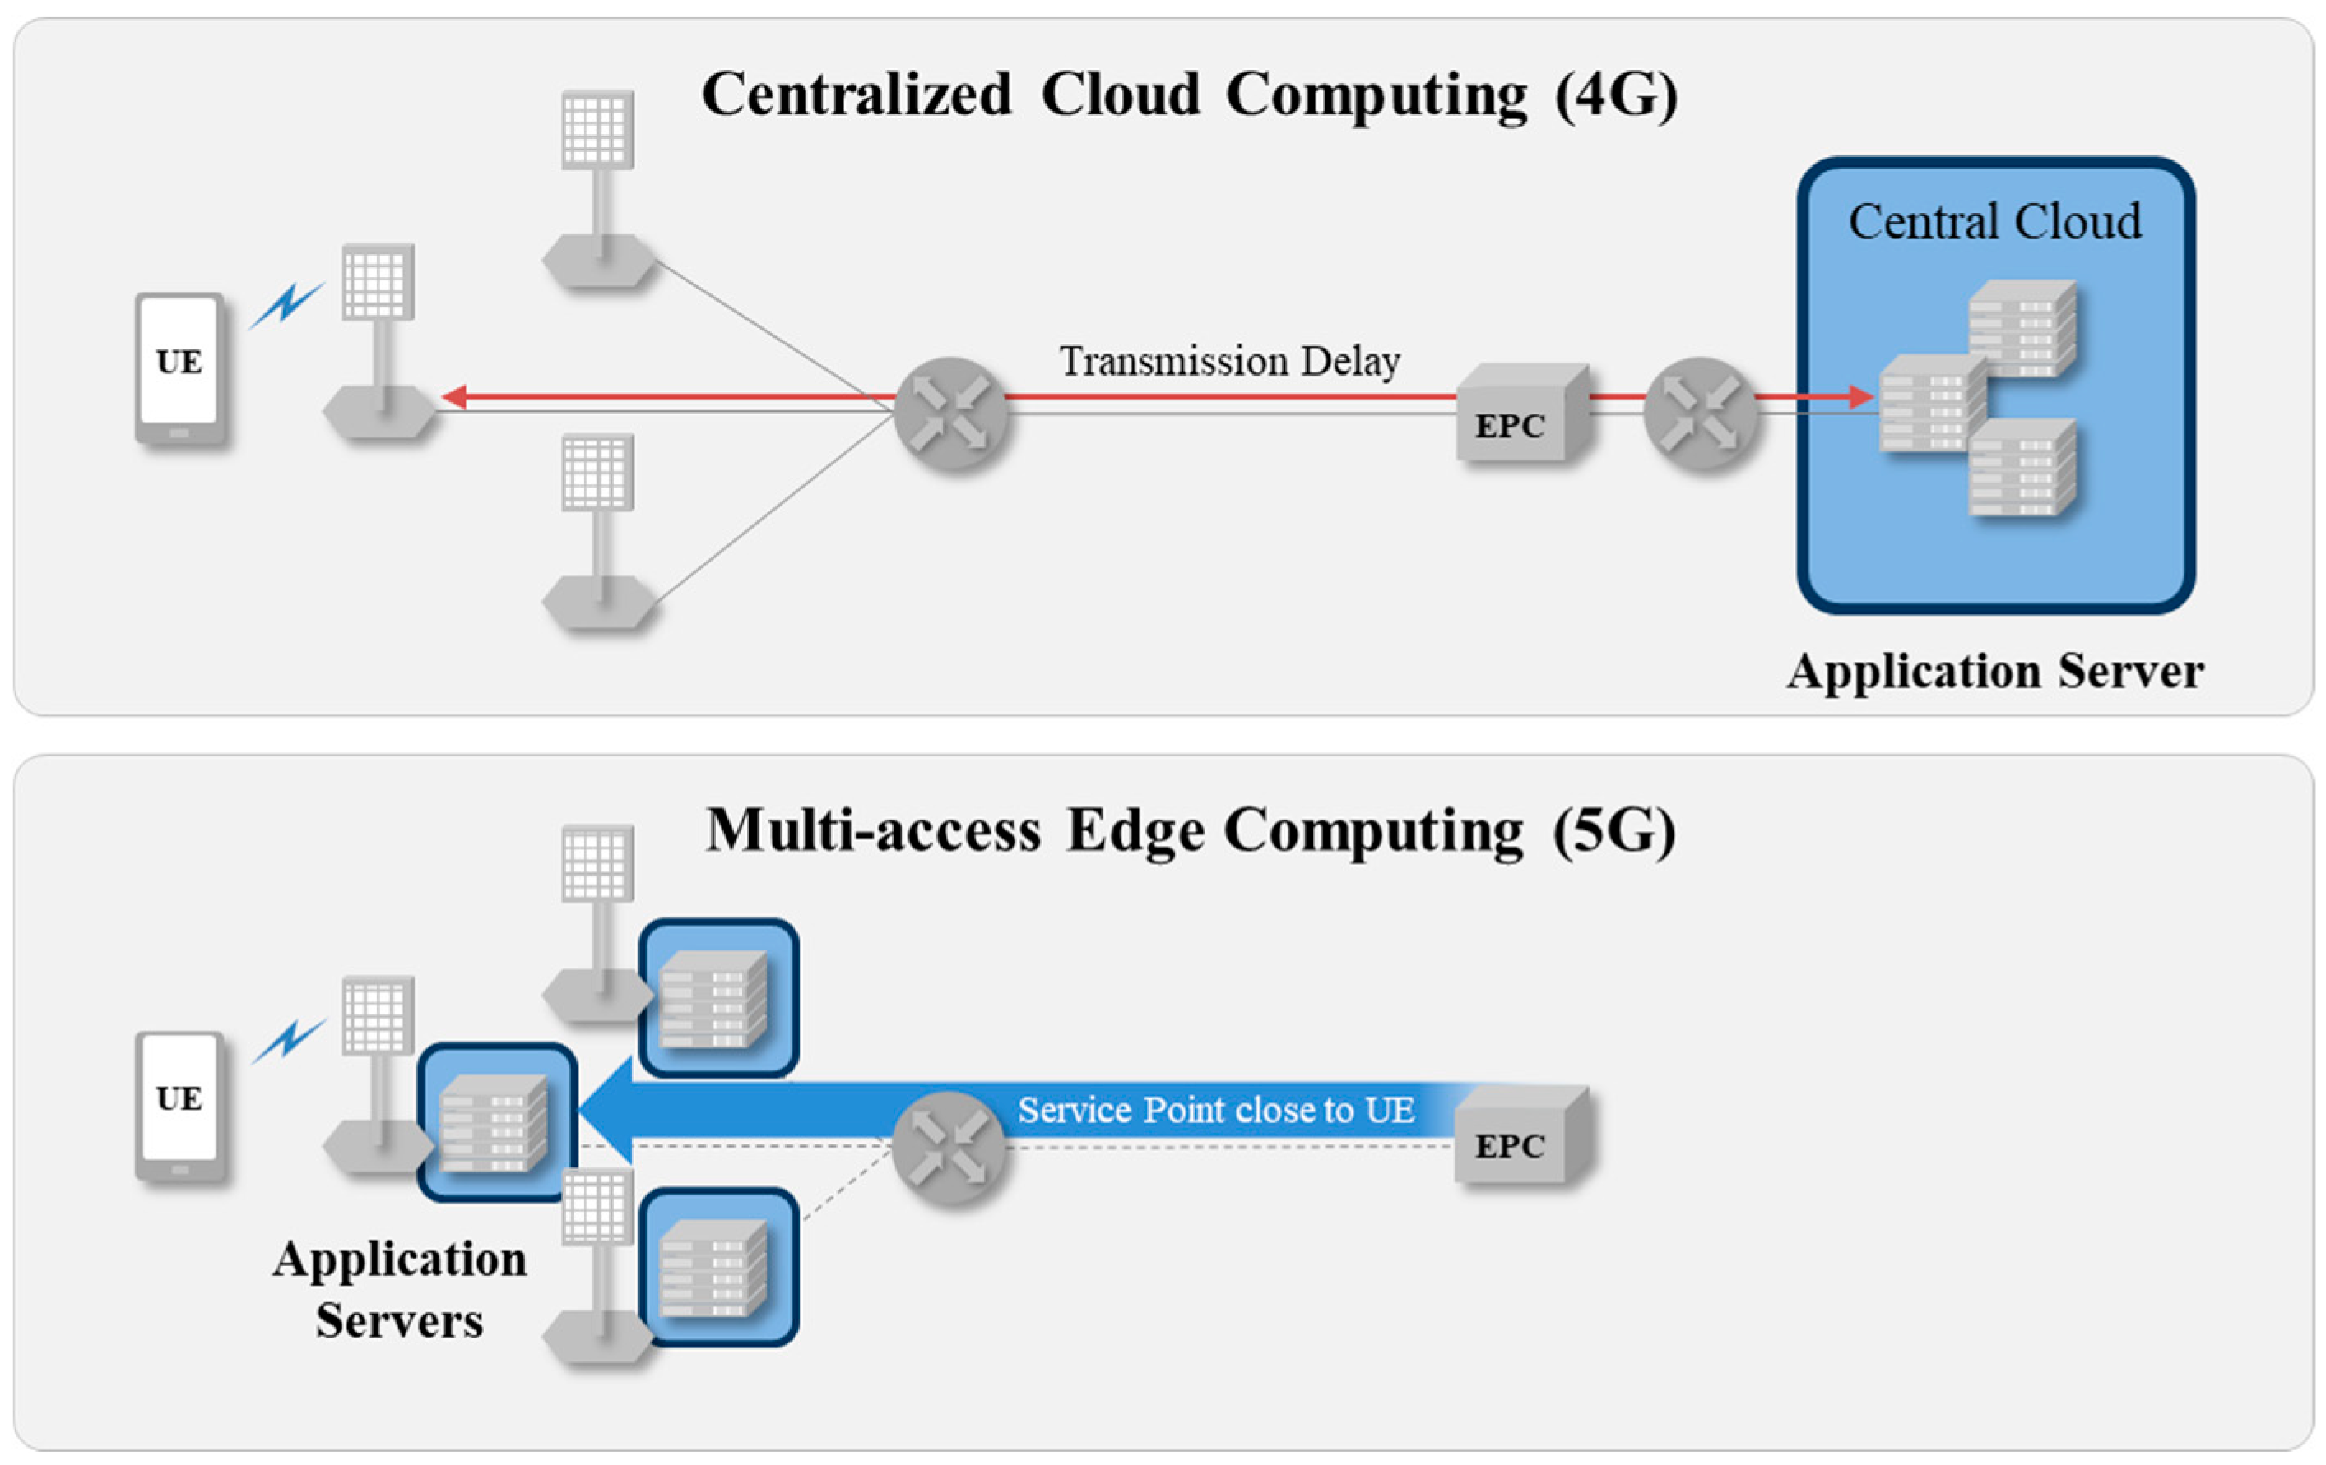
Ultra high reliability and Low Latency

Slide 36



From 4G to 5G Transition
Today – 4G Access
Device attaches to LTE/4G radio and Evolved Packet Core (EPC)
Early 5G – Non-Standalone
Device attaches to 5G-NR, which routes either via 4G Base Station to EPC, or direct to EPC
4G acts as control plane
5G Standalone
Device attaches to 5G-NR and 5G Core Network.
EPC
4G
5G-CN
5G

