Slide 1
Department of Informatics
Networks and Distributed Systems (ND) group
IN 3230 / IN 4230
Networks

Slide 2
Organizational matters
Physical attendance
  1 two-hour lecture per week
  1 two-hour plenary session (Øvelser), starting in less than 2 weeks (1. 9. 2025)
  1 common group exercise (Orakel) per week, starting in 3 weeks (12. 9. 2025)
Theoretical knowledge
  IN 3230: 70% of the grade
  IN 4230: 60% of the grade
  examined in a written 4-hour exam
Practical knowledge
  1 mandatory assignment (must be passed for admission to written exam)
  IN 3230: 1 home exam (30% of the final grade)
  IN 4230: 2 home exams (40% of the final grade)

Slide 3
Course outline
Pensum
All lectures
All lecture slides
All group lessons
All mandatory assignments and home exams
Not pensum
The recommended books
What does that mean?
  The books are recommended to improve understanding of the material that is pensum.
  The books contain more topics.
  These are not part of the course’s pensum.
  In a few cases, the lecture is more up-to-date than the books.

Slide 4
Problem area and focus
What today's networks really are like
  Why they are the way they are
  How we could make them better
→ Critical thinking!
Principles, concepts, and generality
...and learning by doing
  Understand principles and concepts by
  building examples

Slide 5

Internet, previously:
Internet, today:
Try it! For example, try google.com… or speedtest.net:
https://stefansundin.github.io/traceroute-mapper/

Slide 6
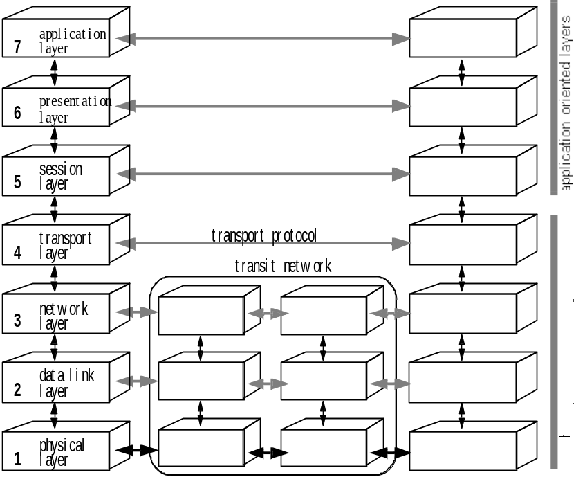
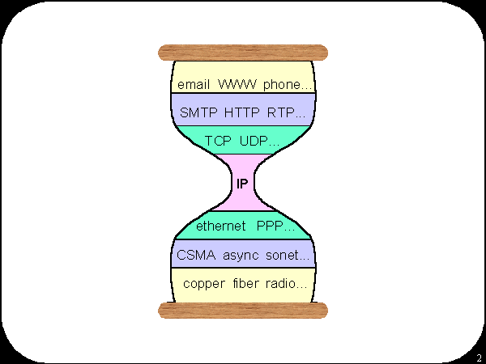
Theory
ISO/OSI model
DoD model
5. Application
4. Transport
3. Network
2. Link Layer

Slide 7
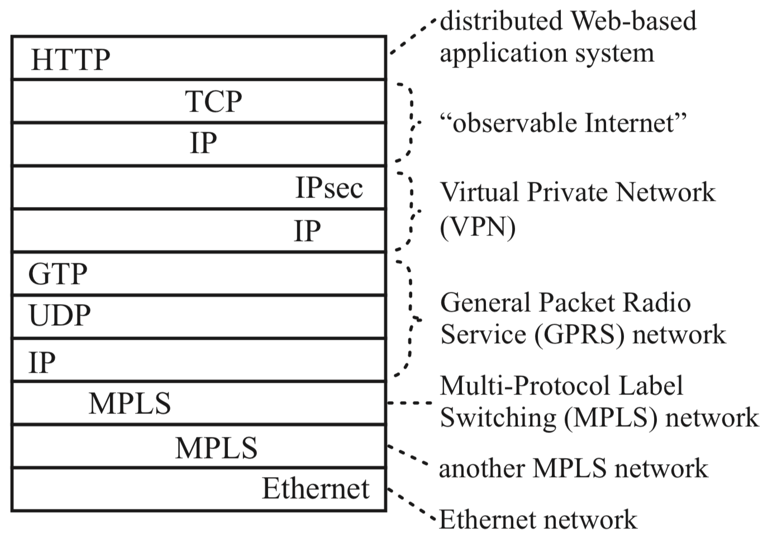
Reality
Typical packet from AT&T backbone network
Pamela Zave and Jennifer Rexford. 2019. The compositional architecture of the internet.
Commun. ACM 62, 3 (February 2019), 78-87. DOI: https://doi.org/10.1145/3226588

Slide 8
Example problem with Internet layers: multi-path transfer
TCP makes many assumptions
(little re-ordering, almost no loss, ..)
  IP tries to be neutral; yet, new in-network mechanisms must not break TCP's assumptions
Multi-path data transfer
  Network layer; routers should not look at transport header
  Per-packet operation creates re-ordering for TCP
  Mechanisms like Equal-Cost Multi-Path (ECMP) or
  Link Aggregation Group (LAG) divide per-connection
  Need to track connections, need functions per transport protocol
  IPv6 flow label could help... but ECMP/LAG rules in RFCs allow hashing on transport header

Slide 9
Non-technical reasons for Internet problems
Compromises
  Standards: often "group 1 demands X,
  group 2 demands Y, so let's have both X and Y !"
Opposing incentives
  Google, Cisco, Netgear, Akamai, Telenor, Apple, Microsoft, ...
Common open interfaces?

Slide 10
By the way… the IT world is not only AI !
Below: some names of companies that have participated in the July 2024 meeting of the Internet Engineering Task Force (IETF)
  and want your network know-how!
Akamai, Apple, Bell, Cloudflare, Cisco, Deutsche Telekom, Ericsson, Fastly, Google, Juniper Networks, Meta, Microsoft, Mozilla, Netflix, NEC, Nokia, Prime Video, Telefonica, Telenor, TikTok, Switch, Verizon, Vodafone

Slide 11
Excerpts from the qualification list in a Netflix job announcement
Extensive experience in designing, implementing, debugging, and deploying kernel-resident network stacks.
Deep understanding of strategies implemented in modern TCP and/or QUIC stacks for balancing network congestion, goodput, latency and reliability in support of SVOD (streaming video on demand) applications.
Experience with the implications for SVOD transport streams of policers & shapers, bufferbloat, active/smart queue management, and highly variable path characteristics.

Slide 12
Conclusion
The Internet is quite different from “theory”
  Layers are often neither OSI nor DoD
  Not much real theory until quite recently
    Recursive architectures offer a "cleaner" look
You will learn what the Internet really is like
  You should learn to appreciate good vs. bad design
  Hopefully deeper understanding than public press or some tech blogs!

Slide 13
Thank you!
Questions?

