Slide 1

Interconnection Networks
High Performance Computing /
Computer Architecture
Tor Skeie
University of Oslo and Simula Research Laboratory
With major presentation contribution from:
José Flich, Universidad Politécnica de Valencia
Timothy Mark Pinkston, University of Southern California

Slide 2
Introduction
Reasons to devote attention to interconnection networks – “interconnects”
  They provide connectivity within a single computer system at many levels, and between aggregated computers to offer High Performance Computing (HPC)
  Trends: The convergence going on between AI and HPC requires smarter networks and ultra-high connectivity – application trends: Big Data, AI/ML, Internet of Things, Life Science …
    increased computing power and storage capacity
    switched networks are replacing buses
  Computer architects must understand interconnect problems and solutions in order to more effectively design and evaluate systems
Goal
  To provide an overview of designing interconnection networks and potential solutions

Slide 3
Outline
  Introduction
  Interconnecting Two Devices
  Interconnecting Many Devices
  Network Topology
  Network Routing
  Concluding Remarks and References

Slide 4
Introduction
Interconnection Network Domains
Interconnection networks can be grouped into two major networking domains, depending on the number and proximity of devices to be interconnected: OCNs and SANs
  On-chip networks (OCNs), a.k.a., network-on-chip (NoC)
    Interconnect microarchitecture functional units, register files, caches, compute tiles, processor GPU and CPU cores
    Chip or multichip modules
    Tens to 100s of devices interconnected
    Maximum interconnect distance on
    the order of centimetres
    Examples (custom designed)
      Element Interconnect Bus (Cell Broadband Engine processor chip) 2,400 Gbps (3.2 Ghz processor clock), 12 elements on the chip

Slide 5

Introduction
Interconnection Network Domains
System/storage area networks (SANs), but also called off-chip networks
  Multiprocessor and multicomputer systems
    Is about aggregating computing power in a way that can deliver extreme computing (HPC)
    Interprocessor and processor-memory interconnections
  Data center and AI factory environments
    CPU, GPU, Storage, and I/O components
  Hundreds to thousands of devices interconnected
    El Capitan, located at Lawrence Livermore National Laboratory (USA), is the world´s most powerful computer right now
    consisting of 11,039,616 CPU and GPU cores in total. The interconnect is HPE´s Slingshot, Capacity: 1.742 ExaFlops. Power: 30 MW
  Maximum interconnect distance typically on the order of tens of meters, but some with as high as a few hundred meters
    InfiniBand: 120 Gbps over a distance of 300 m
  Examples (standards and proprietary)
    InfiniBand, Slingshot, CXL, Omni-Path, BXI, Data Centre Ethernet, Ultra Ethernet is also emerging

Slide 6
Introduction
Interconnection Network Domains
5 x 10⁶
WANs
5 x 10³
LANs
Distance (meters)
SANs
5 x 10⁰
OCNs
5 x 10⁻³
1
10
100
1,000
10,000
>100,000
Number of devices interconnected

Slide 7
Outline
  Introduction
  Interconnecting Two Devices (Now)
    Network Interface Card Functions
    Basic Network Structure and Functions
    Characterizing Performance: Latency & Effective Bandwidth
  Interconnecting Many Devices
  Network Topology
  Network Routing
  Concluding Remarks and References

Slide 8
Interconnecting Two Devices
An Ideal Network
  Two end node devices (A and B)
  Device A (or B) may read an address in device B (or A)
  Interconnection network behaves as dedicated links between A, B
    Unidirectional wires each way dedicated to each device
  Receiving buffers used for staging the transfers at the end nodes
  Communication protocol: request, reply
    basic functions at end nodes to commence and complete communication
Device A
int. network
Device B

Slide 9
Interconnecting Two Devices
Network Interface Functions
  A message is the unit of information: header, payload, trailer
  Interfacing to the network (hardware)
    Communication device itself (OCNs and some SANs)
    Additional network interface card or NIC (SANs, LANs, WANs)
      Embedded processor(s), DMA engine(s), RAM memory
header
trailer
Dest
Information
Type
message payload
checksum
to/from host
Memory
host interface
internal interconnect
DMA
NIC
processor
FIFO
Network
interface
to/from network
DMA
NIC

Slide 10
Interconnecting Two Devices
Communication Protocol
  Typical steps followed by the sender:
    System call by application
      Copies the data into OS and/or network interface memory
      Packetizes the message (if needed)
      Prepares headers and trailers of packets
    Checksum is computed and added to header/trailer
    Timer is started and the network interface sends the packets
processor
memory
ni
ni
memory
processor
proc/mem bus
user
space
IO bus or proc/mem bus
IO bus or proc/mem bus
user
space
proc/mem bus
register
file
Interconnection
network
register
file
FIFO
FIFO
system
space
system
space
packet
user writes
data in
memory
system call
sends
1 copy
pipelined
transfer
e.g., DMA

Slide 11
Interconnecting Two Devices
Communication Protocol
  Typical steps followed by the receiver:
    NI allocates received packets into its memory or OS memory
    Checksum is computed and compared for each packet
      If checksum matches, NI sends back an ACK packet
    Once all packets are correctly received
      The message is reassembled and copied to user's address space
      The corresponding application is signalled (via polling or interrupt)
processor
memory
ni
ni
memory
processor
proc/mem bus
user
space
IO bus or proc/mem bus
IO bus or proc/mem bus
user
space
proc/mem bus
register
file
Interconnection
network
register
file
FIFO
FIFO
system
space
system
space
packet
pipelined
reception
e.g., DMA
interrupt
2 copy
data
ready

Slide 12
Interconnecting Two Devices
Communication Protocol
  OS-bypassing (zero-copy or user-level protocols)
    Direct allocation for DMA transfer to/from memory/NI buffers
    Application directly reads/writes from/to these locations
    Memory-to-memory copies are avoided
    Protection is guaranteed by OS
processor
memory
ni
ni
memory
processor
proc/mem bus
user
space
IO bus or proc/mem bus
IO bus or proc/mem bus
user
space
proc/mem bus
register
file
Interconnection
network
register
file
FIFO
FIFO
system
space
system
space
packet
user copies
data into pinned
user space
system call send.
pipelined transfer
e.g., DMA
Pipelined
peception
e.g., DMA
interrupt:
data ready

Slide 13
Interconnecting Two Devices
Communication Protocol
  OS-bypassing (zero-copy or user-level protocols)
    Direct allocation for DMA transfer to/from memory/NI buffers
    Application directly reads/writes from/to these locations
    Memory-to-memory copies are avoided
    Protection is guaranteed by OS
  Is it possible to take out register to memory/buffer copy as well?
processor
memory
ni
ni
memory
processor
proc/mem bus
user
space
IO bus or proc/mem bus
IO bus or proc/mem bus
user
space
proc/mem bus
register
file
Interconnection
network
register
file
FIFO
FIFO
system
space
system
space
packet

Slide 14
Interconnecting Two Devices
Communication Protocol
  OS-bypassing (zero-copy or user-level protocols)
    Direct allocation of system or network interface memory/buffers
    Application directly reads/writes from/to these locations
    Memory-to-memory copies are avoided
    Protection is guaranteed by OS
  Is it possible to take out register to memory/buffer copy as well?
    NI buffer is associated with (or replaced by) register mapping
processor
ni
ni
processor
proc/mem bus
proc/mem bus
register
file
Interconnection
network
register
file
FIFO
FIFO
packet
Pipelined transfer

Slide 15
Interconnecting Two Devices
Basic Network Structure and Functions
  Reliable delivery of packets: lossy versus lossless networks
    Must prevent the sender from sending packets at a faster rate than can be received and processed by the receiver
    Lossy networks
      Packets are dropped (discarded) at receiver when buffers fill up
      Sender is notified to retransmit packets (via time-out or NACK)
    Lossless networks (flow controlled)
      Before buffers fill up, sender is notified to stop packet injection
        Xon/Xoff (Stop & Go) flow control
        Credit-based flow control (token or batched modes)
    Implications of network type (lossless vs. lossy)
      Constrains the solutions for packet routing, congestion, & deadlock
      Affects network performance
      The network domain dictates which is one used
        OCN, SAN: typically lossless; LAN, WAN: typically lossy

Slide 16
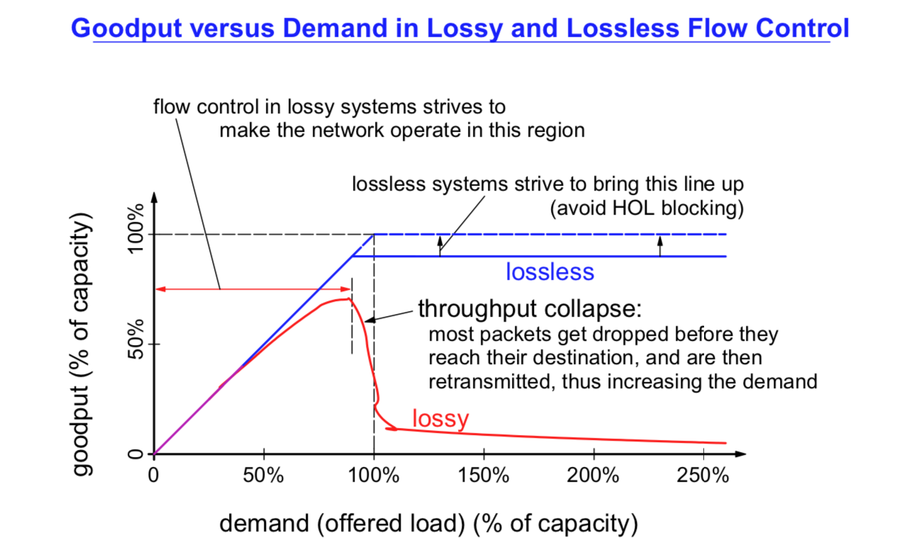
Interconnecting two devices

Slide 17
Interconnecting Two Devices
Basic Network Structure and Functions
  Xon/Xoff flow control
Xon
Xoff
a packet is injected if control bit is in Xon
sender
receiver
Control bit
Xoff
Xon
pipelined transfer

Slide 18
Interconnecting Two Devices
Basic Network Structure and Functions
  Xon/Xoff flow control
When in Xoff,
sender cannot
inject packets
When Xoff threshold is reached, an Xoff notification is sent
Xon
Xoff
sender
receiver
Control bit
Xoff
X
Xon
pipelined transfer
Queue is
not serviced

Slide 19
Interconnecting Two Devices
Basic Network Structure and Functions
  Xon/Xoff flow control
When Xon threshold is reached, an Xon notification is sent
Xon
Xoff
sender
receiver
Control bit
Xoff
X
Xon
pipelined transfer
Queue is
not serviced

Slide 20
Interconnecting Two Devices
Basic Network Structure and Functions
  Credit-based flow control
Sender sends packets whenever credit counter
is not zero
sender
receiver
Credit counter
10
9
8
7
6
5
4
3
2
1
0
X
pipelined transfer
Queue is
not serviced

Slide 21
Interconnecting Two Devices
Basic Network Structure and Functions
  Credit-based flow control
Sender resumes
injection
Receiver sends credits after they become available
sender
receiver
Credit counter
10
9
8
7
6
5
4
3
2
5
4
3
2
1
0
X
+5
pipelined transfer
Queue is
not serviced

Slide 22
Interconnecting Two Devices
Basic Network Structure and Functions
  Comparison of Xon/Xoff vs credit-based flow control
Stop
Stop
Stop
Stop
Go
Go
Go
Go
Stop signal
returned by
receiver
Sender
stops
transmission
Last packet
reaches receiver
buffer
Packets in
buffer get
processed
Go signal
returned to
sender
Sender
resumes
transmission
First packet
reaches
buffer
Stop & Go
# credits
returned
to sender
Sender
uses
last credit
Last packet
reaches receiver
buffer
Packets get
processed and
credits returned
Sender
transmits
packets
First packet
reaches
buffer
Time
Flow control latency
observed by
receiver buffer
Credit
based
Time
➔ Poor flow control can reduce link efficiency

Slide 23
Interconnecting Two Devices
Basic Network Structure and Functions
  Example: impact of different link lengths for credit-based flow control
    Calculate the minimum amount of credits and buffer space for interconnect distances of 1 cm, 1 m, 100 m, and 10 km
    Assume a dedicated-link network with
      8 Gbps (raw) data bandwidth per link (each direction)
    Device A continuously sends 100-byte packets (header included)
    Consider only the link propagation delay (no other delays or overheads), and that the speed of the medium is 2/3 x 300 000 km/sec
Device A
int. network
Device B
Cr
8 Gbps raw data bandwidth

Slide 24
Interconnecting Two Devices
Basic Network Structure and Functions
  Example: comparison of flow control techniques
Packet propagation delay + Credit propagation delay ≤
Packet size
х Credit count
Bandwidth
(
distance
)
100 bytes
х 2 ≤
8 Gbits/sec
х Credit count
2/3 x 300,000 km/sec
1 cm → 1 credit
1 m → 1 credit
100 m → 10 credits
10 km → 1,000 credits
Device A
int. network
Device B
Cr
8 Gbps raw data bandwidth

Slide 25
Outline
  Introduction
  Interconnecting Two Devices
  Interconnecting Many Devices (Now)
    Additional Network Structure and Functions
    Switched-based Networks
    Comparison of Shared-media versus Switched-based Networks
    Characterizing Performance: Latency & Effective Bandwidth
  Network Topology
  Network Routing
  Concluding Remarks and References

Slide 26
Interconnecting Many Devices
Additional Network Structure and Functions
  Network topology – being a regular structure
    What paths are possible for packets?
    Networks usually share paths among different pairs of devices
  Routing
    Which of the possible paths are allowable (valid) for packets?
    Provides the set of operations needed to compute a valid path
    A routing decision is taken at each intermediate node, but the routing tables is programmed by centralized controller, aka SDN (Software Defined Networking)
  Arbitration
    When are paths available for packets? (along with flow control)
    Resolves packets requesting the same resources at the same time
    For every arbitration, there is a winner and possibly many losers
      Losers are buffered (lossless) or dropped on overflow (lossy)
  Switching
    How are paths allocated to packets?
    The winning packet (from arbitration) proceeds towards destination
    Paths can be established one fragment at a time or in their entirety
    Complexity and applied order depends on the category of the topology: shared-media or switched media

Slide 27
Interconnecting Many Devices
Switched-based Networks
  Disjoint portions of the media are shared via switching
  Switch fabric components
    Passive point-to-point links
    Active switches
      Dynamically establish communication between sets of source-destination pairs
  Aggregate bandwidth can be many times higher than that of shared-media networks
Node
Node
Switch
Fabric
Node
Node

Slide 28
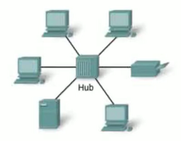
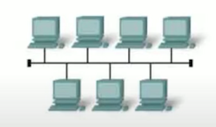
Interconnecting Many Devices
Comparison of Shared-media versus Switched-based Networks
  Shared-media networks
    Low cost
    Aggregate network bandwidth does not scale with # of devices
    Global arbitration scheme required (a possible bottleneck)
    Time of flight increases with the number of end nodes
  Switched-based networks
    Aggregate network bandwidth scales with number of devices
    Concurrent communication
      Potentially much higher network effective bandwidth
    Beware: inefficient designs are possible
      Superlinear network cost but sublinear network effective bandwidth

Slide 29
Interconnecting Many Devices
Characterizing Performance: Latency & Effective Bandwidth
Packet size
Latency = Sending overhead + (T_{TotalProp} + T_{R} + T_{A} + T_{S}) + + Receiving overhead
Bandwidth
T_{R} = routing delay
T_{A} = arbitration delay
T_{S} = switching delay
T_{TotalProp} = propagation delay
lower bound (contention delay not included)
upper bound (contention effects not fully included)
Effective bandwidth = min (BW_{NetworkInjection}, BW_{Network}, σ × BW_{NetworkReception})
= min (N × BW_{LinkInjection}, BW_{Network}, σ × N × BW_{LinkReception})
σ = average reception factor (contention at reception links due to application behavior)

Slide 30
Interconnecting Many Devices
Characterizing Performance: Latency & Effective Bandwidth
Injection
bandwidth
Reception
bandwidth
Network
injection
Aggregate
bandwidth
Network
reception
σ = 1
Device A
int. network
Device B
Dedicated-link network

Slide 31
Interconnecting Many Devices
Characterizing Performance: Latency & Effective Bandwidth
Injection
bandwidth
(N times)
BW_{Link} = 1
Reception
bandwidth
(N times)
Network
injection
Aggregate
bandwidth
Network
reception
BW_{Network} = (BW_{NetworkInjection})/N
Node
Node
Node
Device A
int. network
Device B
X
Dedicated-link network
Shared-media network

Slide 32
Interconnecting Many Devices
Characterizing Performance: Latency & Effective Bandwidth
σ
Injection
bandwidth (N times)
Reception
bandwidth (N times)
Network
bandwidth
Network
injection
Network
reception
Traffic with many-to-one communication
Aggregate
bandwidth (≥ N times)
σ < 1
Node
Node
Node
Node
Node
Switch
Fabric
Device A
int. network
Device B
X
Node
X
Node
Dedicated-link network
Shared-media network
Switched-based network

Slide 33
Interconnecting Many Devices
Characterizing Performance: Latency & Effective Bandwidth
  Characteristic performance plots: latency vs. average load rate; throughput (effective bandwidth) vs. average load rate
T_{contention}
Network
congestion
Latency
T_{R}
T_{A}
T_{S}
Latency for just two devices
T_{propagation}
Effective bandwidth
T_{propagation}
T_{transmission}
T_{transmission}
T_{receive}
T_{receiving}
T_{sending}
Peak throughput
Peak throughput
T_{send}
Average load rate
Average load rate

Slide 34
Interconnecting Many Devices
Characterizing Performance: Latency & Effective Bandwidth
  Example: plot the total packet latency
    Assume N scales from 4 to 1024 end nodes and the following:
    Shared media (one link) and switched-based (N links)
    All network links have data bandwidth of 8 Gbps
    Unicast transmission of packets of size 100 bytes
    Overheads
      sending: x + 0.05 ns/byte; receiving: 4/3(x) + 0.05 ns/byte
      x is 0 for OCNs and 0.3 µs for SANs
      Distances: 0.5 cm for OCNs and 5 m SANs
    Routing, Arbitration, and Switching
      Shared-media: T_{R} = 2.5 ns, T_{A} = 2.5(N) ns, T_{S} = 2.5 ns
      Switched-based: T_{R} = T_{A} = T_{S} = 2.5 (log₂N) ns
    σ = N⁻¹ (shared), σ = (log₂N)^{-1/4} (switched)

Slide 35
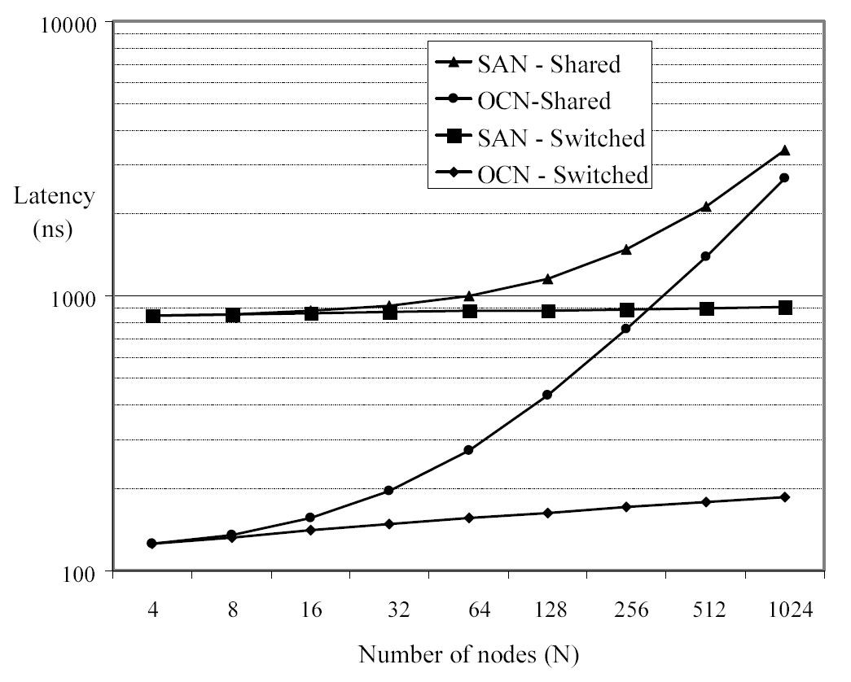
Interconnecting Many Devices
Characterizing Performance: Latency & Effective Bandwidth
For OCNs, T_{R}, T_{A}, and
T_{S} combine to dominate
time of flight delay and
are >> than other
latency components for
all network sizes.
For SANs, T_{R}, T_{A}, and
T_{S} combine to dominate
time of flight delay, but
are less than other
latency components for
switched-based (but,
not negligibly so)

Slide 36
Outline
  Introduction
  Interconnecting Two Devices
  Interconnecting Many Devices
  Network Topology (Now)
    Preliminaries and Evolution
    Indirect Networks
    Direct Networks
    Comparison of Indirect and Direct Networks
  Network Routing
  Concluding Remarks and References

Slide 37
Network Topology
0
1
2
3
Preliminaries and Evolution
  One switch can only connect a small number of devices
    Number of switch ports limited by VLSI technology,
    power consumption, packaging, and other cost
    constraints
  A fabric of interconnected switches (i.e., switch fabric or network fabric) is needed when the number of devices is much larger
    The topology must make a path(s) available for every pair of devices—property of connectedness or full access (What paths?)
  Topology defines the connection structure across all components
    Bisection bandwidth: the minimum bandwidth of all links crossing a network split into two roughly equal halves
    Full bisection bandwidth:
      Network BW_{Bisection} = Injection (or Reception) BW_{Bisection}= N/2
    Bisection bandwidth mainly affects performance
  Topology is constrained primarily by local chip/board pin-outs, and not least the routing function …
0
1
2
3

Slide 38
Network Topology
Preliminaries and Evolution
  One switch suffices to connect a small number of
  devices
    Number of switch ports limited by VLSI technology,
    power consumption, packaging, and other such
    cost constraints
  A fabric of interconnected switches (i.e., switch fabric or network fabric) is needed when the number of devices is much larger
    The topology must make a path(s) available for every pair of devices—property of connectedness or full access (What paths?)
  Topology defines the connection structure across all components
    Bisection bandwidth: the minimum bandwidth of all links crossing a network split into two roughly equal halves
    Full bisection bandwidth:
      Network BW_{Bisection} = Injection (or Reception) BW_{Bisection}= N/2
    Bisection bandwidth mainly defines the performance potential
  Topology is constrained primarily by local chip/board pin-outs, and not least the routing function …
0
0
1
1
2
2
3
3
4
4
5
5
6
6
7
7

Slide 39
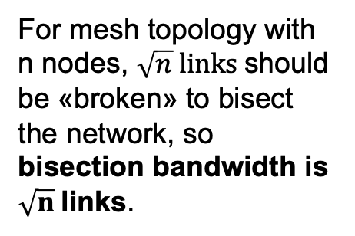
Network Topology
Bisection bandwidth
For tree topology with n nodes can be bisected at the root by «breaking» one link, so bisection bandwidth is one link.
For mesh topology with n nodes, $\sqrt{n} links$should be «broken» to bisect the network, so bisection bandwidth is $\sqrt{n}$links.
For Hyper-cube topology with n nodes, n/2 links should be «broken» to bisect the network, so bisection bandwidth is bandwidth of n/2 links.

Slide 40
Network Topology
Preliminaries and Evolution
  One switch suffices to connect a small number of devices
    Number of switch ports limited by VLSI technology, power consumption, packaging, and other such cost constraints
  A fabric of interconnected switches (i.e., switch fabric or network fabric) is needed when the number of devices is much larger
    The topology must make a path(s) available for every pair of devices—property of connectedness or full access (What paths?)
  Topology defines the connection structure across all components
    Bisection bandwidth: the minimum bandwidth of all links crossing a network split into two roughly equal halves
    Full bisection bandwidth:
      Network BW_{Bisection} = Injection (or Reception) BW_{Bisection}= N/2
    Bisection bandwidth mainly defines the performance potential
  Topology is constrained primarily by local chip/board pin-outs, and not least the routing function …

Slide 41
Network Topology
Single switch (crossbar) Networks
    Crossbar switch complexity increases quadratically with the number of crossbar input/output ports, N, i.e., grows as O(N²)
    Has the property of being non-blocking
0
1
2
3
4
5
6
7
0
1
2
3
4
5
6
7
0
0
1
1
2
2
3
3
4
4
5
5
6
6
7
7

Slide 42
Network Topology
Indirect Networks, a.k.a.
  Multistage interconnection networks (MINs)
    Network split into several stages consisting of crossbars => k x k switches
    Complexity grows as O(N × log_{k}N), where N is # of end (compute) nodes, with log_{k}N switch stages, each with N/k switches, and the total number of switches is N/k(log_{k}N)
    Inter-stage connections represented by a set of permutation functions
0
0
1
1
2
2
3
3
4
4
5
5
6
6
7
7
Omega topology, perfect-shuffle exchange

Slide 43
Network Topology
Indirect Networks
  Going from a single switch network to a MIN comes at the price of performance
    MINs have the property of being blocking
    Contention is more likely to occur on network links
      Paths from different sources to different destinations share one or more links
0
1
2
3
4
5
6
7
0
X
0
0
1
1
1
2
2
2
3
3
3
4
4
4
5
5
5
6
6
6
7
7
7
non-blocking topology
blocking topology

Slide 44
Network Topology
Indirect Networks
  How to reduce blocking in MINs? Provide alternative paths!
    Use larger switches – can equate to using more switches
      Clos network: minimally three stages (non-blocking)
        A larger switch in the middle of two other switch stages provides enough alternative paths to avoid all conflicts
    Use more switches
      Add log_{k}N - 1 stages, mirroring the original topology
        Rearrangeably non-blocking
        Allows for non-conflicting paths
        Doubles network hop count (distance), d
        Centralized control can rearrange established paths
      Benes topology: 2(log₂N) - 1 stages (rearrangeably non-blocking)
        Recursively applies the three-stage Clos network concept to the middle-stage set of switches to reduce all switches to 2 x 2

Slide 45
Network Topology
Indirect Networks / Multistage Interconnection Networks
0
0
1
1
2
2
3
3
4
4
5
5
6
6
7
7
8
8
9
9
10
10
11
11
12
12
13
13
14
14
15
15
16 port Crossbar network

Slide 46
Network Topology
Indirect Networks / Multistage Interconnection Networks
0
0
1
1
2
2
3
3
4
4
5
5
6
6
7
7
8
8
9
9
10
10
11
11
12
12
13
13
14
14
15
15
16 port, 3-stage Clos network

Slide 47
Network Topology
Indirect Networks / Multistage Interconnection Networks
0
0
1
1
2
2
3
3
4
4
5
5
6
6
7
7
8
8
9
9
10
10
11
11
12
12
13
13
14
14
15
15
16 port, 5-stage Clos network

Slide 48
Network Topology
Indirect Networks / Multistage Interconnection Networks
0
0
1
1
2
2
3
3
4
4
5
5
6
6
7
7
8
8
9
9
10
10
11
11
12
12
13
13
14
14
15
15
16 port, 7 stage Clos network = Benes topology

Slide 49
Network Topology
Indirect Networks / Multistage Interconnection Networks
0
0
1
1
2
2
3
3
4
4
5
5
6
6
7
7
8
8
9
9
10
10
11
11
12
12
13
13
14
14
15
15
Alternative paths from 0 to 1. 16 port, 7 stage Clos network = Benes topology

Slide 50
Network Topology
Indirect Networks / Multistage Interconnection Networks
0
0
1
1
2
2
3
3
4
4
5
5
6
6
7
7
8
8
9
9
10
10
11
11
12
12
13
13
14
14
15
15
Alternative paths from 4 to 0. 16 port, 7 stage Clos network = Benes topology

Slide 51
Network Topology
Indirect Networks / Multistage Interconnection Networks
0
0
1
1
2
2
3
3
4
4
5
5
6
6
7
7
8
8
9
9
10
10
11
11
12
12
13
13
14
14
15
15
Contention free, paths 0 to 1 and 4 to 0. 16 port, 7 stage Clos network = Benes topology

Slide 52
Network Topology
Indirect Networks / Multistage Interconnection Networks
  Bidirectional MINs
  Increase modularity
  Reduce hop count, d
  Fat tree network
    Nodes as tree leaves
    Switches as tree vertices
    Total link bandwidth is constant across all tree levels, with full bisection bandwidth
    Equivalent to folded Benes topology
    Preferred topology in many SANs
0
1
2
3
4
5
6
7
8
9
10
11
12
13
14
15
Folded Clos = Folded Benes = Fat tree network

Slide 53
Network Topology
Network
Bisection
Indirect Networks
  Bidirectional MINs
  Increase modularity
  Reduce hop count, d
  Fat tree network
    Nodes as tree leaves
    Switches as tree vertices
    Total link bandwidth is constant across all tree levels, with full bisection bandwidth
    Equivalent to folded Benes topology
    Preferred topology in many SANs
0
1
2
3
4
5
6
7
8
9
10
11
12
13
14
15
Folded Clos = Folded Benes = Fat tree network

Slide 54
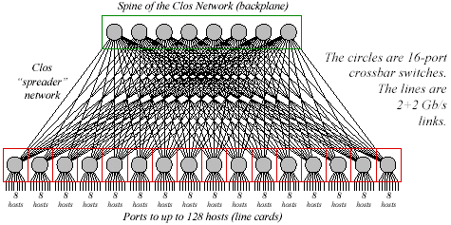
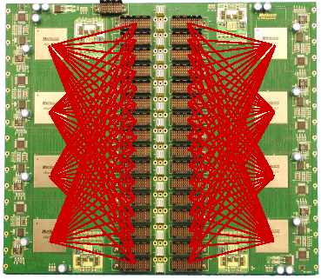
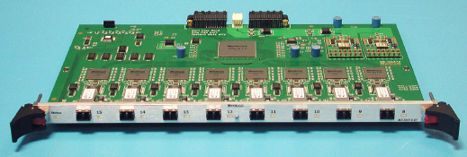
Network Topology
Myrinet-2000, two-level Fat-tee Network for 128 Hosts
Backplane of the M3-E128 Switch
M3-SW16-8F fiber line card (8 ports)
http://myri.com

Slide 55
Network Topology
Direct Networks
  All the switches will have one or more compute directly connected to them, i.e. tight integration of the compute nodes with the network resources
    Compute nodes distributed among the switches within the network
    The packets are routed / forwarded through one or more switches
  Fully-connected network: all nodes (switches) are directly connected to all other nodes using bidirectional dedicated links
Compute node
…
0
7
1
6
2
5
3
4

Slide 56
Network Topology
Direct Networks
  Example: Compute the switch and link costs of interconnecting N nodes using a fully connected topology relative to a crossbar, assuming
      Cost of a k x k switch grows quadratically with the number of unidirectional ports
      Cost of a 1 x k switch on the other hand grows linearly
2N(N-1)
1
Relative cost_{switches} =
= 2 ( 1 -
)
N²
N
N (N + 1)
N+1
Relative cost_{links} =
=
2N
2
As N increases, the switch cost nearly doubles the crossbar’s
Link cost is always higher than a crossbar’s
No extra benefits of a fully connected network over a crossbar!

Slide 57
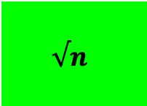
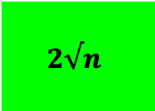
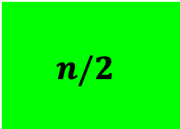
Network Topology
Direct Networks
2D mesh or grid of 16 nodes
2D torus of 16 nodes
hypercube of 16 nodes
(16 = 2⁴, so n = 4)
Network
Bisection
full bisection bandwidth

Slide 58
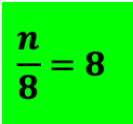
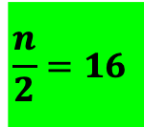
Network Topology
Comparison of Indirect and Direct Networks
  Bristling can be used to reduce direct network switch & link costs
    “b” compute nodes connect to each switch, where b is bristling factor
    Allows larger systems to be built from fewer switches and links
    Requires larger switch degree
    For N = 64 and k = 8, requiring fewer switches and links than a fat tree
64-node system with 8-port switches, b = 4
32-node system with 8-port switches

Slide 59
Network Topology
Comparison of Indirect and Direct Networks
  Blocking reduced by maximizing dimensions (switch degree)
    Can increase bisection bandwidth, but
      Additional dimensions may increase wire length (must observe 3D packaging constraints)
      Flow control issues (buffer size increases with link length)
      Pin-out constraints (limit the number of dimensions achievable)
Evaluation category
Bus
Ring
2D mesh
2D torus
Hypercube
Fat tree
Fully
connected
Perf.
BW_{Bisection} in # links
1
2
8
16
32
32
1024
Max (ave.) hop count
1 (1)
32 (16)
14 (7)
8 (4)
6 (3)
11 (9)
1 (1)
Cost
I/O ports per switch
NA
3
5
5
7
4
64
Number of switches
NA
64
64
64
64
192
64
Number of net. links
1
64
112
128
192
320
2016
Total number of links
1
128
176
192
256
384
2080
Performance and cost of several network topologies for 64 nodes. Values are given in terms of bidirectional links & ports.
Hop count includes a switch and its output link (in the above, end node links are not counted for the bus topology).

Slide 60
Outline
  Introduction
  Interconnecting Two Devices
  Interconnecting Many Devices
  Network Topology
  Network Routing (Now)
  Concluding Remarks and References

Slide 61
Routing in Interconnection Networks
Routing
  Performed at each switch, regardless of topology
  Defines the “allowed” path(s) for each packet (Which paths?)
  Need to direct packets through network to intended destinations
  Ideally:
    Supply as many routing options to packets as there are paths provided by the topology, and evenly distribute network traffic among network links using those paths, minimizing contention
  Problems: situations that cause packets to never reach their dest.
    Livelock
      Arises from an unbounded number of allowed non-minimal hops
      Solution: restrict the number of non-minimal (mis)hops allowed
    Deadlock
      Arises from a set of packets being blocked waiting only for network resources (i.e., links, buffers) held by other packets in the set
      Probability increases with increased traffic & decreased availability

Slide 62
Routing in Interconnection Networks
c_{i} = channel i
s_{i} = source node i
d_{i} = destination node i
p_{i} = routing (packet) dependency i
Routing
  Common forms of deadlock:
    Routing-induced deadlock
Routing of packets in a 2D mesh
Channel dependency graph
p
1
p
1
s
c
3
s
c
0
c
c
1
2
1
2
c
0
c
4
p
p
p
2
2
1
c
1
c
2
d
3
d
4
s
5
c
c
3
4
c
5
c
c
c
12
11
5
p
p
c
8
c
5
p
3
p
3
2
d
5
d
2
d
1
7
c
c
c
12
c
6
c
7
c
10
6
8
s
4
s
3
p
p
p
3
c
9
4
4
c
9
c
10
c
p
4
11

Slide 63
Routing in Interconnection Networks
Routing
  Common strategies to deal with all forms of deadlock
    Deadlock avoidance: restrict allowed paths only to those that keep the global state deadlock-free, i.e. the channel dependency graph cycle free
      DOR (dimension-order routing) on meshes and hypercubes
        Establish ordering on all resources based on network dimension
      DOR on rings and tori (k-ary n-cubes with wrap-around links)
        Ordering on all resources between and within each dimension
        Apply to multiple virtual channels (VCs) per physical channel
        Alternatively, keep resources along each dimension from reaching full capacity by ensuring the existence of a bubble(s)

Slide 64
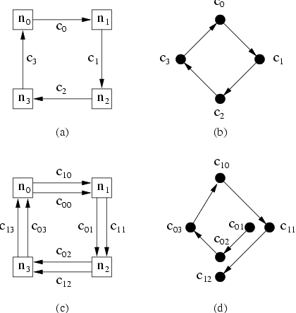
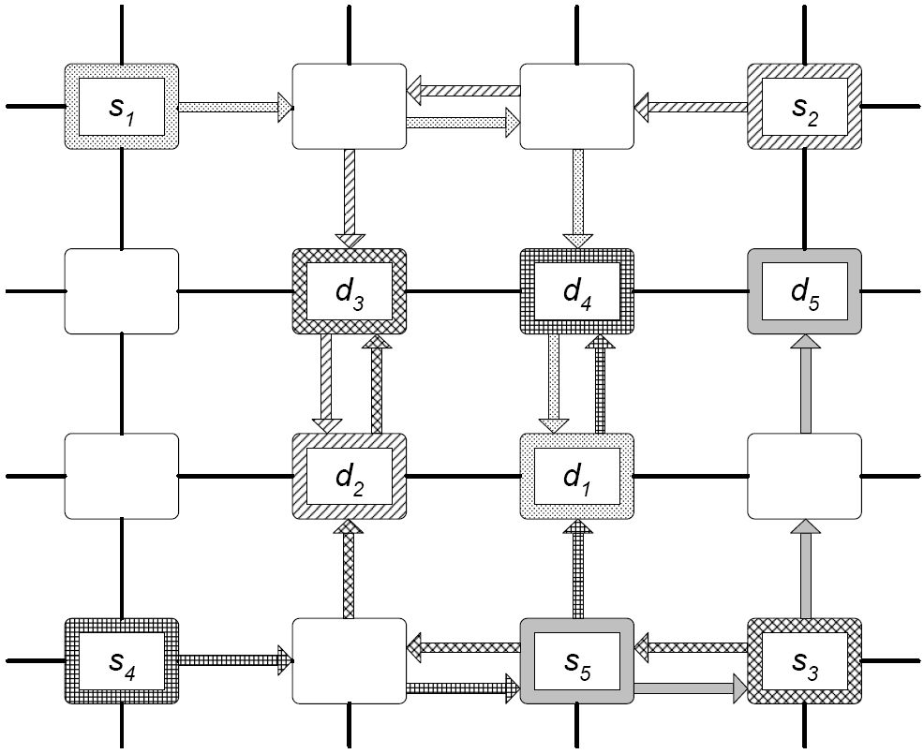
Routing in Interconnection Networks
n_{i} = node i
c_{i} = physical channel i
c_{1i} = high-ordered VC i
c_{0i} = low-ordered VC i
Routing
Routing
  Common strategies to deal with deadlock
    Deadlock avoidance:
Deadlock avoidance in ring using VCs
Deadlock avoidance in 2D mesh using DOR
Network graph
Channel dependency graph
c₁₃
c₀₀
2 virtual channels per physical channel

Slide 65
Routing in Interconnection Networks
Routing
  Common strategies to deal with all forms of deadlock
    Deadlock recovery: allow deadlock to occur, but once a potential deadlock situation is detected, break at least one of the cyclic dependencies to gracefully recover
      A mechanism to detect potential deadlock is needed
      Regressive recovery (abort-and-retry): remove packet(s) from a dependency cycle by killing (aborting) and later re-injecting (retry) the packet(s) into the network after some delay
      Progressive recovery (preemptive): remove packet(s) from a dependency cycle by rerouting the packet(s) onto a deadlock-free lane
  Deterministic routing: routing function always supplies the same path for a given source-destination pair (e.g., DOR)
  Adaptive routing: routing function allows alternative paths for a given source-destination pair
    Increases routing freedom to improve network efficiency, ρ

Slide 66
Routing in Interconnection Networks
Routing
Comparison of Routing Freedom
Legend:
source
destination
permissible paths
restricted paths
Dimension-order routing (deterministic)
Routing freedom can increase ρ ( i.e., ρ_{R} )
Partial adaptive routing (Duato´s algorithm)
Recovery routing (true fully adaptive)

Slide 67
Routing in Interconnection Networks
Routing
  Routing in Fat-tree (indirect) networks
    Least common ancestor (LCA) routing
      Applicable to fat tree and other bidirectional MINs
      Use resources in some partial order to avoid cycles, deadlock
      Reach any LCA switch through any one of multiple paths
      Traverse down the tree to destination through a deterministic path
      Self routing property: switch output port at each hop is given by shifts of the destination node address (least significant bit/digit)
    Up*/down* routing:
      Universally applicable to any topology: map a tree graph onto it
      Assign “up” and “down” directions to network links (or VCs)
      Allowed paths to destination consist of zero or more “up” traversals followed by zero or more “down” traversals
      Up-down traversals impose partial order to avoid cycles, deadlocks

Slide 68
Concluding Remarks and References
Concluding Remarks
  Interconnection network design is an important area of computer architecture, in the era of HPC-AI
    on-chip networks between cores within a chip
    off-chip networks between chips and boards within a HPC-AI system
  Interconnection networks should be designed to transfer the maximum amount of information within the least amount of time (and cost, power constraints) so as not to bottleneck the system
  The design of interconnection networks is end-to-end
    injection links/interface, network fabric, reception links/interface
    topology, routing, arbitration, switching, and flow control are among key concepts in realizing high-performance designs
    a general throughput model can be used to guide design
  Improving the performance of interconnection networks is critical to advancing our AI- and communication-centric world

Slide 69
Interconnecting Two Devices
Characterizing Performance: Latency & Effective Bandwidth
Terms and Definitions:
  Bandwidth:
    Maximum rate at which information can be transferred (including packet header, payload and trailer)
    Unit: bits per second (bps) or bytes per second (Bps)
    Aggregate bandwidth: Total data bandwidth supplied by network
    Effective bandwidth (throughput): fraction of aggregate bandwidth that gets delivered to the application
  Time of flight: Time for first bit of a packet to arrive at the receiver
    Includes the time for a packet to pass through the network, not including the transmission time (defined next)
    Picoseconds (OCNs), nanoseconds (SANs), microseconds (LANs), milliseconds (WANs)

Slide 70
Interconnecting Two Devices
Characterizing Performance: Latency & Effective Bandwidth
  Transmission time:
      The time for a packet to pass through the network, not including the time of flight
      Equal to the packet size divided by the data bandwidth of the link
  Transport latency:
      Sum of the time of flight and the transmission time
      Measures the time that a packet spends in the network
  Sending overhead (latency):
      Time to prepare a packet for injection, including hardware/software
      A constant term (packet size) plus a variable term (buffer copies)
  Receiving overhead (latency):
      Time to process an incoming packet at the end node
      A constant term plus a variable term
      Includes cost of interrupt, packet reorder and message reassembly

Slide 71
Interconnecting Two Devices
Characterizing Performance: Latency & Effective Bandwidth
Sender
Sending
overhead
Transmission time
(bytes/bandwidth)
Time of
flight
Transmission time
(bytes/bandwidth)
Receiving
overhead
Receiver
Transport latency
Total latency
Time
packet size
Latency = Sending Overhead + Time of flight + + Receiving Overhead
Bandwidth

