Slide 1
Department of Informatics
Networks and Distributed Systems (ND) group
IN 3230 / IN 4230
Congestion control
Michael Welzl

Slide 2
A simple router model
Switching
Fabric
In 1
Out 1
In 2
Queue 1
Out 2
In 3
Queue 2
Switch(ing) fabric forwards a packet (dest. addr.)
if no special treatment necessary: “fast path“ (hardware)
Queues grow when traffic bursts arrive
  low delay = small queues, low jitter = no queue fluctuations
Packets are dropped when queues overflow (“DropTail queueing“)
  low loss ratio = small queues

Slide 3
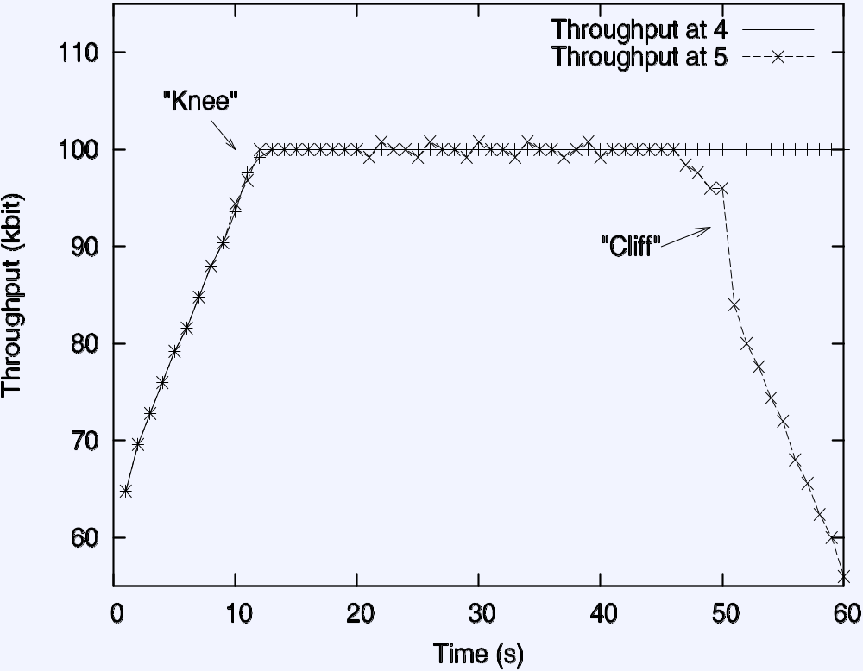
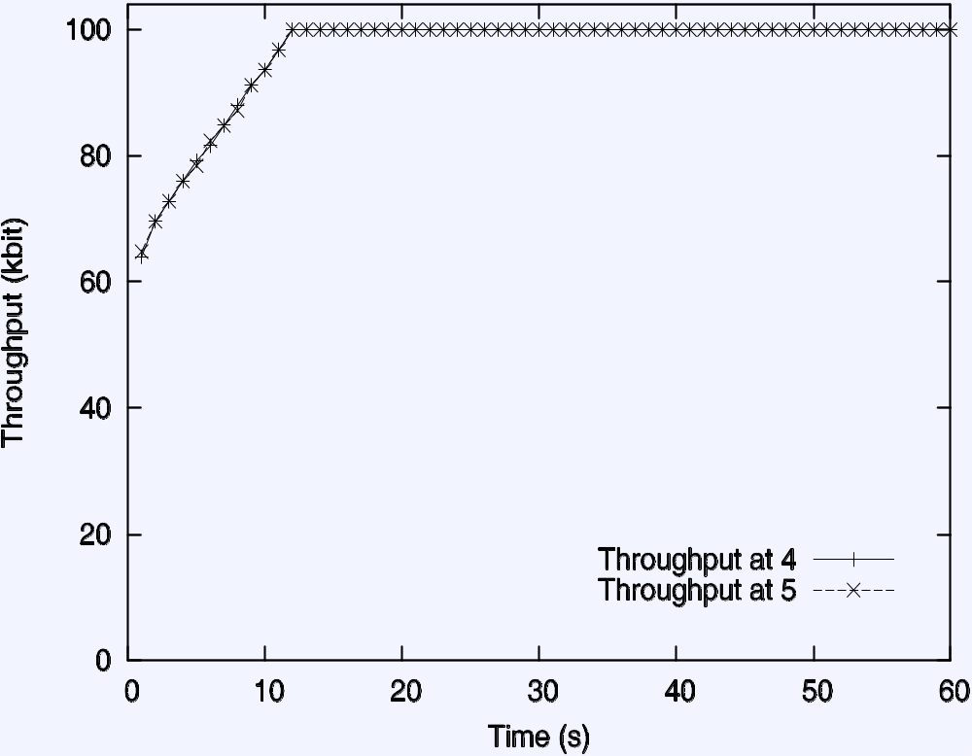
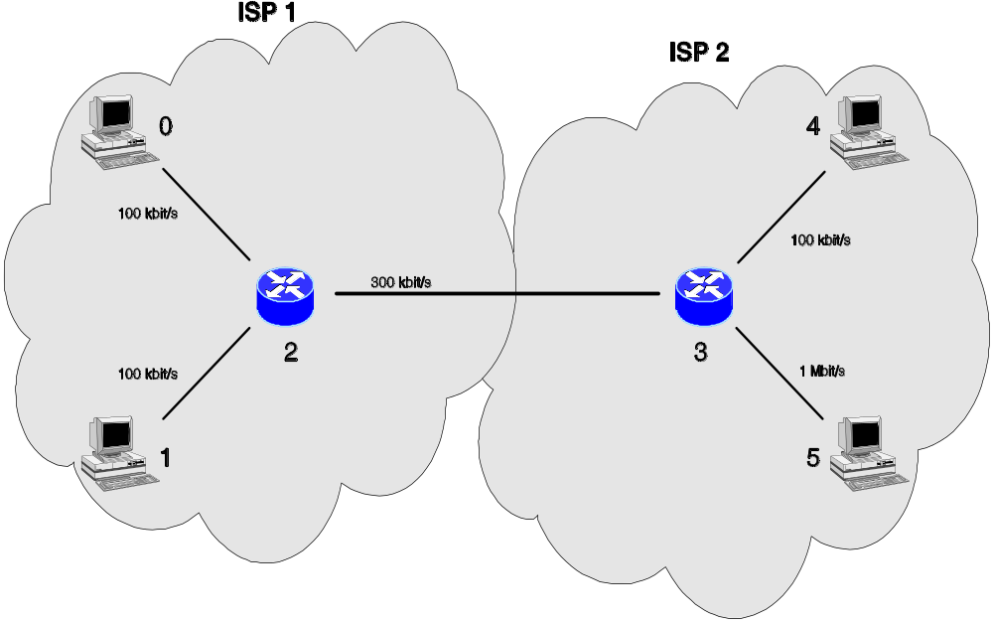
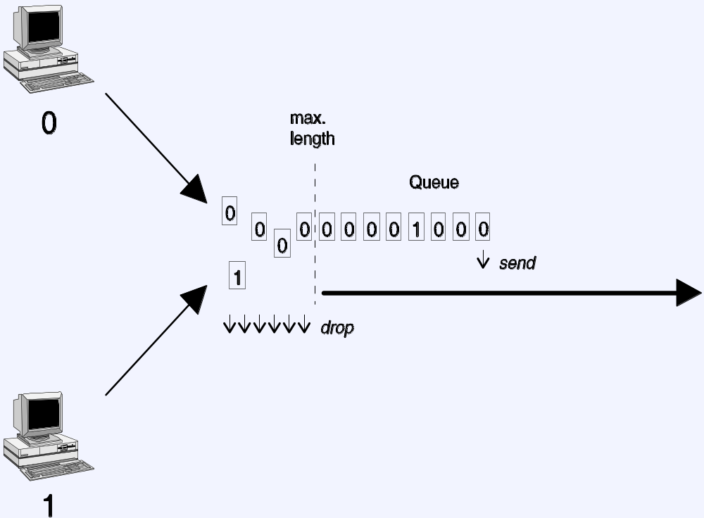
Upgrade to
1 Mbit/s!
Utilization: 2/3

Slide 4
Internet congestion control: history
around 1986: first congestion collapse
1988: "Congestion Avoidance and Control" (Jacobson)
Combined congestion/flow control for TCP
(also: variation change to RTO calculation algorithm)
Idea: packet loss = congestion, so throttle the rate; increase otherwise
Goal: stability - in equilibrum, no packet is sent into the network until an old packet leaves
  ack clocking, “conservation of packets“ principle
  made possible through window based stop+go - behaviour
Superposition of stable systems = stable →
network based on TCP with congestion control = stable

Slide 5


A control loop to stabilize
(bring it to equilibrium and keep it there)
Photos: https://unsplash.com/
not like this:
but rather:

Slide 6
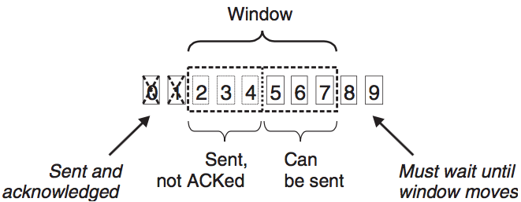
Reminder: TCP's sliding window
Sender buffer
Receiver “grants“ credit (receiver window, rwnd)
  sender restricts sent data with window
Receiver buffer not specified
  i.e. receiver may buffer reordered segments (i.e. with gaps)

Slide 7
TCP Congestion Control: Tahoe
Distinguish:
  flow control: protect receiver against overload
  (receiver "grants" a certain amount of data ("receiver window" (rwnd)) )
  congestion control: protect network against overload
  ("congestion window" (cwnd) limits the rate: min(cwnd,rwnd) used! )
Flow/Congestion Control combined in TCP. Two basic algorithms:
  Slow Start: for each ack received, increase cwnd by 1 packet
  (exponential growth) until cwnd >= ssthresh
  Congestion Avoidance: each RTT, increase cwnd by at most 1 packet
  (linear growth - "additive increase“)

Slide 8
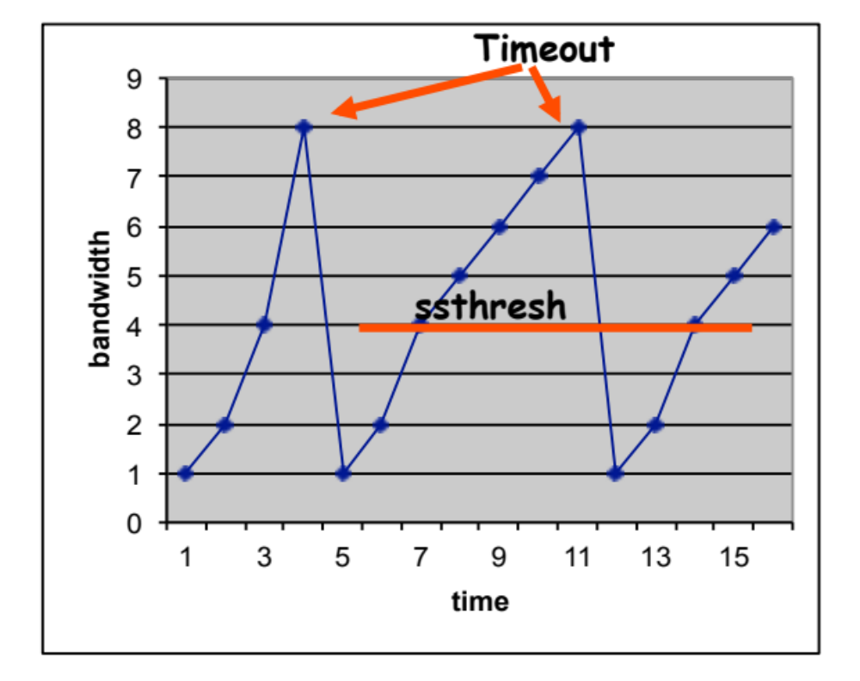
TCP Congestion Control: Tahoe /2
If a packet or ack is lost (timeout), set cwnd = 1, ssthresh = cwnd / 2
(“multiplicative decrease") - exponential backoff
  Actually, “Flightsize/2“ instead of cwnd/2 because cwnd might not always be fully used
Timeout based on RTT;
good estimation is crucial!
Later additions: TCP Reno, 1990
Fast retransmit / fast recovery Sender detects loss via duplicate acks; no need to
slow start to ssthresh
Congestion Avoidance
Slow Start

Slide 9
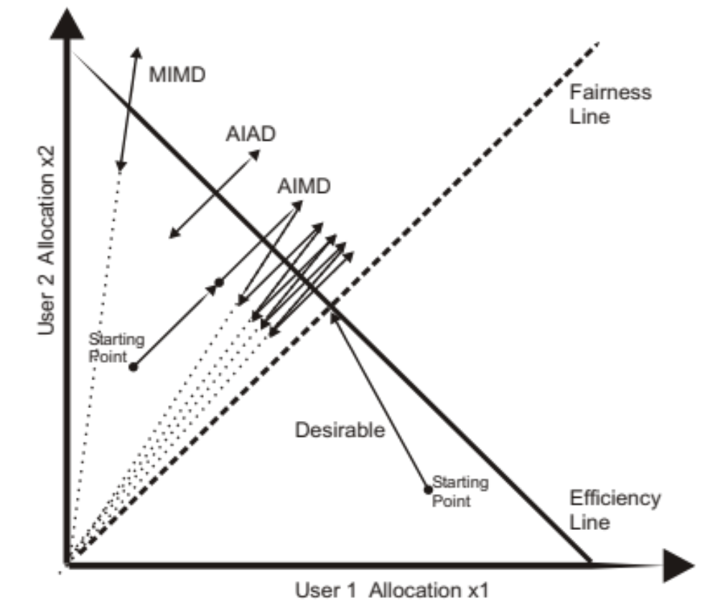
Background: AIMD

Slide 10
AIMD is an easy way out, but...
Michael Welzl, Max Mühlhäuser: "CAVT - A Congestion Avoidance Visualization Tool",
ACM SIGCOMM CCR 3(3), July 2003, pp. 95-101.
http://welzl.at/research/tools/cavt/index.html

Slide 11
Actual TCP (simulation)

Slide 12
TCP Reno: building a queue
Queue begins to grow
(RTT grows)
Packet loss
Queue limit
ssthresh
(initially normally larger)
Capacity limit
cwnd
Congestion Avoidance:
cwnd++ every RTT
Upon loss: cwnd*=beta
(beta=0.5)
Slow Start:
double cwnd every RTT
Time

Slide 13
How large should a queue be?
Old rule-of-thumb: “Bandwidth * delay product” (BDP)
(bw = bottleneck link capacity; delay = RTT)
  Can be unreasonably large,
  causing unnecessary delay
  (severe e.g. for VoIP and games)
  For core routers,
  bw * RTT / sqrt(no. flows) was found to be enough
  No new rule exists for access equipment (routers, modems, ..)
Often, access link = bottleneck;
access equipment’s queue = the one that grows
  Some equipment vendors sell “large buffer = feature”
  Effect: extreme delay, now called “bufferbloat”
Buffer
Link capacity

Slide 14
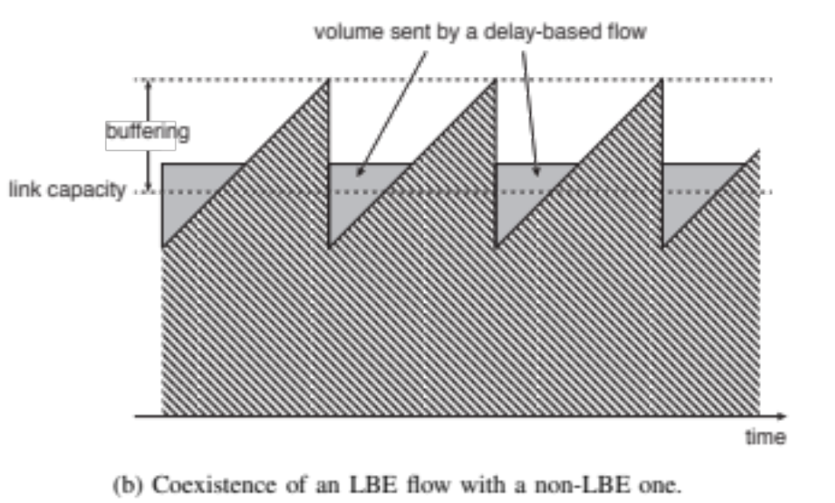
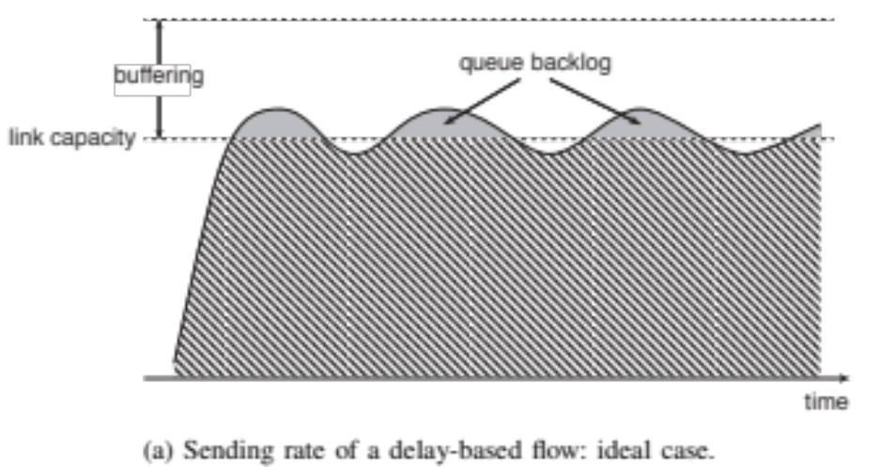
Using delay as a signal
Delay grows before loss, so can react earlier, limit delay
  Noisy signal, but fine-grain and easily available
  Oldest known approach: TCP Vegas; works well but loses against Reno
LEDBAT: turning this bug into a feature
  For low-priority traffic that should not get in the way
  Encapsulation not (yet?) defined; implemented over UDP in BitTorrent

Slide 15
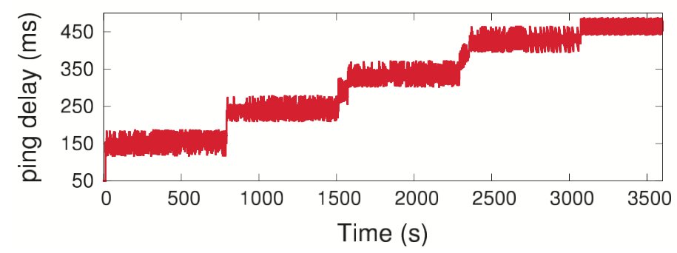
More problems with delay as a signal
RTT easier to measure than One-Way Delay (OWD), but can be noisy (don’t want to react to queue on return path)
  Note: absolute OWD doesn’t usually matter (clock sync not needed), need changes of OWD
Size of buffer determines measurement granularity
Base delay (long-term min. delay) can create problems
  One flow’s congestion is the next flow’s base delay
  Need to occasionally refresh, but don’t measure yourself!
Ping delay across
a 500 kbit/50ms
Ethernet link, with
libutp’s “utp test”
program running

Slide 16
Active Queue Management
1993: Random Early Detection ("Discard", "Drop") (RED)
(since TCP backs off as packets are dropped,
drop packets earlier to avoid queue overflows)
  Adds randomization to avoid traffic phase effects
  "Punishes" unresponsive flows, improving fairness
Qavg = (1 - Wq) x Qavg + Qinst x Wq
(Qavg = average occupancy, Qinst = instantaneous occupancy, Wq = weight - hard to tune, determines how aggressive RED behaves)

Slide 17
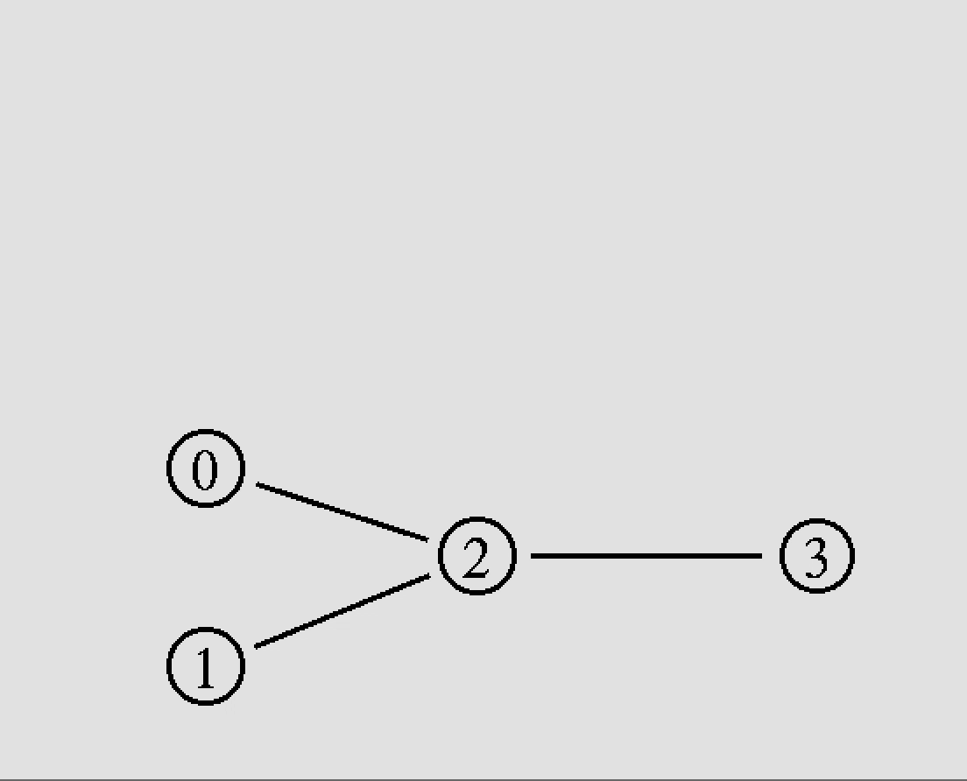
Phase effects of a FIFO queue
Constant bit-rate sender
TCP sender

Slide 18
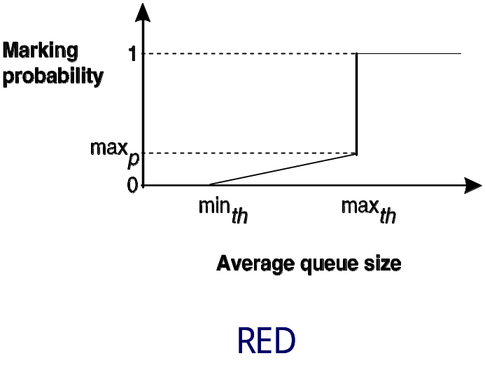
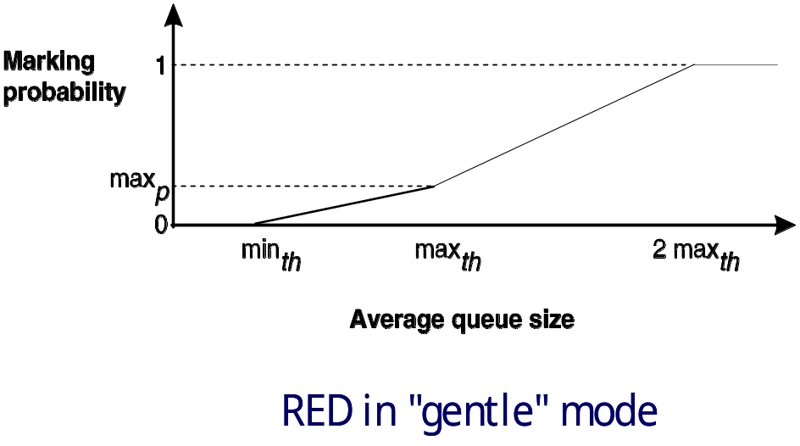
RED
Based on exponentially weighted moving average (EWMA) of instantaneous queue occupancy = low pass filter
  recalculated every time a packet arrives
Several variants exist (also entirely different algorithms): drop from front, drop based on instantaneous queue occupancy, drop arbitrary packets, drop based on priorities...
Drop!
Drop!
Q: does RED interoperate well with LEDBAT?

Slide 19
FQ-CoDel
CoDel AQM algorithm
  Enter "dropping state" when target (5ms) minimum queue delay has been exceeded for interval (100ms)
  Then, drop packets at an increasing frequency until delay reduced
Fair Queuing (FQ)
  A queue per connection (hash based on header "5-tuple")
  Schedule between queues
FQ-CoDel: default in Linux, OpenWRT, ..
  CoDel per queue
  Two groups of queues for scheduling: new flows, old flows
  Prioritize new arrivals (flows that have no packets in the queue)

Slide 20
Explicit Congestion Notification (ECN)
Instead of dropping, set a bit (receiver tells sender about it)
  End systems should act as if packet was dropped
  ⇒ real communication between hosts and routers!
  Alternative Backoff with ECN (ABE): ECN also tells that an AQM is in use => no need to back off by as much as when loss happened
ECN has a long history of non-deployment
  Changing now, with "Low Latency, Low Loss and Scalable Throughput" (L4S)? Comcast roll-out, Apple enabling, ...
    Dual-queue use of ECN bits to differentiate between "low latency" traffic and everything else; richer feedback from receiver, and different send behaviour
    (back-off proportional to # ECN marks)
  Mozilla, 2026, Firefox, typically uplink (QUIC): ~15% congestion responses come from a CE mark (the other ~85% from loss)
    Firefox QUIC implements ABE; others experiment with it (2026)
IFI research

Slide 21
Other implicit signals: delay, arrival rate (via ACKs)
E.g., for multimedia traffic: try to co-exist with TCP, yet avoid building a queue if possible
  E.g., when TCP is absent
IETF RMCAT: delay-based congestion control for WebRTC,
using RTP/RTCP
  Google Congestion Control (GCC) (used in Chrome), Cisco’s NADA, Ericsson’s SCREAM, Netflix' Network Delivery Time Control (NDTC)
BBR (also, older: TCP Westwood)
  RTT: only correct when below the capacity limit
  Attainable throughput: only correct when exceeding the capacity limit
  (Sender increases the rate, but arrival rate at receiver plateaus)
  Need to switch between probing phases

Slide 22

TCP co-existence
Once called "being TCP-friendly"
  i.e., do not send more than TCP would under comparable circumstances
  Can be achieved by emulating the behaviour
  of TCP (or the desired parts of it)
More modern metric: “harm“
  Evaluates impact when sharing a bottleneck
In practice, today, no rule
  But, e.g., when BBR was found to harm Cubic, it was changed
    BBRv2 is "nicer", BBRv3 is less "nice" again?
https://en.wikipedia.org/wiki/Red_Dead_Redemption

Slide 23
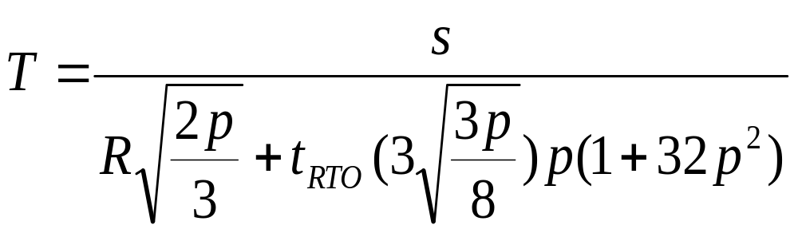
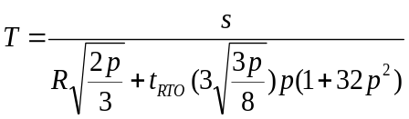
TCP's steady-state equation
Average transmission rate T (bytes/sec):
s: packet size
R: rtt
t_{RTO}: TCP retransmit timeout
p: steady-state loss event rate (the difficult part!)
well known old mechanism TFRC (TCP-friendly rate control) used this as an upper bound, but with a smoother sending rate than TCP
  Less delay fluctuation, good for multimedia
GCC also uses this equation, but as a lower limit

Slide 24
Congestion state and multiple flows
TCP Control Block (TCB): data such as RTO, cwnd, ..
  Related to path, yet separately stored per TCP connection
  Compare: layering problem of PMTU storage
Multiple TCP connections are not TCP-friendly to one
  Neither are short flows which start and stop in Slow Start
  Web browsers open hundreds!
Yet, sometimes fewer competing flows can be better
  E.g., new short flow can use already-large cwnd
  HTTP/2 replaced "sharding", now HTTP/3 ( = HTTP / QUIC / UDP )
TCB interdependence: share TCB info when flows start
  Temporal sharing: learn from previous connection
  Ensemble sharing: learn from existing connections
IFI research

Slide 25
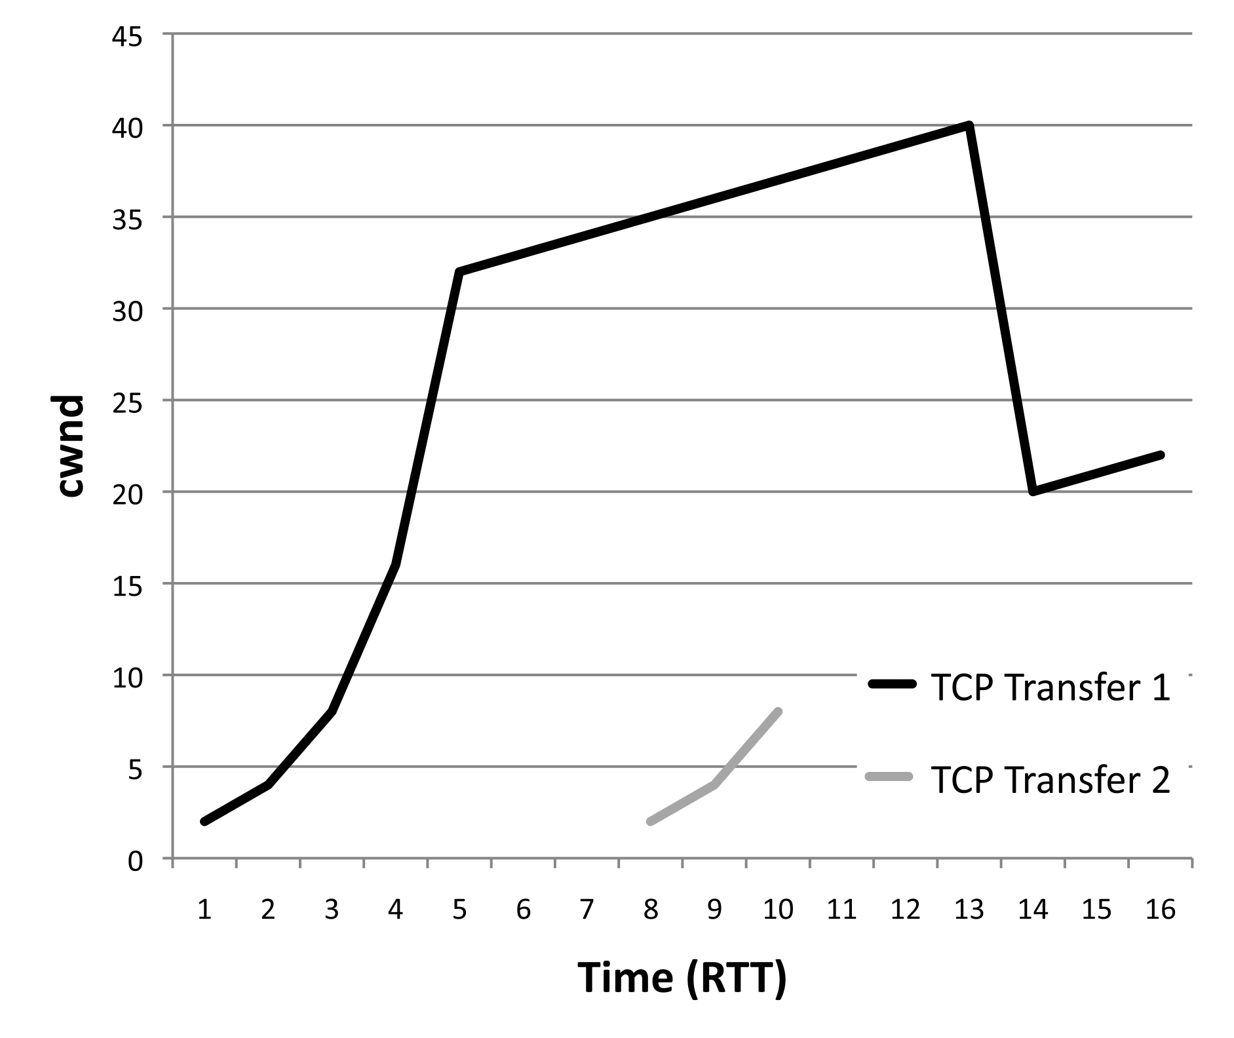
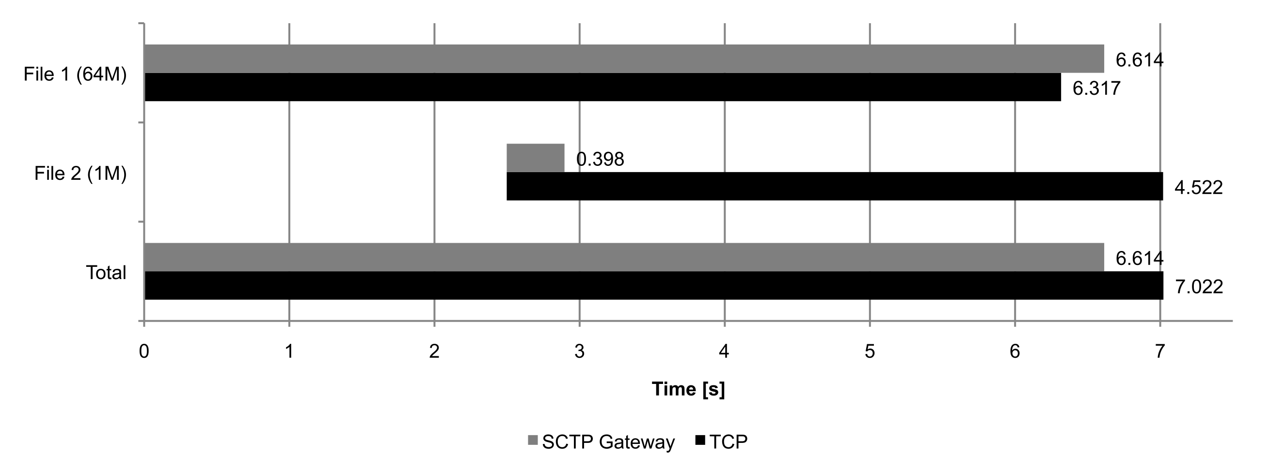
Combining congestion control: an example

Slide 26

MPTCP: being below-TCP-friendly
Many modern hosts are multihomed
  Smartphones (WiFi + 3G), data centers
  Why not use both connections at once?
Cannot know where bottleneck is
  If it is shared by the two connections, they should appear (be as aggressive) as only one connection
  MPTCP changes congestion avoidance “increase” parameter to “divide” aggression accordingly
    but instead of being “½ TCP”, tries to send as much as possible over least congested path
    Least congested = largest window achieved; hence, increase in proportion to window

Slide 27
Fairness principles
TCP-friendliness is a fairness definition
  Based on technical behavior of TCP... is this meaningful?
E.g., ATM ABR: Max-Min-fairness
  “A (..) allocation of rates is max-min fair iff an increase of any rate (..) must be at the cost of a decrease of some already smaller rate.“
  One resource: mathematical definition satisfies "general" understanding of fairness - resource is divided equally among competitors
  Usually requires knowledge of flows in routers (switches) - scalability problem!

Slide 28
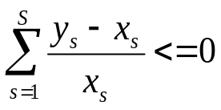
Proportional Fairness
F. Kelly: Network should solve a global optimization problem (maximize log utility function)
Max-Min-fairness suboptimal:
S1 = S2 = S3 = c/2
S2
S3
All link
capacities: c
S1
D1
D2
D3
Proportional fairness:
  “An allocation of rates x is proportionally
  fair iff, for any other (..) allocation
  y, we have: “
  (roughly approximated by AIMD!)
Proportionally fair allocation:
S1 = c/3, S2 = S3 = 2c/3

Slide 29
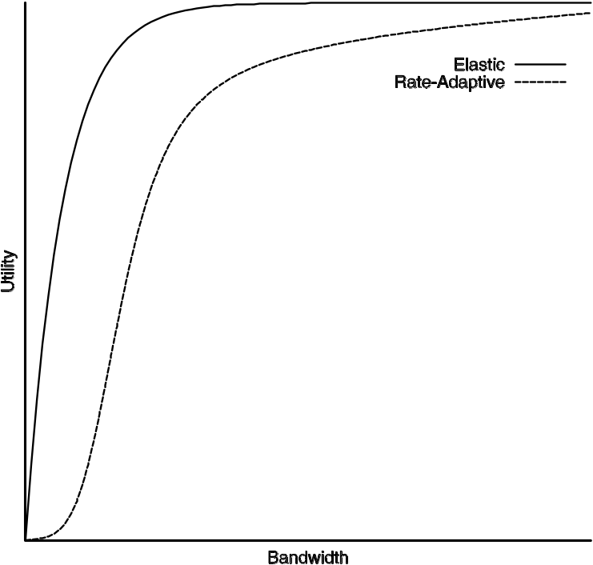
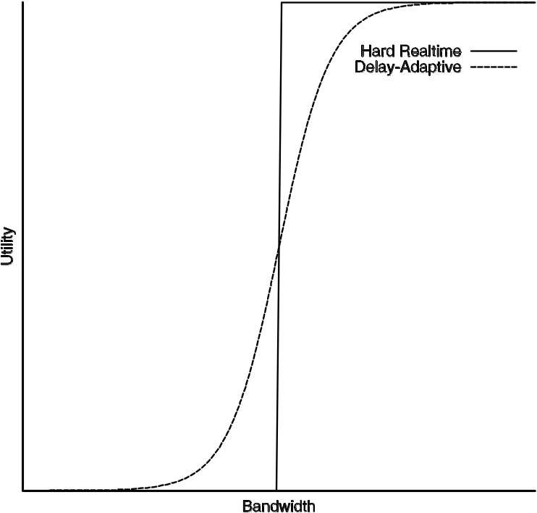
Utility functions
Consider: multimedia applications
  not necessarily logarithmic (e.g. VoIP)
No constraints, like file transfer
Hard real-time constraints
"adaptive"
Soft real-time constraints

Slide 30
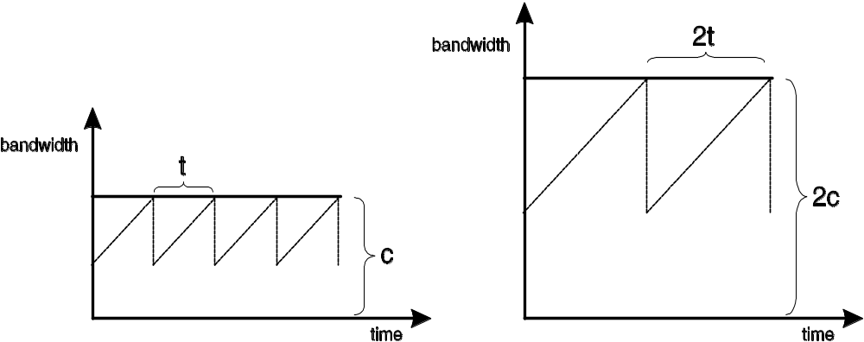
TCP with High-Speed links
TCP over “long fat pipes“: large bandwidth*delay product
  long time to reach equilibrium, MD = problematic
  from RFC 3649 (HighSpeed RFC, Experimental):
  For example, for a Standard TCP connection with 1500-byte packets and a 100 ms round-trip time, achieving a steady-state throughput of 10 Gbps would require an average congestion window of 83,333 segments, and a packet drop rate of at most one congestion event every 5,000,000,000 packets (or equivalently, at most one congestion event every 1 2/3 hours). This is widely acknowledged as an unrealistic constraint.
Theoretically, utilization independent of capacity
But: longer convergence time
Area:
6ct
Area:
3ct

Slide 31
Slow convergence animation
Fast link
Slow link

Slide 32
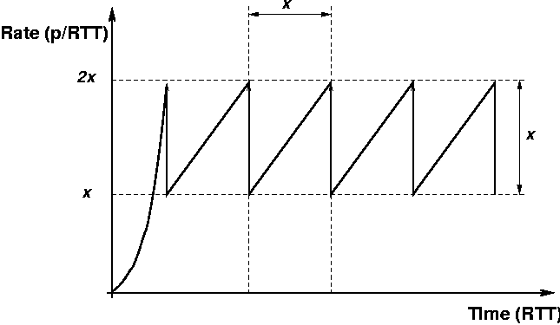
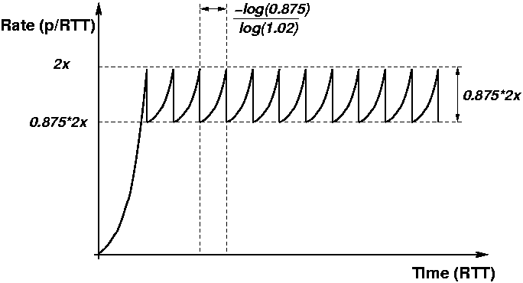
Some proposed solutions
Scalable TCP: increase/decrease functions changed
  cwnd := cwnd + 0.01 for each ack received while not in loss recovery
  cwnd := 0.875 * cwnd on each loss event
  (probing times proportional to rtt but not to the capacity)
Standard TCP
Source: http://www.deneholme.net/tom/scalable/
Scalabe TCP

Slide 33
Some proposed solutions /2
Rate Standard TCP recovery time Scalable TCP recovery time
1Mbps 1.7s 2.7s
10Mbps 17s 2.7s
100Mbps 2mins 2.7s
1Gbps 28mins 2.7s
10Gbps 4hrs 43mins 2.7s
HighSpeed TCP (RFC 3649, includes Scalable TCP discussion):
  response function includes a(cwnd) and b(cwnd), also depend on loss ratio
  less drastic in high bandwidth environments with little loss only
  Significant step!
  Previously, either TCP-friendly or better-than-TCP; no combinations!
"TCP-friendly" is now a term of the past
  "There is no point in being friendly to TCP, it will not return the favour".
  [Andrew McGregor]

Slide 34
Proposed solutions /3
BIC, CUBIC
  BIC (Binary InCrease TCP) uses binary search to find the ideal window size:
    when loss occurs, current window = max, new window = min
    check midpoint;
    if no loss ⇒ new min, increase; else new window = new max
  CUBIC = BIC++ using cubic function
After major press release (Slashdot: “BIC-TCP 6000 times quicker than DSL“), BIC became the default TCP CC. in Linux in mid-2004!
  Major change to the CC. landscape
  Soon after, replaced with CUBIC

Slide 36
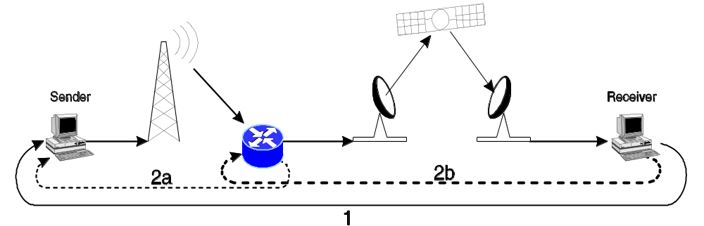
TCP over Satellite, and PEPs
Satellites combine several problems
  Long delay + high capacity (= large BDP)
  Wireless (but usually not noisy (for TCP) because of link layer FEC)
  Can be asymmetric (e.g. direct satellite downlink, 56k modem uplink)
Thus, TCP needs help over satellite
  Transparent improvements ("Performance Enhancing Proxies") common
  Figure: split connection approach: 2a / 2b instead of control loop 1
  Many possibilities - e.g. Snoop TCP: monitor + buffer; in case of loss, suppress DupACKs and retransmit from local buffer
  But: today, this only works with TCP (e.g., not the all-encrypted QUIC protocol)

Slide 37
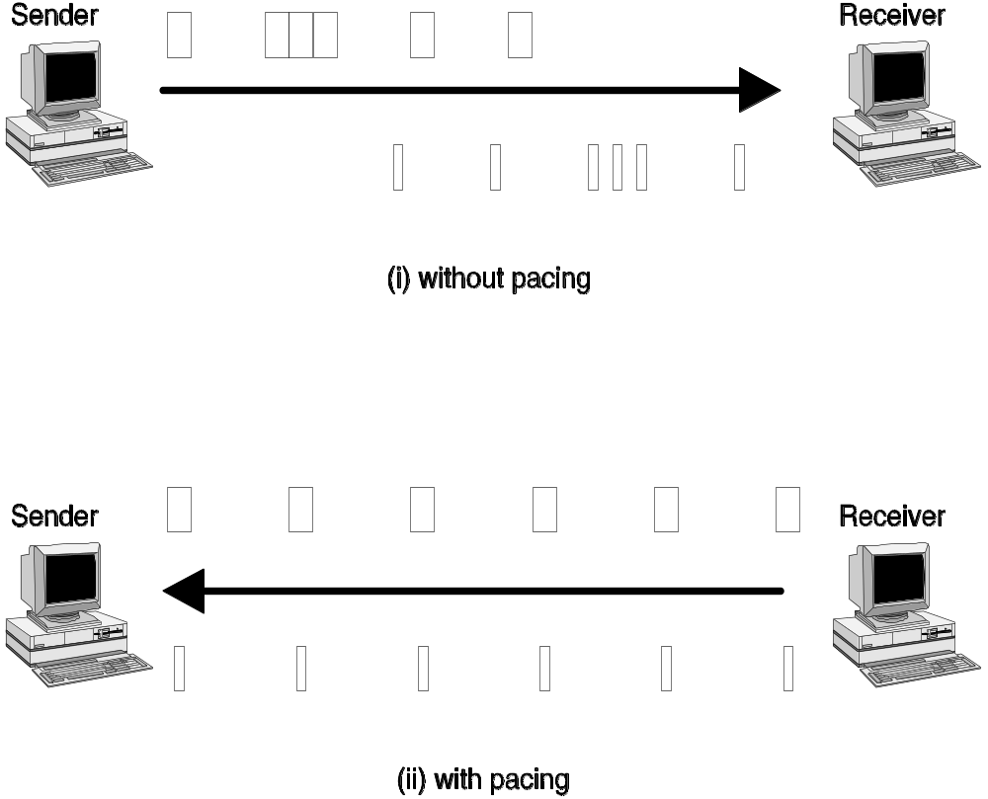
Pacing: increasingly common
"Micro burstiness" can lead to delay + packet drops
Generally, packet gap dictated by bottleneck link; but incoming data can be bursty (e.g. from slow start)
Pacing is hard at high speeds (clock granularity)
  But getting more feasible; increasingly popular!
  Common solution is to allow very small bursts (e.g. 3-4 packets)

Slide 38
Pacing Streaming Video On Demand (SVOD)
Unpaced: send as fast as TCP will go
Paced: less harm to others
Sending
rate
Sending
rate
30 Mbps
30 Mbps
15 Mbps
15 Mbps
Time
Time
~10 seconds
~10 seconds
Video chunk
Pacing is rate-based => enables sender-side rate limits
Netflix and Google experiment with this

Slide 39
Congestion control reality check
(note: no guarantee for correctness of this slide!)
Linux: Cubic (default, many others available)
  Cubic comes with a Slow Start early exit based on delay heuristics, called HyStart
Apple: Cubic and MPTCP
  LEDBAT for OS updates
  Hosts try to negotiate ECN, experimentally support L4S
Windows: Cubic default for Windows 10, Windows Server 2019
  But with their own new HyStart++ (now also in Apple OSes? and Linux?)
  Old delay+loss variant Compound-TCP (CTCP) was default TCP CC. in Windows Server 2008 beta for testing purposes
  When it sees tiny RTTs, switches to Datacenter TCP (DCTCP), a very aggressive ECN based variant ("TCP Prague", for L4S, is based on this)
  LEDBAT++ for OS updates
Applications:
  BitTorrent: LEDBAT
  YouTube: Google experiments with their own BBR cc. (now version 3)
  Netflix and Google: experiment with rate limits via pacing
  Facebook: Meta experiments with delay-based COPA cc. for video
  Browsers: WebRTC: RMCAT congestion controls; Firefox (QUIC): Cubic with ECN+ABE
Amazingly, the Internet still works! ☺

Slide 40
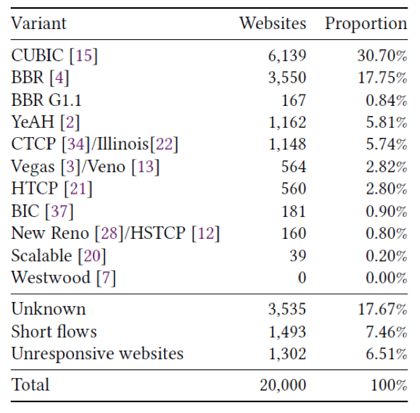
Alexa top 20k websites 2009:
No more Reno!
„New“ only refers to loss recovery (next week!), but
„New Reno“ is the Linux name
wrong, yet common to use
this to refer to Reno CC.
Ayush Mishra, Xiangpeng Sun, Atishya Jain, Sameer Pande, Raj Joshi, and Ben Leong. 2019. The Great Internet TCP Congestion Control Census. Proc. ACM Meas. Anal. Comput. Syst. 3, 3, Article 45 (December 2019), 24 pages.

Slide 41
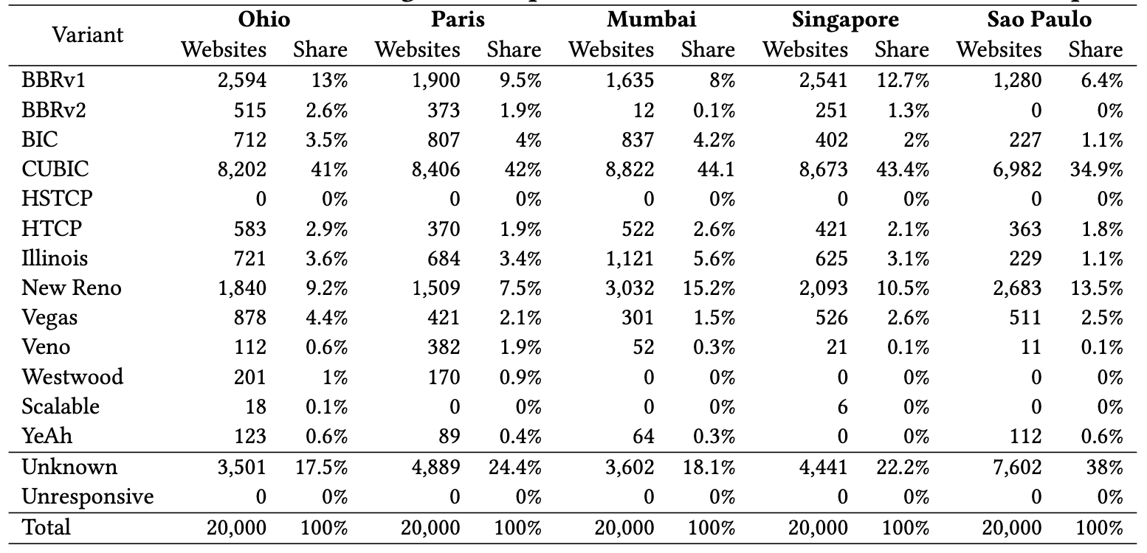
Alexa top 20k websites 2024:
Less BBR, Cubic still strong
From different viewpoints
Ayush Mishra, Lakshay Rastogi, Raj Joshi, "Keeping an Eye on Congestion Control in the Wild with Nebby", ACM SIGCOMM 2024, August 2024.

Slide 42
Thank you!
A humble reference suggestion:

